Slide 1
OSFM TFL PLACARD TRAINING
2022

Slide 2
Firefighter Risk Assessment Placard

Slide 3
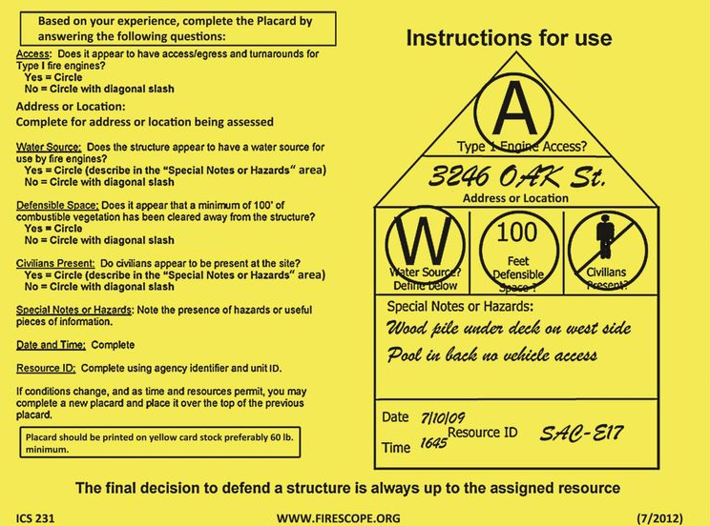
OSFM Placarding
This in an example of the placards used by Cal Fire.
Chief Ron Danielson former Group Supervisor from Lebanon noticed placards in use while deployed to California in 2017.
Notes:
1-Ron saw the placards in use and thought they were a useful tool.
2-Brought the idea back to Lebanon Fire and started developing the idea for use in his own District.
3-Ron and Brent Gaskey made some placards and started drilling on them at Lebanon Fire to see how they would work.
.

Slide 4
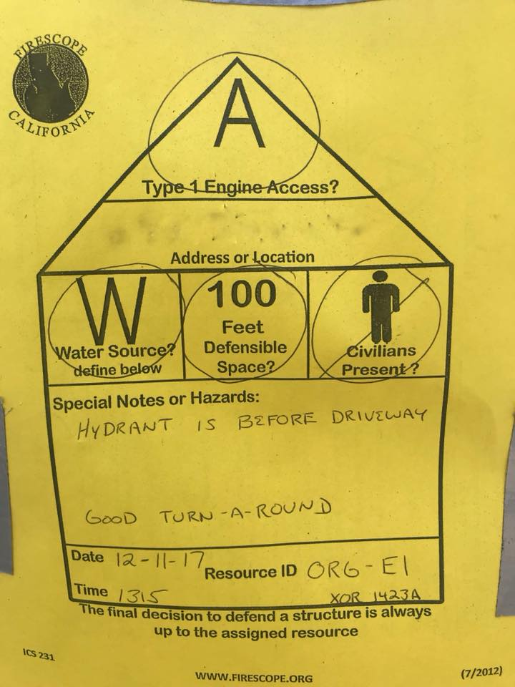
OSFM Placarding
Here is an example of a CalFire placard that has been filled out.
Notes:
1-Found they were a helpful tool for giving firefighters information quickly form the vehicle.
2-Helped with reducing confusion- ten different flagging, Survey 123, Interra etc…
3-Note the pen used. Try to use a dark wide marker so the placard can be read from the engine.

Slide 5
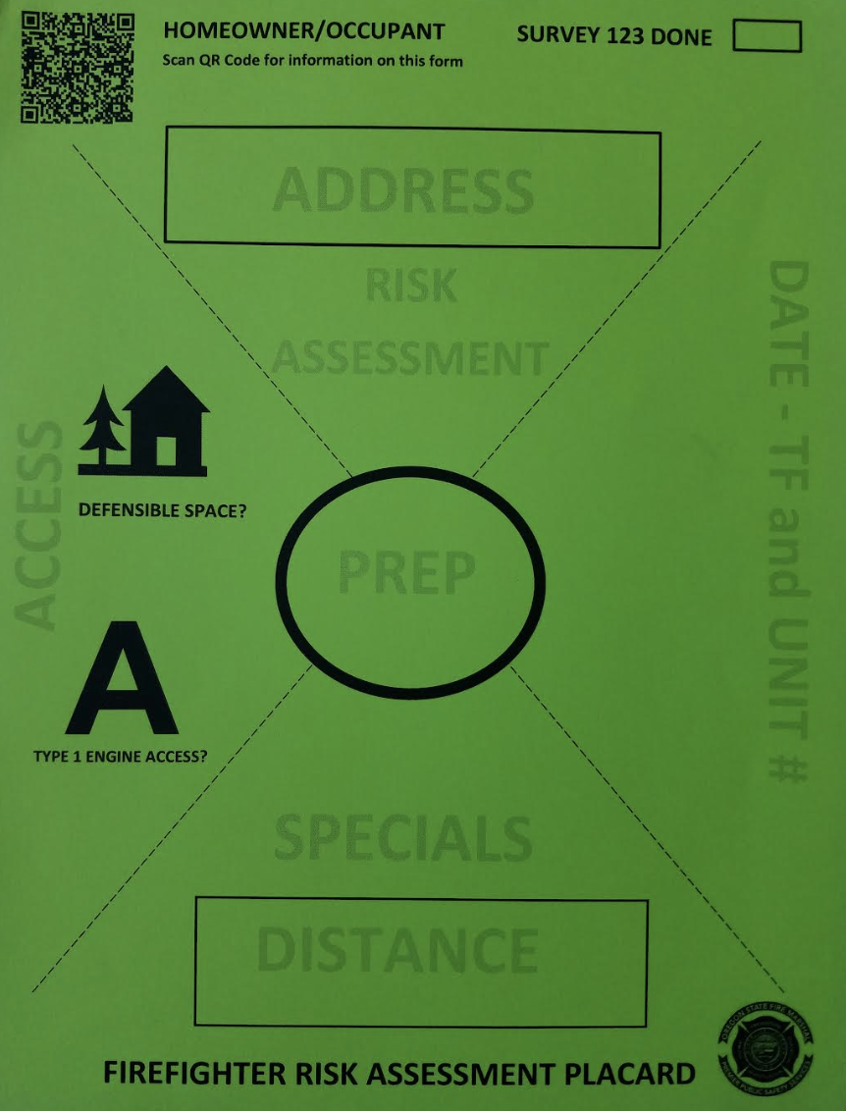
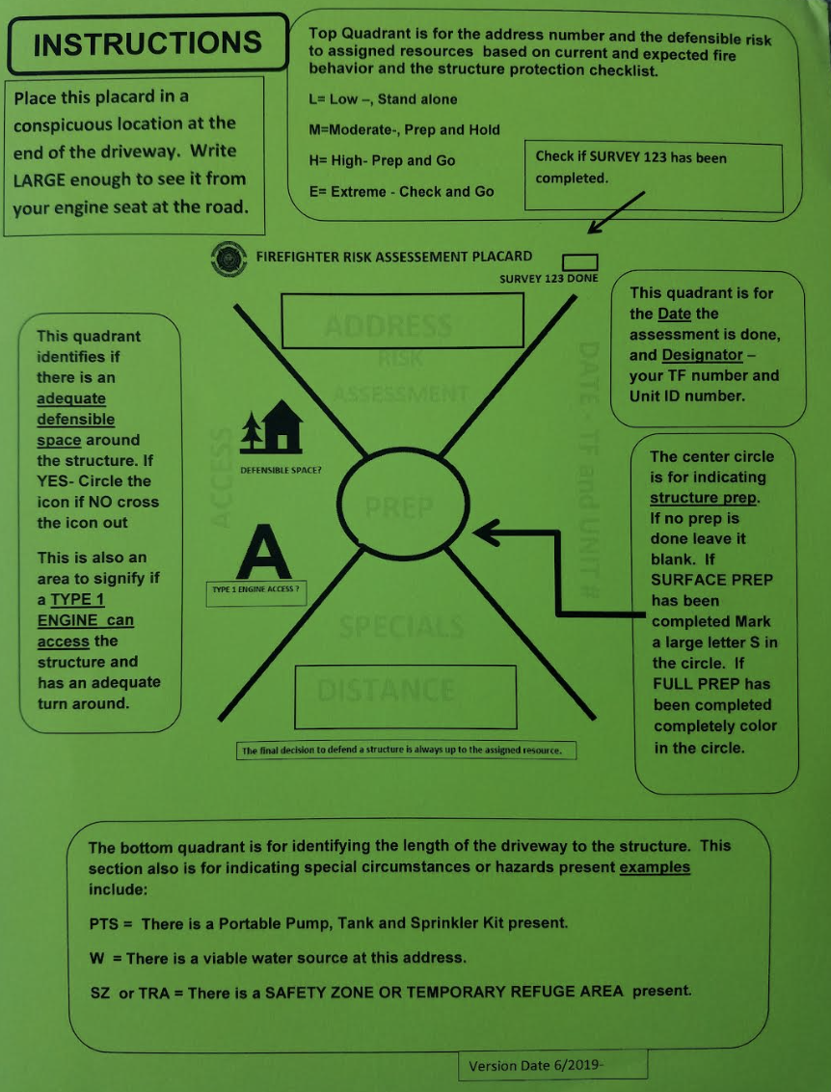
OSFM Placarding
This is current OSFM Placard.
Information recorded on the front and instructions on the back.
Notes:
1-X design was based on the USAR marking system.
2-Placards were tested last summer, and the public was found to misinterpret the X.
From a survey at the Middlefork Fire of TFL’s Placards were found to be useful, had good info? Public thoughts
3-Public said it gave the impression of being their home marked off with the X.
4- Changed X the the lighter dashed line.

Slide 6
OSFM Placarding
Instructions are quite clear and easy to follow.
Please fill out placard completely including unit and date.
Notes:
1-Remember the placard contains information at a specific time.
2-Placard can be updated and changed depending on fire conditions or work completed.

Slide 7
OSFM Placarding
Placard need to be displayed in a conspicuous easy to read location.
Secure Placard with staples or tape securely.
Notes:
1- goal is to see it from the engine

Slide 8







OSFM Placarding
Here is a completed placard
  Address is 4152
  Moderate risk structure
  Survey 123 not complete
  Surface prep complete
  Water and a TRA available
  250’ driveway
  Defensible space is present
  No access for a type 1 engine
  Completed on 8/1 by E163, TF BC1
Notes:
Please try to write neatly
Please note I filled this out with the mouse pad ☺

Slide 9
OSFM Placarding
Note the QR code.
QR code gives information to the resident about the placard and what the markings on the placard mean.
Notes:
1-Very useful tool
2-Helps put residents at ease.

Slide 10
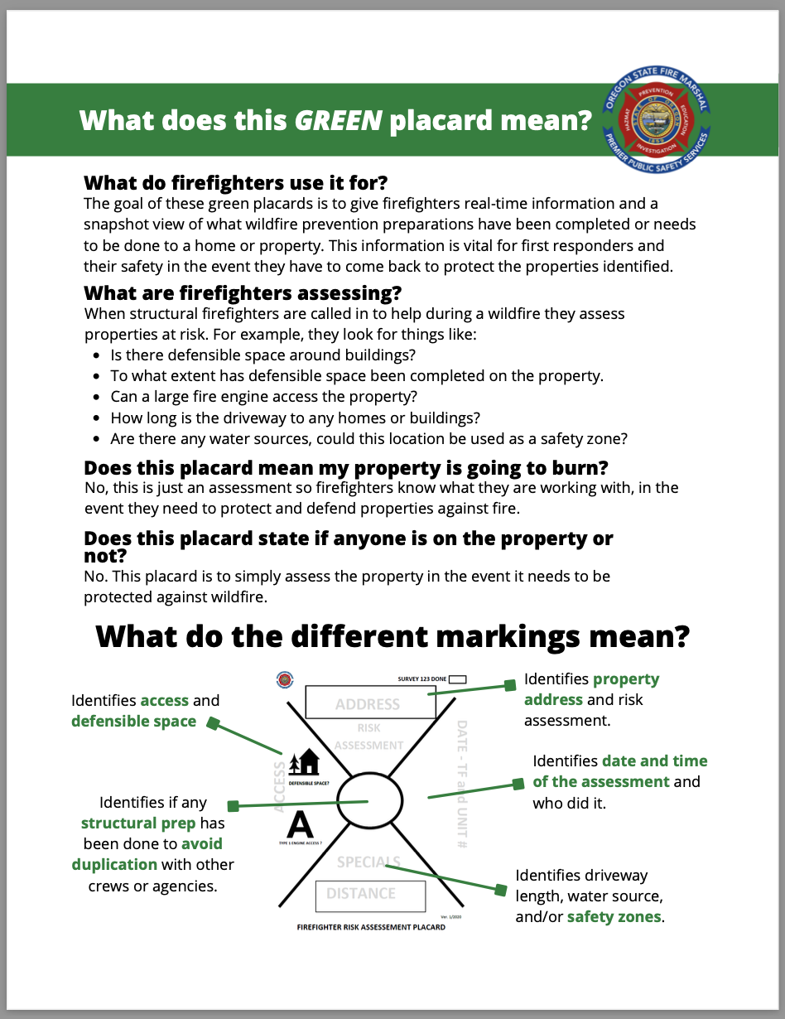
OSFM Placarding
For homeowners or occupants that do not have access to a QR reader the Fire Marshal’s office has developed an information sheet explaining the placards.
Remind residents the Placard does not indicate if they are home
These are great tools when meeting residents with questions.
Notes:
1- Please remember the residents are very nervous when we are in their neighborhoods.
2-If time allows a small amount of conversation helps calm A LOT of their fears and angst.
3- Remember to educate the residents on the things they can quickly do to help protect their property. Clean the roof, clean the gutters, clean the base of the walls.
4- One less house we will have to prep.
5- I’ve had good luck explaining the basic surface prep and full prep to residents, they just want to know what to do.
6-These handouts are carried with the placard kits.

Slide 11
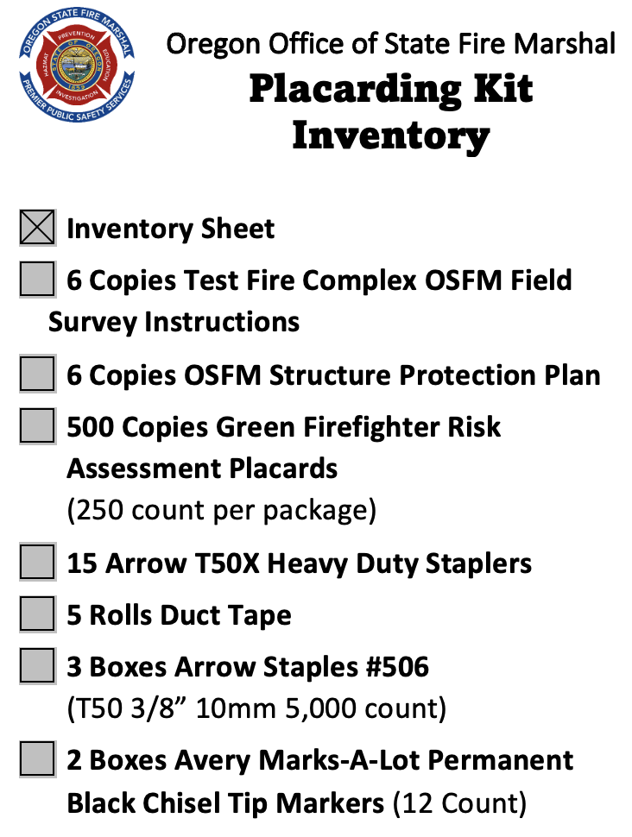
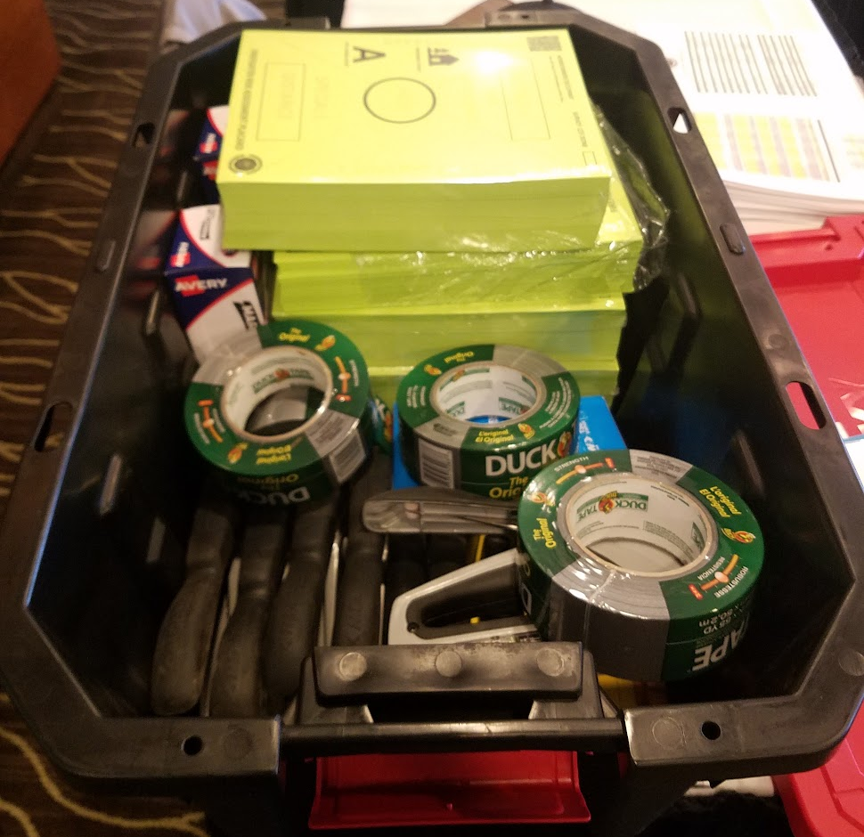
OSFM Placarding
This is the inventory of the Placarding Kits.
Each kit has equipment and supplies for 1 task force.
OSFM owns 12 of these kits
Notes:
There are 4 boxes like this on the Log's trailers.

Slide 12
Structure Prep
Lessons Learned

Slide 13
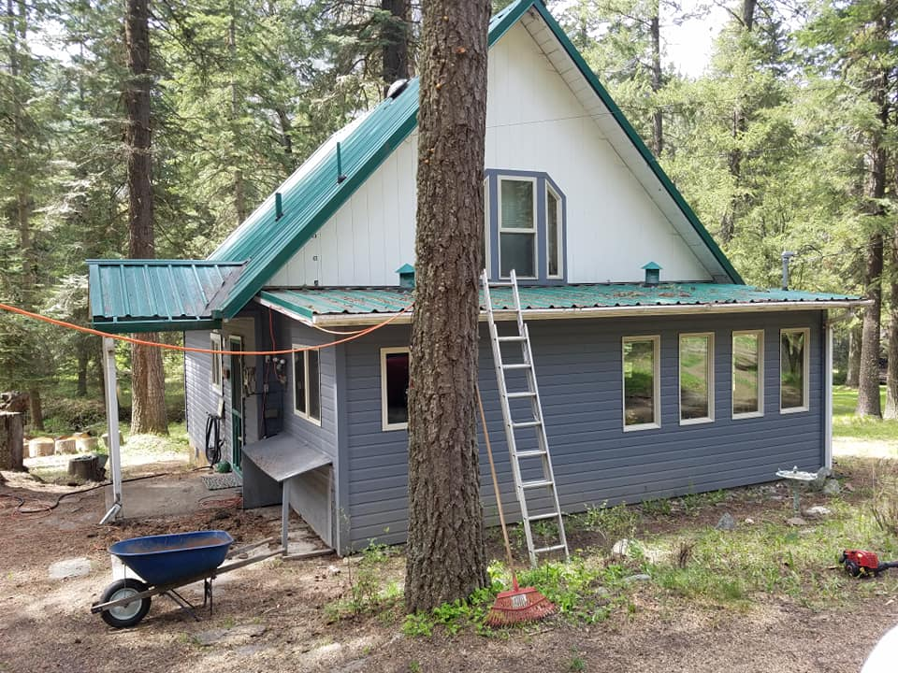
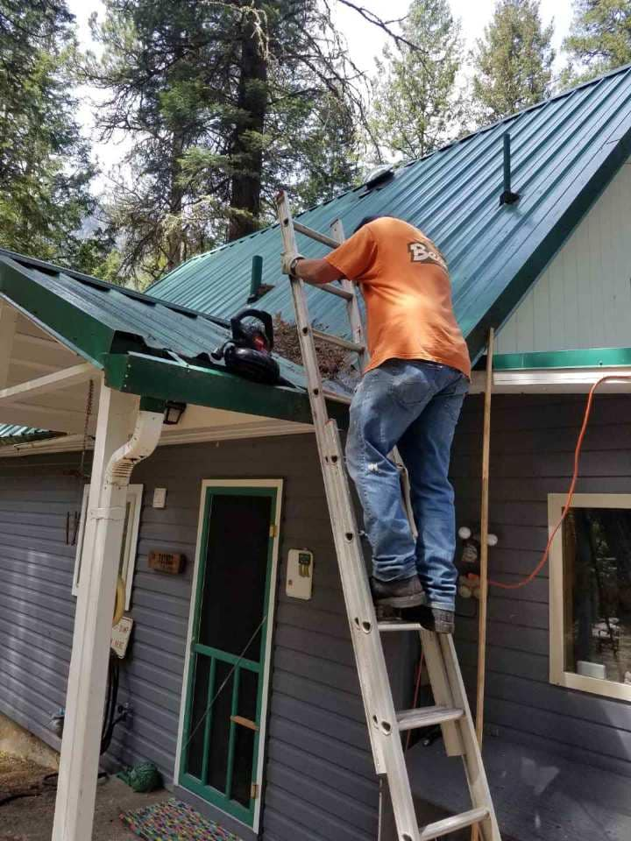
Structure Prep-Lessons Learned
Clean your roof and gutters of all flammable debris. Screen all vents with 1/16" metal screen.
Clean your roof and gutters of all flammable debris. Screen all vents with 1/16" metal screen.
Notes:
Surface prep is one of the most important things we do

Slide 14
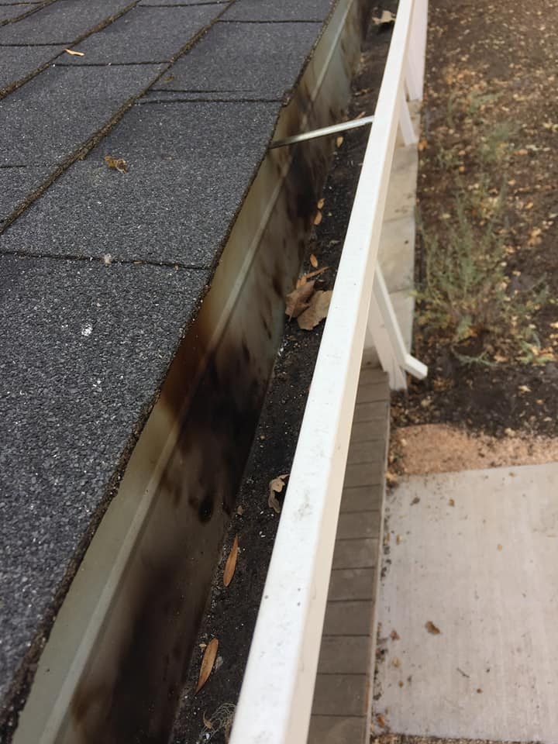
Structure Prep-Lessons Learned
Ember charred gutter that had been cleaned
Notes:
This why surface prep is important
Draw pic of roof assembly

Slide 15
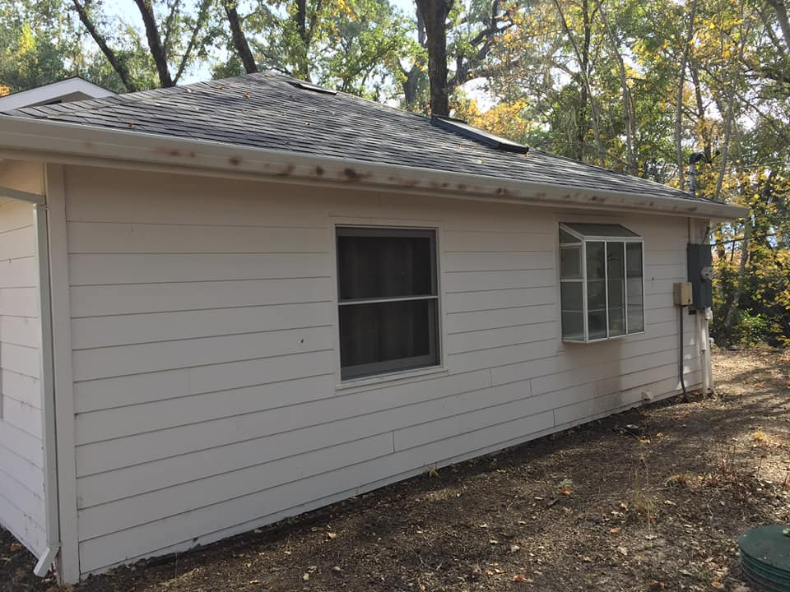
Structure Prep-Lessons Learned
Ember charred gutter that had been cleaned, no ignition.

Slide 16
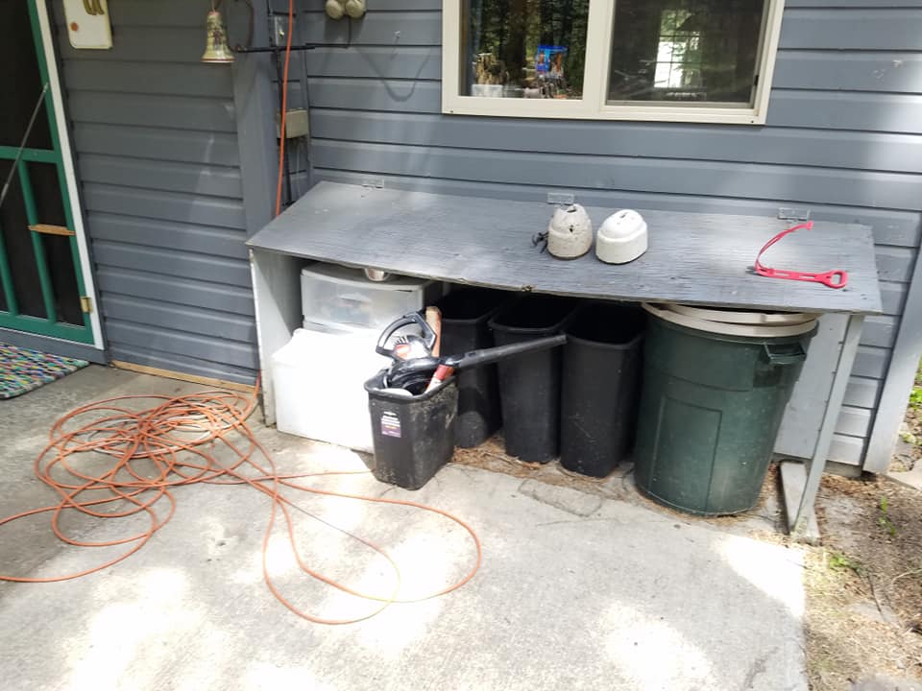
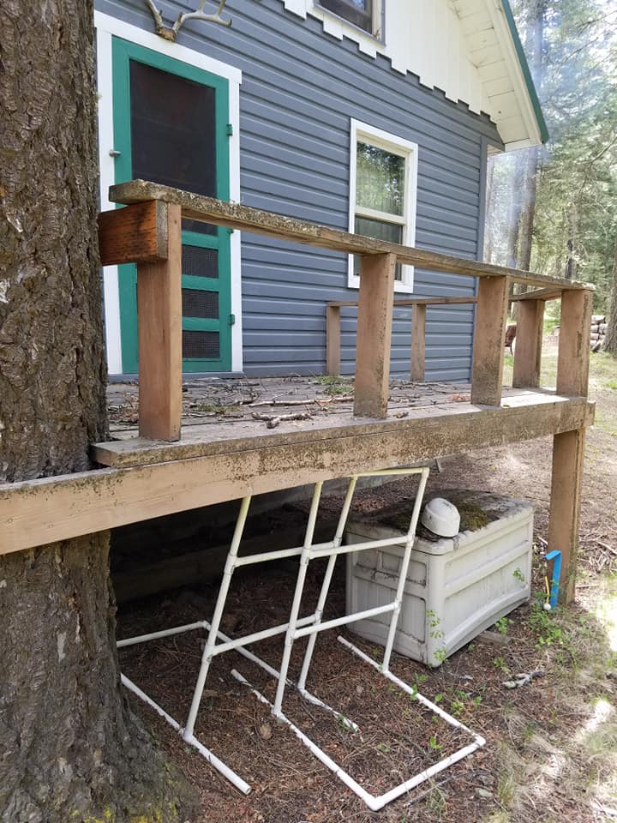
Structure Prep-Lessons Learned
Remove storage from under open decks, they're ember traps. Embers will accumulate the same place the leaves do in the fall

Slide 17
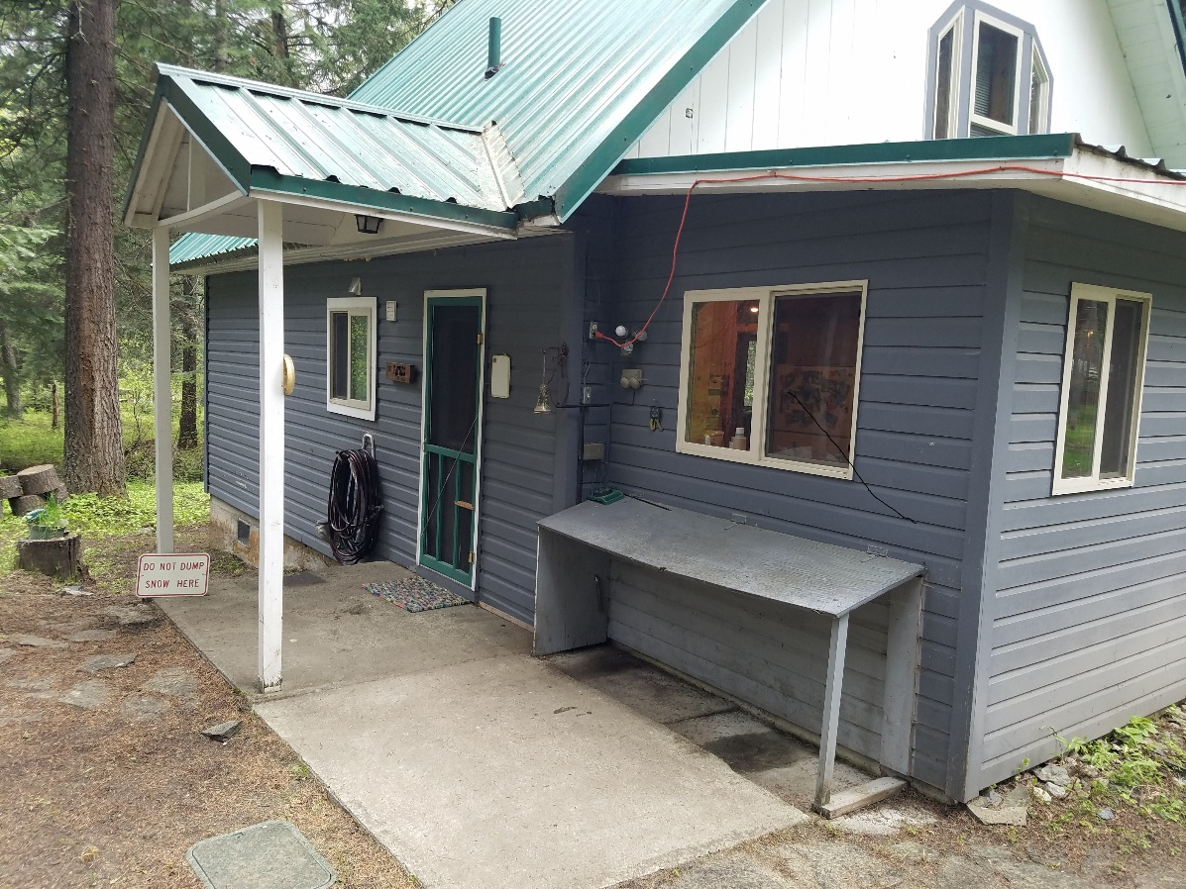
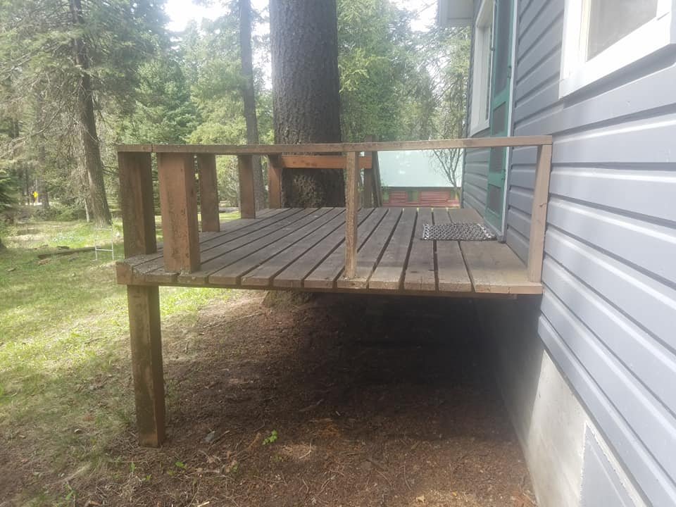
Structure Prep-Lessons Learned
Same areas cleaned up

Slide 18
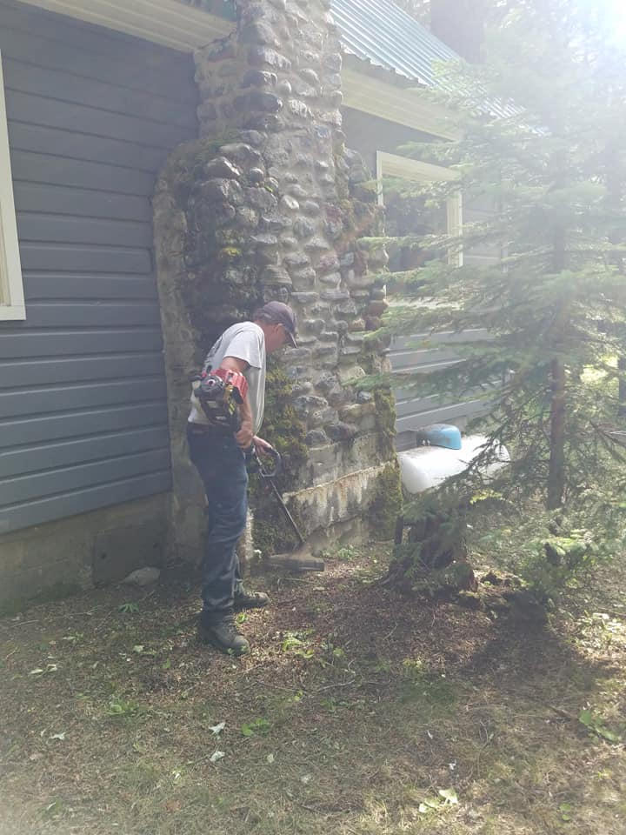
Structure Prep-Lessons Learned
Clean the base of all the walls 3-5 feet. This keeps wall from direct flame contact. Remember a flame will be 1.5 times as high as what's burning
Notes:
Draw wall assembly. Discuss defensible space.

Slide 19
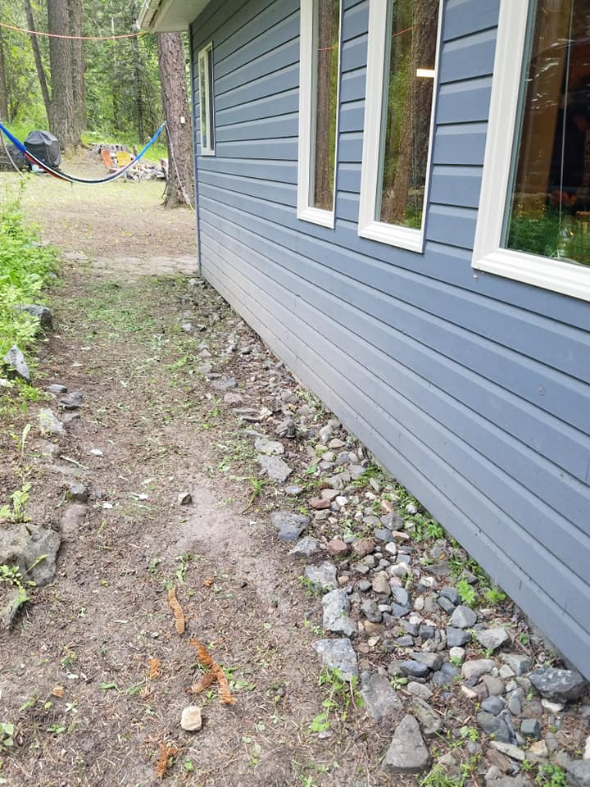
Structure Prep-Lessons Learned
We've added rock around the base of our walls

Slide 20
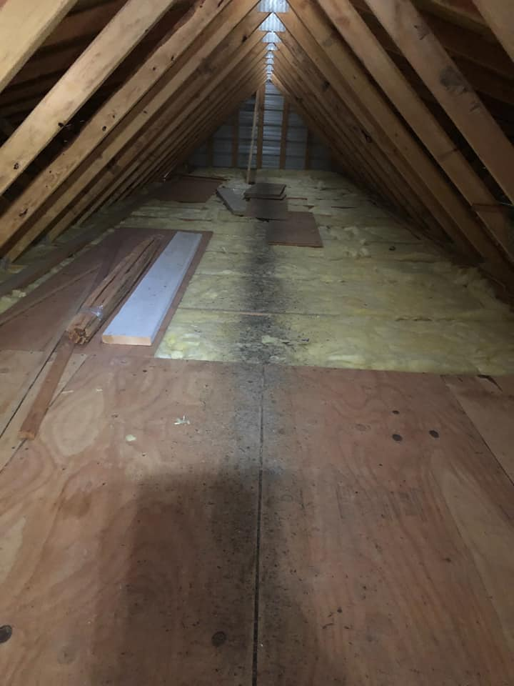
Structure Prep-Lessons Learned
This pic is where embers came into the attic of a home in Central Oregon that had screened vents. Embers were too small to ignite

Slide 21
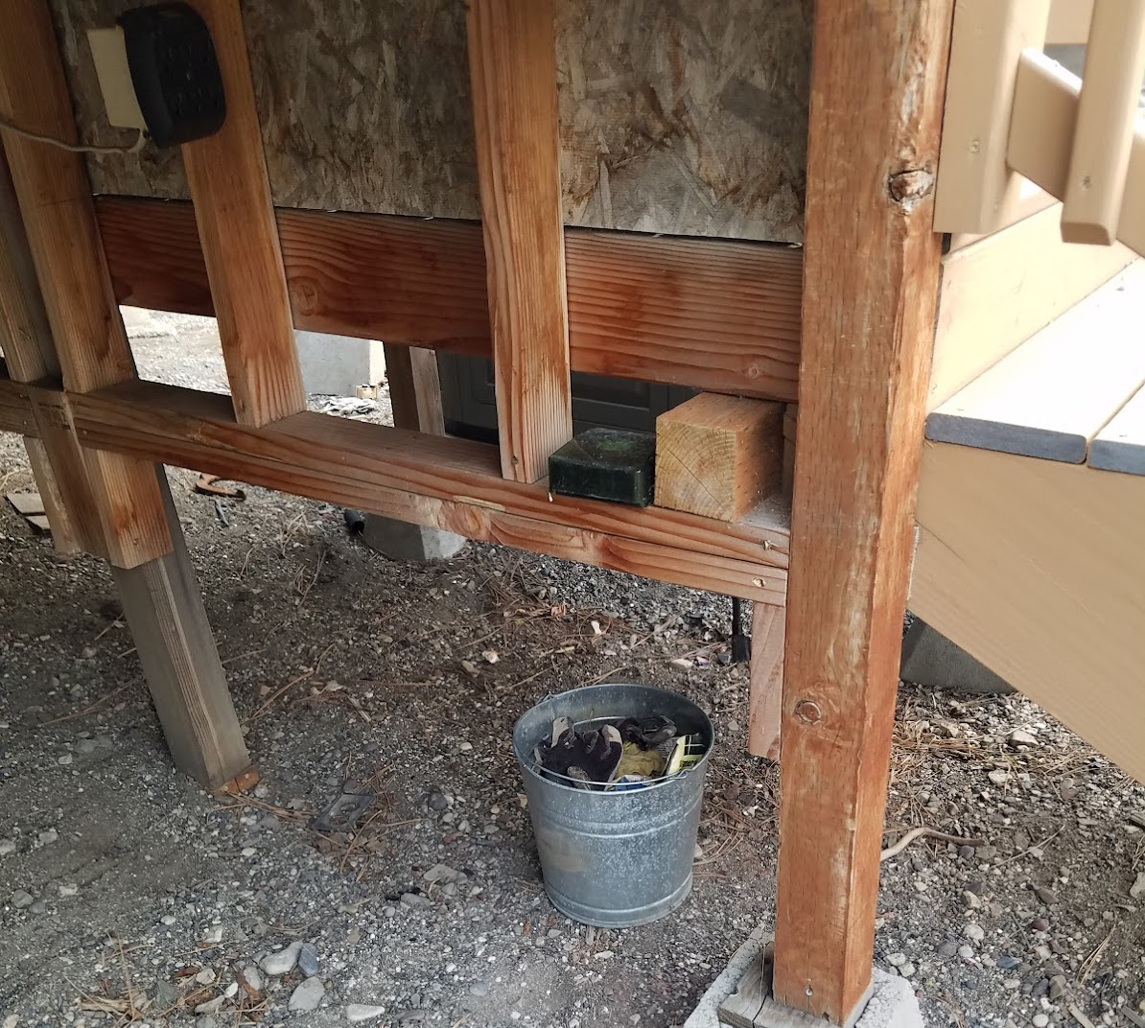
Structure Prep-Lessons Learned
Notes:
Surface prep is one of the most important things we do, and we need to ensure that it is completed with care and an attention to detail. This starts with the company officer with the TFL being responsible.
Company officers should routinely check the work of the crews
If not familiar with the resources or their capabilities make sure they understand the expectation, structure protection plan and their orders.
This bucket was under the stairs of a house that was prepped and sprinkled. Perfect ember trap to catch the deck on fire

Slide 22
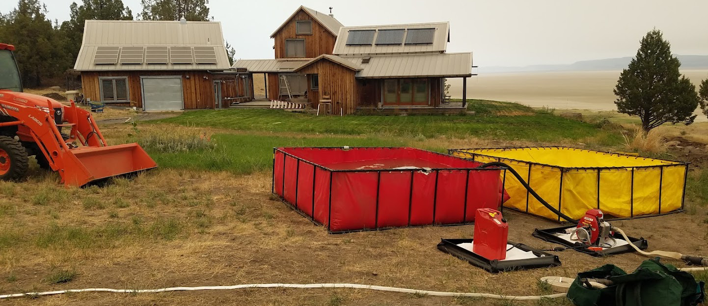
Structure Prep-Lessons Learned
Notes:
Home that has been prepped and sprinklered. Note items on deck and in breeze way. If we are going to be doing things from priority #5 we have got to take care of priority #3 first
Sprinklers not completed and water tanks not filled. Hose not watered or buried. System will take a min of 1700 Gal/hr with one sprinkler kits. System is built to fail. Not a good use of resources
Sprinklers @ $800 x2 =$1600
Hose @ $150 roll x6=$900
Pump@$3500=3500
Porta-a-tank $1500x2=3000
Total=$9000

Slide 23
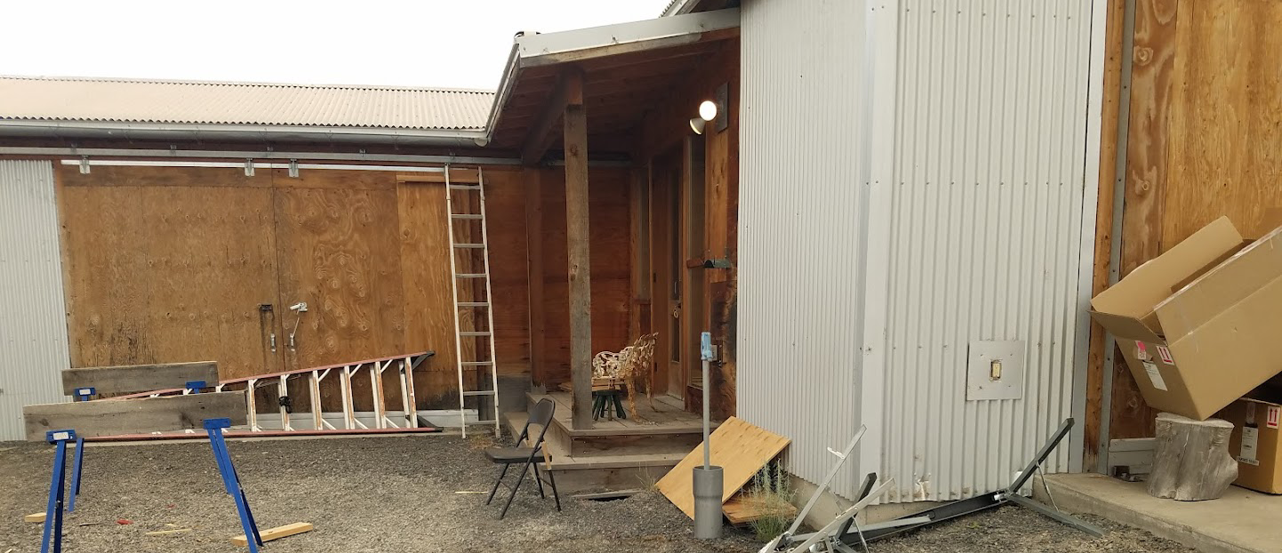
Structure Prep-Lessons Learned
Notes:
Shop adjacent to port-a-tanks. Surface prep not completed. Note the items creating ember traps. We can not start full prep until the surface prep is complete. No reason to jump to priority #5 when priority number #3 is not complete.

Slide 24
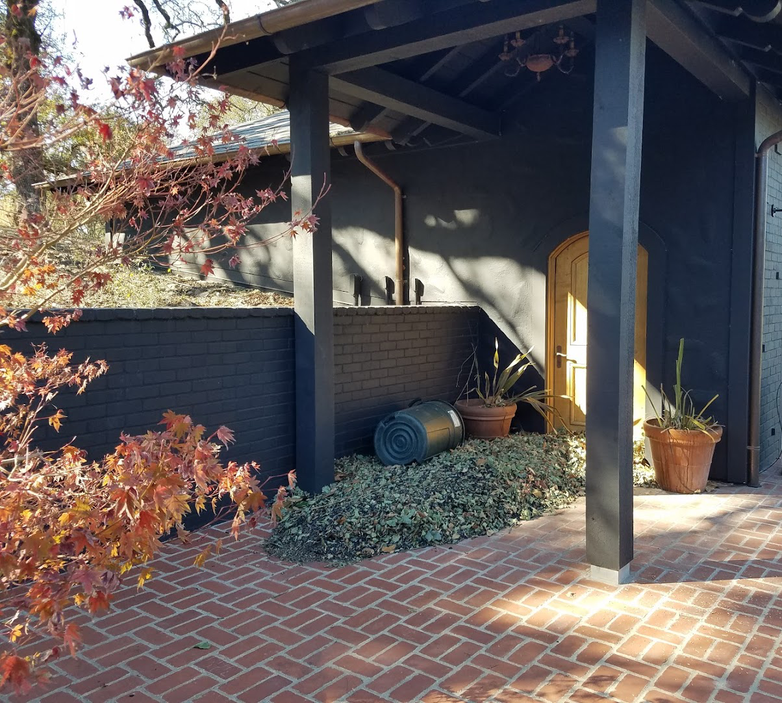
Structure Prep-Lessons Learned
Notes:
Example of the pile of embers and leaves deposited during the fire. This is the reason for a tactical patrol.

Slide 25
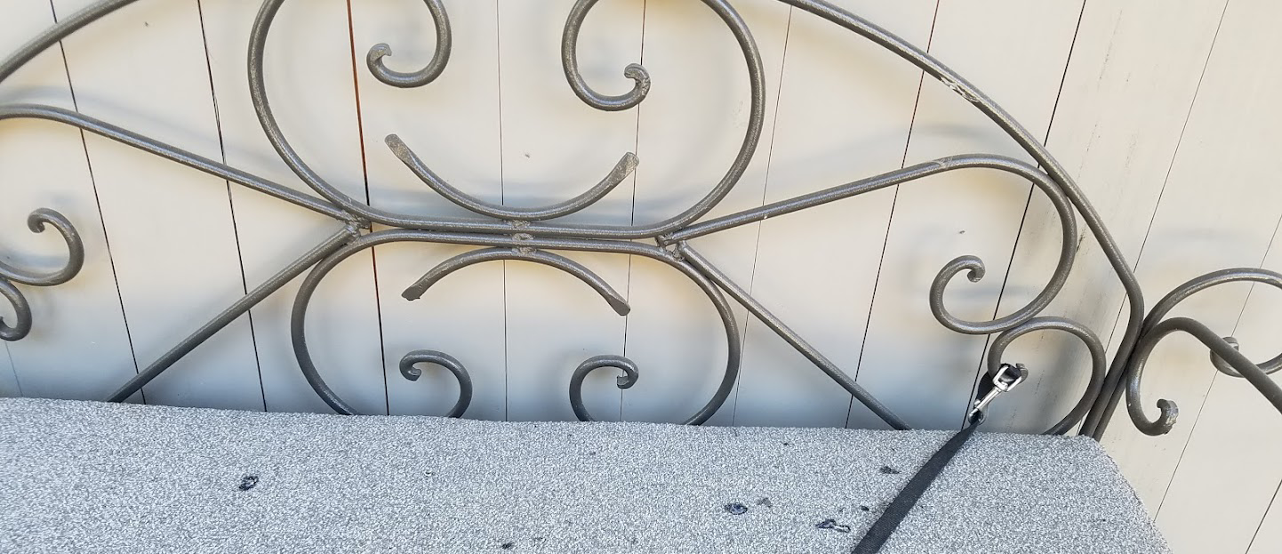
Structure Prep-Lessons Learned
Notes:
Burns on exterior cushion next to the house. Example of why surface prep and Tactical patrol are so essential.

Slide 26
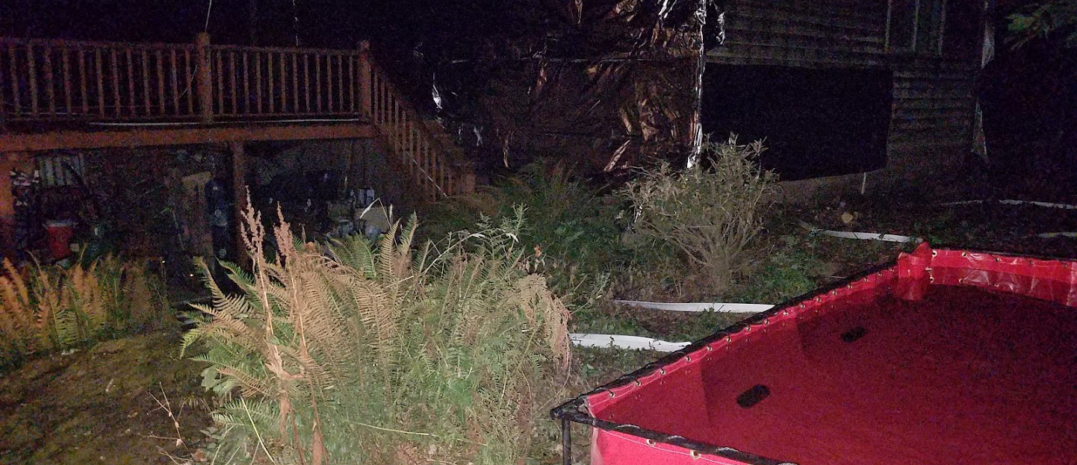
Structure Prep-Lessons Learned
Notes:
Note the large amount of “stuff” under the deck. Structure wrap and sprinklers will be ineffective when the “stuff” catches the deck on fire. Not a good use of resources

Slide 27
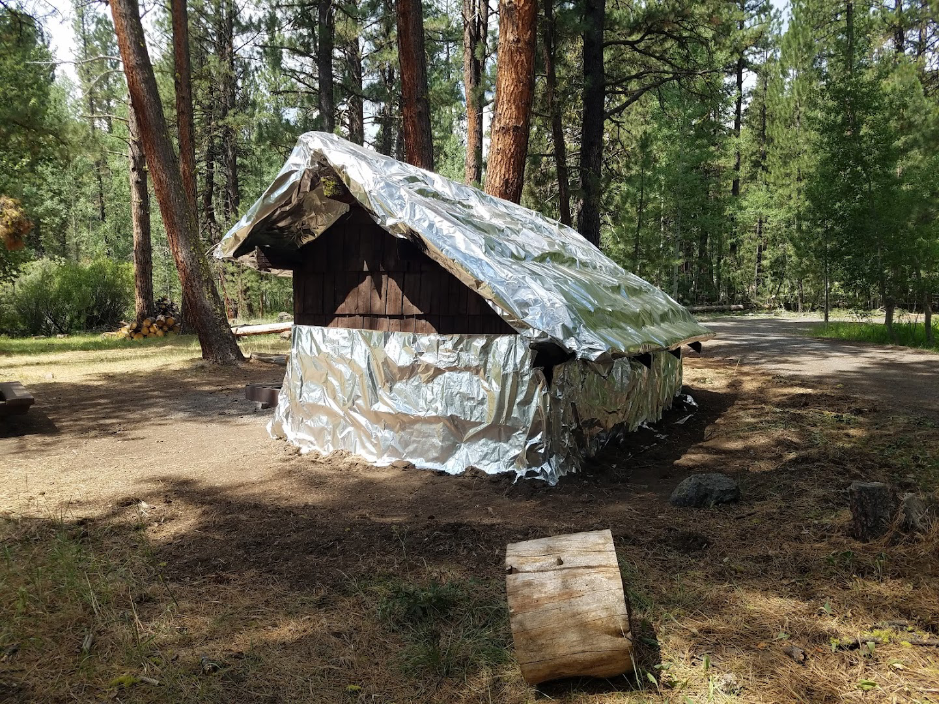
Structure Prep-Lessons Learned
Notes:
Use of structure wrap on a historic picnic shelter. Note base of walls clean, inside was completely clean. Bottom edge secured.

Slide 28
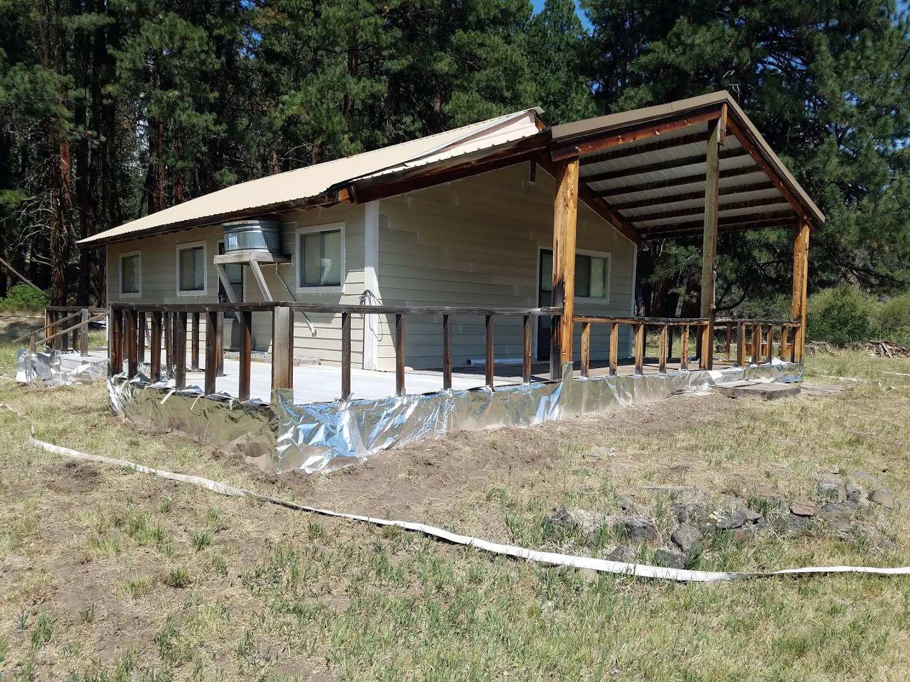
Structure Prep-Lessons Learned
Notes:
Structure wrap cut to cover small areas. Bottom edge secured; no ember traps created.

Slide 29
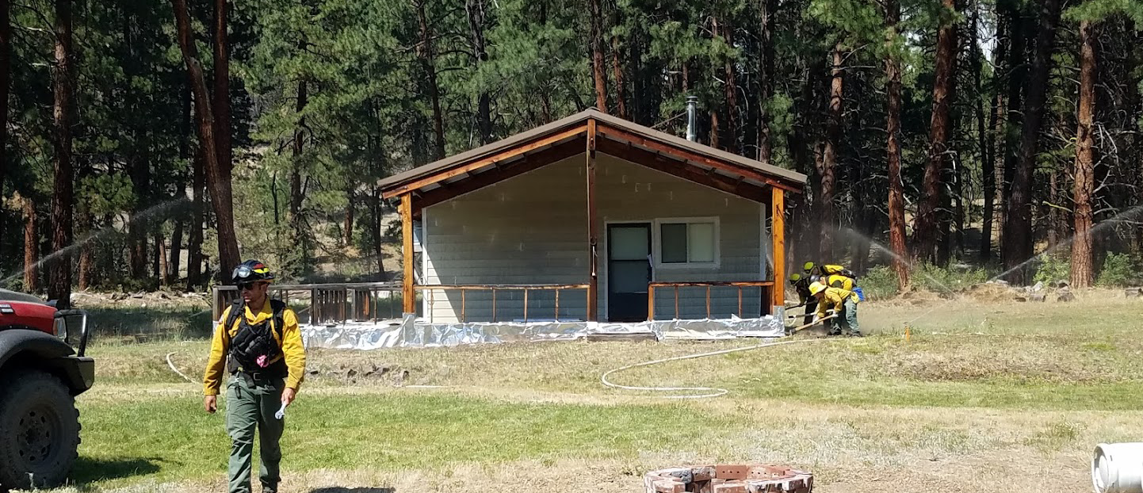
Structure Prep-Lessons Learned
Notes:
Sprinklers being tested. Pump in creek with an unlimited supply of water. Good use of sprinklers and wrap.
Sprinklers @ $800 x2 =$1600
Hose @ $150 roll x6=$900
Pump@$3500=3500
Structure wrap@ $550 roll
Total=$6550

