Slide 1
OMD Safety Training
Excavation and Trenching

Slide 2
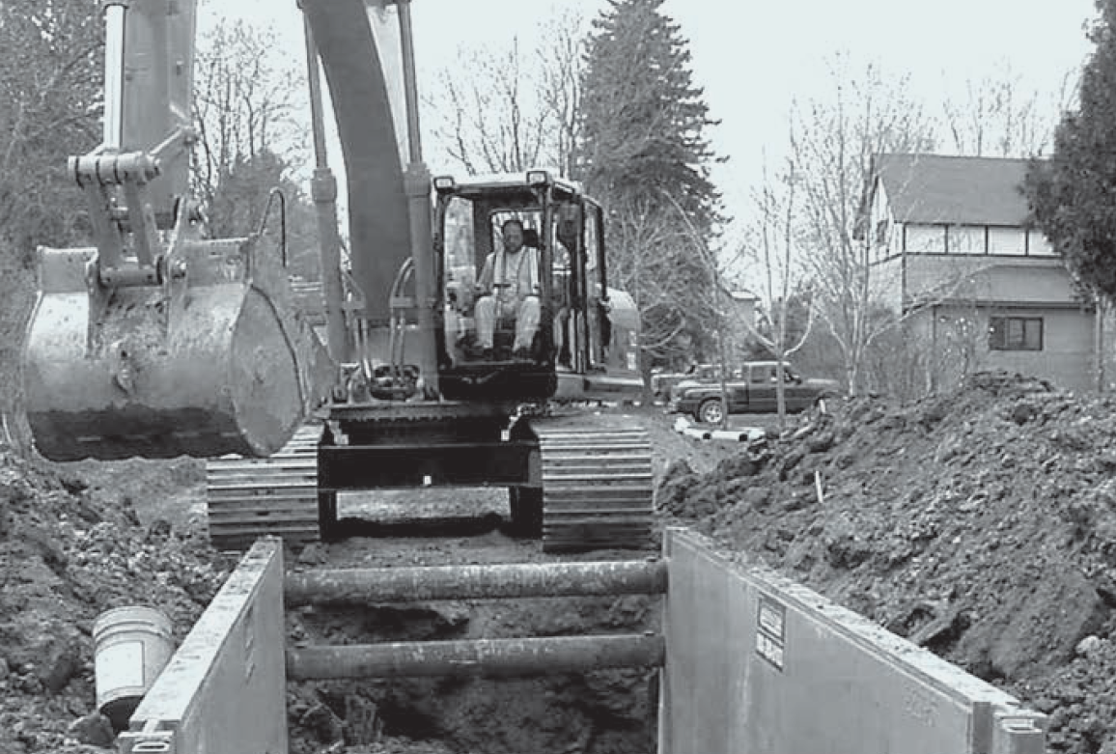
Excavation Information Workshop Module 1: The Basics class time: approximately 45 min
<Location> Safety
This course does not qualify anyone to be a Competent Person for excavation work

Slide 3
The Prelim Stuff
This module is approximately 30 Minutes each.
There will be no breaks.
Please…..
Join in discussions.
Raise your hand and respect others talking.
Mute Phones and Devices.
If you need to take a call, leave and do it as quickly as possible.

Slide 4
Why is this important?
  Excavation is recognized as one of the most hazardous construction operations.
  This workshop is intended to assist in the recognition of trenching and shoring hazards and their prevention.

Slide 5

OR-OSHA arrives just in the nick of time!
What can happen?

Slide 6
Workshop Content
Excavation and Trench Basics
Competent Person Expectations
Hazard Identification and mitigation
Competent Person Duties
Soil Mechanics
Protective Systems
Selection of PPE

Slide 7
DEFINITIONS
ACCEPTED ENGINEERING PRACTICES are procedures compatible with the standards of practice required of a registered professional engineer.
ADJACENT STRUCTURE STABILITY refers to the stability of the foundation(s) of adjacent structures whose location may create surcharges, changes in soil conditions, or other disruptions that have the potential to extend into the failure zone of the excavation or trench.
COMPETENT PERSON is an individual who is capable of identifying existing and predictable hazards or working conditions that are hazardous, unsanitary, or dangerous to employees, and who has authorization to take prompt corrective measures to eliminate or control these hazards and conditions.
CONFINED SPACE is a space that, by design and/or configuration, has limited openings for entry and exit, unfavorable natural ventilation, may contain or produce hazardous substances, and is not intended for continuous employee occupancy.
EXCAVATION. An Excavation is any man-made cut, cavity, trench, or depression in an earth surface that is formed by earth removal. A Trench is a narrow excavation (in relation to its length) made below the surface of the ground. In general, the depth of a trench is greater than its width, and the width (measured at the bottom) is not greater than 15 ft (4.6 m). If a form or other structure installed or constructed in an excavation reduces the distance between the form and the side of the excavation to 15 ft (4.6 m) or less (measured at the bottom of the excavation), the excavation is also considered to be a trench.

Slide 8
DEFINITIONS
HAZARDOUS ATMOSPHERE is an atmosphere that by reason of being explosive, flammable, poisonous, corrosive, oxidizing, irritating, oxygen deficient, toxic, or otherwise harmful may cause death, illness, or injury to persons exposed to it.
INGRESS AND EGRESS mean "entry" and "exit," respectively. In trenching and excavation operations, they refer to the provision of safe means for employees to enter or exit an excavation or trench.
PROTECTIVE SYSTEM refers to a method of protecting employees from cave-ins, from material that could fall or roll from an excavation face or into an excavation, and from the collapse of adjacent structures. Protective systems include support systems, sloping and benching systems, shield systems, and other systems that provide the necessary protection.
REGISTERED PROFESSIONAL ENGINEER is a person who is registered as a professional engineer in the state where the work is to be performed. However, a professional engineer who is registered in any state is deemed to be a "registered professional engineer" within the meaning of Subpart P when approving designs for "manufactured protective systems" or "tabulated data“ to be used in interstate commerce.
SUPPORT SYSTEM refers to structures such as underpinning, bracing, and shoring that provide support to an adjacent structure or underground installation or to the sides of an excavation or trench.

Slide 9
DEFINITIONS
SUBSURFACE ENCUMBRANCES include underground utilities, foundations, streams, water tables, transformer vaults, and geological anomalies.
SURCHARGE means an excessive vertical load or weight caused by spoil, overburden, vehicles, equipment, or activities that may affect trench stability.
TABULATED DATA are tables and charts approved by a registered professional engineer and used to design and construct a protective system.
UNDERGROUND INSTALLATIONS include, but are not limited to, utilities (sewer, telephone, fuel, electric, water, and other product lines), tunnels, shafts, vaults, foundations, and other underground fixtures or equipment that may be encountered during excavation or trenching work.
UNCONFINED COMPRESSIVE STRENGTH is the load per unit area at which soil will fail in compression. This measure can be determined by laboratory testing, or it can be estimated in the field using a pocket penetrometer, by thumb penetration tests, or by other methods.
DEFINITIONS THAT ARE NO LONGER APPLICABLE. For a variety of reasons, several terms commonly used in the past are no longer used in revised Subpart P. These include the following:
Angle of Repose- Conflicting and inconsistent definitions have led to confusion as to the meaning of this phrase. This term has been replaced by Maximum Allowable Slope.
Bank, Sheet Pile, and Walls- Previous definitions were unclear or were used inconsistently in the former standard.
Hard Compact Soil and Unstable Soil- The new soil classification system in revised Subpart P uses different terms for these soil types.

Slide 10
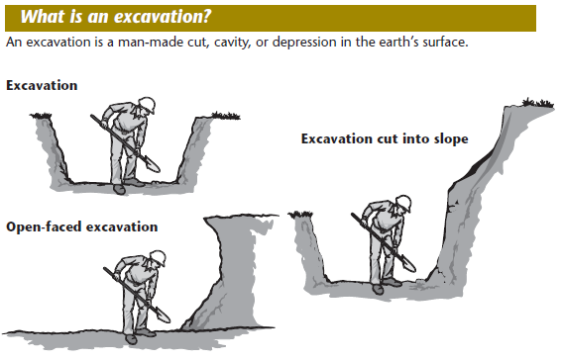
What is an Excavation?
Notes:
An excavation is a man-made cut, cavity, or depression in the earth’s surface
Dig a hole in the ground and you’ve made an excavation. Excavations can be any size: wide, narrow, deep, or shallow.

Slide 11
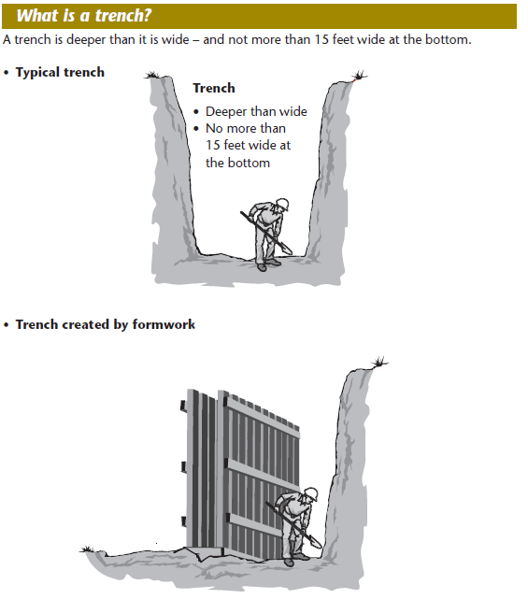
What is a Trench?
Notes:
A trench is a narrow excavation, not more than 15 feet wide at the bottom. If you install forms or other structures in an excavation that reduce its width to less than 15 feet, measured at the bottom, the excavation is also considered a trench.
Trenches 5 feet (1.5 meters) deep or greater require a protective system unless the excavation is made entirely in stable rock. If less than 5 feet deep, a competent person may determine that a protective system is not required.
Trenches 20 feet (6.1 meters) deep or greater require that the protective system be designed by a registered professional engineer or be based on tabulated data prepared and/or approved by a registered professional engineer in accordance with OSHA 29 CFR 1926.652(b) and (c).

Slide 12
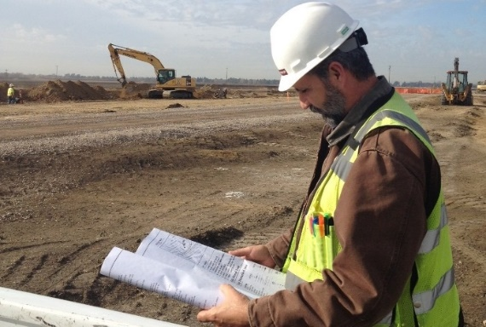
OSHA COMPETENT &
QUALIFIED PERSON
Competent Person:
One who is capable of identifying existing and predictable hazards in the surroundings or working conditions which are unsanitary, hazardous, or dangerous to employees, and who has authorization to take prompt corrective measures to eliminate them.
Qualified Person:
One who by possession of a recognized degree, certificate, or professional standing, or by extensive knowledge, training, and experience, has successfully demonstrated his/her ability to solve or resolve problems related to the subject matter, the work, or the project.

Slide 13
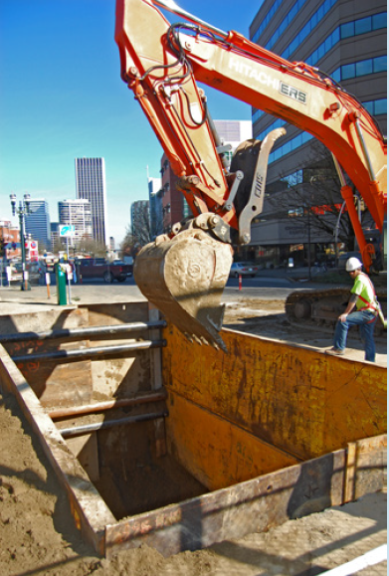

Competent Person Expectations
A designated competent person who has training, experience, and knowledge in:
Soil analysis
Protective systems
Oregon OSHA’s Division 3, Subdivision P, Excavation requirements.
They are TRAINED AND AUTHORIZED TO:
• Recognize and evaluate confined space hazards.
• Take corrective measures to eliminate all hazards and conditions.
• Specify necessary safety control measures to assure worker safety.
• Perform and oversee all tasks required by the OSHA standard.
• Remove any employee in the trench and outside the protection.
A minimum of one CP must remain at job site:
During excavation
Protection installation
When any employee is in the trench

Slide 14
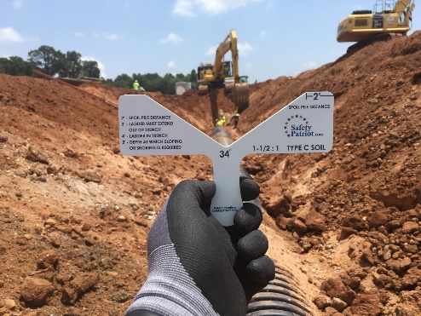
CP INSPECTIONS
Inspections shall be made by a Competent Person and should be documented.
Frequency and conditions requiring inspections:
  Daily and before the start of each shift.
  As dictated by the work being done in the trench.
  After every rainstorm.
  After other events that could increase hazards, e.g. snowstorm, windstorm, thaw, earthquake, etc.
  When fissures, tension cracks, sloughing, undercutting, water seepage, bulging at the bottom, or other similar conditions occur.
  When there is a change in the size, location, or placement of the spoil pile.
  When there is any indication of change or movement in adjacent structures.

Slide 15
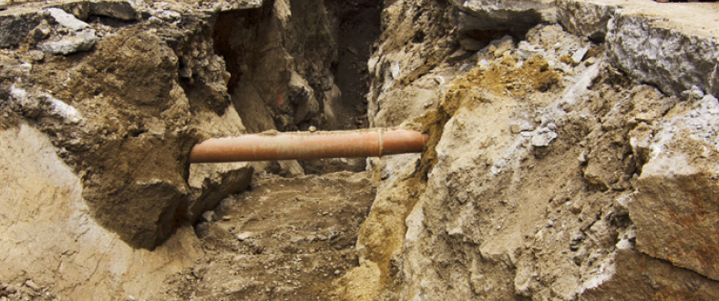
Competent Person
Expectations
If there are no existing hazards the competent person can leave the excavation site for a short time, but must be present when a protective system is moved.
Soil conditions could change or new hazards may arise that require the competent person’s judgment.
The competent person must have authority to immediately correct the hazards and to order employees to leave the excavation until the hazards have been corrected.
NOTE: An employee who is trained and can identify excavation hazards but doesn’t have the authority to correct them is not a competent person.

Slide 16
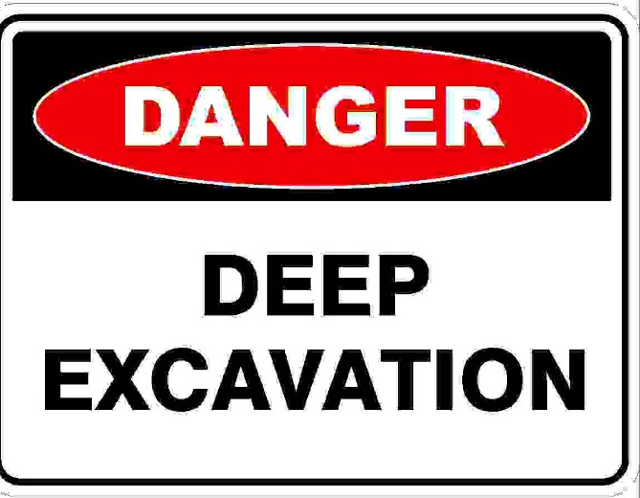
Competent Person
Expectations
REQUIRED TO CONSULT WITH REGISTERED PROFESSIONAL ENGINEER WHEN:
• Trenches are over 20' deep
• Trenches in "C" soil over 15' deep, using hydraulic upright shoring, with standard size
sheeting
• Specially designed shoring, bracing or underpinning is required
• Excavation endangers nearby structures or structures endanger the excavation
(buildings, walls, power poles, sidewalks)
• Standard or conventional protection measures cannot be used
MAY CONSULT WITH REGISTERED PROFESSIONAL ENGINEER WHEN:
• Unusual or changing soil conditions exist or are anticipated
• Dollar-cost comparisons of protection systems are needed
• Questions, interpretations or safety concerns exist

Slide 17
Hazards At The Site- Excavators
EXPOSURE TO FALLING LOADS
Employees must be protected from loads or objects falling from lifting or digging equipment.
Procedures designed to ensure their protection include:
Employees are not permitted to work under raised loads.
Employees are required to stand away from equipment that is being loaded or unloaded.
Equipment operators or truck drivers may stay in their equipment during loading and unloading if the equipment is properly equipped with a cab shield or adequate canopy.
Most accidents happen for three reasons:
• Entering the excavator’s swing area
• Using quick-coupling devices improperly
• Using unsafe rigging methods to drag a trench shield
  Remove any employee in the excavation working outside the protection system.

Slide 18
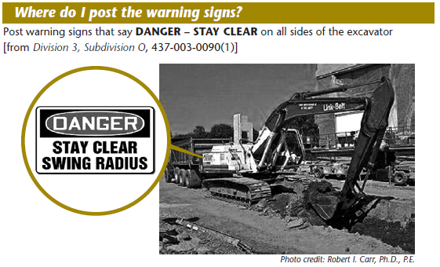
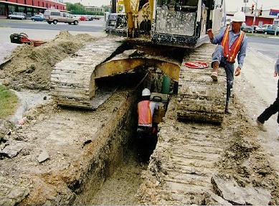
Your Safety At The Site
Be aware of the excavator’s swing area and blind spots.
Always maintain at least three feet of unimpaired clearance between the excavator’s rotating superstructure and adjacent objects.
Keep others outside the area. It should be marked with rope, tape, or a similar barrier, if necessary.
Look for warning signs that say DANGER – STAY CLEAR on all sides of the excavator.
Don’t allow anyone to stand under a suspended load or the boom arm, or bucket.
The bucket should be kept as close to the ground as possible when workers are attaching loads.
Never stand in line with, or next to, a sling that is under tension.
  Remove any employee in the excavation working outside the protection system.

Slide 19
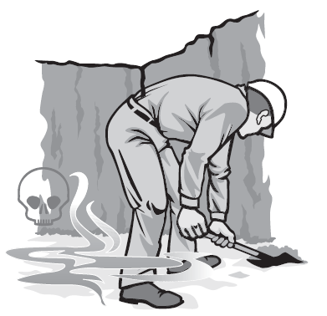
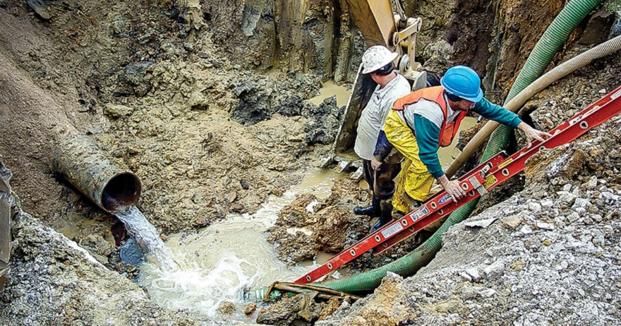
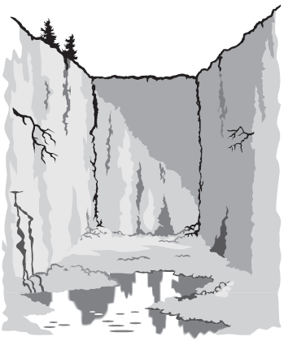
More Hazards At The Site
Water makes soil unstable. Workers can’t enter an excavation when water has built up unless they are protected from the unstable soil.
Protection includes specialized support systems and water-removal equipment. A competent person must inspect the excavation and monitor methods used to control water accumulation.
Hazardous atmospheres can occur in excavations near landfills, sites contaminated by leaking gas lines or storage tanks, in sewers, and in other confined spaces. If these conditions are possible, a competent person must test for oxygen deficiency (oxygen levels less than 19.5 percent) and hazardous atmospheres before workers can enter.
Is the protection adequate for the excavation?

Slide 20
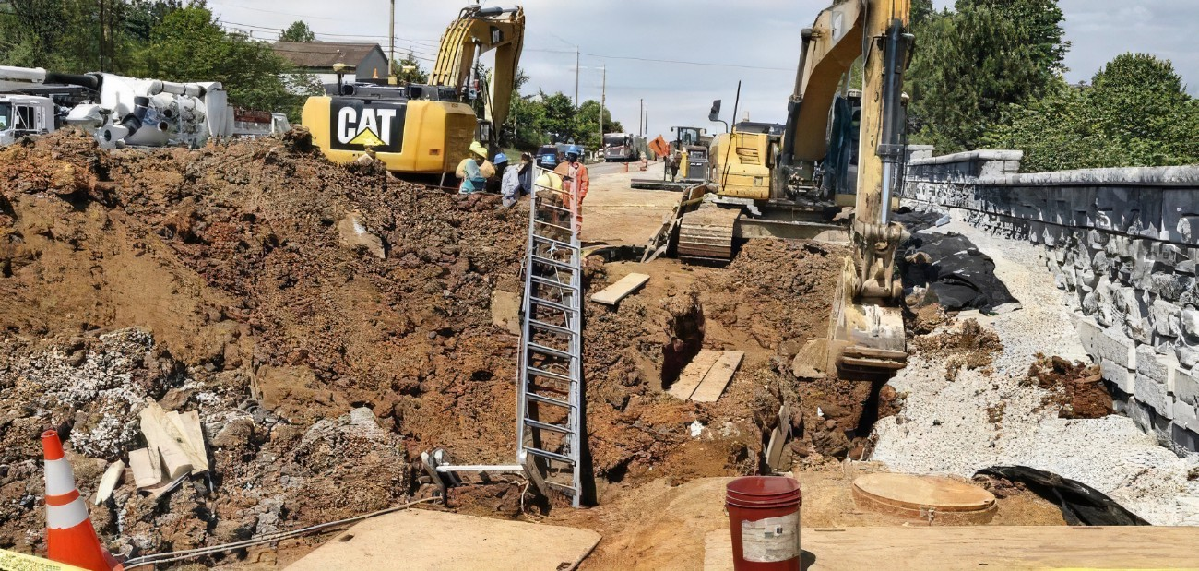



Hazards? What do you See?
Spoil Pile Surcharge Placement >2ft from Zone of Influence
Equipment Surcharge Placement >2ft from Zone of Influence
Traffic Control?
Warning Signs?
Barricade?
No workers
on slopes or benches
No workers
on slopes or benches
Is the protection adequate for the excavation?
No workers
on slopes or benches
Ladders must be placed from bottom of excavation and extend 3ft above ground level

Slide 21
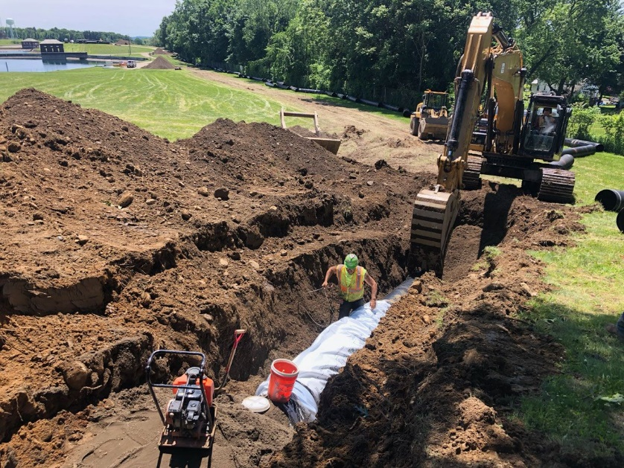
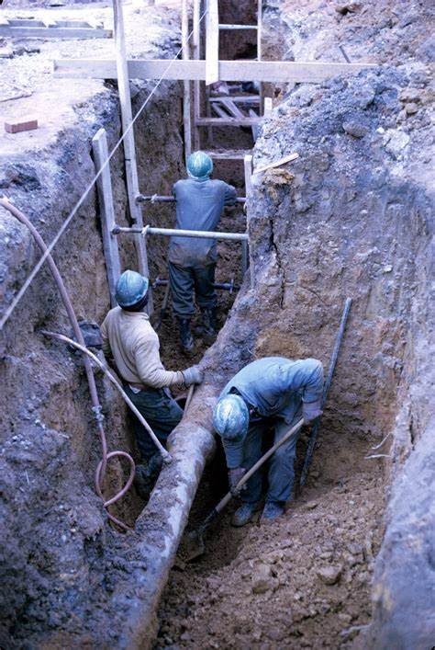
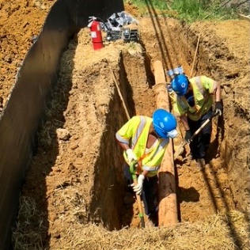


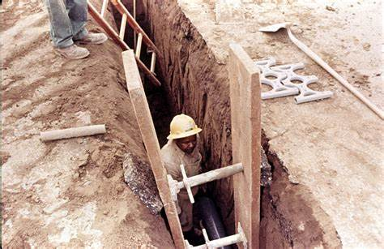
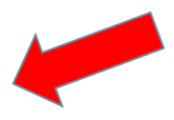
Hazards? What do you See?
Trenches 5 feet (1.5 meters) deep or greater require a protective system
Shoring must extend > 18” above excavation
Trenches 5 feet (1.5 meters) deep or greater require a protective system
Trenches 5 feet (1.5 meters) deep or greater require a protective system
Ladders must be placed from bottom of excavation and extend 3ft above ground level
Ladder? Access?
Ladder? Access?
Is the protection adequate for the excavation?
Is the protection adequate for the excavation?
  Remove any employee in the excavation working outside the protection system.

Slide 22
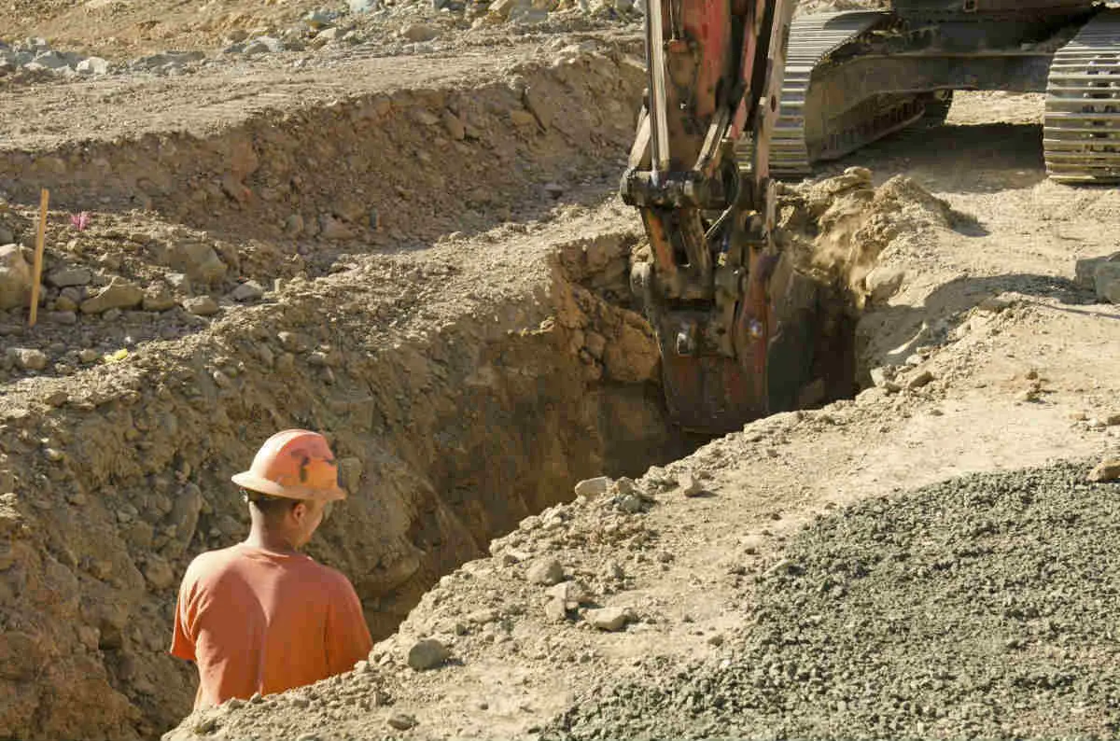

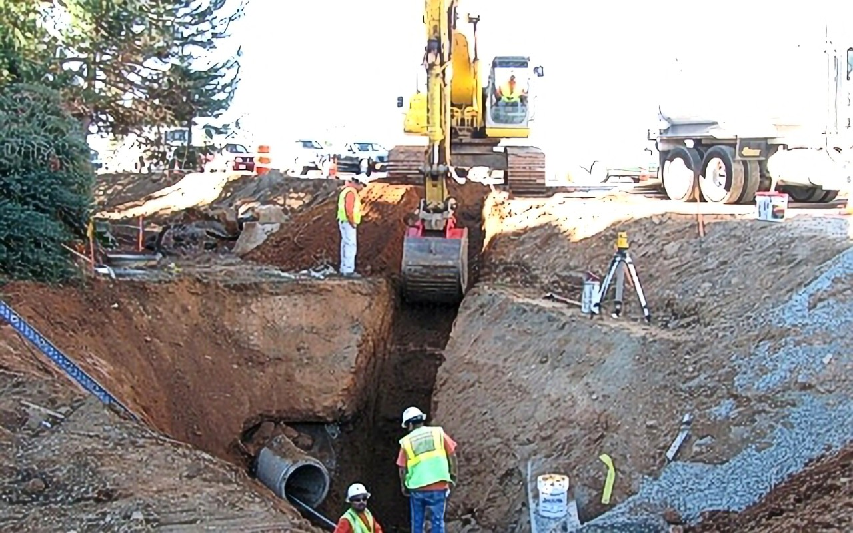
Hazards?
What do you See?
Trenches 5 feet (1.5 meters) deep or greater require a protective system
Ladder? Access?
Traffic Control?
Warning Signs?
Barricade?
No workers
on slopes or benches
No Workers under Excavator or in possible collapse zone
No Workers under Excavator or in possible collapse zone
Ladder? Access?
Is the protection adequate for the excavation?
  Remove any employee in the excavation working outside the protection system.

Slide 23
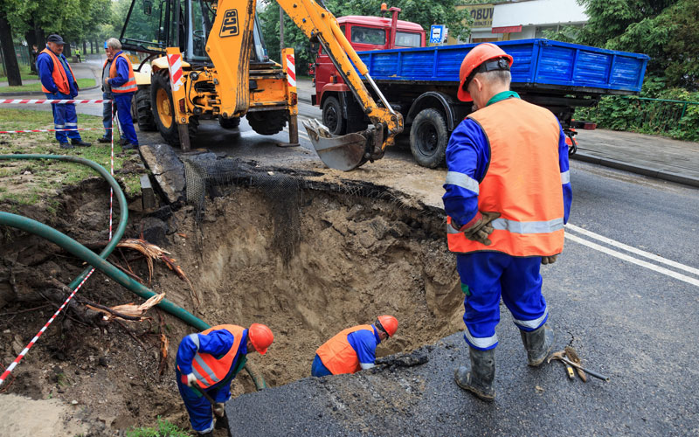
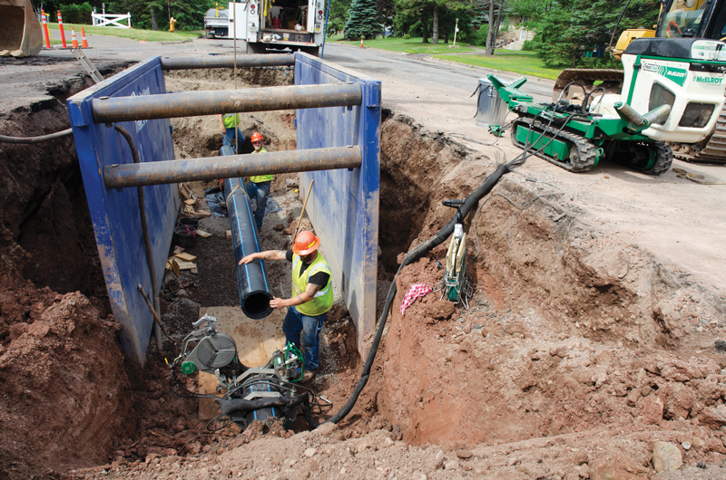
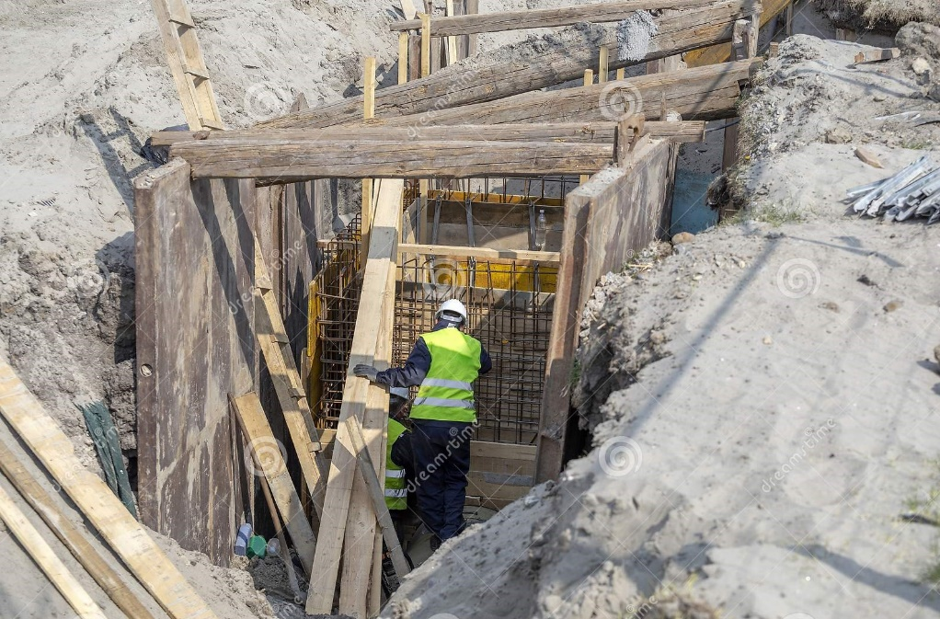
Hazards?
What do you See?
Ladder? Access?
A competent person must also evaluate ramps made from soil that are used to enter and exit an excavation.
Trenches 5 feet (1.5 meters) deep or greater require a protective system
Traffic Control?
Warning Signs?
Barricade?
Traffic Control?
Warning Signs?
Barricade?
Shoring must be designed/engineered for the excavation
Ladders must be placed from bottom of excavation and extend 3ft above ground level

Slide 24
HAZARDOUS ATMOSPHERES AND CONFINED SPACES
Employees shall not be permitted to work in hazardous and/or toxic atmospheres. Such atmospheres include those with:
  Less than 19.5% or more than 23.5% oxygen.
  A combustible gas concentration greater than 20% of the lower flammable limit.
  Concentrations of hazardous substances that exceed those specified in the Threshold Limit Values for Airborne Contaminants established by the ACGIH (American Conference of Governmental Industrial Hygienists).
When testing for atmospheric contaminants:
Testing should be conducted before employees enter the trench and should be done regularly to ensure that the trench remains safe.
The frequency of testing should be increased if:
  Equipment is operating in the trench.
  Welding, cutting, or burning is done in the trench.
All operations involving such atmospheres must be conducted in accordance with OSHA requirements for occupational health and environmental controls (see Subpart D of 29 CPR 1926) for personal protective equipment and for lifesaving equipment (see Subpart E, 29 CFR 1926). Engineering controls (e.g., ventilation) and respiratory protection may be required. Employees required to wear respiratory protection must be trained, fit-tested, and enrolled in a respiratory protection program.
NOTE: Some trenches qualify as confined spaces. When this occurs, compliance with the OSHA Confined Space Standard is also required.

Slide 25

More Hazards At The Site
ELECTRICITY:
Oregon’s Overhead Line Safety Act and Oregon OSHA rules requires that anyone stay at least 10 feet away from these utilities.
Before any work within 10 feet of a high-voltage power line, notify the utility that controls the line at least two business days before work begins.
Underground installations:
1) The estimated location of utility installations, such as sewer, telephone, fuel, electric, water lines, or any other underground installations that reasonably may be expected to be encountered during excavation work, shall be determined prior to opening an excavation.
Note: 1910.651(b)(2) was NOT adopted by OR-OSHA. In Oregon: OAR 437-003-0096 (printed in italics above) applies.
(2) When excavation operations approach the estimated location of underground installations, the exact location of the installations shall be determined by safe and acceptable means.
(3) While the excavation is open, underground installations shall be protected, supported or removed as necessary to safeguard employees.

Slide 26
What causes Cave-Ins?
Vibrations
Freezing and thawing
Adjacent structures
The weight of the soil itself
Addition/removal of water
Capacities of the soil

Slide 27
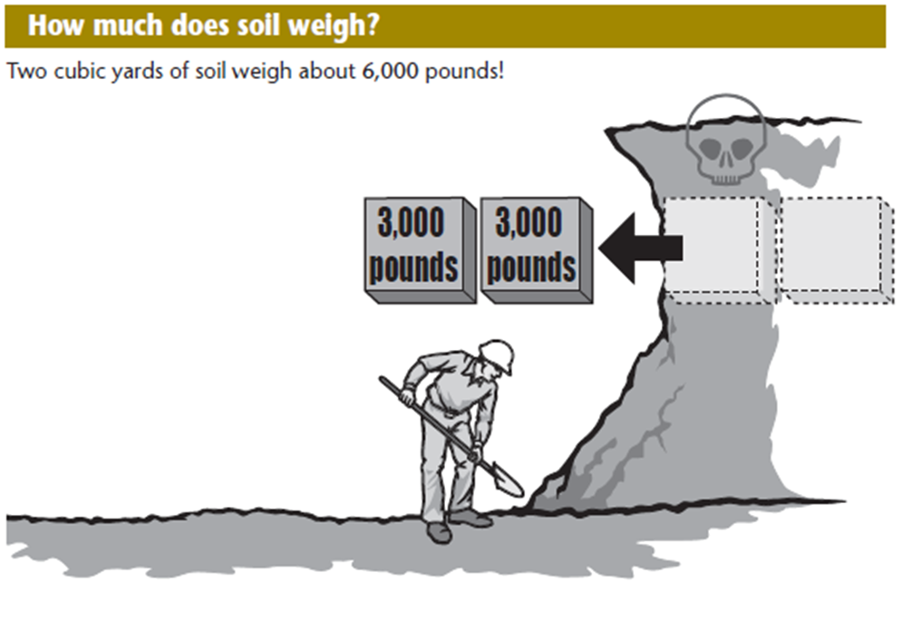
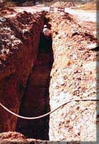
Considerations of soil instability
  Cohesive strength of soil:
    Cohesiveness means how well soil holds together; clay is a cohesive soil.
  Unit weight of soil
  Depth of trench
  Slope of wall
  Surface vibration
  Depth of water table
  Adjacent structures
Is the protection adequate for the excavation?
Ladder? Access?
  Remove any employee in the excavation working outside the protection system.
UNIT WEIGHT OF SOILS refers to the weight of one unit of a particular soil. The weight of soil varies with type and moisture content. One cubic foot of soil can weigh from 110 pounds to 140 pounds or more, and one cubic meter (35.3 cubic feet) of soil can weigh more than 3,000 pounds.

Slide 28
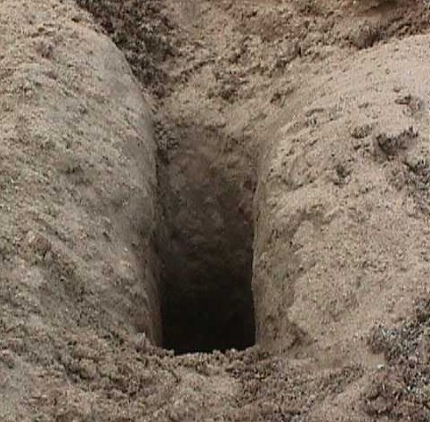
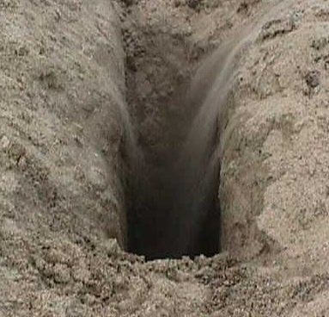
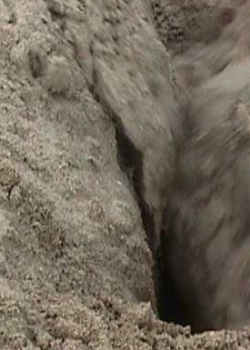
Soil Instability
The sand pit stood for awhile
Then the sides began to shift
Then the entire wall collapses
Similar to water, soil attempts to seek the lowest level, causing a collapse

Slide 29
Soil Instability
Soil exerts horizontal pressure as it attempts to seek a level plane

Slide 30
Mechanics of a Cave-In
Water enters trenches, causing the soil to weaken
Seepage
Rain
Runoff

Slide 31
Mechanics of a Cave-In
If water gets into the bottom of the trench and erodes the soil under the dirt, you may lose support you thought was there.
The unsupported soil eventually will collapse and fill in the void.

Slide 32
Mechanics of a Cave-In
The earth becomes fissured as water eats into the soil and forms cracks.
Each crack will seek the lowest level, crack off, and fill the trench.

Slide 33
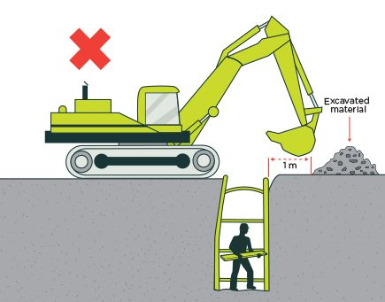

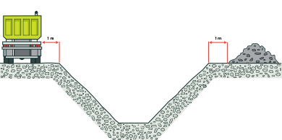


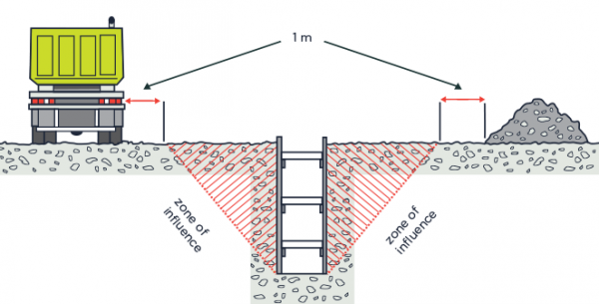
How to Prevent a Cave-in
WRONG
Surcharges MUST be at least 1 Meter outside The Zone of Influence or the edge of slope
Reduce Loads (aka Surcharge) on the sides of the excavation (aka The Zone of Influence) ie. Spoils, equipment.
RIGHT

Slide 34
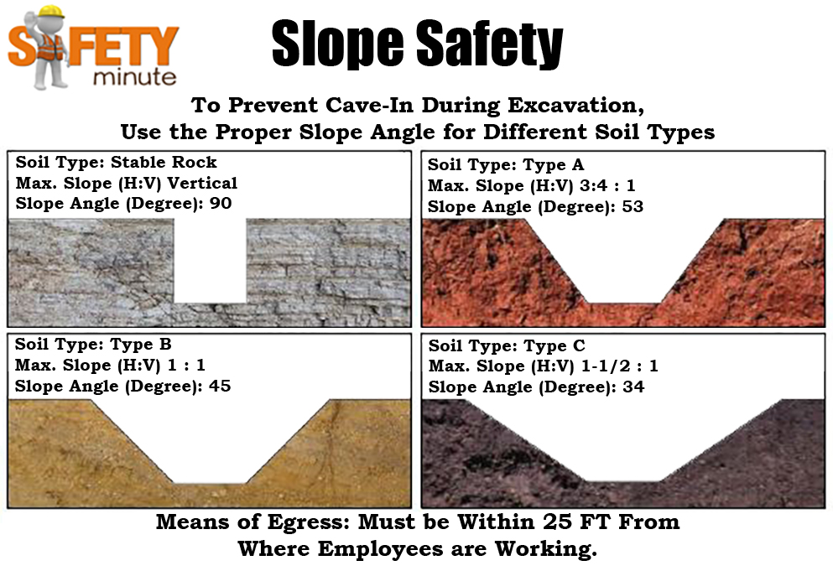
How to Prevent a Cave-in
TYPE A:
Clay, Silty Clay, Sandy Clay
Cohesive soil
It CAN’T be Type A if
the soil is:
  Fissured
  Subject to vibration
  Previously disturbed
  Part of a sloped, layered system
TYPE B:
Crushed rock, silt, sandy loam
Previously disturbed soils, except those which would be classified as Type C
Dry rock that is not stable
TYPE C:
Gravel, sand, loamy sand
Submerged soil or soil from which water is seeping
Submerged rock that is
not stable

Slide 35
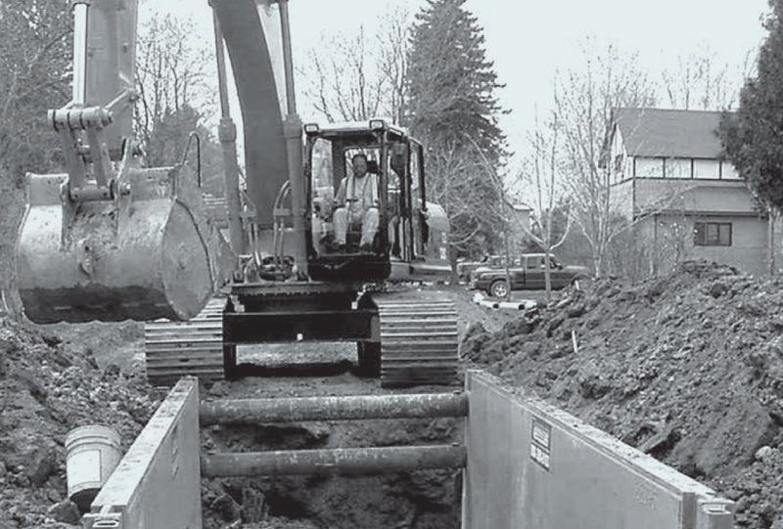
End of Module 1
Next Up…..
Module 2: Competent Person Duties
<Location> Safety is:
<Insert>, Safety Manager
Ph: 503-969-xxxx
email@email.com
<Insert>, Safety Specialist
Ph: 503-969-xxxx
email@email.com

Slide 36
Excavation Information Workshop
Module 2: Competent Person Duties class time: approximately 45 min
<Location>
This course does not qualify anyone to be a Competent Person for excavation work

Slide 37

Competent Person Duties
1. Conduct pre-job site review and develop a job plan which verifies a safe and efficient job process:
  Required protection
  Utility Pole Bracing
  Bracing of adjacent structures
  Support or move other parallel buried utilities
  Removal or support of overhangs & projections
  Public Protection for area congestion
    (Barricades, cones, fencing, security, traffic control)
OSHA QUESTION
Is CP capable of specifying necessary safety control measures to assure worker safety?

Slide 38
Competent Person Duties
2. Design employee & equipment access.
  Verify that a Competent Person:
    Designed ramps and walkways for use by employees to OSHA specifications
    Verify that a person qualified in structural design:
      Ramps designed for equipment to OSHA specifications
OSHA QUESTIONS
Is employee ramp designed by a CP?
Is ramp solely for employee access?
OSHA QUESTION
Is equipment ramp designed by a person qualified in structural design?

Slide 39
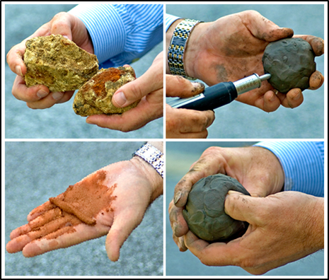
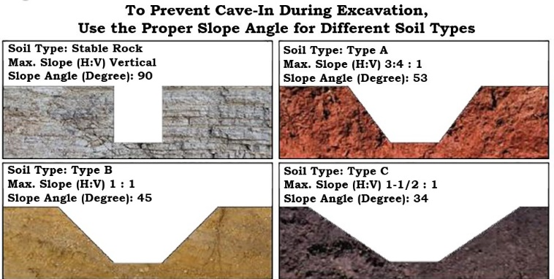
Competent Person Duties
3. Determine Soil Conditions
  Perform Manual and Visual tests to determine stability of soil, surrounding trench conditions and soil type.
  Record results on Daily Excavation Safety Checklist.
    Continually observe trench for changing soil conditions and increase protection or remove employees when soil conditions deteriorate due to: Rain, water, Increased vibration, Increased surcharge loading, Undercutting, Layered soil
Notes:
OSHA QUESTIONS
Has CP correctly classified soil according to manual & checklist?
What Visual & Manual tests did CP perform?
Have conditions changed since classification was made?
Have daily and/or shift change inspections been performed?

Slide 40
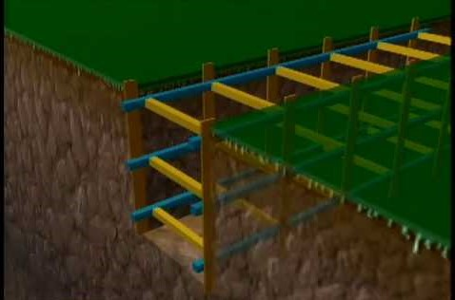
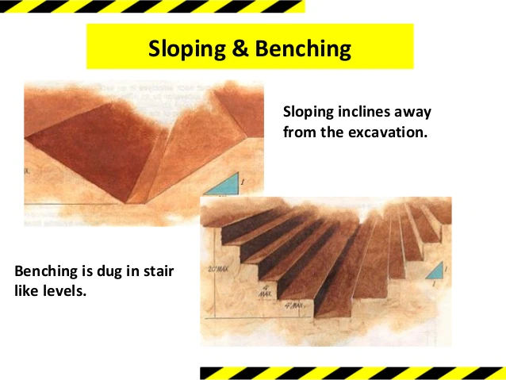
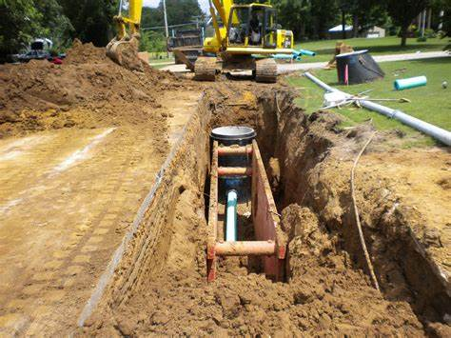
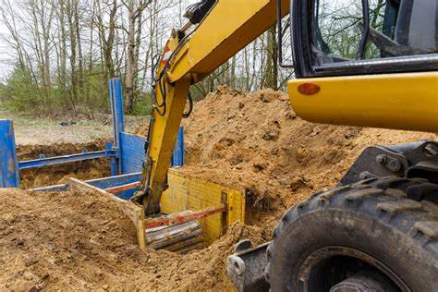
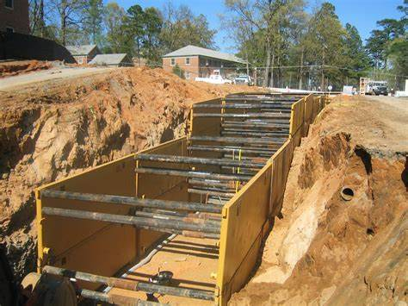
Competent Person Duties
4. Select Protection Systems, Oversee Installation, and Perform Daily Inspections
    Select the most appropriate protection system to be used for the job:
      Slope
      Bench
      Hydraulic shoring (extent of sheeting required)
      Trench shield
Shoring must extend > 18” above excavation
Notes:
OSHA QUESTIONS
What protection systems were selected from manual?
Is CP relying on approved drawings to design sloping and shoring system or to select and construct a protective system?
If not selected from manual, who designed the protection? Are drawings at the job site?
Is the manufacturer's certification for all protective systems available at the job site?

Slide 41
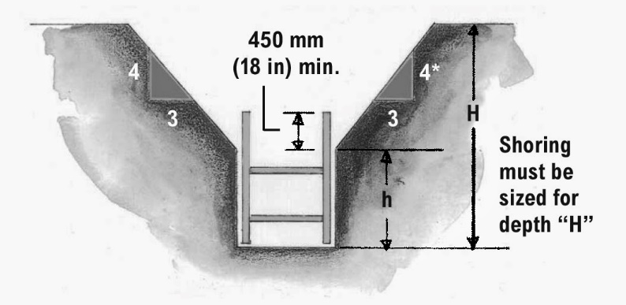
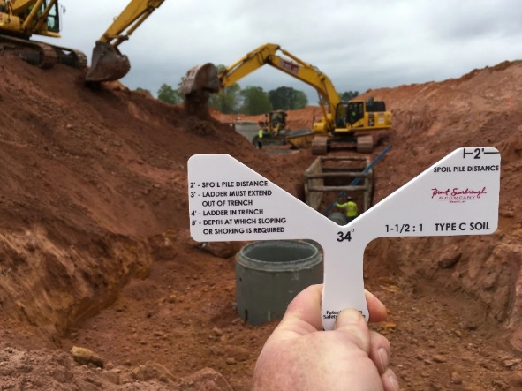
Competent Person Duties
Oversee the installation of the protection system to ensure that it is installed according to the manual or by the manufacturer's tabulated data.
Inspect trench/soil conditions at start of every shift and as needed by changing conditions:
  Deteriorating soil conditions
  Rainstorm
  Spoil pile clearance
  Any hazard increasing in occurrence
Inspect equipment conditions at start of every shift and as needed by changing conditions:
  Protection system
  ladders
  Plating
Is the protection adequate for the excavation?
  Remove any employee in the excavation working outside the protection system.

Slide 42
Competent Person Duties
With regard to:
Selection of Protection Systems, Overseeing Installation, and Performing Daily Inspections
?
Notes:
OSHA QUESTIONS
Has CP conducted daily inspection of excavation, protection systems, adjacent structures?
Has the CP examined any damaged equipment or materials used, and evaluated its suitability for continued use?
When (what time) were inspections conducted by CP?

Slide 43
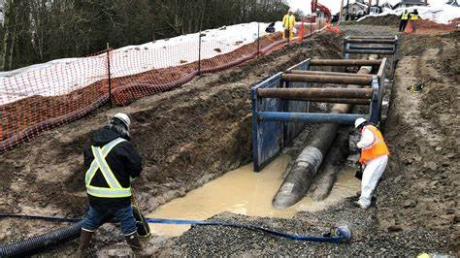
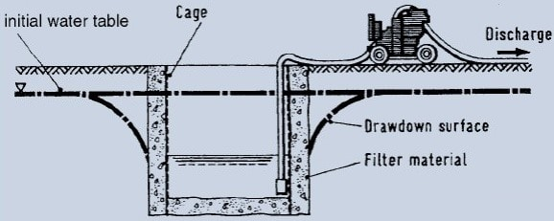
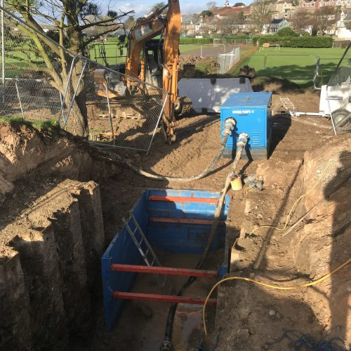
Competent Person Duties
5. Monitor Environmental Conditions to Ensure Safety and Health of Employees
  Remove employees from any trench where water is accumulating (during heavy rains) or has accumulated when no special protection system has been installed.
  Monitor use of water removal equipment.
Shoring must extend > 18” above excavation
Notes:
OSHA QUESTIONS
Is de-watering equipment being used on site?
Is CP monitoring equipment to correct the operations?
Has excavation been subjected to heavy rainfall? Leaking gas/water lines?

Slide 44
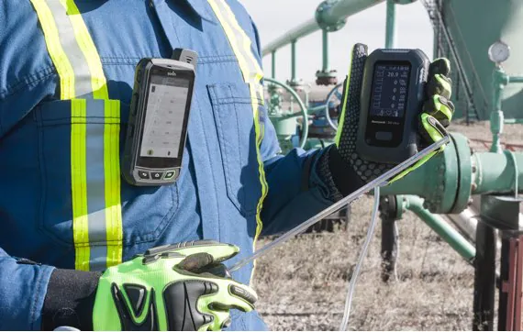
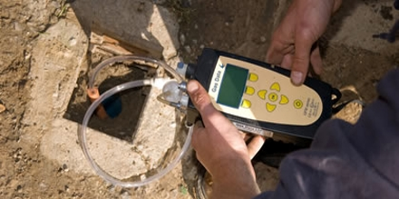
Competent Person Duties
Test for oxygen and air quality using gas monitors when:
  Near landfills, sewer/pipe lines, excavations where hazardous substances are stored nearby, very deep trenches OR
  Competent Person suspects: oxygen deficiency or oxygen enrichment, excess carbon monoxide, or presence of flammable gas beyond OSHA safe levels
Notes:
OSHA QUESTIONS
Is rescue equipment kept on-site when working in areas known to be hazardous?
Does trench/excavation meet definition of confined space?
Is CP trained to use oxygen deficiency/combustible gas monitors?

Slide 45
Competent Person Duties
6. Communicate & Provide for Employee and Public Safety
  Job to be performed, length of time.
  Location (traffic) and trench description.
  Type of protection selected.
  Obstructions: nearby poles, overhangs, buildings, falling loads and others.
  Changing environmental conditions: weather, water accumulation, hazardous atmospheres.
  Job assignments, job priorities, crew changes.
Notes:
OSHA QUESTION
What has the CP told the crew about this job and the details of the work?

Slide 46
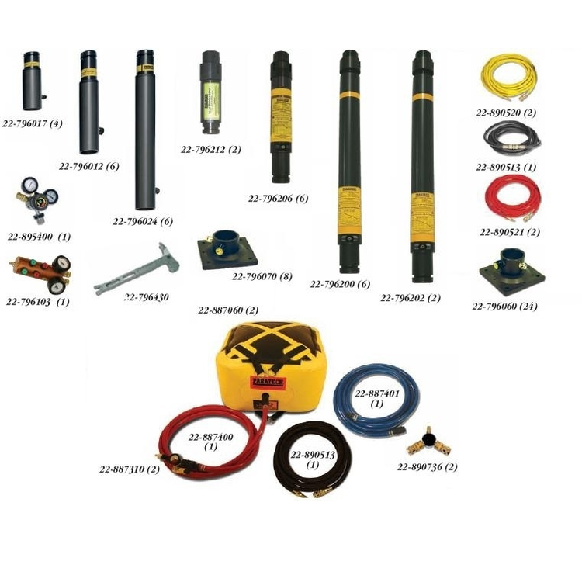
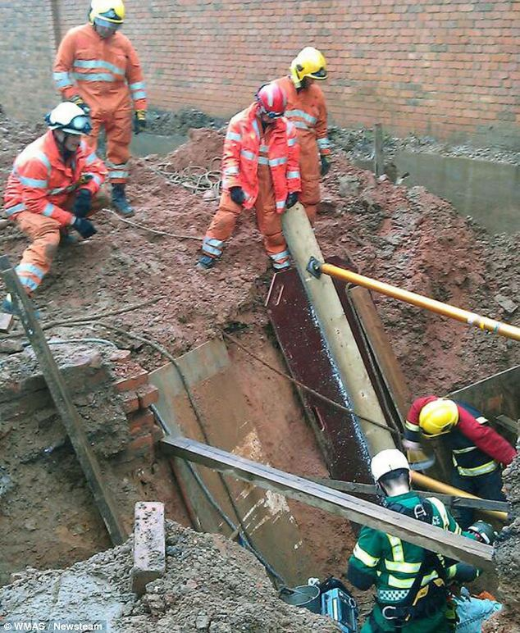


Competent Person Duties
Ensure that emergency rescue equipment is available to meet any conditions that exist or may develop.
Notes:
OSHA QUESTION
Is CP trained to respond to an emergency using company emergency rescue procedures?
Remove employees from hazardous conditions and make all changes necessary to ensure their safety
Does CP know that his/her opinion takes precedence over the Foreman or RPE even if they happen to be present at the job site?

Slide 47




Competent Person Duties
Verify that public protection is provided
  Barricades
  Traffic control equipment
  Steel traffic crossing plates
  Ladder requirements/excavations
  Structural ramps & runways
  Signal person: duties & equipment
  Hazardous atmospheres

Slide 48
End of Module 2
Next Up…..
Module 3: Soil Mechanics & Protection Systems
<Location> Safety is:
<Insert>, Safety Manager
Ph: 503-969-xxxx
email@email.com
<Insert>, Safety Specialist
Ph: 503-969-xxxx
email@email.com

Slide 49
Excavation Information Workshop
Module 3: Soil Mechanics and Protection Systems class time: approximately 45 min.
<Location> Safety
This course does not qualify anyone to be a Competent Person for excavation work

Slide 50




Soil Types
Some soils are more stable than others. The type of soil is one of the factors that determine the chance that an excavation will cave in.
Soil has other qualities that affect its stability. These include:
    Granularity refers to the size of the soil grains; the larger the grains, the less stable the soil.
    Saturation means how much water soil will absorb.
    Cohesiveness means how well soil holds together; clay is a cohesive soil.
    Unconfined compressive strength is determined by a test that shows how much pressure it takes to collapse a soil sample. For example, type A soil must have an unconfined compressive strength of at least 1.5 tons per square foot.

Slide 51




Visual Soil Check by CP
Visual testing involves looking at the soil and the area around the excavation site for signs of instability.
The competent person should do visual tests such as the following:
  Observe the soil as it is excavated.
    Soil that remains in large clumps when excavated may be cohesive. Soil that breaks up easily is granular.
  Examine the particle sizes of excavated soil to determine how they hold together.
  Look for cracks or fissures in the faces of the excavation.
  Look for layers of different soil types and the angle of the layers in the face of the excavation that may indicate instability.
  Look for water seeping from the sides of the excavation.
  Look for signs of previously disturbed soil from other construction or excavation work.
  Consider vibration from construction activity or highway traffic that may affect the stability of the excavation.

Slide 52

Manual Tests by CP
Manual testing involves evaluating a sample of soil from the excavation to determine qualities such as cohesiveness, granularity, and unconfined compressive strength.
Soil can be tested either on site or off site but should be tested as soon as possible to preserve its natural moisture.
Plasticity test. Shape a sample of moist soil into a ball and try to roll it into threads about 1/8-inch in diameter. Cohesive soil will roll into 1/8-inch threads without crumbling.
Dry strength test. Hold a dry soil sample in your hand. If the soil is dry and crumbles on its own or with moderate pressure into individual grains or fine powder, it’s granular. If the soil breaks into clumps that are hard to break into smaller clumps, it may be clay combined with gravel, sand, or silt.

Slide 53


Manual Tests by CP
Thumb penetration test. This test roughly estimates the unconfined compressive strength of a sample. Press your thumb into the soil sample. If the sample resists hard pressure it may be type A soil. If it’s easy to penetrate, the sample may be type C.
Pocket penetrometers offer more accurate estimates of unconfined compressive strength. These instruments estimate the unconfined compressive strength of saturated cohesive soils. When pushed into the sample, an indicator sleeve displays an estimate in tons per square foot or kilograms per square centimeter.

Slide 54

Soil Classification
terrain
Notes:
TYPE A:
Clay, Silty Clay, Sandy Clay
Cohesive soil
It CAN’T be Type A if
the soil is:
Fissured
Subject to vibration
Previously disturbed
Part of a sloped, layered system
TYPE B:
Crushed rock, silt, sandy loam
Previously disturbed soils, except those which would be classified as Type C
Dry rock that is not stable
TYPE C:
Gravel, sand, loamy sand
Submerged soil or soil from which water is seeping
Submerged rock that is
not stable

Slide 55



Slide 56


Slide 57


Soil Classification
Some things to remember:
Soil that stays in clumps is cohesive (closer to Type A)
Soil that breaks up easily or does not stay in clumps is granular (closer to Type C)
One soil inspection and classification may not be enough
Disturbances during excavation may change even the best soil classification
Inspect the soil after ANY change in condition
Keep in mind that different types of soil can co-exist at the same location!

Slide 58



OVERVIEW: SOIL MECHANICS
Stresses and deformations that can occur in an open cut or trench.
Example: Increases or decreases in moisture content can adversely affect the stability of a trench or excavation.
TENSION CRACKS- Tension cracks usually form at a horizontal distance of 0.5 to 0. 75 times the depth of the trench, measured from the top of the vertical face of the trench.

Slide 59



OVERVIEW: SOIL MECHANICS
SLIDING or sluffing may occur as a result of tension cracks.
TOPPLING- In addition to sliding, tension cracks can cause toppling. Toppling occurs when the trench's vertical face shears along the tension crack line and topples into the excavation.
SUBSIDENCE AND BULGING- An unsupported excavation can create an unbalanced stress in the soil, which, in turn, causes subsidence at the surface and bulging of the vertical face of the trench. If uncorrected, this condition can cause face failure and entrapment of workers in the trench.

Slide 60


OVERVIEW: SOIL MECHANICS
HEAVING OR SQUEEZING- Bottom heaving or squeezing is caused by the downward pressure created by the weight of adjoining soil. This pressure causes a bulge in the bottom of the cut. Heaving and squeezing can occur even when shoring or shielding has been properly installed.
BOILING is evidenced by an upward water flow into the bottom of the cut. A high water table is one of the causes of boiling. Boiling produces a "quick“ condition in the bottom of the cut, and can occur even when shoring or trench boxes are used.

Slide 61

OVERVIEW: SOIL MECHANICS
TEMPORARY SPOIL-
  Should be 1m (3.3 ft.) but must be no closer than 2 ft (0.61 m) from the surface edge of the excavation, measured from the nearest base of the spoil to the cut. This distance should not be measured from the crown of the spoil deposit.
  This distance requirement ensures that loose rock or soil from the temporary spoil will not fall on employees in the trench.
  Spoil should be placed so that it channels rainwater and other run-off water away from the excavation.
  Spoil should be placed so that it cannot accidentally run, slide, or fall back into the excavation.

Slide 62
OVERVIEW: SOIL MECHANICS
PERMANENT SPOIL
  Should be placed at some distance from the excavation. Permanent spoil is often created where underpasses are built or utilities are buried.
  The improper placement of permanent spoil, i.e. insufficient distance from the working excavation, can cause an excavation to be out of compliance with the requirement for a particular excavation.
  This can usually be determined through visual observation. Permanent spoil can change undisturbed soil to disturbed soil and dramatically alter slope requirements.

Slide 63


Protective Systems
The basic methods for protection from cave-ins are:
  Sloping
  Benching
  Shoring
  Shielding
  The method you should use depends on factors such as soil type and water content, excavation depth and width, the nature of the work, and nearby activities that could increase the risk of a cave-in. The competent person has the responsibility for considering these factors and for determining the appropriate protective system.
A registered professional engineer must design protective systems for all excavations that are more than 20 feet deep.
Notes:
Remove any employee in the excavation working outside the protection system

Slide 64


Protective Systems - Sloping
Sloping and benching provide protection by removing material from the face of an excavation at an angle to its floor; in general, the flatter the angle, the greater the protection.
Rain, vibration, and pressure from heavy equipment can make soil unstable and increase the risk of a cave-in.
A registered professional engineer must determine the angle of slopes in excavations that are deeper than 20 feet.
Notes:
Sloped or benched excavations that:
Show signs of cracks, bulges, or clumps of soil that fall away from the faces are dangerous and must be inspected by a competent person.
Workers must immediately get out of the excavation and stay away until the competent person determines it is safe to enter.

Slide 65


Protective Systems-Benching
Benches are cuts in the slope that give it a stair-step appearance. There are two types of benches: simple and multiple.
As a general rule, the bottom vertical height of the trench must not exceed 4 ft (1.2 m) for the first bench.
Subsequent benches may be up to a maximum of 5 ft (1.5 m) vertical in:
  Type A soil and 4 ft (1.2 m)
  Type B soil to a total trench depth of 20 ft (6.0 m).
Note: All subsequent benches must be below the maximum allowable slope for that soil type.
For Type B soil the trench excavation is permitted in cohesive soil only.
Notes:
Why is there no Type C Diagram?
Benching in Type C soil REQUIRES design by a Registered Professional Engineer

Slide 66


SAFETY NOTES:
Sloped or Benched Excavations
Employees may not work on the faces of sloped or benched excavations
Employees may not work at levels above other employees, except when employees at the lower levels are adequately protected from the hazard of falling, rolling, or sliding material or equipment

Slide 67



Protective Systems-Shoring
Types of Shoring
Hydraulic trench shoring system
Shoring is placed into position manually
Operator pumps hydraulic fluid into the cylinders to reinforce the walls of the trench.
Operator inserts pins to hold shield in place
Speed Shoring
Operator uses handle to drop the speed shoring into the trench, pressurizes the system, then installs the safety pin.
Notes:
Remove any employee in the excavation working outside the protection system

Slide 68


Protective Systems-Shoring
Shoring and shielding systems can prevent cave-ins in excavations with or without sloped or benched faces. The safest way to install and remove them is from outside the excavation.
Shores are vertical or horizontal supports that prevent the faces of an excavation from collapsing.
Vertical shores are called uprights. They’re easy to install, relatively inexpensive, and often used in stable soil or in shallow excavations that have parallel faces. Vertical shores must be sized for the excavation’s dimensions and soil type.
Horizontal shores are called walers. Walers are often used when unstable soil makes sloping or benching impractical and when sheeting is necessary to prevent soil from sliding into the excavation.
Notes:
Remove any employee in the excavation working outside the protection system.

Slide 69

Protective Systems- Shielding
Shields provide employees a safe work area by protecting them from collapsing soil. Shields don’t prevent cave-ins but “shield” workers if a face does collapse. They are usually placed in the excavation by heavy equipment.
Notes:
Limited by weight limit of the load
Install to restrict hazardous movement
Do not allow employees in shields during installation
Check condition of shield prior to installation
Remove any employee in the excavation working outside the protection system.

Slide 70


Protective Systems- Shielding
Walls of the shields and trench boxes must extend 18 inches over the walls of the trench
Always backfill the space between the box and the trench wall
Shoring and shielding systems are available from manufacturers in a variety of dimensions, usually aluminum or steel, or they can be custom-built from tabulated data approved by a registered professional engineer.
Manufacturers will also provide tabulated data with their systems that includes engineering specifications, depth ratings, special instructions, and system limitations.
Only by carefully studying and understanding the manufacturer’s tabulated data can the competent person choose the correct protective system.
Notes:
Shoring and shielding
Remove any employee in the excavation working outside the protection system.

Slide 71


Access and Escape
More than 4 ft of depth requires means of egress!
An excavation that has a depth of four feet or more must have a means for entering and exiting — such as a stairway, ladder, or ramp — within 25 feet of employees; their safety may depend on how quickly they can climb out.
Structural ramps that are used to enter and exit the excavation must have nonslip surfaces and be designed by a competent person. A competent person must also evaluate ramps made from soil that are used to enter and exit an excavation.
Greater than
4 Ft.
Notes:
A ladder must be provided when workers are required to enter excavations more than 1.2m (4ft) deep.
The ladder must extend from the bottom of the excavation to at least 1m (3ft) above ground level and be placed so that it is protected by the shoring.

Slide 72

The Breakdown- Best Practices
Notes:
Remove any employee in the excavation working outside the protection system.

Slide 73





PPE

Slide 74
Our goals for the course:
Define an excavation and a trench.
Define a Competent Person in Excavation and what is expected of them.
Describe Excavation Hazards and possible mitigation including:
  Equipment Hazards and Awareness
  Hazardous Atmospheres, Confined Spaces, and associated expectations.
  Electrical and Utility Hazards and associated expectations.
  Cave-in Causes, Soil Mechanics, and Soil Types
    Protective Systems- Shoring, Shielding, Sloping and Benching requirements
Outline and discuss Best Practices for Safe Excavation
Discuss the Selection of PPE

Slide 75
Thank you for your participation and for all you do to keep workplaces safe.
<Location> Safety is:
<Insert>, Safety Manager
Ph: 503-969-xxxx
email@email.com
<Insert>, Safety Specialist
Ph: 503-969-xxxx
email@email.com

