Slide 1
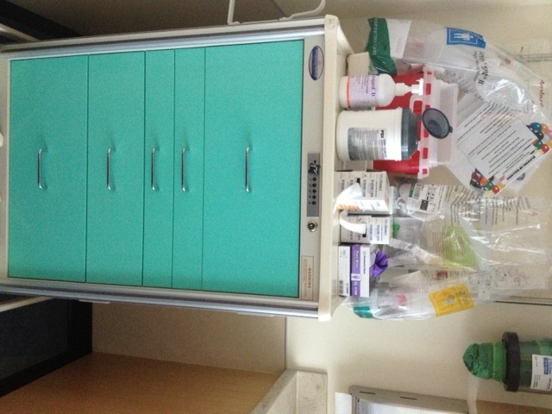
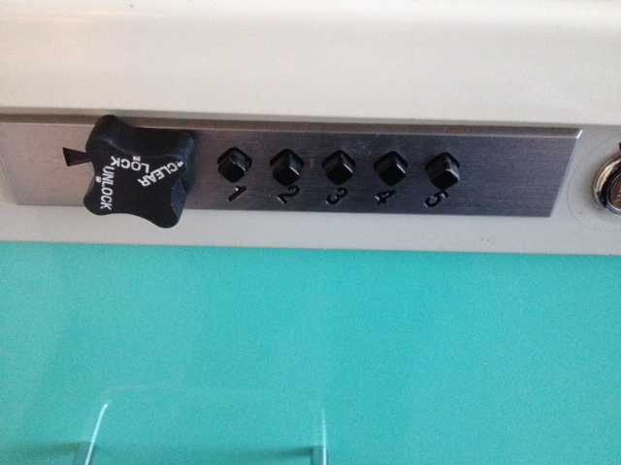
Peds Room Cart Configuration
This is an example cart that can be placed for routine pediatric care. It. contains respiratory equipment, IV supplies, blood draws, and fluids. On the back of each cart hangs an Ambu bag of each size. On top of each cart is a sharps container, Sani Wipes, and tube gauze.
Remember to lock your cart
Cart must remain locked at all times when not in use
*When a bin in the cart is empty toss it on the top of the cart for refilling.

Slide 2
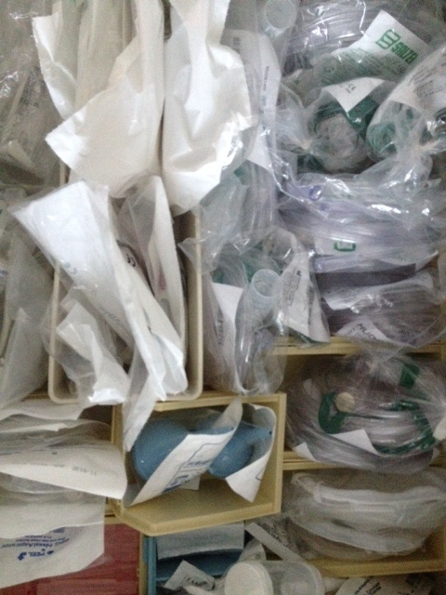
Drawer 1
Adult, Peds, Infant nasal cannulas
Adult and peds non-re-breather masks
Nebulizers
Suction sputum collection container
Bulb suction
Atomizer
Nasal aspirator
Saline Fish
Blood pressure cuffs

Slide 3
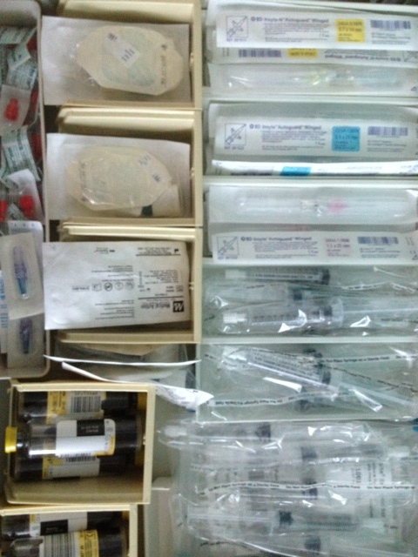
Drawer 2
Remember to only get blood cultures on febrile kids—don’t culture everyone!
Only 1 blood culture in kids <16 years old
Unless they have a central line then, culture every lumen
24G, 22G, 20G caths
IV start Kits
Red caps
Posi-flow valves
Saline flushes
T-connectors
Pediatric Blood culture bottles (for use with <16 years of age)

Slide 4
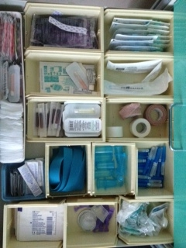
Drawer 3
Remember NO coban or circumferential tape on pediatric peripheral IV sites
Heel stick lancets
VBG syringes for Istat/Blood gases
Tape
Vacutainer
Pacifiers & Sweetese
Heat packs
Tegaderm
LMX
Mastasol
Iodine
Adhesive Remover
Chloraprep
Alcohol pads
2x2 sterile and non-sterile
Band-Aids

Slide 5
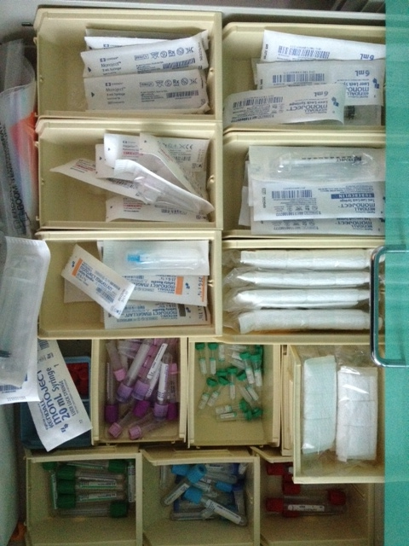
Drawer 4
3 mL Syringes
Tuberculin syringes
6 mL syringes
18 G needles
Various needles
Pediatric and Infant arm boards
12 and 20 mL syringes
Lab Specimen bags
Pediatric and adult blood tubes

Slide 6
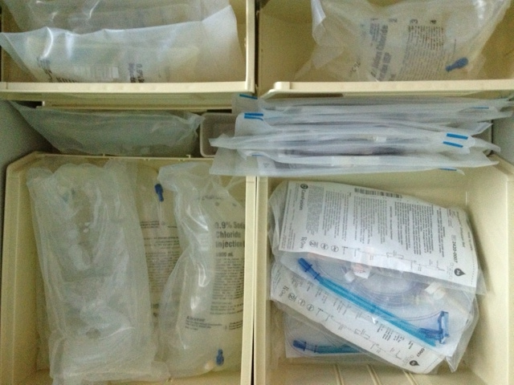
Drawer 5
Remember all pediatric fluids and medications must infuse on a pump per DCH policy.
Alaris Pump tubing
Syringe pump tubing
NS 250 mL, 500 mL, and 1 Liter bags

