Slide 1

Management of Pediatric Pain & Distress
Melinda Hartenstein, BSN, RN, CEN, CPEN
Danielle Sullivan, BSN, RN

Slide 2




Do these faces look familiar?
Notes:
Do these faces look familiar? These are the faces of pain and distress we see each and every day in our emergency departments. These faces portray the fear of pain or anticipation of a potentially painful procedure. Or actual pain from an invasive procedure. Or perhaps pain caused by a disease process. How we can address pain and distress will be discussed in this module, but first we must begin with defining pain itself.

Slide 3
Defining Pain
“Pain is whatever the experiencing person says it is, existing whenever they say it does” (McCaffery, 1968)
"Pain is a complex multidimensional and subjective experience that consists of physiological, sensory, emotional, cognitive, and behavioral components." (Koller and Goldman, 2012)
“Pain management refers to the application of the nursing process—assessment, planning, implementation, and evaluation—to the treatment of pain” (Twycross, 2008)
Pain & anxiety interventions must be done on an age-appropriate level combined with clear age-appropriate communication of what the child should expect.
Notes:
As early as 1960s literature began to suggest that nurses’ do not prioritize pain management.
Margo McCaffery, RN, MS, FAAN, was a leader and pioneer in pain management for nursing. Through her work, she helped to identify and treat patients with acute and chronic pain in a number of healthcare settings. McCaffery’s 1968 definition of pain was simple—“It’s whatever the experiencing person says it is, existing whenever and wherever the person says it does.” Her words have become a touchstone for clinicians addressing and treating patients in pain.
The definition was expanded by Koller and Goldman when they wrote: Pain is a complex multidimensional and subjective experience that consists of physiological, sensory, emotional, cognitive, and behavioral components.
Twycross continued pain research and found that despite all the evidence to guide nursing practice, children were continuing to experience unrelieved pain.
Further the study of pain and anxiety in infants, preschoolers, children, and adolescents has revealed that the nervous system is vulnerable to noxious stimuli during their developmental stages and ages.
Not only does pain have a negative impact on neurological development, but children whose pain has not been adequately treated in infancy or early childhood reported lower pain thresholds as adolescents and adults.
Even if that Pain was just associated with heightened levels of distress and anxiety during procedures, it was found to result in negative long-term emotional consequences.
Therefore in order to prevent long term sequlea pain & anxiety interventions must be done on an age appropriate level combined with clear age appropriate communication of what the child should expect.

Slide 4
Pain Assessment Techniques
Question the child
Use the appropriate pain rating scale
Evaluate behavioral & physiologic changes
Secure the parent’s involvement
Take the cause of pain into account
Take action and evaluate results
Notes:
Here are 6 simple techniques to assess a child’s pain.
Question the child about their pain (or the parent if the child cannot speak ) Where is it? Ask them to point with one finger to where the greatest pain is located. Then ask them to describe how the pain feels? Then does the pain go anywhere else or does it only hurt where you are pointing? Finally, is there anything that makes it better or worse?
Show them or use an age appropriate pain scale such as NPASS for infants <3 months, or FLACC for older infants through about 3 years of age, or faces for kids from about 4-8 years of age and for older children a numeric scale
While your talking evaluate the pt’s behavior and physiologic changes associated with their pain. Are they distractable or not? Do they have vital sign changes? Do they grimace?
Secure the patient’s involvement
Take the cause of pain into account—is it a disease process or chronic pain? IS it r/t an acute injury? Is it from a procedure?
Take action and always return and evaluate the effectiveness of the intervention

Slide 5
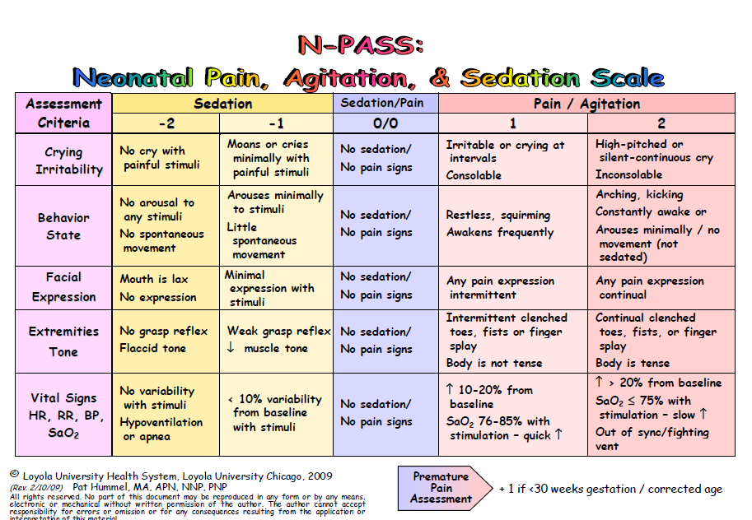
N-PASS
Neonatal Pain and Sedation Scale
Appropriate for Premature Infants (23 weeks) up to 3 months.
Notes:
The N-PASS is a reliable assessment tool for neonatal pain and sedation. It is a valid assessment tool for ongoing pain and sedation for the term and preterm infant through 3 months of age. The tool demonstrates Internal consistency with pain scores between nurses.
The scale is outlined here on this slide and uses both physiological and behavioral assessment criteria including: Crying irritability, behavior state, facial expressions, tone and reflexes, as well as vital sign changes.
Pain should be addressed every time vital signs are taken or more frequently if needed. Pain is scored from 0 to +2 for each behavioral and physiologic criteria listed and then summed together and documented a positive score from 0-10.
Points are added for prematurity.
Scores >3 should have an intervention. Interventions for known painful stimuli should be done before the pain reaches 3. The goal should be to keep the pain score < or equal to 3.
Sedation is scored in addition to pain for each behavioral and physiological criteria to assess the infant’s response to stimuli. Sedation however does not need to be scored with every pain assessment score. Sedation is scored from 0 to -2 for each behavioral and physiological criteria; it is then summed and resulted as a negative score. Deep sedation is anything within the range of -5 to -10 and light sedation is considered -5 to -2. Deep sedation is not recommended infants unless an infant is receiving ventilator support. A sedation score of 0 is given if an infants response is normal for gestational age.

Slide 6
FLACC
Face, Legs, Activity, Cry, and Consolability
Appropriate for developmental level of 3 months to 3 years
Appropriate for non-verbal or cognitively impaired children, including medically induced (intubated/sedated)
Face | 0 No particular expression or smile | 1 Occasional grimace or frown, withdrawn, disinterested | 2 Frequent-constant quiver jaw, clenched jaw
Legs | 0 Normal position or relaxed | 1 Uneasy, restless, tense | 2 Kicking, or legs drawn up
Activity | 0 Lying quietly, normal position, moves easily | 1 Squirming, shifting, back and forth, tense | 2 Arched, rigid, or jerking
Cry | 0 No Cry (awake or asleep) | 1 Moans or whimpers, occasional complaints | 2 Crying Steadily, screams or sobs, frequent complaints
Consolability | 0 Content, relaxed | 1 Reassured by occasional touching, hugging or “talking to”. Distractible | 2 Difficult to console or comfort
Notes:
The FLACC score has been validated for measuring pain in toddlers and children from 3 months to 3 years or in non-verbal children with mild to severe cognitive impairment, including children with a medically induced sedated state. FLACC is an acronym that stands for: Face, Legs, Activity, Cry, and Consolability. Total points assigned for each category may be from zero to 2 within an overall sum from 0 to 10. The numeric rating scale may be categorized into no pain, mild pain, moderate pain, and severe pain based on the 0 (representing no pain) -10 (severe pain) scale.

Slide 7
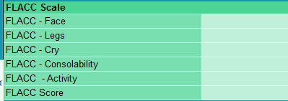
FLACC
In patients who are awake: observe for 1 to 5 minutes or longer. Observe legs and body uncovered. Reposition patient or observe activity. Assess body for tenseness and tone. Initiate consoling interventions if needed.
In patients who are asleep: observe for 5 minutes or longer. Observe body and legs uncovered. If possible, reposition the patient. Touch the body and assess for tenseness and tone.
Assign a numerical score 0-2 to the behavioral observations. Record the score in the designated place in the documentation system.
Interpreting the Behavioral Score
0 = Relaxed and comfortable
1–3 = Mild discomfort
4–6 = Moderate pain
7–10 = Severe discomfort or pain or both
Notes:
To use the FLACC scale observe an awake patient for 1-5 minutes a minimum. Observe their legs and body uncovered. Assess body for tenseness and tone. Initiate consoling interventions if needed. Assign a score of 0-2 to each behavioral observation and then sum and document the score. For sleeping patients, watch for at least 5 minutes, again observe legs and body. Touch the body to assess for tenseness and tone. Then sum the score and document. A score greater than 3 is should have an intervention as the pain goal should be less than or equal to 3.

Slide 8
N-PASS and FLACC
What’s the SAME?
What is DIFFERENT?
Both tools are assessing behavioral criteria:
  Facial Expressions
  Legs
  (N-Pass terminology extremity tone)
  Activity
  (N-Pass uses the term Behavior State)
  Crying and Consolability
  (FLACC separates cry and consolability, N-PASS scores these behaviors together)
N-PASS adds vital sign assessment as criteria
N-PASS can account for prematurity (+1point)
Notes:
Let’s quickly review. In infants and young children, we should always question the parent about what they have observed. Use the appropriate pain scale either NPASS for < 3 months or FLACC for 3 months to 3 years or cognitively delayed non-verbal children older than 3. For both scales observe their behavioral criteria and for NPASS also review their vital sign changes and a points for prematurity as needed.

Slide 9
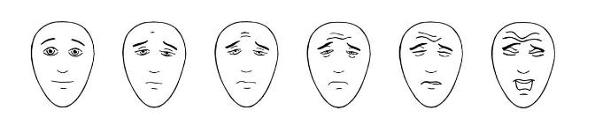

Faces Pain Scale-Revised (FPS-R) or Wong-Baker FACES
Faces Pain Scales:
Appropriate for developmental level 4-8 years
Self- Assessment Tool: patient must be able to understand the tool and be able to indicate which face most closely depicts their pain experience.
In the following instructions use “hurt” or “pain”, whichever is developmentally appropriate for the child
"These faces show how much something can hurt. This face [point to face on far left] shows no pain. The faces show more and more pain [point to each from left to right] up to this one [point to face on far right] - it shows very much pain. Point to the face that shows how much you hurt [right now].”
Notes:
There are a couple of options for Faces pain scales—the Faces Pain scale revised or the Wong-Baker FACES scale. Either of these scales can help measure a child’s pain intensity as they are both relatively easy to use and understand. The important thing is to be consistent in the faces scale you choose to use--don’t switch between pain scales but use the same scale each time pain is assessed. It is also important that you use the word “hurt” or “pain” depending upon a child’s age and understanding to help them understand the face of no pain or no hurt versus the face with very much pain or hurt. The potential draw back with using the Wong baker scale is that the “no hurt” face and “hurts a little bit” faces are both smiling, which may cause a child experiencing mild pain to chose the “hurts a little more” face. Similarly, the “Hurts worst” face is crying and a child may feel that he/she may not choose the “hurts worst” face unless they are crying. The Faces Pain Scale revised, however does not have smiles or tears and is easily correlated with the adult numeric scale, making it potentially easier to use and more reliable.

Slide 10
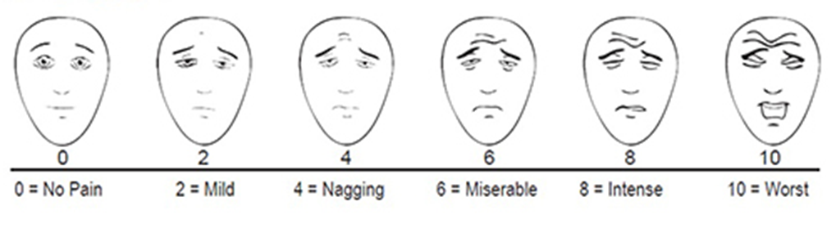


Faces Pain Scale-Revised (FPS-R)
Score the chosen face
0, 2, 4, 6, 8, or 10
counting left to right
Self –Report is the gold standard for children who are developmentally able to do so
Patients should use the diagram without numbers printed. This is a guide for providers.
Do not use words like “happy” or “sad”. This scale is intended to measure how children feel inside, not how their face looks.
Notes:
To use the faces pain scale revised you ask a child to point or self report the face of how much they are hurting. Do not use words like happy or sad so we can assure we are measuring a how child feels inside and not how their face looks. Each face is then scored from 0 to 10 by 2s counting left to right.

Slide 11


Numbers
Numeric Pain Rating Scale
Appropriate for developmental level 8 years or greater.
Self –Report is the gold standard for children who are developmentally able to do so
“On a scale of zero to ten, where zero means no pain and ten equals the worst possible pain, what is your current pain level?”
Don’t compare it to past experiences by saying “…worst pain you have ever had”.
Notes:
Finally for children greater than or equal to 8 years old ask them to self report their pain on a scale of zero to ten as you would an adult patient.

Slide 12
Working Together:
Distraction & Comfort Positioning
for Pediatric Patients
Notes:
Now that we know the definition of pain and the appropriate pain scale to use with our patient based upon age. Let’s discuss how we can work together as a team to minimize procedural pain through the use of distraction and comfort positioning.

Slide 13

"Painful therapeutic procedures are often necessary during emergency care of children who have already painful and frightening injuries and illnesses. These procedures are distressful to children, their parents, and their healthcare providers. Furthermore, inadequately relieved, procedure-related pain produces physiological and psychological reactions that have acute and long-term consequences."
(Kennedy & Luhmann, 1999)

Slide 14

Distress & Anxiety
According to the World Journal of Clinical Practice, in 2016, the most frequently reported emotional responses of young children during hospitalization are: ANXIETY, FEAR, and STRESS.
Cognitive development limits a child's ability to define a distressing event, the duration of the event, and the intensity of the event.
A trauma response can be triggered in children when they feel they are experiencing more severe medical treatment than they may acutely be receiving.
Lerwick JL. Minimizing pediatric healthcare-induced anxiety and trauma. World Journal of Clinical Pediatrics. 2016;5(2):143-150. doi:10.5409/wjcp.v5.i2.143.
Notes:
Because of a child's limited ability to define the event their actual perception of the event is usually inaccurate and thus a painful procedure during hospitalization may trigger a trauma response. This is d/t the fact that they often feel they are experiencing more severe pain and distress than they may actually be receiving. In 2016, it was reported that the most common emotional responses to young children during hospitalization were: anxiety, fear and stress.

Slide 15
Developmental Ages & Stages
AGE | Effects of Hospitalization | Common Fears, Anxiety & Stressors
Infants (0-12 months) & Toddlers (1-2 years old) | Irritability Decreased Activity Clingy Tantrums Decreased appetite | Separation anxiety Fear of unfamiliar Stranger danger Loss of mobility Pain Loss of routine
Preschool (3-4 years old) | Regression Anger Guilt Temper tantrums | Separation anxiety Fear of unknown Magical thinking Misconceptions Fear of pain Loss of control/routine
School Age (5-12 years old) | Regression Perceive pain as punishment Anger Depression Withdrawal Avoidance/Guilt | Death Body mutilation Loss of privacy Pain Loss of control Separation from peers
Adolescents (13-18 years old) | Defense Mechanisms Conformity Uncooperative Non-compliant Avoidant | Invasion of privacy Loss of control Change in body image Fear of rejection Fear of death Restriction of activities Threat to competence
Notes:
Earlier I said that we have to assess pain on a child’s developmental level; we also need to address their fears and anxiety related to procedures at their level and developmental stage as well.
For instance, infants and toddlers fear separation from their parents, so allowing them to be held and comforted by their parent is key. Rather than laying them flat and swaddling them which can provoke extreme anxiety.
School age children fear loss of control, so give them a choice whenever a choice can be had. Adolescents fear privacy and body image, so talk them through the entirety of the procedure. Take time to answer questions and ask if they want others in the room or if they would prefer them to step out. Remembering these key developmental stages and common fears will help you be able to match the appropriate distraction and positioning to the child’s developmental level and stage.

Slide 16
Types of Pain & Distressing Procedures
Untreated pain
Vaccinations
IV placement
Catheterization
Feeding tube placement
Orthopedic procedures
Laceration repair
Notes:
So how are we causing the anxiety and the stress and the fear? There are many types of pain and distressing procedures done in our emergency departments every day…From…
But, let’s talk about how we can counteract the pain and distress.

Slide 17
Distraction
Active Distraction:
Promotes a child’s involvement in the activity
Involve multiple sensory components
Passive Distraction:
Requires that the child remains quiet and calm
Child is an observer of the activity rather than a participant
Notes:
One way to reduce fear, stress, anxiety and pain during painful and/or distressing procedures is distraction. There are two types of distraction.
Active distraction and passive distraction:
Active examples = interactive toys, bubbles, virtual reality, controlled breathing, guided imagery, and relaxation techniques
Passive examples = listening to music; watching TV; listening to a story book
Making decisions regarding distraction interventions for pediatric patients remains a difficult task. Comparison studies done between active and passive forms of distraction have mixed data and findings. Active forms of distraction are often hypothesized to be superior to passive forms of distraction d/t multi-sensory engagement intercepting painful stimuli during active distraction techniques. By contrast, some feel passive forms are more effective because engaging a painful and distressed child can be very challenging.
But, perhaps the key to delineating best practices can be found in identifying individual patient preferences and temperament. In particular, the sense of control pediatric patients can experience from choosing a distraction activity may compensate for the lack of control involved in their treatment environment. Child life therapists can usually help decipher child temperament and appropriate distraction technique for any given procedure.
And most pediatric healthcare providers would agree that given the degree of pain and anxiety associated with needles, and the resource demands within pediatric EDs, the use of active distraction coupled with role of the child life specialist should be considered best practice in pediatric emergency department settings. Now we are going to review a few tools of the trade…

Slide 18
Tools of the Trade
Notes:
If it lights up, if it spins, if it lights up and spins then it can actively engage a child’s senses.
Bubbles are also remarkable. Place a puppet on your hand and have them eat the bubbles the child is blowing causes great play and laughter. Or if the child is too distraught to blow the bubbles, give them the hungry puppet! Many tools of the trade are easily bought in bulk for less expense and most are easily wiped down to decrease infection risk.

Slide 19
“Buzzy”
Commercial device using a combination of vibration and cold to block pain sensations during painful pediatric procedures.
Notes:
Gate Control Theory of Pain
The gate control theory is the basis for the design of Buzzy®. The premise is that when nerves receive non-painful signals such as vibration or cold, the brain closes the gate on pain signals. For example, if you hit your finger with a hammer, you might instinctively begin to rub it, shake it, or run it under cold water. You are sending non-pain signals through your nerves to close the gate on the pain signals.
Descending Inhibitory Controls
The second part of Buzzy efficacy, and the reason it can help even when distant from the site of procedural pain, is something called Descending Noxious Inhibitory Control, or DNIC. While gate control happens locally (confusing nerves right where the pain happens) another effective mechanism of pain control uses the brain’s ability to dampen out unwanted signals. Instead of happening right where the nerves are, though, an intense degree of cold can work anywhere on the body.
The idea is like putting your hand in a bucket of ice water. Whoa, it’s cold! But you can handle the amount of cold initially. Studies have found that when someone’s hand is in ice water, they can handle more intense pain everywhere else in the body, probably because the sensation of ice is so intense it doesn’t leave as much room for the brain to notice pain as sharply other places.
It is as if when one sensation is very intense, the brain turns the volume down on sensations anywhere in the body.
In scientific terms, intense cold activates a supraspinal modulation raising the body’s overall pain threshold.

Slide 20
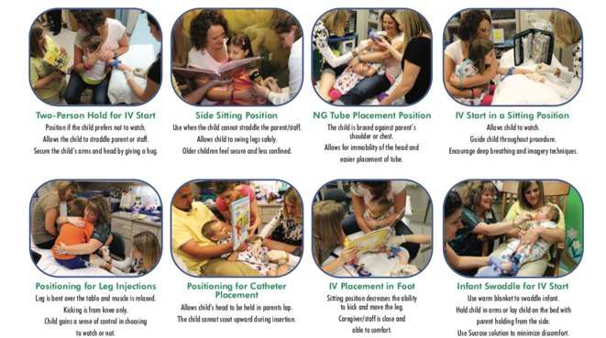
Positioning for Comfort
Notes:
Distracting a child during a procedure is only part of the process for decreasing their fears and their anxieties. The second part is positioning them for comfort while also positioning them so you can adequately and optimally perform the procedure at hand. This slide shows a brief overview but let’s look at a few of these positions a little closer.

Slide 21
Positioning for Comfort
Positions can maximize a child's sense of control and comfort during a procedure
Engage the caregiver
Assign a "Comfort coach"
Allow the patient to sit up whenever possible- decreases child anxiety and increases cooperation
If possible, allow the child to choose the position
Notes:
Positioning for comfort has a few key pearls to know and remember.
Engage the pt’s caregiver. Give them an active role in helping comfort their child. But, always give them the choice to step out if they do not feel like they can handle the situation or the procedure.
Make sure one person is assigned as the comfort coach and only that voice should be heard.
Allow the child to sit up whenever possible, laying a child down places them in a position of vulnerability and will automatically increase their anxiety.
If possible and age appropriate, give the child options of which position they would like to chose this helps them to feel more in control of the situation.

Slide 22


Bear Hug- Arm IV
Notes:
The bear hug is an ideal position for a child that will have increased anxiety from being able to see a procedure such as a venipuncture take place. In the bear hug, the child is chest to chest with their caregiver. If an IV is being placed or blood drawn, then that arm is out to staff, the other arm is tucked in so that it cannot grab at the procedure. The comfort coach or distractor of child life specialist sits opposite of the procedural arm so that the child is looking away actively distracted while also being hugged and comforted by their caregiver.

Slide 23
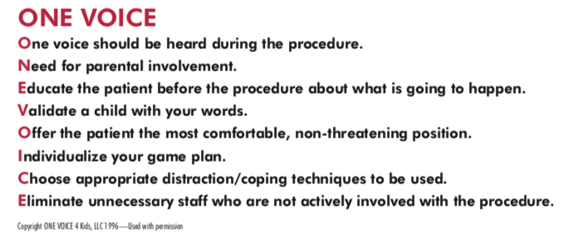
“ONE VOICE”
www.onevoice4kids.com
One person should be designated as the “comfort coach"
Notes:
The One Voice 4 Kids campaign works on the premise of designating one person or one voice as the “comfort coach.” That should be only voice heard during the procedure. One voice is always coupled with distraction and positioning for comfort.
ONE VOICE is an acronym created by the Child Life Specialist Debbie Wagers. It uses each letter in the acronym to help professionals create a more kid-friendly environment….
One voice should be heard during procedure
Need parental involvement
Educate patient before the procedure about what is going to happen
Validate child with words
Offer the most comfortable, non-threatening position
Individualize your game plan
Choose appropriate distraction to be used
Eliminate unnecessary people not actively involved with the procedure

Slide 24
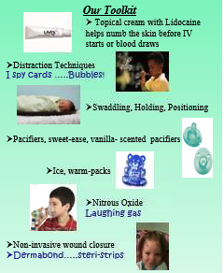
Our Tool Kit
Distraction Techniques
  I spy
  Bubbles!
Position for comfort
  Swaddling, Holding, Positioning
Pacifiers, sweet-ease, vanilla- scented pacifiers
Ice & warm-packs
Child Life Therapy
Nitrous Oxide
Non-invasive wound closure utilizing LET
  Dermabond, Steristrips
LMX and/or J-Tip for blood draws, IVs, LPs
Intranasal Fentanyl or Versed
Notes:
One strategy is staff training with child life specialists but if that is not available, even just simply creating a sign in the rooms to remind staff of the their available tools is helpful. Plus, patients and families will begin to ask you about the tools in your kit if you have it posted. This is a poster we used to post in our emergency department for awhile to help remind staff of the tools and to promote them to patients…
-Topical cream for IV starts, blood draws, or port access
-Distration in the form of bubbles, games or I spy books or cards
-Pacifiers and sucrose for blood draws and straight caths on neonates
-Dermabond skin glue rather than sutures
-or laughing gas
The important thing is to make sure everyone is aware of the tools and make it a part of the culture to use at least 1 if not multiple tools for every procedure. Knowing and using your tools will definitely help you progress to an ouchless ED.

Slide 25
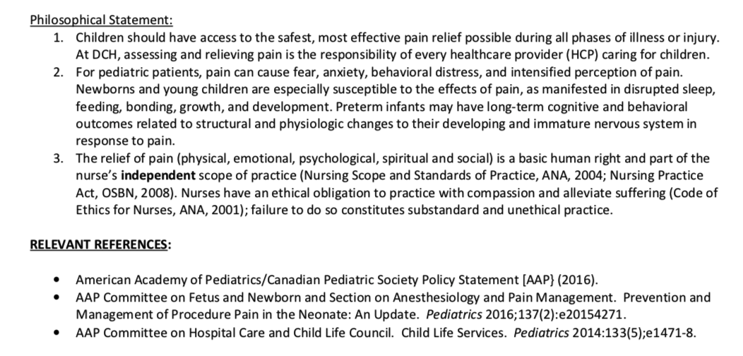
Our Philosophy...
…What’s Yours?
Notes:
This is our philosophy that continues to propel us forward towards an ouchless emergency department…Children should have access to the safest, most effective pain relief possible during all phases of illness and injury…relieving pain is the responsibility of every healthcare provider…for pediatric patients, pain can cause fear, anxiety, behavioral distress, and an intensified perception of pain…The relief of pain is a basic human right and part of the nurses’ independent scope of practice. Nurses have an ethical obligation to practice with compassion and alleviate suffering.

Slide 26
Selected References
Arane K, Behboudi A, Goldman RD. Virtual reality for pain and anxiety management in children. Canadian Family Physician. 2017;63(12):932-934.
Burnweit C, et al. Nitrous analgesia for minor surgical procedures; an alternative to conscious sedation? J Pediatr Surg 2004;39:495-499.
Farrell MK, Drake GJ, Rucker, Finkelstein M, Zier JL. Creation of a nurse-administered nitrous oxide sedation program for radialology and beyond. Pediatr Nurs 2008.
Godwin, Steven A, et al. ”Clinical Policy: Procedural Sedation and Analgesia in the Emergency Department.” American College of Emergency Physicians Clinical Policies Committee. 2013.
Gousie, Patricia J. (2001) “The Effects of Live Music on the distress of pediatric patients receiving injections.” available from:
http://www.musicasmedicine.com/internprojects/upload/trish.pdf
Kennedy, R. M., MD. (1999). The ”Ouchless Emergency Department". Emergency Medicine, 46(6), 1215-1247. Retrieved May 29, 2018.
Koller, Donna. “Distraction Techniques for Children Undergoing Procedures: A Critical Review of Pediatric Research.” Journal of Pediatric Nursing. Dec 2012, Volume 27, Issue 6, Pages 652–681.
Leahy, S., RN, Kennedy, R. M., MD, Hesselgrave, J., RN, Gurwitch, K., PharmD, Barkey, M., MA, & Millar, T. F., MS. (2008). On the front lines: Lessons learned in implementing multidisciplinary peripheral venous access pain managment programs in pediatric hospitals. Pediatrics, 122(3), 5161-5170. Retrieved May 29, 2018, from http://pediatrics.aappublications.org/
Lerwick, Julie L. “Minimizing pediatric healthcare-induced anxiety and trauma.” World J Clin Pediatr. 2016 May 8; 5(2): 143–150.
Lerwick JL. Minimizing pediatric healthcare-induced anxiety and trauma. World Journal of Clinical Pediatrics. 2016;5(2):143-150. doi:10.5409/wjcp.v5.i2.143
Lexi-Comp Online; Wolters Kluwer. 2018.
Twycross, A. (2008). Does the perceived importance of a pain management task affect the quality of children’s nurses’ post-operative pain management practices? Journal of Clinical Nursing, 17(23), 3205-3216. doi:10.1111/j.1365-2702.2008.02631.x

