Slide 1

Maintaining Caseload
Actively working to maintain your caseload throughout the month is the key to keeping your numbers within 97-103%.
Maintaining caseload is essential to maintain funding for your local agency.
You want as many of those already enrolled in your agency (certified caseload) to count toward your participating caseload!

Slide 2


6 ways to maintain caseload
Make sure participants have benefits issued
Keep eligible participants from being terminated
Re-enroll participants who were terminated
Reschedule missed appointments
Help participants keep their scheduled appointments
Track caseload trends over time
These maintenance tasks should be completed on a regular basis throughout the month to help prevent the loss of participants. The following slides cover each of these in more detail and explain which reports can assist you.

Slide 3
1. Make sure participants
have benefits issued
The first way to maintain your caseload is to provide benefits to the people on your certified caseload who have not received benefits. This includes solving problems that are preventing people from having benefits issued.
2 TWIST reports which can help you ensure participants have benefits issued:
  Participants with No Benefits Issued Register
  Percentage Not Receiving Benefits Report
The next two slides explain how to use these reports.

Slide 4

Caseload Reports:
Participants With No Benefits Issued Register
What this report tells you:
Lists all participants who were not issued benefits for the month chosen. It includes information to make follow up easier.
Why use this report:
Run the report at regular intervals during the month and determined why they didn’t receive benefits. Usually the participant needs an appointment rescheduled before the benefits may be issued. Report can also print address labels.
How to run this report:
Client Processes- Output- Reports- Intake. Can enter previous, current, or next month. Most agencies run for current month.
When to run this report:
Run frequently throughout the month so the participants can be contacted and issued benefits.
How to use the Participants with No Benefits Issued Register
Click to play video
Notes:
To watch this video, press the “Ctrl” button and click the green play button.

Slide 5
Caseload Reports:
Percentage Not Receiving Benefits Report
What this report tells you:
Shows the percent of the certified caseload which was not issued benefits – this is the difference between your certified caseload and participating caseload. It show the percentage by month, for the past 12 months.
Why use this report:
A percentage ≤4% is ideal for maintaining your caseload. A lower percentage means a smaller amount of participants are without benefits. Because participants are automatically terminated after 2 months without issued benefits, it is important to reschedule their appointments and issue benefits to keep them on WIC. Use the Participants with No Benefits Issued register for more detailed information.
How to run this report:
Operations Management- Outputs- Caseload. Enter month and year.
When to run this report:
Run on the 2nd of each month.
How to use the Percentage Not Receiving Benefits Report
Click to play video
Notes:
To watch this video, press the “Ctrl” button and click the green play button.

Slide 6
2. Keep eligible participants from
being terminated
The second way to maintain your caseload is to take action before eligible participants are terminated. Once participants are enrolled, keep them enrolled. There are 2 reports that can help you with this.
2 TWIST reports which can help you identify eligible participants at risk of being terminated:
  Register of Clients with Eligibility Pending
  End Cert Client Register – No Appointment Report
The next two slides explain how to use these reports.

Slide 7
Caseload Reports:
Register of Clients with Eligibility Pending Report
What this report tells you:
Shows a list of participants who need to provide one or more “proofs” in order to receive benefits beyond the first 30 days of their cert. This report includes the eligibility pending date, type of missing proof, and phone number.
Why use this report:
Contact to participants marked as eligibility pending to remind them to provide their proofs so they are not terminated after the 30 day grace period.
How to run this report:
Client Processes- Output- Reports- Intake. Enter the date range and clinic. Run for the previous 30 days to see participants who are still active.
When to run this report:
On the 1st and 15th of the month.
How to use the Register of Clients with Eligibility Pending Report
Click to play video
Notes:
To watch this video, press the “Ctrl” button and click the green play button.

Slide 8
Caseload Reports:
End Cert Client Register – No Appointment Report
What this report tells you:
Shows participants whose certification ends in a specified month and who do not have a recertification appointment scheduled.
Why use this report:
Contact participants on the report to schedule a recertification appointment. If they are not recertified before the end of the month they will be automatically terminated from the program.
How to run this report:
Client Processes-Output- Reports- Intake. Enter the current month and year. Can filter for clinic, category, and language to make contacting participants easier.
When to run this report:
At the beginning of every month.
How to use the End Cert Client Register—No Appointment Report
Click to play video
Notes:
To watch this video, press the “Ctrl” button and click the green play button.

Slide 9
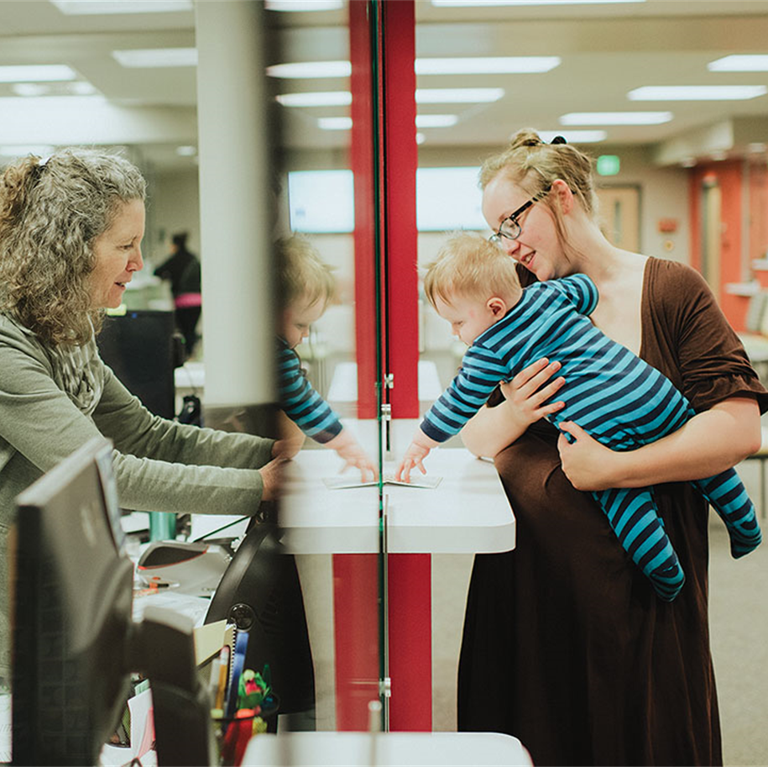
3. Re-enroll participants who
were terminated
The third way to maintain caseload is to re-enroll participants who have been recently terminated, but are still eligible for WIC.
TWIST report which can help you re-enroll participants who are terminated:
  Client Termination Register
The next slide explains how to use this report.

Slide 10
Caseload Reports:
Client Termination Register
What this report tells you:
Shows a list of participants who were terminated in the specified date range sorted by reason for termination and term date. Includes ID number, cert dates, DOB, language, category, and risk level.
Why use this report:
Use to contact participants when the termination reason can be corrected. The most common reasons include:
no proofs
not issued benefits for two months
did not use benefits for two months
two months past due for recertification
How to run this report:
Client Processes- Output- Reports- Intake. Enter the date range.
When to run this report:
Run after the 15th of the month. TWIST automatically terminates participants who were not issued or did not use benefits on the 15th .
How to use the Client Termination Register
Click to play video
Notes:
To watch this video, press the “Ctrl” button and click the green play button.

Slide 11
4. Reschedule missed appointments
The fourth way to maintain caseload is to reschedule missed appointments. A missed appointment can lead to a chain reaction leading to termination.
You can stop this chain reaction by rescheduling the first missed appointment.
2 TWIST reports which can help you reschedule missed appointments:
  No Show Client Register
  Unfilled Appointment Report
The next two slides explain how to use these reports.
missed appointment
no benefit issuance
2 months of no benefit issuance
automatic termination

Slide 12
Caseload Reports:
No Show Client Register
What this report tells you:
The No Show Client Register is a list of participants who did not show for their appointment in a selected date range.
Why use this report:
Use the report to reschedule everyone on the list for another appointment.
How to run this report:
Appointment Scheduler- Outputs. Enter the month and year. Can filter for each clinic site.
When to run this report:
At least weekly. Many clinics run the report daily.
How to use the No Show Client Register
Click to play video
Notes:
To watch this video, press the “Ctrl” button and click the green play button.

Slide 13
Caseload Reports:
Unfilled Appointment Report
What this report tells you:
Shows how many appointment slots are still available in your appointment schedule.
Why use this report:
Use the report to ensure that there are enough unfilled appointment times for rescheduling participants during the month and for new enrollees.
How to run this report:
Appointment Scheduler- Outputs. Enter the month and year. Can filter for each clinic site.
When to run this report:
At least weekly and more frequently toward the end of the month.
How to use the Unfilled Appointment Report
Click to play video
Notes:
To watch this video, press the “Ctrl” button and click the green play button.

Slide 14



5. Help participants keep their
scheduled appointments
The fifth way to maintain your caseload is to help participants keep their scheduled appointments. WIC clinics use post cards, emails, texts or phone calls to remind participants of their appointments and online nutrition education.
TWIST report to help you identify participants who need appointment reminders:
  Daily Clinic Schedule
The next slide explains how to use this report.

Slide 15
6 Ways to Maintain Caseload
5. Help participants keep their scheduled appointments
Daily Clinic Schedule
Caseload Reports:
Daily Clinic Schedule
What this report tells you:
A list of participants scheduled for appointments on the day of the report.
Why use this report:
Use the report to contact participants to remind them of their appointment.
How to run this report:
Appointment Scheduler- Outputs. Select the day and clinic.
When to run this report:
Regularly to make reminder phone calls or texts.
How to use the Daily Clinic Schedule
Click to play video
Notes:
To watch this video, press the “Ctrl” button and click the green play button.

Slide 16
6. Track caseload trends over time
The sixth way to maintain your caseload is to track your caseload trends over time.
TWIST report which can help you track caseload trends over time:
  Transaction Report
The next slide explains how to use this report.

Slide 17
Caseload Reports:
Transaction Report
What this report tells you:
Shows the number of transactions (enrollments, reinstates, reactivates, recerts, changes, and terminations) that occurred in TWIST during a given month.
Why use this report:
This is a comprehensive report that shows how many participants from different categories are being added and terminated from your agency. It can be used to predict scheduling needs and to see categories of participants to target for outreach.
How to run this report:
Operations Management- Outputs- Clinic Non-Caseload Reports. Enter last month and year.
When to run this report:
Run on the 2nd of each month.
How to use the Transaction Report
Click to play video
Notes:
To watch this video, press the “Ctrl” button and click the green play button.

Slide 18
2. D When to check your numbers
Maintaining Caseload:
Interview with an expert
Crook County WIC Program
Salud WIC Program
Click this button to listen to an interview with Crook County about what they do each month to maintain their caseload.
Click this button to listen to an interview
with the Salud local agency coordinator to hear about how they use reports to manage caseload.
Notes:
To watch these videos, press the “Ctrl” button and click the green button.

