Slide 1

Emotional Wellness:
Appreciating Yourself
WIC All Staff Meeting
August 6, 2014

Slide 2
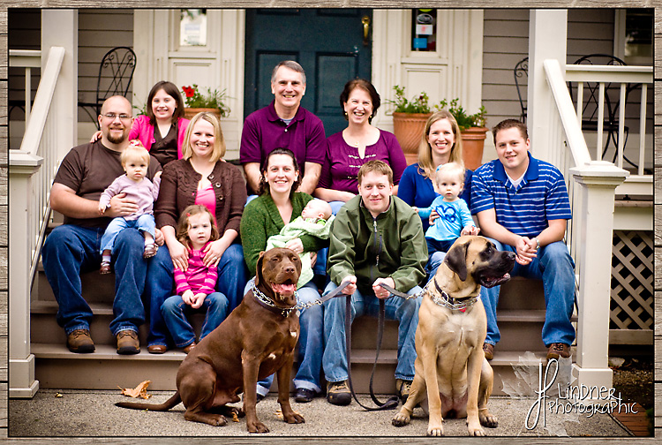
Jessie’s story

Slide 3
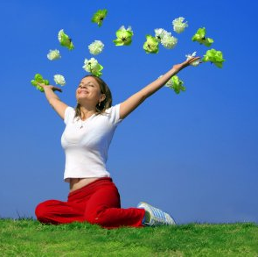
Emotional Wellness
Feeling good about yourself, your relationships, and your purpose in life.
While everyone feels sad, angry or confused from time to time, those who are “emotionally well” are:
  Able to bounce back from sad or stressful times more quickly
  Happier during the good times
  Have fewer lows
Notes:
Source: http://mchb.hrsa.gov/pdfs/bfwomen.pdf

Slide 4

Some Components of Emotional Wellness
Self-confidence
Self-esteem
Self-respect
Taking care of your body
Thinking positively
Setting realistic goals and expectations for yourself
Making time for activities you enjoy and that have meaning for you

Slide 5
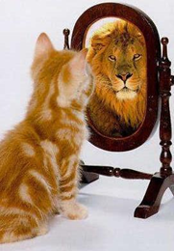
Building Self-Confidence
Self-confidence: confidence in yourself, your powers and your abilities. Helps you believe you can try new things.
Tips to increase your self-confidence:
Try to avoid comparing
  Your abilities and talents are unique and special.
  Everyone has different goals in life and ways of thinking about what success means.
  Decide what success means for you. Try not to worry about what success means for other people in your life.

Slide 6
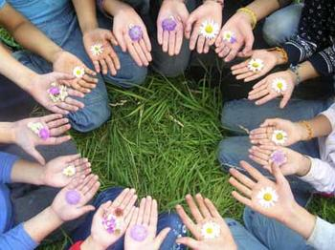
Building Self-Confidence
Remember your good deeds
  Think about the times when you have made a difference in someone else’s life.
  Give yourself credit for the good things you do for others every day.
Forgive yourself and learn from your mistakes
  Everyone makes mistakes from time to time.
  Learn from what went wrong, but try not to dwell on it.

Slide 7

Self Confidence –
Getting to the Heart of the Matter
Describe one good deed you’re proud of.

Slide 8

Building Self-Esteem
Self-esteem: feeling good about yourself and valuing your unique personality and features.
Tips to help boost your self-esteem:
Accept your strengths, and your weaknesses
  No one is perfect.
  Your strengths and weaknesses are what make you unique.
Value yourself
  Try not to depend on others to make you feel good about yourself.

Slide 9
Building Self-Esteem
Encourage yourself and others
  Think positive and kind things about yourself.
  Let others know the good things you feel about them.
Surround yourself with positive people
  Choose friends who value you.
Do good things
  Do at least one thing every day that you feel good about.
Congratulate yourself
  Honor your achievements, big and small.

Slide 10


Self-Esteem–
Getting to the Heart of the Matter
Identify one thing unique about your personality that you value.

Slide 11
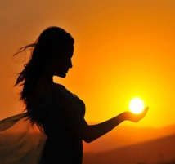
Setting Your Own Goals and Expectations
Tips to help you set your own expectations:
Define beauty for yourself
  Focus on the things about yourself that you think are beautiful.
Define your own values
  Many people feel they need to live up to the expectations of their culture.
  Take a look at your personal beliefs and values, and how those influence the way you live your life.

Slide 12

Setting Your Own Goals and Expectations
Focus on your strengths
  We all have strengths and weaknesses, but many of us focus more on our weaknesses.
Trick to try to change your way of thinking
  Each time you think about one of your weaknesses, follow that with a thought about one of your strengths.

Slide 13

Setting Goals & Expectations–
Getting to the Heart of the Matter
List something you have always wanted to do that you have yet to do.

Slide 14
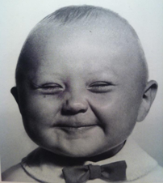
Thinking Positively
While some people are naturally more positive or optimistic than others, you can learn how to be more positive.
Tips:
Seek the positive
  When things go wrong, look for something positive.
  For example, if your friend cancels your dinner plans, look at it as a chance to do something good for yourself.
Focus on the good things
  Even when something has upset you in one part of your life, you can focus on the positive things in other areas.
  This helps you keep perspective and cope with life’s ups and downs.

Slide 15
Thinking Positively–
Getting to the Heart of the Matter
Create a personal affirmation that will help you to stay positive.

Slide 16
Jessie’s story:
“I’m from a big family, and I grew up always comparing myself with everyone else. I was constantly disappointed because whenever I would get a raise at work, one of my sisters would, too, or whenever I would learn a new activity, someone else would beat me to it. But eventually, I started thinking about my life and realized that I was achieving all the things I wanted to do. It didn’t matter what everyone else in my family was doing: I was leading my own life and was happy about it. Now, I try not to compare myself with other people anymore, and I remind myself to feel happy for my siblings when something good happens to them.”
Notes:
Now that you’ve had the chance to learn about various components of emotional wellness, lets reflect back to Tamika.
What did she do to make a difference to her emotional wellbeing.

Slide 17

Gallery Walk:
Concrete Action Steps
What are some strategies you could suggest to improve one’s emotional wellness for each these components?
Notes:
Time for some action. I’d like to invite you to get up and together, let’s come up with a concrete list of action ideas that could assist in improving these components of emotional wellness.

Slide 18
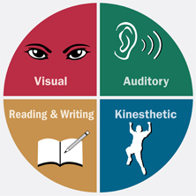
Strategies for all of us!
What would be helpful to:
  see?
  hear?
  say?
  do?
  feel?
Notes:
We all learn differently…for some of us it is helpful to hear, see, say, do or feel something before we can experience a difference. Practice makes progress and having some specific actions.

Slide 19

What works for you?
Notes:
Final gallery walk through: What strategy or two works for you? Using the worksheet provided, take a moment to rate yourself in these four components of emotional wellness. As you walk through each station, record a strategy you are interested in using to continue to enhance your emotional wellness.

Slide 20
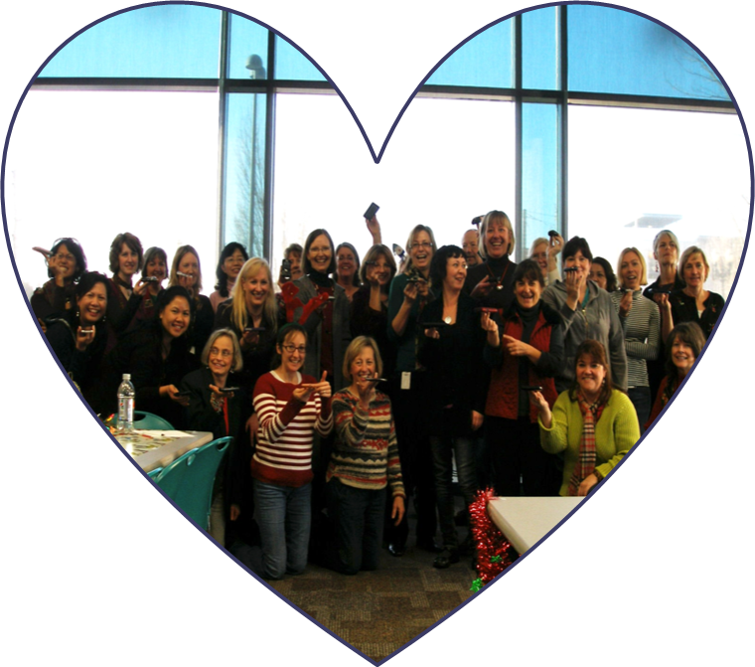
Appreciating Yourself: Pair Share
Notes:
Throughout this presentation each of you has taken the time to examine various parts of your emotional wellness. Now we would like to invite you to take a moment to share that with a partner. Feel free to share the front or back of your heart with those around you.
What did you learn that was interesting?

Slide 21

Notes:
The journey to explore Wellness@WICcontinues next quarter when we discuss the dimension of spiritual wellness.
Homework assignment – personal mission statement.

