Slide 1


Renew counseling:
Skilled staff; Nutrition-focused
March 2018

Slide 2

Housekeeping
Notes:
Housekeeping
Bathrooms
Space rules
Name tags

Slide 3
Today’s Agenda
9:00 Welcome and introductions
Connecting Participant Centered Education (PCE) to Renew
Self assessment and review of basic PCE concepts
Introduce Framework for Nutrition-Focused Counseling
Break
Missed counseling opportunities – why do they happen?
Roadmap for counseling: Engage, Focus, Evoke, Plan
12:00 Lunch (On your own)
Skill building – curiosity, change talk, reflections, summaries
Break
Skill building – Explore-offer-explore, setting next steps, hopes for health outcomes
Developing a plan for yourself and your team
4:00 Adjourn
Notes:
Agenda
Breaks and lunch on own

Slide 4
Objectives for today
Enhance and improve existing participant centered counseling skills.
Develop new and deeper supportive counseling skills, including the active listening skills of humility and compassion.
Apply critical thinking skills and utilize appropriate nutrition knowledge when providing nutrition-focused counseling.
Provide nutrition-focused counseling as described in the framework.
Notes:
Objectives for today
You have heard us talking about Renew
Building on existing counseling skills
Taking them to a deeper level

Slide 5
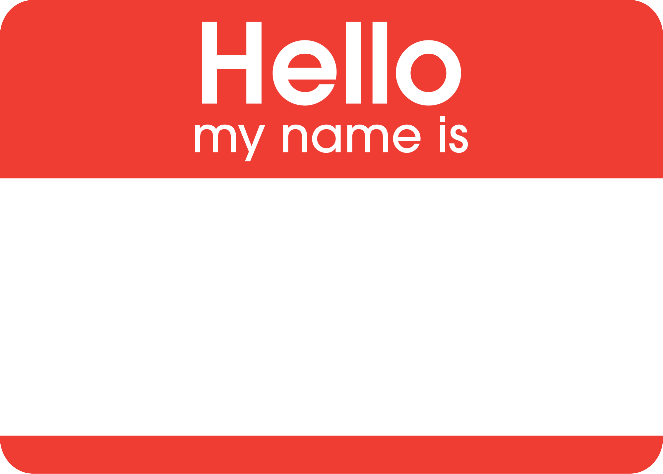
Getting to know you

Slide 6

Looking back…
Participant Centered Counseling to Renew
Notes:
Renew Not new tasks, but a continuation of deepening skills to provide supportive counseling

Slide 7

We have succeeded!
We show the spirit of PCE
We shifted from “telling” to offering

Slide 8

Still more to learn
We observed and learned.
USDA provided feedback.
We focused on eWIC.
We asked you what you thought.

Slide 9

We may need to re-focus on nutrition
Notes:
Improved atmosphere but changed our focus from assessment and NE = missed opportunities NE
Why we are doing renew

Slide 10
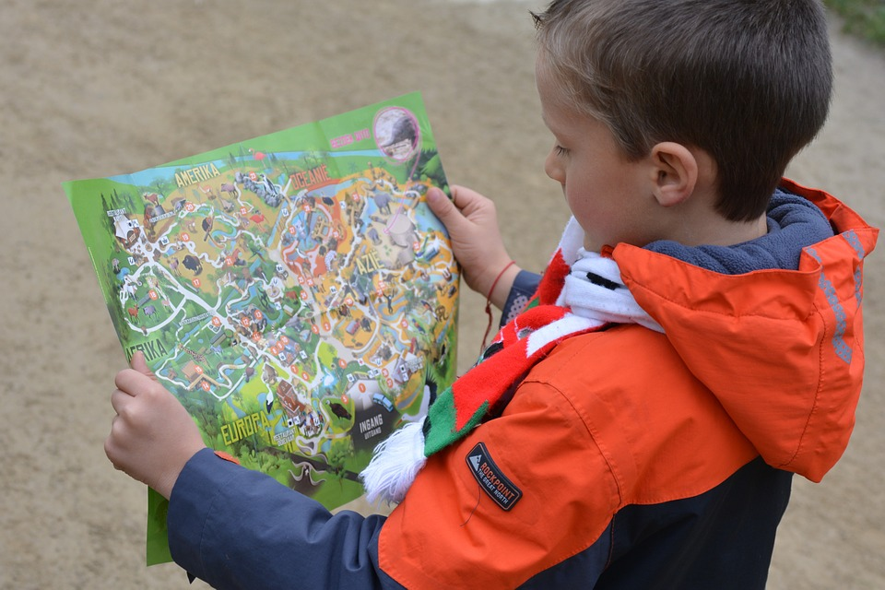
Where are you on your participant centered counseling journey?

Slide 11

Activity 1: Self reflection
Page 3

Slide 12

Nutrition-focused Counseling (NFC):
1 of 4 services that fuel WIC success
Breast-feeding support
Healthy
Foods
Nutrition Education
Referrals
Nutrition-focused counseling

Slide 13

Framework for Nutrition-focused counseling
Notes:
Developed to support what we learned

Slide 14
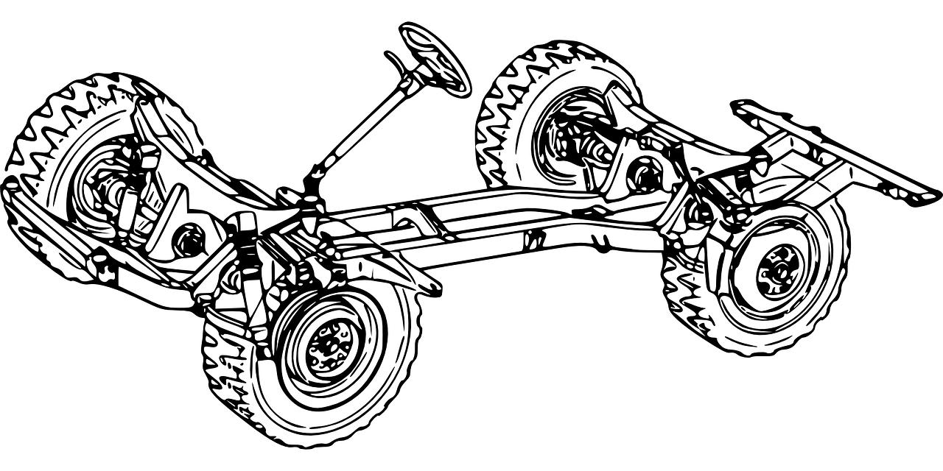
A framework provides structure for counseling
Content areas
Foundational capabilities
Actions
Desired outcomes
See page 4-5
Notes:
Clarifies expectations, will be included in NE guidance and policies

Slide 15


Don’t worry -
Support is planned
We don’t expect everyone to be experts
  Statewide meeting
  September face-to-face training
  New training modules
  WIC Link articles
  Renew Review monthly practice activities

Slide 16
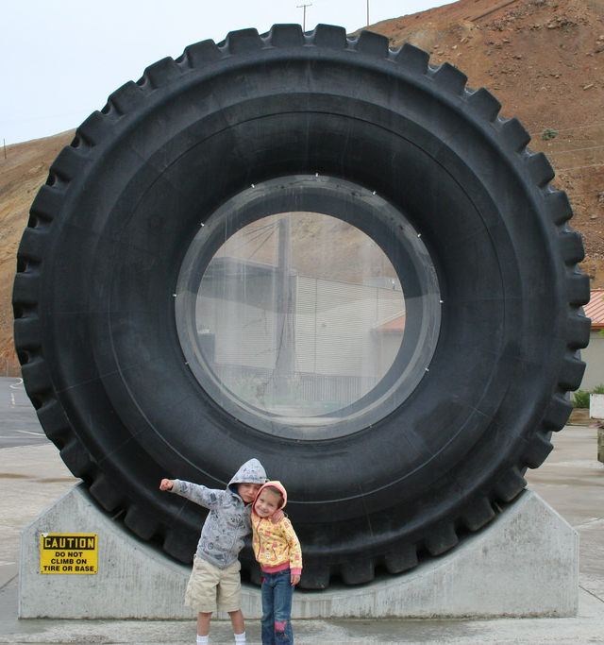
Content areas
Nutrition and Breastfeeding
Feeding/eating environment
Physical activity, play and rest
Parenting
Family environment / social determinants of health

Slide 17

Foundational capabilities
Evidence-based content knowledge;
Critical thinking
Assessment and participant centered counseling skills;
Cultural humility;
Health literacy;
Trauma and resilience informed practices

Slide 18
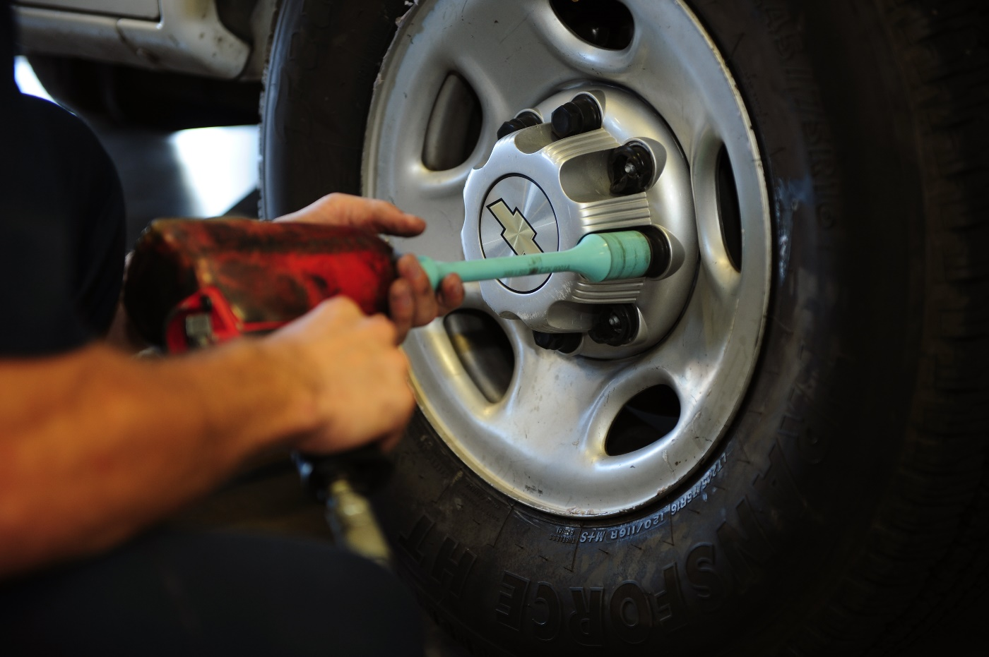
Required actions
Provide nutrition-focused counseling
  Current issues; and/or
  Anticipatory guidance
Make referrals
Schedule appropriate follow-up or quarterly nutrition education
Document each action in TWIST

Slide 19
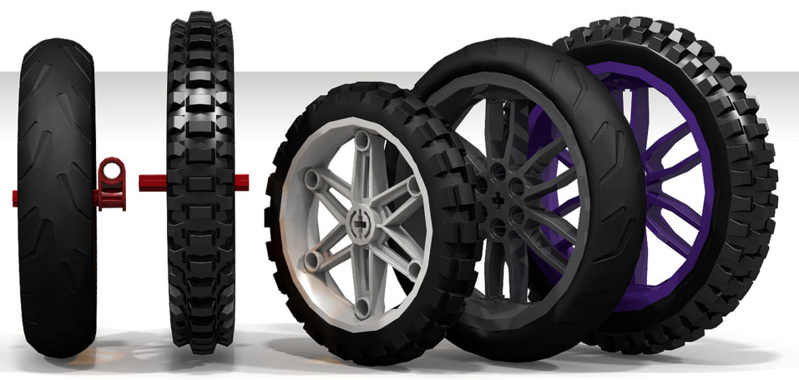
Desired outcomes
Examples of evidence-based, commonly accepted, nutrition-focused outcomes for each content area
Provides a roadmap for participant next steps and health outcomes during counseling

Slide 20

Critical thinking in counseling
4 components of critical thinking
Collect all information
Clarify or gather additional details
Analyze and evaluate the information you collected
Determine the best course of action

Slide 21
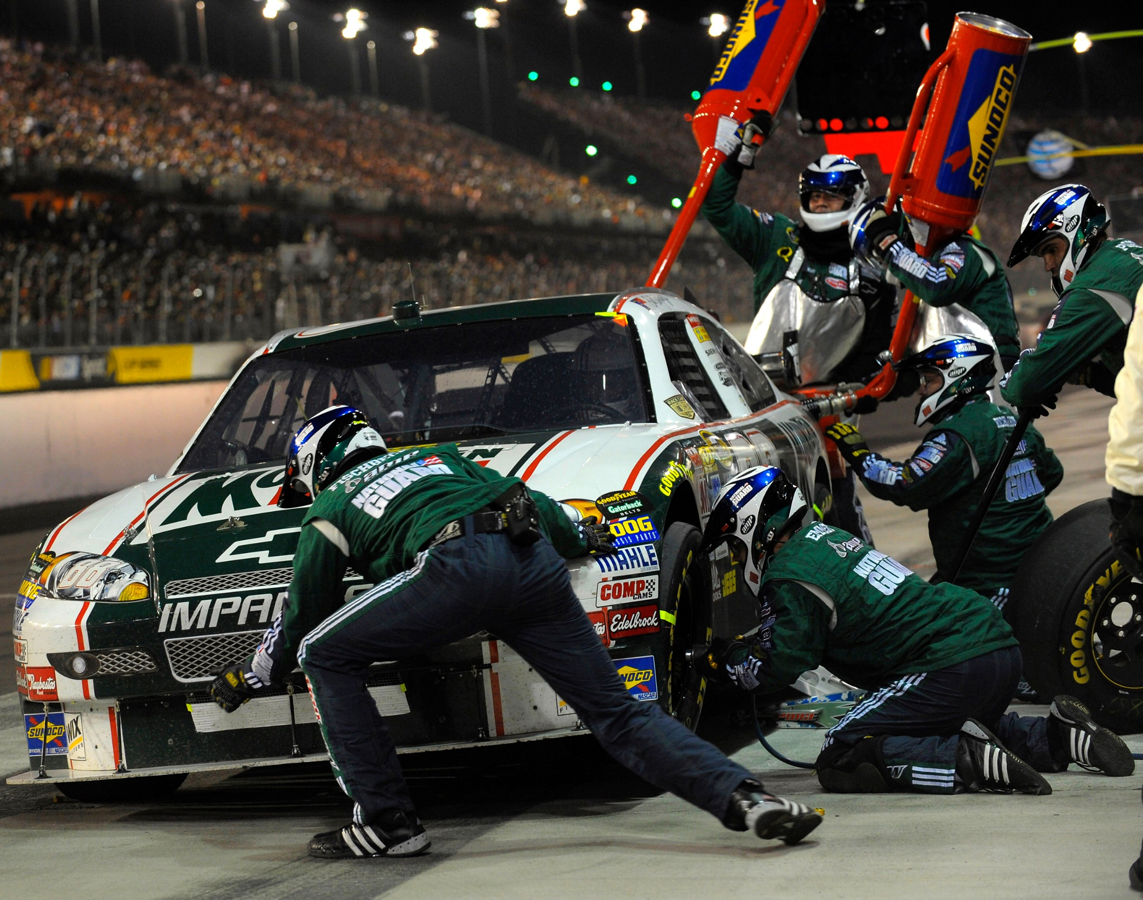
Nutrition-focused counseling (NFC)
The WIC Care Team at its finest
Working together to help participants get where they want to go.

Slide 22

Nutrition-focused counseling defined
Nutrition = The nutrition content or resources you bring. Exploring why to do something or how it improves health.
Focused = Focus on participant needs and experiences, rather than on what is happening with you, the clinic, or the computer.
Counseling = The interaction with the participant

Slide 23
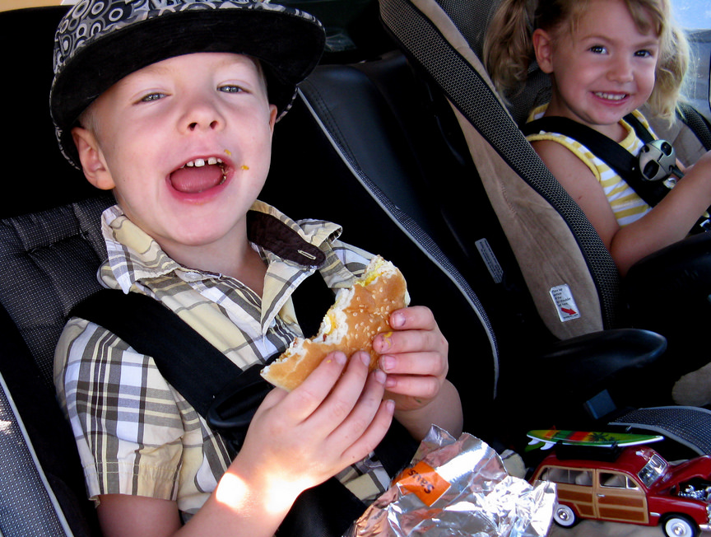
How is NFC different from Nutrition Education?
Nutrition + focus + counseling = a new place
Still focused on nutrition
Takes a broader look at what influences nutrition behaviors
Adds in why we eat/feed instead of just what we eat
Considers participant circumstances and feelings instead of just knowledge
Requires confidence in WIC’s role as nutrition experts

Slide 24
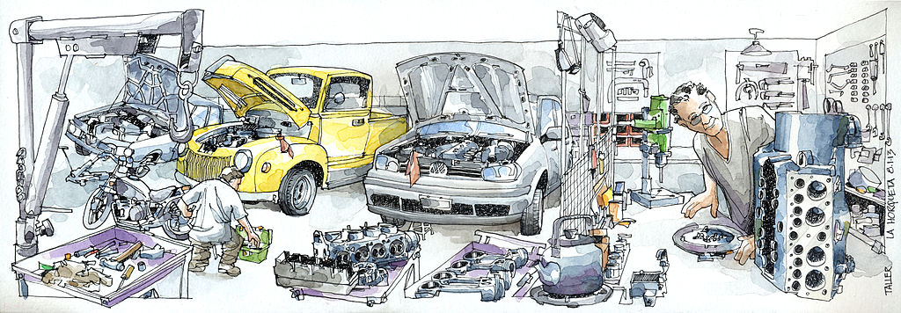
Tools you will need to provide NFC
Curiosity, critical thinking and listening skills to focus and evoke change talk during the assessment.
A way to keep track of potential counseling topics that come up.
Reflections and evoking questions to explore potential topics further.
Ability to prioritize what counseling topics are nutrition-focused and have the biggest impact on the health of the family.
If everything is fine, need the ability to provide anticipatory guidance.

Slide 25
Activity 2: Which WIC service?
Nutrition Education
Nutrition-focused counseling
See Page 6

Slide 26

Missed opportunities –
Why do they happen?
Recalculating!

Slide 27

What are our barriers to listening?
Time
Distractions
TWIST
Waiting to educate
Forgetting what the participant shared
Stressed families
eWIC – focus on food package

Slide 28

What are our comfort areas when counseling?
TWIST questions
Growth grids
Using handouts
Deferring to their doctor

Slide 29

What are our values when counseling?
Respect for expertise
  We want to know our stuff
Respect for our colleagues
  We want to do our share
  Stay on time
Respect for participants
  Respect for their privacy
  Respect for their questions
  We don’t want to wait to provide counseling

Slide 30

Waiting and keeping track
2 types of questions during assessment:
  Process questions – short answers, take care of it now
  “Change” questions – hold on to these to explore more after completing the assessment
Waiting to provide counseling – What does that sound like?
What tool do you use to hold on to information? How do you keep track of what you hear?
RESPECT

Slide 31


Tools to try
Welcome to WIC!
Date: |  | WIC ID:
Caregiver name:
Notes from check-in:
Name:
Appt. type:
Weight
Height/Length
Head circumference
Hemoglobin
Things we could talk about today:
Next step?
Referrals?
Tracking slip
Circle chart
Note pad

Slide 32

Activity 3: Topics of Conversation
Listen to this…
Page 7-8
Case Study – Mandy & Cade

Slide 33

Taking a new look at the Participant Centered Counseling roadmap

Slide 34

Driver or navigator?
Notes:
The participant is in the driver’s seat, but we are the navigators. Our role is to keep the conversation on track so we don’t end up lost/in the ditch/swamp/desert.

Slide 35


Certifications: straight road or frequent turns?

Slide 36

The straight and narrow
Getting started
Assessment
Education
Summary
Health Outcome
We started participant centered counseling with a very linear road map

Slide 37
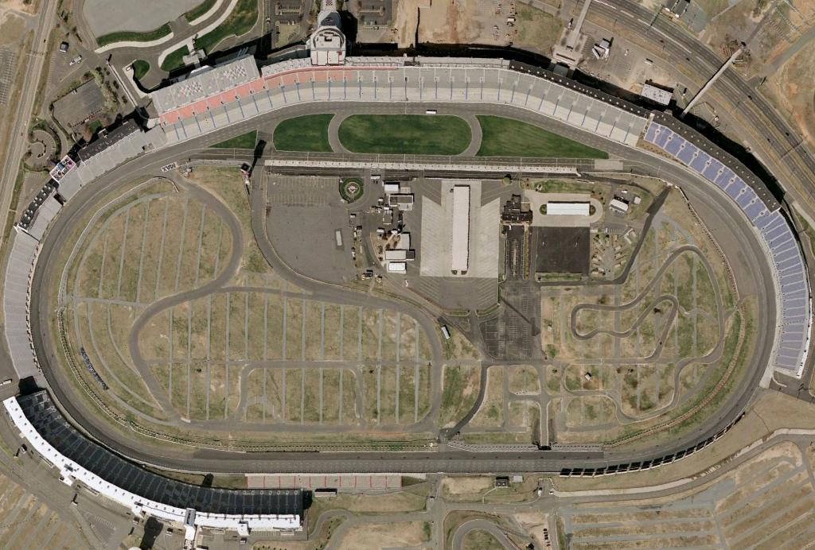
The TWIST Track
TWIST is the tool we are required to use – for now.
When things come up that don’t fit the map, we sometimes stay on our track and miss our chance.
TWIST – round and round we go

Slide 38
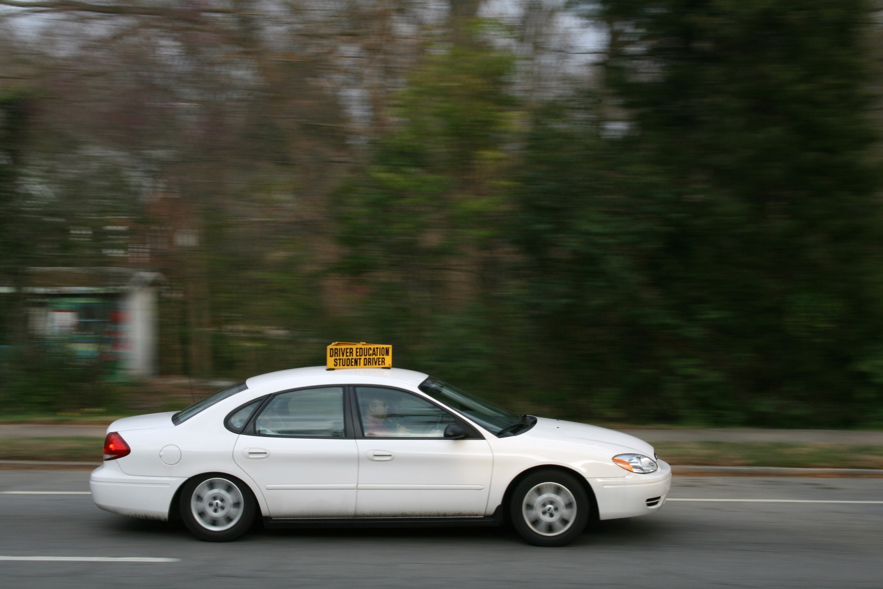
Until we gain skills, we keep it simple

Slide 39
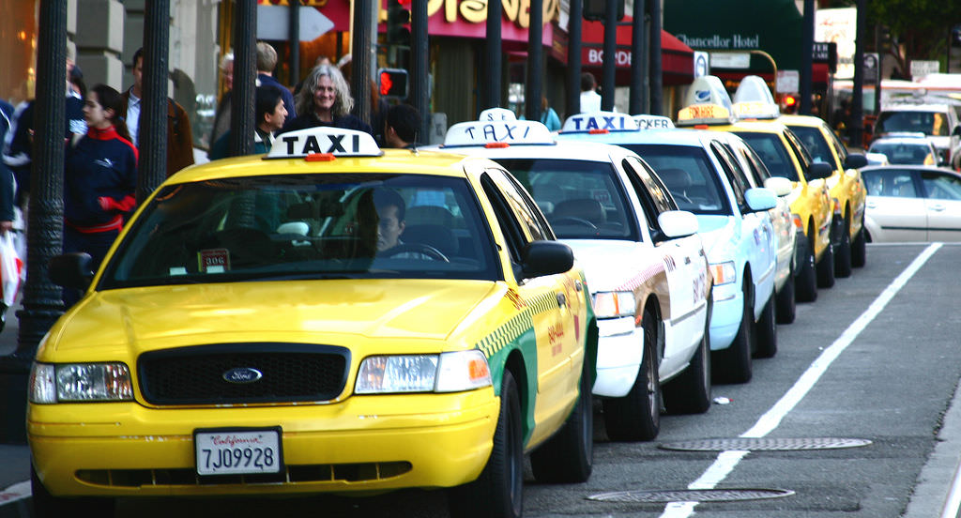
You’ve been around the block, and are ready for more!

Slide 40

Let’s navigate!
We want to focus on the skills that make us better navigators during counseling and avoid missed opportunities.

Slide 41
Four Processes of Participant Centered Counseling
Engaging
Focusing
Evoking
Planning
See page 9

Slide 42
The Four Processes of PC Counseling
Engaging
Setting the stage
The spirit of PC Counseling
Introductions

Slide 43
The Four Processes of PC Counseling
Focusing
Completing the assessment
OARS
Active listening
Prioritizing

Slide 44
The Four Processes of PC Counseling
Evoking
Exploring
Offering nutrition-focused counseling
Listening for change talk

Slide 45
The Four Processes of PC Counseling
Planning
Next steps
Summarizing hopes for health outcome
Documenting the plan

Slide 46

The Four Processes of PC Counseling
Build on one another
Not always linear
Depends on participant’s readiness to change
Each lays the foundation for the next

Slide 47
The more circular route
Explore
Getting started
Assessment
NF counseling
Summary
Health Outcome
Evoke
Explore
Offer
Prioritize

Slide 48

Lunch break

Slide 49

Skill building
One lap at a time

Slide 50
You have the spirit!
Engaging
Setting the stage
The spirit of PC Counseling
Introductions

Slide 51
Focusing skills
Focusing
Completing the assessment
OARS
Active listening
Prioritizing

Slide 52

Quick review – Active Listening
Active vs passive
Acceptance vs judgement
Curiosity - Looking for clues

Slide 53



Quick review – OARS
Open-ended questions
Affirmations
Reflections
Summaries

Slide 54
The more circular route
Getting started
Assessment
Education
Summary
Health Outcome
Explore
Prioritize

Slide 55
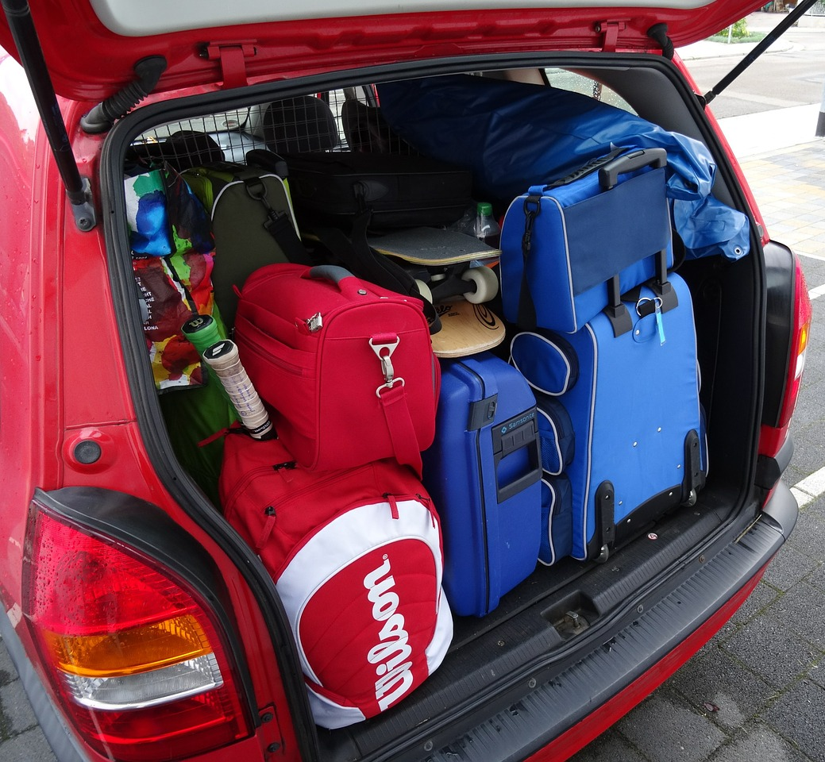
Skills related to “unpacking”
Prioritize
Curiosity
Critical thinking
Probing/evoking/exploratory questions beyond TWIST questions
Using reflections so it doesn’t feel like an interrogation
“Wait to educate” vs “listen first, then share”
Explore

Slide 56
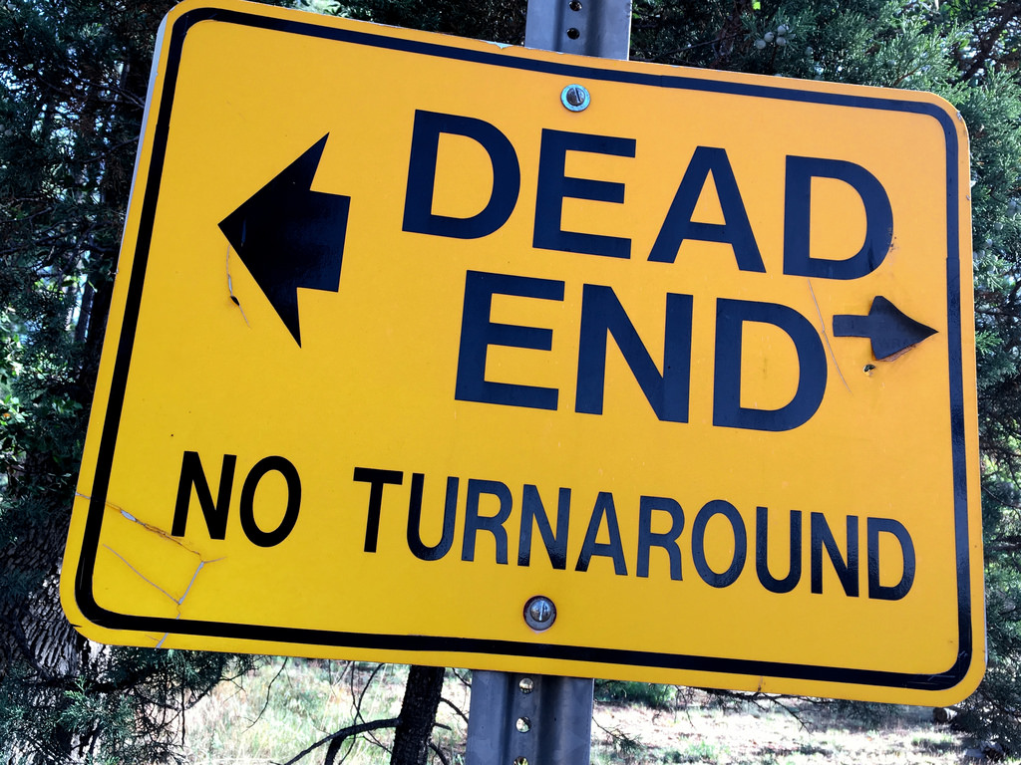
Curiosity keeps us moving forward
Curiosity drives us to find out more.
What keeps us from being curious?
  Concerns about time?
  Judgement?
  Assuming we understand?
  Lack of confidence?
  Will it upset the participant?

Slide 57

The risk of curiosity
We know that sometimes participants get upset.
We are going to focus on the more difficult conversations in September.

Slide 58

Asking open-ended questions beyond TWIST
For women “On a typical day, what meals, snacks and beverages do you have?”
For children “What is mealtime like for you and your family?”

Slide 59
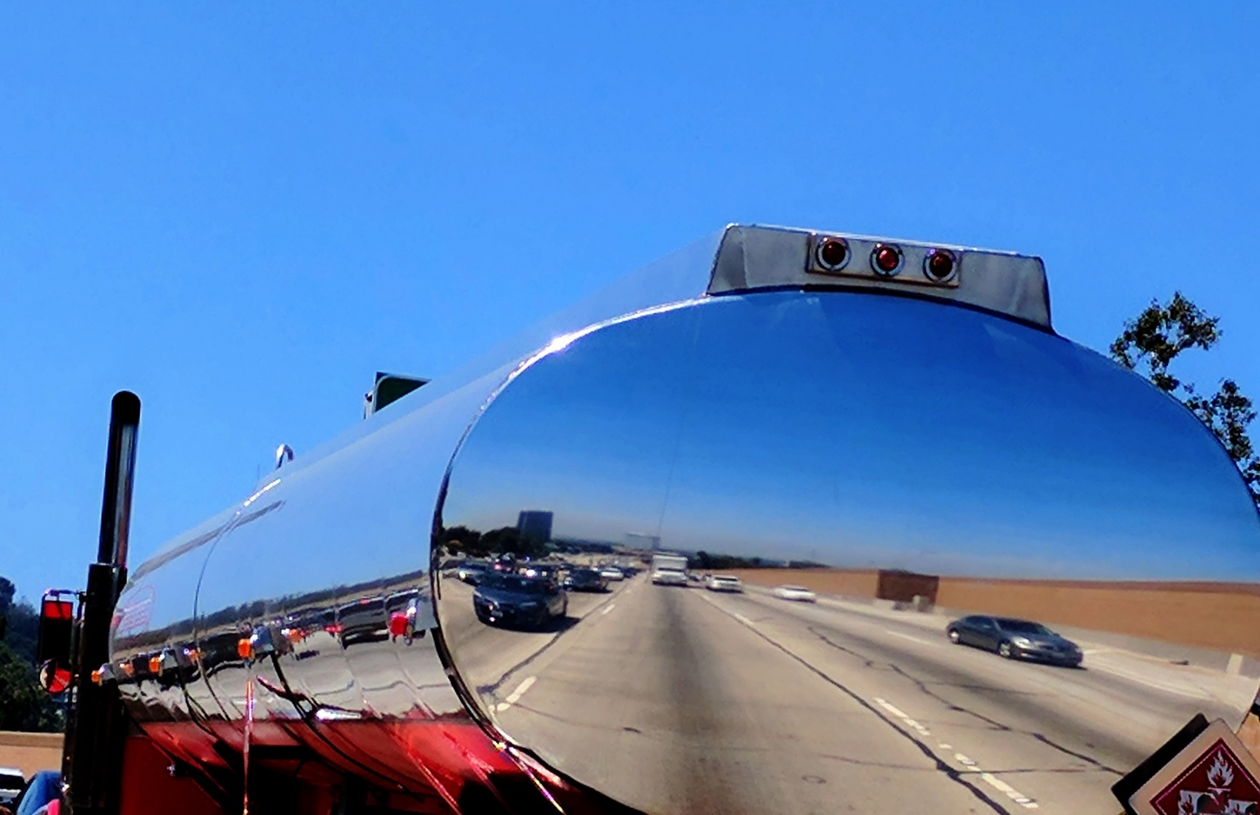
Reflections fuel curiosity
“We eat take-out way too much. It’s just so much easier with the kids.”
Simple reflections
Repeat – You eat take-out.
Paraphrase - It’s easier with kids to get take-out.

Slide 60

Listen first, then share:
Tracking topics to explore and offer later
Use the assessment to find potential destinations the participant is interested in exploring.
Use a tool to remember possible topics.

Slide 61
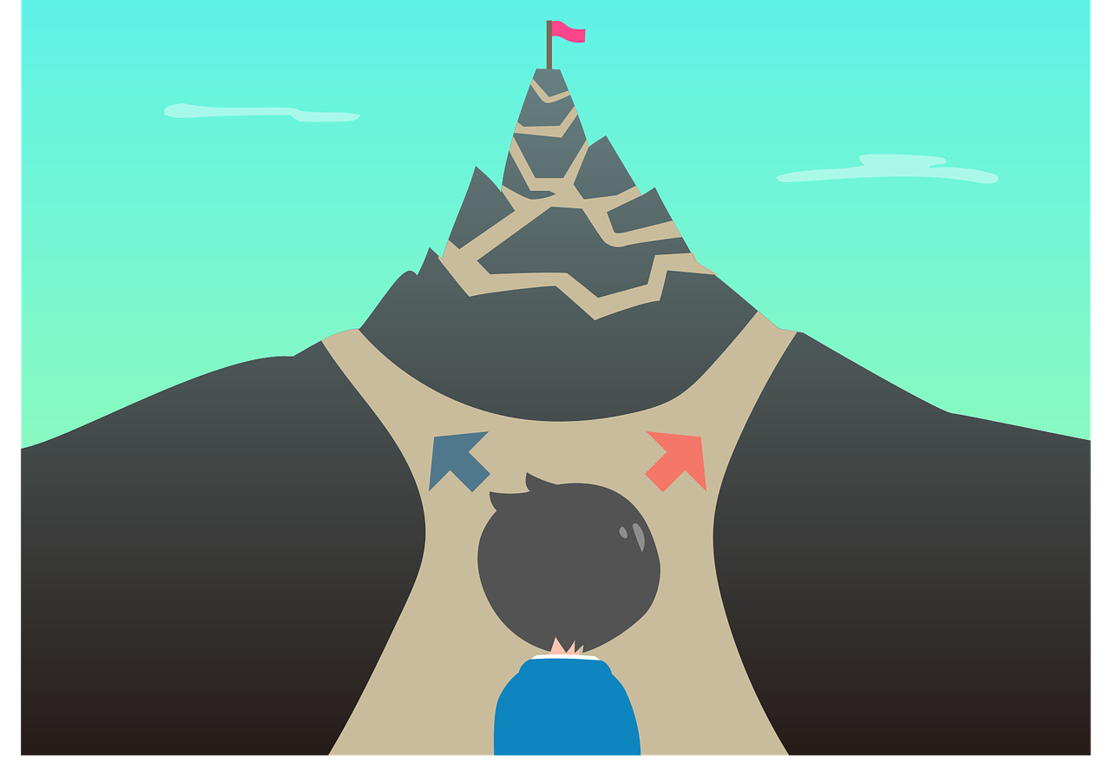
Prioritizing possible topics to offer
Once you have a list of possible topics, you decide which are the top priority to offer to the participant for further exploration.
You don’t have to offer back everything that came up.
  What is the most urgent issue?
  What has the biggest impact on the health of the family?
  What are they most interested in?

Slide 62

Use a summary to offer possible NFC topics
Use a summary to transition from assessment to nutrition-focused counseling.
Summarize the ideas from your tool that you prioritized.
Offer these as possible topics for further exploration.
Ask the participant which of these they are most interested in exploring further.
Save time by narrowing down the options.

Slide 63

Activity 4: Unpacking the Conversation
See page 10

Slide 64
Evoking is exploring
Evoking
Exploring
Offering nutrition-focused counseling
Listening for change talk

Slide 65
The more circular route
Getting started
Assessment
Education
Summary
Health Outcome
Evoke
Explore
Offer
Prioritize

Slide 66
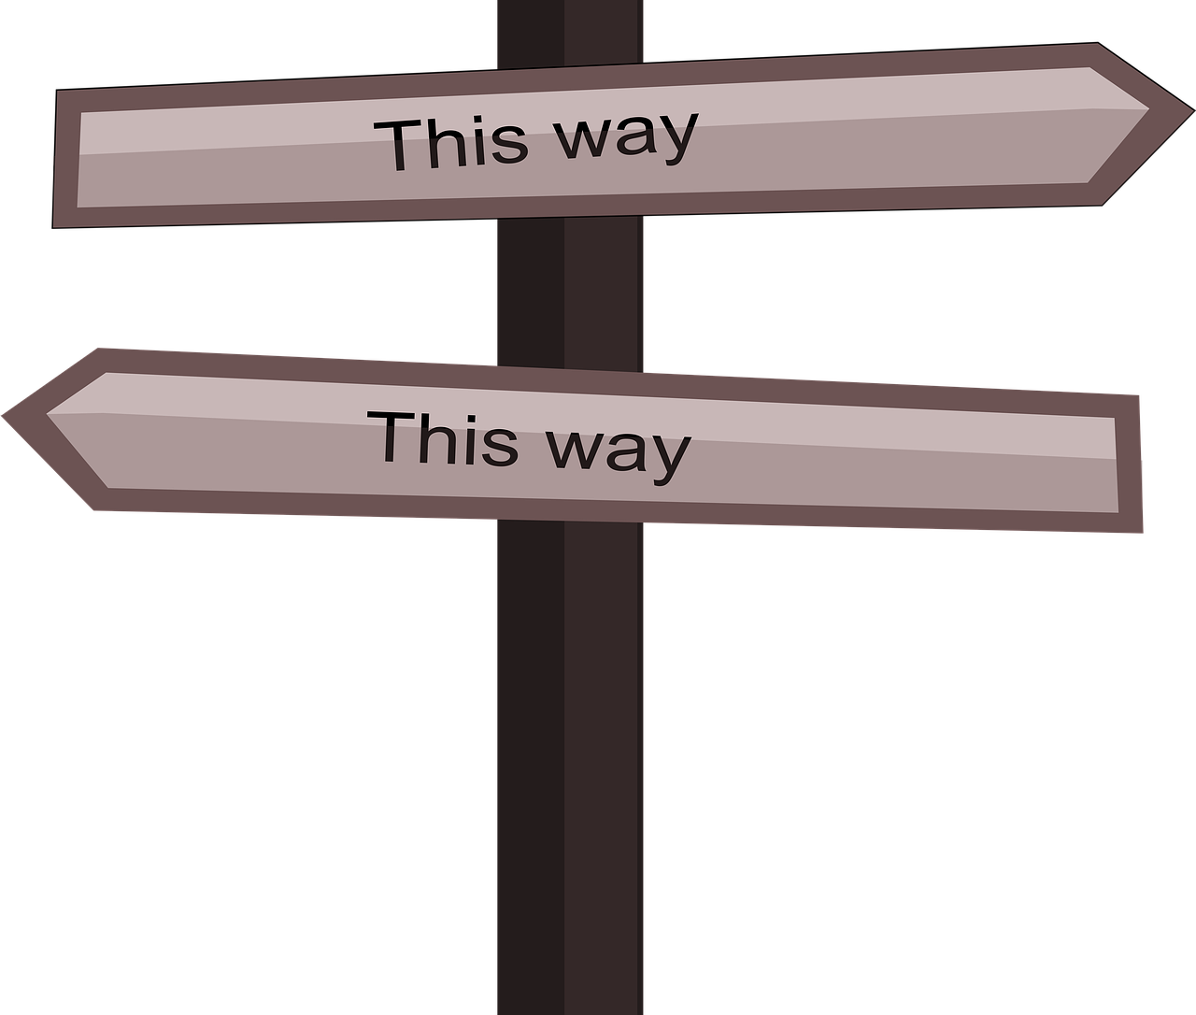
It’s all about the “Change talk”
Change talk are words that show interest in changing something.
More change talk means change is more likely.
We are more convinced by what we say, than by what someone tells us.

Slide 67
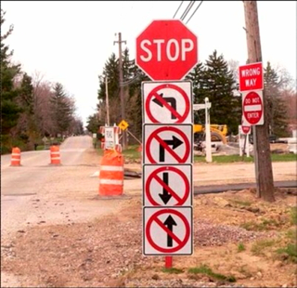
Ambivalence
Ambivalence means that a person has mixed feelings or contradictory ideas about something or someone.
Ambivalence shows that someone has thought about something. They have both reason to change and reason to stay the same.
Fence-sitting is normal.

Slide 68
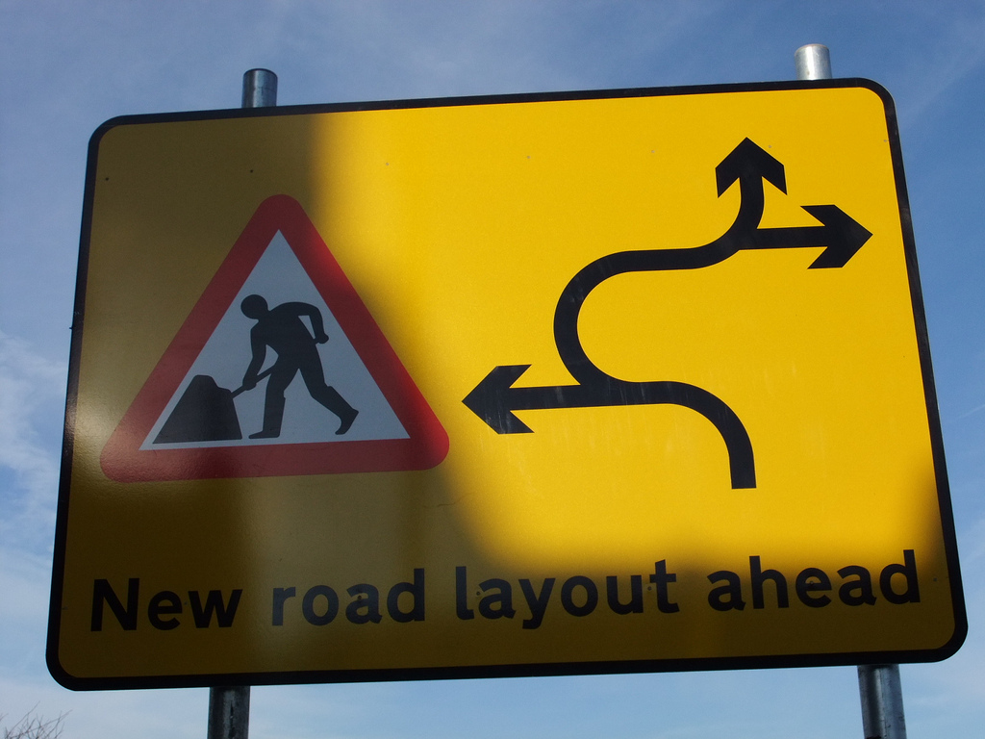
Change talk versus sustain talk
Change talk is speech that favors change
  “I want to eat better”
  “I would probably have more energy”
  “I really need to do this.”
Sustain talk is speech about reasons not to change
  “I just love sweets”
  “I hate sweating”
  “I can’t stand to hear him cry”

Slide 69

Types of change talk
Desire
Ability
Reasons
Need
Commitment
Action
Taking steps
See page 11

Slide 70

Types of sustain talk
Roadblocks
Reasons to stay where they are
Why it is hard
Often, change talk and sustain talk are in the same sentence!

Slide 71
Activity 5: Identifying ambivalence and change talk
Page 11-12

Slide 72

Now that you’ve found it, shine a light on it.
Reflecting change talk

Slide 73

Reflecting change talk
Keep reflections short
Say it in different words so it doesn’t sound like an echo
Avoid “sounds like”, “what I hear you saying” –
  Start a reflection with “You…”
Reflect feelings and intent
Reflect only the change talk, not the sustain talk
Change talk

Slide 74
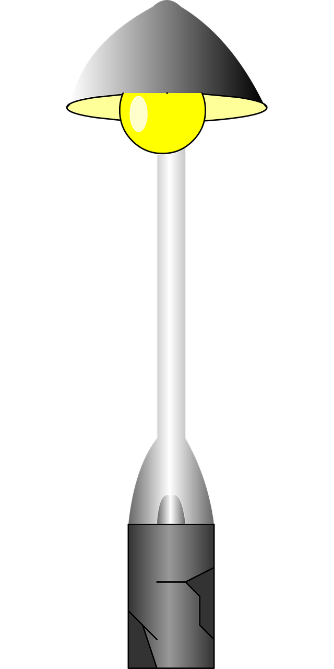
Reflect change talk - examples
I know I’d save money if I cooked more meals at home, but I hate doing all those dishes and cleaning the kitchen. When it is all said and done, it is just easier to get take-out for the kids.
  You would like to save money by finding some simple recipes that the kids like and don’t make too much of a mess.
The kids and I went for a walk the other day, but it was cold and rainy. I felt better after we went, but man I hate this time of year.
  You feel more energized on the days you are active.

Slide 75

Activity 6: Reflecting change talk
Page 13

Slide 76

Explore – Offer - Explore
The bridge between evoking and planning
See page 14

Slide 77
Taking it to the next step
Planning
Next steps
Summarizing hopes for health outcome
Documenting the plan

Slide 78
The more circular route
Explore
Getting started
Assessment
Education
Summary
Health Outcome
Evoke
Explore
Offer
Prioritize

Slide 79
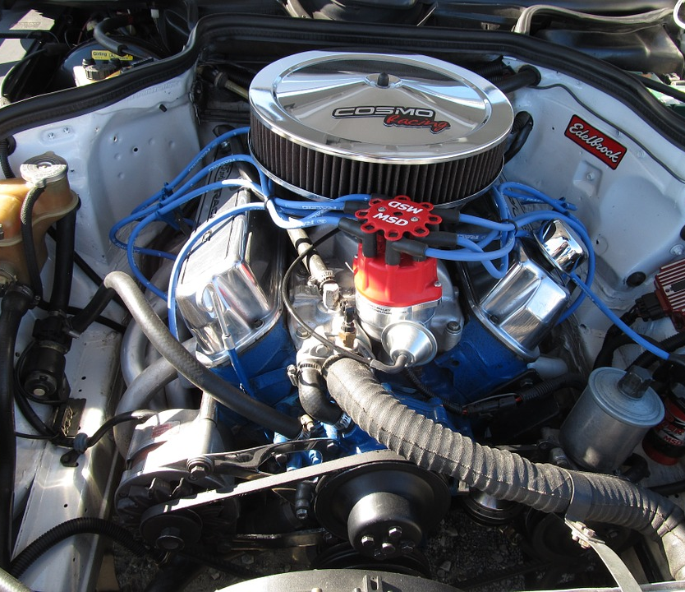
First: Explore “What else do I need to Learn?”
Ask the participants for their ideas for change before providing suggestions.
  What are their ideas?
  What other ideas do they have?
  What do they already know?
  What do they already do?
  What else have they already tried?
  Who else in your life might benefit from this change?
  What strategies would they need to overcome barriers?

Slide 80
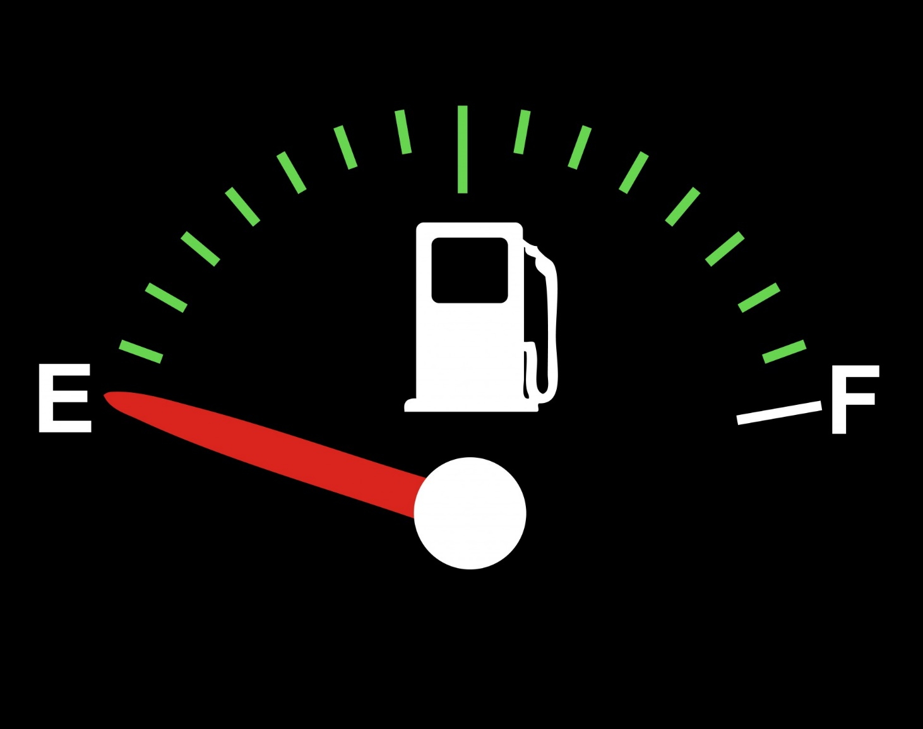

Offer nutrition-focused counseling
Nutrition-focused counseling fuels behavior change.

Slide 81

Ask permission to offer your suggestions
Ask permission before providing information.
  Expresses partnership with the participant
  Supports their autonomy
“Would you be interested in hearing more ideas on _____?”
“Is it okay if I share ideas with you that worked for other WIC families?”

Slide 82


Offer your ideas
Offer in a neutral, non-judgmental manner
  “Research shows…”
  “You might consider…”
  “I hear other mothers suggest…”
  “Some of what I say may be different from what you have heard…”
Emphasize choice
  “And I recognize that it is your choice to …”
  “You are the expert in your child, so take what you think will work for you and leave the rest.”
NeutralOptions
Your choice
Still Your choice

Slide 83
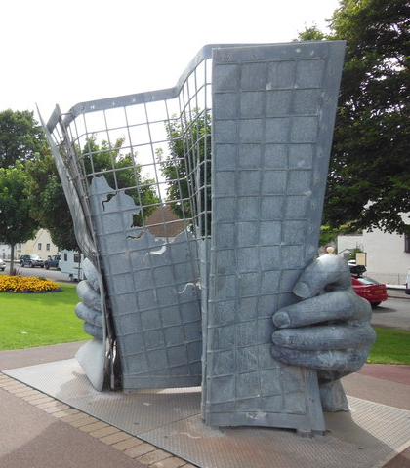
You can answer participant questions!
You don’t have to be an “expert” to answer most questions.
Exploring will help identify which part WIC can help with.
“Talk to your doctor” is not nutrition-focused counseling.
  You have lots of information and suggestions to share!
  Deferring to the health care provider should be reserved for medical diagnosis or condition specific questions.
  What questions or topics are out of scope for WIC and should be referred to the doctor?

Slide 84
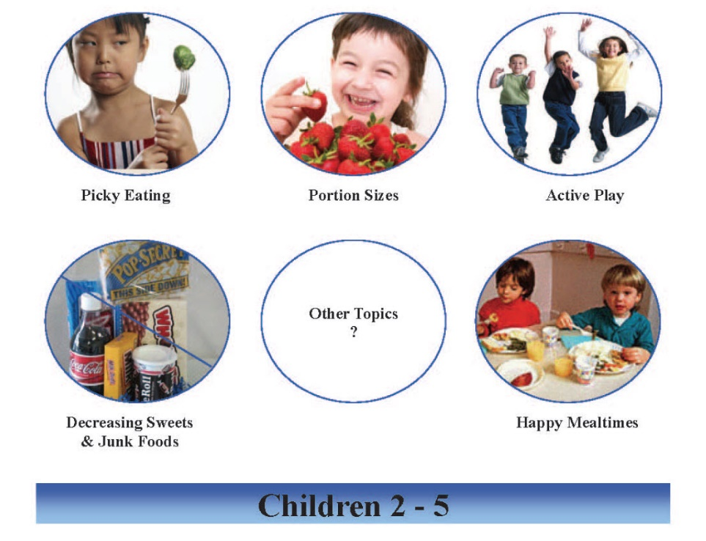
Everything is fine
If you don’t hear change talk to explore (e.g. “everything is fine”) and no potential topics come up during the assessment, offer “anticipatory guidance” for nutrition-focused counseling.
Pick a common issue for that age group and introduce it as a possible counseling topic.
  The circle charts by age group give ideas.
  Have a standard topic for each age group.
  Pick a topic of the month from a health fair

Slide 85

Neutral or not?
Yes, you should start some sort of regular walking routine.
Well, I have some ideas about what might help, but first let me hear what you’ve already considered.
If you want to eat out less often, you need to start going to the grocery store and planning out your meals.
If your blood sugar is high, you really need to start watching your diet.
Have you tried eating more slowly? That really works for me. I tend to not overeat when I slow it down.
It sounds like you aren’t completely convinced that you’d like to start making changes. Whether you decide to try some change is completely up to you. What do you think you will do?

Slide 86

The next “Explore” helps you find a next step
Explore what they think of what you offered and how they might take the next step.
  What do you think of the ideas I just offered?
  What info do you need to be successful in making this change?
  How do you see this working?
  How often, when?
  What will you need to do first to make that change?
  What are the barriers to making the change?
Summarize what they said they will do and you have their next step to document in TWIST.

Slide 87

Next steps are specific, realistic, action-oriented
The next step is not just the topic discussed (e.g. yogurt, breastfeeding, continue good efforts).
The next step should include an action they said they would do, how they would do it, and how often or when they will do it.
The next step comes from them, but doesn’t have to be stated by them.
Summarize their plans for the next step and give the participant a chance to confirm or tweak it.
  Did I get it all?

Slide 88
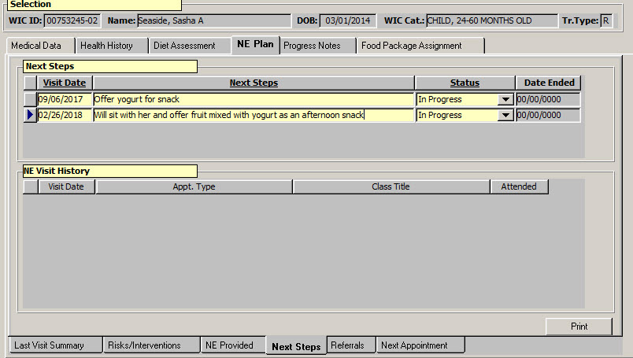
Document the plan
Documenting the nutrition-focused counseling provided and the next step is a required action.
Documentation will save time at the next visit.
Documentation supports the WIC Care Team efforts.

Slide 89
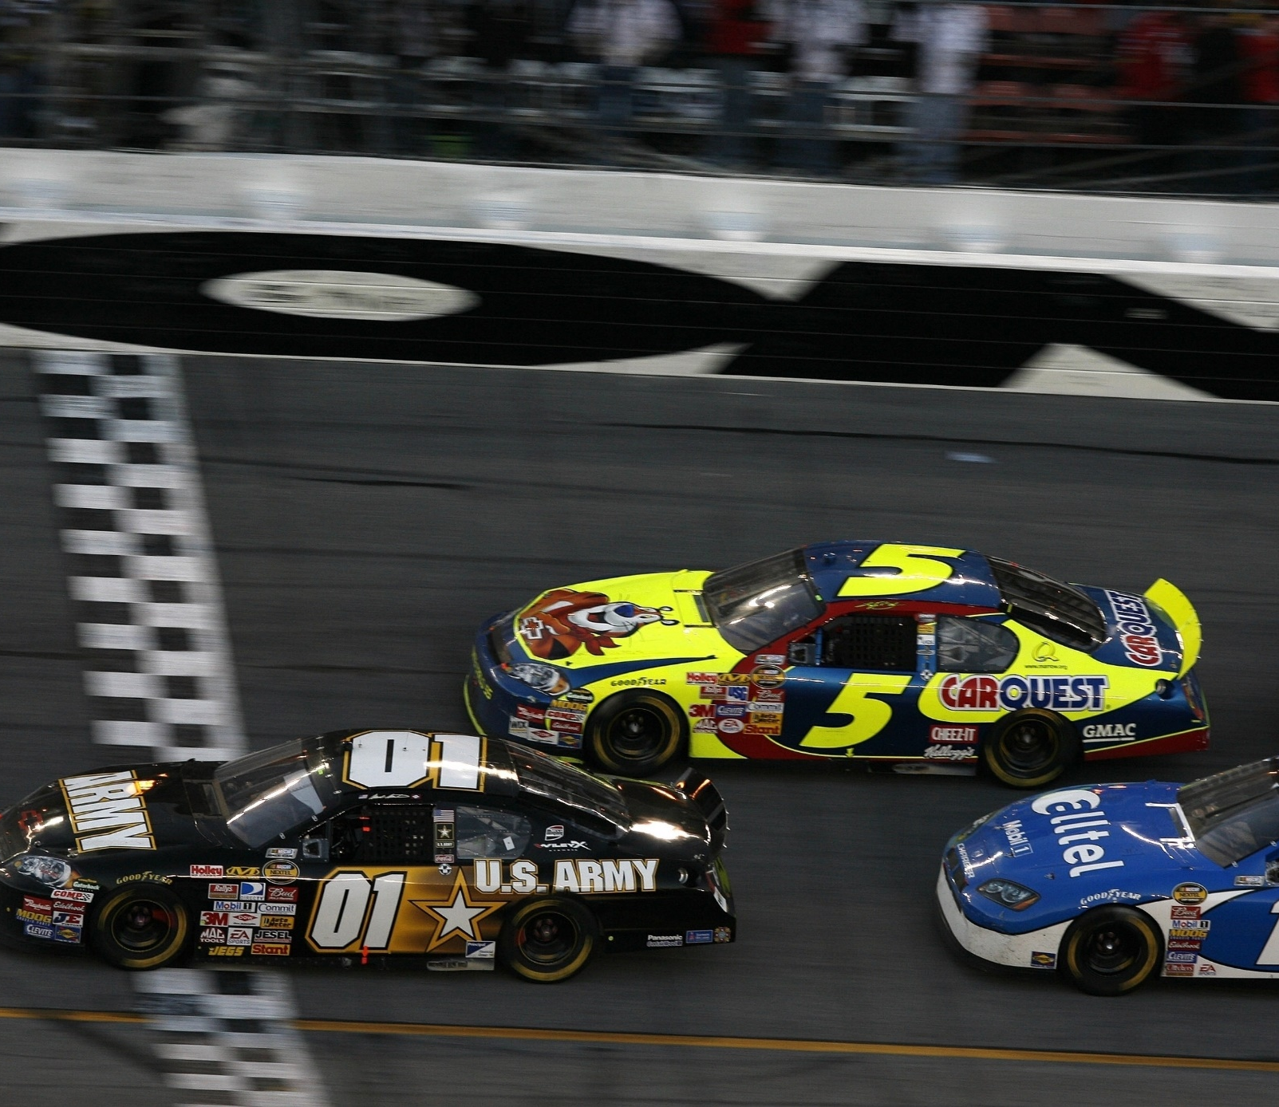
Activity 7: Putting it together
WIC
Page 14 - 15
Participant

Slide 90
Summarizing the next step and hopes for a positive health outcome
Consider combining your summary of the next steps planned with a health outcome statement
Element | Example
Why eligible for WIC | To support you as you work towards (summarize their next step)
How long eligible | When we see you - chance to check in on next step for the next year
Express confidence (affirmation) | I can’t wait to see how things are going
WIC Care Team (build the relationship) | No matter which WIC care team member sees you next time, we will check in to see how we can help support the change you are working towards
If needed, connect to the expert care team member who will see them next - RD, BF counselor, etc. | Because of x, our registered dietitian on our care team and an expert in this area will see you at your next appointment

Slide 91

Activity 8: Summary of Hopes
Page 16

Slide 92

Final reflection…
Your next steps

Slide 93

Activity 9: Your next step
Page 17

Slide 94

Activity 10: A team plan
Page 18

Slide 95
The state’s next steps
Statewide meeting in Portland – May 9-10
  Bridges Out of Poverty – Jodi Pfarr
  Responsive Feeding – Jane Heinig
  Renew for Clerical Staff
Face-to-face training in September
  Deeper and difficult conversations
Renew Review monthly activities
  Chance to practice nutrition-focused participant centered counseling skills
State staff technical assistance
Long term – updated and new training courses

Slide 96

Thanks and see you at the statewide meeting!

