Slide 1
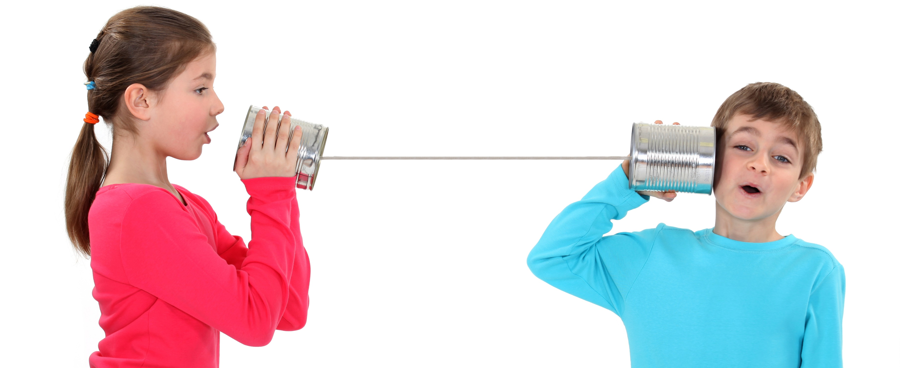

Can you hear me now?
Tips for providing participant-centered remote services

Slide 2
Today’s objectives
At the end of the in-service learners will be able to:
Describe ways communication changes for different ways appointments are provided
Use agendas to set the stage for remote appointments
Use critical thinking to navigate difficult phone conversations using participant-centered strategies
Use O.A.R.S skills for remote appointments and communications
Notes:
We know you have been doing remote appointments for the last 4 years! We hope this will be a refresher for you and maybe we will be able to offer some new ideas!

Slide 3
Remote services: Why?
How remote services impact participants
How remote services impact staff
Notes:
Accept all answers – it’s a brainstorm! There are no wrong answers.
Activity Option: Set up a white board or a word cloud to collect answers. Ahaslides.com has some good options. Staff can access by mobile phone or computer and do not need to leave their names.
In person option: gather ideas on post-it notes and put them on a piece of newsprint on the wall. Discuss and group by topic.

Slide 4


What is communication?

Slide 5
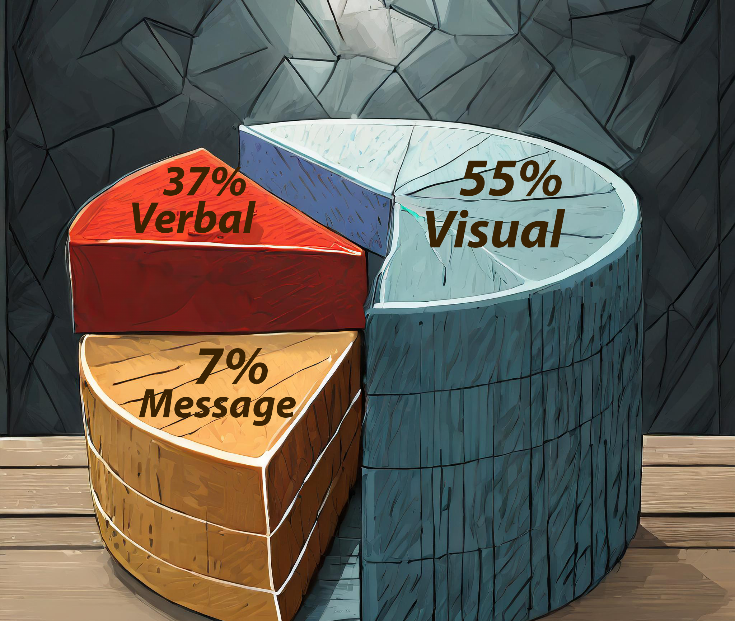
Communication is….
55% Visual
  Facial expressions
  Gestures
  Posture
  Type font
  Spacing of fonts
37% Verbal
  Speed
  Volume
  Enunciation
  Tone of voice
7% The Message
  Words we choose
  Acronyms
  Grammar
  Pronoun use
  Slang
Dr. Albert Mehrabian
Notes:
This slide has animation that will run automatically
Dr Albert Mehrabian first established this definition of communication. The focus of his work was about how these aspects of communication need to match. A Mismatch between the communication types causes confusion.
For example, if we shout, “You’re a great Mom!” in an angry, loud tone while gesturing wildly, a participant might not believe us!
The communication rule is also helpful to understand how much our nonverbal communication influences the message we send. This becomes even more important when one type of communication is missing.
Think about conversations you have had. Can you remember a conversation where the words the other person said did not match what you saw or how it sounded? How did that make you feel? What questions did you have at the time?
Paying attention to our nonverbal communication – even when on the phone or writing text messages – is key to sending a clear message.

Slide 6
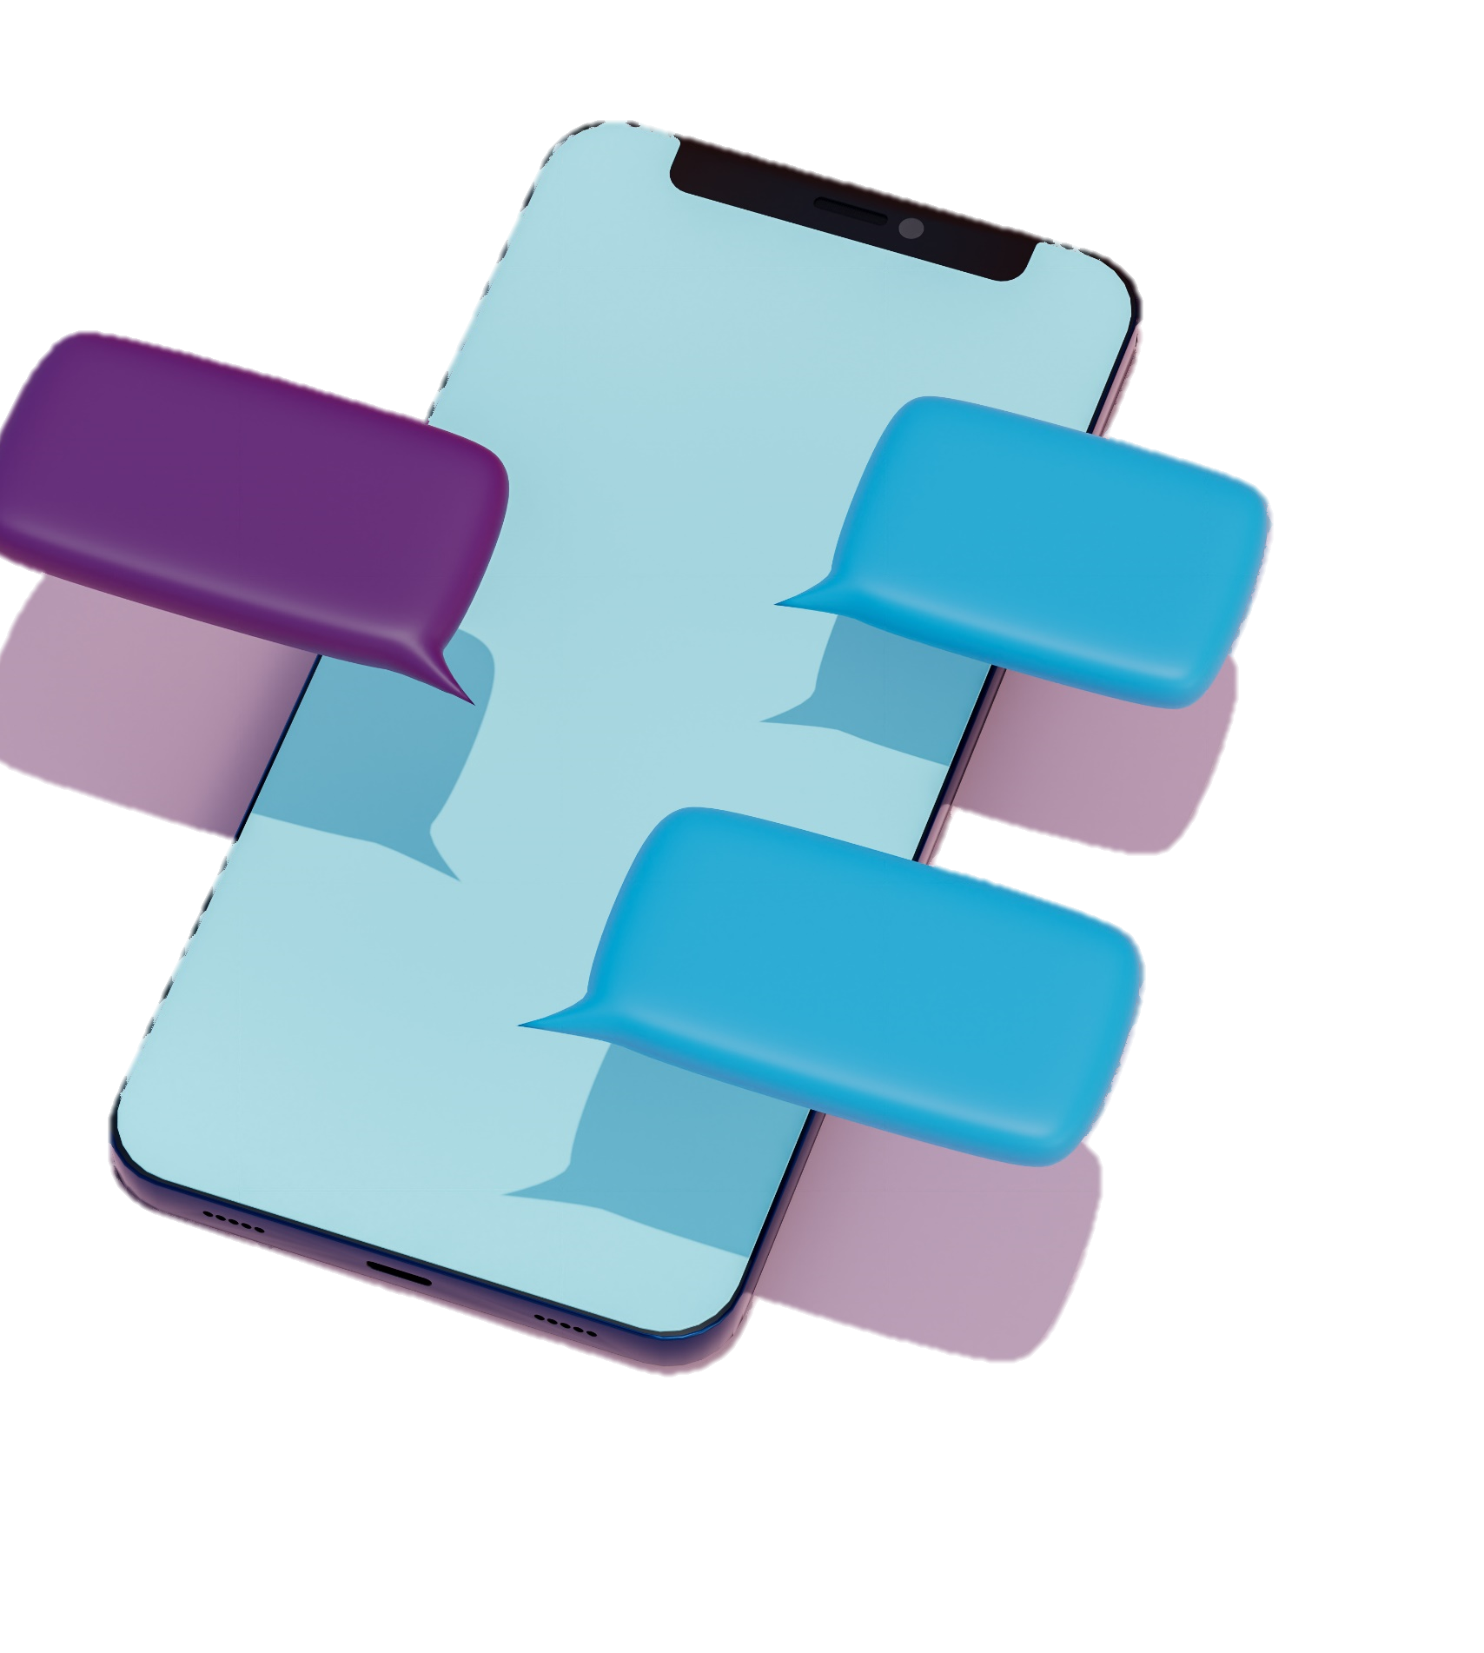
Communicating during remote appointments
Brainstorm a list together:
What’s different?
What’s the same?
Notes:
Activity Option:
Remote meeting: Set up a white board or a word cloud to collect answers. Ahaslides.com has some good options. Staff can access by mobile phone or computer and do not need to leave their names.
In person option: gather ideas on post-it notes and put them on a piece of newsprint on the wall. Discuss and group by topic.
Brainstorm the differences and similarities staff experience when communicating with participants remotely.
Summarize the ideas that are shared. Try to group concepts into categories. This can lead to a discussion about those categories as you need.
Some differences we’ve heard;
Participants forget about the appointment
Participants are often not at home. They’re at the store, driving the car, at a friends’ house, at work.
Participants are at a restaurant or ordering at the drive through
Participants are often distracted by their children.
It can be clunky getting signatures remotely
We can feel more urgency about the content than the participant in the conversation.
Some things that are the same:
There is an agenda to the call.
We need specific information.
There is a time limit to the call
We are following a schedule

Slide 7

It all starts with you

Slide 8

If we can’t see each other, does it matter?
Does this sound familiar?
  They can’t see me, so I can wear my pjs!
  Why do I need to smile? I’m not feeling it today.
  It doesn’t matter where I sit – on the floor is great. No one will know!
  No one will know if I’m scrolling through my email during a call.
Notes:
Ask the group the question on the slide.
After discussing, talk about the things below.
Even though a participant can’t see you when you are talking on the phone, your body language can have a big impact on the quality of the phone call.​
Sit up straight when talking to clients over the phone. Good posture will make you feel more confident and will help ground you in any tough questions or awkward silences.​
If you are able, use a headset so you can use your hands when speaking. This makes the conversation move more smoothly and feel more natural. ​
Smile! Smiling will make your voice sound warmer and boost your mood.
Behavior is communication. Whether it is seen or unseen, your behavior is heard and communicates to your communication partner.

Slide 9

Getting in the right space
Notes:
Tip: There is a group activity at the bottom of this notes section.
In an article about effective health virtual health coaching, one health coach shared, : “I put a mirror next to my laptop to make sure I am engaged.”
She put the mirror next to her computer so she could see her facial expressions while she spoke to people. If she didn’t look engaged in her mirror, she changed what she was doing.
Whether or not the participant can see you, your nonverbal communication comes through, loud and clear. Common trouble spots:
Distracted by email
Distracted by TWIST
TWIST is something we know you need to do while you are on the phone with the participant. Let your participant know that you are putting information in or retrieving information from a data system so you can issue benefits at the end of the call.
Distracted by things on your desk
Mis-matched facial expression and words.
What are some of your observations of when your words do not match what is happening around you?
Why is this important?
The participant hears the disconnect in your words and actions
Participants will reply with the same manner they receive. IT is easier for them to be distracted when they do not hear that you are fully engaged with them.

Slide 10

Tips for better conversations
Be in a space where the conversation
is private
Turn your phone to silent
Minimize your email
Turn off email and chat notifications
Use the mirror trick!
Limit distractions in your workspace
Notes:
Trust is the center for providing participant-centered services. These tips will help maintain trust between you, ensure your participants know what they share is private, and keep you focused so you can listen actively.
Be in a space where the conversation is private.
It is important to remember your conversation with a participant is private. Make sure you are in an area where they will not hear other people talking – and other people will not hear you!
Turn your phone to silent.
If your cell phone is on your desk turn it to silent. Vibrating phones on a desk can be heard over the phone
Minimize your email
If you can’t see it, it’s less tempting!
Turn off email and chat notifications.
This also stops the chimes you receive.
Use the mirror trick on the previous slide
Watch your self out of the corner of your eye. Distraction is easy to see.
Limit distractions in your workspace
This reduces the temptation to work on something else AND your participant can hear you shuffling papers or moving things around.
Activity
Practice what it sounds like when you aren’t engaged…people can tell. Just like you can tell when they are not engaged with you.
Pair up.
Turn your back to each other or go into different rooms and call each other. Practice scowling, slouching in your chair, and flipping through a book or reading a web page while saying the usual pleasantries.
Then repeat the call with your best foot forward: sit up straight, clear your work area, and smile!

Slide 11

It’s your turn!
Pair up.
Turn your back to each other or go into different rooms and call each other. Practice scowling, slouching in your chair, and flipping through a book or reading a web page while saying the usual pleasantries.
Then repeat the call with your best foot forward:
  sit up straight,
  clear your work area, and
  smile!
Can you hear the difference?

Slide 12

The sound of silence
Holding the silence is powerful
Gives the other person time to
      think about what you said
      apply it to their situation internally
      decide how to reply
  Is often so loud it redirects a participant
  back to the conversation
Notes:
Being silent is powerful.
Research tells us that people have different processing times. Some people who experience aphasia or other speech-related challenges take longer to reply. It can take up to a minute to take in what was said, process what it means, and craft a reply for you.
For most people being actively quiet (that is, listening in the silence) for 5- 10 seconds allows the participant enough time to begin to respond or reply.
Silence is also cultural.
A study found that native English speakers start to get uncomfortable after 4 seconds of silence. However a similar study in Japan found they were comfortable with up to 8 seconds of silence.
Activity:
Set a timer for 10 seconds. Have someone in the group ask you a question. Start the timer. Wait for the timer to go off before replying.
How did you feel during your wait for a reply?

Slide 13





O.A.R.S. works remotely, too!
Open-ended questions
Affirmations
Reflections
Summaries
Notes:
Everything we have and will share is done by using OARS.
There are many tools for individual learning on the WIC Staff pages related to OARS skills.
Summarize the O.A.R.S skills.
OARS tip sheets:
Open –Ended questions: https://www.oregon.gov/oha/PH/HEALTHYPEOPLEFAMILIES/WIC/Documents/orwl/ce_open-ended_1_staff.pdf
Affirmations: https://www.oregon.gov/oha/PH/HEALTHYPEOPLEFAMILIES/WIC/Documents/orwl/ce_affirmations_1_staff.pdf
Reflections: https://www.oregon.gov/oha/PH/HEALTHYPEOPLEFAMILIES/WIC/Documents/orwl/ce_reflections_1_staff.pdf
Summaries: https://www.oregon.gov/oha/PH/HEALTHYPEOPLEFAMILIES/WIC/Documents/orwl/ce_summarizing_1_staff.pdf
OARS skill cards you can use:
Open-ended questions: https://www.oregon.gov/oha/PH/HEALTHYPEOPLEFAMILIES/WIC/Documents/orwl/pcg-skills-openended.pdf
Affirmations: https://www.oregon.gov/oha/PH/HEALTHYPEOPLEFAMILIES/WIC/Documents/orwl/pcg-skills-affirmations.pdf
Reflections: https://www.oregon.gov/oha/PH/HEALTHYPEOPLEFAMILIES/WIC/Documents/orwl/pcg-skills-reflections.pdf
Summaries: https://www.oregon.gov/oha/PH/HEALTHYPEOPLEFAMILIES/WIC/Documents/orwl/pcg-skills-summarizing.pdf

Slide 14

Tips for participant-centered conversations
Plan ahead
Know your options
Practice
Use trauma-informed practices
Practice being comfortable with silence
Listen actively
  Remember your OARS training!
Notes:
Silence: It gives you and the participant time to think about the answers. Include a few “mmhmm” and “un-huh” responses so they know you are still there and listening.
Affirmations and reflections
Affirmations are statements and gestures that recognize a participant's strengths and acknowledge behaviors that lead in the direction of positive change, no matter how large or small. Affirmations build confidence in one’s ability to change. To be effective, affirmations must be genuine. Reflective listening is meant to close the loop in communication to ensure breakdowns don’t occur. There are three levels to reflections. Repeating or rephrasing: Listener repeats or substitutes synonyms or phrases and stays close to what the speaker has said. Paraphrasing: Listener makes a restatement in which the speaker’s meaning is inferred. Reflection of feeling: Listener emphasizes emotional aspects of communication through feeling statements. This is the deepest form of listening.

Slide 15
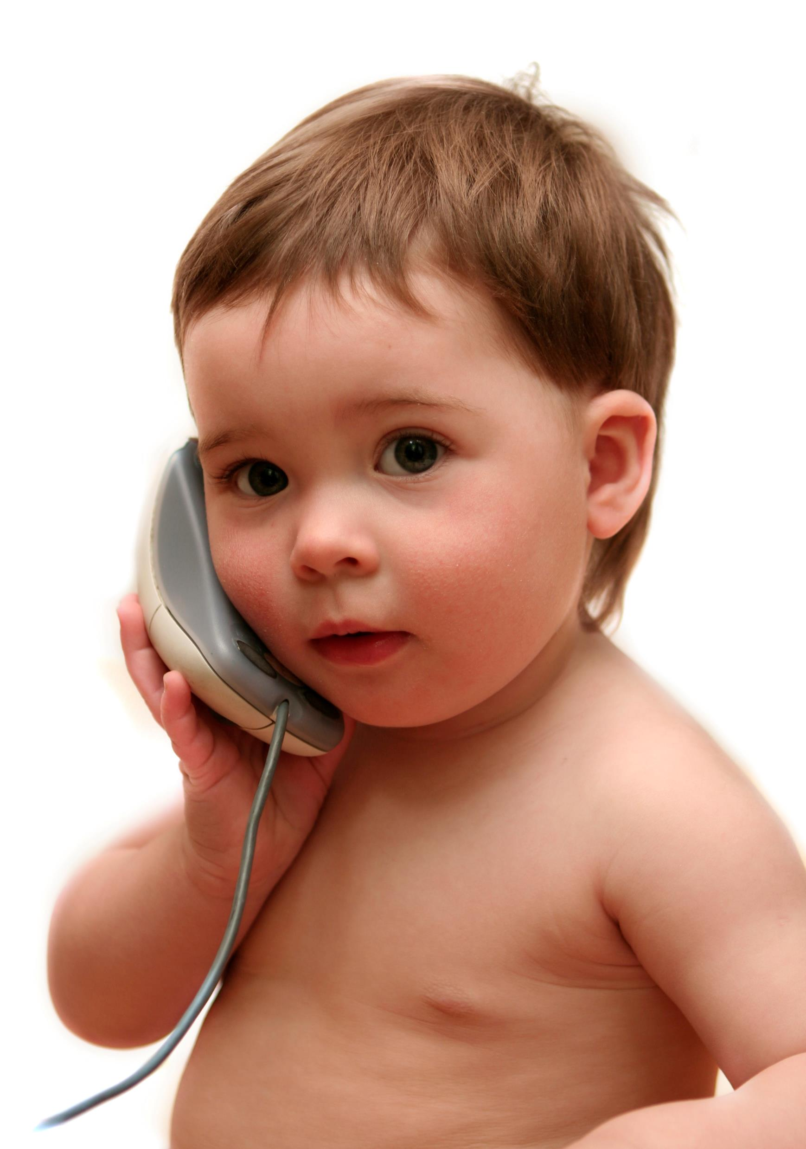
The flow of a phone appointment
1
Review the record
How many people are in the household?
2
Call the participant
Greet the participant by name
What are their names?
What is the most recent goal?
Check food benefit redemption
Introduce yourself, your role and why you are calling.
Ask if this is still a good time to talk
Gather potential information to share (based on what you read in the record)
Take a deep breath and center yourself
Notes:
This slide has animation
Each numbered point will enter automatically. If you need it to fade in before the animation begins, hit “return” or the arrow key to start the animation.

Slide 16
The flow of a phone appointment
3
Set the agenda
4
Follow up on previous plans or goals
Today I’d like to...
After that we will set an appointment for you next visit and issue your benefits
This will take about X minutes
Before we get started, do you have any questions for me?
Probe
Affirm efforts
Explore
Ask permission to offer ideas
Explore possible next steps
What questions do you have for me?
Summarize and review
Notes:
This slide has animation
Each numbered point will enter automatically. If you need it to fade in before the animation begins, hit “return” or the arrow key to start the animation.

Slide 17
The flow of a phone appointment
5
Offer nutrition education
6
Repeat
Steps 4 and 5 for other members of the household
Be mindful of the time
Ask permission to share nutrition education
Offer topics to explore and follow participant lead
Listen for fatigue in the participant
Offer a summary at the end of each discussion topic
Notes:
This slide has animation
Each numbered point will enter automatically. If you need it to fade in before the animation begins, hit “return” or the arrow key to start the animation.

Slide 18
The flow of a phone appointment
7
Talk about WIC food use and possible changes
8
Issue benefits
Tailor the food package as needed
9
10
Schedule the next appointment
Share what to expect for the next appointment
Thank them for their time!
Notes:
This slide has animation
Each numbered point will enter automatically. If you need it to fade in before the animation begins, hit “return” or the arrow key to start the animation.

Slide 19
The flow of a phone appointment
11
      Finish your notes
          Document goals
          Check notes
Take a deep breath and center yourself
Notes:
This slide has animation
Each numbered point will enter automatically. If you need it to fade in before the animation begins, hit “return” or the arrow key to start the animation.

Slide 20
What does it mean to set the agenda?
On the phone
By text or email
Notes:
No matter your role, let people know what’s going to happen during your interaction…whether it is on the phone, by text, or zoom! Knowing what to expect for the call is as important as your “elevator speech” introduction! Take a few minutes to practice setting the agenda for a recertification appointment.
Option 1: Ask staff to share ideas of what it means to set an agenda. They should be similar, but may have some differences based on the mode of the conversation
Option 2: Break into pairs. One is participant, one is WIC staff. Practice the beginning of a phone call by introducing yourself, confirming the participant, and setting the agenda for the appointment.
Look for:
Welcome
Establish rapport
Tell participant what will happen during the conversation or message session
Share how long you think it will take
Ask if there’s anything else they want to discuss that you didn’t mention

Slide 21
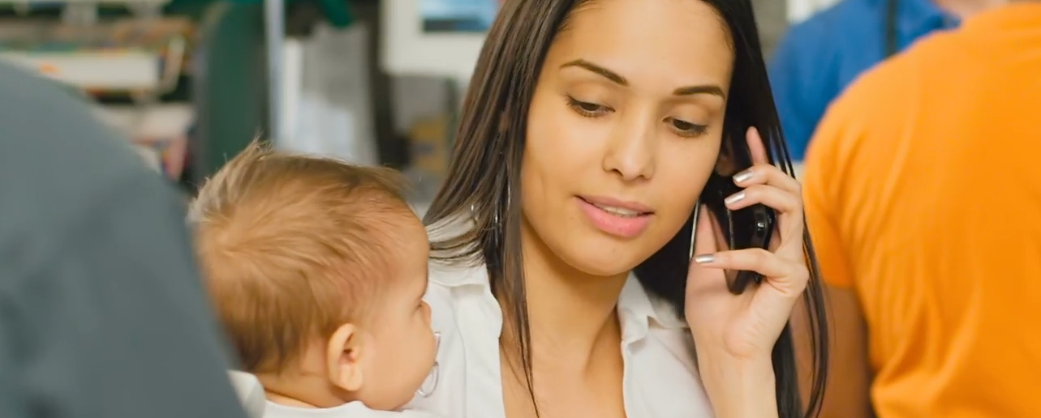
When participants are distracted

Slide 22

When participants are distracted
  Ask if they need a minute to get settled before starting the conversation
  Use clear, plain, and direct language
  Ask if they have specific questions at the start
  Ask “I can tell you’ve got a lot going on.
  What would be the best use of our time today?”
  Consider rescheduling if appropriate
  Take a deep breath
Notes:
Life is busy. Things never quite go the way you plan. Things may have changed since the appointment time was set or the participant may have forgotten. Many times our participants need to pay attention to their children for their safety. Whatever the reason, it’s easy to be distracted when talking on the phone.
This is when it helps to think about how you say things. Keep your messages to the point.
Tips:
Avoid acronyms or “WIC Slang.”
One topic for each sentence or conversation turn

Slide 23

What is your agency’s policy when a participant is distracted?
Talk it over
    You are talking with a participant who is very distracted.
    They will fall off the program if you cannot complete this appointment.
    What is your agency’s guidance for this situation?
Notes:
Here are some tips when talking to someone that is distracted
Ask the participant if there is anything they need to quickly take care of before you start the conversation
Ask them if they have any specific questions and consider addressing those first.
Ask them what the best use of your time together would be.
Use clear and concise language.
Use simple, direct and specific words to convey your main points.
Check for understanding and clarify anything that they may have misunderstood.
Summarize what you have talked about at the end of the call.
Don’t take their distraction personally or get frustrated with them.
Be supportive and understanding. Offer them help or support if they need it.
Discussion prompt:
What is your agency’s policy when a participant is distracted and unable to pay attention to the conversation?

Slide 24
It’s your turn!
You call a participant at the scheduled time.
They answer the phone. You learn they are in the checkout line at the grocery store! They are also managing three children during checkout. You know this because they are calling out to their children during the conversation.
What do you do?
Notes:
Discussion Prompt
Focus questions:
What are some ways you can manage this situation?
With each idea, ask these questions:
Does the solution focus on the participant?
Does the solution use one of the OARS skills?
If not, how can it be reframed to fit the spirit of PCS?
Option1: Discuss this as a group. What are some techniques learned from OARS to help with this? How can we frame our concern so it is focused on the participant?
Option 2: Break into groups and talk about it. Asking the groups to discuss focus questions about this scenario and report back out.
Option 3: If staff are completing this in-service independently, consider starting a chat thread or bring it up as a discussion at the next staff meeting.

Slide 25

Communicating in writing
Notes:
Remote appointment options can mean we are communicating with participants more in writing – by text, email, or through forms – to do the work done in an in-person visit.
Here are some introductory tips to help.

Slide 26
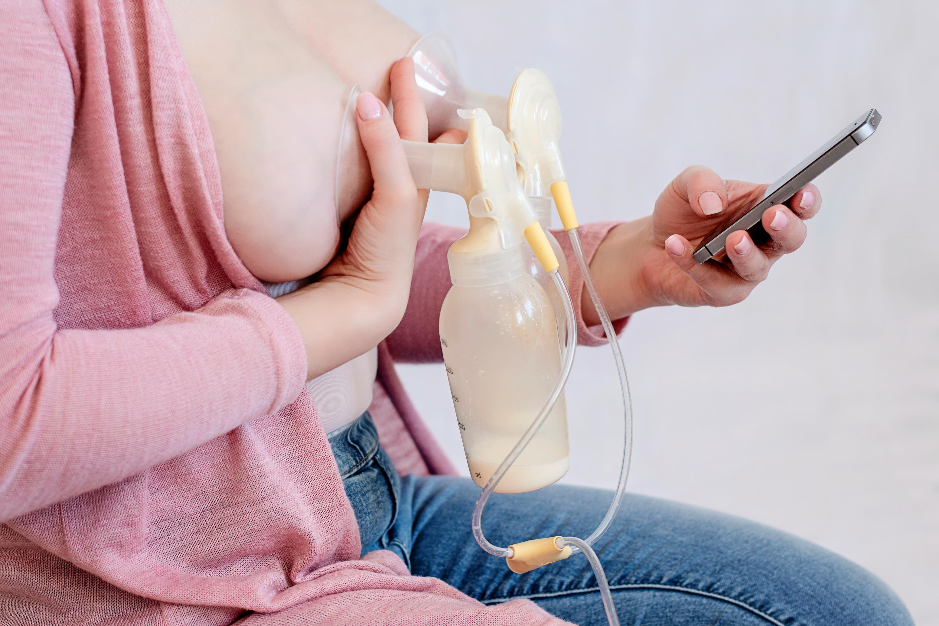
Tips for communicating by text or email
Use active tense
Use fewer words in the text than in person
Set the agenda of what needs to be done:
  There are three documents I need you to sign by Text today.
  We will be talking about the documentation needed for participation in
Get to the point right away
Notes:
It is difficult to convey tone when communicating with a participant over text and email. Some people might interpret too short of an answer as mean or uncaring.​ It’s tricky to get the right balance. Here are some things to consider:
Use language that is easily understood by the recipient. Avoid jargon and abbreviations. Avoiding language that may be unfamiliar to them.​
Avoid texting shorthand such as OMG or LOL or BRB, IDK​
Proofread messages before sending to ensure clarity and accuracy.​
One point per sentence (do not write long run-on sentences)​
Wait for a reply before moving on to the next topic. ​
For example, text: “Here’s the link for Rights and Responsibilities.” Wait for response before sending Voter Registration.

Slide 27
Hi Mary!
Do you have a few minutes to text with me about your appointment with WIC next week?
What do you want to talk about?
I have a few minutes.
I’d like to get the documents for your appointment. It will take about 15 minutes. Would that be ok?
Notes:
How do you respond to texts from your doctor’s office? Do you respond right away? Leave it for a while? Forget about it? Our participants might do the same with our texts.
Participants may not be in a good place to respond to your text if you do not have schedule time. Build in time for replies – even up to da day – rather than expecting people to respond quickly.
Setting an agenda, even over text, gets everyone on the same page about the process.

Slide 28

When things don’t go as planned
Notes:
This document is a great resource for dealing with resistance.
Oregon WIC Listens: Dealing with resistance: https://www.oregon.gov/oha/PH/HEALTHYPEOPLEFAMILIES/WIC/Documents/orwl/ce_resistance_staff_1.pdf

Slide 29
I remember….
On the phone
By text or email
Notes:
Activity
We all have a story of when things did not go well. Share a story about a situation curing which you struggled to keep things on an even keel.
Here are some topic prompts. Share…
A time when the call was doomed from the start (the participant was escalated at the very start)
A participant became escalated during the conversation.
You felt escalated and frustrated and it began to show.
What do you wish you had tried or done differently in this situation?

Slide 30
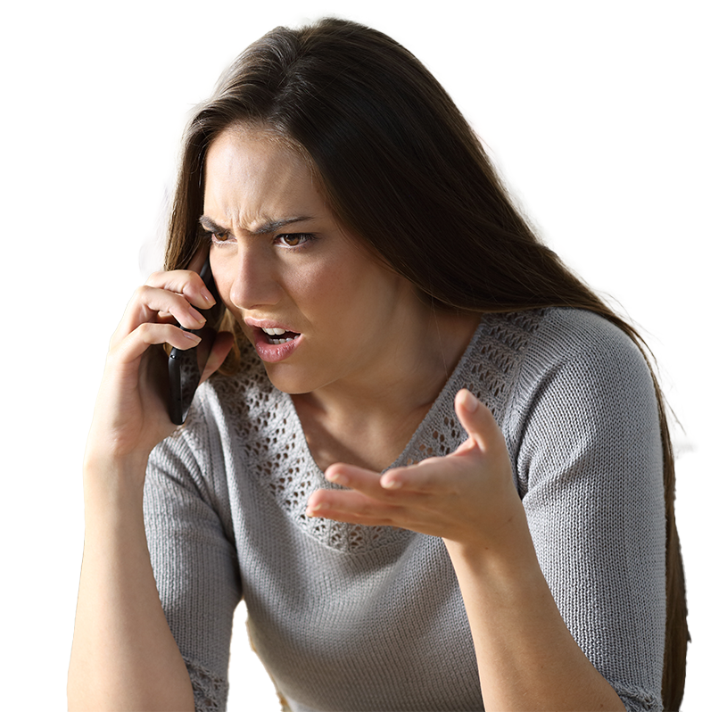
When things don’t go as planned
What are some signs a participant is becoming upset?
  Volume increases
  They use negative or sarcastic comments
  They stop talking
  They interrupt or are quick to cut in
  They stop talking all together
Notes:
These are some common signs a person is “escalating” What does it mean to escalate? It means the person you are talking with is becoming more frustrated as your conversation continues. They may become very angry.

Slide 31
When things don’t go as planned
What can you do?
    Remember:
    You are not required to tolerate abusive behavior.
    Check with your Coordinator for agency policy for this situation
  Stay calm
  Listen. Focus on what they are saying without offering affirmations
  Use a steady, calm tone
  Practice ways to end the call
        “You are upset. Would you like to continue this conversation by email or come into the office?”
Notes:
This slide has animation that runs automatically. The photo of the woman on the slide fades out with a text box that fades in. The text box says,
“Remember: You are not required to tolerate abusive behavior. Check with your Coordinator for agency policy for this situation.”

Slide 32
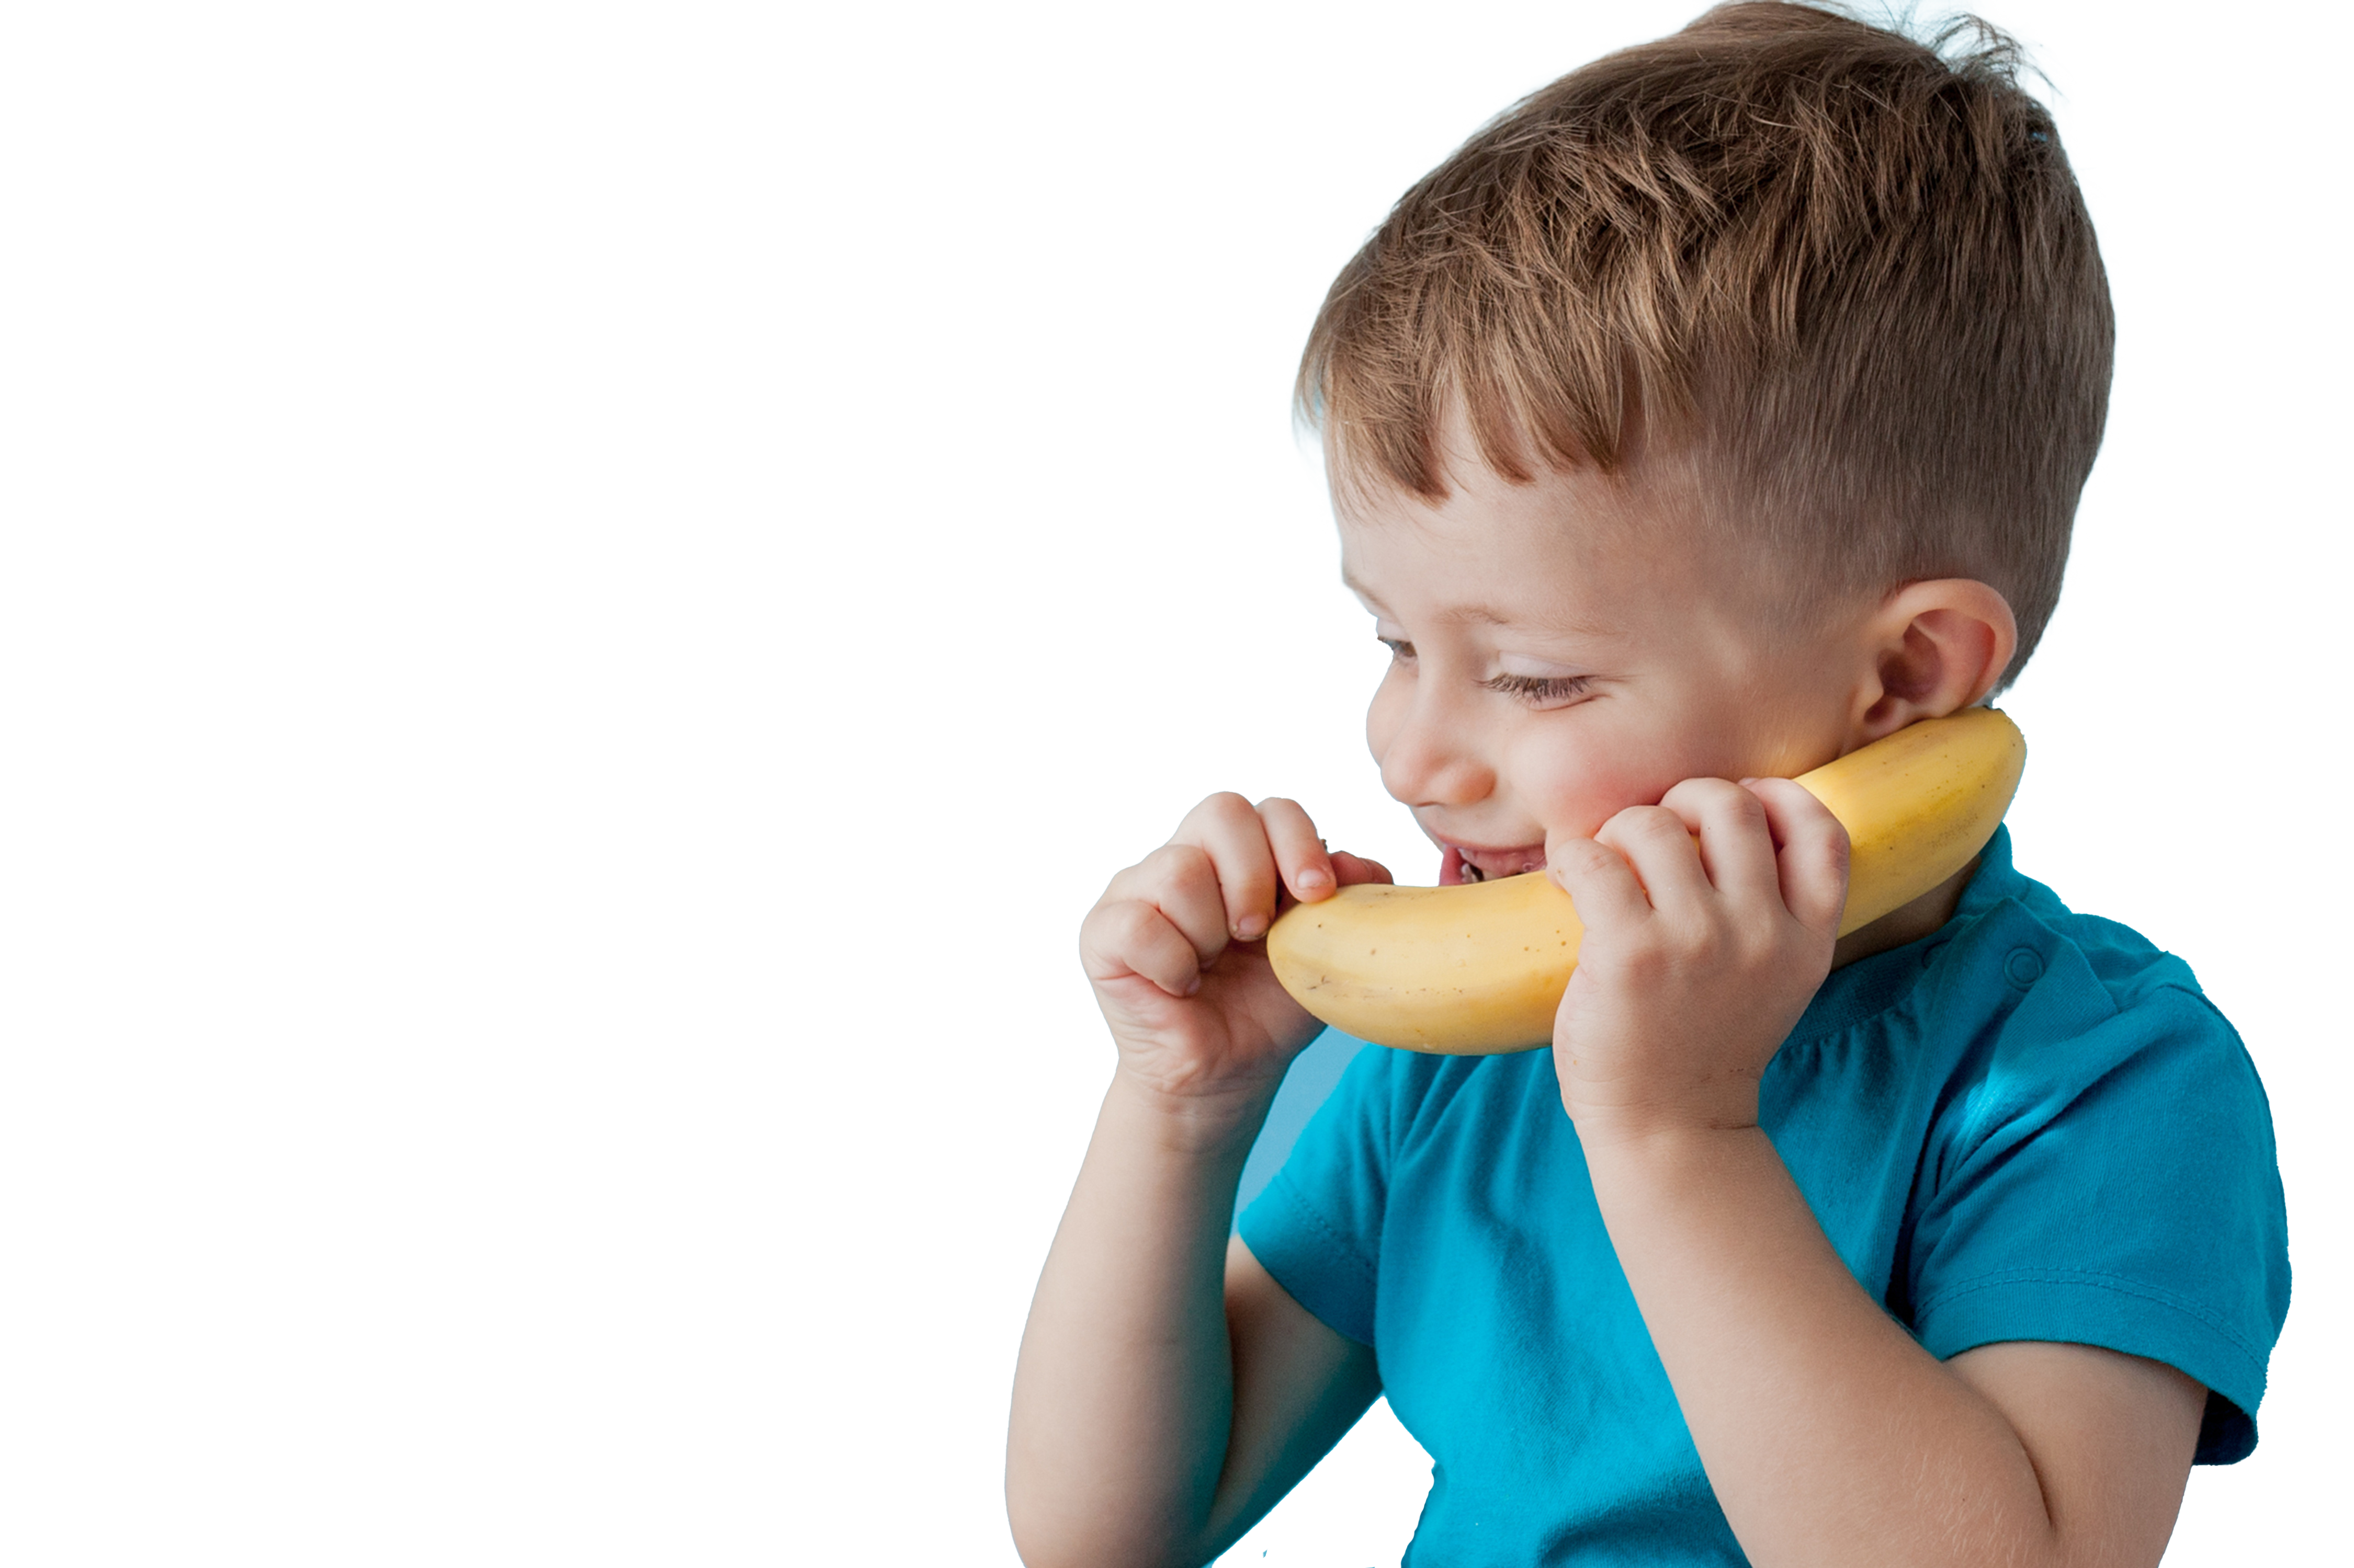
Tips for challenging phone calls
  It’s not you
  Empathy is powerful
  Be trauma informed
  Take care of yourself after the call
Notes:
It’s not you
Hard to remember in the moment, but the person on the phone is not mad at you personally. It could be many things such as
Frustration with children in the room
Frustration that they forgot about the call
Lack of sleep
Frustration with another area of life. One never knows what has been happening right before your call.
Empathy is powerful
Use reflective listening to demonstrate you are listening:
“That sounds hard.”
“I can understand how this is upsetting.”
The classic Empathy video helps frame a discussion of how to respond:
https://youtu.be/1Evwgu369Jw?si=qc78XIQSq1YLwkU7
Be Trauma informed
A key element of being trauma informed is this question: what happened TO you?
Life is hard. Challenging behaviors are often the result of a traumatic or stressful moment in a person’s life. Using the participant-centered skills you have learned is a way of using trauma informed practices.
Sometimes the best thing you can do is listen.
Take a break to take care of you
When the appointment is over, take a break.
Self-care is very important to being able to be participant centered!

Slide 33
It’s your turn!
You are on the phone with a WIC Dad
He is upset that he is not able to buy whole milk for his 4-year-old, who refuses other types of milk
Notes:
Activity
Discussion prompts
What are some ways you can manage this situation?
With each idea, as these questions:
Does the solution focus on the participant?
Does the solution use one of the OARS skills?
If not, how can it be reframed to fit the spirit of PCS?
Option1: Discuss this as a group. What are some techniques learned from OARS to help with this? How can we frame our concern so it is focused on the participant?
Option 2: Break into groups and talk about it. Asking the groups to discuss focus questions about this scenario and report back out.
Option 3: If staff are doing this in-service independently, start a chat thread or bring it up as a discussion at the next staff meeting.

Slide 34
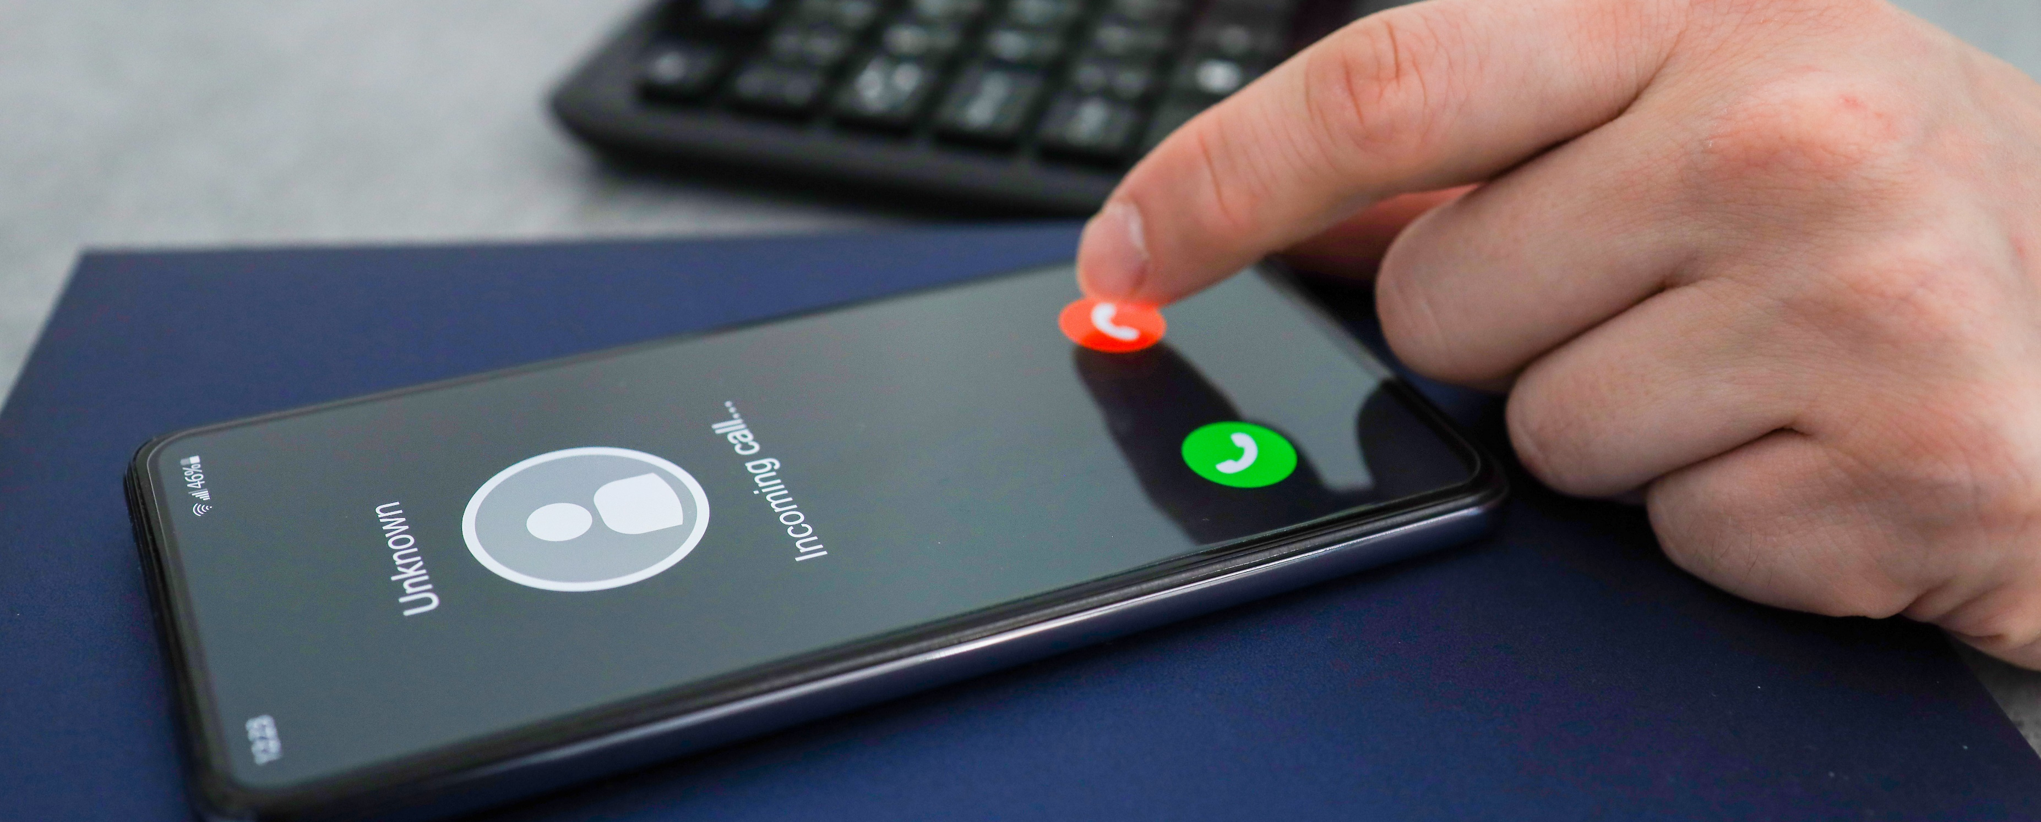
Ending, or closing, the session (call)
Notes:
Resource:
Oregon WIC Listens Skill Card: Ending the session: https://www.oregon.gov/oha/PH/HEALTHYPEOPLEFAMILIES/WIC/Documents/orwl/pcg-skills-closing.pdf
Optional: Run through the points on the skill card linked above as a refresher.

Slide 35
What are some tricks you use to end a call that is going long?
On the phone
By text or email
Notes:
Option 1: Talk about it. Maybe write down ideas on a white board
Option 2: have people post their ideas using a post-it note on the board. Review and categorize.
Option3: Break into pairs. One is participant, one is WIC staff. Practice the ending a phone call using the PCS skill card “Closing the Session”
Online options
Use breakout rooms for a smaller discussion
Use whiteboard or collaborative online space to gather information.

Slide 36
Trauma Informed Care for participants
What you experience
The participant wants to talk about everything but proofs!
What they are experiencing
You are the first person they’ve talked or texted with in DAYS who will listen to them talk about their baby!
What you can do
Listen for understanding
Let them talk until they are ready to pause
Provide an affirming summary as a bridge
Remind them about the agenda – but do it kindly
Ask to reschedule
In most situations, listening is the best thing you can do.
It is a welcome gift.
Notes:
This slide has animation.
The four content areas will automatically appear .
It is always important to keep trauma informed care at the forefront of everything we do.​
Trauma-informed care shifts the focus from “What’s wrong with you?” to “What happened to you?”​
What are some things that may be a symptom of more that you have heard about today?
Some ideas:
The chatty participant may have just delivered a baby without a lot of support and is feeling overwhelmed and lonely.
The angry dad may be frustrated that his child will not eat anything, and milk is the only thing that he consumes. ​
Practicing trauma informed care and having empathy for our participants goes a long way
Consider sharing the Brene’ Brown Empathy video. https://youtu.be/1Evwgu369Jw?si=ziqywWtwZJ9tp99k

Slide 37
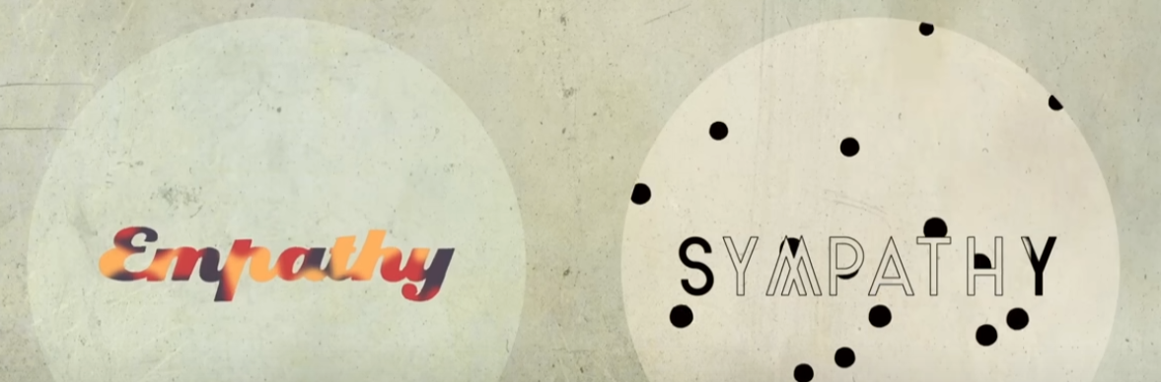
A little empathy goes a long way..
Tips on empathy from Brene’ Brown
(https://youtu.be/1Evwgu369Jw?si=j0cXYLns__0FRMjT )
Notes:
This slide is hidden. To use it in this slide show, right click the slide number in the slide list and select “unhide slide”
Resource
Viewing this video is optional. If you do not wish to use the video, either deleted it from the slide deck or “hide” the slide.

Slide 38

Ending the call
Being participant centered means not offering what you cannot provide.
In this case, it’s more time!
Offering to answer questions at another time leaves the door open and allows you to get to the next participant.
Include a time limit when setting the
agenda
Share a specific time the call needs to end
Watch how you word phrases:
  Please feel free to reach out with questions!
  Rather than, “do you have any other questions?”
Notes:
For many participants, coming to the WIC office may be their only chance for social interaction. When you are in person, there are physical things you can do to naturally close the appointment such as gathering up handouts, standing up from your desk or walking the participant out of the clinic room. When conducting appointments over the phone, you do not have those physical cues. Here are some tips to respectfully end a conversation with a chatty participant.

Slide 39

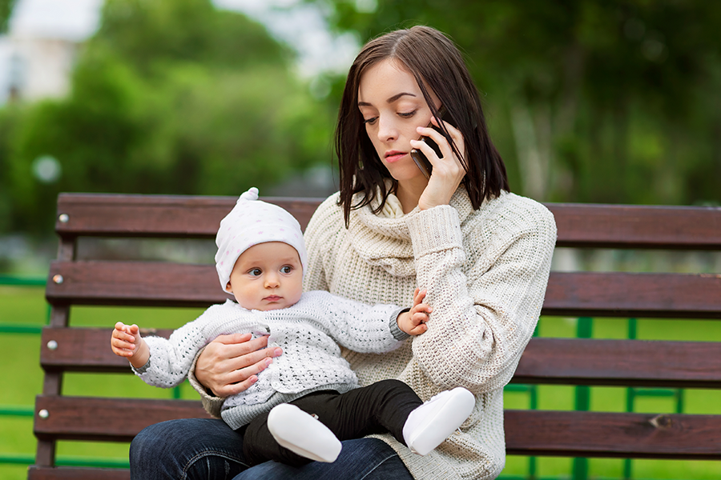
Ending the appointment when the participant has more to say
And when I give him lemon slices, it’s so funny! She makes this face after she takes a bite…and….and…and…………..
It’s fun to hear all that’s going on with [child’s name] and how you are putting what you learn into place. Unfortunately, I do have to move on to another call. I look forward to our next appointment on [insert date]
Notes:
Talk about ways to make these hard transitions as a group.

Slide 40
It’s your turn!
You are on a call with a proud grandma. You have completed the assessment, issued benefits, and discussed next steps.
She has more to say! Not much of it is related to WIC.
She wants to tell you about her other grandchildren and their eating habits too!
Notes:
Activity
Focus questions:
What are some ways you can manage this situation?
With each idea, as these questions:
Does the solution focus on the participant?
Does the solution use one of the OARS skills?
If not, how can it be reframed to fit the spirit of PCS?
Option1:
Discuss this as a group. What are some techniques learned from OARS to help with this? How can we frame our concern so it is focused on the participant?
Option 2:
Break into groups and talk about it. Asking the groups to discuss focus questions about this scenario and report back out.
Option 3:
If staff are doing this in-service independently, start a chat thread or bring it up as a discussion at the next staff meeting.

Slide 41

Taking care of You
It’s a balancing act
Make time for breaks or meals.
  Try not to skip
Make room for a walk around the block
or a “water cooler” break
More ideas in the Compassion Fatigue Toolkit
(March 2022 In-services page)
Notes:
Remote appts take a different kind of energy​
Build in time for compassion fatigue/self care​
Breaks – do not neglect breaks. It’s easy to go back –to-back with appts when done remotely. Make room for a walk around the block or to go to the break area and talk.​
That recharge buffer is just as important when appts are done remotely
More information on ways to support yourself and your WIC Colleagues can be found in the March 2022 Compassion Fatigue Inservice on the WIC staff resources website.
https://www.oregon.gov/oha/PH/HEALTHYPEOPLEFAMILIES/WIC/Pages/InServices.aspx

Slide 42


