Slide 1


2024 Oregon WIC Breastfeeding Inservice
Supporting breastfeeding families in the 4th trimester when issuing formula

Slide 2

Today’s Topics
New food package rule: 0-3 month
Concept of the 4th Trimester
Breastfeeding Assessment
Supplemental formula issuance
Yielding and referrals
Documentation
Prepared by:
Lauren Simmons, RDN
Korina Skaff, BA, IBCLC
Notes:
Put in packaging that it will likely take more than an hour to complete.***

Slide 3
Goals for the Training
Introduce the concept of the 4th trimester
Inform WIC staff about the new food package rule for 0-1 month
Strengthen counseling skills when breastfeeding families ask for formula
Ensure a breastfeeding assessment is completed before issuing formula to a breastfeeding family
Appropriate yielding, referrals, and follow-ups are offered
Breastfeeding plans are documented
Notes:
Add objectives to the Planning Document.
What do we want them to know from this in-service?
The food package rule for 0-1-mo has changed and now can receive the Mostly BF infant and Mostly BF participant.
Breastfeeding assessments must be done when a breastfeeding family asks for formula.
The food package is tailored to provide the least amount of formula the family needs.
Documentation of the breastfeeding assessment and plan is documented.
Follow-up plan is made.
Yielding or referral is offered when appropriate.

Slide 4
Objectives for the training
Describe food package changes for the Infants 0-3 months
Demonstrate food package tailoring when breastfeeding families request formula
Use participant centered education skills when a breastfeeding family requests formula
List required documentation elements
Describe when to yield and offer a follow-up appointment

Slide 5


Infant 0-3 month Food Package
Notes:
Before we begin discussing the breastfeeding assessment process, we need to introduce you to the new food package for infants 0-3 months. This is the mechanism that allows families to get formula in the first month if needed.
In this section we’ll describe how this new food package works and what to consider when talking with a family – which you will do as part of the breastfeeding assessment.

Slide 6

Food Package Changes for Infants 0-1-month
We are now able to provide the “mostly” and “some” breastfeeding food packages in the infant’s first month
Notes:
In Oregon, we have not issued formula to a breastfed infant during the birth month.
The Infant 1-3 month food package has been re-defined to accommodate the 0-1 month formula addition for the IB (mostly and some).
The food package amounts remain the same for this category. The only change is the name. It is now called the 0-3 month food package.
Tailoring the food package is based on the assessment needs of the baby to meet, but not exceed, the infant's nutritional needs.
As always, the infant and breastfeeding participant must be assigned the same food package category.
The breastfeeding assessment will drive which food package to assign.
As a part of the breastfeeding assessment, it is essential to make sure the breastfeeding participant understands the impact on her food package.
For example, If the infant in the birth month falls into the “mostly breastfeeding" category, the breastfeeding participant will receive the same amounts of foods in their food package as they did when pregnant.
However, if the assessment leads to the “some breastfeeding” category in the birth month, the breastfeeding participant will receive fewer foods.
Less juice
No whole grains
Less milk (6 quarts)
Beans OR Peanut Butter rather than Beans AND peanut butter.

Slide 7
0-3 Month Food Packages
0-3-Month Formula Supplementation Chart Bid formula 90 oz of reconstituted powder
0-3 oz. per day |  | 1 can powder per month
4-6 oz. per day |  | 2 cans powder per month
7-9 oz. per day |  | 3 cans powder per month
10-12 oz. per pay |  | 4 cans of powder per month
13-15 oz. per day |  | 5 cans of powder per month
16-18 oz. per day |  | 6 cans of powder per month
19-21 oz. per day |  | 7 cans of powder per month
22-24 oz. per day |  | 8 cans of powder per month
25-27 oz. Per day |  | 9 cans of powder per month
Mostly Breastfeeding
Some Breastfeeding
Non Breastfeeding
(1-4 cans)
(5-8 cans)
(9 cans)
Notes:
Here is the specific information about the infant 0-3 month food packages.
The amount of formula available in the Infant 0-3 month Mostly, Some, and Non Breastfeeding food packages has not changed. The change is the age range for which the food package can be issued.
The information on this slide comes from Policy 713, Use of Supplemental Formula, Appendix A.
One can of Similac Advance powder yields 90 ounces of reconstituted infant formula and Gerber Good Start Soy powder yields 91 ounces.
Ask staff:
How many cans of powdered bid formula does a mostly food package contain for the 0-1 month food package?
And how many cans of powder does the some food package contain for the 0-1 month food package?
You will see in TWIST that the formula amounts for the BF Mostly and BF Some food packages are the same for the 0-1-month infant food packages as they are for the 1-3-month infant food packages.

Slide 8
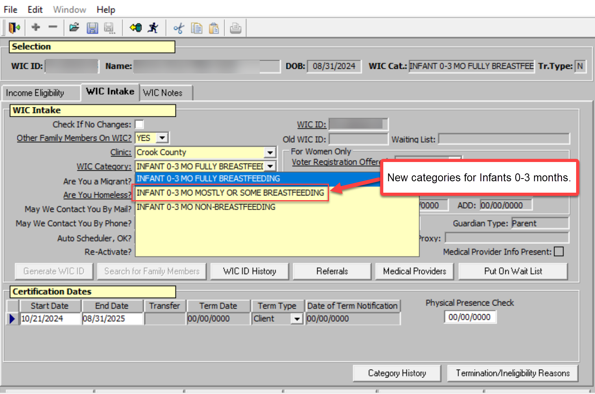
New Infant 0-3 month options in TWIST
Notes:
Here’s what it looks like in TWIST.
Just as before, the Infant’s food package must match the Mom’s food package.
Infant 0-3 mo fully breastfeeding = Woman fully breastfeeding
Infant 0-3 month Mostly or Some Breast feeding must be either the Woman some breastfeeding category OR Woman mostly breastfeeding category
Infant 0-3 month non-breastfeeding = Woman non breastfeeding

Slide 9
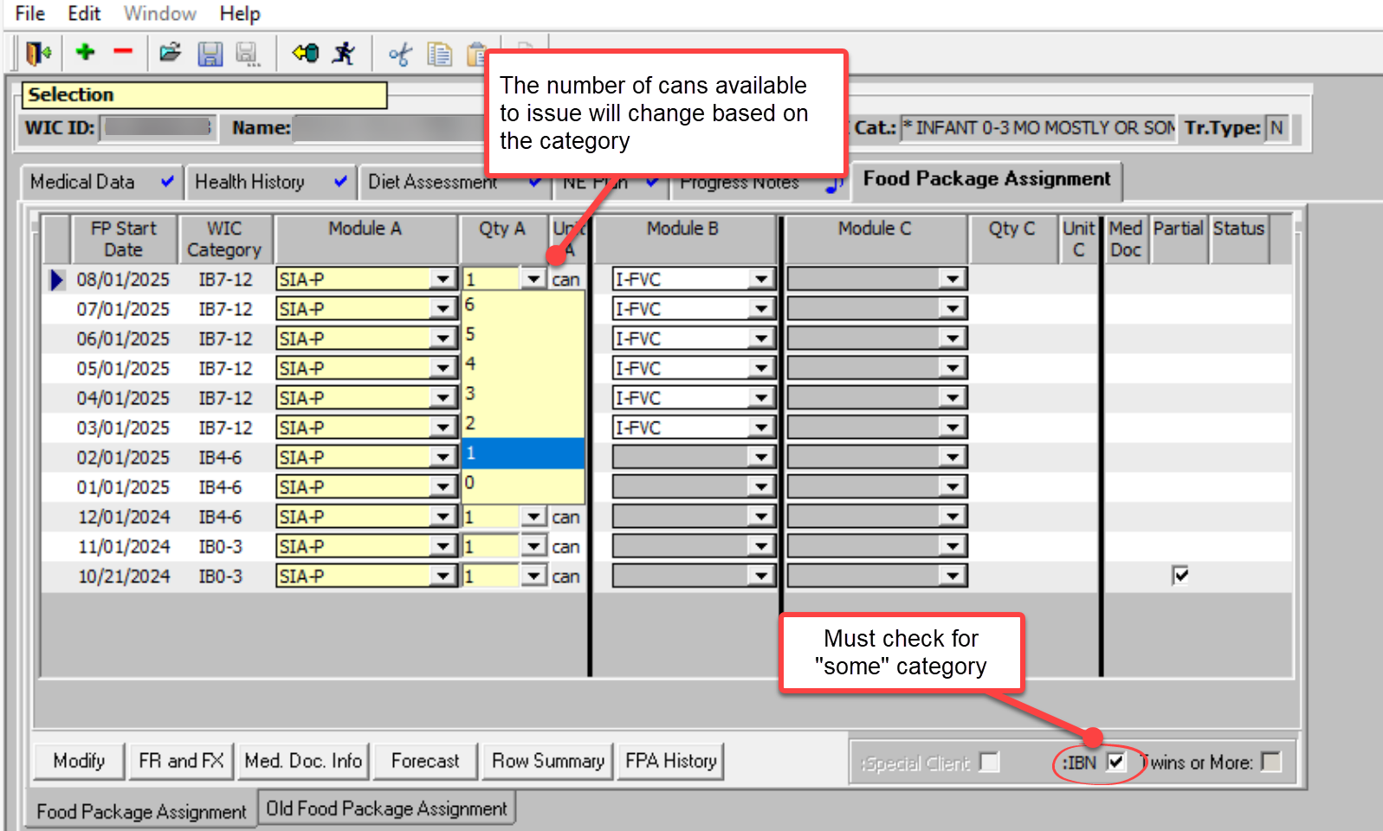
Issuing food package follows same process – inclusive of the birth month
Notes:
TWIST will need the IBN box checked to issue the infant some breastfeeding package – just like it does today for Infant 1-3 months.

Slide 10

The breastfeeding assessment
drives the food package choice
Notes:
Agencies are asked to complete the Breastfeeding in-service prior to assigning the “Mostly” or “Some” Breastfeeding Infant 0-3 month package to a participant.
This food package category is available with the November 18, 2024 TWIST release. Agencies may wait to begin use of the new food package category until December, 1, 2024.
What does FNS expect WIC staff do when formula is issued to a breastfeeding family?
A breastfeeding assessment is completed
The minimum amount of formula is issued to best support breastfeeding and meet the infants nutritional needs
Follow-up appointments are offered when appropriate to assist the family with breastfeeding, lactation, or formula issuance.
Document the assessment in TWIST.
You will get a chance to try it out later in the in-service.
Let’s move on to the assessment.

Slide 11

Breastfeeding Assessment
Notes:
Facilitator Prompt: Read slide

Slide 12

The 4th Trimester
This is a critical time for breastfeeding support
Lasts until day 42
Notes:
*This slide has animation*
Facilitator Notes:
This is when milk production gets established, and bonding takes place.
The World Health Organization's (WHO's) definition of the 4th trimester is the early postpartum period immediately after birth through 6 weeks (the first 42 days after birth. )
All babies are born early, so they can fit through the birth canal. Humans are one of the neediest of species. We are meant to be together 24:7. Human milk is relatively low in fat, so babies need to eat often, so we are often found bound to our parents. We are classified as a catch and carry species.
Mom and baby are often referred to as a dyad, not to be split.
Brandi Gates-Burgess, a guest speaker at the GOLD Lactation Online Conference in 2023, suggests the BF dyad aim for about 20 hours of Skin To Skin contact per day during the 4th trimester. This allows baby access to breast to get the 10-12 feedings they need during the first few weeks to establish a robust milk supply.
*There is so much change happening during the 4th trimester that it makes it a critical time for the breastfeeding dyad and shines the light on their need to be supported.
Whenever formula is issued to a breastfeeding dyad, FNS requires a breastfeeding assessment takes place to support them.
Reference
Policy 713, Breastfeeding: Use of Supplemental Formula

Slide 13

Best practices for Breastfeeding Assessment and Documentation
Notes:
Facilitator Notes:
During the management evaluation, FNS did not see documentation that a breastfeeding assessment is done when breastfeeding participants request formula or when a participant changes from non-breastfeeding/partially (Some BF) package to the partially (mostly) breastfeeding package or to the Fully BF food package.
It is important to document when a breastfeeding assessment is completed, any referrals that are recommended, yielding that takes place, the breastfeeding plan and any future follow-ups. The breastfeeding assessment is also important as it ensures we are providing the least amount of formula needed to support the infant's nutritional needs and to support the parent's breastfeeding goals.
Resource: A note from FNS:
If a breastfed infant is assessed to need more than 104 reconstituted ounces prior to reaching one month of age, it would be appropriate to issue the participant a fully formula-feeding/partially (sometimes) breastfeeding food package tailored up to, but not exceeding the maximum amount, and to recommend a follow up appointment to assess how breastfeeding is going.
It would also be expected that a breastfeeding assessment take place prior to a change in the infant’s assigned food package from the fully formula-feeding/partially (sometimes) package to the partially (mostly) breastfeeding package or to the fully breastfeeding package.
Appropriate support and counseling should also be provided to minimize the number of breastfeeding infants receiving the fully formula-feeding/partially (sometimes) breastfeeding package.

Slide 14
What is a Breastfeeding Assessment?
Use OARS skills to conduct an effective conversation with the participant
Build rapport so the participant feels comfortable engaging in the conversation
Collect relevant information, including a breastfeeding history and data
Identify signs of adequate milk transfer, position and latch, and infant growth trends
Understand the participant’s goals and experiences with breastfeeding
Understand the participant’s social supports
Provide appropriate follow-up and referrals for health and social support.
Notes:
Facilitator Notes:
Breastfeeding Assessment: Collects information related to breastfeeding to determine how breastfeeding is progressing.
Here is a brief look at what a breastfeeding assessment includes:
Assessment of the participant's milk production, baby's intake, and supplementation practices.
Hear what recommendations the infant's healthcare provide has.
The participant's understanding and agreement of breastfeeding plan and amount of formula issued while the breastfeeding concerns/challenges are addressed.
How do we do this? Use our Participant Centered Education (PCE) skills.
Open Ended Questions
Active Listening
Reflections
Summaries
Build rapport: A good reminder that people need to connect before they feel safe to receive information or support.
Breastfeeding history and data: How the participant feels breastfeeding is going and what has happened during their pregnancy and breastfeeding journey that could affect breastfeeding, e.g., pregnancy health issues, preterm delivery, using a nipple shield, infant's birth weight, etc.
Identify signs of adequate milk transfer, position and latch, and infant growth trends: E.g., How long does the infant stay satiated between feeds? What does it feel like when baby feeds? What sounds do you hear when baby feeds? How do you like to hold baby when baby feeds? What was the lowest weight that baby has weighed, when was that?
Understand the participant's goals and experiences with breastfeeding: Showing interest in hearing the participants goals can be done by asking them open ended questions: Showing interest in how their birth went is sometimes a good place to start and you can receive a lot of information to understand what is happening with breastfeeding.
If their breastfeeding experience isn't going as planned, sometimes asking a question like this is helpful in understanding what type of help they might be open to receiving. "In a perfect world, what would feeding baby look like?" "I’m interested in hearing more about what got you interested in breastfeeding your baby. What are some reasons you breastfeed? (We are trying to figure out if they want to breastfeed for the relationship (bonding) or for health factors. This can help us find out how to best support them with their goals.)
Understand the participant's social supports: Who has been your biggest support person with supporting you with your infant feeding goals? Tailoring the breastfeeding plan to match the support and the desire the person has to work through their breastfeeding struggles.
Referrals/follow-up: Depending on the assessment findings, the participant may need to be referred to staff with additional lactation and breast/chestfeeding expertise. Schedule a follow up appointment soon after the breastfeeding assessment to reassess breastfeeding and to determine if the breastfeeding plan needs to change or if there a food package changes needing to be made. The participant may be able to return to full breastfeeding.
Handout Suggestion: Handout 5-2 Touchpoints for Breastfeeding Assessment

Slide 15

When parents request formula, we are required to provide a breastfeeding assessment before issuing formula
Notes:
*This slide has a discussion prompt*
Facilitator Notes:
This can be an uncomfortable encounter for both the participant and for the WIC certifier.
*ASK - What has been your experience with these conversations?
Thank you for sharing.
We can still support parents' infant feeding goals while meeting the requirement to provide a breastfeeding assessment.
Today, we will be reviewing counseling tips to help you feel more confident when supporting breastfeeding parents who request formula

Slide 16

Over 90% of Oregon WIC parents start out breastfeeding. This tells us most parents want to breastfeed.
It isn’t always easy.
Notes:
Facilitator Notes:
Unfortunately, our society does not make it easy for parents to breastfeed. When a parent decides to supplement or switch to formula feeding, it may have less to do with choice and more to do with the countless barriers and challenges parents face.
Fortunately, WIC provides prenatal education which helps build the participant’s knowledge and confidence to breastfeed, and in turn can improve breastfeeding outcomes.
Handout option: Handout 5-1 Social Support Assessment Questions

Slide 17

Our role as WIC staff
Notes:
*This slide has a discussion prompt*
*ASK staff- What is your perception of our role as WIC staff?
Examples of our role as WIC staff.
Our job is not to change the parents mind or talk them out of introducing formula.
Our role is to provide accurate information and anticipatory guidance in a non-judgmental way.
Reference: PCS setting the stage
Handout suggestion:
Handout 6-2 Common Infant Issues Summary
Handout 8 Scope of practice for DBE

Slide 18

Ask Permission
“Is it ok if I ask you some questions to better understand how I can help you with your infant feeding goals?”
Notes:
Facilitator Notes:
Before jumping into an assessment, ask permission from the participant to proceed with the conversation.
Disclosure and permission are key to Trauma Informed Care.
Participants may view care providers with distrust (as gatekeepers with personal agendas).
As WIC staff, we want to ensure that participants feel like they are being heard and not being pushed in a certain direction or that their needs are being ignored.

Slide 19

Counseling by the CPA includes the following steps:
Ask open ended questions
Assess the parent’s understanding of the potential impacts on breastfeeding and potential health changes
Notes:
Facilitator Notes:
Ask open ended questions
Explore how breastfeeding is going and learn what the parent’s desires and intentions are for continued breastfeeding.
Assess understanding and potential impacts
Explore the impact of supplemental formula on milk production, the parent’s own health and the health of their infant.
Ask: What are some examples of effects on
Milk production?
Stooling?
Breastfeeding parent’s health?

Slide 20

Steps for providing empathy and support to breastfeeding parents
Step 1
USE OPEN ENDED QUESTIONS
Notes:
Facilitator prompt: Read slide

Slide 21

What are the participant’s goals?
Notes:
*This slide has a discussion prompt*
Facilitator Notes:
First, we need to find out what the participants goals are for breastfeeding.
Do they want to continue breastfeeding or stop all together?
*ASK staff- What are some open-ended questions you could ask the participant about their goals?
Examples of open-ended questions:
What are your goals for breastfeeding?
What were some of the reasons you started breastfeeding?
What led up to your decision to introduce formula?
What help or support have you already received?

Slide 22

Open Ended Questions
Use open-ended questions to learn about participant infant feeding experience and breastfeeding goals
Notes:
*This slide has a discussion prompt*
Facilitator Note:
*ASK staff: Once we know what the participants goals are, what are some open-ended questions you could ask?
Examples of open-ended questions:
What do you know about milk supply and supplementation?
Can you tell me about your current feeding routine?
Can you tell me more about your work schedule?
What do you know about infant feeding cues?
Can you tell me about your feeding routine?
What do you know about the changes your infant may experience when you introduce formula? Or
What changes have you noticed since introducing formula?

Slide 23

Step 2
PROVIDE AFFIRMATIONS, EMPATHY, and SUPPORT
Notes:
*This slide has a discussion prompt*
Facilitator Note:
It is important to affirm the parent in their abilities before jumping in and trying to solve the problem.
*ASK staff- What are some examples of affirmations you could give a parent?
Samples of affirmations:
“You are an amazing parent, and I can tell how much you love your baby.”
“You know what is best for you baby.”
“I am here to support you no matter what.”
Agree with the parent…
”I see what you mean.”
Show them they are not alone…
”I hear that from other parents.”
Shine the spotlight…
”I think you are doing a great job.”
Assure them they are good parents…
”You want the best for your baby.”
Parents are not ready for information until they feel they’ve been heard.
Sometimes our views as public health employees do not match those of the participant and that is okay.
We can provide empathy and support regardless of their choices.
Resource: 3 minute video https://brenebrown.com/videos/rsa-short-empathy/
Breastfeeding Training Level 3 Handout, Advanced Counseling, Sample Affirmations

Slide 24

Step 3
PROVIDE REFLECTIONS
Notes:
*This slide has a discussion prompt*
Facilitator Notes:
A reflection is listening to what the participant is saying, forming an understanding of what they are talking about and then giving voice to that understanding.
*ASK staff- What are some examples of reflections?
Examples of reflections:
“You feel like you don’t have enough milk”
“Breastfeeding as been really challenging and you don’t have a lot of support”
“You feel like introducing formula is going to be a better fit for your family”

Slide 25

Offer education based on the participants concerns or stated needs
Step 4
OFFER EDUCATION
Notes:
Facilitator Notes:
You’re worried about breastfeeding when you go back to work.
I can help you with a pumping plan if you would like.
You’re concerned that baby never seems satisfied after a feeding.
I have some information about infant feeding if you are interested.

Slide 26

Offer education based on the assessment
Can I share some information with you about paced bottle feeding?
Can I share some information with you about formula preparation, handling and storage?
Can I share some information with you about infant feeding cues?
Notes:
Read bullets on slide

Slide 27
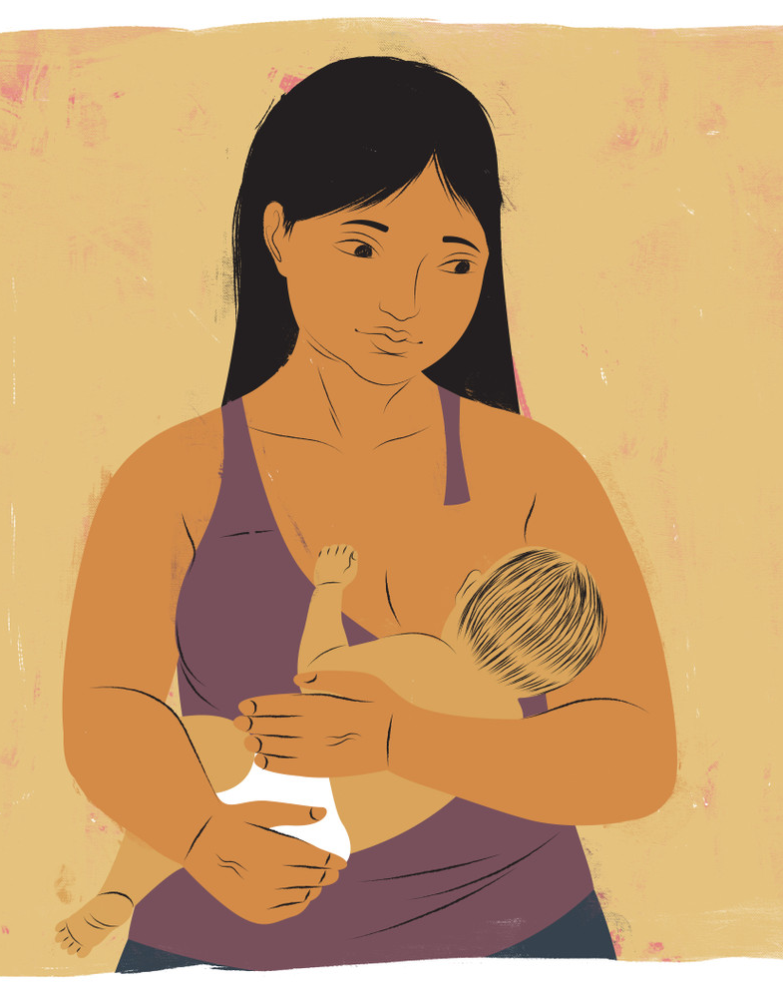
Step 5
DETERMINE NEXT STEPS
Determine a plan together to address concerns or barriers.
Schedule a follow-up contact if issuing formula.
Notes:
*This slide has a discussion prompt*
Facilitator Notes:
Schedule or plan for follow-up to re-assess breastfeeding and supplementation as needed.
*ASK staff - Who do we yield or refer to when circumstances arise that are outside the scope of practice of the CPA?
Importance of yielding:
By yielding, you ensure the parent and baby have access to the best care possible to overcome a challenging situation.
When you yield, you work alongside of the health professional, supporting the parent with breastfeeding.
It is recommended that a WIC DBE tailor the food package when available. However, the CPAs scope of practice also allows them to tailor it. Let's practice tailoring food packages for the breastfed infant.
Resources:
Staff Roles DBE Level 4 Handout Referral Partners and Scope of Practice of the CPA.
To learn more about the WIC DBE role, please contact the Oregon WIC Breastfeeding Coordinator.

Slide 28
Practice tailoring food package
Johny is 3 weeks old.
He is breastfeeding and takes 6oz of powdered bid formula every day.
There are 14 days left in the current month.
What WIC category do you assign Johny and his mother?
How many cans do you issue Johny this month?
How many cans of formula do you issue next month?
Click for Infant
(0-3 month) Food package details
Notes:
This slide includes links to details about the food package and charts that will help with the case study. Click the circle in the middle of the slide.
The purpose for this scenario is to practice calculating how much formula to issue the participant.
*This slide has discussion prompts*
Read the scenario on the left.
*ASK staff the questions on the slide
Responses to questions on slide
Mostly Breastfed
1 can: 14 days x 6oz = 84 oz. 84 oz is less than one can of formula (90oz), so you would issue the least amount of formula that Johny would need.
2 cans: Forecasting future months. 6oz per day x 30 days = 180oz/90oz = 2 cans

Slide 29
More practice tailoring food packages
Situation
Dorsey is a 2-week-old infant.
His mother wants to exclusively feed him her pumped milk until her milk dries-up.
She thinks she will wean him
completely when he is 3-months-old.
He is drinking about 13oz of formula each day.
There are 21 days left in the month.
Questions to consider
What WIC category do you assign Dorsey and his mother?
How many cans of formula do you issue Dorsey for the current month?
How many cans of formula do you issue for subsequent months?
Click for Infant
(0-3 month) Food package details
Notes:
This slide includes links to details about the food package and charts that will help with the case study. Click the circle in the middle of the slide.
*This slide has discussion prompts*
The purpose of this scenario is to calculate how much formula to issue the participant. This scenario can also create conversation about creating a follow-up, a potential for making a referral/yielding to the WIC DBE or to a staff person with knowledge about weaning. It also can lead into a conversation about explaining that issuing infant formula affects the quantities and types of foods they and their infant receive and potentially how long the parent will receive WIC benefits.
*Read the scenario on the slide and ASK staff the questions on the slide
Questions and the responses to the questions on the slide:
What category do you assign the dyad?
Some breastfeeding
How many cans do you issue in the current month?
3 cans: 13oz x 21 days = 273/90oz
How many cans do you issue for future months?
5 cans: 13oz x 30 days = 390/90oz
Additional talking points:
It is in regulations that WIC issues the least amount of formula the participant is using to support and protect breastfeeding.
We would expect to see a follow-up in a couple of weeks to see if the food package needs to be adjusted to meet the infant's needs and to check to see how weaning is going.
Offering a follow-up with the WIC DBE can assist the participant with a successful weaning experience.
It is important to explain to the family that issuing infant formula affects the quantities and types of foods they and their infant receive and potentially how long the parent will receive WIC benefits.

Slide 30

Step 6
SUMMARIZE THE CONTACT
Remind the parent what was discussed and when the next planned contact will be.
Adjust the food package if needed and document justification for the amount of formula being issued.
Provide encouragement and share your confidence in them.
Notes:
Facilitator Prompt: Read information on slide

Slide 31

Documentation
Key components of chart notes
  Participants goals
  Education offered and/or given
  Referrals offered and/or given
  What follow up is needed
  Justification for amount of formula issued
Notes:
Facilitator Notes:
Documentation serves as a record of what has been done.
Remember to include information about what kind of education was given, their concerns, what worked and what did not, and any next steps for support.
If you yield or refer the participant to a WIC DBE or other WIC staff or community partner, document that as well.
Documentation informs the WIC team about the participant's needs and how they can reinforce and follow up on the support you provided.

Slide 32

Support the parent in their infant feeding decisions
Notes:
Facilitator Notes:
The parent will remember more about how they felt during the appointment than what was said during it.
When they feel heard and supported about their infant feeding decisions, they will be more likely to come back the next time they need help.
Remember, the parent is the expert on their infant, and they know what is best for their family.
Walk next to the parent rather than pulling them along with you.

Slide 33

Factors that can affect your ability to listen
1. Positions, points of view, and perspectives
2. Listening from stance as an “expert already on
the subject”
3. Listening for solutions and not hearing what
they are saying
4. Listening with judgment
5. Individual experience, perceptions, beliefs, values
6. Intensity of emotions
Notes:
*This slide has discussion prompts*
*ASK staff- What are some factors and biases that you have that could affect your ability to listen?
Share some experiences.

Slide 34

Meet the parent where they are
Your job is to listen, inform, and support them, so they can reach their infant feeding goals, whatever those might be
Notes:
This slide has animations.
The explanatory paragraph will show on a click
Facilitator Notes:
Remember this is their experience.
They may choose a different path than you would choose, and that is all right.

Slide 35

Prenatal support is important to breastfeeding success
Notes:
*This slide has a discussion prompt*
Facilitator Notes:
Providing our participants with information about breastfeeding throughout the entire pregnancy will increase their chances of breastfeeding success.
*ASK staff -
What are we already doing to support breastfeeding prenatally?
How can we improve?
Who in our community can we connect participants with?
What other resources are available in our agency and community to support breastfeeding parents?
Ideas on how to support participants prenatally:
Help them set up a breastfeeding plan for after they deliver. Encourage them to write it down so a partner can also help advocate for them.
Encourage them to sign up for breastfeeding classes within our agency or community.
Handout suggestion:
Handout 5-1-Breastfeeding Assessment: Prenatal. Handout: Knowledge Assessment Questions

Slide 36

Confidence is Key!
Confident and committed breastfeeding mothers are the most successful!
Notes:
*This slide has discussion prompts*
Facilitator Notes:
A study in 2009 found that mothers, who they labeled as “confident commitment,” were usually successful at breastfeeding.
These mothers believed in their ability to breastfeed no matter what the obstacles were regardless of social support or common challenges such as sore nipples or newborns having difficulty latching on.
*ASK staff- How can we increase our participants confidence and self efficacy?

Slide 37

Case Study
Charlotte gave birth to her baby, Ellie, and was recertified as fully breastfeeding. Two weeks later, Charlotte calls the clinic to request formula. You learn that she is feeling overwhelmed by breastfeeding and is exhausted from the nighttime feedings. She is wondering if introducing some formula would help share some of the responsibility with her partner. She still wants her baby to get breastmilk but is concerned about her mental health.
Notes:
Facilitator prompt: Read slide

Slide 38

Discuss
What are some positive things that you notice?
How would you ask permission to
continue the conversation?
What kind of affirmations and reflections could you use?
What open ended questions could you ask?
What type of education would you
choose to provide?
What kind of follow up is needed?
What should be documented?
Notes:
*This slide has a discussion prompt*
*ASK staff the questions on the slide.
Facilitator Notes:
Positive: Charlotte has a desire to breastfeed and wants to give breastmilk to her baby
Ask Permission: May I ask you some questions, so I know the best way to help you?
Affirmations: Having a newborn can be exhausting! You are doing such a great job. I can really tell how much you love your baby.
Reflections: It sounds like breastfeeding has been overwhelming and you are hoping introducing formula will help share some of the workload with your partner. You are concerned about your mental health if you continue to exclusively breastfeed.
Open-ended questions: What made you want to breastfeed? What are your goals for breastfeeding? What does your feeding schedule look like?
Education: Education could include milk supply, paced bottle feeding, formula transition and tolerance.
Follow-up: Referral/yielding to IBCLC, RD or whoever has the most breastfeeding experience in your agency, community resources, follow up in a week to see how things are going.
Documentation: Document the interaction and justification for how much formula was provided.

Slide 39

Chart note practice
Any issues or concerns
Feeding goals
Education provided and/or offered
Use of supplemental formula including how much
Follow up plans
Food package changes
Notes:
Facilitator Notes:
Sample of a chart note:
Charlotte states that she has been breastfeeding for 2 weeks and she is feeling overwhelmed and exhausted. She states that she would like her partner to start taking over some of the nighttime feedings. She has a desire to continue breastfeeding but is worried about her mental health. Charlotte was open to education about milk supply and formula introduction. Offered to schedule an appointment with IBCLC for further assessment and a referral to a local counselor which she accepted. Issued two cans of formula and changed her and Ellie to mostly breastfeeding category as she thinks partner will take over 2 feedings per day. Scheduled an appointment to check in after IBCLC visit.

Slide 40

Case Study
Charlotte and baby Ellie were recertified as a fully breastfeeding dyad two weeks ago. Today she calls the clinic and is requesting formula. Charlotte tells you that she does not have a desire to continue breastfeeding and she has already introduced formula.
Notes:
Facilitator prompt: Read case study

Slide 41

Discuss
What are some positive things that you notice?
How would you ask permission to continue the conversation?
What kind of affirmations and reflections could
you use?
What open ended questions could you ask?
What kind of education would you choose to provide?
What kind of follow up is needed?
What should be documented?
Notes:
*This slide has a discussion prompt*
*ASK staff the questions on the slide.
Facilitator Notes:
Positive: Charlotte provided breastmilk for 2 weeks and knows what will work best for her family.
Ask Permission: May I ask you some questions, so I know the best way to help you?
Affirmations: Thank you for calling today. You know what is best for you baby and your family.
Reflections: It sounds like you have already introduced formula and would like to continue only formula feeding.
Open Ended Questions: Can you tell me about your current feeding routine? What changes have you noticed since introducing formula?
Education: Education could include formula preparation, paced bottle feeding, weaning and engorgement.
Follow Up: Follow up in a few weeks to check in about formula tolerance. Refer to the WIC DBE for tips about weaning and engorgement if applicable.
Documentation: Document the assessment and the rational for how much formula is provided.

Slide 42

Chart note practice
Notes:
Facilitator Notes:
Sample of a chart note:
Charlotte states breastfeeding did not get off to a good start and was painful. She has stopped breastfeeding. Ellie is taking 2-3oz of formula every 2 hours. Offered education about infant hunger and fullness cues and paced bottle feeding which she accepted. She states that she did not have issues weaning and does not feel engorgement in her breasts. She has been giving Ellie a formula that is not covered by WIC. Discussed options and selected a comparable WIC formula. Discussed a plan for transitioning formula and issued a non-breastfeeding food package. Made a note to check in by phone in 2 weeks to assess formula tolerance.

Slide 43
Resources
FNS/USDA WIC Works website; Policy and Guidance
https://wicworks.fns.usda.gov/sites/default/files/media/document/WIC-Breastfeeding-Policy-and-Guidance_1.pdf
Table for determining supplemental formula amounts for the partially breastfed infant, Policy 713, Appendix A
Staff Roles DBE Level 4 Handout Referral Partners and Scope of the CPA (Email attachment)
Oregon WIC Breastfeeding Coordinator contact information
Korina Skaff, BA, IBCLC
Korinaskaff2@oha.oregon.gov
971-212-4880

Slide 44
References
Policy 713 Use of Supplemental Formula
Policy 769 Assigning WIC Food Packages
WIC Breastfeeding Policy and Guidance
WIC Works Resource System RE: Food Package I: Infants
Supplemental issuance of formula, CFR Title 7, Subtitle B, Chapter II, Subchapter A, Part 246
Oregon WIC Breastfeeding Rates

Slide 45
Optional
Review the WIC Breastfeeding Check-In tool
Review the WIC Infant Formula Tailoring Calculator
Review Brene Brown video on Empathy, 3 minutes https://brenebrown.com/videos/rsa-short-empathy/

Slide 46


Infant: 0-3 Month
Food Package Categories | Monthly Maximum Allowances (MMA) of reconstituted powder
Fully Breastfeeding | N/A
Mostly Breastfeeding | 90 - 435 fl. oz.
Some Breastfeeding | 436- 776 fl. oz.
Non-Breastfeeding | 777-870 fl. oz.
Food Package Reference slide 2 of 3
Notes:
WIC infants (0-1 month) can now be assigned the following categories: Fully Breastfed, Partially Breastfed (Mostly BF), and Fully Formula Fed (Some BF and fully BF).
Fully Breastfed infants receive no formula from WIC.
Mostly BF food packages: Infants can receive up to 435 fl. oz. of reconstituted powder.
Some BF food package: infant receives more formula than the mostly breastfed infant and up to the equivalent of one can powder less than a non-breastfed infant (or less 3 cans concentrate or less 3 cans ready-to-feed.)
Resource: Policy 769, Appendix B is being updated with the new food package rule. WIC Monthly Standard Food Packages for Infants. (Reconstituted concentrate amounts can be found in Appendix B.)
Some Breastfed food package: 436 ounces up to 776 fl. Oz.
Fully Formula Fed infants receive: Up to 870 fl. oz. Of reconstituted powder.
Tailoring the food package is based on the assessment needs of the baby to meet, but not exceed, the infant's nutritional needs.

Slide 47
0-3 Month Food Packages
0-3-Month Formula Supplementation Chart Bid formula 90 oz of reconstituted powder
0-3 oz. per day |  | 1 can powder per month
4-6 oz. per day |  | 2 cans powder per month
7-9 oz. per day |  | 3 cans powder per month
10-12 oz. per pay |  | 4 cans of powder per month
13-15 oz. per day |  | 5 cans of powder per month
16-18 oz. per day |  | 6 cans of powder per month
19-21 oz. per day |  | 7 cans of powder per month
22-24 oz. per day |  | 8 cans of powder per month
25-27 oz. Per day |  | 9 cans of powder per month
Mostly Breastfeeding
Some Breastfeeding
Non Breastfeeding
(1-4 cans)
(5-8 cans)
(9 cans)
Back to Case Discussion
Notes:
The information on this slide comes from Policy 713, Use of Supplemental Formula, Appendix A.
One can of Similac Advance powder yields 90 ounces of reconstituted infant formula and Gerber Good Start Soy powder yields 91 ounces.
Ask staff:
How many cans of powdered bid formula does a mostly food package contain for the 0-1 month food package?
And how many cans of powder does the some food package contain for the 0-1 month food package?
You will see in TWIST that the formula amounts for the BF Mostly and BF Some food packages are the same for the 0-1-month infant food packages as they are for the 1-3-month infant food packages.

Slide 48

Infant: 0-3 Month
Food Package Categories | Monthly Maximum Allowances (MMA) of reconstituted powder
Fully Breastfeeding | N/A
Mostly Breastfeeding | 90 - 435 fl. oz.
Some Breastfeeding | 436 - 776 fl. oz.
Non-Breastfeeding | 777 - 870 fl. oz.
Notes:
WIC infants (0-1 month) can now be assigned the following categories: Fully Breastfed, Partially Breastfed (Mostly BF), and Fully Formula Fed (Some BF and fully BF).
Fully Breastfed infants receive no formula from WIC.
Mostly BF food packages: Infants can receive up to 435 fl. oz. of reconstituted powder.
Some BF food package: infant receives more formula than the mostly breastfed infant and up to the equivalent of one can powder less than a non-breastfed infant (or less 3 cans concentrate or less 3 cans ready-to-feed.)
Resource: Policy 769, Appendix B is being updated with the new food package rule. WIC Monthly Standard Food Packages for Infants. (Reconstituted concentrate amounts can be found in Appendix B.)
Some Breastfed food package: 436 ounces up to 776 fl. Oz.
Fully Formula Fed infants receive: Up to 870 fl. oz. Of reconstituted powder.
Tailoring the food package is based on the assessment needs of the baby to meet, but not exceed, the infant's nutritional needs.

Slide 49
0-3 Month Food Packages
0-3-Month Formula Supplementation Chart Bid formula 90 oz of reconstituted powder
0-3 oz. per day |  | 1 can powder per month
4-6 oz. per day |  | 2 cans powder per month
7-9 oz. per day |  | 3 cans powder per month
10-12 oz. per pay |  | 4 cans of powder per month
13-15 oz. per day |  | 5 cans of powder per month
16-18 oz. per day |  | 6 cans of powder per month
19-21 oz. per day |  | 7 cans of powder per month
22-24 oz. per day |  | 8 cans of powder per month
25-27 oz. Per day |  | 9 cans of powder per month
Mostly Breastfeeding
Some Breastfeeding
Non-Breastfeeding
(1-4 cans)
(5-8 cans)
(9 cans)
Back to Case Discussion
Notes:
The information on this slide comes from Policy 713, Use of Supplemental Formula, Appendix A.
One can of Similac Advance powder yields 90 ounces of reconstituted infant formula and Gerber Good Start Soy powder yields 91 ounces.
Ask staff:
How many cans of powdered bid formula does a mostly food package contain for the 0-1 month food package?
And how many cans of powder does the some food package contain for the 0-1 month food package?
You will see in TWIST that the formula amounts for the BF Mostly and BF Some food packages are the same for the 0-1-month infant food packages as they are for the 1-3-month infant food packages.

