Slide 1

2026 Civil Rights Training
For continuing WIC staff

Slide 2
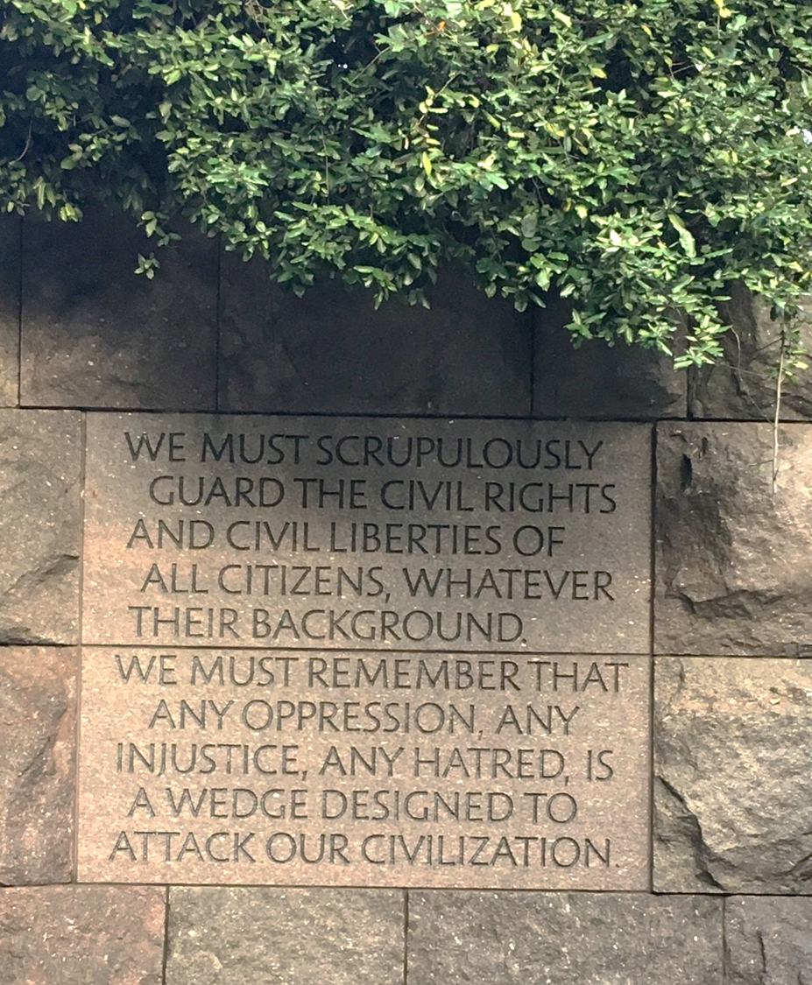
Welcome!
This training takes about 30 minutes to complete.
Image: Franklin D. Roosevelt Memorial in Washington, DC

Slide 3
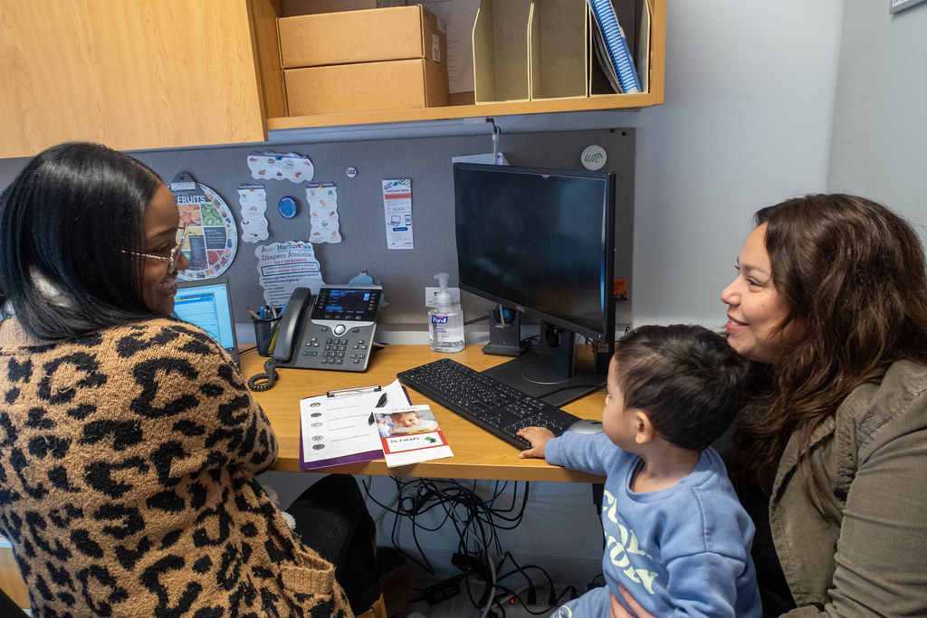
Who is this training for?
For WIC staff who have completed Civil Rights training in previous years
Notes:
Notes:
Refer to Policy 452: Civil Rights for information about required civil rights training for state and local WIC staff.

Slide 4
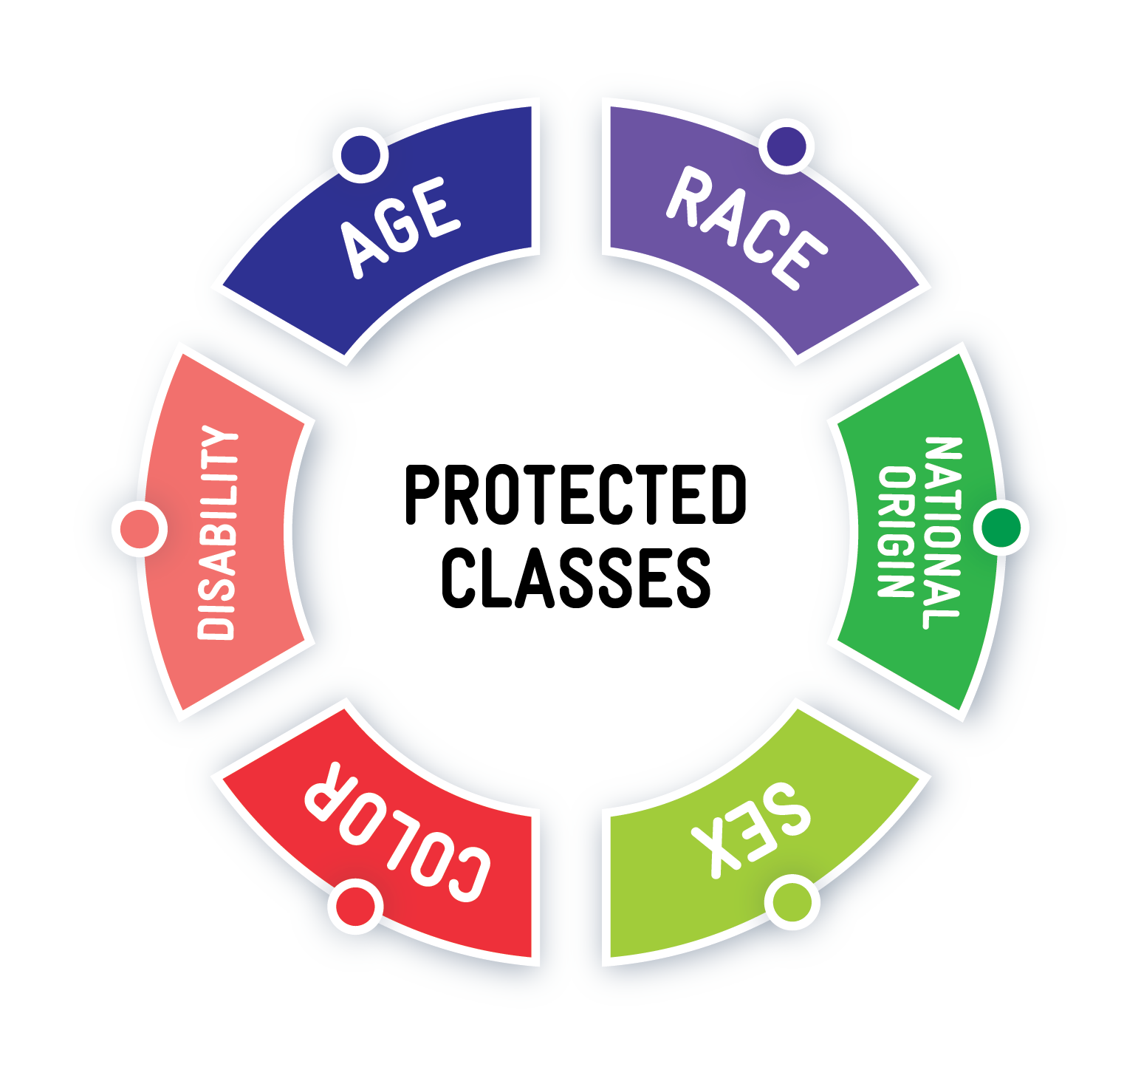
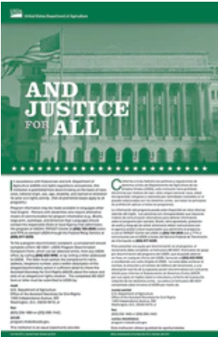

You will learn about:
The six protected classes
Identifying civil rights violations
Data collection requirements
Reasonable accommodation for disability
Language access services
The “And Justice for All” poster
Notes:
Notes:
Refer to Policy 452: Civil Rights for information about required civil rights training for state and local WIC staff.

Slide 5

You will also learn about:
Complaint procedure and requirements
Compliance review and resolution at local agencies
Good customer service, conflict resolution, and complaint prevention
Notes:
Notes:
Refer to Policy 452: Civil Rights for information about required civil rights training for state and local WIC staff.

Slide 6
After this training, you will be able to:
Recall:
  How to appropriately talk to participants about data collection and program eligibility
  Language access service rights for WIC participants
Recognize:
  Effective display locations for the “And Justice for All” poster
  Examples of reasonable accommodations for WIC participants with disabilities

Slide 7
After this training, you will be able to:
Describe:
  What information is needed to document civil rights complaints.
  The state WIC program’s review and resolution process for civil rights compliance.
Identify:
  An effective communication technique for conflict resolution.
  The connection between good customer service, conflict resolution, and complaint prevention.

Slide 8

The six protected classes

Slide 9
The 6 protected classes

Slide 10
Protected classes and discrimination
Protected classes
Groups of people who share a common trait and are legally protected from being discriminated against based on that trait.
Example: Age, race, national origin, sex, color, disability

Slide 11
Protected classes and discrimination
Discrimination
Treating someone unfairly or differently because of who they are. This can happen on purpose, by accident, or even when someone fails to act.
Example: Staff member speaks kindly and helpfully to English-speaking participants but is impatient and dismissive towards those with limited English.

Slide 12
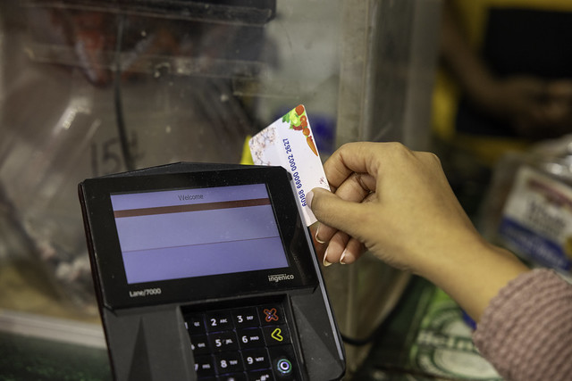
How to identify a civil rights violation
A civil rights violation is not:
Any wrong or unfair treatment of a WIC participant.

Slide 13

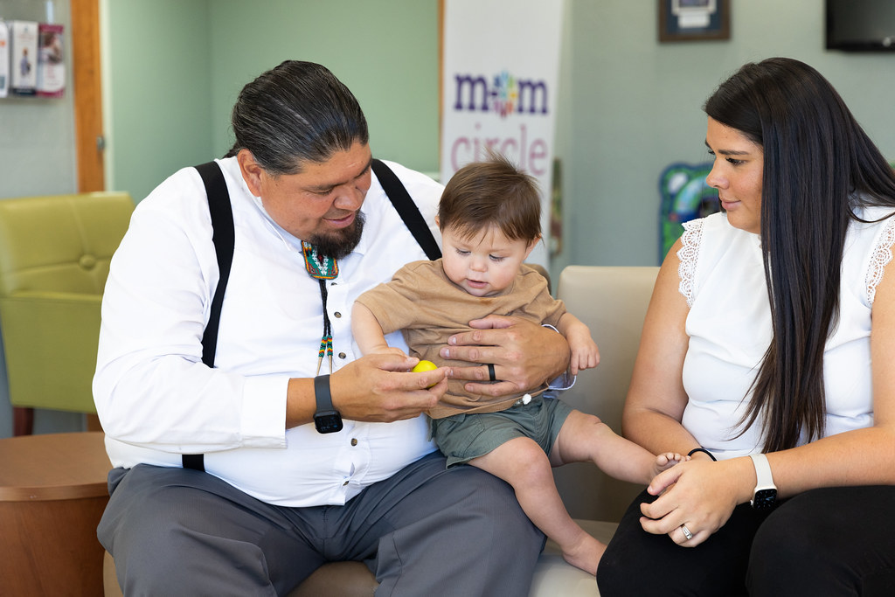
How to identify a civil rights violation
A civil rights violation is:
Discrimination against a WIC participant based on one or more of the 6 protected classes.

Slide 14

Is this a civil rights violation?
Amina is at the store and finds WIC-approved items such as whole wheat naan, goat milk, and dried lentils—foods that are staples in their diet.
At checkout, the clerk looks at the items and says, “Why don’t you people eat normal stuff like everyone else?” The clerk then questions whether the items are WIC-approved and delays the transaction, even though the items scanned through correctly.
Amina leaves embarrassed and without completing the purchase.

Slide 15
Yes, this is a civil rights violation
Store staff did not provide Amina with equal and fair service.
They targeted her cultural or ethnic background, implying her food choices are abnormal or unacceptable.
This is a civil rights violation based on national origin.

Slide 16
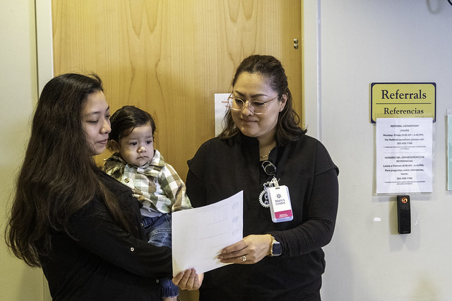
Data collection
Notes:
Notes:
Refer to Policy 452: Civil Rights for more information on racial/ethnic data collection and reporting.

Slide 17
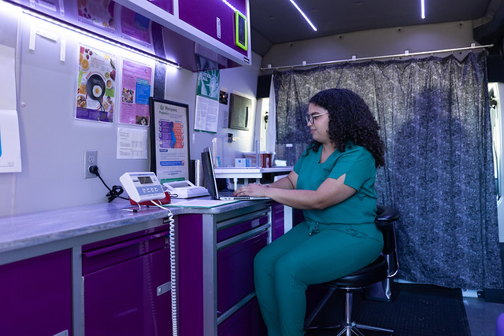
Data collection requirement at certification
WIC staff must collect race and ethnicity data from participants.
Data collection does not impact a participant being able to participate in WIC.
Notes:
Notes:
Refer to Policy 452: Civil Rights for more information on racial/ethnic data collection and reporting.

Slide 18
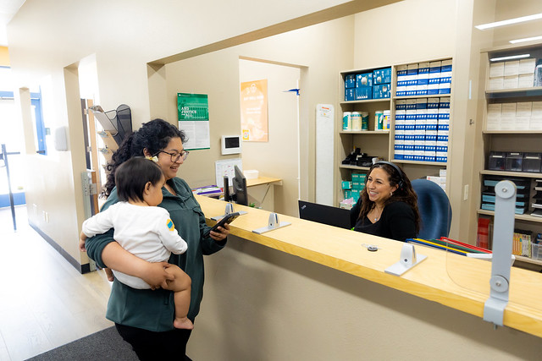
Explaining why we collect data
Use participant-centered language to:
Reassure that their personal information does not affect eligibility.
Explain that federal rules require that we collect the information.
Explain that the information helps the WIC program understand the needs of participants.
Notes:
Notes:
Refer to Policy 452: Civil Rights for more information on racial/ethnic data collection and reporting.

Slide 19
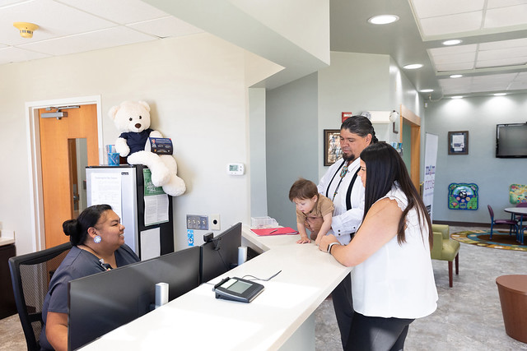
If participant declines data collection
WIC staff must rely on physical appearance to document race and ethnicity if participant declines to share.
Notes:
Notes:
Refer to Policy 452: Civil Rights for more information on racial/ethnic data collection and reporting.

Slide 20
Choose one or more race
Choose between America Indian/Alaska Native, Black/African American, Asian, Native Hawaiian/other Pacific Islander, and White
American Indian/Alaska Native
Black/African American
Asian
Native Hawaiian/other Pacific Islander
White
Notes:
Notes:
Refer to Policy 452: Civil Rights for more information on racial/ethnic data collection and reporting.

Slide 21
Choose only one ethnicity
Choose either Hispanic or Latino or Not Hispanic or Latino
Hispanic or Latino
Not Hispanic or Latino
Notes:
Notes:
Refer to Policy 452: Civil Rights for more information on racial/ethnic data collection and reporting.

Slide 22
Knowledge check!
Which protected class information does Oregon WIC collect from each participant?
Age
Sex
Disability
Race

Slide 23
Knowledge check!
Oregon WIC collects race, sex, and age from participants. Disability is not collected.
Age
Sex
Disability
Race

Slide 24
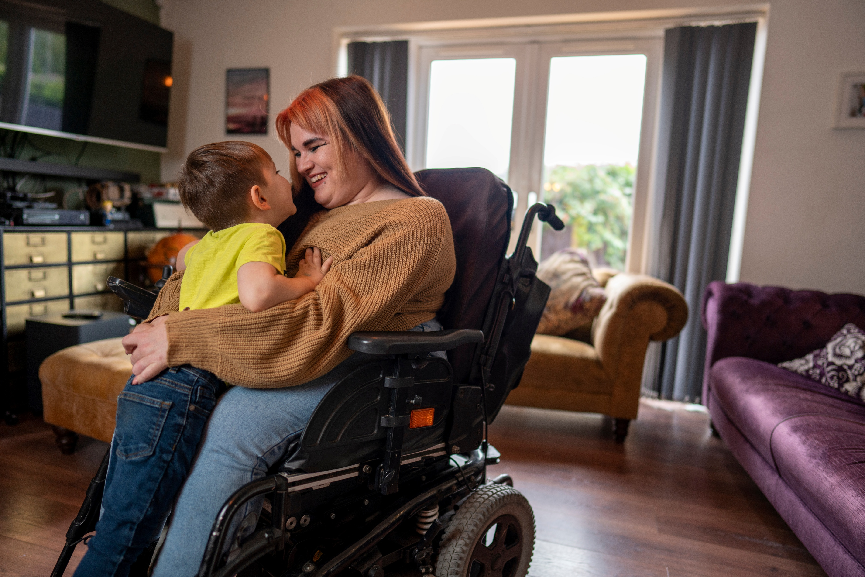
Reasonable accommodations for disability

Slide 25
Reasonable accommodations
WIC programs are required to provide reasonable accommodation to participants.
Reasonable accommodations remove barriers to allow all individuals to participate in WIC.
WIC tries to accommodate participants’ needs whenever possible.
Notes:
Notes:
Refer to Policy 452: Civil Rights for more information on reasonable accommodations for individuals with disabilities.

Slide 26
Examples of reasonable accommodations
Written materials in alternate formats like Braille, larger print, electronic, audio
Wheelchair access at clinic sites
Sign language interpreters for participants
Notes:
Notes:
Refer to Policy 452: Civil Rights for more information on reasonable accommodations for individuals with disabilities.

Slide 27
Reasonable accommodation requests
If you’re not sure about an accommodation request, ask your WIC Coordinator.
Notes:
Notes:
Refer to Policy 452: Civil Rights for more information on reasonable accommodations for individuals with disabilities.

Slide 28
Unreasonable accommodations
Unreasonable requests are uncommon, but are something that would:
Create a safety concern
Need more staff, money, or equipment than a local agency has
Require major changes to how the WIC program works
Notes:
Notes:
Refer to Policy 452: Civil Rights for more information on reasonable accommodations for individuals with disabilities.

Slide 29
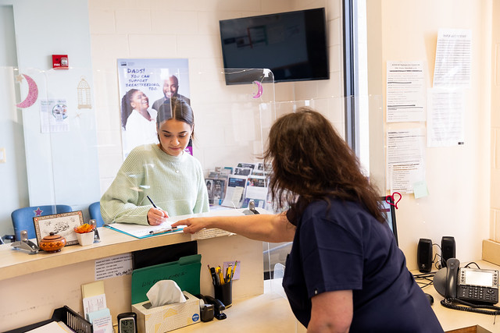
Is this a civil rights violation?
Marcy, who is Deaf, visits her local WIC clinic to enroll. Marcy requests a sign language interpreter, but the staff member is very busy and doesn’t have time to schedule an interpreter.
The staff member writes a note saying only English and Spanish are supported, then leaves for lunch.
Marcy files a complaint against the staff member.

Slide 30
Yes, this is a civil rights violation
Staff intentionally declined interpreter services to Marcy.
This is a civil rights violation based on disability.

Slide 31
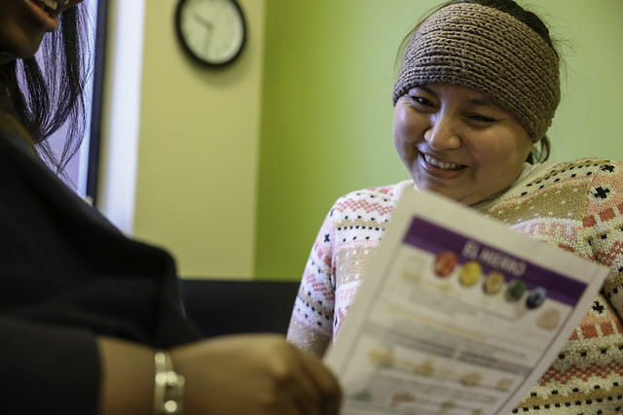
Language access services

Slide 32
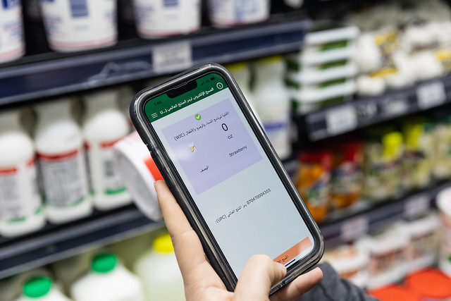
Limited English Proficiency (LEP)
English is not a participant’s first or main language they use.
Or when a participant has limited ability to read, speak, write, or understand English.
Notes:
Notes:
Refer to Policy 452: Civil Rights for more information on LEP and language access services.

Slide 33
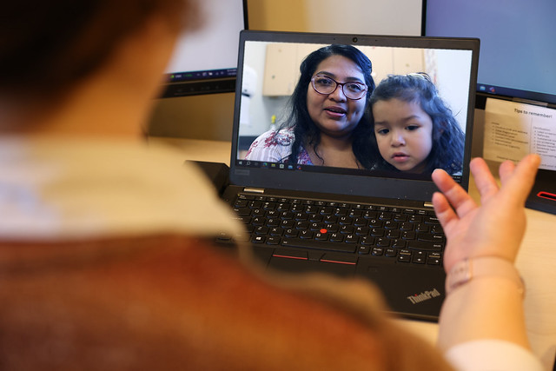
WIC provides services in the language a participant can use
WIC staff must offer interpretation services to participants who have chosen a language other than English.
Notes:
Notes:
Refer to Policy 452: Civil Rights for more information on LEP and language access services.

Slide 34
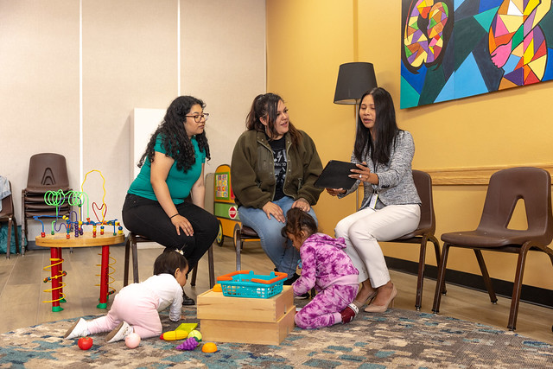
Local agencies support language access services
Local agencies must:
  Know how to access interpreter services
  Offer interpreter services to participants who may need it
Notes:
Notes:
Refer to Policy 452: Civil Rights for more information on LEP and language access services.

Slide 35


The State WIC office supports language access services
The State WIC office:
  Provides clinics with translated documents
  Secures approved translators
  Translates critical print and digital materials into different languages
Notes:
Notes:
Refer to Policy 452: Civil Rights for more information on LEP and language access services.

Slide 36
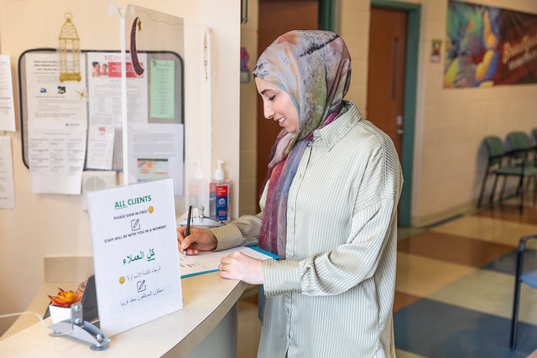
Is this a civil rights violation?
Rania is a participant who immigrated to the U.S. this year.
Rania’s friend, Amy, believes Rania needs help navigating the WIC program. Amy goes to the WIC clinic and requests Rania’s information.
Staff do not have a Release of Information (ROI) to share out Rania’s information. They tell Amy they cannot help without Rania’s consent.
Amy submits a complaint, saying staff are discriminating against Rania based on national origin.

Slide 37
No, this is not a civil rights violation
Staff did not share Rania’s information with her friend Amy because they do not have a Release of Information (ROI).
This is not discrimination or a civil rights violation.

Slide 38
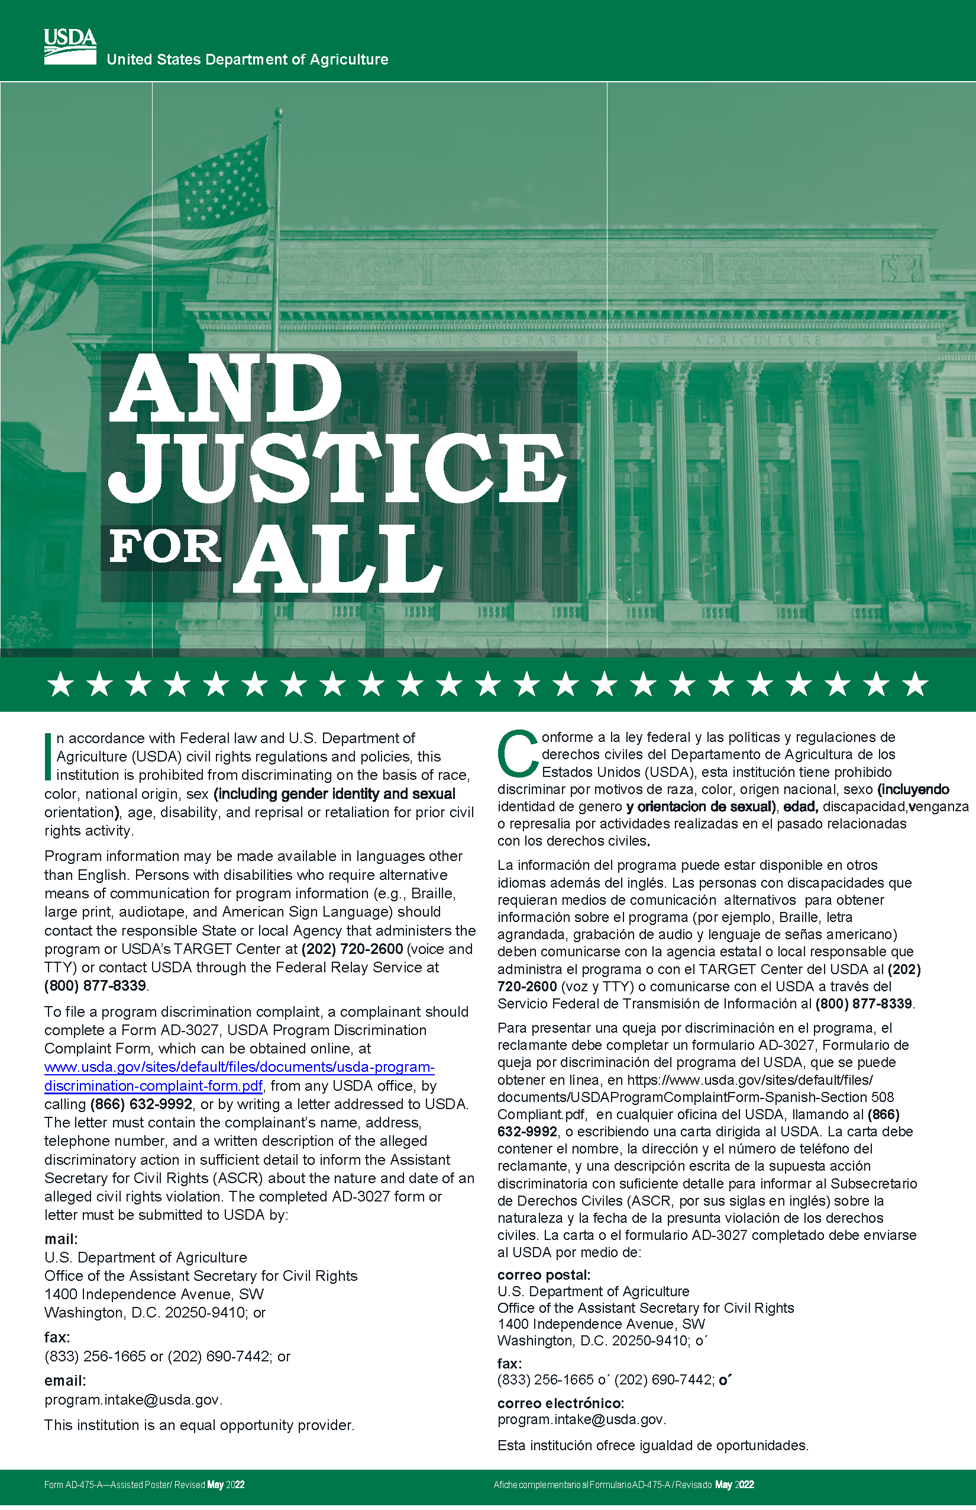
Public notification
Notes:
Notes:
Refer to Policy 452: Civil Rights for more information on the “And Justice for All” poster and non-discrimination statement requirements.

Slide 39
Local agency display requirement
All WIC clinics must display “And Justice for All” posters in easy-to-see locations.
Any place where WIC services are provided for participants, applicants, and the public.
Notes:
Notes:
Refer to Policy 452: Civil Rights for more information on the “And Justice for All” poster and non-discrimination statement requirements.

Slide 40
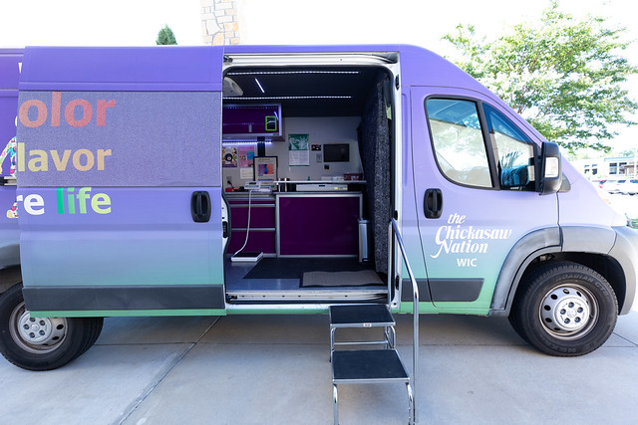
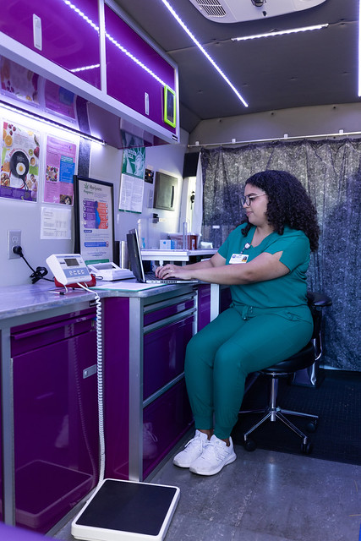
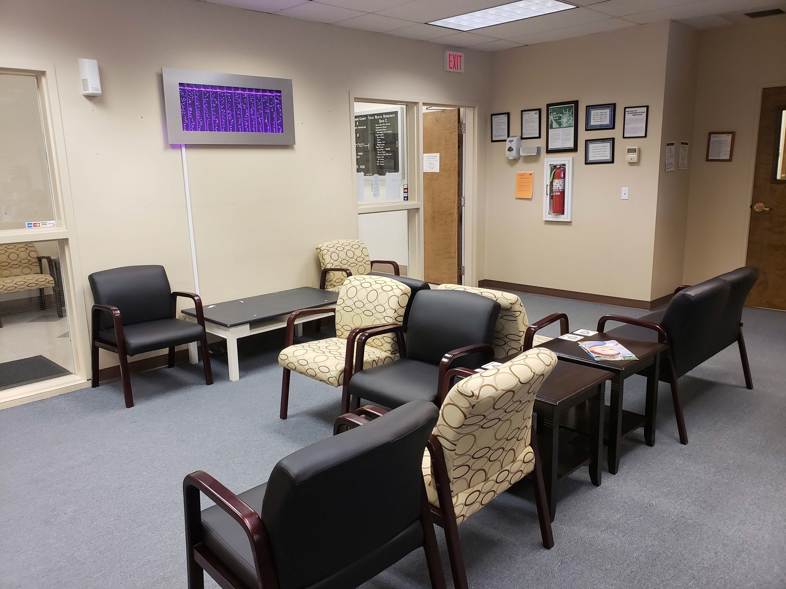
Easy-to-see locations
Notes:
Notes:
Refer to Policy 452: Civil Rights for more information on the “And Justice for All” poster and non-discrimination statement requirements.

Slide 41
Non-discrimination statement
The “And Justice for All” has a full non-discrimination statement.
Statement includes information on:
Protected classes
Language access services
Complaint information
Notes:
Notes:
Refer to Policy 452: Civil Rights for more information on the “And Justice for All” poster and non-discrimination statement requirements.

Slide 42
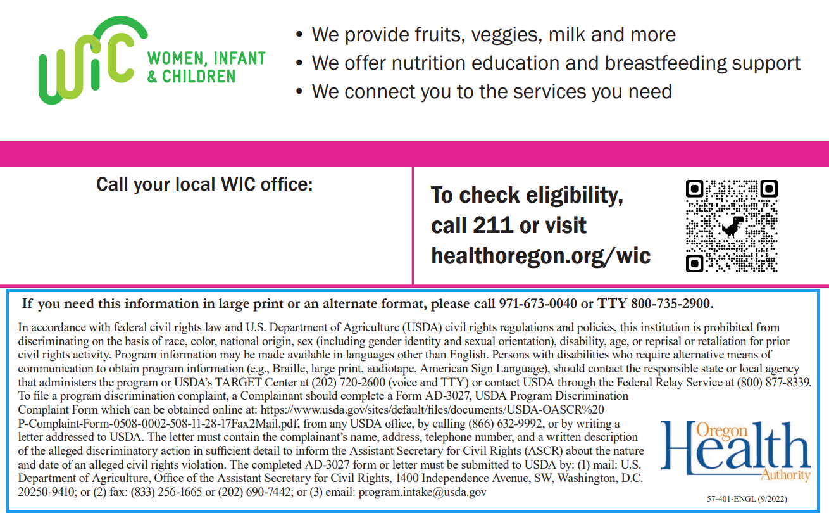
Non-discrimination statement outreach requirement
Non-discrimination statement must be included on any print or digital outreach materials on WIC benefits and services.
Notes:
Notes:
Refer to Policy 452: Civil Rights for more information on the “And Justice for All” poster and non-discrimination statement requirements.
Long and short versions of the non-discrimination statement available in English and Spanish. See Policy 452 Appendix A.

Slide 43

Non-discrimination statement outreach requirement
Shortened versions available for smaller items.
Local agencies may require their own non-discrimination statements, which can supplement—but not replace—the USDA statement.
Notes:
Notes:
Refer to Policy 452: Civil Rights for more information on the “And Justice for All” poster and non-discrimination statement requirements.
Long and short versions of the non-discrimination statement available in English and Spanish. See Policy 452 Appendix A.

Slide 44

The complaint process
Notes:
Notes:
See Policy 588 – Program Integrity: Complaints for more information on complaint procedure and documentation requirements.

Slide 45

Local WIC staff accept and document all complaints
WIC staff document all complaints about poor customer service, civil rights violations, or a combination of both.
Notes:
Notes:
Refer to Policy 588 – Program Integrity: Complaints for more information about documenting different types of complaints.

Slide 46
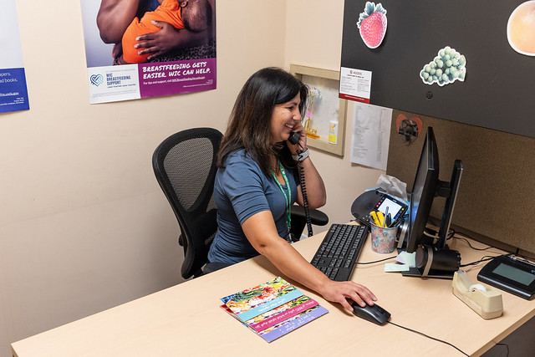
Local WIC staff accept and document all complaints
Complaints can come from phone calls, fax, emails, social media, written statements, in person, or online.
Notes:
Notes:
Refer to Policy 588 – Program Integrity: Complaints for more information about documenting different types of complaints.

Slide 47
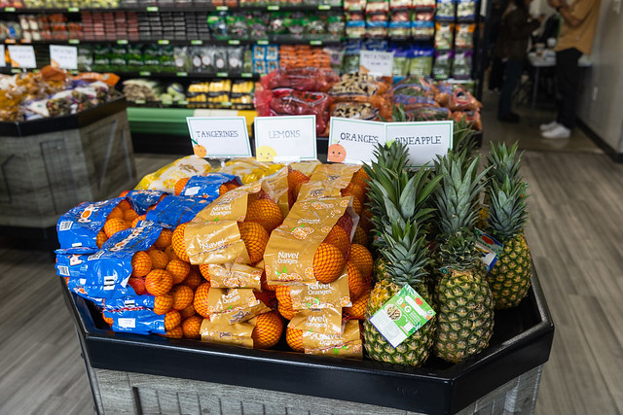
Complaints that go in WIC data system
WIC staff document customer service complaints and civil rights violations in the WIC data system.
These include complaints against:
Store staff or grocery stores
Farmers or farmer's markets
Community partners
Notes:
Note:
Refer to Policy 590 – Program Integrity: Participant Violations for more information on how vendors submit complaints against WIC participants.
Refer to Policy 588 – Program Integrity: Complaints for more information about documenting different types of complaints.

Slide 48
Voiced civil rights complaints
Once a participant voices a civil rights complaint:
Share with them their right to file a complaint directly with USDA within 180 days.
Offer to help write and submit the complaint if necessary.
Share that local staff will document the complaint and forward to the state office.
Document complaint in the WIC data system.
Immediately notify state WIC Compliance and Civil
Rights Coordinator.
Notes:
Notes:
Refer to Policy 588 – Program Integrity: Complaints for more information about documenting different types of complaints.

Slide 49
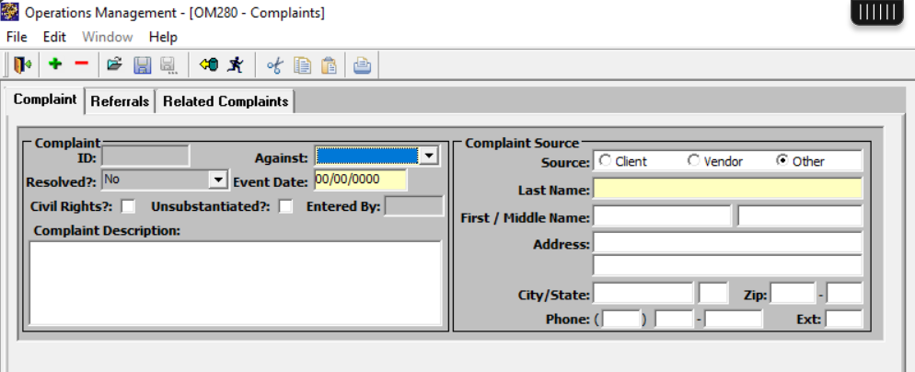
Complaint form in the WIC data system
In Complaint form, include:
Who complaint is against
Participant name and contact information
Event date
Description of event
[] Civil Rights?
Notes:
Notes:
Refer to Policy 588 – Program Integrity: Complaints for more information about documenting different types of complaints.

Slide 50
Check box for possible civil rights complaint
Check this box when a participant’s complaint includes discrimination that you think might be a civil rights violation.
Notes:
Note: It is best practice to check the Civil Rights box when you suspect discrimination occurred. After a complaint with the Civil Rights box is checked is documented in TWIST, state WIC staff review the complaint and make the final determination if a civil rights violation occurred or not.

Slide 51
Check box for possible civil rights complaint
It is OK if you are not 100% sure.
The state WIC Compliance & Civil Rights Coordinator reviews these types of complaints to determine if it was a civil rights violation or not.
Notes:
Note: It is best practice to check the Civil Rights box when you suspect discrimination occurred. After a complaint with the Civil Rights box is checked is documented in TWIST, state WIC staff review the complaint and make the final determination if a civil rights violation occurred or not.

Slide 52
Include as much information as possible for civil rights complaints
Who was involved
What happened during the incident
Where the incident happened
When did the participant realize it happened
Why this complaint may be a potential civil rights violation
Which protected classes may have been involved
Documents related to incident (if available)
Information about witnesses (if available)
Notes:
Notes:
Refer to Policy 588 – Program Integrity: Complaints for more information about what information to include in a civil rights complaint.

Slide 53

Use WIC Notes to include more detail
If you run out of room on Complaint form:
Write “See WIC Notes” in Complaint Description box
Use WIC Notes to add details about the complaint
See WIC Notes
Notes:
Note:
Information to include for a civil rights complaint:
Who was involved
What happened during the incident
Where the incident happened
When did the participant realize it happened
Why this complaint may be a potential civil rights violation
Which protected classes may have been involved
Documents related to incident (if available)
Information about witnesses (if available)

Slide 54

Email the state WIC Compliance & Civil Rights Coordinator
Right after you submit a complaint with Civil Rights box checked:
Send an email directly to the State WIC Compliance & Civil Rights Coordinator.
Let them know a potential civil rights complaint has been submitted.
Notes:
Note: After submitting a civil rights complaint, the Compliance & Civil Rights Coordinator will follow up with your WIC Coordinator for more details if needed.

Slide 55

How we protect employee confidentiality
Complaints against local WIC staff:
Refer general complaints directly to the WIC Coordinator
Send civil rights complaints directly to state WIC Compliance and Civil Rights Coordinator
Notes:
Note: To protect employee confidentiality, we do not enter complaints against local staff members in the WIC data system. This protects employee privacy and confidentiality. The Compliance & Civil Rights Coordinator will follow up with your WIC Coordinator for more details if needed about the complaint.

Slide 56
How we protect employee confidentiality
Complaints against state WIC staff members:
Refer complaints against state WIC staff directly to the state WIC program manager.
Complaints against local agency or WIC program in general:
Enter complaints against local agency or WIC program in general into the Online WIC Complaints form.
Notes:
Note: To protect employee confidentiality, we do not enter complaints against state staff members in the WIC data system. This protects employee privacy and confidentiality. Complaints against local agencies or WIC program in general are submitted in the new online WIC Complaints form.

Slide 57

Submit complaints as soon as possible
Federal rules require state WIC staff to report civil rights violations in a short window of time.
Please submit complaints as soon as possible so we can respond to them and support participants quickly.

Slide 58

Civil rights compliance review

Slide 59


Civil rights compliance review process
Federal review of civil rights compliance
United States Department of Agriculture (USDA) Western Region staff review state and local WIC programs for civil rights compliance.
State review of civil rights compliance
State WIC review local agencies for civil rights compliance during the biennial review.

Slide 60


Corrective action and cooperation
Corrective action
Local agencies not complying with civil rights policies may be issued corrective actions.
Failure or refusal to cooperate
Failing or refusing to cooperate with civil rights policies may result in loss of federal funding for WIC program.

Slide 61



How noncompliance is resolved
When a local agency is not complying with civil rights requirements:
Any findings during biennial review are provided in writing to the local agency.
State Nutrition Consultants and Compliance & Civil Rights Coordinator work with the local agency to resolve findings of non-compliance.

Slide 62
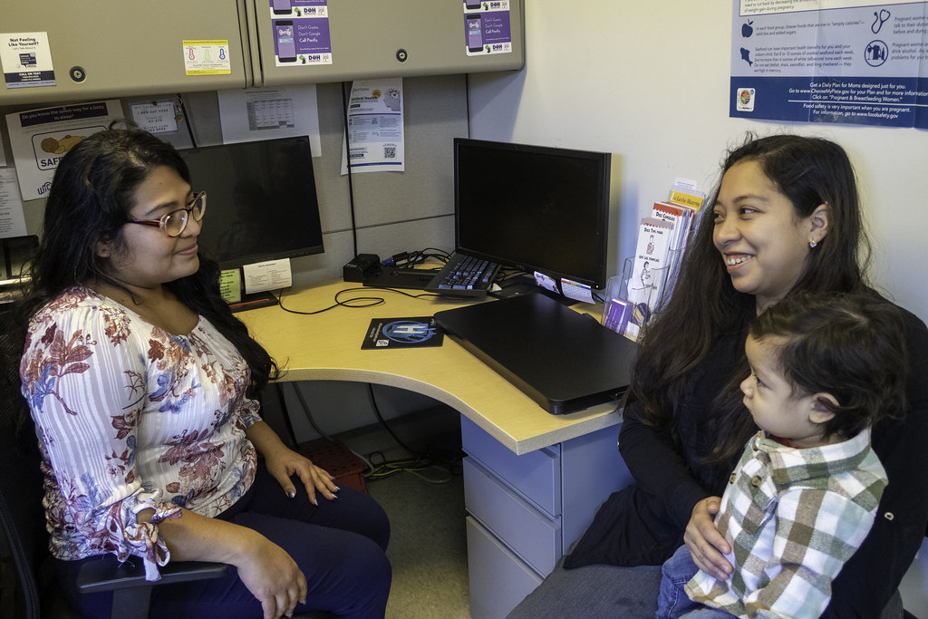
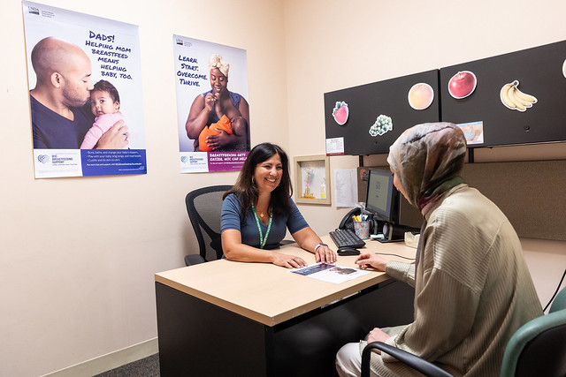
Conflict resolution and customer service

Slide 63
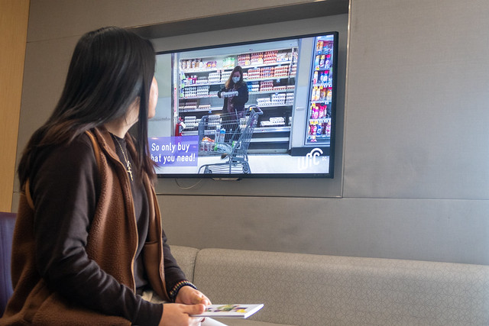
One-minute brainstorm
What situations make participants upset?
Share your thoughts as a group, out loud, or in the chat for one minute.

Slide 64
When participants could become upset
When they:
Are denied benefits or determined to be ineligible.
Experience poor customer service at clinic, store, or market.
See others receiving what they view as better service than them.

Slide 65

LOVE can de-escalate negative experiences or conflict
Listen
Ask Open-ended questions
Validate their concerns
Empower, educate, and empathize

Slide 66
LOVE in practice
Listen. Be sincere and try to understand.
“It sounds like this has been really frustrating for you.”
Ask Open-ended questions to identify the root of the issue.
“What happened from your perspective?”
“What part of this experience was most upsetting?”

Slide 67
LOVE in practice
Validate their concerns.
“I hear you, and you’re not alone in feeling that way. This system can be confusing.”
Empower, educate, and empathize to find a realistic solution.
“One thing that might help is…”
“Let’s see if one of these options could work for you…”

Slide 68
Why conflict resolution is important
Conflict resolution skills are customer service skills
Good customer service can help prevent complaints

Slide 69
Recap

Slide 70
Recap: Civil rights
Civil rights violations include discrimination based on one or more of the six protected classes.
WIC staff must enter one or more races and only one ethnicity in the WIC data system.

Slide 71
Recap: Civil Rights
Reasonable accommodation removes barriers for all individuals to participate in WIC.
WIC staff must know where and how to offer language access services to participants who choose a language other than English.

Slide 72
Recap: WIC data system
Submit participant complaints against stores, farmer’s markets, or farmers in WIC data system.
  Check Civil Rights box if complaint included discrimination against one or more protected classes.
  Use WIC Notes to add more details.
  Email the state Civil Rights Coordinator after submitting possible civil rights complaint.

Slide 73
Recap: Protect employee confidentiality
Refer general, non-civil rights complaints against local WIC staff to your WIC Coordinator.
Send civil rights complaints against local WIC staff directly to the state WIC Compliance and Civil Rights Coordinator.

Slide 74

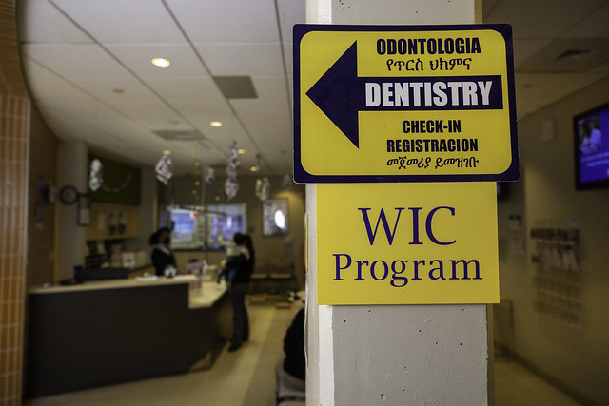
Recap: Protect employee confidentiality
Refer complaints against state WIC staff directly to the state WIC program manager.
Enter complaints against local agency or WIC program in general into the Online WIC Complaints form.

Slide 75
Recap: Compliance review
Local agencies are reviewed for civil rights compliance during every biennial review.
Non-compliance is resolved with corrective actions and working with Nutrition Consultant and state Compliance & Civil Rights Coordinator

Slide 76
Recap: Customer service and conflict resolution
LOVE is a conflict resolution tool that can help improve customer service and prevent complaints.

Slide 77
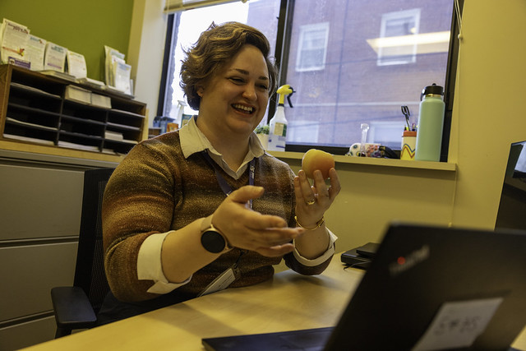
Civil Rights policy for WIC staff
WIC Policy
Policy 452 - Civil Rights
Policy 588 - Program Integrity: Complaints
Policy 635 – Participant Notification: Eligibility, Rights, and Responsibilities

Slide 78
State WIC Compliance & Civil Rights Coordinator
Contact for information, questions, or help with civil rights policy or complaints.
Liliana Auw
Liliana.L.Auw@oha.oregon.gov
503-209-8365

Slide 79

You did it!
You have completed the 2026 Civil Rights training.

