Slide 1

2024 Nutrition Risk Update
CPAs must complete
by September 30, 2024

Slide 2

Introduction
Each year, USDA updates selected risks using evidence-based research
For 2024, there are six risks that are being updated, most changes are minor
Local agency certifiers will complete this in-service by September 30, 2024
This in-service can be completed in about 30-45 minutes

Slide 3
Risks With 2024 Updates
201
Low Hemoglobin/
Low Hematocrit
211
Elevated Blood
Lead Levels
358
Eating Disorders
360
Other Medical Conditions
361
Mental Illnesses*
*Formerly:
Maternal Depression
901
Recipient of Abuse

Slide 4
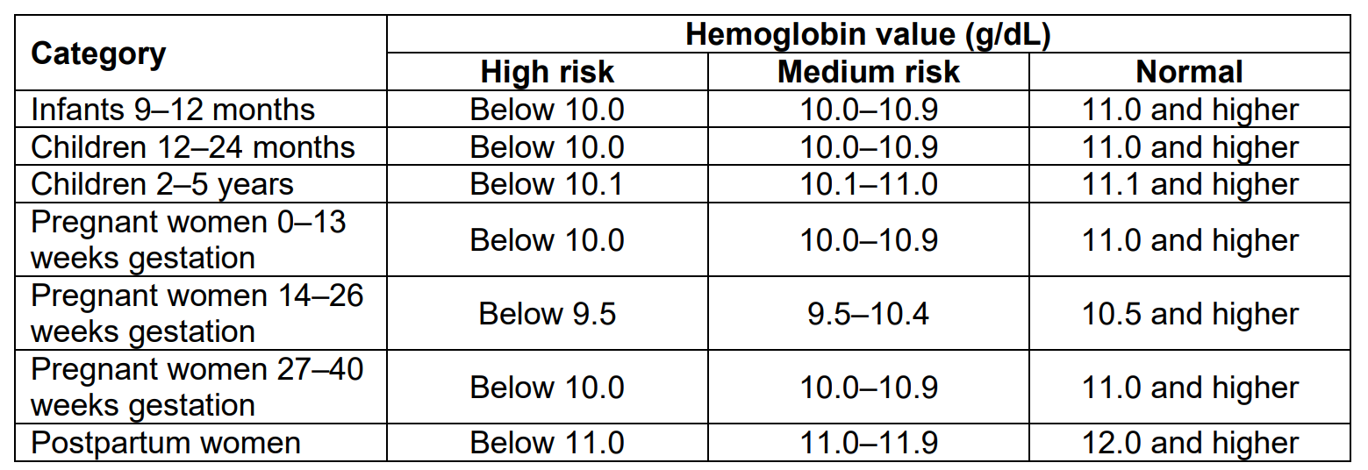
Risk 201: Low Hgb/Hct
201
Low Hemoglobin/
Low Hematocrit
The risk assignment criteria remains the same for Risk 201 (for Hct tables and corrections for smoking status for women and altitude, see Policy 675):
No changes in risk assignment criteria
Clarifications added to definitions and risk info sheet
Low/Very Low refresher
Very Low Hgb
Low Hgb

Slide 5
Hemoglobin and Hematocrit Refresher
201
Low Hemoglobin/
Low Hematocrit
Hemoglobin (Hgb) is the iron-containing, oxygen-carrying protein in blood
Hematocrit (Hct) is the percentage of blood that consists of packed red blood cells
Most Oregon WIC agencies use Hgb tests, though some use Hct
While neither a Hgb nor Hct test are direct measures of iron status, these tests are useful screening tools for iron deficiency anemia
No changes in risk assignment criteria
Clarifications added to definitions and risk info sheet
Low/Very Low refresher

Slide 6
Iron in the Body Refresher
201
Low Hemoglobin/
Low Hematocrit
Iron is present in all cells in the body and serves several vital functions
Iron is involved in the synthesis of hormones as well as normal growth and development
Iron deficiency occurs when the body’s iron stores are depleted
Iron deficiency may be caused by a diet low in iron, insufficient absorption of iron from the diet, increased iron requirements due to growth or pregnancy, or blood loss
No changes in risk assignment criteria
Clarifications added to definitions and risk info sheet
Low/Very Low refresher

Slide 7
Low & Very Low Refresher
201
Low Hemoglobin/
Low Hematocrit
For participants who have low Hgb or Hct:
  Refer participants to their health care provider; only a health care provider can determine a diagnosis, cause and treatment
  Provide follow up testing/referrals at future appointments
For participants who have very low Hgb or Hct:
  Recheck at the time of appointment with a new puncture site
  Manually change risk level to high (if no other high risk is assigned)*
  Refer to health care provider and WIC Nutritionist within 1-2 months
No changes in risk assignment criteria
Clarifications added to definitions and risk info sheet
Low/Very Low refresher
Notes:
Risk 626: https://www.oregon.gov/oha/PH/HEALTHYPEOPLEFAMILIES/WIC/Documents/ppm/626.pdf
Training Supervisors: this is a good time to refresh folks on documentation of Hgb rechecks as well (including documenting only the highest value in the biochemical area of the Medical Data tab)

Slide 8

Nutrition & Iron
Dietary sources of iron come in two major forms: heme and nonheme iron
Heme iron is well absorbed and found primarily in animal food sources, including red meat, liver, poultry, and fish
Nonheme iron is not as well absorbed and is found in foods from plants such as iron-fortified grain products, legumes, fruits, and green leafy vegetables
Consumption of vitamin C-rich foods and meat, fish or poultry increase the absorption of nonheme iron
Calcium intake is linked to a reduction in the absorption of both heme and nonheme iron
Notes:
Information source: 2022 FNS Risk Information Sheet for Risk 201
Further information on Bullet #4: “Consumption of vitamin C-rich foods and meat, fish or poultry increase the absorption of nonheme iron”
Please see reference 8 on the FNS risk info sheet:
Lynch S, Pfeiffer CM, Georgieff MK, Brittenham G, Fairweather-Tait S, Hurrell RF, et al. Biomarkers of nutrition for development (BOND)-iron review. J Nutr. 2018 Jun 1 [cited 2020 Sep 17];148(suppl_1):1001S-1067S. Available from: https://www.ncbi.nlm.nih.gov/pmc/articles/PMC6297556/
From the article: "Absorption [of iron] is markedly affected by meal composition. Unidentified components of meat (thought to be partially digested peptides), ascorbic acid, and to some extent other organic acids promote absorption, …"
So it's not the heme iron of meat, fish or poultry that increases the absorption of nonheme iron, but peptides (when protein begins to break down, before they are broken into individual amino acids), ascorbic acid and other organic acids in the protein source that help promote absorption.

Slide 9

Discussion
Which WIC foods do you like to highlight for families looking to support iron intake and absorption?
Notes:
Encourage consumption of iron-rich foods (with an emphasis on the foods in the WIC food package): Lentils and beans, fortified cereals, red meats, fish, and poultry
https://ods.od.nih.gov/factsheets/Iron-HealthProfessional/#h3
https://oregon-wic.myshopify.com/products/iron-foods-for-moms-and-kids-pad-of-50?_pos=1&_sid=98962571f&_ss=r
Encourage consumption of foods rich in Vitamin C to aid in iron absorption: Citrus fruits, tomatoes, and other fruits and vegetables
http://ods.od.nih.gov/factsheets/VitaminC-HealthProfessional/

Slide 10
Risk 211: Elevated Blood Lead Levels
211
Elevated Blood Lead Levels
CDC updated guidelines in 2021 recommending a lower cutoff for elevated blood lead levels for children ages 1-5
Risk 211 will be assigned for children ages 1-5 who have a blood lead level of 3.5 µg/dl or higher
  The threshold for the assignment of risk 211 for infants and women will remain at 5 µg/dl or higher
Updated values for children 1-5 will be in TWIST by
October 1, 2024
Cutoff levels adjusted to meet 2021 CDC guidance
Lead exposure and effects
Screening and Oregon’s Lead Poisoning Prevention Program

Slide 11
Who is at risk for lead exposure?
211
Elevated Blood Lead Levels
Children enrolled in WIC can be disproportionately affected by lead exposure and lead poisoning, particularly those children living in areas that include:
  homes built before 1978
  low-income or subsidized housing with suspected or known lead hazards
  hazardous waste sites or industrial emissions containing lead
  racial and ethnic minorities and recent immigrants
Cut-off levels adjusted to meet 2021 CDC guidance
Lead exposure and effects
Screening and Oregon’s Lead Poisoning Prevention Program

Slide 12
Health Impacts of Elevated Blood Lead Levels
211
Elevated Blood Lead Levels
There is no known safe level of exposure to lead. The toxic effects of lead have been observed in every organ system in very low levels
Lead exposure during pregnancy or postpartum can harm the mother as well as the developing fetus or breastfeeding infant during critical stages of development
Lead can transfer from maternal blood to breastmilk, and ultimately to the breastfeeding infant
Lead readily crosses the placenta, and lead exposure during pregnancy can cause:
Cut-off levels adjusted to meet 2021 CDC guidance
Lead exposure and effects
Screening and Oregon’s Lead Poisoning Prevention Program
Miscarriage
Preterm birth
Decreased birth size
Damage to organs
Lifelong learning and behavior problems

Slide 13

Lead Screening and WIC
A new question will be added to the Health Questionnaire related to lead screening October 1, 2024
  “Has your child been screened or tested for lead?”
A referral to their healthcare provider or another local resource is needed if lead screening or testing has not been completed for children
Staff are encouraged to begin making this referral now
This becomes a mandatory referral in 2026

Slide 14

Nutrition Education
Limiting potential exposures and maintaining good nutrition are the best prevention to protect the body from absorbing lead
Provide nutrition education that Vitamin C, calcium and iron help limit the body’s ability to absorb lead
  Highlight that many WIC foods help provide these key nutrients
More Information: https://wicworks.fns.usda.gov/resources/protect-against-lead-exposure-wic-foods
Notes:
1993 FNS Memo regarding Lead Screening: https://www.fns.usda.gov/wic/role-screening-childhood-lead-poisoning-0
National WIC Association Resource: https://media.nwica.org/the-role-of-wic-in-lead-screening.pdf
WIC Health also has many resources in their Resource Library, using a search term of “lead” – some are pdf and textable image format; only available in English:
Textable image (also available in PDF): “Protect Your Family From Lead: 5 foods to eat - wichealth to Go”: https://maia-public.s3.us-east-2.amazonaws.com/Products/Wic/Uploads/Resources/4b13ac59-562e-402b-9ab5-ff8d00419d6c.pdf
Textable image (also available in PDF): “Protect Your Family: Foods and tips to absorb less lead - wichealth to Go”: https://maia-public.s3.us-east-2.amazonaws.com/Products/Wic/Uploads/Resources/5fb5e1bf-8eb8-4047-ae38-dff414ad213c.pdf
Article: “What You Need To Understand About The Risks of Lead” https://www.wichealth.org/Member/Resource?id=3562&languageId=1
Article: “What to Do If Your Child Has Been Exposed to Lead” https://www.wichealth.org/Member/Resource?id=3567&languageId=1

Slide 15

Lead Screening & Testing
WIC plays an important role in referring participants for blood lead screening and testing
In many medical offices, lead testing is performed with a capillary blood test, like how WIC screens for hemoglobin
All children enrolled in Medicaid (Oregon Health Plan/OHP) must be tested for lead at 12 and 24 months
  If there is no record of prior testing, any OHP participant from 24 to 72 months must be tested
At this time, children not enrolled in OHP are screened with a questionnaire at the same ages instead of being tested

Slide 16
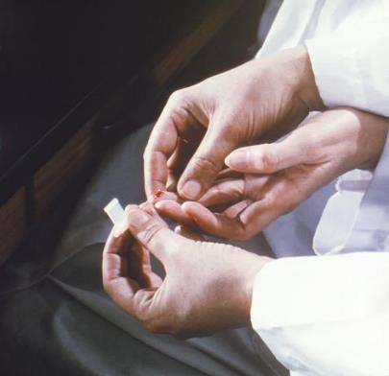
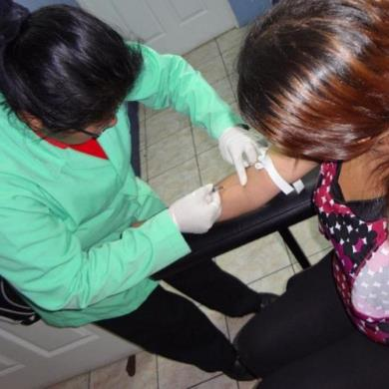
Lead Testing Methods
211
Elevated Blood Lead Levels
Cut-off levels adjusted to meet 2021 CDC guidance
Lead exposure and effects
Screening and Oregon’s Lead Poisoning Prevention Program
Capillary test (Presumptive)
Susceptible to contamination and should be confirmed by venous test
Venous test (Confirmatory)
Recommended before continuing with case management and investigation
Notes:
One elevated capillary test is considered presumptive for elevated blood lead level. Typically, a confirmatory venous blood draw will occur after the initial elevated level from a capillary test.

Slide 17
What happens if someone has an elevated blood lead level?
211
Elevated Blood Lead Levels
When someone is tested and has an elevated blood lead level, Oregon’s Lead Poisoning Prevention Program is notified of the result within one working day
The target population for this program is children less than 6 years of age with a specific focus on children less than 3 years of age
Case management services begin through OHA or a local public health authority, starting with a phone questionnaire to help identify possible sources of the exposure
  This could be followed by a home inspection
  Case manager ensure the family has access to needed resources, such as referral to WIC and other programs
  Follow-up testing every 1-3 months to ensure decreasing blood lead level
Cut-off levels adjusted to meet 2021 CDC guidance
Lead exposure and effects
Screening and Oregon’s Lead Poisoning Prevention Program

Slide 18
Risk 358: Eating Disorders
358
Eating Disorders
The three main eating disorders are added to the definition (though not limited to these three):
  Anorexia Nervosa (AN)
  Bulimia Nervosa (BN)
  Binge Eating Disorder (BED)
Diagnosis from a healthcare provider or self-report of disordered eating behaviors
WIC staff do not diagnose or treat an eating disorder. We can reinforce and support an existing care plan from health care providers
Definition changes
Participant conversations

Slide 19
Risk 358: Eating Disorders
358
Eating Disorders
This can be a very sensitive topic for participants and related discussions require awareness and sensitivity
For individuals affected by an eating disorder, staff can:
  Be gentle and offer options for collecting the participant’s weight or declination:
    Offer a “blind weight” – where participant looks away or steps onto the scale backward so that only the person taking the weight sees the number
    Obtaining a recent weight from their health care provider (HCP)
    Document the reason for not collecting a weight
Definition changes
Participant conversations

Slide 20
Risk 358: Eating Disorders
358
Eating Disorders
Modify conversation with the participant to avoid topics that could be activating, such as:
  Body weight/shape
  Exercise plans
  Calories
Refer the participant to your local agency WIC Nutritionist for further follow up and support
Definition changes
Participant conversations

Slide 21

Discussion
What are some weight-neutral ways WIC staff can support health and nutrition for WIC participants?
Notes:
The Language of Health from Arizona Department of Health: https://www.azhealthzone.org/wp-content/uploads/2021/10/style-guide-language-of-health.pdf

Slide 22
Risk 360: Other Medical Conditions
360
Other Medical Conditions
There are no changes to this risk, only clarifications
Medical conditions with a nutrition-related component fall under this risk
  This remains at the high risk level, and requires a referral to a WIC Nutritionist
Medical conditions must be diagnosed by a medical provider, though participants can still self-report the diagnosis to WIC staff
If you are unsure if this risk fits for a certain medical condition, please connect with your Training Supervisor, WIC Nutritionist or assigned Nutrition Consultant
Risk refresher
Examples of potential conditions and interventions

Slide 23
Risk 360: Other Medical Conditions
360
Other Medical Conditions
Condition | Recommended Interventions
All Types of Medical Conditions | Reinforce healthcare provider treatment and dietary plan (if applicable) Refer for medical nutrition therapy (if available) Recommend a healthy dietary pattern as described in the Dietary Guidelines for Americans
Polycystic Ovary Syndrome (PCOS) | Provide dietary and physical activity guidance to support hormone and blood sugar balance
Asthma | Provide dietary and physical activity guidance to support health Educate on avoidance of allergy-triggering foods, if applicable
Risk refresher
Examples of potential conditions and interventions
Notes:
More examples included on the FNS risk 360 info sheet

Slide 24
Risk 360: Other Medical Conditions
360
Other Medical Conditions
Condition | Recommended Interventions
Cardiovascular Disease | Encourage participant to discuss blood cholesterol and triglycerides with health care provider Recommend limiting alcohol, salt, added sugars, and saturated fat as part of a healthy dietary pattern Suggest dietary fiber food options (e.g., fruit, vegetables, whole grains, legumes) Encourage stress-relieving activities Encourage smoking cessation if participant is a smoker
Cystic Fibrosis | Provide more frequent growth monitoring Encourage adequate caloric intake to maintain healthy weight and normal growth
Risk refresher
Examples of potential conditions and interventions
Notes:
More examples included on the FNS risk 360 info sheet

Slide 25
Risk 361 – Mental Illnesses
361
Mental Illnesses
The name is changing to Mental Illnesses (from Maternal Depression)
Now includes any provider-diagnosed mental illness where the symptoms or the treatment plan may affect nutritional status
Does not apply if a participant’s condition is stable and after a thorough assessment there appear to be no effects on nutritional status
WIC can be a safe place for participants to discuss their mental challenges to help reduce stigma, prejudice and discrimination
Risk name change: formerly “Maternal Depression”
Expanded risk definition and criteria
Notes:
Note: This risk does not include the diagnosis of eating disorders (see Risk 358 Eating Disorders)
Oregon’s Risk Info Sheet: https://www.oregon.gov/oha/PH/HEALTHYPEOPLEFAMILIES/WIC/Documents/modules/risk/361.pdf (
Updated FNS Risk Info Sheet:

Slide 26
Risk 361 – Mental Illnesses
361
Mental Illnesses
Examples of mental illnesses include (but not limited to):
  Depression
  Postpartum Depression
  Anxiety Disorders
  Bipolar Disorders
  Obsessive-Compulsive Disorder (OCD)
  Schizophrenia
  Post-Traumatic Stress Disorder (PTSD)
  Personality Disorders
  Attention-Deficit/ Hyperactivity Disorder (ADHD)
Risk name change, formerly Maternal Depression
Expanded risk definition and criteria

Slide 27

Discussion
When might you refer a participant with risk 361 to your WIC Nutritionist?
What supportive services do you have in your area?
Notes:
Potential Resources:
Postpartum Support International is one resource with a support warm line that can be accessed at 800-944-4PPD (1-800-944-4773) – English and Spanish
Text Line (English): 800-944-4773 Text Line (Spanish): 971-203-7773
https://www.postpartum.net/get-help/

Slide 28
Risk 901- Recipient of Abuse
901
Recipient of Abuse
This risk no longer has a timeframe; “within the past 6 months” is removed
Anyone can report abuse including participants or caregivers, a social worker or a healthcare professional
Abuse comes in many forms and the risk definition has been expanded to reflect that
The risk definition now describes a recipient of abuse as an individual who has experienced physical, sexual, emotional, economic, or psychological maltreatment
Change in timeframe and definition
Updated TWIST questions
Context examples

Slide 29
Risk 901- Recipient of Abuse
901
Recipient of Abuse
TWIST questions will be changed by October 1, 2024 to say:
  Infants/Children:
    “Do you have any concerns about your child’s emotional and/or physical safety?”
  Adults:
    “Do you have any concerns about your safety at home or in your relationships?”
  Follow up question to consider asking (not in TWIST): “Do you know who you would call if you do not feel safe?”
Change in and timeframe & definition
Updated TWIST questions
Context Examples
Notes:
These new questions replace the question on the Health Questionnaire, currently/formerly written as: “In the past 6 mos, has someone pushed, hit, slapped, kicked, chocked or physically hurt your baby? 901”
This Health Questionnaire question still leads to the assignment of risk 901, depending on how it is answered. A “yes” response will assign risk 901. Please ensure that matches what the caregiver has reported (such as, they could have a concern though the participant has not been a recipient of abuse). Refer to local resources as needed.

Slide 30
Risk 901 – Recipient of Abuse
901
Recipient of Abuse
Abuse can also occur in different contexts, such as:
  Domestic violence: abuse committed by a current or former family or household member or intimate partner
  Intimate partner violence (IPV): a form of domestic violence committed by a current or former intimate partner (i.e., spouse, boyfriend/girlfriend, dating partner, or ongoing sexual partner) that may include physical violence, sexual violence, stalking, and/or psychological aggression (including coercive tactics)
  Child abuse and/or neglect: any act or failure to act that results in harm to a child or puts a child at risk of harm. Child abuse may be physical, sexual, or emotional abuse or neglect of an infant or child under the age of 18 by a parent, caretaker, or other person in a custodial role (such as a religious leader, coach, or teacher)
Change in and timeframe & definition
Updated TWIST questions
Context Examples
Notes:
Discussion: Referrals, how do you discuss this sensitive topic with families and make referrals? What referral sources do you have in your area?

Slide 31

Next Steps
State staff will update all related materials by October 1st 2024:
    Risk information sheets in the online Nutrition Risk List
    Nutrition Risk training module
    Policy 675 Risk Criteria: Codes and Descriptions
    TWIST risk codes
    TWIST questionnaire questions

Slide 32

Thank you!
Questions? Contact:
Your agency’s assigned
Nutrition Consultant
Erica Johnson, MPH, RDN
Nutrition Consultant
erica.a.johnson2@oha.oregon.gov

