Slide 1


Choose your in-service adventure!
Instructions for the facilitator
You do not need to cover all the sections in this in-service
Choose the section(s) pertinent for your agency’s needs
Click the section number on the menu to go to the section you wish to complete
  Each section is numbered and has a color bar at the bottom of the slide to identify the sections
Use the “home” button on the last
slide of a section to return to the menu
Back to menu
Notes:
This slide is hidden. That means it will not show when you are presenting.
The 2026 Breast Pump In-service, “Supporting participants who express milk” is designed so you can individualize it for your agency needs. Here’s how it works.
You do not need to complete all the sections of this slide deck.
The requirement is to complete one section.
Use the other sections to support staff learning or for technical assistance as needed for staff.
Review the sections and choose the section(s) that meet your agency training needs.
When presenting, click the number on the menu slide to go to the section you want.
The sections are numbered and color coded at the bottom of each slide to help identify the section you are in.
Use the “home” button at the bottom of the last slide in each section
If you need this presentation in an alternate format, please contact the training unit @ WICTraining@oha.oregon.gov

Slide 2


Supporting participants who express milk
2026 Nutrition Services Plan breastfeeding in-service
Notes:
Supporting Participants Who Are Expressing Breast Milk
Most lactating parents express their milk at some point during their breastfeeding journey.
Ask staff: “What are some reasons participants choose to pump or express their milk?”
Review answers. Here are some ideas to share with staff:
The reasons for expressing human milk can vary from:
building up a freezer stash,
increasing milk supply,
having milk for others to feed baby,
being away from baby for work/school,
inability to feed baby directly from the breast/chest, or
to mix with solids as baby grows older
This in-service will help staff support our pumping participants at WIC.

Slide 3
Pump in-service menu
Click the number of section title you wish to review
  Pump selection and education
  Flange fitting, pumping techniques, and trouble shooting
Pump types, insurance, and decision making (slides 4 – 16)
45 minutes
Effective pumping, concerns, and planning (slides 32 – 43)
45-60 Minutes
  Supporting families who express milk
WIC’s impact and completing a breast pump assessment (slides 17 – 23)
20 Minutes
  Documentation and workflow
Focus: Paperwork, follow-up, and practice skills (slides 44 – 52)
30-45 Minutes
  Pump assembly and equipment (ACES)
Focus: Issuing pumps and proper equipment use (slides 24 – 31)
60+ Minutes
Notes:
The focus of the section is described in the shaded box below the section title. For planning purposes, here are the learning objectives for each section.
At the end of the section staff will be able to:
• Section 1: Determine which pump to use. Slides 4-16. Approximately 45 minutes.
• Section 2: Identify components of a breast pump assessment. Slides 17-23. Approximately 20 minutes.
• Section 3: Demonstrate how to issue a pump using ACES. Slides 24-31. Approximately 60+ minutes. Time is dependent on discussion.
• Section 4:
o Describe how to fit a breast shield
o Describe strategies or schedules for expression
o Slides 32-43. Approximately 45-60 minutes
• Section 5: Describe your agency’s workflow for pump 48-hour follow-up. Slides 44 – 52. Approximately 30-45 minutes

Slide 4

Section 1
Pump selection
Objective:
At the end of this section staff will be able to determine which pump to issue to a participant
Notes:
This section provides an overview of the pumps available through Oregon WIC and how to decide which pump to use.
Objective:
At the end of this section staff will be able to determine which pump to issue to a participant

Slide 5
Pump selection and education
Focus: Pump types, insurance, and making decisions
In this section:
  An overview of insurance pumps
  Deciding which pump to issue
  Oregon WIC manual pumps
  Oregon WIC multi-user electric breast pumps
  Issuing a Lactina Select as a single-user pump
Notes:
In this section:
An overview of insurance pumps
Deciding which pump to issue
Oregon WIC manual pumps
Description, qualifications and reasons for issuance
Oregon WIC multi-user electric breast pumps
Descriptions, qualifications and reasons for issuance
Issuing a Lactina Select as a single-user pump

Slide 6
Insurance and pumps
Insurance companies are the first provider of pumps, this includes the Oregon Health Plan
Participants need to ask their insurance company for a pump before WIC can provide a pump
  Explain this prenatally
Participants should ask their health insurance to fix or replace a broken pump issued by them first
  A WIC pump may be issued as a replacement if denied
Notes:
Insurance and pumps
Ask Staff:
“What do we know about our agency’s Coordinated Care Organizations (CCOs) when issuing pumps?”
Review answers. Here is some information to share with staff:
WIC is the secondary provider of pumps. WIC and OHP cannot both provide pumps as that is considered double-dipping
The participant’s health insurance or Medicaid provider are required to provide a pump to the participant. This is due to requirements in the Affordable Care Act.
Participants may need assistance selecting a good quality pump from the insurance choices.
There are no current “quality standards” for breast pumps. Evaluations are based mainly on user opinions rather than objective criteria.
Participants might need instruction on assembly or use of the pump. Encourage them to reach out to their insurance provider for guidance. Many pump companies have instructional videos online.
Sometimes a participant needs to request a new or replacement pump from their insurance. They may need a temporary pump while waiting for their new one. Consider issuing a WIC multi-user or manual pump until the pump is fixed or replaced.
WIC staff may issue a WIC single-user double-electric pump to replace one provided by OHP when
a replacement is not provided in a timely manner,
A multi-user pump is not available to issue, and
a manual pump does not meet the participant’s pumping needs.

Slide 7
Decide which pump to use
Identify which pumps your local agency has in inventory
Describe when to issue each type of pump
Complete a breast pump assessment to determine the most appropriate pump to issue
WIC pumps can only be issued during the postpartum period
Notes:
Decide which pump to issue
The type of pump issued is decided through assessment and program policy. Pumps are issued based on participant’s needs including, pumping needs, pumping frequency, separation from the infant, and program guidelines.
Always begin the conversation by asking the participant if they checked with their health insurance or with Medicaid to get a pump.
Review with your staff which pumps your agency has and when to issue them.
Completing the breast pump assessment will help staff know which kind of pump will most likely meet the participant’s needs
The rest of this section (slides 8-17) will review when you typically issue each kind of pump, and which kinds of pumps are available through Oregon WIC.

Slide 8
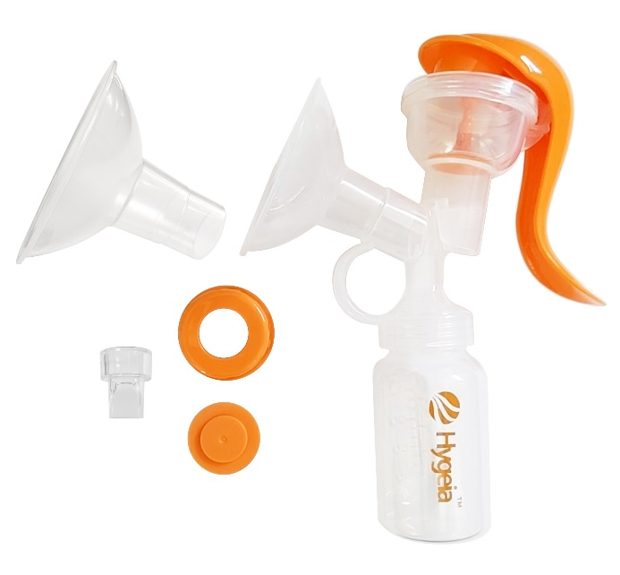
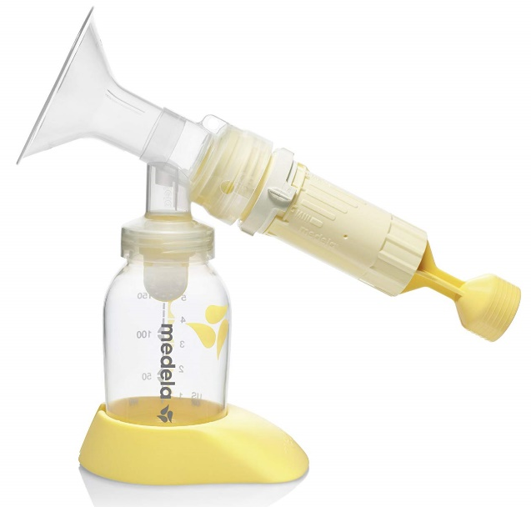
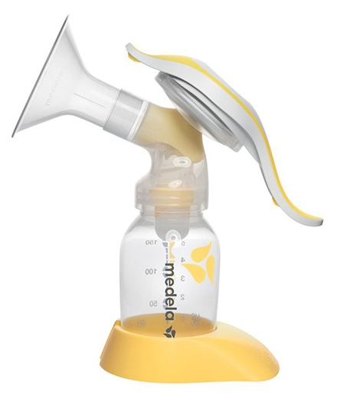
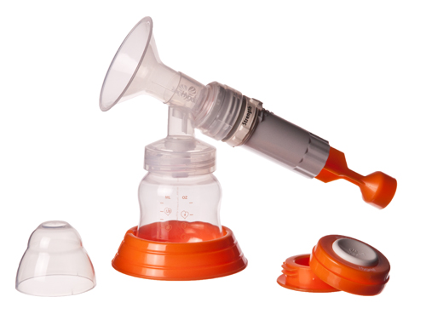
Oregon WIC Manual Pumps
One and two –handed pumps
Medela
2-handed pump
Medela Harmony
1-handed pump
Hygeia
2-handed pump
Hygeia
1-handed pump
Notes:
Manual Pumps- Reason for issuance
Ask staff:
“When might it be useful to issue a single-hand pump?”
Possible answers include: Ease, being able to use the other hand to eat, or being able to hold baby while pumping.
Summary: Manual pumps are wonderful to use for an occasional need to pump or to relieve minor engorgement

Slide 9
Manual pumps (hand pumps)
Reasons to issue a manual pump
  Attempting to breastfeed or provide breast milk
  Temporary issues
    Minor engorgement
    Over supply of milk
    Plugged duct or sore nipples
  Participants who need to pump for infrequent separation from their baby
Notes:
Pump selection & education
Manual Pumps- Reason for issuance
Ask staff: “When might it be useful to issue a one-hand pump?” (Ease, can use the other hand to eat or to hold baby while pumping)
Summary: Manual pumps are wonderful to use for an occasional need to pump or to relieve minor engorgement

Slide 10
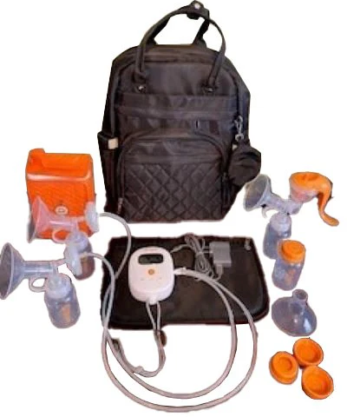
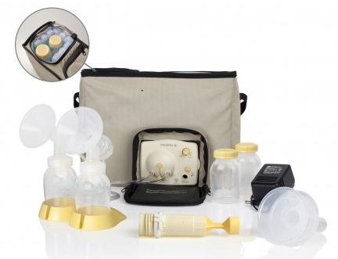
Oregon WIC single-user electric pumps
Medela Pump in Style
Hygeia Pro
Notes:
Single-user pumps offered through Oregon WIC:
Oregon WIC supplies two models of single-user electric pumps.
Cover only the pumps your agency has available.
Hygeia Pro
This pump has a backpack and rechargeable battery. This pump can be ordered through Oregon WIC. This pump is covered under warranty for one year after issuing it to a participant.
Medela Pump in Style
Some clinics may still have some of these pumps on site.
This pump can be ordered through Shopify, when inventory is available. This pump does not have a rechargeable battery. A car battery adapter is available through Shopify.
This pump is not under warranty:
A replacement single-user pump can be issued to a participant if the pump fails while the participant is active on WIC within the same postpartum period the original pump was issued.
Email your nutrition consultant or State breastfeeding coordinator stating a second pump was issued. Document the State was notified in the participant’s chart in the WIC data system.

Slide 11
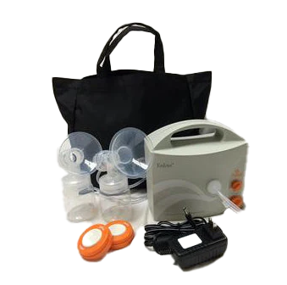
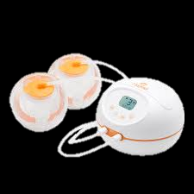
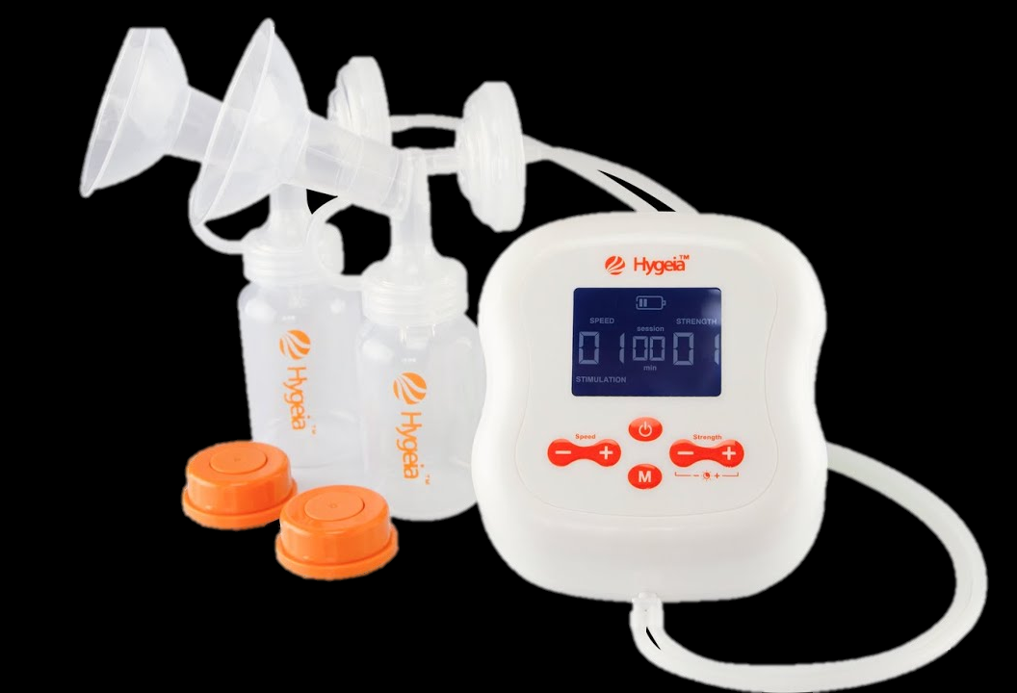
More single-user electric breast pumps
Hygeia Evolve
Hygeia- EnJoye
Hygeia Express
Notes:
Additional Single-user electric breast pumps
Cover only the pumps your agency has available.
Availability of single-user electric pumps varies by local agency and potential surplus inventory available at the State WIC Office. If your clinic has one of these pumps, we encourage you to discuss with your staff your plan to issue these pumps. Only discuss the pumps you have in your local agency's pump inventory.
Hygeia Evolve
This pump is no longer available to order through Hygeia, nor in Shopify. The warranty on these pumps is expired.
Hygeia EnJoye
Some clinics may still have some Hygeia EnJoyes. They are no longer available to order through Shopify. The warranty on these pumps is expired.
Hygeia Express
Not currently available through the Oregon WIC Program. Warranty is active.

Slide 12
Single-user electric breast pumps
Reasons to issue
  Experiencing separation from infant for any period
    Returning to work/school
    Hospitalization of parent or infant
  Problems associated with
    Poor latch
    Low milk supply
  Pumping a few times per day and several days per week
  Exclusive pumping (when a multi-user pump is not available)
Notes:
Single-user electric breast pumps
Cover only the pumps your agency has available.
Reasons to issue
Experiencing separation from infant for any period
Returning to work/school
Hospitalization of parent or infant
Problems associated with
Poor latch
Low milk supply
Pumping a few times per day and several days per week
Exclusive pumping (when a multi-user pump is not available)
Summary:
Post-partum participants need to ask their insurance for a pump before WIC can provide one. In rare circumstances, WIC can provide a single-user electric pump when the participant’s goal is to provide their own milk to their infant by expressing with a pump several times a week and they can’t get a pump through their insurance.

Slide 13
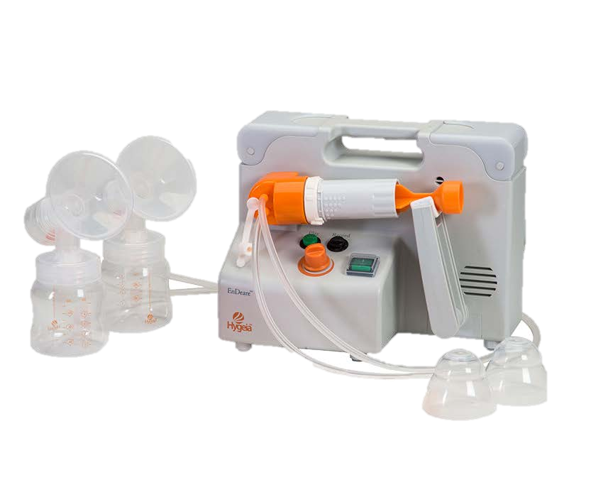
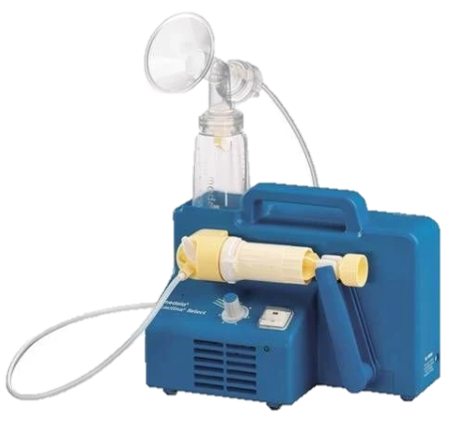
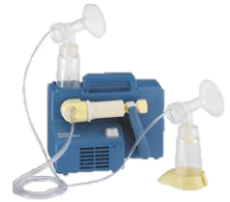
Oregon WIC Multi-user Electric Breast Pumps
Hygeia EnDeare
Medela Lactina Select
Medela Lactina Plus
Notes:
Oregon WIC multi-user electric breast pumps
Cover only the pumps your agency has available.
Description
The Hygeia EnDeare and the Medela Select are the main two pumps Oregon WIC clinics will have in their inventory.
Optional pump to discuss if available to your agency
Some WIC clinics have access to Medela Symphony pumps. These pumps are not offered through the Oregon WIC Pump Program.
Phasing out of the multi-user pump program:
The Oregon WIC Program is moving to a single-user pump program.
No new multi-user pumps will be ordered starting in 2026.
We currently have a surplus of Lactina pumps available for local agencies to order through Shopify as of March 2026.
Once the inventory is depleted, additional multiuser pumps cannot be ordered.
If your clinic has surplus multi-user pumps in your pump inventory that you no longer want, please contact your clinic’s nutrition consultant and we will discuss next steps with you.

Slide 14
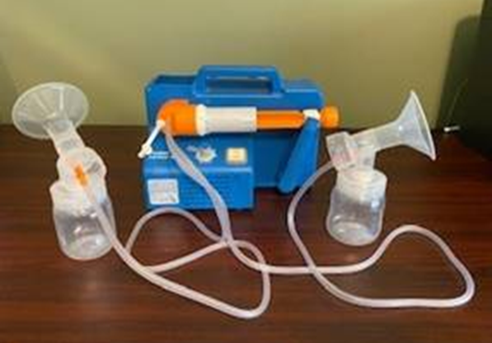
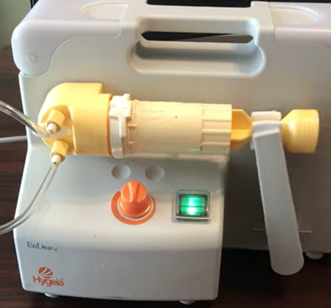
Multi-user pump kits
Medela and Hygeia pump kits are interchangeable between models
Medela Lactina Select pump with a Hygeia multi-user pump kit
Hygeia EnDeare pump with a Medela multi-user pump kit
Notes:
Pump selection & education: Multi-user pump kits
Important information to know to interchange kits:
Lactina and Hygeia multi-user pump kits are interchangeable.
The whole kit must be used
Individual parts are not interchangeable. between Medela and Hygeia products.
Use the multi-user pump kits that you have, before ordering additional
kits.
Hygeia kits can be used with Medela Lactinas or Medela kits can be used with Hygeia EnDeare.

Slide 15
Multi-user electric breast pump
Reasons to issue
  Difficulty initiating and/or maintaining an adequate milk supply
  Extended parent/infant separation
  Maternal/infant illness or separation due to surgery or medical procedure
  When there is a pregnancy loss or loss of an infant
  Other special circumstances determined by the Breastfeeding Coordinator
Notes:
Electric breast pump (Multi-user)
A WIC pump can be issued as a replacement pump for a broken pump provided by the participant’s health insurance pump in limited circumstances.
Check the policy for a replacement pump through the participant’s health insurance. Some companies have overnight delivery. In this case a hand pump might be the best pump to issue.
A second option is to issue a multi-user pump if available while the participant waits for the pump from their health insurance. This includes replacement pumps, repaired pumps, or new pumps.
Another option is to issue a WIC double-electric pump as a single-user replacement pump. The next slide reviews issuing a Lactina multi-user pump as a single-user pump.
Summary:
Multi-user breast pumps can be issued for various reasons, if a participant is expected to pump long-term, a single-user pump is generally the most appropriate option.
Situations requiring longer use must be re-evaluated as determined by WIC staff (usually monthly intervals.)
Situations requiring longer use must be re-evaluated as determined by WIC staff (usually monthly intervals.)
The participant’s goal is usually to provide their own milk to their infant by expressing with a pump several times a week.

Slide 16
Issuing a Lactina as a single-user pump
Reasons to issue
  Premature or medically fragile baby
  Parent is exclusively pumping
Medela Lactina Select
Back to menu
Notes:
Issuing a Lactina as a single-user pump
​Local agencies can decide if they want to issue a Lactina as single-user pump. If your agency decides to do this, talk to your staff about when and how to issue this pump as a single-user or as a multi-user pump. ​
​Important information to know when issuing a Lactina as a single-user pump:​
The Lactina inventory is limited. The State will not be ordering more after the Lactina inventory is gone. ​
The warranty on this pump has expired.​
​Issuing a Lactina as a single-user pump
Consider issuing a Lactina as a single-user pump when
The participant didn’t receive a single-user pump through WIC or through their health insurance ​
Participants meet criteria:
Infant is medically fragile or
Parent is exclusively pumping
Hygeia multi-user pumps cannot be issued to participants as a single-user pumps.​
Use the job aid, “Documenting issuing a Lactina as a single-user pump. The job aid is available in the Job Aid Database.
Summary: ​
The Lactina pumps are meant to be issued to participants who have premature infants (NICU), medically fragile infants or for participants who are exclusively pumping.
End of Section 1
Click the home icon to return to the menu or end your in-service here

Slide 17

Section 2
Supporting families who express milk
Objective:
At the end of this section staff will be able to identify components of a breastfeeding assessment
Notes:
Section 2: Supporting families who express milk
Objective: At the end of this section staff will be able to identify components of a breastfeeding assessment.

Slide 18
Supporting families who express milk
Focus: WIC’s impact and completing a breast pump assessment
In this section:
  Real Moms: Milk and Expression video (2:44 minutes)
  Pumps can interfere with breastfeeding
  Completing a breast pump assessment
  Components of a breast pump assessment
Notes:
In this section:
Real Moms: Milk and Expression video (2:44 minutes)
Pumps can interfere with breastfeeding
Begin by completing a breast pump assessment
Components of a breast pump assessment

Slide 19

Support for families who express milk
What we do at WIC has meaningful impact on families we support
Notes:
Supporting families who express milk: Real Moms: Milk Expression and Pumping (video)
This video is embedded in the slide.
Click to start.
Click “CC” in the bottom right corner for closed captions.
Activity (Video, 2:44 min): USDA WIC Breastfeeding Support website (https://wicbreastfeeding.fns.usda.gov/video-milk-expression-and-pumping)
Video summary: This video touches on the needs and feelings of participants who pump and how skilled WIC staff can help shape a participant's breastfeeding journey by listening and providing supportive care to meet the individual’s needs.
Optional Post video activity:
Explore how WIC staff feel about providing pump assistance with WIC participants by asking staff to consider sharing any pump stories or thoughts they may have about the role WIC plays with providing support to participants who pump.

Slide 20
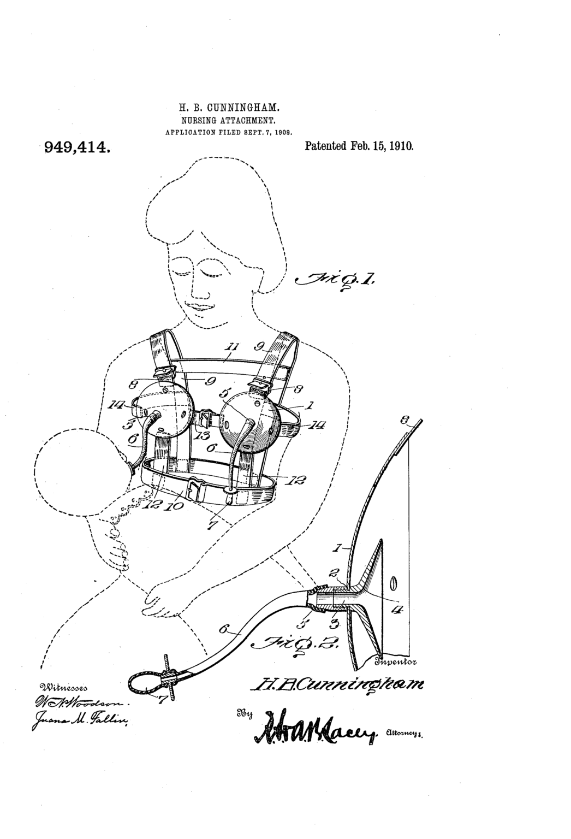
Pumps can interfere with breastfeeding
May lead to early introduction or unnecessary use of formula
Improper use can lead to discomfort
Possible nipple confusion
May affect confidence
Notes:
Sometimes pumps interfere with breastfeeding
Addressing pump interfering with breastfeeding.
Ask staff: “How can pumps interfere with breastfeeding?”
Answers:
May lead to early introduction or unnecessary use of formula.
If used improperly, pumps may cause discomfort.
Could lead to nipple confusion/flow preference in baby. Babies may like the flow from the bottle more than at the breast.
Using a pump may affect a parent’s confidence. If they compare how much they pump with how much others are pumping, social media comparisons, or think how much they pump is how much their bodies are producing.

Slide 21
Supporting families who express milk begins by completing a breast pump assessment
A breast pump assessment:
is the primary tool used to support families expressing milk
helps identify how feeding and pumping are going and what additional support may be needed​
allows for assessment-based support for individualized pumping education tailored to each family
Notes:
Breast pump assessment
Focus: The importance of completing a breast pump assessment with participants who express their milk.
A breast pump assessment provides the key information WIC staff need to support a parent with milk expression.
Completing the assessment with the participant opens the door to probe and learn how things are going, and what additional support may be needed.
This assessment allows WIC staff to individualize pumping education and support to meet the unique needs of each family.

Slide 22
Components of a breast pump assessment
Discover why pumping is needed or wanted
Determine if the participant is exclusively pumping or is pumping and breastfeeding
Assess participant’s knowledge and strengths
Offer education and support to meet their unique needs
Continued on next slide
Notes:
Breast pump assessment
Review components of a breast pump assessment when issuing a pump:
Discover why pumping is needed or wanted
Hearing their reasons for pumping helps staff understand the participant’s knowledge about breastfeeding and milk supply. This conversation helps to identify gaps in understanding and determines the appropriate level of education, support and follow-up needed.
Determine if the participant wants to exclusively pump or pump and breastfeed.
The participant’s goals help determine staff steps for issuing a pump.
Assess participant’s knowledge and strengths about pumping
Do they have support, a place to pump, desire to pump, etc.?
Learning what they already know and what is working helps tailor education to their needs.
Offer education and support to meet their unique needs
Providing education to meet their needs is key to supporting their efforts.
Slide 52 provides pump resources to offer participants to meet their specific needs.

Slide 23
Components of a breast pump assessment (continued)
Create a pumping plan with the participant
Document the breast pump assessment
Yield/refer to a WIC designated breastfeeding expert or lactation support in the community, when appropriate
Ensure 48- hour follow-up is completed and documented after pump issuance
Back to menu
Notes:
Breast pump assessment (continued)
Review components of a breastfeeding assessment when issuing a pump:
Create a pumping plan with the participant.
Focus on their strengths to help them be successful with their efforts.
Slide 43 reviews key components of creating a pumping plan.
Document the breast pump assessment
Documentation of the assessment is recommended but not required. It can happen in various places in the WIC data system. To help retain consistency with documentation, discuss with your staff where your agency documents components of the breast pump assessment.
Breast Pump Questionnaire can be found in the WIC data system’s BF Tracking tab.
Progress Notes can be used to capture the breast pump assessment
Nutrition Education dropdowns can be used to document components of a breast pump assessment.
Note section in the BF Tracking tab can be a space where the breast pump assessment can be documented.
Breastfeeding Topics dropdown in the BF Tracking tab can be used to document elements of the breast pump assessment.
Yield/refer to a WIC designated breastfeeding expert or lactation support in the community, when appropriate.
Documentation of referrals and yielding helps ensure continuity of care and follow-up.
Ensure 48- hour follow-up is completed and documented after pump issuance
Slide 47 reviews 48-hour follow-up requirements
End of Section 2
Click the home symbol to return to the menu page or end the in-service here.

Slide 24

Section 3
Pump assembly and equipment (ACES)
Objective:
At the end of this section staff will be able to demonstrate how to issue a pump using ACES (Assembly, Cleaning, Expressing, Storage)
Notes:
Section 3: Pump assembly and equipment (ACES)
Objective: At the end of this section staff will be able to demonstrate how to issue a pump using ACES (Assembly, Cleaning, Expressing, Storage)

Slide 25
Pump assembly and equipment (ACES)
Focus: Issuing pumps and proper equipment use
In this section:
  How to issue a breast pump using ACES
    Assembly
    Cleaning
    Express
    Storage
    Practice
Notes:
ACES is an acronym used to guide staff with the steps to coach participants about when issuing a breast pump: Assembly, Cleaning, Expressing, and Storing
In this section:
How to issue a breast pump using ACES
Assembly
Cleaning
Express
Storage
Practice

Slide 26
A is for Assembling
  All clinics should have a demonstration model of the pumps they provide
  WIC staff can assemble the demo pump along side the participant who is assembling their new pump
  Most pumps are 5 pieces or less
Notes:
ACES: Assembly
Recommended activity:
if you use the Hygeia Pro at your clinic, view the Hygeia Pro instructional video
Assembly and functionality of the Hygeia Pro - Meeting with Tom Dempski (30 min)
Optional activities:
View instructional videos if your staff want or need a refreshener on pump assembly and demonstration tutorials for the pumps your clinic provides.
Hand pump (https://www.youtube.com/watch?v=7KhJG6W3ciQ) 1:24 min
Hygeia Enjoye https://www.youtube.com/watch?v=QxZS3J1Yhi0 (2:54 min)
Hygeia Evolve pump demonstration https://www.youtube.com/watch?v=H6kuNFzWaHM (35 min)
Medela Personal Pump https://www.youtube.com/watch?v=rtLtqkEgXCM (10:23 min)
Optional activity:
Pair staff to practice or have WIC staff show the WIC DBE or breastfeeding coordinator how to assemble the pumps your clinic provides. Use the Milk Expression Competency Checklist to show the WIC staff knows the steps of issuing the pumps.

Slide 27
C is for Cleaning
Clean Pump parts in soapy water
Run the pump to dry inside tubing after pumping
Do not submerge tubing in water
Demonstrate removing connectors and valves for cleaning
Encourage care with plastic membranes.
A rip affects suction
Notes:
ACES: Cleaning
More information on teaching participant about cleaning and maintenance for pumps is available in the Breast Pump Handbook (Teaching pump cleaning and maintenance, page 25)
Maintaining a clean pump kit and pumping environment is important when expressing human milk.
It is important to keep the pump clean to reduce the chance of unwanted bacteria and dirt build-up on the pump.
Educate pumping participants on the best way to keep their pumps clean and their milk safe for baby.
Cleaning instructions:
Run the pump for 2-minutes or more after a pumping session will help dry out any condensation that forms during pumping.
Tubing only needs to be washed when it comes in contact with milk or somehow gets soiled.
The yellow piece on Medela products is the valve. This piece must be included in cleaning because milk splashes where the valve fits the connector and flange.. Users often forget to remove this piece when cleaning.
Double-electric pump kits come with extra valve membranes. More can be ordered through Shopify.

Slide 28
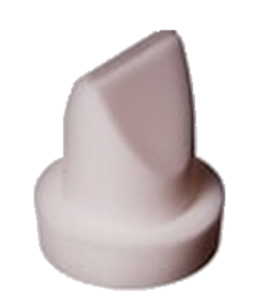

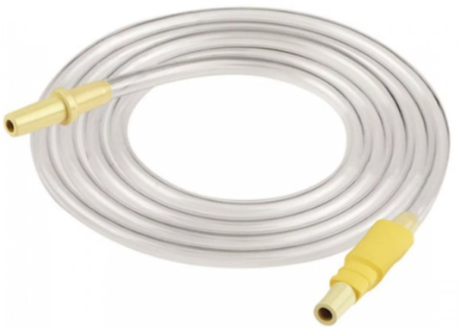
Cleaning
Duckbill valve
Membrane and Valve
Tubing
Notes:
ACES: Cleaning
Soft, plastic parts of a pump wear out. The more the pump is used, the faster these parts become worn. Exclusive pumping or frequent use of the pump may lead to these parts being replaced more frequently. Here’s an idea of how often parts may need to be replaced:
Membranes and duckbills may need to be replaced every 2-3 weeks
Tubing every 4-6 weeks
Breast shields (flanges) every 3-6 months

Slide 29
E is for express
Discuss the participant's plan for expressing milk
Fit the participant with a breast shield (flange) when issuing a WIC pump
Listen for common pumping concerns and address them as needed
Provide encouragement
Notes:
ACES: Express
More information about milk expression is available in the Breast Pump Handbook.
Discussing the participant's plan for expressing milk:
Meet the participant where they are and to support their individual goals.
Help set realistic expectations and achievable goals based on their situation, experience, support, and comfort level with pumping.
Breast shield fitting and common pumping concerns:
Section 4, Pumping Techniques & troubleshooting, reviews how to fit a breast shield and common pumping concerns.
Provide encouragement:
Encouragement is essential.
You may be the only person supporting them or the only one telling them they are doing a good job.
Acknowledge their efforts and reinforce that what they're doing matters, and they are a good mom.
Optional activity:
Ask staff to share affirmations they use with their participants.

Slide 30
S is for storage
Review the basics:
  Freshly expressed or pumped milk can be stored at room temperature for 4 hours, longer in the refrigerator or freezer
  Store in small amounts when freezing
  Thaw under warm water, never reheat in microwave
  Use within 2 hours after baby finished eating
  Never refreeze breastmilk
Notes:
Pump assembly & equipment: ACES: Storage
WIC staff can provide anticipatory guidance on the safe handling of breast milk when participants plan to pump.
Facilitator note:
Review basic information as a reminder. Below are resources for milk storage.
For current CDC guidelines: https://www.cdc.gov/breastfeeding/breast-milk-preparation-and-storage/handling-breastmilk.html The CDC PDF can be printed on magnets through a printing service. English: https://www.cdc.gov/breastfeeding/pdf/HumanMilk-en-4x6-508.pdf Spanish: https://www.cdc.gov/breastfeeding/pdf/HumanMilk-sp-4x6-508.pdf We have provided these pdfs as a handout for this section of the in-service.
The following tips for storage are from the following sources: Office on Women’s Health https://womenshealth.gov/breastfeeding/pumping-and-storing-breastmilk Oregon and Minnesota WIC.
Job Aid: Safe Milk Storage
Storing and Thawing Breast Milk
Storage and Preparation of Breast Milk – English
Storage and Preparation of Breast Milk – Spanish
Pumping and storing breast milk (English and Spanish) - Shopify

Slide 31
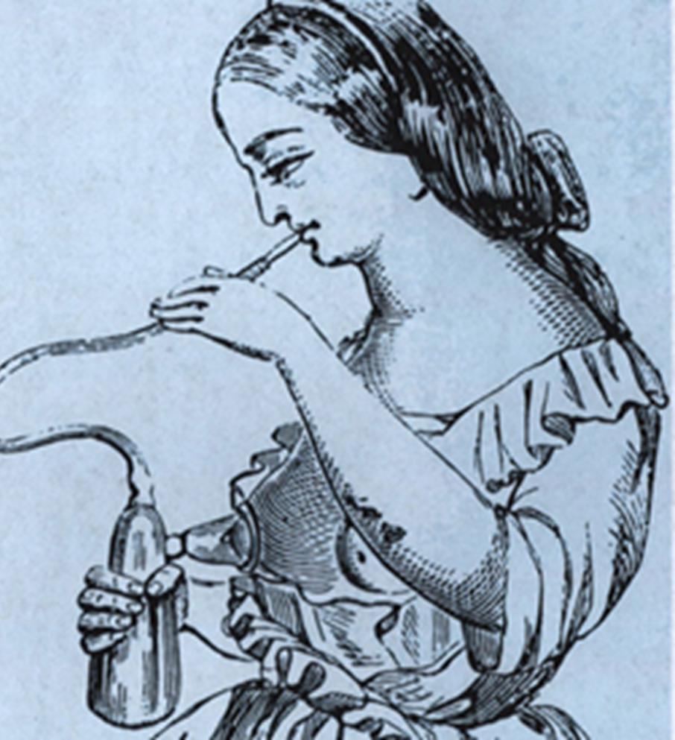
Practice issuing a pump using ACES
Remember
  Assembly
  Cleaning
  Express
  Storage
Back to menu
Notes:
Practice issuing a pump using ACES
Optional Group Activity:
As a group (or individually) go through the ACES steps for teaching pump education which include pump assembly, cleaning the pump, expressing milk and milk storage guidelines. Then practice assembling and disassembling each type of breast pump your agency provides until staff is comfortable with the pumps
Demonstration:
Role play
In groups of two have one person be the staff member and one person be the WIC participant. Both people have the same model breast pump. The staff person will walk through the breastfeeding assessment using ACES technique with the “WIC participant”
Optional: Use the job aid, “Milk Expression Competency Checklist” to staff demonstrated how to issue a breast pump using ACES This job aid can be found in the job aid database.
End of section 3
Click the house to return to the menu or end your in-service.

Slide 32

Section 4
Flange fitting, pumping techniques, and troubleshooting
Objectives:
At the end of this section staff will be able to
Describe how to fit a breast shield
Describe strategies or schedules for expression
Notes:
Section 4:
Flange fitting, pumping techniques, and troubleshooting
Objectives:
At the end of this section staff will be able to
Describe how to fit a breast shield (flange)
Describe strategies or schedules for expression

Slide 33
Flange fitting, pumping techniques, and troubleshooting
Focus: Effective pumping, concerns, and planning
In this section:
  Breast shield (flange) fitting, videos, and takeaways
  Common pumping concerns:
    Milk supply
    Maintaining supply when exclusively pumping
    Discomfort
  Develop a pumping plan
Notes:
Section focus: Effective pumping, concerns, and planning
In this section:
Breast shield and flange fitting, videos, and takeaways
Common pumping concerns:
Milk supply
Maintaining supply when exclusively pumping
Discomfort
Develop a pumping plan

Slide 34
Breast Shield (Flange) fitting
A properly fitted breast shield is key for allowing adequate pump suction and milk removal
An incorrect breast shield size can lead to:
  clogged milk ducts
  mastitis
  lower milk supply
  nipple pain
  damage
Notes:
Breast shield (flange) fitting
Additional information is available in the Breast Pump Handbook (page 51).
A properly fitted breast shield is key for allowing adequate pump suction and milk removal
An incorrect breast shield size can lead to:
clogged milk ducts
mastitis
lower milk supply
nipple pain
damage

Slide 35
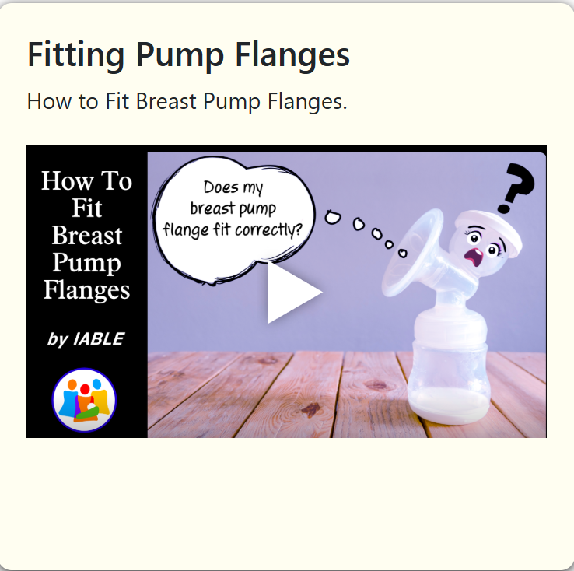
Fitting Pump Flanges
(about half-way down the page)
Notes:
Real life examples showing how to fit a breast shield and what proper fit looks like.
Fitting Pump Flanges – scroll to video about halfway down

Slide 36
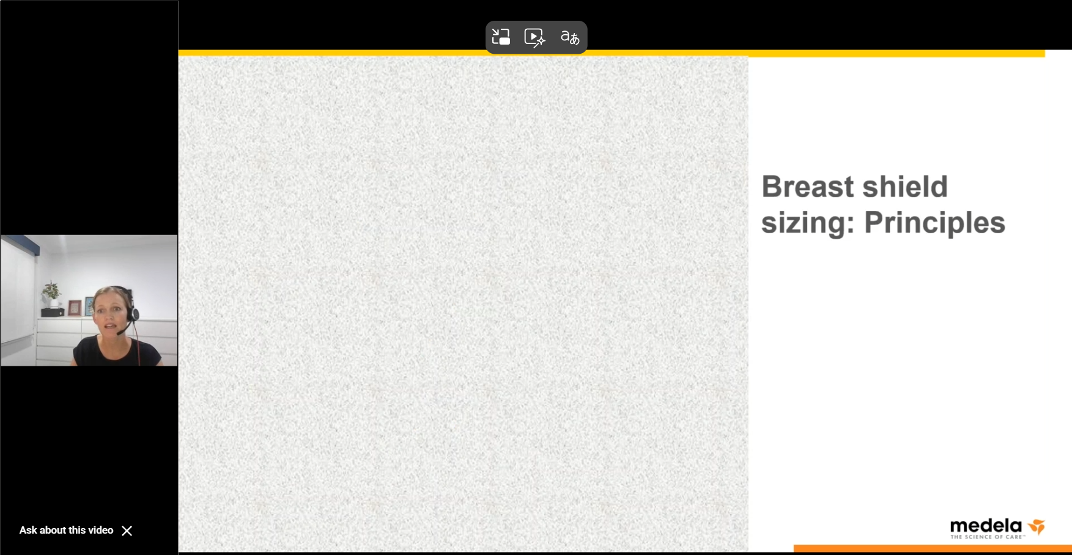
Breast shield sizing: translating the evidence
Notes:
Click to start at 32:29 minutes
Medela Webinar: breast shield sizing-translating the evidence
In depth description of how to properly fit a breast shield and reasons why proper fit is important for expressing milk.
Start at 32:26 minutes and end at 45 minutes.
The link is cued to this spot. Watch to 45 minutes.
Discussion questions on slide 38 focus on this video.

Slide 37
Watch some videos to get started
Fitting Pump Flanges
(about half-way down the page)
Medela Webinar: breast shield sizing-translating the evidence
Start at 35 minutes and end at 45 minutes.
Medela Breast Shield Fitting
Medela Fact Sheet
Notes:
.
Optional videos
This slide is hidden.
It will not show during your presentation. It will show if a person is reading the slide deck independently.
The first two links are the required videos on slides 36 and 37. The second two links are videos your staff may find helpful. Share them if appropriate.
Additional videos (optional)
Medela Breast Shield Fitting
Basic overview of how to fit a breast shield.
Medela Fact Sheet
A written resource for flange fitting.

Slide 38
What do you think?
What were some of the issues with a too large or too small breast shield?
What are some signs during pumping that a breast shield does not fit correctly?
When should a participant be referred to your agencies Designated Breastfeeding Expert for breast shield fitting?
How can we support participants with breast shield sizing using a hands-off approach?
Notes:
Breast shield (flange) fitting discussion
Post video discussion questions for the Medela Webinar: breast shield sizing-translating the evidence video from minute 32:26 to minute 45
What were some of the issues with a too large or too small breast shield?
What are some signs during pumping that a breast shield does not fit correctly?
When should a participant be referred to your agencies Designated Breastfeeding Expert for breast shield fitting?
How can we support participants with breast shield sizing using a hands-off approach?

Slide 39
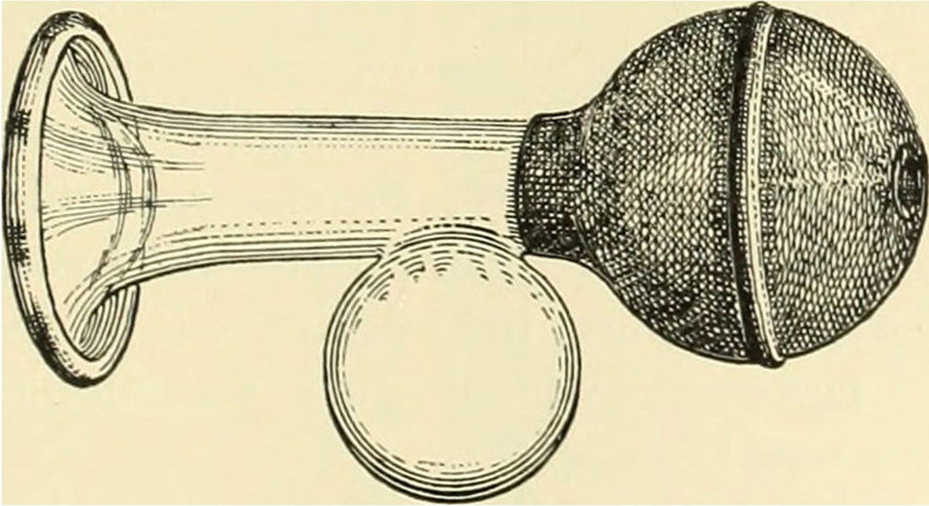
Video takeaways
Notes:
Flange fitting takeaways
The main culprit for sore nipples during pumping is using an incorrectly sized breast shield.
Re-evaluating fit is important for problems related to pumping such as sore nipples, recurrent plugged ducts or low milk supply.
Breast shield sizing is a tool to improve participants pumping journey. The right size is a balance of comfort, performance and safety.

Slide 40
Common pumping concerns:
Milk supply
Milk supply can change and can cause a parent to be concerned about their supply
Pumping can affect how much milk is made
  Pump more often to make more milk
  Pump less often to make less milk
Notes:
Common pumping concerns
Milk Supply
Many pumping participants are concerned about milk supply. These concerns about supply may have led to pumping to increase supply. Sometimes frequent pumping causes an oversupply of milk.
WIC staff can support pumping participants in maintaining an adequate supply after assessing the situation.
The pumping plan may need to increase the frequency of pumping for a participant with low milk supply or decrease the frequency for an oversupply.

Slide 41
Common pumping concerns:
Maintaining supply when exclusively pumping
Discuss the participant’s feeding goals and plans
Ask whether feeding at the breast is an option
Encourage early initiation of pumping after birth
Emphasize frequent pumping to establish supply
Include nighttime expression to support full milk supply
Refer/yield to a WIC DBE or IBCLC for additional lactation support as needed
Notes:
Common concerns
Maintaining supply when exclusively pumping
Assess if direct breastfeeding is an option for the family. If so, encourage continued breastfeeding at the breast.
Studies have shown with pre-term infants that early initiation and frequent pump sessions (at least five to six in 24 hrs. aim for 8 in 24 hours) may increase the establishment of a full milk supply when exclusively pumping.
Nighttime expression is required to maintain full milk capacity during early lactation. The length of time between pump sessions at night depends on the storage capacity of the parent and frequency at which the baby is eating.
Potential support option: WIC clinics who have a surplus of Lactina pumps could discuss if they want to permanently issue Lactina pumps to the exclusively pumping participant. To learn more about this option, please reach out to your local agency’s nutrition consultant or to the breastfeeding coordinator at the Oregon WIC Program.
More information about milk supply is available in the Breast Pump Handbook.

Slide 42
Common pumping concerns:
Discomfort
What can cause breast and nipple pain when pumping?
Over production or swelling
Incorrect sizing of breast shields
Pump vacuum set too high
Vasospasm
Pump cycle set too fast or slow
Long pumping sessions
Dermatitis
Notes:
Slide is animated: click to answer categories for the question. There are 7 answers.
Common pumping concerns: Breast and nipple reveal pain
Ask: “What can cause breast and nipple pain when pumping?”
Review answers as needed:
Overproduction: Increase in supply can create an issue with the breast shield fitting correctly.
Incorrect sizing of breast shields: An overly tight breast shield can pinch the nipple and breast tissue, potentially causing damage to this tissue. It is not uncommon to need to use different sized breast shields during a person’s pumping journey because of changes in breast and nipple sizes
Pump vacuum set too high: Nipple and breast pain or discomfort, nipple swelling, blanching, or bruising, tissue trauma or cracked nipples, reduced milk flow due to pain and stress, increased risk of inflammation or vasospasm, pumping may become less effective over time.
Vasospasm: If the pump vacuum setting is too hard or the breast shield doesn’t fit properly, cold exposure, or nipple trauma can cause vasospasms which are painful, sharp pain, burning, or throbbing during or after pumping. Nipples may change color (white, blue, or red)
Refer or yield participants to a WIC DBE for assistance if they’re experiencing vasospasms that are unexplained, or are untreated, the WIC DBE can provide guidance to manage symptoms and support continued breastfeeding.
Pump cycle set fast/slow:
Cycle is set too fast: can cause nipple pain or irritation, can feel too over stimulating, and can reduce milk flow if the body is tense and won’t release oxytocin, the milk ejection hormone.
Cycle is set too slow: May feel like pulling or tugging and can lead to nipple soreness or swelling. It may not trigger or maintain stimulus for milk ejection.
Long pumping sessions: Most pumping sessions last about 20 minutes. If participants are pumping longer than 20 minutes, reevaluate and offer to yield/refer to a WIC DBE for follow-up, if needed.
Dermatitis: from pump cleaning products or nipple ointment use.
Summary:
Comfort matters- Pain can reduce milk output, it may be caused by many different factors and can lead to shortened breastfeeding duration. Pumping should be comfortable and effective. WIC staff support participants by adjusting pumping plans to meet their comfort, needs, and feeding goals.

Slide 43
Develop a plan for pumping
A pumping plan includes:
  How often the person will pump
  Where they will be pumping (home or work)
  How much time the person has for a pumping session
  Instructions for keeping the pump clean and storing milk
  When to reevaluate the pumping plan
  Schedule a 48-hour check in
Back to menu
Notes:
Pumping plan
Develop a plan for pumping to maintain adequate milk production
Pumping frequency
How often to pump? This varies from person to person and with the circumstances. This is a basic rule.
Pump about as often as the baby normally would eat.
Most babies eat every 2-3 hours. (Around 8-12 times in 24 hours)
Exclusive pumping- Pump at least 5-8 times in 24 hours
Younger babies- may need to pump closer to every 2-2.5 hours
Pump whenever breaks are available.
Pumping location (home or work)
Home:
Suggest pumping in the morning, when milk supply is usually the highest.
Pumping after breastfeeding may yield less milk pumped.
Combine milk from multiple pumps into one container if needed.
Only pool cooled milk with cooled milk.
If freezing the milk, freeze it the same day as it was collected.
Pumping one breast while the baby nurses on the other can often yield more milk in less time.
Work or school:
“How long will you be away from your baby, including commute time”
Explain the amount of time away from the baby will determine how many times you will need to pump.
8-hour pumping plan example (most common)
“If you are away for about 8 hours, try to pump every 3 hours. That usually means pumping 2-3 times while you are away.”
Example:
Pump or breastfeed before leaving to go to work. (Recommend it is the last thing the parent does before commuting to work. Sometimes they can nurse at the sitters before commuting to work.)
Pump mid-morning
Pump mid-afternoon (or try to have baby brought to the parent to nurse or for the parent to go home to nurse at lunch if the commute isn’t far.)
Breastfeed when reunited (Recommend breastfeeding the baby before leaving the sitters if the commute is longer than a few minutes. Ask the sitter not to feed the baby at least an hour before you are due to pick up the baby if you want to breastfeed right away.)
Length of pumping sessions: How long to pump?
Most pumping sessions take about 20 minutes.
Sometimes pumping can slow down if a person isn’t relaxed.
Ask staff:
“What are some relaxation techniques you tell participants?”
Relaxation examples:
If you need help to get your milk to start flowing without your baby there, you can:
Think about the things you love about your baby. Bring a photo or a blanket or item of clothing that has your baby's scent on it.
Apply a warm, moist cloth to your breasts.
Gently massage your breasts.
Gently rub your nipples.
Visualize the milk flowing down.
Sit quietly and think of a relaxing setting.
Duration of pumping plan & scheduling the 48-hour check-in
When to reevaluate pumping plan?
If the pumping plan isn’t meeting the participant’s needs.
They’re requesting formula
Offer encouragement: “Any pumping you can do helps keep up your supply.”
Summary: WIC staff can assist with creating a successful pumping experience by ensuring the pump fits correctly.
End of Section 4.
Click the house to return to the menu or end the in-service

Slide 44

Section 5
Documentation and Workflow
Objective
At the end of this section staff will be able to describe their agency’s workflow for a 48-hour pump follow-up
Notes:
Section 5: Documentation and Workflow
Objective: At the end of this section staff will be able to describe their agency’s workflow for a 48-hour pump follow-up

Slide 45
Documentation and workflow
Focus: Paperwork, follow-up, and practice skills
In this section
  Educational resources
  48-hour follow-up after issuing a pump
  Breast pump scenarios
Notes:
Focus: Paperwork, follow-up, and practice skills
In this section:
Educational resources
48-hour follow-up after issuing a pump
Breast pump scenarios

Slide 46
Educational resources
Shopify
Pumping & Storing Breastmilk (Eng/Span)
Hand Expression (Eng/Span)
Breastfeeding Employee Rights Flyer (Eng/Span)
Links to resources
Your Guide to Breastfeeding from the Office of Women’s Health
Going Back to Work or School (video)
Hand expression of Breastmilk (video)
Notes:
Documentation & workflow
Educational resources for participants
What resources do your staff use?
Ask staff “What are some of the resources you use to educate participants about pumping?”
Resources:
Shopify:
Pumping & Storing Breastmilk (Eng/Span)
Hand Expression (Eng/Span)
Breastfeeding Employee Rights Flyer (Eng/Span)
Links:
Office of Women’s Health downloadable guide:
Your Guide to Breastfeeding
USDA WIC Breastfeeding Support Video:
Going Back to Work or School
Standford Medicine Video:
Hand Expression of Breastmilk
https://wicbreastfeeding.fns.usda.gov/video-going-back-work-or-school (2min)
https://med.stanford.edu/newborns/professional-education/breastfeeding/hand-expressing-milk.html (7:33 min)

Slide 47
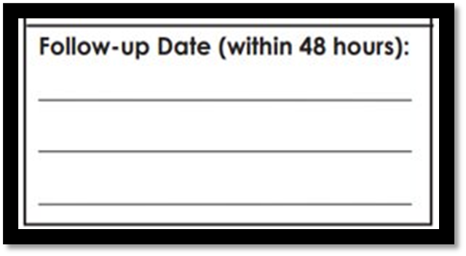
48-hour pump issuance follow-up
Contact with the participant is required 48 hours after issuing a pump
Document the 48-hour contact or the attempt
This supports a successful start to pumping
Notes:
48-hour follow-up
What method does your agency use to track 48-hour follow-up attempts and contacts?
Discussion:
Review your agency’s 48-hour follow-up policy with your staff
Background information:
The pump loan agreement form for multi-user pumps and the pump release form for single-user pumps has been updated to include a section for follow up within 48 hours.
Check to make sure your staff are using the most updated forms. https://www.oregon.gov/oha/PH/HEALTHYPEOPLEFAMILIES/WIC/Pages/breastfeeding.aspx
They can be ordered in print form from Shopify.
They can be completed electronically on the form found on our website.
When any WIC pump is issued to a participant, staff must attempt to contact the participant within 48 hours to assess if further assistance is needed.
48-hour contacts, and attempted contacts, can be documented on the pump release form, in the WIC data system or on a local agency tracking form.

Slide 48
Time to practice!
Read the next three scenarios
Discuss the possible counseling outcomes
Notes:
You may use the scenarios in this slide deck or create your own scenario to review with staff or complete one or more of the following three scenarios together in a group or pair people up to discuss the scenarios.
Let’s practice figuring out which pump to issue participants based on their needs.

Slide 49
Breast pump scenario: Heather
Heather comes into the WIC office for a breast pump. Her son is 6 weeks-old and she is exclusively breastfeeding.
She is going back to work in one week. She’ll be working as a waitress doing split shifts 4 hours in the morning and 4 hours at night.
She won’t have time to pump at work but only works 5 minutes from home. The baby will be staying with grandma while she is at work.
She would like to pump while at home to store breastmilk for when she is away. Her goal is to breastfeed until at least 6 months.
Notes:
Breast pump scenario: Heather
Heather comes into the WIC office for a breast pump. Her son is 6 weeks-old and she is exclusively breastfeeding.
She is going back to work in one week. She’ll be working as a waitress doing split shifts 4 hours in the morning and hours at night.
She won’t have time to pump at work but only works 5 minutes from home. The baby will be staying with grandma while she is at work.
She would like to pump while at home to store breastmilk for when she is away. Her goal is to breastfeed until at least 6 months.
Possible counseling outcomes:
Certifiers will need to use critical thinking skills, these are suggestions.
Ask her how often she works.
If she works more 3 or more days per week, then a single-user double electric pump might be appropriate to offer her.
If she works 2 times per week or fewer, then a hand pump might be appropriate to offer her.
Explore the possibility of Grandma bringing the baby to work, so she can breastfeed baby at work. Maybe it is only one shift a day she does that. Or once or twice a week.

Slide 50
Breast pump scenario: Maureen
Maureen is the mother of a 6-month-old exclusively breastfed girl, Olivia. Maureen shares join custody with her ex-husband.
They have decided the baby will spend one night during the week and one night during the weekend with her father.
Maureen wants to continue providing her breastmilk along with other solid foods.
She needs a breast pump to pump at least 6 times a day for the 2 days a week they are separated. Her goal is to breastfeed to at least one year or maybe longer.
Notes:
Breast pump scenario: Maureen
Maureen is the mother of a 6-month-old exclusively breastfed girl, Olivia. Maureen shares join custody with her ex-husband.
They have decided the baby will spend one night during the week and one night during the weekend with her father.
Maureen wants to continue providing her breastmilk along with other solid foods.
She needs a breast pump to pump at least 6 times a day for the 2 days a week they are separated. Her goal is to breastfeed to at least one year or maybe longer.
Possible counseling outcomes:
Certifiers will need to use critical thinking skills, these are suggestions.
Issue a single-user double-electric pump.

Slide 51
Breast pump scenario: Chris
Chris is returning to work at 7-11 gas station at 4 weeks postpartum.
They work 8 hours a day and has talked to their employer about wanting to pump at work.
Their employer said they may use the back storeroom if there are 2 people working and use their designated break times.
The storeroom has limited access to electricity. They don’t know how long they want to nurse but know they will do it for awhile.
Notes:
Breast pump scenario: Chris
Chris is returning to work at 7-11 gas station at 4 weeks postpartum.
They work 8 hours a day and has talked to their employer about wanting to pump at work.
Their employer said they may use the back storeroom if there are 2 people working and use their designated break times.
The storeroom has limited access to electricity. They don’t know how long they want to nurse but know they will do it for awhile.
Possible counseling outcomes:
Certifiers will need to use critical thinking skills, these are suggestions.
Issue a Hygeia single-user pump and show them how to use the battery.

Slide 52
Resources
Oregon WIC Breast Pump Handbook
FNS Pumping Web page
WIC Breastfeeding Support website
Oregon WIC Policy 712
Oregon WIC Pump Loan Agreement forms
Back to menu
Notes:
Resources
Oregon WIC Breast Pump Training- Part 1: October 2021 and Part 2: January 2022 https://www.oregon.gov/oha/PH/HEALTHYPEOPLEFAMILIES/WIC/Documents/bf/2021-2022-pump-training.pdf
USDA WIC Breastfeeding Policy and Guidance, July 2016 https://wicworks.fns.usda.gov/sites/default/files/media/document/WIC-Breastfeeding-Policy-and-Guidance_1.pdf
Michigan WIC Milki Expression Training Resources: https://www.michigan.gov/mdhhs/-/media/Project/Websites/mdhhs/Folder3/Folder8/Folder2/Folder108/Folder1/Folder208/Resources_for_Milk_Expression_Training_12232020_v2.pdf?rev=7ec9ef2de52344bca31ab3376833de70&hash=6DC412E83484883603870AACFB672500
Minnesota Department of Health and Minnesota WIC Pumping: Topic of the Month, August 7, 2024 https://www.health.state.mn.us/docs/people/wic/localagency/topicmonth/pumping.pdf
U.S. Department of Agriculture, USDA WIC Breastfeeding Support>>Expressing and Pumping Milk https://wicbreastfeeding.fns.usda.gov/expressing-and-pumping-milk
The Office on Women’s Health (OASH) https://womenshealth.gov/breastfeeding/pumping-and-storing-breastmilk
CDC Breast milk storage and preparation https://www.cdc.gov/breastfeeding/breast-milk-preparation-and-storage/handling-breastmilk.html
Oregon WIC Policy 712, Breastfeeding: Pump Ordering, Distribution and Tracking Guidelines, Revised- July 15, 2024 https://www.oregon.gov/oha/ph/HealthyPeopleFamilies/wic/Documents/ppm/712.pdf
AMA Journal of Ethics
WIC breast pump resources https://www.oregon.gov/oha/PH/HEALTHYPEOPLEFAMILIES/WIC/Pages/breastfeeding.aspx
Information on this site:
Oregon WIC breast pump information
Breast Pump Handbook
Breast milk storage guidelines English/Spanish
Sample letter: Request to return electric breast pump (Word) English/Spanish
Breast pump education materials
Pump loan forms and questionnaires
Breast pump management
Cleaning multi-user breast pumps
How to keep your breast pump kit clean (CDC resource) English/Spanish
Multi-user pump assessment chart
Troubleshooting pump problems
Breast Pump Training 2021-2022
Medela pressure gauge instructions
Hygeia resources
End of Section 5
Click the house to return to the menu or end your in-service.

