Slide 1

Using HIA on Climate Change Policy:
A Training Course for Public Health Professionals
Chapter 2: Climate Change Policies
Notes:
Point of slide: Space holder while introduce and explain what we had in mind.
Welcome and introductions.
The purpose of this training module is for local, state and federal public health agency professionals to understand how to apply Health Impact Assessment practice to Climate Change Policy.
See the Participant’s Guide for a complete list of all learning objectives and a description of the training elements and structure.
In Chapters One learners will:
Review how climate change will potentially impact health,
Review HIA stages,

Slide 2
Chapter 2: Learning Objectives
Define critical climate change policy or policy elements among various sectors.
Differentiate among climate change policy types (e.g. mitigation, adaptation, emergency preparedness).
Evaluate appropriateness of HIA on various climate change policy types.

Slide 3
Health Prevention Model
Primary Prevention
  Strategies to avoid the development of disease (most population based health promotion).
Secondary Prevention
  Strategies to diagnose, treat an existing disease and prevent a recurrence or exacerbation.
Tertiary Prevention
  Strategies to provide appropriate supportive or rehabilitative services to minimize morbidity and maximize quality of life after a long-term disease or injury is present.
Definitions adapted from the National Library of Medicine Medical Subject Headings, MeSH 2011

Slide 4
Climate Change Interventions for Health Departments
Primary Prevention
  Changing behaviors/decisions that contribute to atmospheric/climatic changes (Mitigation).
Secondary Prevention
  Identifying, forecasting and monitoring changes in conditions that may leave a community vulnerable to public health challenges that it may be currently ill-equipped to meet (Adaptation).
Tertiary Prevention
  Applying public health interventions to halt an additional increase in the burden of illness and injury other than rates that would have been projected irrespective of climate change (Adaptation).

Slide 5
Climate Change, Policy & Health
Natural & Human Influences on Climate
Intermediate Factors:
Crop Yields,
Air Quality, Social System,
Pollen
Climate Change
Regional Weather Change
Adverse Health Effects
Mitigation Policy or Projects
Adaptation Policy or Projects
Emergency Management Policy or Projects
Adapted from: Haines, A., Patz, J. Health effects of climate change. JAMA. 2004; 291(1): 99-103.
Notes:
Point of slide: Show how each type of climate change policy effort affects contributors to climate related health.
Mitigation policies attempt to curb greenhouse gas emissions or increase carbon sinks through forestry or other land uses. This can reduce the severity of climate change and regional weather conditions we experience.
Adaptation focuses on our social systems to reduce the negative impacts of climate change. Adaptation actions help communities adjust and respond to reduce their vulnerability to climate change conditions.
Emergency management plans and policies play a role in addressing immediate health crises. These involve responding to situations such as wildfires, floods, or disease outbreaks.

Slide 6
MITIGATION: “Technological change and substitution that reduce resource inputs and emissions per unit of output. Although several social, economic and technological policies would produce an emission reduction, with respect to climate change, mitigation means implementing policies to reduce GHG emissions and enhance sinks.” – IPCC Glossary Working Group III, p.18
Natural and Human Influences on Climate
Intermediate Factors:
(Crop Yields,
Air Quality, Social Systems, etc.)
Climate Change
Regional Weather Change
Adverse Health Effects
Mitigation Policy or Projects
Adaptation
Emergency Management
Adapted from: Haines, A., Patz, J. Health effects of climate change. JAMA. 2004; 291(1): 99-103.
Notes:
Point of slide: Reintroduce policy types, focus on Mitigation
Some agencies or jurisdictions may develop Climate Action Commissions who are charged with developing adaptation, mitigation and emergency strategies. A general climate change policy may encompass multiple actions and may need to be teased apart. For example, the Oregon Global Warming Commission recommended in 2010 that in order to meet our 2020 green house gas reduction goal (10% below 1990 levels) set forth by the Governor’s Advisory Group on Global Warming in 2004, we would need a broad state energy and climate policy that encompassed energy, transportation, social and environmental outcomes.

Slide 7
Climate Action Plans
States Developing Climate Action Plans
PEW Center on Global Climate Change http://www.pewclimate.org/
Notes:
Point of slide: States across the country are developing climate actions plans which may influence policies.
State plans may introduce actions that become state policies or affect county and cities.
Image source:
http://www.pewclimate.org/what_s_being_done/in_the_states/action_plan_map.cfm

Slide 8
Mitigation Policy
Vehicle emission restrictions
(NJ SB 2351)
↓ GHG EMISSIONS
Economy-wide GHG reductions (Hawaii HB 226)
Electric Power GHG standards (CA SB 1368)
Notes:
Point of slide: Visual of actual mitigation policies; reinforcing that they focus on ghg reduction.
Some policies may have adaptation and mitigation components.
More policies and action plans are emerging focused on reducing green house gas emissions. As climate change policy includes adaptation, mitigation and emergency management methods, we will identify how some policies or actions address multiple strategies, or provide additional benefits, in chapters 3 and 4.
See the Toolkit for resources on climate change (what specifically to point them to?)

Slide 9
Mitigation Policy Example
Policy
Direct Impacts
Intermediate Outcomes
Health Outcomes
Climate change-related outcomes:
↓Heat-related illness
↓Water-, food-, vector-borne disease
Vehicle Miles Travelled Reduction
(WA HB 2815)
Transportation plans support transportation alternatives and choices
↓ GHG
Notes:
Point of slide: Example of a mitigation policy pathway.
1. Orient them – all pathways from here on will follow this policy/proximal impacts/intermediate outcomes/health outcomes format (there will be a new list at the first pathway in each chapter)
The IPCC (2007) defines Mitigation as the “technological change and substitution that reduce resource inputs and emissions per unit of output. Although several social, economic and technological policies would produce an emission reduction, with respect to climate change, mitigation means implementing policies to reduce GHG emissions and enhance sinks.
In this slide we have an excerpt from a pathway diagram of Washington’s House Bill 2815, which provides a framework for reducing green house gas emissions in the Washington economy.
Example Policies found at: http://www.pewclimate.org/states-regions
_________
Mitigation Definition: IPCC, United Nations Intergovernmental Panel on Climate Change, 2007, Climate Change 2007: Synthesis Report
Do we want to imbed all links or just list them, or both?

Slide 10
Considerations With Mitigation HIAs
High degree of uncertainty in level of impact on GHG and climate change

Slide 11
ADAPTATION: “Adjustment in natural or human systems in response to actual or expected climatic stimuli or their effects, which moderates harm or exploits beneficial opportunities.” IPCC Working Group II, 2007
Natural & Human Influences on Climate
Intermediate Factors:
(Crop Yields,
Air Quality, Social Systems, etc.)
Climate Change
Regional Weather Change
Adverse Health Effects
Mitigation
Adaptation Policy or Projects
Emergency Management
Adapted from: Haines, A., Patz, J. Health effects of climate change. JAMA. 2004; 291(1): 99-103.
Notes:
Point of slide: Show how each type of climate change policy effort affects contributors to climate related health.
Adaptation focuses on our social systems to reduce the negative impacts of climate change. Adaptation actions help communities adjust and respond to reduce their vulnerability to climate change conditions.
Read definition
Source: IPCC, 2007: Climate Change 2007: Impacts, Adaptation, and Vulnerability . Contribution of Working Group II to the Fourth Assessment Report of the Intergovernmental Panel on Climate Change [Parry, Martin L., Canziani, Osvaldo F., Palutikof, Jean P., van der Linden, Paul J., and Hanson, Clair E. (eds.)]. Cambridge University Press, Cambridge, United Kingdom, 1000 pp

Slide 12
States Developing Adaptation Plans
Source: PEW Center on Global Climate Change http://www.pewclimate.org/
Notes:
Point of slide: States across the country are developing adaptation plans which may influence policies.
State plans may introduce actions that become state policies or affect county and cities.
Adaptation plans are not as active yet – but will become increasingly so in the future.
Image source:
http://www.pewclimate.org/what_s_being_done/in_the_states/action_plan_map.cfm

Slide 13
Adaptation
Relocation of water/sewer infrastructure in coastal towns expecting flooding
↑ ABILITY TO COPE WITH CHANGES ↓VULNERABILITY
Weather advisories
Public transportation infrastructure
Home insulation
Notes:
Point of slide: Visual of Adaptation plans/policies.
Some policies may have adaptation and mitigation components.
As climate change policy includes adaptation, mitigation and emergency management methods, we will identify how some policies or actions address multiple strategies, or provide additional benefits, in chapters 3 and 4.
See the Toolkit for resources on climate change (what specifically to point them to?)

Slide 14
Adaptation Example
Policy/ Project
Direct Impacts
Intermediate Outcomes
Health Outcomes
Repaving alleyways with permeable materials to handle greater rainfall
(City of Chicago)
↑Water retention
↑ Moisture exchange
↑ Comfort
↓ Health-related illness and death
↑Surface cooling
Notes:
Point of slide: Bring in examples and discuss them in HIA health determinant way
The European Union defines adaptation as:
"Adaptation actions are taken to cope with a changing climate, e.g. increased rainfall, higher temperatures, scarcer water resources or more frequent storms, [either] at present or anticipating such changes in future. Adaptation aims at reducing the risk and damage from current and future harmful impacts cost-effectively or exploiting potential benefits.”
In this slide we have one element of a pathway diagram tracking policy elements of Washington’s State Bill 5560 which holds state agencies accountable for reducing their green house gas emissions. The requisite planning and coordination among state agencies will increase the likelihood of implementing adaptation priorities and help prevent loss of life.
Example Policies:
Policies found at http://www.georgetownclimate.org/adaptation/adaptation-plans.php
____________
Adaptation Definition: European Union Commission on Climate Change
http://www.euractiv.com/en/climate-change/eu-climate-change-adaptation-policy/article-167826

Slide 15
Health Department Interventions
Internal Responses
External Responses
Apply atmospheric science to forecast likely health impacts and identify vulnerability
Monitor climate and health indicators
Plan, develop and rehearse public health responses based on forecasts
Education and communication strategies
Engage with other Government agencies, NGOs, community groups and private industry
Health Impact Assessments
Evaluating and communicating success of HIA

Slide 16
Considerations With Adaptation HIAs
High degree of uncertainty in conclusions about impact on climate change
Significant resources needed to evaluate health impacts of climate change

Slide 17
EMERGENCY/DISASTER MANAGEMENT: Reduce the risk posed by actual and potential hazards. Hazards can be natural, technological or complex (Alexander, D. 2002).
Intermediate Factors:
(Crop Yields,
Air Quality, Social Systems, etc.)
Natural & Human Influences on Climate
Climate Change
Regional Weather Change
Adverse Health Effects
Mitigation
Adaptation
Emergency Management
Adapted from: Haines, A., Patz, J. Health effects of climate change. JAMA. 2004; 291(1): 99-103.
Notes:
Point of slide: Show how each type of climate change policy effort affects contributors to climate related health.
Mitigation policies attempt to curb greenhouse gas emissions or increase carbon sinks through forestry or other land uses. This can reduce the severity of climate change and regional weather conditions we experience.
Adaptation focuses on our social systems to reduce the negative impacts of climate change. Adaptation actions help communities adjust and respond to reduce their vulnerability to climate change conditions.
Emergency management plans and policies play a role in addressing immediate health crises. These involve responding to situations such as wildfires, floods, or disease outbreaks.
Alexander, D. (2002). Principles of emergency planning and management. NY: Oxford Univ. Press.

Slide 18
Emergency Management
The Cape Cod Commission 2010 Multi-Hazard Mitigation (MHM) Plan
PREVENT OR RESPOND TO EMERGENCIES/DISASTERS
Hurricane recovery teams
Seismic upgrades for buildings
Notes:
Point of slide: Visual of Adaptation plans/policies.
Some policies may have adaptation and mitigation components.
As climate change policy includes adaptation, mitigation and emergency management methods, we will identify how some policies or actions address multiple strategies, or provide additional benefits, in chapters 3 and 4.
See the Toolkit for resources on climate change (what specifically to point them to?)

Slide 19
Emergency Management
Policy or Plans
Policy
Direct Impacts
Intermediate Outcomes
Health Outcomes
Cape Cod Commission
MHM Plan
↑ Coordination of planning
↑ Outreach & education efforts
↑ Capacity to deal with weather-related hazards
↓ Morbidity & fatalities from emergencies
Notes:
Climate change has and will continue to significantly transform our understanding of public safety and our capacity to respond to and adapt to emergencies. Vulnerability to hazards such as: flooding, wind, snow and ice, drought, hurricanes, and other climate change impacts will increase. For example, those residing in coastal areas will have to prepare for sea level rise, shoreline erosion, increased coastal storms, and increased precipitation that will place a great burden on impacted communities.
It will be of great importance for municipalities to have disaster preparedness measures and plans in place to help officials and residents prepare for the hazards associated with climate change. Examples of this type of planning include: increased coordination of planning; assistance with local planning preparation; increase outreach and education efforts for local residents and visitors on hazards and climate change risks; implementation of risk assessment in planning; protection of infrastructure and emergency facilities; including climate adaptation concerns in planning; and increasing and building local capacity to prepare for and deal with coastal hazards, including the development of adaptation plans.
The slide above shows an excerpt from a pathway diagram between the Cape Cod Commission Multi-Hazard Mitigation Plan and its affect on agency’s ability to address weather related hazards, preventing loss of life.
Emergency Preparedness examples found at http://www.cakex.org/case-studies/1081

Slide 20
Considerations With Emergency Management HIAs
Health is already included – HIA may not add value

Slide 21
Policies Can Overlap In Impact
Building infrastructure upgrades – increase energy efficiency and cooling
ADAPTATION
Seismic upgrades for buildings – earthquake protection
EMERGENCY MANAGEMENT
MITIGATION

Slide 22
Co-benefits and Co-costs
Intermediate Factors:
Crop Yields,
Air Quality, Social System
Pollen
Natural & Human Influences on Climate
Climate Change
Regional Weather Change
Adverse Health Effects
Mitigation Policy or Projects
Adaptation Policy or Projects
Emergency Management Policy or Projects
Co-benefits and Co-costs
Adapted from: Haines, A., Patz, J. Health effects of climate change. JAMA. 2004; 291(1): 99-103.
Notes:
Point of slide: Show how each type of climate change policy effort affects contributors to climate related health.
Mitigation policies attempt to curb greenhouse gas emissions or increase carbon sinks through forestry or other land uses. This can reduce the severity of climate change and regional weather conditions we experience.
Adaptation focuses on our social systems to reduce the negative impacts of climate change. Adaptation actions help communities adjust and respond to reduce their vulnerability to climate change conditions.
Emergency management plans and policies play a role in addressing immediate health crises. These involve responding to situations such as wildfires, floods, or disease outbreaks.

Slide 23
Policies Will Have Other Impacts
Co-Benefits
Co-Costs
The benefits of policies that are implemented …acknowledging that most policies designed to address greenhouse gas mitigation also have other, often at least equally important, rationales (e.g., related to objectives of development, sustainability, and equity) (US EPA Glossary).
The negative impacts of policies that diminish health. This term is used to distinguish between the co-impacts that benefit health (co-benefits) and those that have a negative impact on health (co-costs).

Slide 24
Economic Co-Benefits of GHG Mitigation on Health
Health benefits make up between 50% and 400% of carbon mitigation costs
Benefits range from 7 $/t C (USA) to several 100 $/t C (China)
Source: Intergovernmental Panel on Climate Change Assessment Report 4, 2007
Notes:
This slide is from the WHO training module: 2008 in chapter 4 overview

Slide 25
Climate Change Policy &
Health Determinants
How does the proposed
Climate Change mitigation policy
affect health determinants
Noise
Collisions
Air Pollution
Physical Activity
Access to goods and services
Water Quality
and lead to
co-benefit,
And/or co-costs
health outcomes?
Solid Waste
Emissions
Jobs
Notes:
Point of Slide – Introduce health determinants relevant to climate change mitigation policy.
In the previous slides we showed snippets from existing pathway diagrams linking policy elements to health determinants and long-range health outcomes. Climate change policies will have unique impacts on specific health determinants. In this diagram, notice that different climate change policies with a mitigation focus will affect intermediate health determinants such as air pollution or physical activity and that these then impact long term health outcomes.
We will return to these health determinants when we examine example pathway diagrams, discuss co-benefits, and review potential trade offs in chapter three.
Co-benefits are beneficial impacts of a policy beyond direct reduction of green house gases that are estimated to be sizeable relative to the costs of mitigation.
Trade-offs are negative impacts resulting from the policy that may occur as a result of green house gas reductions. A Health Impact Assessment on climate change policies will include a review of these various types of outcomes when understanding how the policy affects human health.

Slide 26
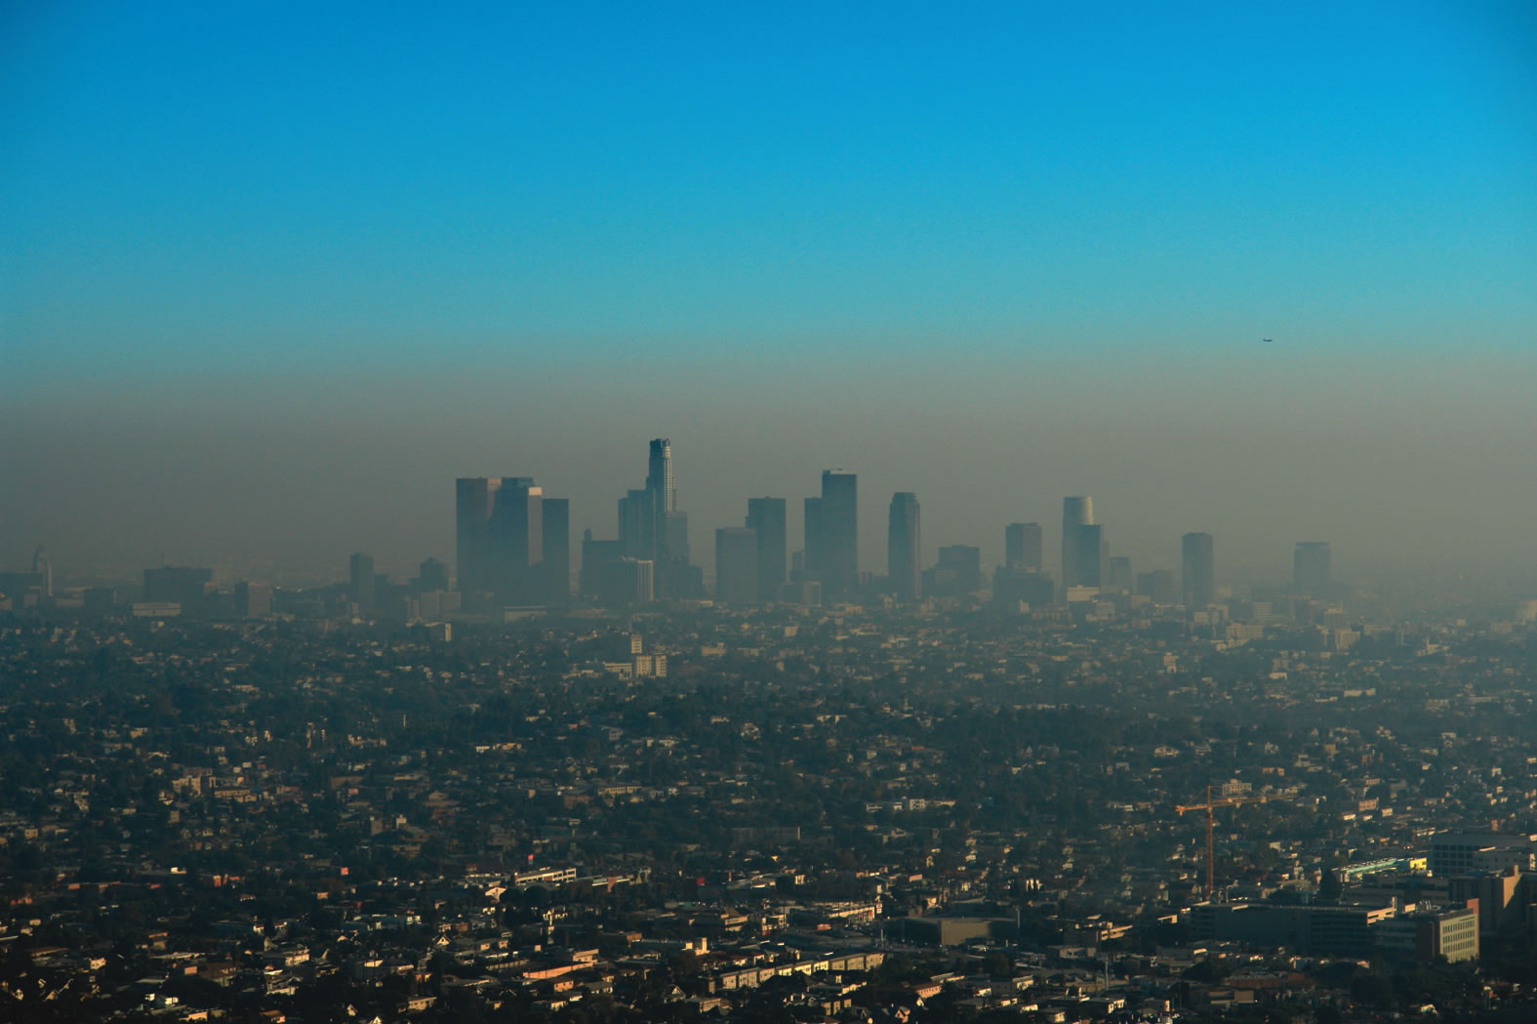
LOOK FOR KEY HEALTH DETERMINANTS
AIR QUALITY
Notes:
Point of slide – Look for health determinants
Air quality

Slide 27

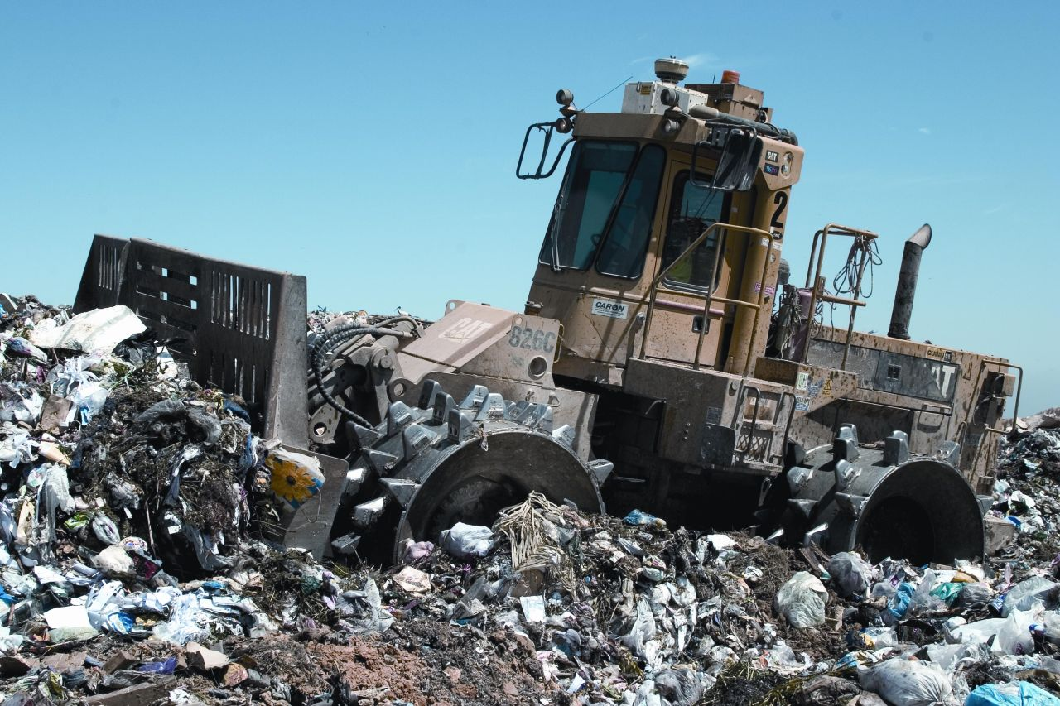

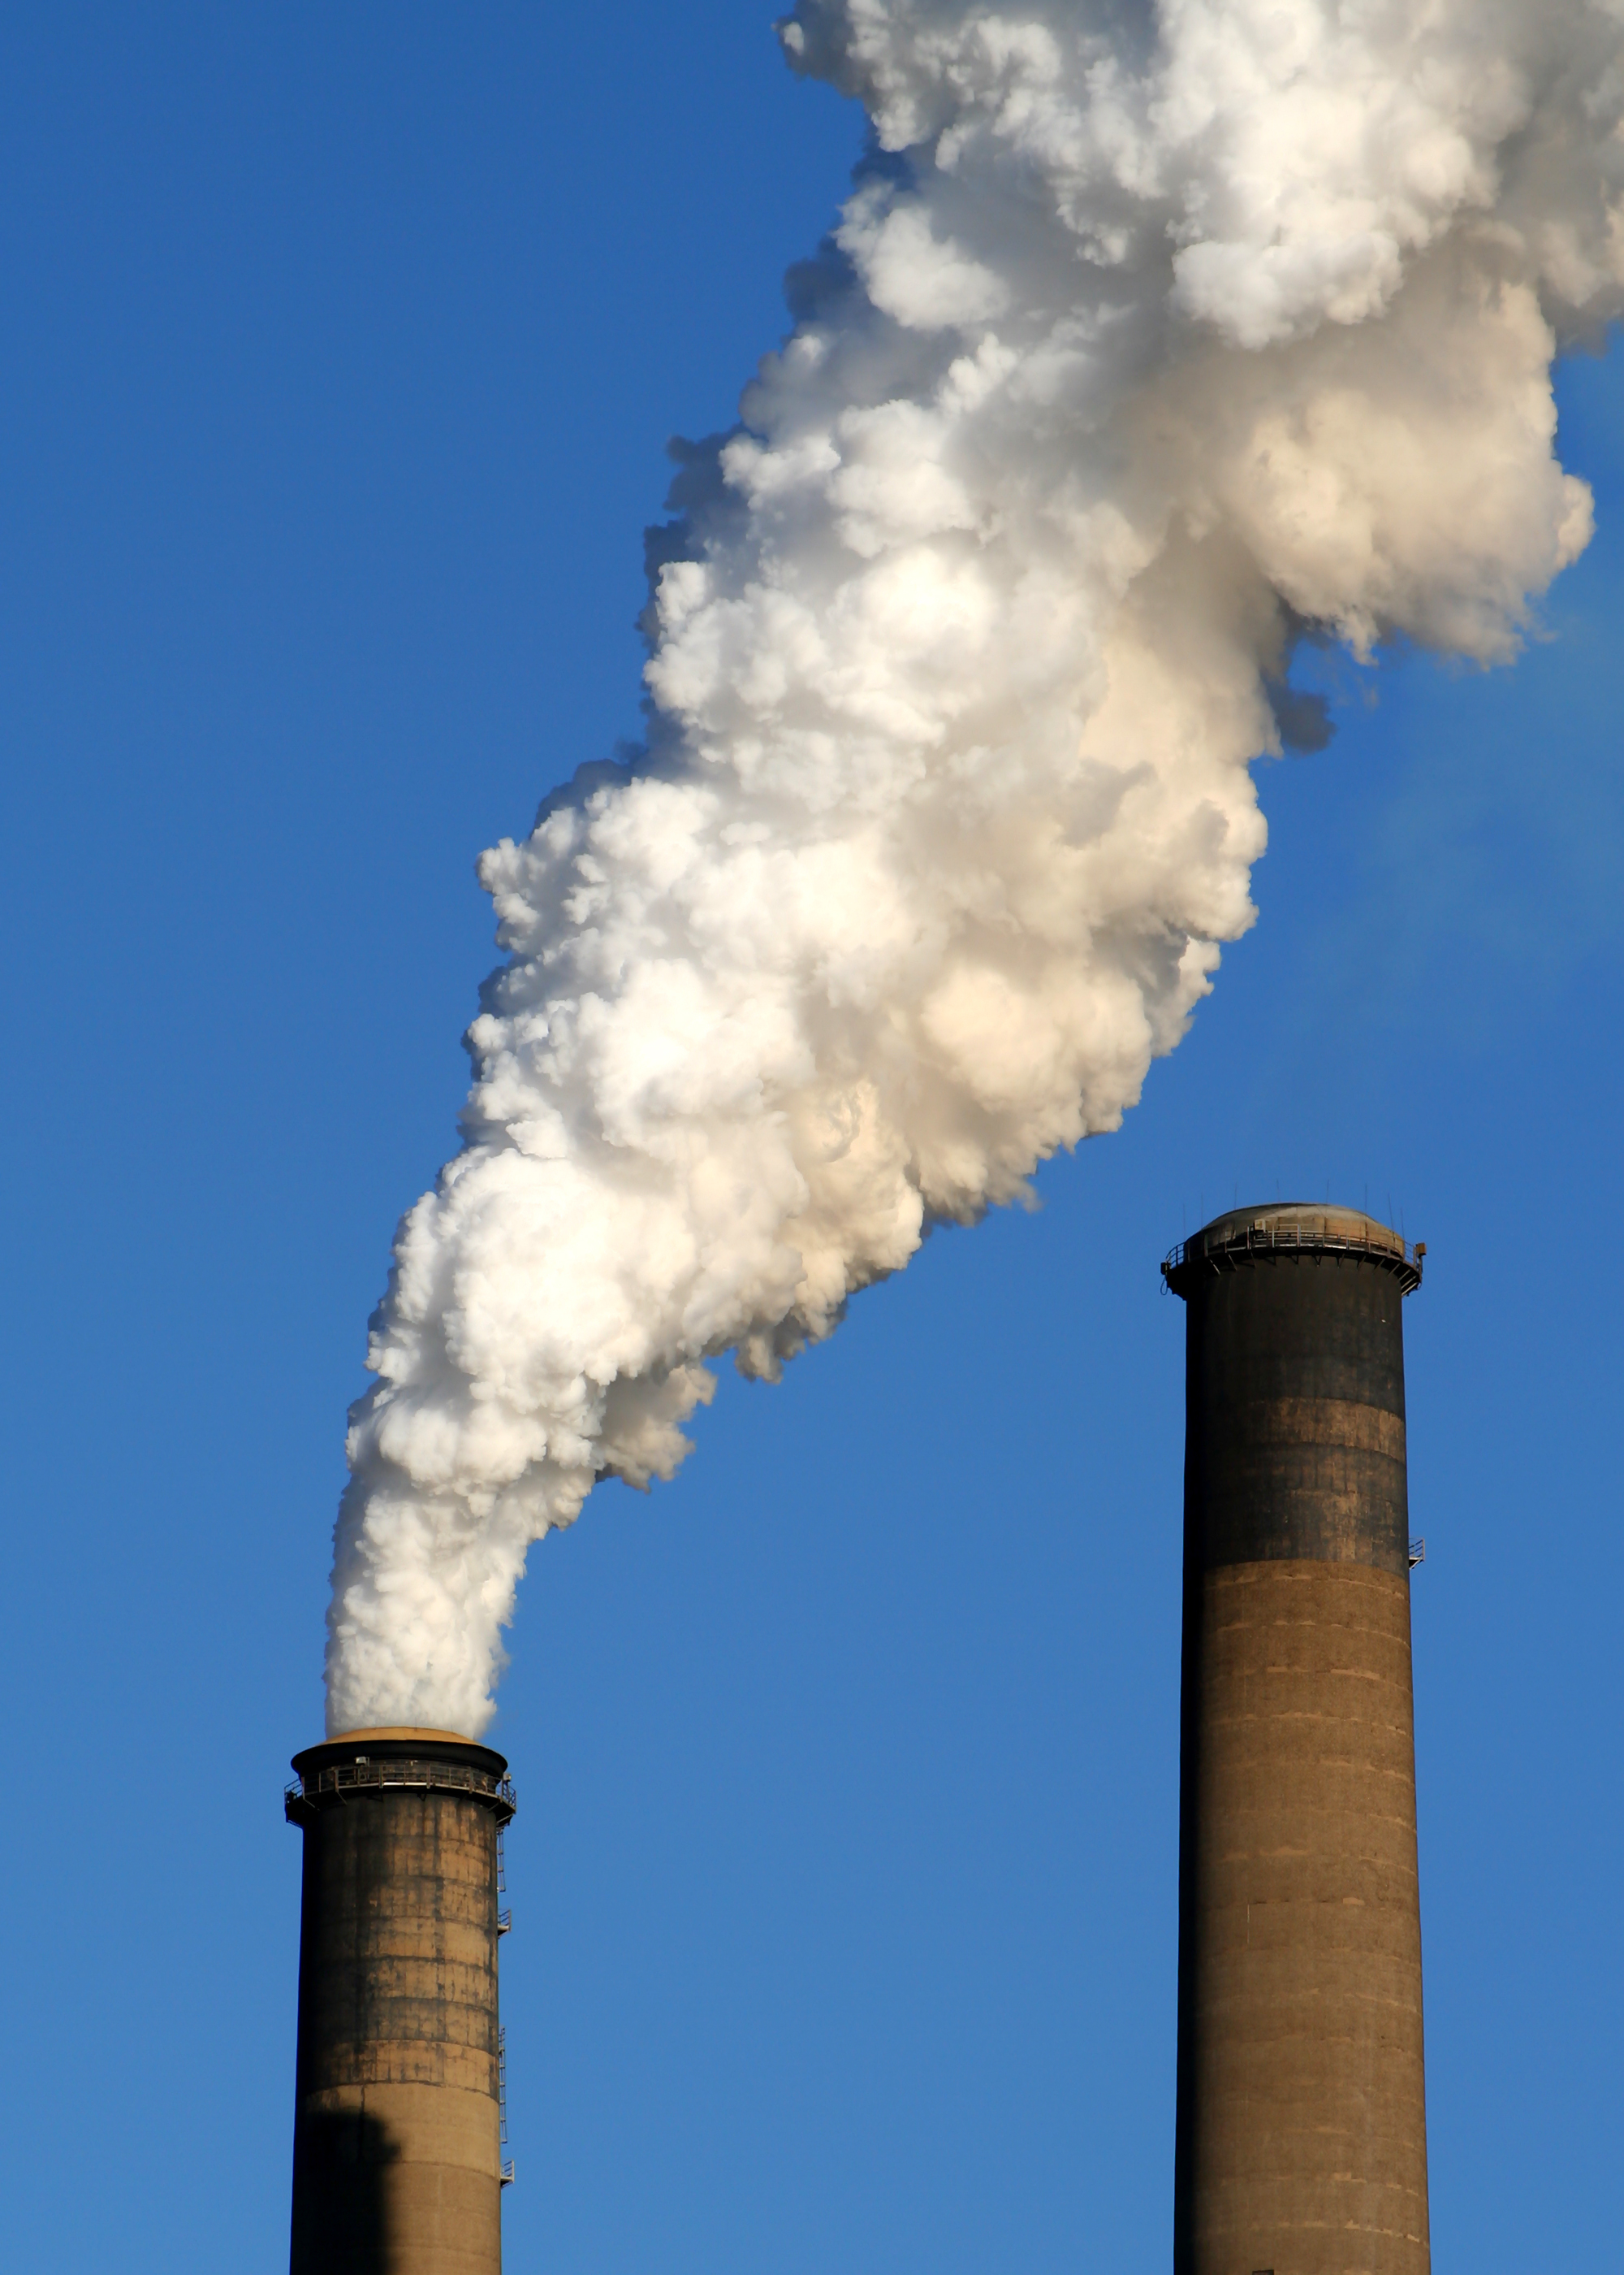
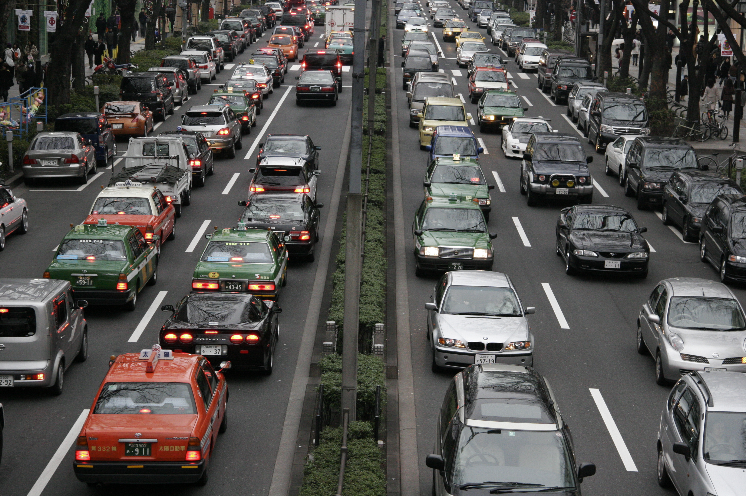
EMISSIONS
Notes:
Point of slide – Look for health determinants
Emissions

Slide 28


PHYSICAL ACTIVITY
Notes:
Point of slide – Look for health determinants
Physical Activity

Slide 29

SOIL QUALITY
WATER QUALITY
Notes:
Point of slide – Look for health determinants
Soil and water quality

Slide 30
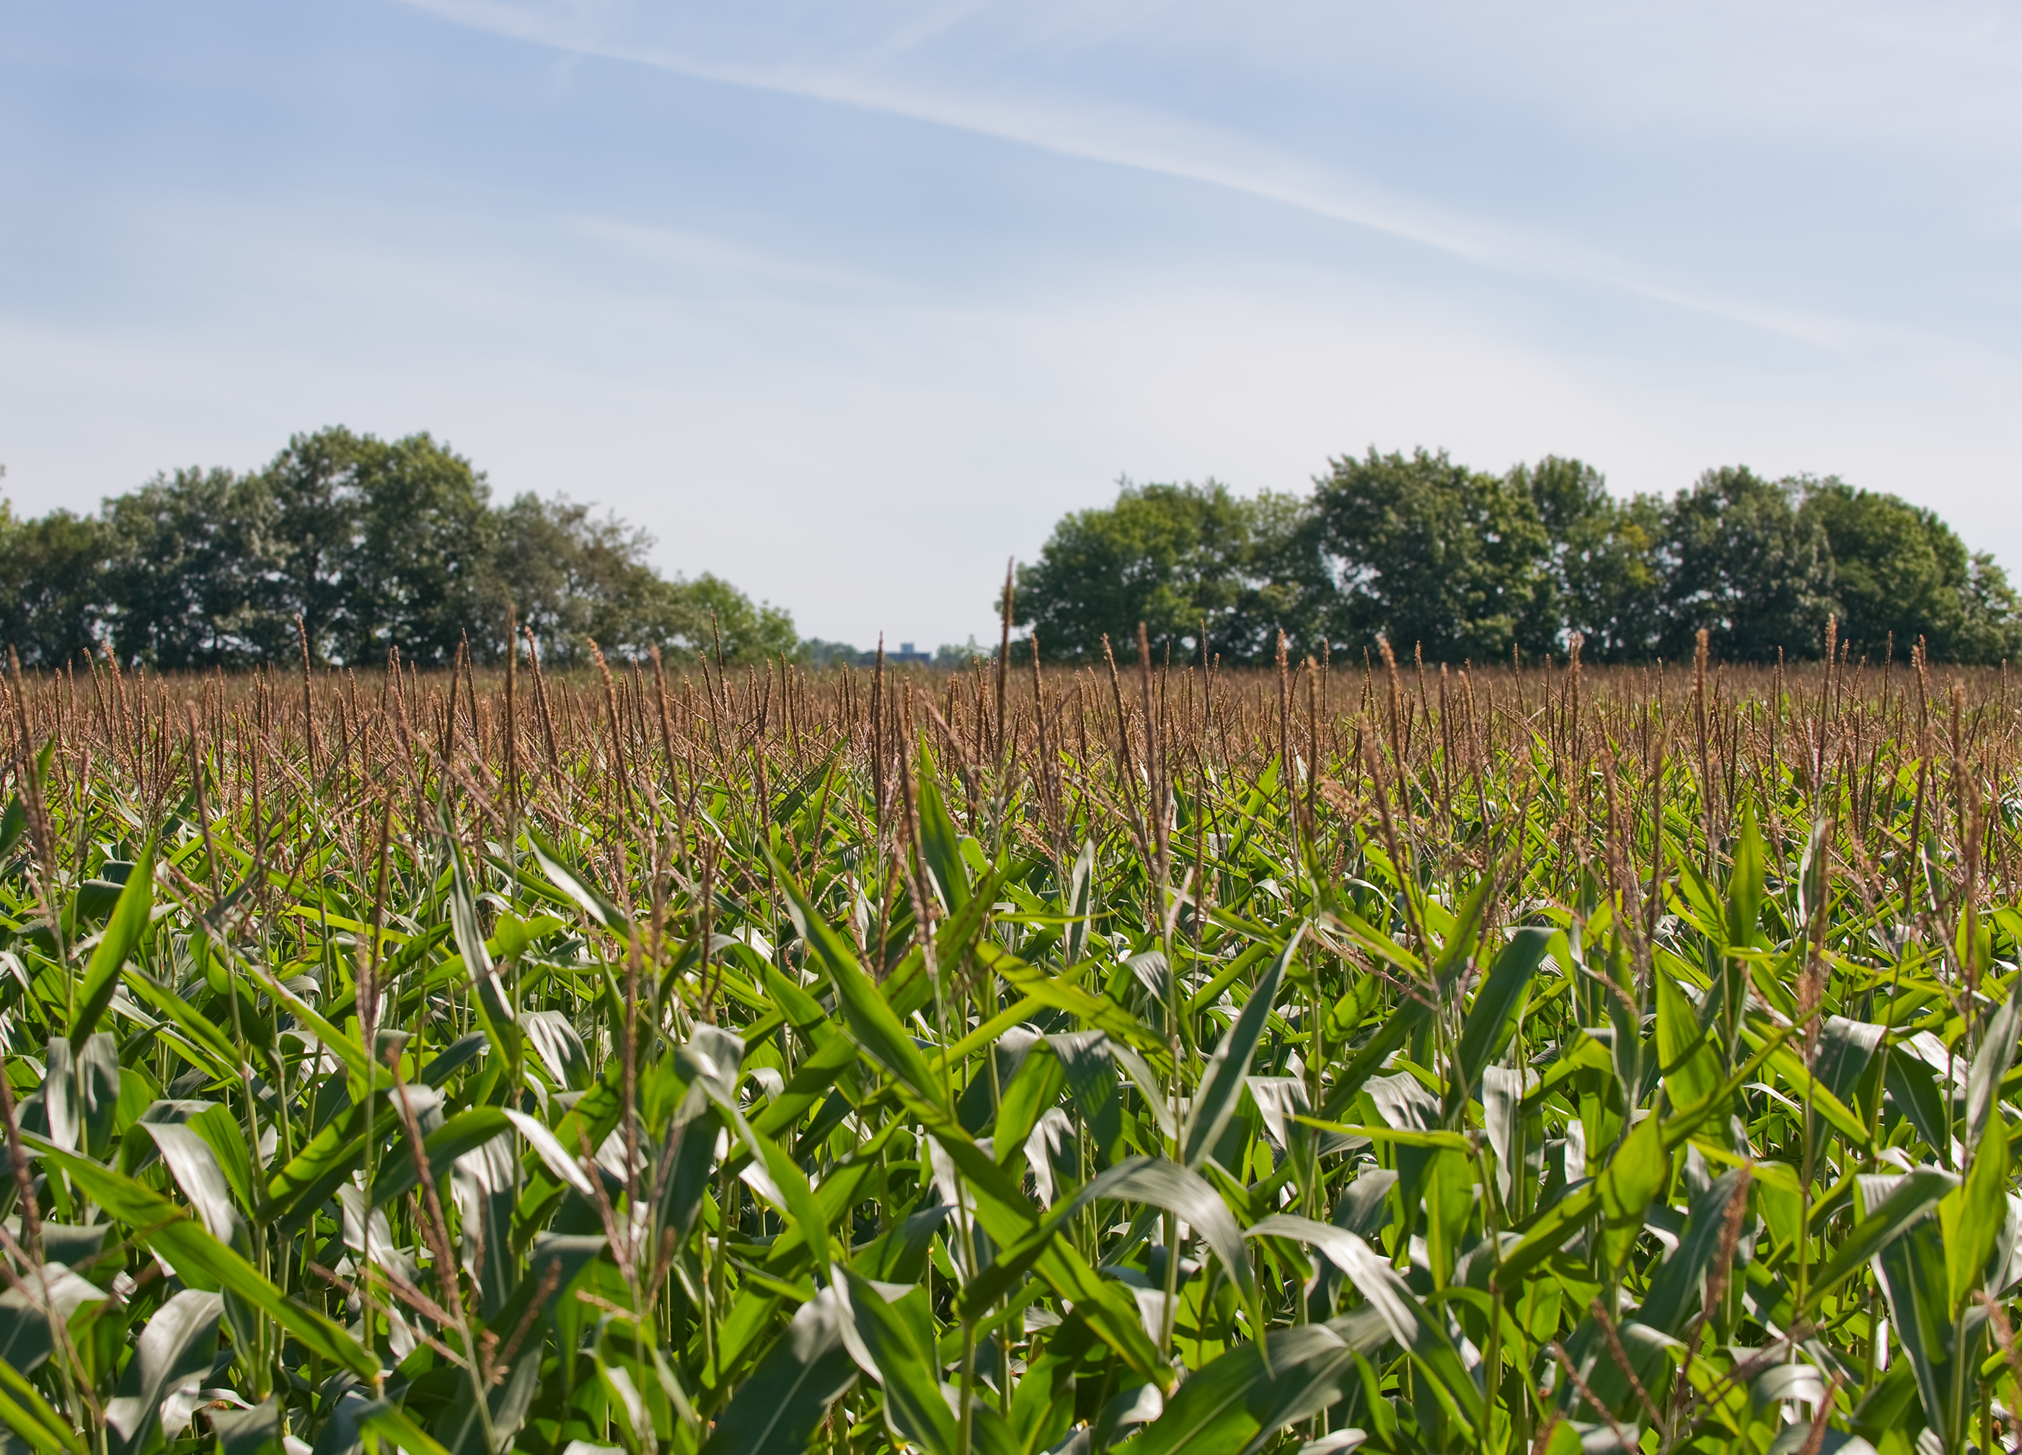
Look For Key Emission Sources
FORESTRY
AGRICULTURE
Notes:
Point of slide – Look for key emission sectors
Agriculture and forestry

Slide 31

ENERGY
BUILDINGS
TRANSPORT
WASTE
Notes:
Point of slide – Look for key emission sectors
Buildlings
Energy Supply
Transport

Slide 32
Policies with ‘Climate Change’ Components
2002 Federal Farm Bill: Subsidies to Support Ethanol Production
Policy
Direct Impacts
Intermediate Outcomes
Health Outcomes
Encourage
Ethanol production
Substitution for/adjunct to petroleum-based fuels
Ethanol transport for use
Air pollution
Respiratory disease
Adapted from: UCLA Health Impact Assessment Group 2002
Notes:
Point of slide: Show element of “non climate change policy” with an element that affects green house gases.
Context: 2002 Farm Bill and subsidies on Ethanol – this is part of a larger, complex, logic model. We’ve included an example from an older HIA on the federal farm bill where ethanol production relates to fossil fuels connected to the health determinant air pollution.
___________
Should we show all of this or just a chunk?

Slide 33
HIA Example 1: Oregon VMT Policies
Source: HIA on Policies Reducing Vehicle Miles Traveled in Oregon Metropolitan Areas, 2009
Notes:
HIA on Policies Reducing Vehicle Miles Traveled in Oregon Metropolitan Areas.
Explain climate change rationale.

Slide 34
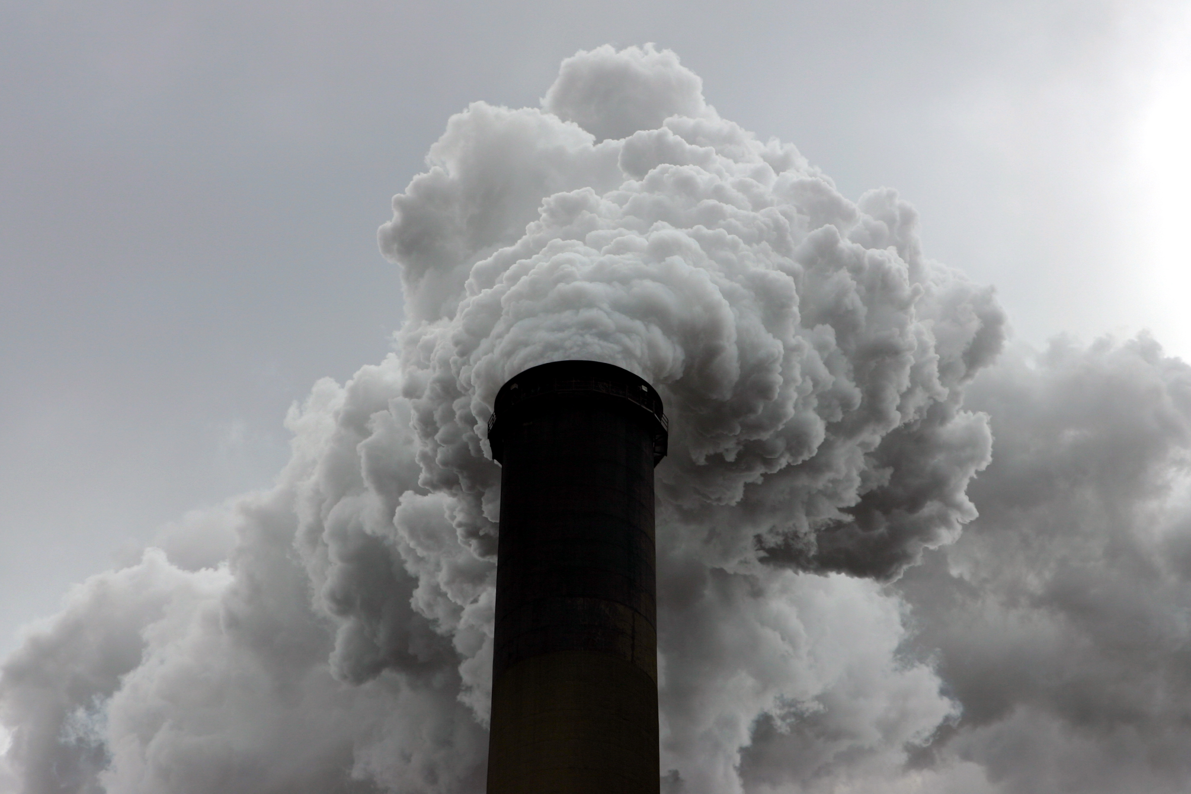
HIA Example 2:
Florida’s Taylor County Energy Plant
Notes:
Explain climate change rationale.
North Florida Power Project, Taylor County Development Authority
In October of 2005 Tallahassee residents were presented with the opportunity to vote on a referendum as to whether the City of Tallahassee should have a say in the design and operation of an 800 MW coal-fired power plant, called the North Florida Power Project (NFPP), being built in rural Taylor County. In part the referendum read: "If a majority of the City Commission determines that the North Florida Power Project coal burning plant will be built in Taylor County, regardless of the City's participation, then shall the City of Tallahassee be allowed to partner in, and derive power from the plant? (Yes/No)".
Healthy Development, Inc. (HDI) was hired by the Taylor County Development Authority (TCDA) to conduct a health impact assessment of the pending Taylor Energy Center (TEC), an 800 megawatt coal fired electric plant slated to be built in four years in rural Taylor County, Florida. Taylor officials anticipated elevating the county's economic, health and social conditions by bringing TEC jobs to the area that come with a full benefits package for employees. However, many community members feared the potential health impacts of the plant’s harmful emissions to both air and water.
This project examined inequitable conditions and potential impacts for economic and health conditions as a result of the plant. We will return to the findings in Chapter 5.
The Development company decided not to build the power plant in the end.
_____________________
Sources:
Coal plant image in Kansas: EPA Issues New Standards for Coal-Burning Plants
http://www.npr.org/2011/07/07/137681222/epa-issues-new-standards-for-coal-burning-plants
Fish Advisory Map: Healthy Development, Inc., Taylor Energy Center Health Impact Assessment Phase 1 of 3, Summer 2006.
UCLA HIA Guide - http://www.hiaguide.org/hia/north-florida-power-project-taylor-county-development-authority
*Rutt, C., Dannenberg, A.L. and Kochtitzky, C. (2008). Using Policy and Built Environment Interventions to Improve Public Health, Journal of Public Health Management and Practice, 14, 3, 221-223.

Slide 35
Exercise 1:
Am I A Climate Change Policy?
San Francisco Housing Authority Policy – public housing development flooring options | Rural Humboldt County – Update to General Plan w/3 growth options | Zoning for Healthy Baltimore – Comprehensive Code Revisions
Fossil Fuel Tax in California | Reducing Speed Limits in California | Rhode Island Flood Awareness and Climate Change Taskforce
Notes:
Point of slide: Table has 6 different policies. Group has to write down which one of the policies they think are climate change related and whether they are mitigation, adaptation or emergency preparedness. Also discuss other policy ideas as a group.
1. See document in Toolkit – should be a table entitled Exercise 1 – label the type of policy on the table.
This is the interactive exercise – we have individuals think about which of these policies are directly climate change, are related to climate change, and unrelated…
See the Toolkit for a list of HIAs that have been conducted on climate change related policies and plans.

Slide 36
Exercise Answers
Climate Change & Climate Change-Related |  | Other
Fossil Fuel Tax in CA – Mitigation | Zoning for Healthy Baltimore – Adaptation | San Francisco Housing Authority Policy – Public housing development flooring options
Reducing Speed Limits in CA – Mitigation | Rural Humboldt County – Update to General Plan w/3 growth options- Adaptation and Mitigation
Rhode Island Flood Awareness & Climate Change Taskforce – Emergency Preparedness
Notes:
Point of slide – Go over answers and discuss.

