Slide 1
Lead Poisoning Prevention, Case Management, and Investigations
6/4/2025

Slide 2
Programmatic Updates

Slide 3
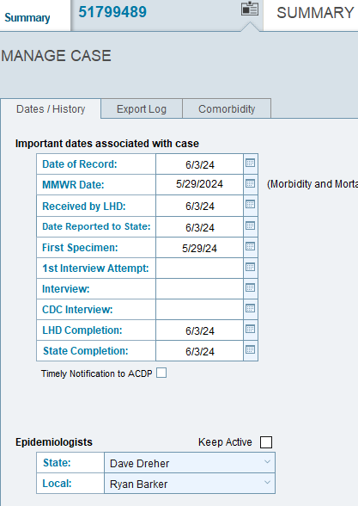
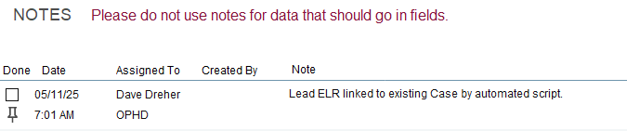
CLPPP Staff at OHA
Child (<18 years) and Pregnant person cases: Ryan Barker
Adult (18 years and older) cases: Alan Martinez
Notes:
Reminder that Dave Dreher at our program retired earlier this year. You might still see his name listed on cases, or possibly even see notes from him due to some scripts. Any notes for child lead poisoning cases should be sent to myself if you’re trying to reach OHA. Any adult cases that are 18 years and older should be sent to Alan Martinez at OHA.

Slide 4
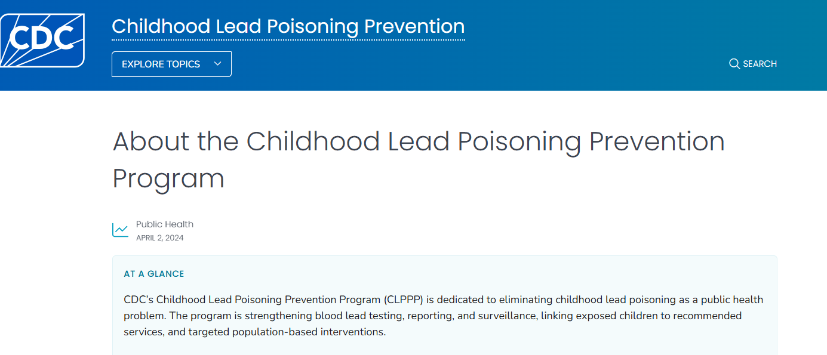
CDC
Notes:
Update on the US Centers for Disease Control and Prevention’s Childhood Lead Poisoning Prevention Program. You may have heard on the news about cuts to staffing at federal agencies, including the CDC. At this point, we have heard that this program along with the entire National Center for Env. Health was eliminated. We have had no communications with federal program staff or our project officer since late March. While the future of funding is an obvious issue with keeping our program open, we are also noticing a lack of communication and awareness of lead-related issues at the federal level. For example, policy updates and product recalls were two areas that CDC staff would often share with us quickly to keep our program up to date, sometimes even before the public knew about certain issues. We no longer have these direct lines of contact.

Slide 5
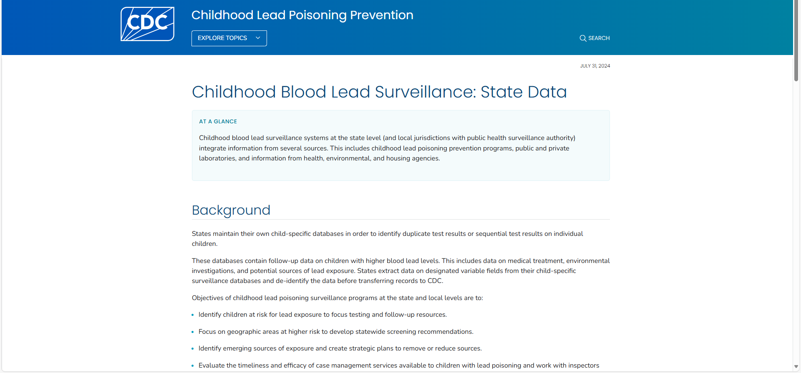
CDC
Notes:
We are still submitting data to the CDC on a quarterly basis per our cooperative agreement requirements. However, at this time, it does not appear that state data is being uploaded to this website, and we have no timeline on if or when this will happen. So at this point it highlights the fact that states might be on their own and that we may no longer have a federal partner that can bring all states and jurisdictions together as a cohesive program, and to provide US-level data.

Slide 6
Lead Testing and Case Criteria

Slide 7
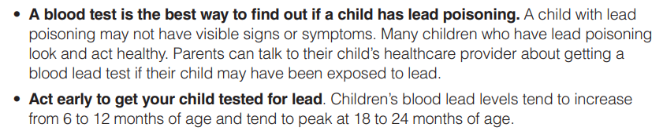

Testing Children for Lead
Notes:
The only way to know if someone has been exposed to lead is by getting a blood lead test. Children don’t often look or act sick after they have been exposed to lead. Testing children when they are young is important. Testing children around their first birthday is important, because this is when children begin to walk around and start to explore their environment.

Slide 8
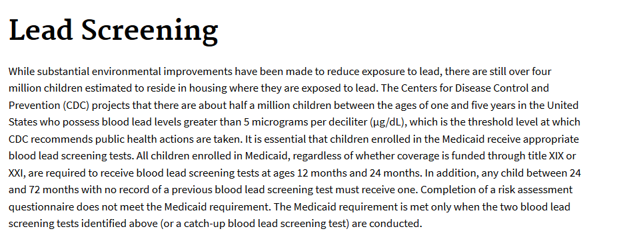

Testing Children for Lead
All children enrolled in Medicaid, regardless of whether coverage is funded through title XIX or XXI, are required to receive blood lead screening tests at ages 12 months and 24 months.
Any child between 24 and 72 months with no record of a previous blood lead screening test must receive one.
Completion of a risk assessment questionnaire does not meet the Medicaid requirement.
The Medicaid requirement is met only when the two blood lead screening tests identified above (or a catch-up blood lead screening test) are conducted.
Notes:
Reminder that all children at 12 and 24 months, or before 6 years, that are enrolled in Medicaid/OHP are required to be tested for lead. https://www.medicaid.gov/medicaid/benefits/early-and-periodic-screening-diagnostic-and-treatment/lead-screening

Slide 9
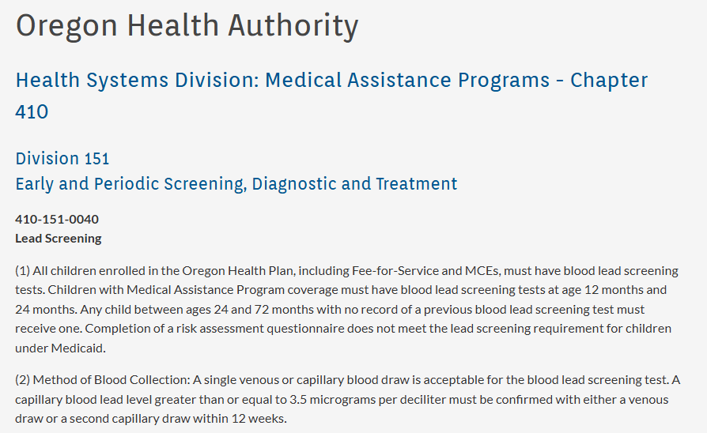
Testing Children for Lead
Notes:
Reminder that all children at 12 and 24 months, or before 6 years, that are enrolled in Medicaid/OHP are required to be tested for lead. https://secure.sos.state.or.us/oard/view.action;JSESSIONID_OARD=60VCFszATH1bTXQJj7HTWtY0D-b6m3nk399L4fauuIU8nhNInBvr!-1804738907?ruleNumber=410-151-0040

Slide 10
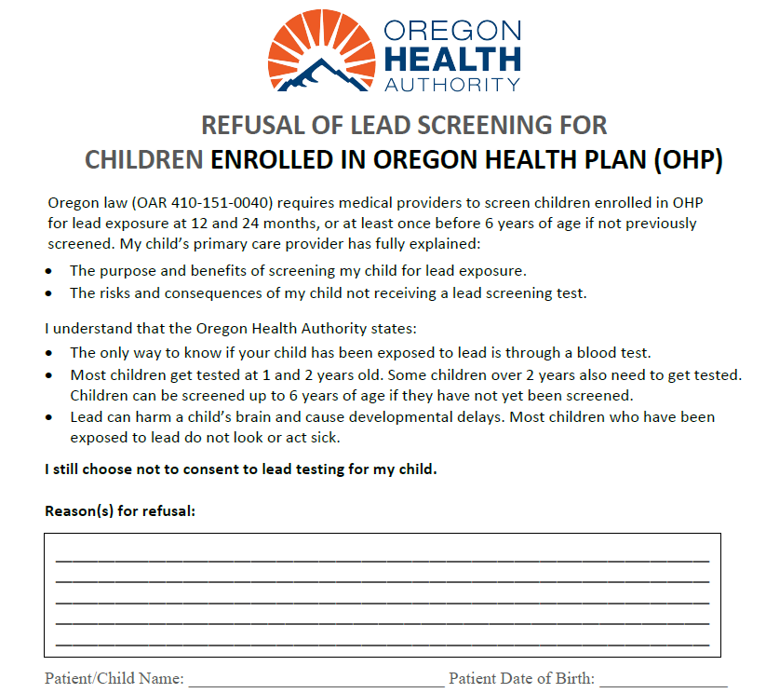
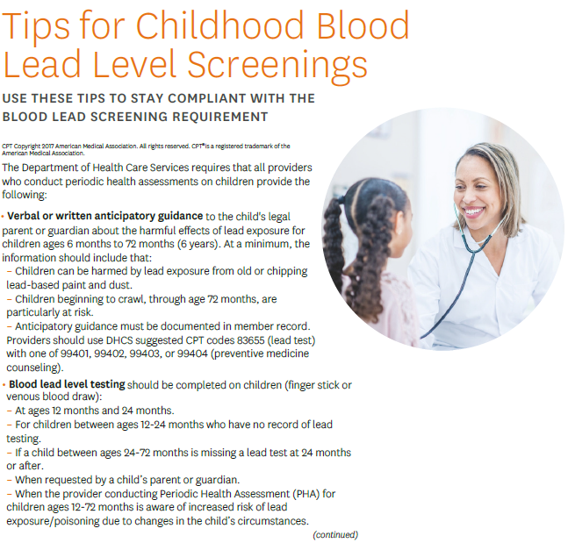
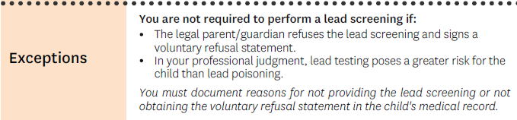
Test Refusal Form for OHP-Enrolled Children
Notes:
I’ve been collaborating with the Early and Periodic Screening, Diagnostic and Treatment (EPSDT) program at the Medicaid Division to develop guidance materials for medical providers performing lead screening on children enrolled in OHP. We’ve been asked by a few providers about documenting refusal to test for enrolled patients. By providing this option, it might actually increase the number of children on OHP that are tested if the provider knows that they have a way to document a family’s decision to refuse testing.

Slide 11
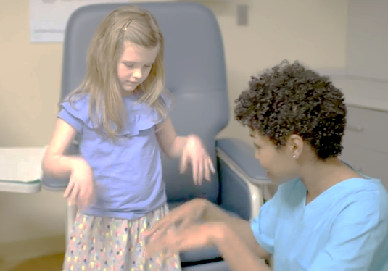
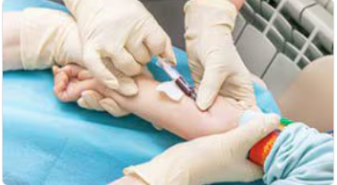
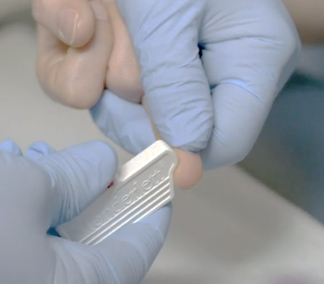
Test Children for Lead Exposure
Venous—Confirmed
Capillary—Presumptive
Notes:
Testing children for lead exposure comes in two formats.

Slide 12
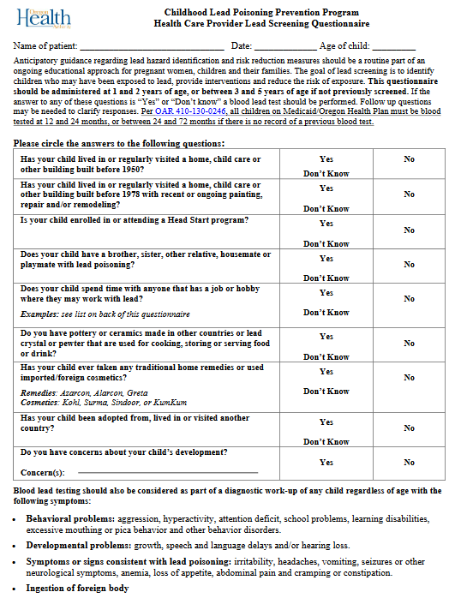
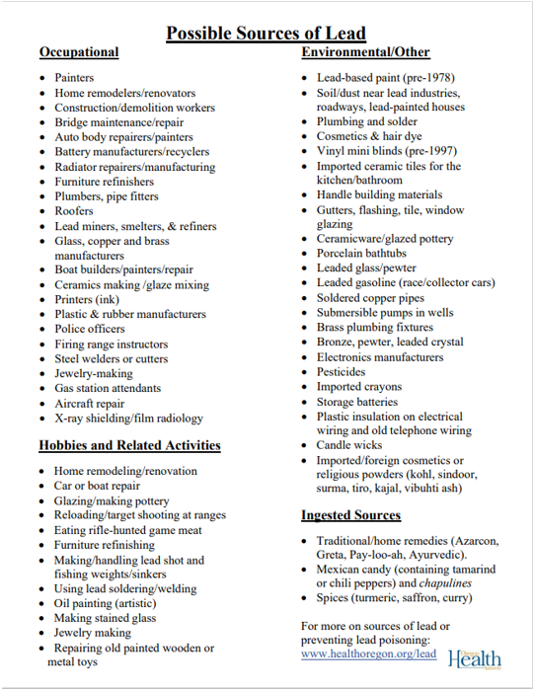
Screening Children for Lead Exposure
Notes:
Pediatrician or medical provider might use a questionnaire like this to ask specific questions about possible lead exposures. Based on the answers given, they will decide if they should test the child for lead. https://www.oregon.gov/oha/PH/HEALTHYENVIRONMENTS/HEALTHYNEIGHBORHOODS/LEADPOISONING/MEDICALPROVIDERSLABORATORIES/Documents/hcpquest.pdf

Slide 13
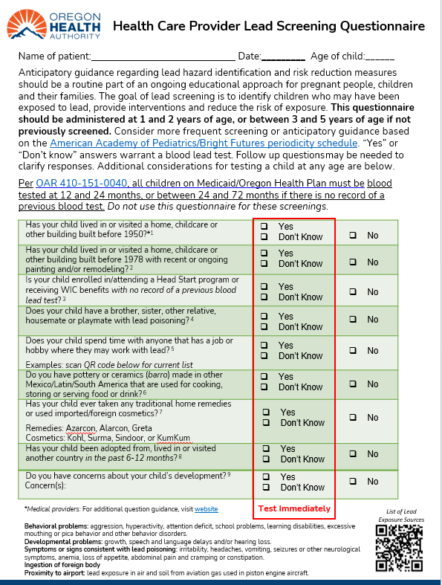
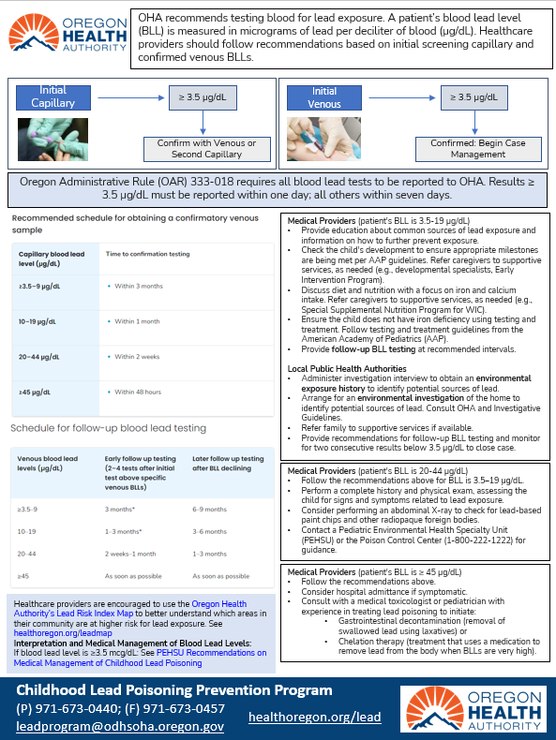
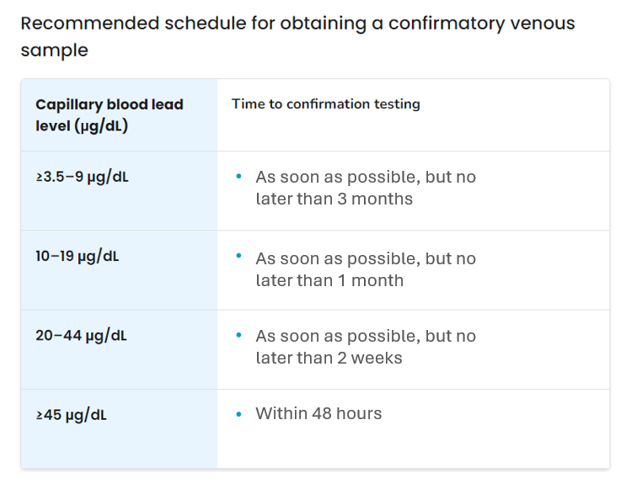
Notes:
This is a draft for an updated screening questionnaire. The intent here is to provide more clarity on risk questions, provide links to updated documents and pictures of exposure sources, and follow-up guidance for medical providers and LPHAs. The latter also could help providers understand what to expect after they report an EBLL to OHA, and can provide this guidance to patient families.

Slide 14
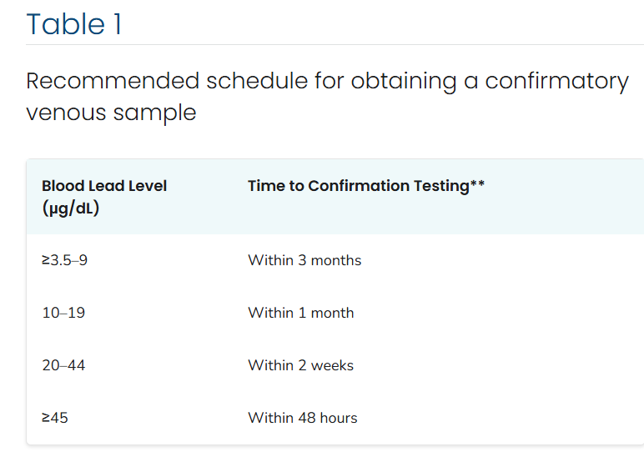
CDC Follow-up Testing Schedule
Notes:
CDC still provides these follow-up testing recommendations on their website, and we see medical providers often following this guidance. I did recommend to the CDC that they reconsider or re-evaluate this guidance, but this was only days before the program was eliminated. https://www.cdc.gov/lead-prevention/hcp/clinical-guidance/index.html

Slide 15
OHA Follow-up Testing Schedule
Prompt confirmation of elevated capillary levels allows Public Health investigators to respond more quickly and prevent additional exposure
Notes:
Recommend changing it to this in Oregon’s IGs and medical provider guidance

Slide 16

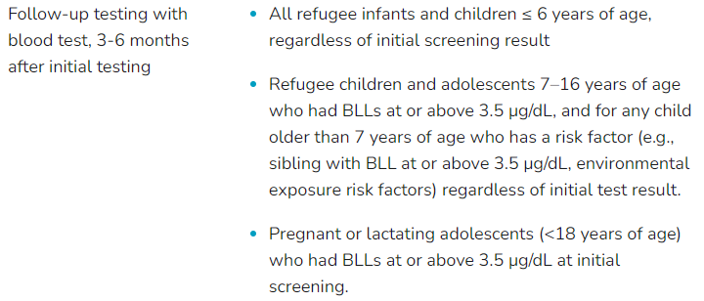

Refugee Lead Testing Recommendations
https://www.cdc.gov/immigrant-refugee-health/hcp/domestic-guidance/lead.html
Notes:
For newly arrived refugee children, the CDC has provided this important re-testing recommendation. We are working on some Orpheus scripting to make sure OHA is notified of needing upcoming re-tests for refugee children. https://www.cdc.gov/immigrant-refugee-health/hcp/domestic-guidance/lead.html

Slide 17
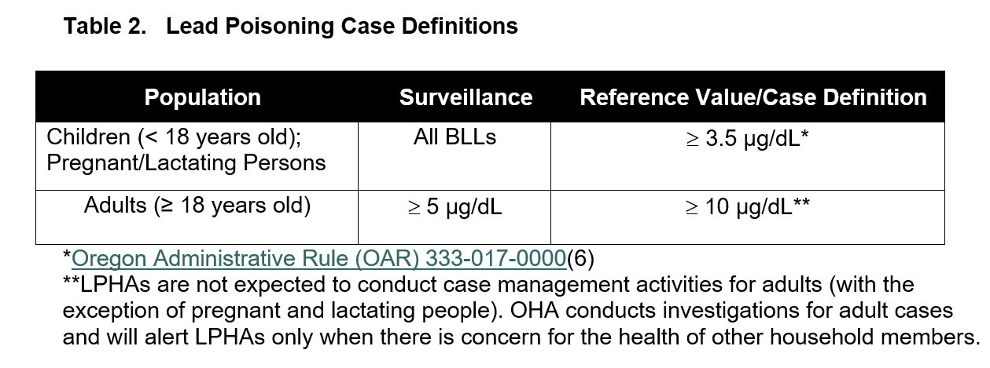
Oregon Lead Case Definition
Notes:
In Oregon, an elevated blood lead level that initiates case management is a result of 3.5 micrograms per deciliter. A blood lead level with this result usually means your local health department and medical provider will recommend follow-up testing and support to help you identify where the lead exposure is coming from.

Slide 18
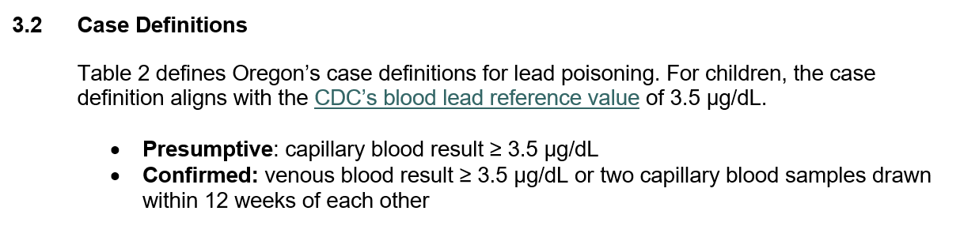
Presumptive Case Management
Notes:
For most LPHAs, OHA is managing Presumptive cases with BLLs between 3.5-4.9 ug/dL. This basically takes the form of mailing a letter immediately to the family recommending a follow-up confirmatory test, and if we receive no follow-up in about one month, we fax the provider with a follow-up recommendation. Cases that are Confirmed then get turned over to the LPHA for follow-up. At this time, only Jackson and Multnomah Co. have stated that they have capacity and are willing to take on all cases even at these Presumptive levels.

Slide 19
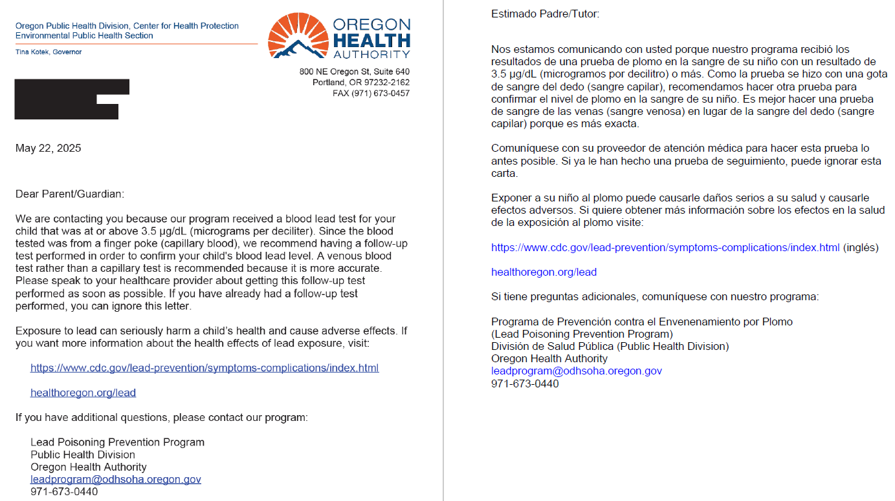
Presumptive Case Management
Notes:
For most LPHAs, OHA is managing Presumptive cases with BLLs between 3.5-4.9 ug/dL. This basically takes the form of mailing a letter immediately to the family recommending a follow-up confirmatory test, and if we receive no follow-up in about one month, we fax the provider with a follow-up recommendation. Cases that are Confirmed then get turned over to the LPHA for follow-up. At this time, only Jackson and Multnomah Co. have stated that they have capacity and are willing to take on all cases even at these Presumptive levels.

Slide 20
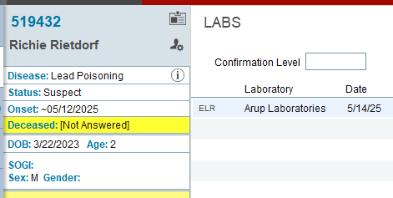
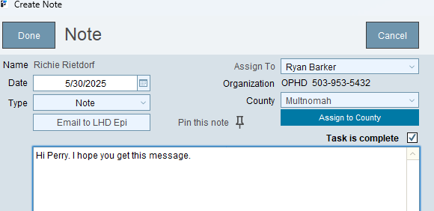
Orpheus Checks and Reminders
Notes:
Suspect status should no longer be used. We were marking cases as this after the CDC reduced their blood lead reference value to 3.5 ug/dL, while Oregon’s case definition was still 5 ug/dL. We used Suspect case numbers to determine the additional caseload expected once we lowered our case definition. Also, if you remember, fix the date of Onset to that for the Initial date of the lab test. Also, remember that Notes should be assigned to the intended sender. I know most of you know this, but I still Notes sometimes days or a week later that were written to me, but were still assigned to the person that wrote it.

Slide 21
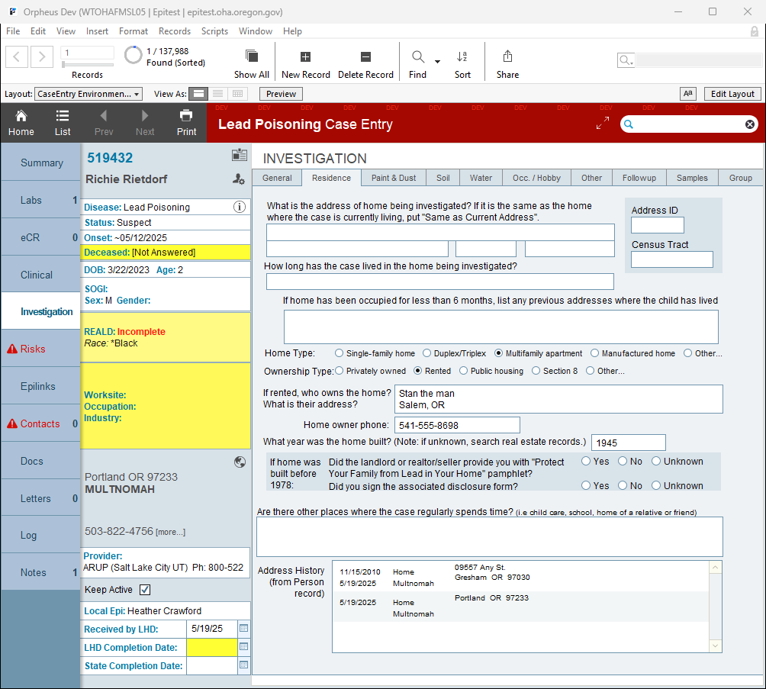
Notes:
It’s also really important to determine the age of housing, and include this in the Residence section in Orpheus. This is also part of the data extract we provide to CDC. In this situation, being an apartment built before 1945, we are concerned with lead-based paint hazards that may be out of the family’s control. During our investigation, we should be looking for these hazards, even just visually, and providing simple recommendations for how the family might be able to mitigate further exposure.

Slide 22
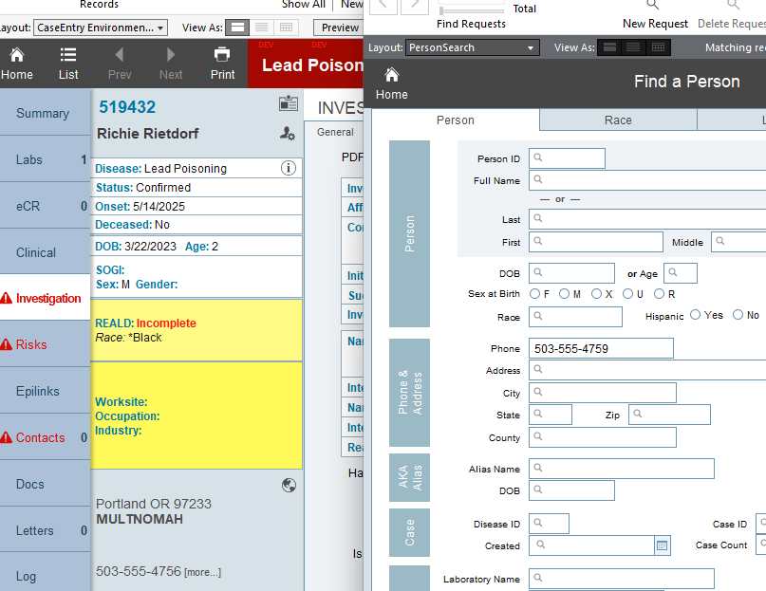
Notes:
The other thing that I find extremely important is to search Person records by the case’s phone number. This is sometimes even more powerful than the address search in finding related cases, including Adults that might also be lead cases that could help in your investigation. This has lead me to find numerous cases that were related to adults that were engaged in lead-related hobbies and occupations.

Slide 23
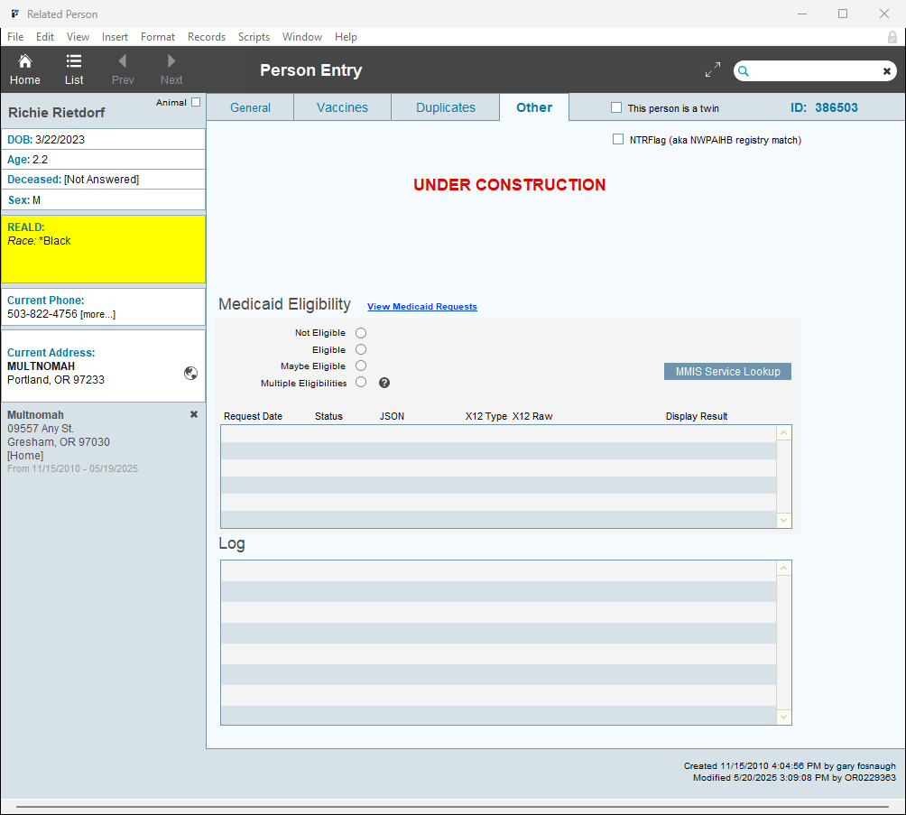
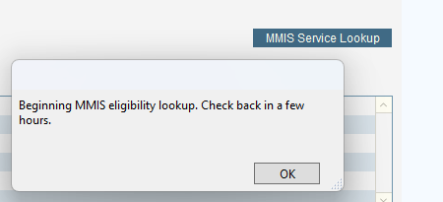
Notes:
Another thing you can do is go into the Person record and find out if a Medicaid or MMIS scan has occurred. In this case, there is nothing here, so you can initiate an “MMIS Service Lookup” by clicking the blue button. Once you click it, come back in a few hours

Slide 24
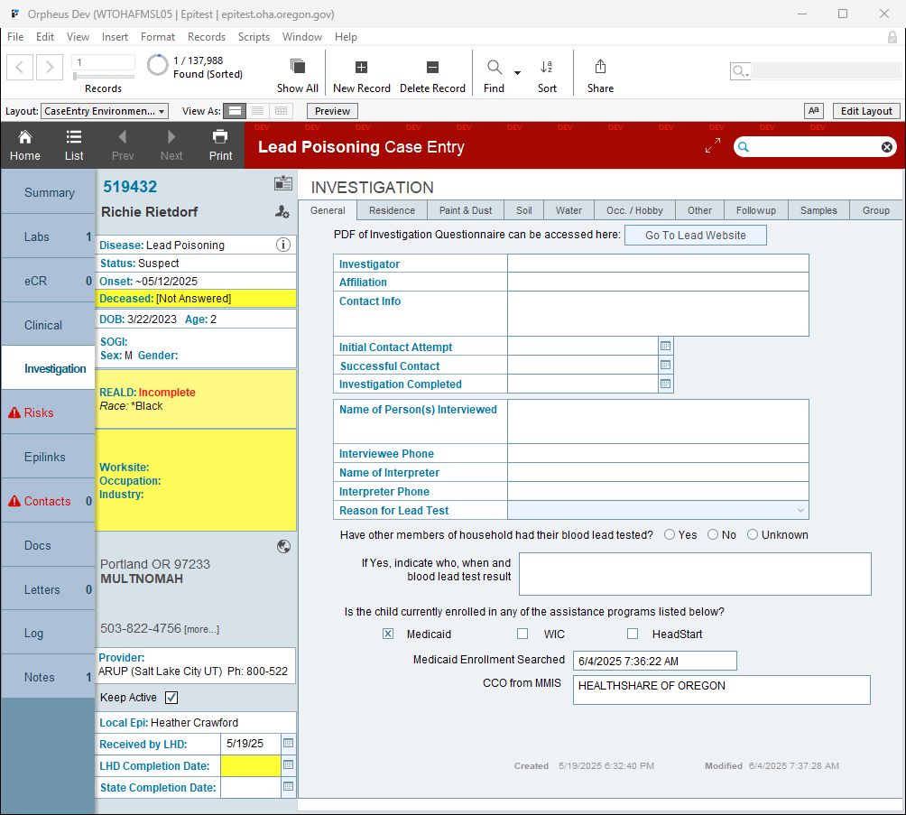
Notes:
That information can later be pulled from the MMIS response and added here.

Slide 25
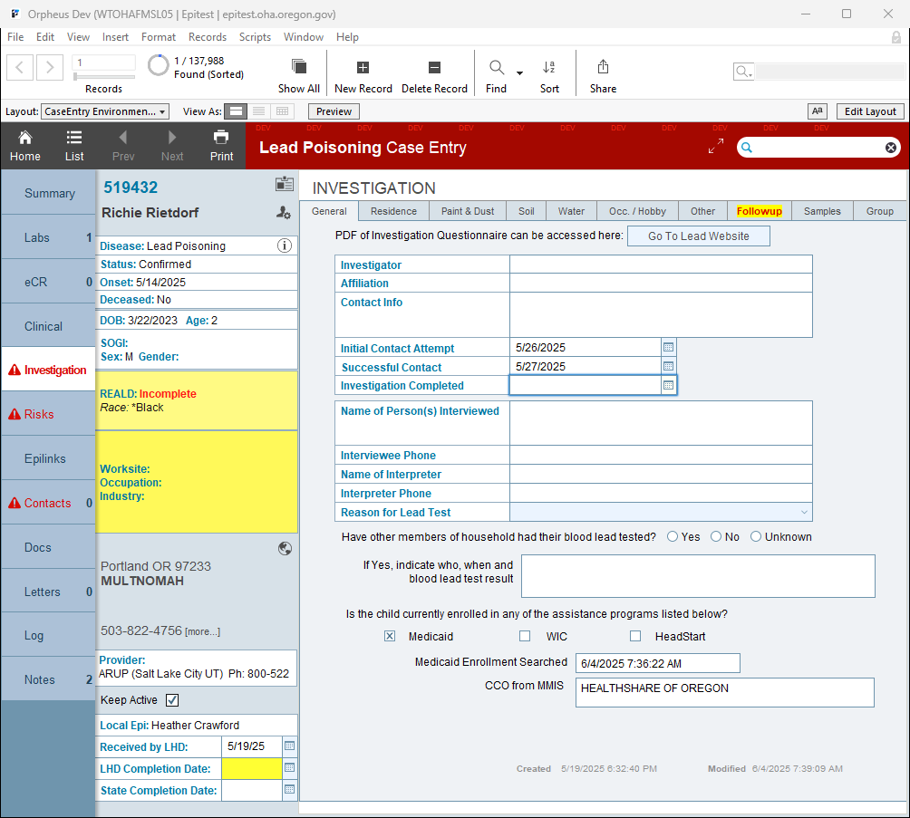
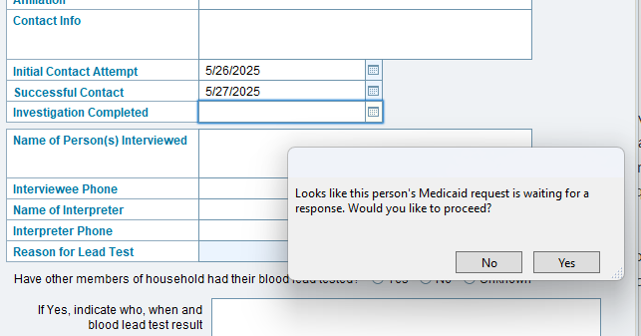
Notes:
This scan should also theoretically happen once you’ve completed the investigation by putting a date in that field. And with that, you should include the date for completed investigation when you believe you’ve identified the most likely lead exposure source and can document this in the Followup section.

Slide 26
Investigations
Notes:
If a child’s BLL is elevated, then we move over into further case management and investigations.

Slide 27
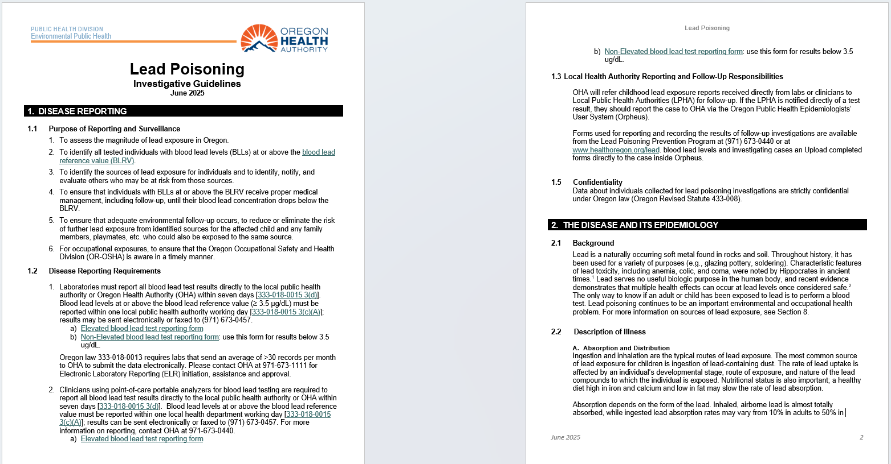
OHA Investigative Guidelines
Notes:
The Investigative Guidelines have been updated and will be posted very soon, incorporating feedback that was provided by LPHAs. They are still long, and I apologize for that. But there’s a lot of content to cover. Some information has been removed or abbreviated to reduce page length, while the actual investigation section has been lengthened to hopefully provide more clarity and include many links to resources and guidance documents that offer additional authoritative information. https://www.oregon.gov/oha/PH/HEALTHYENVIRONMENTS/HEALTHYNEIGHBORHOODS/LEADPOISONING/COUNTYHEALTHDEPARTMENTS/Documents/Diseaseguidelines.pdf

Slide 28
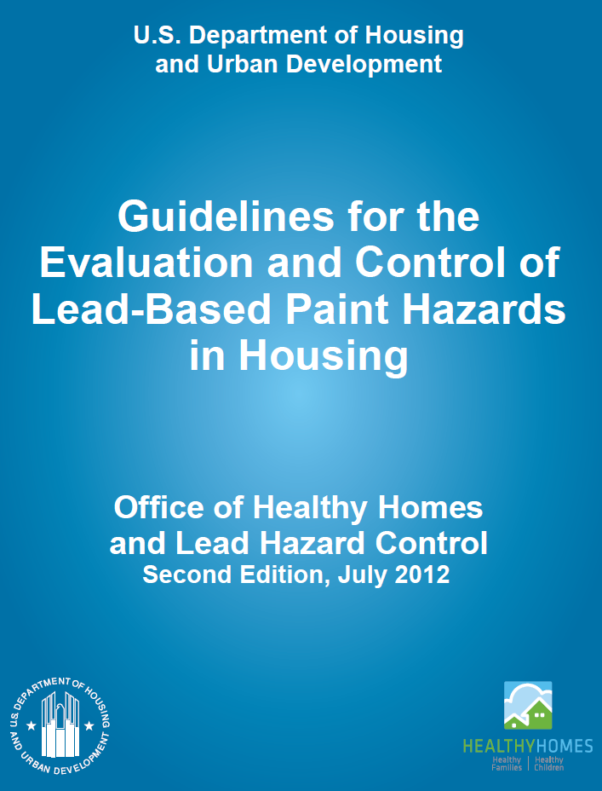
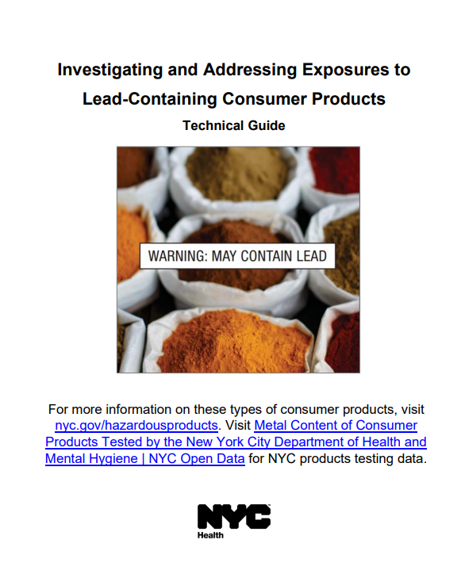
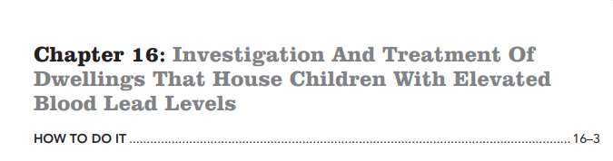
Investigation Guidance
Notes:
Two other extremely helpful resources to provide guidance on investigations are these documents from NYC Health and HUD. HUD’s Chapter 16 has a great questionnaire that can be used along with OHA’s questionnaire during investigations. Both of these documents are linked on our program website: https://www.nyc.gov/assets/doh/downloads/pdf/lead/lead-technical-guide.pdf
https://www.hud.gov/contactus/lead-based-paint-guidelines

Slide 29
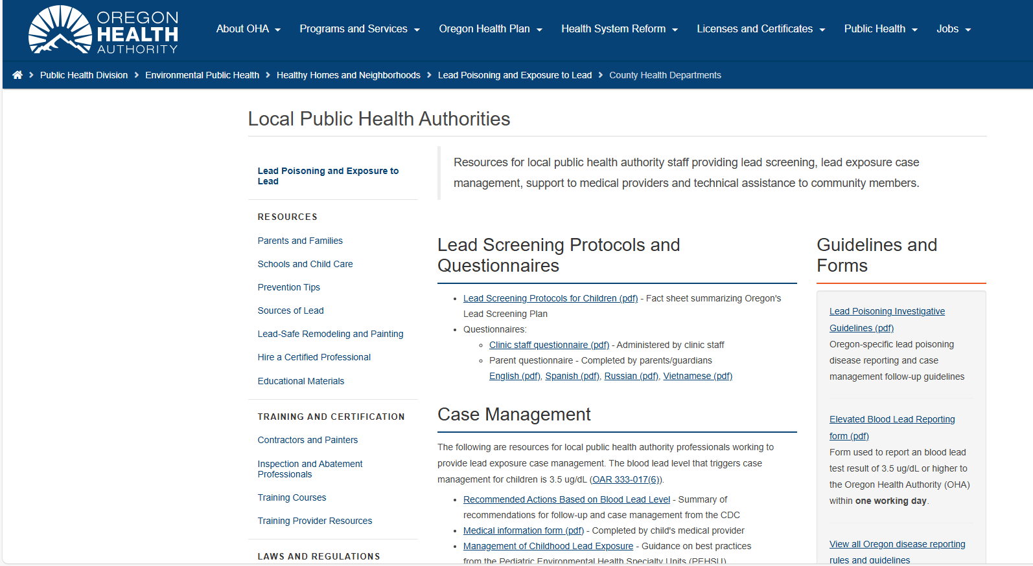
Investigation Guidance
Notes:
Both of these documents and more resources are found on this page: https://www.oregon.gov/oha/PH/HEALTHYENVIRONMENTS/HEALTHYNEIGHBORHOODS/LEADPOISONING/COUNTYHEALTHDEPARTMENTS/Pages/index.aspx

Slide 30
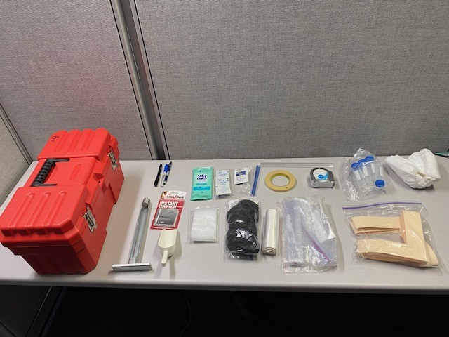
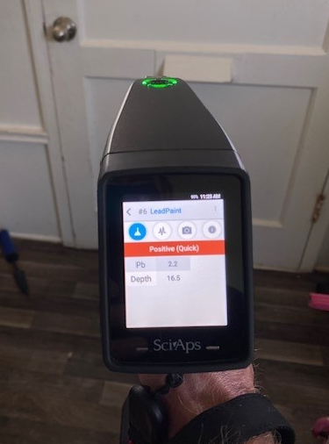
Investigation Supplies
Notes:
Here’s a snapshot of the investigation supplies I typically have with me.

Slide 31
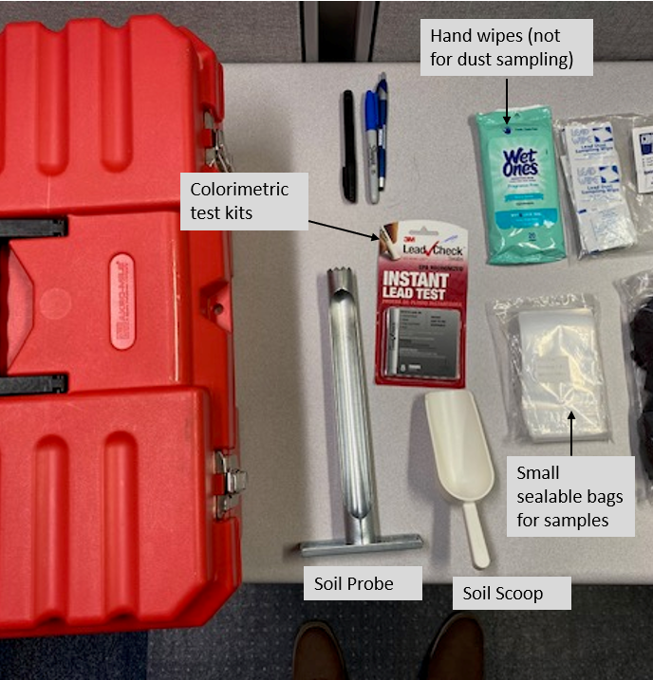
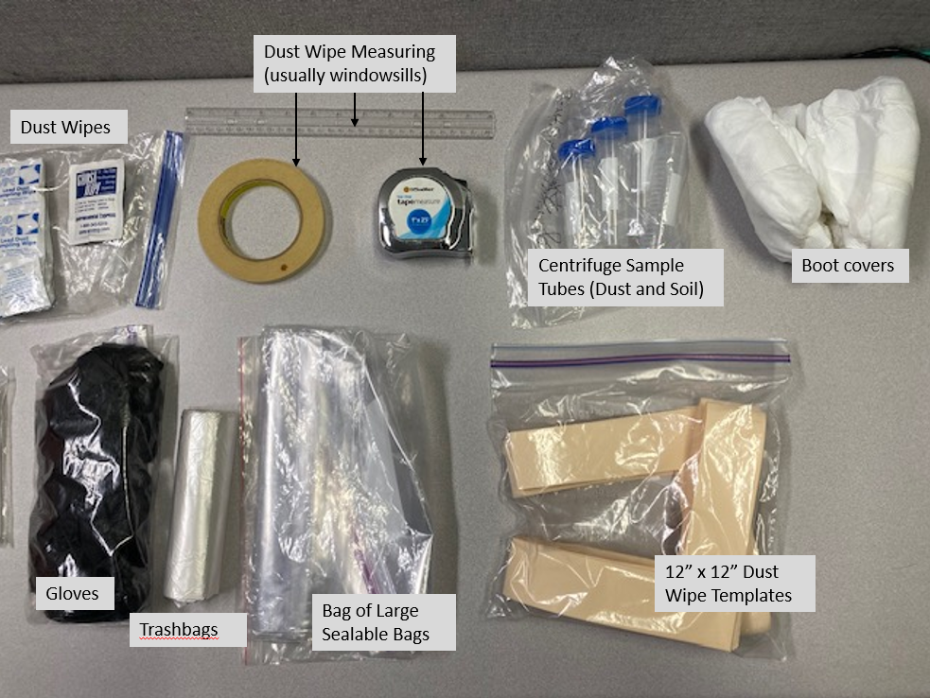
Investigation Supplies
Notes:
Here’s a snapshot of the investigation supplies I typically have with me.

Slide 32
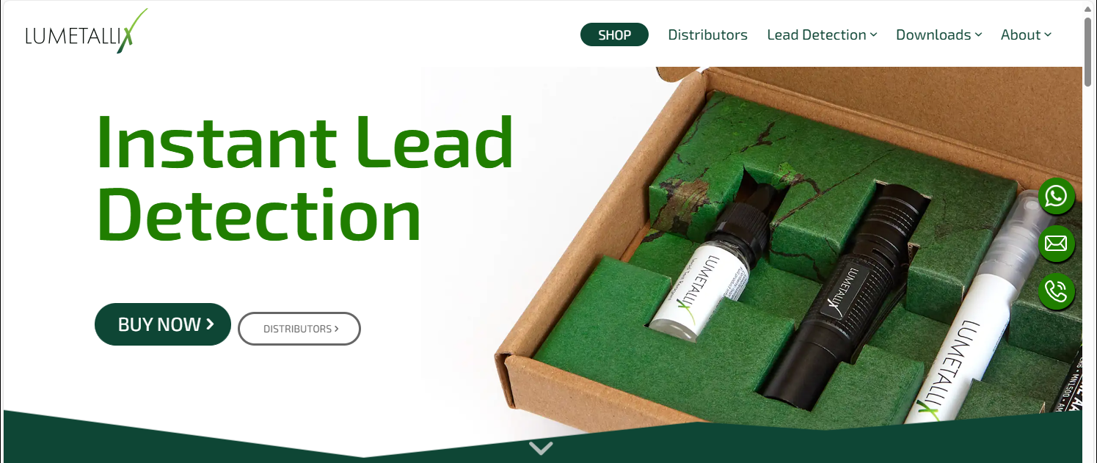
Investigation Supplies
Notes:
While an XRF is the best option for on-site testing of paint and products for the presence of lead, other qualitative and colorimetric tests are available that might provide reliable information for you and the family. https://www.lumetallix.com/ Other options that are available online may have less reliability, but some with experience say that those tests activated with vinegar could be reliable.

Slide 33
Exposure Sources
Notes:
Now we’ll talk about where lead might be found.

Slide 34
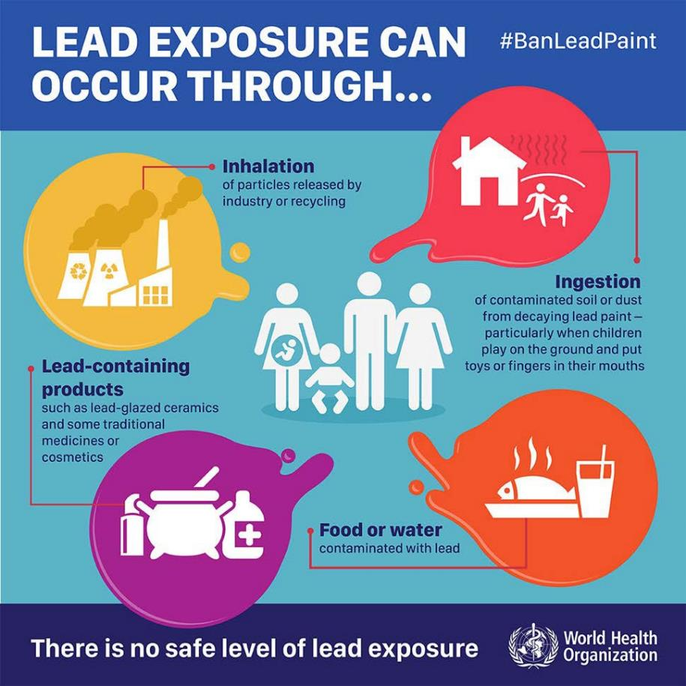
Exposure to Lead
Notes:
Lead exposure can occur in many different ways, and we will talk about these during this presentation. The important thing to remember is that while there is no safe level of lead exposure, you can reduce or prevent exposure to lead once you know where it comes from.

Slide 35
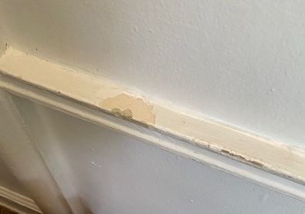
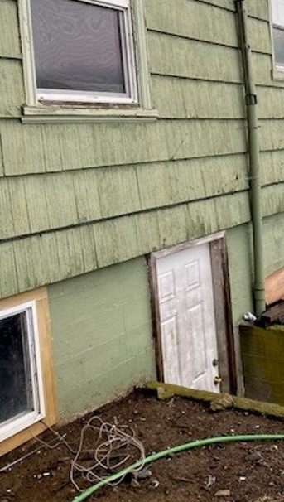
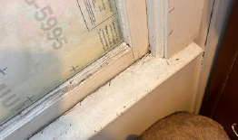
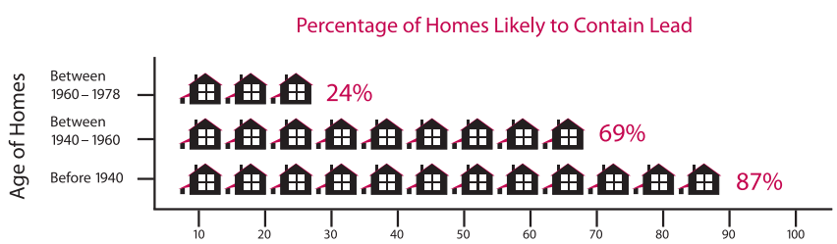
Lead-Based Hazards (Paint, Dust, and Soil)
Notes:
Oregon has hundreds of thousands of homes built before 1978 that may contain lead-based paint. So this is still one of the most common sources of lead exposure for young children. Even if you or other staff at the LPHA are not trained or certified to assess the properties to identify lead-based paint hazards, you can still visit these properties and look for situations like in these pictures that could be an exposure risk. Dust on painted windowsills, visually chewed or mouthed painted surfaces, and paint chips in bare soil are all lead exposure risks. Families can be educated on site about these risks and provided immediate and simple remediation or exposure reduction strategies.

Slide 36
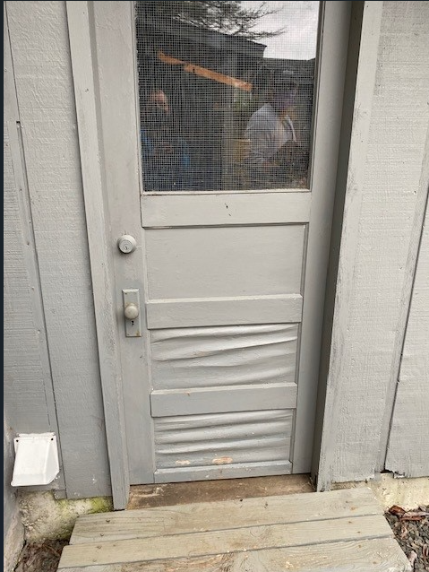
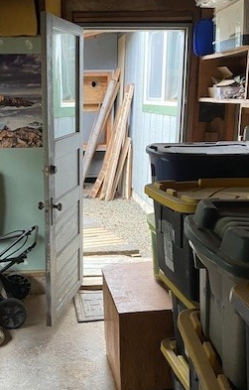
Lead-Based Hazards (Paint, Dust, and Soil)
Notes:
Also, keep an open mind and use your visual assessment skills to look for outliers. For example, we found this extremely old door painted with deteriorated lead-based paint on a 1980s house. Likely it was salvaged from an older building.

Slide 37
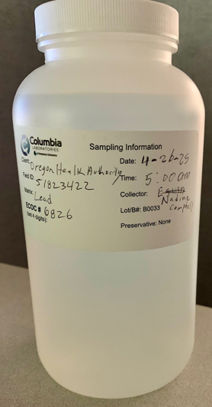

Other Possible Sources of Lead: Water
Notes:
Some plumbing systems might still contain lead that could get into the drinking water. Homes and apartments built between 1970-1985 are at highest risk because plumbers sometimes used lead solder to connect the water pipes. Water samples should be considered for cases in homes built before 1986, unless information gathered proves this is not needed. For example, all new plumbing was recently installed, or family only uses bottled for water for all cooking and drinking. If sampling water, make sure to include the case number on the bottle so it can be linked back to the case record.

Slide 38



Other Possible Sources of Lead: Water
Notes:
However, just last week, about 100,000 new faucets sold on Amazon were recalled due to dangerous levels of lead. One of the most important lead reduction strategies is listed here, which will be reiterated for older homes and plumbing—flush out the faucet before using the water. This will drastically reduce the levels of lead in the drinking water. https://www.cpsc.gov/Recalls

Slide 39


Reduce Exposure to Lead in Drinking Water
Notes:
Some simple ways that you can reduce exposure to lead in drinking water include: flushing your water for 30 seconds or more before using; only using cold water for cooking, drinking and making baby formula; cleaning the screen inside your faucet on a regular basis; and using water filters certified to filter lead. https://www.epa.gov/ground-water-and-drinking-water/basic-information-about-lead-drinking-water#reducehome

Slide 40



Exposure Sources: Glazed Foodwares
chapulines
Notes:
Glazed ceramic bowls, plates, and cups can sometimes have lead in the glaze. Sometimes warnings or stickers might tell you this, but in Oregon, there is no requirement for this kind of warning. If you see products like this in stores, you should not use these for eating or preparing food or for drinking, especially for young children. https://www.fda.gov/food/environmental-contaminants-food/questions-and-answers-lead-glazed-traditional-pottery

Slide 41


Exposure Sources: Glazed Foodwares
Notes:
Glazed ceramics, enamel and porcelain items continue to be found during case investigations. XRF testing has shown that these products contain significant amounts of lead. For example, the cup on the left that was occasionally used by a 1-year-old case had over 1% lead on the colorful painted pattern. To compare, lead-based paint on pre-1978 housing contains 0.5% lead, so this cup has double the amount of lead on old houses.

Slide 42

Exposure Sources
Notes:
https://www.accessdata.fda.gov/scripts/ires/?Event=96501

Slide 43



Slide 44


Cooking Pots and Pressure Cookers
Source: King County Public Health
Notes:
Some aluminum metal pots used for cooking might contain lead. This is because metal parts are recycled and turned into cooking pots and pressure cookers. In the picture on the right, the person is gathering up old car engines to be melted to make new pots.

Slide 45



Cooking Pots and Pressure Cookers
Notes:
Seattle/King County Public Health has done extensive research and outreach on these kinds of cooking pots. While XRF testing can screen for how much lead is in the metal, a leachate test using acid can provide information about how much lead would actually get into the food that is cooked or stored in the pots under normal conditions. https://cdn.kingcounty.gov/-/media/king-county/depts/dph/documents/health-safety/environmental-health/toxins/cookware-releasing-lead.pdf?rev=0798a9c6d2914188a99d54ce6113bcb4&hash=8E46E48FC448CC1679C33A983C51DAFB

Slide 46

Cooking Pots and Pressure Cookers
Notes:
Seattle/King County Public Health has done extensive research and outreach on these kinds of cooking pots. https://cdn.kingcounty.gov/-/media/king-county/depts/dph/documents/health-safety/environmental-health/toxins/toxic-lead-aluminum-cookware.pdf?rev=345f738fd61442debd467cc72818d40e&hash=07EA5ED2F6CBDD438B584088DB2EF45B

Slide 47






Cosmetics (Kohl, Kajal, Surma, etc.)
Notes:
This product is sometimes made from lead sulfide which is turned into a black powder. Some of these products may be 50% or more lead. https://www.fda.gov/cosmetics/cosmetic-products/kohl-kajal-al-kahal-surma-tiro-tozali-or-kwalli-any-name-beware-lead-poisoning

Slide 48




Cosmetics (Kohl, Kajal, Surma, etc.)
chapulines
Notes:
Safer alternatives include products that are made in the USA or Europe. https://wspehsu.ucsf.edu/wp-content/uploads/2019/06/surma_fact-sheet_english_pashto_dari_afgan_pehsu_040419_-1.pdf

Slide 49



Fishing Equipment, Bullets, and Antiques
chapulines
Notes:
Other common sources that are still found during investigations include fishing equipment, bullets, and antiques with lead paint.

Slide 50
Investigation Follow-up
Notes:
After the investigation has been completed, additional steps should be taken to document results, provide information and referrals to the case’s family, and provide follow-up testing recommendations.

Slide 51

Investigation Follow-up Letter
Notes:
If possible, provide a written report to the family summarizing your findings from the investigation. These are particularly important in pre-1978 housing, or when many probable lead exposure sources were identified. The report should also include any mitigation strategies that could reduce further exposure to lead. Pro tip: immediately after a home investigation, try to write down or take verbal notes in your phone everything you remember about what you did and what was said. This will help to make any report writing go much more smoothly.

Slide 52



Investigation Follow-up Letter
Notes:
Including a sample map and identification of areas of concern or that were identified as hazards will also be helpful for the family. Even if no samples were taken, providing this to the family might give them a good start to remember places to avoid or clean more frequently to reduce lead contamination.

Slide 53




Reducing Exposure to Lead
Regularly clean floors, windowsills, and other surfaces.
Wash children’s hands, bottles, pacifiers, and toys often.
Make sure children eat a healthy, nutritious diet consistent with the USDA's dietary guidelines, that helps protect children from the effects of lead.
Wipe off or remove shoes before entering the house.
Notes:
Reducing your family’s exposure to lead is the best way to prevent lead poisoning. The following simple strategies could help.

Slide 54


Cleaning and Reducing Exposure
CDC/ Dawn Arlotta
CDC/ Dawn Arlotta
Notes:
Frequent wet cleaning of surfaces like floors and windowsills where children play can also help to reduce exposure to lead-contaminated dust. Using disposable towels is better than re-using towels, rags or mops. There’s also products that are called window sill protectors or windowsill covers, typically to protect against pet claws. These can be inexpensive and temporary option to reduce exposure to painted windowsills, especially if the child is chewing on them.

Slide 55


Environmental Sample Information
Notes:
If you took any samples and got them analyzed at a lab, please include this information in Orpheus here. If there’s additional family members or contacts that are linked as cases, you’ll get this option to link the result to that case without having to add all the information again.

Slide 56


Probable Exposure Outside of the US
Notes:
Many cases in Oregon can be attributed to exposure outside of the US. This could be from foreign travel, but more often is from exposure in a country where the child and family originally lived. If this is exposure source is identified, please make the source “Travel in Foreign Country”.

Slide 57

Probable Exposure Outside of the US
Notes:
We’ve also updated the Groups section to include certain counties with large amounts of cases that have international travel as the probable exposure source. Grouping the case into the relevant county can help determine how many cases have been attributed to lead exposure outside of Oregon and the US.

Slide 58

Investigation Reimbursement
Notes:
If you were able to determine that the child is enrolled in OHP, the investigation is technically reimbursable under this rule. In the Investigative Guidelines, I have included information about this option, as well as a direct link to a webinar I made last year with colleagues at OHA’s Medicaid Division. https://www.youtube.com/watch?v=xFleZE04lNI

Slide 59

Investigation Reimbursement

Slide 60


Referrals
Notes:
Providing referral information for any kind of programs will be helpful for the family. Brochures like this are on our website and have our contact info. It’s also a good opportunity to find out if the family received the blue pamphlet if they live in pre-1978 housing, which is a federal requirement. https://www.oregon.gov/oha/PH/HEALTHYENVIRONMENTS/HEALTHYNEIGHBORHOODS/LEADPOISONING/Pages/lead.aspx#landlords

Slide 61



Referrals
Notes:
Please remember to share referral information about the Early Intervention program at the OR Dept. of Education during case investigations. https://www.oregon.gov/ode/students-and-family/SpecialEducation/earlyintervention/Documents/dyhcfinalenglish.pdf

Slide 62


Oregon Childhood Lead Poisoning Prevention Program (CLPPP)
healthoregon.org/lead
Notes:
A lot of this information and additional resources can be found on our program website. You can find links to helpful websites and educational materials. https://www.oregon.gov/oha/PH/HEALTHYENVIRONMENTS/HEALTHYNEIGHBORHOODS/LEADPOISONING/Pages/index.aspx

Slide 63

Resources
https://www.epa.gov/lead
Notes:
This website provides helpful information from the US Environmental Protection Agency about lead in paint, dust and drinking water. https://www.epa.gov/lead

Slide 64

Resources
https://www.epa.gov/children/heavy-metals-cultural-products
Notes:
This website has many different links to resources that can help you to identify products that you use that might contain lead. There are many resources here in different languages. https://www.epa.gov/children/heavy-metals-cultural-products

Slide 65


Case Closure
Notes:
Follow-up blood lead testing recommendations. This is the current case closure criteria in the Investigative Guidelines. Testing can be either venous or capillary, although there’s always the issue with potential false positives and less accurate results with capillary testing.
While this is the best-case scenario, we know that families or pediatricians might decide to no longer test the child, or they stop responding when you call or text. Try at least three times by phone and/or mail before deactivating the case. Please remember not to change the Status to No Case but instead unclick the “Keep Active” box and date when it was closed.

Slide 66
Outreach, Training and Collaborative Opportunities

Slide 67

National Repository of Consumer Product Data
Notes:
Our state has been collaborating with other states and the NYC health department to potentially share data on lead in consumer products.

Slide 68

National Repository of Consumer Product Data
Notes:
The intent is to develop a database of product data that could show potential contamination issues that we are seeing, either through case investigations or product surveys, and that identify larger issues outside of our jurisdictions. This could lead to product recalls, regulatory actions, or even further investigations by manufacturers and international government agencies.

Slide 69

National Repository of Consumer Product Data
Notes:
We are hoping to begin this process this year by collecting and sharing basic information about products tested for lead in Oregon.

Slide 70

National Repository of Consumer Product Data
Notes:
We are hoping to begin this process this year by collecting and sharing basic information about products tested for lead in Oregon.

Slide 71



Collecting Product Data
Notes:
If you are collecting product testing data, and the product is associated with a brand or manufacturer, collect as much information about the product as possible. We developed this form to collect product information, and I’ve uploaded it onto our website.

Slide 72



XRF Screening Events/soilSHOPs
Notes:
We’ve also been collaborating with other OHA programs, DEQ, and local organizations to provide 2-3 lead screening events each year. If there’s an event happening in your community where this might be a good fit, let us know.

Slide 73


XRF Screening Events
Notes:
https://www.oregon.gov/oha/ph/healthyenvironments/trackingassessment/environmentalhealthassessment/pages/soilshops-in-oregon.aspx

Slide 74

Risk Assessor Training
The Risk Assessor class that is offered by PBS is a hybrid class over the course of about 8 days, totaling 40 hours of training:
The lecture portion is online through Microsoft Teams. It lasts 6 days and is four hours per day.
The final 16 hours takes place at the PBS location in Portland. This portion consists of hands-on exercises and the course test.
The training will be Sept. 8 – 18, 2025
OHA CLPPP currently has funds to cover LPHA training and certification

Slide 75


Hiring Risk Assessors
Notes:
In situations where cases live in complex older housing and/or are in counties with limited investigation capacity and travel is extensive, we have the option (with current funding) to hire a private risk assessor through a contract using the OregonBuys system. This does take extra time to set up and requires sometimes weeks of approval, and is also based on risk assessor availability, but this is an option when needed.

Slide 76
Quarterly LPHA Meetings
Some LPHAs with large caseloads have expressed interest in meeting virtually to discuss challenges with case closure, changes in Orpheus, and other case management topics
If you’re interested, please contact me after this meeting to express your interest and any topics
Voluntary, no pressure to attend, just opportunities to share good ideas and strategies so you don’t feel alone

Slide 77



Outreach to Immigrant and Refugee Communities
Notes:
Earlier this year we worked with Multnomah and Washington Counties to offer a class to refugees on lead poisoning prevention. While attendance was limited due to participants worried about deportation issues, those that attended still gave good feedback. I also offered to test products that could be brought in. Happy to provide this elsewhere in the state, either in person or virtually.

Slide 78


Data Transparency and Public Dashboard
Notes:
Currently, Oregon’s childhood lead data are displayed on OHA’s Monthly Communicable Disease Surveillance Tableau dashboard report. These are for cases only. https://public.tableau.com/app/profile/oregon.public.health.division.acute.and.communicable.disease.pre/viz/MonthlyReportDashboard_EXTERNAL_AGGREGATED/MonthlyReportDashboard

Slide 79


Data Transparency and Public Dashboard
Notes:
In the future, we would like to make more data available, such as testing rates and risk vulnerability maps. I’ve been inspired by states like Missouri that have made more of their data publicly accessible and helpful for the medical community, researchers, and the general public. https://storymaps.arcgis.com/stories/21da6abba9ca469ab69ce71605469de0

Slide 80
Questions?
Contact Ryan Barker ryan.s.barker@oha.oregon.gov
503-953-5432 (voice/text)
Notes:
Does anyone have any questions? Please don’t hesitate to reach out to me at any time, and I’m happy to discuss any investigation questions, Orpheus issues, or to go out into homes or other situations with you if things get complex.

Slide 81
Thank you
You can get this document in other languages, large print, braille or a format you prefer free of charge. Contact Ryan Barker at ryan.s.barker@oha.oregon.gov or 503-953-5432 (voice/text). We accept all relay calls.
Public Health Division
Childhood Lead Poisoning Prevention Program
800 NE Oregon St. Suite 640
Portland, OR 97232
971-673-0440
leadprogram@odhsoha.oregon.gov
healthoregon.org/lead

