Slide 1
Oregon Childhood Lead Poisoning Prevention Program:
Case Management & Investigation

Slide 2
Case Management & Investigation Training
Childhood Lead Poisoning in Oregon
Lead Poisoning Case Management
  Investigative Guidelines and Case Definition
  ORPHEUS Surveillance System
  Investigative Procedures and Protocols
  Documentation
  Using ORPHEUS to share results
Medicaid Reimbursement for Investigation
Case Closure
Scenarios
Notes:
This training will cover these key topics.

Slide 3
Childhood Lead Poisoning in Oregon

Slide 4
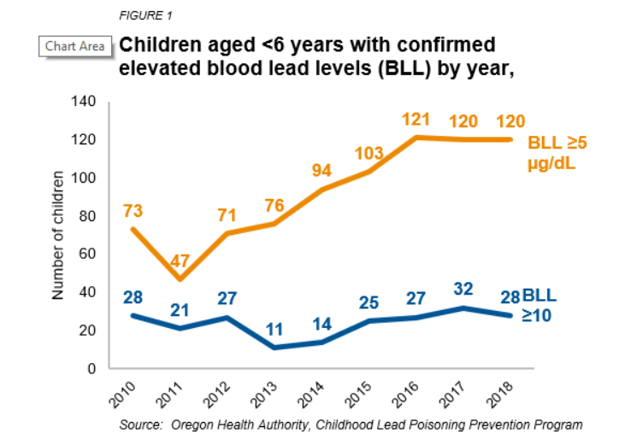
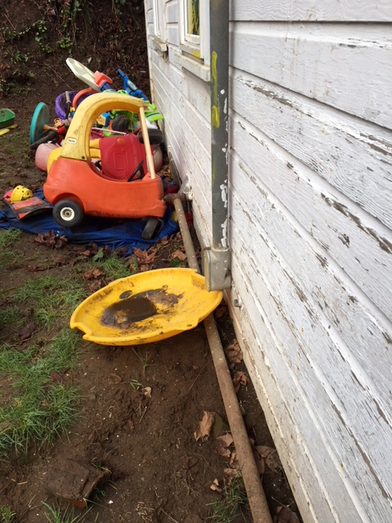
Childhood Lead Poisoning in Oregon
Notes:
Confirmed childhood lead poisoning cases in Oregon have risen during the past decade. This is likely due to an increase in testing of Oregon’s children under 6 years old.

Slide 5
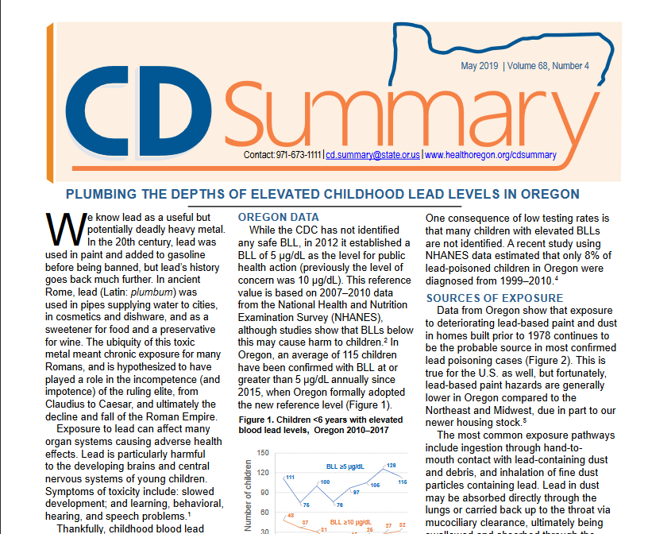
Notes:
The May 2019 CD Summary on Childhood Lead Levels is a good primer on the topic.

Slide 6
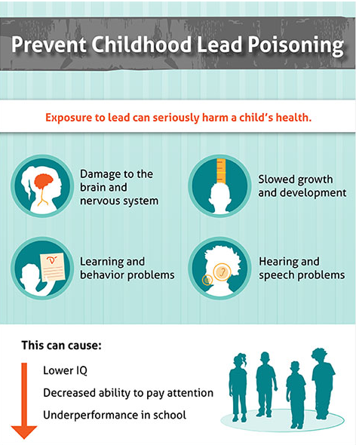
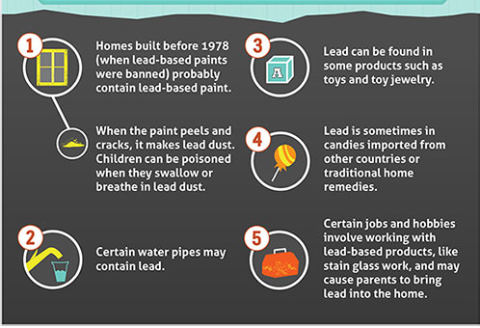

Notes:
The health effects of lead exposure in young children is well documented. Children with elevated blood lead levels (EBLLs) do not usually exhibit symptoms, and the fact that a child with an EBLL is asymptomatic is not a reason to dismiss the child’s condition.

Slide 7
Lead Poisoning Case Management

Slide 8

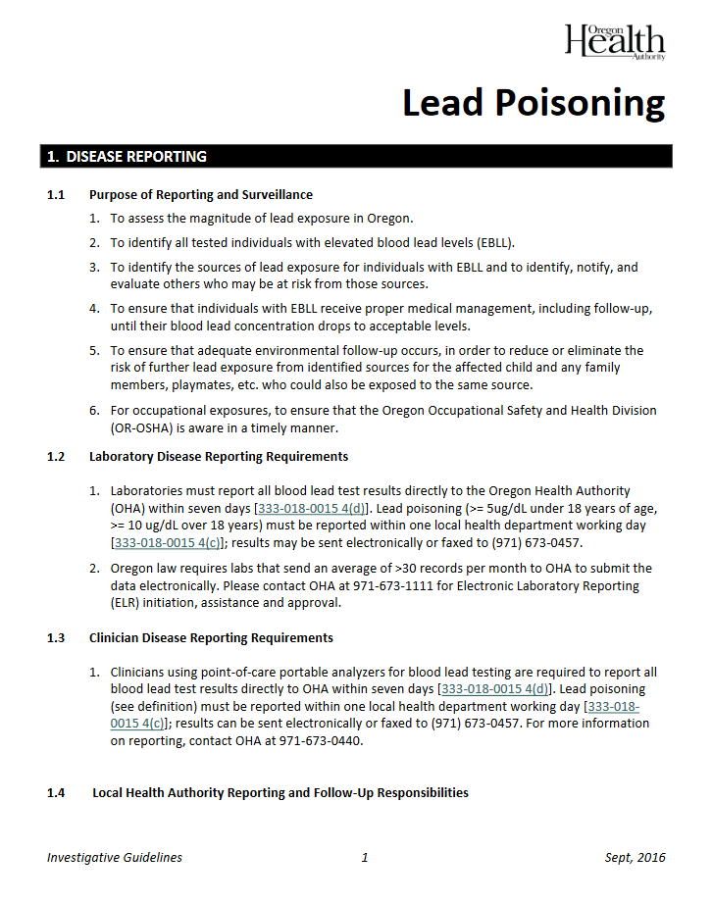
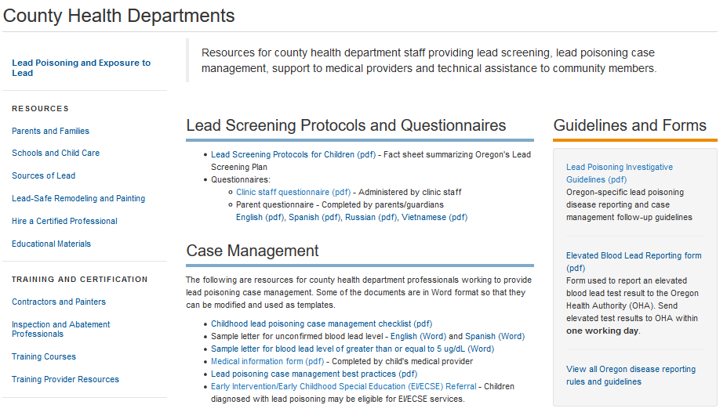
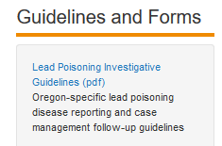
Lead Poisoning Investigative Guidelines
healthoregon.org/lead
Notes:
Familiarize yourself with Oregon’s Lead Poisoning Disease and Investigative Guidelines, found on OHA’s County Health Departments page of the Lead Poisoning Prevention Program.

Slide 9
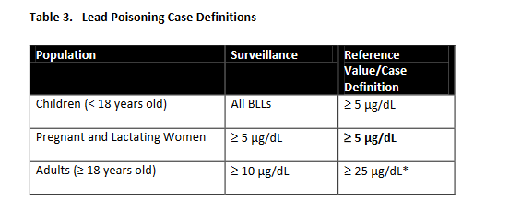
Childhood Blood Lead Levels
Federal
Oregon
2012: CDC updates “level of concern” of 10 µg/dL to “reference level” of 5 µg/dL
CLPPP adopts CDC reference value in May 2016
Notes:
Any blood lead level for a child or pregnant woman above 5 µg/dl will need to be managed until closed (this will be explained further). This may include an interview and/or home investigation; communication to ensure follow-up blood lead testing; connecting the family to education and resources (such as a referral to Early Intervention); and communication with the case’s provider to discuss any details of the case or offer OHA recommendations.

Slide 10
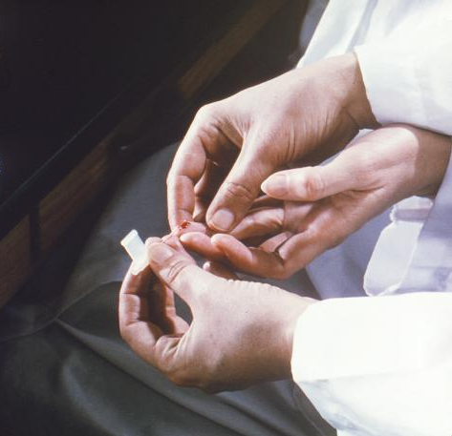
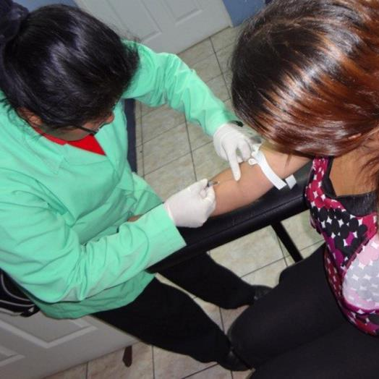
Presumptive vs. Confirmed Blood Lead Test
Capillary test (Presumptive)
Susceptible to contamination.
Should be confirmed by venous test
Venous test (Confirmatory)
If ≥ 5 µg/dl, then it’s a Confirmed Elevated Blood Lead Level (EBLL)
Notes:
Capillary testing is the least invasive way to test a child for lead. However, due to skin contamination, it has a high false-positive rate. Consequently, a venous test is strongly recommended in order to confirm whether a child’s blood lead level is elevated.
There can be reluctance on the part of providers to order a venous confirmatory test and parents to have the test performed (particularly if the BLL is not alarmingly high). If LHD staff managing lead poisoning cases find themselves in this situation, they should recommend the child have second capillary test performed within 1 month.

Slide 11
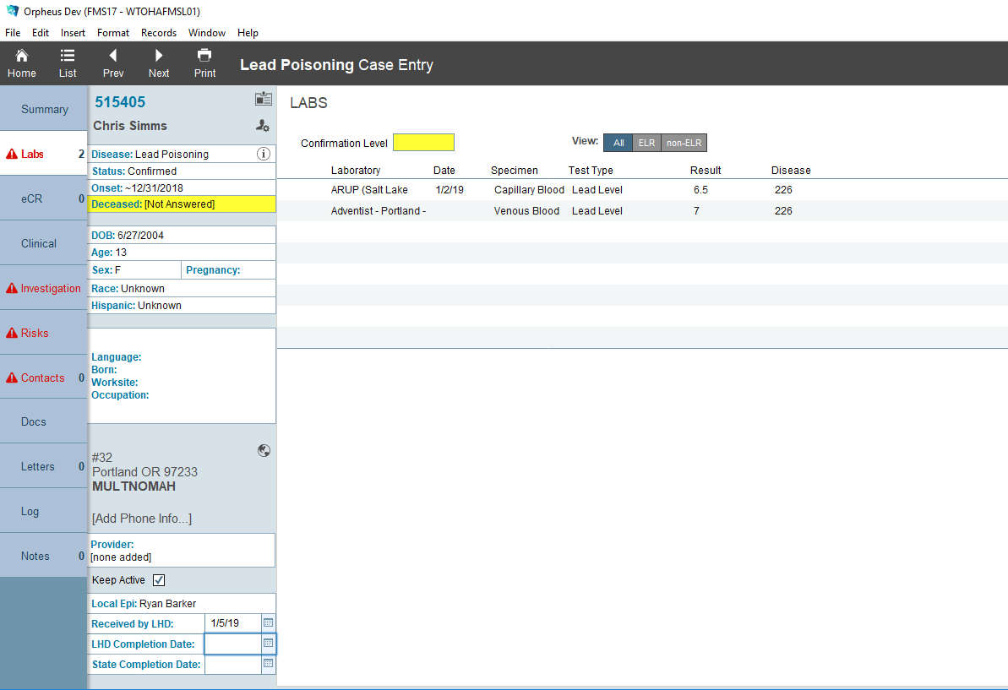
Determining Case Status: Specimen Type and Date
Capillary or Venous?
Notes:
Reported blood tests can be ambiguous as to whether they were capillary or venous. Specimen date may also be missing. Contact the provider to discuss specimen type and/or date if it is unclear from the test record you received and then update information on the Labs tab in the Orpheus case record.
Test Types identified as “POC”, are usually point-of-care systems that analyze blood onsite. The most common POC analyzer, the LeadCare II, is only approved to analyze capillary blood samples. However, confirm the sample type with the provider rather than assume that it is a capillary test.

Slide 12
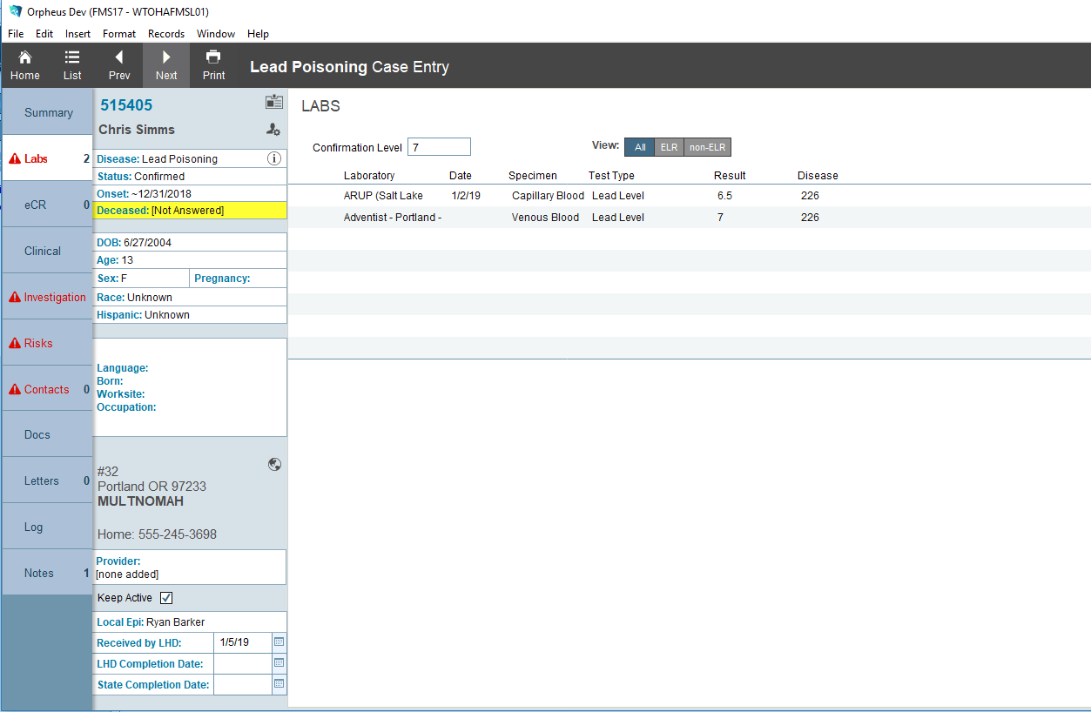
Determining Case Status: Confirmation Level
Update Confirmation Level
Capillary or Venous?
Notes:
When the confirmatory (venous) test result is available, please enter the blood lead level in Confirmation Level.

Slide 13
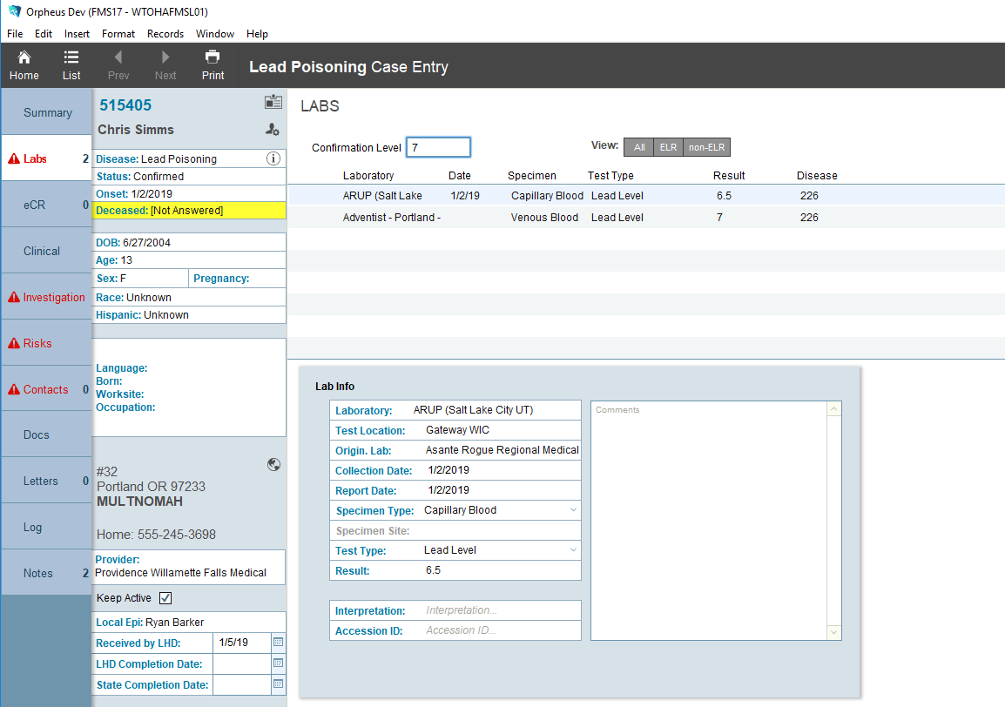
Determining Case Status: Onset Date
Notes:
Next, set the onset date to the date of the earliest blood lead test result that is >= 5 ug/dL.

Slide 14
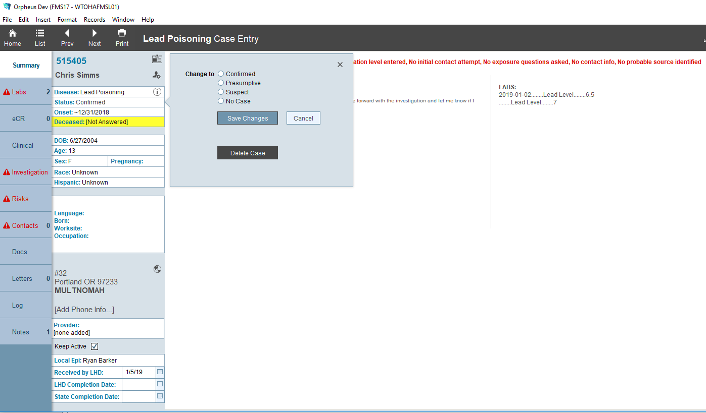
Determining Case Status
Change Case Status
Notes:
Finally, change the case status from Presumptive to Confirmed (when the confirmatory test result is >= 5 ug/dL). Result of <5 ug/dL is considered No Case and case management is not required. Please do not mark a case as Suspect.

Slide 15
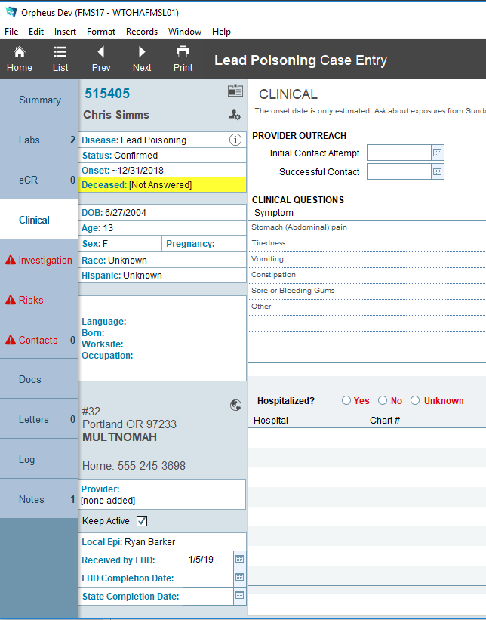
Contact with Provider
Case Management: Recording Provider Contacts
Notes:
Record dates of initial and successful contact with the provider.

Slide 16
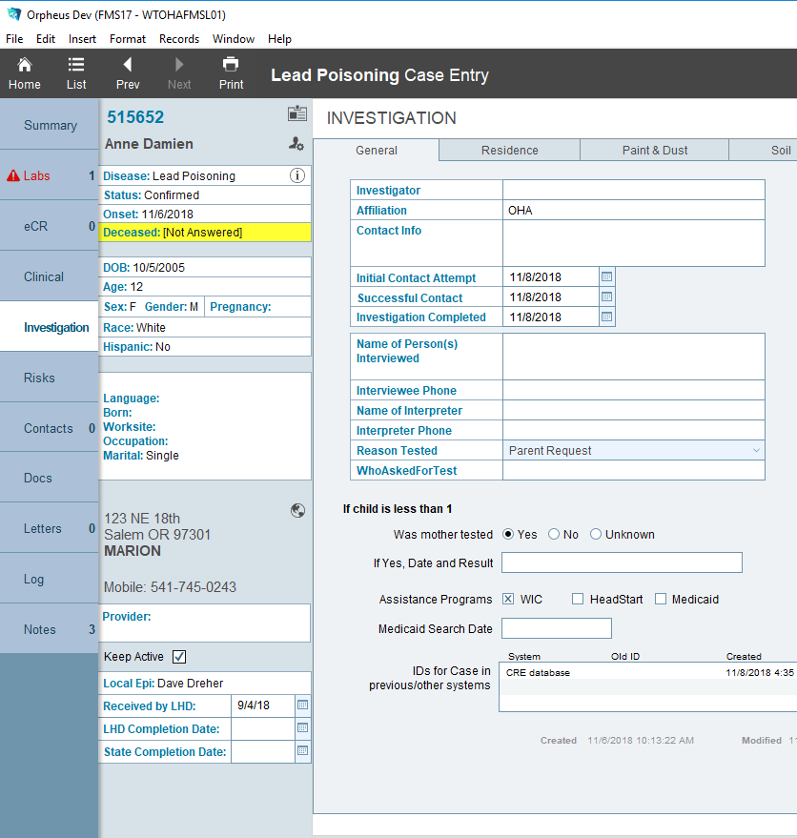
Case Management: Recording Family Contacts
Contact with Family
Contact case family within one week of a confirmed elevated result.
If not possible, contact OHA CLPPP for assistance.
Notes:
In a confirmed case of lead poisoning, an attempt should be made to contact the family within one week of the confirmatory test result. Record initial and successful contact dates on the General tab in the Investigation section.

Slide 17
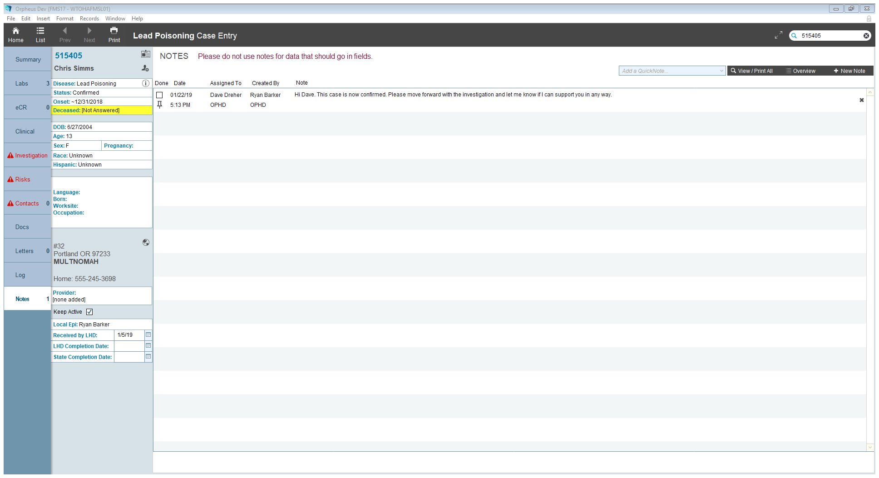
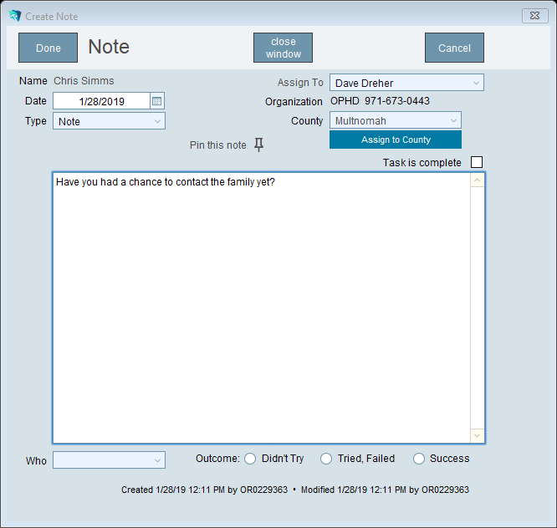
Case Management: Sending Notes
Remember to change the “Assign To” in order to send notes to other Epi staff.
It won’t show up on their To Do tab if you don’t do this step!
Notes:
Different local health departments have different internal protocols for the management of lead poisoning cases. Notes are a useful way to document that steps are being taken to manage the case. That said, please do not enter information into notes that should be stored in other fields.

Slide 18
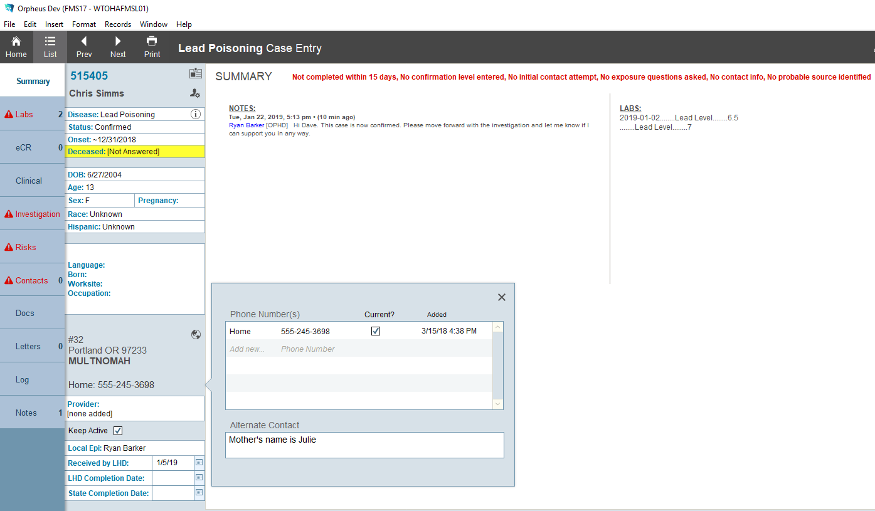
Case Management: Identify Parent/Guardian
Add contact info here
including parent/guardian names
Notes:
It’s important to include a parent/guardian name if known. Do this by clicking the phone number to reveal an additional box for more contact info.

Slide 19
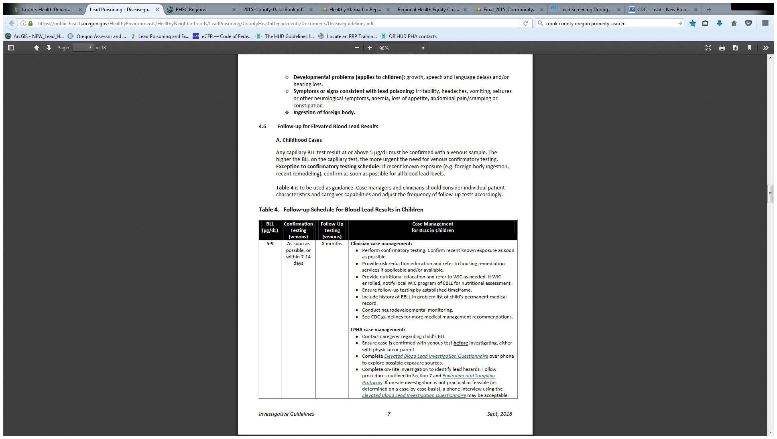
Elevated Blood Lead Level (EBLL)
Case Management
Notes:
Once the confirmatory result is elevated, case management begins. Review Table 4 in the Investigative Guidelines for guidance on next steps.

Slide 20

Elevated Blood Lead Level (EBLL)
Case Management
Notes:
Review Table 4 in the Investigative Guidelines for guidance on next steps. Home investigations should be performed as often as possible with staff capacity. For questions or training on this, please contact OHA. If not feasible, a telephone interview is acceptable.

Slide 21
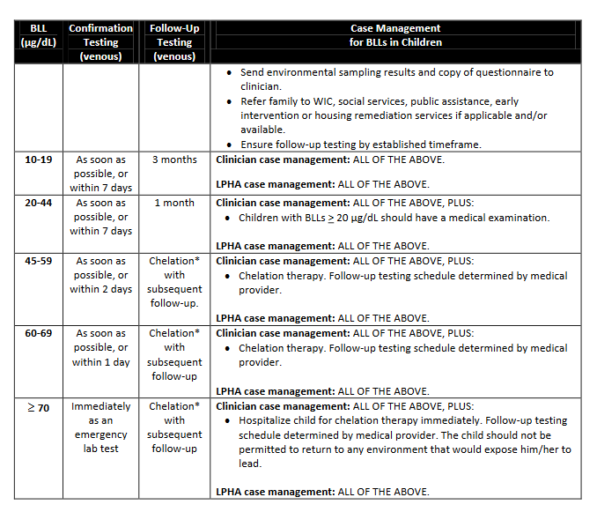
Elevated Blood Lead Level (EBLL)
Case Management
Notes:
In general, case BLL levels up to 20 µg/dl are treated fairly similarly. Above 20 µg/dl, recommendations are to complete additional diagnostic testing, physical exams (including X-rays to locate unpassed ingested objects) and neurodevelopmental screenings. Levels above 45 µg/dl are recommended to be treated through chelation. Providers should be referred to expert toxicologists for additional guidance if needed.

Slide 22
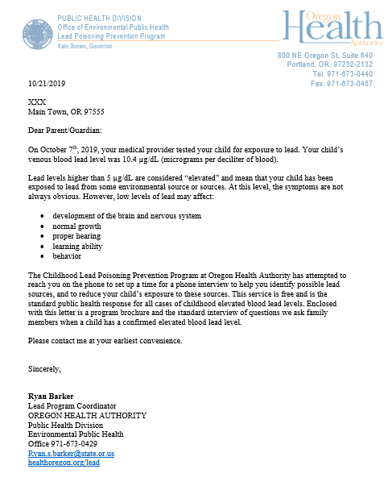
Case Management: Within 7 days of confirmed result
Request investigation with no phone #
Notes:
If the contact has no phone number, or repeated attempts fail to reach the family, send a letter with a request for an investigation or interview.

Slide 23

Case Management Investigation
Determine Age of Housing
  Pre-1950 at greatest risk for lead paint; anything prior to 1978 is a possibility for lead paint
  Pre-1986 homes may also have higher levels of lead in drinking water
Discuss Case with OHA CLPPP
Communicate with parent/guardian
  Determine literacy and language
Schedule Interview/Investigation
CDC/Greg Knobloch
Notes:
Preparing for case management will have several tasks including the bullets above. If at any time you have questions, consult with OHA, either through Orpheus, via email (without confidential information), or phone.

Slide 24
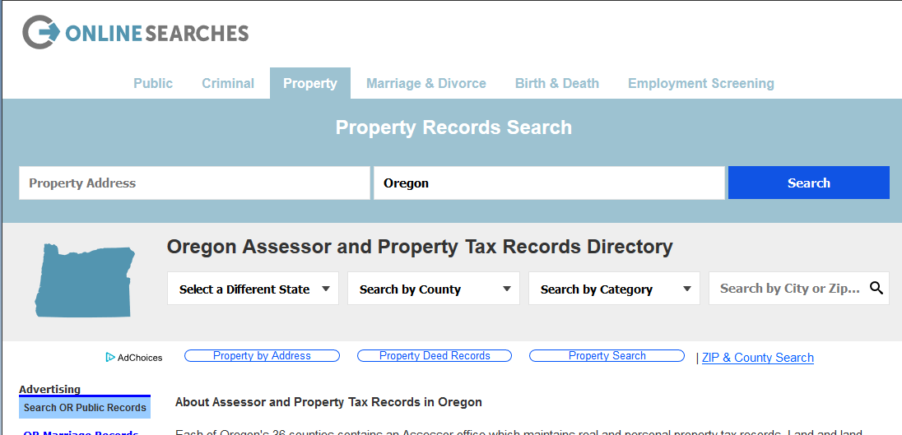
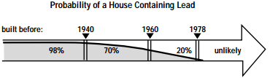
Case Management Investigation
Determine Age of Housing
https://publicrecords.onlinesearches.com/Oregon-Assessor-and-Property-Tax-Records.htm
Notes:
Before the interview or home investigation, attempt to determine the age of the home. All counties have tax assessment data for residential properties, and many of them list the age of the residence. Any residence 1978 or newer will not contain lead-based paint, and this can likely be ruled out from the list of possible exposure sources. When using county assessor data, look for the “Year Built” date, which isn’t always available, especially for apartment buildings.

Slide 25

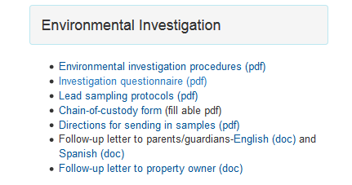
Case Management Investigation
https://www.oregon.gov/oha/PH/HEALTHYENVIRONMENTS/HEALTHYNEIGHBORHOODS/LEADPOISONING/COUNTYHEALTHDEPARTMENTS/Pages/index.aspx
Notes:
Once the family has been contacted and a time has been set for an interview or home visit, open and print a copy of the Environmental Investigation Report, sometimes referred to as the “investigation questionnaire”. It can be found at OHA’s Lead program website for County Health Departments.

Slide 26
During the Investigation

Slide 27
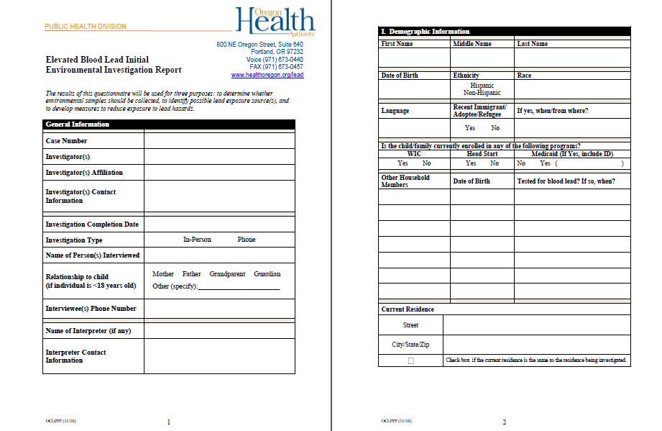
Case Management Investigation
Notes:
The questionnaire has been developed to identify the majority of possible lead exposure sources. Please plan to ask all the questions, as applicable, and fill out as much detail as needed. This document will then be used to determine what are the most likely sources of lead exposure causing the child’s elevated blood lead level. Please also plan to be flexible, and ask follow-up questions or open-ended questions to find any other important information.

Slide 28
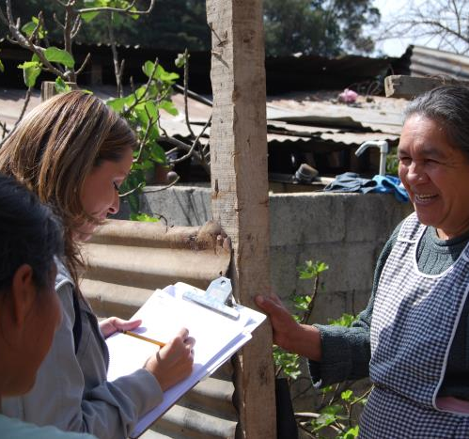
Case Management Investigation Interview
Introduction to parent/guardian
  Identify yourself and ask for permission to enter the home
Ask all questions on questionnaire
  The questions have been designed to pinpoint the most likely source(s) of lead
Determine if source is outside of home
  Childcare facilities, grandparent’s homes, or other relatives
CDC/ Jessie Blount
Notes:
During the interview and/or home investigation, take as much time as is needed while being mindful of the family’s willingness to participate. The more the family warms to your questions or visit, the more access you may gain to potential exposure sources. The exposure sources may not always be evident or out in the open, so use follow-up questions to gather as much information as possible.

Slide 29
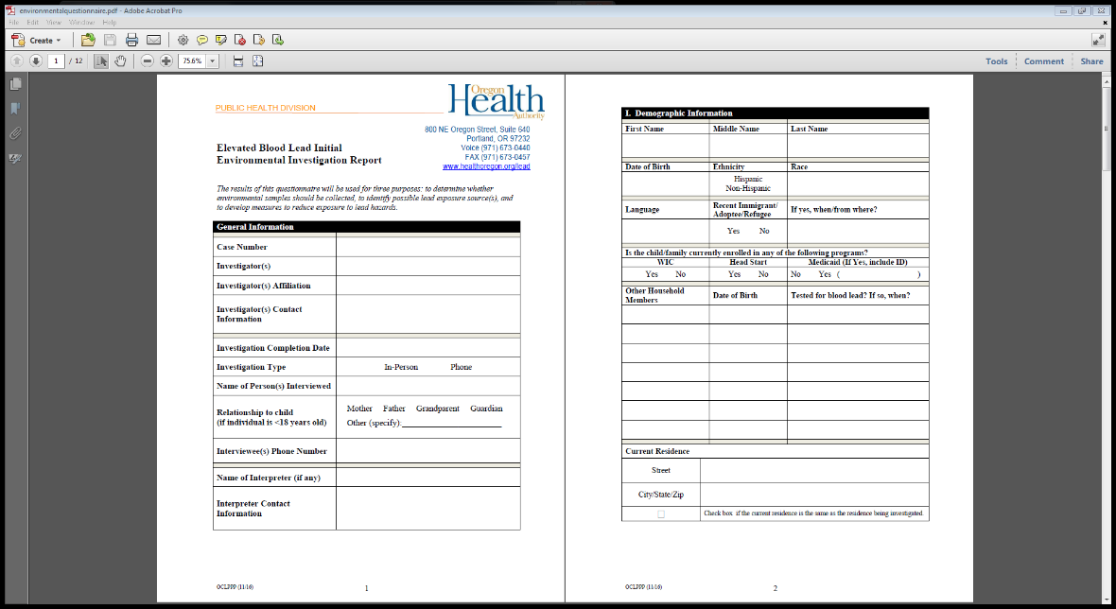
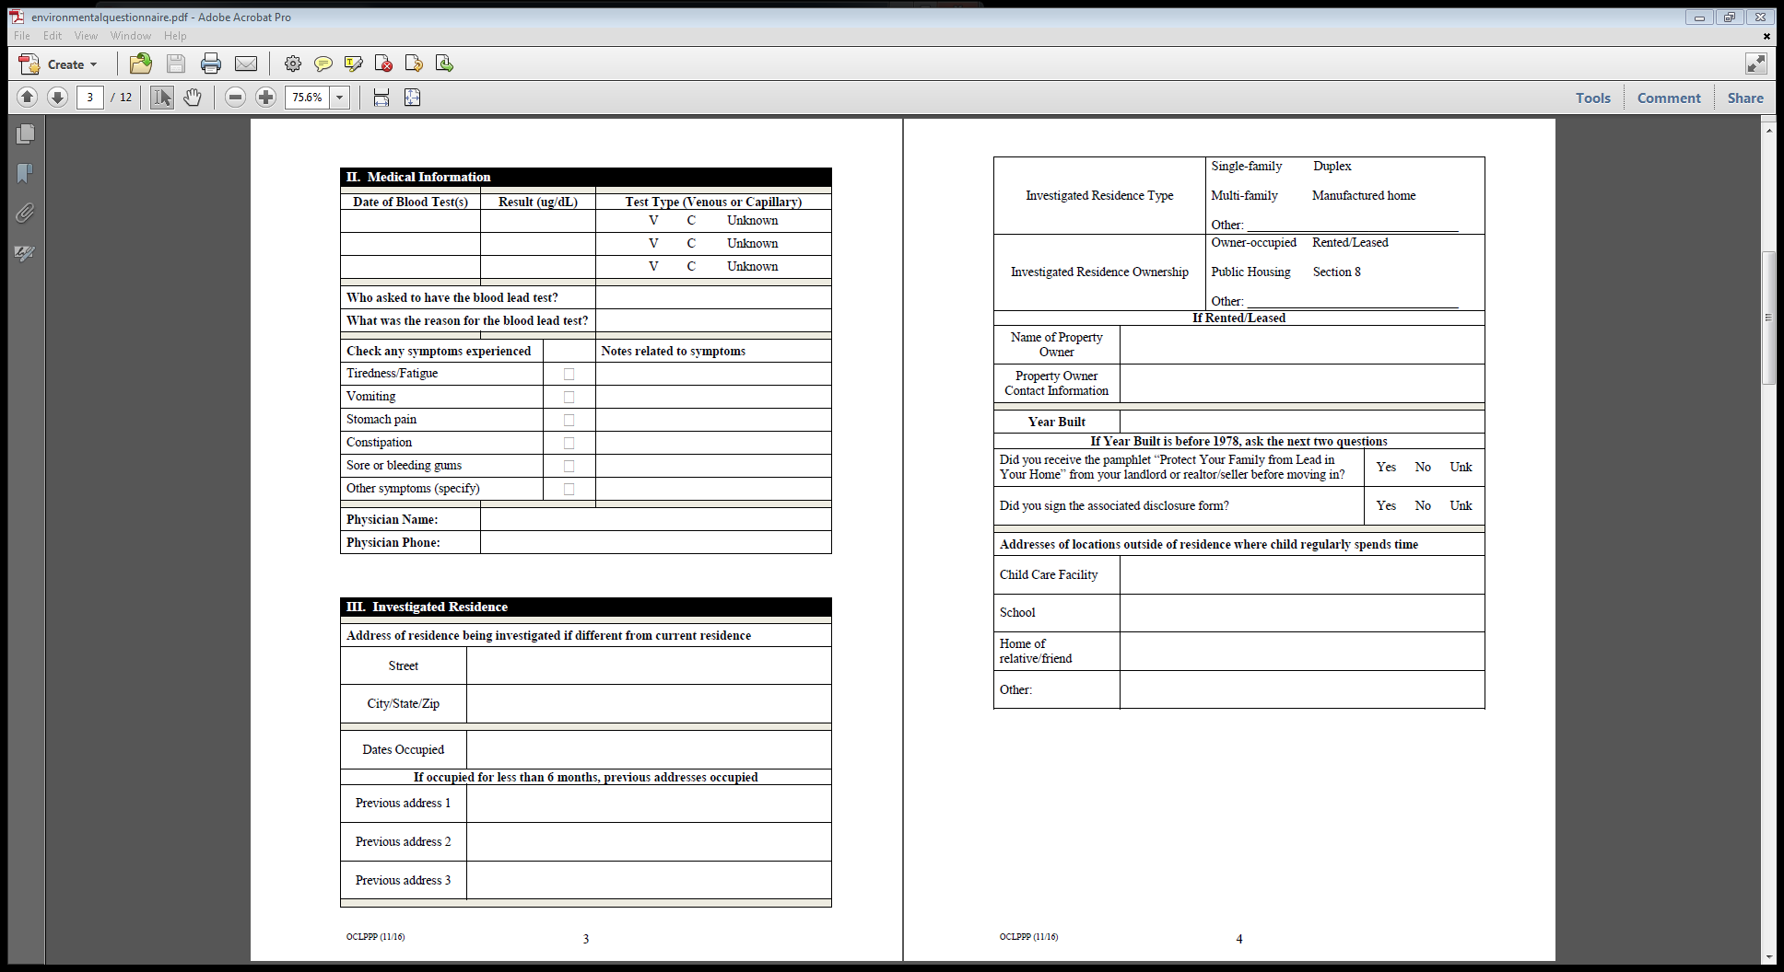
Case Management Investigation Interview
Basic demographic, residence, medical information
Please complete as much as possible
1
2
3
Notes:
If possible, also try to document any other family members living in the home, and whether they received blood lead tests. If date of birth is captured, the person can be searched in Orpheus to look up testing information. Also note any other places where the child spends time (such as a daycare, babysitter, or grandparent’s home) to determine if other residences or facilities should be visited.

Slide 30
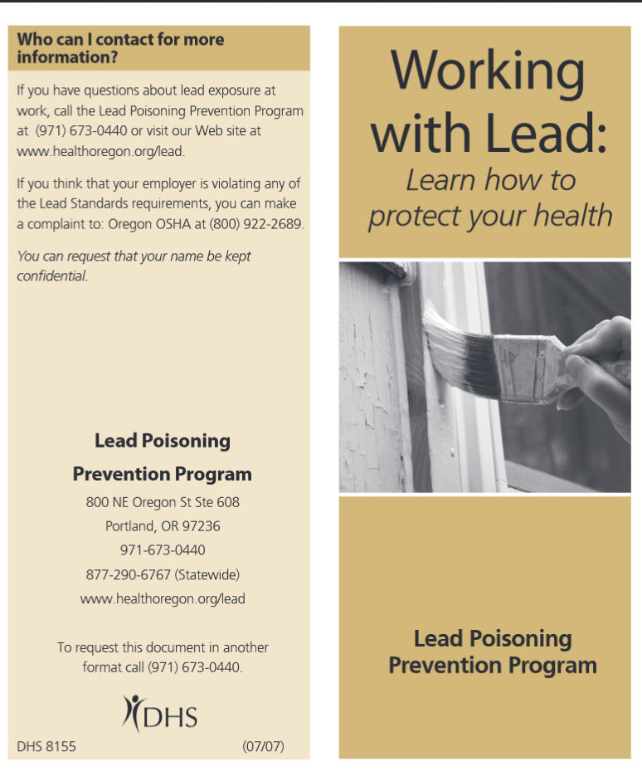
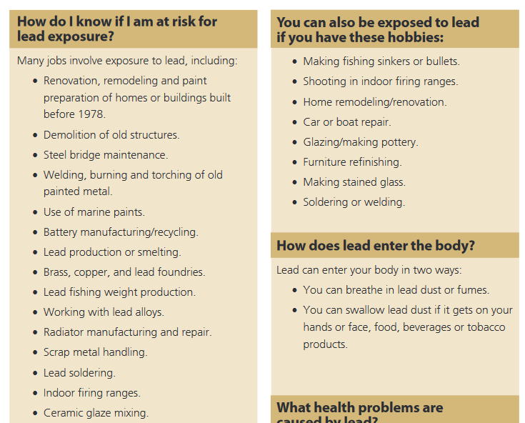

What to Look for During the Investigation
Occupational and Hobby Lead Sources
Notes:
If possible, determine if any adult family members work in occupations that could cause take-home lead exposure. OHA’s “Working With Lead” brochure lists some of these occupations. This is also a good brochure for further education for the family.

Slide 31

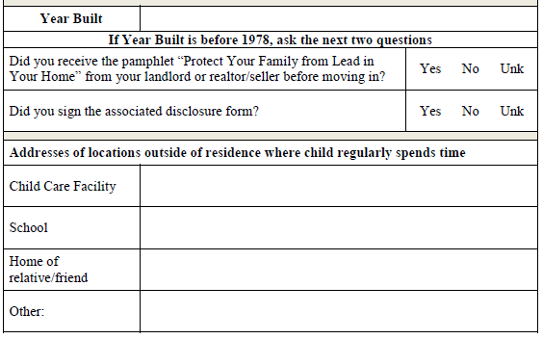
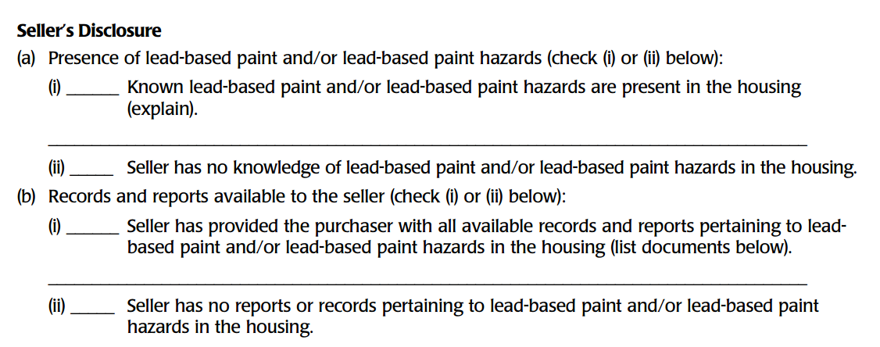
Case Management Investigation Interview
4
https://www.epa.gov/lead/real-estate-disclosure
Notes:
Some questions on the form are specific to federal programs. This question is asking if the resident received a pamphlet and document that is required by federal law for all buyers or lessors of pre-1978 residences. If this law was violated, OHA can issue a complaint to EPA for a follow-up investigation.

Slide 32
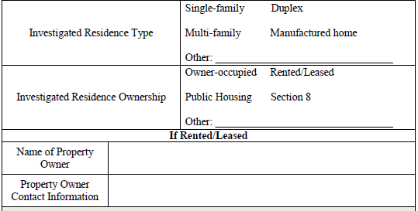

Case Management Investigation Interview
4
Notes:
This question is to determine if the family lives in housing financially supported by the US Housing and Urban Development. Ask the family if they are receiving any kind of assistance paying for rent. OHA may also be able to find this information, but asking the question during the investigation will get the answer more quickly. If “yes”, this case will require additional follow-up with the local housing authority for further investigation.

Slide 33
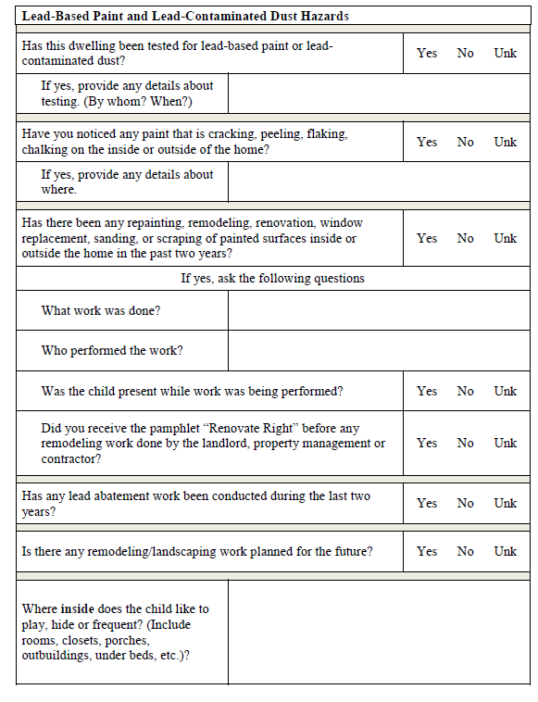
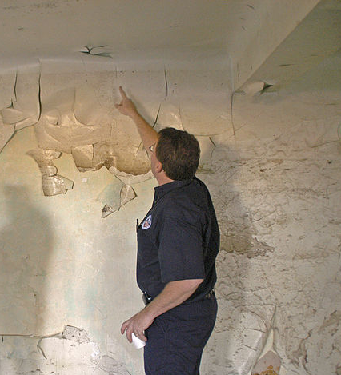
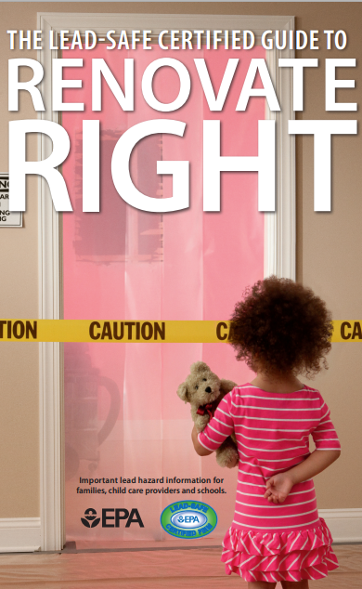
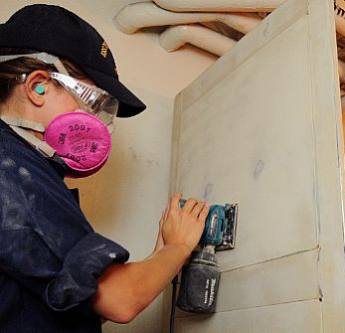
Case Management Investigation Interview
Questions and observations regarding lead-based paint
5
Notes:
Page 5 lists questions regarding any recent renovation work (specifically disturbing paint on pre-1978 homes), as well as a visual inspection for any deteriorated paint. The “Renovate Right” pamphlet is required by state and federal law to be given to occupants when work is performed in pre-1978 homes by contractors, landlords, or property management companies.

Slide 34
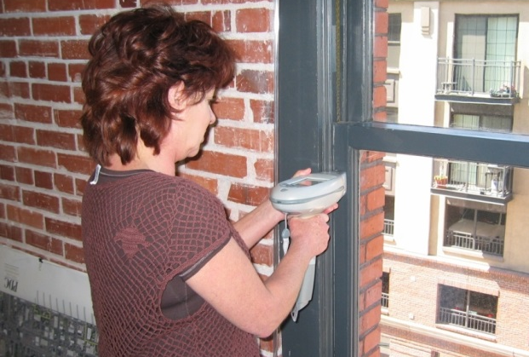
Case Management Investigation Interview
Questions and observations regarding lead-based paint
Lead abatement projects permanently eliminate existing lead-based paint hazards
5
Notes:
These questions are not always easy for the family to answer, especially if they are tenants. If the residence is 1978 or newer, these questions can be skipped.

Slide 35
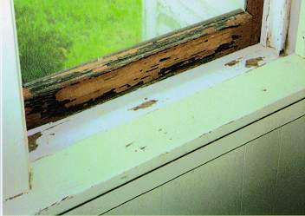
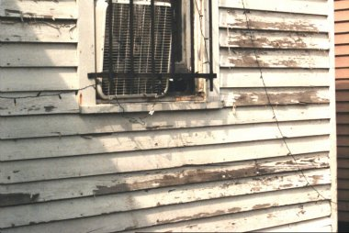
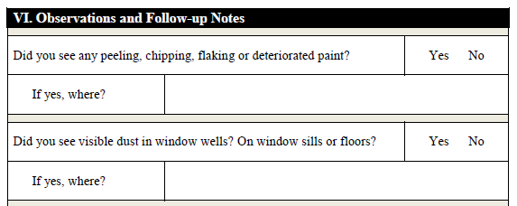
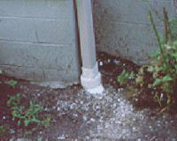
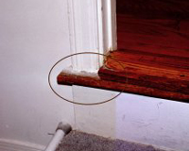
What to Look for During the Investigation
Deteriorated paint in pre-1978 homes
11
Paint dust inside and outside
Notes:
While at pre-1978 homes, inspect any surfaces possible for any kind of deteriorated paint or dust accumulation. Note if children have access to any of these surfaces, or if family members could possibly spread paint chips and/or dust into areas where the child plays, sleeps, and/or eats.

Slide 36
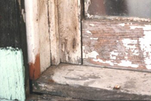

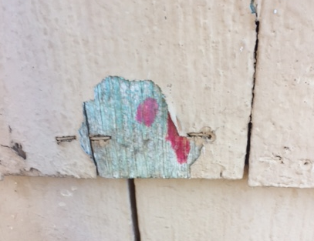
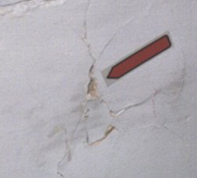
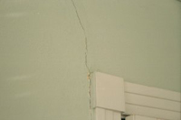
What to Look for During the Investigation
Deteriorated paint in pre-1978 homes
There are many types of deterioration
Peeling
Chipping
Cracking
Holes in walls
Damaged substrates
Notes:
These pictures show extreme examples of deteriorated paint.

Slide 37
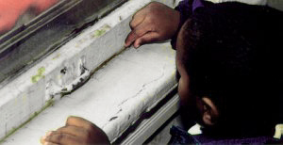


What to Look for During the Investigation
Deteriorated paint in pre-1978 homes: friction and impact surfaces
Notes:
Friction surfaces with old paint are also a problem. Doors that stick and windows that open and close can easily cause paint to chip or dust to fall to surfaces where children can access.

Slide 38

What to Look for During the Investigation
Bare soil and play areas; garden areas; debris in yard where child plays
6
Notes:
If possible, tour the exterior of the home, such as the front and backyard, as well as driplines and gardens, noting any bare soil and/or paint chips.

Slide 39

What to Look for During the Investigation
Bare soil and play areas; garden areas; debris in yard where child plays
Yard
Play area
3’
Pre-1978
House
Dripline
Notes:
If possible, tour the exterior of the home, such as the front and backyard, as well as driplines and gardens, noting any bare soil and/or paint chips. If the child plays in these areas and has access to bare soil, this could be a source of lead exposure. While non-risk assessors cannot sample soil, OHA may be able to assist in sampling if needed.

Slide 40

What to Look for During the Investigation
Fought70
Notes:
Demolitions of older buildings can spread lead dust into neighboring yards. Note if any have occurred recently on nearby lots.

Slide 41

What to Look for During the Investigation
EPA
Notes:
Other things to note include vehicles on the lot that may be in various states of repair, or are being scrapped. The satellite image above shows a home where a scrapyard was previously. Work on metal, car paint, and batteries caused the soil to become contaminated with lead and required a lengthy and expensive cleanup.

Slide 42

What to Look for During the Investigation
Water sources and copper water pipes connected with lead solder
7
Notes:
Other sources of lead include drinking water, as we’ve heard about from Flint, Michigan. These questions get at the use of water for cooking and drinking. If the family reports that only bottled water is used, most of these questions can be disregarded. Depending on the answers, a water test may be recommended. If the child is being breastfed, we often recommend the mother also receive a blood lead test to find out if lead may be transferred through breastmilk.

Slide 43


What to Look for During the Investigation
Copper water pipes connected with lead solder; aged faucets
Faucets installed prior to 2014 may have 8% lead in components
If plumbing was installed prior to 1986, lead solder may have been used
Borsi112
Notes:
In Oregon, the most likely cause of lead-contaminated water is copper pipes connected with lead solder, or older metal faucets containing some lead. If you see these during an investigation, recommend the family always use cold water, and flush out pipes for 30 seconds to 2 minutes before using if the water has been stagnant for 6 or more hours.

Slide 44


What to Look for During the Investigation
Occupational and Hobby Lead Sources
8
Notes:
Many other objects or hobbies in the home can also be possible sources of lead. Go through these questions with the family to determine any other sources not related to the physical home. If any of these are noted, ask if they can be seen and photographed.

Slide 45






What to Look for During the Investigation
Other Household Lead Sources
Metal jewelry and trinkets
Tikka/sindoor powder
Glazed pottery
Surma/kohl
9
© Jorge Royan
Notes:
Pages 9-10 ask questions to determine any other possible lead exposure sources. These could include foreign cosmetics, glazed pottery for cooking or serving food, or metallic objects that the child has put in his/her mouth.

Slide 46




What to Look for During the Investigation
Other Household Lead Sources
Turmeric roots
Chapulines (crickets from Mexico)
Azarcon/greta Mexico)
10
Notes:
Candy and chapulines (crickets or grasshoppers) from Mexico have also been found to be contaminated with lead. Note any kind of consumption of products such as these, and if possible, take note of brand name and/or country of origin. Also, some spices, such as turmeric that are brought in from other countries could be contaminated with lead chromate, which could give the spice that bright yellow color. Folk medicines like azarcon/greta from Mexico are another highly-contaminated source.

Slide 47



What to Look for During the Investigation
Other Household Lead Sources
Homemade fishing gear
Fishing gear
Lead chips
Notes:
Other sources include lead fishing weights or sinkers, as well as homemade lead anchors. Anytime lead is melted down, the molten lead can easily spread and contaminate surfaces, yards, and skin with lead that can cause cross contamination to children.

Slide 48



What to Look for During the Investigation
Checking for the presence of lead-based paint
Notes:
LeadCheck swabs are the easiest way to test surfaces for the presence of lead. When activated and used correctly on a surface, a color change to pink or red indicates lead present of some concentration. If your office does not supply these, contact OHA for a box to use.

Slide 49




What to Look for During the Investigation
Checking for the presence of lead in paint or other surface coatings
Step 1: Check vials inside
Step 2: Crush “A”
Step 3: Crush “B”
Step 4: Shake for 10 secs.
Notes:
It’s important to activate the LeadCheck swab correctly. Follow the manufacturer’s instructions carefully.

Slide 50


What to Look for During the Investigation
Checking for the presence of lead
Notes:
LeadCheck swabs can be used on many different surfaces. If checking paint, find an area that is deteriorated where you can access multiple paint layers. You can also try to make a small score using a utility knife. Realize that the chemical solution often stains the surface, so perform the test in an inconspicuous spot, or have some wet wipes or towels nearby to remove it immediately.

Slide 51
Case Management Investigation Limitations
Risk assessments are on-site investigations to determine the existence, nature, severity, and location of lead-based paint hazards accompanied by a report explaining the results and options for reducing lead-based paint hazards (40 CFR745.227(d)(11))
A lead-based paint hazard is any condition that causes exposure to lead from dust-lead hazards, soil-lead hazards, or lead-based paint that is deteriorated, or present in chewable surfaces, friction surfaces, or impact surfaces that would result in adverse human health effects.
Risk assessments can be performed only by risk assessors certified or licensed by EPA or an EPA-authorized State, Tribe or Territory.
Notes:
Only individuals certified as risk assessors can take dust or soil samples to determine the presence of lead hazards. This means that investigation activities cannot include these unless a certified risk assessor is available to obtain these samples.

Slide 52



Case Management Investigation Limitations
Environmental Sampling by Risk Assessor
Dust
Paint chip
Soil
Notes:
Examples of risk assessor activities.

Slide 53


Case Management Investigation Limitations
Checking for the presence of lead-based paint dust
If you see paint dust on accessible surfaces, note on the report
Since non-certified health staff cannot take dust samples, OHA has kits available for the family
Notes:
One way of getting around this regulatory requirement is to request a lead dust test kit from OHA. These are available for a parent/guardian of the case to perform in their own residence.

Slide 54

Notes:
The investigator can assist the person who is performing the sample better understand the directions. However, they cannot directly take the sample. These instructions are also available in Spanish.

Slide 55
After the Investigation

Slide 56

After the Investigation
Attach Questionnaire, Photos, and any other documentation in Orpheus in Docs tab
Notes:
After the investigation, it’s important to upload the completed questionnaire into Orpheus under the Attachments tab. You can scan the document and attach it.

Slide 57

After the Investigation
Or add fields in Orpheus from Questionnaire in Investigation tab
Notes:
You can also manually enter your notes directly into Orpheus in the Investigation tab.

Slide 58

After the Investigation
Identify Probable Source
Notes:
If a probable source was identified, make sure to document it. Also, add additional notes on this page including any known or recommended follow-up activities.

Slide 59
After the Investigation
x
Identify Probable Source
Notes:
If a probable source was identified, make sure to document it. Also, add additional notes on this page including any known or recommended follow-up activities. Check the boxes as appropriate. “Conducted Investigation” must be checked after complete.

Slide 60


After the Investigation
Identify Risks
Notes:
Also, answer the questions on the Risks tab. This is especially helpful if you have uploaded a scan of the investigation questionnaire. The answers here give a quick snapshot of the likely exposure sources.

Slide 61

After the Investigation
Identify Contacts
Notes:
Make sure to include any known contacts associated with the case. This could include parents, guardian, siblings, cousins, or grandparents.

Slide 62

After the Investigation
Notes:
A new feature in Orpheus, found in the Investigation section, is the Samples section. When quantitative results are received from a lab, they can be stored here. Also, include any lab documentation in the Docs section for further review and archiving.

Slide 63

Follow-up Letter to Family
Notes:
If possible, send a letter to the family after the investigation with follow-up education and summary of activities, as well as any identified lead exposure sources.
This should be done as soon as possible, so the family has the knowledge to limit future exposure to lead and the associated health effects.

Slide 64
Follow-up Letter to Family
Thank you to the family, parent, guardian, or caregiver for giving access to the residence for the investigation
Summary of investigation activities that were conducted
Identification of probable exposure source(s)
Education to limit future exposure from source(s)
Add any additional educational resources that are pertinent to the case
Notes:
Adding as much detail as possible to the letter is helpful, but make sure it is readable and understandable, without technical jargon or acronyms. If you need an example letter, contact OHA.

Slide 65



Early Intervention Referral
Notes:
All children in Oregon with a blood lead level of ≥ 5 µg/dl are now eligible for Early Intervention/Early Childhood Special Education services through the Oregon Dept. of Education. More information on referring a child to these services can be found by following the link on the OHA Medical Providers and Laboratories page. Every child with an EBLL should receive this information. You should also click the box in the Orpheus Investigation Followup tab that states “Early Childhood Education”.

Slide 66
Medicaid Reimbursement for an Elevated Blood Lead Level Home Investigation

Slide 67


Medicaid Reimbursement for Investigation
Notes:
The state’s Division of Medical Assistance Programs is able to reimburse the local health department for a one-time investigation for each child enrolled in OHP that has an EBLL of ≥5 µg/dl.

Slide 68

Medicaid Reimbursement for Investigation
Click Investigation tab to see Medicaid status
Notes:
Find a child’s Medicaid status in the Investigation tab, on the General page. This gets updated on Sunday night, so if there’s no “Medicaid Search Date” in the field, wait until the following Monday and check again. If you have questions about billing, ask the person responsible for billing medical claims with the health department. OHA can also help your office get started on this process.

Slide 69



OHP/Medicaid Status of Child
Notes:
To determine if the child is enrolled in Medicaid/OHP, check the Investigation section and go to the General tab.

Slide 70
Medicaid Reimbursement for Investigation
Claims should be made no more than 1 year after the service
Reimbursement is for a one-time home visit only
Health Systems Division, a separate office within OHA, dictates rules and policies for these reimbursements

Slide 71
Case Closure

Slide 72

Laboratory Case Closure
Unclick the “Keep Active” box and Add “Completion Date”
Child’s BLL has declined to below 5 μg/dL on two consecutive tests at least three months apart.
Notes:
Laboratory case closure happens when two consecutive BLLs <5 µg/dl occur at least 3 months apart. At that point, uncheck the “Keep Active” box.

Slide 73



Laboratory Case Closure
How long will this take?
Notes:
There is no defined length of time for how long it will take an EBLL to get to the point of case closure. However, some research shows that it could take months or even years depending on the initial EBLL. Be patient and persistent.

Slide 74

Laboratory Case Closure
How long will this take?
Notes:
Some levels drop fast, and others are very slow. BLLs that increase should be followed up with the family to find out if other lead exposures are occurring, or if something has changed.

Slide 75
Administrative Case Closure
Child’s case is lost to follow-up
If child/family moves out of state
  Contact appropriate state authority or OHA to notify
Medical provider or family does not plan on further follow-up testing.
    Should be at least three documented attempts to contact the family, whether by phone or letters
    The last attempt to reach the family should be through certified mail
Notes:
There are three other reasons why cases are closed besides a reduction in BLL.

Slide 76

Administrative Case Closure Example
Unclick the “Keep Active” box and Add “Completion Date”
Notes:
One example could be the parent/guardian and/or provider has refused any further testing.

Slide 77
Measuring Case Management Success
Case Management activities start no later than 7 days after onset
Probable lead source(s) identified and education provided to prevent future exposure
Follow-up tests show continued decline in blood lead levels

Slide 78
Scenarios
Notes:
The following slides show a sample of scenarios you may find while on an investigation.

Slide 79
Scenarios
Based on the answers in the EBLL interview with the family, you have narrowed the child’s activities to the following:
  Drinking juice from a favorite heirloom metal cup
  Playing with the dog on the lawn in the backyard
  Watching TV on the floor in the living room
The family’s home was built in 2000. Which of the three activities above would you most suspect be the source of lead exposure?

Slide 80

Scenarios
Based on the answers in the EBLL interview with the family, you have narrowed the child’s activities to the following:
  Drinking juice from a favorite heirloom metal cup
  Playing with the dog on the lawn in the backyard
  Watching TV on the floor in the living room
The family’s home was built in 2000. Which of the three activities above would you most suspect the source of lead exposure?
What might you want to do next?
Notes:
Ask to see the cup. A LeadCheck swab could show a positive reaction on the cup. Otherwise, document it with pictures and encourage the family to discontinue use for drinking liquids.

Slide 81
Scenarios
After speaking with the case’s father during the EBLL interview with the family, you have found out that the child accompanies him during the following activities:
  Hunting
  Fishing
  Canoeing
  Gardening
Which of the following activities would not be a suspected lead exposure source?

Slide 82
Scenarios
After speaking with the case’s father during the EBLL interview with the family, you have found out that the child accompanies him during the following activities:
  Hunting
  Fishing
  Canoeing
  Gardening
Which of the following activities would not be a suspected lead exposure source?
  -Reloading lead bullets
  -Using lead sinkers
  -Soil contamination from disturbed paint

Slide 83
Scenarios
After looking at the property record, you have determined the case’s house was built in 1982. Which of the following potential exposure sources will you be focused on?
  Deteriorated lead-based paint
  Drinking water source and water pipes

Slide 84
Scenarios
After looking at the property record, you have determined the case’s house was built in 1982. Which of the following potential exposure sources will you be focused on?
  Deteriorated lead-based paint
  Drinking water source and water pipes

Slide 85

Scenarios
You locate the drinking water sink, and the pipes are easily accessible. What tool can you use to see if the pipes are soldered with lead?

Slide 86

Scenarios
You locate the drinking water sink, and the pipes are easily accessible. What tool can you use to see if the pipes are soldered with lead?
Notes:
A LeadCheck swab used on the pipe solder can tell you if lead is present.

Slide 87

Scenarios
You visit the case’s home, which was built in 2016. While interviewing the family, you notice the case play on this chair:
Could lead exposure still be an issue in this new home?
Leadline.org

Slide 88
Scenarios
You visit the case’s home, which was built in 2016. While interviewing the family, you notice the case play on this chair:
Could lead exposure still be an issue in this new home?
Leadline.org
Notes:
Yes, especially if the child has easy access to the chair, plays on it, or chews on it. Items like this should be moved away from the child’s reach.

Slide 89
Scenarios
The parents identified the following hobbies they do at home. Which one is not a suspect for lead exposure:
  Car scrapping and battery recycling
  Watercolor painting
  Stained glass
  Metalworking
  Furniture re-finishing

Slide 90
Scenarios
The parents identified the following hobbies they do at home. Which one is not a suspect for lead exposure:
  Car scrapping and battery recycling
  Watercolor painting
  Stained glass
  Metalworking
  Furniture re-finishing

Slide 91
Summary
Confirmed BLLs ≥5 µg/dl for children <18 years old must be investigated onsite or through a phone interview
Venous samples must confirm any elevated capillary sample (with some exceptions)
Case management activities should begin ≤7 days after onset
  Phone call to family; letter sent; scheduling investigation
Focus of the interview and/or investigation is to determine probable lead exposure source(s) and education to prevent future exposure
Environmental sampling (dust, soil, and paint chip) cannot be performed by a non-certified individual (ie. must be risk assessor)
OHA CLPPP is always available for guidance and assistance

Slide 92
Thank you for your time!
Questions can be directed to:
Ryan Barker
Lead Program Coordinator
OREGON HEALTH AUTHORITY
Public Health Division
Environmental Public Health
503-953-5432
ryan.s.barker@dhsoha.state.or.us
healthoregon.org/lead

Slide 93





