Slide 1
Groundwater Basics and
Source Water Protection
Insert Name
Regional Geologist – OHA DWP

Slide 2
Outline
What is groundwater; how does it work?
Well Construction
Source Water Assessments
Source Water Protection
GWUDI & GWR Tie-ins
Hands-on Exercise

Slide 3
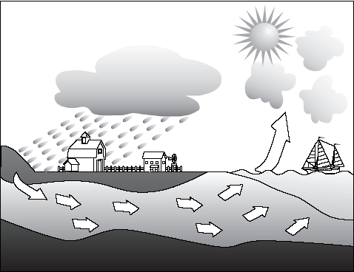
An Introduction to Groundwater

Slide 4
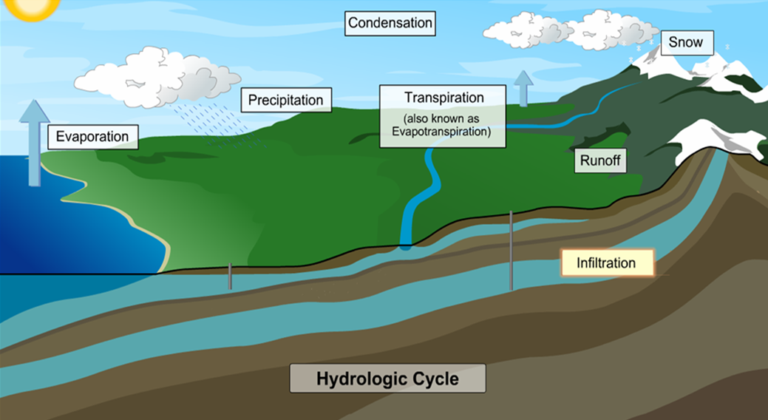
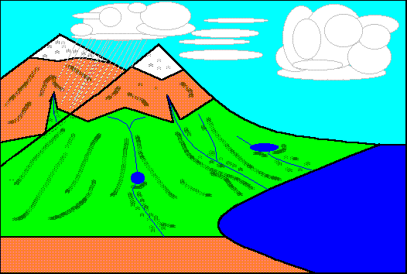
Water Cycle Processes
The entire process can be divided in to five parts
    Condensation
    Precipitation
    Infiltration
    Runoff
    Evaporation
Notes:
4
The process begins with condensation, when water vapor condenses in the atmosphere to form clouds.
The next three stages: infiltration, runoff, and evaporation occur simultaneously. Infiltration occurs when precipitation seeps into the ground. This depends a lot on the permeability of the ground.
If precipitation occurs faster than it can infiltrate the ground, it becomes runoff.
As both of these processes are happening, the power of the sun is driving this cycle by causing evaporation
Believe it or not, there is no new water on the planet. The water that you drank or bathed in recently has been around since the beginning of time
The hydrologic cycle, or water cycle explains where water comes from, and is important to understanding contaminant sources and pathways.
Ultimately, whether we are talking about a shallow well or a deep well, groundwater is replenished or recharged by precipitation. The hydrologic cycle is a major machine on the planet, controlling the distribution of water on the earth's surface.
Water evaporates as a gas or vapor into the atmosphere above the earth due to the heat from the sun.
Plants also transpire (transpiration) moisture back into the atmosphere as a gas or vapor. This is also referred to as evapotranspiration.
Water vapor condenses and forms clouds, which are large masses of tiny drops of water or ice crystals. If enough drops of water combine, they become too heavy to stay airborne and fall to the earth as rain, snow or some sort of precipitation.</page
Precipitation that falls on the earth's surface may be collected as surface water runoff, may be evaporated back into the atmosphere, may be stored temporarily as snow or ice, may be transpired by plants, or may infiltrate into the subsurface.
Most of this water will once again evaporate back into the atmosphere or may be transpired as a gas and start the whole cycle again.
The water that infiltrates, or percolates downward from the surface, is the source of recharge to groundwater.

Slide 5
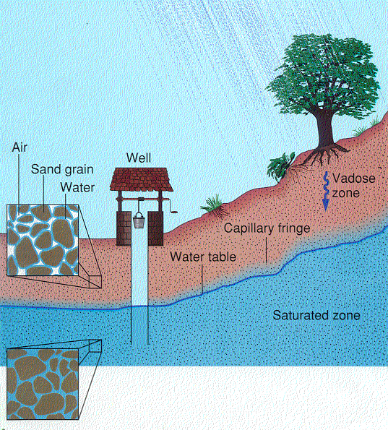
Origin of Groundwater
- Groundwater originates from precipitation sinking into the ground from the surface
to the water table.
- Groundwater occurs in the open spaces between silt, sand, and gravel particles or
in natural fractures with the bedrock.

Slide 6
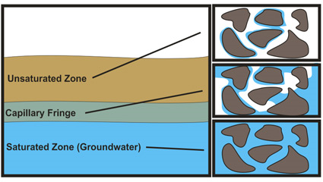
Origin of Groundwater

Slide 7
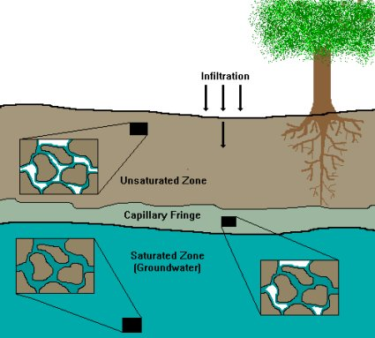
Origin of Groundwater

Slide 8
Aquifers
Once water reaches the saturated zone it is called groundwater.
If the geologic material of this saturated zone is permeable and can yield water to a well in sufficient quantity to supply user needs, it is referred to as an aquifer.
Aquifers can be either unconfined or confined.

Slide 9
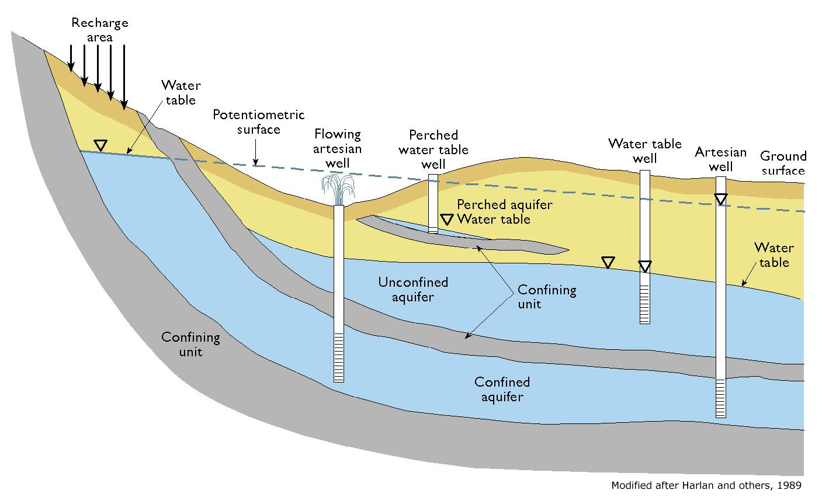
Notes:
9
Unconfined
Shallow
Local Recharge
Water Table
Susceptible
Confined
Deeper
Confining Layer
Distant Recharge
Water under pressure
Less susceptible

Slide 10
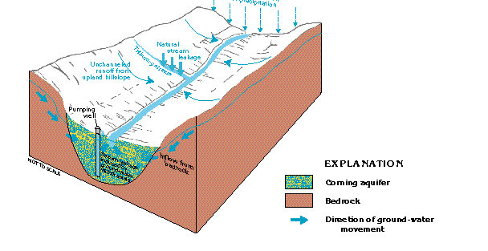
Alluvial Aquifer: Valley Fill

Slide 11
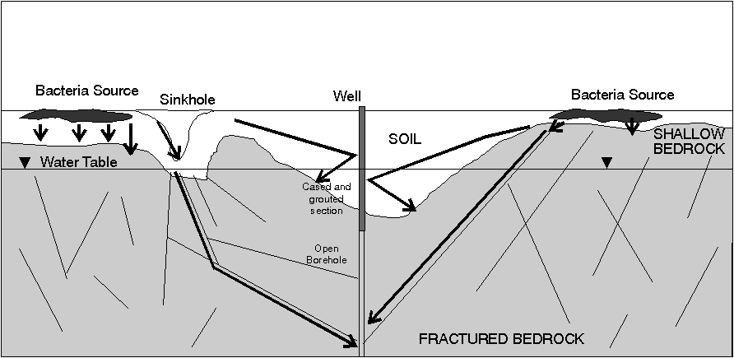
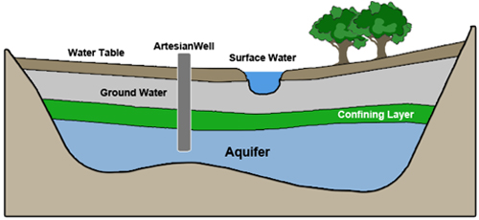
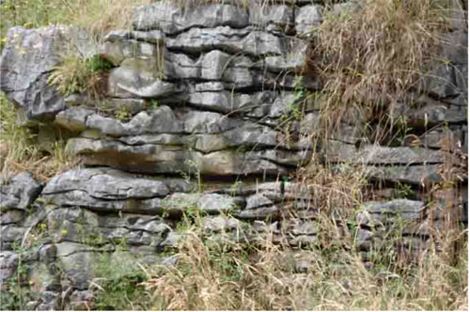
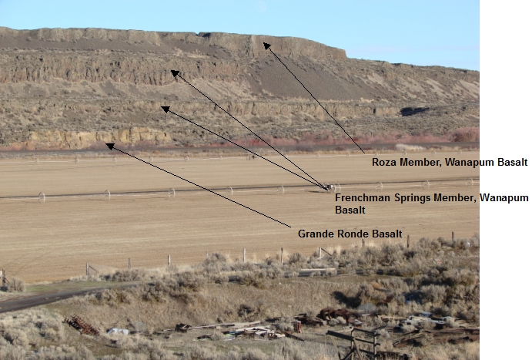
Bedrock Aquifers
Fractured Bedrock
Layered Volcanics

Slide 12
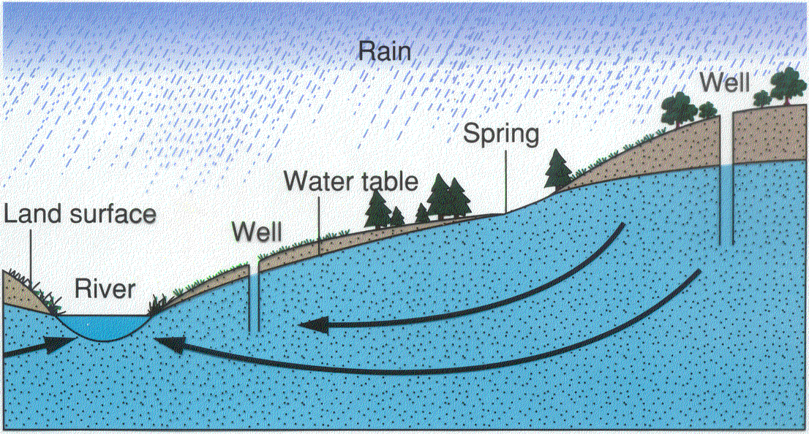
Groundwater Movement: Winter
- Groundwater moves from areas of high elevation to areas of low elevation.
- How easily water travels underground is a function of the type of material that it is
moving through.
- Permeability: gravel > sand> clay

Slide 13
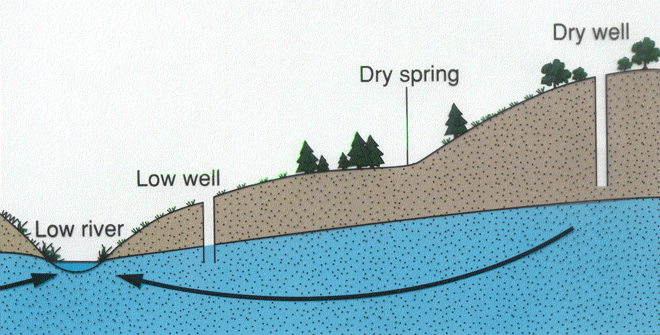
Groundwater Movement: Summer
Groundwater fall during the drier summer months.
- Additionally, the greater number of pumping of wells in the summer impacts groundwater
levels of wells through drawdown.

Slide 14
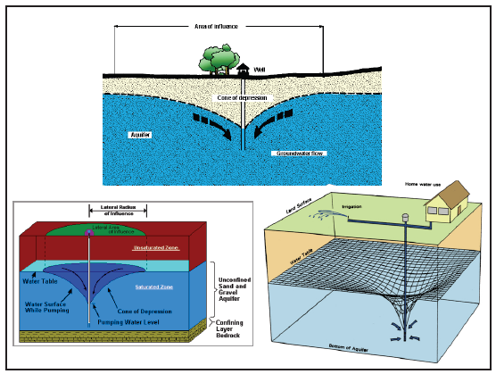

Slide 15
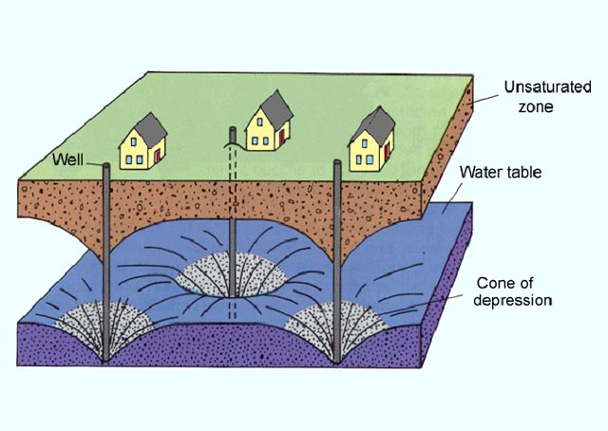
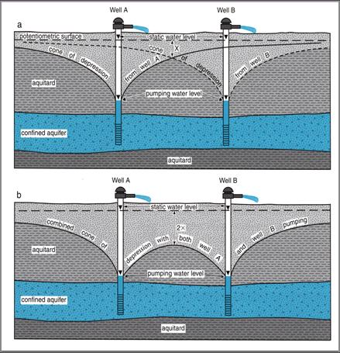
Interfering Wells
Image supplied by Mahometaquiferconsortium.org

Slide 16
Well Construction: Components
Water
Bore Hole
Casing: holds hole open
Casing Seal: Protects against inflow of shallow water
Concrete Slab: protects against inflow of surface water
Screens/Perforations: allow access of water
Slab
Casing Seal
Casing/Liner
Bore Hole
Screen/Perforation
Pump

Slide 17
Well Construction
If not constructed properly, wells can provide access to the aquifer of contaminants from the surface or near surface.
The Oregon Water Resources Department (WRD) regulates the construction of water wells. WRD recognizes that DWP may have additional rules for public water systems.
When a new well is proposed during plan review, the DWP evaluates well reports from the local area in order to make recommendations regarding well construction characteristics like placement of casing seals.

Slide 18
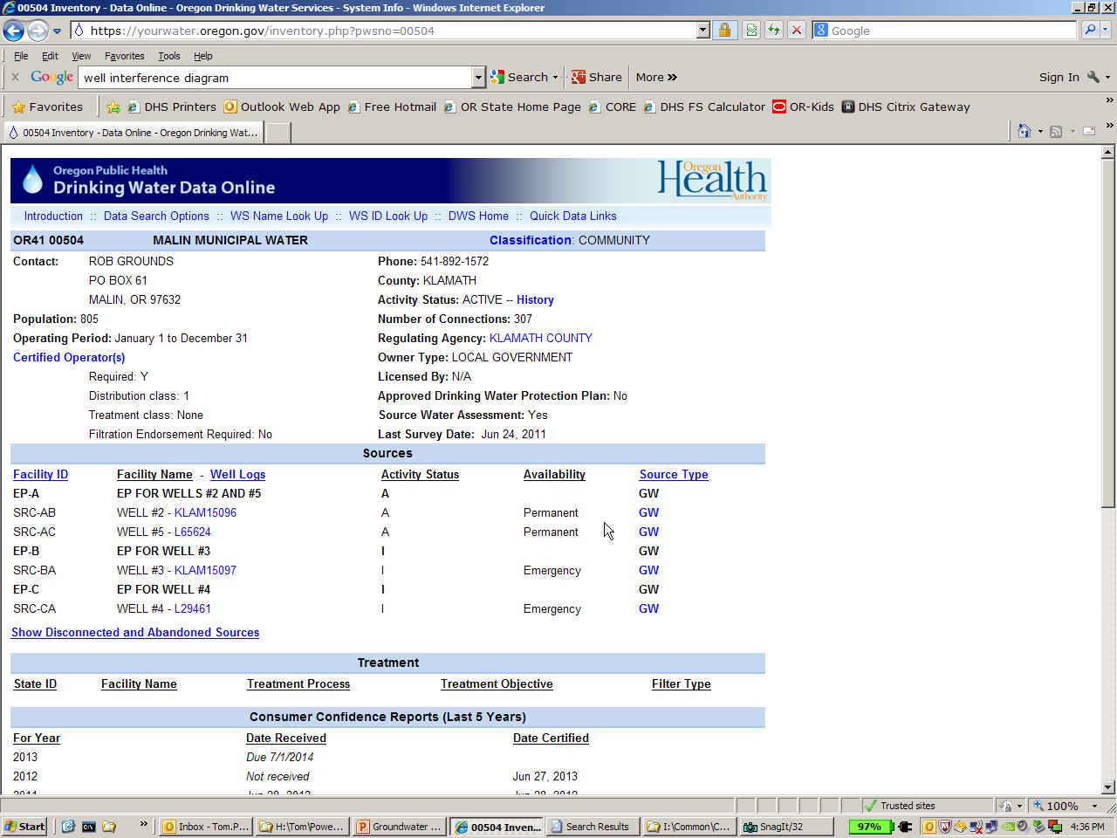
Well Log Data
OHA Data Online: https://yourwater.oregon.gov
GW-GWUDI Link
OWRD Well Log Link
Notes:
Added slide - RAK

Slide 19
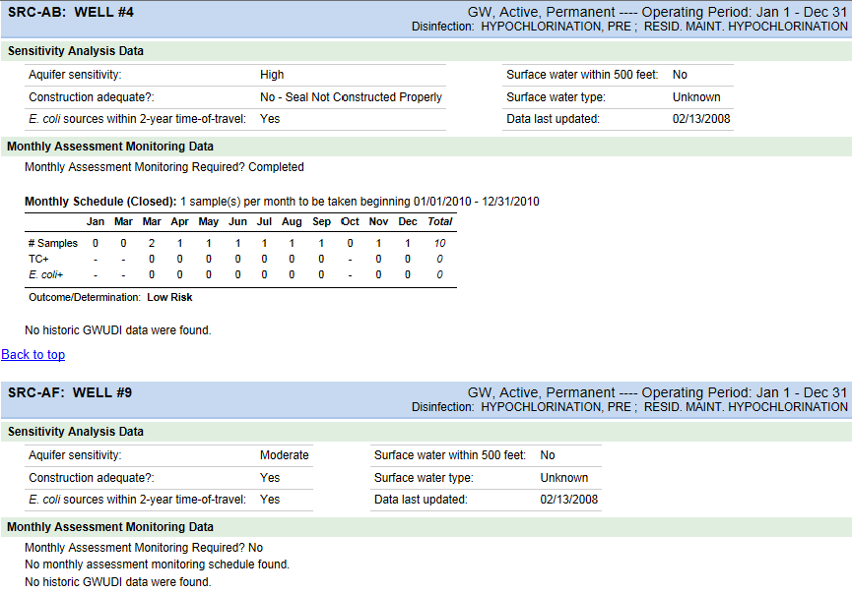
Groundwater/GWUDI
Source Detail Page

Slide 20
Source Water Assessments
1996 Amendments to the Safe Drinking Water Act

Slide 21
Drinking Water Protection Process
for Public Water Systems (PWS)
OHA and DEQ contact PWS; GPS intake or well and request PWS assistance
Activate community citizens,
gather input, select a few
strategies for protecting
the source area
DELINEATION of the source area or “Drinking Water Source Area”
INVENTORY for “Potential Sources of Contamination” per guidance
Source Water ASSESSMENT phase
OPTIONAL: Consider writing a Drinking Water Protection Plan and gaining certification from DEQ
Drinking Water PROTECTION phase
Determine SUSCEPTIBILITY
to contamination
IMPLEMENT the strategies to prevent contamination
SOURCE WATER ASSESSMENT REPORT
Sent to PWS

Slide 23
Value of Planning and Protection
Protecting the current resource
  Water quality – Multiple barrier approach
  Sustainable supply for the future: Resource Adequacy
Preserving public trust
Protecting investment
Protecting economic value: Property values
Community Viability: Attracting new residents and businesses
Avoiding costly treatment, M&O
New regulations, emerging contaminants of concern

Slide 24
“Price Tag” of Contamination
Lakewood Utilities in Marion County: population ~350
February 1991: TCA, 1,1-DCE – MCL violation
Initial Direct Costs covered by DEQ:
  Water and soil analysis: $120,000
  Contractor field work: $300,000
  Treatment System: $150,000
  Total Initial Direct costs = ~$1600/person
Other Costs
  Bottled Water: $300-500/household/year
  O & M of treatment unit: $20/month/household

Slide 25
“Price Tag” of Contamination
Indirect costs
  Fear of unknown chemicals
  Loss of trust in water system
  Frustration in lengthy process
  Noise/Appearance of treatment tower
  Change in water qualilty
  Negative press
  Decrease in property values
Some residents still use individual home treatment device in spite of successful system treatment unit
“An ounce of prevention is worth a pound of cure”

Slide 26
Source Water Assessments completed for all public water systems
Groundwater: 948 systems statewide
Surface Water: 154 systems statewide
Each assessment unique to individual water system
Notes:
26
These numbers are for Community (C) and Non-Transient Non-Community (NTNC) water systems only. Does not include Assessment Reports completed for Transient Non-Community (TNC) water systems.

Slide 27
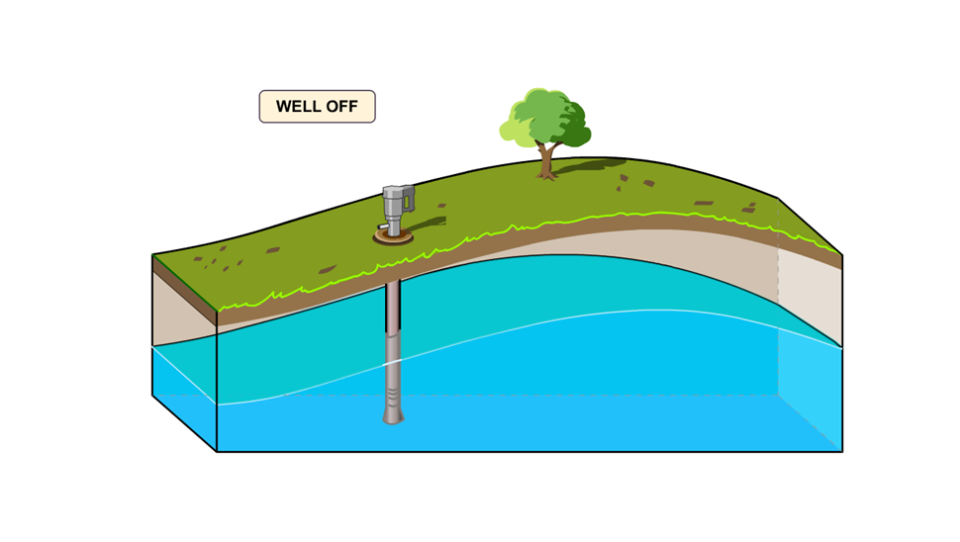
Capture Zone
Notes:
Here is an example of a well system with the pump turned off.

Slide 28
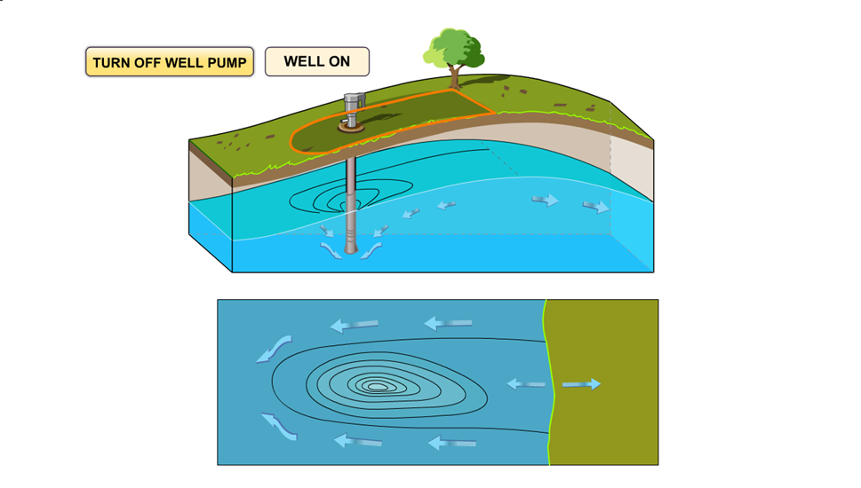

Capture Zone
Notes:
This pictures illustrates the effect on the water table when a well is running.
This is the "capture zone" above or in the aquifer, which is the part of the aquifer that supplies water to the well. Any water or contaminant that is in the capture zone will move towards the drawdown area. The shape of this capture zone is dependent on the material the aquifer is made of.
This is the drinking water protection area... it's the area on the ground surface where a contaminant, if released, may be transported by the flow of groundwater to a well.
Once the capture zone is delineated (or determined), possible contaminants within the capture zone must be identified, assessed and mitigated if necessary.

Slide 29
Procedures for Delineation: Groundwater
Identify that part of the aquifer that supplies water to the well or spring
Site-specific parameters
Radius a function
of time
Project to the surface

Slide 30
Groundwater DWSA

Slide 31
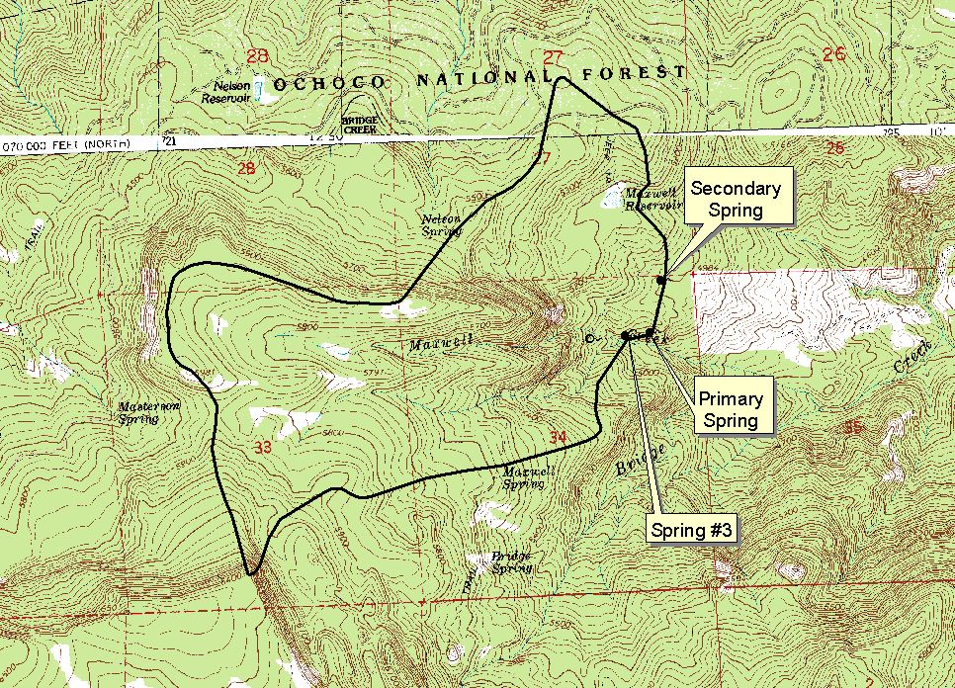
Hydrogeologic Mapping

Slide 32
Surface Water-DWSA

Slide 33
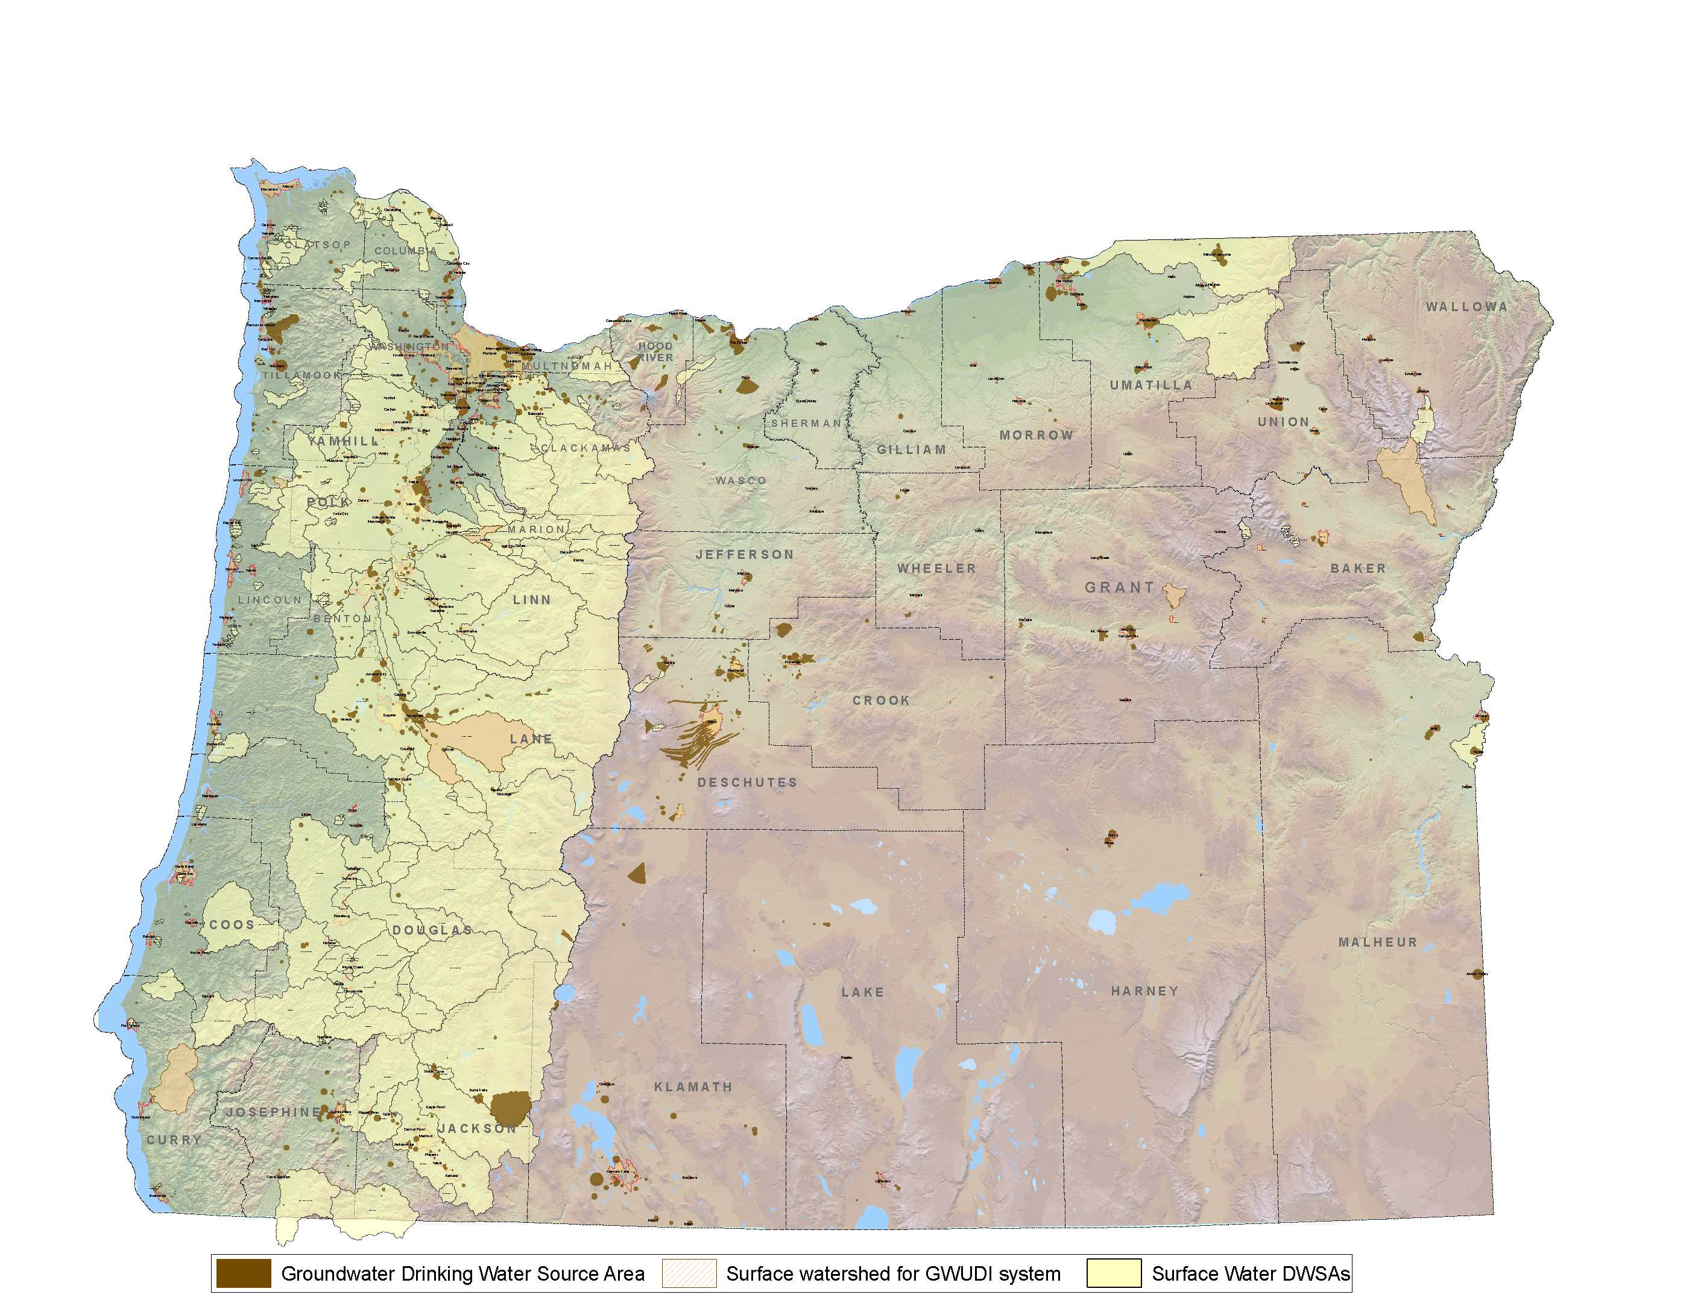
Oregon’s source areas for public water systems
33
Notes:
33

Slide 34
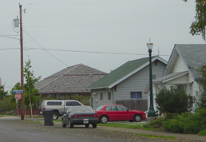
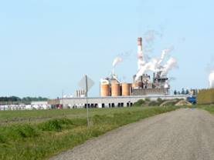
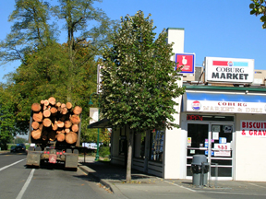
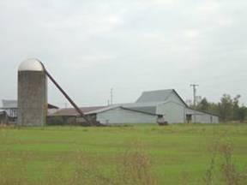
SWA includes… List of potential sources of contaminants
Inventoried >100 types covering various land uses
Identified >15,000 PCSs in source areas
Access Database – readily accessible data
Residential & Municipal
Commercial & Industrial
Transportation Corridors
Forestry and Agriculture
Notes:
9/25/2014
34
Includes point and non-point sources
Looking at all sources i.e. comprehensive
PCS data can be used by other programs
Only potential
Oregon’s Methods:
windshield survey
Met with community
Database searches

Slide 35
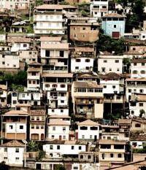
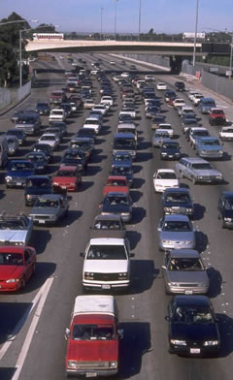
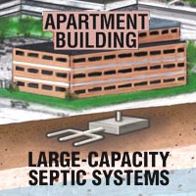

Slide 36
SWA includes…
Evaluation of sensitive areas within source area
  Aquifer characteristics and ease with which water can move from the surface to the aquifer,
  Chemical or coliform detections,
  Well construction, and
  Potential contaminant source inventory
Recommendations for how to protect the water quality, but no new requirements
Notes:
36

Slide 37
Source Water Assessments
Sensitive Areas (Natural Factors)
+
Contamination Risks
=
Susceptibility of the Drinking Water Source

Slide 38
Protecting The Source

Slide 39
Protecting the Source
What Steps Should We Take?
Know where the Drinking Water Source Area is located.
  Within city limits
  Extends into the county
  Rural/private land
Identify who has jurisdiction/regulatory control?
  City
  County
  Dept of Agriculture
  US Forest Service / Oregon Forestry Dept

Slide 40
Protecting the Source
Developing Protection Strategies
Use Source Water Assessment to identify high- and moderate- risks. Update list
  Risk factors
  Aquifer sensitivity
Evaluate based on
  Benefit achieved (risk reduction, economic factors)
  Challenges (time, staff, cost)
  Community buy in
  Long-term plans
Associate appropriate BMPs with each identified risk
Implementation of BMPs through Local authority
  Through land use planning process or through changes in City code

Slide 41
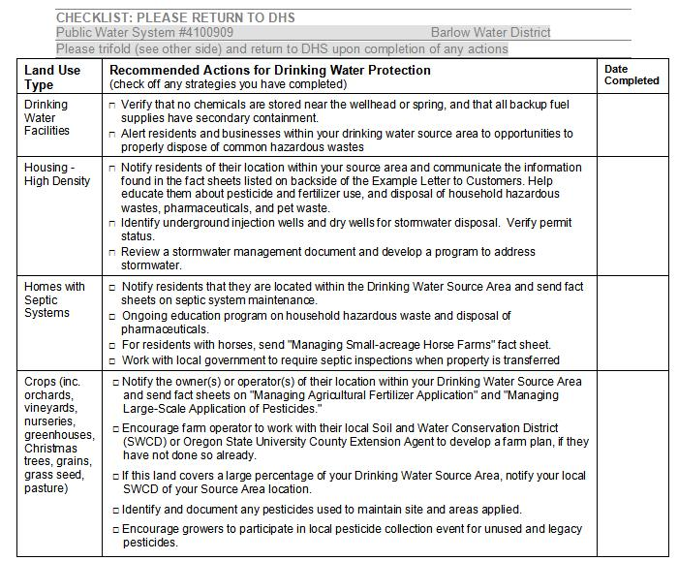

Slide 42
Implementation Matrix: Prioritizing the Approach
BMPs Ease of Implementation | BMPs for High Risk PCSs | BMPs for Mod Risk PCSs | BMPs for Low Risk PCSs
Easy to do | High Risk PCS BMP Easy to do
Mod difficult to do
Difficult to do |  |  | Low Risk PCS BMP Hard to do

Slide 43
Examples of Drinking Water Protection Strategies
public awareness – news features, sign installation
incorporate pollution prevention concepts and BMPs for high-risk locations
household hazardous waste education/collection
community/watershed spill response plans
local zoning ordinances
easements in sensitive areas – agriculture/forestry
septic system outreach/maintenance program
technical training for high risk facilities’ employees
County overlay; early notification re: changes
Notes:
43

Slide 44
Linking Source Water Protection with Groundwater Rule and GWUDI

Slide 45
Inadequately Constructed Well Susceptible to Fecal Contamination

Slide 46
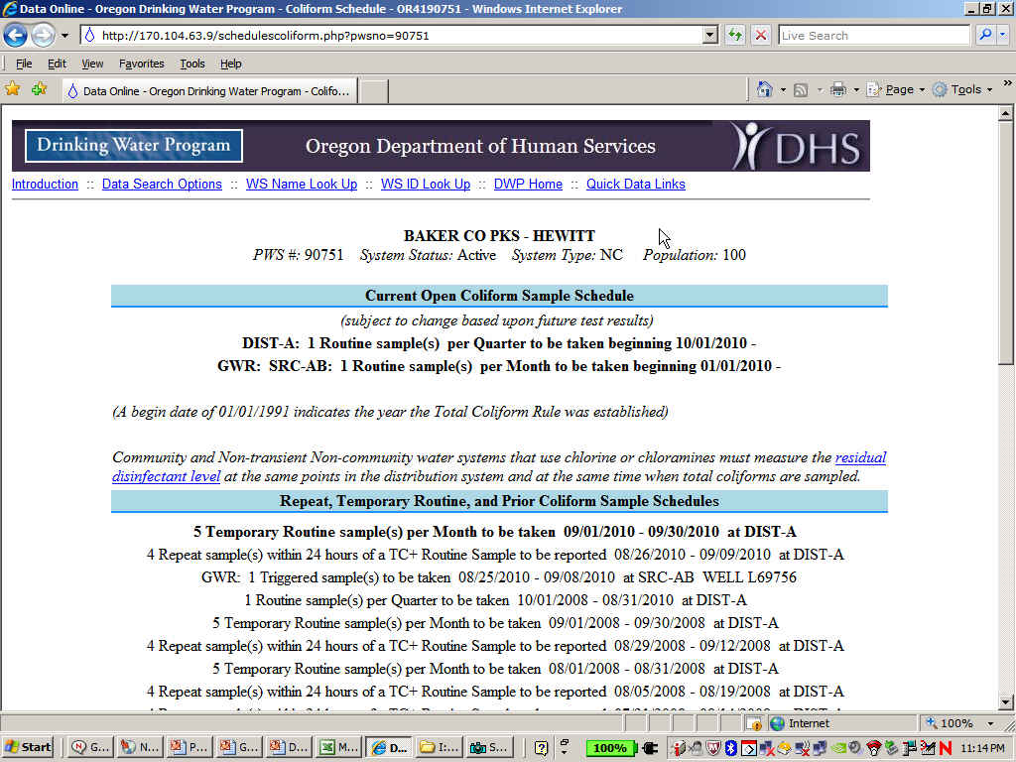
Monthly Assessment Monitoring
Monthly tracking of samples
  Schedules now available on SDWIS on-line
  Violations to be issued for not sampling starting in 2011

Slide 47
The Source Has a Confirmed EC+ result. What Next?
Assessment monitoring for that specific source can stop.
  If your water system has multiple sources on assessment monitoring, the other sources must continue with assessment monitoring.
Regional Hydrogeologist will review the SWA results and determine:
  If GWUDI Coordinator should review results for possible MPA test
  If there are well construction issues that suggest that the groundwater source should be repaired or replaced.
If needed, the GWUDI Coordinator will contact you regarding MPA testing requirements.
Communicate with your County/State Health Dept contact

Slide 48
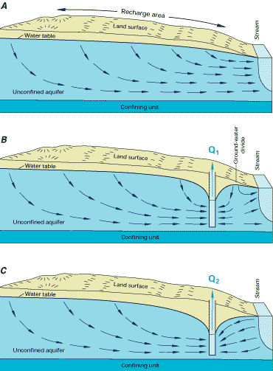
Pumping Wells Close to Streams
Notes:
When a well is turned on, it lowers the water table in its vicinity and intercepts water that flows in from higher water tables towards the well. This water can move sideways - as well as up or down - in response to differences in gravity, elevation and pressure.

Slide 49
Groundwater Under the Influence of Surface Water
Water system vulnerable to microorganisms such as Giardia lamblia or Cryptosporidium.
Protocol for determination:
  Hydrogeologic Assessment (SWA)
  Assessment monitoring - year-long collection of raw water coliform data (if needed): confirmed fecal coliform?
  Microscopic Particulate Analysis (if needed)
If source determined to be GWUDI, then must treat as a surface water source or take other corrective action.
Contact Russ Kazmierczak for more details
  (541) 726-2587 x26

Slide 50
Monthly Assessment Monitoring for GW Rule
Wells and Springs identified as susceptible to fecal contamination.
High sensitivity & fecal contaminant source (includes surface water) within 2-yr TOT Zone.
Monthly Assessment Monitoring
Confirmed EC +
Corrective actions:
Correct all significant deficiencies
Disconnect water source
Eliminate contamination source
Provide 4-log treatment or reconstruct water source
Yes
Is GWUDI an issue?
No
MPA
Groundwater?
No
Yes
Surface Water Treatment

Slide 51
Protecting the Source
SDWA grant opportunities
Apply with simple form to DHS
$30,000 per PWS, per year, maximum
Selection based on risks, reduction, etc.
Examples of eligible projects:
      Drug take-back projects
      Pesticide use / application rate reduction workshops, etc
      Household hazardous waste collection events
      Workshops promoting alternative nonhazardous products
      Abandonment of nearby unused private wells
      Reforestation / replanting of sensitive riparian areas
      Installation of signs / fencing of sensitive protection areas
      Decommissioning septic systems & installation of sewer hookups
If applying for infrastructure loans, having implemented protection strategies will give you more points (but, we must be aware of it!)
Notes:
51

Slide 52
Protecting the Source
Technical Assistance & Information
Technical Assistance
  Groundwater
  Insert Regional Hydrogeologist
  OHA Drinking Water Services
  (541) 726-2587 x??
  XXX.XXXX@state.or.us
  Surface Water
  Sheree Stewart
  DEQ Drinking Water Protection
  (503) 229-5413
  Stewart.sheree@deq.state.or.us
Information
  http://public.health.oregon.gov/HealthyEnvironments/DrinkingWater/SourceWater/Pages/swp.aspx
    Drinking Water Protection Bulletins
    Fact sheets
  http://www.deq.state.or.us/wq/dwp/dwp.htm
    Management strategies for specific land uses
    Fact sheets
    GIS resources

Slide 53
Summary
Water resources are scarce. A decline in water quality can reduce the quantity of water available locally.
Source Water Assessment Reports help identify potential threats to drinking water quality.
The goal of Drinking Water Protection is to reduce the risk of contamination, not necessarily eliminate it
DEQ/OHA can help public water systems prioritize their protection efforts and identify specific strategies
Drinking Water Protection in Oregon is voluntary but is necessary in order to protect existing and future drinking water sources.

Slide 54
Implementation Exercise
Open SWA Report (see Table of Contents for pg #): Review Table 4.1 Aquifer Sensitivity Analysis and Table 4.2 Well Construction Sensitivity Analysis
Review Table 2 Inventory Results located in Appendix. Note BMP section.
Complete BMP Matrix for each of the PCSs.
Discuss completion of the matrix.
  Are the BMPs easy to do, moderate or hard to complete?
Complete Recommended Actions List
Complete Sign-up Sheet or Call for Additional Technical Assistance
  Provide Guidance
  Copies of Fact Sheets
Notes:
Explain the relativity of easy and hard compared to drilling a new well or install costly and complicated treatment.

Slide 55
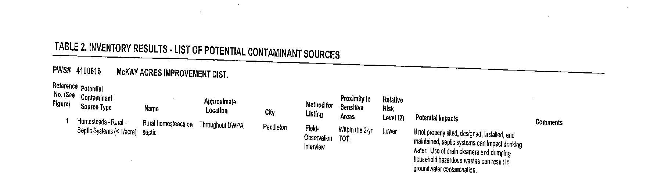
Implementation Exercise
Open the Source Water Assessment Report and turn to Table 2. Inventory Result, near the end of the report, located in Appendix (see below for example).
Select a high relative risk PCS in the 2 year Time of Travel (TOT), see example below. Select a lower risk PCS if none in the 2 yr TOT and/or move out to the next TOT if no PCSs in the 2 yr TOT.
Notes:
Explain the relativity of easy and hard compared to drilling a new well or install costly and complicated treatment.

Slide 56
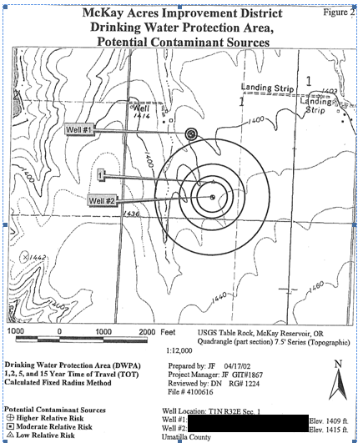
Implementation Exercise
Example of the Potential Contaminate Source Map showing TOT zones, PCSs and well locations

Slide 57
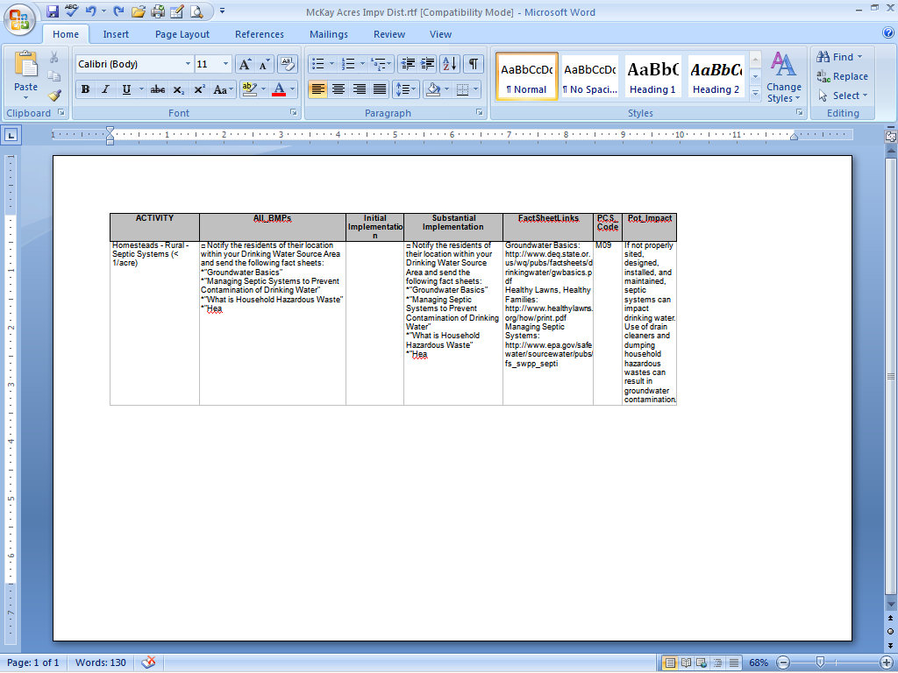
Implementation Exercise
Using handout, review initial/substantial implementation Best Management Practices (BMPs) for each PCS identified in Table 2.

Slide 58
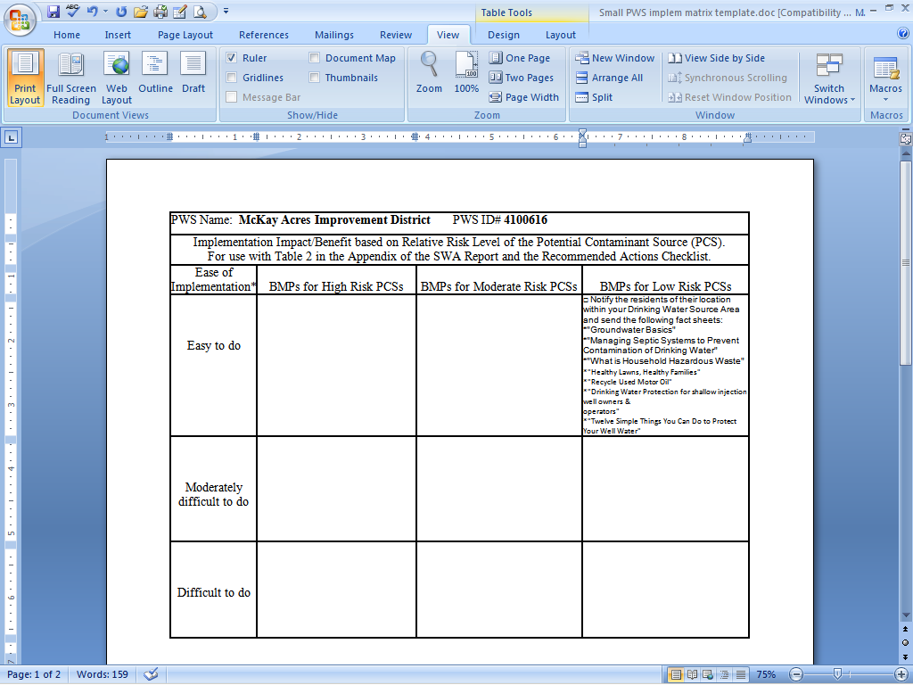
Implementation Exercise
Complete Best Management Practices (BMPs) Implementation Matrix for each of the PCSs listed in Table 2 (see above for example).

Slide 59
Implementation Exercise
Discuss completion of the matrix.
    Are there any BMPs that are “easy to do” that would have a “High” impact?
    Are there any BMPs that are “difficult to do” that would have a “Low” impact?
    Which BMPs would you try to implement first? Which ones last or not at all?
Post Class Implementation: Repeat the exercise above for the remaining PCSs listed in the Source Water Assessment and after the PCSs have been addressed and BMPs implemented (that means provided to the owner of the PCS and used by the owner of the PCS), please send a completed copy of the Checklist to OHA (see example below and included in the handouts).
Address to:
Russell Kazmierczak
Drinking Water Program
444 A Street
Springfield, OR 97477

Slide 60
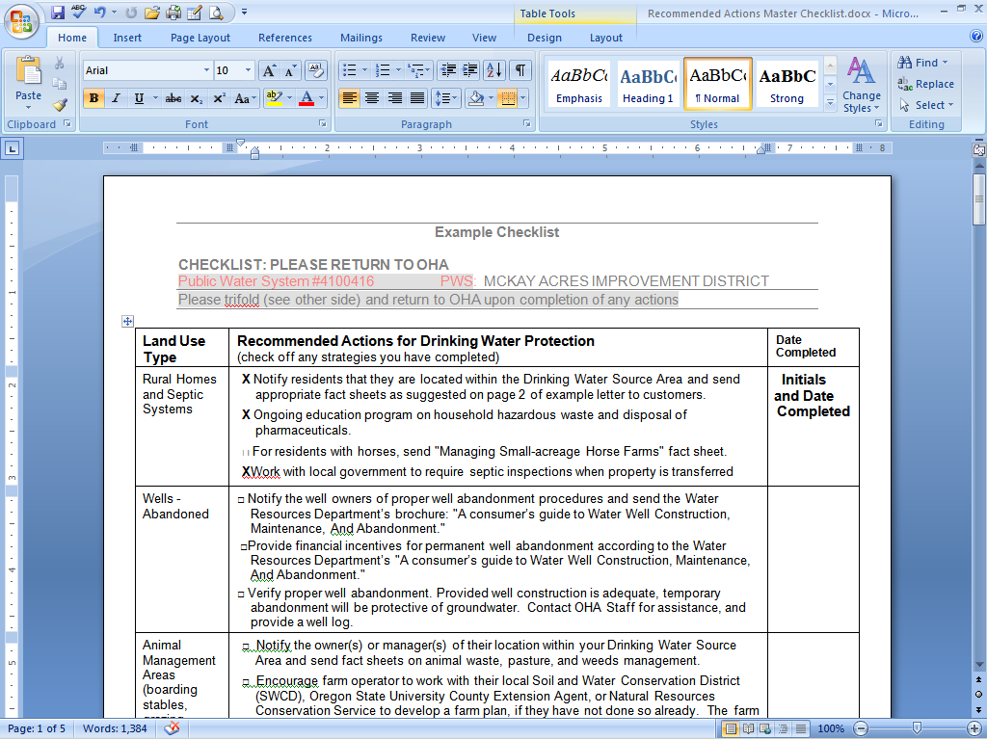
Implementation Exercise
  Eastern Region Geologist
  Russ Kazmierczak
  OHA Drinking Water Program
  (541) 726-2587 x26
  Russell.A.Kazmierczak@state.or.us

