Slide 1
Essentials of Surface Water Treatment
(Part 1 of 2)
Oregon Health Authority
Drinking Water Services
www.healthoregon.org/dwp

Slide 2
Overview of Course:
Part 1
Background of Surface Water Treatment Rules
Filtration
Disinfection
Operations
Part 2
Review of Part 1
Reporting Requirements
Emerging Issues
Resources for Operators

Slide 3
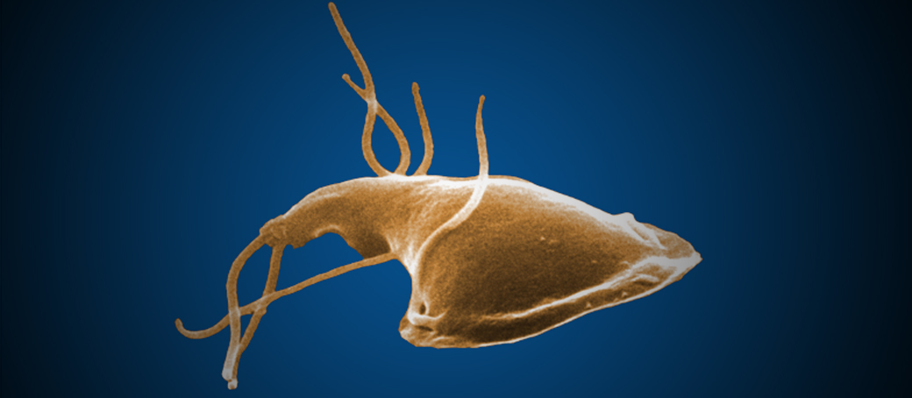
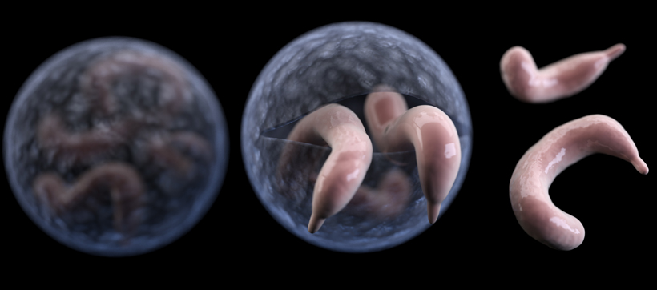
Regulations protect the public from exposure to pathogens:
Protozoa or Parasites
  Giardia Lamblia Cryptosporidium Parvum
Bacteria
  Campylobacter, Shigella, Legionella
Viruses
  Hepatitis A, Norwalk Agents

Slide 4
Oregon Waterborne Disease Outbreaks
(bacteria, viruses, parasites )
~50% drop
~50% drop
Notes:
7,000 people sickened by Oregon’s Public Drinking Water

Slide 5
Waterborne Disease
Outbreak Causes
Most of these outbreaks involve microbiological agents that would respond to proper disinfection
From August 2006 Access AWWA

Slide 6
Filtration is key to preventing waterborne disease outbreaks
Common types of water filtration systems:
  Conventional Filtration (CF) & Direct Filtration (DF) – a.k.a. “Rapid Rate”
  Slow sand
  Membrane
  Cartridge/bag
  Diatomaceous Earth (DE)
We’ll learn more about these later.

Slide 7
Background of Surface Water Treatment Rules
1989 SWTR
Surface Water Treatment Rule
Required filtration for most SW and GWUDI (Groundwater Under Direct Influence).
  States were required to identify GWUDI sources.
Required pathogen removal/inactivation:
  3-log Giardia (99.9%) & 4-log virus (99.99%)
Limited turbidity in filtered water (combined filter effluent):
  Slow sand/DE/membrane/cartridge/bag:
    95% of turbidity readings ≤ 1 NTU; all < 5 NTU
  CF/DF:
    95% of turbidity readings ≤ 0.5 NTU; all < 5 NTU (replaced under LT1)
Required detectable disinfectant residual.
Did not address Cryptosporidium.

Slide 8
U.S. Outbreaks of Cryptosporidiosis in Surface Water Supplies
Five of the outbreaks were associated with filtered drinking waters.
Three systems (Carroll, Jackson - Talent, and Milwaukee) were experiencing operational deficiencies and high finished water turbidities at the time of the out­breaks. All three plants utilized conventional treatment processes that included rapid mix, flocculation, sedimentation, and filtration.
The Clark County outbreak was the only outbreak associated with a filtered drinking water for which no treatment deficiencies were noted.
All five systems were in compliance with the federal regulations in effect at that time.

Slide 9
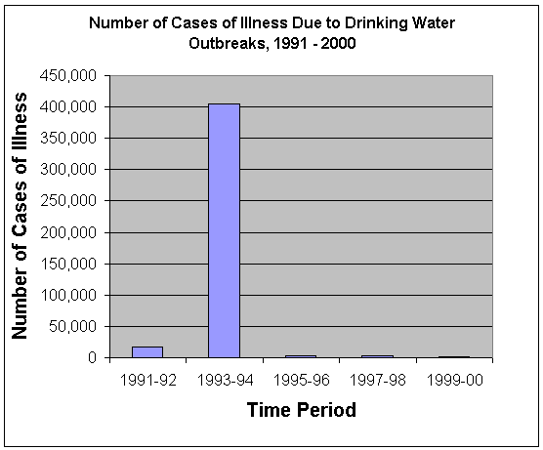
(US)
Milwaukie, WI (Crypto)

Slide 10
Background (continued)
1998 IESWTR
    Interim Enhanced Surface Water Treatment Rule
  Addressed concerns about Cryptosporidium
    required 2-log Crypto (99%) removal)
  Lowered turbidity standard for CF/DF systems:
    95% of readings ≤ 0.3 NTU, all readings <1 NTU for systems with population ≥10,000 (later extended to all CF/DF systems under LT1)
  Required Individual Filter Effluent (IFE) turbidimeters

Slide 11
Background (continued)
2002 LT1
Long-Term 1 Enhanced SW Treatment Rule
  Extended 0.3 NTU requirement to CF/DF systems with <10,000 population.
2006 LT2
Long-Term 2 Enhanced SW Treatment Rule
  Requires additional Crypto treatment for systems with ≥ 0.075 oocysts/L in their source water.
  Very few systems are required to install additional treatment in Oregon.

Slide 12
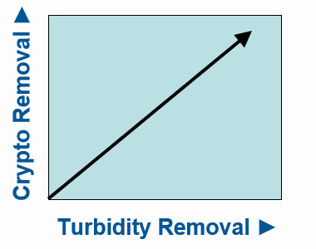
Why Measure Turbidity?
Indicative of pathogen removal
Relatively easy to monitor
Turbidity removal has been shown to be directly related to removal of Giardia and Crypto.
Turbidity maximum contaminant levels (MCLs) are based on the technology used:
  ≤ 0.3 NTU (95% of the time) for conventional or direct filtration; always < 1 NTU.
  ≤ 1 NTU (95% of the time) for slow sand, cartridge, and membrane; always < 5 NTU.

Slide 13
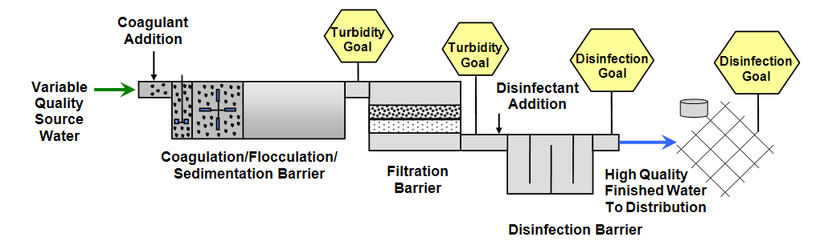
Optimize Particle Removal
Optimize treatment for pathogen removal by optimizing particle removal (i.e., turbidity)

Slide 14
Source water conditions can affect turbidity/pathogens
Watershed control
Intake structure or configuration & pumping facilities
Other factors affecting water quality (harmful algal blooms, point- and non-point source pollution, storms, runoff, etc.)

Slide 15
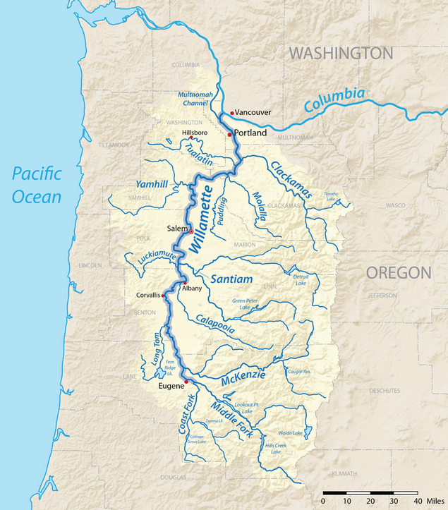
Watershed Control
Owned or managed by the water system?
  Most systems have little control over their watersheds.
Drinking water protection plan
Emergency response plan
Patrols, gates, etc.
Inter-agency agreements (USFS, BLM, ODF, COE)
The Willamette River Basin is the largest watershed in the state, covering more than 11,500 square miles.

Slide 16
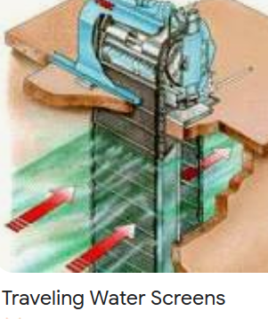
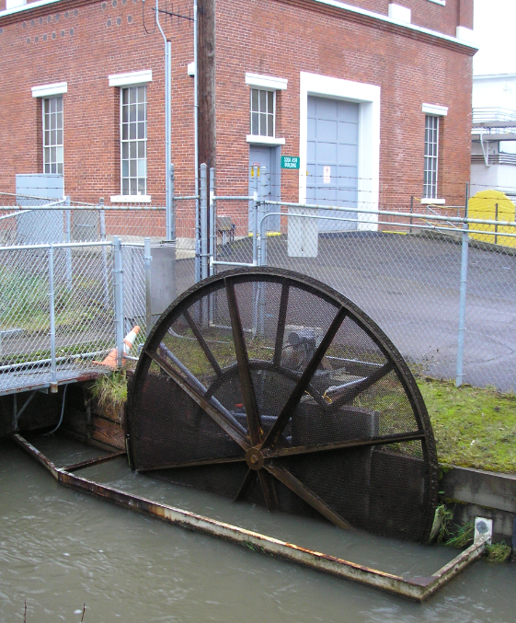
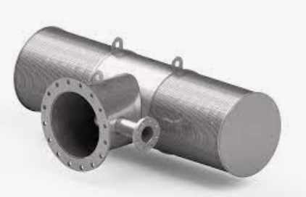
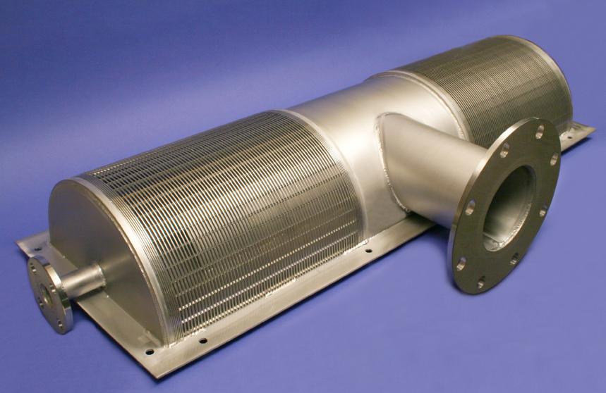
Intakes and Pumps
Screens:
  well screens,
  traveling screens,
  self-cleaning rotating drum screens.
  Cleaned with air or water blast
Submersible pumps in slotted or perforated pipe laid on riverbed.

Slide 17
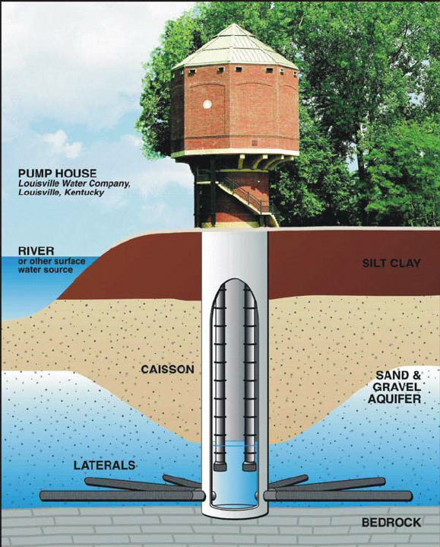
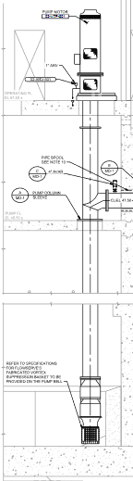
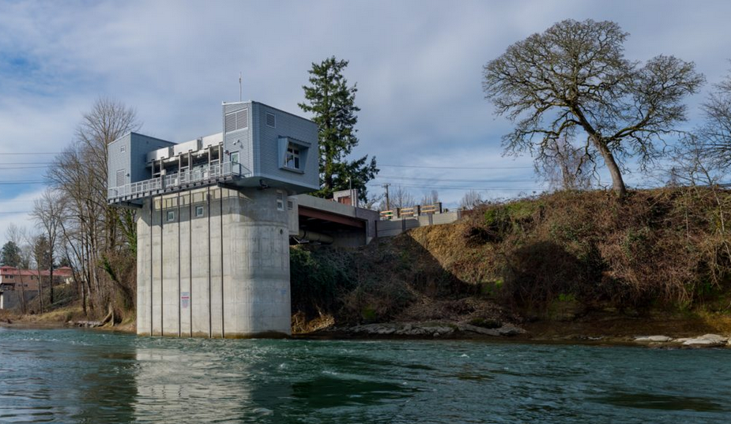
Intakes and Pumps
Infiltration galleries: Slotted pipes or well screens underneath riverbed, provides rough filtration.
Vertical turbine pumps in wet wells are common in larger systems.

Slide 18
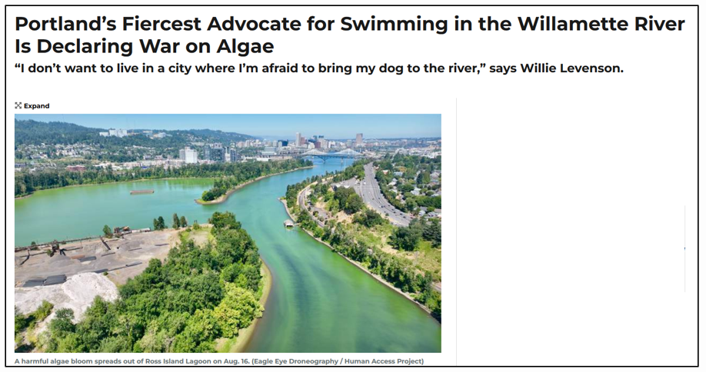
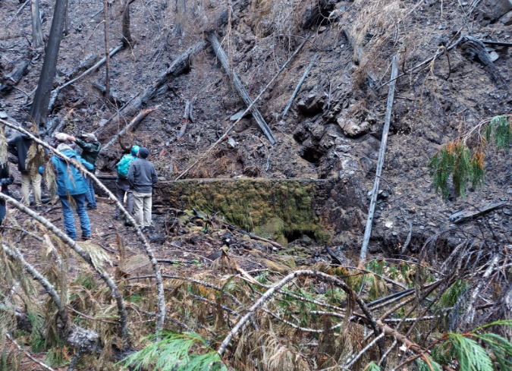
Other Factors
Logging, wildfire, and storm events increase turbidity
Recreation (gasoline engines, oil)
Development (increased stormwater drainage with associated pollutants)
Seasonal and/or daily fluctuations in temp or pH
Harmful algal blooms (cyanobacteria) becoming an increasing problem
Sewage treatment plants upstream, occasional overflows
                2020 Wildfire Damage
                in Detroit, OR watershed
August 23, 2023 - Willamette Week article on HABs in Willamette R.

Slide 19
FILTRATION

Slide 20
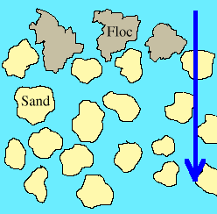
Straining
Passing the water through a filter in which the pores are smaller than the particles to be removed

Slide 21
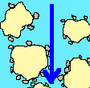
Adsorption
The gathering of gas, liquid, or dissolved solids onto the surface of another material

Slide 22
Types of Filtration
Conventional & Direct Filtration
Diatomaceous earth (DE, only a few in Oregon)
Slow Sand
Alternative (cartridge, bag & membrane)

Slide 23
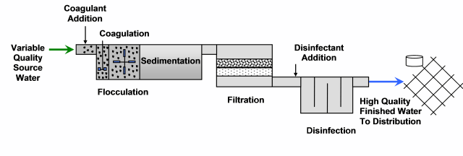
Conventional & Direct Filtration
“Rapid Rate Filtration”

Slide 24
Rapid Sand Filtration
Involves adsorption and physical straining of flocculated particles.
Mixed media filters: layers of support gravel, sand, anthracite.
Requires coagulation for charge neutralization, rapid mix (e.g., static mixer), and some degree of flocculation (e.g., large paddle wheel flocculator).
Filtration rate 2-4 gpm/ft2
Requires controllable backwash with water and perhaps air scour to clean filters.

Slide 25
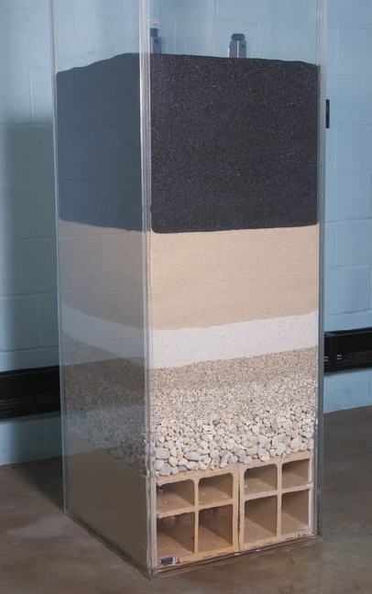
Media
Water flows through progressively larger pores as it passes from coal to sand to gravel.
This example shows the following from top to bottom (as the water would flow)
Anthracite
2 layers of sand
3 layers of support gravels
“Block” underdrain

Slide 26
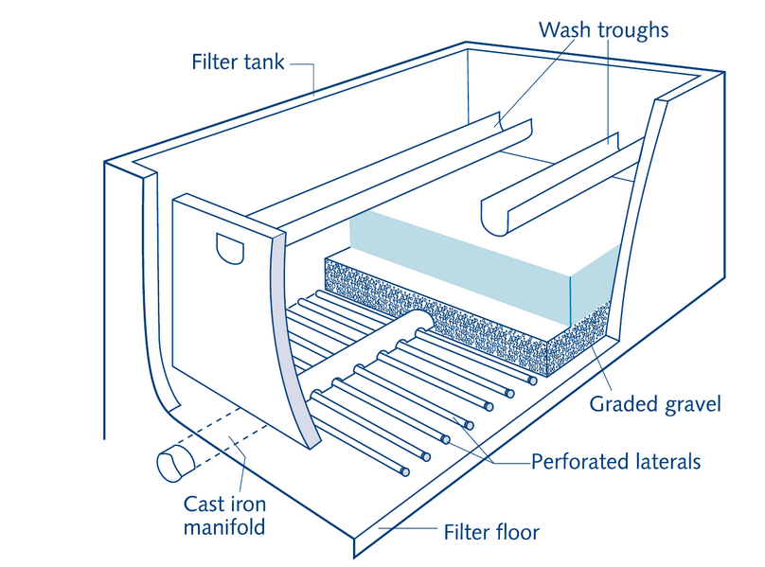
Conventional (and direct) filtration filter box
Perforated Pipe Underdrains

Slide 27
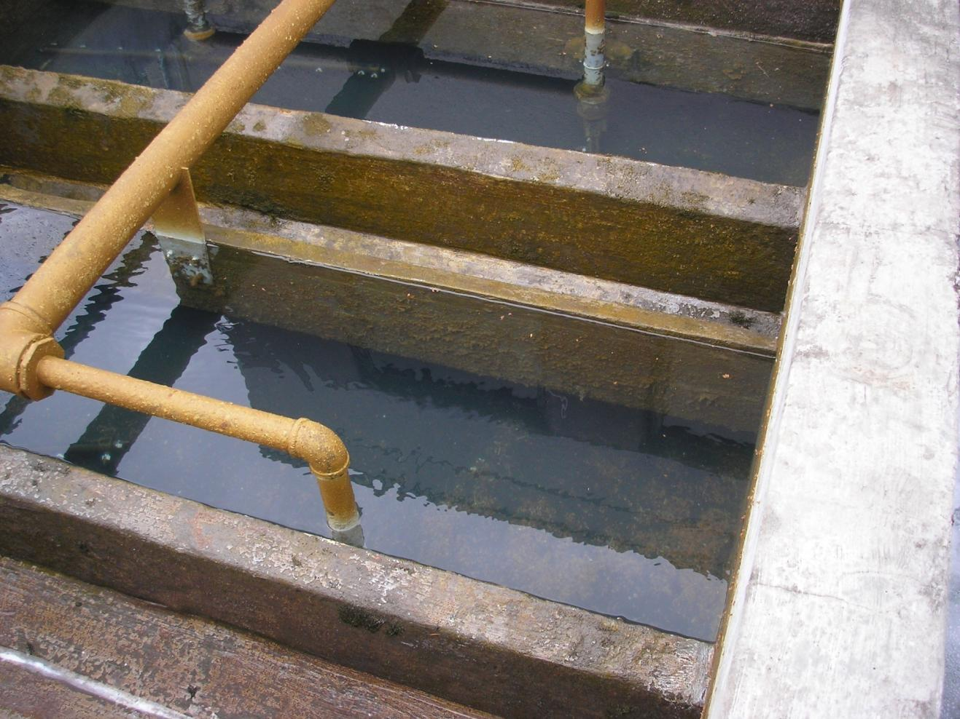
Rapid sand filter
Notes:
City of Forest Grove - CF

Slide 28
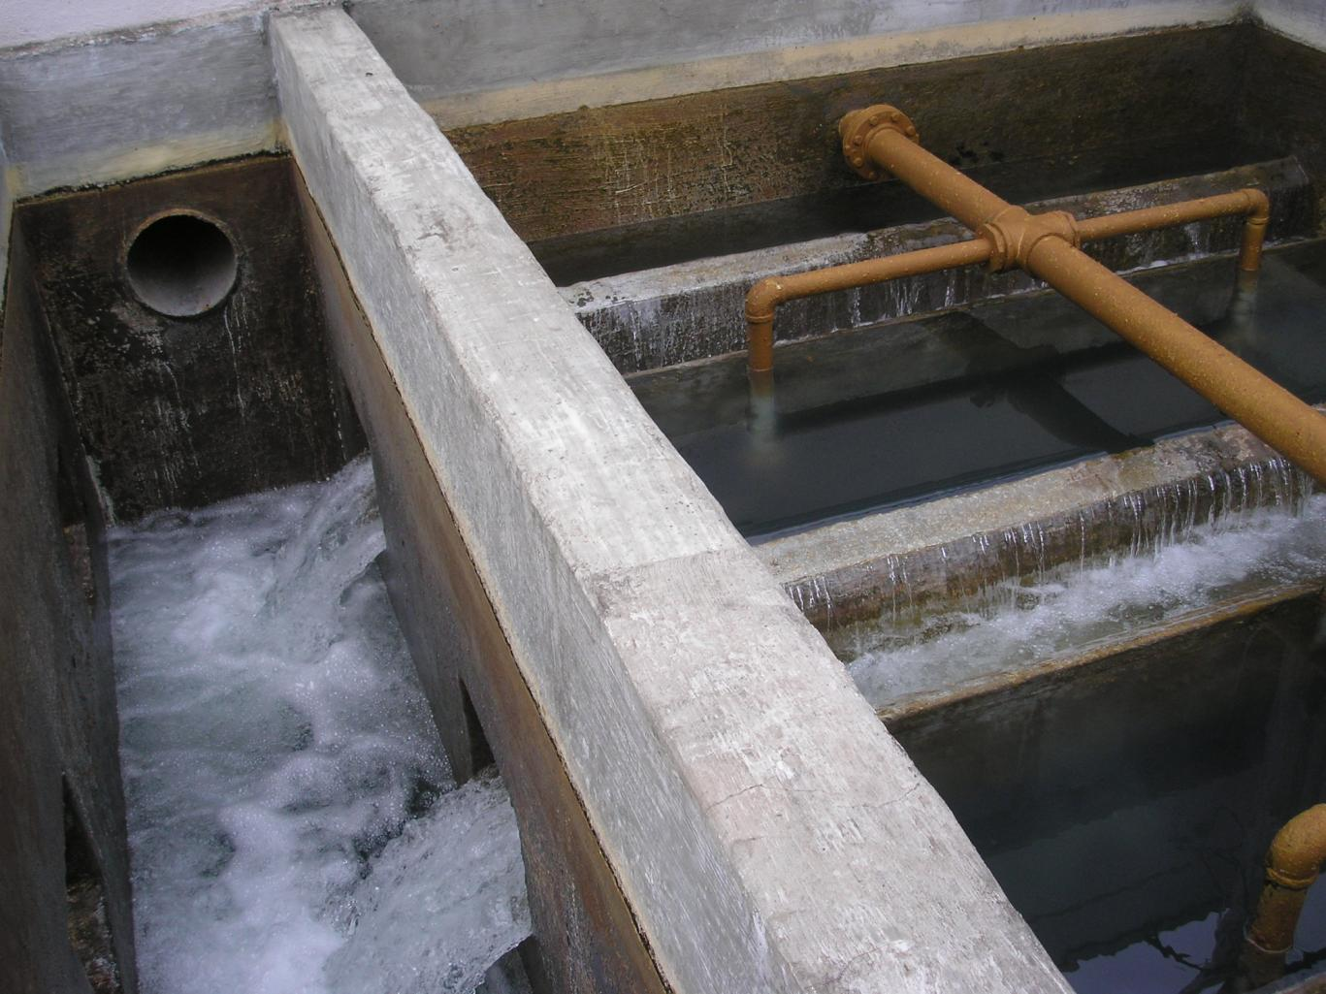
Backwash of filter
Notes:
City of Forest Grove - backwash

Slide 29
Direct Filtration Lacks Sedimentation
  Direct Filtration Treatment
  “means a series of processes including coagulation (requiring the use of a primary coagulant and rapid mix) and filtration but excluding sedimentation resulting in substantial particulate removal.”

Slide 30
Conventional Filtration
  In conventional filtration treatment..
    A coagulation chemical is added and rapidly mixed to neutralize particle charges
    Flocculation is a stage of gentle mixing so that a larger settleable floc forms
    Sedimentation is the stage were floc particles settle out prior to filtration

Slide 31
Conventional Filtration
Sedimentation allows settling of coagulated particles, relieves burden on filter.

Slide 32
Coagulants
Aluminum sulfate (alum): very common, only effective in narrow pH range.
Ferric chloride: More expensive, but works in wider pH range.
Poly aluminum chloride (PACL): not affected by pH, doesn’t change pH, works well with low alkalinity, leaves less sludge because dosage is low.
Aluminum Chlorohydrate (ACH): similar to PACL.

Slide 33
Factors Affecting Coagulation
Dosage: determined by jar test for optimum qualities of floc: (size, settling rate).
Mixing: Mechanical or static. Need to rapidly mix chemicals.
Alkalinity: 50 mg/l or less can shift pH downward.
Temperature: Colder water slows coagulation.
Color: Pre-oxidation may be required.
Turbidity: Changing conditions require more frequent jar tests.

Slide 34
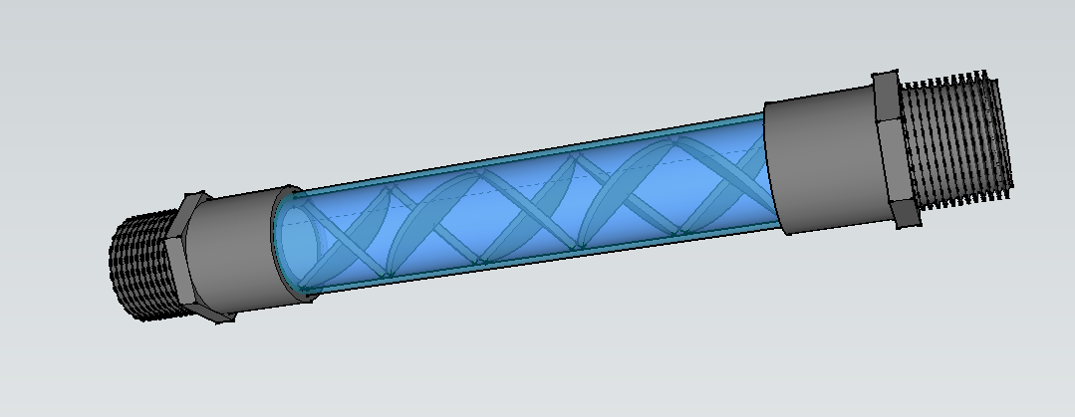
Coagulation Depends on Rapid Mixing
Static mixers have veins or “elements” that promote mixing.
The more water is pushed through a static mixer, the higher the head loss and better mixing you have.

Slide 35
Jar testing is used to optimize coagulant dose for the best floc formation
1 mL
2 mL
3 mL
4 mL
5 mL
6 mL
Current Plant Dose
5 mg/L
10 mg/L
15 mg/L
20 mg/L
25 mg/L
30 mg/L
Coagulant Dose

Slide 36
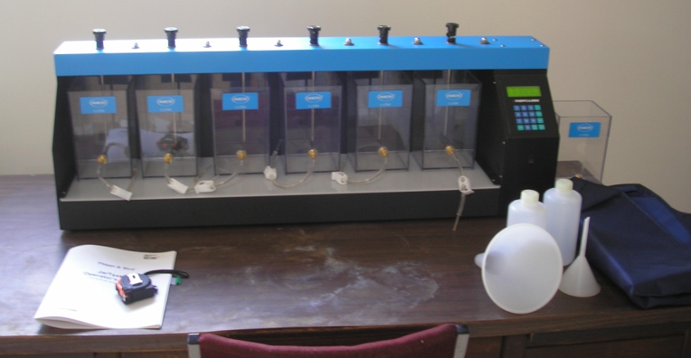
Jar Testing Equipment
Jar Tester (6 jars, 300-rpm)
Six 2-L Square Jars
Portable or benchtop turbidimeter
pH analyzer
Misc. lab ware for making coagulant stock solution

Slide 37
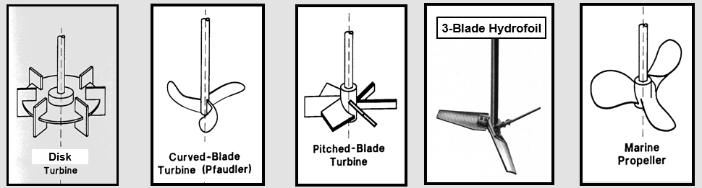
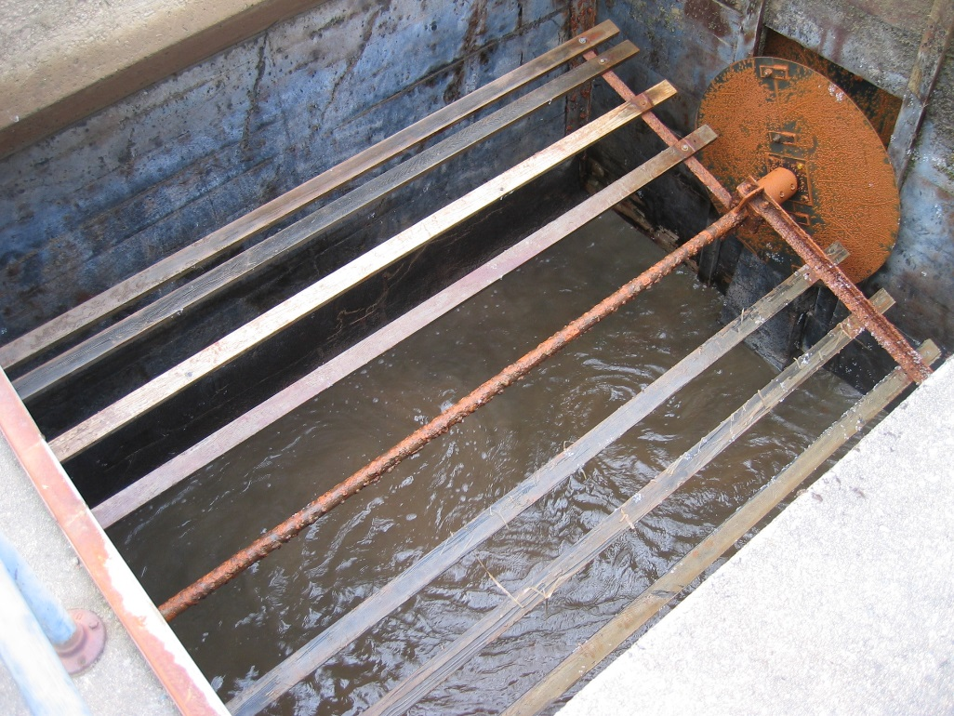
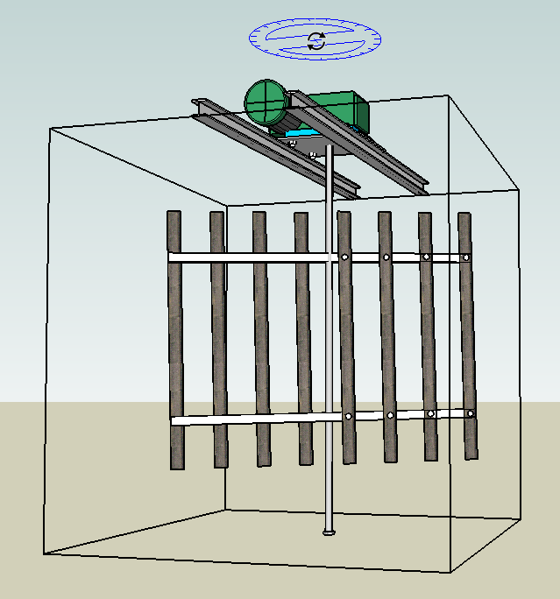
Flocculation
Flocculation involves slower mixing to bring neutralized particles together to form larger particles (floc)
Flocculation paddles - photo from 2007 CPE at Sweethome, OR

Slide 38
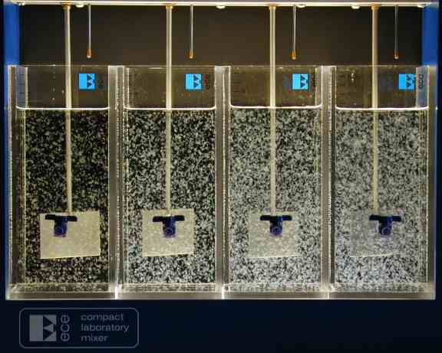
Jar Test showing floc formation

Slide 39
Sedimentation (Conventional Plants)
Standard basin:
  Usually rectangular, goal is to slow down the water so solids settle to bottom by gravity.
  Settled (clarified) water moves to filters slowly.
Tube settlers:
  Add capacity
  Solids only need to settle a few inches
  Water flows up through tubes, solids collect on the side and slide out of the bottom
  Some standard sed basins can be retrofitted with tube settlers
Plate Settlers (Lamella Plates)
  Perform same function as tube settlers
  Not as common in Oregon as tube settlers

Slide 40
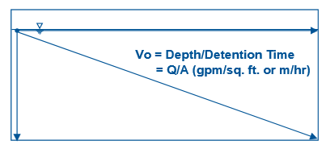
Sedimentation Basins
Sizing is such that the flocculated particles have time to settle out to the bottom of the basin before reaching the filters.
Less settleable particles will need to be removed by the filters
Settling
Distance
Flocculation > Sedimentation > Filtration

Slide 41
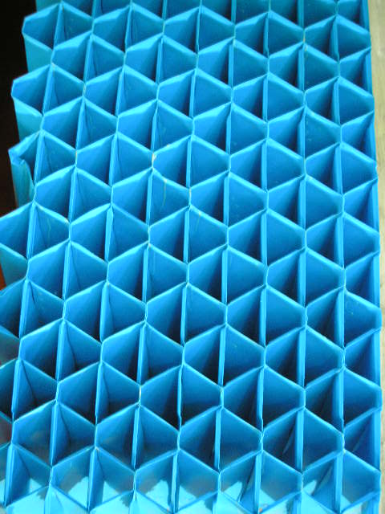
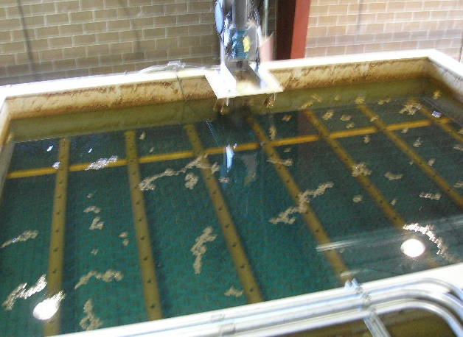
Tube Settlers
Tubes decrease settling distance
Tube settlers decrease the distance floc particles have to travel as they settle out.
In conventional basins, particles settle as much as 5-ft.
As water travel up through the inclined tube settlers, particles only settle about 2” to the floor of the tube.
City of Sweet Home, 2015

Slide 42
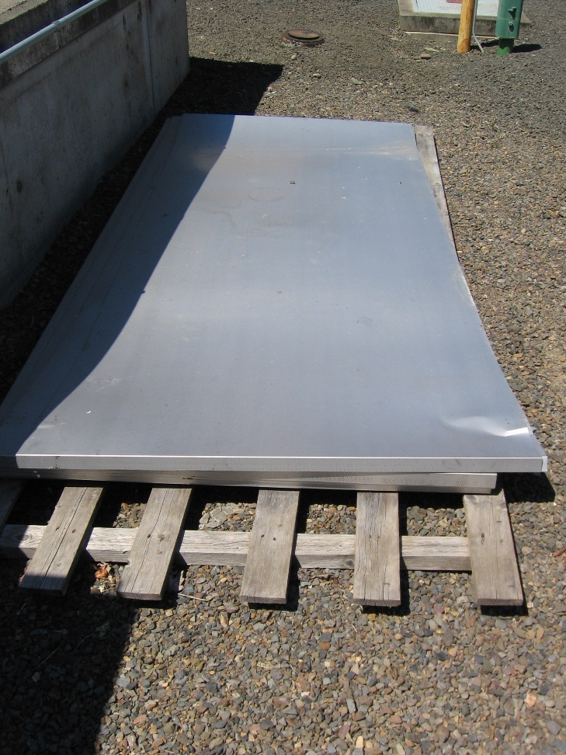
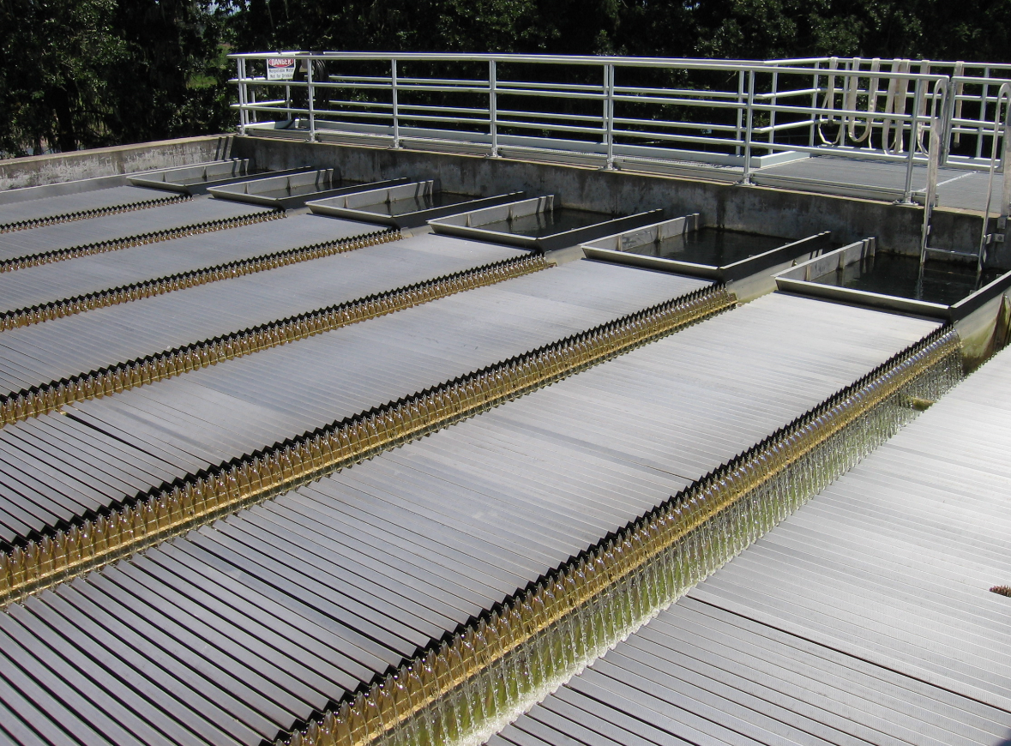
Inclined parallel plates serve a similar purpose as tube settlers
Plates also decrease settling distance
Plates also decrease the distance particles need to fall when settling out
City of Corvallis, 2006

Slide 43
Adsorption (Upflow) Clarifiers
Coagulated water flows up through clarifier.
Clarifier media either gravel or plastic beads. Clarifier is periodically “rinsed” of solids.
Clarified water flows onto filter.
Configured as a package plant, small footprint, easy to increase the capacity.

Slide 44
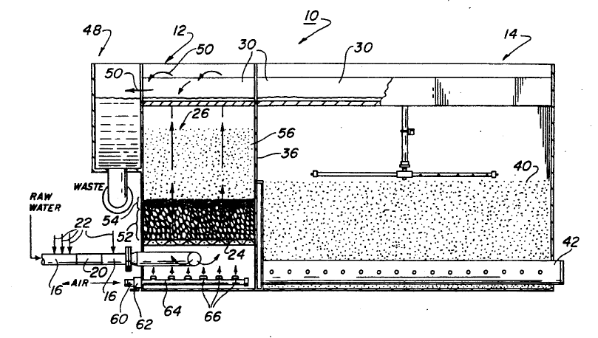
Contact Adsorption Clarifier
Roberts Filter Group Pacer II (model P-1400) ContaClarifierTM

Slide 45
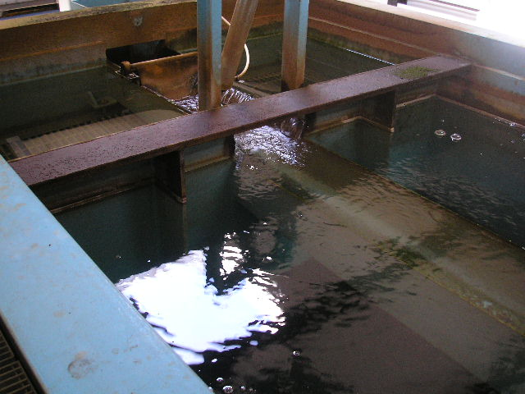
Upflow clarifier. Note screens (upper portion) holding clarifier gravel or plastic beads in place.

Slide 46
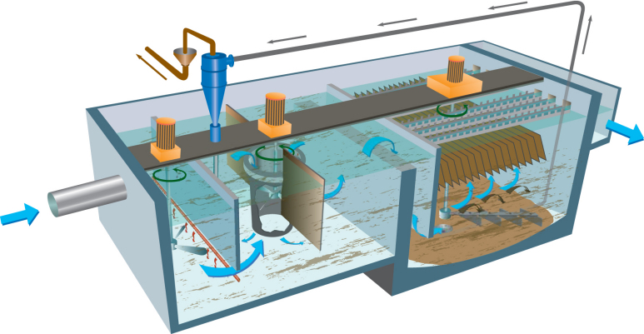
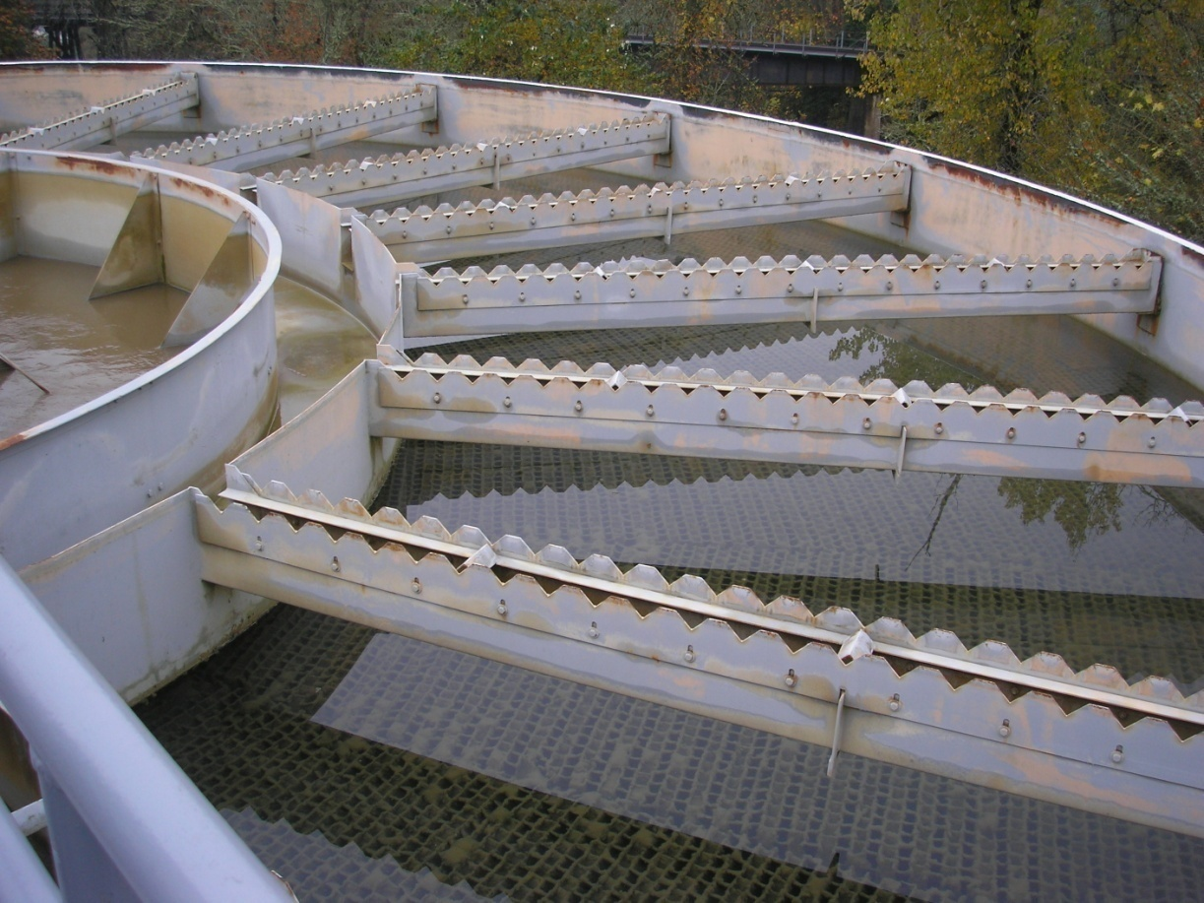
Other Forms of Sedimentation
Other forms of sedimentation/clarification include:
  Solids contact clarifiers
  Sludge blanket clarifiers
  Dissolved air flotation
  Sand ballasted

Slide 47
Direct Filtration
No sedimentation process.
OK for small systems with consistent raw water quality.
May be gravity or pressure filtration.
Usually cannot observe backwash process if pressure filtration.

Slide 48
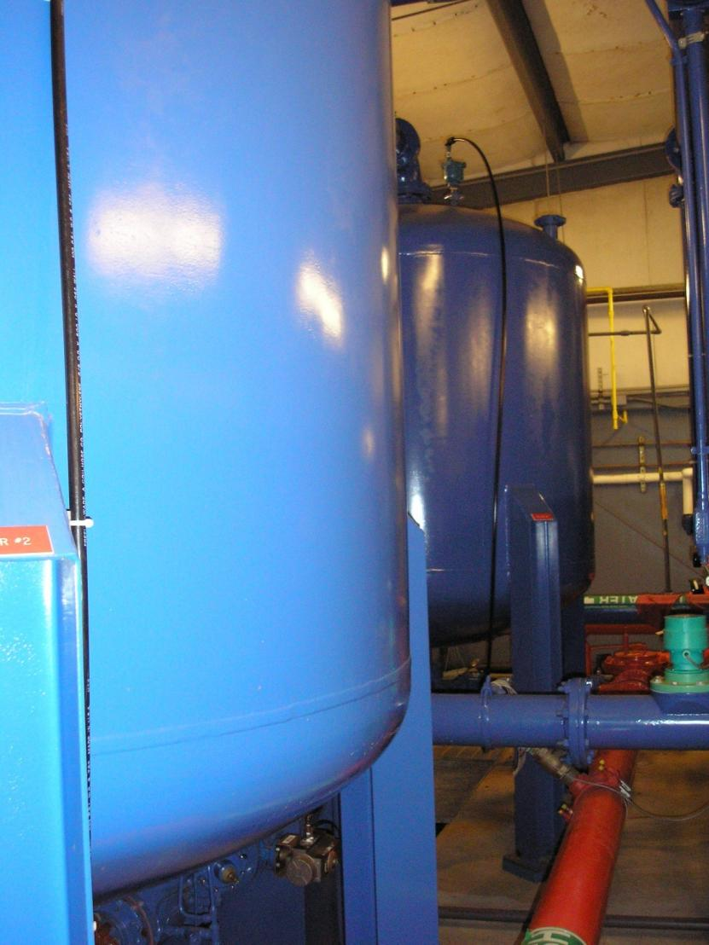
Pressure filters

Slide 49
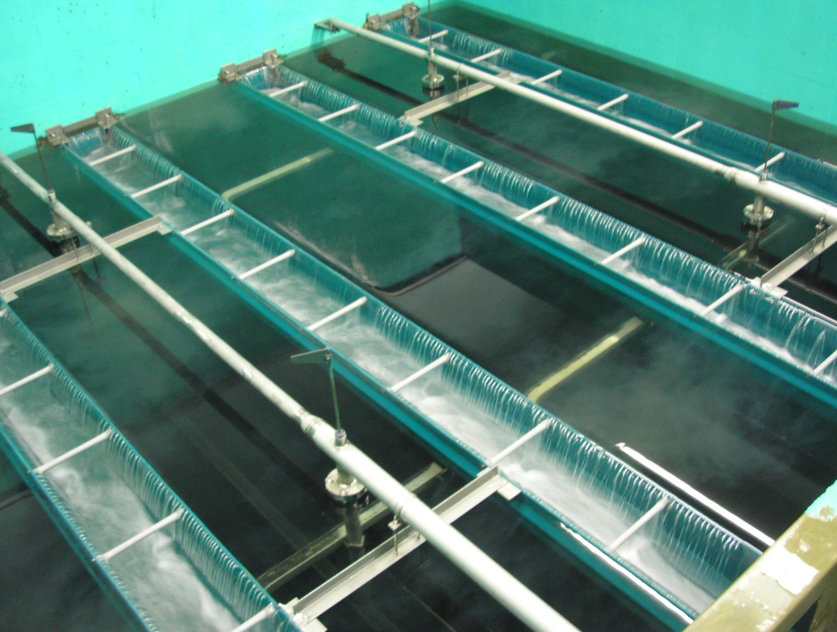
Conventional/Direct Filtration Optimization Objectives
Achieve filtration performance goals.
Minimize turbidity spikes during routine filter operation.
Minimize turbidity spikes following filter backwash.

Slide 50
Optimization Goals for Conventional/Direct Filtration
Practice should embrace the multiple barrier approach
Adopt optimized performance goals
  (e.g., settled water turbidity < 1 NTU, filtered water turbidity < 0.1 NTU)

Slide 51
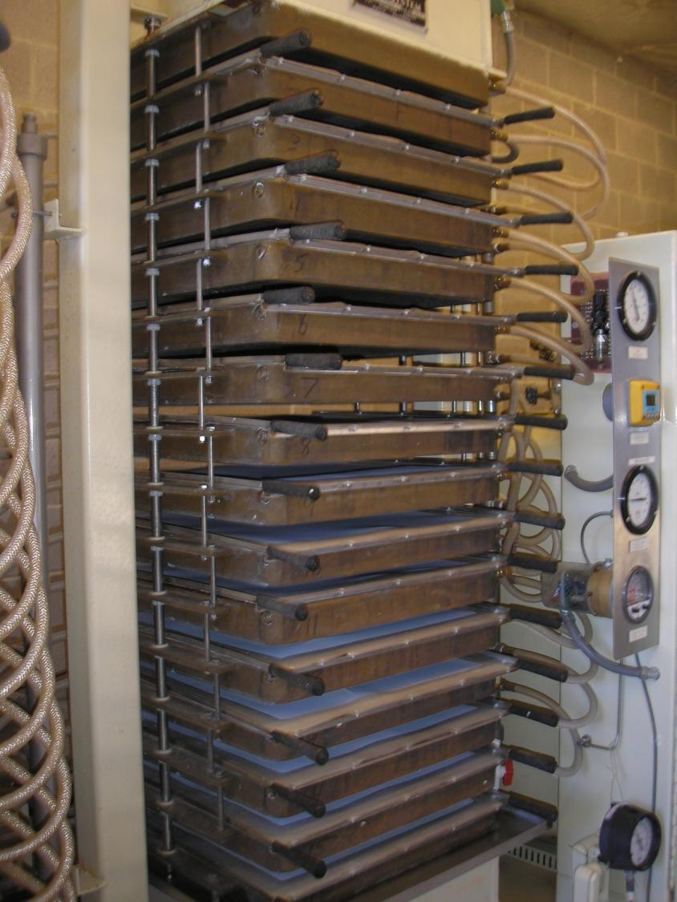
Diatomaceous Earth (DE) Filtration

Slide 52
Diatomaceous Earth (DE)
Common in swimming pools, also approved for drinking water.
Fine, porous, angular media processed from fossil skeletons of microscopic diatoms.
Requires a continuous “body feed” injection of DE, which collects on a filter screen (“septum”).
Only a few DE systems in Oregon.

Slide 53
DE filter stack

Slide 54
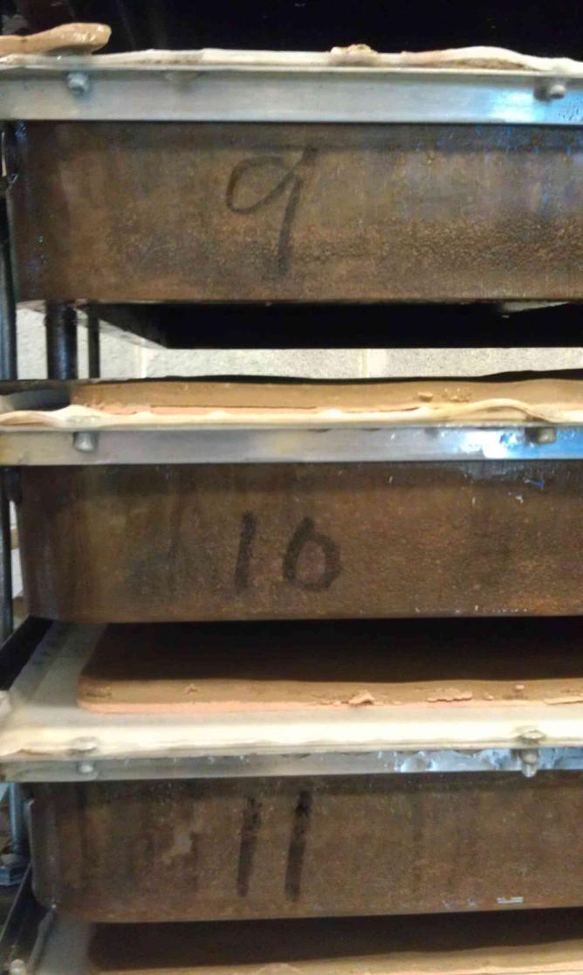
Sediment that’s been filtered out (brown layer)
DE cake (pink layer)

Slide 55
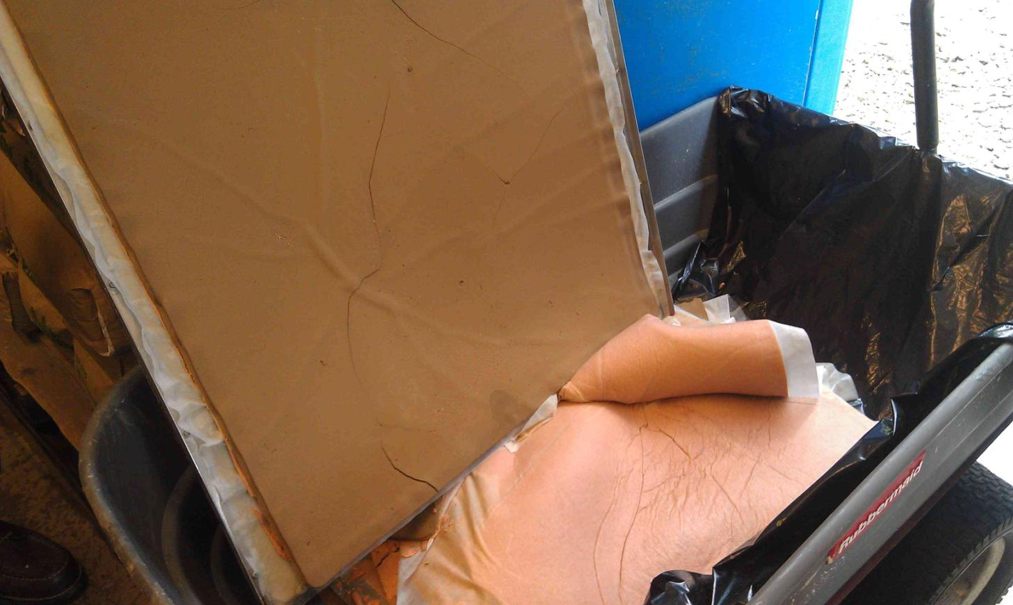
Sediment removed
DE cake

Slide 56
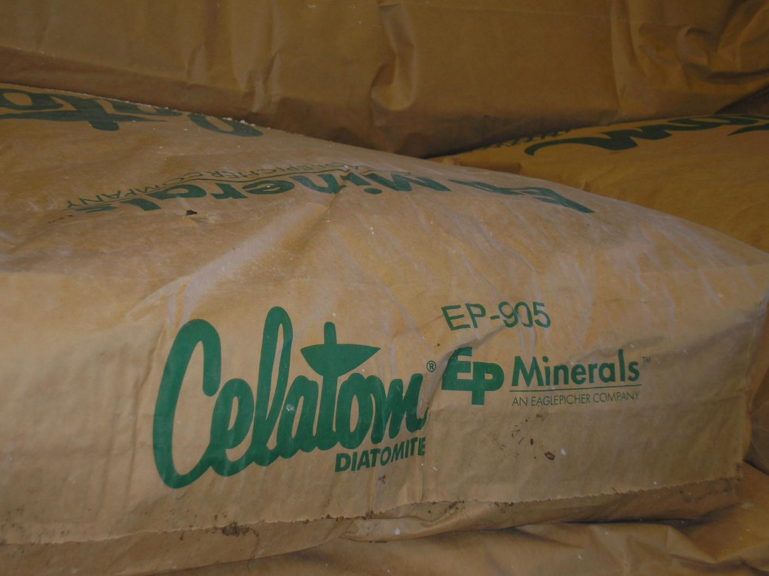
DE

Slide 57
Slow Sand Filtration
Filtration rate < 0.1 gpm/ft2
Need raw water < 5 NTU
No coagulants used
Pathogen removal occurs due to biochemical processes and adsorption.
Cleaned by raking, and eventually removing, top 1/8” to ½” of sand.
Credited with 2.0-log Giardia/Crypto removal

Slide 58
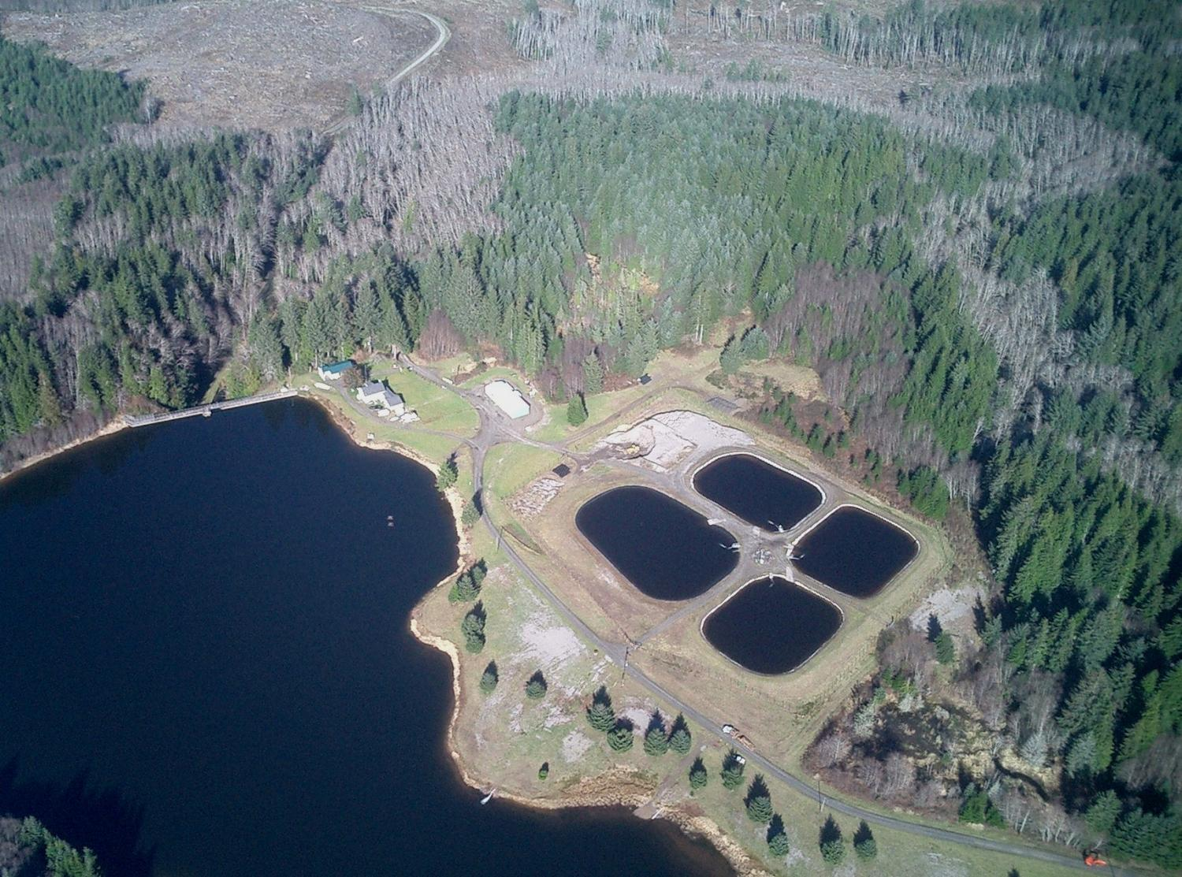
Slow Sand Filtration

Slide 59
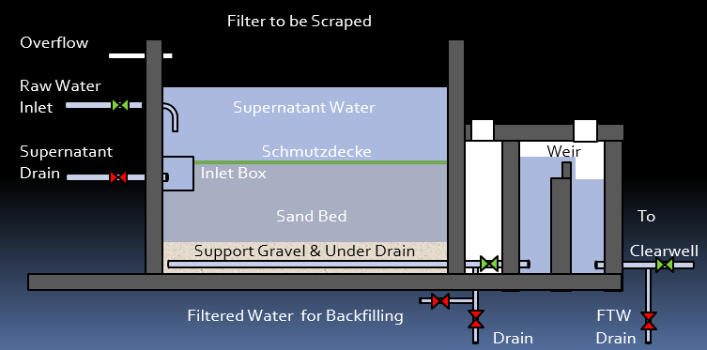
In a typical slow sand filter, water passes first through about 36 inches of sand, then through a layer of gravel, before entering the underdrain.
The sand removes particles from the water through adsorption, straining, and biological/biochemical processes.
A layer of dirt, debris, and microorganisms builds up on the top of the sand.
This layer is known as schmutzdecke, which is German for “dirt blanket“
The schmutzdecke breaks down organic particles in the water biologically and is also very effective in straining out even very small inorganic particles from water.

Slide 60
Bird’s eye view of 4 large slow sand filter cells

Slide 61
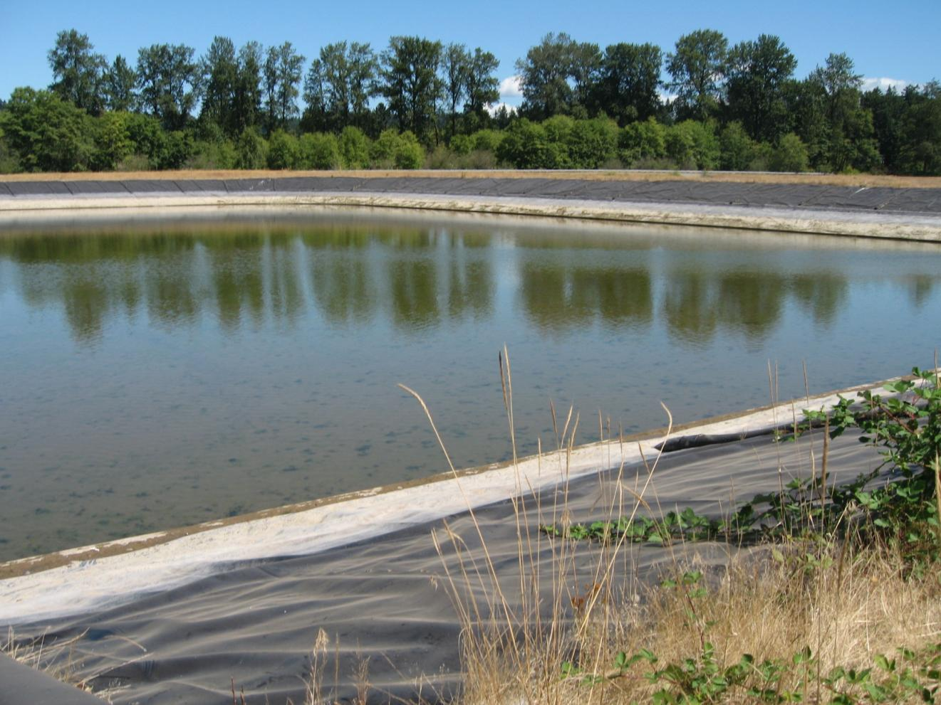
Large slow sand filter bed

Slide 62
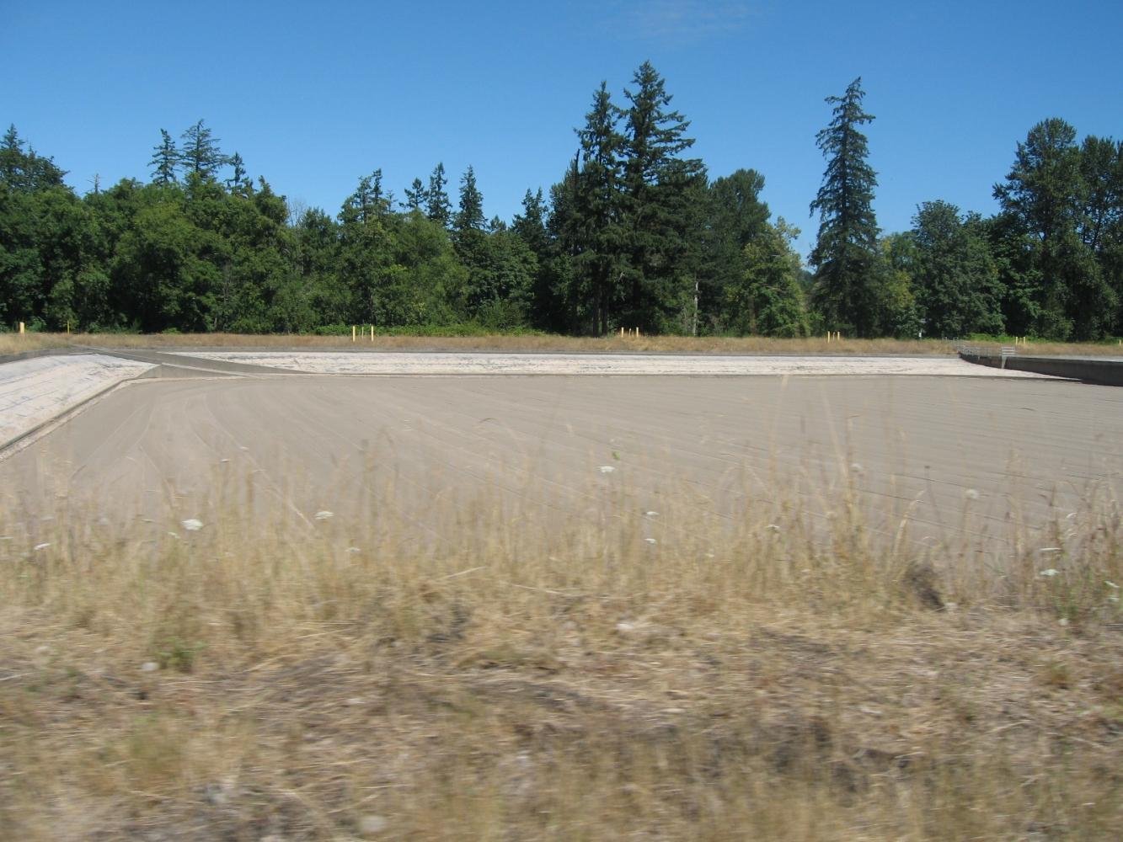
slow sand filter - drained

Slide 63
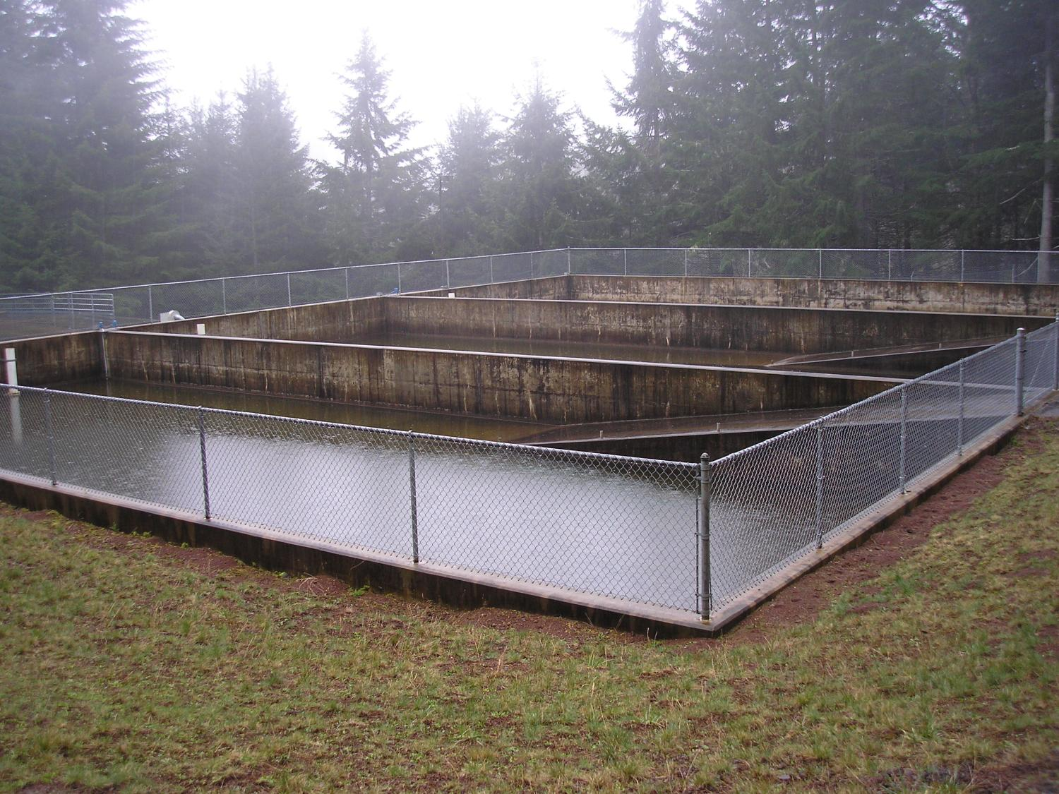
Slow sand filters – 3 bays

Slide 64
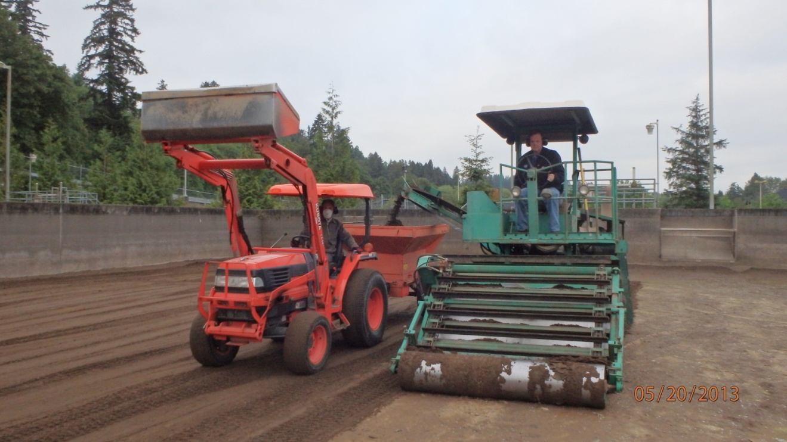
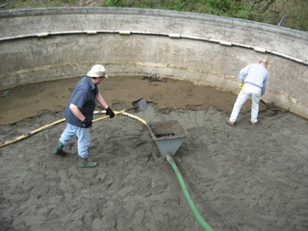

Slow Sand Filtration - Cleaning
Cleaned by scraping (manually with shovels or with a specially designed machine), and eventually removing schmutzdecke and top 1/8” to ½” of sand.

Slide 65

Slow sand: left filter in service, right filter out of service

Slide 66


Slow Sand Filtration - Cleaning
Some filters are designed to be “wet harrowed”

Slide 67

Self-contained slow sand filters at a school designed for wet harrowing.

Slide 68
Alternative Filtration Technologies
Cartridge / Bag Filters
Membranes
Need approved models that have met challenge studies (third party verification of performance) or on-site pilot data.

Slide 69


Cartridge & Bag Filtration

Slide 70
Cartridge Filters
Good for small systems with low flow rates (5-20 gpm).
Some cartridges require a specific pre-filter.
No backwash, cartridges are replaced when pressure differential reaches specified limit.
Must pass a challenge study in order to be approved.

Slide 71

The state maintains a list of approved cartridge units on its website
Operational boundaries (max flow, max pressure drop) associated w/ approval & log removal credit

Slide 72

Cartridge housings in sequence

Slide 73

Cartridge housings in parallel

Slide 74

Another style of cartridge housings

Slide 75
Filter cartridges that go in the housings

Slide 76
Bag filter

Slide 77

Membrane Filtration

Slide 78




Membrane Filtration
Remove pathogens based on pore size
Typically consist of bundles of hollow fibers.

Slide 79



Asahi Kasei Microza™ UNA-620A MF fibers
Fibers can have different wall thicknesses and configurations
Asahi Kasei Microza™ UNA-620A MF fibers in potting resin
Innovative Membrane Technologies (IMT) SevenBore® UF Fiber

Slide 80


Membrane Filtration
Can be in pressurized modules

Slide 81
Pressurized membranes

Slide 82

Large membrane plant.

Slide 83

Membranes (pressure)

Slide 84



Membrane Filtration
May also be submerged in basins

Slide 85

Plant with submerged membranes

Slide 86

Submerged membrane racks
Notes:
.

Slide 87

Membrane backwash, submerged membranes

Slide 88

Membrane Filtration
Very small pore sizes, 1 micron or less

Slide 89

Membrane Filtration
Often need pre-filter/screening (30 – 300 micron screens)
May also need coagulant to remove soluble organics

Slide 90


Membrane Filtration
Requires direct integrity test daily (usually air-hold pressure decay testing which is pre-programmed into automated controls).

Slide 91


Membrane Filtration
Holes in the membrane fibers or broken fibers result in a measurable pressure drop during direct integrity testing as shown by the air bubbles in site tubes.

Slide 92

Membrane Filtration
Control panel showing DIT (pressure decay test) info:
DIT= direct integrity test - sometimes called membrane integrity test (MIT),
pressure decay test (PDT), or air hold test.
LRV=log removal value

Slide 93



Membrane Filtration
Damaged or broken membrane fibers can be “pinned” (plugged).

Slide 94


Membrane Filtration
Membranes are periodically cleaned with acid, caustic, and/or chlorine.
Membrane clean-in-place chemicals

Slide 95

Membrane Filtration
The state maintains a list of approved membrane units on its website
Approved under certain operating conditions (max flow, test pressures)

Slide 96
Different methods of filter cleaning:
Conventional/Direct Filtration
  Backwashing (every 8 – 72 hours)
  Replacing/adding media eventually
Slow sand
  Scraping/ripening (every 1 – 6 months)
  Replacing/adding sand eventually
Cartridge/bag
  Discard/replace used filters
Membrane
  Backwash (every 60 – 90 minutes)
  Chemical cleaning

Slide 97

15 Minute Break

Slide 98

15 Minute Break
10 minutes left

Slide 99

15 Minute Break
5 minutes left

Slide 100


Disinfection
For this section on disinfection, you will need Exercise Handouts #1 - #3 found at the link posted in the chat window on the right.

Slide 101
Disinfection Overview
What is disinfection?
Types of disinfectants
Forms of chlorine
NSF/ANSI Standard 60
Disinfection requirements for surface water
CTs
Tracer Studies and Contact Time
Impact of disinfectants on organics

Slide 102
What is disinfection?
Process of killing microorganisms in water that might cause disease (pathogens)
Should not be confused with sterilization which is the destruction of all microorganisms
Two types:
  Ultraviolet Light (UV) Radiation
  Chemical (chlorine, chloramines, chlorine dioxide, ozone)

Slide 103

Ultraviolet Light (UV)
Works by subjecting water to ultraviolet (UV) light rays as water passes through a tube
https://www.unh.edu/wttac/WTTAC_Water_Tech_Guide_Vol2/uv_homepage.html

Slide 104

Quartz UV bulb sleeve

Slide 105
UV reactors at a large water system

Slide 106

The state maintains a list of approved UV units on its website
NSF 55 units not allowed for SW treatment (only allowed for GW TC+ with small distribution)

Slide 107
UV Drawbacks
Drawbacks for UV include:
  Interfering agents such as turbidity can screen pathogens from the UV light
  Effective against Giardia and Cryptosporidium but not viruses at normal doses
  No residual is present in the water to continue disinfecting throughout the distribution system
  For this reason, chlorination for residual maintenance is required when UV is used

Slide 108

Chemical Disinfection
Chlorine
Chloramines
Chlorine dioxide
Ozone

Slide 109

Chlorine
Most widely used form of disinfection
Also used as an oxidizing agent for iron, manganese and hydrogen sulfide and for controlling taste and odors
Effectiveness as a disinfecting agent depends on factors such as pH, temperature, free chlorine residual, contact time and other interfering agents

Slide 110
Forms of Chlorine
Sodium Hypochorite
Onsite generated sodium hypochorite
Calcium Hypochlorite
Chlorine Gas

Slide 111
Sodium hypochlorite
The liquid form of chlorine
Clear and has a slight yellow color
Ordinary household bleach (~5% chlorine by solution) is the most common form
Industrial strength: 12% and 15% solutions

Slide 112
Sodium hypochlorite (continued)
Can lose up to 4% of its available chlorine content per month; should not be stored for more than 60 to 90 days
Very corrosive; should be stored and mixed away from equipment that can be damaged by corrosion

Slide 113

Diaphragm Pump/Tank for Chlorine

Slide 114
On-site generated sodium hypochlorite
0.8% sodium hypochlorite is produced on demand by combining salt, water & electricity
Electrolysis of brine solution produces sodium hydroxide and chlorine gas, which then mix to form sodium hypochlorite
Hydrogen gas byproduct; vented to atmosphere
Alleviates safety concerns associated w/ hauling and storing bulk chlorine
Higher initial cost, high power cost
Mixed oxidants (proprietary)

Slide 115

Electrodes for onsite chlorine generation

Slide 116

Calcium hypochlorite
The solid form of chlorine
Usually tablet or powder form
Contains ~65% chlorine by weight
White or yellowish-white granular material and is fairly soluble in water
Important to keep in a dry, cool place
More stable than liquid
Used by small systems w/ low flows or no power

Slide 117

Calcium hypochlorite erosion feeder

Slide 118

Calcium hypochlorite hopper interior
Notes:
Cal hypo erosion feeder

Slide 119

Chlorine gas (Cl₂)
99.5% pure chlorine
yellow-green color 2.5x heavier than air
Liquified at room temperature at ~107 psi – hence the pressurized cylinders actually contain liquified chlorine gas.
Liquified Cl₂ is released from tanks as chlorine gas, which is then injected into the water stream.
usually used only by large water systems
Smaller systems may find initial cost of operation prohibitive

Slide 120

1-ton chlorine gas cylinders

Slide 121

1-ton chlorine gas cylinders
Note: scales used to weigh cylinders (to tell when they are empty)
Notes:
1-ton cl2 gas cylinders

Slide 122

150-lbs chlorine gas cylinders
Spare tank on hand
Chain to secure tank in place
Tanks clearly marked

Slide 123
Chloramines
Chlorine + ammonia = chloramination
Two advantages to regular chlorination:
  produce a longer lasting chlorine residual (helpful to systems with extensive distribution systems)
  may produce fewer by-products depending on the application
Disadvantage:
  Need a lot of contact time to achieve CTs compared to free chlorine (300 times more) which is why not used for primary disinfection
  Requires specific ratio of chlorine to ammonia or else potential water quality problems

Slide 124

Ammonia for making chloramines

Slide 125
Ozone
Colorless gas (O₃)
Strongest of the common disinfecting agents
Also used for control of taste and odor
Extremely Unstable; Must be generated on-site
Manufactured by passing air or oxygen through two electrodes with high, alternating potential difference

Slide 126

Large water system ozone
Notes:
Ozone reactors Reedsport

Slide 127

Large water system ozone
Notes:
Ozone reactor Medford

Slide 128

Ozone contactors

Slide 129

Ozone is to reactive to store, so liquid oxygen is used for making ozone

Slide 130
Ozone advantages
Short reaction time enables microbes (including viruses) to be killed within a few seconds
Removes color, taste, and odor causing compounds
Oxidizes iron and manganese
Destroys some algal toxins
Does not produce halogenated DBPs

Slide 131
Ozone disadvantages
Overfeed or leak can be dangerous
Cost is high compared with chlorination
Installation can be complicated
Ozone-destroying device is needed at the exhaust of the ozone-reactor to prevent smog-producing gas from entering the atmosphere and fire hazards

Slide 132
Ozone disadvantages (continued)
May produce undesirable brominated byproducts in source waters containing bromide
No residual effect is present in the distribution system, thus postchlorination is required
Much less soluble in water than chlorine; thus special mixing devices are necessary

Slide 133
Chlorine dioxide
Advantages
More effective than chlorine and chloramines for inactivation of viruses, Cryptosporidium, and Giardia
Oxidizes iron, manganese, and sulfides
May enhance the clarification process
Controls T&O resulting from algae and decaying vegetation, as well as phenolic compounds
Under proper generation conditions halogen-substituted DBPs are not formed
Easy to generate
Provides residual
Notes:
From: EPA Guidance Manual Alternative Disinfectants and Oxidants, April 1999

Slide 134
Chlorine dioxide (continued)
Disadvantages
Forms the DBP chlorite
Costs associated with training, sampling, and laboratory testing for chlorite and chlorate are high
Equipment is typically rented, and the cost of the sodium chlorite is high
Explosive, so it must be generated on-site
Decomposes in sunlight
Can lead to production noxious odors in some systems.

Slide 135
NSF/ANSI Standard 60
Addresses the health effects implications of treatment chemicals and related impurities.
The two principal questions addressed are:
  Is the chemical safe at the maximum dose, and
  Are impurities below the maximum acceptable levels?

Slide 136

NSF approved sodium hypochlorite

Slide 137
Disinfection Requirements for Surface Water
Surface Water Treatment Rule (SWTR) requires 3-log reduction of Giardia using a combination of disinfection and filtration
2.0 to 2.5-log removal is achieved through filtration
0.5 to 1.0-log inactivation is achieved through disinfection
Determines which column of EPA tables used to calculate CTs (0.5 or 1.0-log)

Slide 138
What are CT’s?
It’s a way to determine if disinfection is adequate
CT = Chlorine Concentration x Contact Time
Do not confuse “CT” and “Contact Time”
Notes:
C stands for concentration (not chlorine) which explains how CT can also be used for ozone, UV, etc.

Slide 139
How do we calculate CT’s?
We use the EPA tables to determine the CTs needed to inactivate Giardia (CT_{required})
  We need to know pH, temperature, and free chlorine residual at the first user in order to use the EPA tables.
Then we compare that with the CTs achieved in our water system (CT_{actual})
CT_{actual} must be equal to or greater than CT_{required}

Slide 140
Tracer Studies and Contact Time:
Used to determine contact time (T) which is used in calculating CT’s
Determines the time that chlorine is in contact with the water from the point of injection to the point where it is measured (sometimes referred to as the “CT segment”)
    May be at or before the 1st user
    May be more than one CT segment
Estimates of contact time are not allowed for calculating CT’s for surface water!
  The degree of short-circuiting is only approximately known until a tracer study is conducted.
Notes:
OAR 333-061-0050(6):
(R) Reservoirs and clearwells that are to be used for disinfection contact
time to treat surface water shall use a tracer study to determine the
actual contact time. The Department must approve procedures and
protocols for the tracer study prior to the initiation of the study. The
Department recommends the USEPA SWTR Guidance Manual for
tracer study procedure and protocol.
(S) Reservoirs and clearwells that are to be used for disinfection contact
time to treat surface water shall have a means to adequately determine
the flow rate on the effluent line.
OAR 333-061-0036(5) says that the disinfectant contact time T must be determined each day during peak hourly flow, based on results of a tracer study or other method approved by the Department.

Slide 141



What effects short-circuiting?
Flow rate
Flow path

Slide 142



Slide 143



Slide 144
The CT segment is from where chlorine is added here:

Slide 145
Thru the clearwell, to where chlorine residual is measured here:

Slide 146
So if we were conducting a tracer study, this is the segment we would be looking at and determining the contact time T for.

Slide 147
Tracer studies (continued):
Different methods:
  If water is pumped from the clearwell at different rates depending on time of year, do tracer study at each of those flow rates
  Do at typical winter/summer peak hour demand flows
  Otherwise use “worst-case scenario” parameters:
    Highest flow rate out of clearwell (conduct during peak hour or conditions that simulate e.g. open a hydrant)
    Keep flow rate constant
    Keep clearwell water level close to normal minimum operating level

Slide 148
Tracer studies (continued):
Must redo if peak hour demand flow increases more than 10% of the maximum flow used during the tracer study
Community water systems with populations <10,000 and non-profit non-community systems can use the circuit rider to perform a tracer study
Must submit a proposal to DWS for approval prior to conducting the tracer study (even if using the circuit rider).

Slide 149
Exercise #1
Tracer studies

Slide 150
Exercise #1: Tracer studies
Directions: Look at the diagram and answer the questions.
Figure 1: Water Treatment Plant
Smith Creek
NTU, flow
Slow sand filter #1
Slow sand filter #2
NTU
NTU
Two houses
Chlorine injection
Flow control valve: 270 gpm max
16.1’ max volume
Reservoir
75,000 gal.
Clearwell 220,000 gal
10.5’ min volume
Flow
To distribution
Questions:
If this was your treatment plant, highlight the part of the plant where you might conduct a tracer study.
In a “worst-case scenario” tracer study, what would the flow rate be?
In a “worst-case scenario” tracer study, what would the clearwell level be?

Slide 151

Exercise #1: Tracer studies
Directions: Look at the diagram and answer the questions.
Figure 1: Water Treatment Plant
Smith Creek
NTU, flow
Slow sand filter #1
Slow sand filter #2
NTU
NTU
Two houses
Chlorine injection
Flow control valve: 270 gpm max
16.1’ max volume
Reservoir
75,000 gal.
Clearwell 220,000 gal
10.5’ min volume
Flow
To distribution
Questions:
If this was your treatment plant, highlight the part of the plant where you might conduct a tracer study.
In a “worst-case scenario” tracer study, what would the flow rate be?
In a “worst-case scenario” tracer study, what would the clearwell level be?
Notes:
Mute presenter for 2 minutes

Slide 152
Exercise #1: Tracer studies
Directions: Look at the diagram and answer the questions.
Figure 1: Water Treatment Plant
Smith Creek
NTU, flow
Slow sand filter #1
Slow sand filter #2
NTU
NTU
Two houses
Chlorine injection
Flow control valve: 270 gpm max
16.1’ max volume
Reservoir
75,000 gal.
Clearwell 220,000 gal
10.5’ min volume
Flow
To distribution
Questions:
If this was your treatment plant, highlight the part of the plant where you might conduct a tracer study.
In a “worst-case scenario” tracer study, what would the flow rate be? 270 gpm
In a “worst-case scenario” tracer study, what would the clearwell level be? 10.5 feet

Slide 153
How info from tracer study is used to calculate CTs
Use the time T from the tracer study on the monthly reporting form in the “Contact time (min)” column
  Use the smallest T (highest flow) if the tracer study was done at multiple flow rates
This may not be your exact time, but it represents your worst case (as long as the peak flow is less and clearwell volume is more than they were at the time of the tracer study)

Slide 154
How info from tracer study is used to calculate CTs (cont.)
Or, once you know the time T from the tracer study, you can back-calculate to determine the baffling factor of the clearwell
    Baffling factor (%) = Time (min) x Flow During Tracer Study (gpm)
Clearwell Volume During Tracer Study (gal)
T can be adjusted based on flow (at <110%) with the following equation:
    T = Current clearwell Volume (gal) x Baffling Factor (%)
    Peak Hourly Demand Flow (gpm)
If tracer study includes pipeline segments or multiple tanks, contact the state for guidance on using baffling factors
Notes:
You can go 10% above what it was during the tracer study.

Slide 155
Impact of chlorine and ozone on organics
Disinfectants can react with organics to form disinfection byproducts
  Chlorine: TTHMs & HAA5s
  Ozone: Bromate
Pre-chlorination
TOC

Slide 156
OPERATIONS

Slide 157
Overview
Proper instrument sampling locations
Proper treatment plant sampling locations
  Turbidity
  Chlorine residual
  TOC
Instrument calibration
  Turbidimeters
  Chlorine analyzers
  Chemical feed pumps
Operations & Maintenance Manuals

Slide 158
Proper instrument sampling location
Data provided by instruments provides the basis for assessing water quality – important to get it right!
Common problems
  Sampling location
  Measurement techniques
  Calibration frequency and approach
Possible solutions
  May require investigations (special studies)
  Modifications to sample lines
  Establish guidelines on sample line cleaning
  Establish calibration procedure

Slide 159
Sampling for Turbidity
Raw turbidity
  Applies to all SW systems
  Location: pre-treatment
  Frequency: no regulatory requirement but need to know for proper treatment plant operation
  Settled turbidity
  Water systems using conventional filtration must measure settled water turbidity every day (e.g., grab sample 1x/day).
Individual filter effluent (IFE) turbidity
  CF, DF & membranes only
  Location: after each individual filter
  Frequency: continuous (every 15 minutes)
  Know what the triggers are!

Slide 160
IFE Triggers (Conventional/Direct)
  Report the following events immediately and conduct a filter profile within 7 days (if no obvious reason exists) if the IFE turbidity is:
    > 1.0 NTU in 2 consecutive 15-min readings
    > 0.5 NTU in 2 consecutive 15-min readings within 4 hours of being backwashed or taken off-line
  Report the following events and conduct a filter self assessment within 14 days if the IFE turbidity is:
    > 1.0 NTU in 2 consecutive 15-min readings at any time in each of 2 consecutive months.
  A CPE must be done within 30 days if the IFE turbidity is:
    > 2.0 NTU in 2 consecutive 15-min readings at any time in each of 2 consecutive months.

Slide 161
Proper treatment plant sampling locations: Turbidity (cont.)
Combined filter effluent (CFE) turbidity
  Applies to all SW systems
  Location: post all filtration prior to chemical addition and any storage
  Frequency:
    CF/DF > 3,300 pop. – continuous
    CF/DF ≤ 3,300 pop. – every 4 hrs
    Alternative - daily

Slide 162
Proper treatment plant sampling locations: Chlorine residual
Must be at least 0.2 ppm all times at the entry point (EP) to the system
  EP = post clearwell, at or before 1st user
EP chlorine residual sampling frequency
  Continuous > 3,300 population
  1-4x/day for ≤ 3,300 population
If EP residual falls < 0.2 ppm or required continuous monitoring equipment fails, grab sampling must be done every 4 hours until the residual is > 0.2 ppm and/or equipment is repaired.

Slide 163

Proper treatment plant sampling locations: Chlorine residual
OAR 333-061-0032(5)

Slide 164

Proper treatment plant sampling locations: Chlorine residual
OAR 333-061-0036(5)(b)(D)
Note - OAR 333-061-0036(5)(b) – addresses monitoring for SW and GWUDI systems that provide filtration. Section -0036(5)(a) is for unfiltered systems, but the disinfectant residual monitoring under (5)(a)(E) still applies.

Slide 165

Proper treatment plant sampling locations: Chlorine residual
OAR 333-061-0036(5)(a)(E) – EP Chlorine Residual

Slide 166
Proper treatment plant sampling locations: Total organic carbon (TOC)
Applicability
  CF (2.5-log plants): required raw TOC & alkalinity and filtered TOC
  All others: raw TOC required to qualify for DBP monitoring reduction (>500 population)
Frequency
  Monthly; may be reduced to Quarterly if filtered TOC is <2.0 ppm for 2 years, or <1.0 ppm for 1 year
  Quarterly if DBP reduction is granted

Slide 167

Proper treatment plant sampling locations: Total organic carbon (TOC) (cont.)
Location
  Raw TOC & alkalinity: pre-treatment
  Filtered TOC: CFE prior to chemical addition/disinfection
    <2.0 ppm for 2 years, or
    <1.0 ppm for 1 year
Chlorine
Coagulant

Slide 168
Exercise #2
Proper sampling locations for turbidity, chlorine residual, and TOC
  Determine proper sampling locations on WTP diagrams for conventional and membrane filtration

Slide 169
Conventional Filtration >
Notes:
Mute presenter for 2 minutes

Slide 170
Conventional Filtration >
Settled water turbidity
(required for conventional filtration plants only)

Slide 171
Membrane Filtration>

Slide 172
Membrane Filtration>
Raw water TOC if seeking DBP sampling reduction.
Paired post-filtration TOC is recommended to evaluate organics removal and/or demonstrate impact of coagulation

Slide 173
Instrument calibration
Turbidimeters (online, portable or benchtop)
  Must be calibrated per manufacturer or at least quarterly with a primary standard
    Formazin solution
    Stablcal (stabilized formazin)
  Secondary standards used for day-to-day check
  dayCheck is used to determine if calibration with a primary standard is necessary
    Gelex
    Manufacturer provided (e.g. Hach ICE-PIC)

Slide 174

Portable turbidimeter

Slide 175
Instrument calibration
Chlorine analyzers
  Handheld
    Follow manufacturer’s instructions
  Inline
    Check calibration against a handheld that has been calibrated
    At least weekly
    Follow manufacturer’s instructions if out of calibration

Slide 176

Portable colorimeter

Slide 177
Instrument calibration
Chemical feed pumps
  Calibration measures both the speed and the stroke (amount of chemical pumped) so accurate dosages can be calculated
  Create a “pump curve”;
    Set the stroke at half way point
    On a graph, plot speeds of 10% to 100% on X axis
    Plot chemical output amount on Y axis (ml/min)
    Record drawdown in graduated cylinders for 1 minute

Slide 178


Slide 179
Instrument calibration (cont.)
Chemical feed pumps (cont.)
  Pump curve is an important tool to identify when a pump may be in need of maintenance or replacement
  A smooth pump curve is good (should fit close to a straight line)
  Must compare information at varying speeds to be a full pump calibration process
  Suggested frequency: no less than annual

Slide 180

Chemical feed pumps

Slide 181
Exercise #3
Create a pump curve using made-up data points
Directions: Use the data provided in Exercise #3 to create a pump curve. Pump curves should be smooth and fairly linear. A bouncing or jagged pump curve indicates the pump needs maintenance. Maintenance needed may include cleaning, diaphragm replacement and/or seal replacement.
Notes:
Mute presenter for 2 minutes

Slide 182

Exercise #3: Creating a chemical feed pump curve
Directions: Use the data provided in the examples below to create a pump curve. Pump curves should be smooth and fairly linear. A bouncing or jagged pump curve indicates the pump needs maintenance. Maintenance needed may include cleaning, diaphragm replacement and/or seal replacement.
Feed pump #1 pump curve data:
Plot the data points on the graph. Does the pump need maintenance?
Setting | Time | Volume | Flow Rate
% Speed | Minutes | ml | ml/min
10% | 3 | 60 | 20
20% | 3 | 360 | 120
30% | 3 | 420 | 140
40% | 3 | 810 | 270
50% | 3 | 900 | 300
60% | 1 | 450 | 450
70% | 1 | 400 | 400
80% | 1 | 525 | 525
90% | 1 | 530 | 530
100% | 1 | 575 | 575

Slide 183
Exercise #3: Creating a chemical feed pump curve
Directions: Use the data provided in the examples below to create a pump curve. Pump curves should be smooth and fairly linear. A bouncing or jagged pump curve indicates the pump needs maintenance. Maintenance needed may include cleaning, diaphragm replacement and/or seal replacement.
Feed pump #1 pump curve data:
Plot the data points on the graph. Does the pump need maintenance? Yes (jagged line)
Setting | Time | Volume | Flow Rate
% Speed | Minutes | ml | ml/min
10% | 3 | 60 | 20
20% | 3 | 360 | 120
30% | 3 | 420 | 140
40% | 3 | 810 | 270
50% | 3 | 900 | 300
60% | 1 | 450 | 450
70% | 1 | 400 | 400
80% | 1 | 525 | 525
90% | 1 | 530 | 530
100% | 1 | 575 | 575

Slide 184

Feed pump #2 pump curve data:
Plot the data points on the graph. Does the pump need maintenance? No (straight-ish, smooth line)
Setting | Time | Volume | Flow Rate
% Speed | Minutes | ml | ml/min
10% | 3 | 120 | 40
20% | 3 | 270 | 90
30% | 3 | 480 | 160
40% | 3 | 690 | 230
50% | 3 | 960 | 320
60% | 1 | 400 | 400
70% | 1 | 460 | 460
80% | 1 | 500 | 500
90% | 1 | 540 | 540
100% | 1 | 560 | 560

Slide 185

Bonus question: Referring to feed pump #2 data above, if you normally have your speed set at 50% in order to maintain 1 ppm of chemical, what speed do you need to change it to if you do a new pump curve and get the following results:
Feed pump #2 NEW pump curve data
Answer: 60%
Setting | Time | Volume | Flow Rate
% Speed | Minutes | ml | ml/min
10% | 3 | 60 | 20
20% | 3 | 120 | 40
30% | 3 | 270 | 90
40% | 3 | 480 | 160
50% | 3 | 690 | 230
60% | 1 | 320 | 320
70% | 1 | 400 | 400
80% | 1 | 460 | 460
90% | 1 | 500 | 500
100% | 1 | 540 | 540

Slide 186
Lessons learned from data assessments done in the past
Common findings:
  Most systems have some problems with the way they monitor, record, assemble, and/or report data
  Operators do not know which data to report and which to exclude
  Operators do not know how to correctly use their tracer studies/calculate CTs
  Most system managers and operators are surprised by what they find out from a data assessment

Slide 187
Data assessments (cont.)
Even automated systems require a knowledgeable person to correctly assemble data
Data assessments often used to justify invalidation of turbidity data which would have triggered a CPE
Effective optimization can only be achieved when using valid performance data

Slide 188
How can operators become better data managers?
Make data reliability a plant goal
Only collect data used for process control or compliance reporting
Establish protocols for collection and recording of data
Establish a data verification process that can be routinely used to confirm data integrity
Turn data into information!

Slide 189
Operations & Maintenance Manual
Keep written procedures on:
Instrument calibration methods and frequency
Data handling/reporting
Chemical dosage determinations
Filter operation and cleaning
CT determinations
Responding to abnormal conditions (emergency response plan)

Slide 190
End of Part 1
Attend Part 2 to receive an additional 3 Contact Hours.
Complete the application for both parts attended to get all 6 contact hours online at: https://www.oregon.gov/oha/PH/HEALTHYENVIRONMENTS/DRINKINGWATER/OPERATIONS/TREATMENT/Pages/sw-essentials.aspx
The link to attend Part 2 of the training and application for contact hours is online under “Free Training Resources” at www.healthoregon.org/swt
E-mail questions to: DWS.SurfaceWater@odhsoha.oregon.gov

