Slide 1
Class Outline
9 AM Introduction/Overview
  10:15 AM – 15 minute break
10:30 AM Coagulation/Flocculation
  12 noon – Lunch (on your own)
1 PM Clarification/Sedimentation
2 PM Filtration
  2:15 PM – 15 minute break
2:30 PM Filtration (continued)
3:30 PM General Operations
  4:30 PM - End

Slide 2
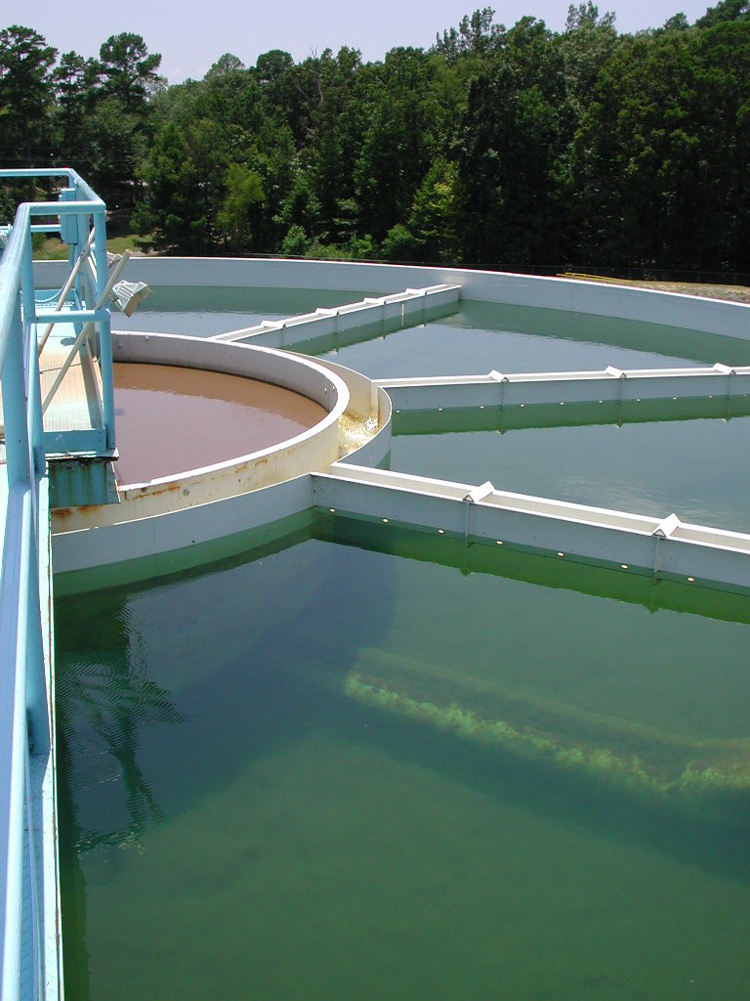
Clarification/Sedimentation
(Conventional Filtration)
Clarification is generally considered to consist of any process or combination of processes which reduce suspended matter prior to filtration.
Sedimentation is clarification that relies on gravity to settle particles out.

Slide 3
Clarification Objectives
(Conventional Filtration)
Key objective is to lower the particulate load to the filters
  Accomplished with gravity or other separation processes
  Collected solids need to be physically removed
  Turbidity removal is typically in the 60-80% range (Hudson, 1981)

Slide 4
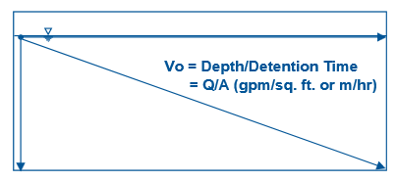
Clarification (Conventional Plants)
Sizing is often defined by hydraulic loading rate (gpm/ft² or m/hr)
0.5 gpm/ft² = 1.2 m/h = 0.066 ft/min

Slide 5
Clarification (Conventional Plants)
Forms of clarification include:
Sedimentation basins (0.5 – 0.7 gpm/ft², depending on depth)
High rate clarification:
  Tube (1-2 gpm/ft²) or plate settlers (~ 4 gpm/ft²)
  Contact adsorption clarifiers or “contact clarifiers” (8 gpm/ft²)
  Solids contact clarifiers (8-12 gpm/ft² for IDI Densadeg)
  Sludge blanket clarifiers (2-4 gpm/ft² for IDI Superpulsator)
  Dissolved air flotation (2-20 gpm/ft² depending on configuration)
  Sand ballasted (15-30 gpm/ft² for Kruger Actiflo®)

Slide 6
Sedimentation Basins
(baffled or unbaffled)
Proper design allows the velocity of water to be reduced so that particles can settle out by gravity.
The rate at which a particle settles out has to be faster than the rate at which the water flows from the basin’s inlet to its outlet.
Baffles help prevent short circuiting and lower detention times.
Surface overflow rate < 0.5 gpm/ft² with velocities less than 0.5 ft/min

Slide 7
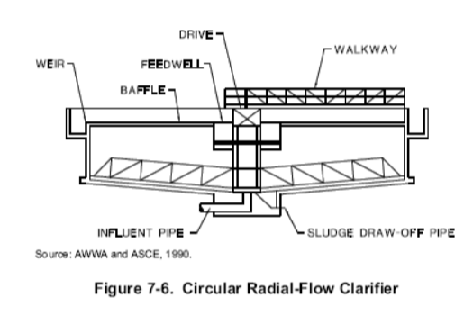
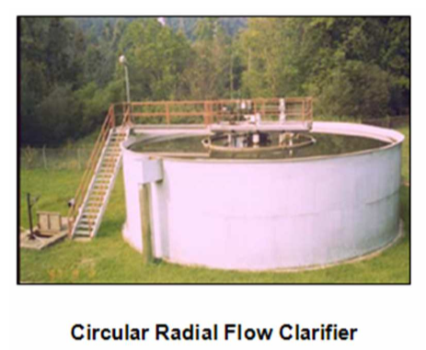
Sedimentation – Basins (radial flow)
Circular radial-flow clarifies direct coagulated water up through the center and then into a weir trough.

Slide 8
Tube and Plate Settlers
Same concepts as sedimentation basins, but can be operated at higher loading rates.
Tubes and plates placed in a basin decrease the distance the particles have to settle out (i.e., particles only need to settle to the surface of the tube or plate below ~ 2 inches)
Tubes and plates are inclined (typically 60°) to allow collected sludge to slide down to the bottom of the basin for removal.
Generally, a space of 2 inches is provided between the tube walls or plates to maximize settling efficiency.

Slide 9
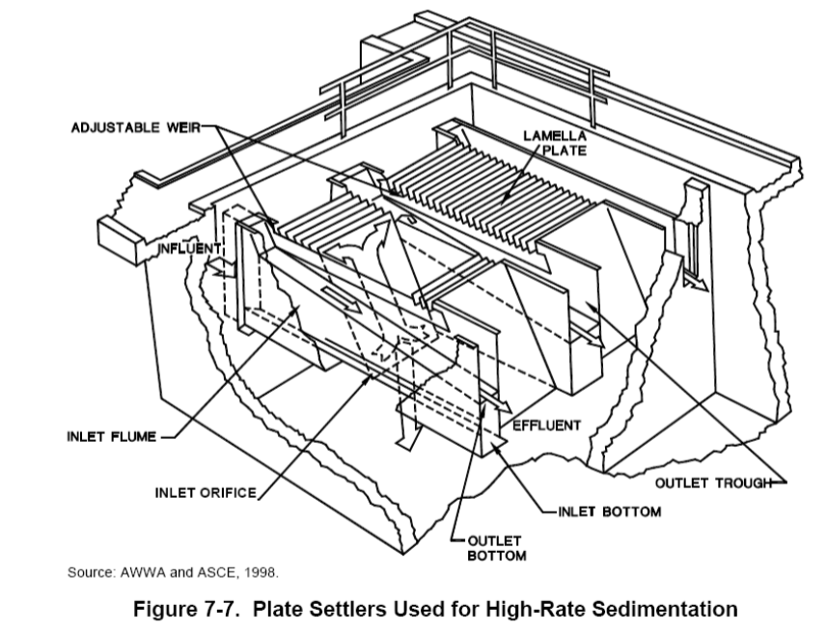
Plate Settlers
Parallel plates set at an incline shorten the distance the particles have to settle out.
(~ 4 gpm/ft² 10-ft long @ 55 with 2” spacing)

Slide 10
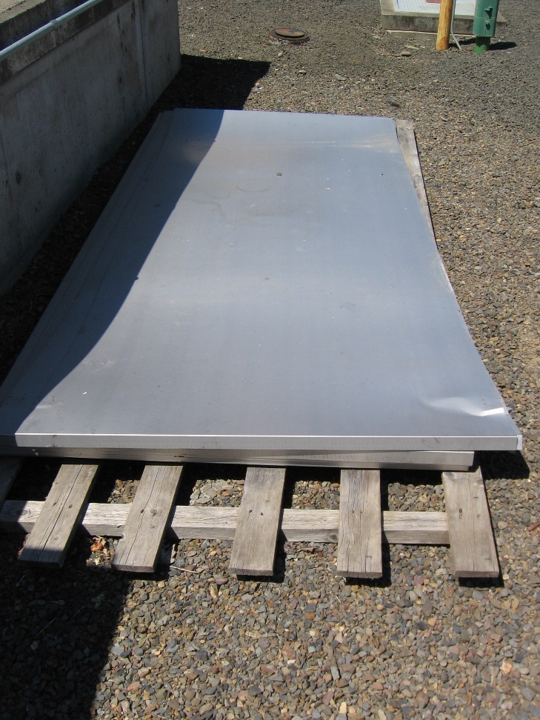
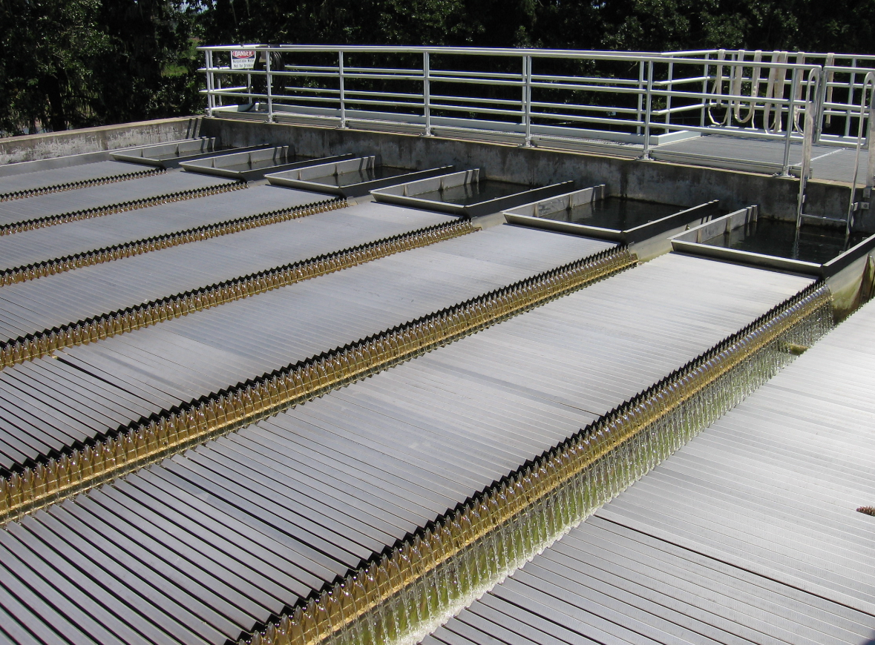
Plate Settlers – City of Corvallis (2006)

Slide 11
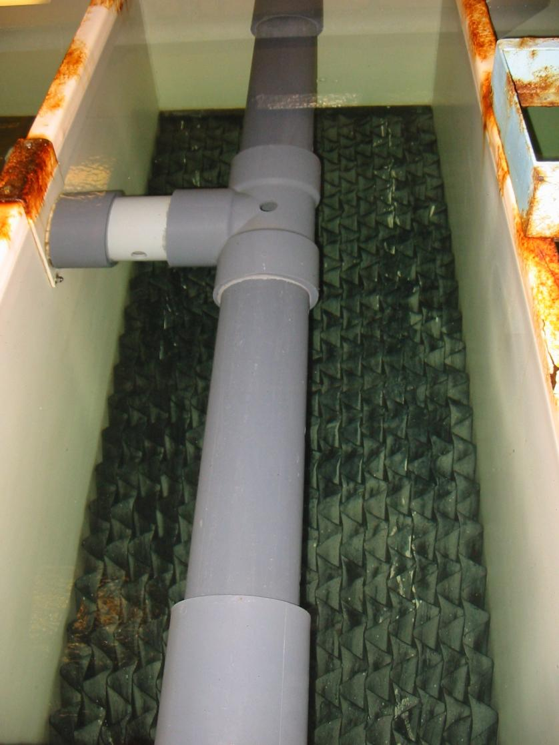
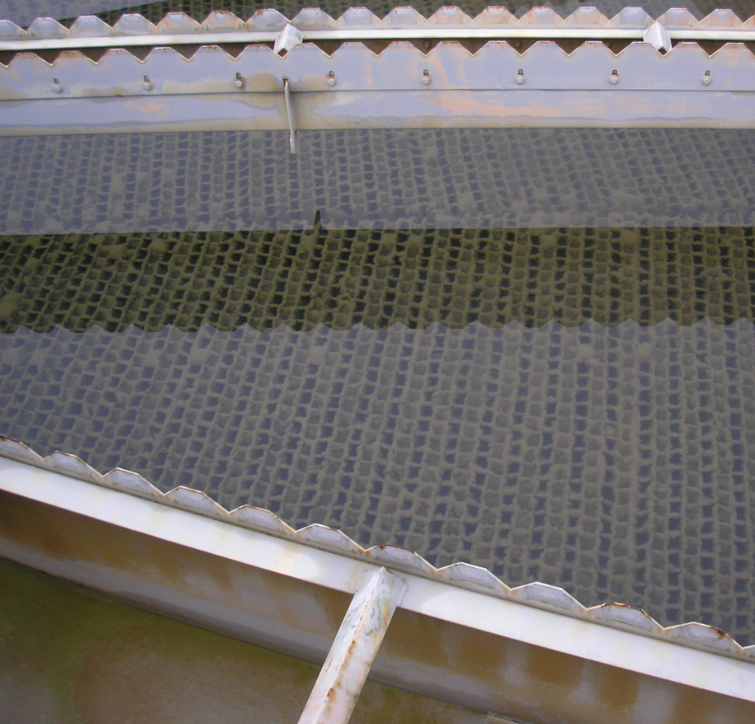
Tube Settlers
Tube settlers are basins filled with tubes set at an incline of generally 60 °. Tube openings are typically around 2” in size.
Loading rate < 2 gpm/ft² of cross sectional area.
City of Albany (2014)

Slide 12
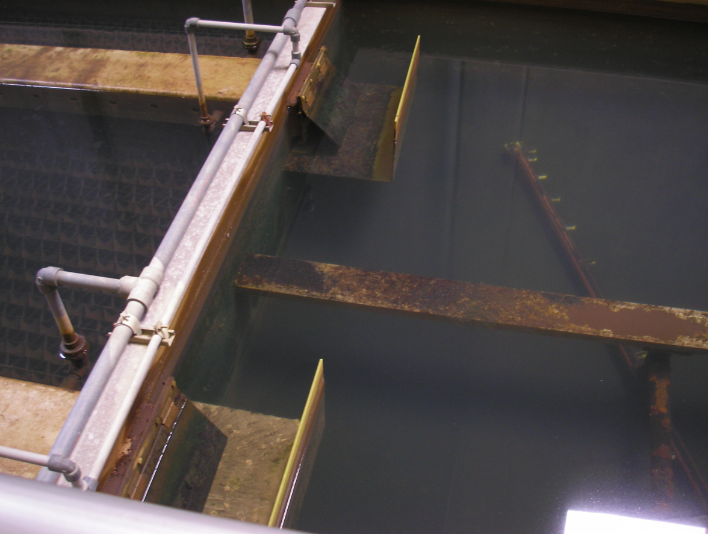
Tube Settlers
City of Scappoose, 2013

Slide 13
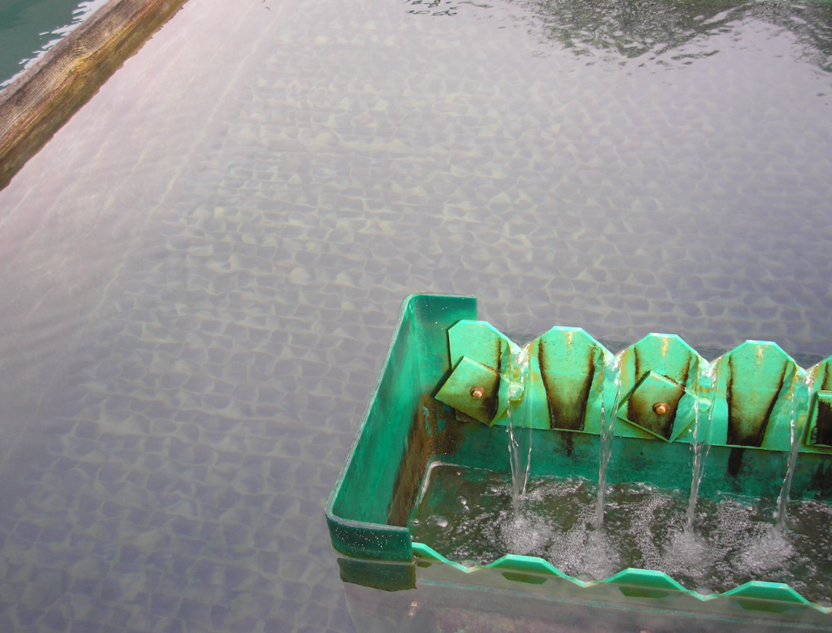
Tube Settlers
City of Corvallis, 2010

Slide 14
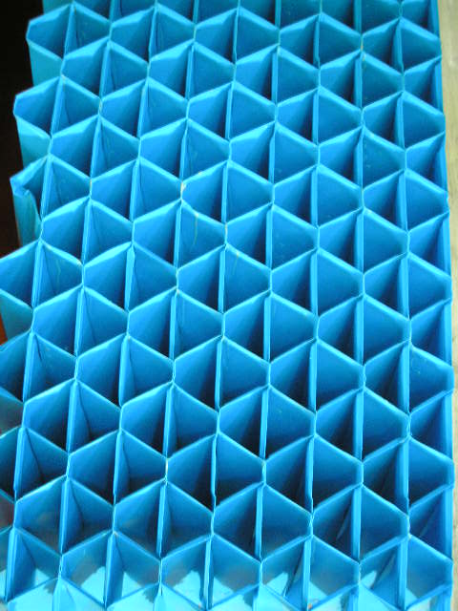
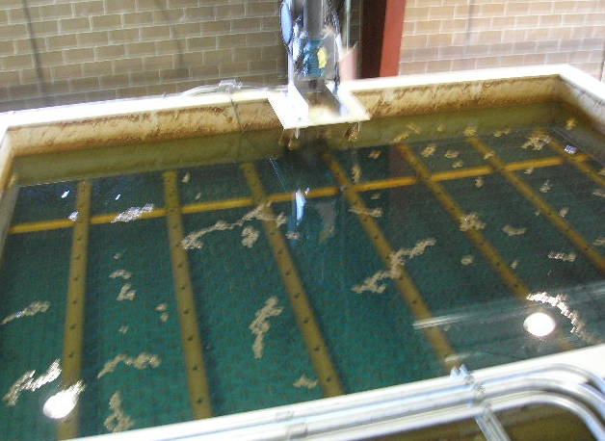
Tube Settlers
City of Sweet Home, 2015

Slide 15
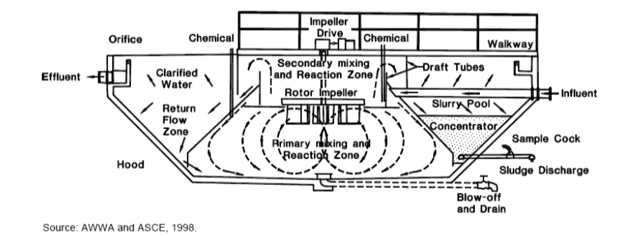
Solids Contact Clarifiers
Accelator® Solids Contact Unit has two mixing zones.
Raw or coagulated water enters the primary mixing zone where coagulation and flocculation begin.
The resulting particles are pumped up into a secondary mixing zone where more gentle mixing allows the completion of the flocculation process.
Water then flows down a draft tube, where particles settle on the hood to the sludge blanket at the bottom of the basin.
Clear water flows upward at constantly reducing velocity to allows small particles to settle out.

Slide 16
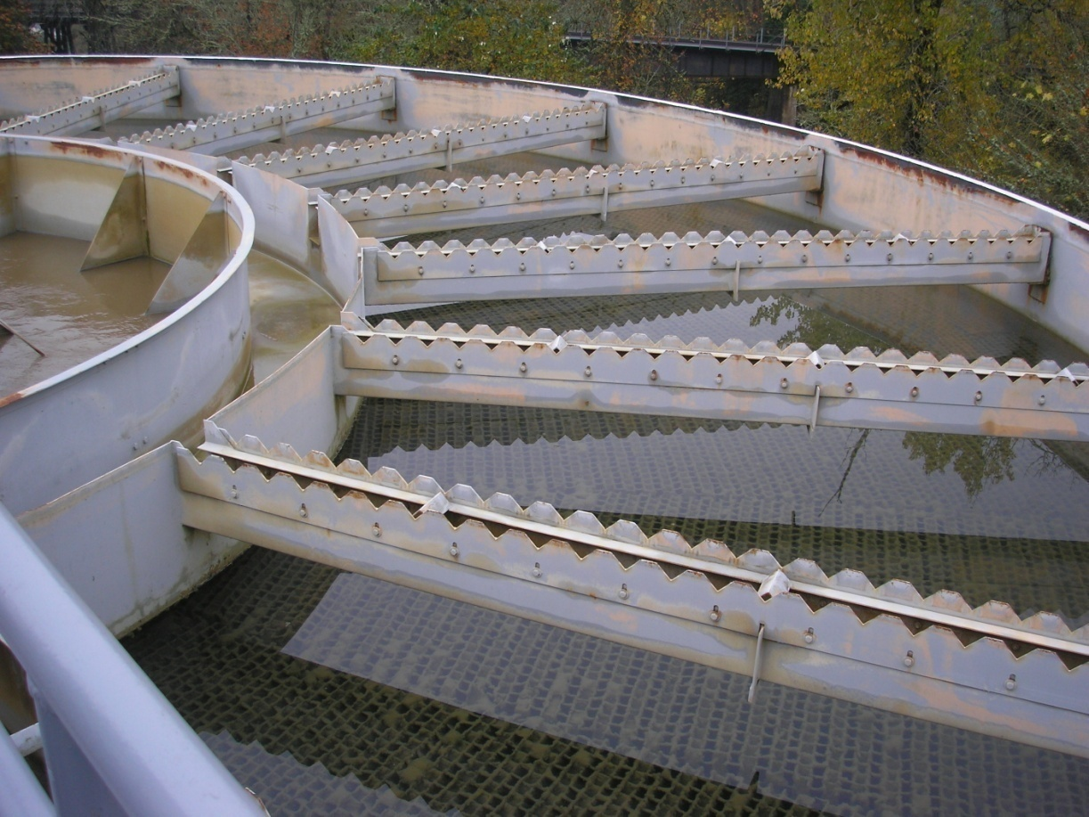
Solids Contact Clarifiers
Accelator® Solids Contact Unit with tube settlers is shown for the City of Albany (2012)

Slide 17
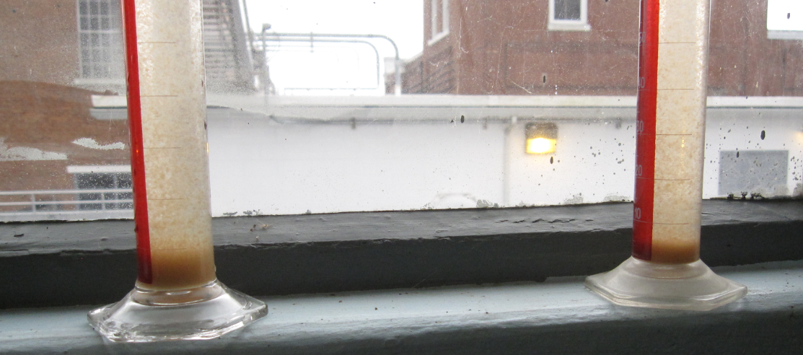
Sludge Blanket Clarifiers
A variation of solids contact units in which coagulated water flows up through a blanket of previously formed solids.
The floc grows in size and becomes part of the blanket, which can develop to a depth of several feet for efficient clarification.
In both sludge and solids contact clarifiers, solids management is key to their efficiency.
Solids analysis for the City of Albany, 2012

Slide 18
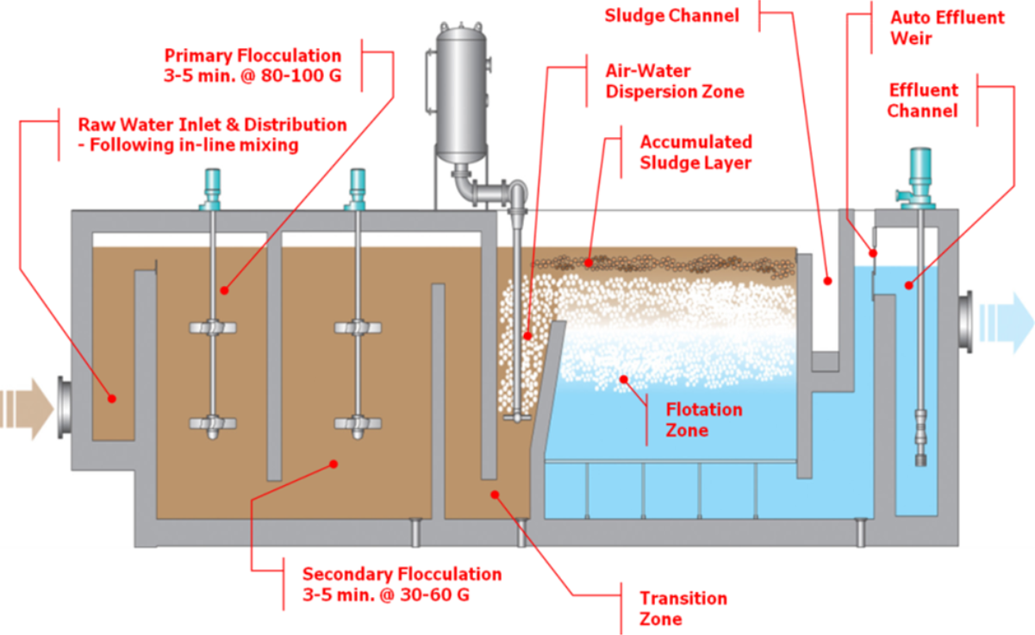
Dissolved Air Floatation
In use since the late 1960’s
Uses micro air bubbles to attached and float flocculated particles and solids to the surface for removal. Primarily for low solids and algae
Loading rate is 2-6 gpm/ft² (6 – 20 gpm/ft² for high rate)

Slide 19
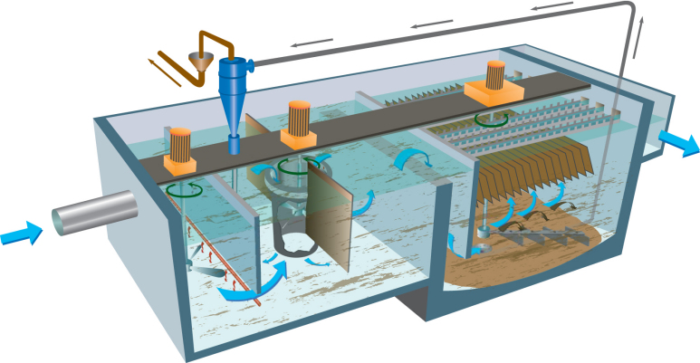
Sand Ballasted Flocculation
Introduced in 1989, the Actiflo® process from Kruger uses microsand and polymer injected into the floc chamber that allows the flocculated particles to settle out much faster through parallel plates.
Microsand is continuously recirculated
Sand Recirculated
Clarified water
Water with coagulant enters rapid mix tank
Plate settlers
Flocculation tank
Rapid Mix

Slide 20
Contact Adsorption Clarifiers
Coagulated water flows up through clarifier.
Clarifier media either gravel or plastic beads. Clarifier is periodically “rinsed” of solids.
Clarified water flows onto filter.
Configured as a package plant, small footprint, easy to increase the capacity.

Slide 21
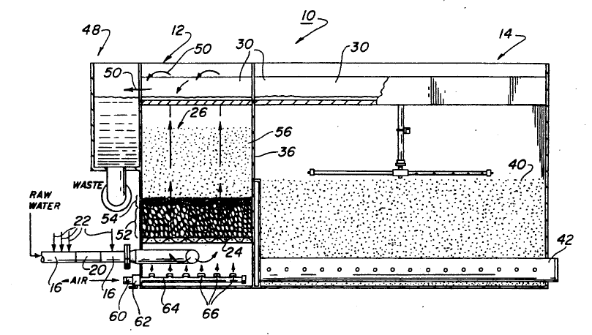
Contact Adsorption Clarifier
Roberts Filter Group Pacer II (model P-1400) ContaClarifierTM
  52 = flocculation layer
  54 = transition layer Contact Adsorption Clarifier (ContaClarifier™)
  56 = filtration layer
  40 = Tri-media rapid sand filter (anthracite, sand, garnet) Polishing Filter

Slide 22
Contact Adsorption Clarifier
Units are backwashed or “rinsed” at the same rate and direction that they filter, except rather than the water going to the top of the filter, it is diverted to waste.
ContaClarifer™ rinse initiated at 5-6 psi (26 – 31 inches head)
1st Stage of Rinse:
  4.5 min air/water flush
  Air Scour Rate @ 840 cfm (140 ft² x 6 cfm/ft²)
  Water rinse @ 10 gpm/ft² (1,400 gpm/140 ft²)
2nd Stage of Rinse:
  6 min water rinse only @ 10 gpm/ft²

Slide 23
Contact Adsorption Clarifier
Individual CAC Unit Turbidity Data (HACH 1720D)
CAC units exhibit similar characteristics as normal filters
Data shows slight increase of clarified turbidity towards end of run prior to rinse

Slide 24
Clarification Optimization Objectives
Achieve clarified/settled water performance goals.
Maintain consistent performance during varying source water conditions.

Slide 25
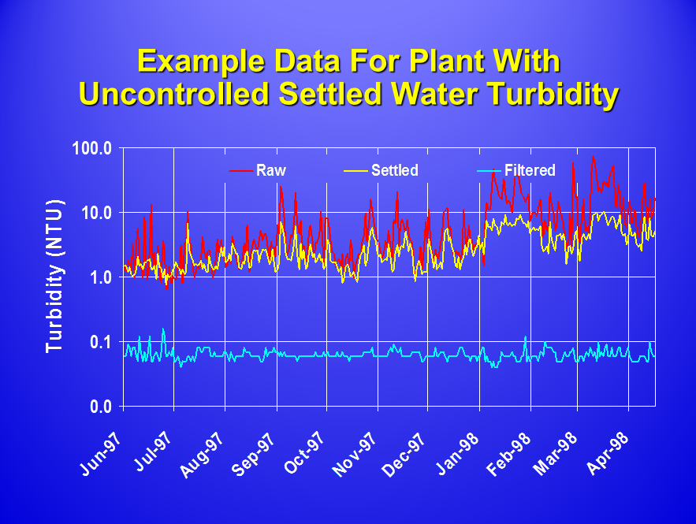
Example Data For Plant With Uncontrolled Settled Water Turbidity
Notes:
Some may say, “what’s the problem with the settled water quality when the filtered water quality is so good?” There are two issues. First, the objective of water treatment is to provide multiple barriers to protect against the passage of microbial contaminants. Second, the reason that the filters may be doing so well could be related to low loading rates. What happens when the plant loadings increase?

Slide 26
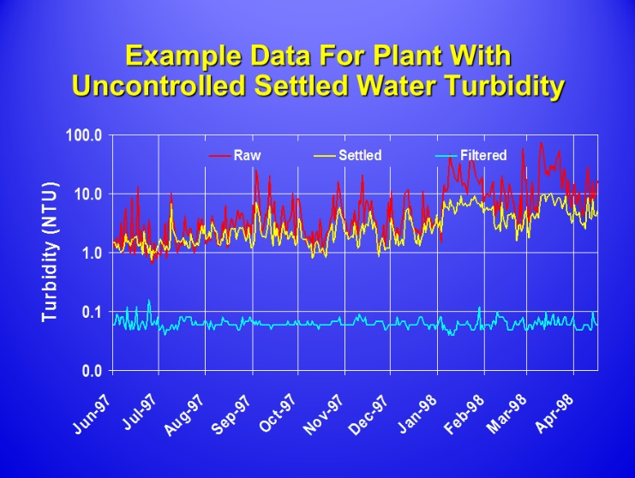
1) The objective is to provide multiple barriers for pathogen removal – this performance relies heavily on the filters.
2) Could the good filter performance be due to a low filter loading rate (gpm/sf). What will happen when flow through the plant increases?
3) What will happen if there is a heavy rainfall or flooding? Will the filters continue to meet 0.1 NTU when raw water turbidity spikes?
The filtered water is less than 0.1 NTU, so what is the problem?
Notes:
Some may say, “what’s the problem with the settled water quality when the filtered water quality is so good?” There are two issues. First, the objective of water treatment is to provide multiple barriers to protect against the passage of microbial contaminants. Second, the reason that the filters may be doing so well could be related to low loading rates. What happens when the plant loadings increase?

Slide 27
Sedimentation Optimization
Possible Special Studies
Inadequate coagulation/overfeed.
Unequal loading to multiple units.
Turbidimeter data integrity (i.e., sample line cleaning issues).
Mass control in solids contact units
(unit start-up and sludge wasting).
Polymer type and dose impact on contact adsorption clarifiers.
Impact of “floc-bubble” aggregate characteristics on dissolved air flotation.
Notes:
Use of additives such as bentonite clay and diatomaceous earth to shorten the start-up time for solids contact clarifiers. Use of flocculant aides can be studied to stabilize performance variations due to temperature changes.
Contact adsorption clarifiers primarily function as roughing filters. The type and dose of polymer can be key to achieving performance goals. Performance in these units can also be affected by sudden changes in flow rate (e.g., during air scour).
Developing a small “floc-bubble” aggregate may be key to achieving performance goals with DAF. Floc weight is not as important as in conventional settling, since particles are removed by floatation. Polymer flotation aids are sometimes used to aid in retention of the float layer.

Slide 28
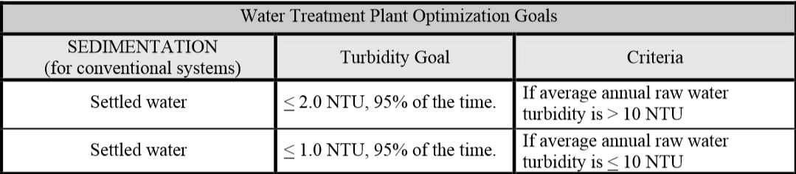
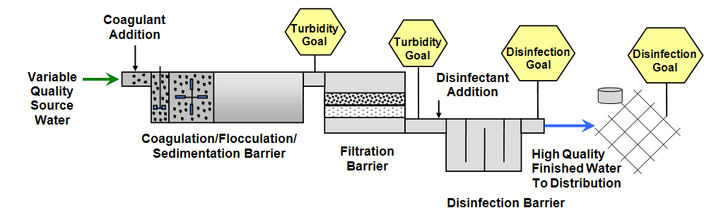
Optimization Goals for Settled Water Turbidity
Practice should embrace the multiple barrier approach, meeting optimization goals 95% of the time.

Slide 29
Class Outline
9 AM Introduction/Overview
  10:15 AM – 15 minute break
10:30 AM Coagulation/Flocculation
  12 noon – Lunch (on your own)
1 PM Clarification/Sedimentation
2 PM Filtration
  2:15 PM – 15 minute break
2:30 PM Filtration (continued)
3:30 PM General Operations
  4:30 PM - End

Slide 30
Conventional and direct filtration
Commonly called “rapid sand” or “rapid rate” filtration (as opposed to slow sand filters at 0.1 gpm/ft²)
Filtration rate typically 2-4 gpm/ft²
Requires controllable backwash with water and perhaps air scour.
Mixed media filters: layers of support gravel, sand, anthracite.
Typical Filtration Loading Rates
Sand Media | 2.0 gpm/ft²
Dual/Mixed Media | 4.0 gpm/ft²
Deep Bed (Typically anthracite >60 in. in depth) | 6.0 gpm/ft²

Slide 31
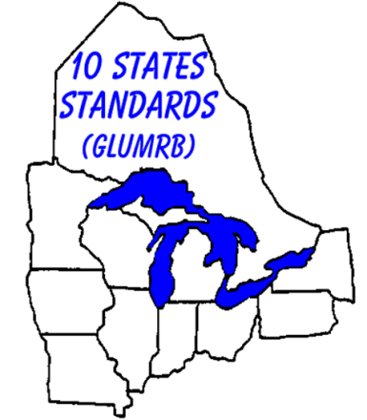
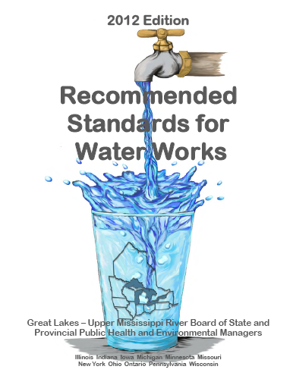
“Ten States Standards”
Ten States Standards
http://10statesstandards.com/index.html
Member States and Provinces
Illinois | New York
Indiana | Ohio
Iowa | Ontario
Michigan | Pennsylvania
Minnesota | Wisconsin
Missouri
Notes:
Recommended Standards for Water Works or “Ten States Standards” were developed with the participation of many state agencies and widely recognized design guidelines for treatment plants.

Slide 32
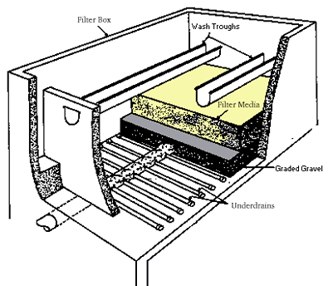
Typical Filter “Box”

Slide 33
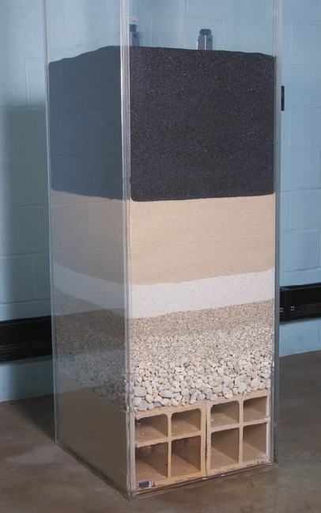
Media
Water flows through progressively larger pores as it passes from coal to sand to gravel.
This example shows the following from top to bottom (as the water would flow)
Anthracite
2 layers of sand
3 layers of support gravels
“Block” underdrain

Slide 34
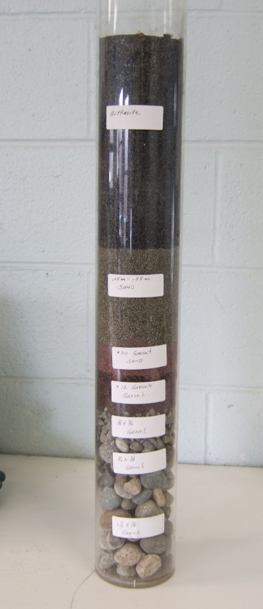
Media
Example shown is from the City of Grants Pass
Top Layer Anthracite
Layer 2 Filter sand
(Silica sand w/ D10 = 0.45 mm- 0.55 mm)
Layer 3 #50 garnet sand
Layer 4 #12 garnet gravel
Layer 5 3/8” x 3/16” gravel
Layer 6 3/4” x 3/8” gravel
Bottom layer 1-1/2” x ¾” gravel

Slide 35
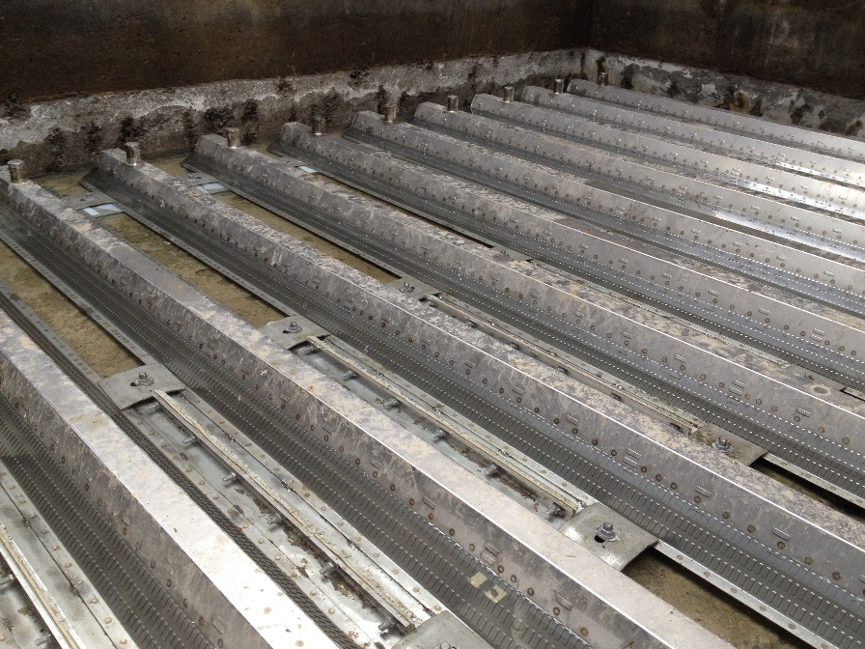
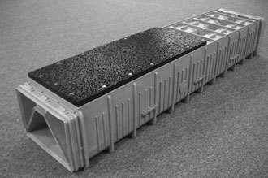
Conventional and direct filtration
Underdrains can be a series of perforated pipe or proprietary underdrain “block”, or “folded plate” underdrains.
  Ovivo Flexscour® “folded plate” Xylem Leopold® “block”

Slide 36
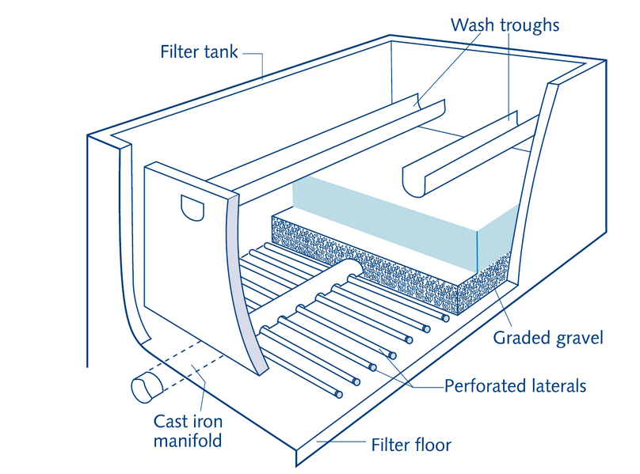
Conventional and direct filtration
Perforated Pipe Underdrains

Slide 37

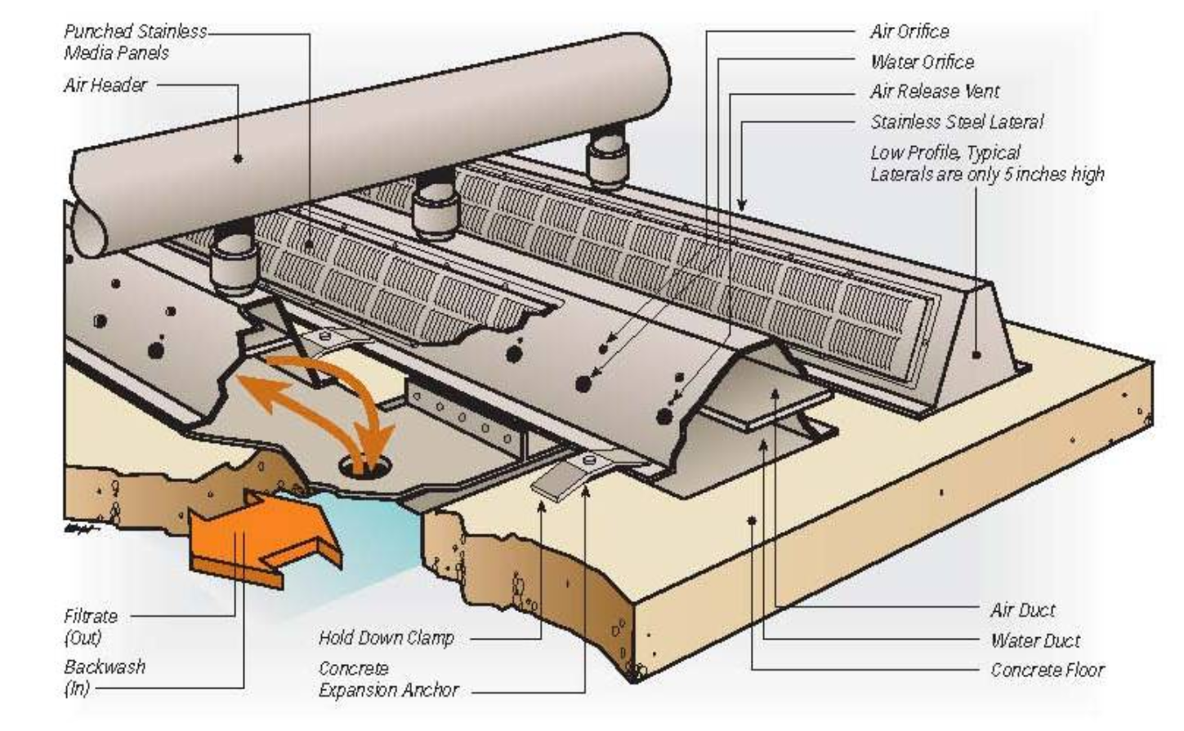
Conventional and direct filtration
Ovivo Flexscour® Folded Plate Underdrains

Slide 38
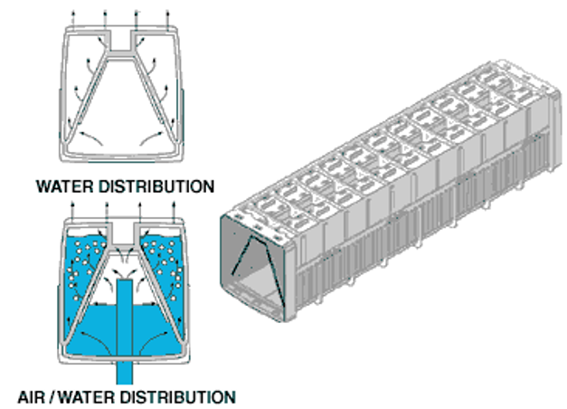
Conventional and direct filtration
Xylem Leopold® “Block” Underdrains

Slide 39
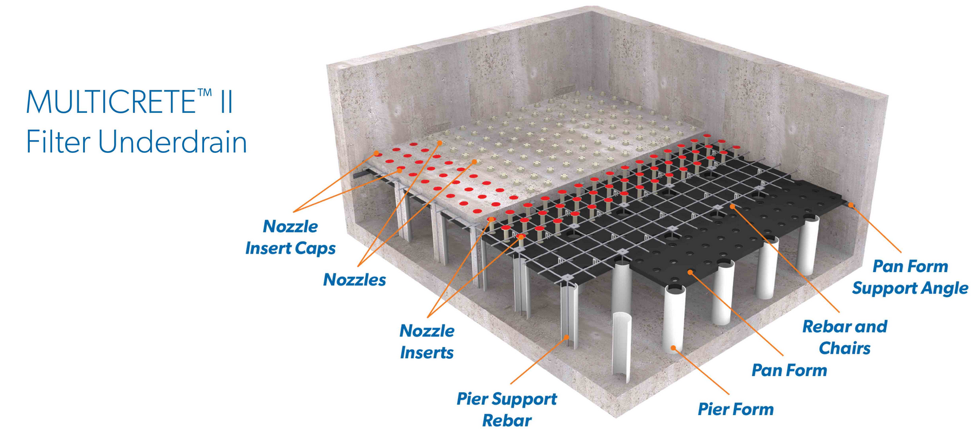
Conventional and direct filtration
WesTech® MulticreteTM II Filter Underdrain

Slide 40
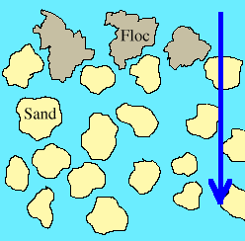
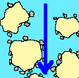
Conventional and direct filtration
Involves adsorption and physical straining of flocculated particles.
Straining:
Passing the water through a filter in which the pores are smaller than the particles to be removed
Adsorption:
The gathering of gas, liquid, or dissolved solids onto the surface of another material

Slide 41
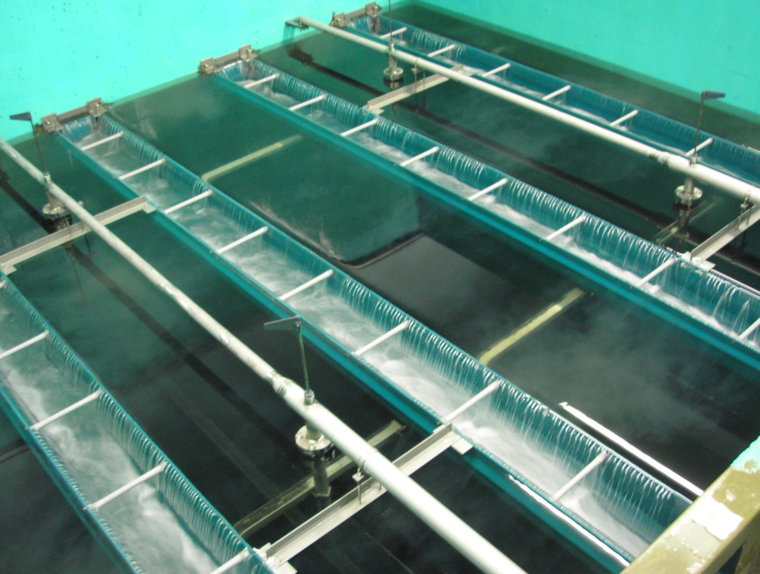
Filtration Optimization Objectives
Achieve filtration performance goals.
Minimize turbidity spikes during routine filter operation.
Minimize turbidity spikes following filter backwash.

Slide 42
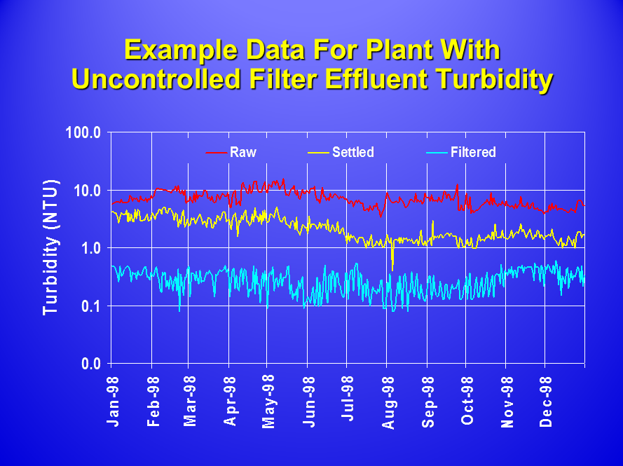

Slide 43
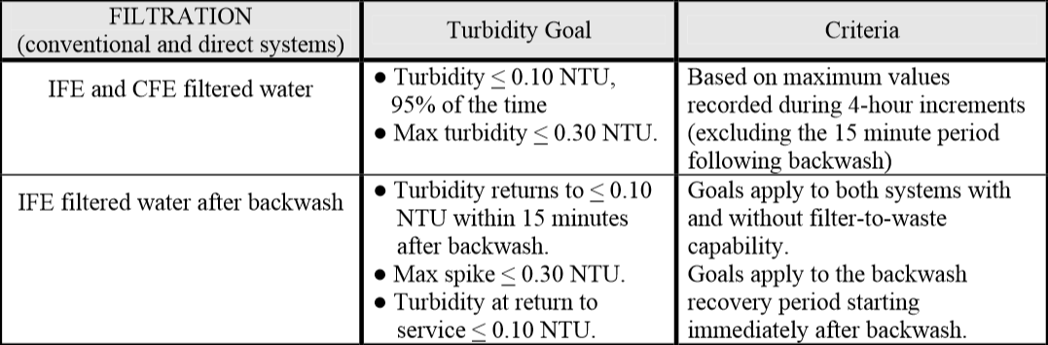
Optimization Goals for Filter Effluent Turbidity
Practice should embrace the multiple barrier approach.

Slide 44
Filtration Optimization
Lowering Filter Effluent Turbidity
Possible Special Studies:
  Coagulation control (use your calibrated jar test procedure!)
  High settled water turbidity (solids loading)
  Initiation of backwash (before breakthrough)
  Media depth and type of media
  Impact of manganese removal on filter performance (oxidation of manganese with chlorine or permanganate can result in small MnO₂ particles that are difficult to settle and filter out).
Notes:
Oxidation of manganese with chlorine or permanganate can result in small MnO2 particles that are difficult to remove through sedimentation and filtration.

Slide 45
Example Data Showing Turbidity Spike Control Problem

Slide 46
Filtration Optimization
Spike Control During Routine Operation
Possible Special Studies:
  Raw and settled water quality variations
  (storm events)
  Hydraulic surges due to flow rate changes
  Start-up/stop operation (small plants)
  Filter backwash effects on loaded filters
  Turbidimeter data integrity (e.g., sample line, sample flow rate). Long sample lines increase signal delay and can allow particles to settle out causing periodic spikes.
Notes:
A short filter-to-waste period could be studied to reduce spikes that occur during morning plant start-ups (small plants).
Long sample lines on turbidimeters can sometimes cause “false” turbidity spikes, the wrong location of the sample tap in a pipe can cause air bubbles in the sample line.

Slide 47
Filtration Optimization
Spike Control During Routine Operation (cont.)
Possible Special Studies (cont.):
  Unequal flow splitting between unit processes
  Return of plant recycle flow
  Malfunctioning filter rate control valves
  Others?

Slide 48
Example Data For Post Backwash Turbidity Spike Control Problem
Performance Goal
Filter-to-waste

Slide 49
Filtration Optimization
Spike Control Following Backwash
Possible Special Studies:
  Inadequate chemical conditioning of water
  Backwash procedures:
    Lack of or inadequate surface wash or air scour
    Backwash flow rate (media expansion)
    Backwash duration
    (too short → dirty filters; too long → too clean)
    Rapid start-up/shut-down of backwash flow (gradual ramping allows for media to gradually expand and re-stratify)
    Applying an extended sub-fluidization (not enough to fluidize media) step at end of backwash (~1 bed volume)
    Length and rate of filter-to-waste
    Lack of or length of filter resting period
Notes:
Gradually ramping of the backwash flow rate up and down has been demonstrated to reduce spikes by allowing time for the media to gradually expand and for the media to re-stratify following backwash.
Extended terminal subfluidization wash (ETSW) has been successfully implemented by plants to reduce their backwash recovery spike i.e.,. the last backwash step is an extended subfluidization wash to remove ~ 1 bed volume.

Slide 50
Filtration Optimization
Spike Control Following Backwash (cont.)
Possible Special Studies (cont.):
  Use of filter aid
  Addition of coagulant or polymer to
  backwash supply water at the end of the backwash cycle to “condition” the water remaining in the filter.
  Loss of filter integrity:
    Loss of media
    Damaged underdrains
    Mud balls in media
    Cracks or sidewall channels in media
  Others?
Notes:
A coagulant or polymer can be added to the backwash supply water at the end of the backwash cycle to “condition” the water remaining in the filter.

Slide 51
Class Outline
9 AM Introduction/Overview
  10:15 AM – 15 minute break
10:30 AM Coagulation/Flocculation
  12 noon – Lunch (on your own)
1 PM Clarification/Sedimentation
2 PM Filtration
  2:15 PM – 15 minute break
2:30 PM Filtration (continued)
3:30 PM General Operations
  4:30 PM - End

Slide 52
Class Outline
9 AM Introduction/Overview
  10:15 AM – 15 minute break
10:30 AM Coagulation/Flocculation
  12 noon – Lunch (on your own)
1 PM Clarification/Sedimentation
2 PM Filtration
  2:15 PM – 15 minute break
2:30 PM Filtration (continued)
3:30 PM General Operations
  4:30 PM - End

Slide 53
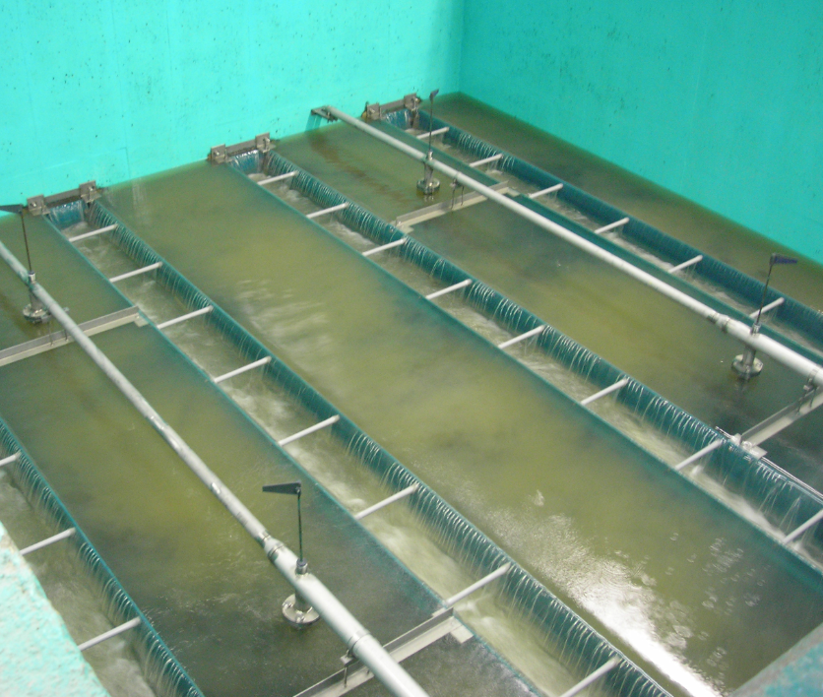
Optimizing Backwash
Backwashing is conducted in order to remove particulates built up in the filter.
Headloss, time, and turbidity can all be indicators of when to backwash.
Fort Richardson, AK

Slide 54
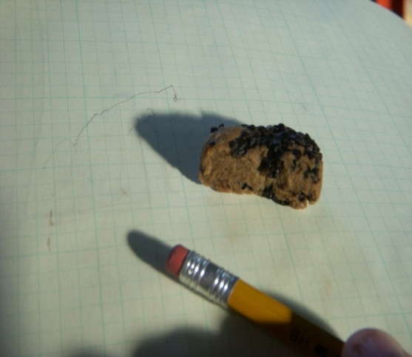
Optimizing Backwash
If backwashing is ineffective, mud balls can develop in the filter, which results in plugged portions of the filter and high localized loading rates (due to the plugged portions).

Slide 55
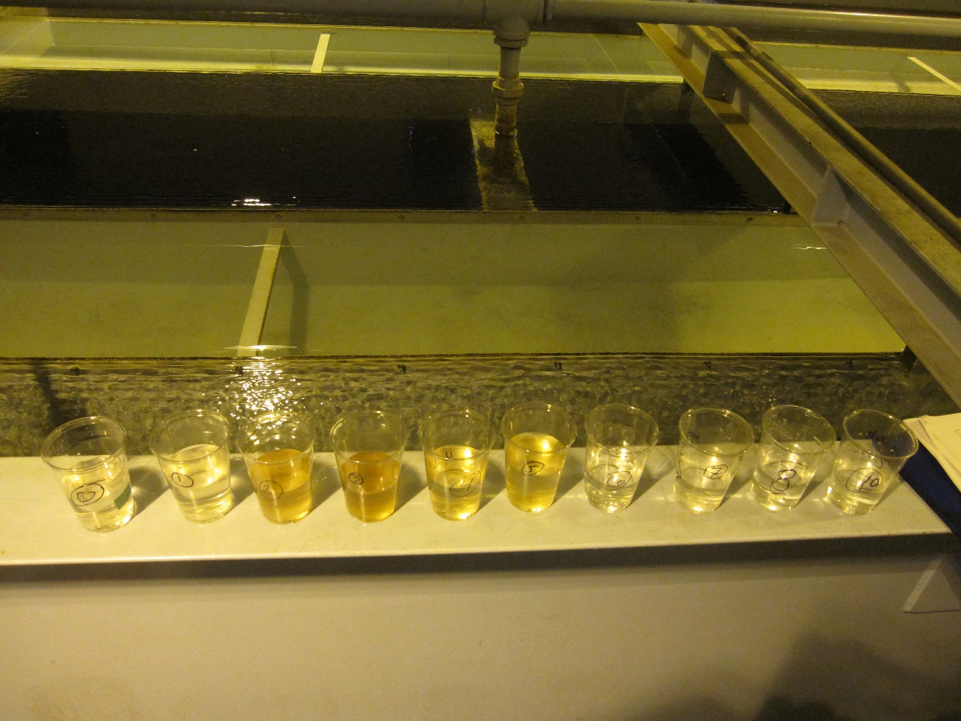
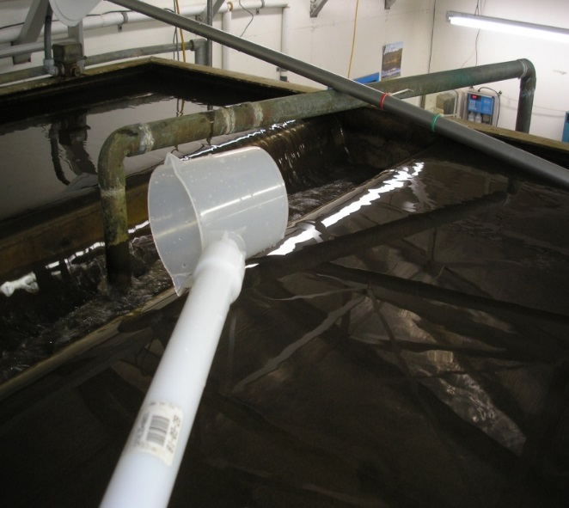
Optimization Studies - Backwash
Backwash trough turbidity can provide a quick evaluation of how well your backwash process is working and where to optimize the process.

Slide 56
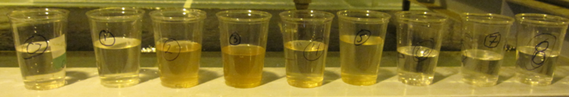
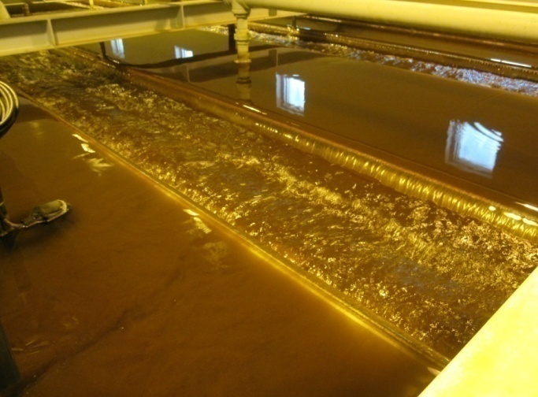
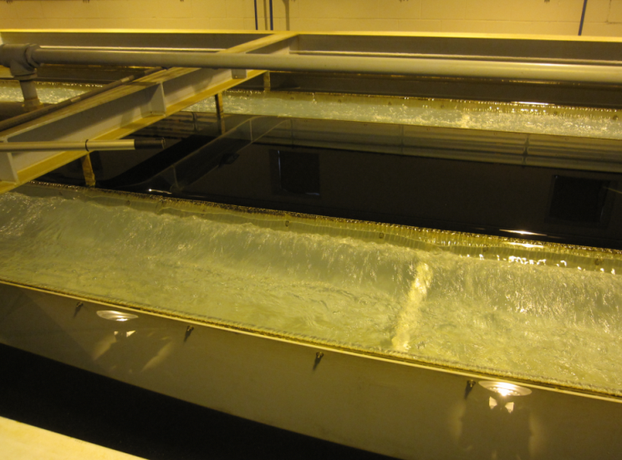
Backwash Trough Turbidity Profile
Measure grab samples for turbidity at 1 minute intervals during high rate backwash.
Record and plot results to see how fast the filter cleans up.

Slide 57

Backwash Trough Turbidity
Develop a graph of your results to help in your evaluation.
Backwashing to where the trough turbidity is below 10 NTU has little benefit and wastes water. 10-15 NTU at the end of the backwash is a reasonable target.

Slide 58
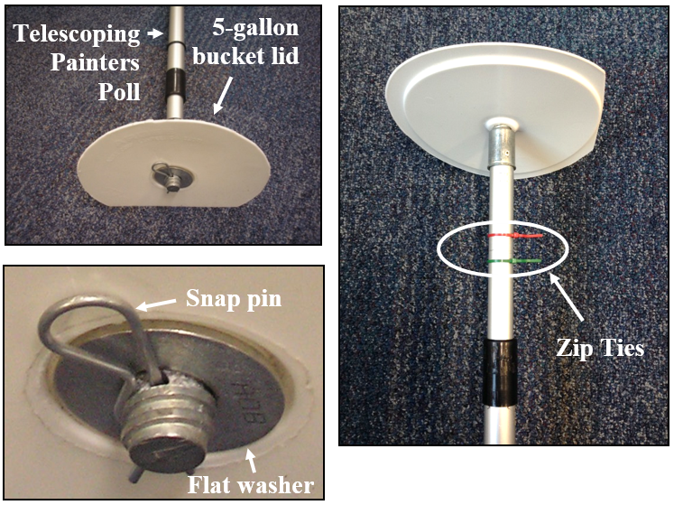
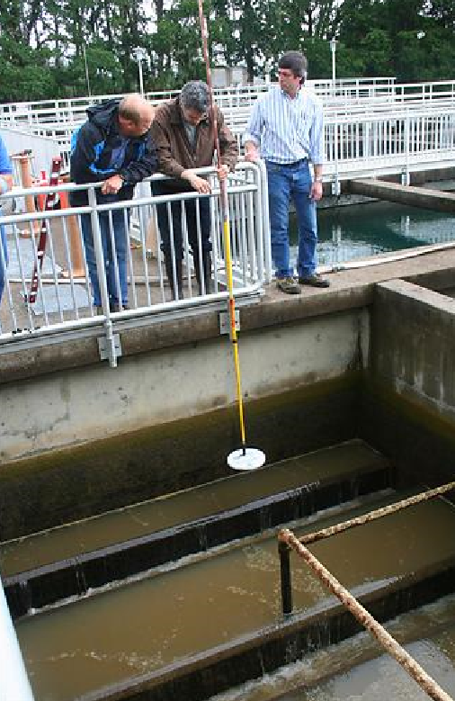
Measuring Bed Expansion During Backwash
Measured bed expansion should be about 20% and such that media is not lost out the backwash trough.
Measurements are easy using a tool you can make yourself.

Slide 59
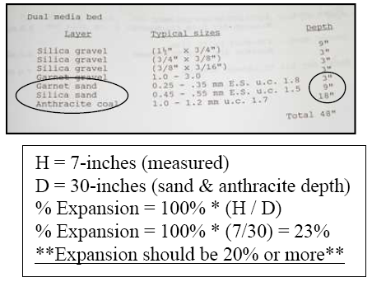
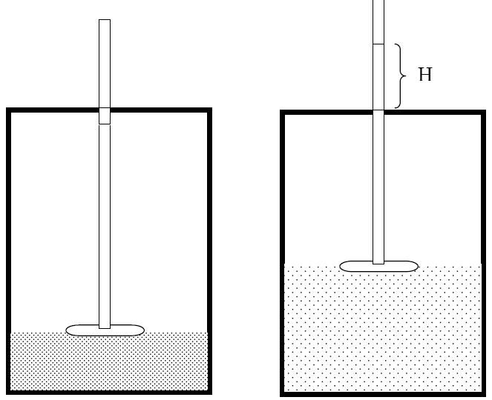
Bed Expansion
Measure the distance of expansion and divide by the depth of expandable media
}D
The calculation is simple.

Slide 60

Bed Expansion
With the filter at rest, measure media depth to a fixed reference (filter side wall)
Move the top zip tie level with the fixed reference

Slide 61


Bed Expansion
During backwash, move bed expansion tool upwards until expanded media is just able to float over the white disk
Move the bottom zip tie level with the fixed reference
Measure the distance between the zip ties (the expansion) and divide by the depth of expandable media

Slide 62

Graph of Bed Expansion Results
Bed expansion was 8-14%

Slide 63

Other Observations During Backwash
Check operation and condition of surface wash.
  Surface wash arm should rotate during the first phase of the backwash, but not continue throughout the backwash.
  This system had a surface wash that continued through to the end of the backwash, causing mounding in the filter bed.

Slide 64

Other Observations During Backwash
Mounding of media after a backwash due to continuous surface wash.
Scour line on filter wall
Mounded Anthracite

Slide 65
Other Observations During Backwash
Mounding of media after a backwash due to continuous surface wash.

Slide 66
Other Observations During Backwash
Check operation and condition of surface wash.
  Surface wash arm should be around 2” above the top of the media
  Corrosion may develop at junctions of dissimilar metals – use dielectric coupling
  Nozzles may be plugged or gasket may be leaking at arm junction causing weak jet as evidenced by slow or lack of arm rotation

Slide 67


Other Observations During Backwash
Look for evidence of air binding that may be due to high dissolved oxygen in colder waters being released inside a warmer plant or air binding as a result of vacuum conditions created in a clogged filter.
Air binding in a contact adsorption clarifier in California

Slide 68
Filter-to-waste Turbidity
Measure filter-to-waste turbidity and plot data
Goal is to minimize post backwash spikes and return filter to service at < 0.10 NTU.

Slide 69



Verify Plant Flows
Verify Plant Flows – 195 gpm or 4,700 gpm???
  Math error in converting to gpm: 195 gpm => 4,700 gpm
  Wrong calibration factor (K): 4,700 gpm => 243 gpm
  Wrong insertion depth (D): 243 gpm => 217 gpm
1 ≠ K = 19.545
6.5 ≠ D = 8.408”

Slide 70
Challenges to optimization
Challenges to optimizing treatment plants include:
  Management and staff buy-in on optimization goals
  Optimization limitations consist of multiple “small” issues
  Duration is multi-year
  (requires patience and tenacity)
  Lack of optimization “tools”
Notes:
Management and staff buy-in provides the support to work toward the optimization goals.
Contrary to the idea that something “big” is stopping a plant from meeting optimization goals (like inadequate sed basins), the more common case is many small issues that must be identified and addressed.
Similar to the operator needing tools to fix an equipment problem, different kinds of “tools” are needed to achieve optimization. These tools come in the form of computer spreadsheets, special study plans, and priority setting models.

Slide 71
Process control is in your control
Process control is any activity required to develop a capable plant and take it to the desired level of performance.
By applying what you learn at your plant, you can demonstrate that it is capable of meeting optimized performance goals.
Meeting optimization goals improves public health protection and can often result in cost savings.

Slide 72
Process control is key to a capable plant
Optimized Performance Goals
Operation (Process Control)
Capable Plant
Administrative
Design
Maintenance

Slide 73
Priority-Setting
Relate activities you do to achieving goals:
  Always start by initiating operations-based activities (within operators’ control!).
  Address administration, design, or maintenance limitations to support capable plant, as needed.
Reassess efforts routinely.
Notes:
As plant operators work on achieving optimization goals for their plant, they will likely identify limitations that slow down their progress. Each of these limitations must be prioritized (Is this an obstacle that cannot be overcome through operational changes? If so, they must be addressed).
Examples of limitations might include limited time to work on optimization (admin), lack of chemical feed capability (design), and malfunctioning filter control valves (maintenance).

Slide 74

Operational guidelines are an important tool
Formalize and provide consistency for plant activities.
Developed by the plant staff (skill development).
Used as communications/ training tool (field test on other plant personnel).
Encourage continuous modification and improvement.
Development of a sampling guideline is suggested as homework from this training.
Notes:
Experience has shown that operational guidelines developed by operators are used. O&M manuals developed by others are not used.
Once a guideline is developed, it should be updated on a routine basis (at least once per year).
Some guidelines will be developed during PBT. Specific ones include the plant sampling guideline (assignment from Session 1), a chemical feed pump calibration guideline, and a calibrated jar test guideline.

Slide 75
Sampling Guideline
Describes how to do a specific operator activity.
  Also describes the what, who, where, and when details.
Don’t make developing guidelines “hard.”
Example Table from a Plant Sampling Guideline
Notes:
Operational guidelines are also referred to as operating procedures (SOPs). The term guideline is preferred because it indicates more flexibility.
This example shows a table taken from a guideline on plant sampling. This is similar to the guideline that you developed as part of your last homework assignment.
Operators sometimes make the process of writing an operational guideline too hard. Start with a simple outline and add more information based on walking through the plant and talking with operators. Keep the guidelines short otherwise they won’t be used!

Slide 76

Special Studies
Tool for conducting plant “research”
Powerful tool for teaching problem- solving skills
Structured approach for assessing and documenting optimization efforts

Slide 77
Special Study Format
“The Scientific Method”
Hypothesis
Approach and resources
Duration of study
Expected results
Summary and conclusions
Implementation
Notes:
Some of you may be familiar with this approach, especially if you worked on science fair projects or have helped your kids with a project.
The scientific method is an organized way of investigating a problem.

Slide 78
Special Study Approach
Identify topic (look at factors that impact ability to meet water quality goals)
Gather information/data.
Don’t make the process intimidating.
Involve plant staff in development.

Slide 79
Special Study Approach (cont.)
Hypothesis:
  Minimize variables to allow determination of a cause/effect relationship.
Approach and resources:
  Develop site-specific aspects of conducting the study.
  Document historical data.
Notes:
Minimize variable – This is often challenging when working with a full scale water treatment plant, but it should always be considered. For example, if you were to investigate the performance of sedimentation basins, you might want to make sure that the sludge removal mechanisms were operating consistently in all basins.
Approach – Work through the details (what, how, who, when) of the study.

Slide 80
Special Study Approach (cont.)
Duration of study:
  Allow time to collect background performance data (before/after process change).
  Establish timeframe that will allow development of reliable results.
Expected results:
  Define expected results and limitations of the study.
Notes:
Collect background data – This step is often overlooked. For example, a filter post backwash spike may be suspected, but limited data exists to fully understand what has happened in the past. The first part of the study should focus on developing performance data under current operating conditions.
Expected results – Describe what you expect to find from your study. This is a good way to see if you’re ready to start the study. For example, an expected result from a study on filter backwashing might be that the bed expansion is at least 20 percent. Did you think of all the details for how to measure bed expansion in your approach?

Slide 81
Special Study Approach (cont.)
Summary and Conclusions:
  Complete after special study activities.
  Summarize data (tables, charts).
  List key findings relative to hypothesis.
  Use as foundation for changing current practices (operations, design, administrative, etc.).
Implementation:
  Completed after conclusions have been developed.
  Basis for full-scale plant operational changes.
  Demonstrates to staff and administration site-specific problem- solving approach (efforts result in verification or change).
Notes:
Feedback from a water plant manager: “If my operators gave me a formal study like this with documented results and recommendations, it would provide a strong basis for making a change to my plant. I could not ignore it”.

Slide 82
Special Study Example – Post Backwash Spikes
Identified Problem:
  After filter-to-waste, turbidity spikes to more than 0.3 NTU and it takes another 15 minutes to drop below 0.1 NTU.
Return to Service Turbidity

Slide 83
Special Study Example – Post backwash spikes
Hypothesis:
  Since filter-to-waste turbidity was always very stable and usually less than 0.1 NTU, the integrity of the turbidity data was suspected.
Approach:
  Investigate source and transmission of filter effluent turbidity data.

Slide 84
Special Study Example – Post Backwash Spikes
Sample tap does not reflect filter-to-waste turbidity during filter-to-waste.
Filter-to-Waste Line
Filter
Filter to Clearwell
Turbidimeter Sample Tap

Slide 85
Special Study Example – Post backwash spikes
Conclusions:
  Optimized filter performance was not demonstrable with current sampling location
Implementation:
  Change sample location and modify data handling to be able to account for filter-to-waste turbidity.

Slide 86
Special Study Example – Coagulation
Identified Problem:
  Performance differences were observed between the north and south filters in a direct filtration plant.
Hypothesis:
  Filter performance discrepancies were caused by different performance from the north and south floc basins.
Approach:
  In the floc basins, monitor variables that could cause performance deviations (e.g., mixing energy, pH).
Conclusions and Implementation:
  pH measurements were different between the two floc basins.
  Develop an alum dose versus pH curve to determine alum dose to north and south basins.

Slide 87

Special Study Example – Coagulation
Based on the differences in pH measured in both basins, the dose would have been:
  4.5 mg/L in the North Basin
  7 mg/L in the South Basin

Slide 88
Special Study Example – Coagulation
Special studies breed new special studies….
Identified problem:
  Coagulation (Alum dosage) was not equal to each floc train
Hypothesis:
  The rapid mix unit was not adequately mixing the alum in the raw water
Approach:
  Inspect the rapid mix unit and assess potential mechanical or plugging problems

Slide 89
Special Study Example – Coagulation
Coagulant Injection Schematic – 45 inch raw water line
Alum Feed to In-Line Diffuser
To North Floc Basin
Mixer
Raw Water
To South Floc Basin

Slide 90
Special Study Example – Coagulation
Coagulant Injection Diffuser
Conclusions and Implementation:
  The design was causing plugging in the rapid mix unit.
  When the diffuser ports were cleaned, the alum feed and pH values in the floc basins were similar.
  Plugging reoccurred in about a week after cleaning.
  Diffuser was modified to feed from the center rather than ports.
  Carrier water for the alum feed was initiated rather than feeding alum in neat form.
Alum Feed to Center
Diffuser Ports
Clean Out Ports

Slide 91

Special Study Example – Coagulation
pH Variations in Floc Basins matched

Slide 92

Special Study Example – Coagulation
Filter performance improved

Slide 93
Exercise –
1 MGD Plant in Berry, Alabama
Develop a special study to evaluate post backwash spikes.

Slide 94
Exercise – Berry, AL
Original backwash sequence:
Air Only (2 minutes)
Air / low-rate backwash at 5 gpm/sq ft (45 seconds)
High-rate backwash at 18.5 gpm/sq ft (160 seconds)
Second low-rate wash to fill filter (165 seconds)

Slide 95

Exercise – Berry, AL
Original backwash profile
Filter-to-Waste (FTW) Spike
0.30 NTU
0.20 NTU
Filter Returned To Service
0.10 NTU
Start of Filter-to-Waste
Total FTW Time of 60 Minutes

Slide 96
Exercise – ETSW at 1 MGD Plant in Berry, Alabama
Post backwash spikes lead operators to want to try an extended terminal subfluidization wash (ETSW)
Develop a special study to evaluate the impact of ETSW.
Notes:
Feedback from a water plant manager: “If my operators gave me a formal study like this with documented results and recommendations, it would provide a strong basis for making a change to my plant. I could not ignore it”.

Slide 97
ETSW Background & Concepts
ETSW is a filter backwash technique that involves extending the normal backwash duration at a subfluidization flow rate for an amount of time sufficient to move one theoretical filter-volume of water through the filter box.
  (reported by Amburgey, 12/03 AWWA Journal)
The intent of ETSW is to remove the backwash remnant particles normally left within and above the media following backwash, preventing their passage into the finished water supply.
Notes:
Another reference on applying ETSW at the Central Lake County Joint Action Water Agency was reported in the May 2007 AWWA Journal

Slide 98
ETSW Mechanisms
Incremental decrease in backwash allows the bed to settle more slowly (dislodges fewer remnant particles).
Media restratification moves more small grains to top of the bed, creating a lower porosity layer.
Most of the dislodged remnant particles are removed from filter box at low flow rate.

Slide 99
Exercise - ETSW
How would you complete the table below?
ETSW Special Study | October 2015
Hypothesis:
Approach and resources:
Duration of study:
Expected results:
Summary and conclusions:
Implementation:

Slide 100
Exercise - ETSW
How would you complete the table below?
ETSW Special Study | October 2015
Hypothesis: | Remnant particles left within and above the media following backwash are reaching their way into the finished water. Implementing ETSW should solve this problem.

Slide 101
Exercise - ETSW
How would you complete the table below?
ETSW Special Study | October 2015
Approach and resources: | Determine if low rate backwash rate of 3 to 6 gpm/ft² can be achieved (be cautious of throttling pumps) Can the flow rate be controlled and measured? If not flow measurement can be a challenge, but it’s not a deal killer. If 1. and 2. are feasible, estimate low-rate wash duration: Determine bed volume to be displaced Based on low-rate wash rate, calculate duration Filter 1 was selected to be the test filter while maintaining Filters 2 and 3 the same (control filters).

Slide 102
ETSW Technique Measurements and Calculations
At what flow rate?
~ 3 to 6 gpm/ft² –
minimal media expansion
Backwash Trough
Volume to Remove Remnant Particles
A
Filter volume above media & below BW trough
B
Filter Media Volume (e.g., GAC)
C
Filter Media Volume (e.g., sand)
Filter Underdrain
How long?
Time to replace ~ 1 bed volume
= A + B + C (assume 100% of volume in A+B+C)
Notes:
For bed volume with media, be conservative and assume 100 % of the volume.
This approach assures that the all of the water in the filter has been displaced during the low wash.

Slide 103
Example ETSW Calculations
Calculate Bed Volume:
  Surface area of filter = 320 ft²
  Media depth = 30 inches (sand & anthracite)
  Water depth between media and top of BW trough = 54 inches
  Total bed depth = 30 + 54 = 84 inches = 7 ft.
  Total bed volume = 320 ft² x 7 ft = 2,240 ft³
  2,240 ft3 x 7.48 gal/ft3 = 16,755 gallons
ETSW wash rate = 5 gpm/ft² x 320 ft² = 1,600 gpm
ETSW time = 16,755 gal. ÷ 1,600 gpm = 10.5 minutes

Slide 104
Exercise - ETSW
How would you complete the table below?
ETSW Special Study | October 2015
Hypothesis:
Approach and resources:
Duration of study: | Try ETSW on three backwashes on filter #2
Expected results: | ETSW will reduce post backwash turbidity spikes
Summary and conclusions:
Implementation:

Slide 105
Exercise - ETSW
How would you complete the table below?
ETSW Special Study | October 2015
Hypothesis:
Approach and resources:
Duration of study:
Expected results:
Summary and conclusions: | ETSW not only reduced post backwash turbidity spikes, it also decreased the amount of water consumed during the backwash process.
Implementation:

Slide 106
Exercise – Berry, AL
Original backwash sequence:
Air Only (2 minutes)
Air / Low Wash at 5 gpm/sq ft (45 seconds)
High wash at 18.5 gpm/sq ft (160 seconds)
Second low wash to fill filter (165 seconds) – extended to 465 seconds
Notes:
Feedback from a water plant manager: “If my operators gave me a formal study like this with documented results and recommendations, it would provide a strong basis for making a change to my plant. I could not ignore it”.

Slide 107

Exercise – Berry, AL – results with second low wash extended to 465 s
Flow to clear well
Turbidity
No Rewash Spike
Filter Returned To Service
Start of Rewash
Total Rewash Time of 20 60 Minutes

Slide 108
Example – Berry, AL
Before ETSW
Backwash:
  10,800 Gallons Used
  9 Minutes
Rewash:
  22,680 Gallons Used
  60 Minutes
Turbidity Spike:
  0.25 NTU
Total:
  33,500 Gallons Used
  75 Minutes
After ETSW for 465 seconds
Backwash:
  15,750 Gallons Used
  18 Minutes
Rewash:
  11,340 Gallons Used
  30 Minutes
Turbidity Spike:
  Spike was reduced to a few minutes, all during rewash. No post rewash spike.
Total:
  27,000 Gallons Used
  60 Minutes

Slide 109
Exercise – Berry, AL
Modified original backwash sequence:
Air Only (2 minutes)
Air / Low Wash at 5 gpm/sq ft (45 seconds)
High wash at 18.5 gpm/sq ft (160 seconds)
Second low wash to fill filter (165 seconds) – extended to 465 seconds
Notes:
Feedback from a water plant manager: “If my operators gave me a formal study like this with documented results and recommendations, it would provide a strong basis for making a change to my plant. I could not ignore it”.

Slide 110
Example – Berry, AL
Berry WTP is saving approximately 15,000 gallons per backwash.
Filters returned to service in less than 15 minutes.

Slide 111
Example – Berry, AL
Feedback from a water plant manager:
  “If my operators gave me a formal study like this with documented results and recommendations, it would provide a strong basis for making a change to my plant. I could not ignore it”.

Slide 112
ETSW Benefits
Lowers filter-to-waste time (rewash).
Reduces or eliminates rewash spike.
Filters return to service quicker.
Less water wasted.
No degradation of filter performance.

Slide 113
ETSW Benefits
Successful ETSW results assume that previous backwash steps result in adequately cleaned media.
Refinements to existing backwash procedure may be part of ETSW evaluation (e.g., changes to initial low wash and high wash duration).

Slide 114
ETSW Benefits
ETSW can be fairly simple to implement, but filter backwash controllability needs to be assessed first.
Potential ETSW benefits include improved filter performance, shorter filter-to-waste time, and water savings.
ETWS will be one special study conducted during the Day 2 plant training.

Slide 115
Impacts of Special Study Approach
Provides data-based reasons for change.
Powerful site-specific training tool:
  Teaches problem-solving skills
  Addresses limitations
Convincing to management and outside technical resources.
Basis for future special studies (i.e., special studies “breed” more special studies).
Notes:
Many times the outcomes of special studies are not what you expected. This may lead you in a different direction to solve the problem. That is why we say that “special studies “breed” more special studies.

Slide 116
Optimization Summary
Develop onsite priority-setting capability:
  Set priorities based on impact to water quality.
  Routinely assess optimization status through formal communication and training.
Develop onsite problem-solving capability:
  Develop and utilize operational guidelines.
  Develop and utilize special studies.
Key to success:
  systematic and ongoing pursuit of optimization goals.

Slide 117
Homework!
Study 1 – Chemical feed pump evaluation
Study 2 – Filter bed expansion and backwash duration
Study 3 – Post backwash performance assessment
Study 4 – Performance of adjacent filters during backwash and turbidimeter signal verification
Study 5 – Comparison of sedimentation basin performance
Study 6 – Turbidimeter calibration check

Slide 118

Don’t ignore tanks/reservoirs/clearwells!
City of Sheridan, 2008

Slide 119


Ensure vents have adequate screens
Clatskanie, 2014

Slide 120


Screened Vents
Clatskanie, 2014
Sheridan, 2011

Slide 121

Screened Vent - #24 mesh (stainless)
Slide courtesy of Bob Clement – USEPA Region 8

Slide 122

Inadequate Screened Vent

Slide 123

Vent allows aspiration…
Tanks can aspirate contaminants through vent if too close to a surface
Slide courtesy of Bob Clement – USEPA Region 8

Slide 124

Allow adequate offset of vent…
Hopefully this vent isn’t close enough to aspirate debris from this pile of dead flies…

Slide 125


Protected Overflow
“Duck Bill”
Sheridan, 2011
Flap valve
Warrenton, 2014

Slide 126

Unprotected overflow clogged with dead mice…
Slide courtesy of Bob Clement – USEPA Region 8

Slide 127

Protected Overflow
A #24 mesh screen provides an additional layer of protection
Slide courtesy of Bob Clement – USEPA Region 8

Slide 128


Physical separation from ground surface prevents animals from gaining access and contaminants from being aspirated…
Slide courtesy of Bob Clement – USEPA Region 8

Slide 129

Separate drain from overflow piping
Slide courtesy of Bob Clement – USEPA Region 8

Slide 130



Separate drain from overflow piping
Slide courtesy of Bob Clement – USEPA Region 8

Slide 131
Recommendations for Tanks/Reservoirs/Clearwells
For vents:
#24 SS screen
Additional vacuum/pressure release valve on steel tanks
Vents discharge 24” above nearest grade
For overflows:
#24 SS screen between pipe and removable flange on all overflows and protected by flap valve, or duck bill
Overflows separate from drains
Overflow drains to daylight 12-24” above grade into a splash block, riprap, or other energy dissipating structure to minimize erosion without the possibility to be submerged or obstructed.
No direct discharge to sewers
36” vertical separation from storm drains
Diameter of overflow be no less than inlet diameter
Overflow is readily visible from the tank or a road and
  within 5-ft of the ground surface.

Slide 132


Watertight Hatch
(keep gutter drains clear of debris)

Slide 133

What happens when gutter drains clog?

Slide 134

Hatch should be rodent proof
(keep gutter drains screened)

Slide 135


Hatch should be locked… unlike these!
Rock lock =>
<= Tire lock

Slide 136

Curbing, lock, and “shoebox” style overlapping lid work best and are required for new tanks

Slide 137

Don’t forget about security
How many think this tank was secure?

Slide 138



Don’t forget about security
How many think this tank was secure?
Animal trail found under the fence

Slide 139

Don’t forget about safety
Great for safety – not sure how secure though??

Slide 140

For more information…
Guidance Manual for Coagulant Changeover (AWWARF, 2003)

Slide 141

For more information…
Filter Evaluation Procedures for Granular Media (AWWA 2003)

Slide 142

For more information…
Filter Troubleshooting and Design Handbook (AWWA 2005)

Slide 143

For more information…
M37 Operational Control of Coagulation and Filtration Prcoesses (AWWA, 2011)
Chapter 1: Particle and NOM Removal
Chapter 2: Jar Testing
Chapter 3: Online Sensors
Chapter 4: Flocculation and Clarification
Chapter 5: Filtration
Chapter 6: Pilot Testing and Pilot Filters
Chapter 7: Case Studies

Slide 144
Conclusion
Keep Corrosion in check and implement routine flushing/valve exercising
Practice should embrace the multiple barrier approach
Develop Drinking Water Protection Plan to protect source water
settled water turbidity < 1 NTU when raw water is < 10 NTU
Free Chlorine > 0.20 mg/l
Meet CT every day
Individual Filter Effluent turbidity < 0.10 NTU
Maintain 0.2 mg/l residual
Keep TTHM and HAA5 < ½ the MCL
Optimize coagulation, flocculation, and sedimentation
50% removal of TOC or
TOC < 2 mg/l

Slide 145

Homework Reminder
Create Standard Operating Procedures (SOPs) for…
Determining chemical dosages
Verifying flow rates
Calculating CT
Calibrating turbidimeters
Conducting a backwash
Data collection and analysis
Regulatory reporting
Homework

Slide 146
Thank You!!

