Slide 1
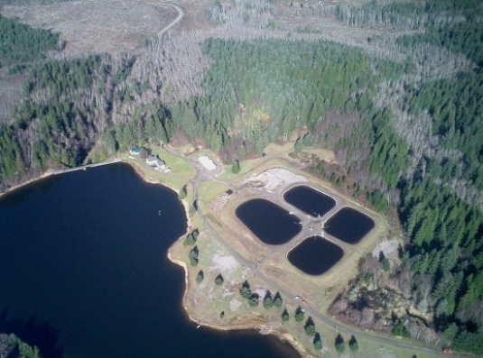
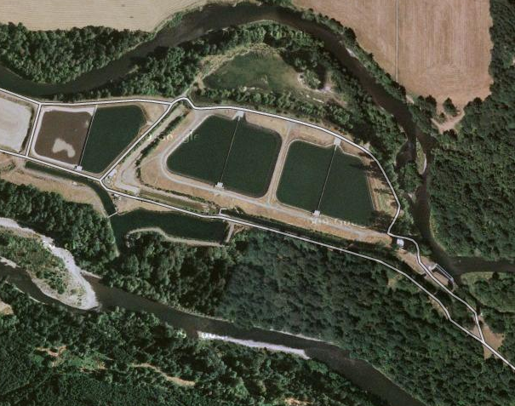
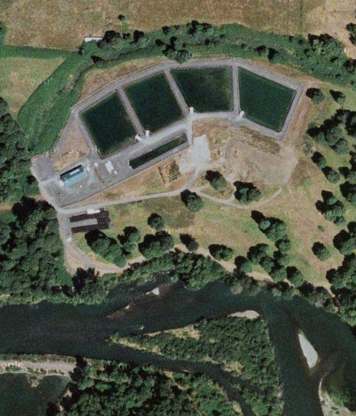
Astoria, OR
5 MGD
Springfield, OR
6.5 MGD
Salem, OR
62 MGD
Design
Notes:
Now we’ll get into some design aspects of slow sand filtration. Aerial photo of Astoria, OR (a 5 MGD) was taken by Frank Wolf in 2010. Other photos are from GoogleMaps downloaded in 2013.

Slide 2
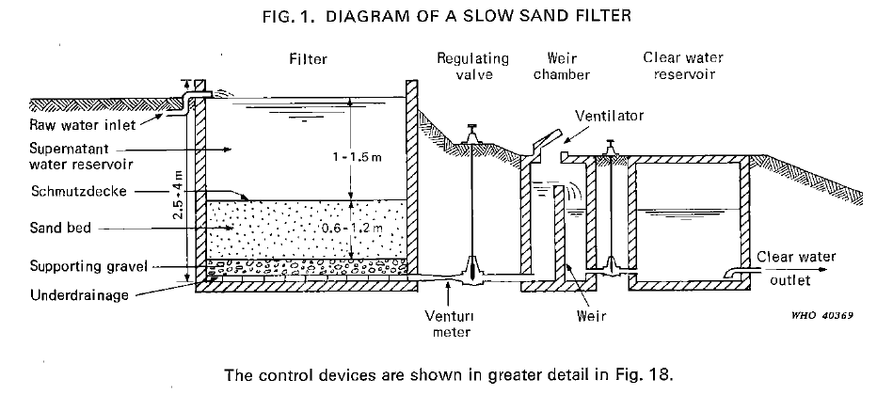
General Schematic (WHO, 1974)
Notes:
This is a schematic from the 1974 World Health Organization (WHO) “Slow Sand Filtration” design manual (Huisman & Wood, 1974. pg 18).

Slide 3
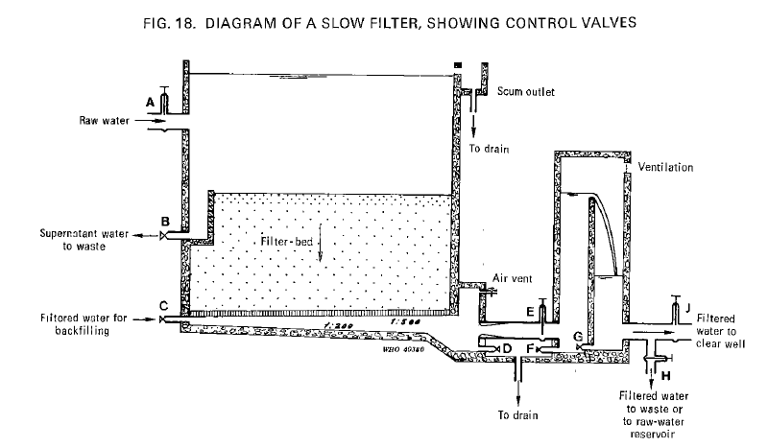
General Schematic (WHO, 1974)
Notes:
This is figure 18 showing more details on the filter controls. Figure 18 is from the 1974 World Health Organization (WHO) “Slow Sand Filtration” design manual (Huisman & Wood, 1974. pg 64).

Slide 4
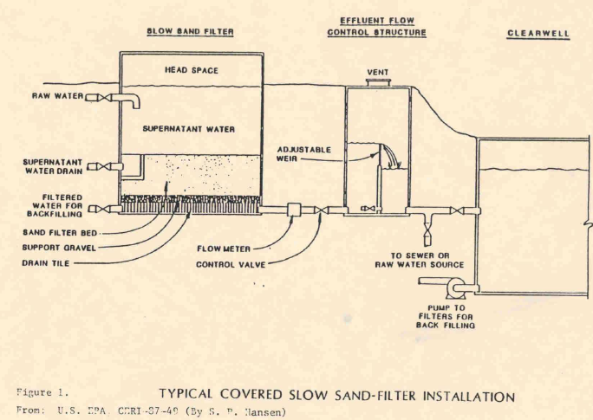
General Schematic (USEPA)
Notes:
This is another schematic from the USEPA.

Slide 5
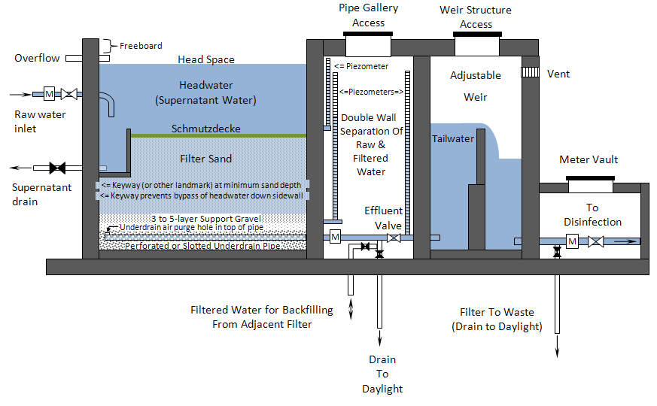
More detailed Schematic
Notes:
A more detailed schematic is shown here, beginning with the raw water inlet into the filter box. The filter box is equipped with a drain and water for backfilling with filtered water. Supernatant (or headwater) filters through the sand bed and support gravel, out of the under drains through a flow meter and control valve and into a flow control structure. The adjustable weir keeps the sand bed from de-watering when the filtration rate declines towards the end of a filter run. The weir is adjustable to facilitate draining the filter bed during cleaning. Filtered water then flows to the clearwell for disinfection. Piezometers are shown where they can be used to measure headloss across the filter bed as well as the tailwater level.

Slide 6
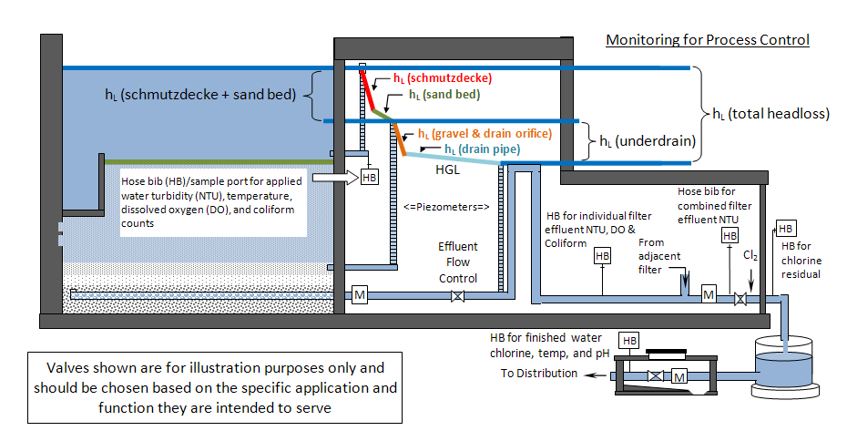
“Gooseneck” Weir
Notes:
This is an example of a “Gooseneck” style weir construction showing process control monitoring points.

Slide 7
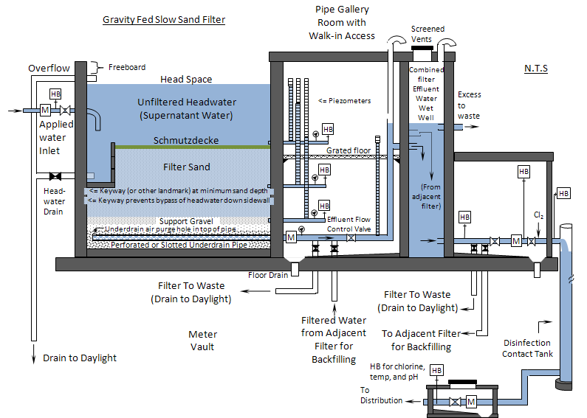
Gravity Fed System
Notes:
Gravity Fed system

Slide 8
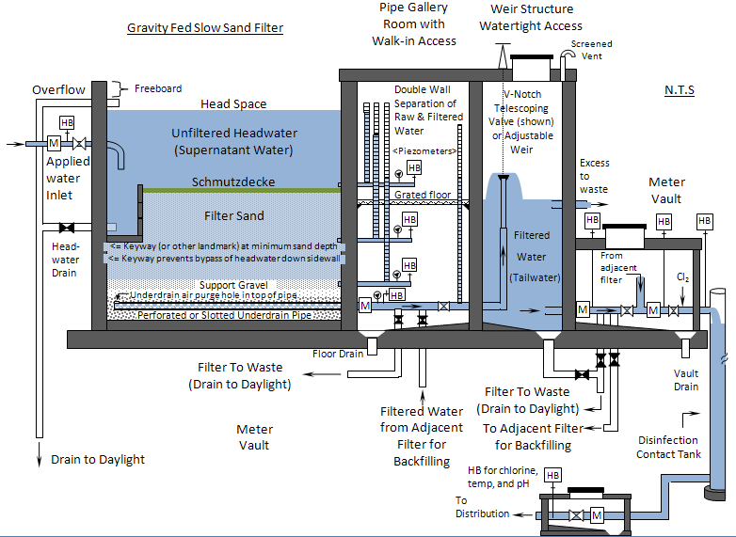
Telescoping Valve
Notes:
Telescoping Valve

Slide 9
Design - SS versus Rapid Rate
Parameter | Slow Sand Filters | Rapid Rate Filters
Influent Flow | Continuous | Intermittent
Filter Box | ☑ - designed to overflow | ☑ - not intended to overflow
Filter Media | - sand - GAC (rare) | - sand - anthracite - GAC (more common)
Underdrain | ☑ | ☑
“Backwash” mechanisms | ☑ - slow filling from bottom of filter – removal of entrained air not media expansion. | ☑ - high rate (and low rate) flow designed to suspend & wash the media
Surface Agitator (breaks up media during backwash) |  | ☑
Notes:
This slide compares slow sand and rapid rate filtration, both utilize similar media (sand), however, there are some important differences. For example, slow sand filters are design to operate continuously, where rapid rate plants are meant for intermittent operation.

Slide 10
Design - SS versus Rapid Rate
Parameter | Slow Sand Filters | Rapid Rate Filters
Filtration Rate | 0.03 – 0.1 gpm/ft² | 2-4 gpm/ft²
Water Above Sand | ~4-6 ft | ~ 5 ft
Sand Bed Depth | ~ 24-48 inches | ~ 24-30 inches
Sand Effective Size (d₁₀) | 0.15 – 0.35 mm | 0.45 – 0.55 mm
Retention Time above Sand | 15 hrs | 9 min
Retention Time in Sand Bed | 3.2 hrs | 2 min
Cycle Length | 1-6 mo | 1-4 days
Removal mechanisms | Chemical, physical, and biological (no chemicals) | Chemical and physical (depends on proper coagulation)
Turbidity Removal | Variable even if optimized < 5 NTU by regulation Not indicative of filter performance or pathogen removal. Sub micron particles are not readily removed. | < 0.1 NTU when optimized Good indicator of filter performance and pathogen removal. Coagulation/flocculation removes even sub-micron particles.
Giardia Removal | >3.0 log | >3.0 log
Raw Water Turbidity | <10 NTU | 100+ NTU
Notes:
Filtration rates for rapid rate filters is roughly 40 times that of slow sand filters and the sand effective size is roughly twice that of slow sand media. Retention time above the slow sand bed is measured in hours rather than minutes and the filter run is weeks long rather than days long for rapid rate plants. The removal mechanism for slow sand filters incorporates a biological process without the addition of any coagulation chemicals. Coagulation is critical for effective rapid rate filtration. Due to the coagulation, rapid rate plants are far less sensitive to elevated raw water turbidity. In spite of all these differences, the removal efficiencies for Giardia are the same at 3.0-log and both are capable of producing finished water with very low turbidity.

Slide 11
Common Design Pitfalls
Common Design Pitfalls
Inappropriate source water quality => inappropriate application Not conducting a pilot study Improperly designed under drains Poorly designed filter piping Inadequate flow control and air binding Insufficient head loss allowed Insufficient sand bed depth Inappropriate filtration rate and variability Poorly specified sand and gravel media (effective size, uniformity, etc.) Poor access to filter bed for cleaning and re-sanding Insufficient sample ports Failure to have the operator involved in design process Failure to provide a good O&M manual with filter cleaning/ripening protocols
Notes:
Even with the best design, there are a number of variables that can have a big impact on performance. Raw water characteristics like turbidity, color, and colloidal content for example. Other critical variables include sand size and uniformity, flow control and management of air binding, headloss development, sand bed depth, filtration rate and flow variability. Allowing sufficient time to mature once a filter has been newly sanded (usually 4 – 6 weeks) and allowing the filter to ripen once cleaned (24 – 48 hours) are very critical to optimal performance.

Slide 12
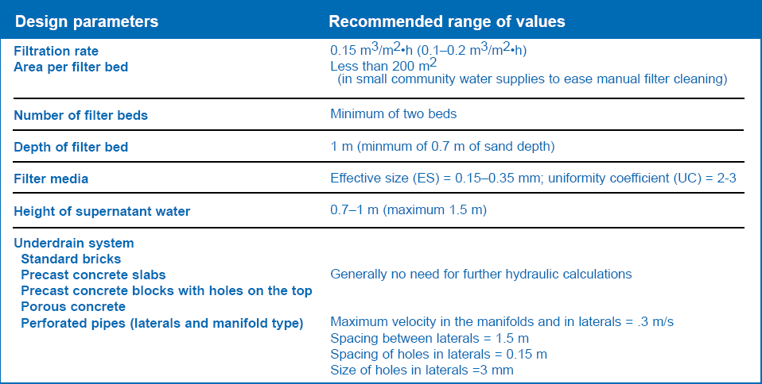
Design Recommendations - Example
Source: Vigneswaran, S. and C. Visvanathan. 1995 http://www.nesc.wvu.edu/ndwc/pdf/OT/TB/TB14_slowsand.pdf
Notes:
There are a number of design references, such as the one shown here.

Slide 13
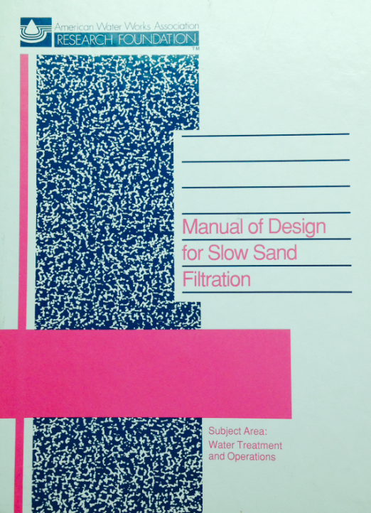
Design Manual - 1991
“Manual of Design for Slow Sand Filtration“ . David Hendricks & American Water Works Association, 1991. ISBN 978-0898675511
Excellent resource that covers design in great detail
Notes:
The “Manual of Design for Slow Sand Filtration” covers design in great detail.

Slide 14
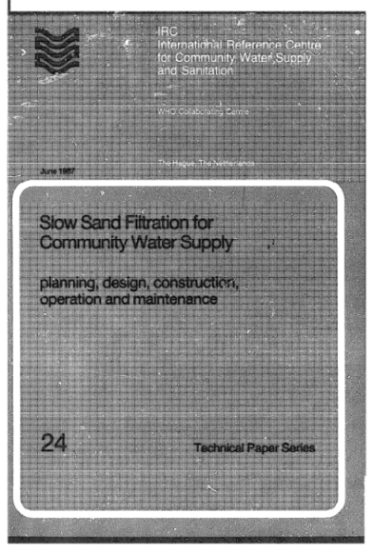

3 Other Design references
The 3 other main design references include:
  Recommended Standards for Water Works (a.k.a., “Ten States Standards”, 2012);
  “Slow Sand Filtration for Community Water Supply”, International Research Center for Community Water Supply and Sanitation (Visscher et al., 1987)
  “Slow Sand Filtration”, World Health Organization (Huisman & Wood), 1974;
http://www.who.int/water_sanitation_health/publications/ssf/en/index.html
http://10statesstandards.com/
http://www.irc.nl/page/4530
Notes:
There are, however, 3 main design references that have either stood the test of time, like the manuals on slow sand filtration produced by the World Health Organization and the International Research Center for Community Water Supply and Sanitation or that are commonly referenced by State regulatory agencies, such as the Ten States Standards.

Slide 15
Design Criteria – 3 other references
The design specifications for these 3 sources are summarized here
Comparison of Design Specifications (Design Period, Operation, and Filtration Rate, # of Units, and Supernatant Depth)
Reference | WHO Manual (Huisman & Wood, 1974) | IRC Manual (Visscher et al., 1987) | Ten States Standards (2012)
Design Period | 7-10 Years | 10-15 years | Not Specified
Mode of Operation | Continuous | 24 hr/day | Not Specified
Filtration Rate (flow rate ÷ filter area) | 0.04 – 0.08 gpm/ft2 (0.1 – 0.2 m/hr) | 0.04 – 0.08 gpm/ft2 (0.1 – 0.2 m/hr) | 0.03 – 0.1 gpm/ft2
Filter Units (a.k.a., cells) | 2 minimum | 2 minimum | 2 minimum
Supernatant Depth | 39 – 59 in, 79 in max (100 – 150 cm, 200 cm max) | 27 – 39 in, 60 in max (70 – 100 cm, 150 cm max) | 36 – 72 in (91 – 183 cm)

Slide 16
Design Criteria – 3 references
Comparison of Design Specifications (Minimum Sand Bed Depth)
Reference | WHO Manual (Huisman & Wood, 1974) | IRC Manual (Visscher et al., 1987) | Ten States Standards (2012)
Minimum Filter Bed Depth* | 28 – 35 in (70 – 90 cm) | 18 – 35 in (45 – 90 cm) | 19 in (48 cm)
*The design should add these minimum sand bed depths to the amount of sand anticipated to be removed during cleanings throughout the design life of the filter (estimates of sand removal can be determined based on cleaning data obtained during pilot testing). Filters designed for harrowing only need to account for minor losses, since sand is not removed due to scraping when using this method of cleaning.

Slide 17
Design Criteria – 3 references
Comparison of Design Specifications (Filter Sand Effective Size and Uniformity Coefficient)
Reference | WHO Manual (Huisman & Wood, 1974) | IRC Manual (Visscher et al., 1987) | Ten States Standards (2012)
Filter Sand Effective Size (d₁₀) | 0.15 – 0.35 mm | 0.15 – 0.30 mm | 0.15 – 0.30 mm
Uniformity Coefficient (U) | 1.5 – 3 | < 3 – 5 | < 2.5
Other specifications include:
Percent of fines passing the #200 sieve < 0.3% by weight
  (can impact post sanding turbidity levels and length of filter to waste time needed to “wash” the fines out)
Acid solubility < 5% (can impact sand grain characteristics, effective size, and uniformity coefficient if acid soluble)
Apparent specific gravity > 2.55

Slide 18
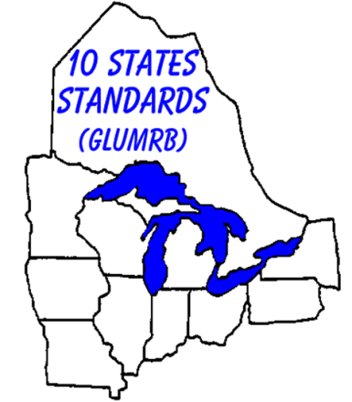
Ten States Standards
Ten States Standards
http://10statesstandards.com/index.html
Member States and Provinces
Illinois | New York
Indiana | Ohio
Iowa | Ontario
Michigan | Pennsylvania
Minnesota | Wisconsin
Missouri
Notes:
Since the Ten States Standards were developed with the participation of many state agencies, are widely recognized, and lay out fairly concise specifications for slow sand filters, I will use this reference to discuss a little about each specification.

Slide 19
Ten States Standards
Application to be based on Studies
4.3.4 Slow Sand Filters
The use of these filters shall require prior engineering studies to demonstrate the adequacy and suitability of this method of filtration for the specific raw water supply.

Slide 20
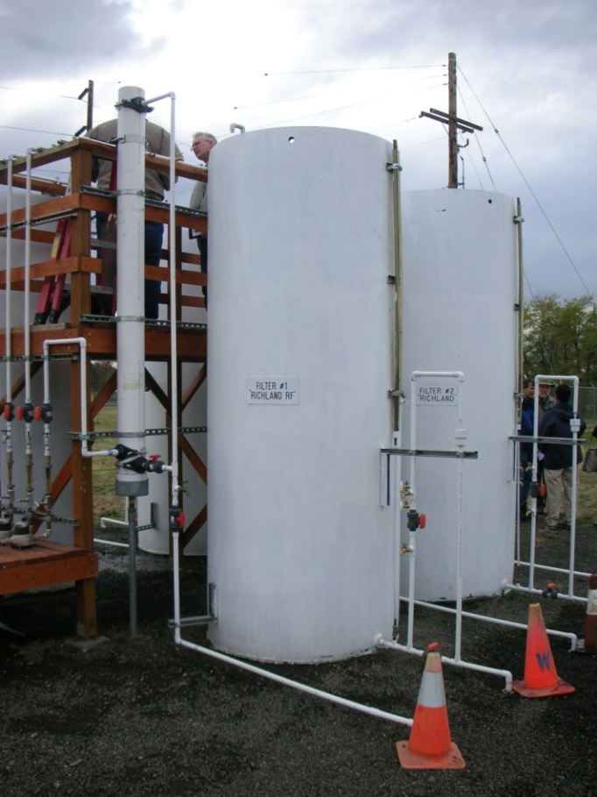
Pilot Testing
Pilot testing
Recommend 1-year pilot study in order to account for seasonal variability of source water variables (required in some cases)
Pilot testing is to determine feasibility (i.e., “will it work when we need it to?”), not just to discover O&M issues.
2010. Walla Walla, WA Pilot filters
Notes:
A pilot study of at least a year should be conducted to determine the suitability of slow sand filtration for the available source water and required system demands. Pilot testing can also uncover unanticipated O&M issues.

Slide 21
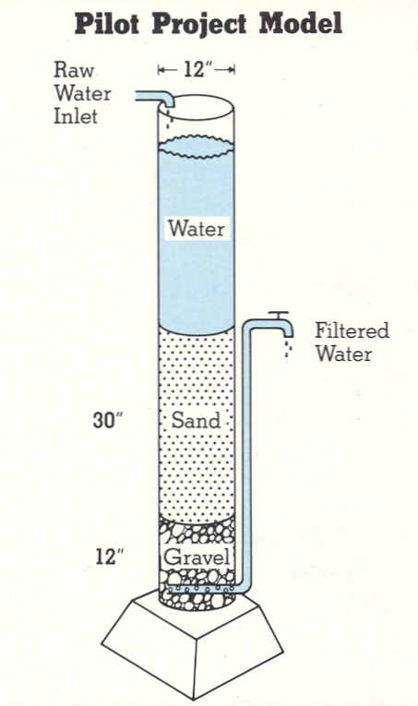
Pilot Testing Benefits
Pilot testing
Pilot testing is relatively easy and can be used anytime to test cleaning procedures, model ripening times, or evaluate new media.
<< It can be done on a
small scale
(1991 - Alsea, OR)
or a very large scale >>
(2010 - Walla Walla, WA)
Notes:
Pilot tests can be small scale like the one on the left with a 12-inch diameter column or large scale like the 4 pilot columns on the right. The one on the left was used to pilot media used in Alsea, Oregon. The pilot study used by Walla Walla Washington in 2010 was used to evaluate media from 3 different sources in 3 of the columns. A 4th column was used to evaluate the effects of a roughing filter.

Slide 22
Info Gained by Pilot Testing
Pilot testing can yield valuable information such as:
The flow to be expected (will the proposed design be enough to meet demands or will more sand bed area be needed?).
Cleaning frequency. As sand is removed during cleaning, the frequency of cleaning can yield information about how many years the sand will last before re-sanding is needed.
O&M requirements that may change seasonally
If algae growth will have an adverse impact
Cold temperature effects (may require longer filter-to-waste times after ripening.
Ripening time (Use plots of turbidity and coliform)
Notes:
Pilot testing yields information on what raw water characteristics may adversely impact performance and operation such as algae, cold temperatures, etc.. Pilot test results can be used to evaluate different sand characteristics and determine how much filter area is needed to meet the anticipated demand. It can also be used to estimate operation and maintenance costs associated with cleaning and re-sanding.

Slide 23
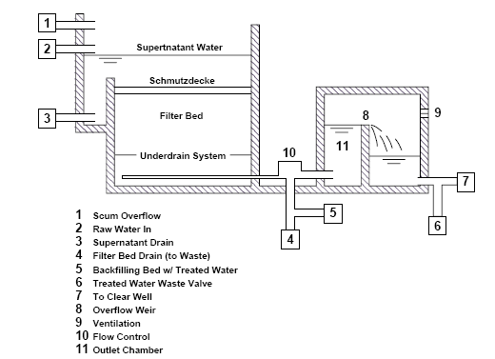
Studies should Replicate Full Scale
Notes:
So what are the features of a full scale plant that should be considered in designing pilot filters? Most properly designed slow sand filters have the same basic design elements, with some variations. There is a raw water inlet (#2 in the diagram) and usually some way to remove surface scum (#1) and drain the headwater for cleaning (#3). In a mature filter, there is the schmutzdecke filter skin, filter bed, and underdrain system with some sort of effluent flow control, which is typically either a valve or moveable weir. The underdrain system also functions to drain the filters for cleaning or resanding. During cleaning, the filter bed should not be completely drained, but rather drained just enough to allow the bed to be walked upon or to allow machinery to safely operate during cleaning. In this example, this level is dictated by the design of the outlet chamber (#11) and overflow weir (#8). In other cases, this level is controlled by valves. The water level is maintained in this example by the overflow weir indicated by #8 in the diagram. Once cleaned, there is often the ability to slowly refill the filter bed with filtered water from another filter as shown by #5. This allows air that gets into the filter bed during cleaning to be purged. This “backfilling” continues until the headwater is roughly 1-ft above the filter bed, which protects the bed from scouring that can occur when top filling with raw water commences. There should be the ability to filter to waste for at least 48 hours until ripened (#4).

Slide 24
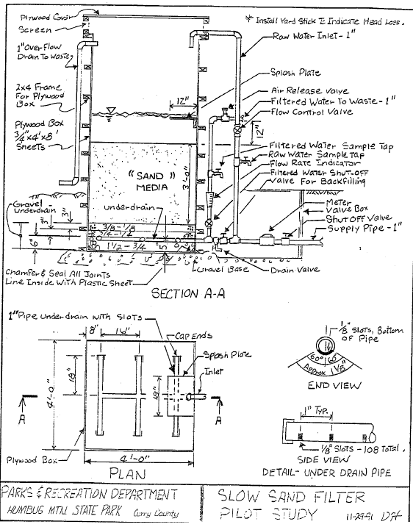
Pilot Filter
Schematic
Intent is to replicate full-scale design.
Pilot testing schematics can be simple, but should clearly show key features that can simplify operation and improve data collection.
Notes:
A schematic is an excellent way to ensure that key features of a full-scale plant are incorporated into a pilot filter. Pilot testing schematics can be simple, but should clearly show key features that can simplify operation and improve data collection. This is a schematic of the pilot filter used at Humbug Mountain State Park in Curry County, Oregon.

Slide 25
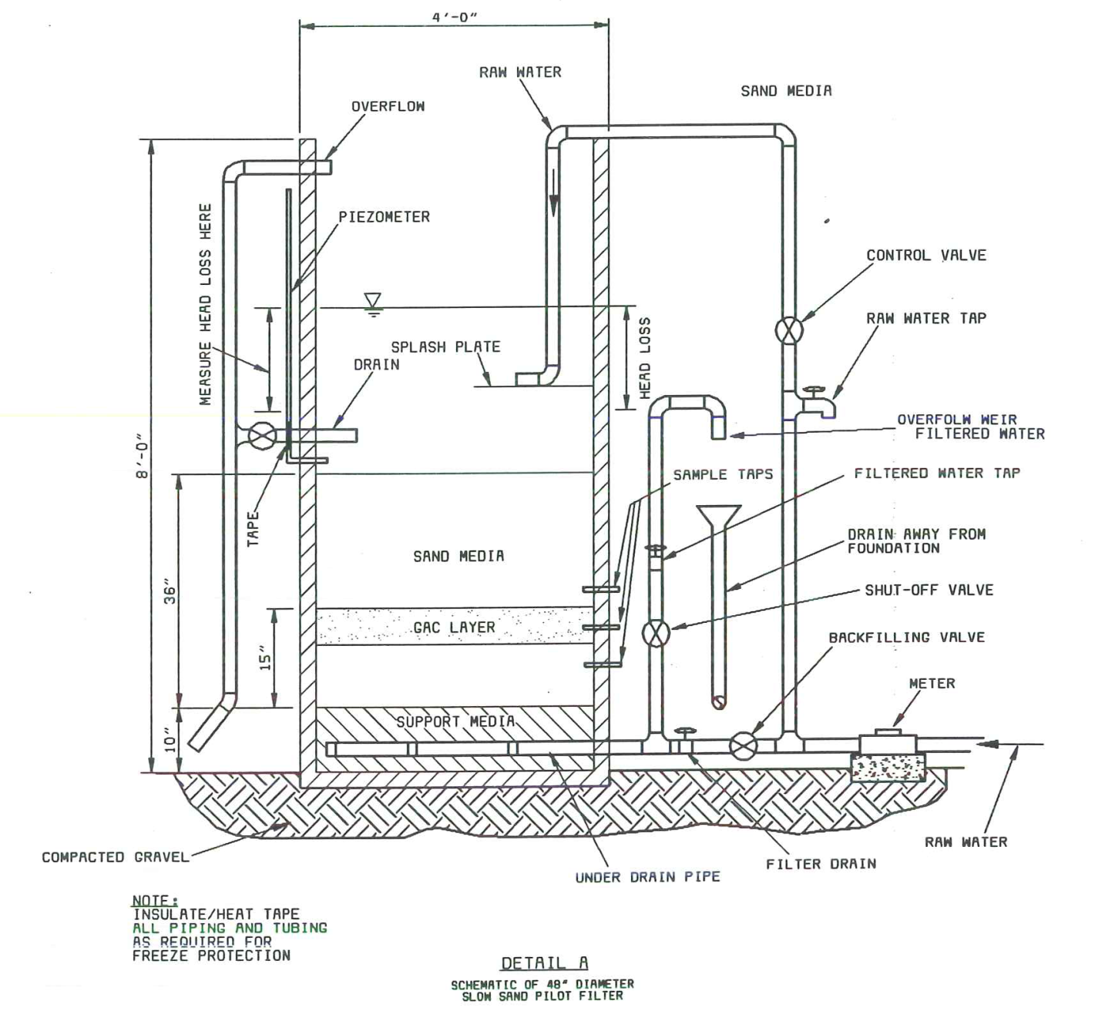
Pilot Filter Schematic - GAC
This design is set
up to evaluate a
layer of granulated
activated carbon
(a.k.a. GAC sandwich)
Notes:
This design incorporates a layer of granular activated carbon for organics removal. This is sometimes called a “GAC sandwich”. These plans are for a pilot filter for the City of Salem.

Slide 26
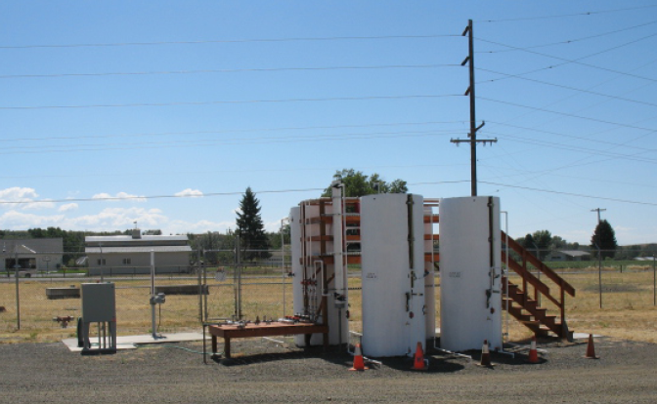
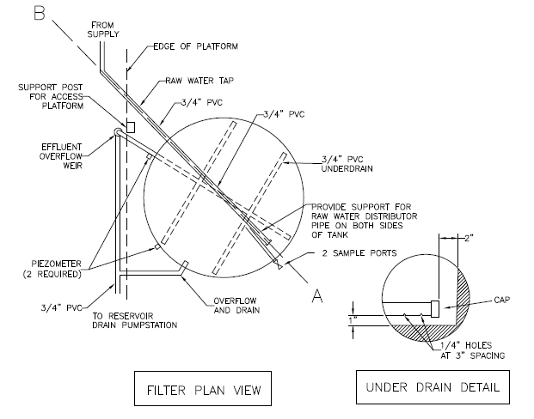
Pilot Filter
Schematic
This is a plan view of a pilot filter (shown above) used by the City of Walla Walla in 2010-2012.
Notes:
This is another schematic of a pilot filter used by the City of Walla Walla in 2010-2012.

Slide 27
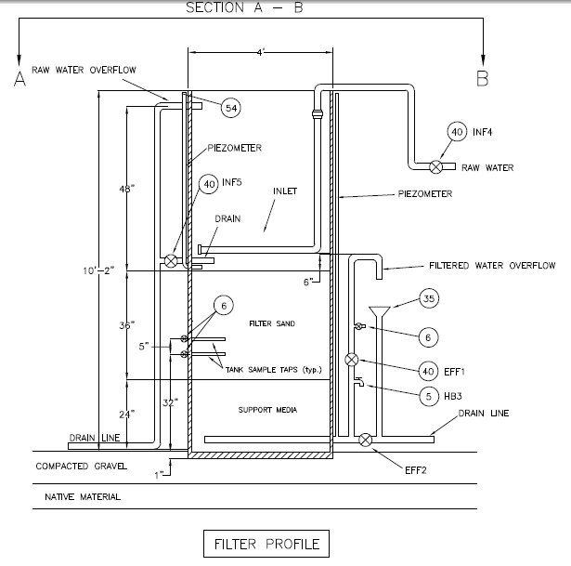
Pilot Filter
Schematic
This is a section view of the filter used by the City of Walla Walla, WA.
Notes:
This is a section view of the filter used by the City of Walla Walla, WA.

Slide 28
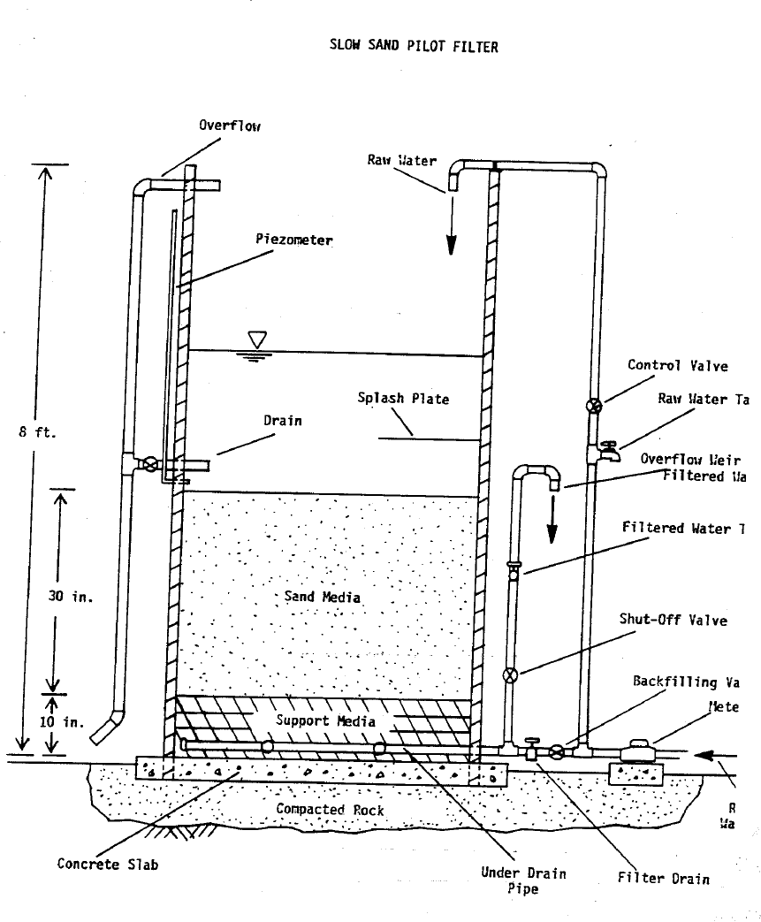
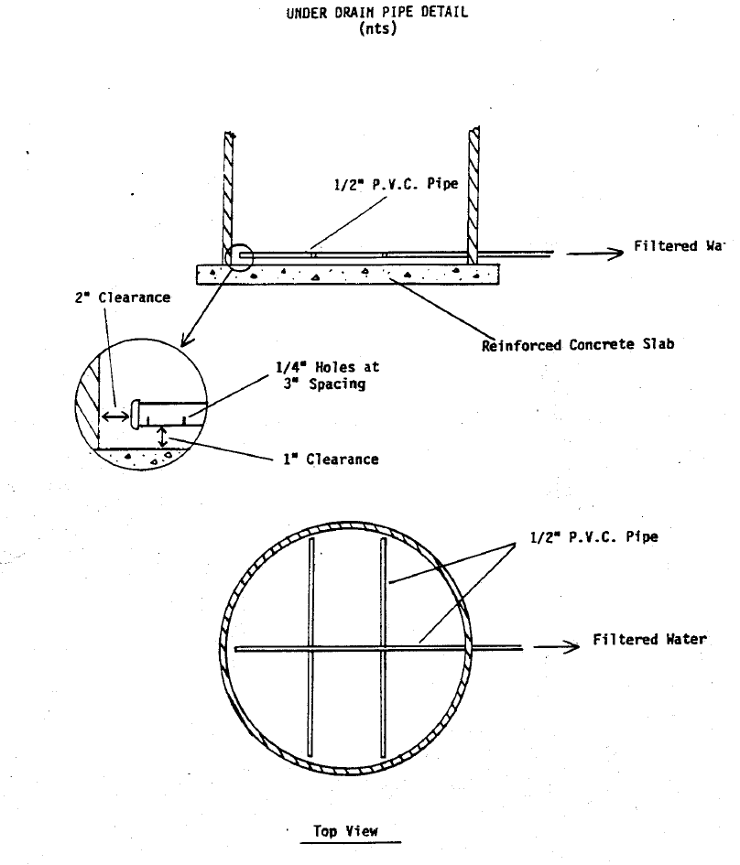
Pilot Filter
Schematic
Notes:
This is another schematic of a pilot filter.

Slide 29
Pilot Filter Column
Pilot Filter Material
  PVC, concrete, fiberglass, etc. (5 gallon buckets have been used). Design some durability into it in order to retain filter for future studies
Pilot Filter Size
  8-12 ft high (replicate full scale filter)
  12 – 36 inch diameter
  Diameter dictated by room needed to fit under drains, sample ports, etc. and accommodate cleaning. A joint constructed just above the sand bed can facilitate cleaning in small diameter filters. A lip below the sand surface can help eliminate side-wall effects (short-circuiting) of smaller diameter filters.
Notes:
Pilot filters can be made out of various materials, but should be made fairly durable so that they can be retained for future studies. Pilot filters should be designed in order to accommodate the entire sand bed, support gravel and under drain system as well as the headwater that would be expected from the full scale installation. Larger diameter filters can help mitigate short-circuiting at the sidewalls, however, a lip built into the filter below the sand bed can help compensate for smaller diameter filters.

Slide 30
Pilot Filter media
Pilot Filter Media
  The media should be the same as that intended to be used in the full scale installation.
  Multiple, identical filters should be used to evaluate various sources or specifications of sand.
  Pilot filter media should be delivered and washed as would be done at full scale in order to help estimate the time needed to wash out fines and for the filter to fully mature.
  The filter bed and support gravel layers should be installed to the same depth anticipated to be used at full scale.
Notes:
Filter media and support gravels should be supplied, washed, and installed in a similar manner to that anticipated with the full scale installation. This helps to determine the filter wash-out and maturation periods that more closely resembles full-scale conditions. The pilot filter should also be covered or left uncovered like the anticipated full-scale design.

Slide 31
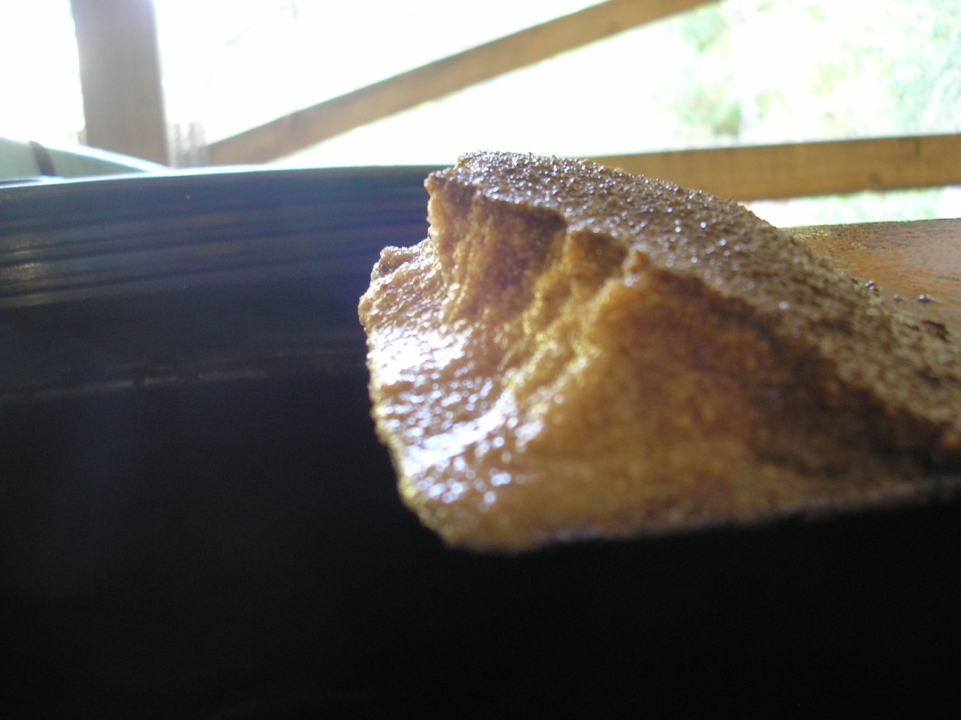
Covered Pilot Filters?
Pilot Filter – to cover or not to cover
  Pilot filters should be covered if the intended full-scale design includes a cover. If not, it may be advantageous to have the ability to cover the pilot filter in order to observe differences in filter performance.
  Note that covered filters may not develop a discernable schmutzdecke, rather they may exhibit a layer of darker sand at the surface when maturing.
Tillikum Retreat Center, OR – Covered “Blue Future” filters
Notes:
The pilot filter should also be covered or left uncovered like the anticipated full-scale design. It may be advantageous to incorporate provisions for covering the pilot filter in order to study differences in filter performance or to evaluate filter covers at a later date. This photograph of excavated media was taken in 2012 at the Camp Tillicum Retreat in Yamhill County, Oregon for a newly installed full-scale filter that was being filtered-to-waste until fully mature.

Slide 32
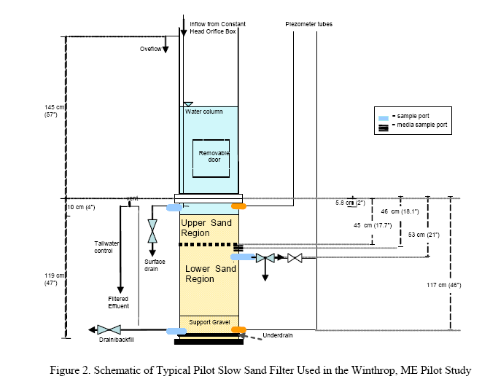
Pilot Filter Sample Ports
Note the sample ports at various locations to evaluate removal mechanisms throughout the filter bed.
Notes:
Here is another example of a pilot filter. Note the sample ports at various column depths. This is not typical, but it demonstrates how a pilot filter can be used to evaluate the removal mechanisms at work throughout the filter bed.

Slide 33
Pilot Test Monitoring – Raw Water
Raw Water
Sample location | Parameter | Sample frequency | Laboratory or field analysis needed
Raw water | Turbidity | Daily | Field
 | Temperature | Daily | Field
 | Apparent color | Weekly | Field
 | pH | Weekly | Field
 | Alkalinity | Weekly | Field
 | Coliform (total and E. coli) | Weekly | Laboratory
 | Dissolved oxygen | Weekly | Field
 | UV 254 absorbance, TOC and/or THM formation potential | Monthly | Field or laboratory analysis
 | Iron and Manganese | Monthly | Laboratory
 | Algae identification and enumeration (toxins if indicated) | Quarterly or with algae blooms | Laboratory or field identification. Laboratory or field test strips for toxins.

Slide 34
Pilot Test Monitoring – Filter Effluent
Filter Effluent
Sample location | Parameter | Sample frequency | Laboratory or field analysis needed
Filter effluent | Turbidity | Daily | Field
 | Temperature | Daily | Field
 | Apparent color | Weekly | Field
 | pH | Weekly | Field
 | Alkalinity | Weekly | Field
 | Coliform (total and E. coli) | Weekly | Laboratory
 | Dissolved oxygen | Weekly | Field
 | UV 254 Absorbance, TOC and/or THM formation potential | Monthly | Field or laboratory analysis
 | Iron and Manganese | Monthly | Laboratory
 | Algal toxins | If indicated by raw water testing | Laboratory or field test strips for toxins.

Slide 35
Pilot Test Monitoring - Other
Other
Sample location | Parameter | Sample frequency | Laboratory or field analysis needed
Other | Filter head loss | Daily | Field
 | Flow rate | Daily and with changes | Field
 | Filter run length | Record cumulative days | Field
 | Cleaning frequency | Record events and unusual circumstances | Field
 | Depth of Sand | Initial amount and amount remaining after each cleaning | Field

Slide 36
Pilot Test conclusions
Key pilot test conclusions that can influence design include…
Flow
  Will it meet system demands?
  What sand characteristics are most appropriate?
  How much filter area do I need?
  Do I need to account for slower flows due to cold temps or should they be covered?
Cleaning.
  What frequency?
  How much ripening time? Cold water effects?
  How long can I go without a filter?
  Will I need multiple smaller filters, rather than fewer large filters due to cleaning and ripening requirements?
  How long will the filter last & how deep will the bed need to be to make it last given the cleaning required?

Slide 37
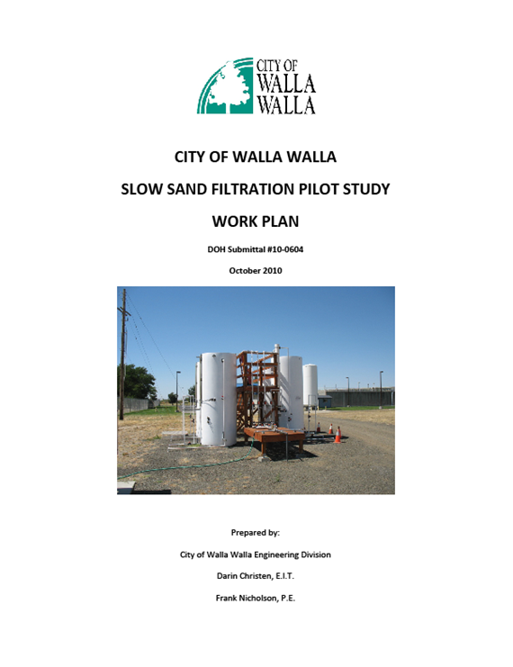
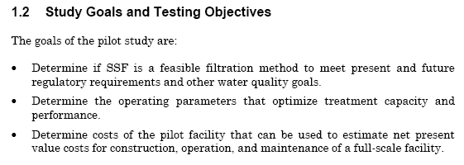
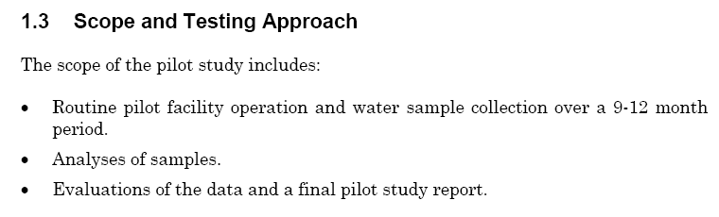
Pilot Test plan and Report
Document the pilot test plan and results for future reference

Slide 38
Ten States Standards
Raw Water Quality
4.3.4.1 Quality of raw water
Slow rate gravity filtration shall be limited to waters having maximum turbidities of 10 units and maximum color of 15 units; such turbidity must not be attributable to colloidal clay. Microscopic examination of the raw water must be made to determine the nature and extent of algae growths and their potential adverse impact on filter operations.

Slide 39
Raw Water Quality
Recommended Limits for Raw Water (Source Water Characteristics)
Turbidity | < 10 NTU (colloidal clays are not desirable)
True Color | < 5 platinum color units
Coliform Bacteria | < 800 /100 ml (CFU or MPN)
Dissolved Oxygen (DO) | > 6 mg/l (filtered water DO > 3 mg/l)
Total Organic Carbon (TOC) | < 3.0 mg/l (low TOC to prevent DBP issues)
Iron & Manganese | Both < 1 mg/l Each
Algae | < 200,000 cells/L (depends upon type)
Notes:
Even with the best design, there are a number of variables that can have a big impact on performance. Raw water characteristics like turbidity, color, and colloidal content for example. Other critical variables include sand size and uniformity, flow control and management of air binding, headloss development, sand bed depth, filtration rate and flow variability. Allowing sufficient time to mature once a filter has been newly sanded (usually 4 – 6 weeks) and allowing the filter to ripen once cleaned (24 – 48 hours) are very critical to optimal performance.

Slide 40
Ten States Standards
Number of filters
4.3.4.2 Number
At least two units shall be provided. Where only two units are provided, each shall be capable of meeting the plant design capacity (normally the projected maximum daily demand) at the approved filtration rate. Where more than two filter units are provided, the filters shall be capable of meeting the plant design capacity at the approved filtration rate with one filter removed from service.

Slide 41
Number of filters
How do you determine a reasonable filter area?
An individual filter should be small enough to allow it to be cleaned in 1 day. Determine the filter size as follows:
Area of 1 filter = (cleaning rate in ft²/person/hr)
x (no. of people available for cleaning)
x (hours allotted to cleaning)
Example:
Cleaning rate: 1,000 ft²/5 persons/hr (Cullen and Letterman, 1985)
(1” of sand hand shoveled with hydraulic conveyance)
Number of people: 2 minimum (think safety)
Hours estimated for cleaning: 2.5 hrs (desired)
Area of 1 filter: 1,000 ft²/5 persons/hr x 2 people x 2.5 hrs = 1,000 ft² => 20 x 50-ft filter

Slide 42
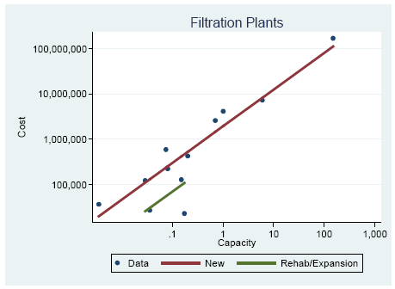
Number of filters
Is there such thing as too small?
The minimum size of a filter depends upon the:
  Cleaning method and equipment access needs
  System demands
  If covers are needed
  Construction costs
Direct, In-line, DE, Slow Sand, or Cartridge/Bag
Filtration Plants
Huisman and Wood (1974) and Sharp et al (1994) indicate a minimum area for one filter of about 1,000 ft² (100 m²). This is due to construction costs being lower per ft² with larger filters (economy of scale).
Small modular units are common and can be very cost effective

Slide 43
Number of filters
How do you determine the number of filters needed?
Equation for number of filters needed: N = 1 + (Q / (HLR * A))
Where:
HLR = hydraulic loading rate (gpm/ft²)
Q = flow needed to meet demands (gpm)
A = The sand bed surface area of one filter bed (ft²)
N = total number of filter beds needed (assumes 1 filter is taken off-line for cleaning and storage can meet peak hour demands)
Example: How many filters are needed, given a peak day demand of 250 gallons per capita per day and a community of 600 people. The peak design filtration rate is 0.1 gpm/ft². A minimum rate of 0.05 gpm/ft² has been identified through pilot testing for operation during cold conditions and to accommodate filters left in service that may be near the end of their filter run. There is also a desire to limit the size of each filter to 20’x50’ in order to facilitate the cleaning:
1 + (250 gpcpd x 600 people x 1 day/1440 minutes) = 3.08 = 3 filters
(0.05 gpm/ft² x (50-ft x 20-ft))
Notes:
The number of filters needed, can be determined using this equation. This equation assumes that the filters are all to be of equal size, only one filter is taken off-line at a time for cleaning, and that peak day demand is the design flow for the plant (i.e., peak hour and fire flow demands can be met by available distribution system storage). Notice, the desire to keep the filter area to a manageable size in order to facilitate cleaning operations and minimize filter down-time. A low rate of 0.05 gpm/sqft is chosen for design as it represents what may be needed should scraping have to occur during colder water temperatures or for filters left in service that may be near the end of their filter run during the remainder of the year (cleaning should generally be scheduled to avoid very cold weather).

Slide 44
Number of filters
Are more filters better?
Equation for minimum number of filters needed: N = 1 + (Q / (HLR * A))
In the previous example, 3 filters were determined to be needed, any 2 of which are capable of meeting 100% of the peak day demand (PDD) to allow for 1 filter being taken out of service for cleaning. This means that each filter is able to meet 50% of the PDD.
3 filters x 50% of PDD = a plant capacity of 150% x PDD
(1 filter off-line leaves 2 filters to meet 100% of PDD)
If 4 smaller filters were constructed, each filter would only need to be capable of meeting ~33% of the peak day demand to allow for 1 being taken out of service.
4 filters x 33% of PDD = a plant capacity of 132% x PDD
(1 filter off-line leaves 3 filters to meet 100% of PDD)
The capital cost involved with fewer large filters should be carefully weighed against the benefits of having a higher number of smaller filters (smaller overall plant capacity, more operational flexibility, shorter time cleaning each filter, although more filters to construct and maintain)

Slide 45
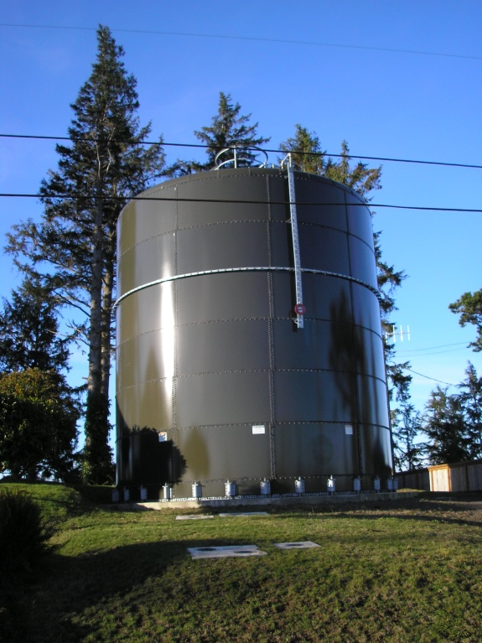
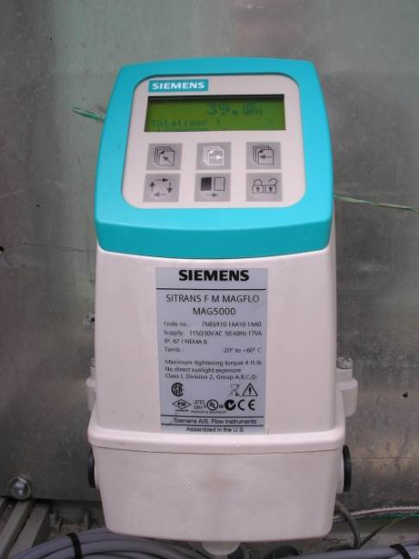
System Demands
System demands and operation to consider…
20-year planning horizon
Average day demands (ADD) – Design Goal
Peak day demands (PDD) – Design Goal
Peak hour demands (use storage)
Available storage (3 days ADD recommended)
Account for cleaning/ripening (min 2 filter beds) – ability to meet PDD with largest filter off-line.
Keep filtration rates below 0.1 gpm/ft²
Avoid rapid flow changes (strive for weekly or monthly changes)
Plan for constant flow through filter (constant supply of nutrients for biological health)
Tank for City of Astoria, OR
Notes:
For planning purposes, system demands should be estimated for a minimum of 20 years into the future. Filters should be designed with enough surface area to meet peak day demands with the largest filter out of service without making drastic flow changes. Even though installations may be small, a minimum of two filters should be installed to allow for taking one filter off-line for several days during cleaning and ripening. The filter area should be large enough to meet these demands, while maintaining a filtration rate between 0.1 and 0.16 gpm/ft2. Should storage not be enough to meet peak hour demands, then the filter area should be expanded to meet these demands as well. Typically this is not needed when storage is capable of meeting 3 or more days of average demand.

Slide 46
Ten States Standards
Structural Details & Hydraulics
4.3.4.3 Structural details and hydraulics
Slow rate gravity filters shall be so designed as to provide:
a. a cover,
b. headroom to permit normal movement by operating personnel for scraping and sand removal operations,
c. adequate access hatches and access ports for handling of sand and for ventilation,
d. an overflow at the maximum filter water level, and
e. protection from freezing.

Slide 47
Filter Box
Filter boxes and earthen cells
Water tight. Filter boxes should be watertight, not merely to prevent loss of treatment water, but to exclude ingress of groundwater, which might contaminate the treated effluent. If possible, ensure the floor is above the highest water table.
Allows for cleaning and re-sanding efforts.
Insulated from freezing (below ground, covered, or fully enclosed) .
Covered as needed to prevent algae blooms and exclude falling leaf litter.
Freeboard of 4 – 12” (10 – 30 cm) above overflow level.

Slide 48
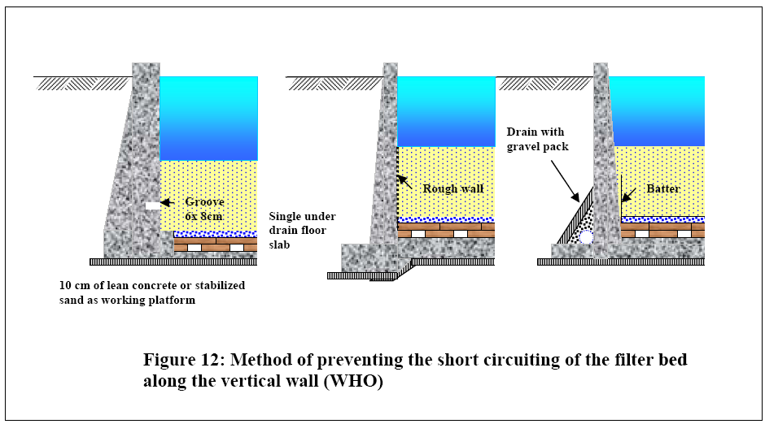
Filter Walls - Vertical
Vertical Walls
Short circuiting of the filter-bed along vertical walls can be mitigated by using a keyway (6x8 cm), rough sloped walls, or a batter.
Notes:
This diagram shows three mechanisms to prevent short circuiting along the interface with vertical side walls and the filter sand bed. The WHO manual indicates that the most effective precaution is to give the walls a slight outward batter, so as to obtain the advantages of sloping walls and to use grooved or roughened surfaces.

Slide 49
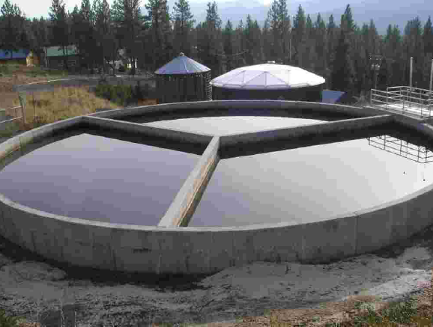
Filter Walls - Vertical
City of Sumpter (Baker Co)
3 cells
360,000 gpd
completed
In the spring of 2003
Notes:
This photograph shows how a circular basin can be divided to provide more cells, making cleaning easier since only 1/3 of the basin needs to be cleaned at a time.

Slide 50
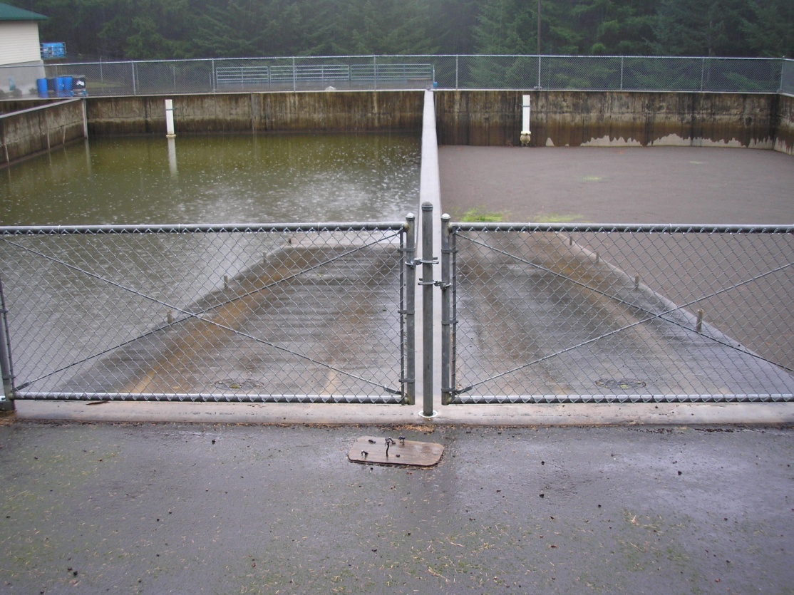
Filter Walls - Vertical
Vertical Walls
Ramps allow to get equipment and new sand in and old sand out.
Notes:
Ramps allow to get equipment and new sand in and old sand out of vertical walled filter boxes. This photograph shows the two of the filters for Falls City, OR.

Slide 51
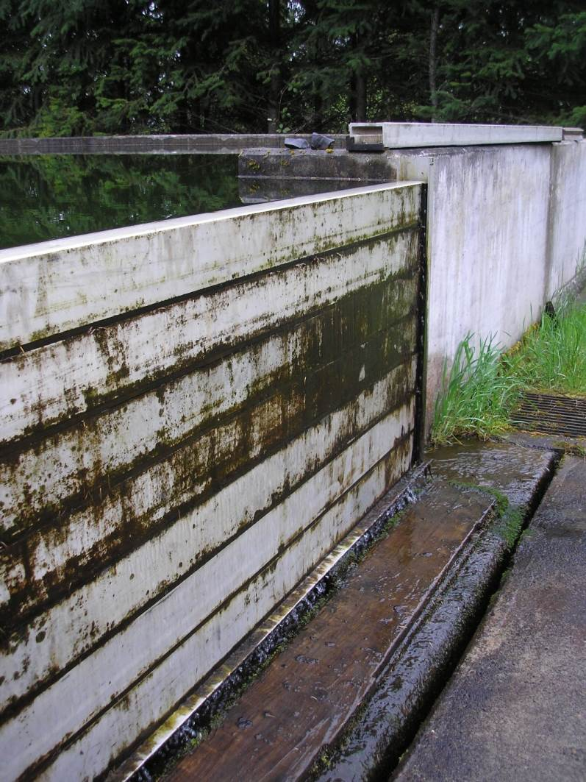
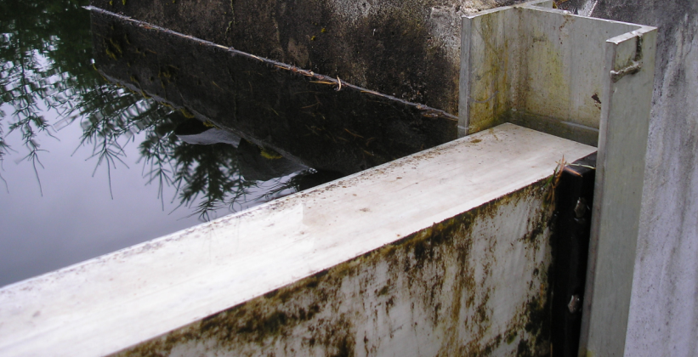
Filter Walls - Vertical
Vertical Walls
Removable stop “logs” allow access to the filters used by the City of Banks, OR.
Top of stop logs also serve as scum outlet/overflow.
Notes:
Removable stop logs allow for cleaning filters used by the City of Banks, OR.

Slide 52
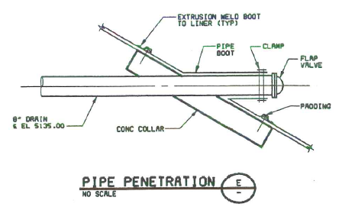
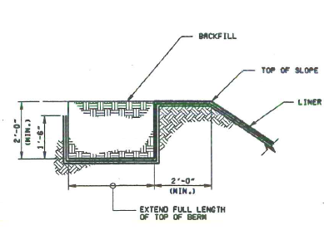
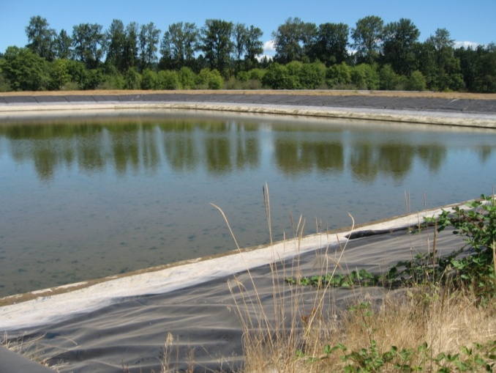
Filter Walls –
Sloped
Design showing sloped walls
with liner
Notes:
These schematics show the construction of an in-ground filter with a liner and sealed pipe penetrations.

Slide 53
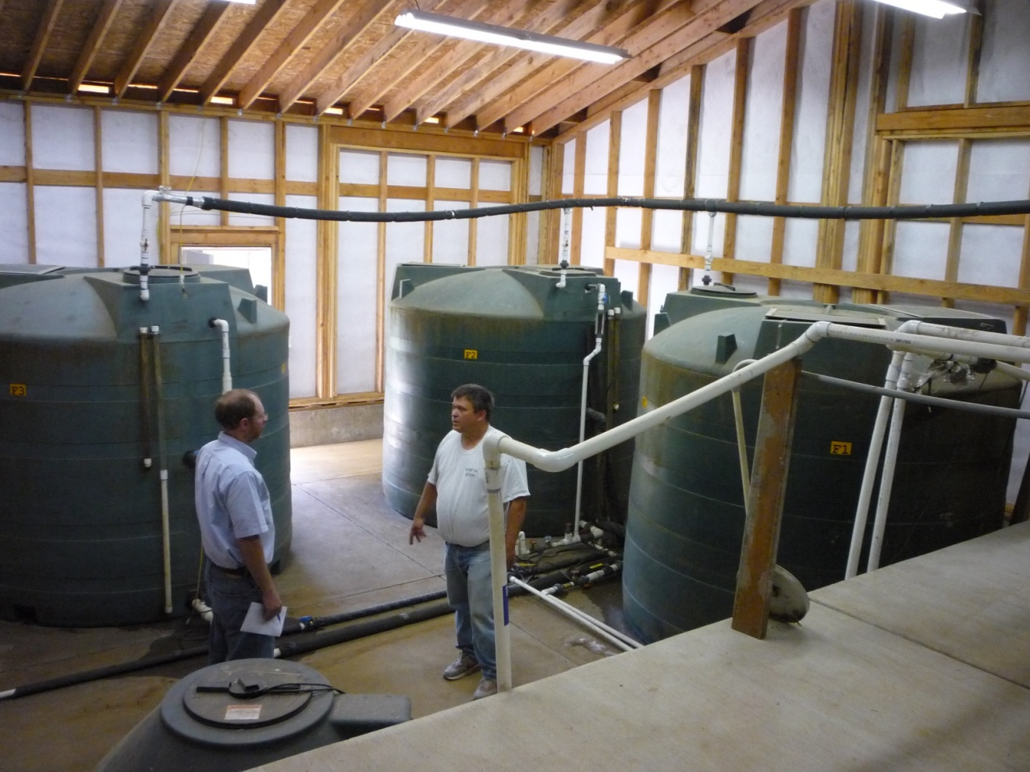
Covered Filters
If covered and/or housed in a filter building, make sure ample room exists to enable cleaning.
2012. Camp Yamhill in Yamhill County Oregon.

Slide 54
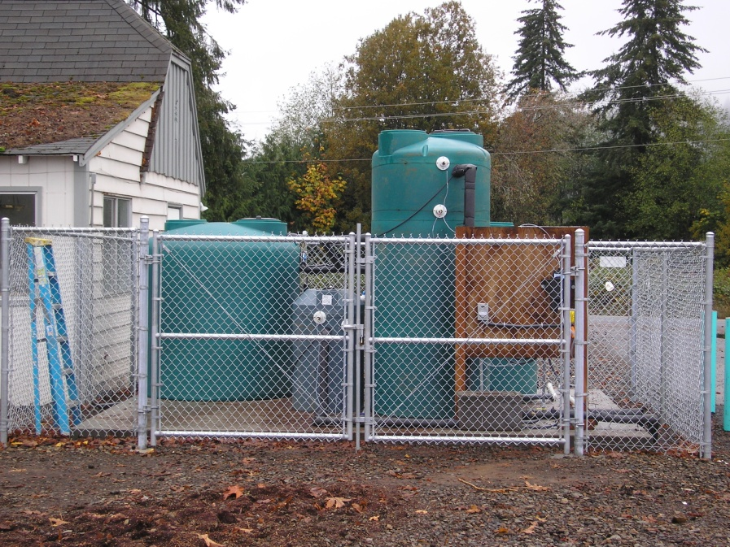
Covered Filters
Protection from freezing
Even if the filters are enclosed, like these “Blue Future” filters, they may not provide enough protection from freezing temperatures. These filters were eventually enclosed in a building.
2009. Jewell School District #8, OR. “Blue Future” covered filter (left) and raw water control tank (right)
Notes:
This photo shows a covered “Blue Future” filter installed at the Jewell School District #8 in 2009. The green tank on the left is the filter, the taller green tank on the right is the raw water control tank, and the small grey tank in the middle is the effluent control tank. These filters are designed to be harrowed rather than scraped. Harrowing will be discussed a little later.

Slide 55
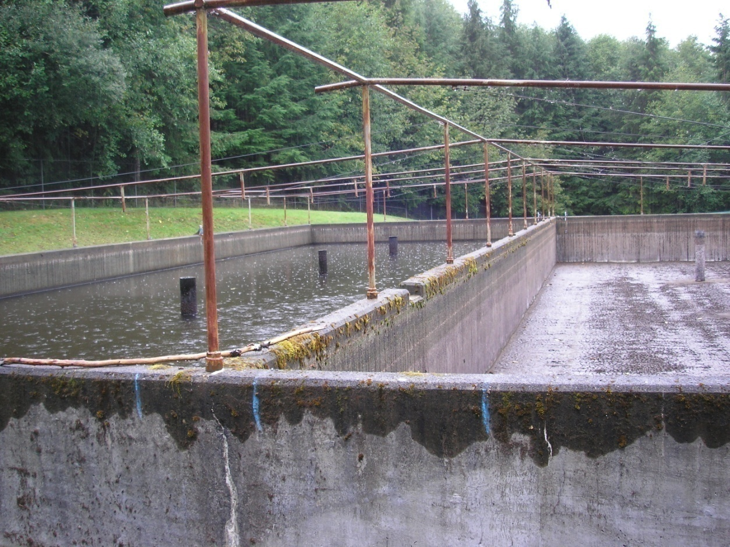
Covered Filters
Wickiup Water District (Clatsop Co)
Two 80’x30’ cells
120 gpm (0.025 gpm/sf)
Framework allows
for shade cloth to be
used during the
summer

Slide 56
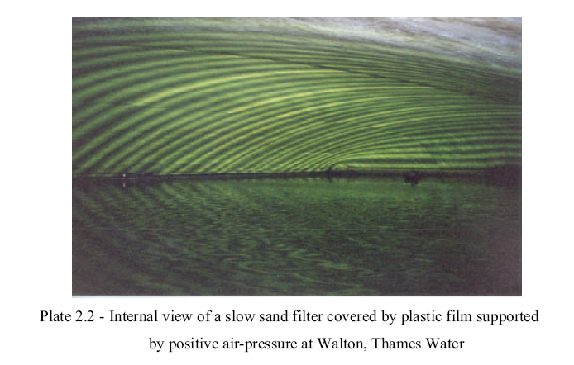
Covered Filters
Thames Water (London England)
Positive air pressure support a plastic film cover at Thames Water.

Slide 57
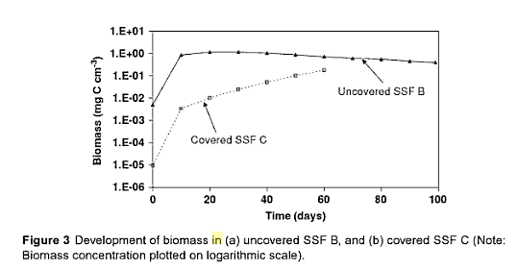
Slow Sand Design
UnCovered vs. covered
Note the difference in biomass development following scraping
(Campos et. al, 2002/2006) – this should be considered in sizing system
Notes:
Note the difference in biomass development following scraping (Campos et. al, 2002/2006). This information can be obtained during a pilot study.

Slide 58
Slow Sand Design
UnCovered vs. covered Filters
Parameter | Uncovered | Covered
Temperature | More exposed to lower temperatures which can adversely impact biological activity and increase filter ripening times. | Less susceptible to temperature effects
Algae | Algal growth/blooms in the headwaters can increase clogging | Not as susceptible to localized algae blooms.
Biomass Development | Filter has a higher biomass and develops a more noticeable schmutzdecke. | Overall biomass levels are lower and schmutzdecke formation may appear non-existent or present as an easily suspended, inert, black carbonaceous deposit of about 1 mm in thickness. Biomass is significantly correlated to bacteria counts.
Removal Efficiency | Equivalent | May be adversely impacted by lack of schmutzdecke layer
Notes:
This table shows some of the differences experienced in filters with and without a cover. Although there are some important differences, deciding to cover the filters may be dictated by site constraints (space, temperatures, etc.) and the amount of filter area needed (is it practical?).

Slide 59
Ten States Standards
Filtration Rate
4.3.4.4 Rates of filtration
The permissible rates of filtration shall be determined by the quality of the raw water and shall be on the basis of experimental data derived from the water to be treated. The nominal rate may be 45 to 150 gallons per day per square foot of sand area (1.8 - 6.1 m/day), with somewhat higher rates acceptable when demonstrated to the satisfaction of the approving authority.
45 – 150 gpd/ft²
(0.031 – 0.10 gpm/ft²)

Slide 60
Filtration rate
(hydraulic loading rate)
Equation for Determine HLR: HLR = Q / (A * (N-1))
Where:
HLR = hydraulic loading rate (gpm/ft²)
Q = flow needed to meet demands (gpm)
A = The sand bed surface area of one filter bed (ft²)
N = total number of filter beds needed > 2 (“N-1” is the total number of filters with 1 filter taken out of service for cleaning)
Example: Given a peak day demand of 250 gallons per capita per day and a community of 600 people served by two 50’x20’ filters:
250 gpcpd x 600 people
(1,000 ft²/filter x (2 filters – 1 filter) = 150 gpd/ft² (0.1 gpm/ft²)
Notes:
This equation is used to determine the filtration rate (or hydraulic loading rate) of slow sand filters.

Slide 61
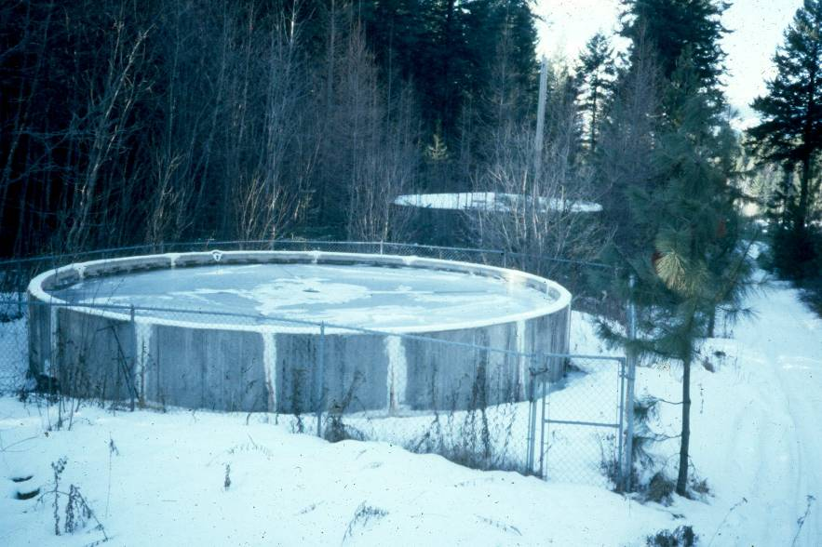
Filtration Rate
Maximum
< 0.1 gpm/ft²
Rate may need to be < 0.05 gpm/ft² when water temp <5 °C
Minimum
> 0.02 gpm/ft² to keep biota viable

Slide 62

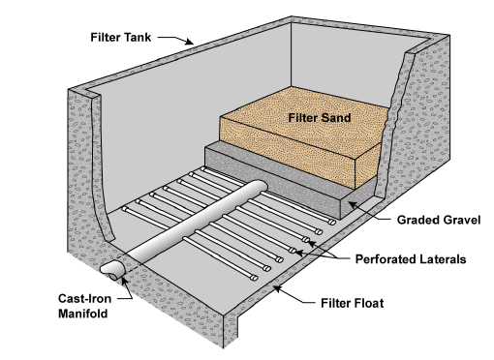
Ten States Standards
underdrains
4.3.4.5 underdrains
Each filter unit shall be equipped with a main drain and an adequate number of lateral underdrains to collect the filtered water.
The underdrains shall be placed as close to the floor as possible and spaced so that the maximum velocity of the water flow in the underdrain will not exceed 0.75 feet per second.
The maximum spacing of laterals shall not exceed 3 feet if pipe laterals are used.

Slide 63
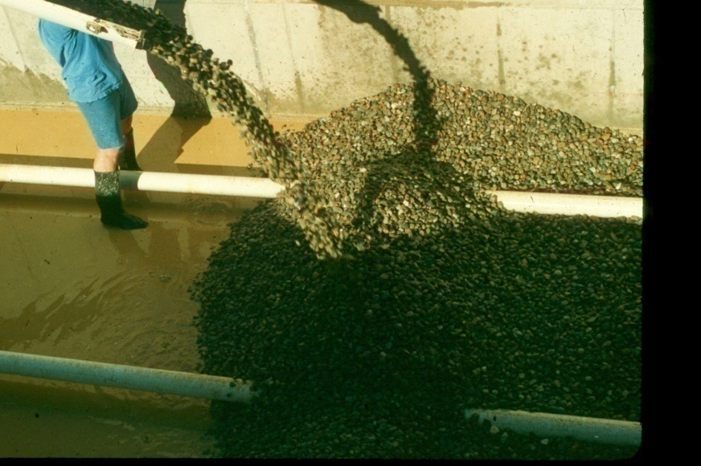
underdrains
underdrains are typically made using perforated pipe laterals (PVC, NSF-61) due to minimal head loss.
For larger installations, laterals are typically 4-8” in diameter, while main drains are 12-18” in diameter.
Notes:
underdrains are typically constructed of PVC (NSF-61), which has minimal head loss.

Slide 64
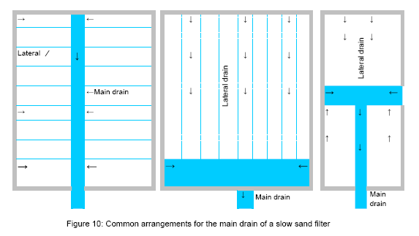
underdrain Configurations
Common configurations include laterals that connect to a main drain system. Smaller filters will often have only 1 main drain like the one shown on the right.
Notes:
Common configurations include laterals that connect to a main drain system. Smaller filters will often have only 1 main drain like the one shown on the right.

Slide 65
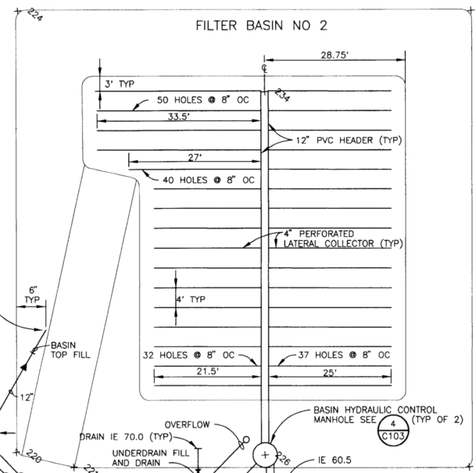


underdrains
City of Cannon Beach
12” PVC header
4” laterals
48” lateral spacing
8” hole spacing
Access Ramp for Cleaning/
Resanding
“Hydraulic Control
Manhole”
Notes:
Here is a plan view of the underdrains for the City of Cannon Beach, Oregon.

Slide 66




underdrains
City of Astoria (5 MGD)
Filter Cell #2
1993 filter rebuild
15” PVC manifold
14” PVC header
6” laterals
60” lateral spacing
6” hole spacing
¼” drain holes
Notes:
This shows a detail of the lateral pipe perforations of the underdrain system for filter cell #2 for the City of Astoria, Oregon.

Slide 67


underdrains
Velocity in laterals and main drain should not exceed
0.75 fps (0.23 m/sec.)
Notes:
Velocity in the laterals and main should not exceed 0.75 fps (0.23 m/sec). This diagram shows the configuration of the main drain pipe and laterals. Note the spacing of laterals at 3 – 5 feet apart (1-2 meters). Drain holes should be 5/64” – 5/32” in diameter (2-4 mm) and spaced every 4 to 12 inches apart (0.1 – 0.3 meters).

Slide 68

Underdrains – Lateral spacing
Streamlines forming a streamtube
Closer lateral spacing leads to a more even distribution of headloss
and more consistent filtration rates across the filter
Notes:
This diagram illustrates how the spacing of laterals can impact the flow of water through the underdrains (indicated by streamlines) and the resulting increase in headloss and decrease in filtration rate with larger lateral spacing.

Slide 69

underdrains
City of Astoria (5 MGD)
Filter Cell #2
1993 filter rebuild
Keep laterals spaced away from filter walls to avoid short-circuiting of raw water down the filter wall
Notes:
Keep laterals spaced away from filter walls to help prevent sidewall effects where unfiltered water can slip past the filter media down the sidewall.

Slide 70
underdrains
Underdrain Design Parameters | Recommended Specification
Maximum Velocity in Laterals¹ | 0.75 fps (0.23 m/sec)
Maximum Velocity in Main Drain¹ | 0.75 fps (0.23 m/sec)
Spacing of lateral drain pipes¹ | 36 inches (91.4 cm)
Spacing of bottom lateral drain holes² | 4 – 12 inches (0.1 – 0.3 m) (include air release holes @ ends on top of laterals)
Diameter of drain holes² | 5/64” – 5/32” (2-4 mm) (needs to be determined through hydraulic calculations)
Material | Non-Corrosive and meeting NSF-61 (e.g., PVC)
¹ Source: 2012 Edition of the Recommended Standards for Water Works (Ten States Standards). Visscher et., al. (see footnote 2) recommended 1.64 fps (0.5 m/sec).
²Source: Visscher, J.T., R. Paramasivam, A. Raman, and H.A. Heijnen. 1987. Slow Sand Filtration for Community Water Supply, Planning, Design, Construction, Operation and Maintenance. Technical Paper No. 24, The Hague, Netherlands: International Reference Center for Community Water Supply and Sanitation.
Notes:
Design recommendations from the IRC manual are included here. One addition is the provisions for air release holes at the ends on top of the laterals to purge air pockets in the laterals upon initial filling.

Slide 71

Ten States Standards
Filter media
4.3.4.6 Filter material
a. Filter sand shall be placed on graded gravel layers for a minimum depth of 30 inches.
b. The effective size shall be between 0.15 mm and 0.30 mm. Larger sizes may be considered by the reviewing authority; a pilot study may be required.
c. The uniformity coefficient shall not exceed 2.5.
d. The sand shall be cleaned and washed free from foreign matter.
e. The sand shall be rebedded when scraping has reduced the bed depth to no less than 19 inches. Where sand is to be reused in order to provide biological seeding and shortening of the ripening process, rebedding shall utilize a “throw over” technique whereby new sand is placed on the support gravel and existing sand is replaced on top of the new sand.

Slide 72

Filter Media
Plan the work and provide an adequate budget so recommended media specifications and placement practices are able to be followed – it will pay off in the long run!
Notes:
Plan the work and provide an adequate budget for media – it will pay off in the long run!

Slide 73
Sand Bed Depth Recommendations
Notes:
Various sources all fall within 16 – 35 inches, however, most recognize 20 – 24 inches as a minimum level the sand bed ought to be allowed to operate with.

Slide 74

Freeboard | Air above water (4 – 12”)
Headwater | Sedimentation (39-59”)
Schmutzdecke | Biological (1-2 cm)
Filter Sand | Biochemical (12-16”)
 | Adsorption (8”)
 | Sand allowance for cleanings
Sand Support | Support Gravel (15-24”)
Sand Bed Depth
According to the WHO manual,
  biochemical and adsorption removal mechanisms are in effect immediately below the schmutzdecke down to a depth of around 24-inches.
Therefore the total bed thickness would need to be at least 24 inches in order for these two mechanisms to be fully effective.
Additional sand is needed to accommodate the amount of sand anticipated to be removed due to cleanings over the design life.
Notes:
As covered in the discussion on removal mechanisms, a certain amount of sand ranging from 20 – 24” is needed to ensure that the removal mechanisms remain available for the entire life of the filter bed. In order to ensure this, an added sand allowance is needed to account for successive cleanings over the life of the filter.

Slide 75
Sand Bed Depth - formula
Formula for determining depth of sand:
D_{i} = [Y (R * f_{scraping})] + D_{f}
Re-arrange to find design life: Y = (D_{i} – D_{f}) / (R * f_{scraping})
Where:
Y = years of operation before sand bed needs rebuilding
D_{i} = initial sand bed depth (inches)
D_{f} = final sand bed depth before rebuilding (inches)
R = sand depth removal per scraping (inches/scraping)
f_{scraping} = frequency of scraping (scrapings/year)
Notes:
This is used to determine the additional sand allowance needed to account for successive cleanings over the life of a filter.

Slide 76
Sand Bed Depth - Example
Example: D_{i} = [Y (R * f_{scraping})] + D_{f}
Given:
  D_{i} = initial sand bed depth (inches)
  D_{f} = 24 inches
  f_{scraping} = 6 cleanings per year
  R = Removal of 1.3 cm (1/2”) of sand per cleaning
  Y = 7-year design life (before re-sanding is needed)
Di = 7 yrs * (0.5 in/scraping * 6 scrapings/year)] + 24 in
= 45 inches
Therefore, an additional 21 inches (53 cm) of sand is needed to allow for scraping over 7 years.
Notes:
This example shows how one would use the same formula to determine the additional sand allowance needed to account for successive cleanings over the life of a filter.

Slide 77


Filter Media - Silica
Silica sand
Durable
Inexpensive
Readily available
The most important feature is the pore space in the media.
Removal mechanisms occur in the pores where suspended solids are trapped, microorganisms grow, and air and water flow.
Using media with an appropriate effective size and uniformity ensures an optimal pore space.
Notes:
Media selection is critical to proper operation and should be primarily silica sand, due to it’s durability and availability.

Slide 78






Filter Media – Grain Size
There are many different
“grades” of sand available
“Sand” ranges from 0.0625 mm (#230 sieve) – 2.0 mm (#10 sieve)

Slide 79



Filter Media - Sieve Sizes
Sieves larger than the #4 sieve are designated by the size of the openings in the sieve.
Smaller sieves are numbered according to the number of openings per inch.
Example: A #10 sieve is made with 0.0237” thick wire. What is the opening size?
  9 wires/in x 0.0237”/wire = 0.213”
  1” – 0.213” = 0.787”
  Opening width = 0.787”/10 openings = 0.0787”
  0.0787” = 2.0 mm
Notes:
Sieves are numbered in one of two ways. Sieves larger than the #4 sieve are designated by the size of the openings in the sieve. Smaller sieves are numbered according to the number of openings per inch. The thickness of wire must be accounted for in determining the opening. For example, a #10 sieve has 10 openings per inch. The openings are only 0.0787 inches (2.0 mm) because the sieve is made using 0.0237” thick wire. Since there are 9 wires within an inch to make up 10 openings per inch, the wire accounts for the remaining 0.213” inches.

Slide 80

Filter Media - Effective Size (D₁₀)
Effective Size (D₁₀)
Range should be 0.2 mm to 0.35 mm
The effective size gives a good
  indication of the permeability characteristics of sand.
D₁₀ is the size of grain such that 10% by weight of the total sample is smaller. (i.e., 10% of the sand, by weight, is finer than a given grain size).
D₁₀ = 0.2 mm 90% #70 Sieve (70 openings/inch = 0.212 mm opening)
(10% passes
through to the pan)
10% (by weight) of this sample is smaller than 0.2 mm
10% Pan
Notes:
One critical sand specification is the effective size. The effective size (or diameter) is typically expressed as D₁₀ and indicates the grain diameter in millimeters at which 10% of the total grains of a given sample are smaller and 90% of the total grains are larger, based on weight. The effective size for slow sand media should be between 0.2 mm to 0.35 mm. Ten States Standards recommends a range of 0.15 – 0.35 mm, but the 0.15 mm specification often only restricts production without any added benefit.

Slide 81




Filter – Determining D₁₀
Effective Size (D₁₀)
Range should be 0.2 mm to 0.35 mm
A sieve analysis is done to determine D₁₀ by:
Passing a known amount of media through a series of progressively smaller sieve sizes; and
Weighing the amount of media retained on each sieve.
Notes:
The effective size is determined by doing a sieve analysis. So for example, you take a measured quantity of sand and weigh it. Then you sift it through a series of sieves with progressively smaller screens and weigh the portion of sand retained on each sieve.

Slide 82
Filter Media -
Determining D₁₀
Percentage retained on any sieve:
  = 100% x (weight of soil retained / total soil weight)
Cumulative percentage retained on any sieve:
  = Σ percentage retained
Percentage passing the sieve:
  = 100% - Σ percentage retained
Sieve # | Diameter (mm) | Mass of soil retained on each sieve (g) | Percent retained (%) | Cumulative Retained (%) | Percent Passing (%)
20 | 0.850 | 5 | 1.00% | 0.00% | 100%
30 | 0.600 | 27.5 | 5.50% | 5.50% | 95%
40 | 0.425 | 85 | 17.00% | 22.50% | 78%
50 | 0.300 | 125 | 25.00% | 47.50% | 53%
70 | 0.212 | 128 | 25.50% | 73.00% | 27%
100 | 0.150 | 77.5 | 15.50% | 88.50% | 12%
140 | 0.106 | 40 | 8.00% | 96.50% | 4%
200 | 0.075 | 10 | 2.00% | 98.50% | 2%
Pan | N/A | 2.5 | 0.50% | 99.00% | 1%
 | Total => | 500 gram sample
Notes:
Then you determine the % of the sample, by weight, that passes (is finer than) each successive sieve. This example shows how data from a sieve analysis is tabulated.

Slide 83
Filter Media – Determining D₁₀
Effective Size (D₁₀)
Range should be 0.2 mm to 0.35 mm
The results are plotted (% passing vs. sieve/grain size (mm)).
D10 is where a horizontal line drawn from the 10% passing mark intersects the grain size.
Notes:
The tabulated results are plotted on a graph of % passing versus sieve (i.e., grain size). D₁₀ is where a horizontal line drawn from the 10% passing mark intersects the sieve size – that sieve size intersected is the D₁₀.

Slide 84
D₆₀
Filter Media - UC
UC =
------
D₁₀
Uniformity Coefficient (UC)
Range should be 1.5 – 3.0
D₆₀ is the size of grain such that 60% by weight of the total sample is smaller. (i.e., 60% of the sand, by weight, is finer than a given grain size).
D₆₀ = 0.3 mm 30% #50 Sieve (50 openings/inch = 0.3 mm opening)
(50% on #100 sieve
plus 10% in pan)
D₁₀ = 0.15 mm 50% #100 Sieve (100 openings/inch = 0.15 mm opening)
(10% passes
through to the pan)
60% (by weight) of this sample is smaller than 0.3 mm (50% + 10%)
D₆₀ = 0.3 mm
10% is smaller than 0.15 mm = d₁₀
UC = D₆₀/D₁₀ = 0.3 mm/0.15 mm = 2.0
10% Pan
Notes:
The uniformity coefficient, denoted by “U” or “C_{u}”, is determined by dividing D₆₀ by D₁₀. Similar to D₁₀, D₆₀ is the sieve size through which 60% of the sample by weight passes and 40% is retained. You will not usually see D₆₀ referenced, however, it is used to determined the uniformity coefficient, which is an important specification for slow sand filter sand.

Slide 85



D₆₀
Filter Media - UC
UC =
------
Uniformity Coefficient (UC) = 1.5 – 3.0
D₁₀
If the grain sizes vary greatly, the smaller ones will fill the spaces between the larger particles, making it easier for the filter to clog.
Notes:
The uniformity coefficient is related to the distribution of grain sizes of soils. Uniformly graded soils have soil grains that are mostly the same size. This keeps the pore spaces between the grains open. Well graded sand has a broader size distribution (higher uniformity coefficient), which results in the fines filling up the pore spaces of the media resulting in less space for biological removal mechanisms to work and higher head loss.

Slide 86
Filter Media – Determining UC
Quiz:
What is D₁₀, D₆₀ and UC for this sieve analysis?
Sieve # | Diameter (mm) | Mass of soil retained on each sieve (g) | Percent retained (%) | Cumulative Retained (%) | Percent Passing (%)
20 | 0.850 | 0 | 0.00% | 0.00% | 100%
30 | 0.600 | 30 | 30% | 30% | 70%
50 | 0.300 | 10 | 10% | 40% | 60%
70 | 0.212 | 40 | 40% | 80% | 20%
100 | 0.150 | 10 | 10% | 90% | 10%
200 | 0.075 | 5 | 5% | 95% | 5%
Pan | N/A | 5 | 5% | 100% | 0%
Notes:
Quiz – What is d10, d60 and UC for this sieve analysis?

Slide 87
Cumulative percentage retained on any sieve:
  = Σ percentage retained
Percentage passing the sieve:
  = 100% - Σ percentage retained
Filter Media – Determining UC
  D10 = 0.15 mm
  D60 = 0.3 mm
  UC = d60/d10 = 0.3/0.15 = 2.0
Sieve # | Diameter (mm) | Mass of soil retained on each sieve (g) | Percent retained (%) | Cumulative Retained (%) | Percent Passing (%)
20 | 0.850 | 0 | 0.00% | 0.00% | 100%
30 | 0.600 | 30 | 30% | 30% | 70%
50 | 0.300 | 10 | 10% | 40% | 60% | d60
70 | 0.212 | 40 | 40% | 80% | 20%
100 | 0.150 | 10 | 10% | 90% | 10% | d10
200 | 0.075 | 5 | 5% | 95% | 5%
Pan | N/A | 5 | 5% | 100% | 0%
Notes:
Answer: D₁₀ = 0.15 mm, D₆₀ = 0.3 mm and UC = 0.3/0.15 = 2.0. This example illustrates how the mass retained on each sieve relates to the determination of d10, d60 and UC.

Slide 88



D₆₀
Filter Media – Determining UC
UC =
------
D₁₀, D₆₀ and UC can also be determined
graphically
D₁₀
D₆₀
D₁₀
Notes:
This slide shows how to identify D₁₀, D₆₀, and UC graphically.

Slide 89

Filter Media
http://www.slowsandfilter.org
Recommended effective diameter (D₁₀) – 0.2 mm to 0.35 mm
Notes:
Shown here are sand sizes from 0.15 – 0.35 mm. Photo from www.slowsandfilter.org.

Slide 90

Sieve Analysis – good sand
Notes:
This chart illustrates the results of a sieve analysis for sand primarily within the recommended specifications.

Slide 91

Sieve Analysis – not so good sand
Notes:
This chart illustrates the results of a sieve analysis for sand with an effective diameter larger than the recommended specification, although the uniformity coefficient is just within the specifications.

Slide 92

Other media Considerations
% of fines passing #200 sieve
< 0.3% by weight
Acid solubility
< 5%
Apparent Specific Gravity
  > 2.55
Minimum depth
  20-24 inches before re-sanding
Availability
  Local supply options (keep transport costs low)
  Redundant/backup supply (e.g. 2 or more quarries)
  Ability to meet specifications
  Consider ability to clean/stockpile scraped media
NSF-61 or equivalent (tested for contaminants)
Notes:
% of fines passing the #200 sieve should not be more than 0.03% by weight. The more fines, the longer it will take for turbidity in a newly sanded filter to clear. Acid solubility should be less than 5%. Media with more acid soluble content, think of limestone, could eventually end up with an undesirable effective diameter or uniformity coefficient in the presence of acidic waters. Sand beds are typically 30 to 36 inches in depth and should not be allowed to drop below 20-24 inches. Some references indicate lower levels may still provide adequate filtration, but as discussed earlier, this may inhibit removal mechanisms that occur deeper in the sand bed. Another thing to consider is where the sand is going to come from. Finding one or more local sources keeps transportation costs low. Not all quarries can provide sand meeting the desired specifications. Some systems have made provisions for cleaning and stockpiling sand that has been removed during the scraping process. This sand should then be analyzed for conformance with the desired characteristics and can then be re-used in subsequent re-sanding efforts.

Slide 93

Sources of Sand
CEMEX, Vancouver, WA & Boardman, OR
Kleen Industrial Services, Danville, CA
Knife River Corporation, Corvallis, OR & Stayton, OR
Naselle Rock and Asphalt, Naselle, WA
Fazio Brothers, Vancouver, WA
Others???
Notes:
Some suppliers of slow sand filtration sand.

Slide 94




Other media Considerations
Monitoring Media Depth
Incorporate a means of monitoring media depth
  Keyway (also mitigates sidewall effects)
  Staff gage
2x4 Keyway
Notes:
Design should incorporate a way to measure sand bed depth. A keyway can serve to both indicate the minimum sand depth (when the top of the keyway is reached), while interrupting flow down the sidewall.

Slide 95

Other media Considerations
Monitoring Media Depth
Incorporate a means of monitoring media depth
“Marks on Liner Side”
Notes:
This construction plan shows “marks” at 18” sand depth on the liner of a sloped filter wall (cell #3) for the City of Astoria (1993)

Slide 96
Recommended Media Specs
Media specifications (silica sand) - summary
Filter Sand Specification | Recommended Range
Effective Diameter (d10) | 0.2 – 0.35 mm
Uniformity Coefficient (U) | 1.5 – 3.0
% fines passing #200 sieve | < 0.3% by Wt.
Acid Solubility | < 5%
Apparent Specific Gravity | > 2.55
Minimum Depth | 20-24 inches
Delivery/Installation | Sand washed prior to installation
NSF/ANSI Standard 61 | Certified or equivalent
Notes:
This table summarizes some of the main specifications for sand and bed depth.

Slide 97

Support Gravel
Support gravel prevents migration of sand down to underdrains, while allowing passage of filtered water.
Proper gradation is key to prevent migration
Rounded rock is used to promote drainage
Example shown* is for a rapid rate plant
(City of Grants Pass)
Top Layer 1 Filter sand
(Silica sand w/ D₁₀ = 0.45 mm- 0.55 mm)
Layer 2 #50 garnet sand
Layer 3 #12 garnet gravel
Layer 4 3/8” x 3/16” gravel
Layer 5 3/4” x 3/8” gravel
Bottom layer 1-1/2” x ¾” gravel
*Anthracite is on top of filter sand, but is not shown.

Slide 98


Ten States Standards
Support Gravel
4.3.4.7 Filter gravel
The supporting gravel should be similar to the size and depth distribution provided for rapid rate gravity filters. See 4.2.1.6.f.2. (e.g. 4.3.1.6.e. – Support Media (for rapid rate gravity filters))

Slide 99


Ten States Standards
Support Gravel, Cont.
4.3.1.6.e. – Support Media (for rapid rate gravity filters)
4.3.1.6.e.1. Torpedo sand (often used to backfill utility pipes)
A three-inch layer of torpedo sand shall be used as a supporting media for filter sand where supporting gravel is used, and shall have:
a. effective size of 0.8 mm
to 2.0 mm (1/32” – 5/64”)
b. uniformity coefficient
not greater than 1.7.

Slide 100


Ten States Standards
Support Gravel, Cont.
4.3.1.6.e.2. Gravel ‑ Gravel, when used as the supporting media shall consist of cleaned and washed, hard, durable, rounded silica particles and shall not include flat or elongated particles. The coarsest gravel shall be 2.5 inches in size when the gravel rests directly on a lateral system, and must extend above the top of the perforated laterals. Not less than four layers of gravel shall be provided in accordance with the following size and depth distribution:
Size Depth
3/32 to 3/16 inches 2 to 3 inches
3/16 to 1/2 inches 2 to 3 inches
1/2 to 3/4 inches 3 to 5 inches
3/4 to 1 ½ inches 3 to 5 inches
1 ½ to 2 ½ inches 5 to 8 inches
Reduction of gravel depths and other size gradations may be considered upon justification to the reviewing authority for slow sand filtration or when proprietary filter bottoms are specified.

Slide 101
Sand & Gravel
ASTM E11 standard sizes for woven wire test sieve cloth
No. | Mesh Size (mm) | No. | Mesh Size (mm) | No. | Mesh Size (mm) | No. | Mesh Size (mm)
1” | 25.0 | 7 | 2.80 | 20 | 0.85 | 60 | 0.250
¾” | 19.0 | 8 | 2.36 | 25 | 0.71 | 80 | 0.180
½” | 12.5 | 10 | 2.00 | 30 | 0.60 | 100 | 0.150
3/8” | 9.5 | 12 | 1.70 | 35 | 0.50 | 120 | 0.125
4 | 4.75 | 14 | 1.40 | 40 | 0.425 | 140 | 0.106
5 | 4.00 | 16 | 1.18 | 45 | 0.355 | 170 | 0.090
6 | 3.35 | 18 | 1.00 | 50 | 0.300 | 200 | 0.075
Notes:
There are standard mesh sizes for grading sand and gravel. Some of these mesh sizes likely to be used in slow sand filters identified under ASTM E11 are shown here for reference.

Slide 102

Support Sand
Concrete Sand
(a.k.a. “Torpedo Sand”)
Fine Aggregate grade 1 or 2 (FA-1 or 2)
Angular to sub-angular
3/8” x #100 mesh (9.5 x 0.15 mm)
Washed and screened
Used in production of ready mixed concrete
Commonly used for pipe bedding & Backfill
Meets ASTM C33 standard
Torpedo Sand
Notes:
Photos of gravel from Phil’s Topsoil, Inc., http://www.philstopsoil.com/stone_and_sand.html

Slide 103


Support
Gravel
Pea Gravel (CA-16)
Round to sub-angular river rock
3/8” x #16 (9.5 x 1.18 mm)
  (1.18 mm ~ 3/64”)
Washed but may contain smaller sediment
Commonly used for decorative landscaping,
retaining wall backfill, or where finer aggregates are needed when drainage through stone is
desired.
#8 Gravel (a.k.a. #8 pea gravel)
3/8” x #8 (9.5 x 2.36 mm) (2.36 mm ~ 3/32”)
Pea Gravel
#8 Pea Gravel
Notes:
Top photo of gravel from Phil’s Topsoil, Inc., http://www.philstopsoil.com/stone_and_sand.html
Bottom photo of gravel from The Gravel Guy – Don Brown. http://thegravelguy.com/gravel/

Slide 104


Filter Media
#57 gravel
1” x #4 (25.0 x 4.75 mm) (4.75 mm ~ 3/16”)
#4 gravel
1-1/2” x 3/4” (37.5 x 19 mm)
#4 Gravel
#57 Gravel
Notes:
Photos of gravel from The Gravel Guy – Don Brown. http://thegravelguy.com/gravel/

Slide 105


Filter Media
3/4” washed Gravel (CA11)
1-1/2” Washed Gravel (CA5)
3/4” River Rock
1-1/2” River Rock
Notes:
Photos of gravel from Phil’s Topsoil, Inc., http://www.philstopsoil.com/stone_and_sand.html

Slide 106



Support Media
City of Salem, OR
Filter sand D₁₀ = 0.27 – 0.33 mm
4” Top Layer #4 x #8 sieve
4” Middle Layer 1/2” x #4 sieve (3/16”)
10” Bottom Layer 7/8” x 1/2”

Slide 107
Support Media
3 layers of support gravel can be adequate, but 4 or more layers is recommended due to product and placement uncertainties.
Considerations
Durability
Cost
Availability
Layer | D10 (mm) | D90 (mm) | Depth (inches)
Top Layer | 3/64” (1.0 mm) | 1/16” (1.4 mm) | 6
Middle Layer | 5/32” (4.0 mm) | 7/32” (5.6 mm) | 6
Bottom Layer | 5/8” (16 mm) | 29/32” (23 mm) | 6
Each successive layer should be graded so that its smaller (D₁₀) particle diameters are not more than four times smaller than those of the layer immediately below.
The grains of the bottom layer should have an effective diameter of at least twice the size of the drain holes or slots.
* The gravel support using three layers as specified will work if the orifices into the under drain pipe are less than 8 mm in diameter. If the orifices are larger, more than three layers of gravel may be needed.

Slide 108
Support Media
Discard
2nd Layer (1/8” x 1/16”)
3rd Layer (1/4” x 1/8”)
4th Layer (1/2” x 1/4”)
Discard
Example of a 4 layer support media for use with a filter sand with an effective size (D10) of 0.2 mm and 1/8” drain holes.
1/16”
1/8”
Discard
Top Layer (0.8-1.2 mm)
Discard
0.8 mm
1/4”
1/2”
1.2 mm
Support media for use with a filter sand with an effective size (d10) of 0.2 – 0.35 mm and 1/8” underdrain holes (for ¼” underdrain holes a fifth layer of ¾” x ½” or 1” x ½” gravel is needed).
Layer | Size Range |  | Depth (inches) | Specification
Top Layer | 1/32” (0.8 mm) | 1/21” (1.2 mm) | 3 | Largest Size/Smallest Size = 1.5 Smallest Size in Top Layer /D₁₀ Filter Sand = 4.0
2nd Layer 1/8” x 1/16” | 1/16” (1.588 mm) | 1/8” (3.175 mm) | 3 | Largest Size/Smallest Size = 2.00 Largest Size/Smallest Size of Top Layer = 3.97
3rd Layer 1/4” x 1/8” | 1/8” (3.175 mm) | 1/4” (6.35 mm) | 3 | Largest Size/Smallest Size = 2.00 Largest Size/Smallest Size of 2nd Layer = 4.00
4th Layer 1/2” x 1/4” | 1/4” (6.35 mm) | 1/2” (12.7 mm) | Embed and bury underdrain piping with 1” of cover | Largest Size/Smallest Size = 2.00 Largest Size/Smallest Size of 3rd Layer = 4.00 Smallest Size = 2x Drain Diameter

Slide 109
Support Media
4-5 Layer Option
Filter sand D₁₀ = 0.2 mm
3” Top Layer #20 sand
3” Second Layer 1/8” x 1/16“
3” Third Layer 1/4” x 1/8”
3” Fourth Layer ½” x ¼” (4 layers work with 1/8” drain holes)
Bottom Layer ¾” x ½” (5 layers are needed with ¼” drain holes)
4-5 Layer Option | d10 (mm) | d90 (mm) | d10 (in) | d90 (in) | AWWA B100-09 & WHO d10 > 2xDrain? | AWWA B100-09 d10 top gravel between 4 and 4.5 times d10 sand | WHO (Huisman & Wood) d10 lower/d10 upper (<3 where d90/d10 of same layer < 2 or < 4 if d90/d10 of same layer < 1.4) | AWWA B100-09 d90 lower/d10 upper (<4) | AWWA B100-09 d90/d10 same layer (<2) (< 1.4, WHO)
Sand | 0.2 | N/A |  |  | N/A | N/A | N/A | N/A | N/A
Top Gravel | 0.8 | 1.2 | 1/32 | 1/21 | No | 4.00 | 4.00 | N/A | 1.50
2nd Gravel | 1.5875 | 3.175 | 1/16 | 1/8 | No | N/A | 1.98 | 3.97 | 2.00
3rd Gravel | 3.175 | 6.35 | 1/8 | 1/4 | No | N/A | 2.00 | 4.00 | 2.00
4th Gravel | 6.35 | 12.7 | 1/4 | 1/2 | Yes | N/A | 2.00 | 4.00 | 2.00
5th Gravel | 12.7 | 19.05 | 1/2 | 3/4 | Yes | N/A | 2.00 | 3.00 | 1.50
Drain | 3.175 | N/A | 1/8 |  | N/A | N/A | N/A | N/A | N/A

Slide 110

Support Media
Rapid Rate Filter (City of Grants Pass)
Top Layer 1 (#50 garnet sand w/ D₁₀ = 0.25 mm)
Layer 2 #12 garnet gravel
Layer 3 3/8” x 3/16” gravel
Layer 4 3/4” x 3/8” gravel
Bottom layer 1-1/2” x ¾” gravel
Grants Pass using Garnet Sand as Filter Medium | d10 (mm) | d90 (mm) | d10 (in) | d90 (in) | AWWA B100-09 & WHO d10 > 2xDrain? | AWWA B100-09 d10 top gravel between 4 and 4.5 times d10 sand | WHO (Huisman & Wood) d10 lower/d10 upper (<3 where d90/d10 of same layer < 2 or < 4 if d90/d10 of same layer < 1.4) | AWWA B100-09 d90 lower/d10 upper (<4) | AWWA B100-09 d90/d10 same layer (<2) (< 1.4, WHO)
Sand | 0.25 | N/A |  |  | N/A | N/A | N/A | N/A | N/A
Top Gravel | 1.18 | 1.7 | 2/43 | 1/15 | No | 4.72 | 4.72 | N/A | 1.44
2nd Gravel | 4.7625 | 9.5 | 3/16 | 3/8 | No | N/A | 4.04 | 8.05 | 1.99
3rd Gravel | 9.5 | 19.05 | 3/8 | 3/4 | No | N/A | 1.99 | 4.00 | 2.01
4th Gravel | 19.05 | 38.1 | 3/4 | 1 1/2 | Yes | N/A | 2.01 | 4.01 | 2.00
5th Gravel |  |  | 0 | 0 | No | N/A | 0.00 | 0.00 | #DIV/0!
Drain | 6.35 | N/A | 1/4 |  | N/A | N/A | N/A | N/A | N/A

Slide 111

Support Media
Opal Creek, OR (Blue Future Filters)
Filter sand D₁₀ = 0.3 mm
2” Top Layer 3/8” x 3/16”
2” Middle Layer 1” x 7/8“ (or 1” x 1/2”)
8” Bottom Layer 1-1/2” x 3/4”
Drain orifice = ¼” slots
Opal Creek, Oregon (Blue Future Filters) | d10 (mm) | d90 (mm) | d10 (in) | d90 (in) | AWWA B100-09 & WHO d10 > 2xDrain? | AWWA B100-09 d10 top gravel between 4 and 4.5 times d10 sand | WHO (Huisman & Wood) d10 lower/d10 upper (<3 where d90/d10 of same layer < 2 or < 4 if d90/d10 of same layer < 1.4) | AWWA B100-09 d90 lower/d10 upper (<4) | AWWA B100-09 d90/d10 same layer (<2) (< 1.4, WHO)
Sand | 0.35 | N/A |  |  | N/A | N/A | N/A | N/A | N/A
Top Gravel | 3.175 | 9.525 | 1/8 | 3/8 | No | 9.071429 | 9.07 | N/A | 3.00
2nd Gravel | 22.25 | 25.4 | 7/8 | 1 | Yes | N/A | 7.01 | 8.00 | 1.14
3rd Gravel | 19.05 | 38.1 | 3/4 | 1 1/2 | Yes | N/A | 0.86 | 1.71 | 2.00
4th Gravel |  |  | 0 | 0 | No | N/A | 0.00 | 0.00 | #DIV/0!
5th Gravel |  |  | 0 | 0 | No | N/A | #DIV/0! | #DIV/0! | #DIV/0!
Drain | 6.35 | N/A | 1/4 |  | N/A | N/A | N/A | N/A | N/A

Slide 112

Support Media
City of Salem, OR
Filter sand D₁₀ = 0.27 – 0.33 mm
4” Top Layer #4 x #8 sieve
4” Middle Layer 1/2” x #4 sieve (3/16”)
10” Bottom Layer 7/8” x 1/2”
City of Salem, Oregon | d10 (mm) | d90 (mm) | d10 (in) | d90 (in) | AWWA B100-09 & WHO d10 > 2xDrain? | AWWA B100-09 d10 top gravel between 4 and 4.5 times d10 sand | WHO (Huisman & Wood) d10 lower/d10 upper (<3 where d90/d10 of same layer < 2 or < 4 if d90/d10 of same layer < 1.4) | AWWA B100-09 d90 lower/d10 upper (<4) | AWWA B100-09 d90/d10 same layer (<2) (< 1.4, WHO)
Sand | 0.27 | N/A |  |  | N/A | N/A | N/A | N/A | N/A
Top Gravel | 2.36 | 4.75 | 4/43 | 3/16 | No | 8.740741 | 8.74 | N/A | 2.01
2nd Gravel | 4.75 | 12.7 | 3/16 | 1/2 | No | N/A | 2.01 | 5.38 | 2.67
3rd Gravel | 12.7 | 22.25 | 1/2 | 7/8 | Yes | N/A | 2.67 | 4.68 | 1.75
4th Gravel |  |  | 0 | 0 | No | N/A | 0.00 | 0.00 | #DIV/0!
5th Gravel |  |  | 0 | 0 | No | N/A | #DIV/0! | #DIV/0! | #DIV/0!
Drain | 6 | N/A | 17/72 |  | N/A | N/A | N/A | N/A | N/A

Slide 113

Support Media
More layers of support gravel is often needed,
due to product cost and availability.
For material size and layer depth, follow the latest:
  Guidelines in Appendix D of ANSI/AWWA B100 Standard; or
  Ten States Standards for slow sand filter construction

Slide 114
Support Media
Support Media Installation
For material washing/handling/delivery/installation recommendations, follow the ANSI/AWWA B100 Standard
Desired layer elevations should be marked on filter wall and each layer added and screeded level and even with the mark.
The elevation of the top surface of each layer shall be checked using water that is introduced into the filter as a guide with the media within + 0.5 inch of the desired level and the areas above and below the desired level within 10% of each other.
Support gravel should washed prior to placement of filter sand (see AWWA B100 Standard).

Slide 115



Filter Fabric?
City of Astoria
Filter Cell #2
(1993 filter rebuild)
(Note: CH2MHill did not install fabric – only removed it as part of rebuild)
Filter fabric between sand and gravel often gets clogged as in this case. This fabric was discarded and is not needed with proper gravel gradations
Notes:
A filter fabric layer originally installed for filter cell #2 for the City of Astoria, Oregon was later removed in 1993 due to clogging.

Slide 116

Ten States Standards
Supernatant water (headwater)
4.3.4.8 Depth of water on filter beds
Design shall provide a depth of at least 3 – 6 feet of water above the sand. Influent water shall not scour the sand surface.
Wickiup Water District, OR

Slide 117
Headwater
Purpose is to provide driving head
Provides retention/settling
Little benefit to exceeding a depth of 4-5 feet
Shallow levels may increase algae due to sunlight penetration
Important to include:
    Side stream influent piping if harrowing
    Overflow
    Drain
    Backflush piping
Headwater | Sedimentation 4 – 5 ft (48-60”)
Schmutzdecke | Biological (1-2 cm)

Slide 118

Influent Energy Dissipation
“Influent water shall not scour the sand surface”
Energy Dissipation (to avoid sand scouring)
Energy dissipation helps to keep sand from scouring and erosion of the filter cell liner.
2011. City of Corbett, OR
Notes:
This is filter influent piping for the City of Corbett, OR.

Slide 119

Influent energy dissipation
Jewell School District #8 (Clatsop Co)
3 cells (Blue Future)
18 gpm (0.1 gpm/sf)
Completed in 2010
Cleaned using wet harrowing
Notes:
Even in smaller covered filters, influent energy should be minimized.

Slide 120


Influent Energy Dissipation
Energy Dissipation (“Splash Plate”) for Jewell SD #8
2012. Jewell School District #8, OR
Notes:
This picture shows a splash plate under the inlet piping for an enclosed slow sand filter for the Jewell School District #8 in Clatsop County, Oregon.

Slide 121



Influent Energy Dissipation
Sections showing influent baffles
Overflow
M
Filter Inlet
Min sand
level
Gravel
Drain
M
Filter Inlet
Notes:
These designs allow influent water to enter a filter bed without the risk of scouring the sand bed.

Slide 122


Influent Energy Dissipation
City of Salem, Oregon
influent baffles
Notes:
These designs allow influent water to enter a filter bed without the risk of scouring the sand bed.

Slide 123
Ten States Standards
Monitoring & Influent Controls
4.3.4.9 Control appurtenances
Each filter shall be equipped with:
Influent and effluent sampling taps;
An indicating loss of head gauge or other means to measure head loss;
An indicating rate-of-flow meter. A modified rate controller that limits the rate of filtration to a maximum rate may be used. However, equipment that simply maintains a constant water level on the filters is not acceptable, unless the rate of flow onto the filter is properly controlled. A pump or flow meter in each filter effluent line may be used as the limiting device for the rate of filtration only after consultation with the reviewing authority.

Slide 124
Headloss measurement
Piezometers
Measurement of head loss can be accomplished with simple piezometers mounted outside the filter and tailwater structures.
h_{L} (schmutzdecke)
h_{L} (sand bed/gravel)
h_{L} (drain orifice)
h_{L} (drain pipe)
Schmutzdecke
Filter Sand
4 to 5-layer Support Gravel
Underdrain
h_{L} (schmutzdecke + sand/gravel)
h_{L} (total headloss)
h_{L} (underdrain)
Tailwater
HGL
<=Piezometer
Notes:
Screened probes at the top and bottom of the filter sand can allow easy measurement of head loss with simple piezometers mounted outside the filter. This diagram illustrates how headloss is greatest in the schumtzdecke and top few centimeters of sand towards the end of the filter run. This diagram also shows how design ensures an even distribution of flow by having a much higher headloss through the drain pipe orifices compared to the underdrain piping.

Slide 125
Ten States Standards
Effluent controls
4.3.4.9 Control appurtenances, continued
Each filter shall be equipped with:
Provisions for filtering to waste with appropriate measures for cross connection control;
An orifice, Venturi, or other suitable means of discharge measurement installed on each filter to control the rate of filtration.
An effluent pipe designed to maintain the water level above the top of the filter sand.

Slide 126
Key Flow Control Elements
Key flow control elements:
Effluent weir or controls to prevent air entrainment
Ability to fill from the top with raw water or the bottom with filtered water from another cell – a flow meter is needed to control this flow to a rate of 0.3 – 0.6 ft of filter bed per hour (0.0374 – 0.0748 gpm/ft²).
Continuous operation (constant supply of nutrients)
Gradual flow rate changes (ideally no more often than weekly or monthly)
Flexibility to change sources or use various combinations of filter beds

Slide 127
Filtration
Rate
Filtration rate should be continuous
  Good for dissolved oxygen
  Good for nutrient supply
  Good for biological mechanisms
  Influent flow should not scour sand surface
  0.1 gpm/ft² maximum filtration rate
  0.03 gpm/ft² minimum filtration rate
  Cold temperatures may need lower filtration rates (e.g., 0.05 gpm/ft² when water temp < 5°C)
  Controls should be in place to prevent the tail water (effluent side) from dropping below the sand bed during operation (e.g., an effluent weir) – this helps prevent vacuum conditions and air entrainment.
Notes:
The filtration rate should be continuous with rate changes needed to accommodate system demands made gradually over a period of several days or weeks. Operating this way keeps a constant supply of nutrients and dissolved oxygen needed for healthy biological activity. Filtration rates should not exceed 0.1 gpm/ft² and should not drop below 0.03 gpm/ft².

Slide 128
Flow Control –Inlet vs Outlet
Flow control can be practiced at the inlet or outlet. Inlet flow control can be either operated as constant rate or declining rate modes.
Inlet flow Control – Constant Rate
Uses a throttling valve plus a flowmeter or V-notch weir prior to each filter. The operator uses the flow control valve to set the desired filtration rate. As the resistance of the filter bed increases, the water level rises. When the headwater level approaches the overflow pipe the bed should be cleaned.
  Requires less operator involvement
  Ensures a more constant rate of filtration
  Allows operator to see headloss development as headwater rises
  Low headwater at the beginning of filter runs may make filters more vulnerable to freezing in the winter if filters are not covered or insulated
Inlet Flow Control – Declining Rate
Uses a hydraulic control valve with a flowmeter and valve at the raw water line prior to each filter that regulates flow while maintaining a constant water surface elevation above the filter. Effluent flow decreases as the filter plugs.
  Headwater level is not indicative of headloss development (piezometers or pressure gages are needed)
  Decline in effluent rate or approach to terminal headloss indicates cleaning

Slide 129

Inlet
Flow
Control
Inlet
(Influent)
Control
Valve for raw water inlet and regulation of filtration rate
Valve for draining supernatant water layer
Valve for backfilling the filter bed with clean water
Valve for draining the filter bed and outlet chamber
Filter to waste valve
Valve for delivery of treated water to the disinfection clear well
Inlet weir
Calibrated flow indicator
Notes:
Influent control regimes use a weir box and/or valves to control the flow of water into the filter. The outlet weir structure is still in use to ensure that the water level never drops below the sand bed during normal operation.

Slide 130
Constant Rate Inlet Control
Starts off with a lower headwater level
Influent valve is set to the desired rate (e.g., 0.03-0.1 gpm/ft²)
Outlet valve is fully open
The filter will need to be cleaned when the headwater approaches the overflow
Overflow
Filter inlet
Filter
Drain
To waste or return to inlet
Filter effluent
What goes into the filter will go out of the filter (filter effluent or to waste/inlet)
Headloss builds up towards the end of the filter run as it plugs up causing headwater to rise
Cleaning unplugs filter allowing headwater to drop
Excess water produced is re-circulated (pumped) to influent or sent to waste (gravity)
Notes:
In inlet controlled filters, the rate of filtration is set by the filter inlet valve. Once the desired rate is set, no further adjustment of the valve is needed. At first the headwater level will be relatively low, but will gradually rise as the filter plugs. Once the level has reached the scum outlet or overflow, the filter has to be cleaned. Inlet control reduces the amount of work and keeps a constant rate of delivery of water into the filter.

Slide 131


Declining Rate Inlet Control
Inlet float control valve
Some systems use influent float control valves in order to control the headwater level above the sand. This shows the location of the inlet float control valve on the inside of a small package filter.
2012. Camp Yamhill in Yamhill County Oregon.
Notes:
Some systems use influent float control valves in order to control the headwater level above the sand. This shows the location of the inlet float control valve on the inside of a small package filter. [This photo is from Camp Yamhill in Yamhill County, Oregon.]

Slide 132
Flow Control –Inlet vs Outlet
Outlet Flow Control (declining rate)
Uses a control valve and flowmeter on the outlet pipe from each filter. As the filter plugs, the filtration rate will decrease, even if the headwater level is increased. The level of water on top of the filter can be controlled by using float switches to turn on and off raw water pumps or control inlet control valves. Excess water can also be diverted out an overflow and directed back to the source.
  Most common.
  Fairly simple control method although operator involvement is higher if no automation is used.
  Higher rates may be implemented faster for emergency situations, since you don’t have to wait for headwater to rise as with constant rate influent control.
  Ability to maintain higher headwater level provides better protection from freezing.
  Higher headwater level provides raw water storage should influent flows be interrupted due to power failure or intake shutdown due to damage or to avoid high turbidity events.
  Headwater level is not indicative of headloss development (piezometers or pressure gages are needed)

Slide 133

Outlet
Flow
Control
Outlet (effluent) control is
most
common
Raw water inlet valve
Valve for draining supernatant water layer
Valve for backfilling the filter bed with clean water
Valve for draining the filter bed and outlet chamber
Valve for regulation of the filtration rate
Filter to waste valve
Valve for delivery of treated water to the disinfection clear well
Outlet weir
Calibrated flow indicator
Notes:
Effluent control regimes use a weir box and/or valves to control the flow of water out of the filter. The outlet weir structure ensures that the water level never drops below the sand bed during normal operation. This prevents a vacuum from developing and air being entrained in the sand bed should headloss due to plugging increase to high levels.

Slide 134
Declining Rate Outlet Control
Starts off with a higher headwater level
Influent valve is adjusted to keep filter from overflowing
Outlet valve is partially closed at first and then is gradually opened as the yield drops due to filter plugging
The filter will need to be cleaned when the yield cannot keep up with demands
Overflow
Filter inlet
Filter
Drain
Overflow
Filter effluent
What goes into the filter will go out of the filter (Excess can be overflowed if needed)
Headloss builds up towards the end of the filter run as it plugs up causing headwater to rise
Cleaning unplugs filter allowing yield to recover
Influent water is balanced with effluent or excess can be overflowed from headwater
Notes:
In outlet control, the effluent is restricted at the beginning of the filter fun to keep flows down to 0.1 gpm/sf or less, while the headwater level is maintained by adjusting the filter inlet. Daily or every couple of days the valve has to be opened a little further to compensate for the increase in headloss, causing a slight variation in the rate of filtration. Inlet and outlet flows have to adjusted periodically to balance flows into and out of the filter throughout the filter run.

Slide 135



Float control valve. Camp Yamhill in Yamhill Co. Oregon. 2012.
Valves
Select valves for the purpose they are intended to serve and the pressures they are needed to withstand
Telescoping Valve. City of Cannon Beach in Clatsop Co. Oregon. 2013.
Butterfly valves. City of Banks in Washington Co. Oregon. 2011.

Slide 136



Gate Valves – Isolation or Throttling
GATE VALVES
Gate valves contain a solid gate that is lowered for closing and raised for opening. This gate may be in the form of a square, rectangle, circle, oval, or ellipse. There is very little pressure loss through a gate valve and because they operate slowly, they are unlikely to cause water hammer. In the fully closed position, gate valves provide a positive seal under pressure. However, under very low pressure, i.e. 5 psi, light seepage would not be considered abnormal with this kind of valve. Gate valves should always be left fully open or fully closed. Throttling or fine controlling of gate valves, which places the gate into the flow of the liquid, can cause serious erosion of the gate. Most sedimentation basin inlet valves are gate valves. Gate valves are also commonly used as main raw water intake valves at the heads of water treatment plants.

Slide 137



Ball Valves - Isolation
BALL VALVES
Description - Ball valves are very similar to plug valves, except have a ball-shaped plug with a hole bored through its center that can be rotated to throttle flow. Ball valves are relatively simple and trouble free, have low pressure drops, and open and close quickly, although opening or closing a ball valve too quickly can cause water hammer.
Isolation – Allow quick, quarter turn on-off operation, making them good for isolation. With the development of Teflon seals, ball valves have grown in popularity.
Throttling – Generally have poor throttling characteristics. Ball valves have a ported ball that can be rotated to throttle the flow of clear water, however, they should be operated either fully open or fully closed with any liquid containing particles that could scratch the ball.
Common Uses – They can be used for high or low pressure applications. Most water treatment plant storage tank, day tank, and chemical feed line valves are ball valves.

Slide 138




Butterfly Valves – Isolation or Throttling
BUTTERFLY VALVES
Description - Butterfly valves, like ball valves, operate with an adjustable circular disc mounted on a shaft in the center of the valve that can be opened or closed with just a 1/4 turn.
Isolation – Not normally rated as bubble tight.
Throttling – Can be used for throttling, but should not be used for throttling for extended periods of time.
Common uses - They are often used for backwash, filter-to-waste, and filter effluent valves. They are generally used for handling large flows of gases or liquids, including slurries. Butterfly valves are also commonly used as large water line valves because they are less expensive than similarly sized ball valves. They are also very compact relative to flanged gate and ball valves.

Slide 139



Globe Valves – Precise Throttling
GLOBE VALVES
Description - Globe valves have a casing that historically has been shaped more globe-like than today’s models. Globe valves have a plug that fits into a seat within the main cavity area of the globe. Like a gate, globe valves close slowly to prevent fluid hammer.
Isolation – Not typically used for isolation
Throttling - You can throttle the flow and they will not leak under low pressure when they are shut off, but have relatively high head loss.
Common Uses - Flow and pressure control valves as well as hose bibs generally use the globe pattern. The disadvantage of this design is that the "Z" pattern restricts flow more than the gate, ball, or butterfly valves.

Slide 140




Plug Valves – Isolation or Throttling
PLUG VALVES
Description - Like the gate valve, a plug valve has an unobstructed flow, yet requires only a 90 degree turn to open it. It also requires very little headroom. Stem corrosion is minimal because there are no screw threads. Almost all plug valves now are furnished with an elastomer-coated plug and will seal off drip-tight.
Isolation – Plug valves can seal well and have a tight shutoff, however, some plug valves are made with a reduced port, which means the valve is smaller than the adjoining pipe’s cross-sectional area, leading to higher pressure drop – look for full bore plug valves if you need them.
Throttling – Not typically used for throttling, but they have been used for throttling.
Common Uses - Plug valves are available in much larger sizes than ball valves and are highly suitable for use in wastewater plants.

Slide 141



Telescoping ValveS
TELESCOPING VALVES
Telescoping valves use a gasketed slip pipe to allow the outlet to be raised or lowered. They can be fitted without weirs or with V-notch weirs.

Slide 142


Telescoping Valves
TELESCOPING VALVES
Image to the right shows:
Traditional hand wheel
Self locking bevel gear
Clear acrylic stem cover tube
Remote (electric) actuator
Valve position indicator

Slide 143



Telescoping Valves
TELESCOPING VALVES
Image to the right shows:
Rack and pinion
Worm gear box
Acrylic rack cover tube
Depth indication markings
Slip tube lubrication system
In a work gear, the worm can move the wheel, but the wheel cannot move the worm. In that way the weight of the slip pipe will not turn the hand wheel when released.

Slide 144
Effluent Weir
Depth
Depth
Filter skin
Filter skin
weir absent
Hydrostatic pressure
weir present
Hydrostatic pressure
Effluent weir prevents air binding caused by a drop in hydrostatic pressures low enough to cause a partial vacuum in the filter media below the schmutzdecke . This can seriously impact water quality because algal activity causes the supernatant water to become supersaturated with oxygen, which would be released as tiny bubbles in the partial vacuum below the schmutzdecke – the condition known as “air binding”. If air binding occurs in a part of the filter, the remaining filter can become overloaded. If air binding is more widespread, the hydrostatic head above the filter can greatly increase, causing a rupture in the schmutzdecke and breakthrough of pathogens.

Slide 145


Effluent Weir
Effluent piping can be configured to simulate weir in order to prevent unplanned bed dewatering and air binding
BioSand Filter (Dr. David Manz)

Slide 146

Effluent Weir
Telescoping valve with a V-notch weir serves the same function as an effluent weir.
Latanick Equipment, Inc.
Notes:
A telescoping valve serves the same function as an effluent weir. Water can either flow over the V-notch weir into or out of the slip pipe.

Slide 147

Effluent Weir
Telescoping Valve – Cannon Beach
City of Cannon Beach, Oregon
Notes:
Here is an example of a telescoping valve installed for the City of Cannon Beach, Oregon.

Slide 148




Effluent Weir
Telescoping Valve – Cannon Beach
To Clearwell
Cannon Beach, Oregon
Filter Effluent Pipes
(2 filters)
Notes:
These photos show the interior of the basin outlet control structure with the two filter effluent pipes and the single telescoping valve outlet pipe. A visible site tube allows operators to see and measure the position of the telescoping valve. For Cannon Beach, filtered water flows into the telescoping valve slip pipe and out to the clearwell.

Slide 149

Effluent Weir
Telescoping Valve – City of Sumpter
8” Stainless Steel Telescoping Valve
To Clearwell
City of Sumpter, Oregon =>
Cannon Beach, Oregon
Notes:
For the City of Sumpter, water flows from the filter underdrain up through the telescoping valve slip pipe and into the control structure.

Slide 150

Effluent Weir
Floating effluent weirs
Notes:
These are examples of floating effluent weirs.

Slide 151
Ten States Standards
Filter Ripening
4.3.4.10 Ripening
Slow sand filters shall be operated to waste after scraping or rebedding during a ripening period until the filter effluent turbidity falls to consistently below the regulated drinking water standard established for the system.

Slide 152
Ripening new filters
Basic steps to ripening a new filter are as follows:
Backfill slowly to displace air pockets at a rate of 0.3 – 0.6 feet of filter bed depth per hour (0.0374 – 0.0748 gpm/ft²) until the inlet jets are covered.
Set the weir plate with the crest at the level of influent jets
Begin top filing through the inlet jets and begin filtering to waste.
The water in the filter box will rise slowly due to the Schmutzdecke buildup and when the level reaches twice the distance between the sand bed and influent jets, lower the weir plate slowly so that the crest is at the level of the sand bed surface.
Continue filter-to-waste until the filter is ripened as indicated by turbidity < 1 NTU and coliform < 10 CFU/100 ml.

Slide 153
Filter To Waste
Allows for cleaning newly sanded beds.
Allows for ripening without public health risk.
Air-gap is recommended to prevent cross-contamination.

Slide 154
Design for wet harrowing
Facilities Needed:
Access for harrowing equipment
Harrowed water influent distribution system
  Cross-flow (raw water)
  Up-flow (filtered water)
Harrowed wastewater collection system
Holding lagoon for the harrowed wastewater
Filter-to-waste piping
Provisions to prevent equipment from contaminating filter bed
Notes:
Facilities needed if designing for harrowing are shown here. Note the additional piping and controls to allow cross-flow of raw water, which is used to flush debris out of the filter bed during harrowing through a waste collection system, as well as up-flow of filtered, but unchlorinated water, to prevent debris from being driven deeper into the sand bed during harrowing.

Slide 155

Design for Wet Harrowing
Wet Harrowing
Wet harrowing is a common method
of cleaning small filters.
Basic process:
Lower water level to ~6” above
  the top of the sand.
Use a rake or rake-like
  Mechanism
agitate top 2”-3” of sand
  while slowly backflushing with
  filtered, but unchlorinated water
Wastewater is collected through
  A harrowing valve and waste piping
Notes:
Wet harrowing is a common method of cleaning small filters. This is often accomplished with just a stiff-tined garden rake. With the water level lowered to about 6” above the sand, the top 2-3 inches of sand is agitated. The material suspended by the raking action is then decanted from the top of the filter through a harrowing valve and waste piping. A slow backflush using filtered (but unchlorinated water) helps keep the suspended material from being driven down into the filter.

Slide 156
Design for wet harrowing
Harrowing
Inlet float control valve
Harrowing
Valve &
Waste Line
2012. Camp Yamhill in Yamhill County Oregon.
Notes:
This shows the location of the inlet float control valve as well as the harrowing waste line on the inside of the filter. [This photo is also from Camp Yamhill in Yamhill County, Oregon.]

Slide 157
Slow Sand Design
Scraped vs. Harrowing
Parameter | Scraped | Harrowed (wet harrowed)
Biomass Development | Biomass and schmutzdecke take longer to develop due to the removal of biomass | Biomass and schmutzdecke restore at a faster rate, however, the sudden release of nutrients can cause dissolved oxygen to dip as microbial grazing intensifies. Keeping influent water flowing and filtering to waste at a higher initial rate can help to replenish depleted oxygen levels.
Removal Efficiency | Equivalent once filter is properly ripened | Equivalent once a filter is properly ripened – usually takes less time to accomplish this.
Filter life | Impacted by removal of top ~2 cm of plugged sand layer | Little media loss leads to longer filter life. Media is more susceptible to deep bed clogging if not done properly.

Slide 158


Other Design Considerations
Additional treatment may be needed for challenging waters
Examples:
Roughing Filters (turbidity)
Calcite Contactors (pH)
Ozone (DBP precursors)
Granular activated carbon (TOC/Color)
Filter mat (schmutzdecke removal)
Aeration (low dissolved oxygen)
Michigan Environmental Education Curriculum
City of Astoria, OR
Middle Lake Source 8-28-13
Photo by Gary McLauchlin
Aphanizomenon flos-aquae
Notes:
Challenging source waters may require additional treatment. For example, roughing filters may be used prior to slow sand filtration to combat high turbidity, calcite contactors may be used after filtration to increase pH with corrosive waters, and ozone prior to filtration may be needed to address DBP precursors. These processes may all be piloted if needed.

Slide 159

Other – Roughing Filters
Roughing Filters
Indicated with pilot
test results.
May be required in the
future due to changes
In source water
quality.
Pre-planning
ensures flexibility
Notes:
Pilot testing may reveal that roughing filters are needed. Changes to water quality over time also may dictate the need for roughing filters at a future date. Pre-planning ensures this flexibility.

Slide 160

Roughing filters, cont.
Roughing Filters
Reduces the algae
and sediment load to
the filters
As with slow sand filters,
biological maturity is key to
optimal performance
Effectiveness
90% removal of particles > 10 microns (medium silt and larger)
72% removal of 2-5 micron particles (Cryptosporidium size particles)
Notes:
Roughing filters can be 90% effective in removing particles larger than 10 microns and 72% effective at removing particles in the 2-5 micron size range. This diagram shows the basic elements of a roughing filter, with the gradual gradation of larger and larger size media.

Slide 161

Roughing filters, cont.
Roughing Filters
Can be upflow, downflow, or horizontal
Filtration rates of 0.12 – 0.62 gpm/ft²
Cleaned by flushing at high hydraulic rates. Hydraulic surges can be generated by rapid openings and closings of the inlet and outlet valves
Horizontal flow roughing filters are considered to have greater silt storage capacity and lower hydraulic cleaning needs than upflow or downflow roughing filters.
Notes:
Roughing filters can be upflow, downflow, or horizontal in configuration with filtration rates of 0.12 – 0.62 gpm/ft². They are cleaned by flushing at high hydraulic rates, sometimes generated by the rapid opening and closing of inlet and outlet valves.

Slide 162


Roughing Filters, cont.
Roughing Filters
Gravel size range from
  0.2 – 2 in.
3/8” Rock
60”
1” Rock
1.5” Rock

Slide 163


Other – pH control
Calcite Contactors
Used to increase the pH in
  Corrosive waters
Limestone can work well
Privately owned
slow sand filter & limestone calcite contactor
Photos by Stephen Tanner
Notes:
Calcite contactors like this limestone contactor can help increase the pH in corrosive waters.

Slide 164

Other - ozone
Ozone
Used prior to or after filtration for organics removal
  (DBP precursors)
Oxidizes iron and manganese
Reduces some algal toxins
Removes color, taste, and odor causing compounds
Increased O&M due to shorter filter runs
Notes:
Not commonly used in conjunction with slow sand filters in the Northwest is the use of ozone. Ozone is an effective means of addressing DBP pre-cursors as well as high iron and manganese. The use of ozone may lead to shorter filter runs and, hence, more frequent filter cleaning.

Slide 165

Other – Activated Carbon
Granular Activated Carbon
Removes color, taste, and odor causing compounds.
Needs to be replaced when depleted (i.e., deactivated)
Comparison of Slow Sand with and without a layer of GAC
Parameter | SSF w/out GAC | SSF with GAC
Cleaning Frequency | 30 days | No change
Color Removal | 20% | 50%
TOC reduction | 20% | 35-40%
TTHM Formation Potential Reduction (24-hr contact time) | 130 µg/L | 60 g/L
Notes:
Also not commonly used in conjunction with slow sand filters in the Northwest is the use of GAC.

Slide 166
Other – Filter mats
Nonwoven Synthetic Filter Mats
Nonwoven synthetic fabric helps to concentrate the macro-particle removals on the fabric layers, thereby avoiding the need to remove sand.
Fabric increase filter runs due to lower head loss development.
Filter cleaning involves removal and cleaning of fabric
Typically for filters smaller than about 3oo ft² due to logistics of cleaning the mat. Limit thickness to 1-1.5 inches (2-3 cm).
Properties of Nonwoven Synthetic Fabrics:
    Thickness of 0.36 – 20 mm
    Bulk density 0.02 – 0.4 g/ml
    Mean fiber diameter 27-48 µm
    Porosity 0.56-0.99
    Specific surface area 13,000 – 14,000 m²/m³
Notes:
Although not common, nonwoven synthetic fabrics may be used to assist with cleaning while minimizing sand removal. It does this by trapping macro particulate matter in the mat rather than the sand, which means that you do not have to scrape the sand to restore headloss.

Slide 167


Other – Aeration
Aeration
May be needed if
DO < 6 mg/l
May be required in
the future due to
changes in source
water quality.
Pre-planning
ensures flexibility
Notes:
Pilot testing may reveal that aeration is needed. Changes to water quality over time also may dictate the need for aeration at a future date. Pre-planning ensures this flexibility.

Slide 168


Monitoring Points
The recommended minimum location points
for recording and monitoring include:
Source water for:
  Turbidity
  Flow
  Temperature
  pH
  Grab sampling of coliform, TOC, or other water quality parameters
Supernatant for:
  Level
  Headloss
  Grab sampling of coliform, TOC, or other water quality parameters
Notes:
It is important to account for monitoring requirements as part of the design process. This ensures that sample taps and flow monitoring is adequate to support operations.

Slide 169


Monitoring
Individual filter effluent for:
  Flow rate and quantity
  Turbidity
  Grab sampling of coliform, TOC, or other water quality parameters
Combined filter effluent for:
  Flow rate and quantity
  Turbidity
  Grab sampling of coliform, TOC, or other water quality parameters
Finished water (post disinfection and storage used for disinfection contact time) for:
  Flow rate and quantity
  pH
  Temperature
  Chlorine residual
  Grab sampling of coliform, TOC, or other water quality parameters
Finished water storage for:
  Effluent flows
  Level

Slide 170

Monitoring Head Loss
Head loss Measurement
On smaller facilities, routine visual observation of the supernatant depth and recording of the flow rate may be sufficient to monitor filter head loss development.
On larger facilities, screened probes at the top and bottom of the filter sand can allow easy measurement of head loss with simple piezometers mounted outside the filter, or through the use of a differential pressure transducer connected to the facility’s SCADA system.
Tracking this data will allow the operator to predict and plan filter cleanings.

Slide 171
Frequency and tasks are adapted from WHO, 1996. Fact Sheets on Environmental Sanitation, Fact Sheet 2.12: Slow Sand Filtration
O&M Manual
Frequency | Labor (person hours) | Slow Sand Filter Maintenance Task
Daily | 1 - 3 | Check raw water intake Check/adjust filtration rate Check water level in filter Check water level in clear well Sample & check water quality (raw/finished NTU, raw temp) Check pumps Enter observations in logbook
Weekly | 1 - 3 | Check & grease any pumps & moving parts Check/re-stock fuel Sample & check water quality (coliform) Enter observations in logbook
1 – 2 months | 5 / 1,000 ft2 50 / 1,000 ft2 /12 inches of sand for re-sanding (Letterman & Cullen, 1985) | Scrape filter beds Wash scrapings & store retained sand Check & record sand bed depth Enter observations in logbook
Notes:
Design should include development of an Operation and Maintenance Manual. Some of the tasks that should be included are shown here. More about this will be discussed later as we get into operations.

Slide 172
Key References – 1974, 1987
  “Slow Sand Filtration”, World Health Organization (Huisman & Wood), 1974;
  “Slow Sand Filtration for Community Water Supply”, International Research Center for Community Water Supply and Sanitation (Visscher et al., 1987)
http://www.who.int/water_sanitation_health/publications/ssf/en/index.html
http://www.irc.nl/page/4530
Notes:
Again, the key references are shown here.

Slide 173
Key References - 1991
“Manual of Design for Slow Sand Filtration“ . David Hendricks & American Water Works Association, 1991. ISBN 978-0898675511
Notes:
The “Manual of Design for Slow Sand Filtration” covers design in great detail.

Slide 174

Key References - 2012
“Water Treatment Plant Design, 5th Edition”. Stephen J. Randtke, Ph.D., P.E.; Michael B. Horsley, P.E. Co-published by the American Water Works Association; Environmental and Water Resources Institute of American Society of Civil Engineers; McGraw-Hill Professional. 2012. ISBN: 9780071745727
  Recommended Standards for Water Works (a.k.a., “Ten States Standards”, 2012);
http://10statesstandards.com/
Notes:
Here is a more recent publication, which covers design as well.

Slide 175

Questions about Design?

