Slide 1
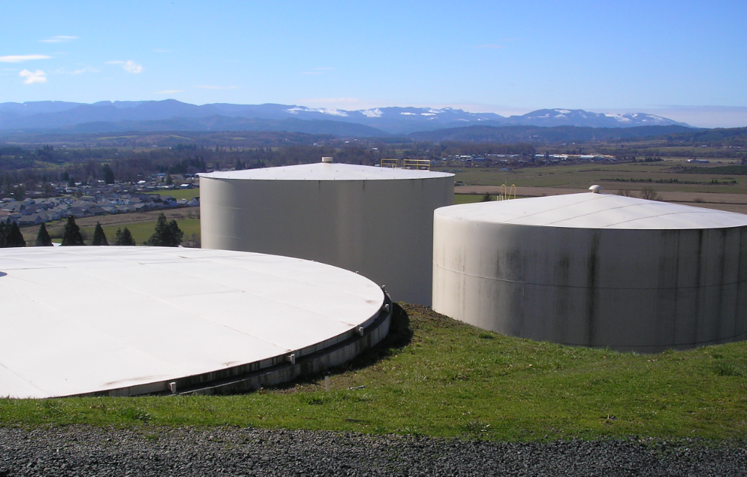

Distribution System Optimization
Oregon Health Authority - Drinking Water Services

Slide 2
Distribution System Optimization
What is Optimization?
Tanks and Reservoirs
  Purpose
  Disinfection v. Distribution
  Contact Time v. Water Age
  Baffling, Mixing & Turnover
  Pathways for Contamination
Distribution
  Effective Sampling
  Chlorine Residual & DBPs
  Flushing
  Cross Connection/Backflow Prevention
Additional Resources
Notes:
So what is optimization? Optimization is a process that includes identifying the desired level of performance, establishing performance goals, and making improvements and monitoring performance to meet those goals. The process follows the multiple barrier approach in that each major unit process within a treatment plant (e.g. coagulation, flocculation, sedimentation, and filtration) provides an added barrier to the passage of pathogens through the plant.

Slide 3
What is optimization?
Optimization is a process (not an event)
Follows multiple barrier approach
Includes identifying the desired level of performance (water quality goals and levels of service)
Data integrity is key to making good decisions.
Notes:
So what is optimization? Optimization is a process that includes identifying the desired level of performance, establishing performance goals, and making improvements and monitoring performance to meet those goals. The process follows the multiple barrier approach in that each major unit process within a treatment plant (e.g. coagulation, flocculation, sedimentation, and filtration) provides an added barrier to the passage of pathogens through the plant.

Slide 4
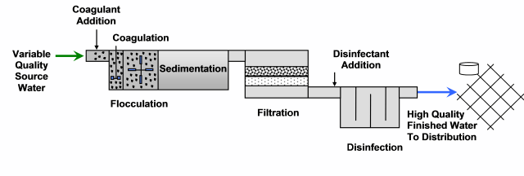
Oregon AWOP Overview
The objective of Oregon’s Area Wide Optimization Program is to educate water system operators in optimizing principles with the ultimate goal of improving public health protection.
Focus is on conventional and direct filtration (other technologies are also addressed in support of Region 8/9/10 collaborative efforts).

Slide 5
National Optimization Efforts
Started with rapid rate plants (“microbial removal” turbidity goals).
Development of tools and goals

Slide 6
National Optimization Efforts
Tools now have extended uses…
  Alternative filtration (slow sand & membrane);
  Disinfection byproducts;
  Distribution systems;
  Groundwater;
  Chloramination;
  Lead and copper; and
  Arsenic treatment optimization.

Slide 7
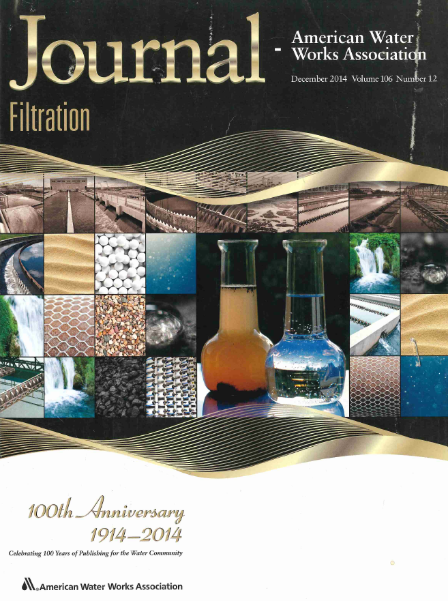
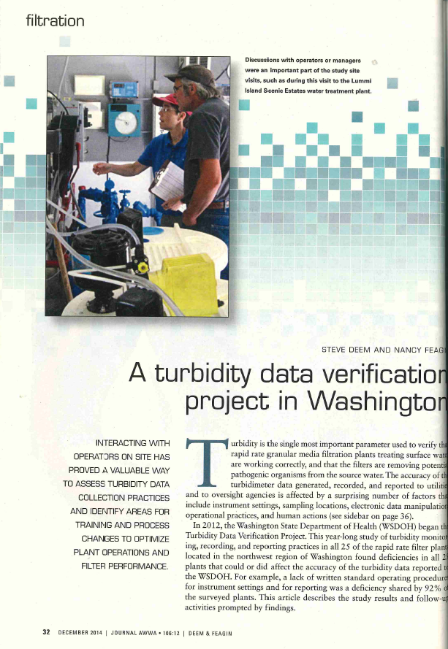
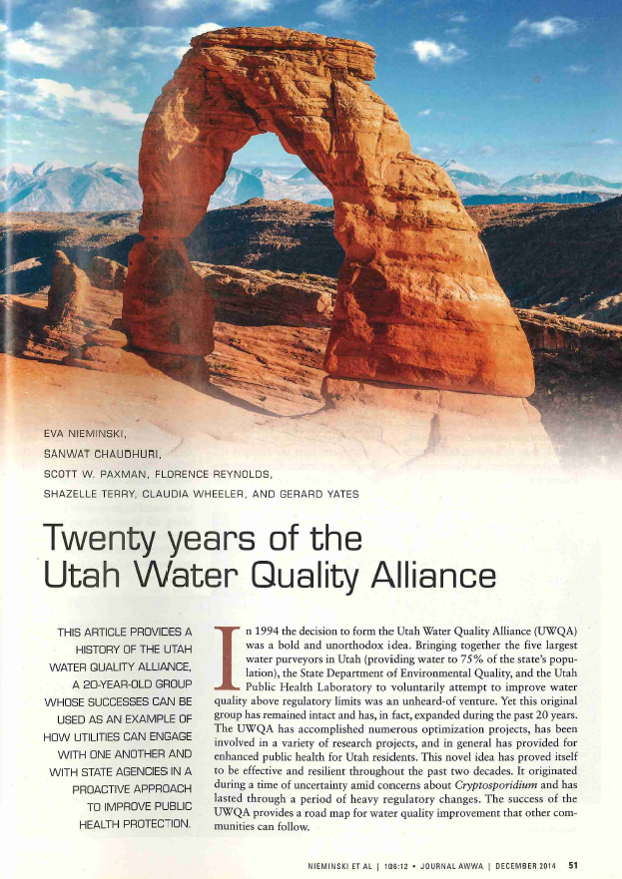
Journal Articles
December 2014
Notes:
The December 2014 JAWWA has two articles of interest. The first is on Washington’s turbidity data integrity verification project (an AWOP activity). The second article is on the success of the Utah Water Quality Alliance.

Slide 8


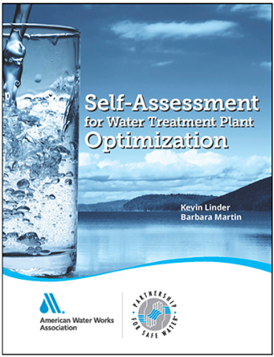
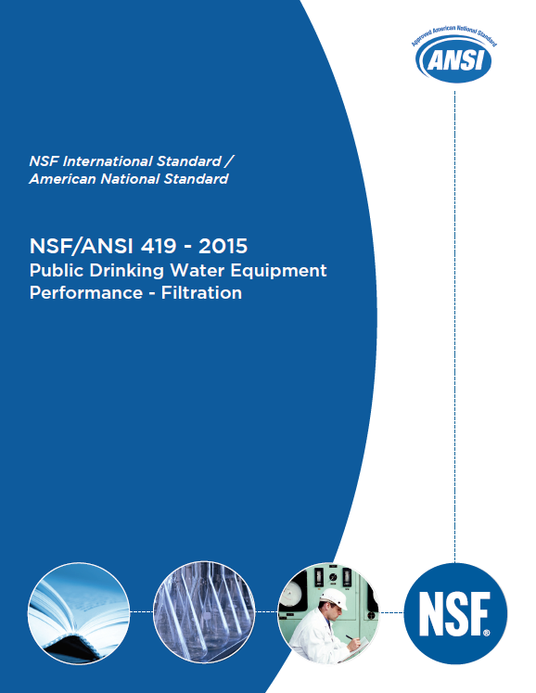
Contributions to References

Slide 9
Development of Optimization Goals
Identify achievable goals to support process optimization.
Results in better public health protection.
Potential added benefits includes cost savings to the water utility.

Slide 10

Distribution System Optimization Goals
  https://www.dep.pa.gov/Business/Water/BureauSafeDrinkingWater/DistributionOptimization/Pages/Optimization-Goals.aspx
Secondary Disinfectant | Parameter | Goal
Free Chlorine | Free Chlorine | ≥ 0.20 mg/L at all locations at all times
Chloramines | Monochloramine | ≥ 1.50 mg/L at all locations at all times
 | Free Ammonia | Detectable, but ≤ 0.10 mg/L at Entry Point
 | Free Ammonia Dosing | 4.5 - 5 parts Cl to 1part NH3-N
All | Storage Tank Turnover | ≤ 5 days
 | Storage Tank Mixing | Performance Ratio ≥ 1
 | Disinfectant Byproducts (ideally non-detect) | 20/15 µg/L at Entry Point
 |  | 70/50 µg/L at individual site LRAAs
It is important to note that the goals presented are general goals and are a good starting point for systems that may be considering distribution optimization. A system may wish to establish additional or more stringent goals to ensure enhanced public health protection.
Notes:
Our website offers links to training information as well as general information on optimization and various treatment processes.

Slide 11
What does it mean to have an optimized distribution system?
Optimal… | Generally requires attention to…
Infrastructure | Asset management (AM) and capital improvement programs (CIP) Inventory of assets (age, material, useful life, condition) Expected useful life of inventoried assets Identify levels of service goals Risk assessment (likelihood and consequence of failure for flood, fire, seismic, end of useful life failure, etc.) Estimated costs to replace assets and mitigate risks Develop feasibility studies, basis of design, and other planning documents as needed. Develop long-term (e.g., 20+ year) and short term (e.g., 5-year prioritized list of capital improvement projects and plan (CIP) for routinely updating projects (e.g., every 5 years) Budget and rates to maintain infrastructure (O&M), fulfill CIP projects & timelines, mitigate risks, and hire/retain skilled employees.
Water Quantity | Source & Treatment: Ability to meet ADD and MDD Storage & Distribution: Ability to meet PHD (+FF+…) w/out stagnation Level of Service Goals
Water Quality | Residual Disinfectant (Coliform Bacteria) Disinfection Byproducts (TTHM/HAA5) Corrosion Control - lead/copper/asbestos (from AC pipe)/pH/alkalinity

Slide 12
Today’s Focus
Tanks and Reservoirs
  Purpose
  Disinfections v. Distribution
  Contact Time v. Water Age
  Baffling, Mixing & Turnover
  Pathways for Contamination
Distribution
  Effective Sampling
  Chlorine Residual & DBPs
  Flushing
  Cross Connection/BF Prevention
Notes:
So what is optimization? Optimization is a process that includes identifying the desired level of performance, establishing performance goals, and making improvements and monitoring performance to meet those goals. The process follows the multiple barrier approach in that each major unit process within a treatment plant (e.g. coagulation, flocculation, sedimentation, and filtration) provides an added barrier to the passage of pathogens through the plant.

Slide 13
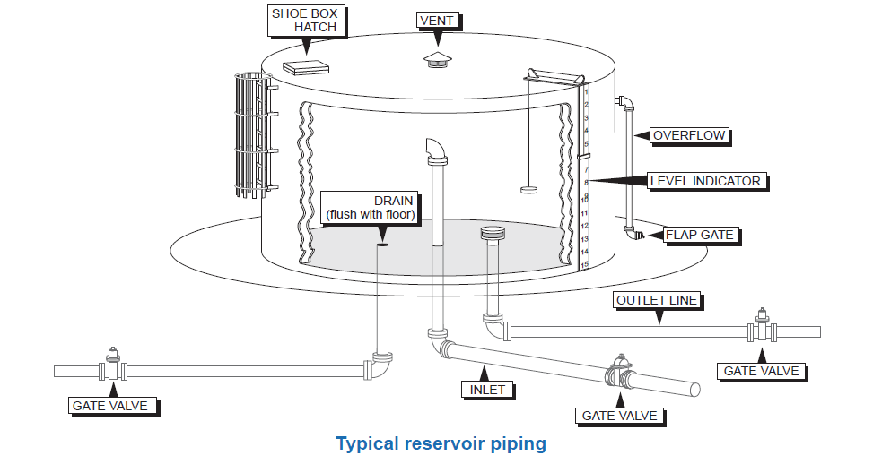
Tanks and Reservoirs

Slide 14
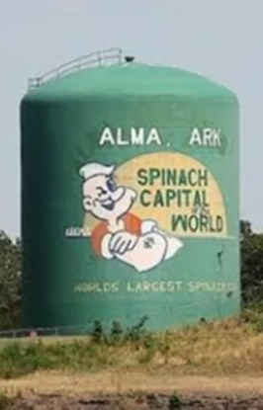
What purpose do tanks serve?
Disinfection tanks:
  Provide contact time needed for disinfection
  Commonly referred to as “clearwells” (although clearwell can also refer to pump wet well or raw water storage, regulators typically call tanks clearwells if they are used to provide disinfection contact time)
  Chlorine is the most common form of disinfectant, which is routinely injected into the influent of clearwells (sometimes it is injected prior to other treatment).
  Located between source/filtration and first customer
Distribution tanks and reservoirs:
  Primarily equalize water supply to reduce
    demands on pumping.
  Filled by dedicated pump mains, gravity flow, or
    distribution system pressures (“float on the system”)
  Located in the distribution system beyond first customer
Notes:
Our website offers links to training information as well as general information on optimization and various treatment processes.

Slide 15
Disinfection & Other Functions
Disinfection - CT:
  Pathogens like E. coli, viruses, and Giardia are inactivated (killed) when in contact with a disinfectant concentration for a sufficient amount of time.
  Studies have determined what disinfectant Concentration and contact Time is needed for various pathogens – this is known as CT_{required}
  Actual disinfectant Concentration at the clearwell effluent or distribution system entry point (EP) x contact Time provided in the clearwell is the achieved CT….
    C x T = CT_{achieved}
  Adequate disinfection occurs when….. CT_{achieved} > CT_{required}
Distribution Other functions include:
  Pressure maintenance
  Fire storage
  Emergency storage
  Reduce energy costs associated with pumping
  Controlling pressure transients
Notes:
Our website offers links to training information as well as general information on optimization and various treatment processes.

Slide 16
Plotting EP Chlorine Residual w/ CT_{achieved} and CT_{required}
  Plotting achieved & required CT versus entry point (EP) chlorine residual can be another way help you visualize seasonal variability and optimize disinfection practices.
CT_{achieved}
Chlorine Residual
CT_{required}
Notes:
Our website offers links to training information as well as general information on optimization and various treatment processes.

Slide 17
Disinfection Benchmark Profile (ask your regulator)
  Plotting the ratio of CT _{achieved} / CT _{required} for 3.0-log inactivation of Giardia is another way of showing variation in the amount of disinfection achieved and is used to generate a disinfection benchmark.
  Ratio > 1.0 means that disinfection is adequate.
  Ratio > 1.5 could be considered excessive.
Disinfection Benchmark
(Ratio = 1.48)
(CT_{achieved})
------------ = 1
(CT_{required})
Notes:
Our website offers links to training information as well as general information on optimization and various treatment processes.

Slide 18
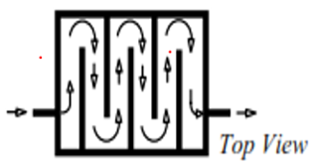
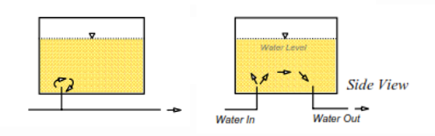
How can tanks adversely impact water quality?
Disinfection:
  Disinfection can be impacted by:
    Size and shape of clearwell
      (high flow path length/width ratio = more contact time)
    Poor Inlet/outlet configuration
    Flow rate and path through the tank
    Improperly designed vents, hatches, and overflows resulting in insect and rodent intrusion
Distribution tanks and reservoirs:
  Distribution water quality can be impacted by the same things resulting in high water age
Notes:
Our website offers links to training information as well as general information on optimization and various treatment processes.

Slide 19
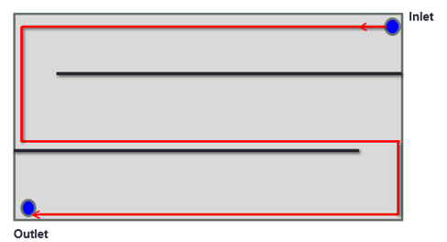
Low L:W Ratio Reduces Disinfection Contact Time
Disinfection:
  Disinfection contact time can be impacted by:
    Size and shape of clearwell
  high flow path length / width ratio = more contact time
Determining L:W Ratio
Length is the longest flow path (red line)
Width is the average channel width for each flow path
Notes:
Our website offers links to training information as well as general information on optimization and various treatment processes.

Slide 20
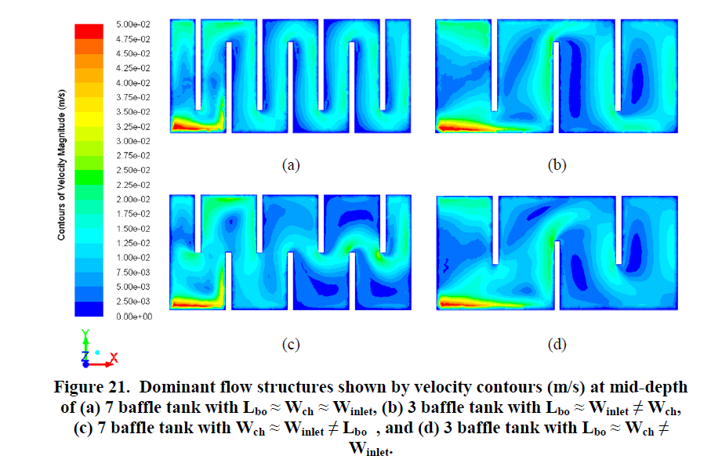
L:W ratio impacts disinfection effective volume, V_{eff}
Low L:W ratios can reduce the effective volume (V_{eff}) and contact time (T) for a given flow (Q) T = V_{eff} / Q
pathogens travel shorter distances through chlorinated water, thereby increasing their chance of survival.
Notes:
Our website offers links to training information as well as general information on optimization and various treatment processes.

Slide 21
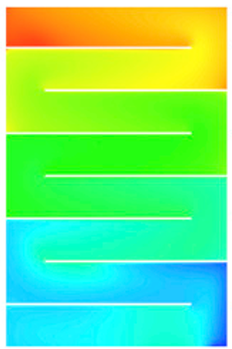
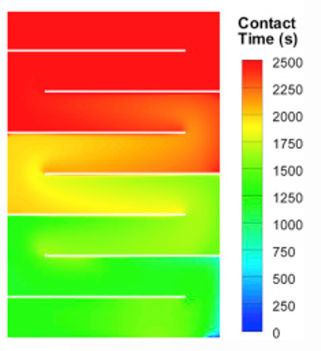
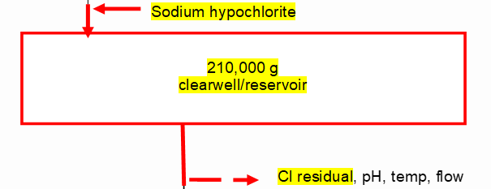
Determining contact time and water age
Disinfection Clearwells:
  Tracer studies are required to verify contact time (modelling using computational fluid dynamics (CFD) can also be a useful tool to determine contact time)
Distribution tanks and reservoirs:
  CFD modelling can be a powerful tool to evaluate water age and mixing improvements.
Notes:
Our website offers links to training information as well as general information on optimization and various treatment processes.

Slide 22
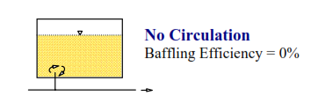



Baffling Efficiency
Once you know the time (T) from the tracer study, you can determine a baffling efficiency factor for a clearwell
  Baffling factor (%) = Time (min) x Flow During Tracer Study (gpm)
Clearwell Volume During Tracer Study (gal)
Notes:
Our website offers links to training information as well as general information on optimization and various treatment processes.

Slide 23
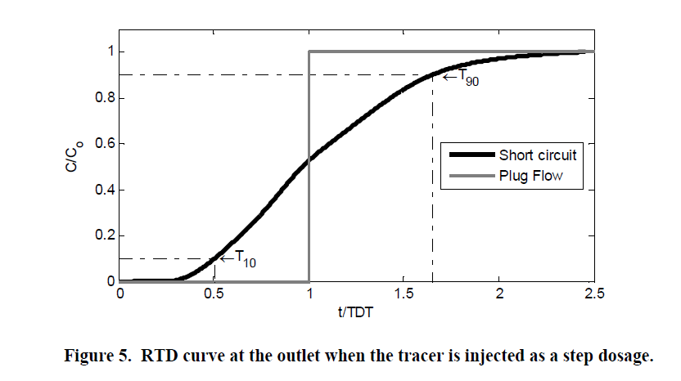
100% Baffling Efficiency
Step-dose tracer study curves are strikingly different for plug flow conditions.
T₁₀ = the time at which 10% of the tracer is detected
T₁₀₀ = the time at which 100% of the tracer is detected
←T₁₀₀ (Plug Flow)
Notes:
Our website offers links to training information as well as general information on optimization and various treatment processes.

Slide 24
Step-dose tracer study curves
Step-dose tracer study curves start to resemble plug flow with longer contact times the higher the baffling efficiency.
Notes:
Our website offers links to training information as well as general information on optimization and various treatment processes.

Slide 25
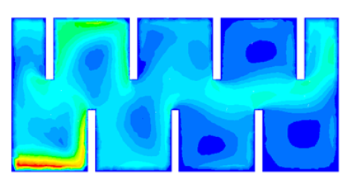
Baffling, short-circuiting and effective contact volume
Baffling factors can also be applied to current clearwell volumes to determine an effective volume (V_{eff})
V_{eff} in gallons = Baffling Factor (% expressed as a decimal) x Clearwell Volume (gal)
Dead zones =
unusable contact volume
pathogens get swept up in faster currents, short-circuiting the dead zones as they travel through the effective clearwell volume.
Dead zone
Dead zone
Notes:
Our website offers links to training information as well as general information on optimization and various treatment processes.

Slide 26
Impacts of high water age in distribution systems
  Water age refers to the time it takes for water to travel from its source to consumers and is influenced by distribution system flow velocities and pipe lengths. Residence time in reservoirs is probably the most important contributor to age.
  Distribution tanks contributing to higher water age results in lower chlorine residuals, which can allow biofilm to develop, sometimes causing coliform detections.
  Chlorine reacts with organics over time to form disinfection byproducts (e.g., TTHM & HAA5)
biofilm
Notes:
Our website offers links to training information as well as general information on optimization and various treatment processes.

Slide 27
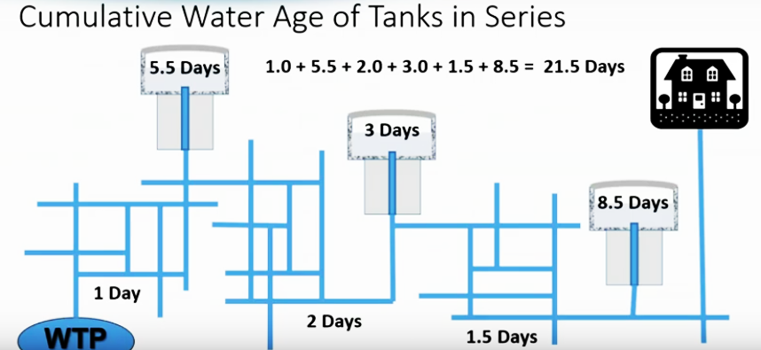
Water age accumulates
Keep water age < 5 days
Notes:
Our website offers links to training information as well as general information on optimization and various treatment processes.

Slide 28
Turnover & tank mixing reduce water age
Fully mixed storage tanks that are frequently turned over minimizes average water age.
Turnover time is the amount of time that it takes for the volume of the water in a tank to be completely replaced. For example, if a 1-million-gallon tank draws 20% of its tank volume once per day, the total volume of the tank (1 million gallons) will be replaced in 5 days.
  Turnover is a function of operations (management of system demands and storage levels)
Tanks and reservoirs not used for disinfection are often designed or modified to improve mixing. The goal is to convert a heterogeneous condition (plug flow) into a homogenous condition (e.g., a continuously stirred tank reactor or “CSTR”)
  Mixing is a function of:
    Tank design
    Environmental factors (temperature)
    Operations
Notes:
Our website offers links to training information as well as general information on optimization and various treatment processes.

Slide 29
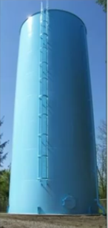
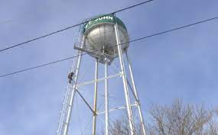
Tank Design
  Standpipes and elevated tanks can be more difficult to mix
Notes:
Our website offers links to training information as well as general information on optimization and various treatment processes.

Slide 30
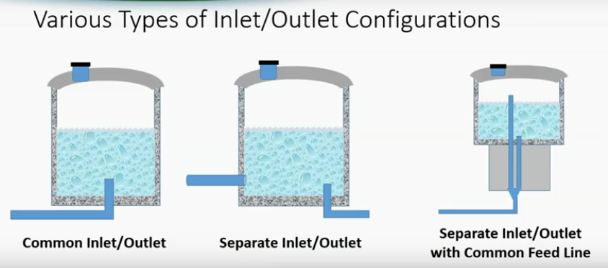
Inlet Configuration
  Tanks that “float” on the system with a single inlet/outlet are also more difficult to mix
Notes:
Our website offers links to training information as well as general information on optimization and various treatment processes.

Slide 31




Environmental Factors
  Thermal stratification hinders good mixing
+/- 5°C can adversely affect DBP formation
Notes:
Our website offers links to training information as well as general information on optimization and various treatment processes.

Slide 32

Isothermal (same temperature)
  Isothermal conditions facilitate mixing
Notes:
Our website offers links to training information as well as general information on optimization and various treatment processes.

Slide 33
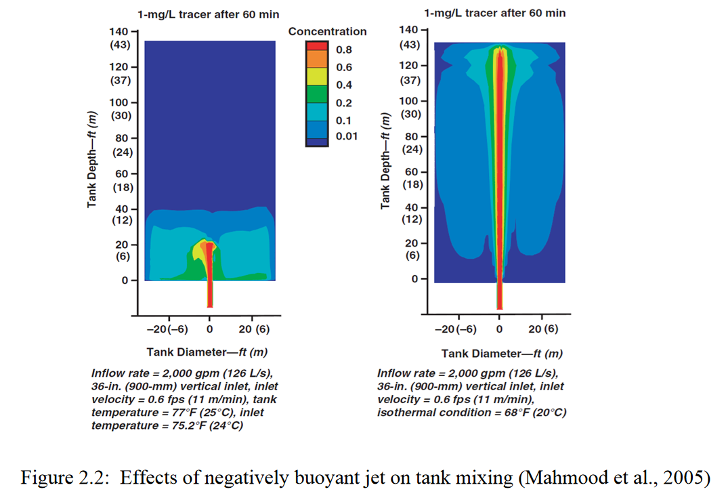

Thermal Stratification vs. Isothermal Conditions
  Tank Temp = 77 °F Tank Temp = 68 °F
  Influent Temp = 75.2 °F Influent Temp = 68 °F
Notes:
Our website offers links to training information as well as general information on optimization and various treatment processes.

Slide 34

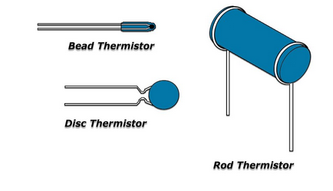
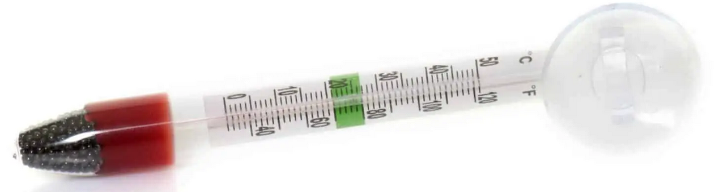
Measuring temperature at different depths
  NTC thermistors suspended in a tank at various levels can log temperature data over time to assess seasonal changes in tank temperatures and assess stratification
  thermistor suspended from a float
  Thermistors connected to a weighted drop line
Notes:
Our website offers links to training information as well as general information on optimization and various treatment processes.

Slide 35

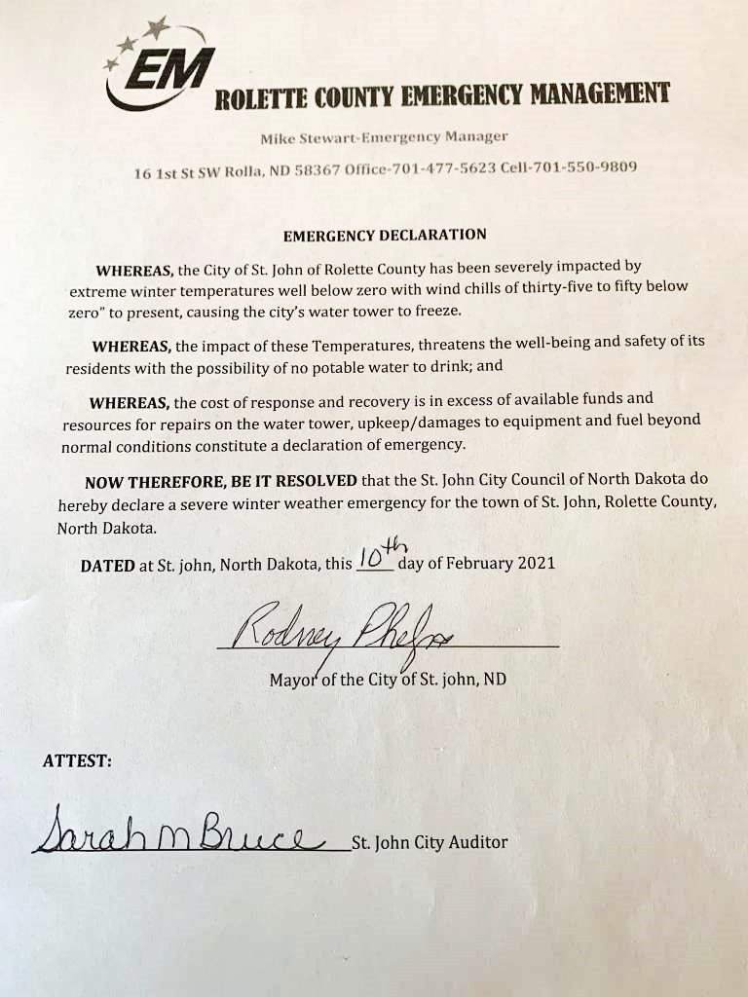
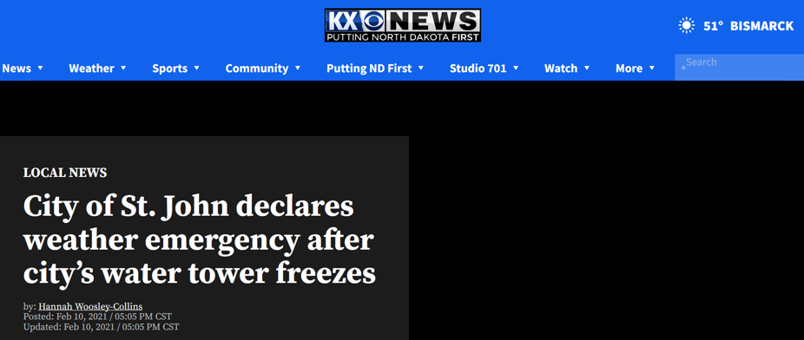
Freezing is also not good
  Water Tower
  St. John, North Dakota
  February 2021
  Wind Chill -35°F to -50°F
  High winds knocked off insulation around inlet pipe causing it to freeze
Notes:
Our website offers links to training information as well as general information on optimization and various treatment processes.

Slide 36
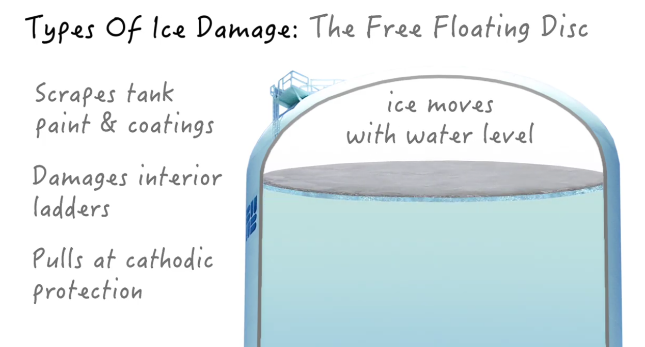
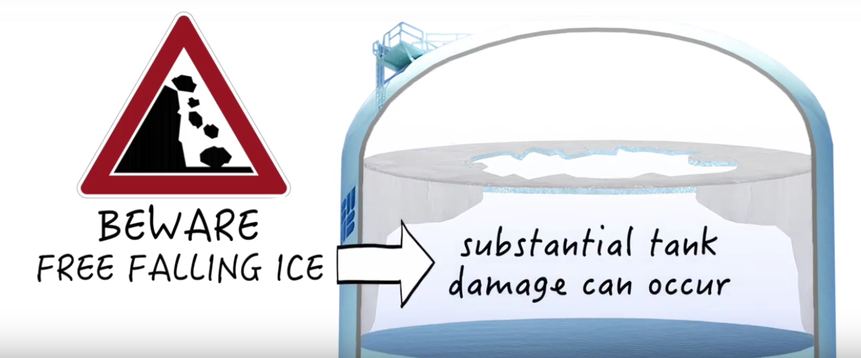
Ice can damage internal coatings and structures
https://www.ixomwatercare.com/video/1977/ice-prevention-white-board
Notes:
Our website offers links to training information as well as general information on optimization and various treatment processes.

Slide 37
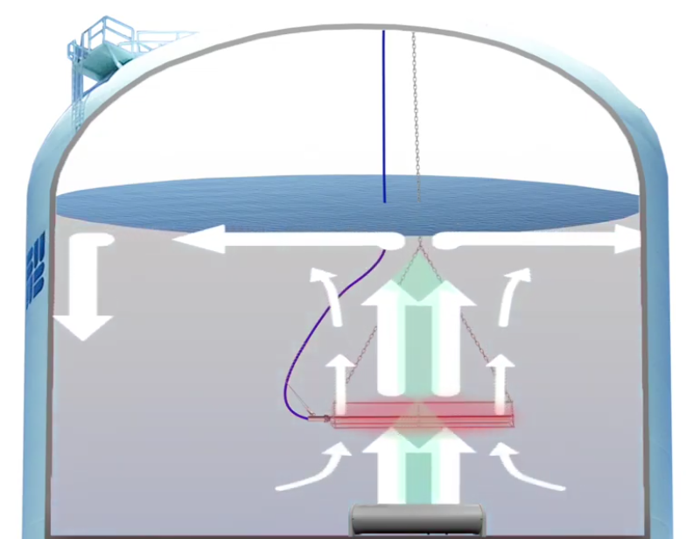
Heaters can also be used either as a stand-alone solution or in tandem with mixers
IXOM Mixer and Heater
https://www.ixomwatercare.com/
Notes:
Our website offers links to training information as well as general information on optimization and various treatment processes.

Slide 38
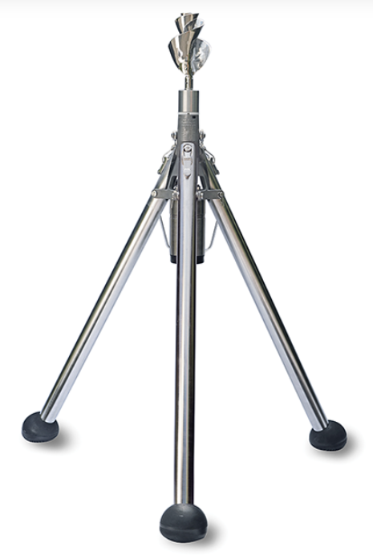
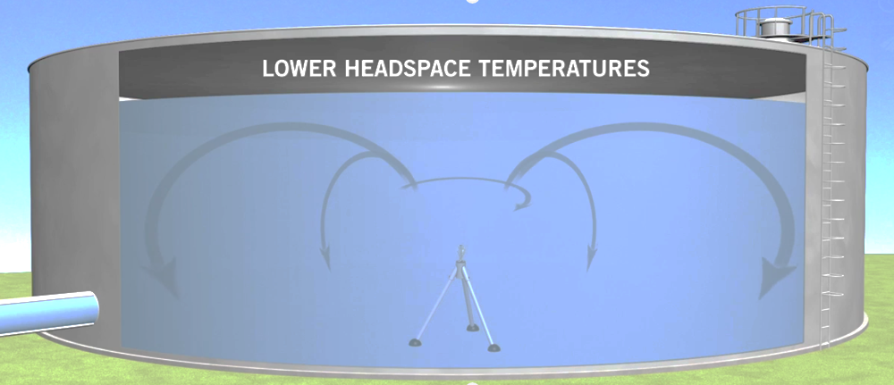
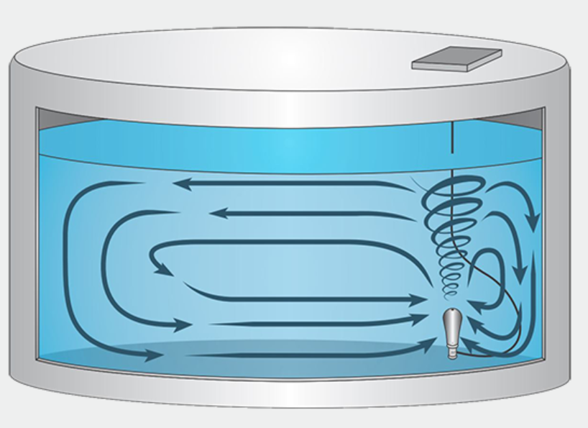
Mixers can help with challenging tank configurations and prevent thermal stratification and freezing
PAX jet vortex & impeller mixers
https://www.paxwater.com/tank-mixer
Notes:
Our website offers links to training information as well as general information on optimization and various treatment processes.

Slide 39
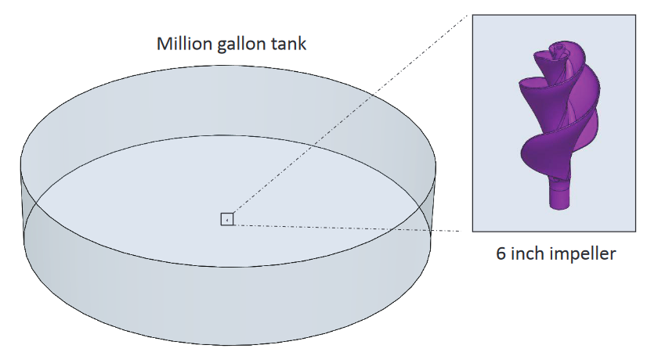
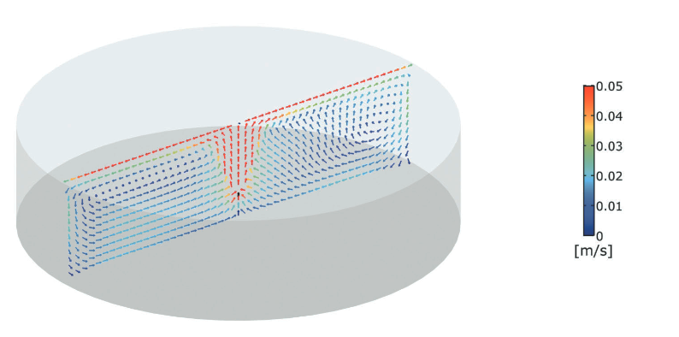
CFD modelling helps determine the best solution
https://79614.fs1.hubspotusercontentna1.net/hub/79614/file15758143.pdf/case_study_cfd_012011.pdf
https://www.paxwater.com/tank-mixer
Notes:
Our website offers links to training information as well as general information on optimization and various treatment processes.

Slide 40
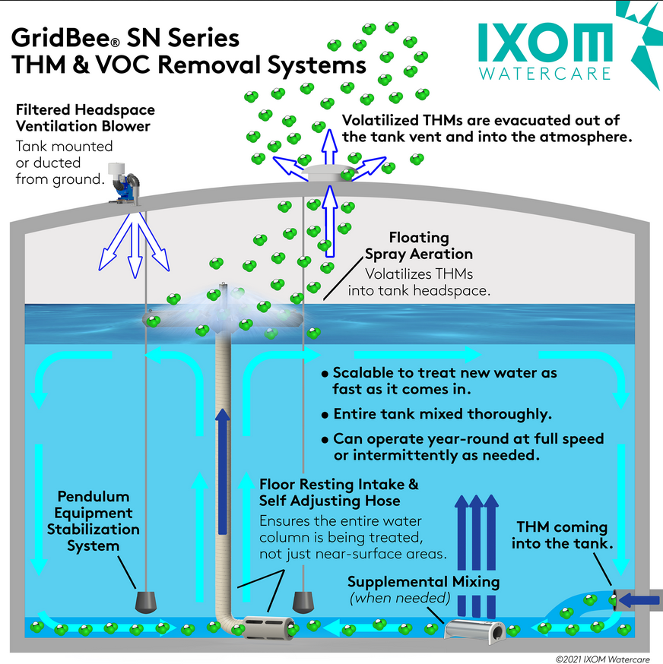
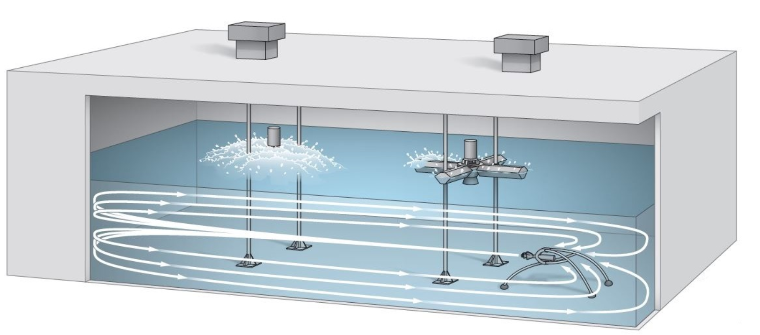
Mixers & spray aerators can reduce volatile disinfection byproducts like TTHMs
← IXOM Mixer and Aerator
https://www.ixomwatercare.com/
↓ PAX Aerators
https://4psi.net/THM%20Removal-overview.php
Notes:
Our website offers links to training information as well as general information on optimization and various treatment processes.

Slide 41
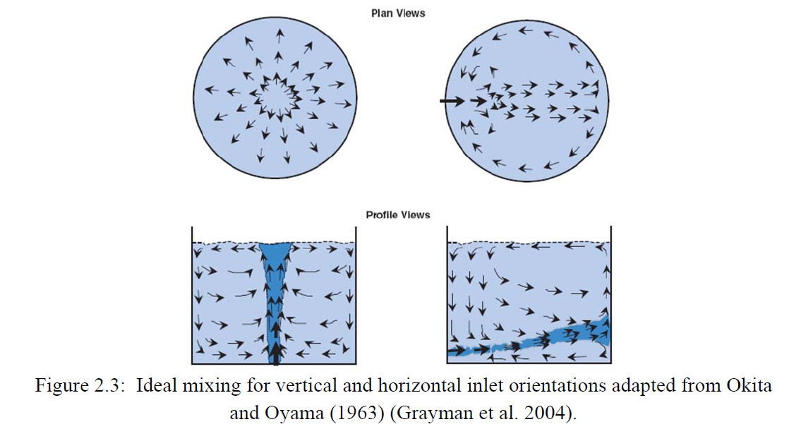
Operational Improvements - Influent Momentum
Influent momentum can be increased to promote mixing by increasing the influent flow rate or decreasing the inlet diameter
  http://www.sdarws.com/assets/impactsofmixingonstoragetankwaterquality.pdf
Notes:
Our website offers links to training information as well as general information on optimization and various treatment processes.

Slide 42
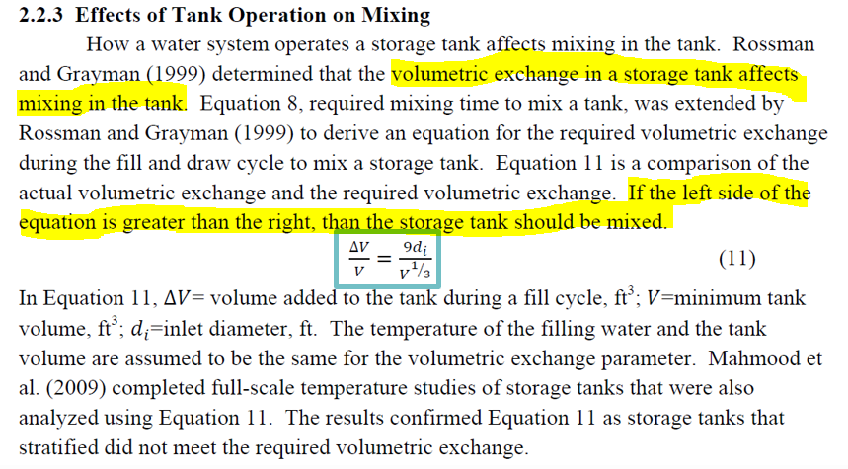
Operational Improvements – Modifying Fill Cycles
  http://www.sdarws.com/assets/impactsofmixingonstoragetankwaterquality.pdf
Notes:
Our website offers links to training information as well as general information on optimization and various treatment processes.

Slide 43
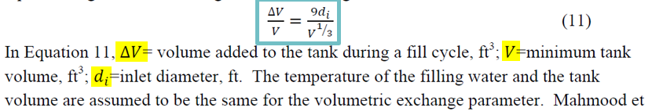
A spreadsheet can be set up to estimate if the volume added to the tank during a fill cycle is adequate for mixing.
The spreadsheet can be very simple…
Notes:
Our website offers links to training information as well as general information on optimization and various treatment processes.

Slide 44

Or more complicated to be able to adjust flows to get the fill volume.
Notes:
Our website offers links to training information as well as general information on optimization and various treatment processes.

Slide 45
Turnover time is determined from influent flow and average tank volume over the course of one or more fill cycles.
For a single fill cycle:
Days to Turnover a Tank = Average Tank Volume in MG
Tank Influent Flow in MGD
For multiple fill cycles:
Average the average tank volumes for all the individual fill cycles
Average the influent flow rates for all the individual fill cycles
Days to Turnover a Tank = Average of Average Tank Volumes in MG
Average of Tank Influent Flows in MGD
Notes:
Our website offers links to training information as well as general information on optimization and various treatment processes.

Slide 46
You can develop a spreadsheet to test multiple fill scenarios quickly and provide tank levels in feet and flow in both GPM and MGD…
Notes:
Our website offers links to training information as well as general information on optimization and various treatment processes.

Slide 47

…or you can download a free spreadsheet for evaluating both turnover and mixing in tanks
Instructions: https://www.epa.gov/sites/default/files/2021-05/documents/storage-tank-spreadsheet-assessment-protocol.pdf
Direct link to spreadsheet:
https://www.google.com/url?sa=t&rct=j&q=&esrc=s&source=web&cd=&ved=2ahUKEwjPjpuk8OD2AhV9IjQIHZg5Cr8QFnoECEYQAQ&url=https%3A%2F%2Fwww.epa.gov%2Fsites%2Fproduction%2Ffiles%2F2021-05%2Fstorage-tank-assessment-spreadsheet.xlsx&usg=AOvVaw0C9xreDO_KQcxLWpnFCe5T
Notes:
Our website offers links to training information as well as general information on optimization and various treatment processes.

Slide 48
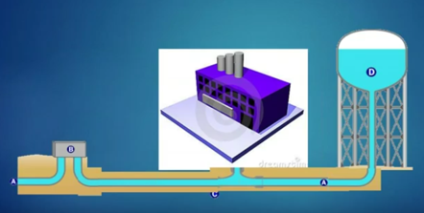
Modify operations to your advantage to improve water turnover and reduce water age, biofilm, and DBPs.
Consider changes to pumping to make better use of system demands in aiding turnover.
Notes:
Our website offers links to training information as well as general information on optimization and various treatment processes.

Slide 49
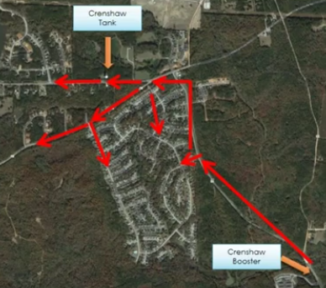
Re-routing the flow of water may be needed in some cases.
Crenshaw Tank
Here is an example showing the tank is filled from the distribution system pressure (it floats on the system), which results in low turnover in the tank.
Booster Station
Notes:
Our website offers links to training information as well as general information on optimization and various treatment processes.

Slide 50
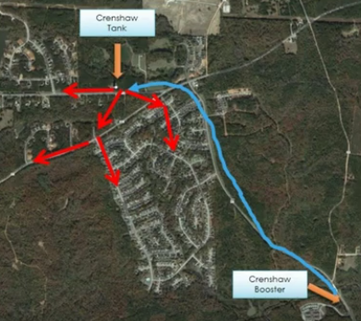
Re-routing the flow of water may be needed in some cases.
Crenshaw Tank
Flows were routed to the tank first from the pump station through a dedicated pump main
Booster Station
Notes:
Our website offers links to training information as well as general information on optimization and various treatment processes.

Slide 51
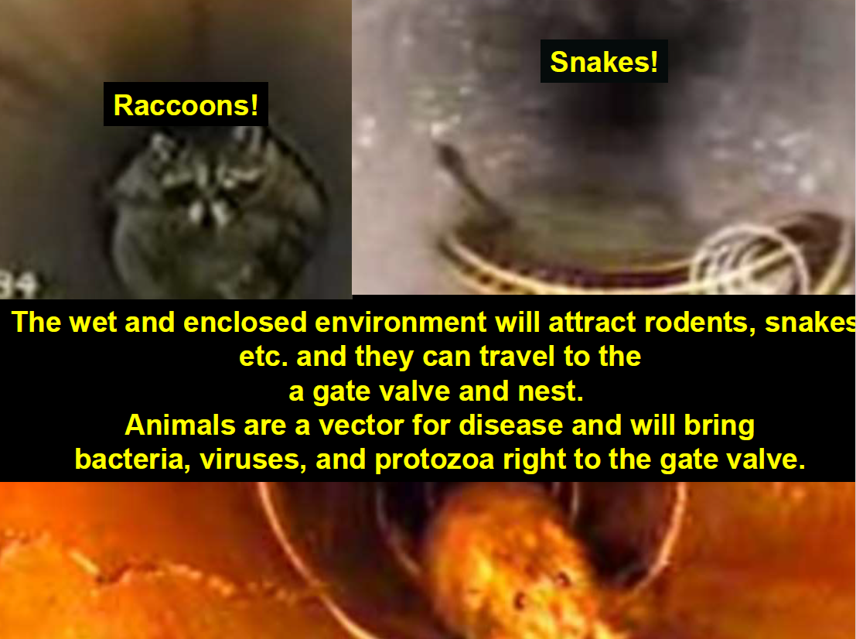
Pathways for contamination in tanks and reservoirs (includes clearwells)
Notes:
Our website offers links to training information as well as general information on optimization and various treatment processes.

Slide 52
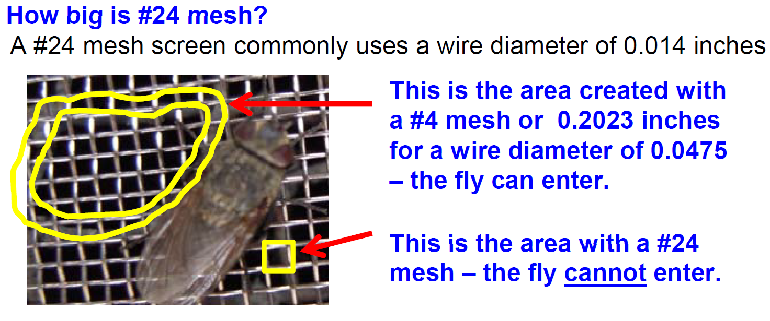
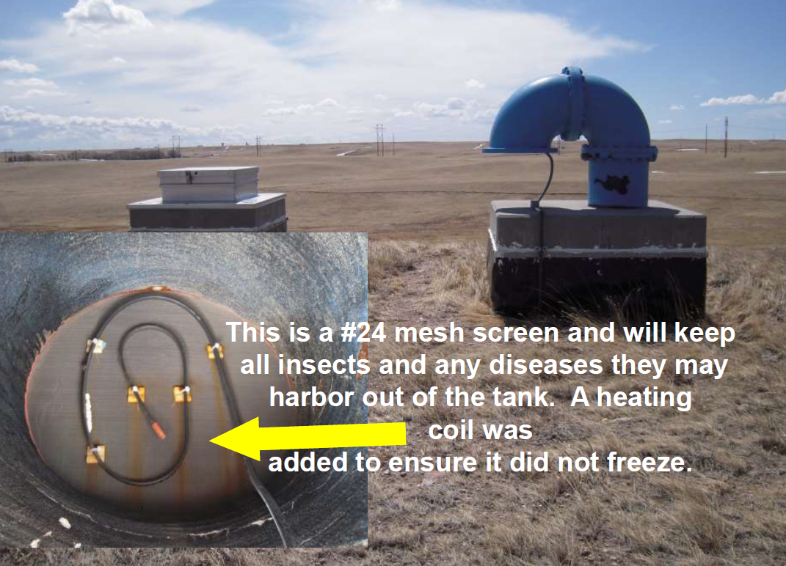
Vents
Vent screens should keep out insects (#24 mesh stainless steel screen is a good option with a coarser outer screen to protect the mesh from damage) – same recommendation applies to wellhead vents.
Notes:
Our website offers links to training information as well as general information on optimization and various treatment processes.

Slide 53
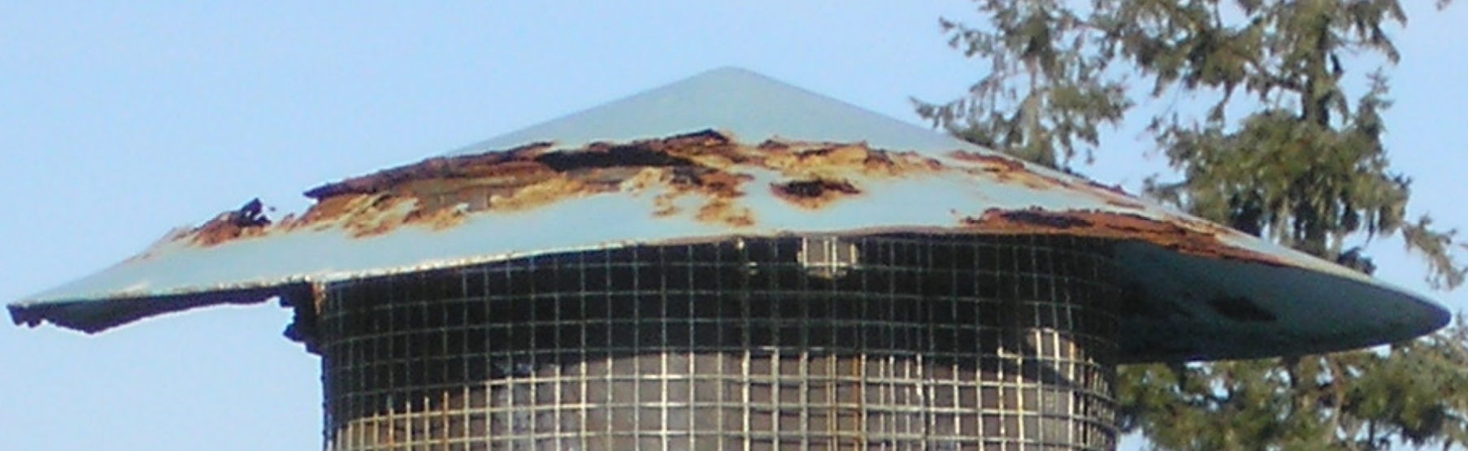
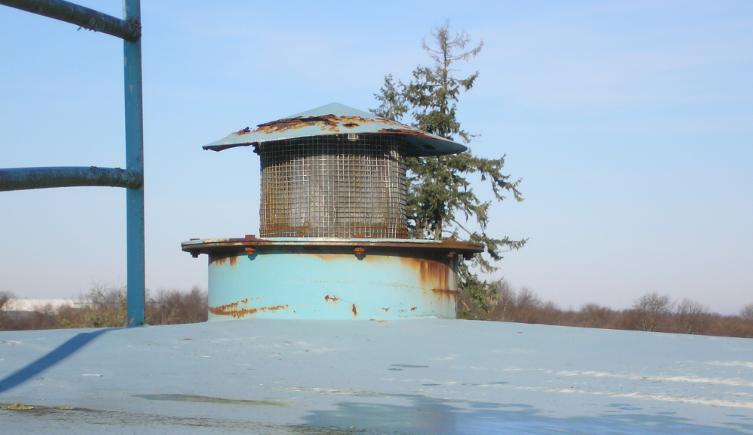
Right idea with the screen…wrong idea letting the top rust out.
Notes:
Our website offers links to training information as well as general information on optimization and various treatment processes.

Slide 54
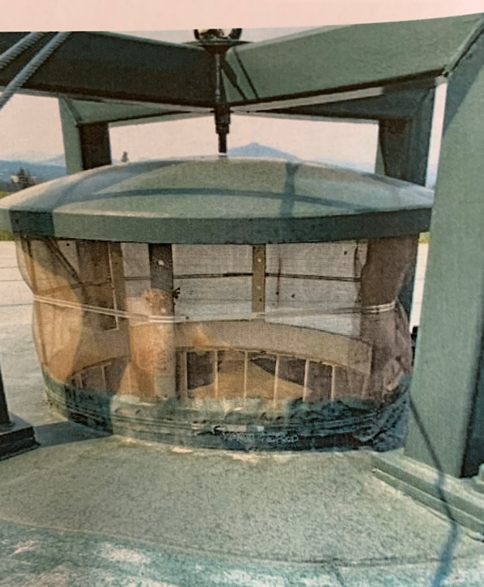

Where are these flies coming from?
Notes:
Our website offers links to training information as well as general information on optimization and various treatment processes.

Slide 55



Overflows
Ensure overflow flap valves are well maintained and terminate above water and/or ground surface.
Notes:
Our website offers links to training information as well as general information on optimization and various treatment processes.

Slide 56


Flap valve was stuck in open position. Screen is torn and mesh is too course.
Notes:
Our website offers links to training information as well as general information on optimization and various treatment processes.

Slide 57

Notes:
Our website offers links to training information as well as general information on optimization and various treatment processes.

Slide 58

Notes:
Our website offers links to training information as well as general information on optimization and various treatment processes.

Slide 59

Remember the flies?
This is the overflow screen from the same tank.
Notes:
Our website offers links to training information as well as general information on optimization and various treatment processes.

Slide 60

Hatches
Ensure hatches keep out debris and secured.
  Overlapping “shoebox” style lid
  Locked
  Raised 4” curb
Notes:
Our website offers links to training information as well as general information on optimization and various treatment processes.

Slide 61


Climb that ladder!
Notes:
Our website offers links to training information as well as general information on optimization and various treatment processes.

Slide 62

Notice any unusual staining as it could indicate a problem.
Notes:
Our website offers links to training information as well as general information on optimization and various treatment processes.

Slide 63

Check gutter drains
Notes:
Our website offers links to training information as well as general information on optimization and various treatment processes.

Slide 64

Or better yet, retrofit to a better solution.
Notes:
Our website offers links to training information as well as general information on optimization and various treatment processes.

Slide 65

Check wellheads for excessive corrosion and inadequate or missing well vent screens
Notes:
Our website offers links to training information as well as general information on optimization and various treatment processes.

Slide 66

Distribution

Slide 67

Effective Sampling
  Sampling should be carefully planned as good operational decisions depend upon valid data.
  Flush / waste the water in the service line before collecting a sample, but avoid over-flushing.
  Stable water quality (i.e., temperature, residual) is not used as an indicator of adequate flushing.
                USEPA
                “Falmouth Hydrant Sampler”
https://www.epa.gov/sdwa/hydrant-sampler-procedure-and-parts-lists
Notes:
Our website offers links to training information as well as general information on optimization and various treatment processes.

Slide 68

Develop sampling protocols & calculate flush times
Calculating flush times provides a consistent & technically sound approach for sample collection*
  Based this flush time on the service line length, diameter, and pre-determined flow rate.
12” main
6” main
Intended
Sample site
* Based on Draft Distribution System Guideline for Obtaining a Representative Sample for Optimization,
Opflow (January 2009).
Notes:
Our website offers links to training information as well as general information on optimization and various treatment processes.

Slide 69
Calculated Flush Time (CFT) Method
Four main steps:
Estimate length and diameter of service line / hydrant piping.
Determine necessary flush time (CFT) based on pipe length, diameter, and anticipated flow rate.
Open tap, begin flushing, and confirm flow rate (adjust flow rate and/or flush time if needed).
After twice the calculated flush time, collect the sample.
12” main
6” main
Intended
Sample site
Notes:
Our website offers links to training information as well as general information on optimization and various treatment processes.

Slide 70

Calculated Flush Time (CFT) – Example Calculation
Notes:
Our website offers links to training information as well as general information on optimization and various treatment processes.

Slide 71
Calculated Flush Time (CFT) – Rule of Thumb
Based on the CFT concepts, but allows for quick determination (one-time sample sites).
Applies to “common” locations (standard pipe diameter and relatively close to the main).
    Hydrants: < 20’ & 6” diameter hydrant lead
    Taps: < 100’ & 3/4” diameter service line
Assumes constant flow rate (20 gpm for hydrants, 2 gpm for taps).
RULE OF THUMB
Hydrants: 3 minute flush
Taps: 2 minute flush
Notes:
Our website offers links to training information as well as general information on optimization and various treatment processes.

Slide 72







US EPA TSC
“Falmouth Hydrant Sampler”
Notes:
Our website offers links to training information as well as general information on optimization and various treatment processes.

Slide 73

US EPA TSC
Hydrant Sampling Procedure
Dry barrel hydrants, the most common type of hydrant, are designed to be operated with their valves fully open. The “Falmouth” Hydrant Sampler was designed to allow the hydrant valve to be fully open, while collecting samples in a controlled, safe manner.
Notes:
Our website offers links to training information as well as general information on optimization and various treatment processes.

Slide 74
Chlorine Residual
Importance of routinely monitoring disinfectant residual:
  Free chlorine residual is an excellent indicator of microbial contamination in the distribution system (Helbling and VanBriesen, 2008).
  In other words, chlorine residual verifies that the physical (and disinfection) barriers are in place.
Notes:
Our website offers links to training information as well as general information on optimization and various treatment processes.

Slide 75



Chlorine Mapping – 3 Steps
  Use existing knowledge about the distribution system to identify sample locations, measure chlorine residuals, and plot the data on a map.
  Low residual ◄► High water age
Notes:
Our website offers links to training information as well as general information on optimization and various treatment processes.

Slide 76
Chlorine Mapping – Using the mapped results
Use the map to identify DBP sample locations
  Sample DBPs (TTHM & HAA5) in low residual areas.
  Sample for:
  TTHM
  HAA5
  Temperature
  Chlorine residual
  pH
  < 0.2 mg/l
Notes:
Our website offers links to training information as well as general information on optimization and various treatment processes.

Slide 77

Chlorine Mapping – Using the mapped results
Use the map to identify DBP sample locations
  Low residual ◄► High water age ► High DBPs
  > 80 ppb TTHM
  < 0.2 mg/l
Notes:
Our website offers links to training information as well as general information on optimization and various treatment processes.

Slide 78

Chlorine Mapping – Predictive Tool
Use the data as a predictive tool for DBP formation
  Long-term sampling can be used to predict DBP levels.
Notes:
Our website offers links to training information as well as general information on optimization and various treatment processes.

Slide 79
Chlorine Mapping – Focus Improvements
Target areas for distribution system improvements
  Use the map to identify distribution system capital improvements/O&M Changes. Continue sampling to evaluate the impact.
  CIP Projects & O&M Changes
  Reduce “A” St. Waterline
  Loop “B” and “C” Avenues
  Lower operating level in
    “D” Street tank
  > 0.5 mg/l
Notes:
Our website offers links to training information as well as general information on optimization and various treatment processes.

Slide 80
Chlorine Mapping – Proceed Cautiously
DO NOT make big changes with the system until adequate data is collected and studied
  Repeat sampling several times to confirm results.
  Consider hydraulic influences (tanks filling/drawing) and impact of finished water quality on results.
  Hydraulic modelling may be used to test potential capital improvements, tank level & pumping changes, and other O&M strategies.
  One-time sampling is not sufficient for making process changes!
Notes:
Our website offers links to training information as well as general information on optimization and various treatment processes.

Slide 81
Chlorine Hold Study – Uses and limitations
  Measures the decay of chlorine residual in “bulk” water samples grabbed at a particular location held over several days.
  “bulk” water is water grabbed from a particular sampling location. The measured chlorine residual decay does not reflect downstream water chemistry, which can change due to biofilm, pipe material, tanks, etc.
  Uses:
  Determine chlorine decay rate for tank mixing models
  Identify impacts from source treatment changes
  Identify the degree to which the source impacts chlorine decay (organics)
  Assess maximum DBP formation potential
  Compare raw water chlorine demand to filtered water chlorine demand
  Limitations:
  Measures only decay rate of bulk water sampled at a specific location.
  Does not measure chlorine decay due to downstream conditions.
  Limitations can be mitigated by measuring chlorine decay at several upstream and downstream locations to help pinpoint what segment contributes most to the decay.
Notes:
Our website offers links to training information as well as general information on optimization and various treatment processes.

Slide 82

Chlorine Hold Study – Materials
  “bulk” water is water grabbed from a particular sampling location and measured at set times for chlorine residual and TTHM/HAA5.
  Materials needed:
  5 chlorine-demand free amber glass bottles (recommended 1-L bottles) with Teflon-lined caps (one extra bottle is recommended in case one breaks during the study)
  Chlorine test kit or pocket colorimeter with powder pillows
  Digital thermometer
  Water bath to maintain temperature of collected samples:
    (ideally) water bath or constant temperature incubator that can be set a specific temperature; or
    a container designed for continuous flow-through of sampled water
  Data Collection Sheet
  Review sampling procedures – see EPA Quick Reference Guide:
  https://www.epa.gov/sites/default/files/2017-04/documents/quick-guide-drinking-water-sample-collection-2ed-update-508.pdf
Notes:
Our website offers links to training information as well as general information on optimization and various treatment processes.

Slide 83
Chlorine Hold Study – Materials, Continued
To determine DBP formation potential, you will need:
  6 sets of sample vials with preservative for TTHM
  6 sets of sample vials with preservative for HAA5
  Label bottles with hold time
Notes:
Our website offers links to training information as well as general information on optimization and various treatment processes.

Slide 84


Chlorine Hold Study – Materials, Continued
Notes:
Our website offers links to training information as well as general information on optimization and various treatment processes.

Slide 85


Chlorine Hold Study – Materials, Continued
Notes:
Our website offers links to training information as well as general information on optimization and various treatment processes.

Slide 86

Chlorine Hold Study – Materials, Continued
There is an excel spreadsheet to help with conducting this study available under “Forms, Tools, & Resources” on-line at:
  www.healthoregon.org/swt
Notes:
Our website offers links to training information as well as general information on optimization and various treatment processes.

Slide 87
Chlorine Hold Study – Procedure
  “bulk” water is water grabbed from a particular sampling location and measured at set times for chlorine residual and TTHM/HAA5.
  Gather materials.
  Identify sample locations and plan. Sample locations can include treatment plant finished water (entry point), after a distribution tank, a dead-end distribution line, etc..
  Prepare the water bath. This will serve as an incubator for the hold study bottles. The temperature in the water bath should be set to the temperature of the water to be sampled.
  Sample.
    Measure chlorine residual twice using a duplicate to confirm initial measurement – calculate and record the average of the two results.
    Record water temperature & pH
    Sample for TTHM & HAA5
Notes:
Our website offers links to training information as well as general information on optimization and various treatment processes.

Slide 88

Example: 3-Day Entry Point (EP) Chlorine Hold Study
  “bulk” water grabbed at the entry point to the distribution system (same location as nitrate sampling, CT sampling, etc.) and measured for chlorine residual decay and DBP formation potential.
Notes:
Our website offers links to training information as well as general information on optimization and various treatment processes.

Slide 89

Example: 3-Day Entry Point (EP) Chlorine Hold Study – Sampling Plan
  Identify a week to conduct the study and a time of day you will be able to consistently check bottles for 3 consecutive days (allow for about 2 hours on the first day and 1-hr for each subsequent day)
Notes:
Our website offers links to training information as well as general information on optimization and various treatment processes.

Slide 90
Example: 3-Day Entry Point (EP) Chlorine Hold Study – Data Table
  Set up a data table to record results.
EP-A Hold Study Sample | Date / Time | Elapsed Time days | Free Cl mg/l | Free Cl Duplicate mg/l | Avg Free Cl mg/l | In (Avg CL / C_{O}) | Temp of Sample °C | Temp of Water Bath °C | Sample pH | TTHM µg/L | HAA5 µg/L
First Sample (Start) | 3/28/22 15:45 | 0 | 1.12 | 1.09 | 1.11 | 0.00 | 19.4 | N/A | 7.25 | 30 | 16
Bottle #1 | 3/28/22 22:00 | 0.26 | 1.01 | 1 | 1.01 | -0.09 (-0.085) | 22.5 | 22.7 | 7.23 | 32 | 18
Bottle #2 | 3/29/22 7:30 | 0.66 | 0.94 | 0.95 | 0.95 | -0.16 | 22.1 | 22.6 | 7.22 | 36 | 19
Bottle #3 | 3/29/22 21:30 | 1.24 | 0.84 | 0.84 | 0.84 | -0.27 | 21.9 | 22.3 | 7.58 | 40 | 21
Bottle #4 | 3/30/22 21:30 | 2.24 | 0.72 | 0.73 | 0.73 | -0.42 | 21.6 | 21.8 | 7.42 | 47 | 25
Bottle #5 | 3/31/22 16:05 | 3.01 | 0.63 | 0.63 | 0.63 | -0.56 | 21.9 | 21.8 | 7.87 | 48 | 25
  Avg Free Cl = [(Free Cl) + (Free Cl Duplicate)]
  2
  LN Average Free Chlorine Residual in mg/l
  Initial Free Chlorine Residual (C_{o}) in mg/l
  For Bottle #1: LN 1.01 mg/l = -0.085
  1.1 mg/l
Notes:
Our website offers links to training information as well as general information on optimization and various treatment processes.

Slide 91



Example: 3-Day Entry Point (EP) Chlorine Hold Study – Water Bath
  On the first day (hold time = 0 days), measure entry point water temperature and set up water bath to match this temperature. In this example, a hose attached to a hose bib at the entry point is allowed to continuously flow through a stock tank placed in the treatment plant.
  Water bath setup should have a way to keep sample bottles in the dark to match conditions in the distribution system as the water travels through pipes/tanks.
Notes:
Our website offers links to training information as well as general information on optimization and various treatment processes.

Slide 92
Example: 3-Day Entry Point (EP) Chlorine Hold Study - Start T = 0 hours
  At the start of the study (hold time = 0 days), measure EP chlorine residual twice using a duplicate to confirm initial measurement – calculate and record the average of the two results).
EP-A Hold Study Sample | Date / Time | Elapsed Time days | Free Cl mg/l | Free Cl Duplicate mg/l | Avg Free Cl mg/l | In (Avg CL / CO) | Temp of Sample °C | Temp of Water Bath °C | Sample pH | TTHM µg/L | HAA5 µg/L
First Sample (Start) | 3/28/22 15:45 | 0 | 1.12 | 1.09 | 1.11 | 0.00 | 19.4 | N/A | 7.25 | 30 | 16
  Record EP water temperature & pH
  Sample EP for TTHM & HAA5
Notes:
Our website offers links to training information as well as general information on optimization and various treatment processes.

Slide 93

Example: 3-Day Entry Point (EP) Chlorine Hold Study - Start T = 0 hours
  At the start of the study (hold time = 0 days), fill all 5 amber sample bottles to the top (do not allow any headspace (no air bubbles).
  Fill a 6th bottle in case one of the 5 breaks.
  Place all sample bottles in the water bath and cover to keep them in the dark
Notes:
Our website offers links to training information as well as general information on optimization and various treatment processes.

Slide 94

Example: 3-Day EP Chlorine Hold Study – T = 6 Hours
  Within 6-hrs (hold time = 0.25 days), measure EP chlorine residual twice using a duplicate to confirm initial measurement – calculate and record the average of the two results).
EP-A Hold Study Sample | Date / Time | Elapsed Time days | Free Cl mg/l | Free Cl Duplicate mg/l | Avg Free Cl mg/l | In (Avg CL / CO) | Temp of Sample °C | Temp of Water Bath °C | Sample pH | TTHM µg/L | HAA5 µg/L
First Sample (Start) | 3/28/22 15:45 | 0 | 1.12 | 1.09 | 1.11 | 0.00 | 19.4 | N/A | 7.25 | 30 | 16
Bottle #1 | 3/28/22 22:00 | 0.26 | 1.01 | 1 | 1.01 | -0.09 | 22.5 | 22.7 | 7.23 | 32 | 18
  On the 2nd day (Hold time = 1 day), measure the chlorine residual of the 1st bottle in the water bath and label bottle:
  EP-A – 1 day – 3/31/2020 – 9:00 AM
  Record EP water temperature & pH
  Sample EP for TTHM & HAA5
Notes:
Our website offers links to training information as well as general information on optimization and various treatment processes.

Slide 95

Example: 3-Day EP Chlorine Hold Study – T = 12 Hours
  Within 12-hrs (hold time = 0.5 days), measure EP chlorine residual twice using a duplicate to confirm initial measurement – calculate and record the average of the two results).
EP-A Hold Study Sample | Date / Time | Elapsed Time days | Free Cl mg/l | Free Cl Duplicate mg/l | Avg Free Cl mg/l | In (Avg CL / CO) | Temp of Sample °C | Temp of Water Bath °C | Sample pH | TTHM µg/L | HAA5 µg/L
First Sample (Start) | 3/28/22 15:45 | 0 | 1.12 | 1.09 | 1.11 | 0.00 | 19.4 | N/A | 7.25 | 30 | 16
Bottle #1 | 3/28/22 22:00 | 0.26 | 1.01 | 1 | 1.01 | -0.09 | 22.5 | 22.7 | 7.23 | 32 | 18
Bottle #2 | 3/29/22 7:30 | 0.66 | 0.94 | 0.95 | 0.95 | -0.16 | 22.1 | 22.6 | 7.22 | 36 | 19
  Record EP water temperature & pH
  Sample EP for TTHM & HAA5
Notes:
Our website offers links to training information as well as general information on optimization and various treatment processes.

Slide 96

Example: 3-Day EP Chlorine Hold Study – T = 24 Hours
  Within 24-hrs (hold time = 1 day), measure EP chlorine residual twice using a duplicate to confirm initial measurement – calculate and record the average of the two results).
EP-A Hold Study Sample | Date / Time | Elapsed Time days | Free Cl mg/l | Free Cl Duplicate mg/l | Avg Free Cl mg/l | In (Avg CL / CO) | Temp of Sample °C | Temp of Water Bath °C | Sample pH | TTHM µg/L | HAA5 µg/L
First Sample (Start) | 3/28/22 15:45 | 0 | 1.12 | 1.09 | 1.11 | 0.00 | 19.4 | N/A | 7.25 | 30 | 16
Bottle #1 | 3/28/22 22:00 | 0.26 | 1.01 | 1 | 1.01 | -0.09 | 22.5 | 22.7 | 7.23 | 32 | 18
Bottle #2 | 3/29/22 7:30 | 0.66 | 0.94 | 0.95 | 0.95 | -0.16 | 22.1 | 22.6 | 7.22 | 36 | 19
Bottle #3 | 3/29/22 21:30 | 1.24 | 0.84 | 0.84 | 0.84 | -0.27 | 21.9 | 22.3 | 7.58 | 40 | 21
  Record EP water temperature & pH
  Sample EP for TTHM & HAA5
Notes:
Our website offers links to training information as well as general information on optimization and various treatment processes.

Slide 97

Example: 3-Day EP Chlorine Hold Study – T = 36-48 Hours
  Within 36-48-hrs (hold time = 1.5 - 2 days), measure EP chlorine residual twice using a duplicate to confirm initial measurement – calculate and record the average of the two results).
EP-A Hold Study Sample | Date / Time | Elapsed Time days | Free Cl mg/l | Free Cl Duplicate mg/l | Avg Free Cl mg/l | In (Avg CL / CO) | Temp of Sample °C | Temp of Water Bath °C | Sample pH | TTHM µg/L | HAA5 µg/L
First Sample (Start) | 3/28/22 15:45 | 0 | 1.12 | 1.09 | 1.11 | 0.00 | 19.4 | N/A | 7.25 | 30 | 16
Bottle #1 | 3/28/22 22:00 | 0.26 | 1.01 | 1 | 1.01 | -0.09 | 22.5 | 22.7 | 7.23 | 32 | 18
Bottle #2 | 3/29/22 7:30 | 0.66 | 0.94 | 0.95 | 0.95 | -0.16 | 22.1 | 22.6 | 7.22 | 36 | 19
Bottle #3 | 3/29/22 21:30 | 1.24 | 0.84 | 0.84 | 0.84 | -0.27 | 21.9 | 22.3 | 7.58 | 40 | 21
Bottle #4 | 3/30/22 21:30 | 2.24 | 0.72 | 0.73 | 0.73 | -0.42 | 21.6 | 21.8 | 7.42 | 47 | 25
  Record EP water temperature & pH
  Sample EP for TTHM & HAA5
Notes:
Our website offers links to training information as well as general information on optimization and various treatment processes.

Slide 98

Example: 3-Day EP Chlorine Hold Study – T = 60-72 Hours
  Within 60-72-hrs (hold time = 2.5 - 3 days), measure EP chlorine residual twice using a duplicate to confirm initial measurement – calculate and record the average of the two results).
EP-A Hold Study Sample | Date / Time | Elapsed Time days | Free Cl mg/l | Free Cl Duplicate mg/l | Avg Free Cl mg/l | In (Avg CL / CO) | Temp of Sample °C | Temp of Water Bath °C | Sample pH | TTHM µg/L | HAA5 µg/L
First Sample (Start) | 3/28/22 15:45 | 0 | 1.12 | 1.09 | 1.11 | 0.00 | 19.4 | N/A | 7.25 | 30 | 16
Bottle #1 | 3/28/22 22:00 | 0.26 | 1.01 | 1 | 1.01 | -0.09 | 22.5 | 22.7 | 7.23 | 32 | 18
Bottle #2 | 3/29/22 7:30 | 0.66 | 0.94 | 0.95 | 0.95 | -0.16 | 22.1 | 22.6 | 7.22 | 36 | 19
Bottle #3 | 3/29/22 21:30 | 1.24 | 0.84 | 0.84 | 0.84 | -0.27 | 21.9 | 22.3 | 7.58 | 40 | 21
Bottle #4 | 3/30/22 21:30 | 2.24 | 0.72 | 0.73 | 0.73 | -0.42 | 21.6 | 21.8 | 7.42 | 47 | 25
Bottle #5 | 3/31/22 16:05 | 3.01 | 0.63 | 0.63 | 0.63 | -0.56 | 21.9 | 21.8 | 7.87 | 48 | 25
  Record EP water temperature & pH
  Sample EP for TTHM & HAA5
Notes:
Our website offers links to training information as well as general information on optimization and various treatment processes.

Slide 99
Example: 3-Day EP Chlorine Hold Study – Tabulated Results
  Complete data table.
EP-A Hold Study Sample | Date / Time | Elapsed Time days | Free Cl mg/l | Free Cl Duplicate mg/l | Avg Free Cl mg/l | In (Avg CL / CO) | Temp of Sample °C | Temp of Water Bath °C | Sample pH | TTHM µg/L | HAA5 µg/L
First Sample (Start) | 3/28/22 15:45 | 0 | 1.12 | 1.09 | 1.11 | 0.00 | 19.4 | N/A | 7.25 | 30 | 16
Bottle #1 | 3/28/22 22:00 | 0.26 | 1.01 | 1 | 1.01 | -0.09 | 22.5 | 22.7 | 7.23 | 32 | 18
Bottle #2 | 3/29/22 7:30 | 0.66 | 0.94 | 0.95 | 0.95 | -0.16 | 22.1 | 22.6 | 7.22 | 36 | 19
Bottle #3 | 3/29/22 21:30 | 1.24 | 0.84 | 0.84 | 0.84 | -0.27 | 21.9 | 22.3 | 7.58 | 40 | 21
Bottle #4 | 3/30/22 21:30 | 2.24 | 0.72 | 0.73 | 0.73 | -0.42 | 21.6 | 21.8 | 7.42 | 47 | 25
Bottle #5 | 3/31/22 16:05 | 3.01 | 0.63 | 0.63 | 0.63 | -0.56 | 21.9 | 21.8 | 7.87 | 48 | 25
Notes:
Our website offers links to training information as well as general information on optimization and various treatment processes.

Slide 100

Example: 3-Day EP Chlorine Hold Study – Graphing Results
Determine Chlorine Residual Decay Rate Constant, K
  Graph ln(Avg C / C_{o}) on the Y-axis versus Elapsed Time (days) on the X-axis.
  The slope of the line is the chlorine residual decay rate constant, k.
  The slope is negative, indicating that the chlorine residual decays rather than increases.
  In this case, the chlorine decay rate constant is -0.1777 or simply 0.1777 1/day
remember the slope of the line is “m” in the equation y=mx+b
= y = -0.1777x - 0.032
Notes:
Our website offers links to training information as well as general information on optimization and various treatment processes.

Slide 101
Example: 3-Day EP Chlorine Hold Study – Predict when residual = 0.2 mg/l
  Add a row for estimated bottle #6 (Est. #6) when the residual will get to 0.2 mg/l
  0.2 mg/l was chosen because it is a well recognized optimized chlorine residual goal.
EP-A Hold Study Sample | Date / Time | Elapsed Time days | Free Cl mg/l | Free Cl Duplicate mg/l | Avg Free Cl mg/l | In (Avg CL / CO) | Temp of Sample °C | Temp of Water Bath °C | Sample pH | TTHM µg/L | HAA5 µg/L
First Sample (Start) | 3/28/22 15:45 | 0 | 1.12 | 1.09 | 1.11 | 0.00 | 19.4 | N/A | 7.25 | 30 | 16
Bottle #1 | 3/28/22 22:00 | 0.26 | 1.01 | 1 | 1.01 | -0.09 | 22.5 | 22.7 | 7.23 | 32 | 18
Bottle #2 | 3/29/22 7:30 | 0.66 | 0.94 | 0.95 | 0.95 | -0.16 | 22.1 | 22.6 | 7.22 | 36 | 19
Bottle #3 | 3/29/22 21:30 | 1.24 | 0.84 | 0.84 | 0.84 | -0.27 | 21.9 | 22.3 | 7.58 | 40 | 21
Bottle #4 | 3/30/22 21:30 | 2.24 | 0.72 | 0.73 | 0.73 | -0.42 | 21.6 | 21.8 | 7.42 | 47 | 25
Bottle #5 | 3/31/22 16:05 | 3.01 | 0.63 | 0.63 | 0.63 | -0.56 | 21.9 | 21.8 | 7.87 | 48 | 25
Est. #6 |  | ? | - | - | 0.2 | ? | - | - | - | - | -
Notes:
Our website offers links to training information as well as general information on optimization and various treatment processes.

Slide 102
Example: 3-Day EP Chlorine Hold Study – Predict when residual = 0.2 mg/l
  Add a row for estimated bottle #6 (Est. #6) when the residual will get to 0.2 mg/l
  0.2 mg/l was chosen because it is a well recognized optimized chlorine residual goal.
Importance of providing a disinfectant residual barrier:
  Studies indicate that a free chlorine residual of 0.2 to 0.5 mg/L is needed to provide adequate protection against microbial contamination (Baribeau, 2005).
  Systems that maintained free chlorine residual of greater than 0.20 mg/L had at least 50% lower rate of coliform occurrence (LeChevallier, 1996).
Notes:
Our website offers links to training information as well as general information on optimization and various treatment processes.

Slide 103
Example: 3-Day EP Chlorine Hold Study – Predict when residual = 0.2 mg/l
  Add a row for estimated bottle #6 (Est. #6) when the residual will get to 0.2 mg/l
  0.2 mg/l was chosen because it is a well recognized optimized chlorine residual goal.
EP-A Hold Study Sample | Date / Time | Elapsed Time days | Free Cl mg/l | Free Cl Duplicate mg/l | Avg Free Cl mg/l | In (Avg CL / CO) | Temp of Sample °C | Temp of Water Bath °C | Sample pH | TTHM µg/L | HAA5 µg/L
First Sample (Start) | 3/28/22 15:45 | 0 | 1.12 | 1.09 | 1.11 | 0.00 | 19.4 | N/A | 7.25 | 30 | 16
Est. #6 |  | 9.6 | - | - | 0.2 | -1.71 | - | - | - | - | -
Initial Concentration, C_{o} = | 1.11 | mg/L
Final Concentration, C = (inside "Estimated" Bottle #9) | 0.2 | mg/L
ln (C/C_{o}) = | -1.71
Chlorine Decay Rate Constant (get from slope of trendline on Cl2RateConstant chart) = k = | -0.1777
"Estimated" Time Bottle #6 = [Ln (C/C_{o}) / k] = | 9.6 | days
Notes:
Our website offers links to training information as well as general information on optimization and various treatment processes.

Slide 104
Example: 3-Day EP Chlorine Hold Study – Predict when residual = 0.01 mg/l
  Add a row for estimated bottle #7 (Est. #7) when the residual will get to 0.01 mg/l
  0.01 mg/l was chosen as it should be the lowest the residual is allowed to go.
EP-A Hold Study Sample | Date / Time | Elapsed Time days | Free Cl mg/l | Free Cl Duplicate mg/l | Avg Free Cl mg/l | In (Avg CL / CO) | Temp of Sample °C | Temp of Water Bath °C | Sample pH | TTHM µg/L | HAA5 µg/L
First Sample (Start) | 3/28/22 15:45 | 0 | 1.12 | 1.09 | 1.11 | 0.00 | 19.4 | N/A | 7.25 | 30 | 16
Est. #6 |  | 9.6 | - | - | 0.2 | -1.71 | - | - | - | - | -
Est. #7 |  | 26.5 |  |  | 0.01 | -4.7
Initial Concentration, C_{o} = | 1.11 | mg/L
Final Concentration, C = (inside "Estimated" Bottle #9) | 0.01 | mg/L
ln (C/C_{o}) = | -4.7
Chlorine Decay Rate Constant (get from slope of trendline on Cl2RateConstant chart) = k = | -0.1777
"Estimated" Time Bottle #6 = [Ln (C/C_{o}) / k] = | 26.5 | days
Notes:
Our website offers links to training information as well as general information on optimization and various treatment processes.

Slide 105
Example: 3-Day EP Chlorine Hold Study – Generate Multiple Estimates
EP-A Hold Study Sample | Date / Time | Elapsed Time days | Free Cl mg/l | Free Cl Duplicate mg/l | Avg Free Cl mg/l | In (Avg CL / CO) | Temp of Sample °C | Temp of Water Bath °C | Sample pH | TTHM µg/L | HAA5 µg/L
First Sample (Start) | 3/28/22 15:45 | 0 | 1.12 | 1.09 | 1.11 | 0.00 | 19.4 | N/A | 7.25 | 30 | 16
Bottle #1 | 3/28/22 22:00 | 0.26 | 1.01 | 1 | 1.01 | -0.09 | 22.5 | 22.7 | 7.23 | 32 | 18
Bottle #2 | 3/29/22 7:30 | 0.66 | 0.94 | 0.95 | 0.95 | -0.16 | 22.1 | 22.6 | 7.22 | 36 | 19
Bottle #3 | 3/29/22 21:30 | 1.24 | 0.84 | 0.84 | 0.84 | -0.27 | 21.9 | 22.3 | 7.58 | 40 | 21
Bottle #4 | 3/30/22 21:30 | 2.24 | 0.72 | 0.73 | 0.73 | -0.42 | 21.6 | 21.8 | 7.42 | 47 | 25
Bottle #5 | 3/31/22 16:05 | 3.01 | 0.63 | 0.63 | 0.63 | -0.56 | 21.9 | 21.8 | 7.87 | 48 | 25
Est. #6 | 4/6/22 12:51 | 8.88 | - | - | 0.23 | -1.58 | - | - | - | - | -
Est. #7 | 4/12/22 9:38 | 14.75 | - | - | 0.08 | -2.62 | - | - | - | - | -
Est. #8 | 4/18/22 6:25 | 20.61 | - | - | 0.03 | -3.66 | - | - | - | - | -
Est. #9 | 4/24/22 3:12 | 26.48 | - | - | 0.01 | -4.71 | - | - | - | - | -
Notes:
Our website offers links to training information as well as general information on optimization and various treatment processes.

Slide 106
Actual and estimated free chlorine residual versus elapsed hold time
Notes:
Our website offers links to training information as well as general information on optimization and various treatment processes.

Slide 107
Free chlorine residual, TTHM, and HAA5 versus elapsed hold time
Notes:
Our website offers links to training information as well as general information on optimization and various treatment processes.

Slide 108

Flushing can help improve turnover (water age) & remove sediments & biofilm in the distribution system…
Strive for annual unidirectional flushing for sediments (5-6 fps)
    (“Chase” dirty water out with clean water)
Flush dead ends more often or install automatic flushers
5-6 fps (sediment removal)
< 5 fps (turnover)
                << Unidirectional flushing
                chases dirty water out with clean water
Notes:
Our website offers links to training information as well as general information on optimization and various treatment processes.

Slide 109



Meter manual and automatic flushers
Manual and automatic flushers should be metered to track water consumption and set flushing flow rates
Notes:
Our website offers links to training information as well as general information on optimization and various treatment processes.

Slide 110

Example flushing record
Establish a meter ID# for each flushing location
Meter flushed water for better water loss accounting
Measure water temp, chlorine residual, and corrosion parameters (pH and/or alkalinity)
Note any customer complaints that may have prompted flushing
Notes:
Our website offers links to training information as well as general information on optimization and various treatment processes.

Slide 111

Account for all water usage – both billable and “other” non-billable (unaccounted for water)
OT BW/FTW
Metered
Flushing
Billable Metered
Connections
Graphing unaccounted for water (“OT”) may help focus efforts and communicate needs to management.
Notes:
Our website offers links to training information as well as general information on optimization and various treatment processes.

Slide 112

Don’t hide water quality issues with flushing.
Chose DBP/Coliform sampling times and locations representative of what customers are drinking on a daily basis (i.e., don’t flush or sample to hide a problem as it not only puts your customers at risk, but also gives you useless water quality data upon which to base operational decisions)
Notes:
Our website offers links to training information as well as general information on optimization and various treatment processes.

Slide 113



Cross Connection & Backflow Prevention
Fully implement cross-
  connection/backflow
  Prevention program
Identify high hazards
Test devices annually

Slide 114

Additional Resources…USEPA
  https://www.epa.gov/dwreginfo/drinking-water-distribution-system-tools-and-resources
Distribution System Evaluation
Distribution System Research
Microbial Growth, Biofilms and Sediments
Disinfectants and Disinfection Byproducts
Water Age
Storage Facility Management
Pressure Management
Water Losses and Main Breaks
Corrosion, Permeation, and Leaching
Cross-Connections and Backflow
Notes:
Our website offers links to training information as well as general information on optimization and various treatment processes.

Slide 115
A spreadsheet is available online from USEPA for evaluating mixing and estimating turnover in tanks
Instructions: https://www.epa.gov/sites/default/files/2021-05/documents/storage-tank-spreadsheet-assessment-protocol.pdf
Direct link to spreadsheet:
https://www.epa.gov/sites/default/files/2021-05/storage-tank-assessment-spreadsheet.xlsx
Notes:
Our website offers links to training information as well as general information on optimization and various treatment processes.

Slide 116

For more information…US EPA
  https://www.epa.gov/sdwa/optimization-reduce-disinfection-byproducts-dbps
Notes:
Our website offers links to training information as well as general information on optimization and various treatment processes.

Slide 117

For more information…PA DEP
  https://www.dep.pa.gov/Business/Water/BureauSafeDrinkingWater/DistributionOptimization/Pages/Optimization-Goals.aspx
Notes:
Our website offers links to training information as well as general information on optimization and various treatment processes.

Slide 118
Distribution System Optimization Goals
  https://www.dep.pa.gov/Business/Water/BureauSafeDrinkingWater/DistributionOptimization/Pages/Optimization-Goals.aspx
Secondary Disinfectant | Parameter | Goal
Free Chlorine | Free Chlorine | ≥ 0.20 mg/L at all locations at all times
Chloramines | Monochloramine | ≥ 1.50 mg/L at all locations at all times
 | Free Ammonia | Detectable, but ≤ 0.10 mg/L at Entry Point
 | Free Ammonia Dosing | 4.5 - 5 parts Cl to 1part NH3-N
All | Storage Tank Turnover | ≤ 5 days
 | Storage Tank Mixing | Performance Ratio ≥ 1
 | Disinfectant Byproducts (ideally non-detect) | 20/15 µg/L at Entry Point
 |  | 70/50 µg/L at individual site LRAAs
It is important to note that the goals presented are general goals and are a good starting point for systems that may be considering distribution optimization. A system may wish to establish additional or more stringent goals to ensure enhanced public health protection.
Notes:
Our website offers links to training information as well as general information on optimization and various treatment processes.

Slide 119


Free Flow Modelling Software…EPANET
  https://www.epa.gov/water-research/epanet
Notes:
Our website offers links to training information as well as general information on optimization and various treatment processes.

Slide 120

For more information…AWWA
  https://awwa.onlinelibrary.wiley.com/doi/10.5942/jawwa.2013.105.0066
https://awwa.onlinelibrary.wiley.com/action/doSearch?AllField=optimized+corrosion+control&SeriesKey=15518833
Notes:
Our website offers links to training information as well as general information on optimization and various treatment processes.

Slide 121

For more information…AWWA PfSW
  https://www.awwa.org/Resources-Tools/Programs/Partnership-for-Safe-Water
Notes:
Our website offers links to training information as well as general information on optimization and various treatment processes.

Slide 122

For more information…OHA
  www.healthoregon.org/swt
  Water System Operations => Surface Water Treatment
Notes:
Our website offers links to training information as well as general information on optimization and various treatment processes.

Slide 123
Questions?
Evan Hofeld
Evan.e.Hofeld@dhsoha.state.or.us
971-200-0288

