Slide 1

www.healthoregon.org/climate
Notes:
State’s Public Health Division – Environmental Public Health Section
One of 16 states and cities funded through the CDC’s Climate-Ready States and Cities Initiative to study and plan for the health effects of climate change.

Slide 2
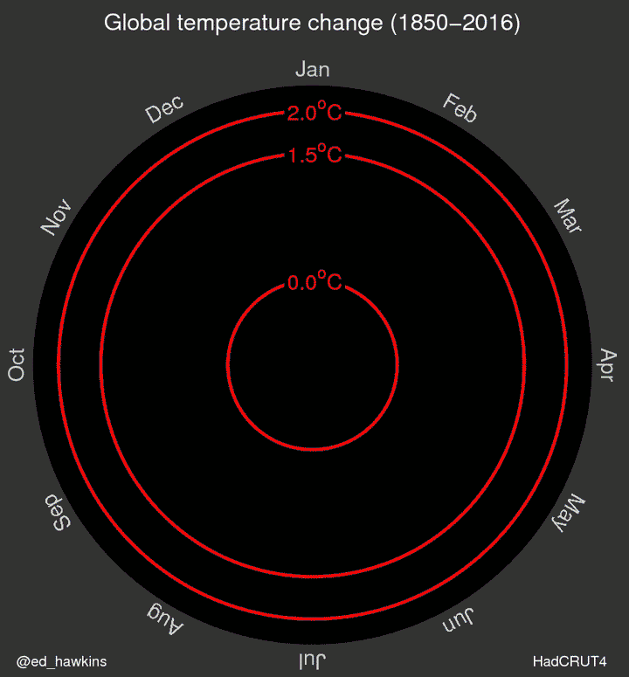
Global Average Temperatures have been increasing
Source: http://www.climate-lab-book.ac.uk/2016/spiralling-global-temperatures/

Slide 3
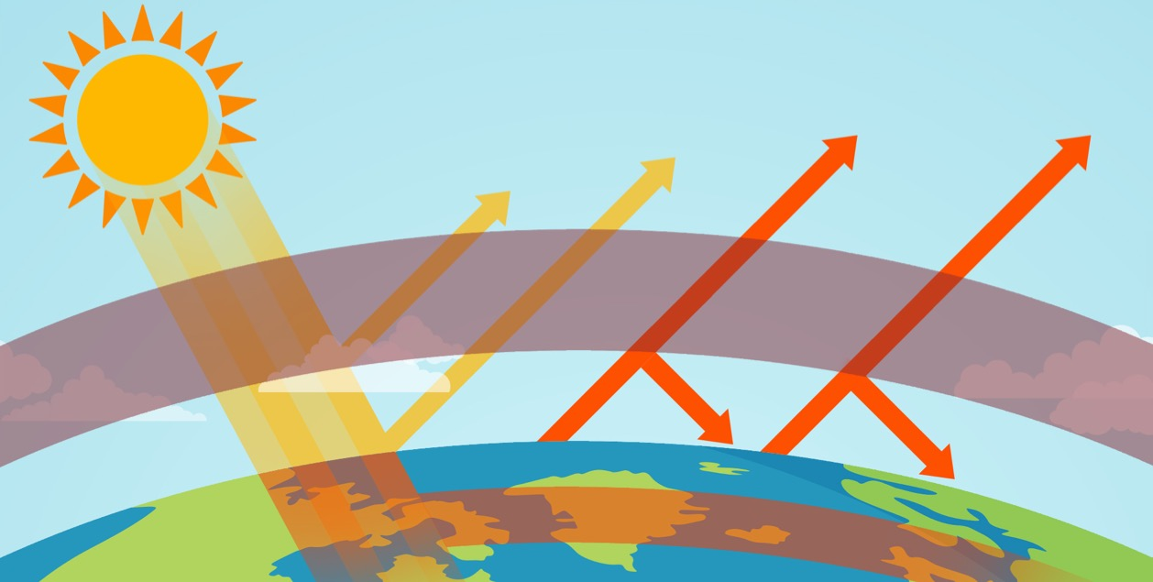
What is Climate Change?
Some solar radiation is reflected back into space
Greenhouse gases act like a blanket
Solar radiation is
trapped in Earth’s
atmosphere
Solar radiation enters Earth’s atmosphere
Notes:
When sunlight reaches the earth’s surface, it can be absorbed into the atmosphere or reflected back into space. Certain gases in the atmosphere prevent the sun’s heat from escaping. These “greenhouse gases,” including water vapor, carbon dioxide, methane, and nitrous oxide, have been increasing. More greenhouse gases in the atmosphere lead to an increase in both average and extreme temperatures, which impact human health.

Slide 4
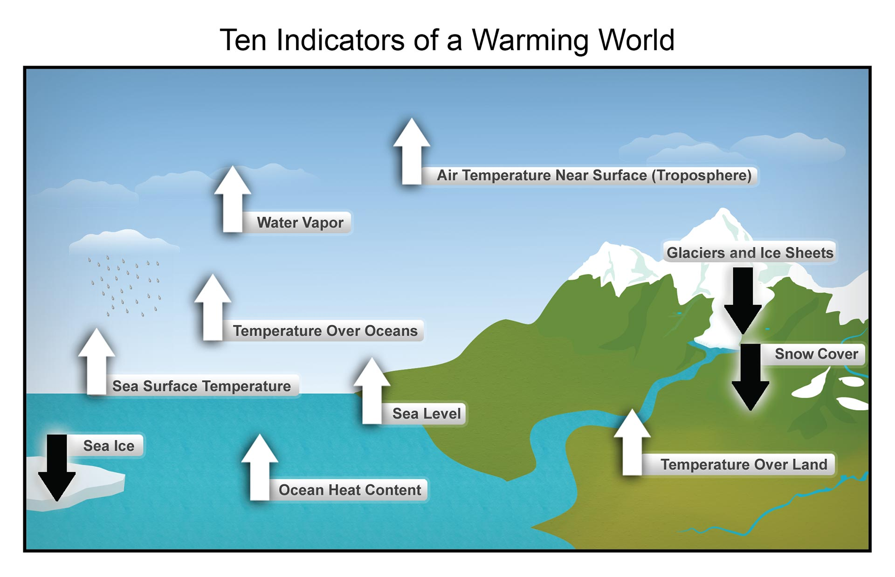
Notes:
And it’s not just temperature and precipitation.
Globally, the evidence goes beyond average temperature: glaciers, ice caps, and oceans are all changing in ways consistent with , and the pace is accelerating faster than climate scientists first estimated in the early IPCC reports.
Here in Oregon, since our first report was published, in addition to recording our hottest year, we also had our lowest snowpack on record. We had one of the most severe fire seasons in modern history and 24 counties declared drought emergencies.

Slide 5
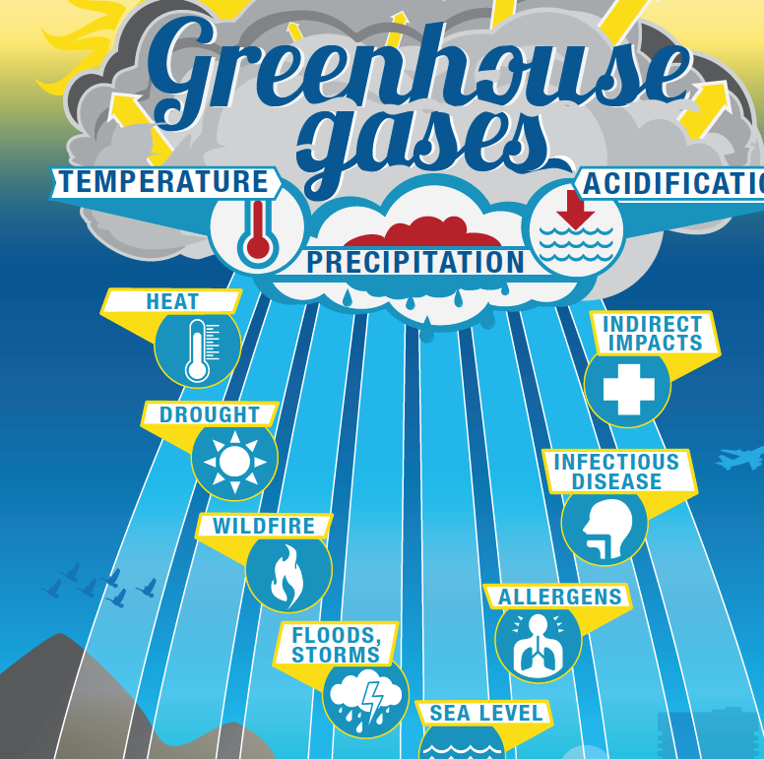
Notes:
Because this is such a complex topic, we asked our communications department to help us create an info-graphic that helps us explain how we get from greenhouse gas emissions to health outcomes (this can also be found online.)
The report looks at 8 different climate impacts depicted in this graphic (heat, drought, wildfire, floods & storms, sea level rise, allergens, infectious disease, indirect impacts).
These impacts are created by changes in temperature, precipitation, and acidification which are in turn created by the increase in greenhouse gases in our atmosphere.

Slide 6
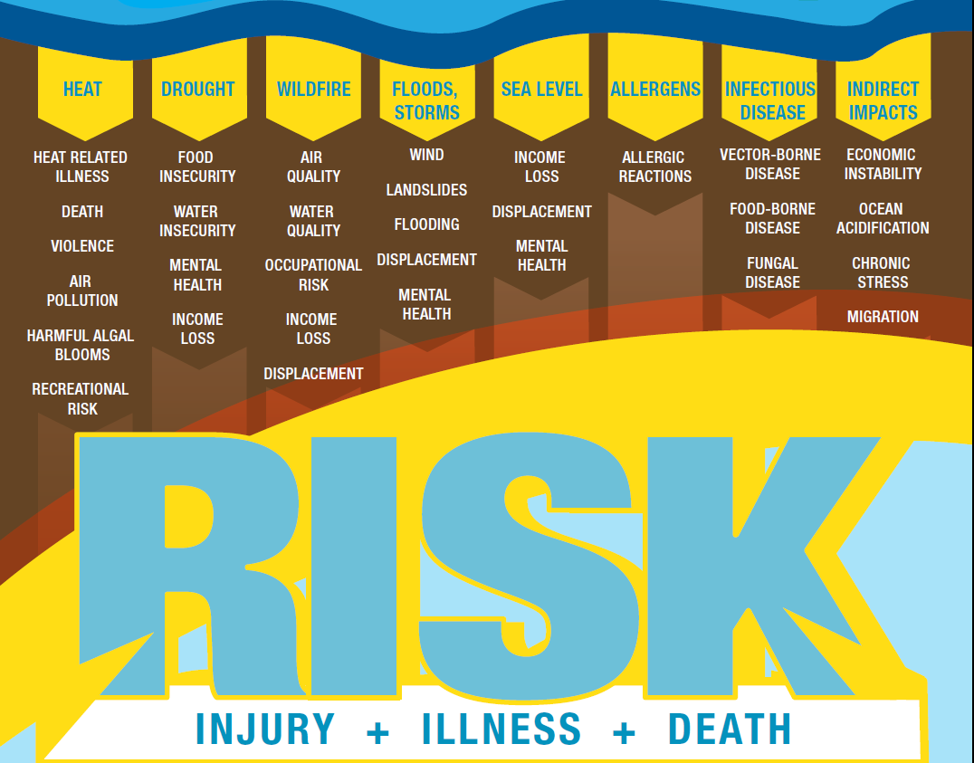
Notes:
This is a continuation of the graphic which shows the health effects considered in the report.
Climate change has the potential to affect economic, social, physical, and mental well-being through many pathways. They can be interrelated in that one event may increase the probability of another to occur. In this graphic we treat each climate impact separately to simplify causal relationships, but recognize that impacts are often interrelated.
This is also not an exhaustive list of health outcomes, but represents the ones that are most supported by current research literature.

Slide 7
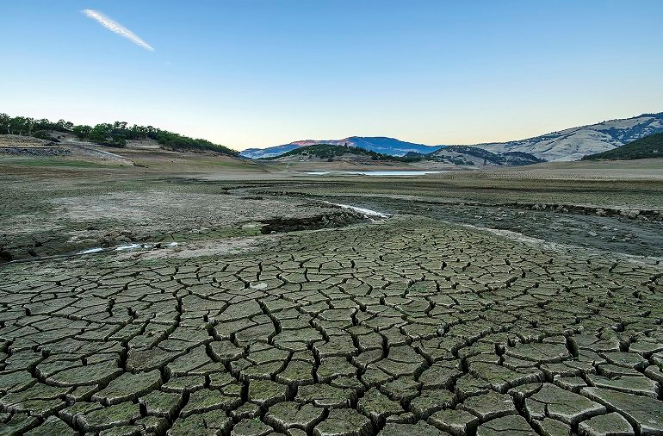
Notes:
Here in Oregon….
Climate scientists say that by 2050, we can expect less snowpack in our mountains, less water in our aquifers, less moisture in our soils...

Slide 8
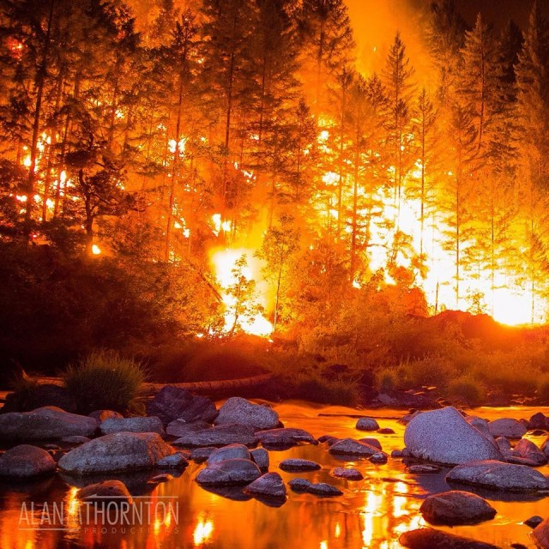
Notes:
By 2050, we can expect 300% more acres burned each year… increasing smoke exposure and further compromising our air quality.

Slide 9
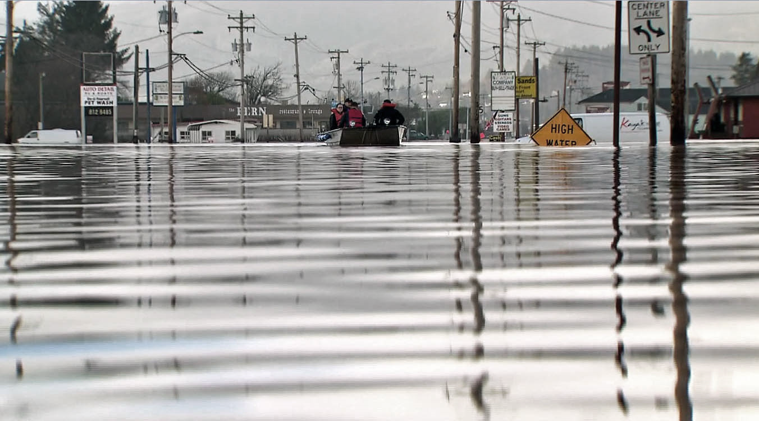
Notes:
By 2050, we can expect more extreme precipitation events, more storms causing communities to flood, coastlines will further erode and landslides will occur more often.

Slide 10
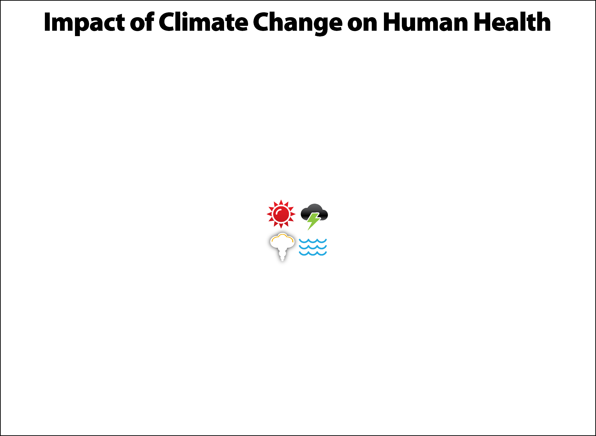
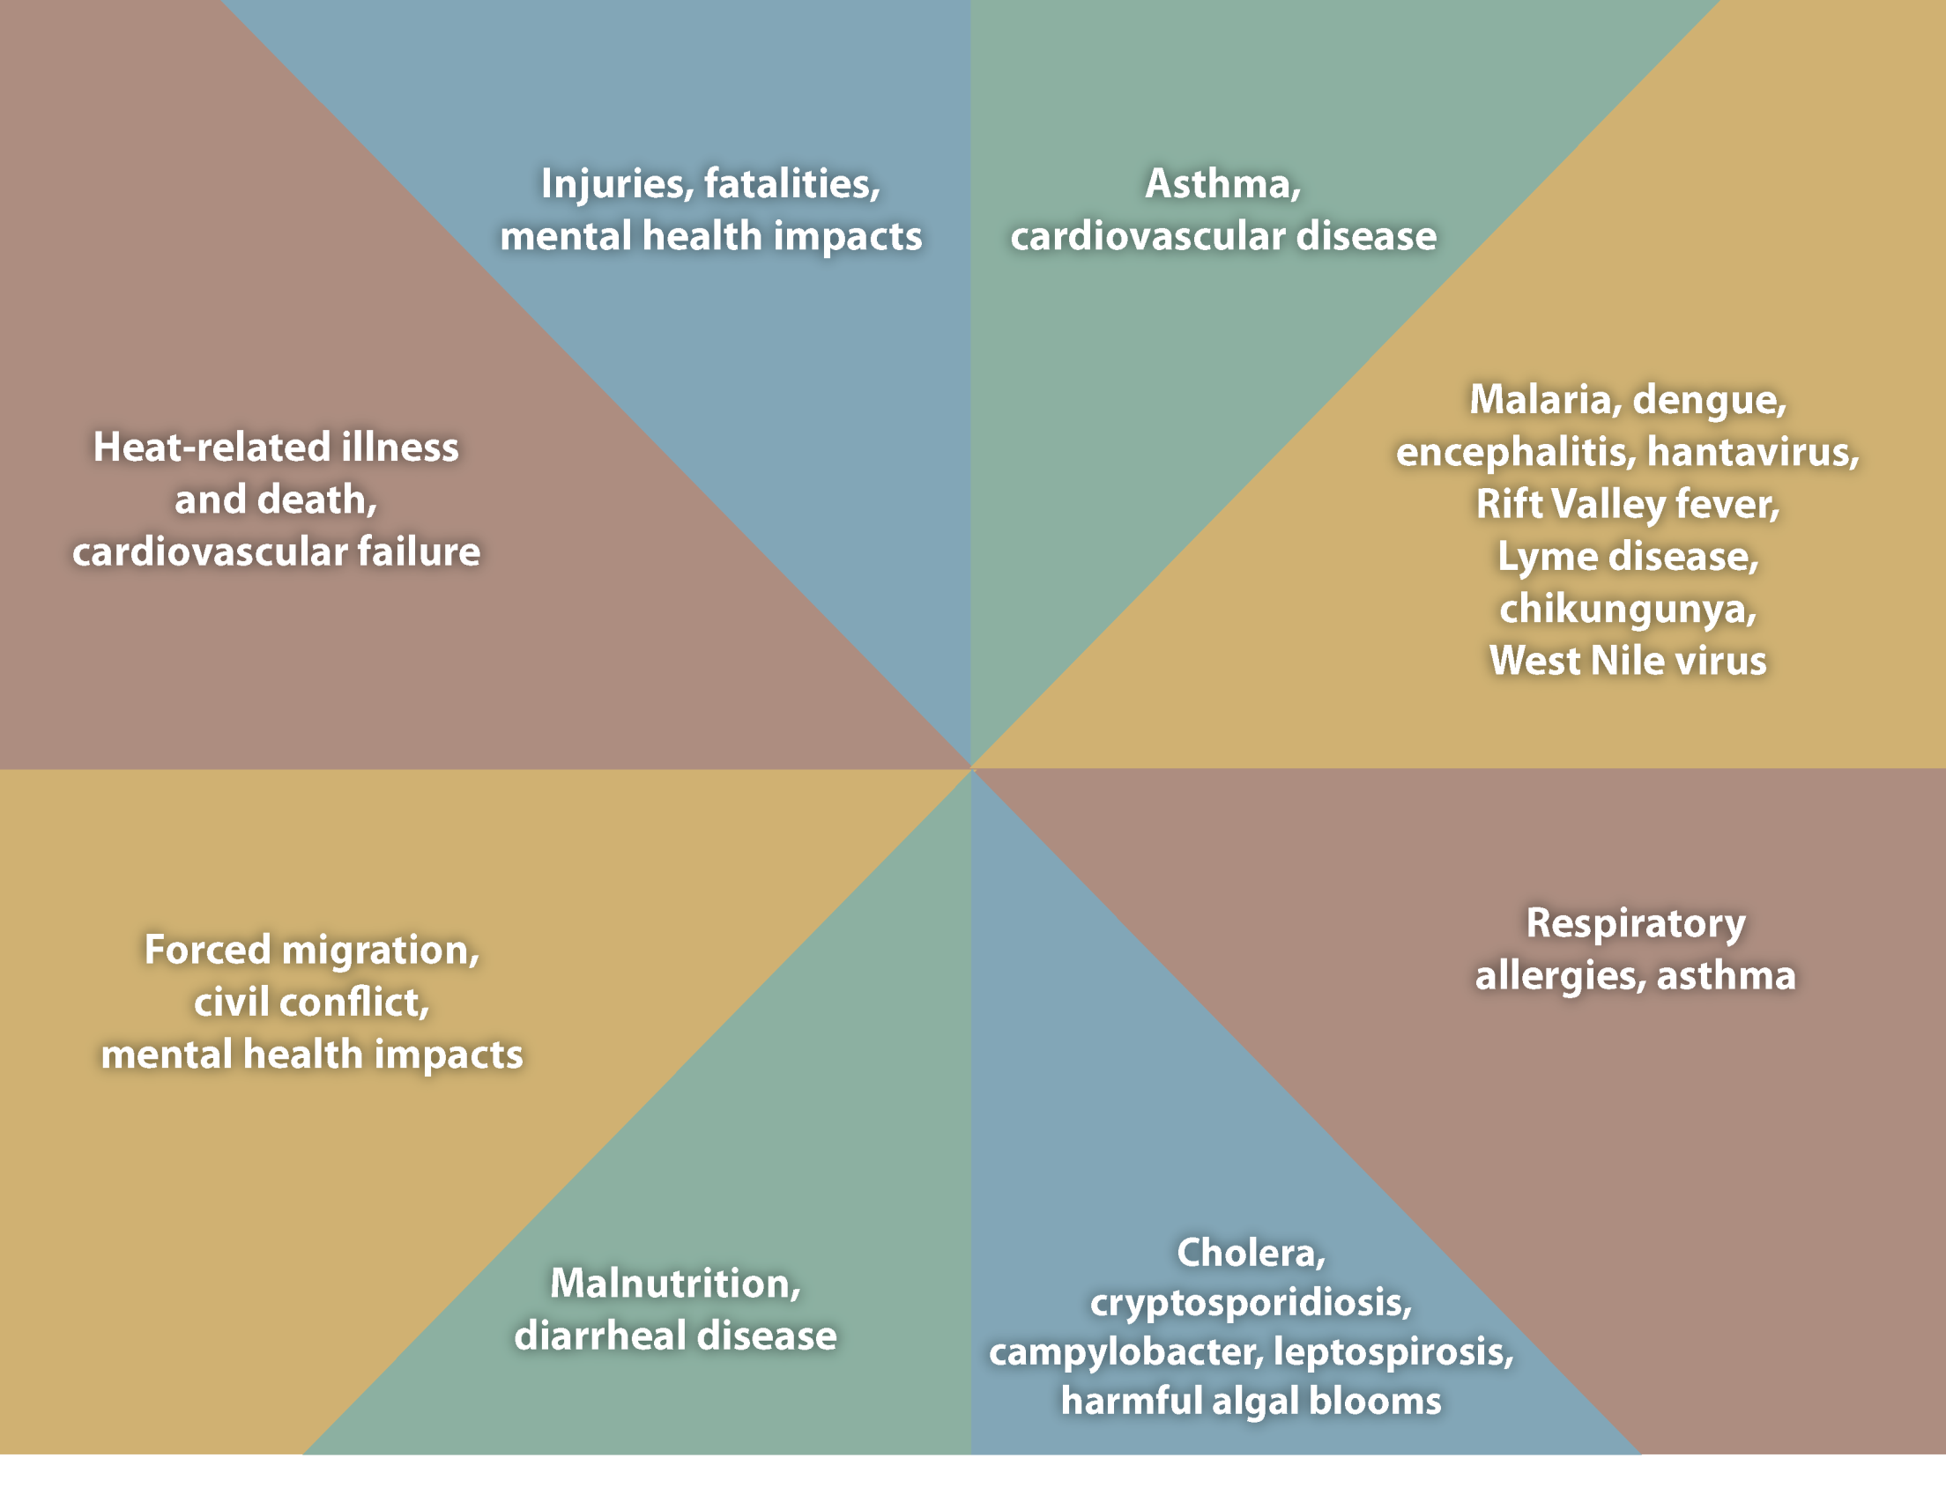
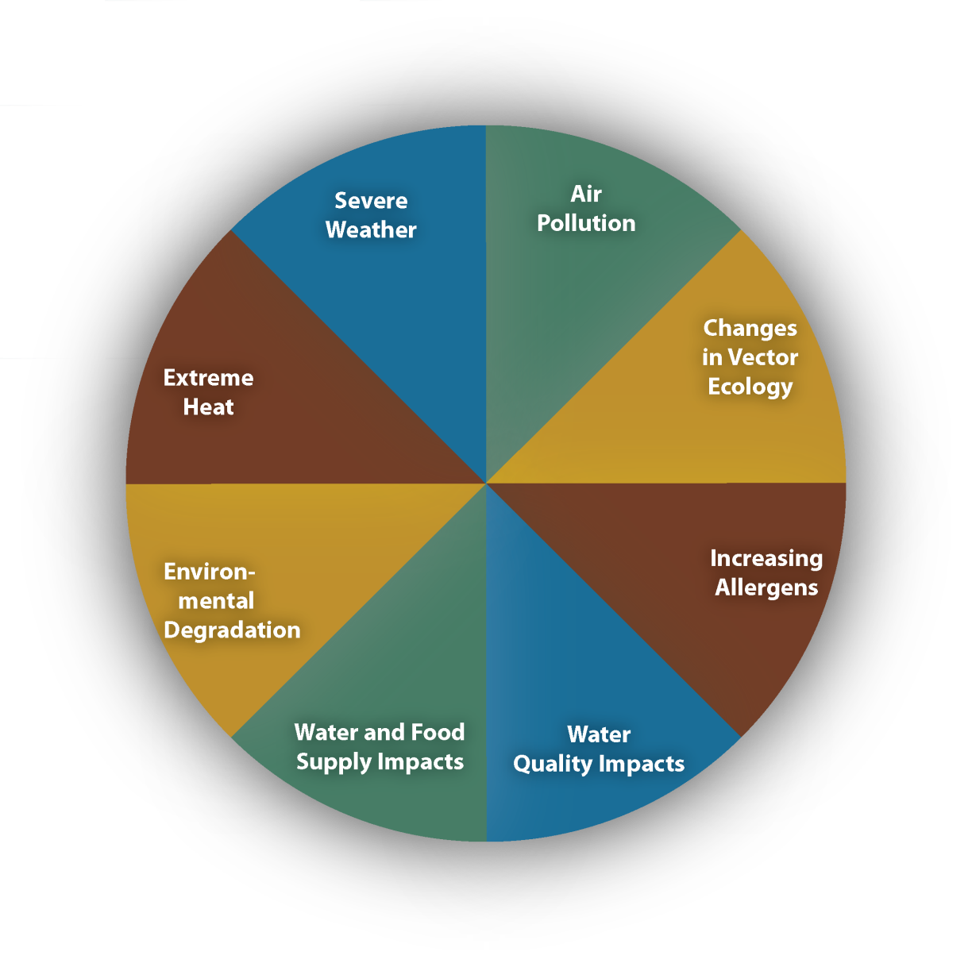
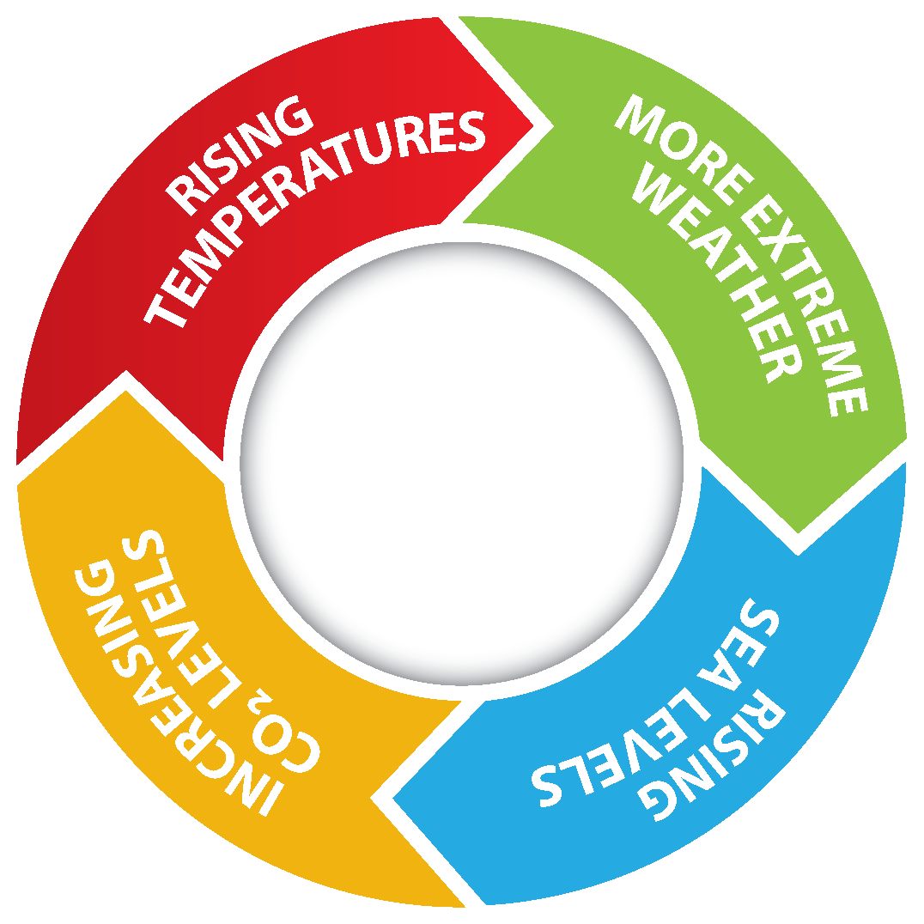
Notes:
Health: Current and Future Trends
Warmer and dryer conditions have led to:
Increases in respiratory hospital admissions among adults over 65
Increases in heat and smoke-related hospital admissions and deaths
Increases in Lyme Disease cases
Earlier onset of West Nile Virus-carrying mosquitos
Notable incidents in 2015 include:
Spikes in cases of Salmonella and E-coli during months with extreme heat
Shigellosis outbreak in late 2015 associated with heavy rainfall. This affecting a large number of homeless people in the Portland-Metro region.
These physical health impacts will disproportionately impact people with chronic health conditions, children, and elderly people.
Health departments in OR and WA are also monitoring shellfish toxins and harmful algal blooms, though the latter is hard to track at times. HABs and toxin outbreaks directly affects Tribes who harvest shellfish for economic, cultural, and livelihood purposes too.

Slide 11
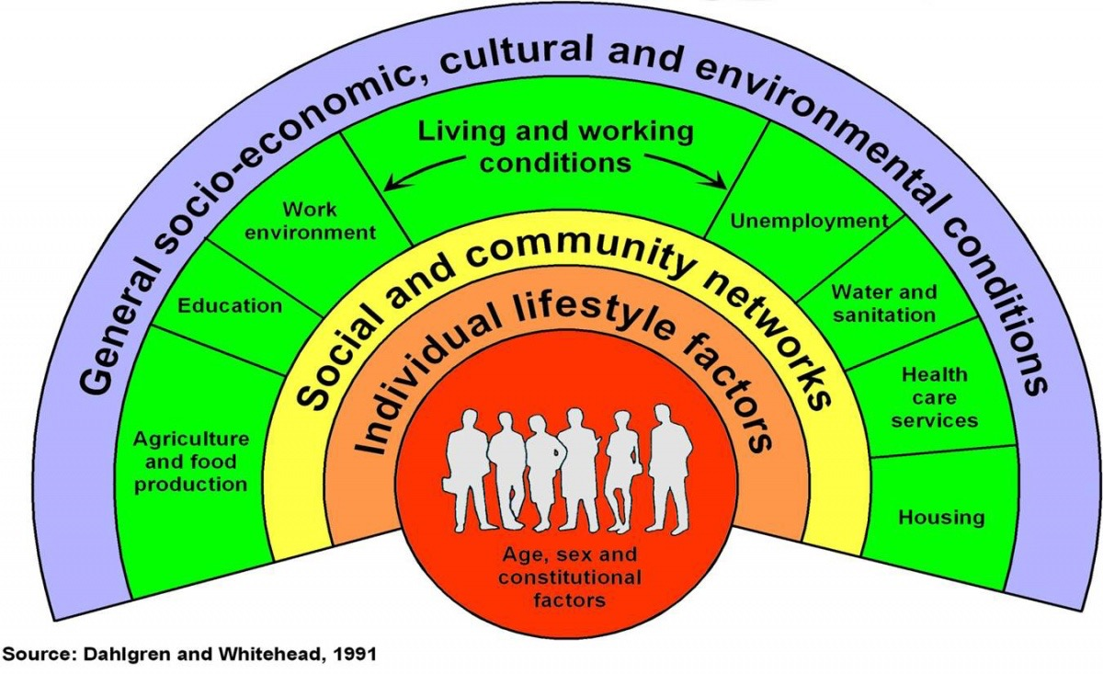
Notes:
The field of public health is starting to get this and is now starting to move upstream… to the root causes of health outcomes and health disparities.
Because of the growing evidence that our social and community networks and the cultural and environmental conditions we live within are as important to health outcomes as medical interventions.

Slide 12
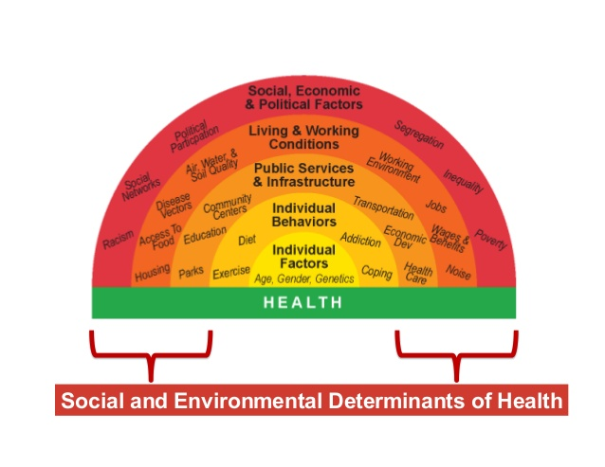

Slide 13
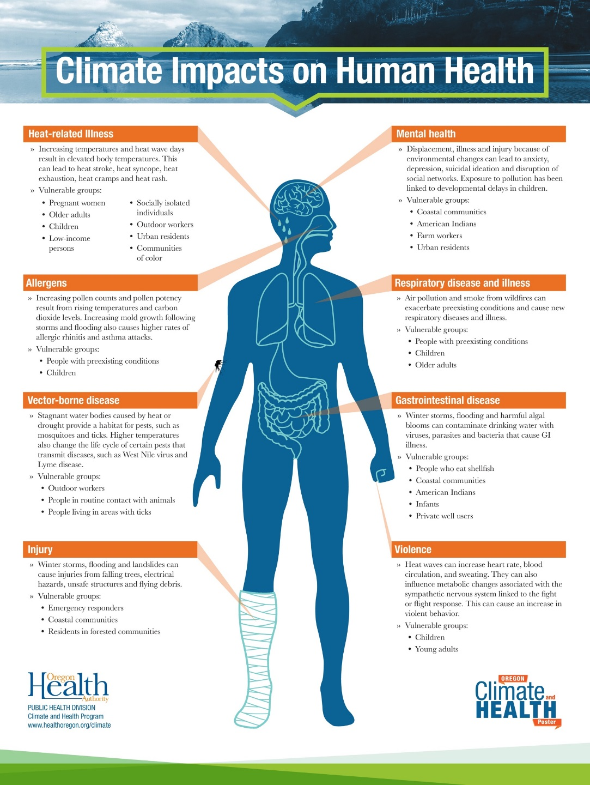
Notes:
Make it personal – how will it impact an individual?

Slide 14


Slide 22
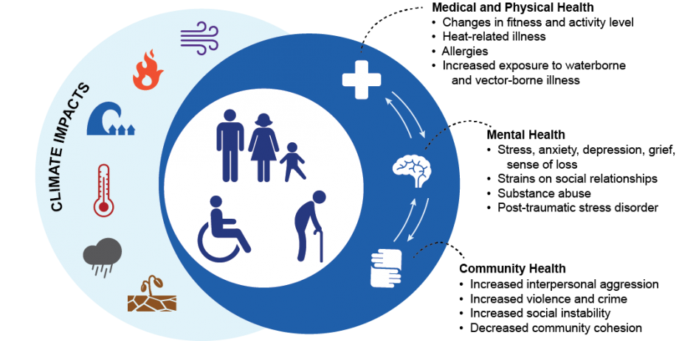

Slide 23

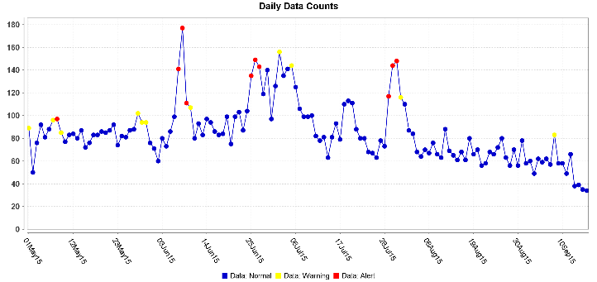
Heat related illness
Heat related death
Violence
Air pollution
HABs
Recreational risks
Notes:
HEAT: heat-related illness and death, air pollution, HABs, recreational risks…
EXAMPLES:
This past summer we saw an increase in heat-related hospitalizations during extreme heat (spikes in graph correlate to heat waves).
Willamette and Clackamas River HABs
Over 600 people drowned in Oregon between 2000 and 2010. A third of those were in swimming pools.
Vulnerable Populations: Outdoor workers, agricultural workers,

Slide 24

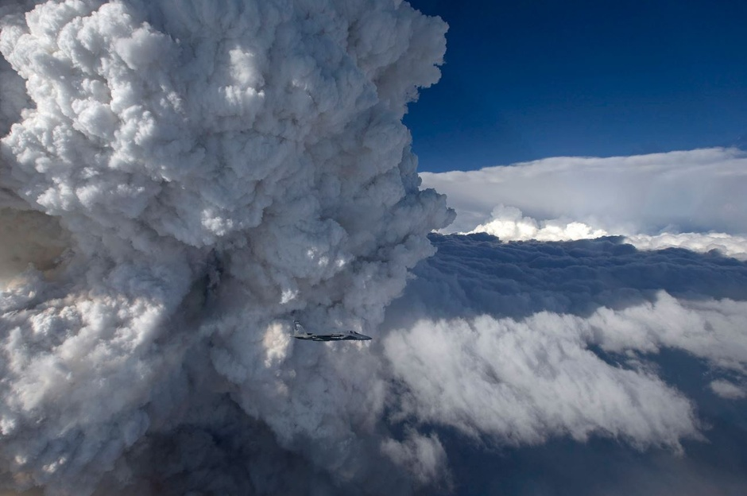
Air quality
Water quality
Occupational risks
Income loss
Displacement
Notes:
WILDFIRES: air quality, water quality, occupational risks…
This is a picture of a Pyrocumulus cloud over the Oregon Gulch Fire, 2014
Studies are projecting an average of a 300% increase in areas burned by mid-century. Fire season spreading from 3 months to 5.
Smoke exposure both causes and exasperates asthma and other respiratory diseases. About one in ten Oregon adults has asthma, and we already spend $1.5 billion per year to treat it.

Slide 25

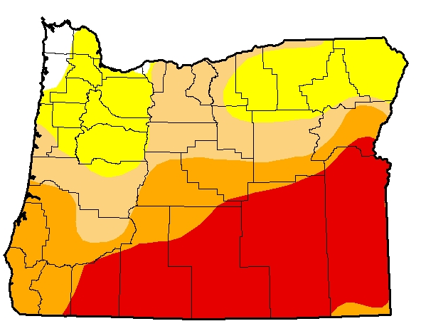
Food insecurity
Water insecurity
Mental & behavioral health
Income loss
Notes:
Already experiencing drought. Region-level projections about drought “ingredients” are fairly solid: less snow-pack, more heat, less summer precipitation.
In addition to impacts you may already expect, such as impacts to agriculture, drought can also compromise our drinking water quality and availability.

Slide 26
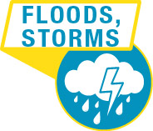
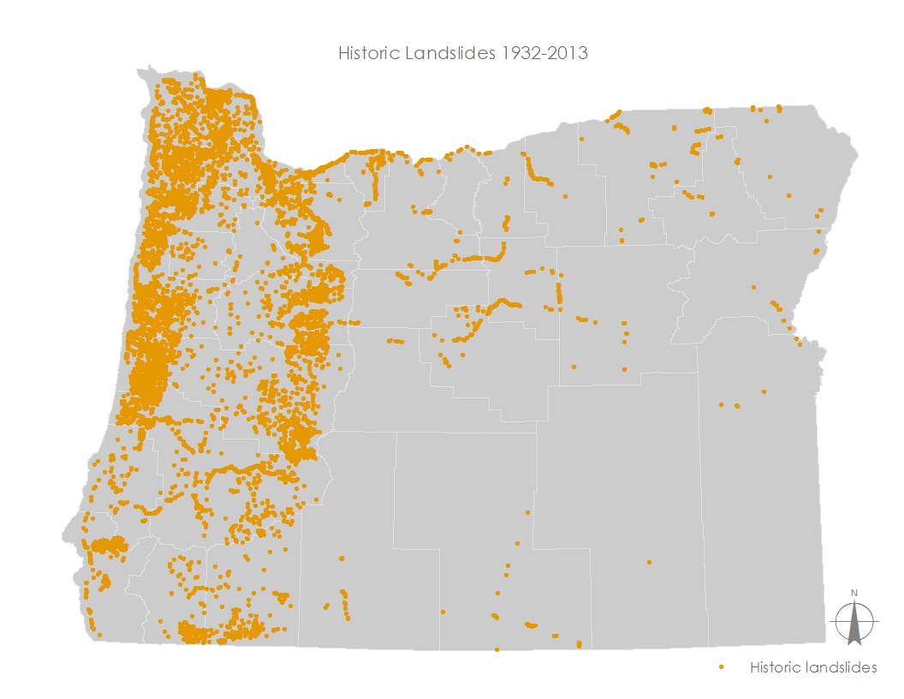
Wind
Landslides
Flooding
Displacement
Mental & behavioral health
Notes:
FLOODS & STORMS: can lead to injuries, displacement, flooding can cause exposures to mold & mildew,
Source: DOGAMI Landslides that have occurred in OR
Power outages caused by storms can also increase risks like food poisoning and carbon monoxide poisoning. Lack of access to roads and transportation can lead to disruptions in care.

Slide 27
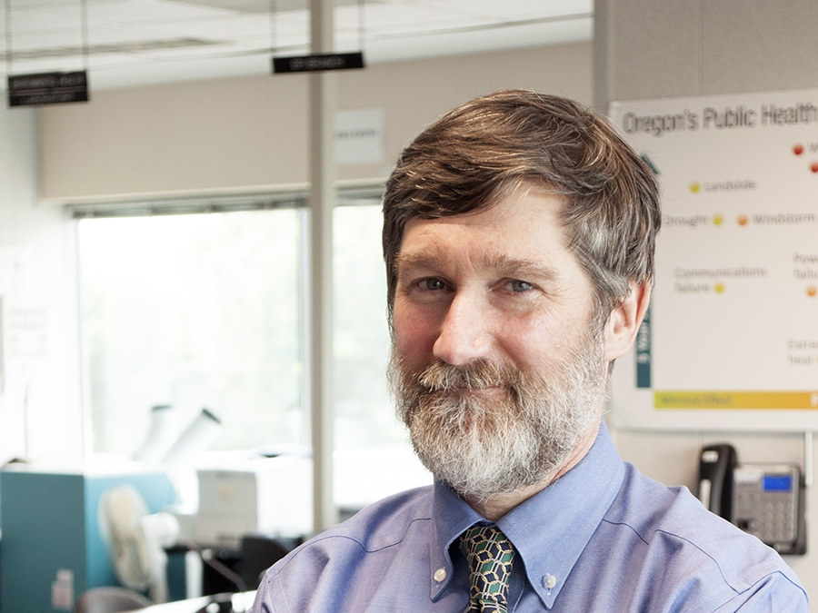
“Rising temperatures and changes in precipitation will likely result in changes in the distribution of disease-carrying insects.”
Richard Leman, MD
Epidemiologist
Notes:
We spoke with experts in our own agency who pointed to a number of ways in which climate change might increase existing risks…

Slide 28

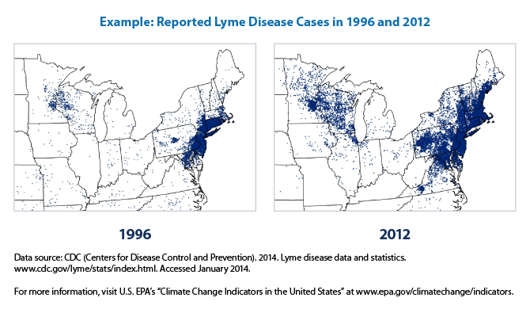
Vector-borne
Food-borne
Fungal
Notes:
Vector habitat will change. Lyme disease is projected to gradually move earlier by two weeks.
Heavy rainfall causes higher pathogen concentration in water
Increase in waterborne disease outbreaks (Funari et al, 2012, Curriero et al, 2001)

Slide 29
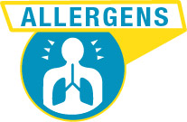
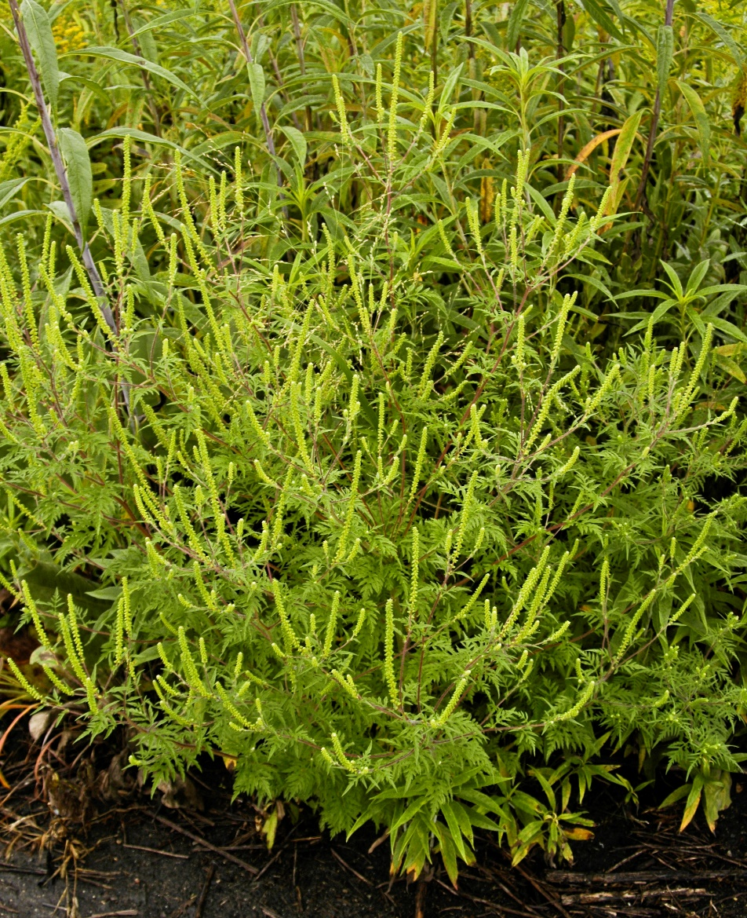
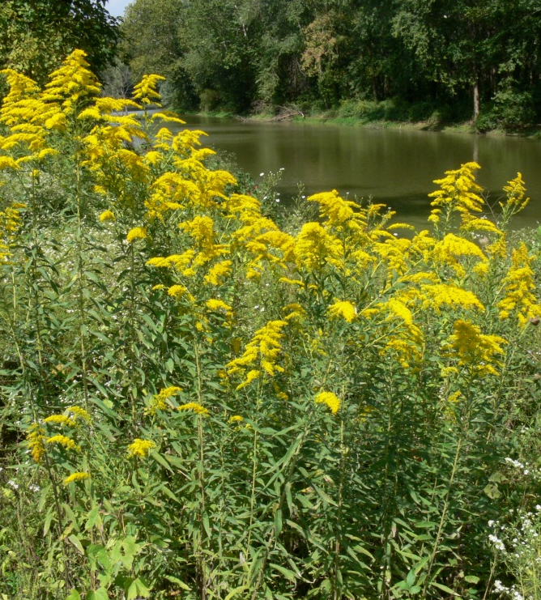
Allergy symptoms
RAGWEED GOLDENROD
Notes:
Around 25% of adults are allergic to ragweed pollen.
Allergens may become a bigger issue for multiple reasons… Ragweed grows easier in warmer weather and with CO2 fertilization, plus the proteins that cause allergic reactions are more potent.
Ragweed is wind pollinated and causes allergies. It blooms at the same time as Goldenrod so they are often confused. However, Goldenrod is NOT wind pollinated nor allergenic, and IS highly important as a pollinator plant. We want people to plant Goldenrod, not be scared of it.
For more information: https://aafa.org/allergies/types-of-allergies/pollen-allergy/ragweed-pollen/

Slide 30

The worst thing on the horizon for mental health care is climate change and the economic stresses it will cause, falling disproportionately on those already close to poverty, where the vulnerabilities are greatest.
Jim Phelps, MD
Director of Mental Health Integration, Samaritan Health Services
Notes:
People not only talked about physical health, but also mental health.

Slide 31

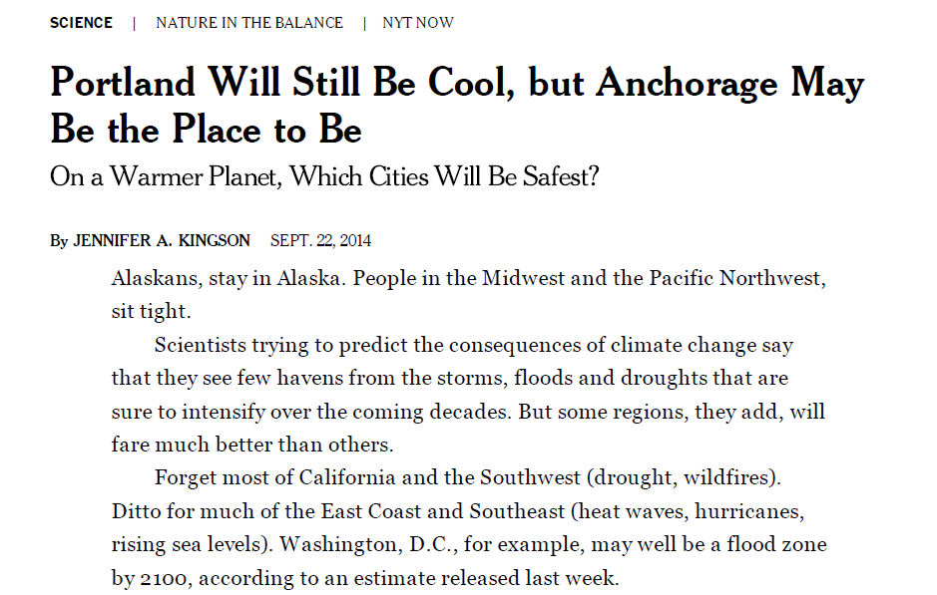
Economic instability
Unhealthy coping
Migration
Notes:
We know that international migration is happening as a result of climate-driven disasters. Domestic migration is also a concern among stakeholders in Oregon. Affordable housing advocates are concerned that climate change-related disasters could place further pressure on Oregon’s rental markets and social safety net services.

Slide 32

“Climate change is a reality we all must face. Yet, the most impacted communities are those who are least responsible.”
Faduma Ali
Groundwork Portland
Notes:
Grounded in health equity and an understanding of the social determinants of health.
I want to take a minute to talk about how we integrated and prioritized health equity.
Innovative way of integrating impacted communities priorities. Challenges we have had with engaging meaningfully….lack of resources at every level. Other issues are better funded.. Review of plans.
We led with health equity in our framing and put the list of equity focused strategies first in our plan and then also weaved them throughout.
We invested resources into explainer video to help explain connection between equity and climate to include in our plan.

Slide 33
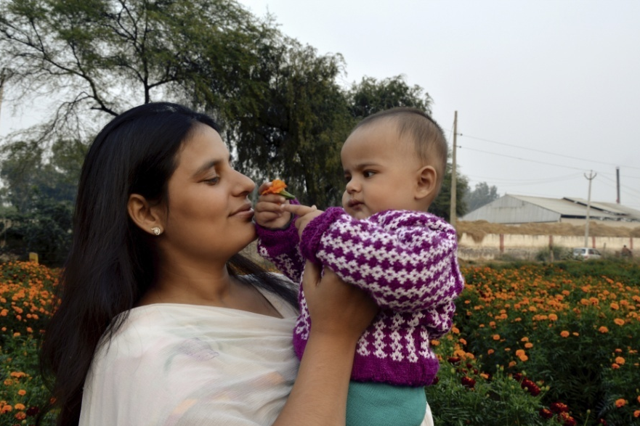
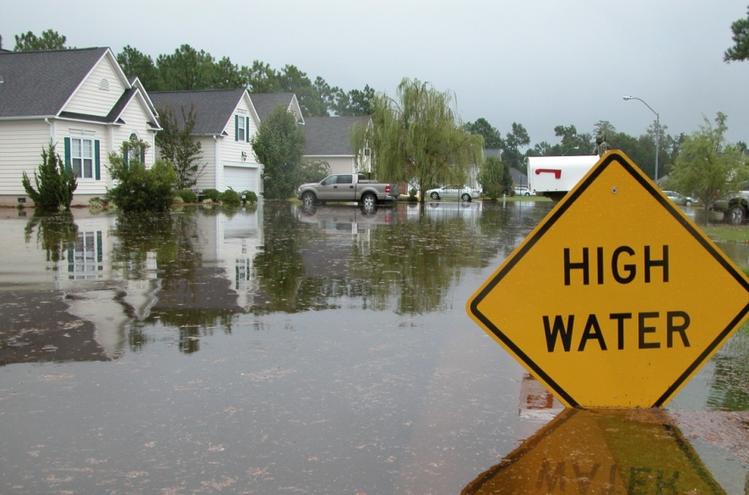
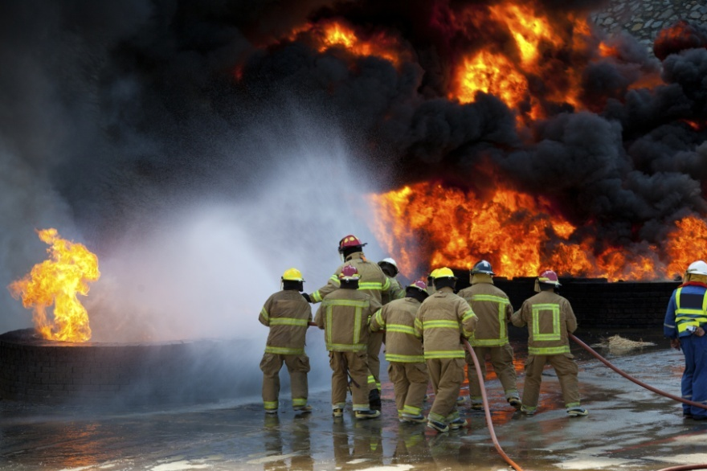

Demographic
Tribal
Geographic
Occupational
Vulnerability
Notes:
In the climate and health profile report we go more into depth about vulnerable populations in Oregon, as a summary… our vulnerability can be broken into 4 categories:
Demographic – low-income households, people with existing illnesses, older adults, children, people with disabilities, immigrants and refuges, communities of color
Geographic – urban (heat island, air quality, ), rural (land slides, wildfire, drinking water contamination), coastal (storms, floods, sea-level rise)
Occupational - outdoor workers, those working in the agricultural sector, first responders and health care workers
Tribal – further loss of cultural resources, first foods

Slide 34
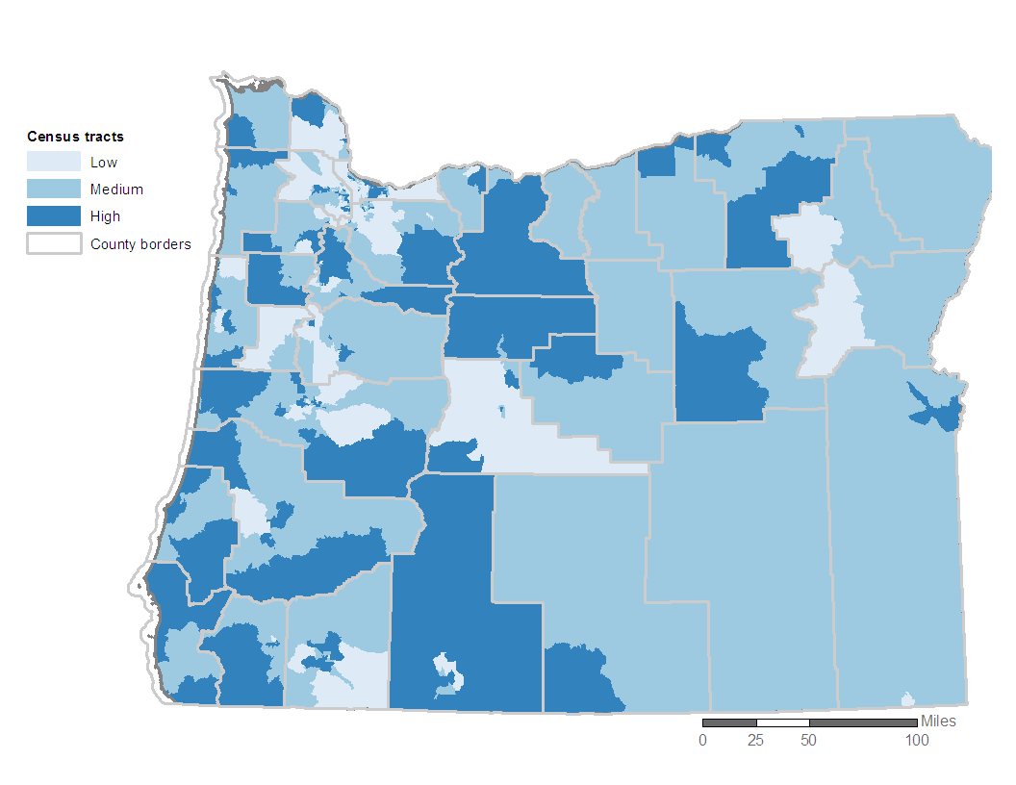
Social Vulnerability
Notes:
Local jurisdictions often lack the capacity to quantify and assess the interactions of social vulnerability and health risks related to climate change. In response to this need, we developed a climate-focused vulnerability assessment.
The Social Vulnerability Index is a composite of 9 indicators, that can then be layered with other hazard-related data to communicate risks and inform planning efforts.

Slide 35


Slide 36
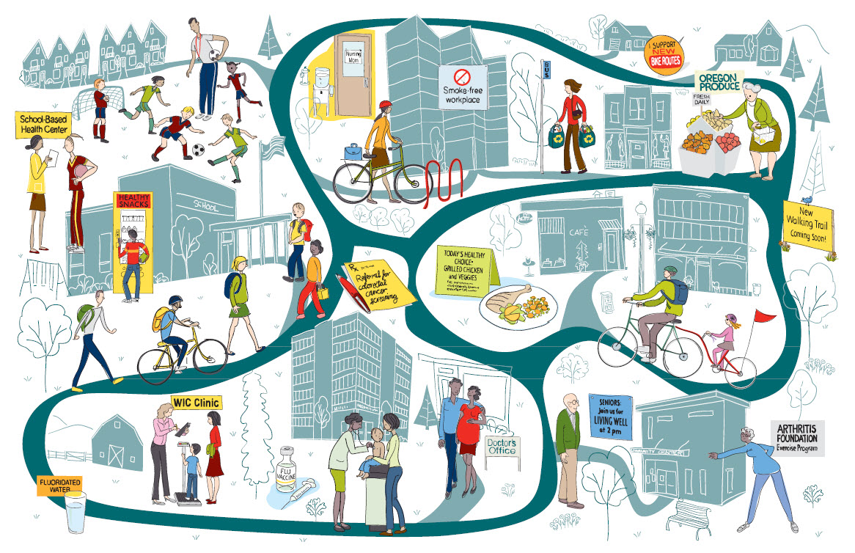
Social Resilience & Food Systems
Notes:
A lot of our plan and approach to creating a public health system that builds community resilience is integrating climate and equity considerations into the work that we are doing: preparedness, communicable disease, environmental health.
So our role is to provide tools and support for public health programs and staff to be able to do that.
Our role as a C& H program is to identify emerging and cross-cutting areas of public health that are important to climate change. These are the two areas that we identified and are actively exploring.

Slide 37
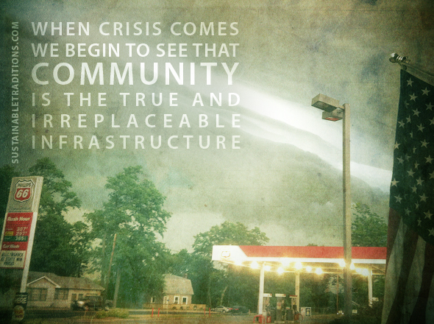

Slide 38
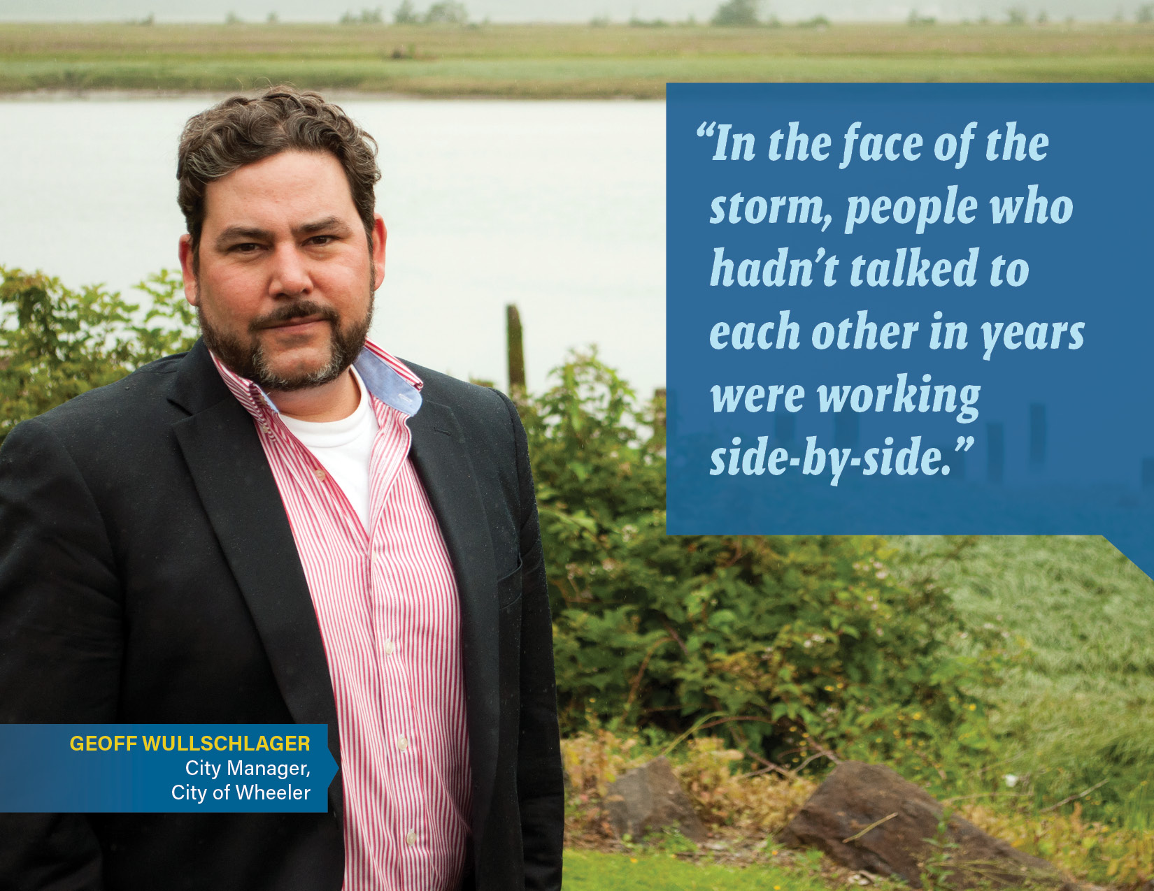
Notes:
Social cohesion – not only can we build it during an event, but even better – we can invest in social capital as a preparedness measure

Slide 39

“Strengthening social networks, building social resilience,
and supporting efforts that build community are probably the most important long range strategies we have to avoid climate disaster”
-Tom Engle, RN MN
Board Chair, Alliances of Nurses for a Healthy Environment
Notes:
There is growing evidence that the social cohesion of a community is a key indicator of community resilience.
We also know that an indicator of institutional resilience is the connectivity across an organization.
The strategies in our ‘partner’ category emphasize the importance of relationships between households in a neighborhood, between community organizations and local agencies, between programs within our public health system.
Some public health programs already have a social cohesion component, such as facilitating peer-to-peer learning networks… now we see this as not just an effective tool for health education, but also a strategy for building community resilience.

Slide 40
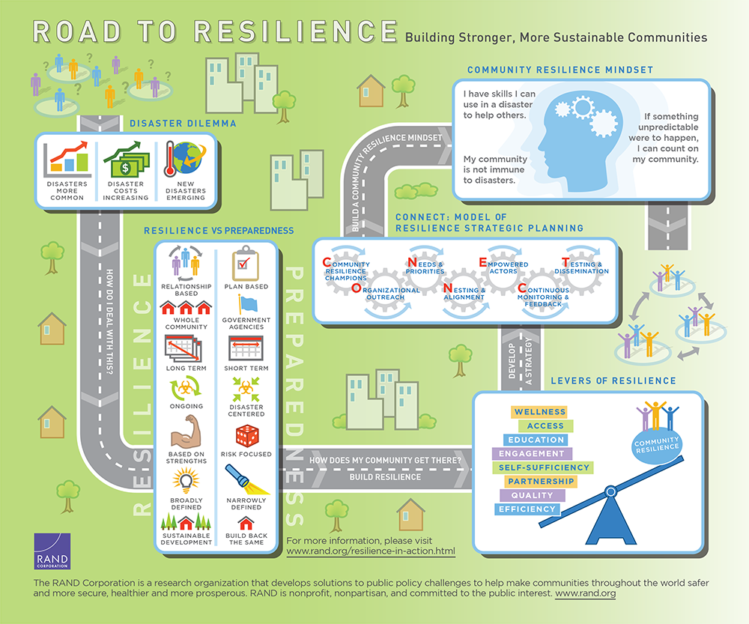
Notes:
“Resilience” is defined differently depending on who you talk with.
What we’re learning is that Resilience planning may be different than preparedness planning. This graphic does a really great job of differentiating the two… RAND Corporation
Resilience is relationship-based… It’s less of a plan and more like a compass… giving us direction, improving our practice, and giving plenty of room to adapt because we know that every community has a different set of strengths and because with every year we are learning more about the challenges and opportunities before us.
Building resilience involves the whole community and cannot be solely led by government agencies.
Resilience planning prioritizes long-term investments and considers slower-moving long term shifts in our environments, communities, economies, technologies and culture.
It’s considered an ongoing practice, rather than the planning for specific disasters or acute events. That is important work that our emergency preparedness experts work on every day, resilience challenges us to not focus on what could go wrong, but what could go right…
This is the “strengths-based” approach and it helps us shift away from the doom and gloom and into the action and solutions. In many ways, I find that in the world of climate change planning, we spend too much time analyzing our vulnerabilities and not enough time studying and replicating our many diverse strengths and community assets...

Slide 41
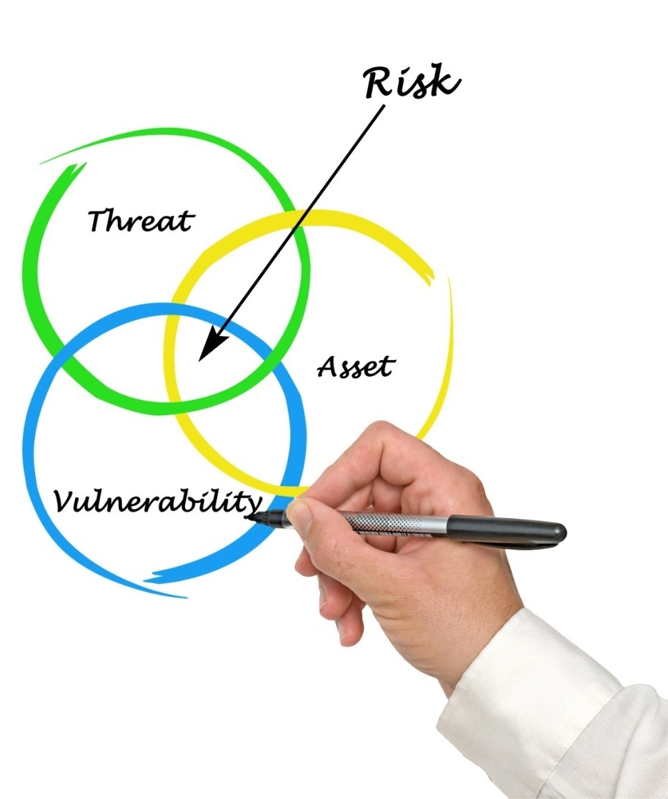

Solutions
Solutions
Solutions
Notes:
So at this point, we decided not to follow the BRACE approach. In part because of the issues with uncertainty, but also because instead of conceiving of this as a plan to reduce risks, we envisioned a plan to build resilience across all of the different hazards. The decision to call it a resilience plan reflected our desire to take a different approach.
A resilience plan is different than a preparedness plan or even an adaptation plan. It requires taking a more systems-based, strengths-based, relationship-based approach. It requires us to think longer term and about all of the potential community partners.
Strengths-based – In the spirit of appreciative inquiry, grounded in the neuroscience behind gratitude practices.
Instead of focusing and prioritizing on particular threats, we focused on systems changes that would be protective across different threats and make our public health system more resilient and equitable. (Challenging because of uncertainty and because different priorities in different parts of the state)
Engagement and assessment through storytelling and also…

Slide 42
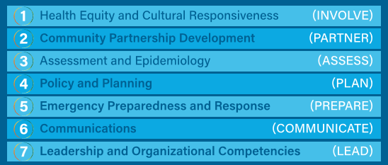
Climate Resilience Plan
Strategies are organized by public health capabilities
Notes:
Organized around a strategic priority for our agency. We were able to use the foundational public health capabilities as outlined in the new public health modernization manual – to steer the selection of strategies. For simplicity, we summarize these capabilities into 7 action words.
Robust stakeholder engagement
Review of plans of impacted populations
Digital and interactive, including links to videos
Highlighting work around the state
Led with health equity
Each of the 7 sections outline a set of strategies that we can take at both the local and state levels of our public health system. Today, I will just quickly touch on each of the overarching strategies, without getting into the specific actions that are recommended.

Slide 43
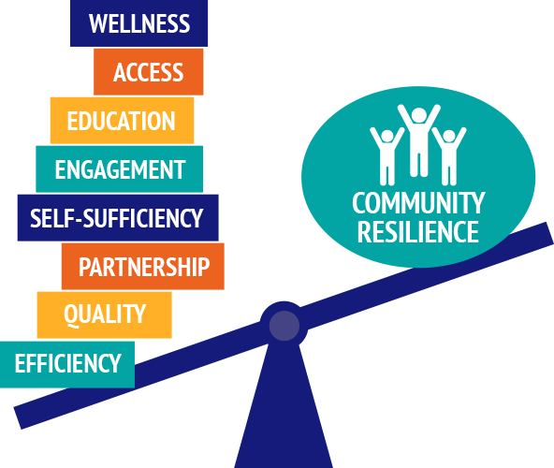
Notes:
Those of us working to improve public health are already building community resilience… whether or not we call it that.

Slide 44
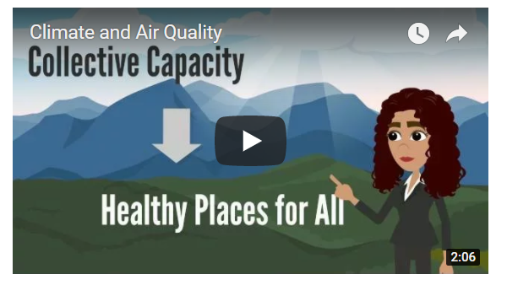
Increasing Climate Literacy
Notes:
https://www.youtube.com/watch?v=X0w76Mh36VA&list=PLd4xfJU3qzMWQlcfWZDGEj1rMncXTUeWV

Slide 45

“To support community change we have to be grounded in what the community needs, not just what we perceive they need.”
Charmaine Kinney, MPA-HA
Multnomah County Mental Health

Slide 46
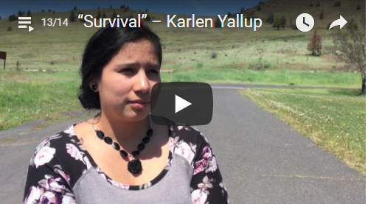
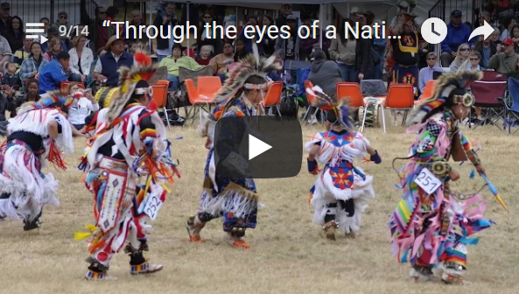
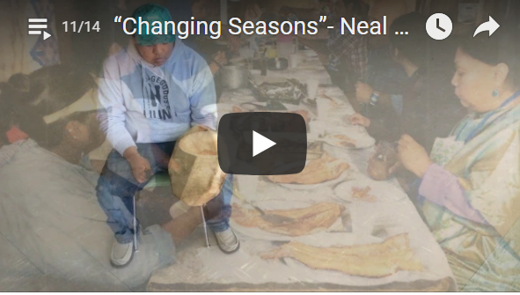
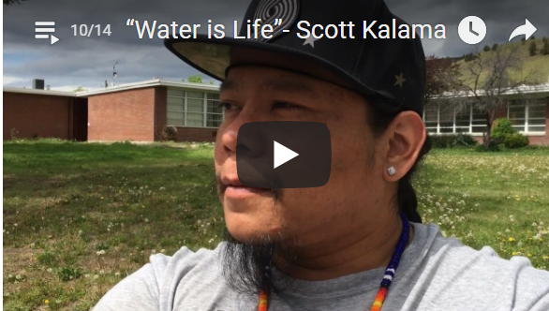
Voices of the Confederated Tribes of Warm Springs
Notes:
https://www.youtube.com/watch?v=5fVxUT4Ey7w&index=8&list=PLd4xfJU3qzMWQlcfWZDGEj1rMncXTUeWV

Slide 47
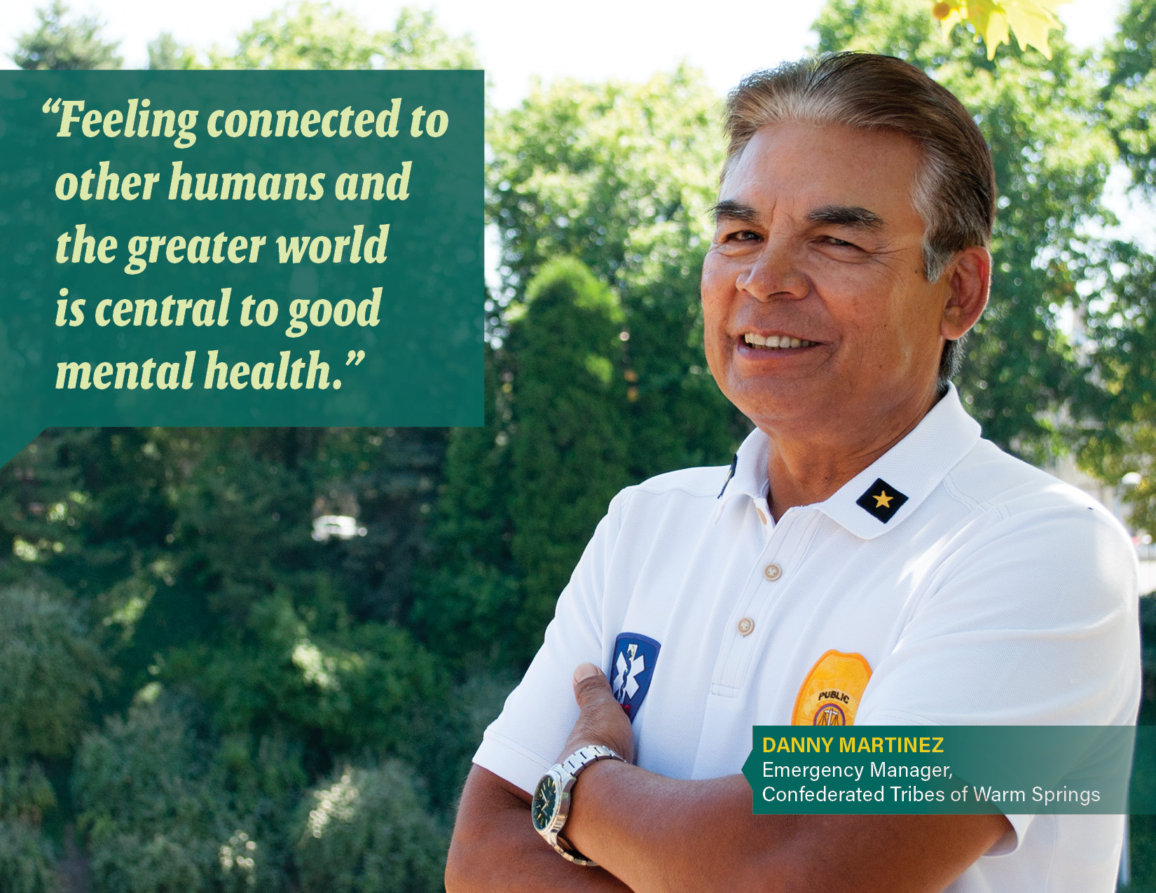
Notes:
Implementation:
Warm Springs Story Project
Social Resilience Indicator Project

Slide 48
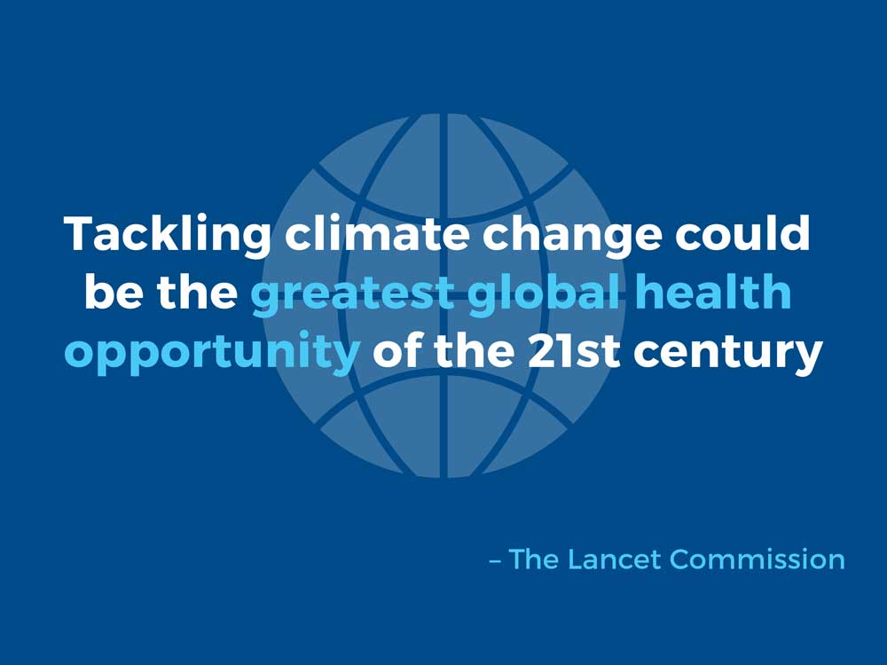
Notes:
The Lancet Climate Commission has been a global leader in highlighting the health effects of climate change and the urgent need for health leaders to get involved.
“Whether we respond to climate change, turning the threat it poses into an opportunity to improve public health, is no longer a question of scientific evidence or technical capability… it is now entirely a matter of political commitment and the health profession has a vital role in driving this transition.”
https://www.youtube.com/watch?v=sWhoe9xTC4A

Slide 49
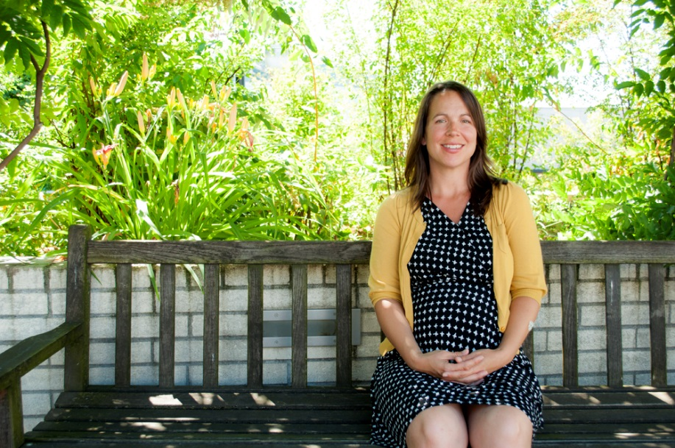
"When we pair qualitative data with quantitative data, we get a much richer picture of what’s going on in a community.
- Kari Christensen, MPH
Brownfield Coordinator
OHA-Public Health Division
Notes:
There are many environment and health indicators that we can be tracking. We now have a syndromic surveillance system up and running that allows us to query hospitalizations in near real time… when we layer this health data with other environmental data, we have a window into the health effects of climate change in Oregon.

Slide 50
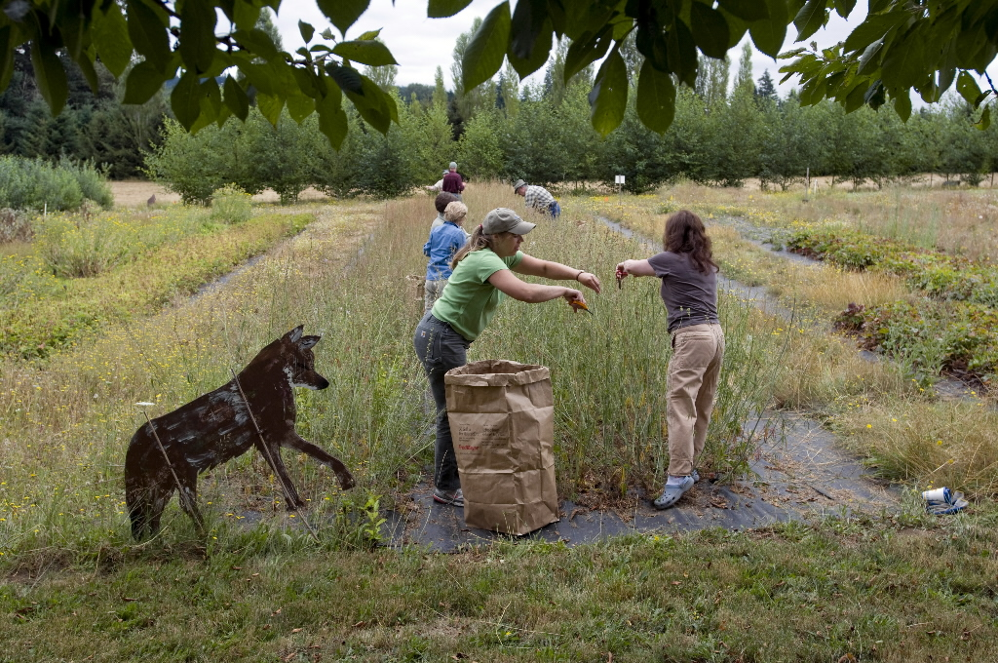
When I think about climate change, it’s so easy to think about gloom and doom, but it’s so much more motivating to think about it as an opportunity to come together and do things better.
Bonnie Shoffner
Restoration Volunteer Coordinator
Notes:
It’s scary stuff, but it’s also a call to action, a catalyst for real change.

Slide 51

“Adapting to climate change will require agencies to work together to develop strategies that address the interconnected impacts of climate change.”
-Malia Losordo, JD
Graduate Student in Water Resources Policy and Management at OSU
Notes:
When it comes to the complex issues like these, no one organization or sector can do it alone.
We need to work across many sectors – government, non-profits, businesses – to identify and move forward sustainable solutions. This type of innovative cross-sectoral collaborative work is what it will take to continue to build resilient, healthy, thriving communities.
When we collectively go upstream, to the root causes of health outcomes and health disparities, we are investing in solutions that can have the greatest impact for people downstream. This is a metaphor we use a lot in the field of public health, but today this metaphor is really quite literal.
Today’s conversations are asking us, as leaders in Oregon, to hike further upstream in our thinking and in our collaborative solutions. Together, each of us has a role in building and sustaining healthy environments that protect our water, our air, and ultimately our health.

Slide 52
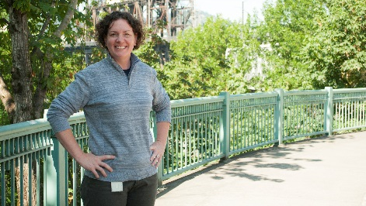
“It doesn’t necessarily mean taking on more work, but doing our work differently and hopefully, in more meaningful ways.”
-Julie Black
Workforce Development Coordinator, Oregon Public Health Division

Slide 53
www.healthoregon.org/climate
Notes:
State’s Public Health Division – Environmental Public Health Section
One of 16 states and cities funded through the CDC’s Climate-Ready States and Cities Initiative to study and plan for the health effects of climate change.

