Slide 1
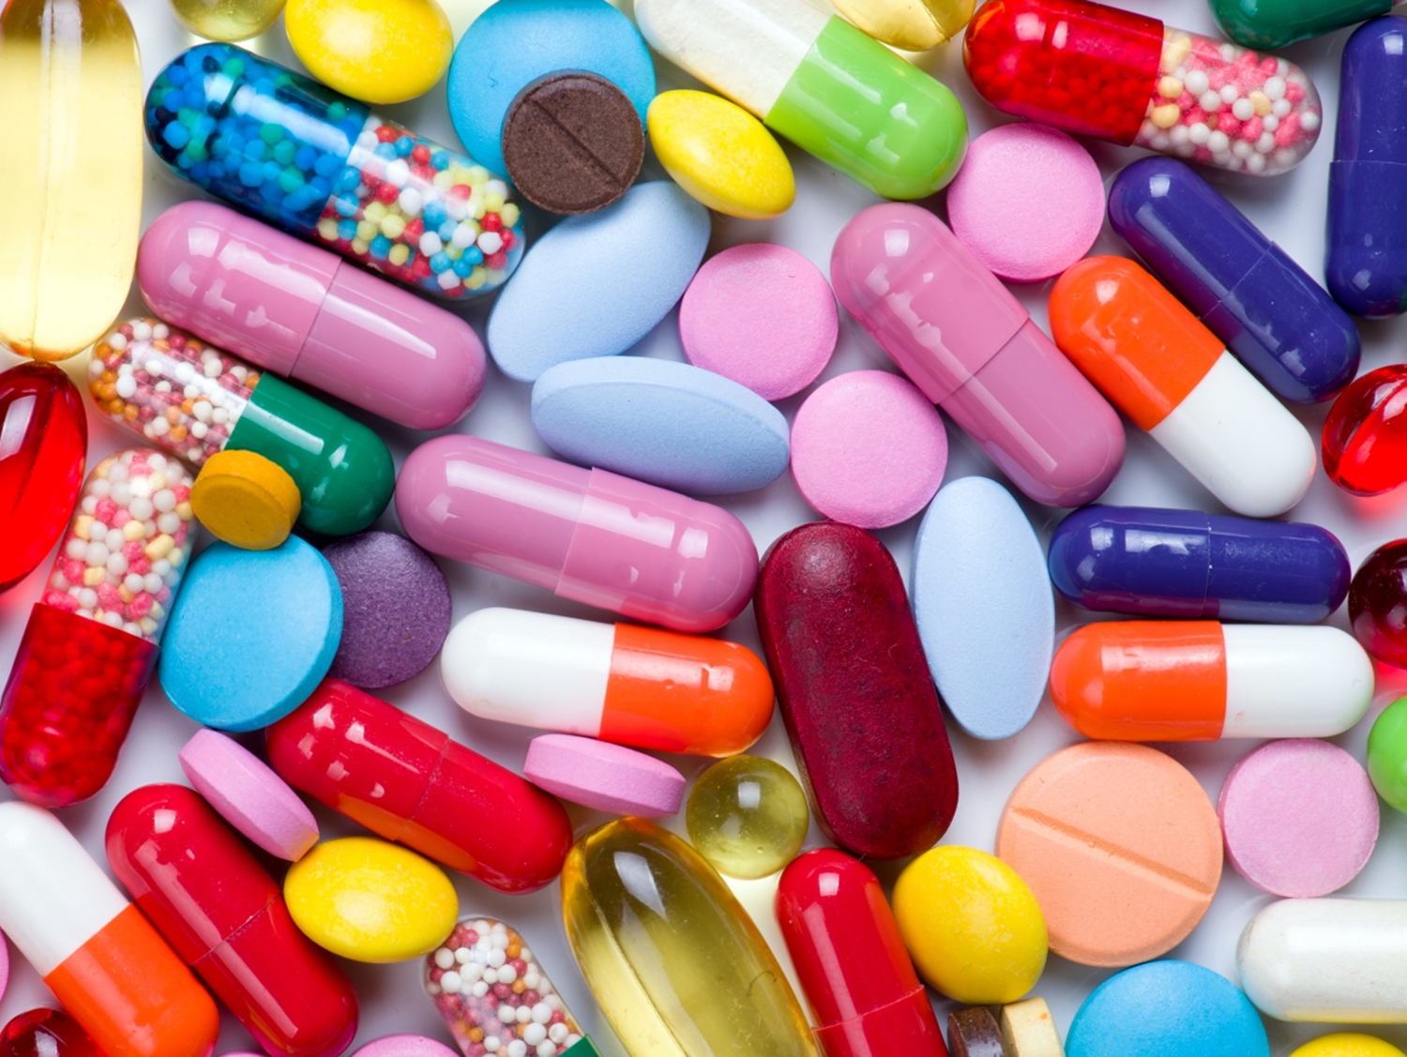
Antibiotic Resistance
Module 2
Notes:
Yesterday we learned about what bacteria are, how some are good and some cane make us sick. We also learned about antibiotics and how they can help to cure bacterial infections. Today we are going to learn all about a problem know as antibiotic resistance and what we can all do to help stop it.

Slide 2

Overview: What Will We Learn?
What is the history of antibiotic use and resistance?
What is meant by spectrum of antibiotic activity?
How do bacteria acquire resistance?
How do bacteria become resistant?
What has led us to the problem of antibiotic resistance?
How do we prevent and combat resistance?

Slide 3
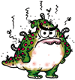

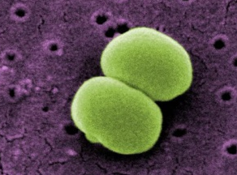
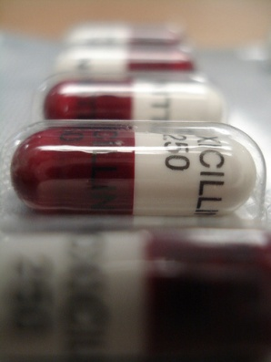
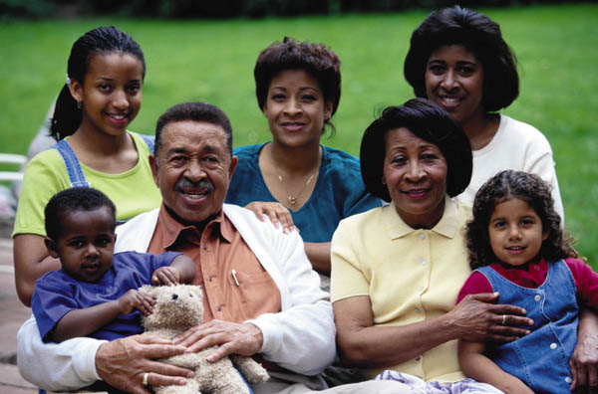
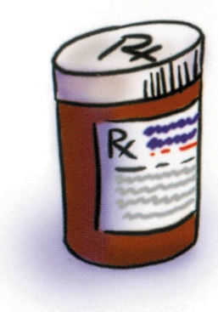
Antibiotic Timeline
Today
Some antibiotics no longer work and few new ones are in the pipeline
Way B.C.
Bacteria were present before
the dinosaurs
1940s
The first antibiotics are mass produced for humans and work well
1950s
1990s
Current teenagers are born!
2030
Will we have antibiotics that work?
Antibiotic resistance begins as soon as the first antibiotics are used
Millions of years later
?
?
Notes:
Key points:
Bacteria have been around for millions of years, surviving the ice age and the dinosaurs.
In the 1940s, antibiotics were mass produced and first used by humans to treat infections in people.
Before antibiotics were discovered and made available for physicians to prescribe, there was no effective treatment for bacterial infections. People often died from these infections. In 1924, President Calvin Coolidge’s 16-year old son, who had the best treatment available, died from an infected blister on his foot.
Bacteria have continued to develop new resistance, outsmarting our antibiotics. If we don’t use antibiotics properly, they may not work in the future. Today, microbiologists and researchers are discovering strains of bacteria that are resistant to multiple types of antibiotics. We even have some pathogenic bacteria that do not appear to respond to any of the antibiotics currently available.
Optional video: https://www.youtube.com/watch?v=xZbcwi7SfZE

Slide 4
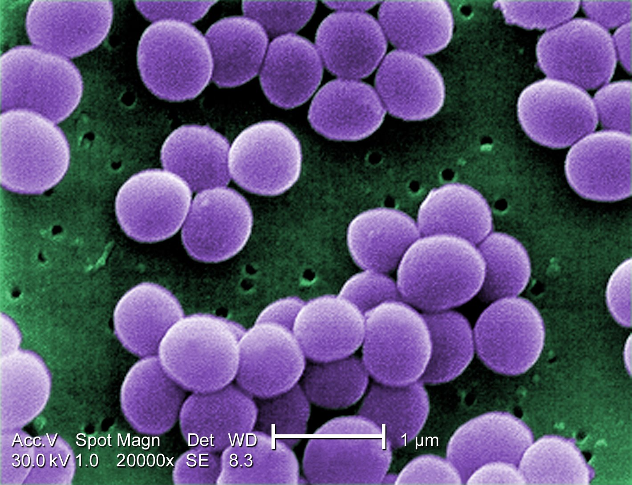
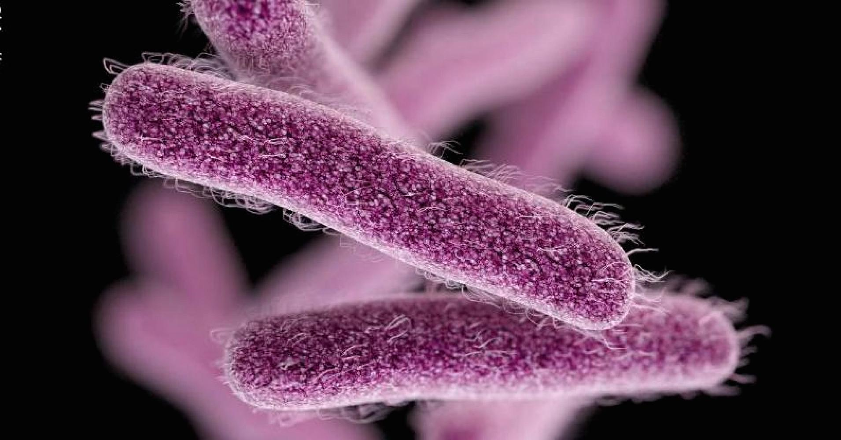
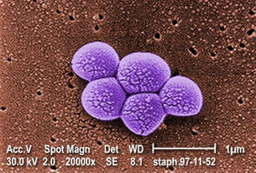
Antibiotics and Resistance (CDC, 2013)
Penicillin
  Introduced (widespread use) in 1943
  Resistance discovered in late 1940s (Staphylococcus)
Tetracycline
  Introduced in 1950
  Resistance discovered in 1959 (Shigella)
Methicillin
  Introduced in 1960
  Resistance discovered in 1962 (Staphylococcus, MRSA)
Notes:
The most important point to make with this and the next slides that it is not IF resistance develops, but WHEN.
Methicillin is a modified form of penicillin that was created to circumvent penicillin resistance.

Slide 5
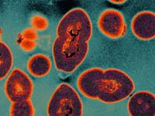
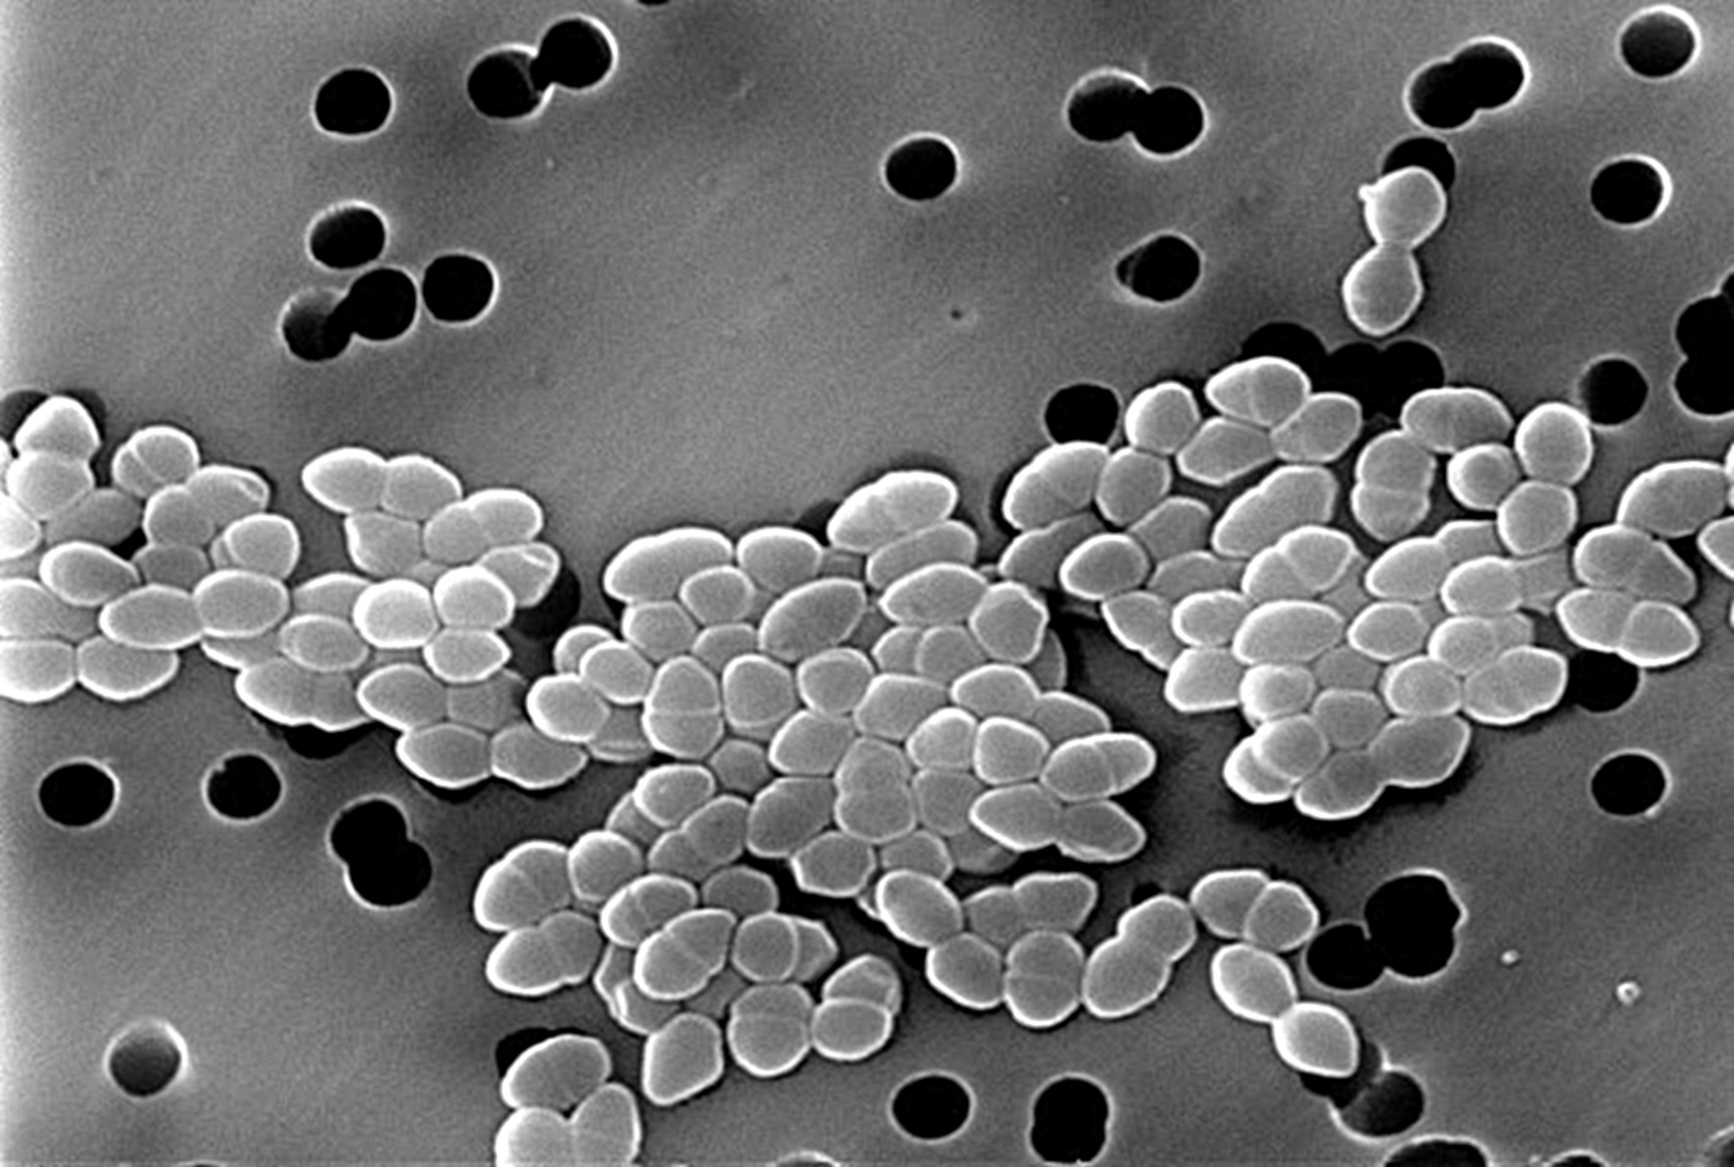
Antibiotics and Resistance (CDC, 2013)
Vancomycin
  Introduced 1972
  Resistance discovered 1988 (Enterococcus, VRE)
  Resistance discovered 2002 (Staphylococcus, VRSA)
Linezolid
  Introduced 2000
  Resistance discovered 2001 (Staphylococcus)
Notes:
The most important point to make with these slides that it is not IF resistance develops, but WHEN.
Vancomycin has been the drug of choice to treat MRSA for some time.
Although scary, there have been very few cases of VRSA – vancomycin resistant staphylococcus aureus, infections. VREs - vancomycin resistant enterococci, are opportunistic pathogens in hospitals.
Linezolid is the drug used for MRSA, VRSA and others when vancomycin doesn’t work.

Slide 6
Timeline of Resistance
Penicillin
Tetracycline
Methicillin
Vancomycin
Linezolid
1940
1950
1960
1970
1980
1990
2000
Introduced
Resistance discovered

Slide 7

Spectrum of Antibiotic Activity
Spectrum of Activity
  Describes how many types of bacteria the antibiotic is effective against
  Narrow spectrum works on only one or a few types
  Broad spectrum works on several types
Notes:
This concept is important in that broad spectrum drugs are known to kill not only the target pathogenic bacteria, but beneficial bacteria as well.
This can lead to a secondary infection known as a superinfection. This is what typically occurs with Clostridium difficile in health care and long term care settings.
The ideal situation for antibiotic use is to know what type of bacterium is being targeted, then to use a narrow spectrum drug effective for that target.

Slide 8
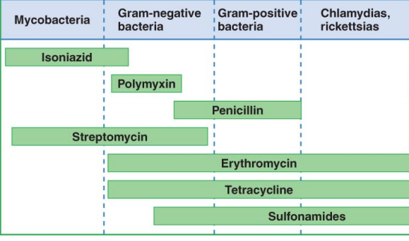
Spectrum of Activity

Slide 9
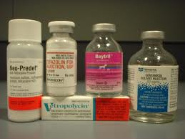
Spectrum of Activity
Broad-spectrum antibiotics are often used when the bacteria causing the infection is unknown
Narrow-spectrum antibiotics are preferable for use, as they are less likely to harm beneficial bacteria
Notes:
Text:
Narrow-spectrum antibiotics are targeted for a limited group of bacterial species.
Broad-spectrum antibiotics are effective against a wide range of bacterial species.
A narrow-spectrum antibiotic should be used, whenever possible, to target the specific bacterial infection. This preserves the colonizing bacteria in your body and avoids selection of resistance in these bacteria that might later cause an infection. A lab test will show the sensitivity (or susceptibility) of the bacteria to specific antibiotics. This is the most effective way to treat the bacterial infection and prevent the development of resistance.
Sometimes a laboratory sensitivity test cannot be done. In that case, a broad-spectrum antibiotic is often used. This may or may not be the most effective antibiotic for the bacteria.

Slide 10
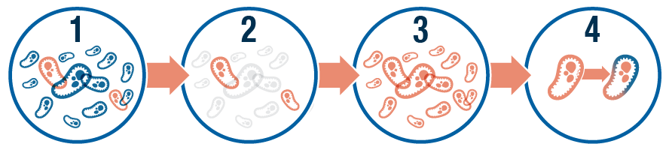
Selection for Resistance
Example of Natural Selection
  Bacteria either have gene or do not have gene for antibiotic resistance
  Bacteria are exposed to drug; susceptible bacteria (no resistance gene) die, while resistant bacteria (the ones with a resistance gene) survive
  Over time, resistant bacteria multiply, and the infection becomes resistant to that drug
Notes:
Bacteria do not ‘become’ resistant in response to the presence of drug. Those that have the correct genes are selected for in the presence of drug, then those survivors reproduce to create a resistant population.
So, bottom line, any time a drug is used, it has the potential to select for those bacteria that have resistance genes.
Once again, not a matter of ‘if’, but ‘when’

Slide 11
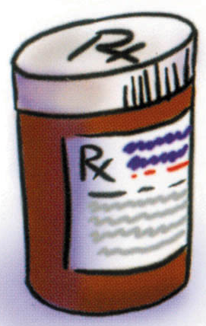
Drug Use Selects for Resistance
Sensitive and resistant bacteria live together.
Antibiotics kill sensitive bacteria.
The resistant bacteria are left to multiply.
Notes:
Text:
An antibiotic kills the susceptible bacteria but the resistant bacteria stay in the body and multiply.
When a person develops resistant bacteria, other antibiotics that have disadvantages (such as toxicity, less convenient administration, or greater cost) may be required. Some resistant bacterial infections become resistant to multiple classes of antibiotics or cannot be treated at all.
Every time you take an antibiotic, even when there is a good reason and the antibiotic is appropriate, you subject the bacteria to this selection process.

Slide 12
Unnecessary Antibiotics Cause Resistance
X
X
X
X
X
R
X
R
X
X
Jane takes penicillin.
Susceptible bacteria are killed off.
A few hardy survivors are left behind.
The survivors can withstand penicillin.

Slide 13
Resistant Bacteria Can Multiply and Spread
The resistant survivors multiply.
R
R
R
R
R
R
R
R
R
Treatment with penicillin has no effect.
X
R
R
Jane is now a carrier of
penicillin-resistant bacteria.
Notes:
Now that Jane is a carrier of resistant bacteria, she can spread resistant infections to others in her family and community.

Slide 14
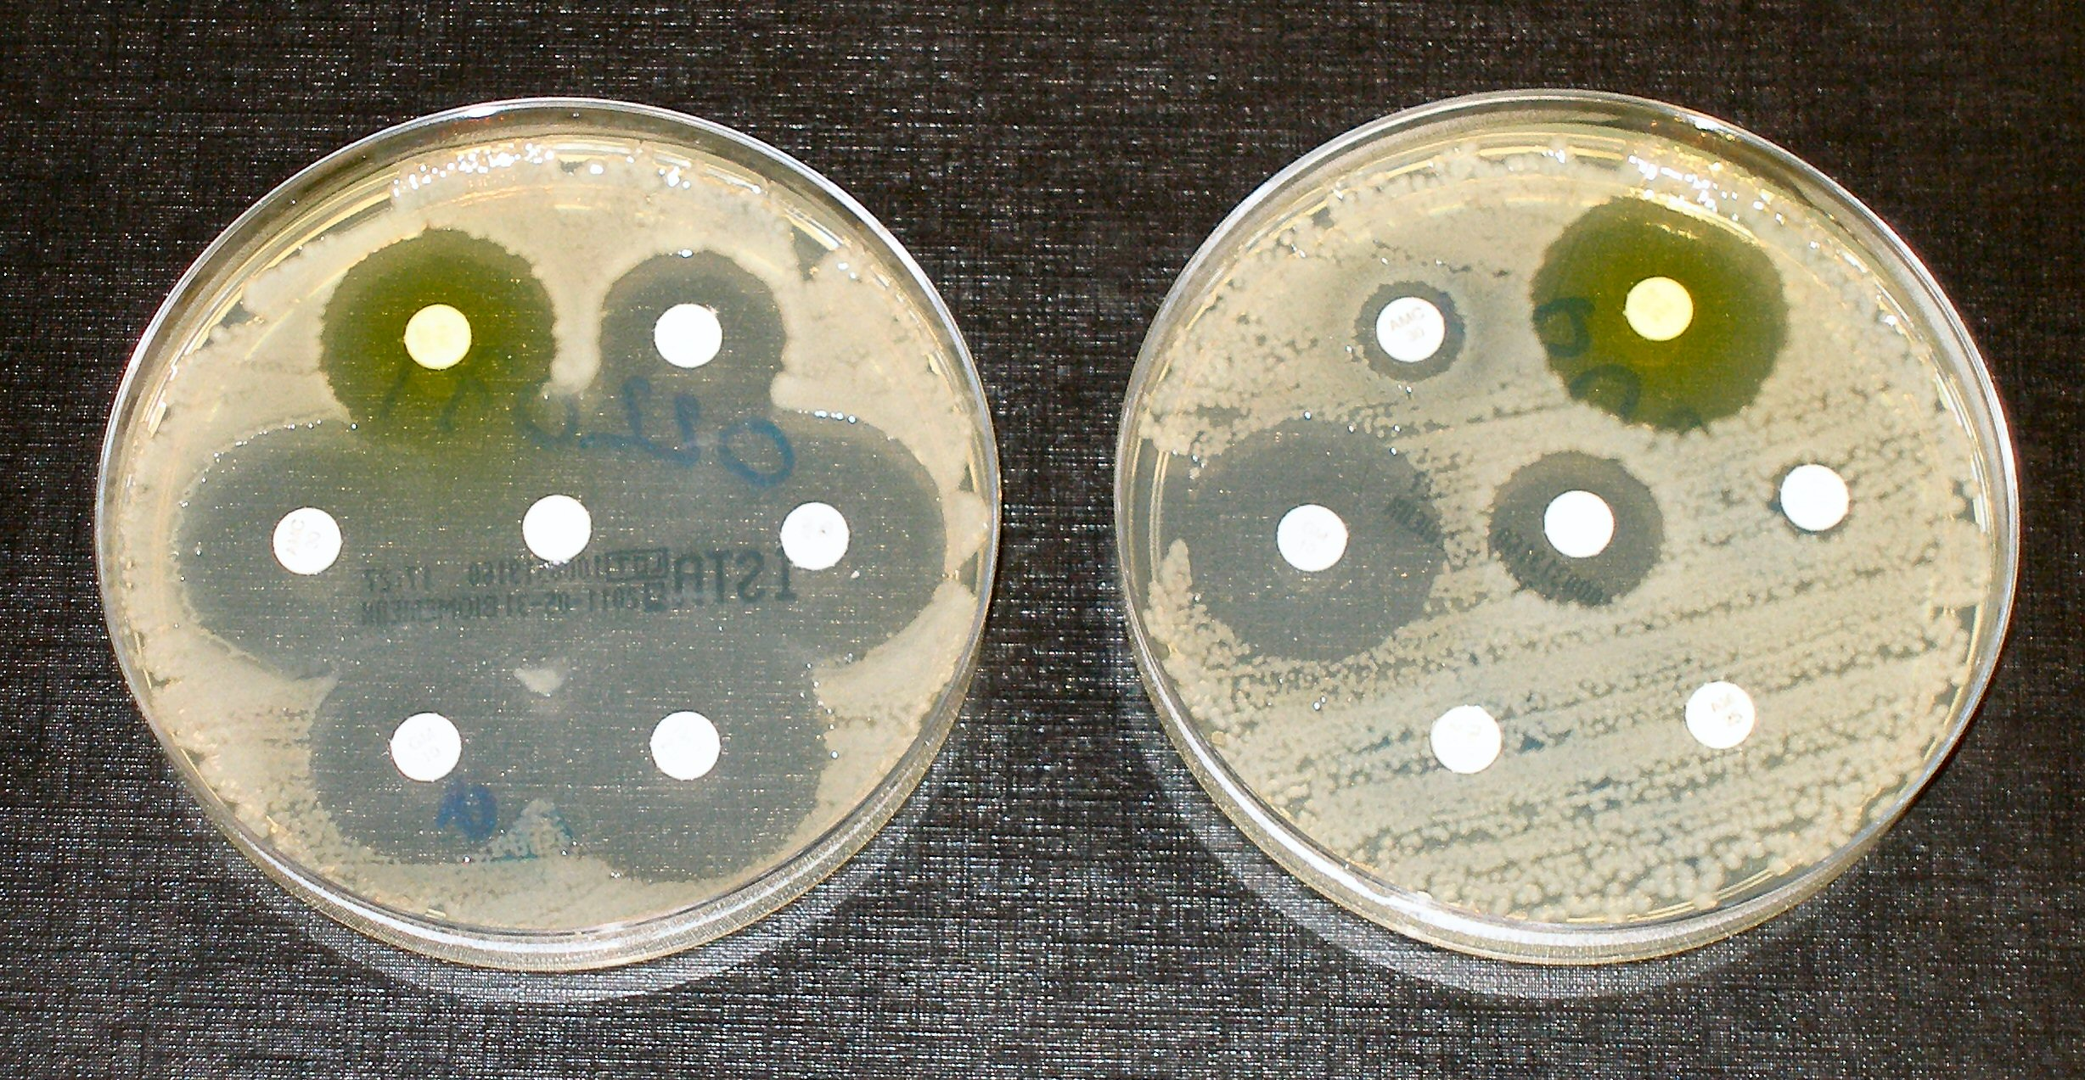
Types of Antibiotic Resistance
Two main types of resistance
  Intrinsic Resistance
  Acquired Resistance
Acquired resistance is the most problematic form

Slide 15

Intrinsic Resistance
Intrinsic Resistance
  Normal aspect of a bacterial cell that prevents drug from working
  Penicillin works for Gram-positive bacteria, but not effective against most Gram-negative bacteria
Notes:
Not all drugs are effective against all types of bacteria – intrinsic resistance.

Slide 16
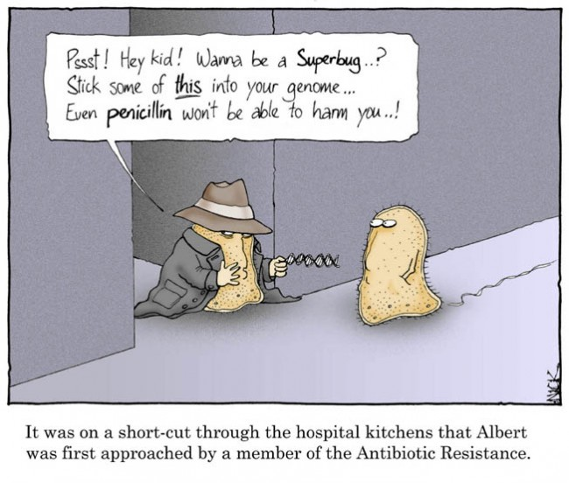
Acquired Resistance
Acquired resistance can arise in two ways
  Novel mutations in the DNA of a bacterial cell that lead to mechanism that counteracts effects of drug, OR
  Acquisition of new
  genes via sharing of
  DNA from other
  bacteria
    Transformation
    Conjugation
Notes:
There are two ways novel resistance genes are acquired by a susceptible bacterium.
The first is that a spontaneous mutation occurs that alters the gene that leads to resistance. An excellent example is resistance to ciprofloxacin in Campylobacter jejuni, a leading cause of self-limiting diarrhea. Ciprofloxacin binds to DNA gyrase, a key enzyme in DNA replication. In some resistant strains of C. jejuni, a single substitution mutation leads to a single amino acid difference in the DNA gyrase enzyme. This single change prevents ciprofloxacin from binding.
Mutations do not have to be dramatic to cause resistance.

Slide 17
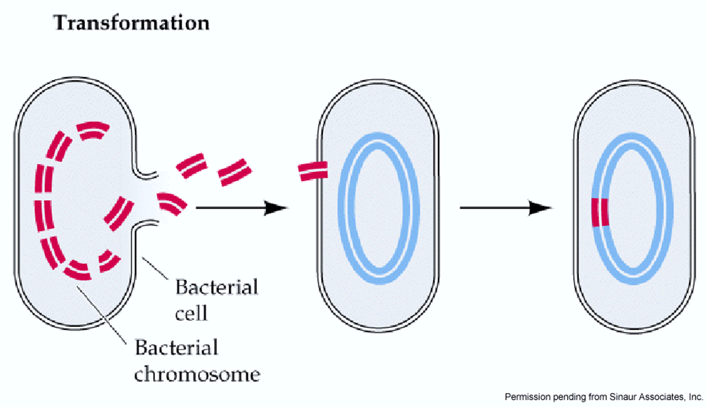
Transformation
Some bacterial cells can take up pieces of DNA from environment
This DNA could contain a gene (or genes) for antibiotic resistance
Notes:
Transformation is the uptake and incorporation of a piece of DNA from the environment. Often, the source of this DNA are dead bacteria that release their contents upon lysis.
In the spread of antibiotic resistance, this commonly happens in the intestines of the host organism.

Slide 18
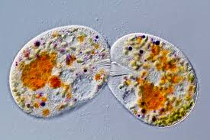
Conjugation
Transfer of a copy of a plasmid, a small, circular piece of DNA, from one bacterium to another
Plasmids often contain antibiotic resistance genes
Entire populations of bacteria can share resistance genes very quickly

Slide 19
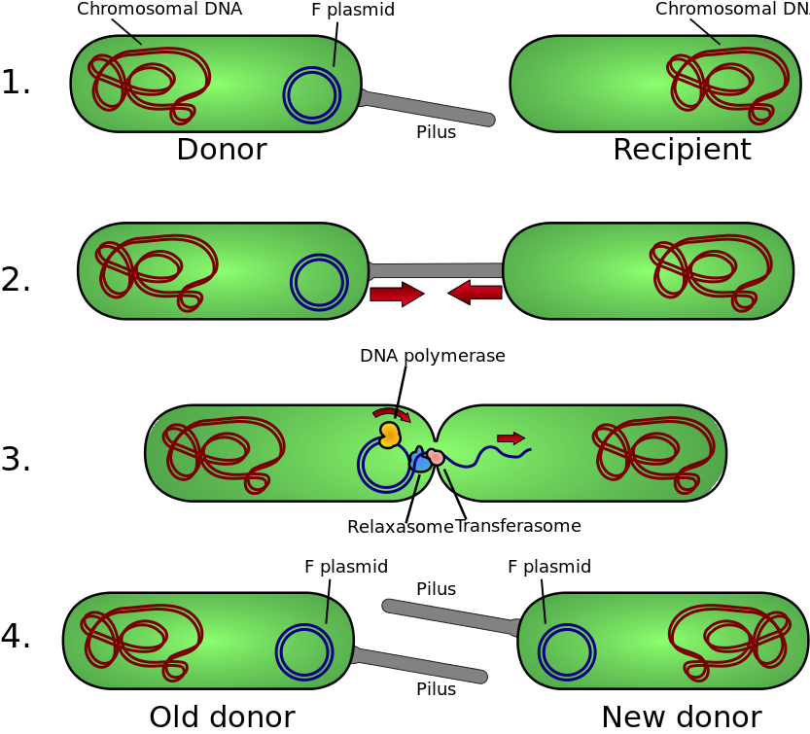
Conjugation
By Adenosine (Own work) [CC BY-SA 3.0 (http://creativecommons.org/licenses/by-sa/3.0)], via Wikimedia Commons

Slide 20
Spread of Resistance Genes
Notes:
A good exercise to complement this slide is to have students play a game of ‘tag’. Start with one student who is resistant – they ‘tag’ one other student, now there are two that are resistant. These two ‘resistant’ students then ‘tag’ one more student each, and so on.
This shows the exponential spread of the resistance genes in a population, and is a good way of showing just how fast the genes can spread.

Slide 21
Resistant Infections Require Special Treatment
Longer treatment
More expensive medication
Higher dosage
Intravenous (IV) medication,
hospitalization
R
R
R
R
R
R
R
Notes:
Treatments for resistant infections are more dangerous and expensive.

Slide 22
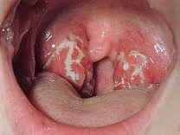
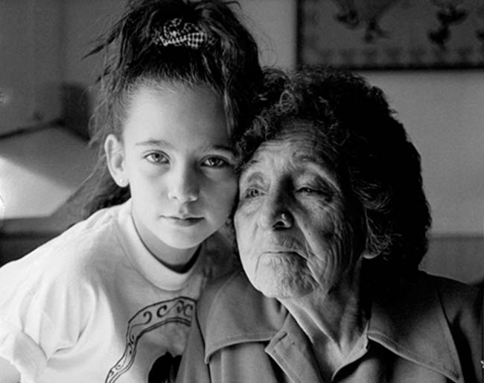
Scenario 3
Amy has strep throat and has been given penicillin
She feels better after a couple of days, and her parents decide she no longer needs the medicine
A few days later, her grandmother comes down with strep throat
The doctor prescribes penicillin, but it is ineffective

Slide 23

Scenario 3
How did Amy’s grandmother acquire strep throat?
Why did the penicillin not work for Amy’s grandmother?
What mistake did Amy’s parents make regarding her penicillin usage?
What was the ultimate cause of penicillin resistance in the strep bacteria?

Slide 24
Mechanisms of Resistance
Bacterial genes produce different mechanisms of resistance
For example:
  Produce enzymes that inactivate the antibiotic
  Pump the drug out of the cell before it gets a chance to work
  Alter the target site where the drug usually binds to the bacteria, so it can’t bind anymore
Notes:
Text:
Bacteria are clever! Bacteria become resistant to antibiotics by mutations in their bacterial genes preventing susceptibility to current antibiotics. Such bacterial gene mutations include:
Changing the bacterial cell wall so it is less permeable and prevents the antibiotic from entering the cell
Producing enzymes that inactivate the antibiotic
Pumping the antibiotic out of the cell before it gets a chance to work
Altering the target site where the antibiotic usually binds to the bacteria, preventing the antibiotic from binding to the site where it has its effect

Slide 25
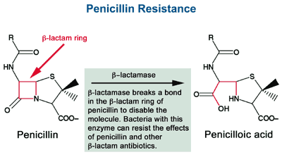
Antibiotic Inactivation

Slide 26
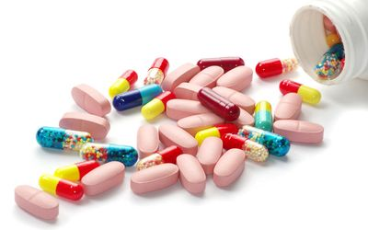
The Problem of Antibiotic Resistance
The misuse and overuse of antibiotic drugs in food production and health care has led to the current state of widespread
antibiotic resistance at both national and global levels

Slide 27
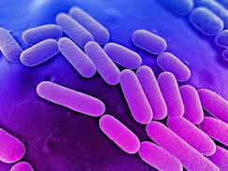
The Problem of Antibiotic Resistance
Resistance rates in bacteria are still increasing
For example, rates of resistance to Carbapenem (similar to penicillin) among Klebsiella samples (a common hospital acquired bacterium) increased from 1.6 % to 10.4% from 2001 to 2011 (MMWR, 2013, 62:9)
Notes:
CRE – Carbapenem Resistant Enterobacteriaceae are a growing concern in hospitals and other health care facilities.
These opportunistic pathogens are highly problematic with regard to immunocompromised patients.
Note - There was no graphic in the original paper.

Slide 28
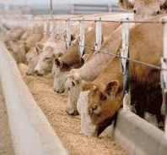
Agriculture
Bacteria with resistance can be transmitted to humans through animal products
Two main factors are related to increased rates of resistance in bacteria
  In-feed antibiotics given
  at low dosages (known to
  increase growth rate of
  animals)
  Antibiotics added to water
  and feed as a preventative
  measure against common
  infections
Notes:
Drugs are given to animals in feed and water to boost growth rate – this increases productivity and profit.
Some animals, such as chickens, are given drugs as prophylactics to prevent the acquisition of infection.
In each case, the dosages may not be high enough to kill bacteria, and over time, those bacteria with greater resistances are selected for.

Slide 29

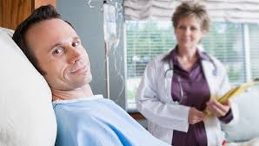
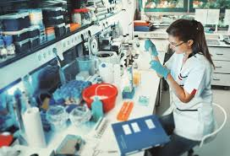
Health Care
Antibiotic use in health care is problematic at many levels
  Patient
  Provider
  Pharmaceutical Industry
Notes:
Antibiotic resistance in the health care field is a multi-faceted problem.

Slide 30

Health Care
Patient
  Antibiotics not taken as directed
    Skipping doses
    Not taken for full length of prescribed time
  Antibiotics asked for in cases of viral infection – cold, flu, sinusitis, etc.
    Antibiotics not effective against viral infection
Notes:
Antibiotics must be taken as directed. This is critical, as clinical dosages must be maintained within the patient. Additionally, if a prescription is ended early, it is very likely that only the most susceptible bacteria have been eliminated. Any bacteria remaining will multiply and there is a likelihood that resistance can develop.
Antibiotics are not effective against viral infections. Most cases of sinus infections (~90%) are viral. Many patients will demand antibiotics – puts provider under pressure to comply.

Slide 31
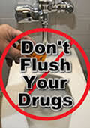
Health Care
Patient
  Self-prescribing
    In some countries, do not need prescription for antibiotics
    Some people will take old antibiotics if they think they have a new infection
  Improper Disposal
    Flushing drugs down the toilet or sink can lead to resistance in environmental bacteria
Notes:
Self-prescribing – in some countries, you do not need a prescription to buy antibiotics at a drug store. In the US, people will take antibiotics they have at home as a form of treatment, whether appropriate or not.
Drugs that are flushed down the drain have an impact on the number of bacteria in the environment that develop resistance. These bacteria are then a potential source of infection, or at the least a potential source of new genes for other bacteria.

Slide 32

Health Care
Provider
  Prescribe antibiotics when not needed
    Pressured by patient to prescribe antibiotics when ineffective
    Incorrect diagnosis (viral v. bacterial sinusitis)
  Broad spectrum drugs
  prescribed
    May affect more than
    just infective bacteria
    Can promote
    selection of resistance
    genes in otherwise
    harmless bacteria
Notes:
Practitioners have become much better educated over the past decade, but instances of over-prescription overuse still exist.

Slide 33

Health Care
Pharmaceutical Industry
  Very little development of new antimicrobials over last three decades
  Medications for chronic conditions such as high cholesterol, diabetes, etc. more profitable than antibiotics
Notes:
Most research in to new antibiotics takes place in academia. Unfortunately, researchers do not have the means to follow through and develop a drug for commercial use. Over the past 30 or so years, the pharma industry has ignored antibiotics, as they do not provide the return on investment that life-long drugs do.

Slide 34
Consequences of Resistance
Number of appropriate antibiotics decreasing
Limited number of drugs available for use
Drugs with greater cost, toxicity and side effects must be used
Resistant infections increasingly difficult to treat
Notes:
As the number of effective drugs decreases, those drugs that are more toxic, more expensive or with negative side effects must be used.
Colistin has been a useful drug because it has not been in use for some time. Recently, a patient with colistin resistant E. coli was found in the US. That means that this drug of last resort is already on its way out as a useful drug.

Slide 35
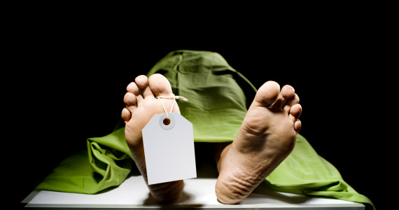
Consequences of Resistance
Number of infections that cannot be treated with known antibiotics increasing
  Colistin resistance – drug of last resort, no way to treat infection
Notes:
As the number of effective drugs decreases, those drugs that are more toxic, more expensive or with negative side effects must be used.
Colistin has been a useful drug because it has not been in use for some time. Recently, a patient with colistin resistant E. coli was found in the US. That means that this drug of last resort is already on its way out as a useful drug.

Slide 36
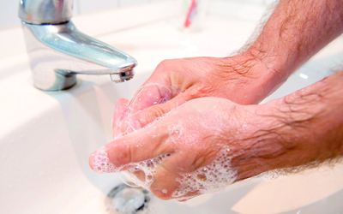
Combating Resistance
Prevent Infection
  Hand-washing and proper hygiene
  Immunization
  Healthy lifestyle: proper nutrition, exercise, regular sleep habits
  Handle and prepare
  food properly

Slide 37

Combating Resistance
Proper antibiotic use
  Take for prescribed time
  and as directed
  Do not share antibiotics
  Dispose of properly
  Only take for bacterial infection
  Limit use in food animals
  Use narrow spectrum drugs after infective agent has been identified

Slide 38
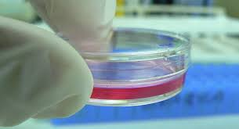
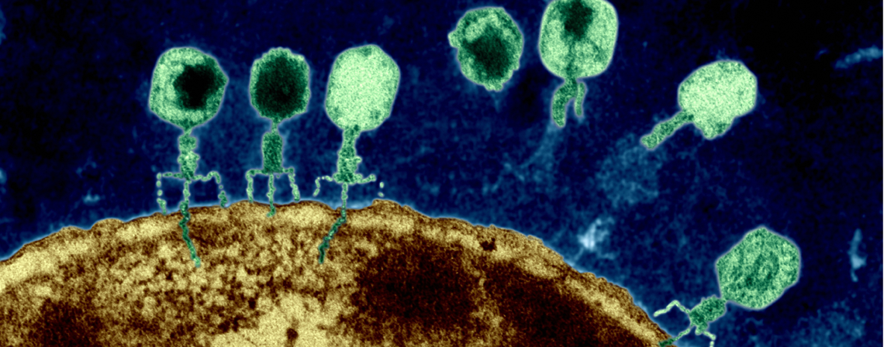
Combating Resistance
Drug and alternative treatment discovery
  Support for new drug discovery
    Lugdinin – substance produced by bacteria in nose that kills Staphylococcus aureus (MRSA)
  Alternative therapies
    Bacteriophage therapy
      Bacterial viruses that are specific to certain types of bacteria
      Bacterial viruses do not infect humans
      Shown to be effective against skin and eye infections
Notes:
Recently in the news, lugdinin is a protein produced by the bacterium Staphylococcus lugdunensis. This bacterium is a natural inhabitant of the nose and produces the protein lugdinin that kills the more harmful Staphylococcus aureus. Researchers wanted to know why some people did not harbor S. aureus in their noses, and it was found that they had S. lugdunensis in their noses. This is a great example of how new drugs can be discovered.
Bacteriophage therapy has been used for decades in Russia and other old Soviet Union countries. These viruses are specific to bacteria and do not infect humans. In addition, resistance is not likely, as the viruses themselves mutate to keep up with the bacteria. So far, their use has been limited in the US, but studies from Europe have suggested the treatment method works.

Slide 39
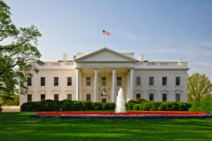
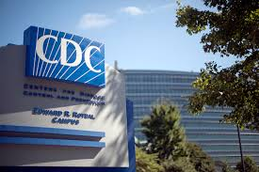
Combating Resistance
National (USA) Initiatives
  National Action Plan for Combating Antibiotic Resistant Bacteria – March 2015, Executive Order 13676
  Antibiotic Resistance Solutions Initiative – CDC, 2016
Notes:
Both national and international programs have been established to combat the growing problem of antibiotic resistance.

Slide 40

Every time someone takes an antibiotic, resistant bacteria may be selected for and multiply
Resistant bacteria may then spread to others, compromising the effectiveness of treatment for future infections
Share what you have learned with your friends and family members

Slide 41
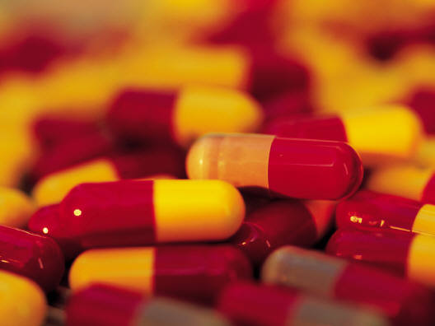

Notes:
Another way you can make a difference is to share what you have learned about bacteria, appropriate antibiotic use, how resistance develops and how to prevent it. Share this information with your families, friends and other people in your community. Think twice about asking your care provider for an antibiotic. You can also consider how you can make a difference in the professional world when you graduate. There are may kinds of jobs in multiple fields that can help prevent antibiotic resistance including research, microbiology, animal husbandry, medicine, and health care administration to name a few. YOU CAN MAKE A DIFFERENCE!

