Slide 1
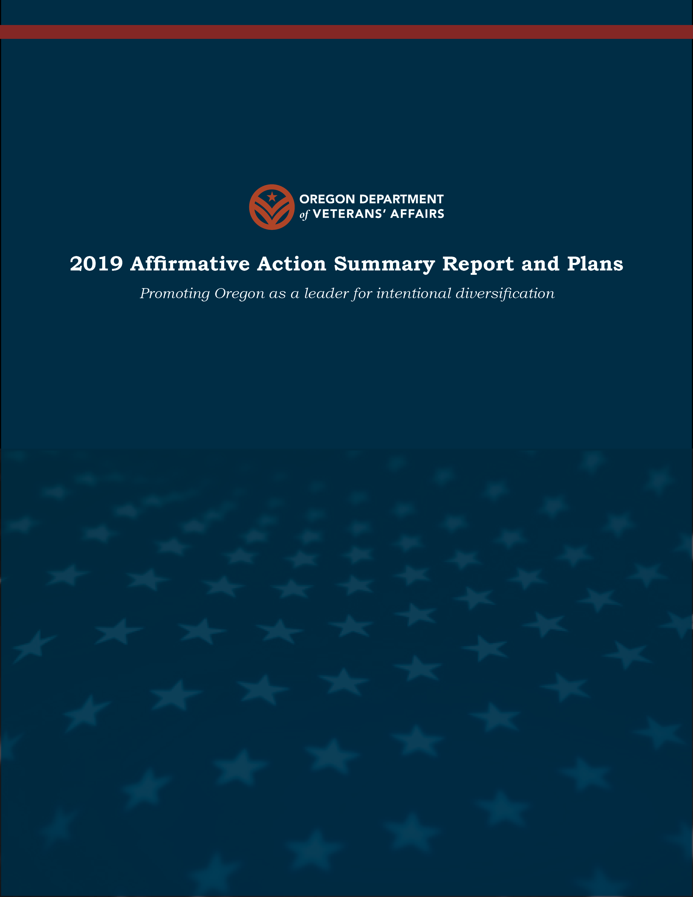

ODVA Rules Advisory Committee
HB 2147
PRESENTED BY
Jay DeFillipo, Legislative Director

Slide 2
HB 2147 RAC Participants
  Joe Glover (ODVA)
  Vicki Horn (CVSO ASSN)
  Chad Dresslehaus (OMCB)
  Mary Newman-Keyes (CVSO)
  Wally Orderman (OFDA)
    Jason Widing
  Dwight Terry (Funeral Home Director)
  Connie Tanaka (CVSO)
  John Lee (United Veteran Groups of Oregon)

Slide 3
Rules for discussion
This is intended to be a creative space where we can think about new ways of doing business.
To accomplish this, participants are asked to respect the following process agreements:
  Have grace, give grace: we are in extra-challenging times, please have grace with yourselves, each other, and the technology.
  Lead with curiosity: test assumptions and inferences, and balance clarifying questions with positional advocacy. Give people the benefit of good intent.
  Be mission-centric: share all relevant information from your world, and think about how your connections and insights can strengthen the effort at hand.
  Respect confidentiality: be mindful of what you share about this space outside of this space, not all topics or ideas may be appropriate or ripe for discussion in a broader venue. If you mention something you do not want to be discussed outside of this space, please verbally note that.

Slide 4
Way ahead
Way Ahead for Rules:
RAC will meet on 2, 9 and 16 November.
RAC final recommendations will close on 17 November.
Anticipate Rules notice for Temporary rules on 30 November.
Proposed notifications on final Rules to be published by 31 Dec 2023.
Temporary Rules will be in effect until the publishing of permanent rules estimated Feb 1, 2024.

Slide 5
DISCUSSION?

Slide 6
Topics for Rules to address
  Appointment of a Veterans Remains Coordinator
  Qualifications of a Veterans Remains Coordinator
  Training of a Veterans Remains Coordinator
  Forms and documents required
  Storage requirements
  Interaction with Funeral Establishments
  Connection with USDVA
  How to process a request with USDVA
  Transparency and validation

