Slide 1
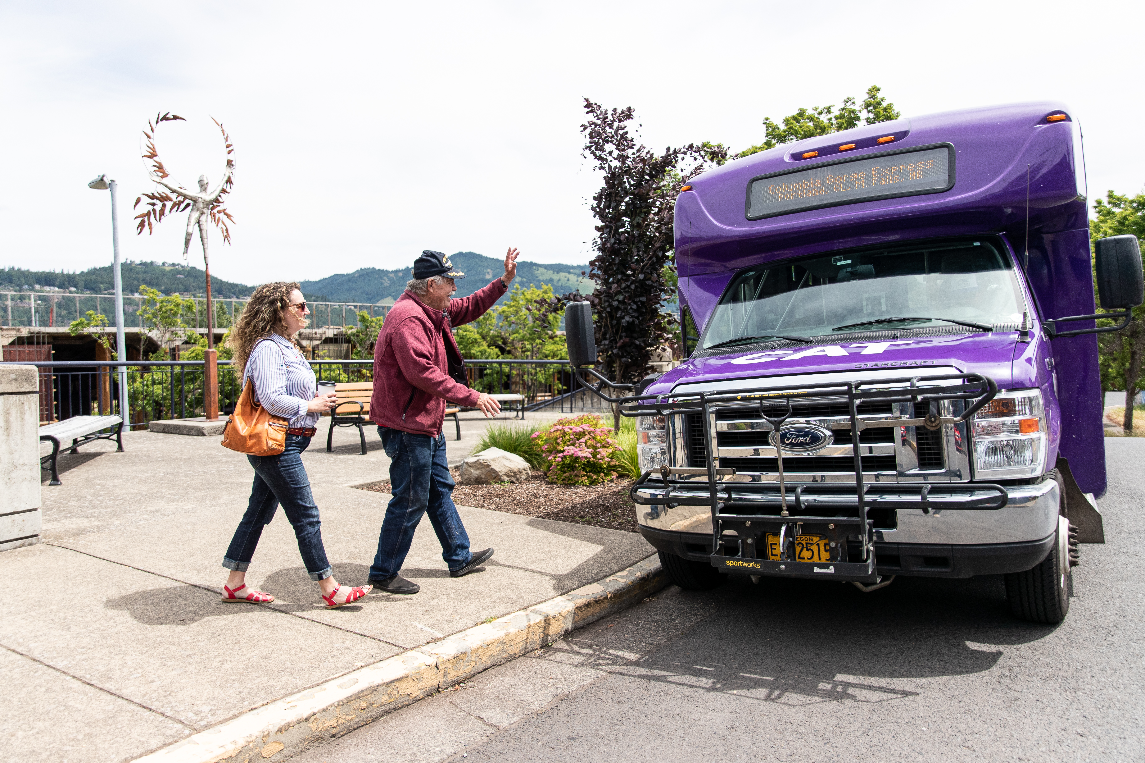
WE HAVE A GRANT
FOR THAT!
Accessing ODOT Local Funding Opportunities
Name of group you are presenting to
Date
Your name
Notes:
Quick question – WHO has applied to ODOT before? What programs are you most interested in?
This presentation is very text heavy! We intend to share the PDF so you will have it all. You are also encouraged to take pictures of the slides that you want to spend more time with! My future hope is to have an ODOT webpage that can hold this information.

Slide 2
Presentation
Outline
What Local Funding Opportunities Are Available?
  Program Eligibilities
  State and Federal Funding
When Can You apply?
  Timeline
  Meet the Program Managers
Discussion: What is your community’s priority project, and will you apply for an ODOT grant?
Questions and Answers
Notes:
This presentation is very text heavy! We intend to share the PDF so you will have it all. You are also encouraged to take pictures of the slides that you want to spend more time with! My future hope is to have an ODOT webpage that can hold this information.

Slide 3
ODOT Local Funding Opportunities Overview
15 Local Funding Opportunities (only includes some transit)
  Are we missing anything?
Most programs and processes are dissimilar and have room for improvement!
  Do you have any feedback for us as we get started on this initiative?
We are working on creating a local funding opportunities program manager peer group to better coordinate local funding opportunities so that local communities have better and easier access to funds for their priority projects while meeting agency goals.
Notes:
Grant Managers would love for our programs to be better for us and for you! We are at the beginning of a collaboration that will help.
The list of the grant programs in on the next slide.

Slide 4
Local Funding Opportunities in 2024-2025
All Roads Transportation Safety Program
Carbon Reduction Program
Community Charging Rebates Program
Connect Oregon
Immediate Opportunity Fund
Innovative Mobility Microgrants
Innovative Mobility Program*
Oregon Community Paths
Safe Routes to School- Construction, Education, Rapid Response, and Project Identification
Small City Allotment Program
Transit Discretionary Grants (multiple)
Transportation and Growth Management Planning Grants
A grant/incentive program is a program that has an application that local communities can fill out to access funds.
*Schedule Information not available at this time.
Notes:
ADD CMAQ and FLAP?
DMV grants not included

Slide 5
Federal Funding* and State Funding
Program | Funding
All Roads Transportation Safety | Federal
Carbon Reduction Program | Federal
Community Charging Rebates Program | ?
Connect Oregon | State
Immediate Opportunity Fund | State
Innovative Mobility Microgrants | State
Innovative Mobility Program | Federal/State
Oregon Community Paths | Federal/State
Safe Routes to School- Construction and Rapid Response | State
Safe Routes to School- Education | Federal
Small City Allotment Program | State
Transit Discretionary Grants (multiple) | Federal
Transportation and Growth Management Planning Grants | Federal
*Note construction projects that are federally funded must be delivered by a federally certified agency.
All future slides show these programs as highlighted.

Slide 6
Eligibility- Which entity are you a part of?
Transit agencies are eligible for
  Carbon Reduction Program
  Community Charging Rebates program (provided charging is open to public)
  Innovative Mobility Microgrants
  Innovative Mobility Program
  Oregon Community Paths
  Safe Routes to School- Construction, Education, Project Identification, and Rapid Response
  Transit Discretionary Grants (multiple)
  Transportation and Growth Management Planning Grants
Tribes are eligible for
  All Roads Transportation Safety Program
  Carbon Reduction Program
  Community Charging Rebates Program
  Connect Oregon
  Immediate Opportunity Fund
  Innovative Mobility Microgrants
  Innovative Mobility Program
  Oregon Community Paths
  Safe Routes to School- Construction, Education, Project Identification, and Rapid Response
  Transit Discretionary Grants (multiple)
  Transportation and Growth Management Planning Grants
Notes:
Working on a tool- Draft- ODOT Grant Programs (cognitoforms.com)
Highlighted programs are federally funded or partially federally funded construction programs. You must me federally certified to deliver these projects or ODOT must deliver.

Slide 7
Eligibility- Which entity are you a part of?
Some businesses are eligible for
  Community Charging Rebates Program
  Safe Routes to School Education (non-profit)
  Connect Oregon
School Districts are eligible for
  Community Charging Rebates program (provided charging is open to public)
  Innovative Mobility Microgrants
  Oregon Community Paths
  Safe Routes to School Education and Project Identification
Cities and Counties may be eligible for all opportunities (transit funds only if also a transit agency),
MPOs are eligible for
  Carbon Reduction Program
  Community Charging Rebates Program
  Innovative Mobility Microgrants
  Safe Routes to School Construction, Education, Rapid Response and Project Identification
  Transportation Growth Management Planning Grants
Notes:
Working on a tool- Draft- ODOT Grant Programs (cognitoforms.com)
Highlighted programs are federally funded or partially federally funded construction programs. You must me federally certified to deliver these projects or ODOT must deliver.

Slide 8
Fund | Description
All Roads Transportation Safety (ARTS) Program | Safety projects that reduce fatal and serious injury crashes on a public road in Oregon.
Carbon Reduction Program | Projects that reduce greenhouse gas emissions in urban and rural areas with less than 200,000 residents Carbon Reduction Funds can be used for a wide range of projects including alternative fuel vehicles and charging stations, bicycle and pedestrian projects, transit capital projects, intelligent transportation projects, and others.
Community Charging Rebates Program | Supports the installation and maintenance of Level 2 chargers at public parking sites and multi-family housing. Majority of funds reserved for projects in disadvantaged and rural communities.
Connect Oregon | Connect Oregon is an initiative established by the 2005 state legislature to invest in non-highway modes of transportation. Future rounds of the program will fund aviation, rail, and marine projects, and previous rounds included bicycle/pedestrian &transit projects.
Immediate Opportunity Fund | Program supports economic development through roadway improvements and provide funds in order to respond quickly to economic development opportunities.
Innovative Mobility Microgrants | Projects that encourage innovation and collaboration in meeting the transportation needs of members of historically excluded groups.
Innovative Mobility Program | Projects that encourage innovation and collaboration in meeting the transportation needs of members of historically excluded groups.
Oregon Community Paths | Projects that are off system, multi-use, bicycle or foot paths. There are two project categories: regional paths and critical links. Funds are State or Federal (construction) or Federal (Preliminary Planning)
Notes:
Highlighted programs are federally funded or partially federally funded construction programs. You must me federally certified to deliver these projects or ODOT must deliver.

Slide 9
Fund | Description
Safe Routes to School- Construction | Construction programs ensuring that safe walking and biking routes exist through investments in crossings, sidewalks and bike lanes, and flashing beacons.
Safe Routes to School- Project Identification Program | Program provides services (not funds) that help communities plan to address barriers to students walking and bicycling to school.
Safe Routes to School- Education | Programs focusing on education and outreach to assure awareness and safe use of walking and biking
Safe Routes to School Rapid Response | Rapid Response Grants are for communities in which a recent crash occurred in the last twenty-four months involving a pedestrian or a bicyclist and the pedestrian/bicyclist was injured, seriously injured, or killed and the proposed project specifically addresses this incident effectively and cost effectively, or an urgent opportunity arises which means that something substantial and unexpected has changed and must be addressed before the next Competitive Grant cycle.
Small City Allotment Program | Incorporated cities with populations of 5,000 or fewer. Projects located on streets that are not part of the state highway system and that are inadequate for the capacity they serve or are in a condition detrimental to safety.
Transportation and Growth Management Planning Grants | Program helps communities address pressing transportation, land use, and growth management issues. TGM grants are for long range planning work that lead to local policy decisions.
Notes:
Highlighted programs are federally funded or partially federally funded construction programs. You must me federally certified to deliver these projects or ODOT must deliver.

Slide 10
Transit Discretionary Grants (work in progress)
5304: Statewide Transportation Planning Grant Program
5307: Mass Transit Vehicle Replacement (focus on MPO areas)
Statewide Transportation Improvement Fund Discretionary Program
Statewide Transit Network Program (STIF Intercommunity Discretionary Fund)
Focus on Rural/Small Urban:
5310: Enhanced Mobility of Seniors and Individuals with Disabilities
5339 Bus and Bus Facility Discretionary Program STBG Discretionary Bus Replacement Program
Technical Assistance Program Scholarships
Notes:
Didn't include Rural Veterans Healthcare because I think it is an ODVA program not ODOT

Slide 11
Transit Solicitation | Description
Transit Mid-Cycle Solicitation | Provides funding to transit providers for capital purchases, planning projects, operations and maintenance, including but not limited to, vehicle purchases and facility improvements, investments in multi-modal connectivity, transportation improvement planning, and route operations. Selection criteria focus on safety, equity, climate impacts, and useful life benchmarks. Eligible recipients and projects vary by funding cycle.
Funds may include: 5304 Statewide Transportation Planning, 5307 (STGB Flex), ARP 5310, 5310 (STGB Flex), 3559 Buses and Bus Facilities, 5311 (STGB Flex)

Slide 12
Safe Routes to School Rapid Response, Technical Assistance Program Scholarships (transit), Immediate Opportunity Fund have ongoing solicitations. Innovative Micro-mobility Grants: Feb – Nov
Q1 2024
Safe Routes to School Construction, Education and Project Identification
Carbon Reduction
Q2 2024
Transportation and Growth Management Planning Grants
Q3 2024
Small City Allotment
All Roads Transportation Safety
Community Charging Rebates
Oregon Community Paths
Transit Mid-Cycle Solicitation
Connect Oregon
Every 2 years
Every 2 years
Please note that solicitation times are approximate and subject to change. Sign up for program update to receive notifications. Oregon Department of Transportation (govdelivery.com)
Notes:
Highlighted programs are federally funded or partially federally funded construction programs. You must me federally certified to deliver these projects or ODOT must deliver.
Add transit discretionary

Slide 13
Q1 2025
Q2 2025
Transportation and Growth Management Planning Grants
Q3 2025
Community Charging rebates
Small City Allotment
All Roads Transportation Safety
Q4 2025
Transit Mid-cycle Solicitation
Safe Routes to School Rapid Response, Technical Assistance Program Scholarships (transit), Immediate Opportunity Fund have ongoing solicitations. Innovative Micro-mobility Grants: Feb – Nov
Every 2 years
Please note that solicitation times are approximate and subject to change. Sign up for program update to receive notifications. Oregon Department of Transportation (govdelivery.com)
Notes:
Highlighted programs are federally funded or partially federally funded construction programs. You must me federally certified to deliver these projects or ODOT must deliver.

Slide 14
Meet the Program Managers
All Roads Transportation Safety Program: Jiguang Zhao
Carbon Reduction Program: Rye Baerg
Community Charging Rebates Program: Jenna Compton
Connect Oregon: Cecelia Gilbert/John Boren
Immediate Opportunity Fund: Cecelia Gilbert
Innovative Mobility: Amanda Howell
Oregon Community Paths: Alan Thompson
Safe Routes to School- Construction, Rapid Response and Project Identification: Xao Posadas
Safe Routes to School- Education: Heidi Manlove
Small City Allotment Program: Deanna Edgar
Transportation and Growth Management Planning Grants: Elizabeth Ledet
Delivery and Operations
Policy and Data Analysis
Finance and Budget
Public Transportation
DMV
Finance and Budget
Policy and Data Analysis
Notes:
Transit is on a separate slide

Slide 15
Meet the Solicitation Managers (Transit)
Transit Mid-Cycle Solicitation, Ryan Phillips
  Funds may include: 5304 Statewide Transportation Planning, 5307 (STGB Flex), ARP 5310, 5310 (STGB Flex), 3559 Buses and Bus Facilities, 5311 (STGB Flex)
Statewide Transportation Improvement Fund Discretionary Program, TBD
Statewide Transit Network Program (STIF Intercommunity Discretionary Fund), TBD
Technical Assistance Program Scholarships: Tyler Tweedy
Notes:
Didn't include Rural Veterans Healthcare because I think it is an ODVA program not ODOT

Slide 16
Discussion
What is your community’s priority project/initiative, and will you apply for an ODOT grant?
Questions and Answers
Notes:
This presentation is very text heavy! We intend to share the PDF so you will have it all. You are also encouraged to take pictures of the slides that you want to spend more time with! My future hope is to have an ODOT webpage that can hold this information.

Slide 17
Feedback? Questions?
leeanne.fergason@odot.oregon.gov
503-910-8994
Notes:
LeeAnne

