Slide 1
Transportation Safety Action Plan (TSAP)
SCOACT Sept 23rd

Slide 2
Meeting Objectives
Provide an overview of ODOT’s TSAP Update
Preview preliminary crash analysis results
Get your perspective on issues of roadway safety and how best to address them
Notes:
We will accept questions along the way so please feel free to raise your hand – Sunshine will give you mic access OR enter your comment/question into the Chat.

Slide 3
TSAP Overview
Notes:
And now I'll share how the TSAP is aligned with the Oregon Transportation Plan and other statewide planning efforts.

Slide 4
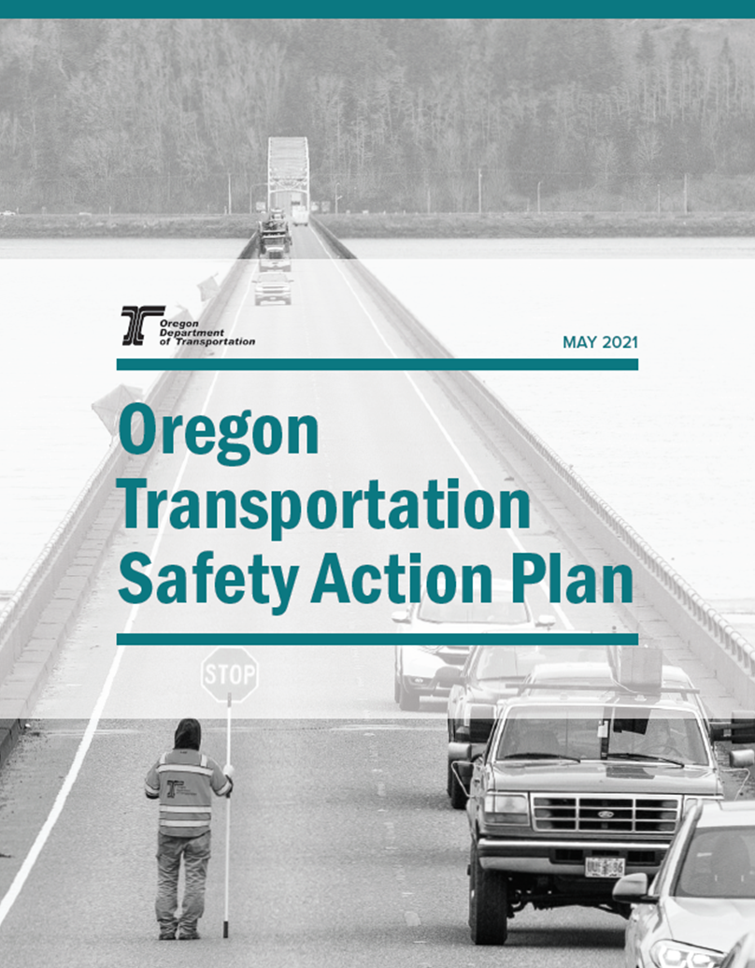
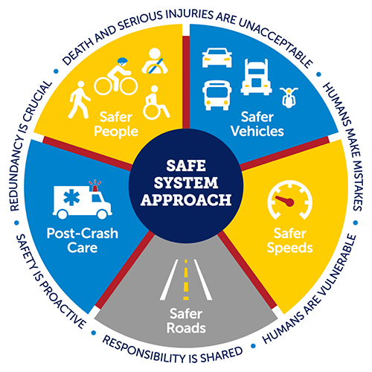
What is the TSAP?
The Transportation Safety Action Plan unifies transportation safety planning in Oregon for:
  •All users
  •On all roads
  •Across all jurisdictions
Requirements:
  Updated every 5 years
  Maintains eligibility for critical safety funding (e.g. ARTS)
  Consistent Objectives
Notes:
The Transportation Safety Action Plan outlines how to improve roadway safety for all users, on all roads, across all agencies/jurisdictions. The plan’s goal is to create a transportation system where everyone can travel safely, whether they drive, walk, roll, bike, or take public transportation.
The TSAP establishes the long-range vision for transportation safety and identifies short-term actions to eliminate deaths and life-changing injuries. Short term actions focused on the next 5 years.
Federal Requirements –
Required to be updated every 5 years (the current plan was approved in 2021, update due by October 2026)
Required to be eligible for critical safety funding
Partners
A successful TSAP relies on partners who commit to making the plan's policies, programs, and projects a reality in order to save lives and prevent injuries.
This is an Oregon plan, and not just an ODOT plan
State, regional, county and city agencies
Tribal governments
Enforcement/EMS providers
Public health agencies
All travelers!
Objectives of the 2026 Update:
Conduct a collaborative process, with safety partners throughout the state
Analyze safety data to identify trends and solutions for all public roads and users, including vulnerable users like pedestrians and bicyclists.
Evaluate progress toward eliminating fatalities and serious injuries.
Identify actions based on input from partner feedback and data trends that will be implemented in the next five years.
Integrate the safe system approach to guide future safety decisions and investments.​ + Land Use
Safe People: The Safe System approach addresses the safety of all road users, including those who walk, bike, drive, ride transit, and travel by other modes.
Safe Vehicles: How vehicles are designed with the latest technology to support safe travel, but also recognizing that distractions may also increase due to tech. Vehicle size/weight also has a role to play in crashes and severity of them
Safe Speeds: Reducing speeds can dramatically improve the survival rate of crashes and reduce severity of crashes – this includes not only supporting safe speeding behavior, but also how we design the system appropriate for the context.
Safe Roads: Thinking about how we design, maintain and operate a system to accommodate human mistakes – such as physically separating modes (bikes and vehicles), or providing dedicated times for different users to move through a space (advanced signal priority to pedestrians at intersections)
Post Crash Care: When a person is injured in a crash they rely on emergency response to quickly locate them, stabilize them and get them to a hospital – making sure we have system designed and available resources to support this is critical.
The actions within the TSAP that will advance the SSA will have a direct impact on the programs and services delivered throughout ODOT, other statewide and local partners.
---
Thinking about our role as ODOT employees…much of what we do here at ODOT focuses on safety and this may be different in different parts of the agency – but we all have a role to play.
Here are just a few examples ODOT addresses safety and how our work is reflected in the TSAP:
Policies and plans: OTP/TSAP/SAP – this is both long range policy direction, and also short-range implementation
Behavioral resources: education/outreach to all 5 regions to support safe behaviors (SRTS, proper car seat usage), another example is supporting patrol efforts through law enforcement campaigns with local communities
Guidance and resources:
Design guidance for pedestrian crossings
Speed setting methodology
Capital Investments:
ARTS

Slide 5
Project Schedule
Q1 2025
Q2 2025
Q3 2025
Q4 2025
Q1 2026
Q2 2026
Q3 2026
Steering Committee meetings and partner workshops
Public review/ Draft revisions/ OTSC/ OTC
Project kick-off
Existing conditions analysis, interviews
Draft TSAP development
Draft complete
Notes:
Here is a high level schedule of our work.
February 2025 – Kickoff Meeting
April 2025 – Steering Committee Meeting #1
April-July 2025 – Existing Conditions Analysis, Interviews, SC Meetings, Partner Workshops
August-December 2025 – Draft TSAP Development
December 2025 – TSAP Draft Complete
January-October 2026 – Draft Revisions, Public Review, OTSC, OTC

Slide 6
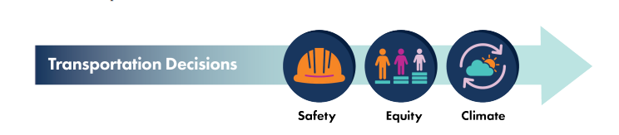
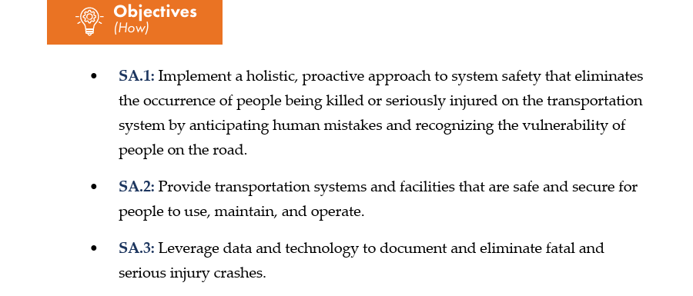
Oregon Transportation Plan Safety Elements
  OTP Safety Target
  Est. Zero Fatalities and Serious Injuries Target
  OTP Safety Goal
  Enable safe travel for all people, regardless of their age, ability, race, income or mode of transportation
Notes:
The OTP Establishes several safety elements that the TSAP will work to refine.
OTP goals:
Establishes a Zero target for fatalities and serious injuries
A safety, climate and equity decision-making lense for our work; and when solutions are identified that can save lives but may be on conflict with other goals – safety takes precedence.
Lastly, the OTP establishes a safety goal and objectives
This TSAP update will be unique in that we will not be recreating the goal – we will take this safety goal from the OTP and develop a TSAP that will help us get there. The actions that we will identify in the TSAP update will add more specificity to the objectives outlined in the OTP. Regarding topics that the OTP does not address or get specific enough this is what the TSAP will refine. (i.e. specific needs for transportation vulnerable users, infrastructure design, risky behaviors, enforcement needs, etc.)

Slide 7
OTP Investment Framework
SAFETY-RELATED ELEMENTS
Strategic Approach to Investment
Top Tier addresses fatalities and serious injuries
Second Tier addresses contributing factors to reduce severity
Third Tier increases users' sense of safety and comfort
Notes:
The TSAP is also looking to the OTP for direction on prioritizing investments. With limited resources, Oregon must be strategic – the OTP established a tiering structure – for purposes of this presentation I have pulled out the safety-specific elements
Review the tiers.
Top Tier: The EAs and actions we categorize as the top tier will be priority when receiving funding as these activities address the top offenders in FSI crashes. A couple examples of these – when looking at the crash data are FSI crashes that involve roadway runoff, or intersections.
Second Tier: these are contributing factors – that perhaps we want to monitor ongoing trends as these are showing to have a correlation to FSI, but a little less significant than the Top tier. E.g.s Distracted Driving, Occupant protection

Slide 8
Draft Crash Data Analysis
Notes:
Walt

Slide 9
Crash Data Analysis Methodology
  Summarize most recent 5 years: 2019-2023
  Compare to previous 5 years (2014-2018) used in 2021 TSAP
    Note changes and trends over time
  Statewide focus (includes ODOT, city and county facilities) for the TSAP
Notes:
Not specific location focused
The data will raise questions, we won't have time to answer all questions – but we want to capture them and reflect on them.

Slide 10
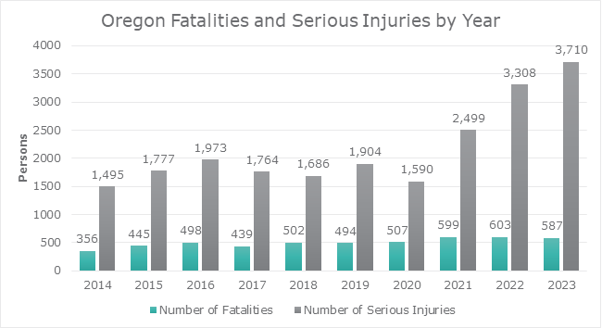
Crash Data: Trends by Year
Notes:
This is a high-level review of fatal and serious injury crash trends.
We are witness to a significant spike in Serious injury crashes. Serious injuries are debilitating injuries and inflict hardship on families - emotional, financial.
Looking at the last few years. We are reflecting a slight decrease in fatal crashes statewide on all roads (down 3% between 2022 and 2023) this trend is continuing in 2024 (preliminary data).
However, overall we are seeing much higher numbers of fatalities and serious injury crashes than we did several decades ago.
For comparison purposes, the total number of fatal and serious injury crashes (combined) increased by 44% from 2014-2018 to 2019-2023.
Injury level (A, B, C) is a subjective measure by on-scene law enforcement.
While the change in SI is drastic, the proportion of F to FSI only decreased from 21% to 18%. It's always been the case that SI are "driving the narrative" - that remains true.
- However, this had gone down a lot in the 2021-2023 period
What we are doing to try to better understand this spike in Serious Injuries:
ODOT will dig into verifying that the data processes haven’t changed that would result in this spike
ODOT will compare to health data and confirm they are seeing similar trends that we are seeing in the crash reports to ensure nothing has changed in the reporting/law enforcement side. (this could reveal changes in crash reporting)
ODOT will do a scan of a handful of other states to compare FSI, to confirm if Oregon is an anomaly

Slide 11
Crash Data: Top Contributing Factors
Proportion of Fatal and Serious Injury (FSI) Crashes 2019-23
39% | 38% | 25% | 24% | 23% | 14% | 14%
Roadway Departure Crashes | Intersection Crashes | Speed-Related Crashes | Aging Drivers Involved Crashes (65+) | Alcohol and/or Other Drugs Involved Crashes | Young Drivers (15-20) Involved Crashes | Motorcycle Involved Crashes
# FSI Crashes
5,299
5,201
3,360
3,196
3,179
1,962
1,903
Notes:
Includes crash cause and types – one crash can fit multiple categories.
Shifting reported data from people to crash events for this analysis: e.g. Crashes involving pedestrians injured or killed
These are not exclusive, you can have alcohol and youth together, etc.

Slide 12
Crash Data: Top Contributing Factors
+44%
All FSI Crashes
Percent Increase in Number of FSI Crashes 2014-18 to 2019-23
+116% | +68% | +54% | +53% | +52% | +50% | +49%
Distracted Driver Involved Crashes | Unrestrained Occupant Involved Crashes | Aging Drivers (65+) Involved Crashes | Commercial Motor Vehicle Involved Crashes | Intersection Crashes | Alcohol and/or Other Drugs Involved Crashed | Speed-Related Crashes
‘14-’18
’19-’23
806
1,737
900
1,513
2,082
3,196
527
805
3,413
5,201
2,121
3,179
2,251
3,360
Notes:
Summary of Fatal Serious Injury crashes – increased 44% from 2014-2018 to the 2019-2023
Includes crash cause and types – one crash can fit multiple categories.
Shifting reported data from people to crash events for this analysis –
All FSI crashes increased 44% from 2014-19 to 2019-23
Note what our role is to influence these trends?
To educate and design a system that reduced user error.
We’re trying to understand why the spike is this different – is it data related, reporting related, population. We don’t know yet and are working to better understand the nuances of differences – we’re also comparing it to other states as well.

Slide 13
Discussion
  What areas of roadway safety are the most worrisome to you?
  What are the game changers to help Oregon get to zero fatalities and serious injuries (e.g. rumble strips, teen driver education, enforcement)?

Slide 14
Thank You!

Slide 15
Next Steps
Notes:
Mary

Slide 16
Opportunities to Stay Informed and Engaged
Project Website at https://www.oregon.gov/odot/Safety/Pages/TSAP.aspx
Receive e-mail newsletter
Email comments/questions to safety@odot.Oregon.gov
Mary McGowan, ODOT Statewide Planning Mary.M.Mcgowan@odot.Oregon.gov
Walt McAllister, ODOT Safe Communities Program
Walter.J.McAllister@odot.Oregon.gov
Notes:
Mary

