Slide 1
Forest Carbon Basics:
Key Scientific Concepts
Mark E. Harmon
Richardson Chair and Professor in Forest Science
Oregon State University

Slide 2
Key Concepts
Conservation of mass
The leaky bucket (simultaneous input-output)
Reference point or baseline
Scale and systems level
Systems boundaries
The importance of timing
The basic parts and processes

Slide 3
Conservation of Mass Law
For a closed system mass cannot be created or destroyed, although it may change form
1756 Mikhail Lomonosov
1774 Antoine Lavoisier
A key building block of modern science
Allows us to use mass balance

Slide 4
Conservation of mass law
Carbon
Atmosphere
Atmosphere
Land surface
Land surface
Ocean
Ocean
Rocks
Rocks

Slide 5
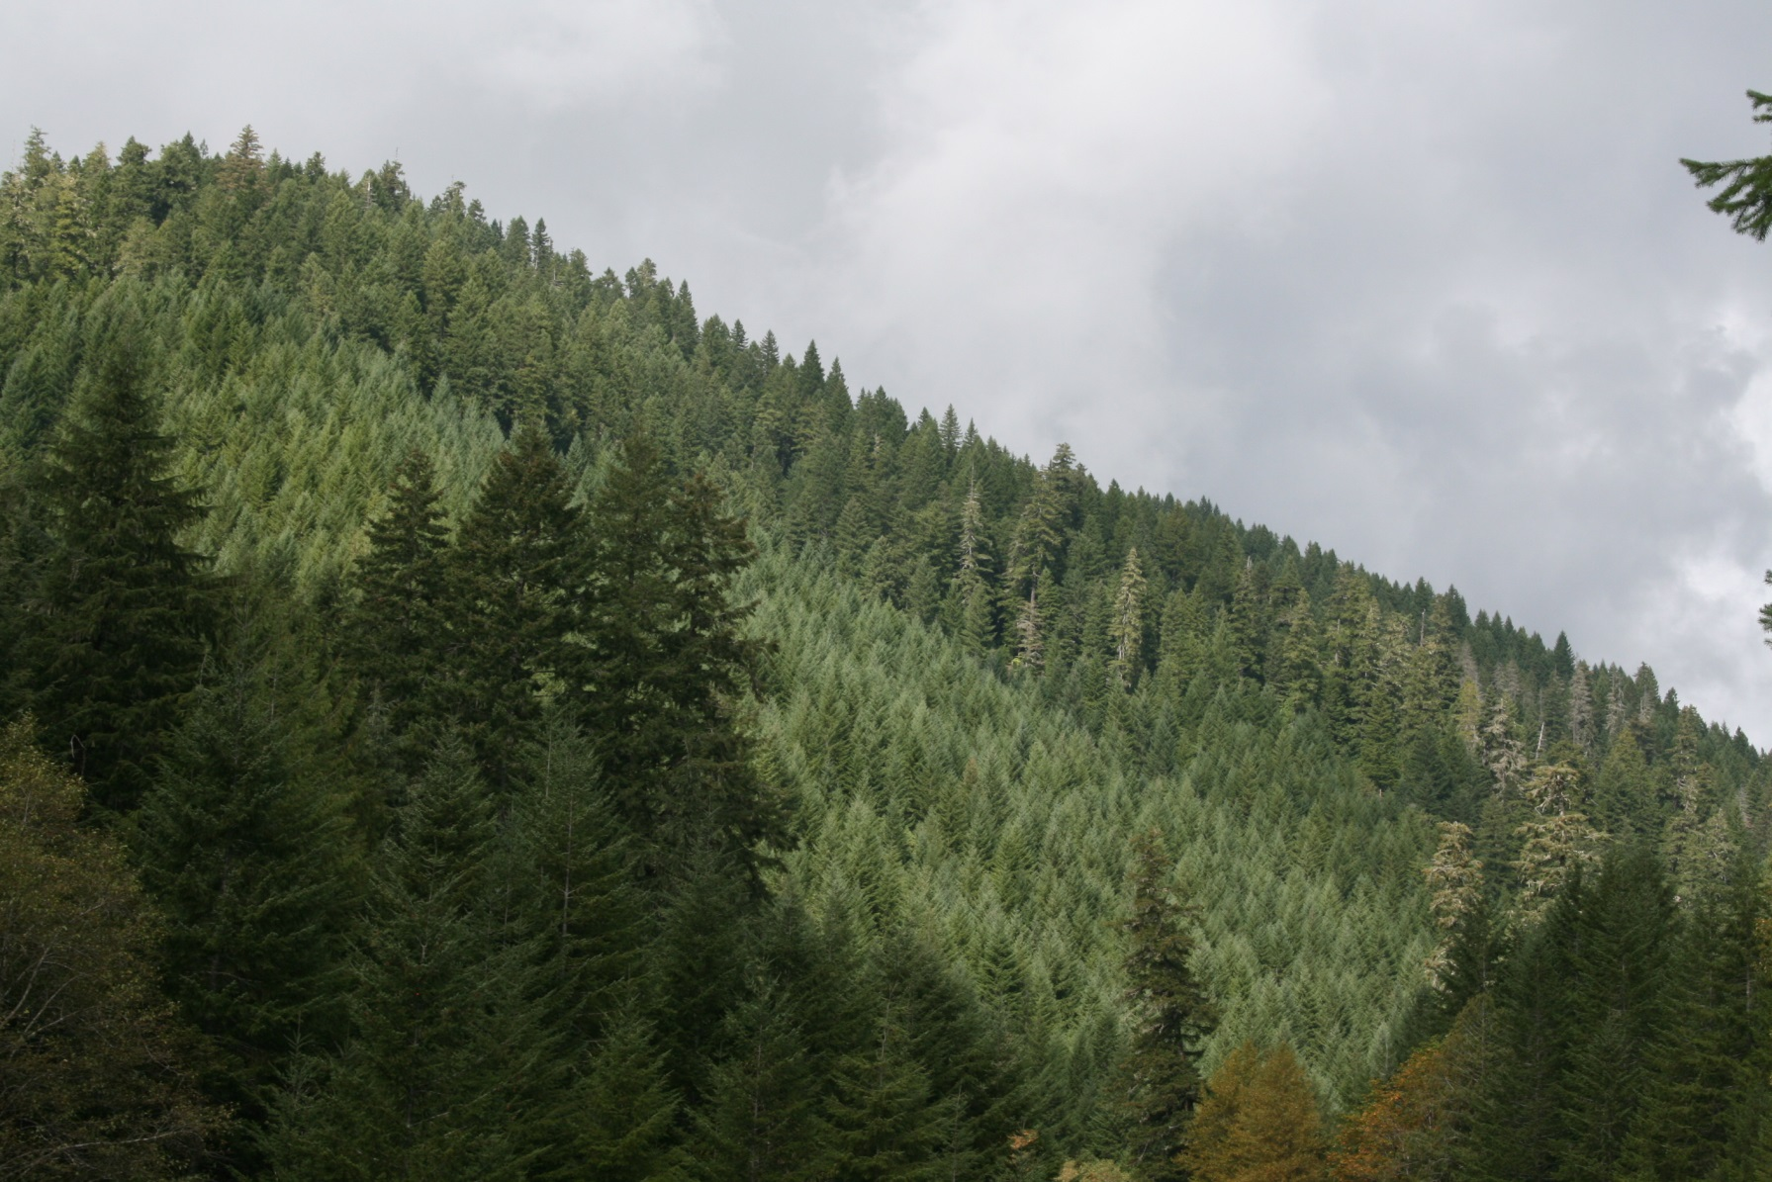
Which forest stores more carbon?
OG=600 MgC/ha
Harvested forest=325 MgC/ha
Young forest=260 MgC/ha
Forest products= 65 MgC/ha
At current uptake rates
130 years to reach OG store
Notes:
Applying conservation of mass shows us that converting an old-growth forest with high stores to a young forest with forest products must add carbon to the atmosphere. The higher rate of net carbon uptake of the younger forest is irrelevant because it would have to be vastly larger that it is (over 100 times higher) for the stores to be the same (which of course they are not).

Slide 6
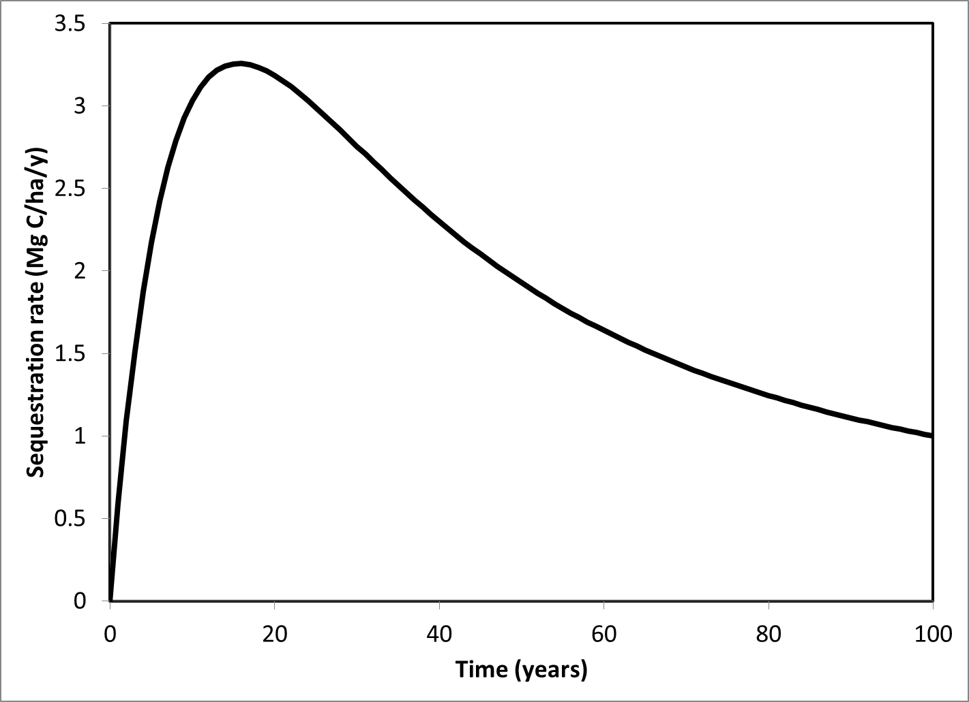
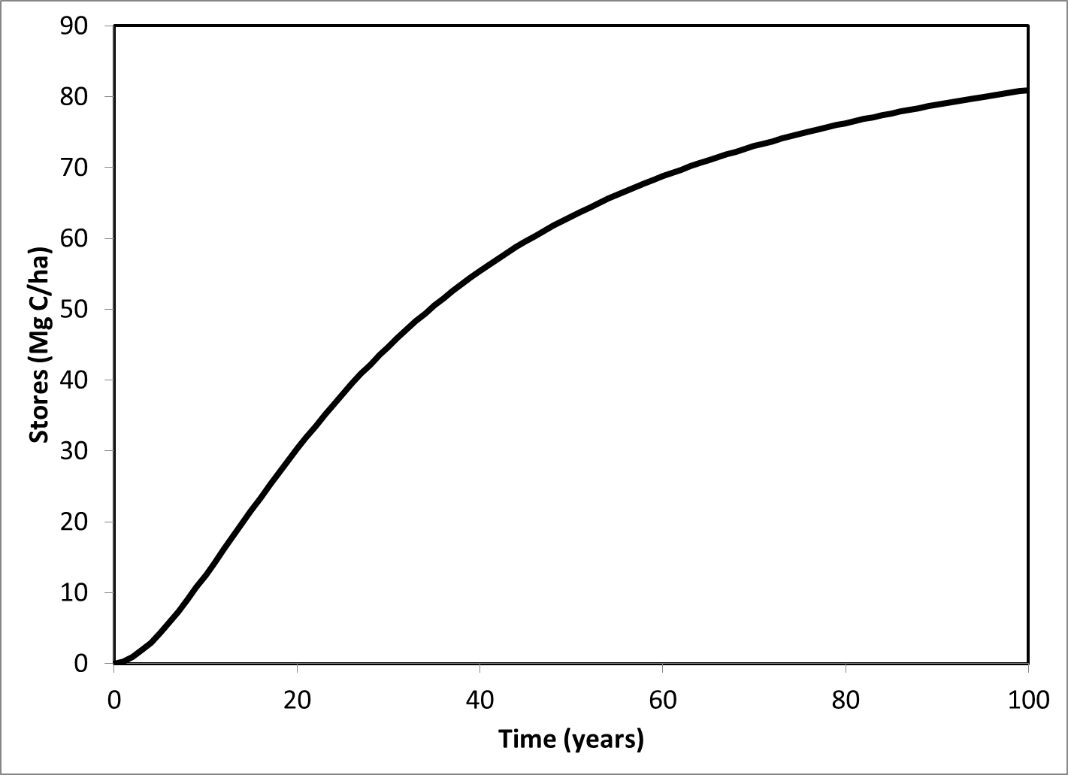
Do we care about Sequestration rate or Stores?
System average (all ages)
Sequestration rate
Stores
Notes:
Here an example based on a manuscript I recently reviewed. The authors analyzed the average sequestration rates of different hybrid poplar plantations. Since the 15 year sequestration rate was the highest they recommend that China manage on a 15 year rotation. The problem is that the average store increased far beyond the 15 years they were recommending. A 40 year rotation would store 2.5 times more carbon which conservation of mass tells us would not be in the atmosphere. Why the difference? The scientists forgot that one also has to consider the average leakiness of the system to understand its effect on atmospheric carbon. Imagine a country as large as China with a policy based on maximizing sequestration rates! Note that time is the length of the rotation.

Slide 7
The leaky bucket
Not an input only system
Not a output only system
It is a simultaneous input-output system
Does not behave as one might expect
  Can store material
  The speed a which it fills is dependent largely on the proportion being lost NOT the input rate!
  The store is dependent on input rate & leakiness

Slide 8
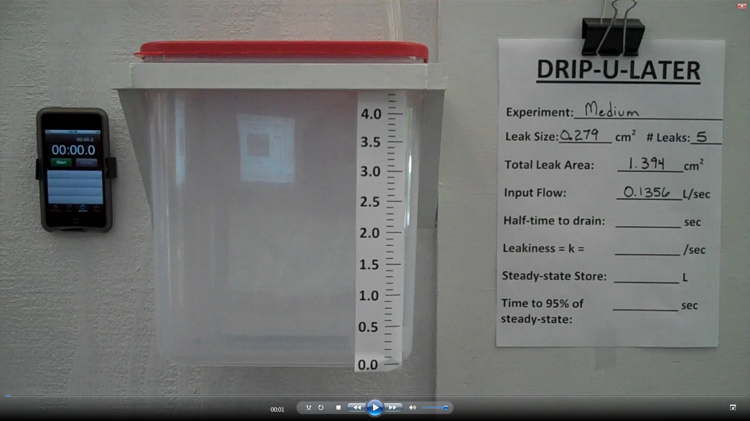
Notes:
Here is an actual leaky bucket. It currently resides in RH269.

Slide 9
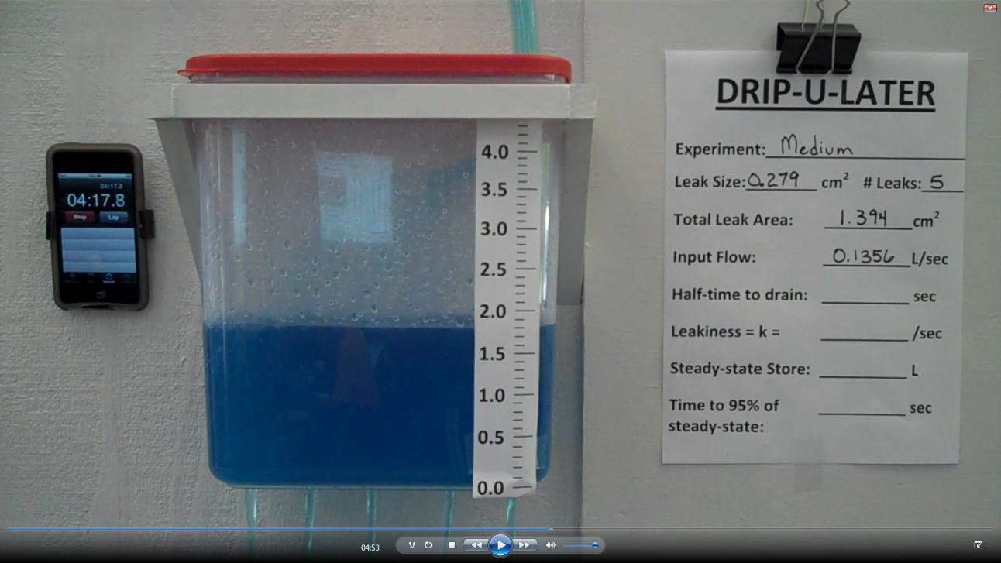
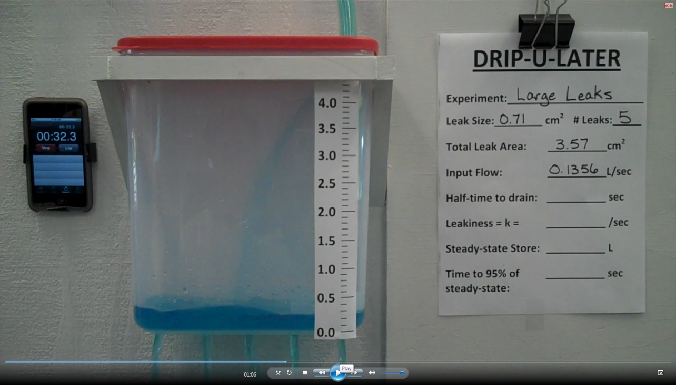
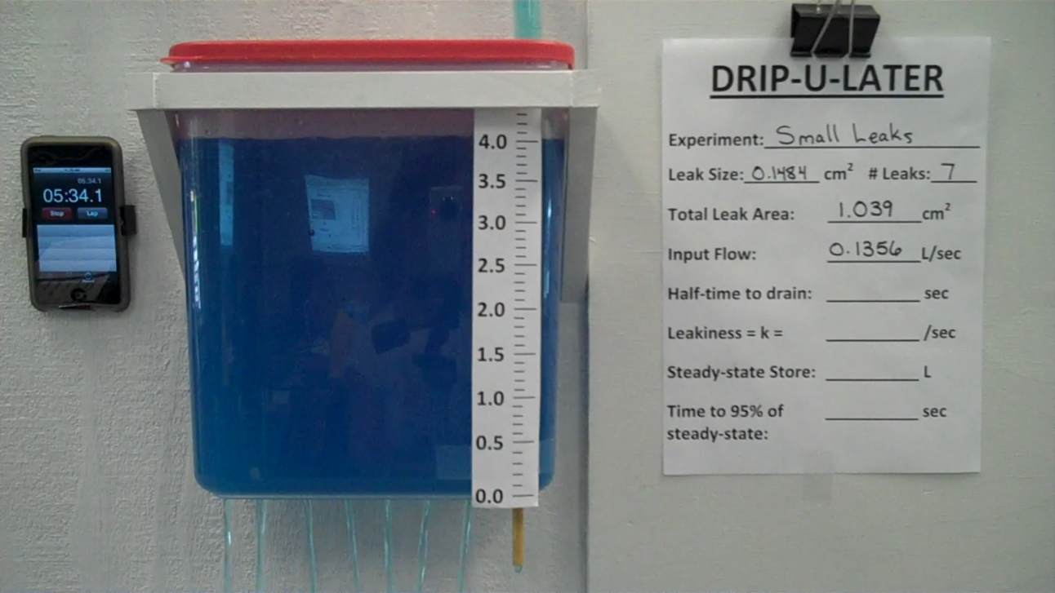
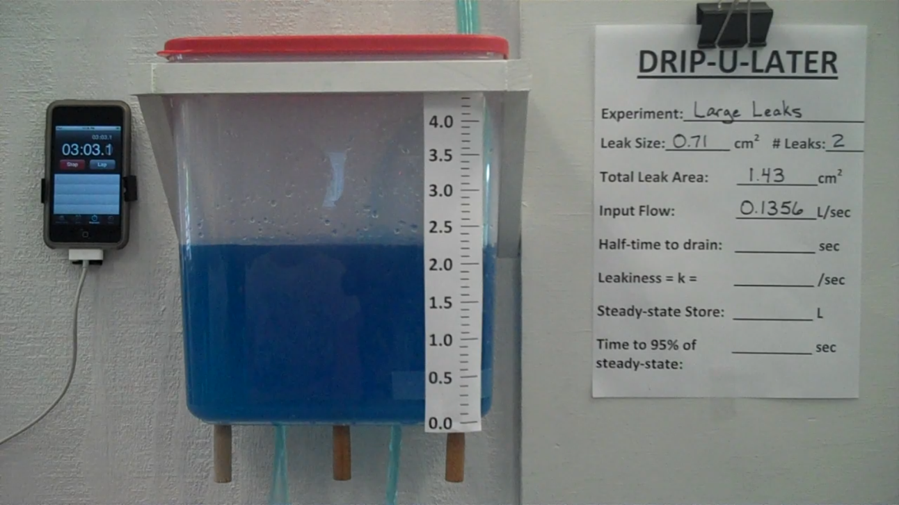
5
Medium
leaks
5
Large
leaks
7
Small
leaks
2
Large
leaks
Notes:
Here are photos of the leaky bucket once it has reached a steady-state, that is the inputs equal the outputs. For each experiment the flow into the bucket was the same. However, the store differs. Why?

Slide 10
The Math of Leaky Buckets
I
C_{ss}=I/k
I is the input rate
k is the rate-constant of losses
C_{ss}
O
Notes:
We can derive a simple formula to describe the relationship we just observed. Let’s start with the fact that the steady-state carbon store is a function of the input as well as the rate-constant of loss. This follows for a steady-state system because inputs equal outputs and outputs are a function of the store and the fraction being lost, or as we call it here the rate-constant of loss, k.
10

Slide 11
As the leakiness increases, the amount stores decreases (hyperbolically)
Notes:
Here is a plot of the results from the leaky buckets. As the leakiness increases, the amount that can be stored decreases.

Slide 12
As the input increases, the amount stored increases (linearly)
Notes:
The amount stored is also a function of the size of the input. In a leaky bucket the input does not have the ideal linear effect on stores, in part because the leakiness is not a function of the volume, but of the area of the bottom, hence a larger store is less leaky for a given hole size than a smaller store.

Slide 13
The fewer and smaller the holes the more stored
Full input (NPP) returns in 25 years
Notes:
Here we take the leaky bucket and turn it into a mathematical model. As the time between disturbances increases the number of leaks decreases. As the severity of disturbances increases the hole size increases. Even when a disturbance does not directly remove carbon (severity equals zero), it has an effect. By setting NPP (the net input to the forest) back, even if it takes as little as 25 years to recover as in this example, a disturbance can reduce the amount of carbon in a landscape.
13

Slide 14
Prediction of a simulation model
Notes:
Just for reference, here the results of a simulation model similar to the one you are using in class. In this case it is the STANDCARB model. This model is very complicated and probably includes thousands of lines of computer code. But we can see that it predicts something very similar to our analytical model: that is when the interval between disturbances increases, the carbon stores in a landscape increases. Further, that when the severity of the harvest increases, expressed as the percent of live trees harvested increases, the carbon store decreases.

Slide 15
Reference point or baseline
One cannot tell the distance from one point
One cannot tell the difference from one line
To tell a difference one needs to have a reference or control
A control is the basis of modern science

Slide 16
If one implemented one of these management systems how much carbon would be gained or lost?
Harvest interval
Notes:
Here are the results of a detailed simulation model. As with the simple formula we developed the rotation length makes an important difference. One can gain a 50% increase in C stores by extending rotation from 40 to 100 years. And it makes sense – keeping trees growing and accumulating C should lead to more C in live biomass and in other forest C pools as well.

Slide 17
Notes:
What is relevant in terms of policy is the difference in where we started versus where we end. Here are three cases with very different endpoints: continuing a 60 year harvest interval, halving it, or doubling it. These results are for a landscape level.

Slide 18
Scale or level
Many results are scale or level dependent
Statements can be true but not policy relevant
Scale represents the temporal or spatial dimensions
System level
  Individual/ecosystem/stand
  Population/landscape

Slide 19
Differences can disappear at the some levels
Dead carbon
1 unit
Amount →
Live carbon
1 unit
Time →
Notes:
While we see differences at the stand level in many of the pools, this can disappear at the landscape level. Here is a bit of a puzzle. What is the average store of carbon in the dead and live over a rotation? Assume the maximum for each is 1 and the minimum is zero. Explain why in terms of basic math.

Slide 20
Differences between individuals and collections of individuals
All logs
Log 10
Log 9
Log 8
Log 7
Log 6
Log 5
Log 4
Log 3
Log 2
Log 1
Notes:
We have seen this figure before. Recall that it is completely possible for individual logs to lose mass, but also completely possible for a collection of logs to gain mass. This indicates that we really need to qualify our statements regarding pools and the biological level we are considering. If you read and listen to the debates about forest carbon you should be able recognize when behaviors of biological levels are being mixed up. For example, the general assumption is that when a tree dies it can not store carbon. But that is only true for individual dead trees and only over a long period of time.

Slide 21
Differences between individuals and collections of individuals
All trees
If we do not replace trees as they die, then
live C can decrease at population level
Notes:
In this slide we see that this concept, that behavior changes with biological levels is actually very general. We can see for example that there are cases in which live carbon can decrease at the level of collections of individuals.

Slide 22
Effect of adding stands to landscape to carbon stores
Notes:
Why is it that carbon appears more stable at the landscape level? In this figure we are averaging simulated stands. We start with one stand and can see that it is quite variable, with a large amplitude of change, going down when the stand is harvested (in this case every 100 years) and going up as it regrows. As we add stands (or runs) in to the landscape we seen that the amplitude of the change decreases and when we have 100 stands we see some random noise about an average store. The point is that decreases in some stands are offset by increases others. This offsetting effect is at the maximum when there is a regulated disturbance system, that is disturbances at regular intervals. But synchrony of stands is also important. In the preceding slide we assumed that stands were perfectly offsetting each other.

Slide 23
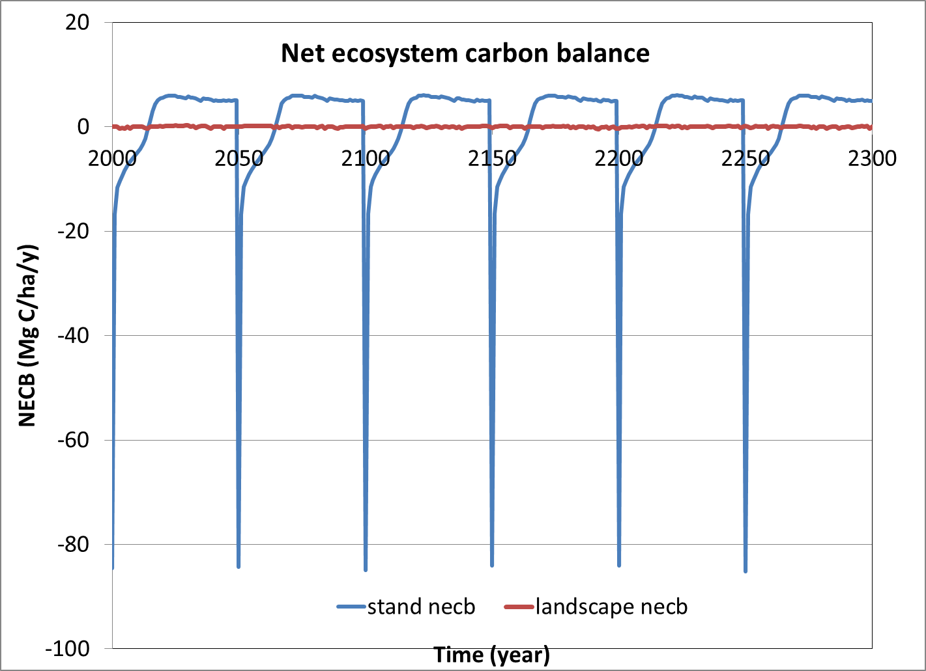
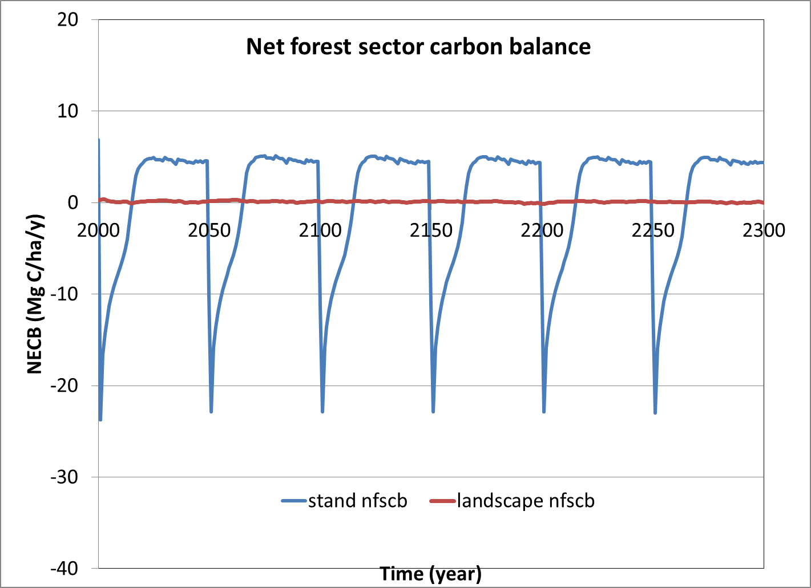
Balances are also level dependent
Forests harvested every 50 years

Slide 24
Stands harvested at various intervals
Harvest interval
Notes:
Let’s review what happens to a stand when we harvest an old-growth forest and put it on a repeating cycle of harvests at the level of a stand. Hit the advance button.
The first cyan line is for a 40 year rotation. We see the stand loses carbon initially, but eventually starts to gain carbon, then it is harvested and cycle starts again. Notice that in time the forest moves around a mean store and that this mean is lower than the old-growth store.
We can look at other intervals between forests. You should notice that as the interval becomes longer the frequency decreases and the amplitude increases. However, you can also see that the mean that the cycle moves around increases as the interval of disturbance increases.

Slide 25
Harvest interval
Landscape translation
These are the steady-states
Notes:
We can get a clearer picture if we run the model for a large population of stands within a landscape. This gets rid of all those ups and downs and just shows the mean trend, which by the way is the landscape average of many stands. The landscape level is the ideal level to assess policy questions because it reveals long-term trends.
Clearly rotation length makes an important difference. One can gain a 50% increase in C stores by extending rotation from 40 to 100 years. And it makes sense – keeping trees growing and accumulating C should lead to more C in live biomass and in other forest C pools as well.

Slide 26
Notes:
Let’s look a bit deeper into why the behavior of carbon changes when we go to the level of a landscape. The question we need to ask is why does one system sequester more carbon than another. In the upper graph we see two systems, one disturbed by wind and another by timber harvest every 50 years. Notice that carbon decreases after disturbance in each system and that with time the system increases carbon stores.
Also notice that the negative parts of the lower graph are offset by the positive parts of the parts. This means that for a landscape with all age classes present the landscape is balanced. So the natural wind disturbed system removes zero carbon and so does the harvest system.
But the stores of the two systems differs. This means that if we move from the wind disturbance system to the harvest system we actually lose carbon to the atmosphere. Or if we move from the harvest system to the windthrow system one can actually take carbon from the atmosphere.
The argument that young stands take up more carbon than old stands is largely one focused on an inappropriate scale in terms of time and space. It focuses on stand for limited time period. As you can see the statement is true at that scale, but certainly not true at the scale that matters: large areas and long time periods.

Slide 27
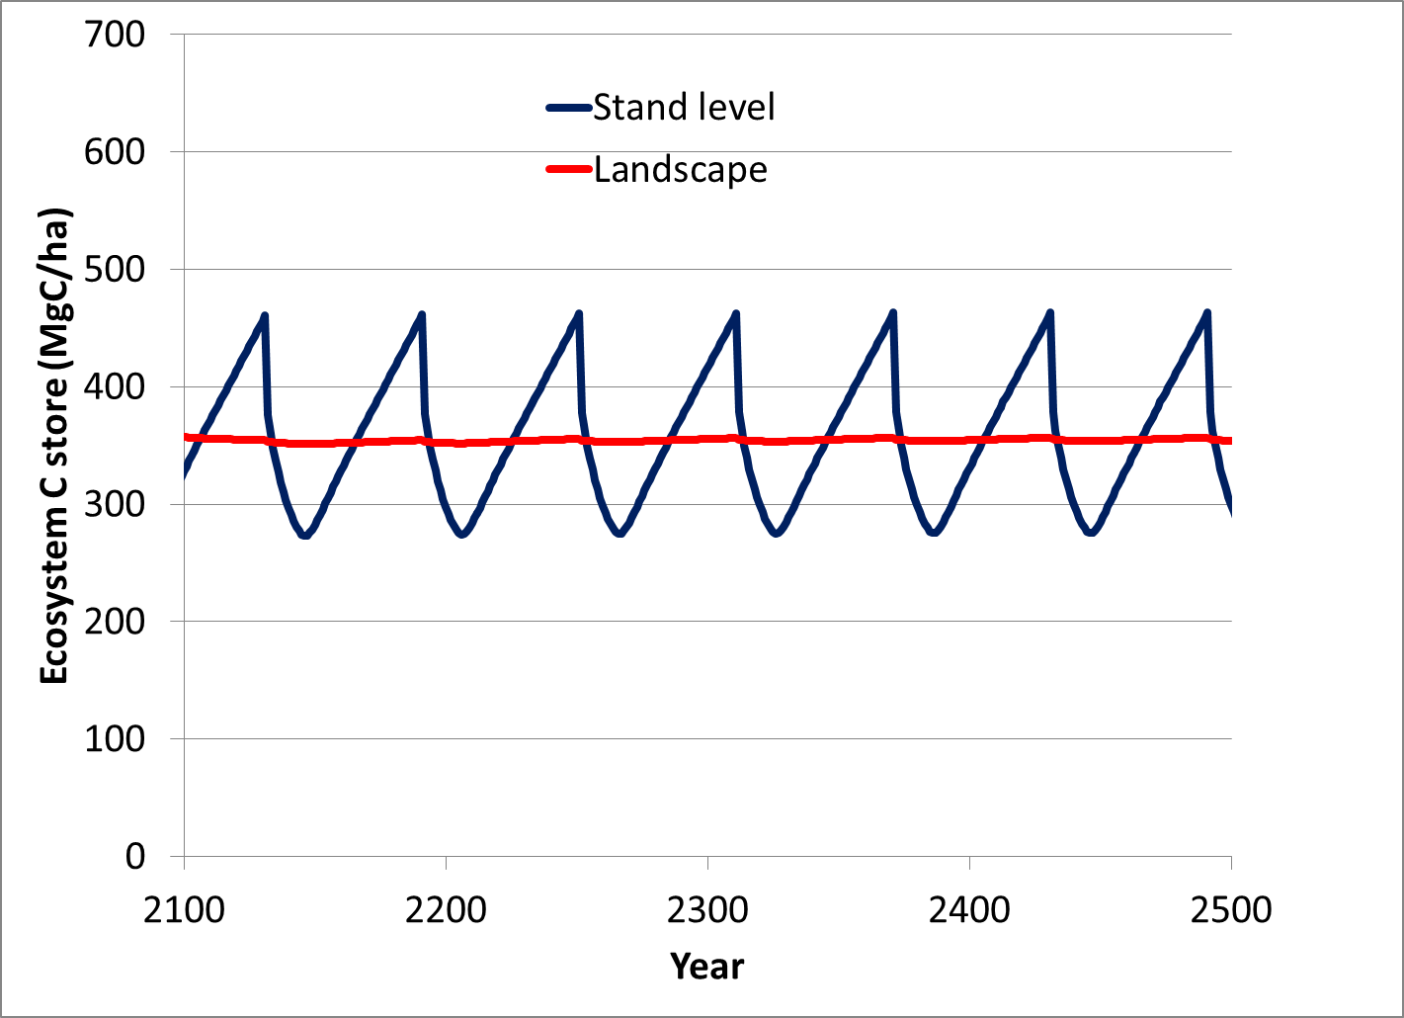
Is the order of carbon debt/credit relevant at all levels? Not really.
Credit
Debit
Notes:
Why is it that carbon appears more stable at the landscape level? In this figure we are averaging simulated stands.
We start with one stand and can see that it is quite variable, with a large amplitude of change, going down when the stand is harvested and going up as it regrows. At the landscape level the decreases in some stands are offset by increases others. This offsetting effect is at the maximum when there is a regulated disturbance system, that is disturbances at regular intervals.

Slide 28
System Boundaries
What appears to happen using one boundary is not necessarily what happens at another
Results are therefore dependent on systems boundaries
Live→Ecosystem→Forest Sector→Energy

Slide 29
After harvest how much carbon is “lost”?
live
lost
dead
products

Slide 30
Live Wood-Dead Wood Modulation
Notes:
Here are results from a field study in which the live and dead woody carbon were determined. The squares indicate the times of measurements. For the dead the death of trees and knowledge of the decomposition rate were used to empirically model the dead mass each time the live pool was measured. We see that when the live goes down the dead goes up and when the live goes up the dead goes down. When the two are added there is very little change in the overall woody carbon store.

Slide 31
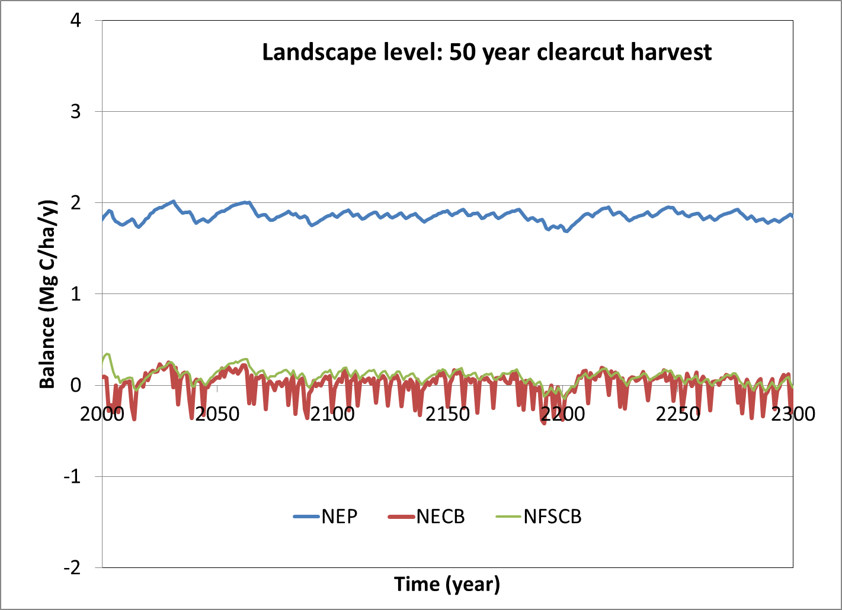
Balances can differ depending on system boundaries
NEP=NPP-RH NECB= NEP-H NFSCB= NECB-FP losses
Notes:
Here are the same two kinds of disturbance, but in this case for the landscape level. The amplitude is reduced at least 5-fold and the deviations from zero appear to be random and to change over time periods far shorter than the stand.

Slide 32
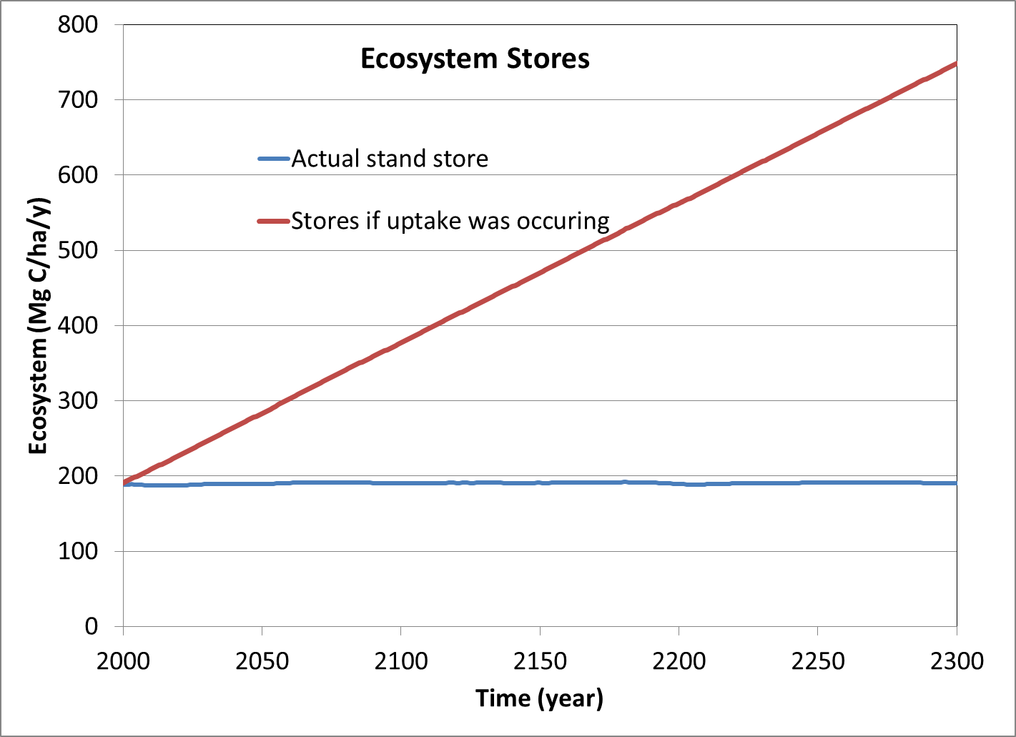
A check: Does mass increase?

Slide 33
The importance of timing
Many processes take time
One cannot assume everything is either instantaneous or happens anyways
In certain situations systems seem to respond instantaneously and other situations they take substantial amounts of time
“Renewability” needs to be conditioned on time

Slide 34
Dead stores
Notes:
As we have seen in lecture 6, a similar effect of scale occurs for decomposition. When we consider the landscape average store of carbon we can find a fairly large store even when the decomposition rate is high. For example, a pool that loses all it’s carbon in 40 years or so can store a bit less than 20% of the input in a landscape for a system disturbed every 100 years. Usually it is assumed that if nothing is left in a period, then nothing can be stored. This is view not justified based on this simple analysis.

Slide 35
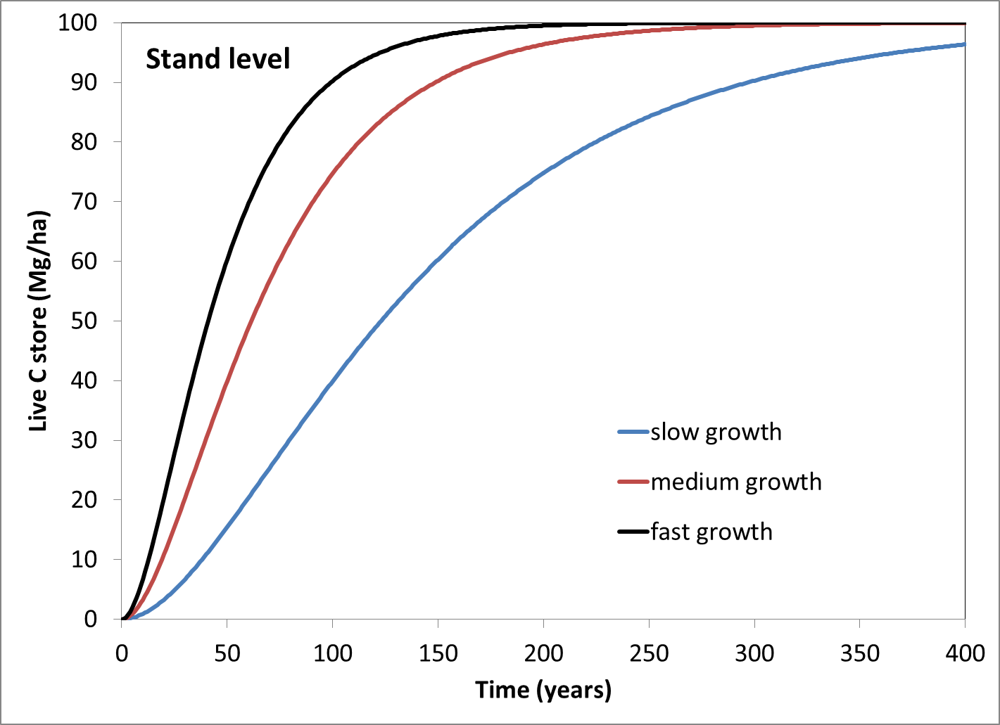
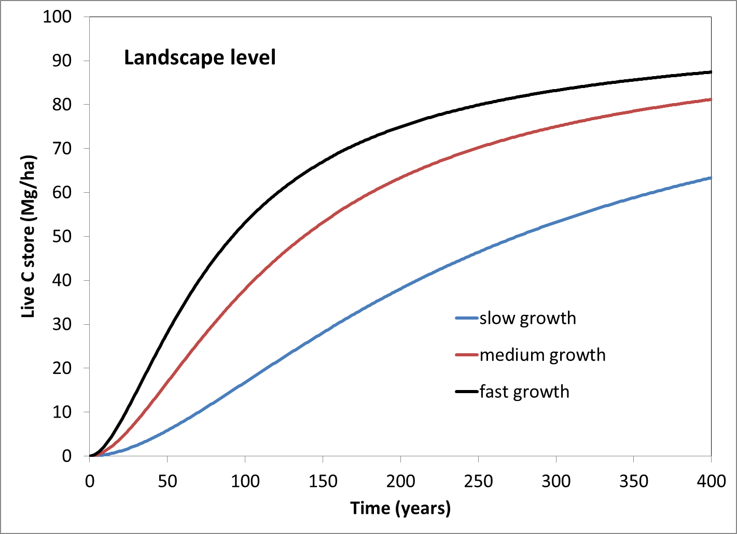
Live Carbon

Slide 36
The forest sector: Basic Parts
Atmosphere
substitutions
Forest ecosystem
Forest products
Fossil carbon
Aquatic systems
Notes:
Here are the basic parts of the forest sector in terms of carbon. Carbon is removed from the atmosphere via photosynthesis and released back by respiration and combustion. Some forest ecosystem carbon is lost to the aquatic system via erosion and leaching, while some is lost via timber harvest. Although some of the harvested carbon is stored in products being used or that have been disposed (e.g., landfills), eventually this carbon is released back to the atmosphere via respiration and combustion. Although fossil carbon is outside the forest sector, it is influenced by substitutions related to the forest sector as shown by the dashed line. That is why I have included it in this figure.

Slide 37
Outside forest system
photosynthesis
Live
Plants
mortality
Timber harvest
Dead
Plants
Wood
Products
Soil formation
Soil
Outside forest
system
Respiration and combustion
Notes:
We can use the idea of stores and flows to see how the forest carbon system works.The forest carbon system can be envisioned as a series of leaky buckets. The amount stored in each bucket depends on the amount coming in versus the proportion leaking out. Carbon enters the forest systems via photosynthesis. Carbon leaks out via many processes, but the main ones are respiration and combustion.

Slide 38
How do the parts behave?
Despite all being input-output systems there are differences in the way the parts act at the stand level
At the stand level this is largely due to the timing of the inputs and outputs
Live increases slowly, decreases quickly
Dead increases quickly, decreases slowly
Soil appears to be “stable”

Slide 39
Forest ecosystem-related parts
Notes:
39
All the pools that store carbon in a forest act like dynamic input-output systems. But the live, dead, and soil parts of the forest ecosystem has a different temporal behavior and set of controlling processes. Together, they interact in ways that produces a completely different behavior.
The differences have to do with the timing of the inputs and outputs. Decreases in live pools tend to be sudden as does increases in the dead pool. Soil is gradually formed from dead carbon.

Slide 40
Forest Products-related parts
“Substitution effects are permanent and independent of product life-span”
Lippke et al 2011
Notes:
40
Here are forest products related pools and how they behave at the stand level. These also have different behaviors. Interestingly forest products in use and disposal act a lot like dead plant material (because it has a sudden intput).
Note that current estimates of product substitution seem to be ignoring key factors such as permanence, an issue that needs to be addressed before it can be integrated into the forest sector (at least in my opinion).

Slide 41
Summary
One should use science and not rationalizations to determine policy
There are just a handful of scientific concepts to put on your check list
Being aware of these concepts should help you navigate the various claims being made

