Slide 1


Medication Administration
Oregon Training Protocol For School Personnel
Notes:
Note to Trainer: Qualified trainers identified in state law should be familiar with the school setting and may revise training content to address local policy, practice, and materials.
Reference local school policies. See Training Protocol Manual Section II: Medication Program Resources.
Use local district medication forms when discussing documentation procedures.
May include parent/guardian medication instructions, Medication Administration Record (MAR), self-medication agreement, incident form.
Oregon School Nurses Association offers examples if needed. See https://www.oregonschoolnurses.org/resources/toolkits.
Assess trainee competency before issuing a Certificate of Completion.
The Trainer may refer to Training and Evaluation Resources from Manual Section III.
The Trainer may develop alternative assessments if preferred.
The Trainer may require return demonstration.

Slide 2
Outline
Introduction
Medication Management
Medication Administration
Demonstration and Evaluation
References
Oregon Health Authority
Notes:
Note to Trainer: The content covered in this Training Protocol is intended to align with state law at the time of writing. Approved trainers may modify content if they maintain alignment with current law. See OAR 581-021-0037.

Slide 3
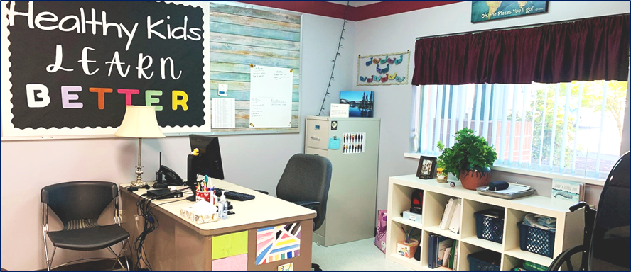
1. Introduction
Notes:
All photos on title slides are from Oregon schools.

Slide 4


Training Objectives
Learners will
Enhance skills and knowledge to engage in safe medication administration aligned with local policies and practices
Identify individual responsibilities to ensure student access to medications needed at school and student safety, reducing medication errors
Oregon Health Authority
Notes:
This training provides evidence-based guidance for consistent medication practices in Oregon schools.
Training content requirements are outlined in state law. [OAR 581-021-0037]. Participants will engage in discussion of policy, practices, and materials, including:
Storage, Accessibility, Availability, Handling, and Disposal
Accessibility During an Emergency
After Administering Medication: monitoring and other actions
Emergency Response Procedures
Record-keeping and Confidentiality

Slide 5
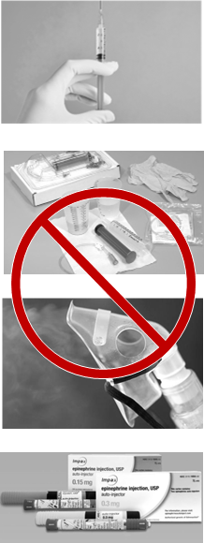
What is Not Covered?
Not injections
Not emergency medications and protocols
  See Lifesaving Treatment Protocols
Not high-risk or specialized procedures
These require
  Additional teaching and training, and/or
  RN licensed care delegation, and/or
  RN, or LPN under RN supervision, to administer
Oregon Health Authority
Notes:
This training does not cover medication administration routes that carry increased risk or require specialized procedure training.
The registered nurse (RN) familiar with the school setting (school nurse) may offer more in-depth training for school staff who perform specialized medication administration.

Slide 6

Why is This Training Required?
  Student civil rights
    Access for all; related services
  Student safety
    Health professional trainers
    Consistent evidence-based practices
  State laws
    Legal requirements, related immunities
Oregon Health Authority
Notes:
Medications may be necessary for students to access their education, such as to treat illness and chronic health conditions.
Civil rights: Federal and state laws, including Oregon’s Medication Administration laws and related guidance, are in place to ensure that students can receive necessary medication in school and at school-sponsored activities.
Safety: This training offers guidance for school staff including safe practice expectations. It covers topics required per Medication Administration law [OAR 581-021-0037].
State laws: In addition to supporting safe student care, observing regulations may help protect school districts and staff from liability. [ORS 339.870; ORS 433.830]

Slide 7

District Policy, Procedure, Materials
Review medication policy and procedures for your district and school(s)
Laws establish minimum requirements
Districts can establish local policies; may go beyond minimum
Oregon Health Authority
Notes:
In addition to state laws, it is critical for learners to be familiar with local policy and procedures for their school setting. District policies and procedures may go beyond the minimum required by law and include details not covered in law such as roles of individual staff members.

Slide 8
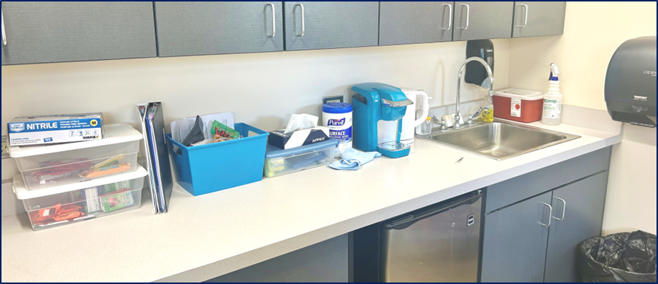
2. Medication Management
Notes:
Corresponds to Protocol Training Manual Section I: Administration of Medication in Schools, "Medication Management.” See Manual for full text of each section.

Slide 9
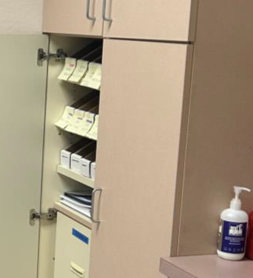
Medication Management
__________________
Storage, Accessibility, Availability, and Disposal
Notes:
Medication management includes ensuring all medications are stored and handled properly, available when needed, and disposed of properly.

Slide 10
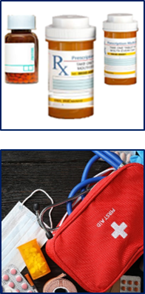
Storage and Accessibility
Storage
  Original containers: never repackage.
  Safety: limited access; appropriate signage
  Refrigeration: follow label instructions
Accessibility
  Verify locations: rooms, go-bags, self-carry
  Process for routine versus emergency medications
    If locked, key protocols
  Predictable events: staff absence, field trips
Oregon Health Authority
Notes:
Original containers: Never accept medications brought to school in a non-original bag, bottle, or other container. Never administer medication out of a container that is not labeled by the pharmacy or medication manufacturer.
Store all medication safely. Protect against theft, damage, and mediation mix-ups while ensuring access when needed. Different processes may apply to emergency medications (i.e. no locks) for medications such as epinephrine, naloxone, and medications that students self-carry, such as inhalers, epi pens, and diabetes supplies.
Refrigeration: Failing to follow refrigeration instructions may reduce the medication’s efficacy. Some medications should not be refrigerated, including most brands of injectable epinephrine.

Slide 11

Availability and Disposal
Availability
  Tracking & timely communication
    medication in stock, non-expired doses
    monitoring: sign in/out, 2-person counts
  Related supplies: soap, med cups, gloves, etc.
Disposal
  return to family and/or staff to witness
  local pharmacy, EMS partners
Oregon Health Authority
Notes:
Monitoring supplies: School districts should designate personnel to be responsible for monitoring medication supplies and ensuring medications are available and secure. Medication-related supplies must also be monitored and maintained, such as hand soap, medication cups, gloves, and other supplies used per district protocols.
2-person counts: District policy may require two-person counts for some medications, especially controlled substances with potential for addition and diversion (theft). Verify monitoring policy with the school RN or building administrator.
Medication disposal: Your district must have a procedure. Medication disposal process should follow Department of Environmental Quality (DEQ) guidelines and any applicable district protocols. Never flush medication down the toilet or drain. Be sure to document the return to parent/guardian or disposal of medication on the student’s MAR or per district protocols.

Slide 12

Access consideration:
Emergencies and Atypical Events
Emergency impacting school - fire drill, lockdown, etc.
  “Go-bag” and/or grab-and-go plan for medications
Off-campus events
  Trained & designated staff; medications transported
School personnel coverage
  Ensure accessibility even if staff are absent
Emergency related to individual student
  Rapid access to medications; signage
Oregon Health Authority
Notes:
Off campus events and staff absences: District policy must ensure necessary medications are available to students, even when a building is evacuated or locked down; when students are participating in off-campus school-sponsored events; and when primary health staff are absent.
Verify local practices, such as will you be responsible for carrying medications during a fire drill? Who would you notify if you were absent to ensure medication administration duties are covered?

Slide 13

Access consideration:
Student Self-Carry or Administration
A student may self-carry and/or self-administer a medication when policies permit [OAR 581-021-0037]
  Common examples: inhalers, epi pens
  Approval required; school RN, administrator, provider
  Review local process, forms
Self-administration refers to independent student
  No school personnel involvement
  No documentation except agreement forms
Self-carry may be independent OR may require assistance
  If assisting, follow administration protocol & document
Oregon Health Authority
Notes:
Corresponds to Protocol Training Manual Section II: Medication Program Resources, "Medication Administration Regulations FAQ," questions 6, 16, 17, and 18.
A student self-carrying or self-administering a medication is only permitted after appropriate assessment and approvals are complete.

Slide 14
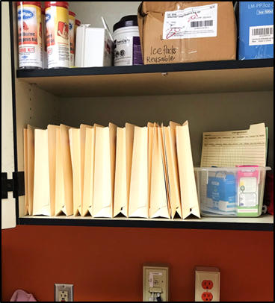
Medication Management
__________________
Handling Medications
Notes:
Corresponds to Protocol Training Manual Section I: Administration of Medication in Schools, "Medication Management: Handling Medications,” and Section II: Training and Evaluation Resources, “Strategies for Risk Reduction by Medication Route.” See also “Step-by-Step” beginning slide 48.
Safe medication administration requires consistent practices.

Slide 15

Handling Medications
Protect students & school personnel
Standard precautions: handwashing, cleaning
Specific process & precautions for different medication routes, such as precautions for:
  aspiration or biting with oral medications
  skin contact, accidental dosing with topical medications
  coughing, respiratory droplets with inhalers
Oregon Health Authority
Notes:
Prior to administering any medication:
Prepare: wash hands and gather necessary supplies. Put on gloves when required by local protocol. Remove gloves (if used) and wash hands between each student.
Follow instructions step-by-step for each medication: To verify correct administration methods, refer to student instructions and consult the school RN as needed. For more information see Protocol Training Manual, Section I “Steps of Medication Administration” and Section III “Strategies for Risk Reduction by Medication Route.”

Slide 16

Handling Includes Checking the “Six Rights” of Medication Administration
Always check “rights” (1) prior to; (2) while; and (3) after handling medications:
  Right person
  Right medication
  Right time
  Right route
  Right dose
  Right documentation
Oregon Health Authority
Notes:
Note to Trainer: If you intend to discuss each Right, consider moving slides into this section: review "Medication Administration" slides, beginning on slide 23; and/or review "Scenarios" slides beginning on slide 42; or leave slides in current order and state, "Rights will be discussed in more depth in a moment, with specific actions related to each of the 6 rights."
Rights of medication are essential for safe medication administration.
In brief: check the 6 rights with every student, every time, every medication. Open the student’s medication administration record (MAR) and review person, medication, time, route, dose, documentation. Ensure “six rights, three checks” – verify the “rights” before, during, and after administration.

Slide 17
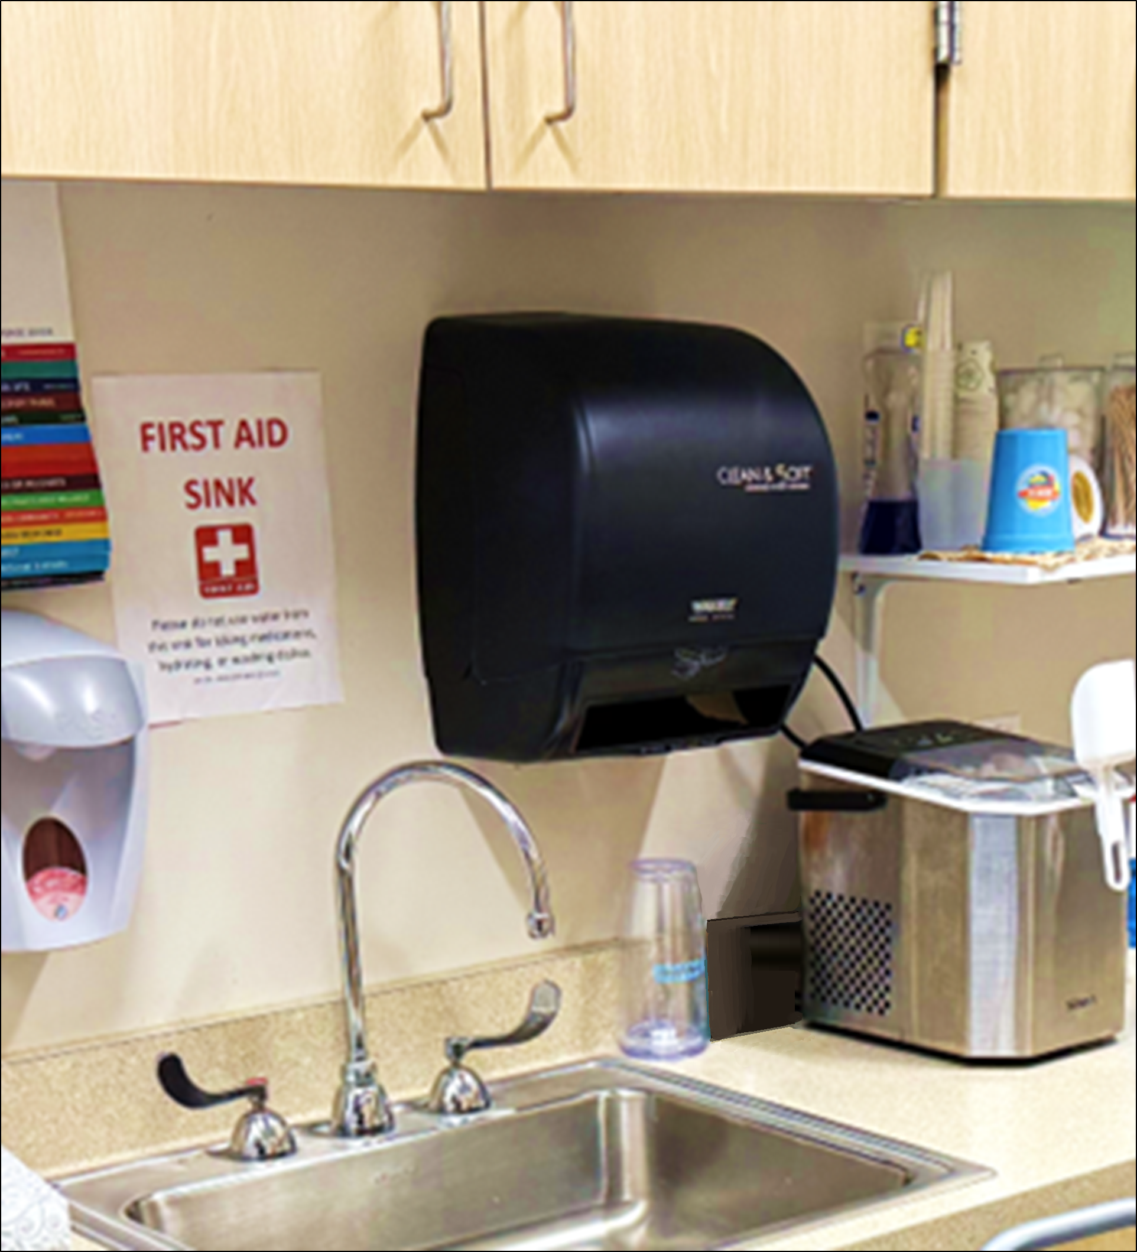
Medication Management
__________________
After Medication Administration
Notes:
Corresponds to Protocol Training Manual Section I: Staff Resource Manual, "Medication Management: After Medication Administration.”

Slide 18


Monitoring After Administration
  Every medication: standard precautions (handwashing), safe storage, documentation.
  Some medications: monitor response.
  Verify:
    Your role in monitoring
    What to report and any other required actions
    Include the student and keep them informed:
    “I’m going to check your [heartrate, blood sugar, etc.] again in 15 minutes. …Ok, your [heartrate, blood sugar, etc.] is where we want it.”
Oregon Health Authority
Notes:
Additional monitoring is required in some situations, such as after administering certain PRN medications. Verify your responsibilities with your school RN.

Slide 19

Emergency Response
  For emergency reaction or event after a dose:
  Do not leave the student alone
  Call 9-1-1 if life-threatening. When in doubt, call 9-1-1.
  Notify RN, school admin, parent/guardian per protocols
  For medication given because of emergency condition, designated staff follow student Emergency Care Plan.
  Remain calm and reassure student:
  “I know this is scary. I’m going to stay with
  you. Help is coming.”
Oregon Health Authority
Notes:
Side-effects and reactions are rare, but possible with any medication, and any student can develop a medication allergy. Follow local emergency response procedures if you suspect a life-threatening reaction or condition.
For any emergency, follow local emergency response procedures. Do not leave the student alone. Call 9-1-1 if the event is life-threatening. When in doubt, call 9-1-1.
Notify the school RN and school administration as soon as possible and follow school protocols for parent/guardian notification.
Designated staff: Students with known risks should have Emergency Care Plan (ECP) in place. Examples include students with asthma; life-threatening allergies; seizures; diabetes; etc. Additional training is required for staff designated for student-specific emergency response and medication administration. Examples include staff designated to administer epinephrine, glucagon, etc.

Slide 20
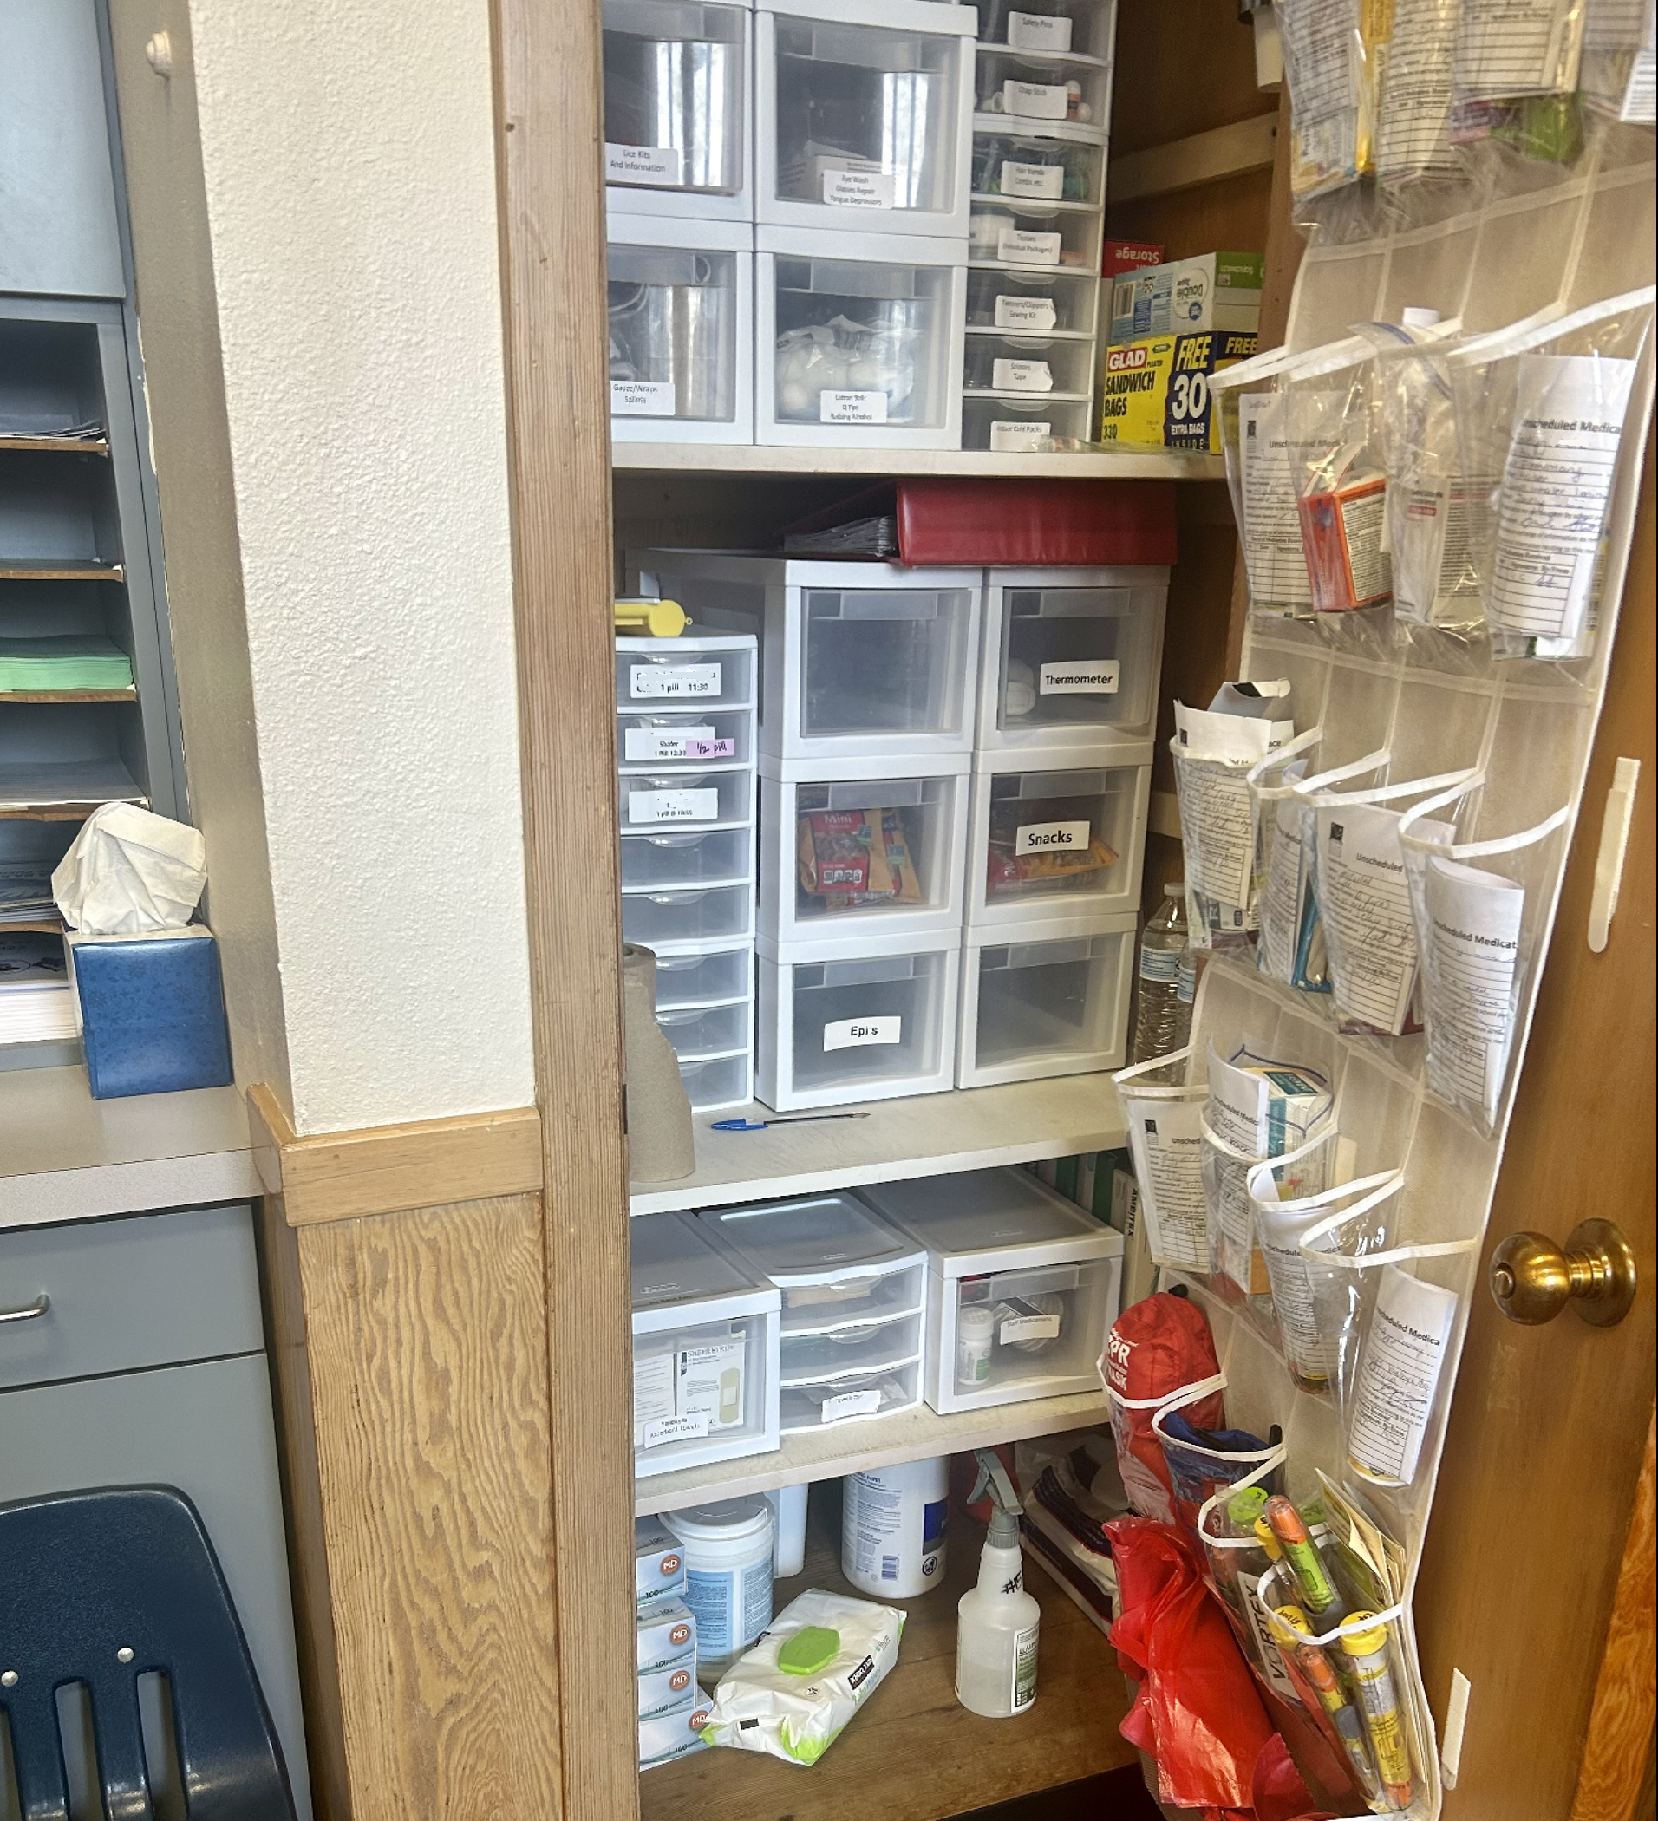
Medication Management
__________________
Communication and Documentation
Notes:
Corresponds to Protocol Training Manual Section I: Administration of Medication in Schools, "Medication Management: Documentation, Record-Keeping, and Confidentiality.”
See also Section III: Training and Evaluation Resources, "Communication: SBAR Example Report Format" and slides 40-41.

Slide 21

Reporting Problems, Changes, or Errors
  Timely and accurate reporting is critical!
  Problem such as medication error or reaction:
    Notify RN as soon as possible (after 911, if needed)
    Notify others per protocol: school admin, family
    Document
  “We don’t get in trouble for making mistakes,
  we get in trouble for hiding them.”
Oregon Health Authority
Notes:
Verify preferred communication methods with your school RN and other care team members. Verify your responsibilities including what to document and what to communicate immediately.
Timely and accurate reporting is critical. Communicating a problem or error can ensure
medication reactions are identified
rapid response is activated when needed
medical orders and treatments are changed when needed
gap areas are identified (staffing, supplies, training, etc.)
future problems are reduced or prevented
Medication errors are more common than people might think. To develop a culture of safety, many health programs adopt the practice that, “We don’t get in trouble for making mistakes, we get in trouble for hiding them.”
Document and notify individuals on the same day unless other instructions apply.

Slide 22

Record Keeping
Document immediately
  Avoid double-charting: document on record
Keep confidential; share *only* as permitted
  Health record is part of student education record
    “legitimate educational interest” to access
  Parent/guardian may authorize release of information
  Exceptions for emergencies: 911 / EMS personnel; public health emergency
Retain records per district and state policy
Oregon Health Authority
Notes:
Documentation is required when medication is administered, and when a scheduled medication is missed.
Protect confidentiality of student information, while ensuring need-to-know staff remain informed. Ensure the school RN is aware when new information, permission form, or prescriber order is received.

Slide 23
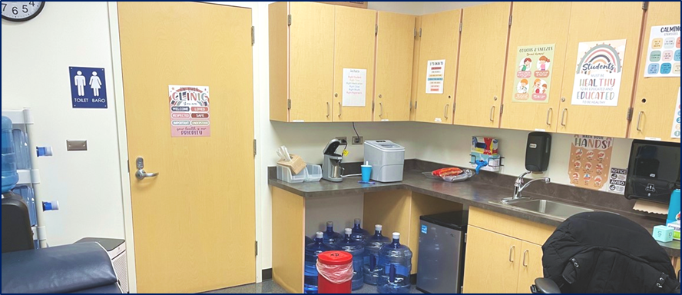
3. Medication Administration
Notes:
Corresponds to Protocol Training Manual Section I: Staff Resource Manual, "Medication Management: Administering Medication: SIX RIGHTS.”
See Manual for full text of each section.
See also Manual Section III: Training and Evaluation Resources, "Review and Practice: Medication Administration Sample Script” and "Discuss and Evaluate: Scenarios.”
See also "Sample Script" on slide 39 and "Scenarios slides" beginning on slide 42.

Slide 24
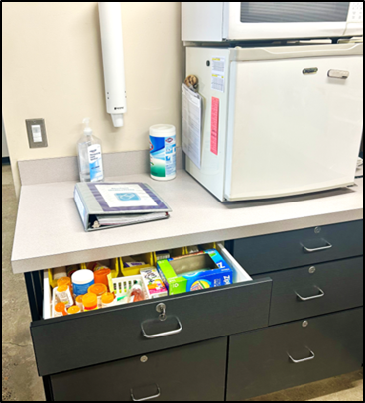
Medication Administration
__________________
Six Rights
Notes:
This section reviews the six rights step by step.
Student engagement is an important part of safe medication administration. For this reason, each of the six rights slides includes an example script to use with students.

Slide 25
Six Rights of Medication Administration
Safe medication administration means
the right person gets
the right medication at
the right time via
the right route in
the right dose and
the right documentation shows what is expected and what has been done.
…and proper process protects health, privacy, and dignity.
Oregon Health Authority
Notes:
Prior to administering medication, always check the SIX RIGHTS. Then prepare the medication dose with the student present and continue checking the six rights with each step of administration.
A school RN or designated health professional may conduct additional verifications before medication is administered, including orders clarification, review of medication interactions and allergies, assessment of student skills and goals, identification of expected side effects and/or sign and symptoms to monitor, and more.
Proper process (a) prevents disease transmission; (b) avoids cross-contamination of medications; (c) protects privacy; and (d) engages the student, respecting dignity and self-management goals.

Slide 26
Six Rights, Three Checks
Check the six rights when administering medication.
Before
During
After
Check the six rights by reviewing
written instructions
medication labels
Medication Administration Record (MAR)
student ID and student self-reports (name, symptoms)
Oregon Health Authority
Notes:
Always check the 6 rights when administering medication. These are critical safety checks.
Written instructions: Medications must be administered per written instructions on file at the school. Do not act on verbal requests to change medication instructions.

Slide 27

Proper Process
Standard precautions: handwashing, surface cleaning
  If gloves, change between students
  Prevent contamination of medications
Prepare the dose with student present
Protect privacy and confidentiality
Engage the student per developmental abilities
Explain actions:
  “You’ll take your medication over here, to be private with no distractions. I’ll wash my hands and then put your pills in the cup [or] your drops in your ears.” etc.
Oregon Health Authority
Notes:
Proper process includes practices to prevent germ transmission and medication contamination, protect student privacy and dignity, and promote health awareness.

Slide 28

Right Person
Use at least two student identifiers
  name, student ID, date of birth, social security number, other ID used by facility
Compare to medication label and MAR
  Ask the student to provide the required information:
  “Please tell me your name and birthday.”
Oregon Health Authority
Notes:
Always ask the student to say their own full name
Alternative verification methods may be required in some situations, such as if the student is developmentally unable, or has a preferred name different than legal name.
If you are not certain of the student’s identity, do not administer the medication. Consult the school RN or school administrator for direction.

Slide 29

Right Medication
Check written instructions, label on container.
Reason for use should match
  PRN = as needed: for what?
  Encourage and verify student awareness:
  “Could you tell me the name of the medication you’re taking?
Oregon Health Authority
Notes:
Verify the medication name and reason for use.
Check the medication prescription label or container matches the name of the medication on the MAR. If there is a discrepancy that is not resolved by existing instructions, consult the school RN.
Medication may be ordered as-needed (PRN; “pro re nata” is Latin for “as needed”). For PRN medications, check instructions regarding reason for us, and ensure the reason matches the student situation.

Slide 30

Right Time
Verify written instructions
  Scheduled time: daily or weekly?
  PRN = as needed: how often?
Must be 30 minutes before or after scheduled time (rare exceptions, consult RN).
  Verify time of prior dose, if applicable:
  “It’s been long enough since you took this, and since you have [reason; symptoms] you may have another dose.”
Oregon Health Authority
Notes:
The person administering the medication is responsible to ensure it is administered on time, in collaboration with the student to the level appropriate for developmental abilities.
If medication cannot be administered within the scheduled time, staff must notify the school RN or designated personnel and parent/guardian, unless local protocols provide other instructions.
For PRN medications, check the time of last dose and do not administer if it has not been long enough. When PRN is administered, it is recommended to inform parent/guardian so they know time next dose is available. Refer to local protocols.

Slide 31
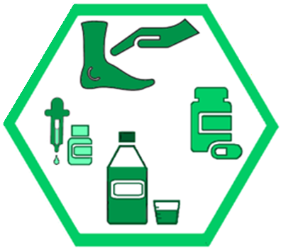
Right Route and Method
Verify details of route, method, and location.
  Is it an eye drop, or an ear drop?
  If in the nose: one nostril or both?
  Is it swallowed whole, or chewed?
  Should it be taken with food?
  Engage and remind the student:
  “Tell me how you take this. Are you supposed to chew it, or swallow it whole? [or] Point to the ear where you get the drops.” etc.
Oregon Health Authority
Notes:
Additional details: see "Handling Medication" and "Step-by-Step" slides beginning slide 50. Consider return demonstration of specific routes during learner engagement.
Verify the medication administration route such as by mouth (oral), on the skin (topical), in the ears (otic), etc.
Verify the specific method for the route, such as whether oral medications are chewed, and whether ear drops require a specific position.
Ensure you know how to administer via the specified method. Consult the school RN for additional instruction as needed.

Slide 32

Right Dose
Check labels carefully
  How many milligrams, micrograms, etc.
  How many pills, puffs, drops, mL, etc.
  Communicate during administration:
  “Here you go, one tab of [name of medication].”
  “I’m putting two drops in your ear. Here’s the first. Here’s the second.”
Oregon Health Authority
Notes:
Verify the dose of medication you should be giving.
Check the medication label, and the MAR, and cross-check with the written instructions if needed.
If the parent/guardian’s written instructions are not consistent with the manufacturer’s instructions for use, the school must have a written, signed order from a prescriber allowing for alternative administration.
Administer the exact amount of medication per written instructions. (See also Section II: Medication Program Resources, "Medication Administration Regulations FAQ, Relevant Laws")
Dosage is commonly measured by milligram (mg), microgram (mcg or µg), or unit (IU).
Note the number of pills, drops, puffs, milliliters, or other volume measurements needed to provide the correct dosage, such as two (2) 5mg tabs for a 10mg dose.

Slide 33

Right Documentation
Medication Administration Record = MAR
Timely, accurate documentation for student safety.
Timely communication is also important, especially if there are changes.
  Document before dismissing student.
  “Well done, [Student]. I’ve recorded that you took your medicine. You may go back to class now.”
Oregon Health Authority
Notes:
Document medication administration on the student’s MAR according to district procedure. Use this time for a final check of SIX RIGHTS – document on the right person’s record; the dose you gave corresponds to the dose per the MAR; etc.
Changes, errors, and concerns should be documented promptly. Policy may also require prompt notification to school RN or others. Verify local protocols for communication. (See Protocol Training Manual Section 1, Medication Management, “Reporting a Problem or Error.” Consider also slides 40-41, SBAR report examples.)

Slide 34
Right Documentation (2)
Each MAR:
Student name and second identifier
Medication name
Medication dose
Medication route
When to administer
Why to administer if PRN (as needed)
Full name of person administering
Each dose
  Time given
  Site if applicable (left ear, etc.)
  Response to medication, if applicable
  Signature or initials of person administering the medication (written or electronic)
For scheduled medications:
  Rationale if not given (refused; absent)
For as-needed (PRN) medications:
  Reasons for administering (symptoms, etc.)
Oregon Health Authority
Notes:
The MAR used to verify the SIX RIGHTS should include (1) student name and second identifier, such as DOB or SID; (2) the medication name, dose, and route, (3) the time including either clock time or time between doses, (4) for PRN medications, the reason for giving such as symptoms or activities, and (5) the full name of the person(s) administering the medication. Document for each dose:
Time administered
Site if applicable
Signature or initials of the person administering
Additional documentation may be required such as
Reason for administering PRN medication (signs, symptoms, activities)
Reason for not administering scheduled medication (refused, absent)
Response to medication if instructions require this

Slide 35
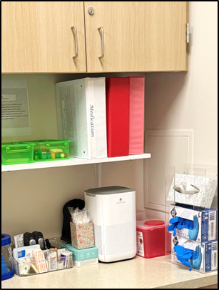
Medication Administration
__________________
Step-by-Step
Notes:
For use at trainer discretion: training for specific medication routes.
Note to trainer: if you intend to provide detailed training on specific routes, consider moving applicable slides from "Step-by-step" into this section.
Corresponds to Protocol Training Manual Section I: Administration of Medication in Schools: "Medication Management: Handling Medications, Common Routes and Methods” and Section III “Strategies for Risk Reduction by Medication Route.” See also "Step-by-Step" slides beginning slide 50.
Medication administration routes and methods should follow manufacturer guidelines and student’s individual written instructions.
Specialized routes and methods require additional training and/or nurse to administer.
Some routes and/or situations require medication to be administered by the RN, or the LPN under the direction and supervision of the RN.
Some routes and/or situations may be considered for nursing care delegation, a licensed process outlined in Nurse Practice Act laws. By law, the decision whether to delegate rests with the Registered Nurse.

Slide 36

Steps of Medication Administration
Wash hands and prepare necessary supplies: med cup, gloves, tissues, gauze, etc.
  Check the SIX RIGHTS prior to beginning
With student present, prepare and administer the medication dose per manufacture guidelines and student written instructions.
  Check the SIX RIGHTS during administration
Document
  Check the SIX RIGHTS while completing tasks
Oregon Health Authority
Notes:
Preparation and first check of SIX RIGHTS may occur before student arrives.
Always prepare the dose with the student present – a med cup with liquid or pills should never be left sitting on a counter.
Medication administration routes and methods should follow manufacturer guidelines and student’s individual written instructions. Specialized routes and methods require additional training and/or nurse to administer.
Follow instructions step-by-step for each medication: To verify correct administration methods, refer to student instructions and consult the school RN as needed.

Slide 37
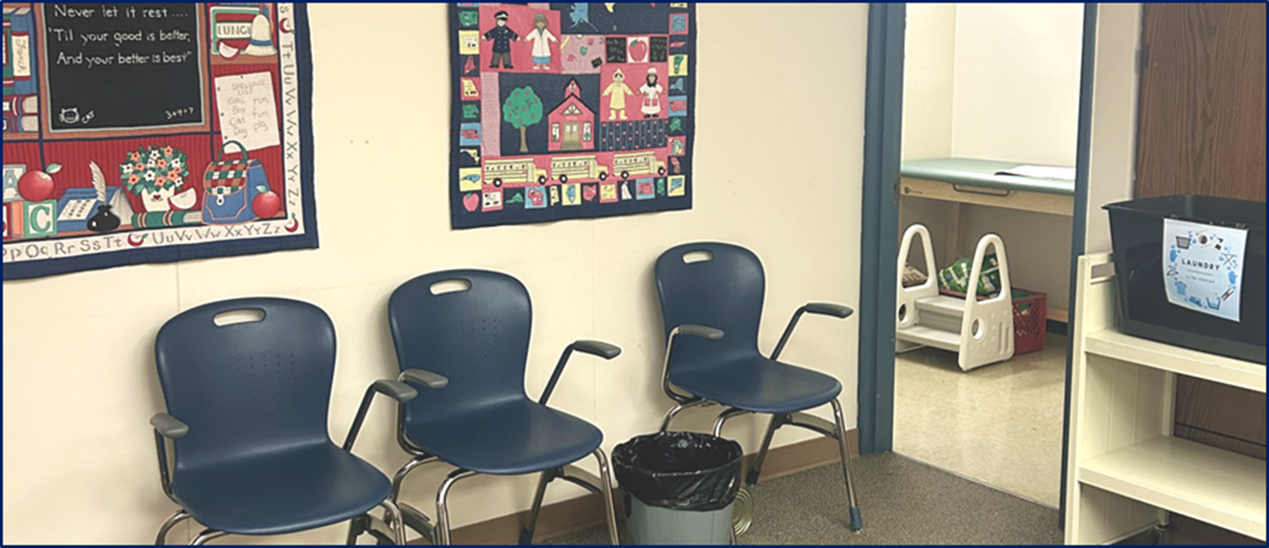
4. Demonstration and Evaluation
Notes:
For use at Trainer discretion. This section includes optional material for learner engagement. The Qualified Trainer may select which/whether slides will be shared as part of review and evaluation.
See additional evaluation options in Protocol Training Manual Section III: Training and Evaluation Resources.

Slide 38
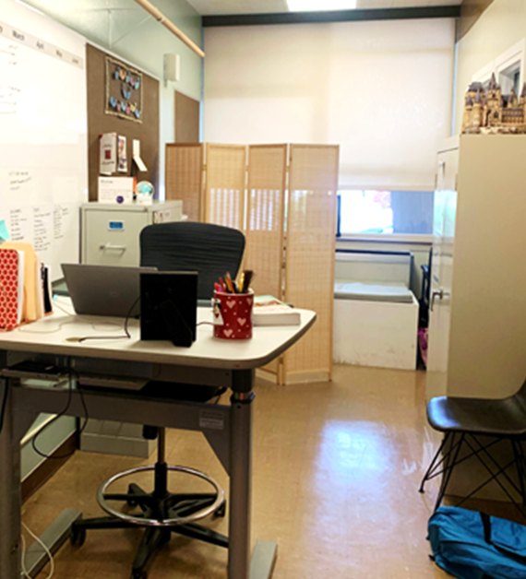
Demonstration and Evaluation
__________________
Sample Scripts
Notes:
For use at Trainer discretion.
Corresponds to Protocol Training Manual Section I: Administration of Medication in Schools, "Medication Management,” and Section III: Training and Evaluation Resources: Review and Practice, "Medication Administration: Sample Script" and "Discuss and Evaluate: Scenarios."

Slide 39
Six Rights + Student Engagement
Hello, [Student]. It’s good to see you. You’re right on time today! We’ll give your medication over here, for privacy. I’ll wash my hands first.
Please tell me your name and birthday. (Great, I have the right MAR open!)
What’s the name of the medicine you’re getting? (That matches this label!)
Remind me how you take this: Are you supposed to chew it, or swallow without chewing? Point to the ear where you get the drops. (Perfect, that’s what the written instructions say.)
Here is your one tab of __. I’m putting the two drops of __ in your ear now.
Well done, [Student]. I’ve documented that you took your medicine. See you tomorrow!
Oregon Health Authority
Notes:
Script: Using a standard script or framework for conversation with students may support safe medication administration, as the interaction moves through each of the six rights.
Student engagement: Student engagement helps to build medication awareness and self-management skills. When used in combination with required information sources such as the MAR, medication labels, and written instructions, information from the student can serve as additional confirmation of the six rights.

Slide 40
SBAR: Reporting a Medication Error
S - Situation: [Student] received an extra dose of [name of medication] today. [Aide] gave the medication. [Student] returned later, and I gave it again.
B - Background: [Student] likes the taste of the medication and often asks for more. [Aide] doesn’t have access to the electronic record; they write notes for me to enter later. I found the note after giving the medicine.
A - Assessment / Observed outcome: After 15 minutes in the office, [Student] asked to go back to class and doesn’t seem to have any side effects.
R - Recommendations / Requests: I will notify the parents. Could you contact the doctor, and let me know if there are any follow-up orders? [and/or] We need to change access so [Aide] can chart on the record. [and/or] Could you do some teaching with [Student] about this?
Oregon Health Authority
Notes:
Verify your responsibilities including what to document and what to communicate immediately.
Verify preferred communication methods with your school RN and other care team members.
“SBAR” format is one example of a standardized way to communicate information about a problem, change or error. Your setting might use another method, such as communication that includes the required areas of an incident report.

Slide 41
SBAR: Reporting a Suspected Reaction
S- Situation: [Student] had a dizzy spell about 30 minutes after taking [name of medication] today. They are resting in the office now.
B - Background: [Student] has been taking [name of medication] for two weeks. Today the order was increased to double the dose.
A - Assessment / Observed outcome: [Student]’s heart rate is a little fast, at 125, but they say they can breathe fine and just want to rest.
R - Recommendations / Requests: Could you come assess the student? [and/or] I will notify the parents. Could you contact the doctor, and let me know if there are any follow-up orders?
Oregon Health Authority
Notes:
Verify your responsibilities including what to document and what to communicate immediately.
Verify preferred communication methods with your school RN and other care team members.
“SBAR” format is one example of a standardized way to communicate information about a problem, change or error. Your setting might use another method, such as communication that includes the required areas of an incident report.

Slide 42
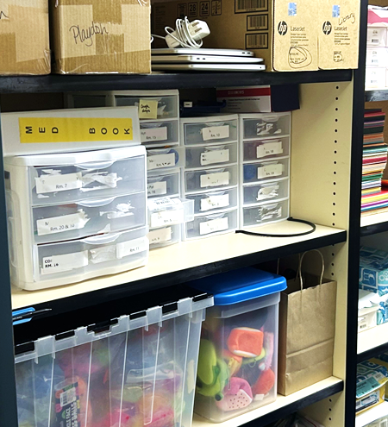
Demonstration and Evaluation
__________________
Scenarios
Notes:
For use at trainer discretion. Corresponds to Protocol Training Manual Section III: Training and Evaluation Resources: Discuss and Evaluate, “Scenarios.”
Each of these scenarios links to one or more of the six rights.

Slide 43
What Would You Do? (1)
[Student] has come in for a medication. Another student is in the office waiting to be picked up. The waiting student says, "Why is [Student] here? Is [Student] sick too?"
Oregon Health Authority
Notes:
Let's discuss.
Example responses:
This scenario relates to general practices. Protect student confidentiality. Examples:
Gently but firmly decline to share private information.
Ensure sick care space is separate from well-care space. [OAR 581-022-2220]
Ensure student records are visible only to need-to-know school district personnel, including sign-in entries with health information, MAR, and other identifiable information.

Slide 44
What Would You Do? (2)
You are preparing to give [Student] a daily medication. Due to developmental stage, [Student] is unable to provide reliable information about their name, birthday, or other forms of ID.
Oregon Health Authority
Notes:
Let's discuss.
Example responses:
This scenario relates to RIGHT PERSON. Use alternative strategies to verify it is the right student. Examples:
Verify ID with two school district personnel members who know the student.
Use photo ID and/or the photo on student record and/or MAR.

Slide 45
What Would You Do? (3)
[Student] has a preferred name, aligned with their gender identity, which is different than the name on the prescription.
Oregon Health Authority
Notes:
Let's discuss.
Example responses:
This scenario relates to RIGHT PERSON. Respect the student’s preferred name while verifying identity. Examples:
Seek options that do not require the student to state their legal name for every dose.
May require individualized review, to determine to whom the student has disclosed their gender identity and preferred name, including provider and parent/guardian.
Possible action could include written instruction kept with the medication container regarding the preferred name – from the parent/guardian or school RN – clarifying that the student’s preferred name has been verified and should be used for ID during medication administration.
Contact the school RN for support as applicable.

Slide 46

What Would You Do? (4)
[Student] says,
“My inhalers are here in the office. I want to use one now before I go to PE.”
Oregon Health Authority
Notes:
Let's discuss.
Example responses:
This scenario relates to RIGHT MEDICATION name and reason. Check written instructions and medication order (pharmacy label).
Verify the student has orders to use the inhaler as requested.
If yes, administer the inhaler.
If not, advise the student that it is not permitted (yet) and written instructions are needed.

Slide 47

What Would You Do? (5)
[Student] has a medication scheduled for 10am.
[Student] has not shown up by 10:15am.
Oregon Health Authority
Notes:
Let's discuss.
Example responses:
This scenario relates to RIGHT TIME. Send for the student immediately
Remember that medication must be given within the hour window, 30 minutes before or after the scheduled time.
Failure to give medication under these circumstances is dose omission and a medication error.
If the medication cannot be administered, notify the school RN or building administrator, and contact the parent/guardian per local protocols.
Carefully document the circumstances, including your actions, on the MAR.

Slide 48

What Would You Do? (6)
[Student] says,
“This pill is too big for me. Can you crush it and mix it in pudding like my grandma does?”
Oregon Health Authority
Notes:
Let's discuss.
Example responses:
This scenario relates to RIGHT ROUTE and method. Check the medication instructions and label.
If written instructions are to crush pills, and the student has a personal pill crusher, proceed.
Otherwise, DO NOT crush pills, and advise the student this is not permitted (yet).
Contact the parent/guardian and school RN for verification and written instructions.

Slide 49

What Would You Do? (7)
[Student] says,
“You only gave me one pill. At home I take two.”
Oregon Health Authority
Notes:
Let's discuss.
Example responses:
This scenario relates to RIGHT DOSE. Check the medication instructions and label.
Advise the student that you must give what the orders say.
Follow up with parent/guardian and school RN to verify current orders.

Slide 50

What Would You Do? (8)
You give [Student] medications daily.
Today, when you open the chart to document, you see the order changed from two pills – which you gave – to one pill.
Oregon Health Authority
Notes:
Let's discuss.
Example responses:
This scenario relates to RIGHT DOCUMENTATION and overall procedure. Carefully check all RIGHTS before administering any medication. Report any errors promptly.
Remember: reporting medication errors protects students and school district personnel.
If you are aware of an error, report immediately to the school RN or building administrator, and parent/guardian per local protocols.
Coordinate actions with parent/guardian and health partners as appliable. Additional action may be required, depending on the type of error. Instructions may come from prescriber, school RN, pharmacist, or poison control.
Always report and document any of the following events:
Wrong medication or incorrect dose given.
Medication not given.
Medication administered to the wrong student.
Medication given by the wrong route or method.
Medication given at the wrong time (> 30 minutes from scheduled time).

Slide 51
Demonstration and Evaluation
__________________
Medication Administration Step-by-Step
Notes:
For use at trainer discretion: training for specific medication routes.
Corresponds to Protocol Training Manual Section I: Staff Resource Manual, "Medication Management, Handling Medications: Common Routes and Methods” and Section III “Strategies for Risk Reduction by Medication Route.” See also "Step-by-Step" slides beginning slide 50.
Medication administration routes and methods should follow manufacturer guidelines and student’s individual written instructions.
Specialized routes and methods require additional training and/or nurse to administer.
Some routes and/or situations require medication to be administered by the RN, or the LPN under the direction and supervision of the RN.
Some routes and/or situations may be considered for nursing care delegation, a licensed process outlined in Nurse Practice Act laws. By law, the decision whether to delegate rests with the Registered Nurse.

Slide 52
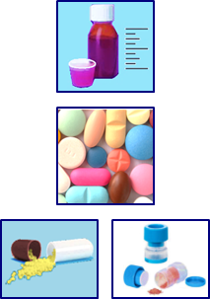
Oral Route
Medications via oral route are swallowed into the stomach, such as pills and elixirs.
Verify the method per written instructions: a pill may be
Swallowed whole
Chewed
Dissolved in the mouth
Crushed
Sprinkled onto food or liquid
Oregon Health Authority
Notes:
Types of oral medications
PILL is a generic term for oral medication that may be a tablet, capsule, gel-cap, lozenge, or troche.
TABLETS come in various forms
Standard tablets should be swallowed without chewing.
Chewable tablets should be chewed fully.
Dissolvable tablets dissolve on or under the tongue.
CAPSULES may be coated, or in a form which can be opened.
Coated capsules have a protective coating around a solid medication and should be swallowed whole.
Capsules that contain sprinkles are twisted apart and sprinkled onto soft food.
GEL-CAPS have a gel coating around a liquid center and should be swallowed whole.
LOZENGES or TROCHES may be hard (i.e. cough drops) or soft (i.e. gummies); should be chewed or dissolved in the mouth.
SUSPENSIONS are liquids which are not clear, because they contain medication that does not dissolve completely.
Suspensions typically need to be refrigerated and typically separate when stored. Always shake a suspension per label instructions prior to administering.
SYRUPS and ELIXIRS are liquids in which medicines are fully dissolved; they may appear see-through or clear.

Slide 53
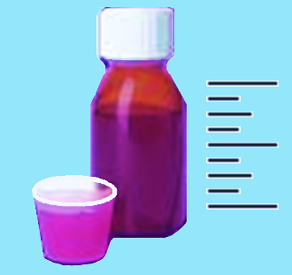
Liquids (Elixirs, Solutions, Syrups, Suspensions)
1. Prepare and verify the SIX RIGHTS.
2. Measure the liquid medication, after shaking bottle if applicable.
  a. Pour from the side of the bottle opposite the label, so the label stays clean and readable.
  b. Place medication cup on flat surface; read at eye level.
  c. Only use calibrated devices designed for medication administration (med cup, med spoon, med syringe).
3. After pouring, replace the cap and clean medication bottle.
4. Be sure the student takes all the medication. If some sticks to the administration device, add water and administer it to the student.
5. Offer additional liquid after the dose if indicated for the student.
6. Document.
DO NOT USE household utensils such as teaspoons. These are not accurate for medication measurement.
Oregon Health Authority

Slide 54

Pills (Tablets, Capsules, Gel-caps, Troches, Gummies)
Prepare and verify the SIX RIGHTS.
Prepare pills for the student
  a. Pour into the lid first. Then pour correct number of pills into a medicine cup, paper cup, or spoon. If written instructions state pill may be placed in soft food, do so.
Have student put pill(s) into their mouth.
  If student needs assistance, use alternative strategies; consult the school RN for guidance.
  Have student sip water to swallow pill.
  Or, per student written instructions: use other food/liquid; tell student to chew or dissolve pill under tongue, etc.
If indicated, offer additional food or liquid.
Document.
DO NOT touch pills bare-handed or put fingers in a pill bottle.
DO NOT use fingers to give a pill if there is a risk of biting.
DO NOT put the pill bottle or lid near the student’s mouth.
DO NOT tell student to tip their head back; this increases aspiration risk. Chin-to-chest is safer.
Notes:
Pour pills into the lid: Do not pour pills directly from bottle to med cup. This risks contamination of medications as extra pills are returned to the bottle. Instead, pour into the bottle cap and after the correct number of pills are in the cap, pour from the cap into the medication cup.

Slide 55
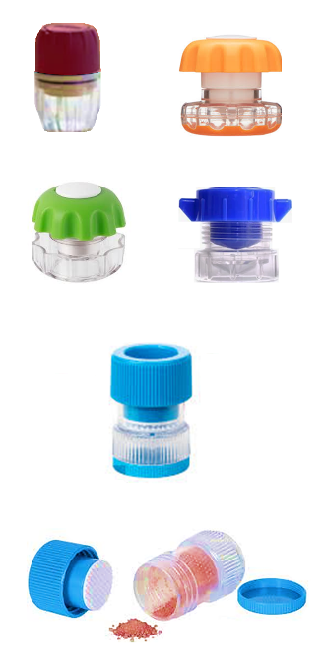
Crushing Tablets
Prepare, and verify the SIX RIGHTS.
  Verify instructions in writing to crush pills.
  Verify food or liquid permitted for mixing.
  Verify amount of food or liquid to be provided.
Prepare an open cup or container with the food or liquid to be mixed.
Open the pill crusher. Place the tablet in the pill crusher and crush into fine powder. Be sure to break up any larger pieces.
Mix powder thoroughly with small amount of the food or liquid.
Administer to the student.
Offer additional food or liquid after the dose if indicated.
Document.
Thoroughly clean pill crusher and returned to safe storage.
Oregon Health Authority
Notes:
The pill crusher: Individual pill crushers should be clean, dry, and labeled for the student.
Small amount of food: if medication can be taken in one or two bites or sips, this reduces risk of under-dosing if the student does not finish all of the food or liquid. Additional food or liquid can be given immediately after the dose.

Slide 56
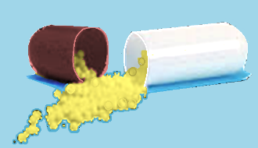
Sprinkling Capsules
Prepare, and verify the SIX RIGHTS.
  Verify instructions in writing to sprinkle pills.
  Verify food or liquid permitted for mixing.
  Verify the amount of food or liquid to be provided.
Prepare a cup or container with the food or liquid to be mixed.
Holding the capsule shell over the container, twist the two sides of the capsule and pull apart. Sprinkle medication into the food/liquid. Be sure all medication is emptied out by rolling the capsule shell between thumb and forefinger.
Mix sprinkles thoroughly with small amount of the food or liquid.
Administer to the student.
Offer additional food or liquid after the dose if indicated.
Document.
DO NOT crush sprinkles. Doing so may cause faster absorption and potential overdose with some types of medication.
Oregon Health Authority
Notes:
Food or liquid for mixing: Common examples include applesauce, yogurt, jam, pudding, or syrup.
Small amount: Mix medication dose itself into a small amount of the food or liquid, so that the medication can be taken in one or two bites or sips. This reduces risk of under-dosing if the student does not finish all of the food or liquid.

Slide 57
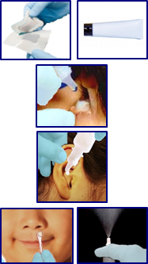
Topical Route
Medications via topical route are applied to surfaces of the body. Topical route includes:
Transdermal: applied to the skin
Ophthalmic: applied in the eyes
Otic: applied in the ears
Nasal: applied in the nose
Use gloves with any topical route medication to reduce risk of absorption by the person administering.
Oregon Health Authority
Notes:
DROPS, SUSPENSIONS, and SPRAYS are liquids, typically applied to areas that are difficult to reach or should not be touched, such as inner nasal passages or the eyeball.
GEL typically contains cellulose, alcohol, and water; often oil-free. Absorbs well into mucous membranes such as lips (interior), nasal passages, and rectal tissues.
FOAM has a light consistency due to tiny air bubbles. It spreads thinly and absorbs very quickly into the skin.
LOTION contains more water than oil. Spreads thinly and absorbs quickly into the skin.
CREAM contains equal parts oil and water. Spreads easily and absorbs more slowly, staying on the skin longer.
OINTMENT contains more oil than water. Stays on the skin a long time, absorbs more slowly for longer release of medication.
BALM is usually very thick and waxy, often used as a hydrating barrier. May be used when slower absorption is needed.
PATCHES contain medication and are held in place with adhesive. The medication in the patch is absorbed through the skin slowly over time.

Slide 58
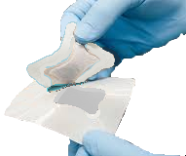
Medicated Patches
Prepare, and verify the SIX RIGHTS.
Put on gloves. Clean the application site, unless otherwise instructed.
Apply the patch.
  a. If applicable, remove old patch and document its location. Place new patch per written instructions.
  b. If instructions permit, choose a location that can be covered by clothing to protect the site and minimize transfer to other individuals.
Follow OR-OSHA and local protocols for disposing of items contaminated with body fluids, such as saturated gauze dressings over weeping rash or lesion.
Remove gloves and wash hands.
Document. Include location of topical patch.
Oregon Health Authority

Slide 59
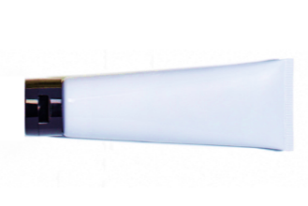
Applications (Gel, Foam, Lotion, Cream, Ointment)
Prepare, and verify the SIX RIGHTS.
Put on gloves. Clean the application site, unless otherwise instructed.
Apply the amount of medication per written instructions.
  a. If instructions permit, choose a location that can be covered by clothing to protect the site and minimize transfer to other individuals.
  b. Wooden tongue blades, cotton swabs, or gauze may be used as applicators.
  c. Place gauze over the site if required per written instructions.
Remove gloves and wash hands.
Document. Include location of topical application.
Oregon Health Authority

Slide 60
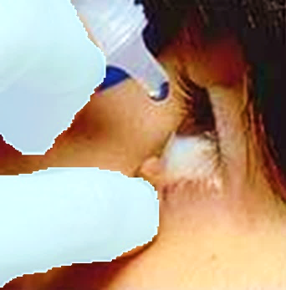
Eye Drops, Ointments
Prepare, and verify the SIX RIGHTS. Put on gloves.
Follow label instructions and shake prior to administering if instructed.
Have the student lie on a cot or sit with their head tilted back.
Ask the student to close their eyes and look up with eyes closed.
With gloved finger on lower eyelid, gently pull down to open a pocket.
Hold the bottle or tube with the tip just above the eyelid pocket. Gently squeeze a drop of medication into the pocket.
Encourage student to place gentle pressure where the eye meets the nose. Allow student to blink and gently dab around eye with tissue.
For additional drops, wait allotted time and follow the same steps.
  2nd dose of the same medication: 3 minutes between doses
  two different eye drop medications: 5 minutes between medications
Remove gloves and wash hands.
Document. Include location (left, right, or both eyes).
DO NOT touch the eye with bottle/tube. Use extreme caution to avoid injury or medication contamination.
Oregon Health Authority

Slide 61
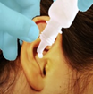
Ear Drops, Ointments
Prepare, and verify the SIX RIGHTS. Put on gloves.
Follow label instructions and shake prior to administering if instructed.
Have student sit or lie down, turned with affected ear facing up.
Gently pull the outer flap of ear upward and backward.
Squeeze the dropper slowly and firmly to release the ordered number of drops.
Instruct the student to remain in position with the treated ear facing up for at least one full minute. Gently rub the skin in front of the ear, or move the outer flap of the ear. Student may do this if able.
If written instructions require it, place or tape a cotton ball against ear.
Rinse the dropper tip with water after each use. Tip down slightly while rinsing to prevent water entering the tip. Replace the cap promptly.
Remove gloves and wash hands.
Document. Include location (left, right, or both ears).
Oregon Health Authority

Slide 62

Nasal Ointment, Gel
Prepare, and verify the SIX RIGHTS. Put on gloves.
Follow medication instructions. Example:
  Apply the amount of ointment in written instructions onto the tip of a cotton tipped applicator.
  Insert the applicator just inside each nostril in the front, no deeper than the nasal flare (1cm or less).
  After medication is inserted, remove the applicator, then gently press the nostril to spread ointment throughout the nose. If developmentally able the student may perform this action.
Remove gloves and wash hands.
Document. Include location (left, right, or both nostrils).
Oregon Health Authority

Slide 63
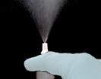
Nasal Spray
Prepare, and verify the SIX RIGHTS. Put on gloves.
Provide tissues and instruct student to blow their nose.
Follow label instructions: shake bottle if indicated; remove cap and squeeze the bottle to prime (mist should spray out).
Gently insert spray bottle tip into nostril; plug the other nostril.
  Point the tip away from the center of the nose, toward the ear.
Instruct the student to breathe out through their mouth, then breathe in while you squeeze the spray bottle. Student may do this if able.
Keep the bottle compressed while removing it (prevent contamination).
Instruct student to hold their breath for a few seconds then breath out through their mouth.
Instruct the student to avoid blowing their nose for 5 to 10 minutes after the medication.
Wipe the outside of the bottle with a clean tissue and replace the cap.
Remove gloves and wash hands.
Document. Include location (left, right, or both nostrils).
Oregon Health Authority
Notes:
Some nasal sprays may cause slight bleeding after extended use. If this happens, notify the parent/guardian after documenting.

Slide 64
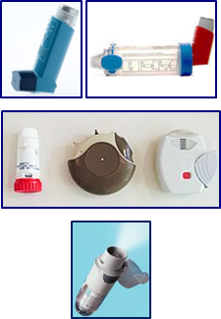
Respiratory Route
Medications via respiratory route are breathed into the lungs such as via
Metered-dose inhaler (MDI)
Dry powder inhaler (DPI)
Soft mist inhaler (SMI)
Oregon Health Authority
Notes:
Specialized routes and procedures including nebulizer, oxygen, and tracheostomy, require additional training beyond the scope of this protocol.
METERED-DOSE INHALER (MDI) has a propellent to spray a fine mist.
DRY POWDER INHALER (DPI) has a capsule or chamber of dry powder medication within the device.
SOFT MIST INHALER (SMI) release medication in a fine mist, which stays in the air longer than MDI aerosols.

Slide 65
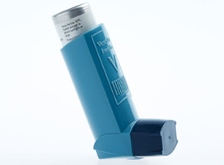
Metered Dose Inhaler (MDI)
Prepare, and verify the SIX RIGHTS. Follow manufacturer’s directions for priming and cleaning inhalers.
Remove the cap from the inhaler holding case.
Instruct student to blow out a big breath, then place their lips tightly around the inhaler mouthpiece and breathe in deeply. As they inhale, press down once on the canister. Student may do this if able.
Direct the student to hold their breath for a count of 3 seconds (or up to 10 if possible) the breathe out slowly.
If written orders include a second puff, wait at least one full minute before giving the second puff, or the length indicated in student’s written instructions. this allows the first puff to begin opening lung tissues so the second puff can reach more lung tissues.
Wipe inhaler or spacer mouthpiece with a clean damp cloth, replace mouthpiece cover(s), and store in a dry place.
Document.
Oregon Health Authority
Notes:
Metered dose inhalers: MDIs have a pressurized canister, housed in a plastic holding case, which propels a fine mist of medication into the lungs.
Spacers: A spacer (holding chamber) may pared with the MDI. If the student’s provider has recommended a spacer, strongly encourage its use! When used correctly, a spacer can increase the amount of medication that reached the lungs. Colalborate with the school RN and student to ensure correct technique.
Wait between puffs: this allows the first puff to begin opening lung tissues so the second puff can reach more lung tissues.

Slide 66
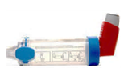
MDI with a Spacer
Prepare, and verify the SIX RIGHTS.
Remove the cap from the inhaler. Place inhaler mouthpiece into rubber opening on back of spacer, then shake well.
  Press down once on the inhaler to fill the spacer chamber.
  Instruct student to blow out a big breath, then place their lips tightly around the spacer mouthpiece and breathe in slowly and gently as long as they can.
Direct the student to hold their breath for a count of 3 seconds (or 10 if possible) the breathe out slowly.
If written orders include a second puff, wait at least one full minute before giving the second puff, or per student’s written instructions.
Wipe spacer mouthpiece with a clean damp cloth, replace mouthpiece cover(s), and store in a dry place.
Document.
DO NOT make the spacer whistle. If the spacer whistles the student is breathing in too fast.
Oregon Health Authority
Notes:
Metered dose inhalers: MDIs have a pressurized canister, housed in a plastic holding case, which propels a fine mist of medication into the lungs.
Spacers: A spacer (holding chamber) may pared with the MDI. If the student’s provider has recommended a spacer, strongly encourage its use! When used correctly, a spacer can increase the amount of medication that reached the lungs. Colalborate with the school RN and student to ensure correct technique.
Wait between puffs: this allows the first puff to begin opening lung tissues so the second puff can reach more lung tissues.

Slide 67
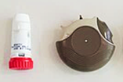
Dry Powder Inhaler (DPI)
Prepare, and verify the SIX RIGHTS.
Follow DPI device instructions to load or prime the medication.
  For single-dose DPIs: load a capsule into the chamber, then click to pierce the capsule. For multi-dose DPIs: click to load.
Instruct student to blow out a big breath, then place their lips tightly around the spacer mouthpiece and breathe in quickly and forcefully.
Direct the student to hold their breath for a count of 3 seconds (or 10 if possible) then breathe out slowly.
Open the DPI chamber and check to see if powder was fully inhaled. If powder remains, close the device and direct student to repeat steps 3 and 4.
If second dose is ordered, re-prime or re-load the DPI device and repeat steps.
Use a dry cloth to wipe the mouthpiece, and store in a dry place. Document.
DO NOT use water to clean. Moisture can impair DPI function.
Oregon Health Authority

Slide 68

Soft Mist Inhaler (SMI)
Prepare, and verify the SIX RIGHTS.
Follow SMI device instructions to prime when applicable. Example:
  Hold capped inhaler upright. Twist base clockwise until it clicks. Uncap. Point inhaler at the floor. Press button on side till mist comes out. Repeat 3 more times, for a total of 4 sprays.
Hold inhaler upright, cap closed. Turn base to right until it clicks. Uncap.
Instruct student to blow out a deep breath, then place mouth over the mouthpiece. Direct student to hold SMI horizontally so it points toward the back of the mouth.
Instruct the student to breathe in slowly and deeply for as long as comfortable (3 to 5 seconds). As they inhale, press the button on the side of DPI to release the mist. Student may do this if able.
Direct student to hold breath 3 seconds (up to 10 if possible), then breathe out slowly.
Use a clean damp cloth to wipe the mouthpiece. Store in a dry place.
Document.
DO NOT cover the vents near the mouthpiece. Student should position lips farther back.
Oregon Health Authority

Slide 69
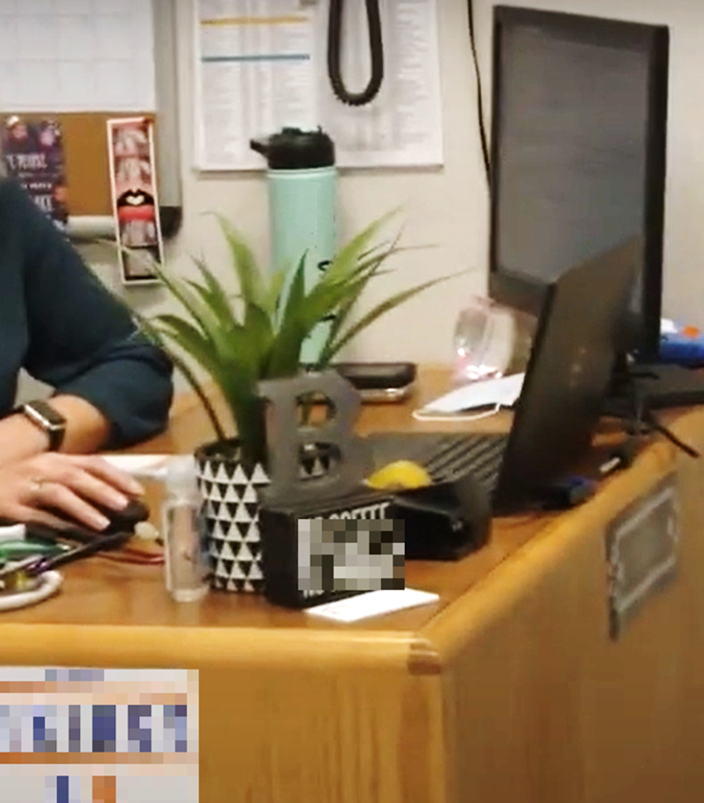
Demonstration and Evaluation
__________________
Local Policies, Protocols, and Practices
Notes:
For use at trainer discretion.
Note to Trainer: Consider review of local setting policies and standard practices, to provide sample responses.
Corresponds to Protocol Training Manual Section II: Staff Resource Manual Section, "Medication Program Resources: Local Program Details."

Slide 70

Health Policies and Practices
Where are health policies, procedures kept?
Who oversees medication administration?
What supplies are maintained?
Oregon Health Authority

Slide 71
Medication Management
Where are medications kept?
When are student medications accepted; checked; replaced; disposed?
What are your responsibilities related to storage, access, handling, and disposal?
Oregon Health Authority

Slide 72
Medication Administration
How do you maintain standard precautions? (what cleaning supplies, when to use gloves)
How do you verify the SIX RIGHTS?
How do you protect student privacy in your school setting?
Oregon Health Authority

Slide 73
After Administering Medication
Which medications are you likely to administer?
What are your responsibilities after each medication?
When should you contact the RN or designated personnel?
  What’s expected (side effect) versus concerning (adverse reaction)?
  Will you report doses remaining; need for refills?
  What’s the plan for reporting errors or problems?
Oregon Health Authority

Slide 74
Emergency Response Procedures
What signs and symptoms would indicate an emergency?
  Recommended: review expectations for medications
  Recommended: complete “Severe Allergic Reaction” training
How do you activate school emergency response?
Who will call 911 during an emergency?
Who calls parent/guardian – school nurse, administrator, yourself, etc.?
What are your responsibilities after an event (notifications, documentation, etc.)?
Oregon Health Authority

Slide 75
Record Keeping
What information may you access?
How do you access orders, instructions, time of prior dose, etc.?
What information must you document?
Where is information documented as medications are given?
  Electronic v paper; drop-down menus, check-boxes, codes, etc.
When (to whom) are you permitted to share information?
  Which situations; which members of care team, teachers, coaches, etc.?
Oregon Health Authority

Slide 76
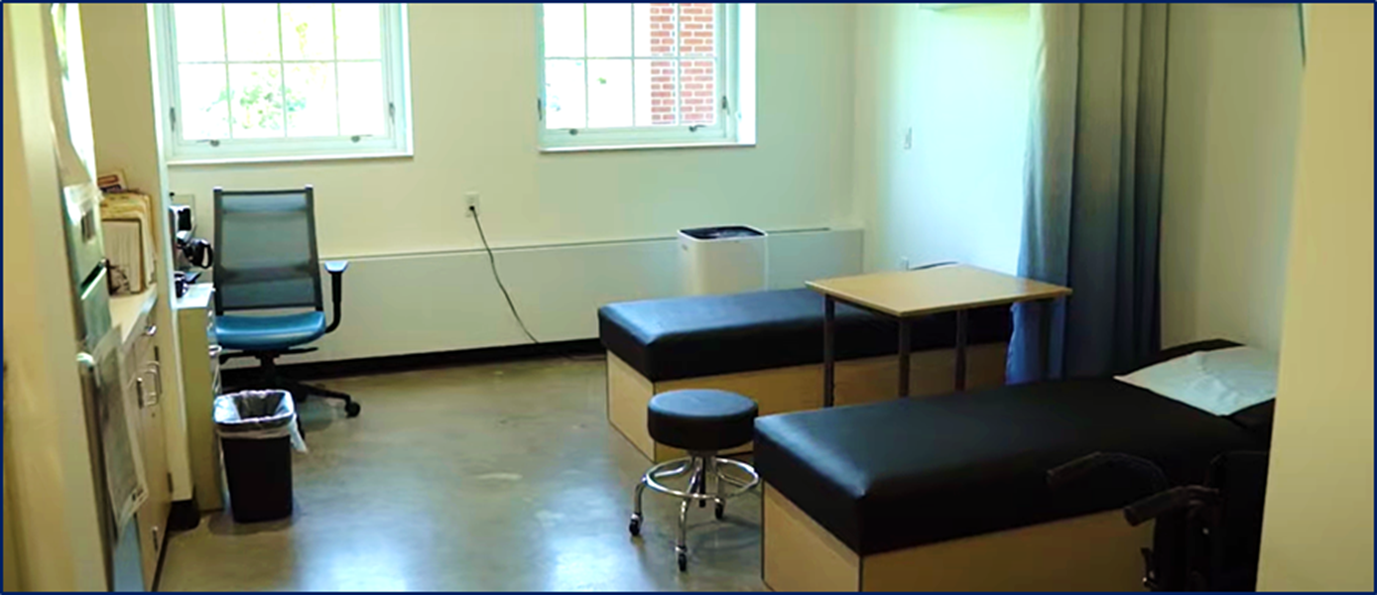
5. References
Notes:
Please refer to the Protocol Training Manual for the direct connection between references and text.

Slide 77
References 1 of 5
AAO American Academy of Ophthalmology (2023) How to Put in Eye Drops. https://www.aao.org/eye-health/treatments/how-to-put-in-eye-drops
AAP American Academy of Pediatrics (2022) How to Give Ear Drops to a Child. https://www.healthychildren.org/English/safety-prevention/at-home/medication-safety/Pages/how-to-give-ear-drops.aspx
Allergy & Asthma Network (2024). How to use nasal spray. https://allergyasthmanetwork.org/allergies/how-are-allergies-treatment/how-to-use-nasal-spray/
Allergy and Asthma Network (2024) How to Use Dry Powdered Inhaler https://allergyasthmanetwork.org/what-is-asthma/how-is-asthma-treated/how-to-use-a-dry-powder-inhaler/
Bergren M. D. (2022). NASN's Medication Administration Clinical Guideline. NASN school nurse (Print), 37(4), 176–178. https://doi.org/10.1177/1942602X221098735
Oregon Health Authority

Slide 78
References 2 of 5
Butler, S. M., Boucher, E. A., Tobison, J., & Phan, H. (2020). Medication Use in Schools: Current Trends, Challenges, and Best Practices. The Journal of Pediatric Pharmacology and Therapeutics : JPPT : the official journal of PPAG, 25(1), 7–24. https://doi.org/10.5863/1551-6776-25.1.7 Accessed June 2024.
Children’s Hospital of Philadelphia (2024) How to Use A Metered Dose Inhaler with Spacer https://www.chop.edu/health-resources/how-use-metered-dose-inhaler-spacer
Children’s Hospital of Philadelphia (2024) How to Give Your Child Crushed Pills https://www.chop.edu/health-resources/how-give-your-child-crushed-pills
DeCoster, M. M., Spiller, H. A., Badeti, J., Casavant, M. J., Rine, N. I., Michaels, N. L., Zhu, M., & Smith, G. A. (2023). Pediatric ADHD Medication Errors Reported to United States Poison Centers, 2000 to 2021. Pediatrics, 152(4), e2023061942. https://doi.org/10.1542/peds.2023-061942
Dilber, D. H., Ozceker, D., & Terzi, O. (2022). Drug Allergy in Children: What is the Actual Frequency of Drug Allergies?. Sisli Etfal Hastanesi tip bulteni, 56(4), 552–558. https://doi.org/10.14744/SEMB.2022.65642
Oregon Health Authority

Slide 79
References 3 of 5
Doğan, M., Şahiner, Ü. M., Ataç, A. S., Ballıkaya, E., Soyer, Ö. U., & Şekerel, B. E. (2021). Oral health status of asthmatic children using inhaled corticosteroids. The Turkish journal of pediatrics, 63(1), 77–85. https://doi.org/10.24953/turkjped.2021.01.009
Ear Nose and Throat United Kingdom (2022) How to Use Nasal Ointment
Eluri, M., Spiller, H. A., Casavant, M. J., Chounthirath, T., Conner, K. A., & Smith, G. A. (2018). Analgesic-Related Medication Errors Reported to US Poison Control Centers. Pain medicine (Malden, Mass.), 19(12), 2357–2370. https://doi.org/10.1093/pm/pnx272
Kotloski, R. J., & Gidal, B. E. (2022). Rescue Treatments for Seizure Clusters. Neurologic clinics, 40(4), 927–937. https://doi.org/10.1016/j.ncl.2022.03.016
Miotto, Mary Beth, et al. (2024) Safe Administration of Medication in School: AAP Policy Statement. Pediatrics, (2024) 153 (6): e2024066839. https://doi.org/10.1542/peds.2024-066839 Accessed June 2024.
Oregon Health Authority

Slide 80
References 4 of 5
NIH National Eye Institute (2021) How to Put Drops in Your Eyes https://www.nei.nih.gov/Glaucoma/glaucoma-medicines/how-put-eye-drops#:~:text=Squeeze%20the%20prescribed%20number%20of,from%20draining%20into%20your%20nose
NIOSH [2023]. Managing hazardous drug exposures: information for healthcare settings. By Hodson L, Ovesen J, Couch J, Hirst D, Lawson C, Lentz TJ, MacKenzie B, Mead K. Cincinnati, OH: U.S. Department of Health and Human Services, Centers for Disease Control and Prevention, National Institute for Occupational Safety and Health, DHHS (NIOSH) Publication No. 2023-130, https://doi.org/10.26616/NIOSHPUB2023130
Open Resources for Nursing (Open RN); Ernstmeyer K, Christman E, editors.(2021) Nursing Skills [Internet]. Eau Claire (WI): Chippewa Valley Technical College. Chapter 16 Administration of Medications Via Other Routes. Available from: https://www.ncbi.nlm.nih.gov/books/NBK593196/
Oregon Nurse Practice Act, Chapter 851, Division 45, Standards and Scope of Practice for the Licensed Practical Nurse and Registered Nurse, 851-045-0065 Standards of Practice for the LPN and the RN. https://secure.sos.state.or.us/oard/viewSingleRule.action?ruleVrsnRsn=314766
Oregon Health Authority

Slide 81
References 5 of 5
Patel, A., Jacobsen, L., Jhaveri, R., & Bradford, K. K. (2015). Effectiveness of pediatric pill swallowing interventions: a systematic review. Pediatrics, 135(5), 883–889. https://doi.org/10.1542/peds.2014-2114
Payne, J., Habet, K. A., Pona, A., & Feldman, S. R. (2019). A Review of Topical Corticosteroid Foams. Journal of drugs in dermatology : JDD, 18(8), 756–770.
Redstone, F., & West, J. F. (2004). The importance of postural control for feeding. Pediatric nursing, 30(2), 97–100. https://pubmed.ncbi.nlm.nih.gov/15185730/
Türkeli, A., Yılmaz, Ö., & Yüksel, H. (2016). Metered dose inhaler-spacer use education effects on achieve asthma control in children. Ölçülü doz inhaler-spacer kullanımı eğitiminin çocuklarda astım kontrolü sağlanmasındaki etkileri. Tuberkuloz ve toraks, 64(2), 105–111. https://doi.org/10.5578/tt.9142
UpToDate (2024) Patient Education: Inhaler techniques in adults (Beyond the Basics). https://www.uptodate.com/contents/inhaler-techniques-in-adults-beyond-the-basics
Wong, W. F., Ang, K. P., Sethi, G., & Looi, C. Y. (2023). Recent Advancement of Medical Patch for Transdermal Drug Delivery. Medicina (Kaunas, Lithuania), 59(4), 778. https://doi.org/10.3390/medicina59040778
Oregon Health Authority

