Slide 1
Oregon Title VI Indian Education
Community of Practice
Thursday September 18, 2025 10AM-11AM
Rename your Zoom Name to your –
first and last name
name of district ,ESD, or Tribe, and
official role for Title VI - Project Coordinator, Authorized Official Representative, student liaison, etc.
Pronouns

Slide 2
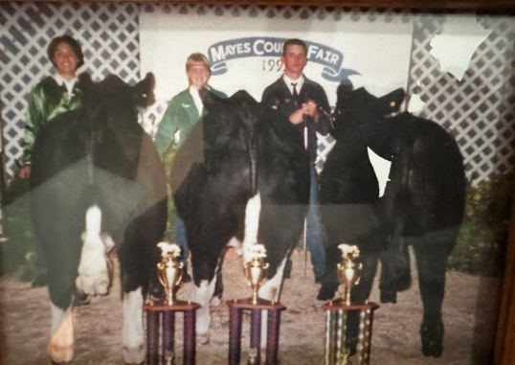
Introduction
Stacy Parrish, Klamath Tribes (Yahooskin)
Education Program Specialist II in the Office of Indian Education
Former Life: High School Principal, Assistant Principal, and Middle and High School English Language Arts teacher
Within OIE I help support -
The TAPP grant
Title VI Community of Practice
Tribal Consultation between Tribes and School Districts and ESDs
Special Education
Discipline/Restorative Justice
Other Duties as Assigned
Everyone – Please take time to further introduce yourself in the chat!

Slide 3
Welcoming Our Newest Awardees!
Clackamas ESD -
Proudly serving Lake Oswego SD 7J, Molalla River SD 35, Oregon City SD 62, Oregon Trail SD 46, and West Linn-Wilsonville SD 3J
🙌
All Oregon awardees for SY25-26

Slide 4
Today’s Agenda -
Community of Practice - New Traditions
US Department of Education Deadlines and Announcements / ODE Updates and Information
Title VI Indian Education Promising Practice
Professional Learning Series

Slide 5
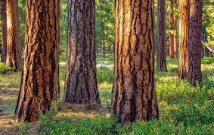
Community of Practice - New Traditions
Land-Based Teachings and Stories
This year we will open meetings with a land-based teaching from one of our Title VI formula grant sites.
Send a picture(s) to stacy.parrish@ode.oregon.gov
Share with the group a story or a teach us a lesson about the Land (i.e. a place, a medicine, a first food, etc).
Who can share in October? The next meeting is Wednesday, October 22, 2025 at 10AM.

Slide 6
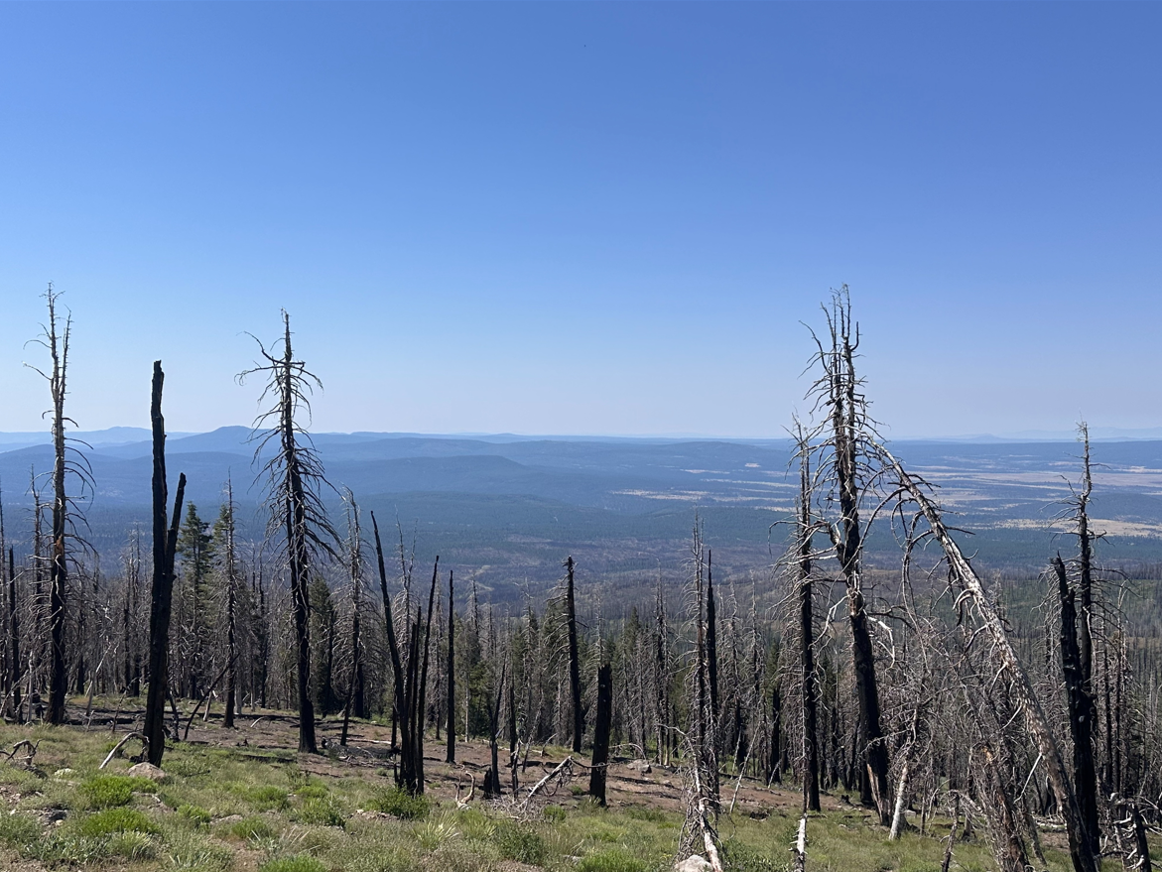
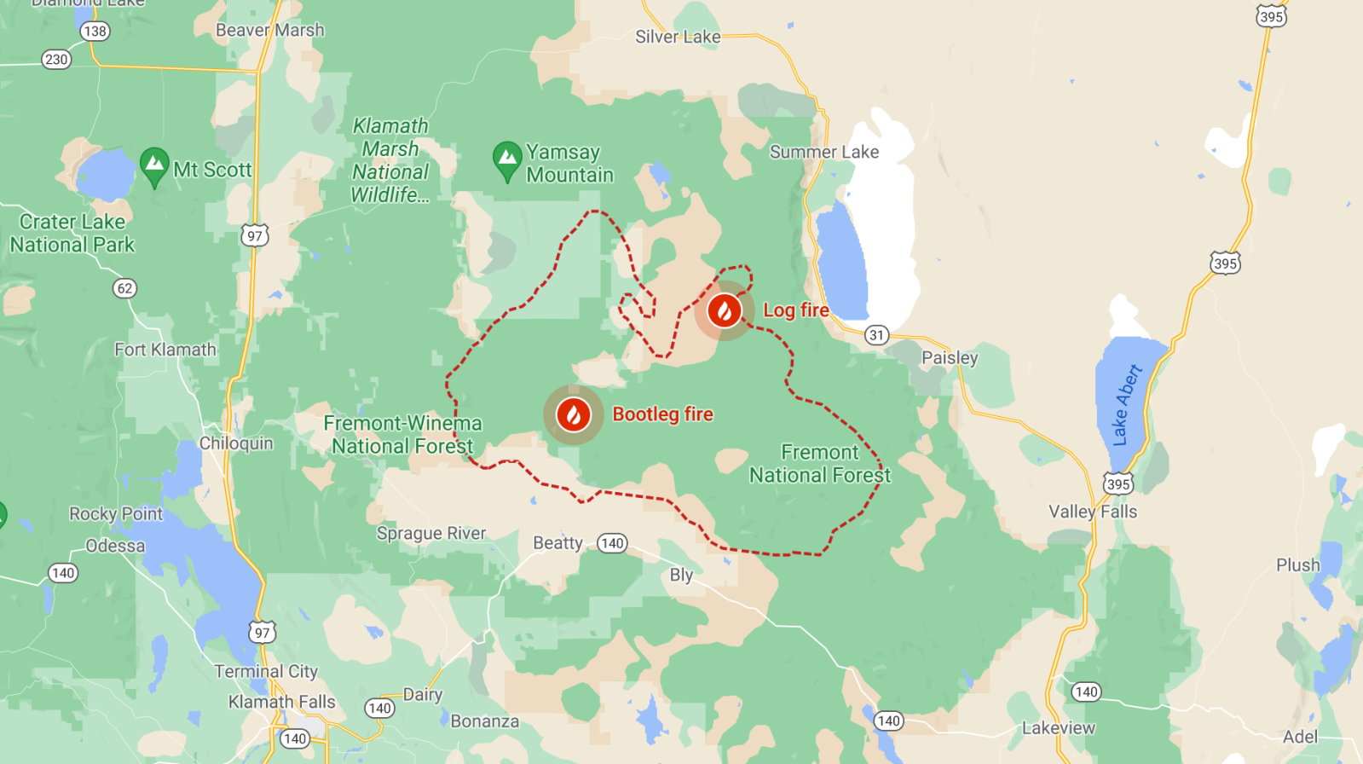
temada dzia?a - “Shade your eyes/Looks all around”; Gearhart Mountain, eastern side of the 1864 Peak to Peak Reservation of the Klamath Tribes; post-Bootleg Fire of 2021

Slide 7

Purpose of ODE’s Title VI Indian Education Community of Practice
As Defined by our AI/AN Advisory Committee State Agency Purpose -
Objective 4C: Invest in Targeted Programs Designed to Increase Outcomes for Native Students
Cultivate a Title VI Indian Education Community of Practice to reduce professional isolation, foster greater collaboration, and spread the expertise and insights of individual Title VI educators throughout the state
The US Department of Education administers the Title VI Indian Education formula grant. As a state agency, we are not permitted to advise on issues related to statute.
Our authority is limited to ensuring compliance to Section 6119.
The US Department of Education DOES NOT communicate with ODE or share information with ODE on grantees.

Slide 8
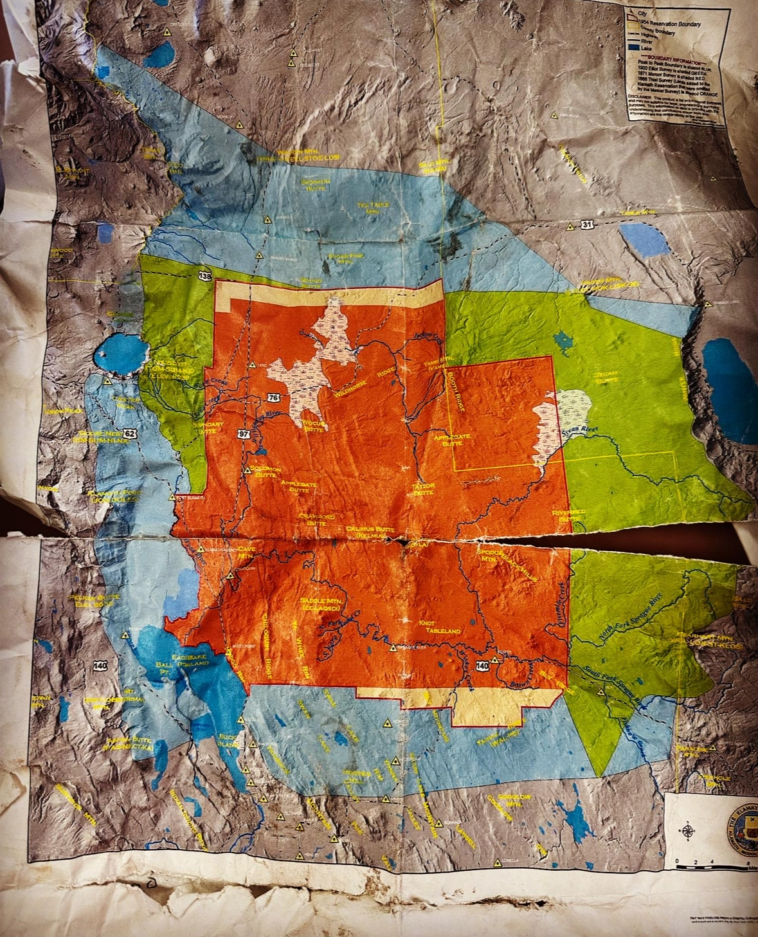
Title VI, Part A, Indian Education Legislation
SEC. 6101. [20 U.S.C. 7401] STATEMENT OF POLICY.
It is the policy of the United States to fulfill the Federal Government’s unique and continuing trust relationship with and responsibility to the Indian people for the education of Indian children. The Federal Government will continue to work with local educational agencies, Indian tribes and organizations, postsecondary institutions, and other entities toward the goal of ensuring that programs that serve Indian children are of the highest quality and provide for not only the basic elementary and secondary educational needs, but also the unique educational and culturally related academic needs of these children. It is further the policy of the United States to ensure that Indian children do not attend school in buildings that are dilapidated or deteriorating, which may negatively affect the academic success of such children.
Image of a torn map depicting three color coded boundaries of diminishing Klamath tribal lands located in southern Oregon since the 1864 Klamath Treaty was signed.

Slide 9
Title VI, Part A, Indian Education Legislation
SEC. 6111. [20 U.S.C. 7421] PURPOSE.
It is the purpose of this subpart to support the efforts of local educational agencies, Indian tribes and organizations, and other entities in developing elementary school and secondary school programs for Indian students that are designed to−
  meet the unique cultural, language, and educational needs of such students; and
  ensure that all students meet the challenging State academic standards.

Slide 10


Most Important Resource
The EASIE (Electronic Application System for Indian Education) Communities 360 Website -
https://easie.communities.ed.gov/#program
VISIT IT OFTEN: FAQs, Trainings, Calendar, Contacts
Have a question? Go to the website?

Slide 11
Quick Updates from the EASIE Website
Has Official Personnel Leading or Supporting the Grant Changed?
You must complete the Administrative Action Memo ASAP.
There have been challenges to the system this is uploaded to. Please also email your completed memo to gregory.hindsley@ed.gov
Start of Year To-Do’s
The Annual Performance report for FY2024-2025 OPENED September 2.
It closes October 10.
Go to the EASIE 360 Communities EASIE APR page.
  See the “Broadcasts” that went out this year.
  Read what this is, what to do, where to go, etc.

Slide 12
General Formula Grant Timeline
✅Public Hearing and ✅Meaningful Collaboration must be held before Part II closes
-EASIE PART II Submission Deadline TBD
-EASIE PART I Closes TBD
- EASIE PART II Application Opens TBD
-EASIE APR for FY 24-25 opened Sept. 2
-Indian Parent Committee Start of Year Outreach
-Native American Heritage Month
-Winter Solstice, Dec 21
SEPTEMBER
NOVEMBER/DECEMBER
MARCH
MAY
OCTOBER
JANUARY/FEBRUARY
APRIL
-EASIE APR for FY 24-25 closes October 10
-Indigenous Peoples Day, Monday Oct 13
-EASIE Part 1 Opens - TBD
Applications submitted to ODE for Comments TBD
Public Hearing Time
Meaningful Collaboration with Tribes Time
This is a general visual of the Title VI school year timeline. All LEAs and LEA-Cs should adhere to all published DOE timelines to plan their efforts.

Slide 13
Title VI Indian Education Promising Practice
Indian Parent Committee

Slide 14

Indian Parent Committee - EASIE 360 Communities
First –
Revisit all Indian Parent Committee materials
  Look for them under EASIE Part II
  Review the posted webinar Indian Parent Committee - Title VI Application Process and Addressing Concerns Webinar FY 2024-25
  Review the EASIE Part II FAQ at an absolute minimum
We will take five minutes to open and review the Indian Parent Committee posted powerpoint. Pay attention to the Speaker Notes – LOTS OF GEMS IN THERE!
ODE has made a resource to reflect on your current IPC efforts. Here is our CoP folder to see examples of Bylaws.

Slide 15
Professional Learning Series
Today - The American Indian and Alaska Native Student Success Plan

Slide 16

Looking Ahead
October - Substance Abuse Month
Alternative to Suspension for Substance Abuse
November - Special Education Family Guides*
Please rank these topics by dropping the numbers in the chat (Example: 2, 5, 2, 4, 6, 1)
Family literacy with culturally based materials
Types of Culturally Responsive needs Assessments
Decrease school dropout rate (Initiatives, Strategies, Communication)
Culturally-responsive academic support
Cultural enrichment
Increase support for at-risk students

Slide 17


American Indian and Alaska Native Student Success Plan 2025-2030

Slide 18
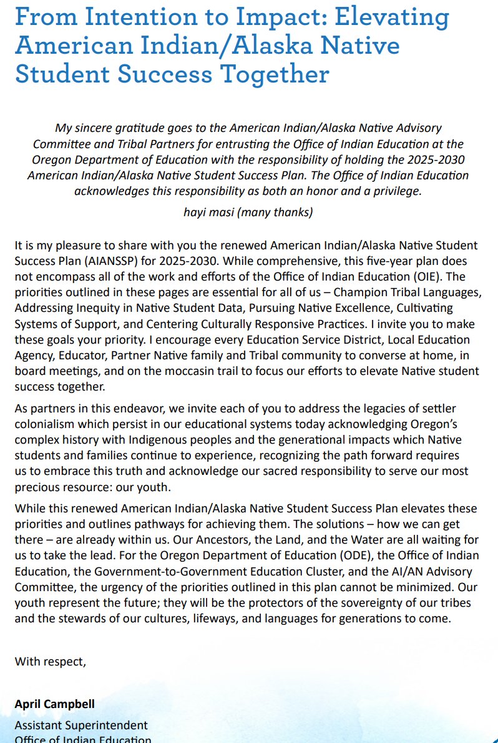

Reflection
As you read the letter from Assistant Superintendent of the Office of Indian Education April Campbell, identify words or phrases which impact you. Jot down your initial reaction and thoughts after reading it.
Then, we will share out any reflections or reactions you have.

Slide 19





Five Key Goals to Advance AI/AN Outcomes
Champion Tribal Languages
Share Out - With only knowing the five goals of the plan, where does this work already show up concretely in your work?
Address Inequity in Native Student Data
Pursue Native Excellence
Cultivate Holistic Systems of Support
Center Culturally Responsive Approaches
Notes:
.

Slide 20
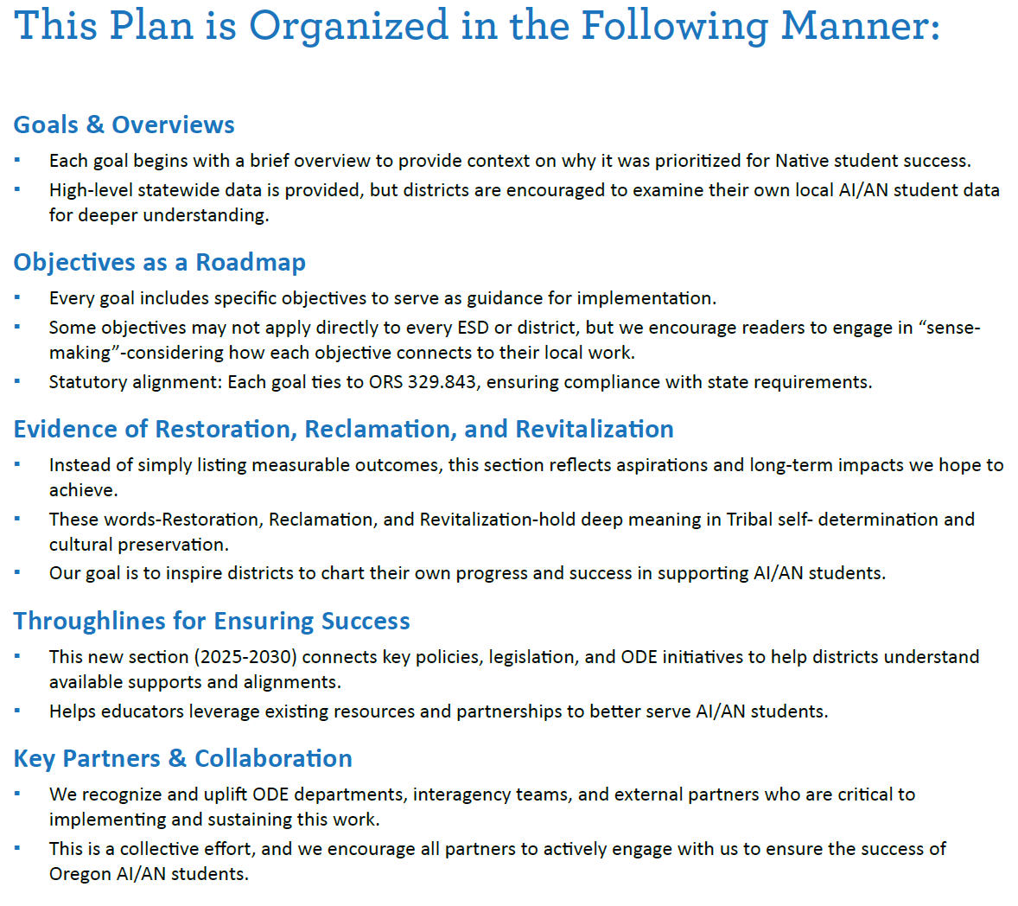
✔ In what ways can these Goals and Objectives guide me/us?
✔ What data do we need to know how we are doing with this goal?
✔ How can I ensure district policies meet statutory requirements?
✔ What might this work look like in our district, in my school, or in my classroom?
✔ How might we better leverage available resources?
✔ What might it look like to better partner with Tribes and key agencies?
Notes:
Note: This slide is where the most time will be spent, as it is essentially a “training” on how to use the SSP. There is ample room for further discussion with each component.

Slide 21

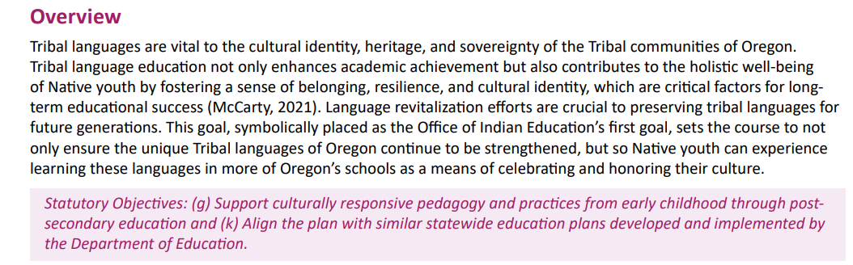
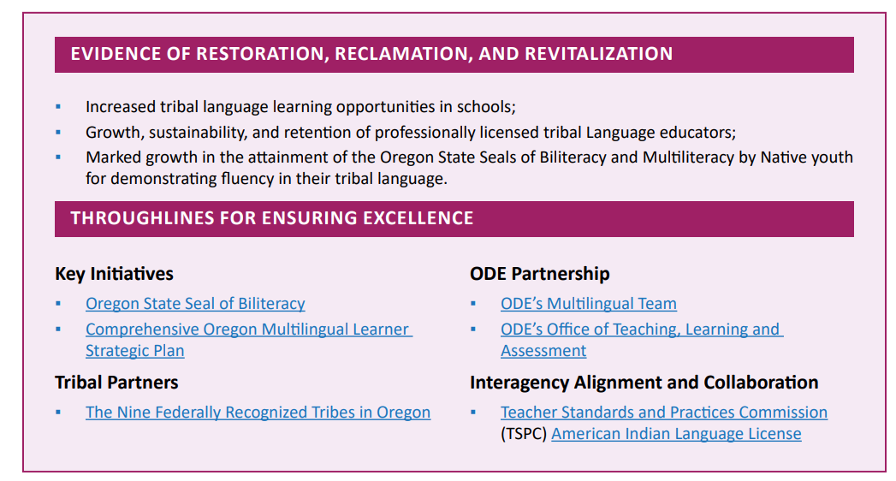
Example of the Layout -
Champion Tribal Languages
Notes:
Note: This slide is to highlight the indigenized shift in the plan – the addition of the “Evidence of Restoration, Reclamation, and Revitalization” section. Furthermore, the “Throughlines for Ensuring Excellence” is in alignment with ODE’s Equity stance and the Mission and Vision of OIE – this is about calling everyone in and doing this work in good relation with one another.

Slide 22
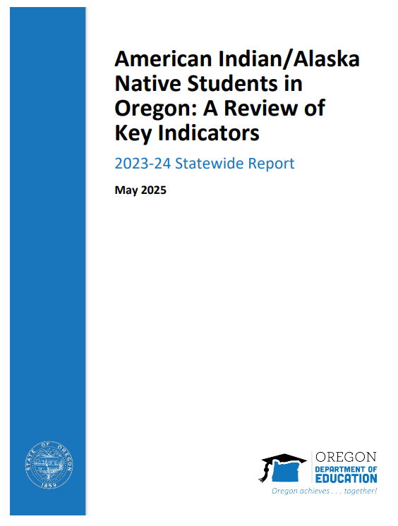
AI/AN Key Indicator Report - Released May 2025
Provides a comprehensive and inclusive overview of American Indian/Alaska Native (AI/AN) student educational experiences and outcomes statewide, while honoring the full diversity of AI/AN student identities.
  Includes AI/AN multiracial and AI/AN Hispanic/Latino identifying students (collectively shown as AI/AN Plus in report)
Access the AI/AN Key Indicator Report here
Notes:
https://www.oregon.gov/ode/students-and-family/equity/NativeAmericanEducation/Documents/SB13%20Curriculum/AIAN%20Students%20in%20Oregon%20A%20Review%20of%20Key%20Indicators%202023-24.pdf

Slide 23
Using the report to support Native students
Complements the Office of Indian Education 2025-30 AI/AN Student Success Plan goals
Aligning for Student Success: Integrated Guidance application
Grant applications (Title VI Indian Education formula grants)
Tribal Consultation
Research initiatives and proposals
Programming for community-based organizations
Inform examination of AI/AN student data at local level
Notes:
IG, state grant that combines previously separated grants. Each district develops a plan to invest these funds to increase academic achievement, close gaps between groups of students
The 5 Integrated Guidance, Longitudinal Performance Growth Targets (LPGTs): Common metrics
4-Year Graduation, 5-Year Completion
3rd grade reading
9th grade on track
Attendance

Slide 24
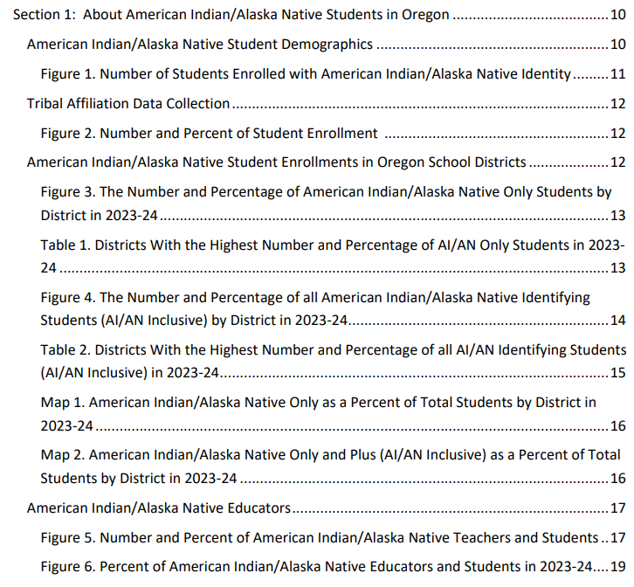
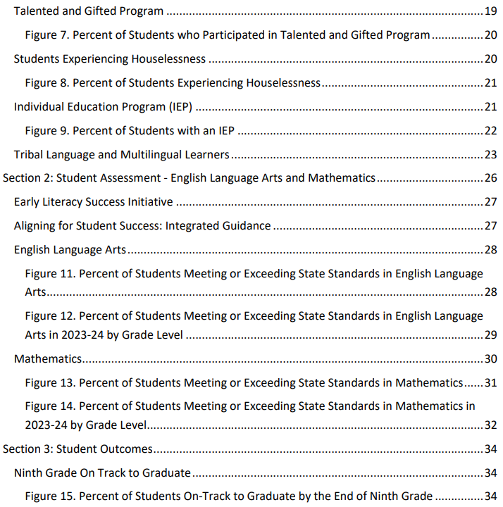
Notes:
Note - This is intended as a flash-visual of just how much data is included in the Key Indicator report.

Slide 25
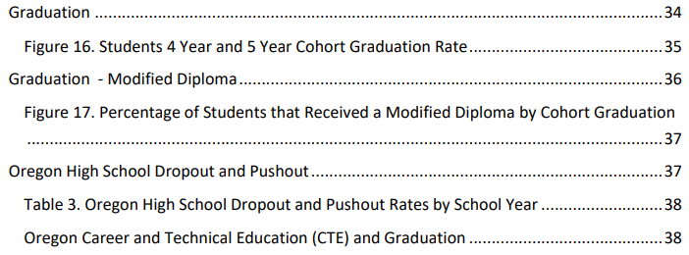
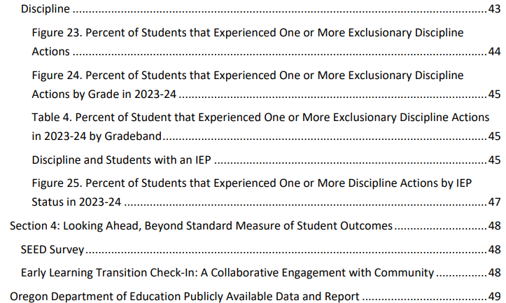
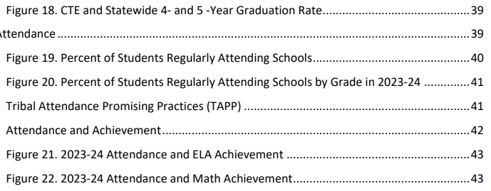
Notes:
Note - This is intended as a flash-visual of just how much data is included in the Key Indicator report.

Slide 26
ODE Publicly Available Data and Report
Achievement Data (ELA, Math, Science)
Attendance and Absenteeism
Cohort Graduation Rate
Dropout Rates in Oregon High Schools
Discipline Data
English Learners
Houseless Student
Language of Origin
Ninth Grade On-Track
Postsecondary Enrollment
Student Enrollment Reports
Student Educational Equity Development Survey (SEED)
Special Education Data
Reports published by ODE
At-A-Glance School and District Profiles
Educator Equity Report
Oregon Report Card (Online)
Oregon Statewide Educator Survey
Oregon Statewide Report Card
ODE Research and Data Briefs
Note. This list is not exhaustive of all data available from ODE. Visit the ODE website for other data availability.

Slide 27
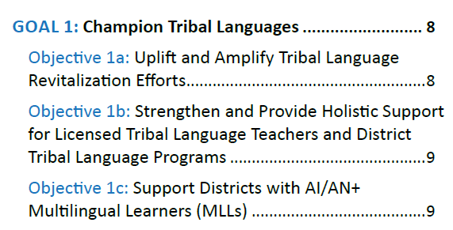

Champion Tribal Languages
Notes:
Note: These slides are meant to be a snapshot of the plan vs. going through each goal one by one. The purpose of this and the next slides is to be able to show this snapshot and keep asking the members of the PLC what this work currently looks like, could look like, and where they identify entry points into the highest leverage priority of where they should focus their change and improvement efforts.

Slide 28
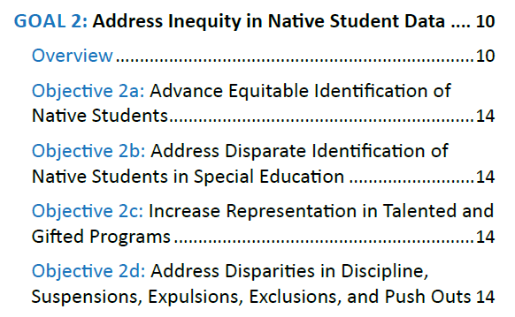
Address Inequity in Native Student Data

Slide 29
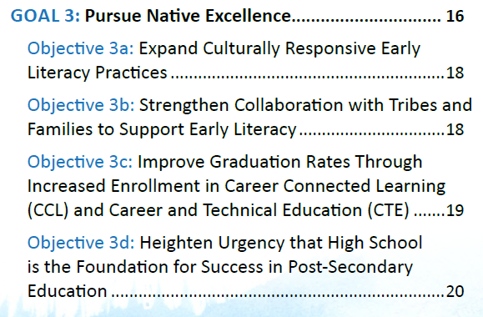
Pursue Native Excellence

Slide 30
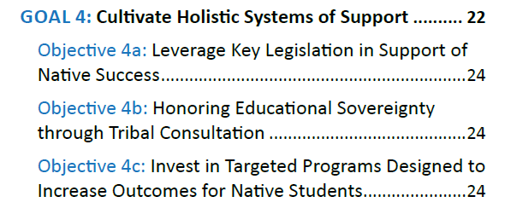
Cultivate Holistic Systems of Support

Slide 31
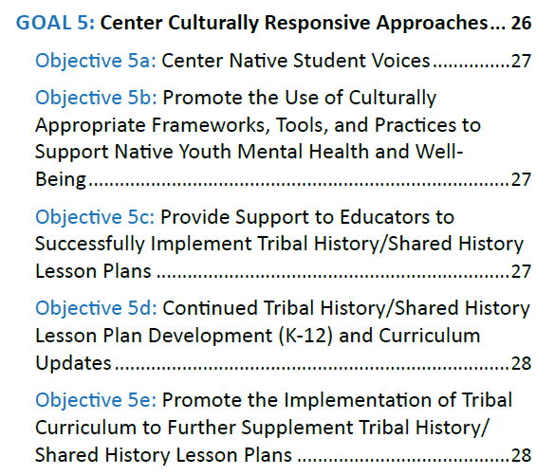
Center Culturally Responsive Approaches

Slide 32
Contact Stacy Anytime
Stacy Parrish, Education Program Specialist II
Email - stacy.parrish@ode.oregon.gov
Book an Office Hours -
Book time with STACY PARRISH * ODE
Text/Call - 971-208-0270

