Slide 1
Office of RADAR
Tribal Consultation Training
Presented by Stacy Parrish, Indian Education Specialist
Member of the Klamath Tribes (Yahooskin Paiute)
A copy of this slidedeck will be provided at the conclusion of this presentation.

Slide 2

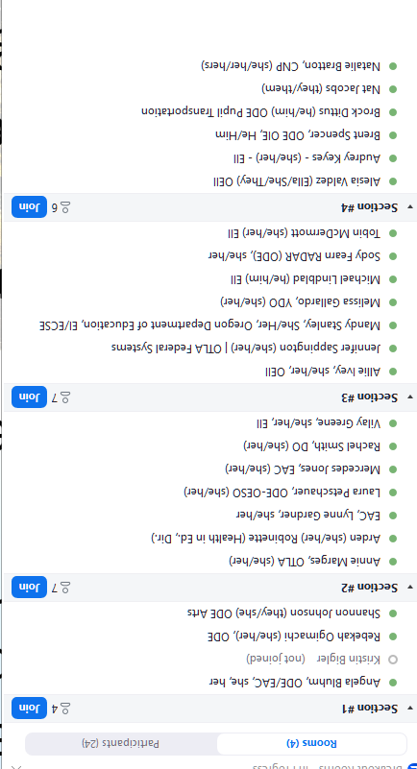
Learning Arc for Our Time
This session will –
Share out an overview on Tribal Consultation between LEAs, LEA-Cs, and tribes
Learn about ODE’s standard for Tribal Consultation (i.e. the Toolkit)
Share out on Tribal Communication and how it differs from Tribal Consultation
As you engage in this training, determine your role in RADAR regarding Tribal Consultation. In what ways does your work intersect with consultation efforts?
Every ODE staff member has a role in supporting consultation.
Notes:
Resource: ODE Tribal Consultation Website - https://www.oregon.gov/ode/students-and-family/equity/NativeAmericanEducation/Pages/Tribal-Consultation.aspx

Slide 3
Overview
Tribal Consultation Between LEAs, LEA-Cs, and Federally Recognized Tribes

Slide 4

Grounding
The Historical Significance of Tribal Consultation
In exchange for their Land, the Federal government promised tribes they would ensure Native American students received a high quality education in perpetuity - forever.
The first iteration of the Federal government fulfilling that promise was the American Boarding School Policy.
Consultation later shifted into a tri-lateral responsibility (federal, state, tribal)
An LEA or LEA-C receiving federal funds for the education of Indian children (i.e. Title VI, Part A, Indian Education Formula Grant) are a part of this trust treaty responsibility of ensuring Native students receive that high quality education.
Consultation with Sovereign Nations is intended to help ensure Native students receive a high quality education.

Slide 5


Two Types of Consultation
“Little c” Consultation
Colloquially, this refers to Tribal Consultation efforts between affected LEAs and LEA-Cs* and any federally recognized tribe(s) with a tribal reservation boundary, Indian Lands, ceded, unceded, and aboriginal lands located within 50 miles of the LEA or LEA-C.
In our state’s context, this includes:
the the nine federally recognized tribes of Oregon, and
the Confederated Tribes and Bands of the Yakama Nation in Washington and the Tolowa Dee-Ni’ Nation in California.
“Big C” Consultation
Colloquially, this refers to Tribal Consultation efforts between the nine federally recognized tribes of Oregon and another state agency. It occurs when an action impacts tribal interests.
An “action” can include, but is not limited to the following ODE actions related to ODE programs:
a. Regulations or rules
b. Legislative proposals
c. Policies, guidance documents, directives, initiatives, or other policy statements.
Resource: Heart and Spirit of Tribal Consultation videos

Slide 6
ODE “Little c” Tribal Consultation History
2017 - The Tribal Consultation federal requirement under ESEA began during FY 2017.
2018 - ODE Launched Tribal Consultation Toolkit 1.0. This was guidance in effect until Fall of 2023.
November 1, 2023 - ODE Launched the Revised Tribal Consultation Toolkit 2.0
  Symbolically coincided with Native American Heritage Month
  OIE created a new Tribal Consultation website
  Internal and External Trainings Commenced
June 2024 - ODE Launched an Updated Tribal Consultation Toolkit 2.1 (to include Integrated Guidance)
December 2024 - On Demand Tribal Consultation Modules launched in Canvas via PDNetworks; a GovDelivery was sent to LEA and ESD Superintendents and Charter School Leaders

Slide 7
*LEA-Cs - What are those?
LEA-C - Local Education Agency Consortium
In Oregon, this refers to an Education Service District who is the lead for a Title VI, Part A Indian Education consortium formula grant application. Any school district with at least 10 tribally affiliated students may join the consortium.
The following ESDs are considered LEA-Cs:
Southern Oregon ESD
Columbia Gorge ESD
Willamette ESD
For SY24-25, only Southern Oregon ESD is considered an affected LEA-C. Not only do they engage in Tribal Consultation, but each of their respective LEAs.

Slide 8
What are the Requirements?
Consultation requirements under section 8538 of the ESEA, as amended by ESSA, require affected local education agencies (LEAs) to consult with Indian tribes, or those tribal organizations approved by the tribes located in the area served by the LEA, prior to submitting a plan or application for covered programs. This requirement is designed “to ensure timely and meaningful consultation on issues affecting American Indian and Alaska Native students.”
Affected LEA Criteria:
Title VI Indian Education Formula Grant was >$40K in previous fiscal year, including LEA-Cs and LEAs who are members of a consortium who received >$40K | Has 50% or more of its student enrollment made up of AI/AN+*
Required Plans or Applications:
Title VI Part A Formula Grant (Completed Annually in Spring) | Application for SEA-Administered Covered Programs (Annually, Due Oct. 1) *Any grant disbursed with Federal funding also requires Tribal Consultation. | SEA Application Integrated Guidance (Spring, every odd year) A state requirement
Impacts LEAs and LEA-C’s | Impacts LEAs and LEA-C’s | Impacts LEAs ONLY
US Department of Education | Oregon Department of Education | Oregon Department of Education

Slide 9
SY25-26 Affected LEAs and LEA-Cs
Title VI Awardee Name | Title VI 24/25 Allocation
Ashland - SOESD | Based on LEA-C - $81,309.00
Beaverton SD | $41,950.00
Central Point 6 - SOESD | Based on LEA-C - $81,309.00
Eagle Point School District 9 - SOESD | Based on LEA-C - $81,309.00
Eugene School District-4J | $230,424.00
Grants Pass 7 School District - SOESD | Based on LEA-C - $81,309.00
Hillsboro SD | $41,039.00
Klamath County School District | $125,632.00
Klamath Falls City Schools | $51,368.00
Lincoln County School DIstrict | $122,697.00
Medford 549C School District - SOESD | Based on LEA-C - $81,309.00
Multnomah School District No. 1 | $143,538.00
Phoenix-Talent 4 School District - SOESD | Based on LEA-C - $81,309.00
Rogue River 35 School District - SOESD | Based on LEA-C - $81,309.00
Salem Keizer Public Schools | $191,090.00
Southern Oregon ESD | $71,452.00
Springfield School District | $49,020.00
Three Rivers/Josephine County - SOESD | Based on LEA-C - $81,309.00
Willamina School District 30 J | $69,567.00
Important -
LEAs and LEA-Cs required to engage in Tribal Consultation for SY25-26 will differ from those who were required to engage for SY24-25. This is because it is based on an awardee’s Title VI award amount for the previous fiscal year.
Where Can This Information Be Found?
-The US Department of Education publishes the list publicly each Fall, typically in October on their federal website.
-ODE maintains an up to date list of awardees and tribal consultation requirements on the Tribal Consultation and the Title VI website.
Take a look: FY24-25 Oregon Title VI Awardees and Student Information

Slide 10
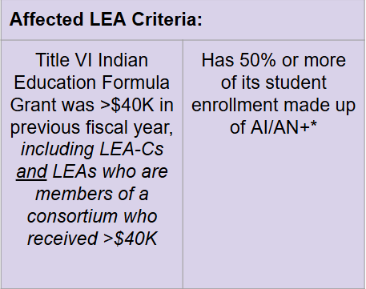
Why Do Affected School Districts Change?
A Quick Case Study - One Example
In the 2023-2024 school year, Beaverton SD received $38,159 for their Title VI Indian Education award.
So for any required plans or applications for SY24-25, they did NOT have a requirement to engage in Tribal Consultation for those plans.
Since the new Integrated Guidance plan will begin in the 2025-2026 school year and because Beaverton’s 2024-2025 award was for $41,950 (an award >$40K), they are now required to engage in Tribal Consultation for all plans and applications for SY25-26.

Slide 11
Unpacking the Term “Indian Tribes”
Consultation requirements under section 8538 of the ESEA, as amended by ESSA, require affected local education agencies (LEAs) to consult with Indian tribes, or those tribal organizations approved by the tribes located in the area served by the LEA, prior to submitting a plan or application for covered programs. This requirement is designed “to ensure timely and meaningful consultation on issues affecting American Indian and Alaska Native students.”
Definition -
Is a federally recognized tribe that has a tribal reservation boundary, Indian Lands, ceded, unceded, and aboriginal lands within 50 miles of the LEA or LEA-C. Consultation does not include state recognized tribes; Oregon has no state recognized tribes. (FAQ, p. 41)
Important Note -
An affected LEA or LEA-C should conduct Tribal Consultations with each tribe that has a tribal reservation boundary, Indian Lands, ceded, unceded, and/or aboriginal lands within 50 miles of their location.

Slide 12
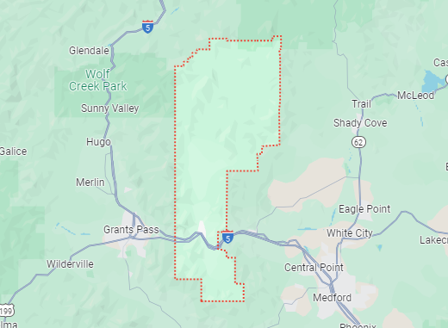
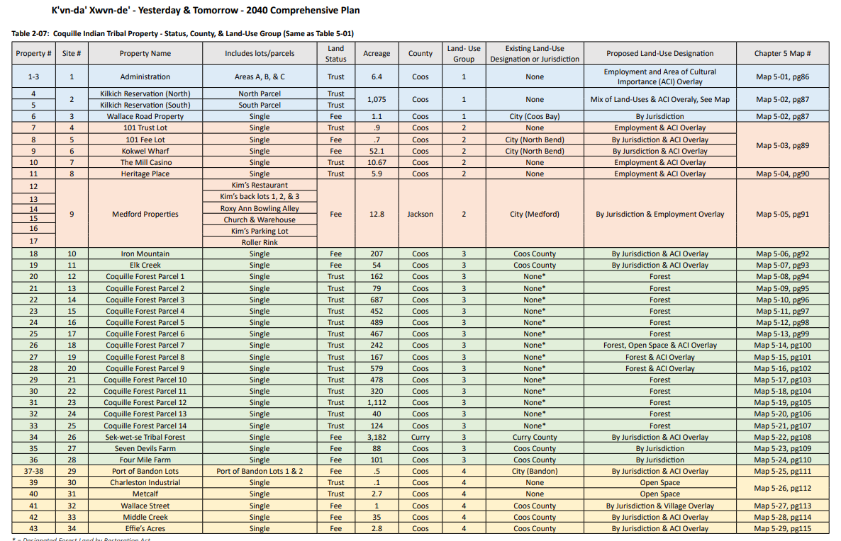
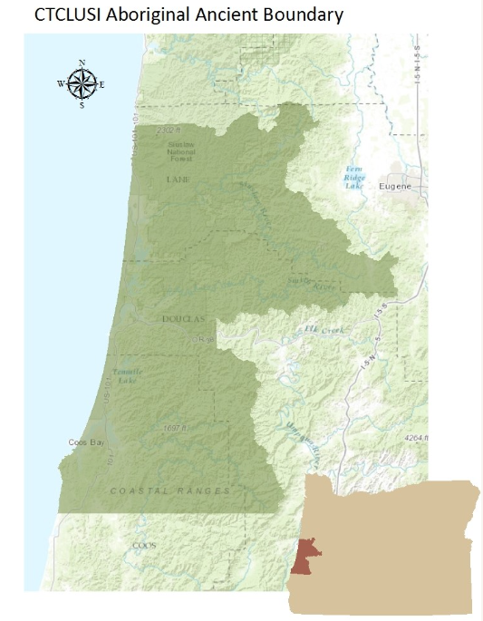
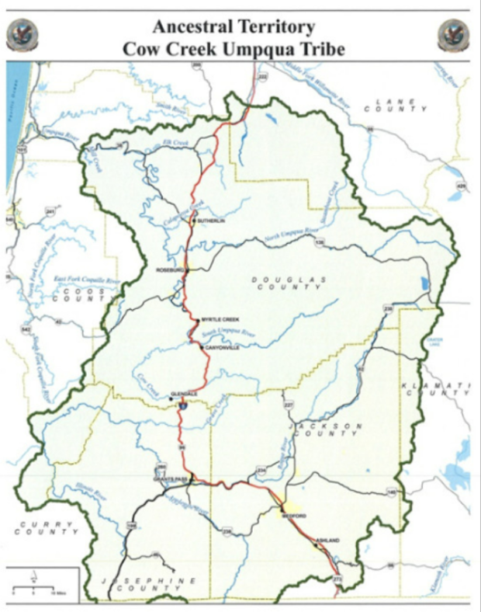
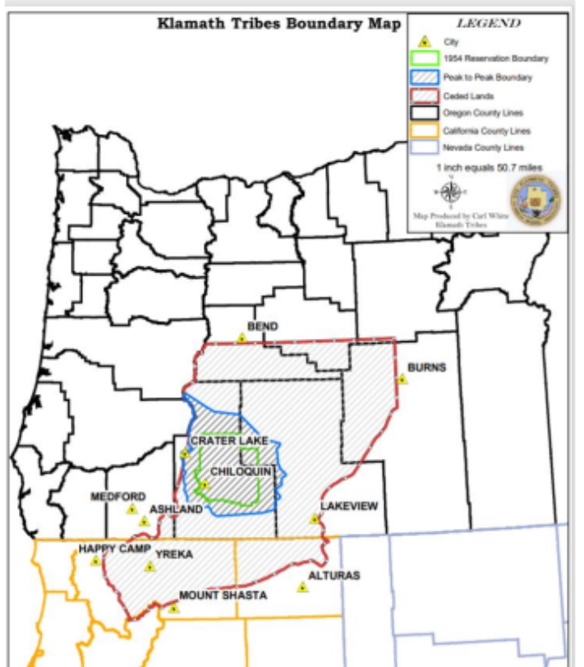
Example: Rogue River SD - member of the Southern Oregon ESD Consortium
Screenshot of Coquille Indian Tribe land holdings
Confederated Tribes of Coos, Lower Umpqua and Siuslaw Indians map
Cow Creek Band of Umpqua Tribe of Indians
Klamath Tribes

Slide 13
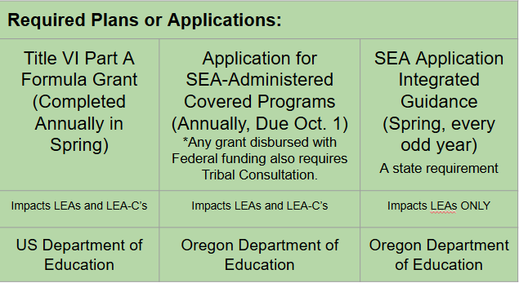
Who Leads Consultation Efforts in an LEA or LEA-C?
The ESD/District Superintendent or their Designee leads consultation.
* Budgetary * Personnel * Decision Making Authority *
Key Support Staff: Title VI Coordinator or Federal Title Staff
Key Support Staff: Federal Title Staff
Key Support Staff: Numerous
Notes:
Numerous - district leaders of Multilingual

Slide 14

SY24-25 - When Should Tribal Consultation Take Place?
✅All Tribal Consultation meetings are calendared for SY24-25.
✅Phase 1 - Pre Consultation Planning is Completed for Upcoming Oct Window
Integrated Guidance Application
July - September
March 1 - April 30, 2025
Late Summer/Early Fall
Districts Receive Data from Previous SY
Late Spring
Districts Reflect on the SY and Plan for Fall
October 1, 2024
May 2025
SEA-Administered Covered Programs
Title VI Indian Education
EASIE Part 2 Application
Certified and Submitted

Slide 15
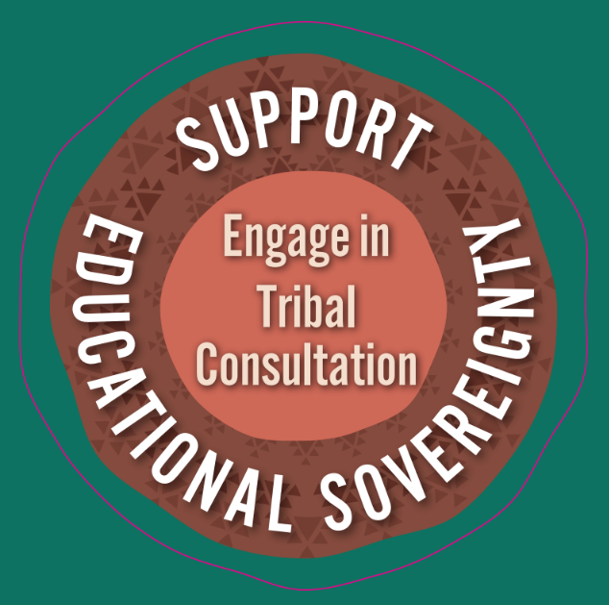
Checking In
Share out an overview on Tribal Consultation between LEAs, LEA-Cs, and tribes
✔Why is it a requirement?
✔ What is the requirement
✔ Who must engage in tribal consultation and why
✔ What plan and applications are impacted
✔ Who leads consultation in an LEA
Learn about ODE’s standard for Tribal Consultation (i.e. the Toolkit)
Share out on Tribal Communication and how it differs from Tribal Consultation
Notes:
Resource: ODE Tribal Consultation Website - https://www.oregon.gov/ode/students-and-family/equity/NativeAmericanEducation/Pages/Tribal-Consultation.aspx

Slide 16
ODE’s Standard for Tribal Consultation
The Tribal Consultation Toolkit 2.1

Slide 17
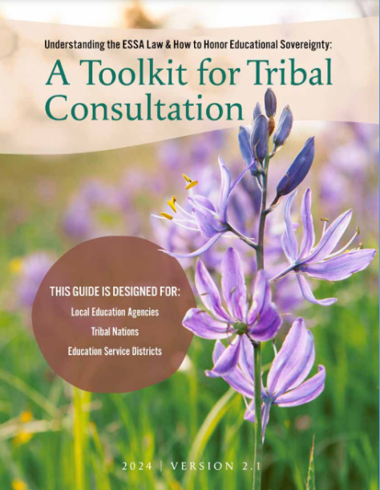
The Toolkit is the Standard
Purpose - Transparent Process and to Provide Technical Assistance to LEAs, LEA-Cs, and Tribes
The Tribal Consultation Toolkit 2.1 speaks to –
History of Native Education in Oregon
A Case Study from an exemplar District and Tribal partnership
Support for unique plans and application
  All Federal Title programs
  Integrated Guidance
The Four Phases of Tribal Consultation identified by the nine federally recognized tribes in collaboration with ODE’s OIE
  Phase 1: Invitation and Pre-Consultation Preparation
  Phase 2: Come Together for Consultation
  Phase 3: Completing the Affirmations of Tribal Consultation
  Phase 4: Post Consultation - Monitor and Review Progress

Slide 18
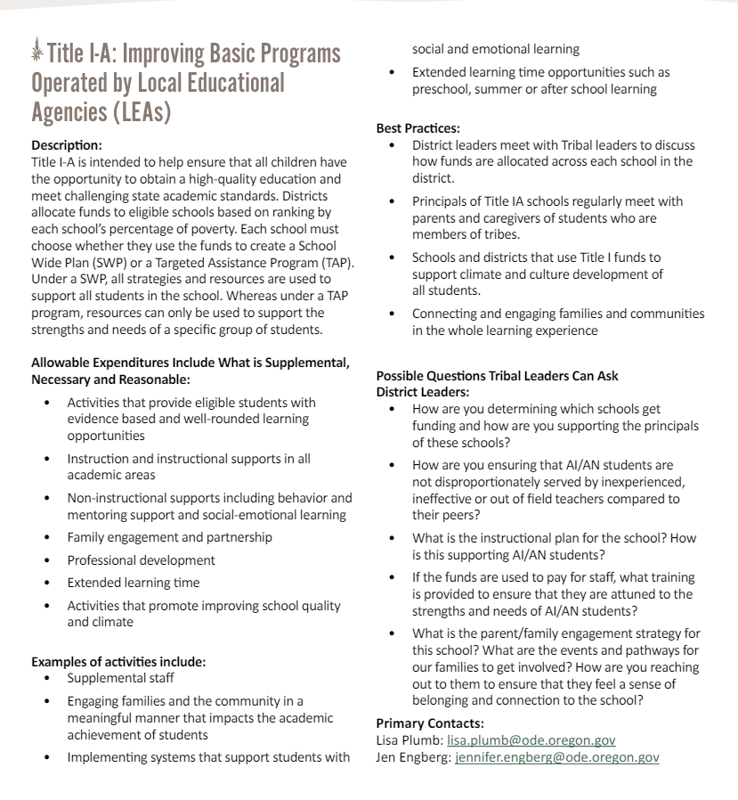
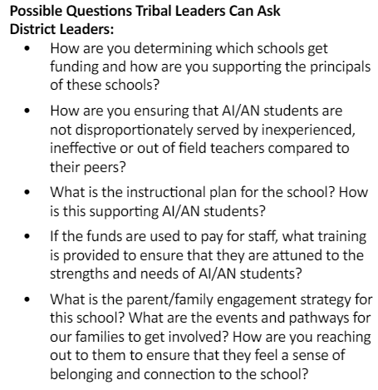

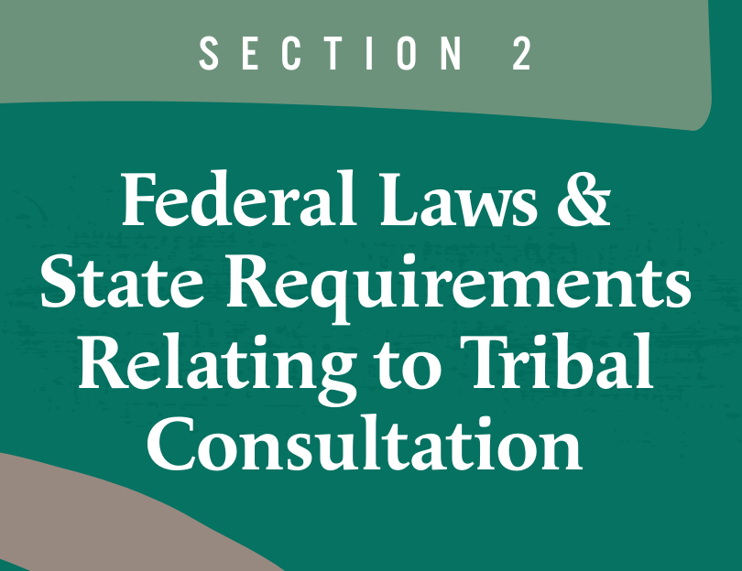
Federal Title Programs Support in the Toolkit

Slide 19
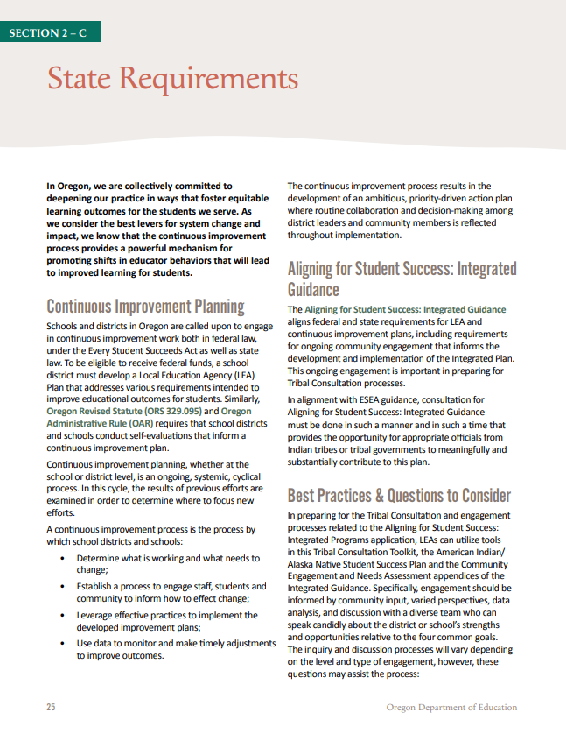
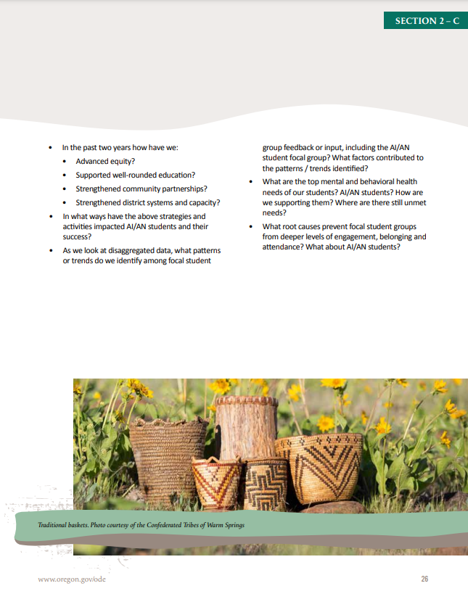
Integrated Guidance Support in the Toolkit
State Requirement p. 25-26

Slide 20
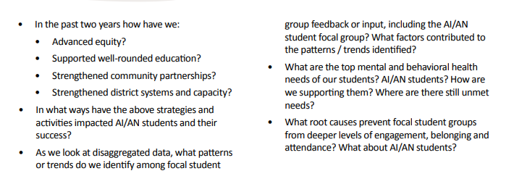
Integrated Guidance Support in the Toolkit
State Requirement p. 26

Slide 21
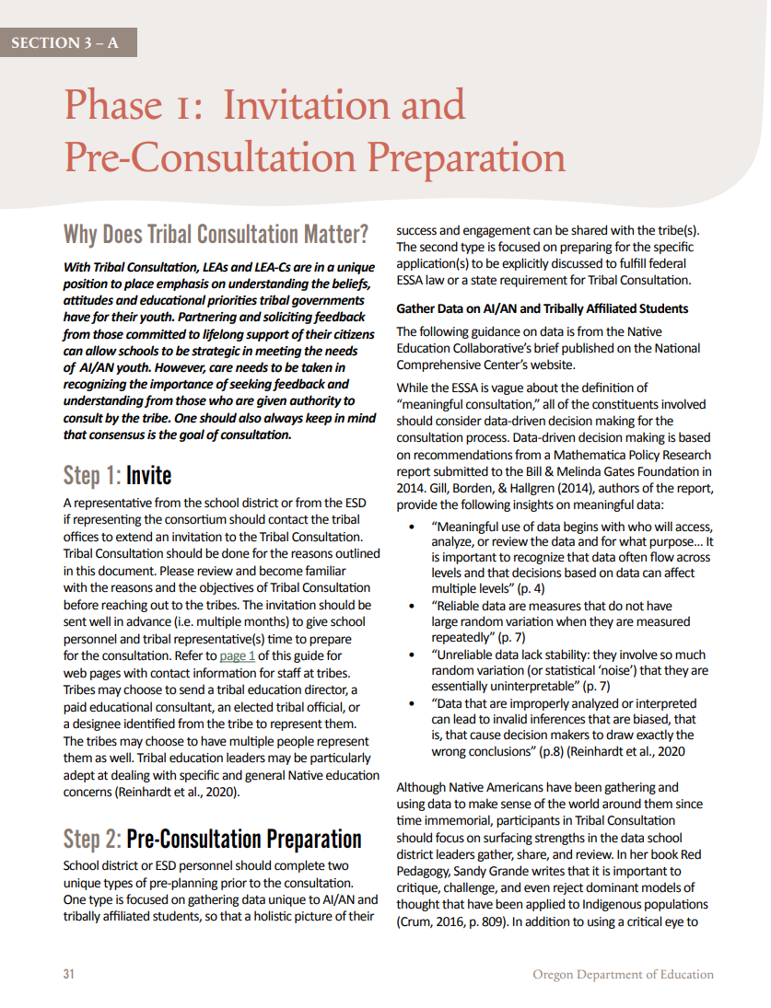
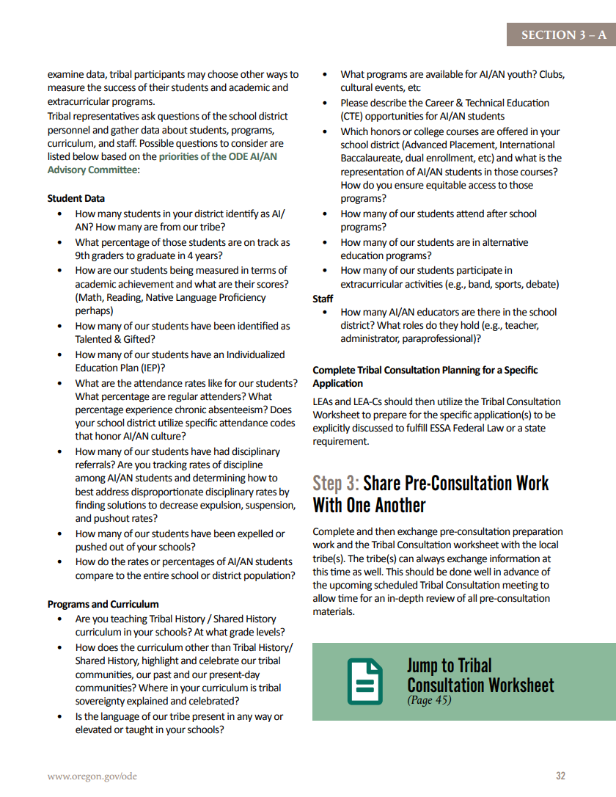
The Role of Data in Tribal Consultation
During Phase 1 District Leadership prepares for consultation for any plan or application in the following ways –
✔ Preparing Data
Step 1 - Data on American Indian and Alaska Native students is assembled and disaggregated to create a holistic overview of their success, representation, and engagement. (Phase 1, Step 2, pg. 32)
Step 2 - LEAs prepare for information specific to the plan or application being discussed.
Toolkit p. 31-32

Slide 22
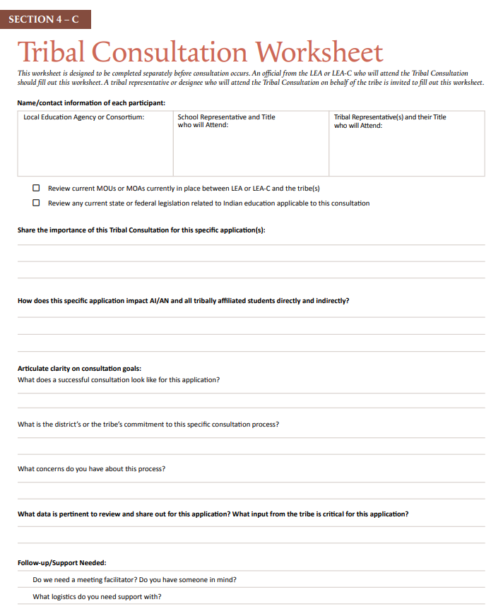
Completing the Tribal Consultation Worksheet
These reflection questions are critical for an LEA and their District’s leadership to prepare for the formality of the upcoming consultation.
This worksheet also provides space for leadership to identify the areas they are really seeking input from the tribe on.
Toolkit p. 45

Slide 23
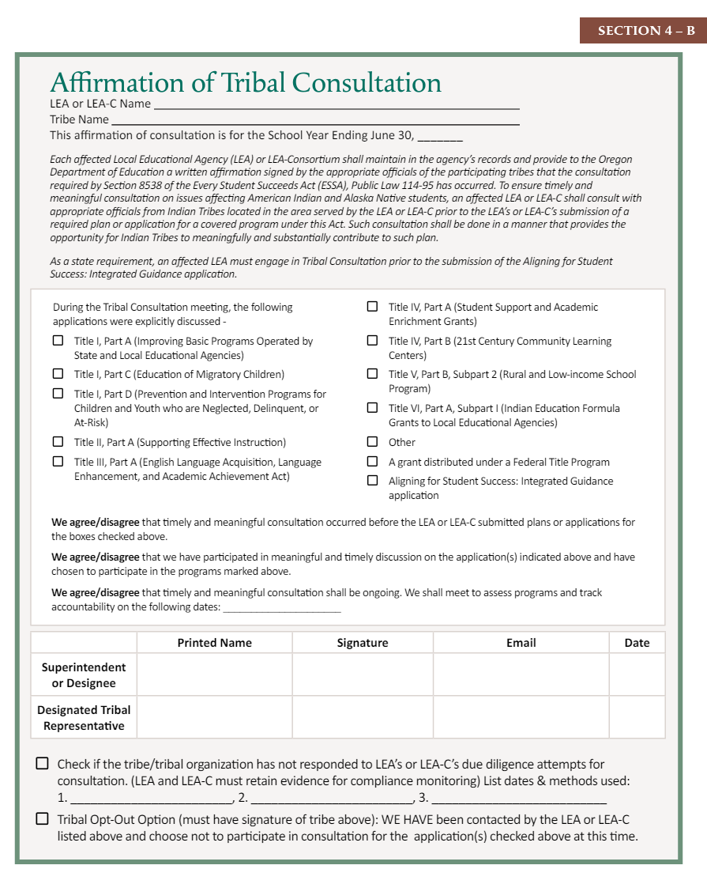
Verification Consultation was Completed
Required Information for Every Submission
The manner in which consultation was completed will require different sections of the form to be completed, which are outlined below.
Three Ways to Demonstrate This -
Tribal Consultation Occurred
  Required Information + We Agree/Disagree Statements + Superintendent and Tribal Representative Signatures, OR
A Tribe did not respond to three due diligent attempts for consultation
  Required Information + Superintendent Signature + Checkbox with Information, OR
A Tribe Opted Out
  Required Information + Superintendent and Tribal Representative Signatures + Checked Box

Slide 24
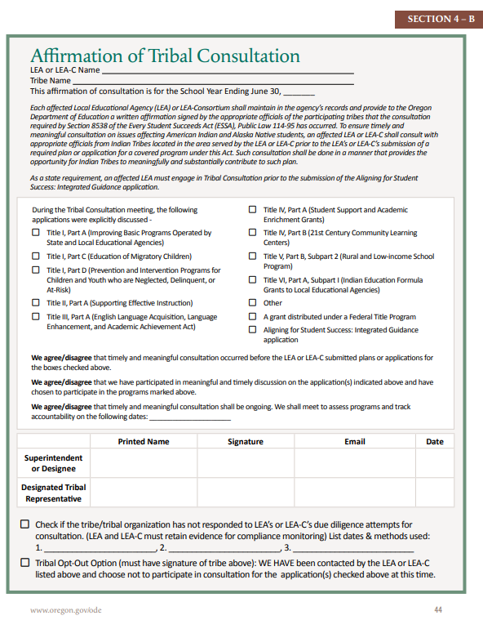
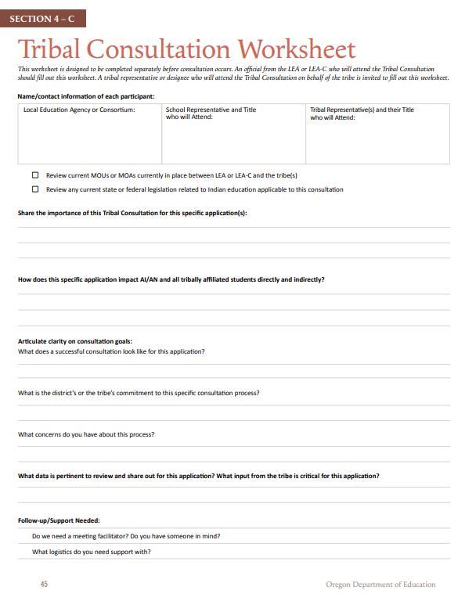
Verifying Tribal Consultation was Completed
The Lead ODE Department tracks all affected LEAs and LEA-Cs to make sure EACH entity is submitting the required documents for all local tribes in their area under the 50 mile rule. Only after the documents have been verified can an LEA have an approved application and receive their full funding.
Affirmation of Tribal Consultation p. 44
Tribal Consultation Worksheet p. 45

Slide 25

How Have LEAs and LEA-Cs Been Supported in Consultation?
Office of Indian Education Trainings
Tribal Consultation Toolkit Trainings (Version 2.0 and 2.1)
July District Leaders Training for SY24-25 Consultation Cycles
Multiple Gov Deliveries
  Toolkits 2.0 and 2.1
  One Year Anniversary and Module Launch
Personal Outreach - Beaverton and Hillsboro
District Requested Trainings
Technical Assistance/ Regular Office Hours
All Affected LEAs just finished the last consultation window for SEA-Administered Covered Programs
NEW!!! On-Demand Tribal Consultation Modules
In partnership with Southern Oregon ESD, anyone can take up to five tribal consultation modules through PDNetworks.
Audience and Recommended Modules -
  Any Oregonian - Module 1
  Affected LEAs - Modules 1-4
  Tribes - Module 1 and 5

Slide 26
Tribal Communication
Why Some LEAs Should Consider It

Slide 27
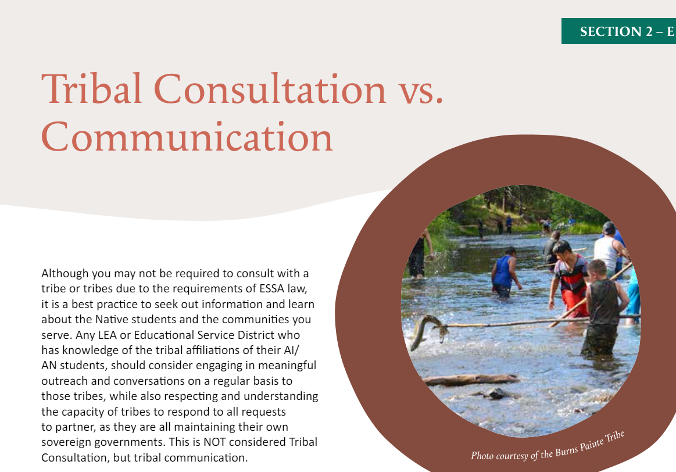
Tribal Communication
Although and LEA may not be required to consult with a tribe or tribes in accordance with ESSA, it is a best practice to share information with tribes and seek out feedback about the Native students and the tribal communities one serves.
LEAs must understand the capacity of tribes to respond to all requests to partner, as they are all maintaining their own sovereign governments.
This process is NOT considered Tribal Consultation, but tribal communication.
Tribal Consultation Toolkit, p. 28

Slide 28
Key Questions
Who might consider initiating Tribal Communication for a plan or application?
  Title VI Districts under the $40K threshold
  An LEA residing near a tribal headquarters
  LEAs who might be required to engage in Tribal Communication because of MOUs or MOAs such as
    “Mascot” districts
    LEAs who are part of a Tribally-run Title VI program (i.e. Athena Weston, Jefferson County 509J, etc)
Will the information being shared require Releases of Information or will the data be shared at a higher level?
  Example - In their “Tribal Affiliation Data Collection” an LEA sees they have a small community of students from a Montana tribe in their district. The District can initiate communication with the tribe to learn if they would like the district to work with families on sharing any additional information;
  If no, the LEA can proceed with sharing general information, as a courtesy, to the tribe on how they support Native students in their district, how students are performing, and key initiatives being taken to address the data
Notes:
Philomath School District and CTSI - HS and MS Agreement
Banks School District and CTGR
Siletz Valley Charter School and CTSI
Amity School District and CTSI
Rogue River School District and CTSI
Roseburg School District and CCBUTI (10 Years)
Scappoose School District and CTGR (8 years)
Molalla School District and CTGR (10 Years)

Slide 29
RADAR - Your Role in This Work
Consistent Messaging on the Requirements for Tribal Consultation from all ODE Departments
Include information it in any applicable communication
  Websites
  Training Slidedecks
  Email Communication
  Data Releases (i.e. “Ensure you are prepared for any upcoming Tribal Consultation windows”)
For Affected LEAs, ask questions about Tribal Consultation during check-ins about Tribal Consultation
Always link to our Tribal Consultation webpage instead of linking it to the Toolkit
Advocating and Working Toward increasing access to more usable forms of data for districts to use.
Slide deck templates for districts to visually display their data
Provide AI/AN+ data to affected LEAs and LEA-C’s as a Norm
Provide Tribal Affiliation as a Norm
Help districts with MOUs and MOAs for data sharing create data decks to use for consultation

Slide 30

Additional Support
Reach out Anytime – Really! stacy.parrish@ode.oregon.gov
Visit our Website for -
Current and upcoming Tribal Consultation windows
Link to Register for the Tribal Consultation modules
The Updated Tribal Consultation Toolkit 2.1
List of Affected LEAs and LEA-Cs
Detailed Title VI Awardee Spreadsheet
Updated PDFs required for Tribal Consultation -
  Affirmation of Tribal Consultation
  Tribal Consultation Worksheet
  Alignment Rubric (for Covered Programs)
Links to past trainings
Tribal Consultation Website

