Slide 1
Oregon Title VI Community of Practice
Wednesday, May 21, 2025, 11AM-12PM
Rename your Zoom Name to your –
first and last name
name of district ,ESD, or Tribe, and
official role for Title VI - Project Coordinator, Authorized Official Representative, student liaison, etc.
pronouns

Slide 2

Everyone - Greet one another in your tribal language or in the language of the local tribe(s).
Then, drop into the chat the ways in which you get out on the Land over the summer.

Slide 3
Today’s Agenda -
ODE Reminders and EASIE Reflections on this Past Year
Beaverton School District Spotlight
Looking Ahead - Start of Year Professional Development Offerings for Educators
Community of Practice Shared Folder - Update it and the Contact List Regularly

Slide 4
Section 6119 Compliance
Thank you to the Districts and ESDs who submitted their EASIE Part 2 Applications and their IPC Attestation forms.
Updates and Next Steps
Compliance is tracked on the Oregon’s Title VI Awardees Form posted on the Title VI and Tribal Consultation websites.
Superintendents will be notified of non-compliance Thursday, May 22.
If you did not submit your EASIE Part 2 Application, please email it ASAP to stacy.parrish@ode.oregon.gov. Comments will be provided and sent to you.

Slide 5
The “Real” Formula Grant Timeline
-EASIE PART II Submission Deadline to US Department of Ed May 9 and to the Oregon Department of Education
🎓Celebrate continuations and your Native graduates
✅ Ensure SY25-26 Professional Development days and times have been finalized with all key staff
-Know the District’s Tribal History/Shared History Implementation Plan and Tribal Curriculum Plan (if applicable)
-Indian Parent Committee Start of Year Outreach
-Share Title VI Indian Education goals and student caseloads widely to schools, especially support staff
Never too early to backwards plan
-Indigenous People’s Day
-Native American Heritage Month
BEFORE START OF SCHOOL
OCT/NOV
MAY
JUNE
AUG/SEPT
- District Registration Info Updated with 506 Forms
- Update website with summer information
- Calendar Tribal Consultations for the Fall
- Culture Camps and hit the Powwow Trail
Welcome back students and educators
APR Opens approximately Second Week of September

Slide 6
Beaverton School District Spotlight
Indian Education Program

Slide 7

History/Background of this Powwow
Partnership with Hillsboro SD
Growth of this Event Over Time
Indigenous Student Alliance - What is it and Role They Play
Logistical Information and Lessons Learned
https://youtu.be/o6LOJvo6Mdc

Slide 8
Start of the Year Professional Development
Sharing, Preparing, and Learning as a Community

Slide 9
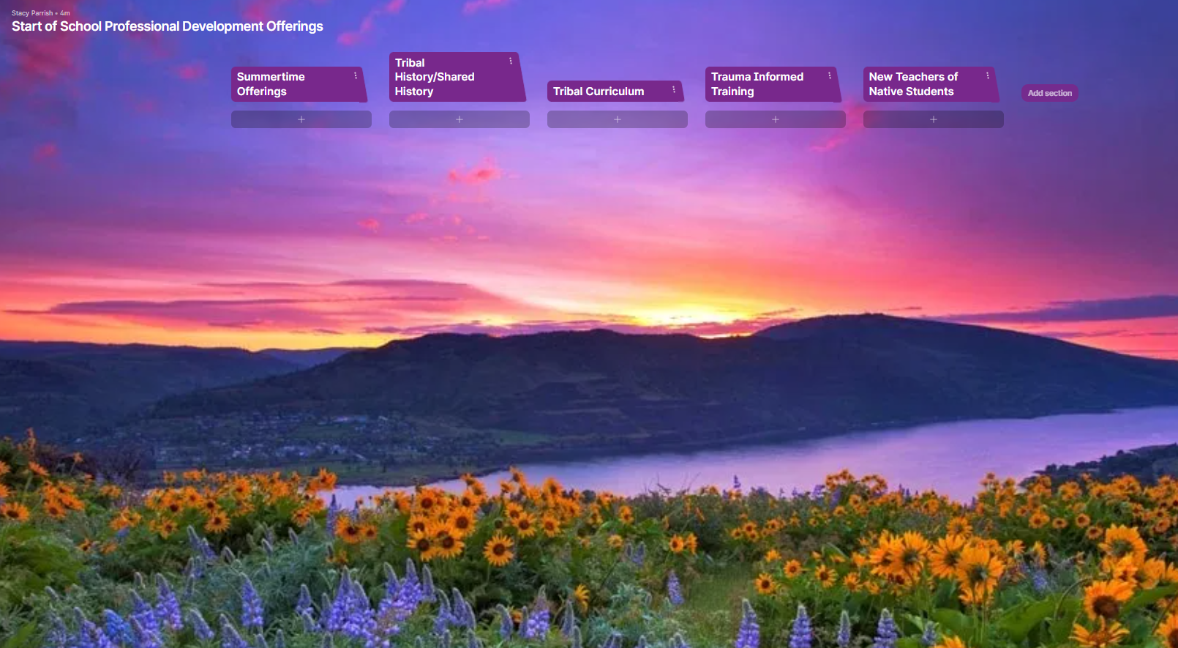
Please share what PD you are offering to educators, students, or the community either over the summer or in August/Sept.
Click on the + below the relevant category of the PD or “Add Section” if you are providing training for another topic.
Please add your contact information for outreach from your peers!
Padlet Link - https://padlet.com/stacyparrish/start-of-school-professional-development-offerings-yncnitb7wreck5xi

Slide 10
Community of Practice Shared Drive
Please bookmark the link to the folder dropped in the Chat. We will not be posting it here, because these slides are shared publicly.
Notes:
https://drive.google.com/drive/folders/13H1gX2FzA_edl5cKmGq0MyAiD30yhcGO?usp=drive_link

Slide 11
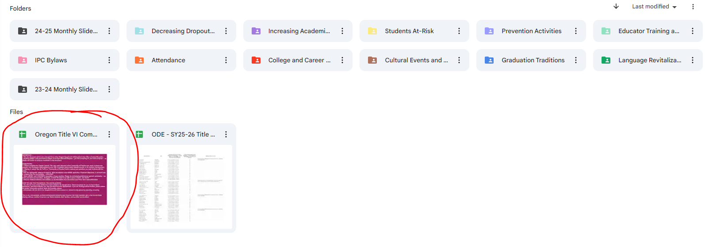
Step 1 - Open the circled document. Read the directions.
Step 2 - Fill out the Contact List first. This list is not public, but for internal use.
Step 3 - Contribute to the CoP tab as much or little as you like!

