Slide 1


The Coquille Indian Tribe & Forestry Management
Our Lands
Design, evaluate, and refine a solution for reducing the impacts of human activities on the environment and biodiversity. (HS-LS2-7)

Slide 2
The Coquille (Ko-Kwel)
Part of this community for millennia
Notes:
Activity 1: Introduction

Slide 3
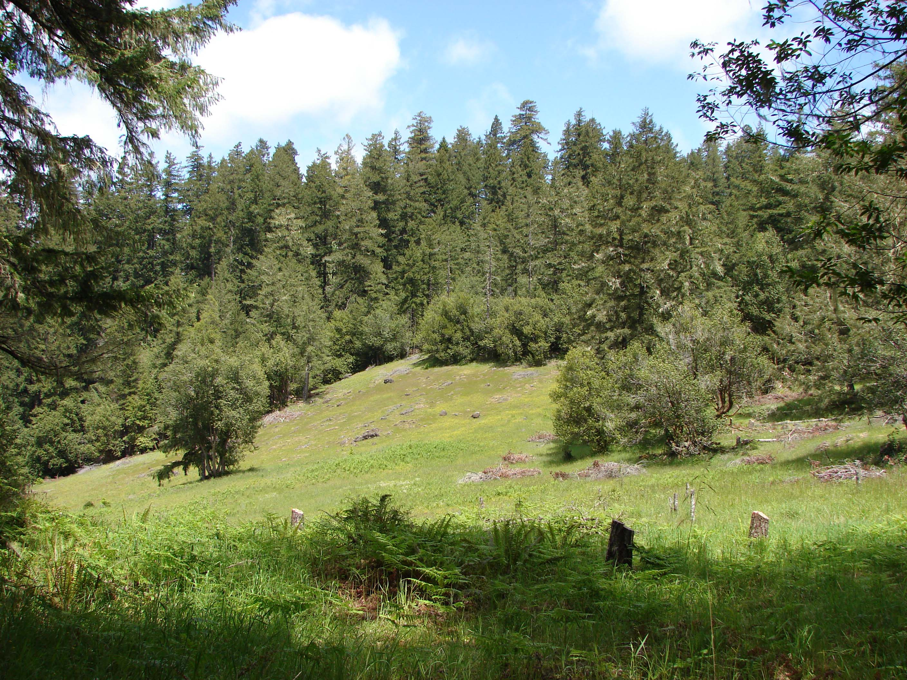
Coquille Forest
14 parcels of timberland
Eastern Coos County
5,410 acres
Euphoria Ridge Meadow
Notes:
Activity 2: Activate Prior Knowledge – Forest Ecosystems and Forest Management
The following picture slides can be used as a brief introduction to the Coquille Forest to prime student thinking. Say something like:
The Tribe manages the Coquille Forest, which is made up of 14 separate parcels of timberlands in eastern Coos County, totaling 5,410 acres. It is a complex forest ecosystem with many different varieties of plants and animals. Let’s take a few minutes to review what you know about forest ecosystems and situate that next to what you wonder about the tribe’s methods for forest management. We are going to work on a K-W-L activity in small groups. For this activity, I want you to imagine yourself in one of the many forested areas near our school or near your home. You will each have a role in the group, and you will discuss and write down what you already know about the forest ecosystem and forest management along with what you wonder about the tribe’s methods for forest management.
Here are a few slides of the tribe’s forest to help make connections for your K-W-L activity.

Slide 4
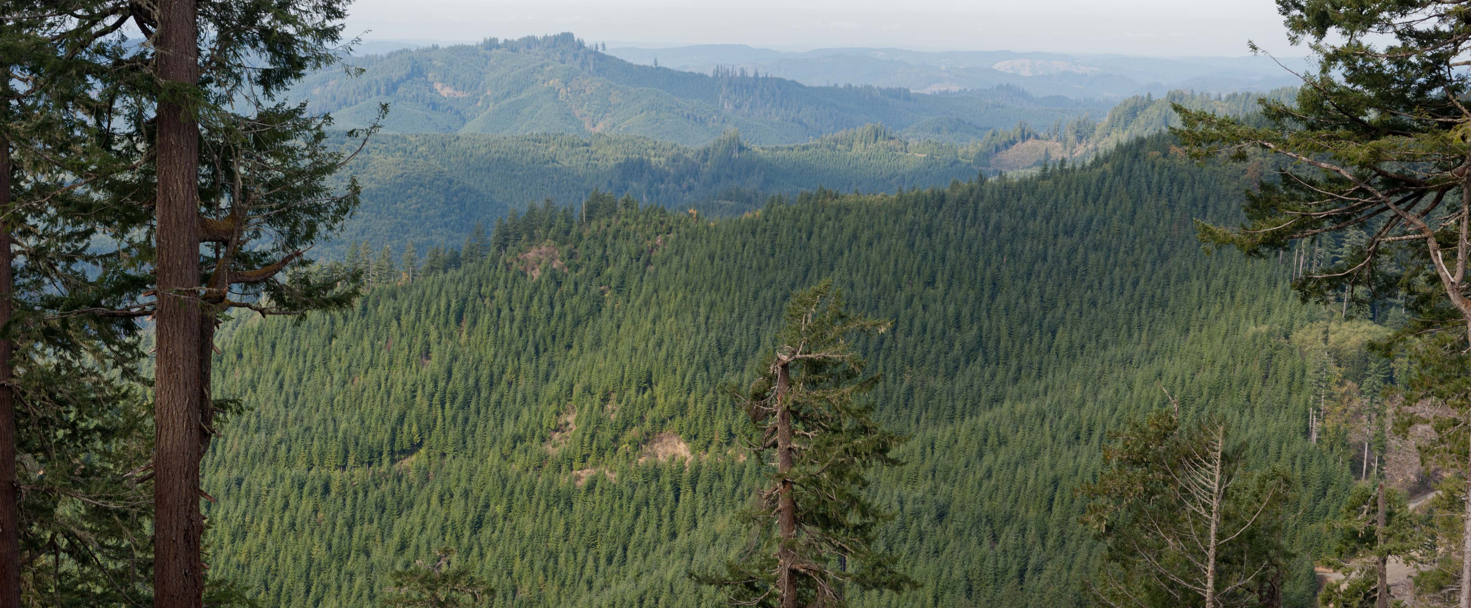
Coquille Forest Management
Notes:
Activity 2: Activate Prior Knowledge – Forest Ecosystems and Forest Management

Slide 5
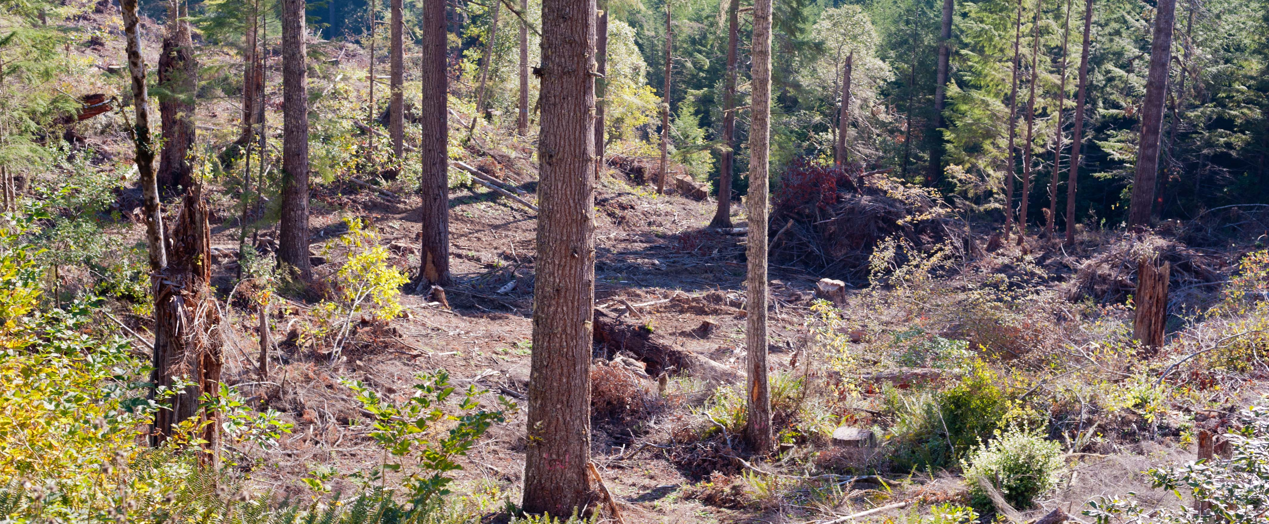
Maintaining Biodiversity
Notes:
Activity 2: Activate Prior Knowledge – Forest Ecosystems and Forest Management

Slide 6
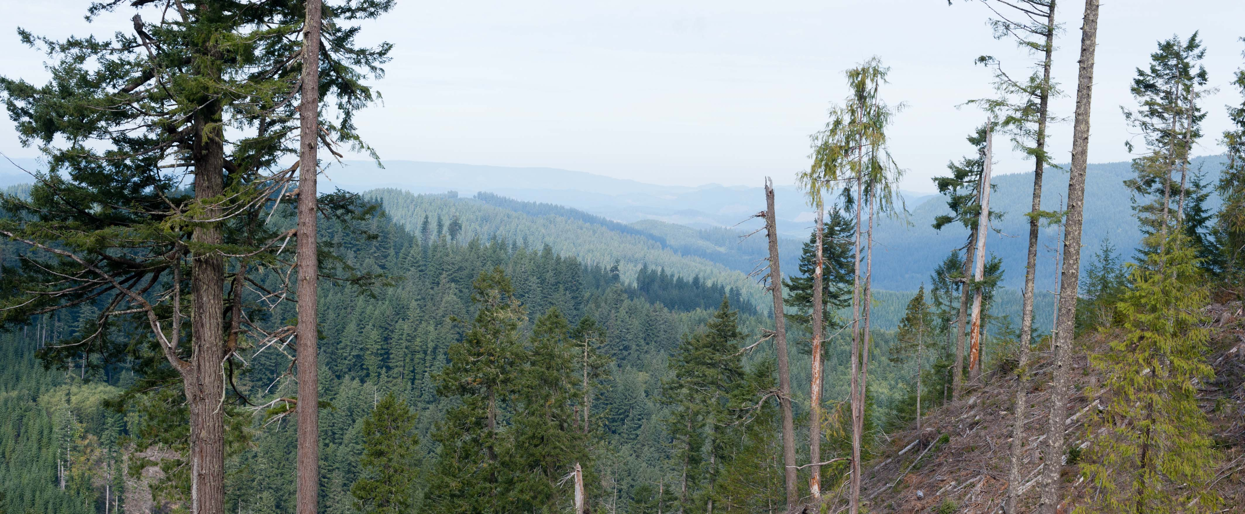
Leaving Trees Behind
Notes:
Activity 2: Activate Prior Knowledge – Forest Ecosystems and Forest Management

Slide 7
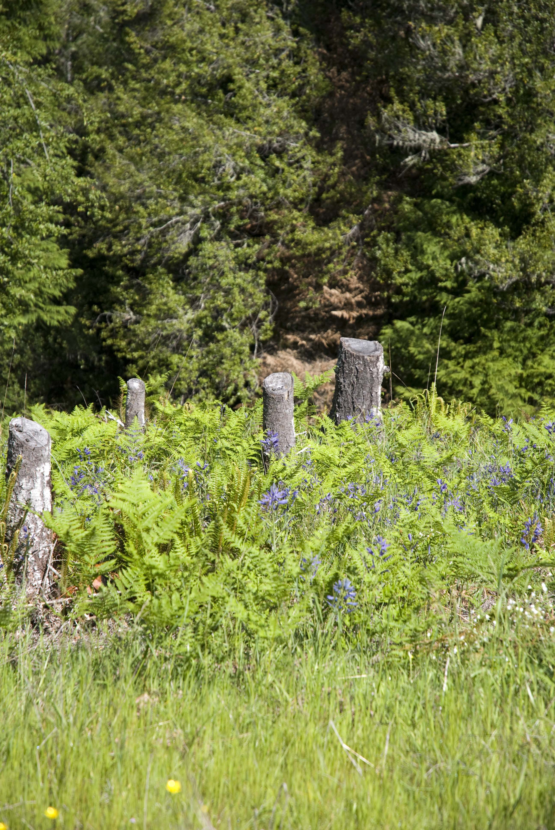
Euphoria Ridge Meadow
Camas – Maintaining biodiversity for cultural purposes
Notes:
Activity 2: Activate Prior Knowledge – Forest Ecosystems and Forest Management
The following picture slides can be used as a brief introduction to the Coquille Forest to prime student thinking. Say something like:
The Tribe manages the Coquille Forest, which is made up of 14 separate parcels of timberlands in eastern Coos County, totaling 5,410 acres. It is a complex forest ecosystem with many different varieties of plants and animals. Let’s take a few minutes to review what you know about forest ecosystems and situate that next to what you wonder about the tribe’s methods for forest management. We are going to work on a K-W-L activity in small groups. For this activity, I want you to imagine yourself in one of the many forested areas near our school or near your home. You will each have a role in the group, and you will discuss and write down what you already know about the forest ecosystem and forest management along with what you wonder about the tribe’s methods for forest management.
Here are a few slides of the tribe’s forest to help make connections for your K-W-L activity.

Slide 8




Group Activity Roles
Contributor
Give all your ideas; add value to your group.
Recorder
The person who will write down your ideas on the K-W-L handout.
Reporter
The person who will summarize and share what you write with the rest of the class.
Question Leader
The person who will ask the group questions about ideas and probe for more detail.
Notes:
Activity 2: Activate Prior Knowledge – Forest Ecosystems and Forest Management
The following picture slides can be used as a brief introduction to the Coquille Forest to prime student thinking. Say something like:
The Tribe manages the Coquille Forest, which is made up of 14 separate parcels of timberlands in eastern Coos County, totaling 5,410 acres. It is a complex forest ecosystem with many different varieties of plants and animals. Let’s take a few minutes to review what you know about forest ecosystems and situate that next to what you wonder about the tribe’s methods for forest management. We are going to work on a K-W-L activity in small groups. For this activity, I want you to imagine yourself in one of the many forested areas near our school or near your home. You will each have a role in the group, and you will discuss and write down what you already know about the forest ecosystem and forest management along with what you wonder about the tribe’s methods for forest management.
Here are a few slides of the tribe’s forest to help make connections for your K-W-L activity.

Slide 9
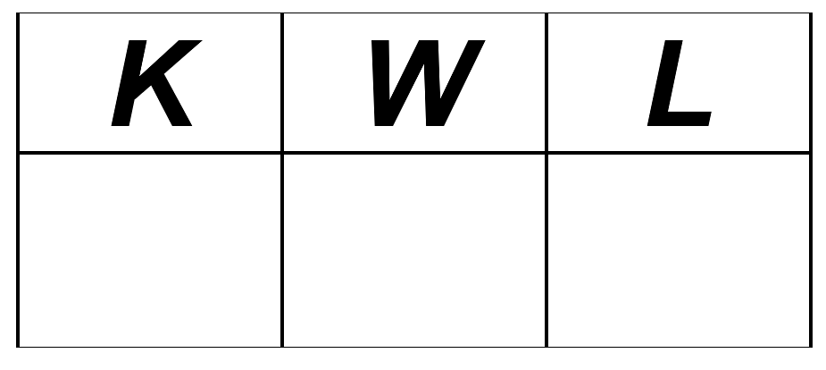
Questions to Consider
What type of forest ecosystem is it?
What types of interactions might you expect to see in the forest ecosystem (biotic, abiotic)?
What types of human interactions or impacts might be occurring?
What types of biological or physical disturbances (moderate or extreme) might there be?
Is there anything else you know/wonder?
Notes:
Activity 2: Activate Prior Knowledge – Forest Ecosystems and Forest Management
The following picture slides can be used as a brief introduction to the Coquille Forest to prime student thinking. Say something like:
The Tribe manages the Coquille Forest, which is made up of 14 separate parcels of timberlands in eastern Coos County, totaling 5,410 acres. It is a complex forest ecosystem with many different varieties of plants and animals. Let’s take a few minutes to review what you know about forest ecosystems and situate that next to what you wonder about the tribe’s methods for forest management. We are going to work on a K-W-L activity in small groups. For this activity, I want you to imagine yourself in one of the many forested areas near our school or near your home. You will each have a role in the group, and you will discuss and write down what you already know about the forest ecosystem and forest management along with what you wonder about the tribe’s methods for forest management.
Here are a few slides of the tribe’s forest to help make connections for your K-W-L activity.

Slide 10
HS-LS2 Ecosystems: Interactions, Energy, and Dynamics
NGSS # | Ecosystem Standards
HS-LS2-1. | Use mathematical and/or computational representations to support explanations of factors that affect carrying capacity of ecosystems at different scales.
HS-LS2-2. | Use mathematical representations to support and revise explanations based on evidence about factors affecting biodiversity and populations in ecosystems of different scales.
HS-LS2-3. | Construct and revise an explanation based on evidence for the cycling of matter and flow of energy in aerobic and anaerobic conditions.
HS-LS2-4. | Use mathematical representations to support claims for the cycling of matter and flow of energy among organisms in an ecosystem.
HS-LS2-5. | Develop a model to illustrate the role of photosynthesis and cellular respiration in the cycling of carbon among the biosphere, atmosphere, hydrosphere, and geosphere.
HS-LS2-6. | Evaluate the claims, evidence, and reasoning that the complex interactions in ecosystems maintain relatively consistent numbers and types of organisms in stable conditions but changing conditions may result in a new ecosystem.
HS-LS2-7. | Design, evaluate, and refine a solution for reducing the impacts of human activities on the environment and biodiversity.
HS-LS2-8. | Evaluate the evidence for the role of group behavior on individual and species’ chances to survive and reproduce.
Notes:
Activity 3: The Coquille Indian Tribe Forest Management Methods
Prepare to Read

Slide 11


Scientific Essay Elements
Introduction and Summary
A brief statement on why humans engage in forest management processes
An explanation of the Tribe’s methods for managing the Coquille Forest
An analysis of the philosophy or rationale of their methods and the role of traditional ecological knowledge
Discussion
Analysis of the primary benefits, and any disadvantages, of their methods (including scientific benefits/disadvantages to the ecosystem and other considerations such as social, cultural, or spiritual benefits)
Advocacy
Based on your evaluation of the Tribe’s methods and knowledge about other forest management practices, design/refine a solution that addresses human interests while reducing the impacts of human activities on the environment by persuasively arguing for either:
a. at least one way in which the Tribe could improve their current methods or
b. persuasively arguing for other communities and/or forest managers to adopt the Tribe’s methods.
Notes:
Activity 3: The Coquille Indian Tribe Forest Management Methods
Prepare to Read

Slide 12

Notetaking Columns
2 ½”
Cue-Column
6”
Note-Taking Column
2” After class or after reading a text, reflect on the notes that have been written and summarize the page of notes at the bottom of each page.
Notes:
Activity 3: The Coquille Indian Tribe Forest Management Methods
Prepare to Read

Slide 13
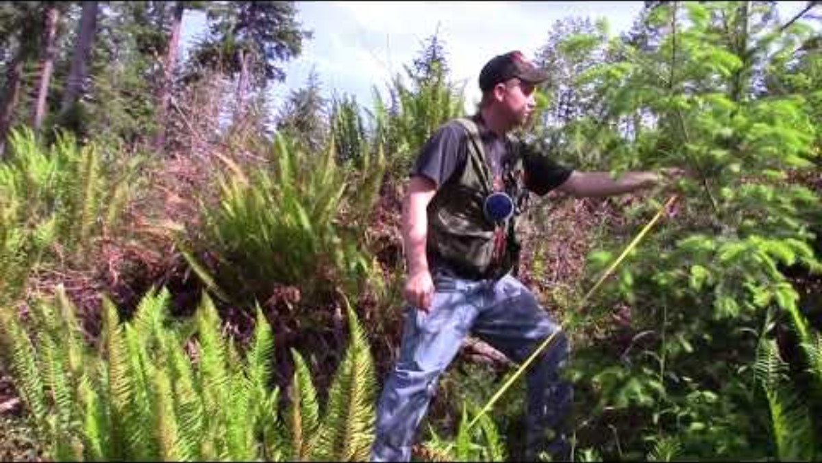
Coquille Indian Tribe Forest Management Methods
Notes:
Activity 3: The Coquille Indian Tribe Forest Management Methods
Introductory Video
Title: Coquille Tribe balances business with culture for conservation success.
Link: https://youtu.be/bOzsOgEphFc

Slide 14
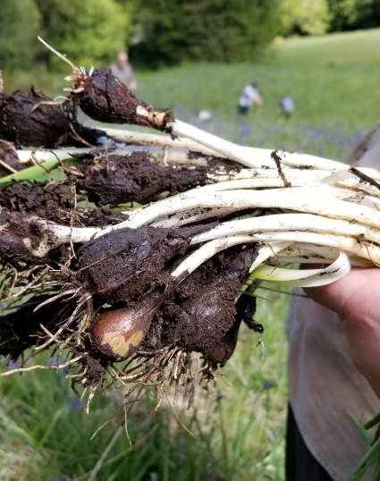
Coquille Indian Tribe
Forest Management
Read three articles:
In the Garden of Our Ancestors
Native American Forestry Combines Traditional Wisdom with Modern Science
Top Timber Forest Balances Business with Culture
Notes:
Activity 3: The Coquille Indian Tribe Forest Management Methods
Reading and Notetaking
This slide can be used as a placeholder while students work on the activity of reviewing the Coquille Indian Tribe’s methods and core values.
In setting up for the transition for the next activity, students should understand that the tribe is making use of modern day practices that are rooted in thousands of years of tribal beliefs and practices. For example, the tribe managed the land with intentional burning to promote new grow and healthier habitat for various animals that were of interest to the tribe. In the following activity, students will have a brief overview of the various philosophical influences on land management that settlers brought to the Oregon lands that were taken from the Coquille and other tribes. Students should notice that there has been an evolution in forest management from the individualism and greed that once drove the earlier settlers and timber companies to a modern approach that is more environmentally friendly. In other words, the pendulum in western science has swung in many ways to reflect what the tribes’ “traditional ecological knowledge” has been all along. There is an ongoing recognition of the need to return to practices similar to the Coquille’s forest management methods because they are in everyone’s long-term interest, locally and globally, to have healthy forests with great biodiversity.
As an instructor, it would bring honor to the tribe to explicitly make this point. Typically in Western narratives, only white, and predominantly male, voices are given credit. In the following slides, it would be easy to think of the progression to Aldo Leopold’s view and the environmentalist movement as a great advancement in human progress. In reality, it is a course correction in human history. The tribes were very aligned with Leopold’s worldview long before Western Civilization existed. Considering the various human impacts on the world and our ecosystem, it is a valuable time in human history to return to practices that are informed by “traditional ecological knowledge.”

Slide 15
Western Conservation Philosophies
Notes:
Activity 3: Expanding Knowledge about Forest Management
Western Beliefs about Conservation
Key concept:
Using the next few slides, communicate to students that Western attitudes toward the forest used to be the exact opposite of the Tribe’s and that Western conservation efforts have become more closely aligned in recent years to the practices the Tribe has known for millennia. Now, Western science, to an extent, has come to understand the value of traditional ecological knowledge and the Tribe’s methods for land use.

Slide 16
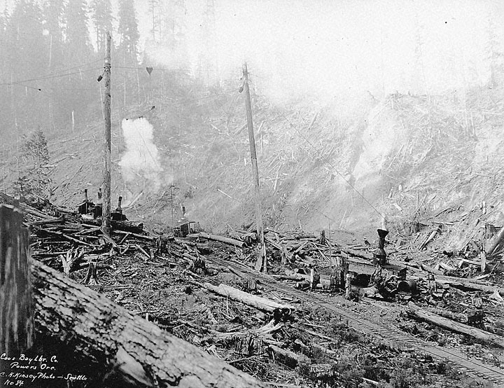
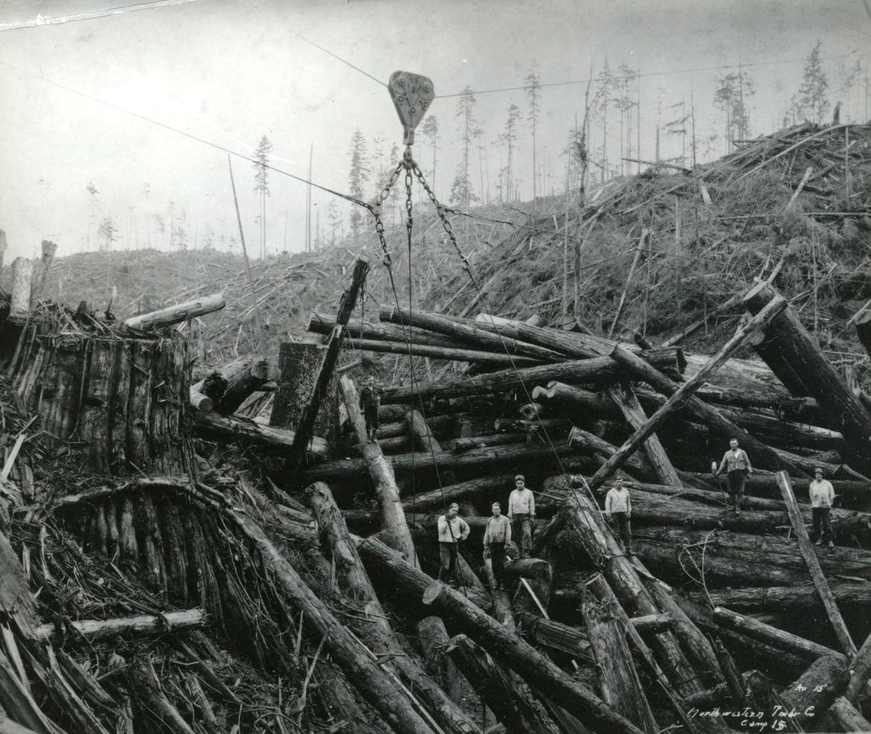
Industrial Age Timber Companies
(1850s – early 1900s)
Strip the land
Take everything of
monetary value
No focus on replanting
Move on to the next parcel
Symptomatic event: Oregon Land Fraud Trial
Notes:
Activity 3: Expanding Knowledge about Forest Management
Western Beliefs about Conservation
Industrial Age Timber Companies: Early settlers and businessmen (forest industrialists) saw the land as an untapped, unrestricted commodity in which every person should fend for themselves and gain as much profit as possible in the process. People believed they could take as much as they wanted because forests were “inexhaustible.” The practice was to cut down as much timber as they wanted, regardless of age or habitat. The bottom line was that people saw the forest as a simple commodity from which they should maximize profit as much as they could.
Key points to make about this approach:
When settlers came to Oregon, many if not most of them were characterized by a greediness for what they could take from the land. Two big resources they took were minerals and lumber.
With lumber, they would cut down everything and haul what was valuable to faraway places, such as China, to sell it for a profit. Coos Bay had one of the largest timber mills in the late 1800s and early 1900s that served this purpose.
The land was taken from the Native Americans who lived here for millenia. The U.S. government made treaties with tribes, like the Coquille, but then broke them almost immediately after taking the land.
The U.S. government then gave settlers “free” parcels of land in exchange for settling on the land.
This quickly turned to greedy ventures where companies would falsely have individuals make a land claim, and then the individuals would deed it over to the timber company. This practice came to light in the infamous “Oregon Land Fraud Trial” in which many people in powerful positions played a role in supporting fraudulent land give-aways.
The Industrial Age Timber Industry approach was focused on taking everything it could, and there was little to no thought about conversation practices or impacts on the ecosystem.
Websites with further information:
a) Oregon Timber Industry
https://oregonencyclopedia.org/articles/timber_industry/#.XRqGzehKh1M

Slide 17
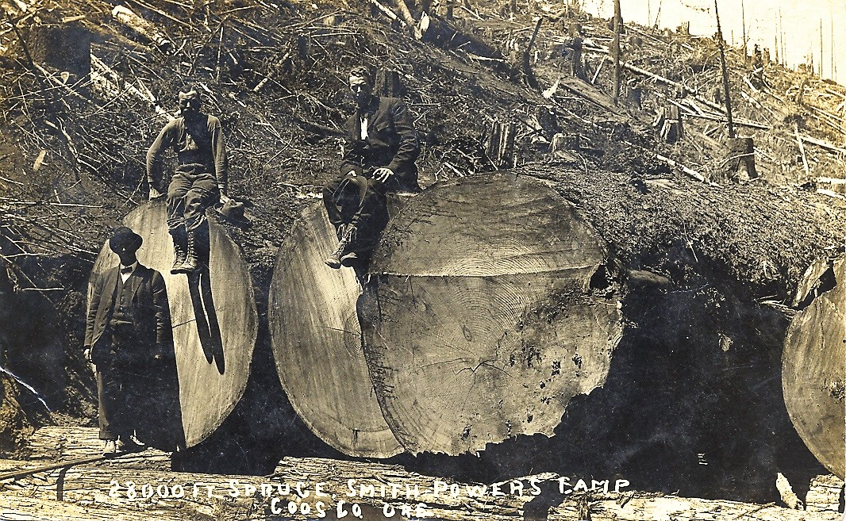
Western Beliefs about Conservation
Notes:
Activity 3: Expanding Knowledge about Forest Management
Western Beliefs about Conservation
Example of how early timber companies took the most valuable resources. The ancient trees were cut down for the sake of profit.
The Tribe’s land was actually at the epicenter of the Oregon Timber Industry (Coos Bay Timer Company). The lumber from their land was cut down and sent all around the world (e.g., China, San Diego).

Slide 18
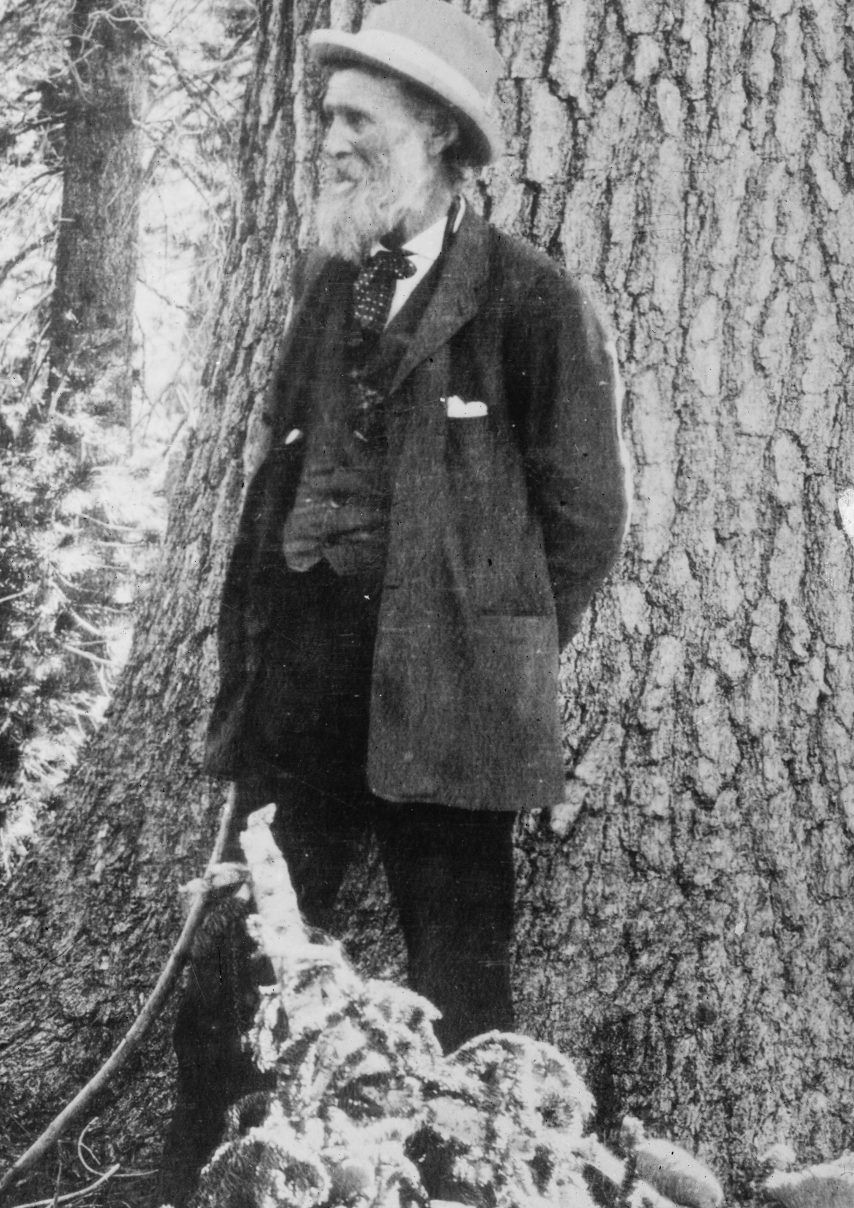
John Muir
(1838-1914)
Protect nature from the impact
of humans or machines
Nature has value apart from what economic benefit it can provide
Leave pristine, untouched
wilderness areas
Key event: Founding of the
Sierra Club
Notes:
Activity 3: Expanding Knowledge about Forest Management
Western Beliefs about Conservation
John Muir: In the late 1800s, John Muir was an advocate who wanted to see nature protected from industrialized humanity. He saw the vast forest landscapes being cut down by modern timber company practices and believed that nature had value apart from what economic benefit it could provide. John Muir believed spaces should be preserved from all human impact. This resulted in places like our federal wilderness areas that do not allow any motorized entry, only people on foot or horseback. Wilderness areas are not sold for timber or other economic purposes.
Key Points:
John Muir’s version of conservation was focused on keeping man out. In other words, he believed there were areas that should stay completely untouched by humans and their machines.
He saw aesthetic value in nature for its ability to restore the soul and spirit of people.
His influence led to the wilderness designations we have today where places do not allow motorized vehicles, man made roads, or any other man-made features. These places tend to only be accessible by foot or on horse.
The Sierra Club is the direct result of his legacy. It’s a group that advocates for untouched wilderness areas.
Wilderness areas would not be managed in the traditional sense for timber or other uses.
Other resources with further information:
Handout on John Muir

Slide 19
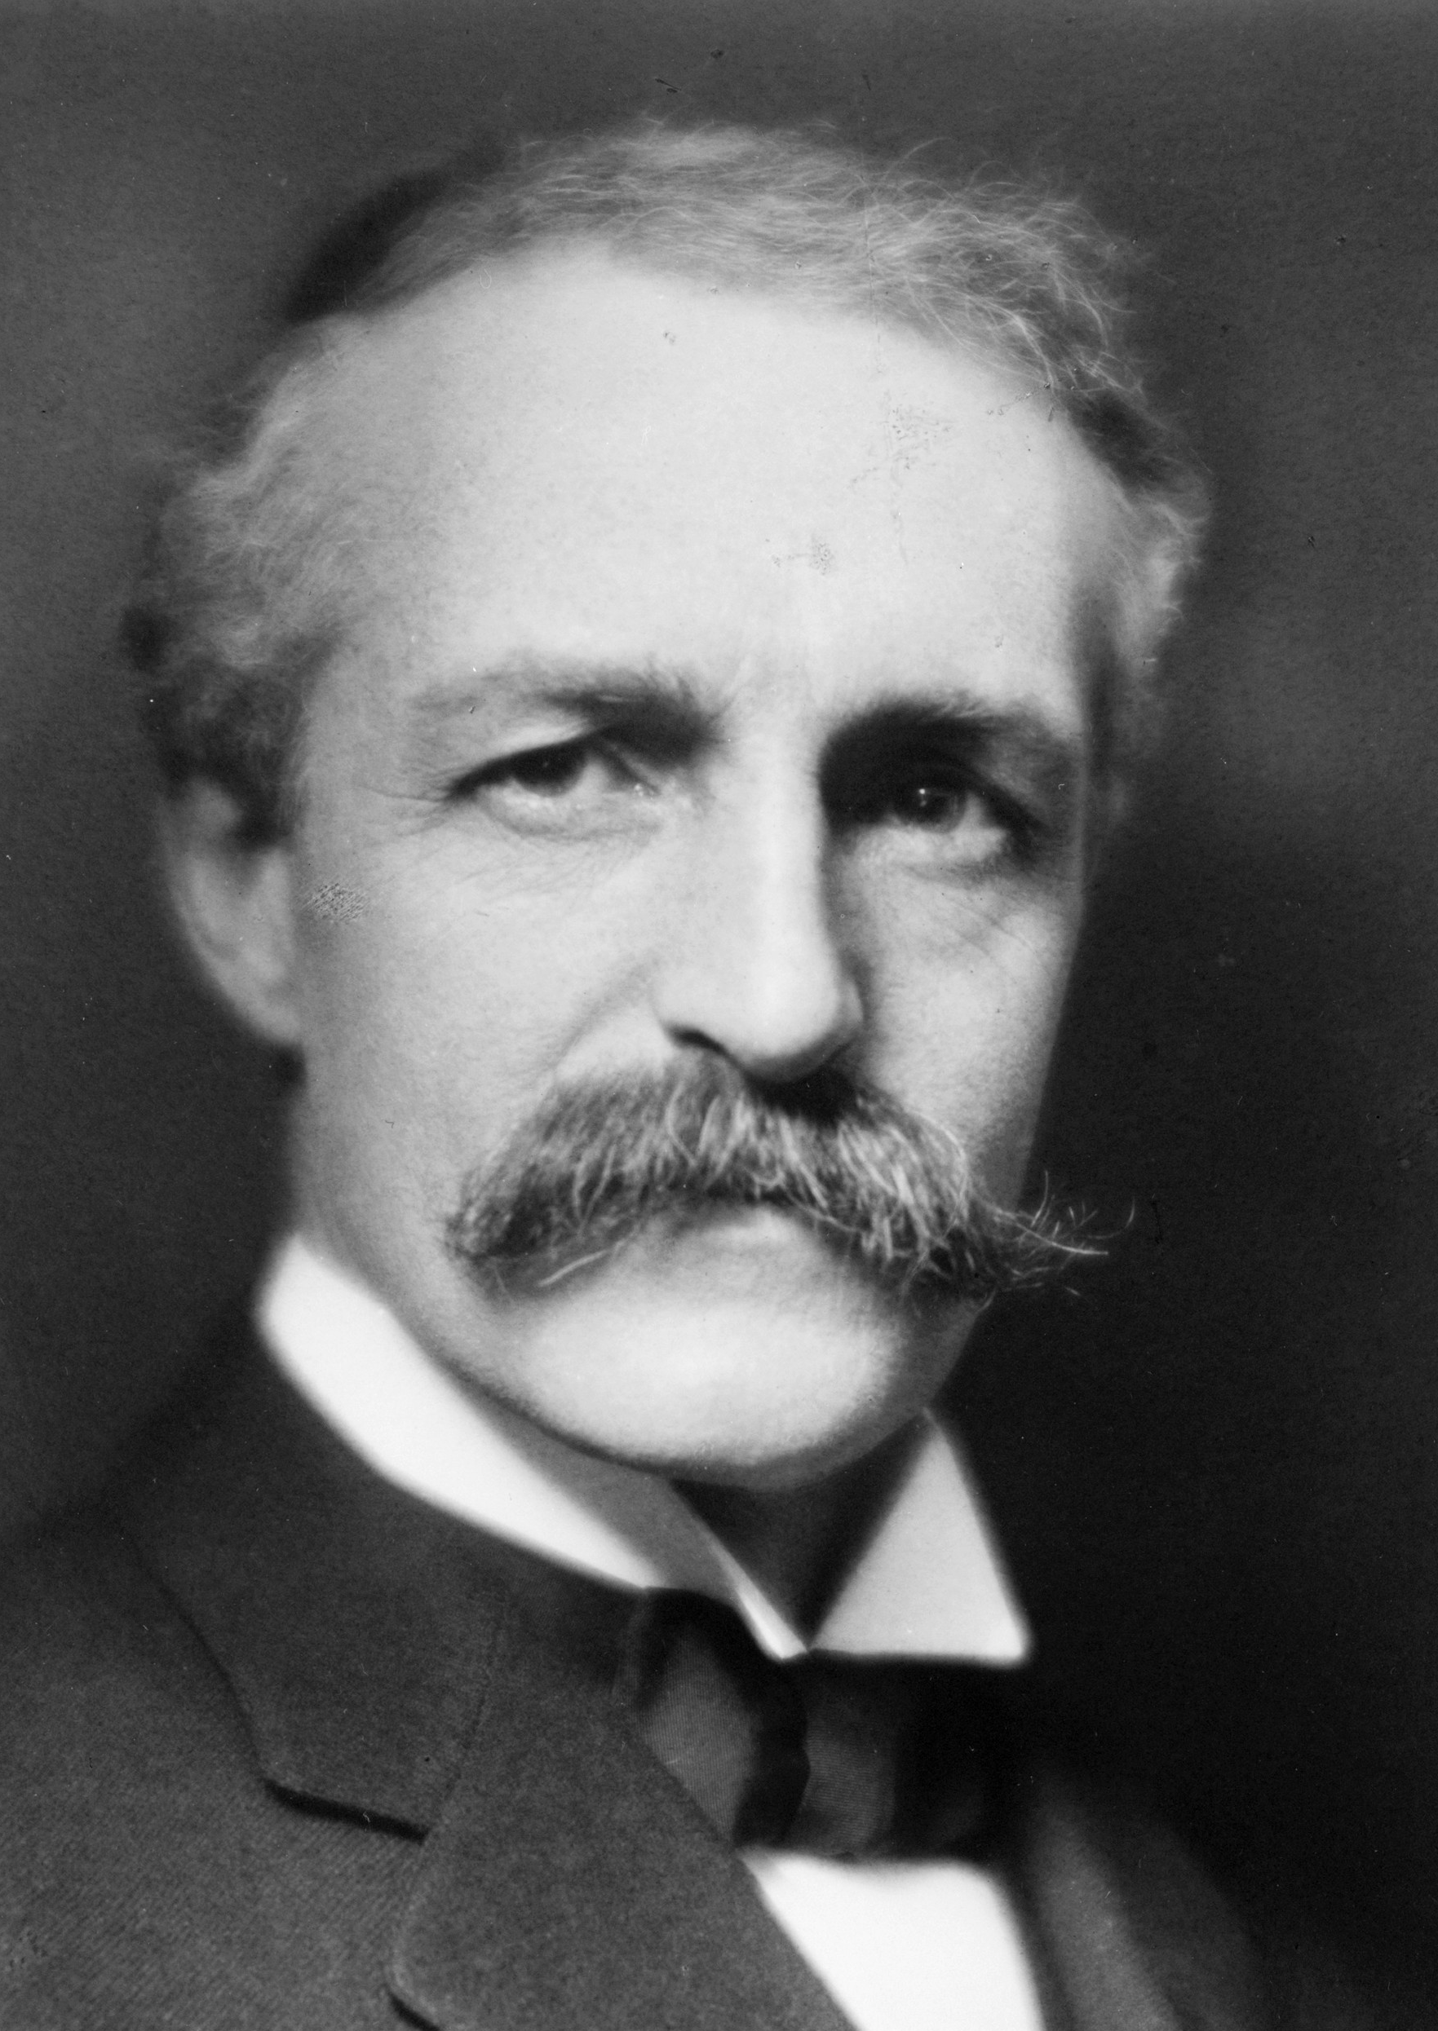
Gifford Pinchot
(1865-1946)
Efficient use of natural resources,
Utilitarian view – forests are for people
to use, but wisely.
Natural “resources” should be managed
Principle: “greatest good for the greatest number of people over longest time”
Key event: Founding of the U.S.
Forest Service
Notes:
Activity 3: Expanding Knowledge about Forest Management
Western Beliefs about Conservation
Gifford Pinchot was the first head of the US Forest Service. He advocated that the land was a resource that people should use wisely and efficiently. He argued that the economic use of natural resources, such as water, timber, and minerals, should be managed in a way that it would provide the “greatest good for the greatest number of people for the longest time.” Those who determined the definition of the “greatest good” were typically white Westerners.
Key Points:
He was the first professionally trained forester in the US.
His goal for conservation was to preserve the forests for long term resource use. In other words, ensure that future generations would have plenty of timber, minerals, water, and other resources that come from the forest.
This differs from Muir, because he saw the forest as a commodity to be managed.
It is similar to Muir in that he believed the forests should be conserved for the greatest good of many people, rather than the explicit profit of a few.
He was appointed by Teddy Roosevelt to be the first Chief Forester of the newly formed U.S. Forest Service, and he would shape the philosophy of the US Forest Service for decades.
Other resources with further information:
Handout on Gifford Pinchot

Slide 20
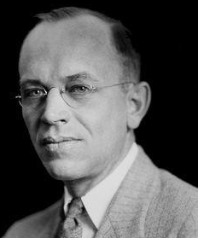
Aldo Leopold
(1887-1948)
Land ethic – value in all living things
Manage land based on ecology and the interconnected of people, other living things, and the land itself
Key event: Writings spurred the environmentalist movement
Notes:
Activity 3: Expanding Knowledge about Forest Management
Western Beliefs about Conservation
Aldo Leopold argued that there was value in all living things and their interactions in the environment. Unlike Pinchot, he believed that the environment should not be managed simply as an economic resource for current and future generations. Rather, he believed the land should be managed based on ecological principles, which he called a “land ethic.” His views were a middle ground between John Muir and Gifford Pinchot, and his writings launched the modern environmentalist movement.
Key Points
Believed in the principle of “land ethic” – that there is a value in all living things and their interactions in the environment.
Conservation meant to manage based on ecological principles, not just the economics of what a “resource” could bring as a commodity.
He bridged Muir’s view of protecting nature from people and Pinchot’s view of nature as a commodity for people to use.
He helped people understand our interconnected relationship with the natural world.
His writings helped spur the environmentalist movement.
Other resources with further information:
Handout on Aldo Leopold

Slide 21
Activity
In small groups, compare and contrast the philosophical views of Oregon settlers and three white men who have played pivotal roles in U.S. forestry management.
Industrial Age Timber Industry Companies/Leaders
John Muir
Gifford Pinchot
Aldo Leopold
How are their approaches similar or different from the Coquille Tribe’s forest management methods?
Notes:
Activity 3: Expanding Knowledge about Forest Management
Western Beliefs about Conservation
Set up this activity by explaining to students that they should plan to use this information in their persuasive essay as they discuss the benefits and/or disadvantages to the Tribe’s methods. These philosophies demonstrate very different ideas about the purpose and value of the land as well as human’s interaction with it.
As students discuss, monitor for their understanding of how Western views begin as completely opposite to those of the Tribe (early timber companies) and slowly evolve to be more in line with the Tribe’s historical way of approaching the forest―what can be called “traditional ecological knowledge.” In other words, the environmental movement and the ecological principles Aldo Leopold espoused are not a new idea, but rather show Western society catching up with the Tribe, so to speak.

Slide 22
Conservation, Science, and Racism
Neglected American Indians at minimum
Fully racist against and opposed to American Indians at worst
Policies put specific classes of white people and their forest uses above others’ interests
Notes:
Activity 3: Expanding Knowledge about Forest Management
Conservation, Science, & Racism
It is important to understand some of the historical context of what has happened in the scientific community in the past 150 years to empathize with the journey of the Coquille Indian Tribe. Most of the time, we hear about one side of science, which is usually from a Western perspective. However, to understand the context of the Coquille and other tribes, we need to remember that the common explicit and implicit approaches the majority of people took in the 1800s and 1900s contained the general beliefs that:
White people were civilized, and Indians were not.
[Example: In 1885, the U.S. Secretary of the Interior appointed Sheldon Jackson to be the general agent of the District of Alaska. Jackson wrote in a report that Alaska Native people “are savages, and, with the exception of [a few] have not had civilizing, educational, or religious advantages.” (1885 report on education) This belief that Indians were savages was common across government and local groups of white settlers in the United States at large, not just Alaska.]
White people had a right to the land, and Indians did not.
[Example: “Manifest Destiny” – In 1845, an editorial in the Democratic Review argued that the United States was destined by God to take over all the land to the West and the Pacific Ocean. By December of that same year, the phrase was applied specifically to the Oregon Territory in the New York Morning News. It was based on the idea that U.S. culture and agrarian practices were supposedly superior to those of American Indians.]
The white race needed to be preserved, and Indians and other races were expendable.
[Example: The eugenics movement (selective breeding of supposedly the highest quality people, usually whites) was advancing in the United States long before the atrocities associated with eugenics in Nazi Germany. By the late 1800s, there was a movement to push for better genes and selective human breeding, the sterilization of unfit classes of people (regardless of their race), and ridding society of defective or deformed children and anyone else who was deemed “unfit.” This paralleled the rise of Darwinian thought (survival of the fittest) and thus racism was defended in the name of science. Since American Indians were seen to be “savages,” their breeding was considered inferior, which is often how their outright extermination was justified. High-ranking members of U.S. government society were part of the movement, with many joining organizations such as the Race Betterment Foundation (founded 1906), the Galton Society (1908), the American Eugenics Society (1926), and others. This cultural tide in the United States, focused on race betterment (specifically the white European race that was “civilized”), was widespread and had been growing since the mid-1800s, and directly impacted beliefs about American Indians. In general, people in the United States thought eugenics was scientific and used it to defend atrocious policies.]
These general beliefs were deeply rooted in the American consciousness and showed up in various writings of the conservationists. For example:
John Muir wanted to force the Miwok Indians out of the Yosemite Valley. He called them dirty, deadly, and lazy. (http://www.independent.org/news/article.asp?id=8775; https://vault.sierraclub.org/john_muir_exhibit/life/fleck-john-muir-evolving-attitudes-toward-native-american-cultures.aspx)
Gifford Pinchot was an active participant in the American Eugenics Society. (https://www.newyorker.com/news/news-desk/environmentalisms-racist-history)
In his seminal 1949 essay (The Land Ethic), Aldo Leopold, despite living and working in New Mexico with its rich American Indian culture and history, simply describes how the “soil-oak-deer-Indian [food] chain … has now been largely converted to 'soil-corn-cow-farmer. Each species, including ourselves, is a link in many chains.” (https://rintintin.colorado.edu/~vancecd/phil3140/Leopold.pdf) In this and his other writings, he seems to describe the forcible removal of native people from their lands as simply a product of evolutionary process where the weaker species (Indians) were replaced by the fittest species (white people).
As we explore the return of Coquille Forest land to the original occupants, it’s helpful to understand how destructive those perspectives were and how we often do not hear the accurate or complete story. The Coquille are not only overcoming more than a century of policies that ignored and mistreated them and their ancestral land, they are overcoming deep-seated racism that was at the core of U.S. culture, politics, and science. Keep that in mind as you consider your essay advocacy position.

Slide 23
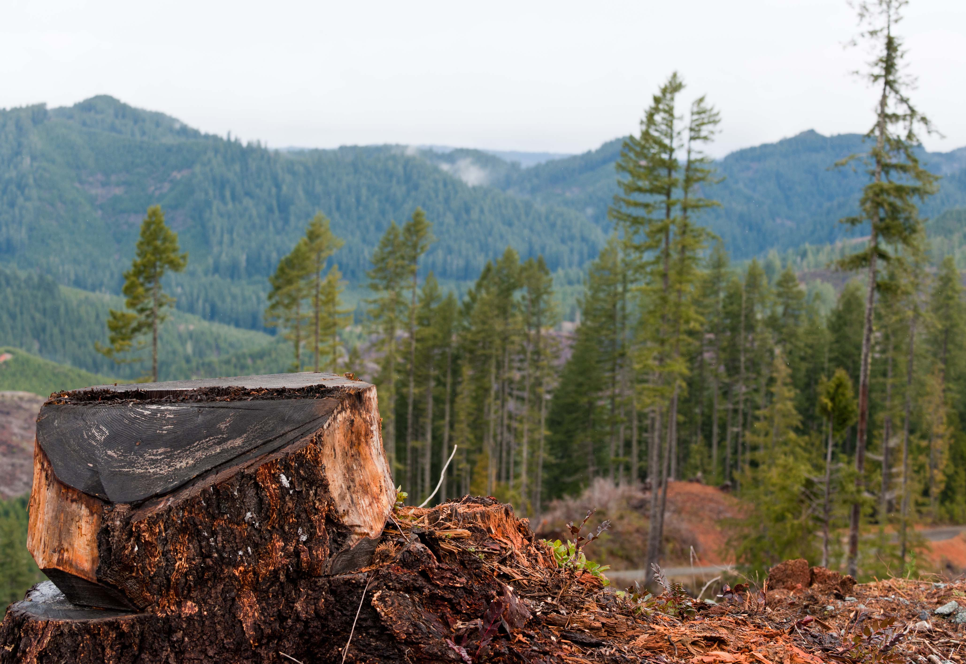
Three Types of Forest Management
Reserve – Managed primarily for environmental attributes, such as old-growth habitat, protection of a species, or wilderness designations
Wood production – Managed primarily for timber production, to create the wood supply for industry, while protecting watershed quality and overall habitat
Multi-resource – Managed for multiple uses including recreation (e.g., camping, hiking), safe watersheds, wildlife habitat, and some timber production
Notes:
Activity 4: Expanding Knowledge about Forest Management
Three Types of Forest Management
Reserve – managed primarily for environmental attributes, such as old-growth habitat, protection of a species, or wilderness designations
Wood production – managed primarily for timber production, to create the wood supply for industry, while protecting watershed quality and overall habitat
Multi-resource – managed for multiple uses including recreation (e.g., camping, hiking), safe watersheds, wildlife habitat, and some timber production

Slide 24
Complex Interactions &
Forest Disturbances
What are some key events or conditions that you are aware of that can negatively impact forests?
Which events or conditions are caused directly
or indirectly by human activity?
What practices can people employ to mitigate against these negative impacts?
Notes:
Activity 4: Expanding Knowledge about Forest Management
Complex Interactions & Forest Disturbances

Slide 25
Forest Disturbances
Fire
Insects
Tree Disease
Climate Change & Severe Weather
Land Use Conversion
Notes:
Activity 4: Expanding Knowledge about Forest Management
Complex Interactions & Forest Disturbances

Slide 26
Forest Disturbances and Management
What is the disturbance and how does it negatively affect or disturb the forest ecosystem?
How do humans directly or indirectly cause this negative impact?
(e.g., with insects, how do humans create conditions that make
forests susceptible to pine beetles?)
What suggestions are provided for how forest managers can prevent
the negative impact or handle the disturbance once it has happened?
Based on the earlier readings, how does the Coquille Indian Tribe
approach the disturbance (if known/applicable)?
Notes:
Activity 4: Expanding Knowledge about Forest Management
Complex Interactions & Forest Disturbances

Slide 27
Scientific Essay Elements Reminder
Introduction and Summary
A brief statement on why humans engage in forest management processes
An explanation of the Tribe’s methods for managing the Coquille Forest
An analysis of the philosophy or rationale of their methods and the role of traditional ecological knowledge
Discussion
Analysis of the primary benefits, and any disadvantages, of their methods (including scientific benefits/disadvantages to the ecosystem and other considerations such as social, cultural, or spiritual benefits)
Advocacy
Based on your evaluation of the Tribe’s methods and knowledge about other forest management practices, design/refine a solution that addresses human interests while reducing the impacts of human activities on the environment by persuasively arguing for either
a. at least one way in which the Tribe could improve their current methods or
b. persuasively arguing for other communities and/or forest managers to adopt the Tribe’s methods.
Notes:
Activity 5: Write Persuasive Scientific Essay

