Slide 1
ESD Liaisons Tribal Consultation Training
Presented by Stacy Parrish, Indian Education Specialist
Member of the Klamath Tribes (Yahooskin Paiute)
A copy of this slidedeck will be provided at the conclusion of this presentation.

Slide 2

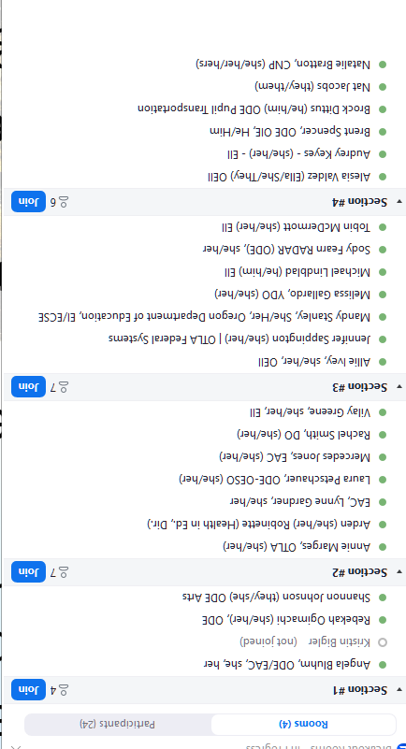
Learning Arc for Our Time
This session will –
Share out an overview on Tribal Consultation between LEAs, LEA-Cs, and tribes
Highlight key sections about Tribal Consultation in ODE publications most related to your work as liaisons
Define Tribal Communication and why some LEAs not required to engage in Tribal Consultation might consider it for Integrated Guidance
Notes:
Resource: ODE Tribal Consultation Website - https://www.oregon.gov/ode/students-and-family/equity/NativeAmericanEducation/Pages/Tribal-Consultation.aspx

Slide 3
As you Engage in this Training…
Determine your role in your ESD regarding Tribal Consultation
  What do your districts need from you?
  How do you know?
Consider the context of each school district who must engage in Tribal Consultation
  Capacity (District Leadership, District Leadership Teams, BOE)
  Historical Context with Consultation and District Goals for Consultation
  Health of Title VI Program (Integrated or Siloed)
  Holistic Data Practices
  Tools and platforms for assessing student sense of belonging
Conduct an inventory of your own knowledge of Native History in Oregon and of the local tribe(s)

Slide 4
Key Terms to Track
LEA-C - Local Education Agency Consortium
In Oregon, this refers to an Education Service District who is the lead for a Title VI Indian Education consortium formula grant application. Any school district with at least 10 tribally affiliated students may join the consortium.
Southern Oregon ESD, Columbia Gorge ESD, and Willamette ESD are all LEA-C’s in Oregon for SY24-25.
Affected LEAs and LEA-C
A term from the US Department of Education which identifies -
  LEAs or LEA-Cs that receive >$40K for their Title VI Indian Education formula grant, including school districts who are members of a consortium that receives >$40K for their formula grant, or
  Districts with an AI/AN+ population of 50% or more are also considered

Slide 5
Overview
Tribal Consultation Between LEAs, LEA-Cs, and Federally Recognized Tribes

Slide 6


Two Types of Consultation
“Little c” Consultation
Colloquially, this refers to Tribal Consultation efforts between LEAs and LEA-Cs and any tribe(s) with a tribal reservation boundary, Indian Lands, ceded, unceded, and aboriginal lands located within 50 miles of the LEA or LEA-C.
In our state’s context, this includes:
the the nine federally recognized tribes of Oregon, and
the Confederated Tribes and Bands of the Yakama Nation in Washington and the Tolowa Dee-Ni’ Nation in California.
“Big C” Consultation
Colloquially, this refers to Tribal Consultation efforts between the nine federally recognized tribes of Oregon and another state agency. It occurs when an action impacts tribal interests.
An “action” can include, but is not limited to the following ODE actions related to ODE programs:
a. Regulations or rules
b. Legislative proposals
c. Policies, guidance documents, directives, initiatives, or other policy statements.
Resource: Heart and Spirit of Tribal Consultation videos

Slide 7
ODE Tribal Consultation History
2017 - The Tribal Consultation federal requirement under ESEA began during FY 2017 aligned to Title VI formula grant funding for the 2017-2018 school year.
2018 - ODE Launched Tribal Consultation Toolkit 1.0. This was guidance in effect until Fall of 2023.
November 1, 2023 - ODE Launched the Revised Tribal Consultation Toolkit 2.0
  Symbolically coincided with Native American Heritage Month
  OIE created a new Tribal Consultation website
  Internal and External Trainings Commenced
June 2024 - ODE Launched an Updated Tribal Consultation Toolkit 2.1 (to include Integrated Guidance)
December 2024 - On Demand Tribal Consultation Modules launched in Canvas via PDNetworks; a GovDelivery was sent to LEA and ESD Superintendents and Charter School Leaders

Slide 8
What are the Requirements?
Consultation requirements under section 8538 of the ESEA, as amended by ESSA, require affected local education agencies (LEAs) to consult with Indian tribes, or those tribal organizations approved by the tribes located in the area served by the LEA, prior to submitting a plan or application for covered programs. This requirement is designed “to ensure timely and meaningful consultation on issues affecting American Indian and Alaska Native students.”
Affected LEA Criteria:
Title VI Indian Education Formula Grant was >$40K in previous fiscal year, including LEA-Cs and LEAs who are members of a consortium who received >$40K | Has 50% or more of its student enrollment made up of AI/AN+*
Required Plans or Applications:
Title VI Part A Formula Grant (Completed Annually in Spring) | Application for SEA-Administered Covered Programs (Annually, Due Oct. 1) *Any grant disbursed with Federal funding also requires Tribal Consultation. | SEA Application Integrated Guidance (Spring, every odd year) A state requirement
Impacts LEAs and LEA-C’s | Impacts LEAs and LEA-C’s | Impacts LEAs ONLY
US Department of Education | Oregon Department of Education | Oregon Department of Education

Slide 9
SY25-26 Affected School Districts*
Title VI Awardee Name | Title VI 24/25 Allocation
Ashland - SOESD | Based on LEA-C - $81,309.00
Beaverton SD | $41,950.00
Central Point 6 - SOESD | Based on LEA-C - $81,309.00
Eagle Point School District 9 - SOESD | Based on LEA-C - $81,309.00
Eugene School District-4J | $230,424.00
Grants Pass 7 School District - SOESD | Based on LEA-C - $81,309.00
Hillsboro SD | $41,039.00
Klamath County School District | $125,632.00
Klamath Falls City Schools | $51,368.00
Lincoln County School DIstrict | $122,697.00
Medford 549C School District - SOESD | Based on LEA-C - $81,309.00
Multnomah School District No. 1 | $143,538.00
Phoenix-Talent 4 School District - SOESD | Based on LEA-C - $81,309.00
Rogue River 35 School District - SOESD | Based on LEA-C - $81,309.00
Salem Keizer Public Schools | $191,090.00
Springfield School District | $49,020.00
Three Rivers/Josephine County - SOESD | Based on LEA-C - $81,309.00
Willamina School District 30 J | $69,567.00
Important -
LEAs required to engage in Tribal Consultation for SY25-26 will differ from those who were required to engage for SY24-25. This is because it is based on an awardee’s Title VI award amount for the previous fiscal year.
*Affected Consortiums are not included in this list, because they do not completed an Integrated Guidance application.
Determine your role in your ESD regarding Tribal Consultation
Consider the context of each school district who must engage in Tribal Consultation

Slide 10
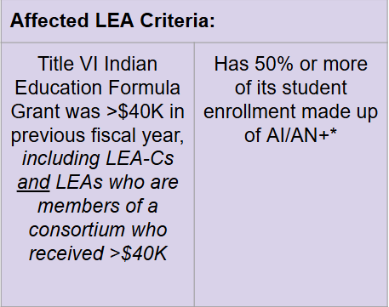
Why Do Affected School Districts Change?
A Quick Case Study -
In the 2023-2024 school year, Beaverton SD received $38,159 for their Title VI Indian Education award.
So for any required plans or applications for SY24-25, they did NOT have a requirement to engage in Tribal Consultation for those plans.
Since the new Integrated Guidance plan will begin in the 2025-2026 school year and because Beaverton’s 2024-2025 award was for $41,950 (an award >$40K), they are now required to engage in Tribal Consultation for all plans and applications for SY25-26.
Where Can This Information Be Found?
-The US Department of Education publishes the list publicly each Fall, typically in October on their federal website.
-ODE maintains an up to date list of awardees and tribal consultation requirements on the Tribal Consultation and the Title VI website.
Let’s take a look: FY24-25 Oregon Title VI Awardees and Student Information

Slide 11
Unpacking the Term “Indian Tribes”
Consultation requirements under section 8538 of the ESEA, as amended by ESSA, require affected local education agencies (LEAs) to consult with Indian tribes, or those tribal organizations approved by the tribes located in the area served by the LEA, prior to submitting a plan or application for covered programs. This requirement is designed “to ensure timely and meaningful consultation on issues affecting American Indian and Alaska Native students.”
Definition -
Is a federally recognized tribe that has a tribal reservation boundary, Indian Lands, ceded, unceded, and aboriginal lands within 50 miles of the LEA or LEA-C. Consultation does not include state recognized tribes; Oregon has no state recognized tribes. (FAQ, p. 41)
Important Note -
An affected LEA should conduct Tribal Consultations with each tribe that has a tribal reservation boundary, Indian Lands, ceded, unceded, and/or aboriginal lands within 50 miles of each LEA, LEA-C, and LEAs who are members of an affected consortium.

Slide 12
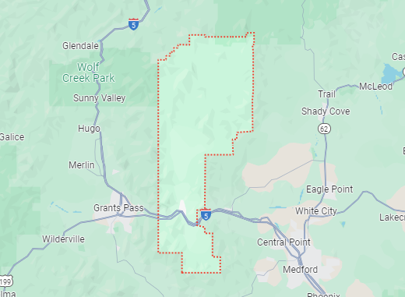
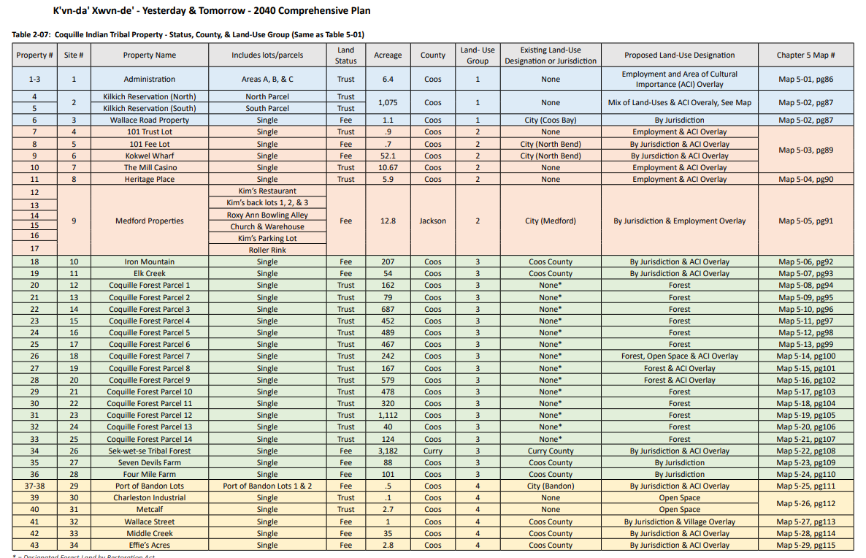
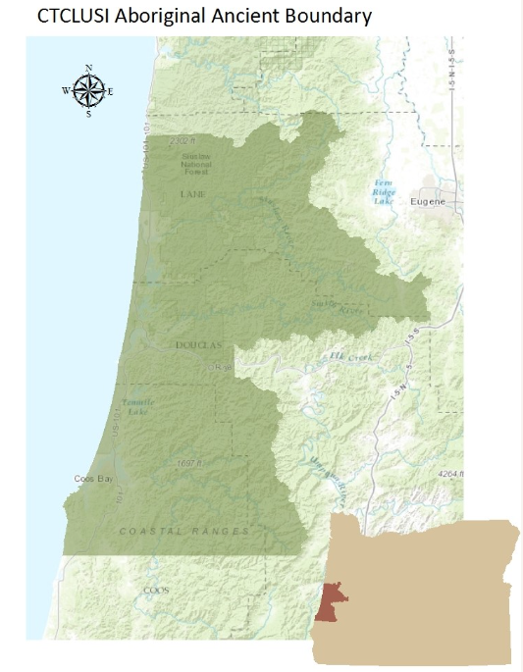
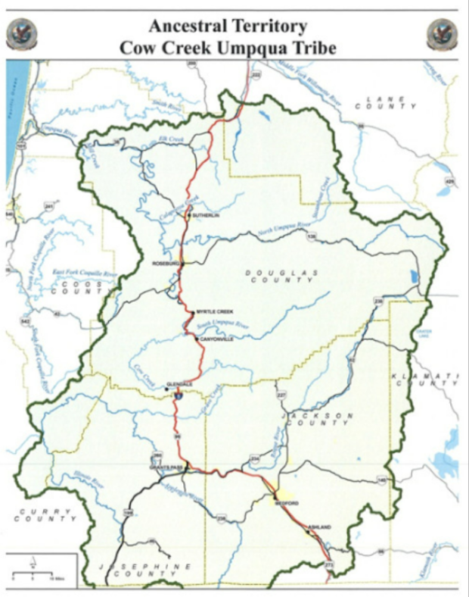
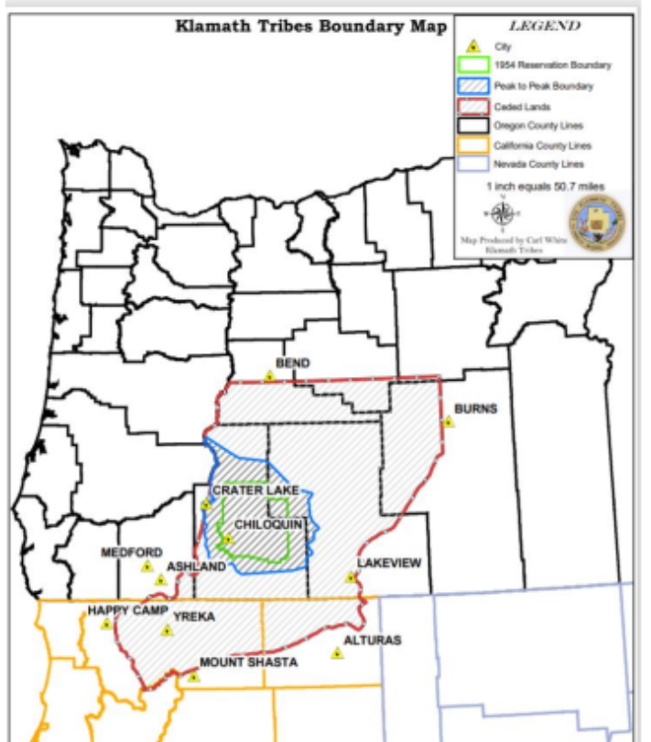
Example: Rogue River SD - member of the Southern Oregon ESD Consortium
Screenshot of Coquille Indian Tribe land holdings
Confederated Tribes of Coos, Lower Umpqua and Siuslaw Indians map
Cow Creek Band of Umpqua Tribe of Indians
Klamath Tribes

Slide 13
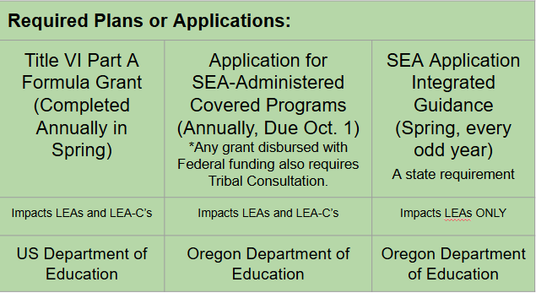
Who Leads Consultation Efforts in an LEA?
The District Superintendent or their Designee leads consultation.
Key Support Staff: Title VI Coordinator or Federal Title Staff
Key Support Staff: Federal Title Staff
Key Support Staff: Numerous
Notes:
Numerous - district leaders of Multilingual

Slide 14

Checking In
Share out an overview on Tribal Consultation between LEAs, LEA-Cs, and tribes
✔ What is the requirement
✔ Who must engage in tribal consultation and why
✔ What plan and applications are impacted
✔ Who leads consultation in an LEA
Highlight key sections of the Tribal Consultation Toolkit 2.1 most related to your work as liaisons
Define Meaningful Collaboration and why some LEAs not required to engage in Tribal Consultation should consider it for Integrated Guidance
Notes:
Resource: ODE Tribal Consultation Website - https://www.oregon.gov/ode/students-and-family/equity/NativeAmericanEducation/Pages/Tribal-Consultation.aspx

Slide 15
Key Sections of ODE Publications
Tribal Consultation and Integrated Guidance

Slide 16
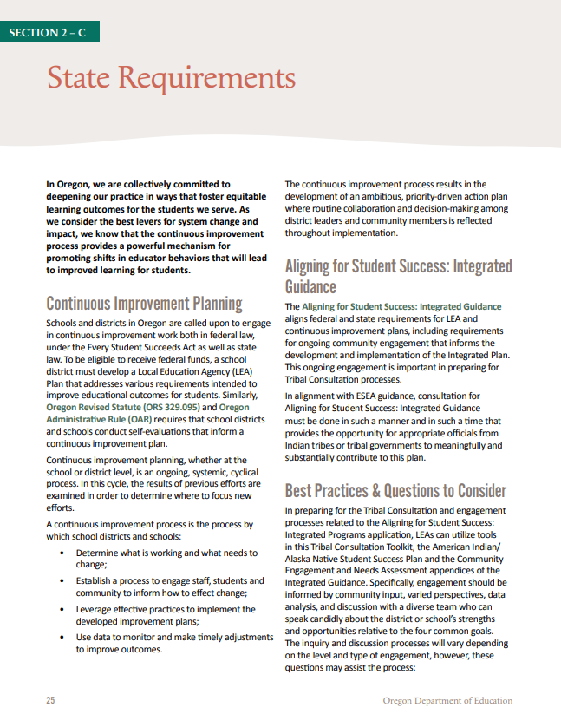
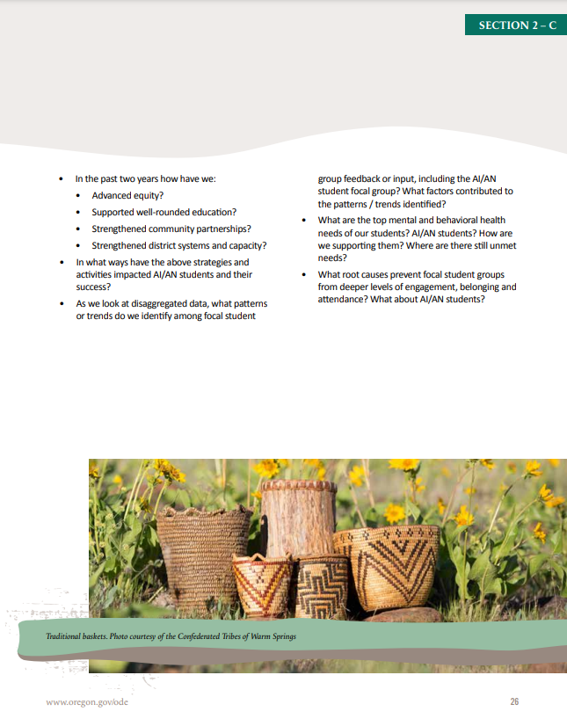
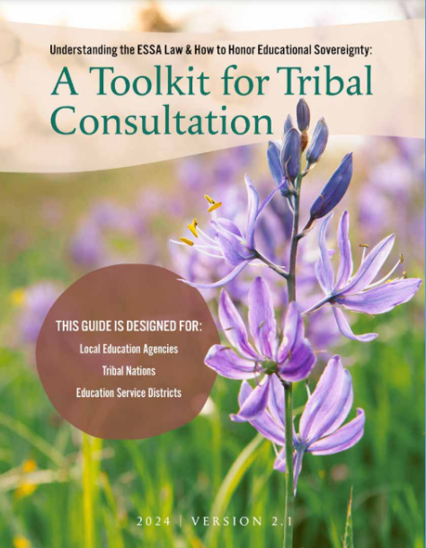
Integrated Guidance Support in the Toolkit
State Requirement p. 25-26

Slide 17

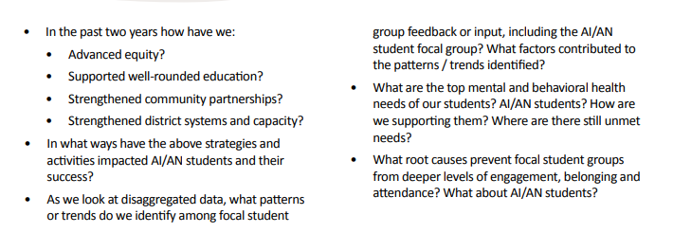
Integrated Guidance Support in the Toolkit
State Requirement p. 26

Slide 18
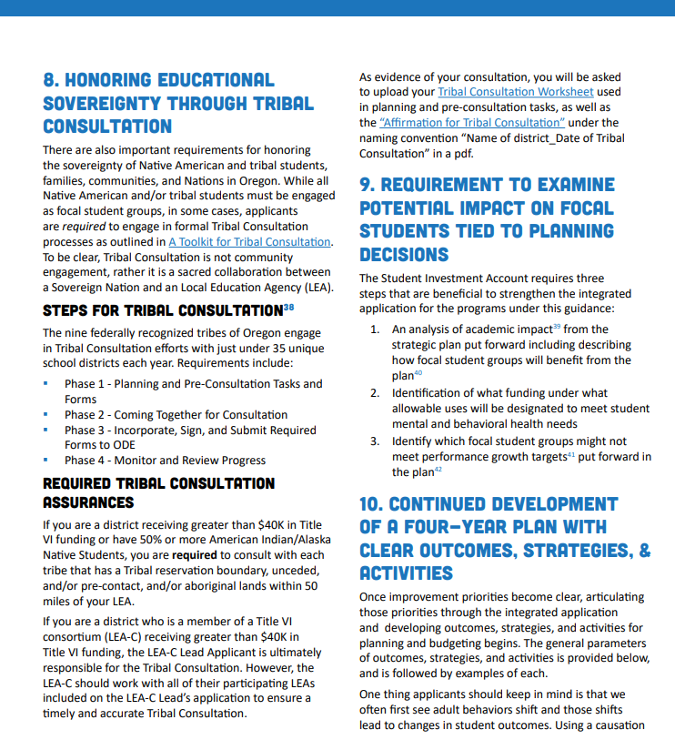

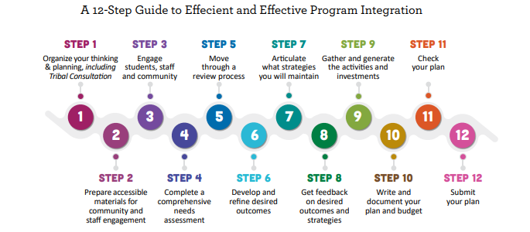
Tribal Consultation Support in the Aligning for SS Doc
Integrated Guidance Update p. 14
Integrated Guidance Update p. 29

Slide 19
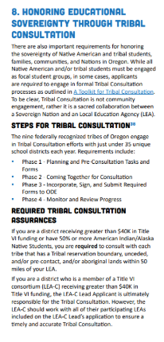
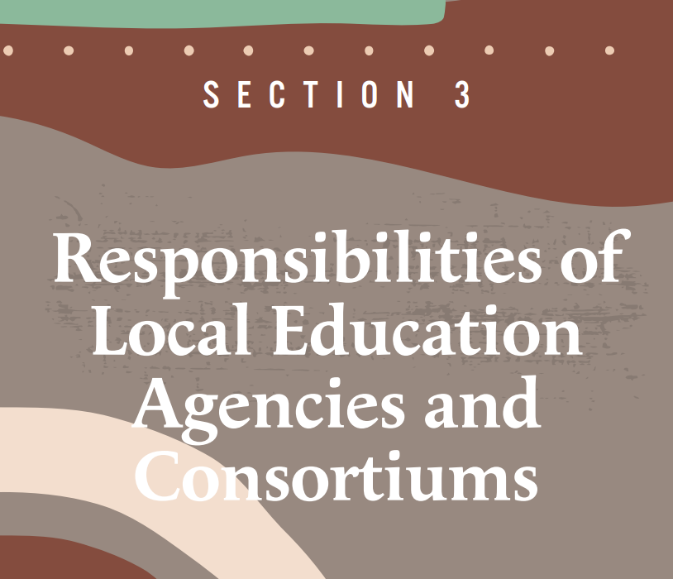
Tribal Consultation Support in the Toolkit
Section 3 of the Tribal Consultation Toolkit Dives Deeply into the Four Phases of Tribal Consultation (pgs. 31 - 36)
Phase 1 - Planning and Pre-Consultation Tasks and Forms
  Initial Invitation and Outreach
  LEA pre-planning
Phase 2 - Coming Together for Consultation
Phase 3 - Incorporate, Sign, and Submit Required Forms to ODE
  Affirmation of Tribal Consultation
  Tribal Consultation Worksheet
  Any supplemental materials provided by the LEA or local tribe(s)
Phase 4 - Monitor and Review Progress
Tribal Consultation Toolkit p. 31-36
Integrated Guidance Updated Document p. 29
Notes:
Speaker notes = Dive into Phase 1 and the data collection

Slide 20
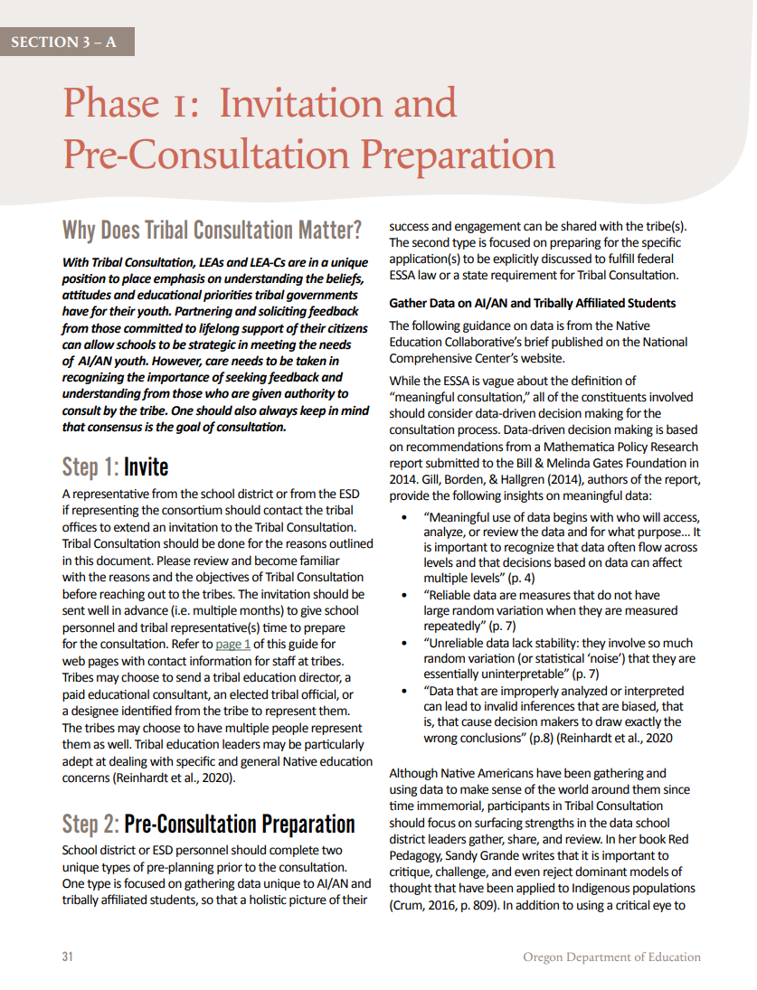
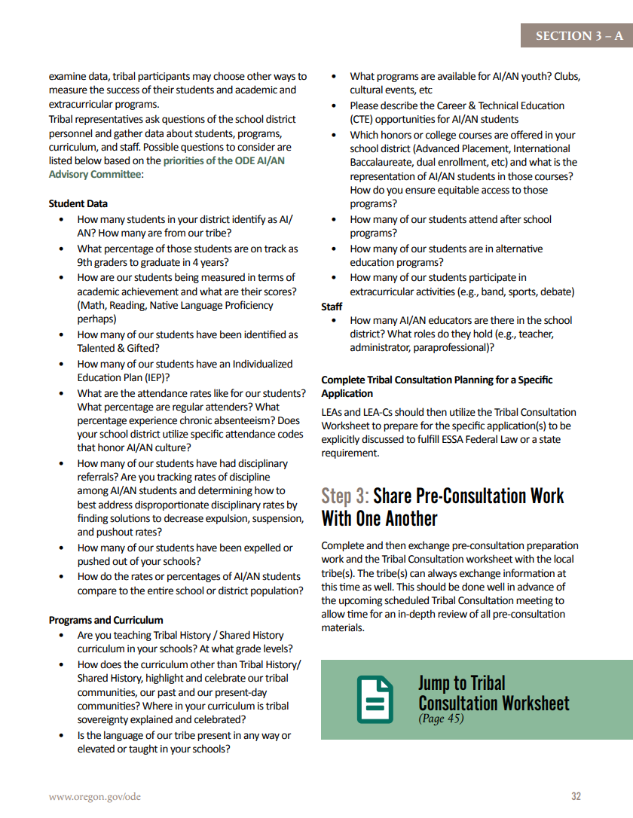
Phase 1, Step 2 Pre-Consultation Tasks and Forms
During this phase District Leadership prepares for consultation for Integrated Guidance in the following ways –
Data
Data on American Indian and Alaska Native students is assembled and disaggregated to create a holistic overview of their success, representation, and engagement. (Phase 1, Step 2, pg. 32)
LEAs prepare for information specific to the Integrated Guidance application.
Tribal Consultation Worksheet - Reflection and Intentions
LEAs utilize the Tribal Consultation Worksheet to prepare for the upcoming Tribal Consultation.
Determine your role in your ESD regarding Tribal Consultation
What do your districts need from you?
How do you know?

Slide 21
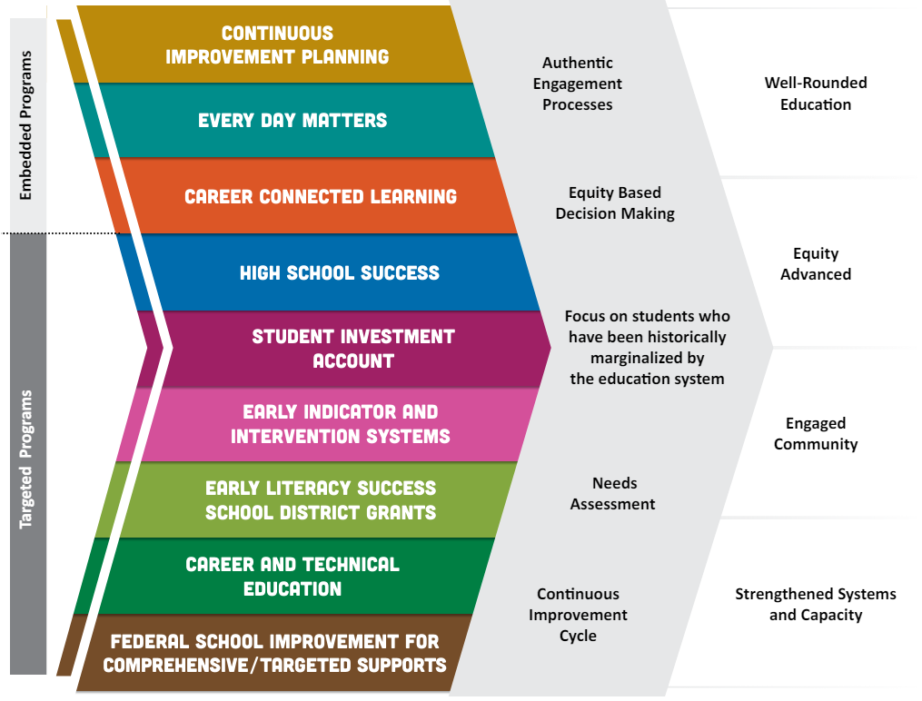
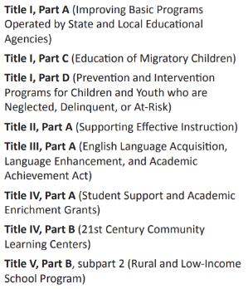
Title VI Indian Education Formula Grant Purpose
SEA-Administered Federal Title Programs:

Slide 22
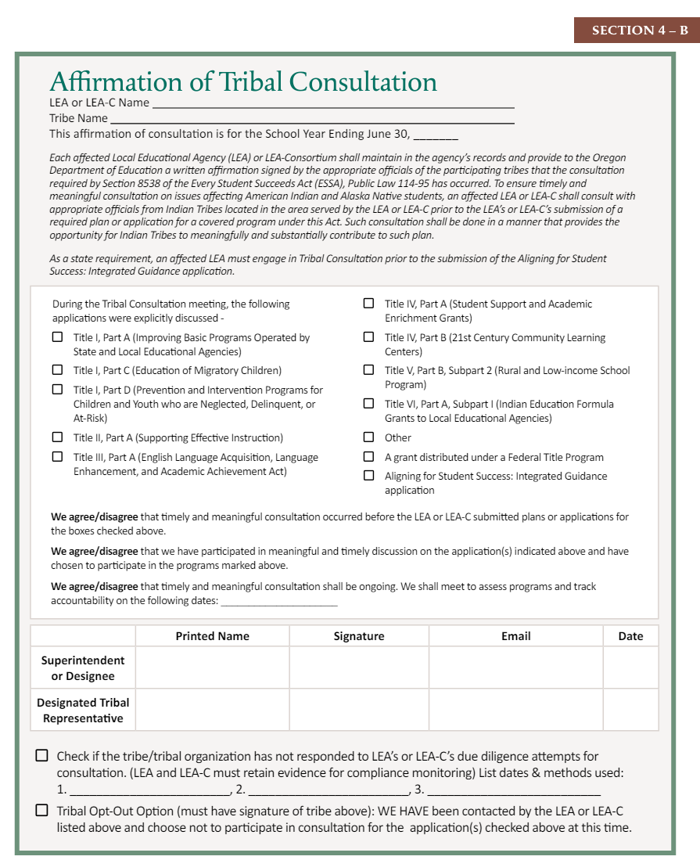
Verification Consultation was Completed
Required Information
Verification Consultation was Completed: Three Ways to Demonstrate This -
Tribal Consultation Occurred
  Required Information + We Agree/Disagree Statements + Superintendent and Tribal Representative Signatures
A Tribe did not respond to three due diligent attempts for consultation
  Required Information + Superintendent Signature + Checkbox with Information
A Tribe Opted Out
  Required Information + Superintendent and Tribal Representative Signatures + Checked Box

Slide 23
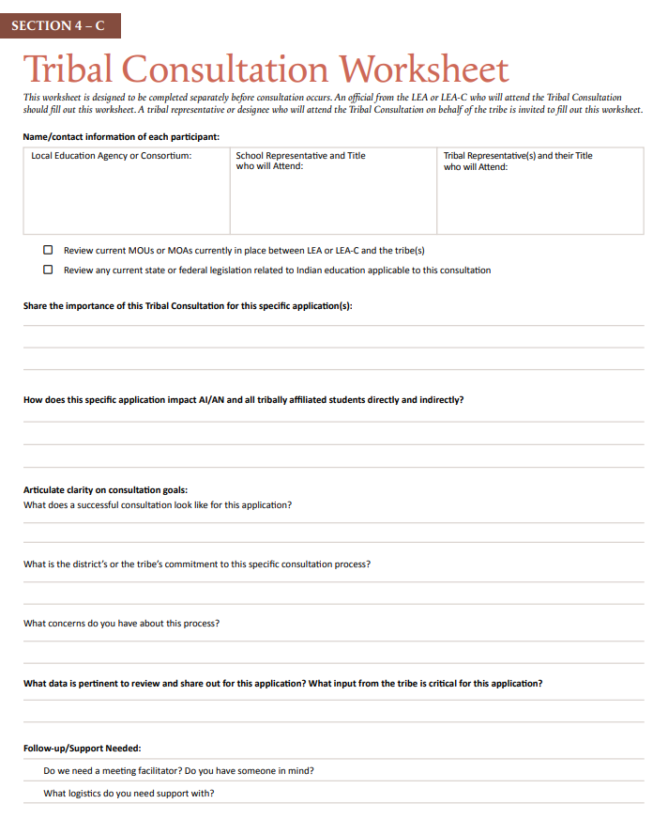
Verification Consultation was Completed
These reflection questions are critical for an LEA and their District’s leadership to prepare for the formality of the upcoming consultation.
This worksheet also provides space for leadership to identify the areas they are really seeking input from the tribe on.

Slide 24
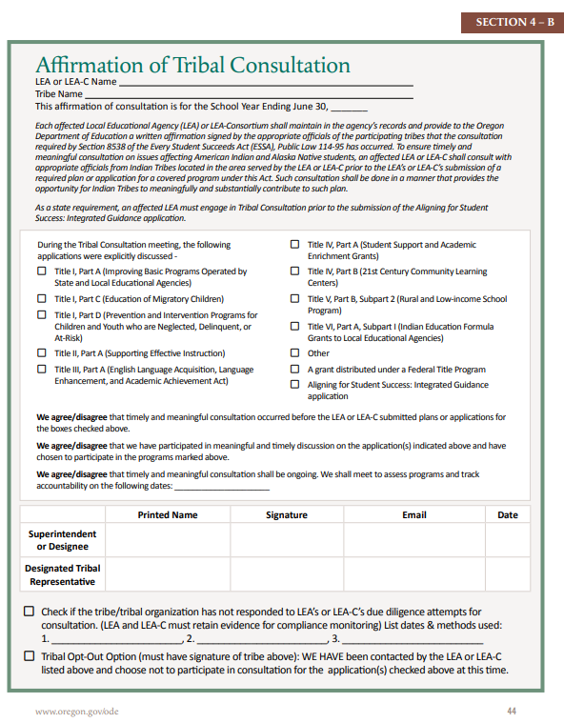
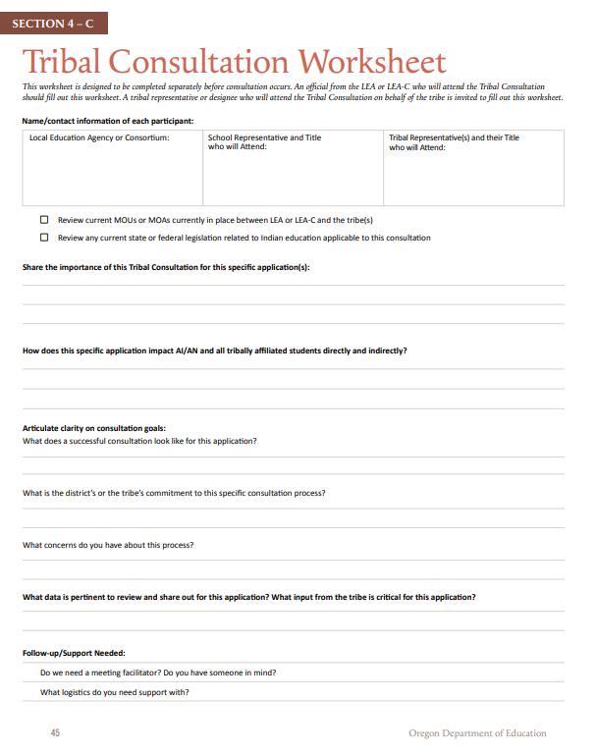
Verifying Tribal Consultation was Completed
Designated Staff from EII will -
Utilize templates provided by the Office of Indian Education to track Affirmations of Tribal Consultation and the Tribal Consultation Worksheets in Smartsheet
Affirmations of TC can be submitted to reflect -
  Completed Tribal Consultation
  A Tribe Opted Out (p. 43, FAQ #12)
  A Tribe was unresponsive to LEA communication
Use the guidance provided by OIE for -
  Communication to LEAs Before, During, and After the window
  Reviewing Affirmations of Tribal Consultation
Upcoming - EII will be tracking all affected LEAs to make sure EACH entity is submitting the required documents for all local tribes in their area under the 50 mile rule. Only after the documents have been verified can an LEA have an approved application and receive their full funding.
Affirmation of Tribal Consultation p. 44
Tribal Consultation Worksheet p. 45

Slide 25

How Have LEAs and LEA-Cs Been Supported in Consultation?
Office of Indian Education Trainings
Tribal Consultation Toolkit Trainings (Version 2.0 and 2.1)
July District Leaders Training for SY24-25 Consultation Cycles
Multiple Gov Deliveries
  Toolkits 2.0 and 2.1
  One Year Anniversary and Module Launch
Personal Outreach - Beaverton and Hillsboro
District Requested Trainings
Technical Assistance/ Regular Office Hours
All Affected LEAs just finished the last consultation window for SEA-Administered Covered Programs
NEW!!! On-Demand Tribal Consultation Modules
In partnership with Southern Oregon ESD, anyone can take up to five tribal consultation modules through PDNetworks.
Audience and Recommended Modules -
  Any Oregonian - Module 1
  Affected LEAs - Modules 1-4
  Tribes - Module 1 and 5

Slide 26
Tribal Communication
Why Some LEAs Should Consider It

Slide 27
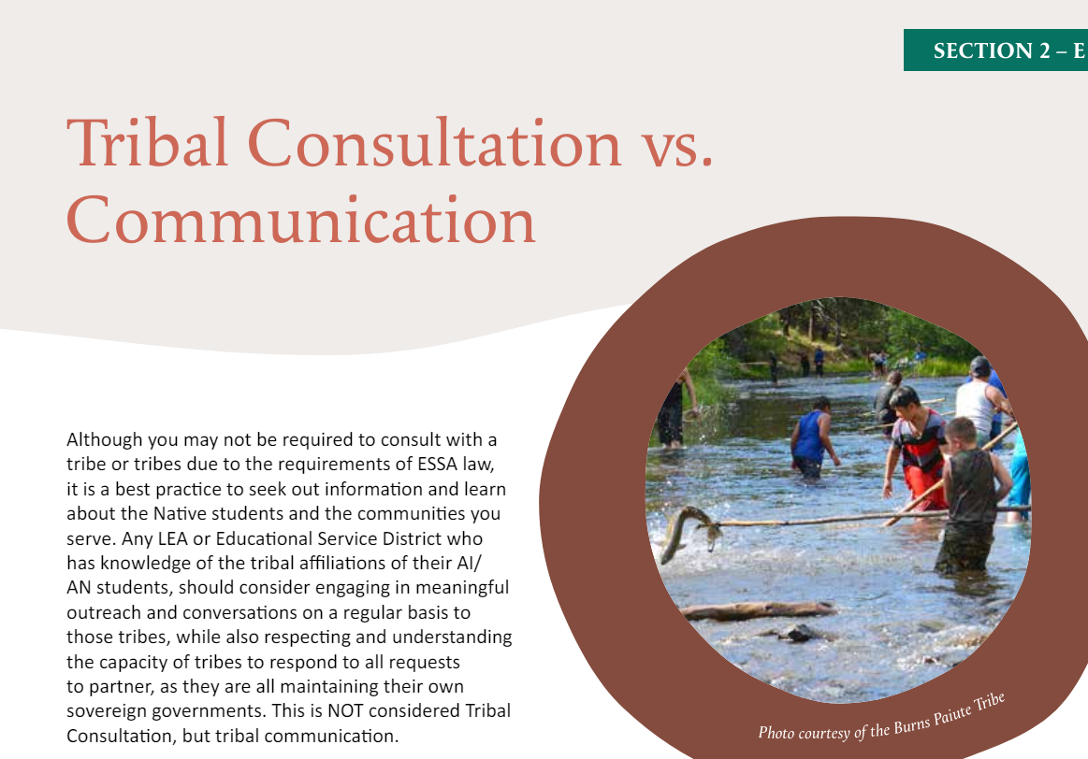
Tribal Communication
Although and LEA may not be required to consult with a tribe or tribes in accordance with ESSA, it is a best practice to share information with tribes and seek out information and feedback about the Native students and the tribal communities you serve.
Title VI awardees have intimate knowledge of the tribal affiliations of their AI/ AN students and should consider engaging in meaningful outreach and on a regular basis to those tribes, while also respecting and understanding the capacity of tribes to respond to all requests to partner, as they are all maintaining their own sovereign governments.
This is NOT considered Tribal Consultation, but tribal communication.
Tribal Consultation Toolkit, p. 28

Slide 28
What about Title VI School Districts who are NOT required to engage in Tribal Consultation?
Let’s Dive Back Into the List of FY 24-25 Awardees -
FY 24-25 Title VI Awardees
Key Questions
Who might consider initiating Tribal Communication for Integrated Guidance?
Who might be required to engage in Tribal Communication because of MOUs or MOAs?
  Consider “Mascot” districts
  Consider LEAs who are part of a Tribally-run Title VI program
  Consider geographic location
Notes:
Philomath School District and CTSI - HS and MS Agreement
Banks School District and CTGR
Siletz Valley Charter School and CTSI
Amity School District and CTSI
Rogue River School District and CTSI
Roseburg School District and CCBUTI (10 Years)
Scappoose School District and CTGR (8 years)
Molalla School District and CTGR (10 Years)

Slide 29
ESD Liaisons - Your Role in This Work
The Historical Significance of Tribal Consultation
The Bigger Picture
In exchange for their Land, the Federal government promised tribes they would ensure Native American students received a high quality education in perpetuity - forever.
An LEA or LEA-C receiving Federal funds for the education of Indian children are a part of this trust treaty responsibility of ensuring Native students receive that high quality education. Consultation with Sovereign Nations helps to ensure that.
Allyship - “To Be in Relations”
This isn’t an ODE Office of Indian Education “thing” - it is a federal requirement.
Consistent Messaging on the Requirements for Tribal Consultation from all ODE Departments
Include information it in 100% of general information regarding the Integrated Guidance application
  Applicable websites
  ESD Training Slidedecks
  Email Communication
For Affected LEAs, ask questions during check-ins about Tribal Consultation
Always link to our Tribal Consultation webpage instead of linking it to the Toolkit

Slide 30
ESD Liaisons - Your Role in This Work
Shared Understanding
While the toolkit and the requirements might convey this is largely technical, this work is relational and complex.
Anticipate and have plans to address microaggressions when they arise - such as:
  LEAs continuing to mispronounce or not learn the names of the local tribes
  Allowing debates on whether consultation “matters”
  Denying the importance of consultation because “only 1% of our District is AI/AN”
  Making generalities or reinforcing stereotypes on Native students or tribal communities
As an Organization with an Equity Stance - Expanding Your Learning is a Requirement
Read books – use search engines to find quality book lists on the topic of Native American history
Read everything you can on tribal websites
Watch documentaries and informational videos produced by reputable sources and the tribes themselves.
Instead of saying, “I never learned that in school,” say “I was taught a one-sided account of US History which erased and also misrepresented the impacts of settler colonialism on Native American tribes and the people who have been here since time immemorial. Because of that, I am unlearning and relearning the accurate history of what happened by __________ and _________. I am also keeping up with the contemporary issues tribes face by _______.

Slide 31

Additional Support
Reach out Anytime – Really! stacy.parrish@ode.oregon.gov
Visit our Website for -
Current and upcoming Tribal Consultation windows
Link to Register for the Tribal Consultation modules
The Updated Tribal Consultation Toolkit 2.1
List of Affected LEAs and LEA-Cs
Detailed Title VI Awardee Spreadsheet
Updated PDFs required for Tribal Consultation -
  Affirmation of Tribal Consultation
  Tribal Consultation Worksheet
  Alignment Rubric (for Covered Programs)
Links to past trainings
Tribal Consultation Website

