Slide 1
How Tribes and the Environment Take Care Of Each Other
2nd Grade
TH/SH Lesson
Lifeways is how a group of people live, work and play together.

Slide 2
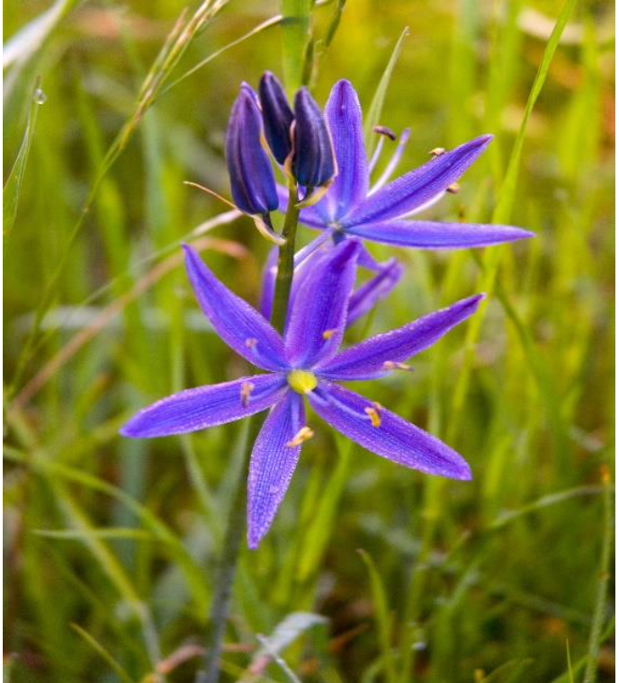
Group Talk
What kinds of animals and plants live around your home?
How do the plants and animals interact with one another?
Courtesy of the Coquille Indian Tribe
Notes:
Opening
Ask students, “What kinds of animals and plants live around your home?” Record student responses.
Explain that animals, plants, and people are all living things, and are all part of an ecosystem - a place where plants, animals, people, and the land live in support of one another.
Ask students, “How do the plants and animals interact with one another?” “How do you interact with them?” Record student answers
Explain to students that they can learn a lot about a place by observing and listening. Since time immemorial, families in Native Tribes in Oregon have been teaching their children about their world by having them observe and listen to the plants and animals around them. These are the ecosystems that they are a part of, and these environments shape the way they live.
Image from the Essential Understandings document.

Slide 3
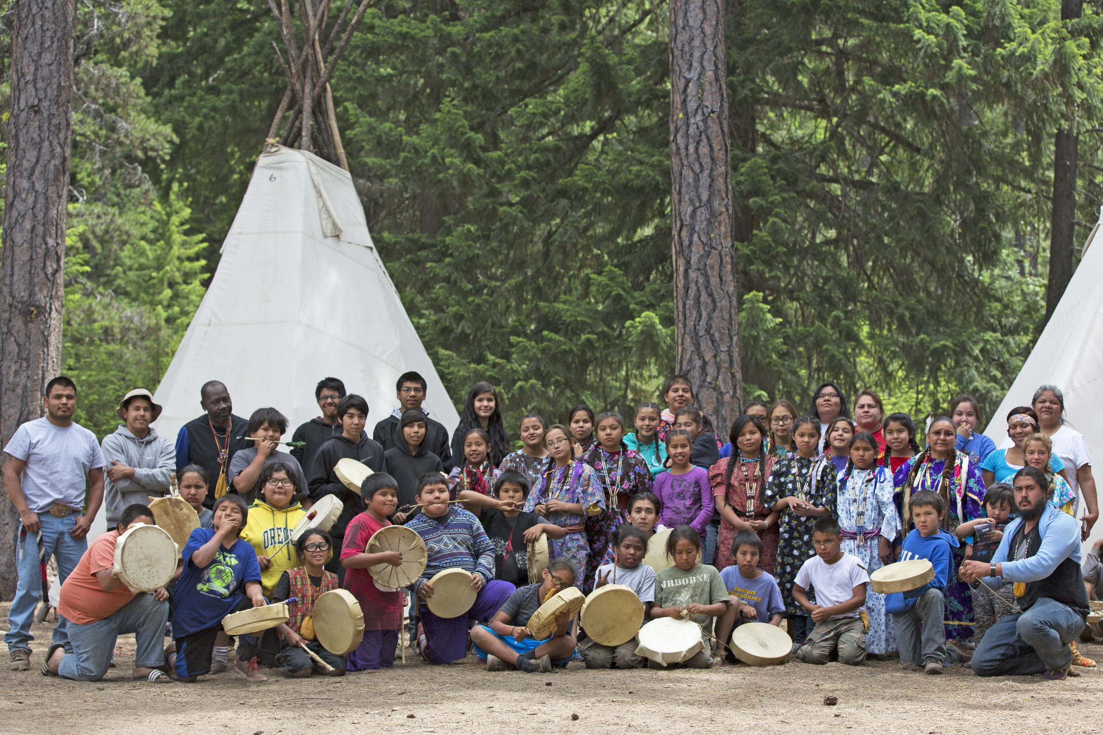
Native Lifeways
are influenced by the environment.
The people take care of the land, and the land takes care of the people.
Image source: https://warmsprings-nsn.gov/contact/
Notes:
Explain to students that they can learn a lot about a place by observing and listening. Since time immemorial, families in Native Tribes in Oregon have been teaching their children about their world by having them observe and listen to the plants and animals around them. These are the ecosystems that they are a part of, and these environments shape the way they live.
Image source: https://warmsprings-nsn.gov/contact/

Slide 4
Essential Questions
What can I learn from observing plants and animals in their habitat?
How are Native lifeways in Oregon shaped by the environment?
Notes:
Preview Essential Questions, Learning Outcomes, Success Criteria and vocabulary for the lesson.

Slide 5
Learning Outcomes
Success Criteria
I understand why Native people in Oregon take care of plants, animals and the land.
I understand how to observe plants and animals in their habitats.
I understand that living things influence one another in an ecosystem.
I can describe the plants, animals, and habitats I observe.
I can explain how plants, animals, and habitats influence one another.
I can explain how Oregon Tribes, the land, and waterways take care of each other.
Notes:
Preview Essential Questions, Learning Outcomes, Success Criteria and vocabulary for the lesson.

Slide 6
Key Words and Ideas
Habitat: The natural home or environment of an animal, plant, or other organism.
Organism: Any individual living thing
Ecosystem: A community of living organisms interacting with one another and their environment
Region: An area of land that has common features.
Notes:
Preview Essential Questions, Learning Outcomes, Success Criteria and vocabulary for the lesson.

Slide 7
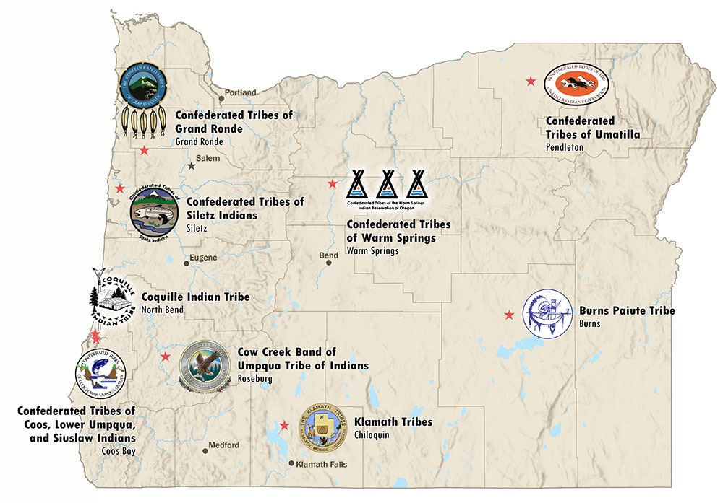
Nine Federally Recognized Tribes in Oregon
Can you find the Burns Paiute Tribe?
The Confederated Tribes of Warm Springs?
Notes:
Using a map of Oregon, ask students to find the Burns Paiute Tribe and the Confederated Tribes of Warm Springs. Explain to students that they will be looking at examples of plants and animals found on their lands.

Slide 8
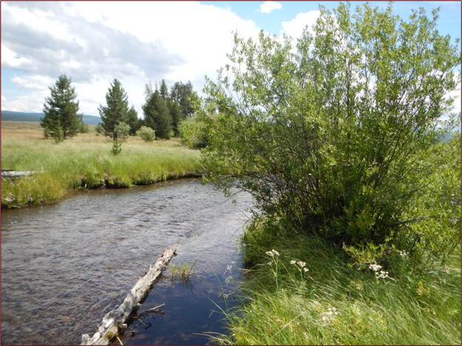
The Burns Paiute Tribal Lands
What do you see?
Image source: https://bptdnr.org/
Notes:
Ask students to look at the photograph and then turn to a peer and explain what they see. Share that what they're looking at is a habitat.
Explain: Like all Oregon Tribes, The Burns Paiute Tribe protects animals and plants. Teams of Tribal members observe the people, plants and land to understand how they can take care of the environment.
Let students know that today they will practice observing also.
Image source: https://bptdnr.org/

Slide 9
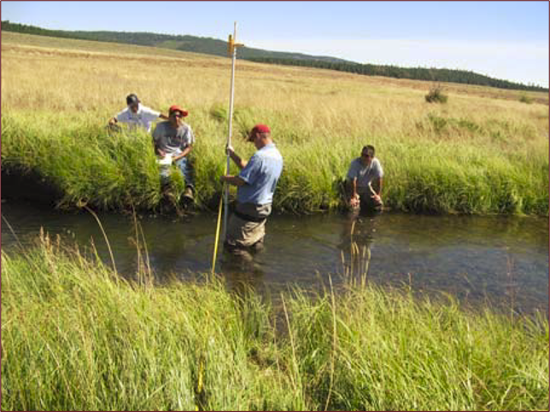
The Burns Paiute Tribal Lands (2)
How do the people and land take care of each other?
Image source: https://bptdnr.org/
Notes:
Ask students if they have any ideas about how the people and land take care of each other.
Explain: The Tribe lives near wet meadows and wetlands, where they find fish for food and good soil for planting. The Tribe takes care of the river and land by making sure people do not fish too much or pollute the river.
Image source: https://bptdnr.org/

Slide 10
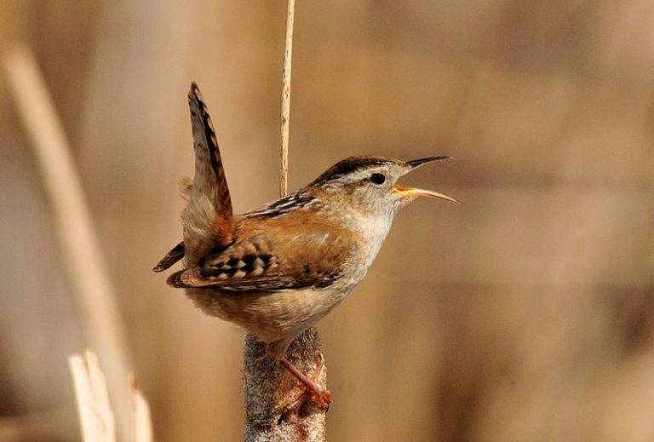
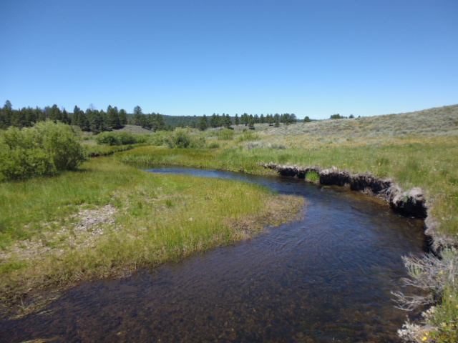
The Burns Paiute Tribal Lands (3)
What animal do you observe?
What do you notice about it?
Images source: https://bptdnr.org/projects-2/
Notes:
Ask students to share about the animal they observe.
Explain: Near the Malheur River, cows eat grass and birds sing in the trees. The Tribe builds fences to make sure the cows do not eat plants that are dangerous. The Tribe checks on the birds to make sure they are healthy and safe.
Images source: https://bptdnr.org/projects-2/

Slide 11
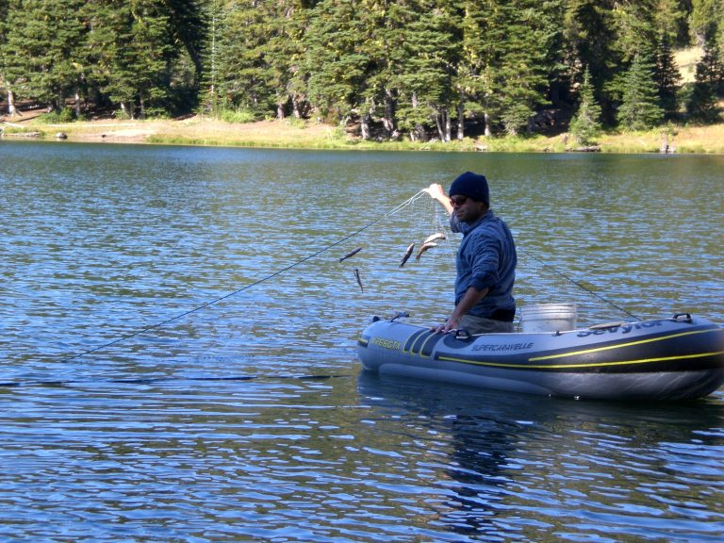
The Burns Paiute Tribal Lands (4)
What animals do you observe?
What do you notice about them?
Image source: https://bptdnr.org/fisheriesprojects/
Notes:
Ask students to share what animal they can see and what they notice about it.
Explain: The Tribe has a fishing program to help fish live and grow in the rivers. The fish help keep the river clean, and the Tribe uses some of the fish for food.
Ask students to share with one another one thing they learned about how the people and the land take care of each other.
Image source: https://bptdnr.org/fisheriesprojects/

Slide 12
Let's look at more habitats!
Notes:
Explain to students that next they'll be using their powers of observation to learn about the people and lands of the Confederated Tribes of Warm Springs Tribe

Slide 13
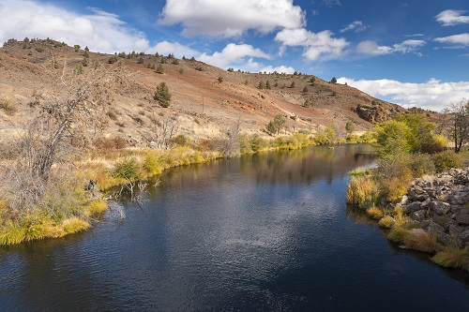
The Confederated Tribes of Warm Springs Tribal Lands
What do you see in this habitat?
Image source: https://sos.oregon.gov/blue-book/Pages/national-tribes-warm-springs.aspx
Notes:
Explain: Like all the Tribes in Oregon, The Confederated Tribes of Warm Springs also protect animals and plants. They observe the plants, animals and habitats to understand how to make sure they are safe and healthy.
Image source: https://sos.oregon.gov/blue-book/Pages/national-tribes-warm-springs.aspx

Slide 14
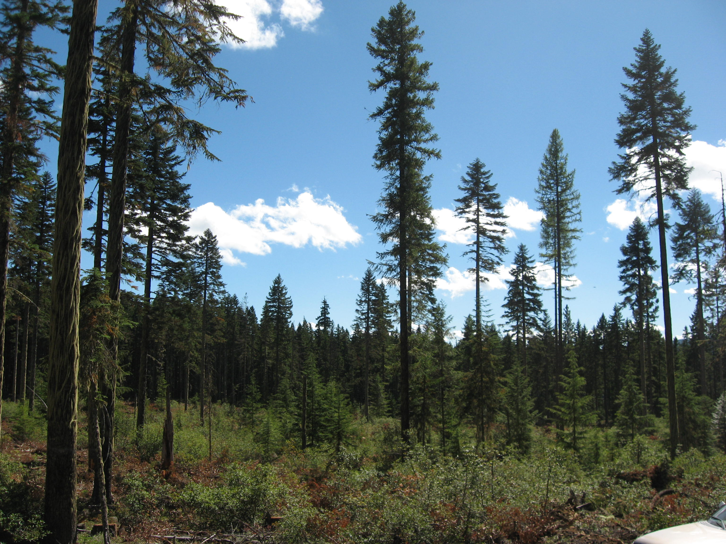
The Confederated Tribes of Warm Springs Tribal Lands (2)
What do you see in this habitat?
Image source: https://warmsprings-nsn.gov/program/department-of-forestry/
Notes:
Explain: Some of the Tribe live near a forest. The tribe helps take care of the trees, keeping the forest safe from fires. The tribe also plants new trees for birds to live in. The Tribe also makes sure that the deer, elk, sheep and goats in the forest are safe from hunters.
Image source: https://warmsprings-nsn.gov/program/department-of-forestry/

Slide 15
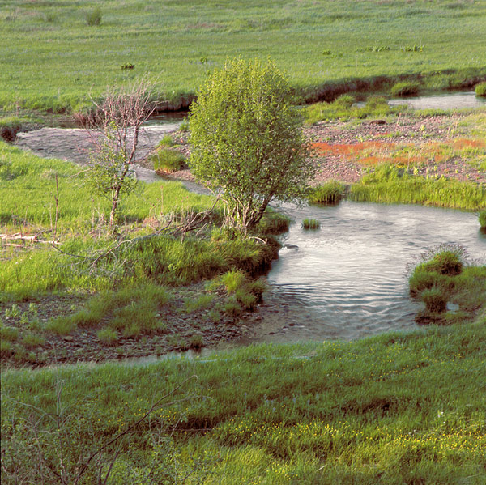
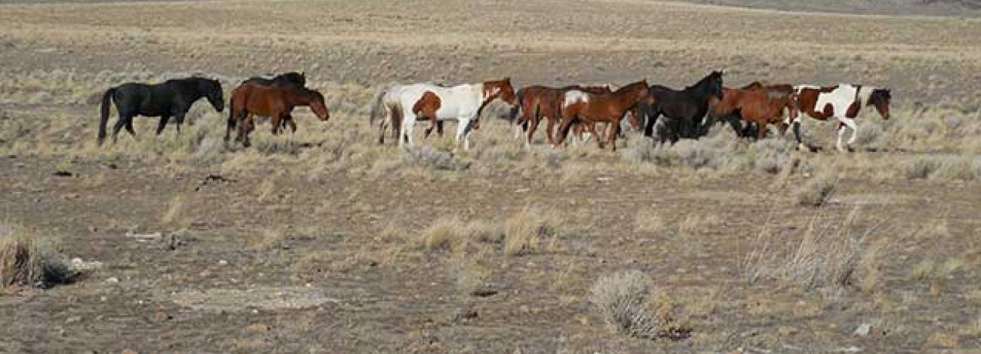
The Confederated Tribes of Warm Springs Lands (3)
What do you notice about the animals and the waterway?
Image source: https://critfc.org/member-tribes-overview/the-confederated-tribes-of-the-warm-springs-reservation-of-oregon/
Image source: https://www.blm.gov/programs/wild-horse-and-burro/herd-management/herd-management-areas/oregon-washington/warm-springs
Notes:
Ask students to share what they notice about the animals and waterways in these pictures. Reinforce that they are using their skills of observation to learn in this process.
Explain to students that the birds need to have water, so the Tribe also takes care of the streams and rivers. Horses also live near the streams and rivers. The Tribe makes sure the horses have a place to live and be safe, because when the horses eat grass, they make it easier for the Tribe to plant crops in the soil.
Image source: https://critfc.org/member-tribes-overview/the-confederated-tribes-of-the-warm-springs-reservation-of-oregon/
Image source: https://www.blm.gov/programs/wild-horse-and-burro/herd-management/herd-management-areas/oregon-washington/warm-springs

Slide 16
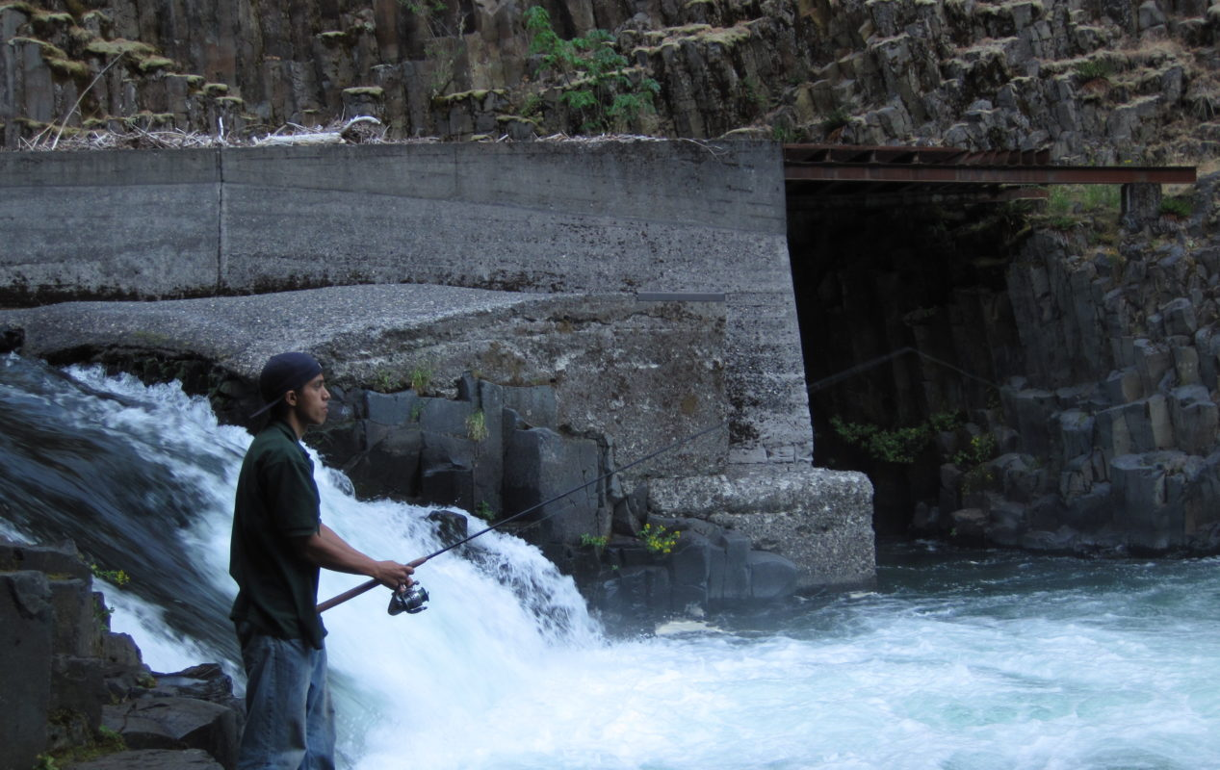
The Confederated Tribes of Warm Springs Lands (4)
How would you describe this waterway?
Image source: https://fisheries.warmsprings-nsn.gov/
Notes:
Ask students how they would describe the waterway in this picture. Ask if they notice any differences between it and the other waterways they've looked at.
Explain to students that many fish live in the streams and rivers. The Tribe takes care of the fish by making sure the water stays clean. The Tribe only fishes during some parts of the year so that the fish can grow in the river.
Image source: https://fisheries.warmsprings-nsn.gov/

Slide 17
Closing
Some of the plants and animals I observed were __________.
Native people in Oregon take care of plants, animals and the land because ___________.
One way Native people in Oregon take care of the environment is _______________.
One way the environment takes care of Native people in Oregon is _____________.
Notes:
Ask students to use sentence stems to write or orally demonstrate their learning. Students can do this independently, in pairs, or in a whole group discussion.
Some of the plants and animals I observed were _______________.
Native people in Oregon take care of plants, animals and the land because _______________.
One way Native people in Oregon take care of their environment is ______________.
One way the environment takes care of Native people in Oregon is ____________________.

Slide 18


Self-assessment
Success Criteria | Not Yet | Yes
Can I describe plants, animals and habitats I observed?
Can I explain how plants animals and habitats influence each other?
Can I explain how the environment and Tribes take care of each other?
Notes:
Share "Today we learned about how tribal people and the environment take care of each other."
Ask students to self-assess based on the success criteria. They can pick their level of learning (sort of or yes) and share with a peer, or you can print out the self-assessment and ask students to fill it out and turn it in. Students can also explain what they well and what a next step is they can take.

