Slide 1

GRADE 4 HEALTH LESSON 2
Cultural Bias, Stereotypes, and Boarding School Education

Slide 2
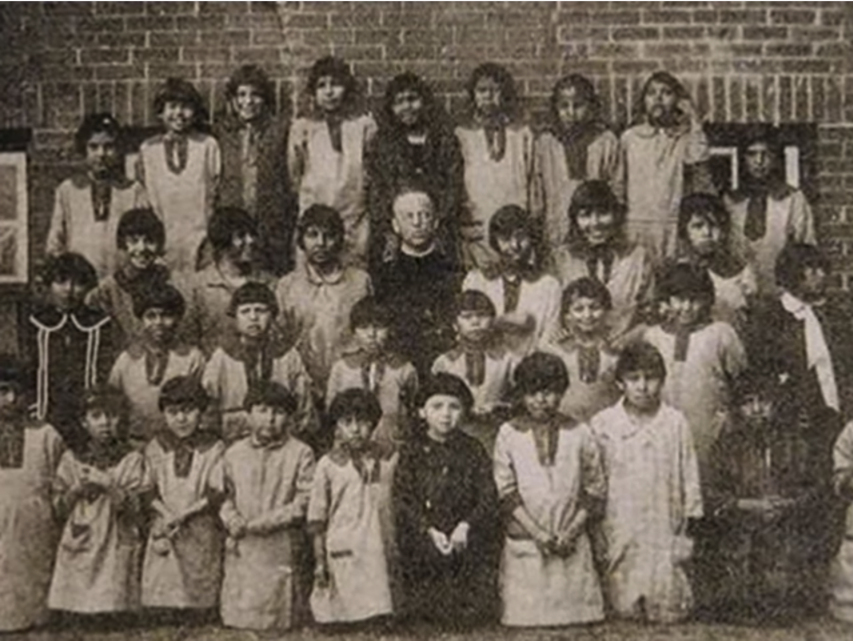
Bias and Stereotyping

Slide 3
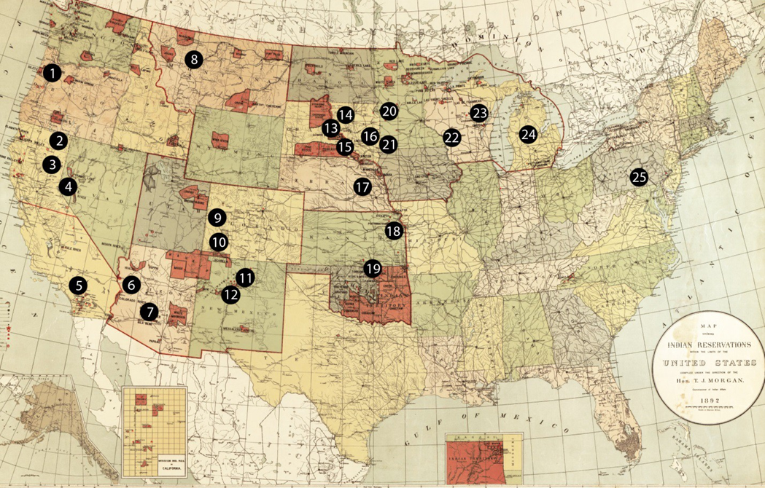
Where were Indian Residential (Boarding) Schools?
Notes:
Native American students from Oregon did not just go to Boarding Schools in Oregon, but all over the country.
United States Office Of Indian Affairs, and T. J Morgan. Map showing Indian reservations within the limits of the United States. Washington, D.C.: Office of Indian Affairs, 1892. Map. Retrieved from the Library of Congress, https://www.loc.gov/item/2009579467/. Names of Indian Boarding Schools added by the Carlisle Indian School Digital Resource Center at Dickinson College.

Slide 4
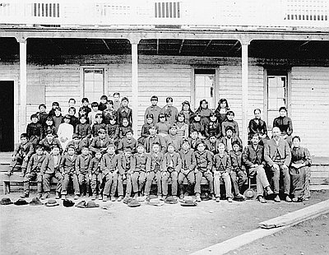
Warm Springs Agency Boarding School
Notes:
Photo from Oregon Historical Society

Slide 5
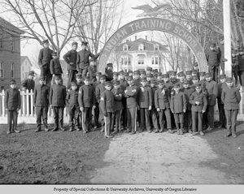
Chemawa

Slide 6
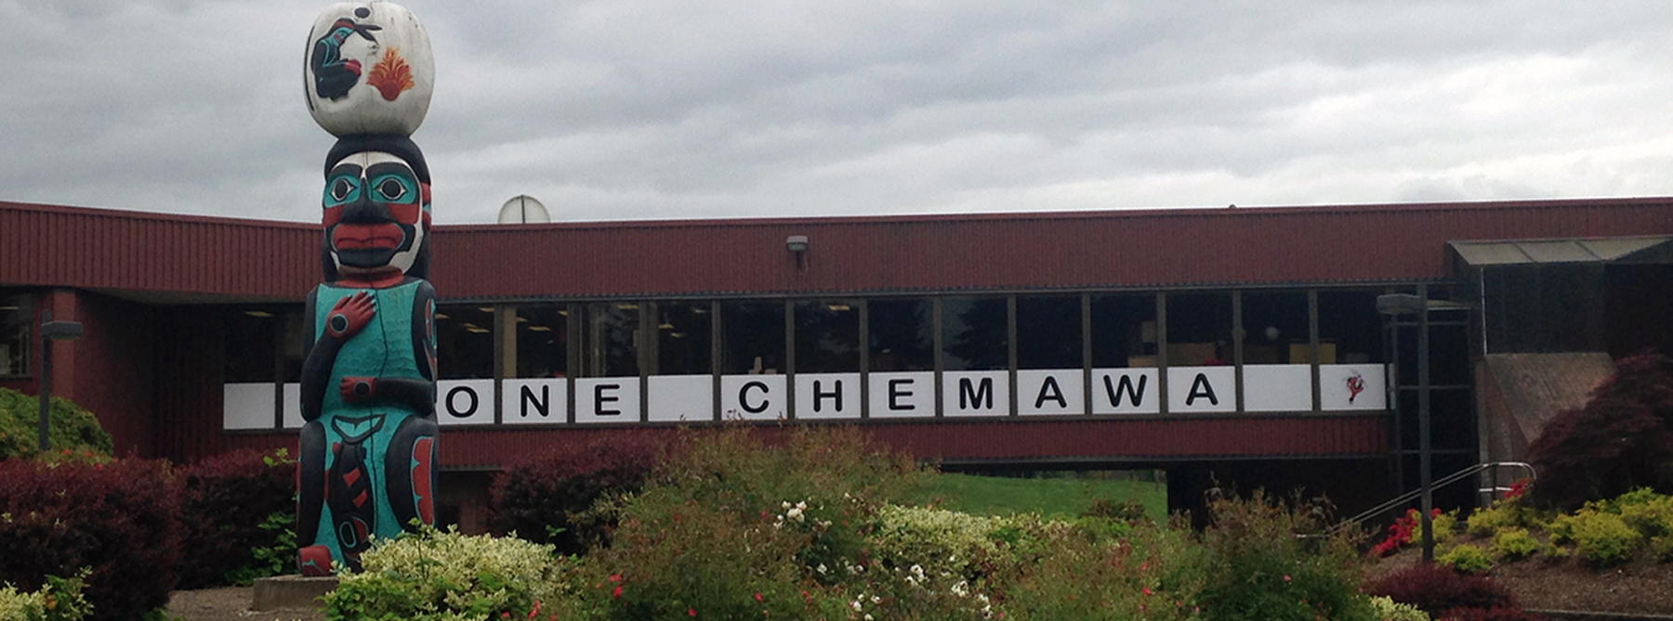
Chemawa Indian School

Slide 7
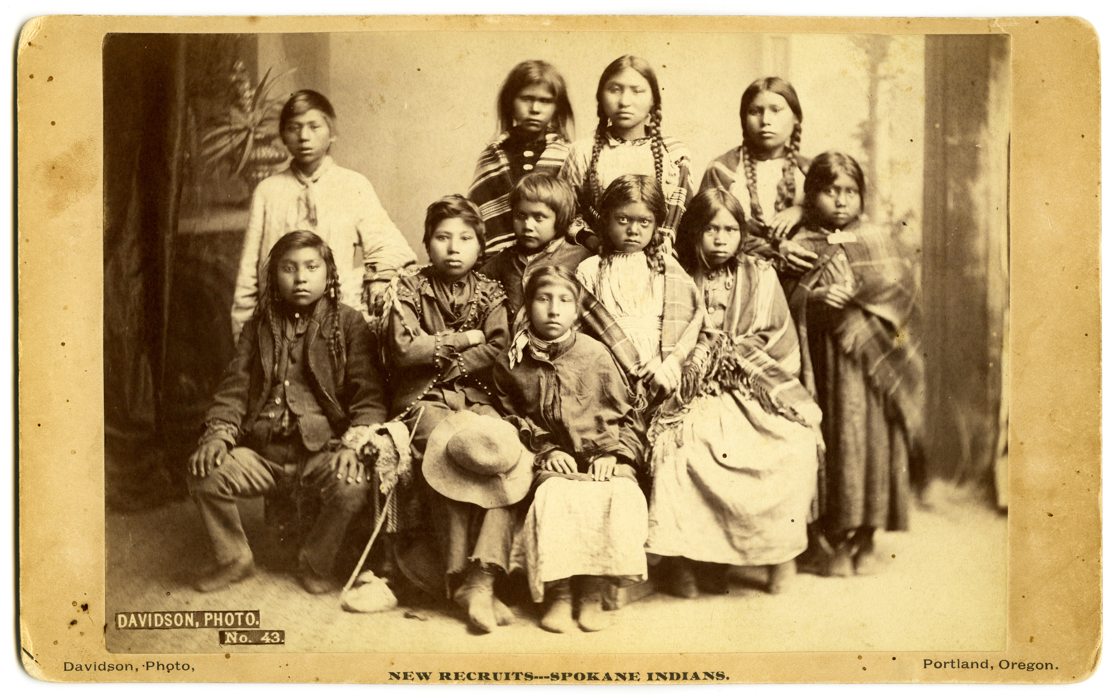
Before Chemawa Indian School
Notes:
Photos from: http://osupress.oregonstate.edu/blog/in-forest-grove-echoes-of-chemawa-indian-school
Assimilation practices began immediately. Children were separated from siblings. Hair was cut. Uniforms were distributed. No traditional dress was allowed. The students marched to class in the mornings, and had trades training in the afternoons. Students were forced to learn and speak English; their native languages were to be unspoken.
In 1890, ten years after the creation of the Carlisle schools, the Santa Fe Indian School was founded. It became one of many boarding schools, including the Chemawa Indian School in Salem, Oregon; the Pueblo Indian School in Pueblo, Colorado; and the Haskell Indian School in Lawrence, Kansas. All of them followed the Carlisle model of trying to eliminate all native culture and influence

Slide 8
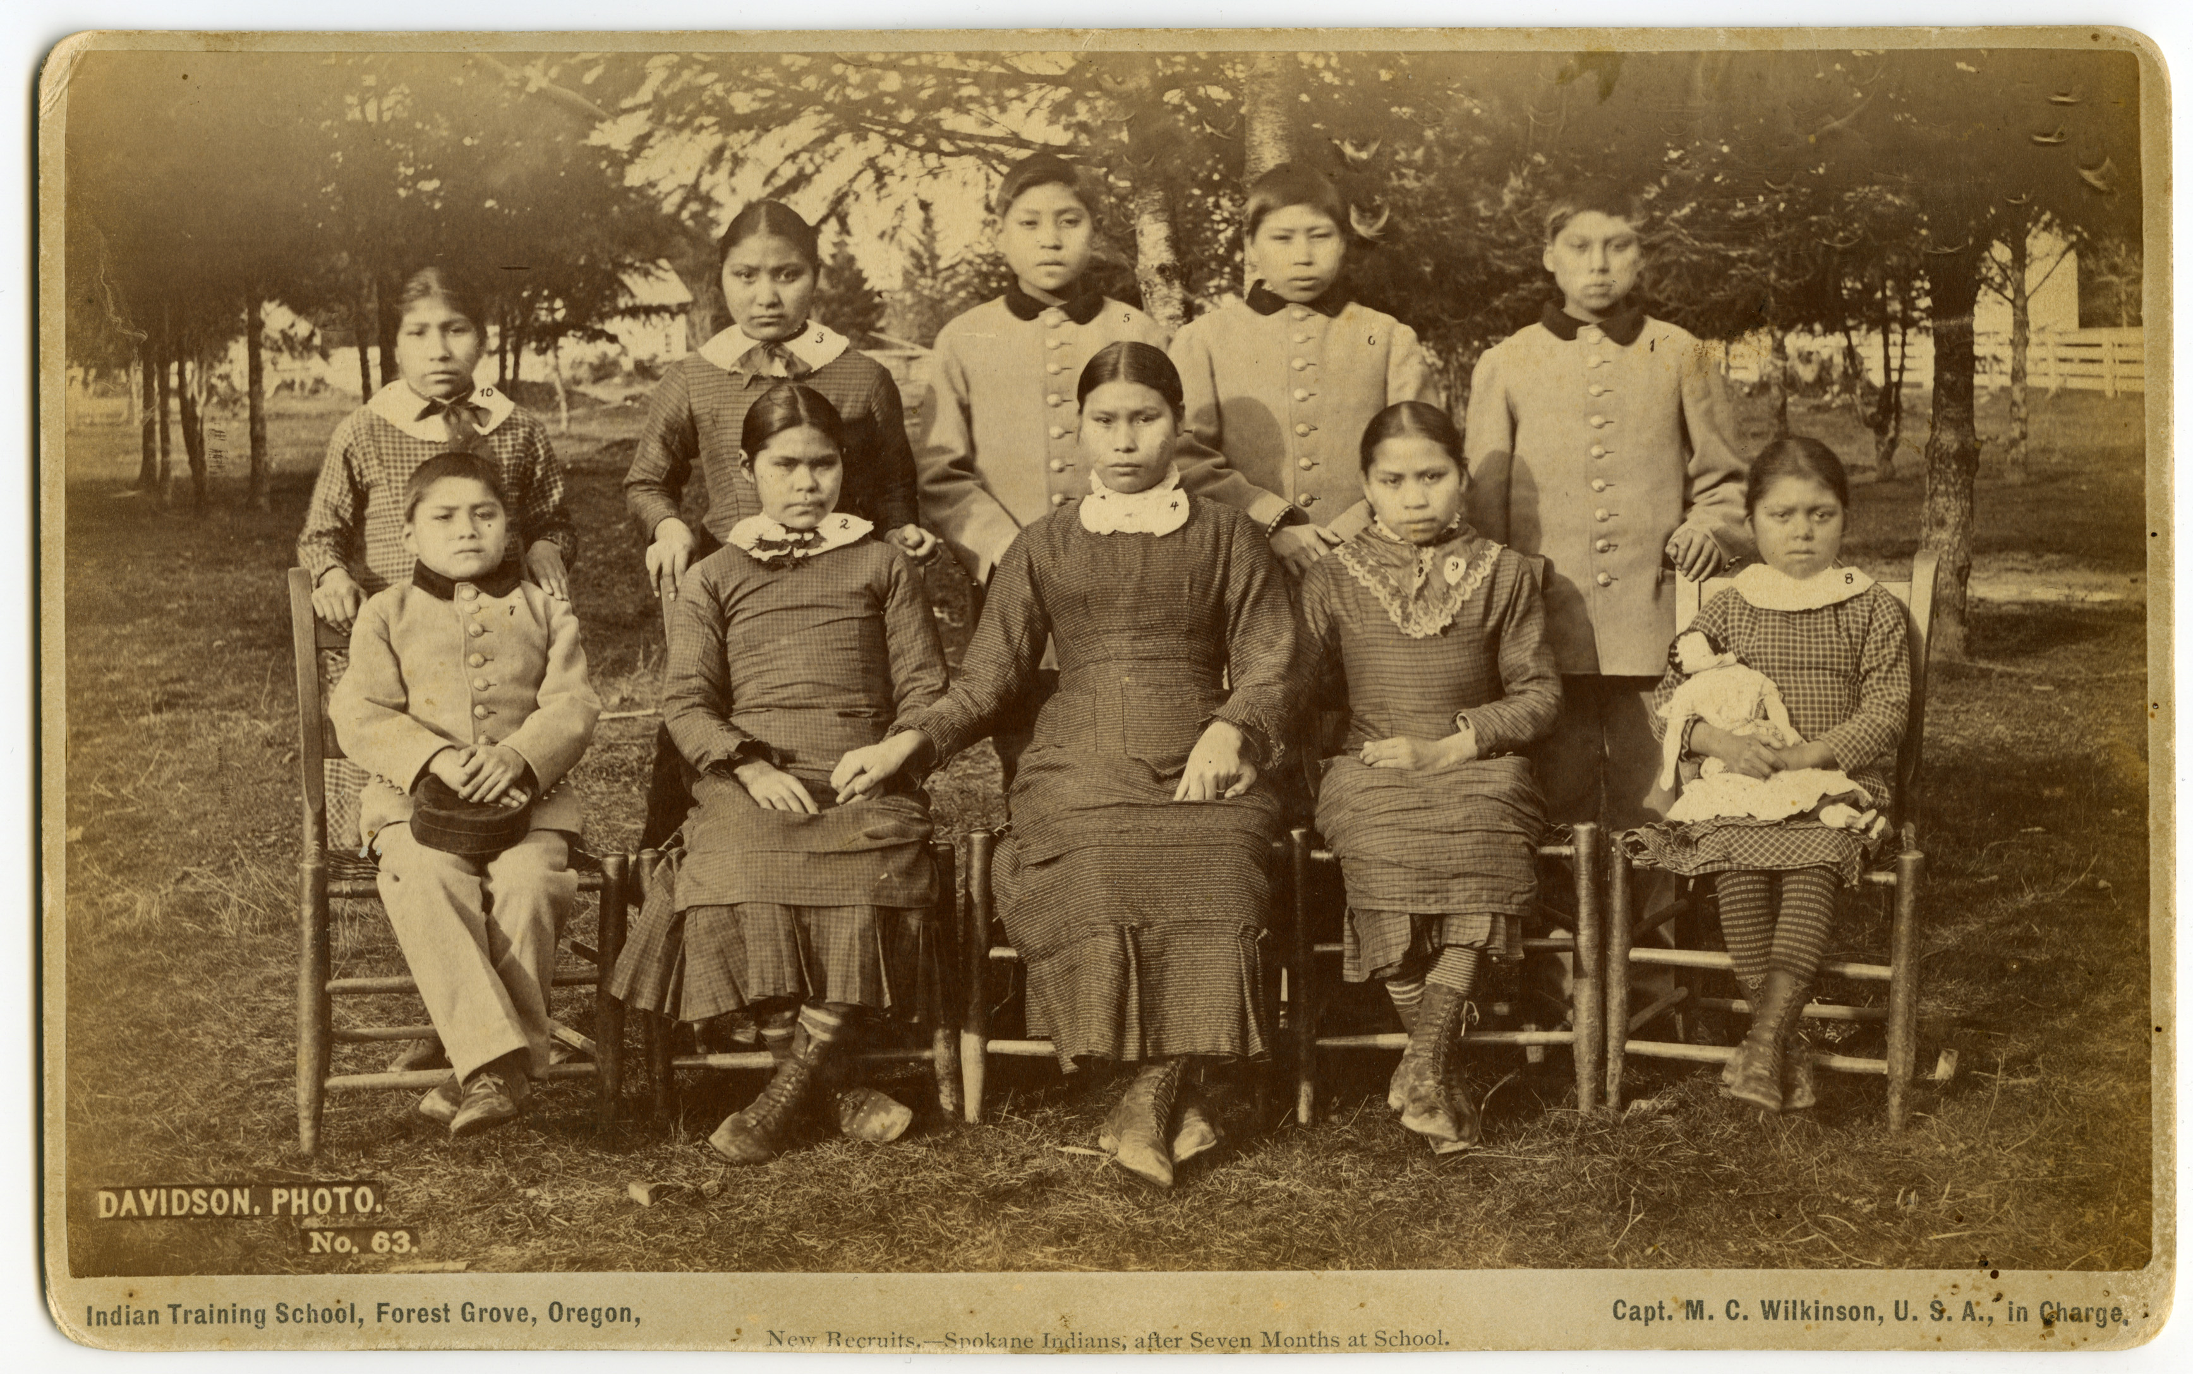
After Chemawa Indian School
Notes:
Photos from: http://osupress.oregonstate.edu/blog/in-forest-grove-echoes-of-chemawa-indian-school

Slide 9
Worksheet for Chemawa Photo Activity
How do these two pictures make you feel?
What is different about the two pictures?
Who decides who is “civilized” and who is not?

