Slide 1
Title I-A Comparability Report
October 15, 2025
Notes:
Sarah

Slide 2

Agenda for Today’s Session
Purpose of the Title I-A Comparability Report
Comparability Requirements
Completing the Report
Supports and Resources

Slide 3
What is comparability?
Comparability is a school-level calculation that measures the level of State and Local funds and resources provided to a district's Title I-A and non-Title I-A schools.
The goal is to determine whether the distribution of State and Local funds and resources to schools, including charter schools, are comparable, regardless of Title I-A status.
ESSA Quick Reference Brief: Comparability under Title I-A
Title I-A Fiscal Requirements
Supplement not Supplant
Comparability
Maintenance of Effort
Notes:
Comparability is one of three fiscal tests under Title I-A through which districts demonstrate that the use of Title I-A funds is supplemental to state and local funds.
Comparability’s focus is educational materials and resources specifically. While comparability and methodology requirements both examine how the district distributes state and local funds and resources to schools, they are separate tests that measure different aspects of the supplemental nature of Title I-A funds.
Remember that comparability includes district sponsored charter schools.

Slide 4

Meeting the Requirement
An LEA is considered to have met the statutory comparability requirements if it has implemented:
  An LEA-wide salary schedule;
  A policy to ensure equivalence among schools in teachers, administrators, and other staff; and
  A policy to ensure equivalence among schools in the provision of curricular materials and instructional supplies.
Notes:
Each year districts submit their ESEA assurances that includes these three items. The assurance is your district’s attestation that it has policies ensuring comparability. The comparability report is how districts are asked to demonstrate the policy in action.

Slide 5

Methods for Demonstrating Comparability
Student-Instructional Staff Ratio
Student-Instructional Staff Salary Ratio
Per Pupil Expenditures
Resource Allocation Plan, based on student characteristics
Notes:
Districts have several options for demonstrating comparability. The simplest and most frequently used is the Student to Instructional Staff ratio, which is what our comparability template includes. If a district fails to demonstrate comparability using the first method, there is the "traditional" template which can be used to demonstrate any of the remaining three options.

Slide 6
Which Districts?
This requirement applies to all public school districts that accept Title I-A funds, except LEAs that do not have more than one building per grade span.
Notes:
Because the comparability report depends on comparing similar schools, districts with only one building per grade span are exempt from this requirement

Slide 7
Which Schools?
All district schools, including charter schools, are part of the calculation.
  The comparison is made between like grade spans, i.e. elementary-to-elementary.
Student/instructional staff ratios are calculated between Title I-A schools and non-Title I-A schools.
*If a district has a school with fewer than 100 students enrolled, the school does not need to be included.
Notes:
AMY

Slide 8
Which Students?
All students enrolled in Title I-A and non-Title I-A schools must be included in the Comparability Report.
Preschool students are not included, even if they attend a Title I-A funded preschool.
Notes:
The Title I-A status of each funded school should be the same for both the Title I-A budget narrative and the comparability report.

Slide 9
Which Staff?
Calculate the Full Time Equivalent (FTE) numbers of certified and non-certified instructional staff who are paid with State and Local funds that are regularly assigned to each school listed.
Staff members whose full salaries are paid with federal dollars are not to be included in this report.

Slide 10
Which Staff (Part II)?
When comparing student/instructional staff ratios, the LEA must consistently include the same staff members in the ratios for both Title I-A schools and the comparison non-Title I-A schools.
“Instructional staff” is defined as anyone who provides direct instruction to children or who assists or supervises those staff members who provide instruction.

Slide 11
Showing Comparability
A Title I-A school is comparable if the school’s average student/teacher ratio does not exceed 110 percent of the average student/teacher ratio of schools not participating in Title I-A.
For example, if the average ratio of students to instructional staff is 20 to 1 for an LEA’s non-Title I-A schools, the ratio at each Title I-A school can be no higher than 22 to 1.

Slide 12
When?
All Title I-A funded schools in an LEA should meet the Title I-A “equivalence” staffing requirement by December 1 each year.
Per statute, any district not in compliance with this comparability requirement is subject to suspension and withholding of Title I-A funds.

Slide 13
How?
Download the Comparability Report Template
  Validate the pre-populated information
  Enter current school year data
  If necessary, adjust grouping
  Choose comparison schools
Submit the report via Comparability Report Smartsheet Form
Notes:
KYLE – Walkthrough Report

Slide 14
Next Steps
To meet the target date of December 1, LEAs should collect the comparability information by October 1 each year.
  This allows the LEA time for allocation, placement, and/or realignment of staffing in Title I-A schools prior to December 1st.
Materials can be found on the Title I-A District Resources web page.
Submit the report via Comparability Report Smartsheet Form.
Notes:
KYLE

Slide 15

Resources
ESSA Quick Reference Brief: Comparability
Comparability Report Template
Comparability Report Smartsheet Form
Sample Comparability Timeline
Comparability Checklist
Comparability Report FAQs
Title I-A Data Collections
Notes:
Kyle

Slide 16

Please reach out!
Amy Tidwell
amy.tidwell@ode.oregon.gov
Jen Engberg
jennifer.engberg@ode.oregon.gov
Sarah Martin
sarah.martin@ode.oregon.gov
Notes:
KYLE

Slide 17
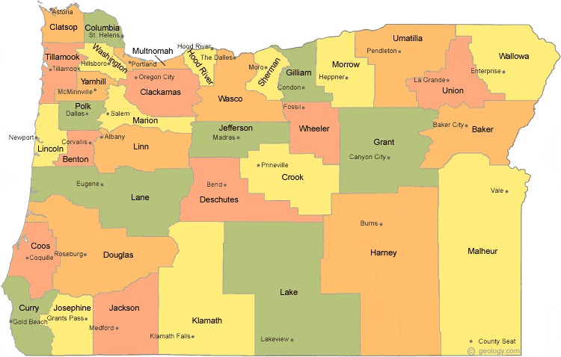
Regional Contacts by ESD
Amy Tidwell
  Grant, Harney, High Desert, InterMountain, Jefferson, North Central, Region 18, and Willamette
Jen Engberg
  Clackamas, Columbia Gorge, Linn-Benton-Lincoln, Multnomah, and Northwest Regional
Sarah Martin
  Douglas, Lake, Lane, Malheur, South Coast, and Southern Oregon
Notes:
We have divided up the state into three sections. Each of us serves as the primary contact for the districts in these ESDs

