Slide 1
Title IV, Part A: Basics
Student Success and
Academic Achievement

Slide 2

Oregon Department of Education – Our “Why”
Equity and Excellence for Every Learner
The Oregon Department of Education works in partnership with school districts, education service districts and community partners;
Together, we serve over 580,000 K-12 students;
We believe every student should have access to a high-quality, well-rounded learning experience;
We work to achieve the Governor’s vision that every Oregon student graduates with a plan for their future.

Slide 3

Outcomes for Today
Overview of Title IV, Part A
Allowable Uses of Funds
Eligibility and Funding
Resources

Slide 4

Purpose of Title IV-A
The purpose of Title IV-A is to improve student academic achievement through:
Access to a well-rounded education;
Improved school conditions regarding the health and safety of students; and
Improved use of technology in order to improve the digital literacy of all students.
Notes:
The purpose of the SSAE grant program is to improve students’ academic achievement by increasing the capacity of states, LEAs, schools, and local communities to:
Provide all students with access to a well-rounded education;
Improve school conditions for student learning; and
Improve the use of technology in order to improve the academic achievement and digital literacy of all students.

Slide 5

Consultation
Districts must meaningfully consult with a wide array of stakeholders when determining the use of Title IV-A funds
  Administrators
  Teachers
  Paraprofessionals
  Instructional support personnel
  Families
  Community members and partners
  Tribes and tribal organizations

Slide 6
Based on Needs Assessment
Required for districts that receive $30,000 or more
  Identified Needs and Priorities
  Program Objectives and Intended Outcomes
Must be completed even if the district plans to transfer funds into other programs
  Consult with stakeholders prior to transfer
Notes:
Ideally, the district’s application for Title IVA reflects the larger district plan for improvement. Districts are not expected to engage in a “needs assessment process” just for Title IVA.
In the Needs Assessment section of the Title IVA application, districts respond to two prompts: one identifying the needs and priorities of the district that will be supported with IVA funds and the other listing the program objectives and outcomes for the Title IV-A funded activities and how the district will periodically evaluate the effectiveness of these activities.
LEAs must meaningfully consult with a wide array of stakeholders when designing their SSAE programs and before transferring funds.
They must also engage in continuing consultation with stakeholders to improve SSAE activities and to coordinate SSAE activities with other activities conducted in the community.
6

Slide 7

Equitable Services*
Private schools are eligible for equitable services under Title IV-A
Timely, meaningful, annual consultation
Activities based on the needs of the private school
Most activities allowable for the district are allowable for the private school
  Must be secular, neutral, non-ideological
  No salaries, benefits, or substitute costs
ESSA Quick Reference Brief: Equitable Services
*Administrative costs cannot exceed 2%
Notes:
It is important to note that private schools are eligible for equitable services under Title IIA. Districts must engage in consultation with private schools within district boundaries annually to determine if they wish to participate. As a result of completing the Private School information linked in the district’s CIP Budget narrative dashboard an equitable services worksheet will automatically be generated. When calculating total enrollment on the ES worksheet – all students in the district and PS are included which is different from the Title IA calculation.
The amount a district must reserve to provide equitable services for private school teachers and other educational personnel is based on the district’s total Title II allocation less administrative costs.
The district can deduct costs for administering IIA to private schools, which means costs that are incurred in operating the grant. This includes things like conducting meetings, negotiating contracts, processing purchase orders, accounting activities, file maintenance, conference registration, etc. However, the total for administrative costs for the purpose of calculating the equitable share cannot exceed the district’s indirect rate.

Slide 8
Allowable Uses

Slide 9
Allowable Costs Under Title IV-A
Well-Rounded Education | Safe and Healthy Students | Use of Technology
College & career guidance Music & Arts STEM Accelerated learning History, civics, economics, geography, government education Foreign language Environmental education Volunteerism & community involvement Integrating multiple disciplines | Drug & violence prevention School-based mental health services Health & safety programs Addressing trauma Addressing sexual abuse Reducing exclusionary discipline practices Positive behavioral interventions Resource coordinator Pay for success | Professional learning Technological capacity & infrastructure Delivering courses through technology Blended learning PD on use of technology in STEM areas Access to digital learning
Notes:
The spending options are organized by the three spending categories described in the law.

Slide 10
Well-Rounded Education (at least 20%*)
Provide enriched curriculum and education experiences to all students
  Promotes a diverse selection of content that goes beyond the core;
  Integrates learning across subjects;
  Prepares students for college, careers, and community involvement.
Removal of barriers to courses and other educational opportunities is central to providing all students the opportunity for a well-rounded education.
* Applies to districts that receive $30,000 or more in IV-A funds
Notes:
This is language out of the non-regulatory guidance. Activities in the well rounded education bucket should reflect increasing opportunities for students. Making sure that all students have access is a central tenet of WRE.
Districts that receive more than $30K in Title IVA funds must spend at least 20% in this category.

Slide 11
Safe and Healthy Students (at least 20%*)
Improve school conditions for student learning
  Fosters safe, healthy, supportive, and drug-free environments;
  Addresses students’ physical health and mental health;
  Can be coordinated with other schools and community-based services and programs.
When students are healthy and feel safe and supported, they are more likely to succeed in school.
* Applies to districts that receive $30,000 or more in IV-A funds
Notes:
Safe and healthy students encompasses environment as well as programs. It can also support professional development in these areas. Activities in this bucket should demonstrate how they foster safe, healthy, supportive, and drug-free school environments.

Slide 12
A note about mental health supports…
SEC. 4001. 20 U.S.C. 7101 GENERAL PROVISIONS
PARENTAL CONSENT.—(1) IN GENERAL.—
(A) INFORMED WRITTEN CONSENT.—A State, local educational agency, or other entity receiving funds under this title shall obtain prior written, informed consent from the parent of each child who is under 18 years of age to participate in any mental-health assessment or service that is funded under this title and conducted in connection with an elementary school or secondary school under this title.
(B) CONTENTS.—Before obtaining the consent described in subparagraph (A), the entity shall provide the parent written notice describing in detail such mental health assessment or service, including the purpose for such assessment or service, the provider of such assessment or service, when such assessment or service will begin, and how long such assessment or service may last.
Notes:
Even though Oregon has a law allowing students ages 14 and above to consent to treatment, the parent/guardian consent required by federal law applies if Title IVA funds are being used.

Slide 13
Use of Technology (some funds)
Improve the academic achievement, academic growth, and digital literacy of all students.
  Increases equity of access to high-quality learning materials and experts;
  Offers opportunities to rethink when, where, and how students learn;
  No more than 15% used for technology infrastructure.
Technology can accelerate, amplify, and expand the impact of effective practices that support student learning.
Notes:
Providing PD to staff in technology increases the capacity of staff to take full advantage of technology-rich learning environments.
Districts that receive more than $30K in Title IVA funds cannot spend more than 15% of their Title IVA allocation on tech infrastructure costs.

Slide 14

Defining “Technology Infrastructure”
Devices
Equipment
Software applications and platforms
Digital instructional resources
Other one-time IT purchases
Private school equitable share for all three categories is part of the district’s percentage, including technology infrastructure
Notes:
This definition comes from the Oregon Federal Funds Guide, p. 37. This is not an exhaustive list.

Slide 15
Supplement Not Supplant
Federal funds cannot be used to supplant, or take the place of, state and local funds that would have been spent if Title IV-A funds were not available
  Test I: Are the services that the district wants to fund with ESEA funds required under state, local, or another federal law? If they are, there could be the presumption of supplanting.
  Test II: Were state or local funds used in the last year to pay for these services? If they were, there could be a presumption of supplanting.
ESSA Quick Reference Brief: Supplement Not Supplant
Notes:
There is a federal provision of supplement, not supplant in Title IV, Part A: Funds received under this subpart shall be used to supplement, and not supplant, non-Federal funds that would otherwise be used for activities authorized under this subpart.
To determine whether a fiscal expenditure supplements and does not supplant, school districts must run the following tests:
Test I: Are the services that the district wants to fund with ESEA funds required under state, local, or another federal law? If they are, there could be a presumption of supplanting.
Test II: Were state or local funds used in the past to pay for these services? If they were, there could be a presumption of supplanting.
It is possible for districts to overcome the presumption of supplanting. Overcoming the presumption of supplanting requires that districts keep documentation (e.g., budget information, planning documents, or other materials). In general, a district must determine what educational activities it would support if no ESEA funds were available. If it is clear that no State or local funds remain available to fund certain activities that previously were funded with State or local resources, then the district may be able to use ESEA funds for those activities.

Slide 16
Eligibility & Funding

Slide 17
Eligibility and Funding
Formula grant to all districts based on Title I-A formula
  No eligible district can receive less than $10,000
Districts receiving $30K or more must spend:
  At least 20% to support well-rounded education;
  At least 20% to support safe and healthy students; and
  “Some funds” to support effective use of technology
    No more than 15% on technology infrastructure
Districts receiving less than $30K must meet at least one of the above requirements
Costs deducted for administrative costs cannot exceed 2%
Notes:
In order to be eligible for Title IV-A funds, an LEA must have been allocated Title I-A funds the prior year, then applied for and been approved for those funds. For example, a district that received 5% of Oregon’s Title I-A allocation to districts in 2020-21 can expect to receive 5% of Oregon’s Title IV-A allocation to districts in 2021-22. Districts that did not qualify for or that did not accept a Title I-A allocation in the previous year do not receive a Title IV-A grant for the following school year.
No eligible district may receive less than $10,000. If the $10,000 threshold cannot be reached for every LEA, then all grants are ratably reduced.
Cap on Technology Infrastructure
Of the SSAE funds spent on technology, LEAs may not spend more than fifteen percent of those technology funds to purchase technology infrastructure. Specifically, this means that LEAs may not spend more than fifteen percent of its SSAE technology funds on devices, equipment, software applications, platforms, digital instructional resources and/or other one-time IT purchases.
Cap on Administrative Costs
LEAs may not spend more than two percent of their SSAE funds on direct administrative costs.

Slide 18



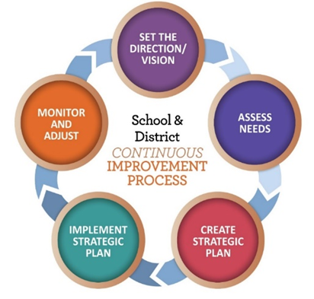


Funding Process
U.S. Census Bureau calculates annual poverty estimates for all public school districts
The U.S. Department of Education allocates program funding to states based on poverty percentages
Congress passes appropriations to federal education programs
The Oregon Department of Education finalizes allocations for all Oregon School Districts
Oregon Department of Education
Notes:
First: Federal funds originate in Congress
Second: The U.S. Department of Education calculates state level allocations
Third: ODE calculates each district’s allocation
Title I-A is comprised of four separate formulas. Some districts are eligible to receive funding in all four areas, while others are eligible in only a few. There are different criteria for each formula, though all are based on census poverty.

Slide 19
Transferability
Can transfer out of or into Title IV-A
Must consult with private schools prior to transfer
Must complete needs assessment if over $30K, even if transferring funds
Can transfer all or a portion of the funds into a grant award for the same year
Must be claimed from IV-A award in EGMS
Carryover funds cannot be transferred
ESSA Quick Reference Brief: Transferability
Notes:
Under ESEA districts have the ability to transfer funds it receives by formula under certain programs to other programs to better address local needs. It is important to keep in mind that once funds are transferred, they take on the identity of the Title to which they were transferred and must be spent under rules applicable to that Title.
Before an LEA may transfer funds from a program subject to equitable services requirements, it must engage in timely and meaningful consultation ​
with appropriate private school officials. (ESEA section 5103(e)(2).) With respect to the transferred funds, the LEA must provide private school students and teachers equitable services under the program(s) to which, and from which, the funds are transferred, based on the total amount of funds available to each program after the transfer. A district may not reserve Title II-A or IV-A funds solely to provide equitable services.
There is no limit on the amount of funds that can be transferred from one grant to another, but transfers of funds cannot cross years.​
​
A district cannot transfer funds into a program it does not receive an allocation for, or a program for which it declined an allocation.​
​
Carryover funds cannot be transferred between title programs. Once it becomes carryover, transferability is no longer an option. (NOTE FOR US: This means that if you didn’t transfer it in the initial year, you can’t transfer the remainder once it becomes carryover. If a district did not spend all its transferred funds from the first year it can still use them as transferred funds in the carryover year.

Slide 20
2022-23 FEDERAL FUNDS TIMELINE
JULY
2022
AUG 2022
NOV 2022
BEGINNING OF 2022-23 GRANT PERIOD
2022-23 BUDGET NARRATIVE APPLICATION OPENS
2022-23 BUDGET NARRATIVES DUE
NOV 2023
SEPT 2023
FINAL DATE FOR ALL 2022-23 CLAIMS FOR *INITIAL GRANT PERIOD
FINAL DATE FOR OBLIGATION OF 2022-23 FUNDS FOR *INTIAL GRANT PERIOD
*INITIAL GRANT PERIOD: 7/1/22 – 9/30/23
(15 MONTHS)
NOV 2023
UNCLAIMED FUNDS BECOME “CARRYOVER”
NOV 2023
SEPT 2024
NOV 2024
CARRYOVER APPLICATIONS FOR 2022-23 FUNDS OPEN
FINAL DATE FOR OBLIGATION OF 2022-23 FUNDS
FINAL DATE FOR ALL 2022-23 GRANT CLAIMS
Oregon Department of Education
20
Notes:
Title IVA funds are made available on July 1 of the fiscal year and remain available for obligation for a period of 27 months. This 27-month period includes an initial 15-month period of availability and an automatic 12-month extension permitted under the “Tydings Amendment”. While districts are encouraged to obligate funds in the initial grant year, it is not uncommon for districts to have funds available from two different grant years.
This slide shows the 2022-23 grant year timeline.

Slide 21
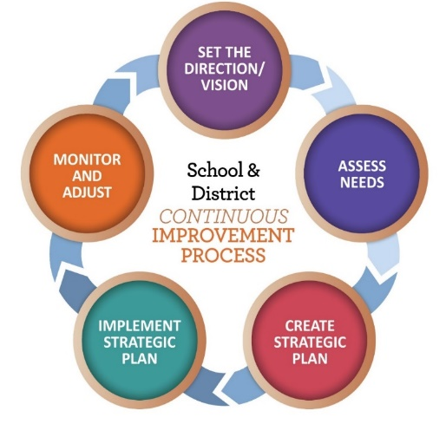
Application Requirements
Needs Assessment
  What does the data tell us?
  Which schools have the highest need?
Budget Narrative
  What will we do to meet our needs?
Equitable Services Worksheet
  Only for districts with participating schools
21
Notes:
The district applies for Title IVA funds through the CIP Budget narrative on the secure district site. Ideally, the district’s application for Title IVA reflects the larger district plan for improvement.
The two main parts are the needs assessment and the budget narrative. If a district has participating private schools then an Equitable Services tab will also appear. The Overview and Spending pages are auto-populated.
21

Slide 22
Prioritizing High Needs Schools
LEAs must prioritize SSAE funds to schools that
  Have the greatest need as determined by the LEA
  Have the highest percentages or numbers of children experiencing poverty
  Are identified for CSI or TSI support
  Are identified as a persistently dangerous school under Section 8532
22
Notes:
22

Slide 23

Measuring Progress
What need(s) are you trying to meet?
  (Priority/Goal)
What action(s) will you take to meet that goal?
  (Objective)
What do you expect to happen?
  (Outcome)
How will you know?
  (Measure)
How can we use what we learned through Integrated Guidance work?
Notes:
This information is included in the Needs Assessment section of the IVA CIP Budget narrative. While districts that receive less than $30K do not have to conduct a comprehensive needs assessment, all districts should reflect on these questions when planning how to spend IVA funds.
Needs identified as part of the integrated guidance plan can be used to meet the IVA needs assessment requirement, as long as activities identified meet allowability and SNS requirements.

Slide 24
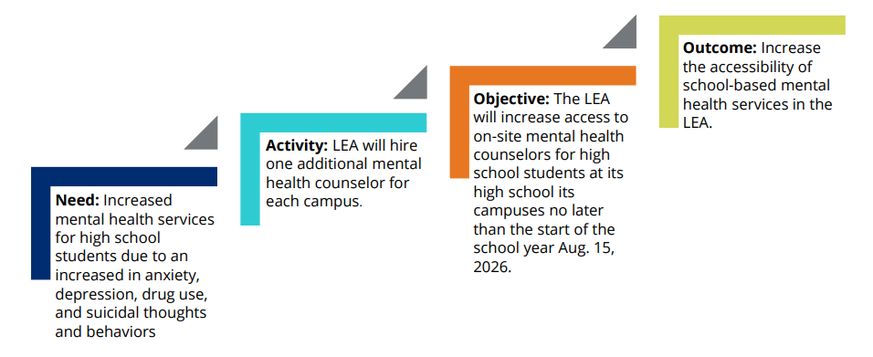
Example
Excerpted from Tennessee Department of Education: Guide to Writing Quality Objectives and Outcomes
Notes:
Objectives are the actionable, incremental steps that LEAs take toward achieving their outcomes. Once LEAs identify outcomes tied directly to needs, they can create high-quality objectives that align with the needs and outcomes. However, objectives must also be measurable to determine whether the outcomes are met. Therefore, when writing high-quality objectives, it is best to use the S.M.A.R.T or S.M.A.R.T.I.E. acronym so that they are specific, measurable, attainable, relevant, and time bound or, additionally, inclusive, and equitable.
Outcomes are the broad, big-picture end results that LEAs expect their Title IV, Part A programs to accomplish. If objectives are the incremental steps that LEAs take toward achieving the end results, then outcomes are the top of the staircase. Although outcomes can be broken down into short- or long-term outcomes, they still encompass the overall impact the program expects to achieve. High-quality outcomes tie back to the needs identified in the needs assessment. Additionally, outcomes should be actionable and easily convey the change or effect the LEA expects to see.

Slide 25
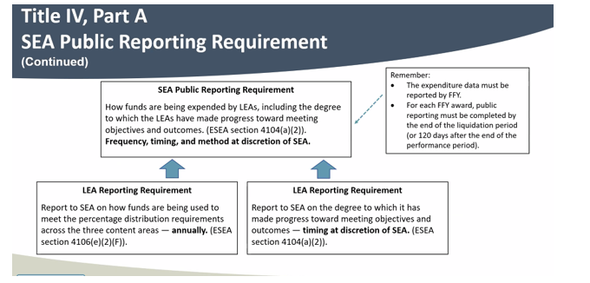
Measuring Progress and Public Reporting
Notes:
We don’t know yet what the reporting will look like, but our team is working on it.

Slide 26

Resources
Title IV-A web page
USED Non-Regulatory Guidance
Oregon Federal Funds Guide
CIP Budget Narrative User Guide
CIP Budget Narrative Checklists
Humanities Education
STEM and CTE
Notes:
There are a wide variety of resources available to support districts with Title IVA. The CIP Budget Narrative User Guide and Checklists are particularly helpful tools when submitting the narrative application.

Slide 27
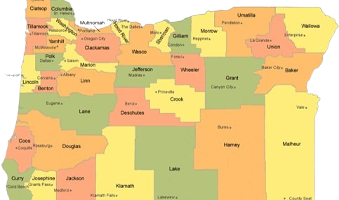
Regional Contacts by ESD
Amy Tidwell
Grant, Harney, High Desert, InterMountain, Jefferson, North Central, Region 18, and Willamette
Jen Engberg
Clackamas, Columbia Gorge, Linn-Benton-Lincoln, Multnomah, and Northwest Regional
Sarah Martin
Douglas, Lake, Lane, Malheur, South Coast, and Southern Oregon
Notes:
We have divided up the state into three sections. Each of us serves as the primary contact for the districts in these ESDs

Slide 28

Please reach out!
Amy Tidwell
amy.tidwell@ode.oregon.gov
Jen Engberg
jennifer.engberg@ode.oregon.gov
Sarah Martin
sarah.martin@ode.oregon.gov
Notes:
Our team has moved from a programmatic model to a regional support model. Each of us has taken a section of the state to support across Titles IA, IIA, IVA and VB.

