Slide 1
Reconciling CIP Budget Narratives
& Spending
May 7, 2024

Slide 2

Agenda for Today’s Session
Budget Narrative and Fiscal Timelines
Reconciliation – What, Why, and When
Reconciling and Personnel Costs
Key Takeaways

Slide 3
2023-24 FEDERAL FUNDS TIMELINE
JUL 1
2023
AUG 2023
OCT 2023
NOV 2023
PREREQUISITES DUE
BEGINNING OF GRANT PERIOD
BUDGET NARRATIVE APPLICATION OPENS
BUDGET NARRATIVES DUE
NOV 14 2024
SEPT 30 2024
FINAL DATE FOR CLAIMS FOR *INITIAL GRANT PERIOD
FINAL DATE FOR OBLIGATION OF 2023-24 FUNDS FOR *INTIAL GRANT PERIOD
NOV 2024
UNCLAIMED FUNDS BECOME “CARRYOVER”
*INITIAL GRANT PERIOD: 7/1/23 – 9/30/24 (15 MONTHS)
NOV 2024
SEPT 30 2025
NOV 14 2025
CARRYOVER APPLICATIONS FOR 2023-24 FUNDS OPEN
FINAL DATE FOR OBLIGATION OF 2023-24 FUNDS
FINAL DATE FOR ALL 2023-24 GRANT CLAIMS
Notes:
Federal funds are made available on July 1 of the fiscal year and remain available for obligation for a period of 27 months. This 27-month period includes an initial 15-month period of availability and an automatic 12-month extension permitted under the “Tydings Amendment”. While districts are encouraged to obligate funds in the initial grant year, it is not uncommon for districts to have funds available from two different grant years.
This graphic shows the funding timeline for the funds districts received in the 2023-24 school year.

Slide 4
Annual Budget Narrative and Fiscal Timeline
Signed Assurances and Prayer Certificate due
CIP Budget Narrative opens
CIP Budget Narratives due
Claiming funds in EGMS
June 30
August
November 1
Quarterly
July
October 1
January
Final allocations posted
Prerequisites due
Contacts
Private Schools
Consolidated Spending
Carryover CIP Budget Narratives due
Notes:
While the previous graphic shows the full 27 month lifetime of federal funds, there is an annual timeline for budget narratives that districts should also be tracking.
We recommend that districts submit claims at least quarterly.

Slide 5

Reconciliation Basics
What: Ensuring actual spending aligns to narrative
Why: Demonstrate that each award is used as intended
  Identify transaction errors
  Ensure that award expenditures are complete
  Plan for remaining funds as carryover
When: At least annually (quarterly is better)
  Anytime a new activity is added
  If the change is 10% or more
Oregon Department of Education
Notes:
Reconciliation is also helpful when the district is selected for monitoring. We often find that districts have activities in their expenditure report that are allowable, but not approved. Reconciling ensures that your fiscal documentation matches your narrative.

Slide 6
Ensuring Alignment with Personnel Costs
Positions described in Budget Narrative
Object codes in Expenditure Reports
Time and Effort Reporting
Notes:
Reconciliation also has implications for Time and Effort. During monitoring we compare your approved narrative to your expenditure reports, breakdown sheets and payroll reports.
A common finding is that there is not alignment between the positions described in the Budget narrative, the expenses charged to the grant and the documentation of people paid with federal funds. As part of the reconciliation process you will want to make sure that these align.

Slide 7
Checking for Understanding
Personnel costs came in lower than projected for participation in professional learning. The district would like to use the remaining funds to pay a higher percentage of an already approved instructional coaching position.
  NO, unless the change in the costs is more than 10% for either activity.
The district was unable to hire for an EA position in one of the Title I-A schools. The school would like to use the funds to support a new activity aligned to the school plan.
  YES, because a new activity is proposed.
A training had to be rescheduled. Staff will attend the same training, but on a different day and at a different location.
  IT DEPENDS. Will there be any new costs incurred by traveling to the new location? Are the same number of staff attending?

Slide 8

Have a Game Plan
Current year narratives
  Hit REVISE in CIP Budget Narrative dashboard
  Resubmit for review
Approved Carryover Narratives
  Complete the Carryover Revision Request form
Fiscal returns to ODE
  Reimbursement SmartSheet
Don’t forget to revise private school descriptions if needed for II-A/IV-A
Notes:
We know that the application you submit is your intended plan and that plans change. When you go through the reconciliation process and find mismatches there are several solutions. If you have an allowable expense that is aligned to your needs but not in your narrative, you can change your narrative.
If you need to make changes to a current narrative, you can do that through your CIP BN dashboard. Simply pull the narrative back out, make any needed revisions and resubmit for approval.
Because of issues on ODE’s end, approved CARRYOVER narratives cannot be revised. Instead, complete the Carryover Revisions Request form and email it to your regional contact.
If you find expenditures that are not allowable or were charged to the wrong account, you send a reimbursement to ODE.
Sometimes the district submits its narrative with a placeholder for private school activities. Update private school line items if the narrative was submitted before the school communicated its plan to the district so that narrative accurately reflects PS activities.

Slide 9
Key Takeaways
It is okay if plans change
Expenditures must match approved plans
Accurate reconciliation requires regular communication between fiscal and program staff

Slide 10
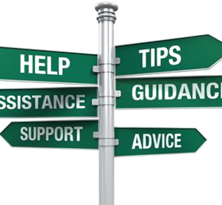
Resources
Oregon Federal Funds Guide
CIP Budget Narrative User Guide
CIP BN Quick Start Guide
Federal Funds Timeline
Carryover Revision Request Form
Reimbursement form
ESSA Quick Reference Brief: Time and Effort

Slide 11
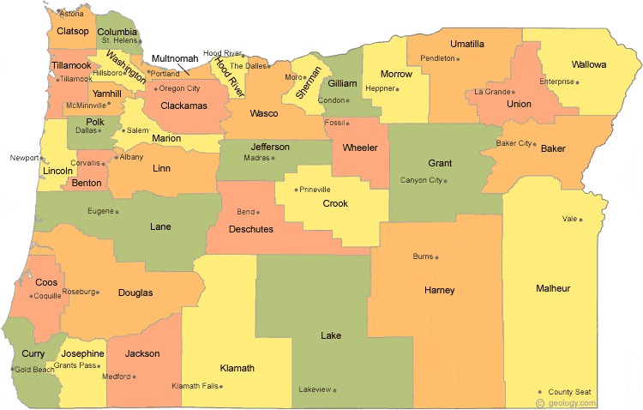
Regional Contacts by ESD
Jen Engberg
  Clackamas, Columbia Gorge, Multnomah and Northwest Regional
Sarah Martin
  Douglas, Lake, Malheur, South Coast and Southern Oregon
Lisa Plumb
  Lane, Linn Benton Lincoln and Willamette
Amy Tidwell
  Grant, Harney, High Desert, InterMountain, Jefferson, North Central and Region 18

Slide 12

Please reach out!
Jen Engberg
jennifer.engberg@ode.oregon.gov
Sarah Martin
sarah.martin@ode.oregon.gov
Lisa Plumb
lisa.plumb@ode.oregon.gov
Amy Tidwell
amy.tidwell@ode.oregon.gov

