Slide 1
Locally Developed Student Leadership
In Oregon CTE POSs
Fall 2024

Slide 2
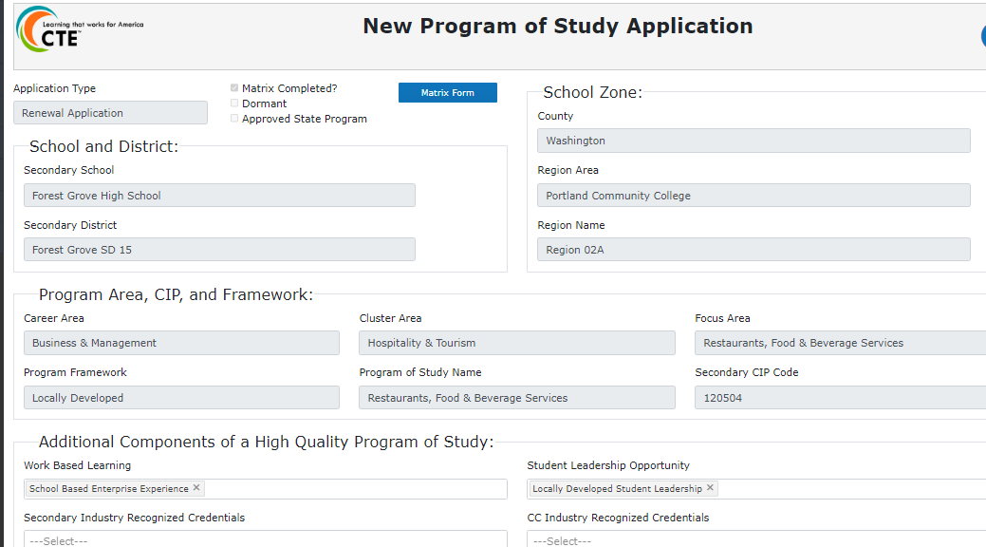
CTE-IS application
Notes:
When a school applies for approval of a CTE POS–or renews a previously approved CTE POS–they submit that application through the CTE Information System database. That application interface collects all the information ODE needs in order to approve the CTE POS, including school, district and region information, Career Area, Career Cluster, Focus Area, CIP codes, Work Based Learning and Industry Recognized Credential information, teacher licensure information, and Student Leadership information. The student Leadership information is initially given through a pull down menu that lists all the State Board recognized CTSOs (i.e., DECA, FBLA, FCCLA, FFA, FNRL, HOSA, SkillsUSA, and TSA).

Slide 3
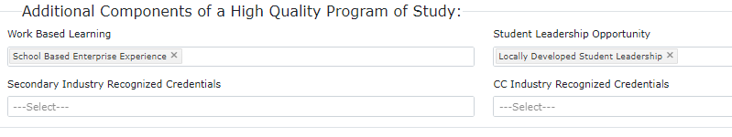
CTE-IS application (cont.)
Notes:
Last year, when we started to focus on input regarding student leadership information in these applications, we got some push back that some CTE POSs were… for one reason or another… not going to participate with any of the recognized CTSOs for their student leadership experiences, and couldn’t therefore select anything from the Student Leadership Opportunity menu. So we added an additional item to that pull-down menu: Locally Developed Student Leadership opportunities. That selection was to be accompanied by an explanation in the Student Support Services Comment Box (further down the application) of how the CTE POS was going to provide students those student leadership experiences.

Slide 4
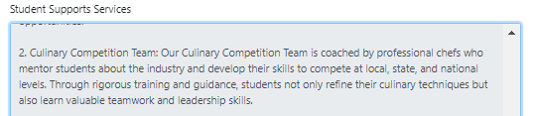
Student Support Services Comment Box
Notes:
Many times, however, what is included in the Student Support Services Comment Box relative to Locally Developed Student Leadership doesn’t really address all three of the general elements that make student leadership a significant piece of a CTE Program of Study. In this example, it’s just not enough to know that there is a competition linked to the program. That addresses the first element of content, instruction, and evaluation. But it does not address how the students will interact with the community, or how the students will have opportunities to participate in an organization as members, administrators, and especially, as leaders. So what should be included in the SSS Comment Box?

Slide 5
Why student leadership?
Question?
What is there about student leadership that has made it–nationally–a big part of CTE expectations?
Notes:
Well, first, we should review why student leadership should be part of a CTE Program of Study. To address this, let’s pair up with a table partner and discuss why you think student leadership is considered to be a significant part of a CTE POS. Let’s take 5 minutes, then come back to the main conversation.
[Report out of discussions.]

Slide 6
What is student leadership?
Definition:
Student leadership opportunities are an integral piece of the secondary component of Career Technical Education Programs of Study (CTE POS). A student leadership structure within a CTE POS provides leadership development opportunities that meet the following expectations:
Instruction, Career Development, and Assessment based on CTE Skill Sets
Community-based connections
Organizational Participation/Administration/Leadership opportunities
Notes:
Sometimes, what people think of when discussing or thinking about “student leadership” isn’t what we want people to understand about student leadership. We try hard to make people aware that we are not talking about “clubs” or social circles operating within the background of the school environment. We also don’t want people to only see student leadership as that once- or twice-a-year competition that five or six students go to, the results of which may or may not show up in the daily announcements the following week. The definition you see shows us that student leadership is an integral part of the CTE POS system that provides 1) Instruction, career development, and assessment based on the applicable CTE Skill Set from the Oregon Skill Sets, 2) intentional and guided interactions for all students in the program where they interact at some level with adults from the community they live in, and 3) instruction and opportunities to participate in the operation of an organization, including opportunities to function as a member, as an administrator of that organization’s functions, and as a leader.

Slide 7
Why student leadership? (part 2)
CTE: Preparing students for their next step
  Education–Higher Education, trade school, military, others
  Career–knowledge and skills for success: entry to advancement
  Life roles (Learner, Producer, Consumer, Citizen, Individual, Family Member)
(These roles were determined by the Oregon State School Board in the 1980’s)
Benefits of student leadership for students
  Context for learning
  Bridges academic world to the real world
  Gives student a sense of belonging
  Provides opportunities for positive interaction with adults/practitioners
Notes:
CTE itself is about preparing students for their ‘next step’, whether that is in education as a learner, going directly into the workforce as a producer, or any of the other life roles as identified by the Oregon State Board of Education as the purpose of Public Education. But the benefits specifically for each CTE student is the opportunity to learn in an applied context where what the student is learning makes sense, is relevant, and will be retained for much longer than content learned in rote learning exercises. It helps students bridge the academic content of school to their life in the real world. Student leadership, although not a “club,” does give students a sense of belonging and teaches them to network within the context of their career pathway. And student leadership provides opportunities for students to engage in meaningful interactions with professionals and practitioners in their career pathway.

Slide 8
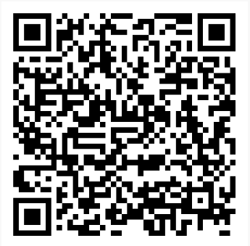
CTE Student Leadership Organizations
Criteria for Locally Developed Student Leadership/CTSOs
Student leadership opportunities are an integral piece of the secondary component of Career Technical Education Programs of Study. A student leadership structure within a CTE Program of Study provides leadership development opportunities that meet the following expectations:
1 – Delivery mechanism for career area content (tied to skill sets)
2 – Community connected (including WBL, Project Based Learning, etc.)
3 – Enterprise management and membership (member, leader, meeting process)
(the full text of the Criteria document is available on the ODE CTSO website)
Notes:
Old slide 8 speaker notes:
For some time now, ODE has had a list of the expectations we have for student leadership experiences in a CTE POS–whether that is through a CTSO or through a locally developed set of student experiences. The QR code you see takes you to the ODE Student Leadership page, and the link takes you to the actual document that lists those expectations.
Old slide #9 notes: This is what that list of expectations looks like. And you will note that there are three major expectations….
Old slide #10 notes: You will hear several times through the rest of this presentation what those three major expectations are. [ Read list] We feel very strongly that student leadership is a tool in a CTE POS. But like any tool, it needs to be used correctly to have the most value for the student, as well as for the instructor.

Slide 9
CTSO versus Locally Developed Student Leadership
State-recognized CTSOs:
  DECA (Marketing)
  FBLA (Business Management and Administration)
  FCCLA (Child Development, Education)
  FFA (Agriculture)
  FNRL (Natural resources)
  HOSA (Health sciences)
  SkillsUSA (Engineering, Construction, Automotive, and other trades, etc.)
  TSA (Technology and Electronics)
Notes:
Currently, there are eight ‘official’ Board Recognized CTSOs in Oregon. Many of these organizations have been part of the Oregon education landscape for years. Some, like TSA and FNRL, have only been on the books for a couple years and haven’t taken root in all places those organizations can help. But you will notice, not all the Career Clusters for which Oregon has approved CTE POSs have one of the Board Recognized CTSOs to use. Programs in at least a half dozen Career Clusters need to develop local student leadership opportunities to provide equal opportunities for students in those programs.

Slide 10
CTSO versus Locally Developed Student Leadership (part 2)
Making a choice…
State Board recognized CTSO –or–
Locally Developed Student Leadership opportunities
Notes:
Even in those Clusters that DO have a Board Recognized CTSO available, as mentioned earlier, for one reason or another a teacher of record may not–or can not–offer a home for that CTSO. So a decision needs to be made to develop a local student leadership opportunity.

Slide 11
Why Decide to Offer a Locally Developed Student Leadership Opportunity?
Thought partners:
What are some reasons to not have a CTSO in your POS? –or–
What are some benefits for having locally developed student leadership?
Notes:
Again, let’s turn to our thought partners and answer one of the two questions posed: 1) what are some reasons to not offer a CTSO, or 2) what are some benefits of offering a Locally Developed Student Leadership component instead?
[Report out]

Slide 12
So… What do you need to have in place for a Locally Developed Student Leadership opportunity?
The three large criteria
Tied to curriculum (Skill Sets)
Community connections with business and/or industry practitioners
Organizational membership, process, and leadership
Notes:
Bottom line: if you want to offer a Locally Developed Student Leadership opportunity for your students, you must meet the same three expectations we have for chapters of any of the eight Board Recognized CTSOs: 1) the opportunity needs to be tied to the curriculum (which is based on the skill set for the CTE POS), 2) the students must have opportunities to connect with the community and industry practitioners, and 3) students need instruction and practice in belonging as members, administrators and leaders in an organization.

Slide 13
Co-curricular (tied to Skill Sets)
  Helps teach toward skill sets
    Not just a “cookie & milk club”
    Delivery of knowledge and skills
    Opportunities for student to demonstrate K&S
  School-based enterprises and learning/demonstration labs (WBL)
  Possible IRCs
Notes:
When we say ‘tied to curriculum,” we mean that student experiences are a source of curriculum delivery and assessment of the acquisition of knowledge and skills. Students need to learn by doing, then have multiple opportunities to demonstrate those knowledge and skills. This can be done, for example, through school-based enterprises or other Work Based Learning experiences. These experiences may even lead to acquisition by the student of Industry Recognized Credentials.

Slide 14
2. Community connected (project based)
  Working with community partners
    Community members on advisory board
    Help with POW and design of calendar/agenda
  Mentorships/internships
  Service learning
  Identify/design projects
    Community needs
    Community contacts
    Communications
    Evaluation of projects
Notes:
There are many ways a teacher/advisor can turn student leadership opportunities into student interaction with local business and industry partners, including through students engaging with speakers, mentors, internships, service learning or other community projects. And those projects should be done in partnership with the community, with community partners helping students identify community need, find community contacts, prepare and disseminate communications, and ultimately judge or otherwise evaluate those projects.

Slide 15
3. Enterprise management and membership
  Membership experience for student
  Leadership experiences for students
  Opportunities for networking
  Instruction on organizational processes and procedures
  Develop an organization’s Plan of work
  Designing and following agenda (meetings)
  Parliamentary procedure/rules of order
  Financial strategy instruction
Notes:
But one of the major lessons missing from many students’ secondary experience involves being a member of an organization, or making decisions about how an organization functions, or leading and guiding that organization, or leading and guiding projects that are part of that organization’s Plan of Work. CTSOs and locally developed student leadership opportunities fill that need for students. Student leadership often provides the only exposure students have to structured experiences, like how to design and follow an agenda, how to use rules of order to run meetings (for example, Parliamentary Procedure), and how to practice basic fiduciary functions.

Slide 16
Note: Financial strategy instruction
Understand basic financial concepts
Understand rules and laws regarding enterprise finances
Help with the cash flow of an organization
Adhere to financial ethics
Notes:
It should be noted here that SB 3, which includes a new ½ credit graduation requirement for students graduating in 2027 and beyond, requires that ALL students be given some basic education about their personal finances. The expectations of student leadership experiences is a perfect place to teach some of those basic financial concepts, including financial rules and laws regarding organizational finances, how supply and demand works, elementary principles of cash flow, how basic microeconomics work, and how to make ethical decisions regarding finances.

Slide 17
CTE-IS application (part 2)
Notes:
So… coming full-circle to the CTE Information System and your CTE POS application–or your CTE POS Update–student leadership is one of the principle pieces of a CTE POS. Selecting a CTSO is one way to identify how you intend to go about meeting that student leadership expectation. But whether you select one of the Board Recognized CTSOs, or Locally Developed Student Leadership, you have the opportunity to take your students to the next level by providing a student leadership experience that meets all the criteria listed in the one-pager found on our website. But choosing Locally Developed Student Leadership requires you share with us your plans to meet that criteria… and you would do that in the Student Support Services Comment Box.

Slide 18
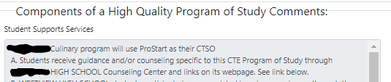
CTE-IS application (part 3)
Notes:
But let’s look at some of the responses we have had to date. If you were an Education Program Specialist at ODE, would you approve this comment on how this CTE POS intends to meet the student leadership expectations outlined on the one-pager? Hint: Does it list how it will meet the three major elements of student leadership?

Slide 19
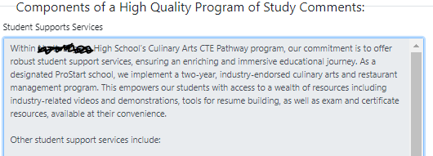
CTE-IS application (part 4)
Notes:
How about this one? It’s better… but does it clearly illustrate how the three major expectations will be met?

Slide 20
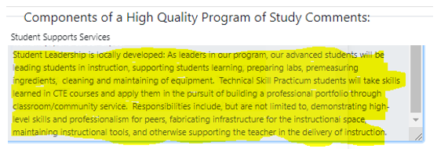
CTE-IS application (part 5)
Notes:
How about this one? It talks about leadership roles… and a mention of some community involvement. But for ALL students? There will be lots of teacher assisting, but how extensive will that community engagement be? How about organizational opportunities for all students to be members, administrators, or leaders? (This response might get approved… for now. But there might be a response from the ODE Specialist regarding the weak community involvement and missing organization piece.)

Slide 21
CTE-IS application (part 6)
Curriculum, teaching, and workplace experiences will reflect the Oregon Skill Sets for the Marketing Cluster. Instruction will be focused on internal and external sales, as well as market research…
Program design, implementation, and evaluation is done collaboratively with local business and industry partners engaged with students. Those partners also provide external opportunities for students to work with the community on projects connected back to the POS curriculum…
Students meet twice each month, following Robert's’ Rules of Order to conduct meetings that follow student-developed agendas. Students each take turns at leading initiatives, projects, and the operation of the chapter itself…
Notes:
To make sure your Application or your Update sails through the approval process, make sure you talk about how your CTE POS will provide students all three parts of student leadership expectations: 1) tied to curriculum, 2) connected to community, and 3) opportunities to participate in organizational process. This entry may not be very detailed, but the meat of what the teacher is providing is very clear here.

Slide 22
Resources:
Student Leadership Expectations
CTSO Board Approval Process
Oregon Skill Sets
Tri Leadership Resources
TEACH CTSO
These slides
Notes:
These are resources that will help you flesh out your plans for using student leadership in your CTE POS, whether you select one of the Board Recognized CTSOs, or you design something geared for yours and your students’ local needs. These links are current as of today, and the last link will take you to a version of this slide deck, including the talking points. Thank you for listening, and feel free to email me with any comments or questions you might have.

Slide 23
Questions ??
Thank you!
Ron Dodge
(ron.dodge@ode.oregon.gov)

