Slide 1


2022-2023 Social Science
Update
Presentation
Tribal History, Ethnic Studies, Holocaust,
& Civics
Notes:
Since the Adoption of the of the 2018 Social Science Standards, there have been several new laws passed by the Oregon Legislature that have important implications for social science instruction Kindergarten through high school.

Slide 2

Objectives
Overview of Ethnic Studies, Tribal History Shared History, Holocaust and Genocide Studies, Civics
Culturally Relevant and Responsive Teaching
Resources for Teachers
Notes:
This presentation will provide a brief introduction to the requirements for Ethnic Studies, Tribal History-Shared History, Holocaust and Genocide studies, and Civics.
The presentation also includes a basic introduction to culturally relevant and responsive teaching and includes links to resources throughout the slide deck.

Slide 3


Inclusive Education
Reference Guide
Tribal History/ Shared History
Curriculum
The law requires instruction to the Tribal approved Essential Understandings across five content area. Lesson are available in grade 4, 8, 10 from ODE. Additional resources available from local tribes.
Grades:
4, 8, 10
Subject Areas:
Language Arts, Health/PE, Math, Science, and Social Science
Holocaust and Other Genocides
Learning Concepts
The law identifies learning concepts related to Holocaust and other genocides education. Resources and training are available through local and national organizations as well as ODE.
Grades:
K-12
Subject Area:
Social Science
Ethnic Studies
Standards
Ethnic studies integrated with social science standards. The 2021 social science standards are available for implementation now and are required in 2026-2027.
Grades:
K-12
Subject Area:
Social Science
Notes:
We are now several years into the three legislative requirements that have a significant impact on social science instruction. Each of these is slightly different in what is available for teachers and what is required for implementation.
Tribal History Shared History includes a set of lessons for grades 4, 8, 10. Each grade level includes lessons for the Language Arts, Math, Science, Health, and Social Science. These lessons should already be part of classroom instruction and are available on the ODE webpage
The guidelines from the Holocaust and other Genocides law were adopted as learning concepts to be integrated into social science curriculum. These learning concepts will be used to inform the next round of social science standards writing.
The State Board adopted 2021 ethnic studies integrated social science standards are available for implementation and will be required in the 2026-2027 school year.

Slide 4
Getting Ready for 2026-2027 Implementation
Identify current curricula connections to new standards & learning concepts
Determine professional learning needs for new social science standards
Create and support conditions for equity learning in the district
Identify resources for professional learning and instructional materials
Develop and share with educators, students, and families information about the new social science standards and highlighting ethnic studies
Harness student voice and community engagement
Notes:
For many schools and teachers, the new laws require an expansion of the perspectives and voices included within the social science curriculum.
Equity for students is at the heart of these new standards and concepts. It is important for educators to work in an environment that embrace equity learning
In order to successfully implement the new standards, it is important that a district, school, or social science department have a good assessment of their needs.
This should include;
Identifying current curricula connections to the standards and concepts to determine what instructional materials are already in place.
Listening and responding to teachers needs concerning how to teach these new, sometimes difficult histories, and what support teachers need to build content knowledge to address the new standards.
Seeking additional resources and trainings to help teachers implement the new standards
It is also integral to the successful implementation of these changes to make sure educators, parents, community members, and students are familiar with the new, expand perspectives and have a voice in helping to guide curricular choices.

Slide 5
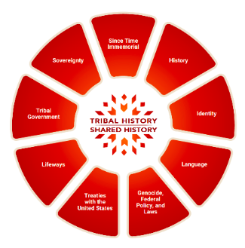
Tribal History Shared History Lessons
Online Training on Essential Understandings from Office of Indian Education
Tribal History/Shared History Social Science Lessons For Grades 4, 8, 10
Additional Lessons Available From Tribal Education Centers
Contact: Brent Spencer Office Of Indian Education
Notes:
In 2017, the Oregon Legislature enacted Senate Bill (SB) 13, now known as Tribal History/Shared History. THSH is centered around the nine Essential Understandings identified by the Nine Federally recognized Tribes of Oregon.
These essential understandings form the basis of the content based grade level lesson plans supporting a deeper understanding of Tribal History.
The office of Indian Education at ODE hosts a number of training resources on its webpage. Teachers should familiarize themselves with the Online Modules that help ground educators in the Essential Understandings that create the foundation for the lessons in grades 4, 8, and high school.
In addition, tribal education centers near your community may also offer additional lessons to help supplement the required lessons or to use for other grades.
Please contact Brent Spencer at the Office of Indian Education for more information

Slide 6

2021 ETHNIC STUDIES INTEGRATED
SOCIAL SCIENCE STANDARDS
2021 ETHNIC STUDIES INTEGRATED SOCIAL SCIENCE STANDARDS
HISTORIES
The 2021 Social Science Standards shift and expand the perspective on history, geography, civics, and economics in Oregon’s K-12 classrooms.
RESISTANCE
RESILIENCE
2021 SOCIAL SCIENCE
CIVIC ENGAGEMENT
IDENTITY
TRIBAL HISTORY
HOLOCAUST/GENOCIDE
Notes:
The 2021 Standards continue to be organized by social science domains, Civics, Geography, Economics, Financial Literacy, History, and social science analysis.
There is no subheading or domain identified as ethnic studies. Instead ethnic studies concepts are integrated into the traditional domains.
However, the inclusion of ethnic studies helped to identify themes or ways to approach the teaching of the new standards.
Beginning with K-2, students explore issues of identity. Who they are in a family, at school, and in the community. Students will also explore the identity of others and the role different identities play in a community and throughout history. As students move through each grade they will consider how identity shapes worldview/perspective.
Resistance- Is most likely where many teachers will feel most prepared to discuss incidents and types of oppression (institutional, political, legal, cultural, economic, custom, etc.). Ideally, these lessons should be centered on resistance rather than oppression. Students should examine individual and/or group strategies for undermining, combating, and overcoming oppression.
Resilience - Explorers how individuals and groups overcome adversity through traditions, cultural values, language, the arts, sports, celebrations, community engagement, and politics. Stories of resilience help students understand that individuals that experienced oppression and practiced resistance, can continue to thrive.
The Histories theme focus on developing an understanding of the history of traditionally underrepresented groups with or without interaction with a dominant or colonial society. Students should have the opportunity to explore the history of a group prior and beyond moments of oppression. As an example, Jewish history or the stories of Jewish people, should not be limited to WWII era Europe. The same is true of Black History. Students should encounter African history and the African diaspora in a context greater than enslavement.
The latest social science standards continue to include the concept of civic engagement- For ethnic studies this includes an understanding and appreciation of successful and unsuccessful movements that strive toward “Liberty and Justice for All.”
These five themes, are also evident in the Tribal History Essential Understandings and the Holocaust and Genocide learning concepts.

Slide 7

Ethnic Studies Standards
2021 Standards available for implementation
New standards required In 2026-2027 school year
Resources on Oregon Open Learning & ODE Social Science webpage
Monthly Newsletter with resources & opportunities
Contact: Amit Kobrowski Social Science Specialist
Notes:
Currently, some school districts are implementing the 2021 ethnic studies integrated social science standards this school year.
However, many school districts are using these next few years to help build content knowledge and create a social science scope and sequence inclusive of culturally relevant and responsive teaching.
ODE’s webpage, social science newsletter, and Oregon Open Learning platform offer resources, lessons, and training opportunities for teachers.

Slide 8

Holocaust and Other Genocide Learning Concepts
K-12 learning concepts required for integration into social science
Crosswalk social science standards and Holocaust/Genocide concepts
Resources on Oregon Open Learning, Every Student Belongs, and OJMCHE
Learning Concepts will be integrated into standards for 2026-2027
Contact: Amit Kobrowski Social Science Specialist
Notes:
Beginning with the 2021 School Year, Social science teachers are incorporating the nine learning concepts supporting the teaching of the Holocaust and other Genocides
The nine learning concepts will be incorporated into the next set of social science standards
A crosswalk connecting the learning concepts to grade level standards is available on the ODE social science website
Additional resources are available on the ODE social science and every student belongs page, Oregon Open Learning, and the Oregon Jewish Museum educator webpage

Slide 9

Civics and Government
Course Requirements
Class of 2026 must complete .5 credits in a stand alone Civics/Gov Course
Civics course must be aligned to 2018 or 2021 standards
Total number of Social Science credits (3) and required credits for graduation (24) remains unchanged
Social science credit is awarded for geography, civics/govt., history, economics/financial literacy
New Civic and Government standards will be integrated
into 2026-2027 standards
Notes:
In 2022 the Oregon legislature passed SB 513 requiring student in the class of 2026 to earn .5 credit in a stand alone civics or government course
The civics course must teach and assess to all of the civics standards from the 2018 social science standards. In School districts implementing the 2021 ethnic studies integrated standards, the civics course must teach and assess to all of those civics standards
The requirement for a .5 civic credit does not change the total amount of required social science credit which remains 3. Social science credit is earned through standards aligned courses in geography, civics/govt., history, and economics/financial literacy
The total credits needed for graduation also remains the same at 24

Slide 10
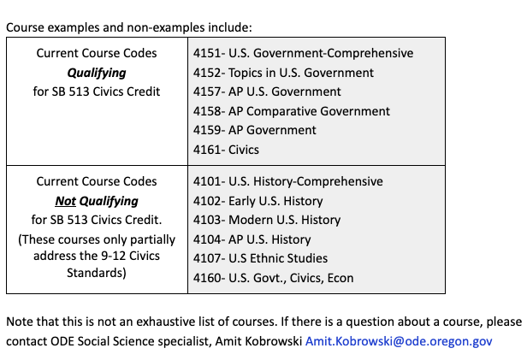
Civics Course Examples
Courses must focus on Civics standards
Combination courses do not meet requirements
Notes:
This is a partial list of the most frequently used course codes previously used for awarding civics credit. Courses in the top box meet the new civics credit requirement
The course in the lower box are representative of courses where civics standards were included within a history or economics course and will no longer qualify for civics credit.

Slide 11
Culturally Relevant and Responsive Teaching
Culturally Relevant
Prioritizing students’ intellectual growth
Affirming students culture of origin while also developing fluency in at least one other culture
Identifying, analyzing, and solving real-world problems, especially those that result in societal inequities against marginalized groups
Culturally Responsive
A strong knowledge base about cultural diversity
High expectations for all students
An appreciation for different communication styles
Connect students’ prior knowledge and cultural experiences with new knowledge
Notes:
Successful implementation of these new social science requirements relies on schools and teachers constructing culturally relevant and responsive learning environments.
The principles of culturally responsive and culturally relevant teaching are complementary and support growth for both teachers and students.
Gloria Ladson-Billings, whose work is most closely associated with culturally relevant teaching, defined it as a “theoretical model that not only addresses student achievement but also helps students to accept and affirm their cultural identity while developing critical perspectives” to identify, analyze, and solve real-world issues.
Culturally relevant teaching is a way to “empower students intellectually, socially, emotionally, and politically by using cultural referents to impart knowledge, skills, and attitudes”
More recently, Geneva Gay’s work on Culturally responsive teaching identifies additional concepts to improve learning for all students.
Gay defines culturally responsive teaching as “using the cultural knowledge, prior experiences, frames of reference, and performance styles of ethnically diverse students to make learning encounters more relevant and effective.
Culturally responsive teaching is validating, comprehensive, multidimensional, empowering, transformative, and emancipatory

Slide 12
Cultivating an Environment for Learning
“Transformative Social Emotional Learning is a process whereby young people and adults build strong, respectful, and lasting, relationships that facilitate co-learning to critically examine root causes of inequity, and to develop collaborative solutions that lead to personal, community, and societal well-being.” - CASEL
Attending to:
Identity
Agency
Belonging
Collaborative Problem-Solving
Curiosity
Notes:
Transformative Social Emotional Learning is a way to integrate culturally relevant and responsive approaches that can shift and expand the perspective on history, geography, civics, and economics in K-12 classrooms
Identity, agency, belonging, collaborative problem-solving, curiosity…. These are all transformative social emotional constructs that are helpful when discussing and studying social science. It is important to pay attention to how the educator is setting up the environment, lesson/unit, student engagement, and providing support before, after, and throughout in ways that attend to trauma-informed and social emotional learning so that students can bring their whole selves to the learning. Attending to both the mind and heart is essential to cultivating an environment for learning.

Slide 13
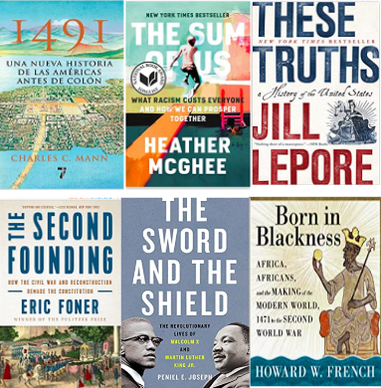
Additional Resources
Supplementary Non-Textbooks
Ethnic Studies Essential Questions
Ted Talk- Confronting Hard History
Professional Library for Ethnic Studies
Ethnic Studies FAQ
Amit.Kobrowski@ode.oregon.gov
Notes:
The ODE social science webpage will continue to provide updated information and resources for implementation of the most recent social science initiatives.
Please contact Amit Kobrowski with any questions about additional resources or professional development opportunities.

