Slide 1
Oregon Statewide Assessment System (OSAS)
Module 5
English Language Arts & Math Test Training
Required for all DTCs and STCs
Required for TAs who administer general ELA and Math summative tests
Notes:
Welcome to the training module for Oregon’s general English language arts and math summative tests. This is a required part of annual training for all District and School Test Coordinators, as well as OSAS ELA and Math Test Administrators.

Slide 2
Module Topics
Key Elements of OSAS ELA and Math Tests
ELA and Math Test Updates
Test Scheduling
Test Administration
Resources
Notes:
The topics covered in this module include: a brief overview of key elements of the OSAS ELA and Math tests, updates for the current school year, scheduling considerations, appropriate administration, and available resources to support testing.
References to specific sections of Oregon’s Test Administration Manual and the Oregon Accessibility Manual are included, where applicable. These resources are also hyperlinked at the end of this presentation. We encourage you to bookmark these in your browser for future reference, as well as the ODE Student Assessment homepage.

Slide 3
Acronym Guide
CAT: Computer Adaptive Test STC: School Test Coordinator
CRS: Centralized Reporting System TA: Test Administrator
DTC: District Test Coordinator TAM: Test Administration Manual
ELA: English Language Arts TIDE: Test Information Distribution Engine
OAM: Oregon Accessibility Manual
ODE: Oregon Department of Education
OSAS: Oregon Statewide Assessment System
PT: Performance Task
Notes:
Before we begin, here is a helpful list for your reference of acronyms that you will find in these slides.

Slide 4
Key Elements of
OSAS ELA and Math Tests
Notes:
TOPIC 1: Key Elements of the OSAS ELA and Math Tests
The learning goal for this section is for test administrators to understand the key features of each test.

Slide 5
OSAS ELA & Math Test Overview
The OSAS ELA & Math Tests both consist of two components: the Computer Adaptive Test (CAT) and the Performance Task (PT).
Content Area | CAT | PT
English language arts | About 25 items | 1 research item 1 full write composition
Mathematics | About 20 items | 1 stimulus connected with 4 – 6 items
Notes:
Both the OSAS ELA and Math Tests consist of two components: A computer adaptive test, or CAT, and a performance task, or PT.
The ELA CAT consists of approximately 25 items across all grade levels. The ELA Performance Task consists of 1 research item and 1 writing extended response or full write composition.
The Math CAT consists of approximately 20 items. The Math Performance Task includes 4-6 items connected to a common stimulus.
Be sure to check out ODE’s ELA and Math Assessment webpages for more specifics on OSAS test design and blueprints.

Slide 6
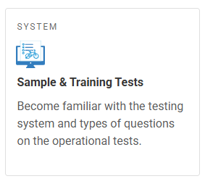
OSAS Item Types
    Multiple Choice – Single Correct Response
    Multiple Select – Multiple Correct Responses
    Hot-Text – Text Highlighting
    Drag-and-Drop
    Matching Interaction
    Table Interaction
    Technology-Enhanced/Enabled Items (e.g. Graphing, Equations)
Access Sample & Training Tests in the OSAS Portal
Notes:
The OSAS ELA and Math tests are adaptive, which means the question difficulty adjusts as the student works through the test, providing either easier or more difficult items based on correct and incorrect student responses.
Students will interact with different items, such as Multiple Choice, where there is a Single Correct Response
Multiple Select where there are Multiple Correct Responses
Hot-Text or Text Highlighting
Drag-and-Drop
Matching items and other table interactions
Some items are technology-enhanced or enabled to allow students to enter an equation or create a graph.
TAs and students should access the Sample & Training Tests in the OSAS Portal to learn how to interact with each item type. This is especially important for students using embedded accessibility supports.

Slide 7
Key Elements of the General ELA Test
  The OSAS ELA Test combines four elements (claims) of literacy into one test.
    Reading (40% of test items), Writing (40%), Listening (10%), and Research (10%)
  Students will receive an overall score and claim scores for reading and writing.
  Students in all tested grades will be asked to complete an essay (i.e., full write composition) as part of their Performance Task, which can take multiple test sessions.
  Listening items will require each student to have headphones.
  Refer to the Oregon Accessibility Manual for specific allowable supports.
Notes:
The OSAS ELA Test combines four elements (claims) of literacy into one test: Reading, Writing, Listening, and Research.
Students will receive an overall score and claim scores for reading and writing.
In the Performance Task, students will write an extended essay that often spans multiple test sessions.
Listening items will require each student to have headphones.
Check the Oregon Accessibility Manual for specific allowable supports.

Slide 8
Key Elements of the General Math Test
  The OSAS Math Test includes items that assess both math content standards and math practice standards.
  Students will receive an overall score and a claim score for Concepts and Procedures (Claim 1).
  Beginning in Grade 6, the CAT consists of two segments: one with access to an embedded Desmos calculator and one without.
    The Desmos Testing website shows the different calculators used across grades
  Refer to the Oregon Accessibility Manual for specific allowable supports.
Notes:
The OSAS Math Test also combines four areas (or claims) of Mathematics into one test: Claim 1 is Concepts & Procedures, Claim 2 is Problem Solving, Claim 3 is Communicating Reasoning, and Claim 4 is Modeling & Data Analysis.
Claim 1 items assess Oregon’s Math Content Standards. Items in Claims 2-4 assess Oregon’s Math Practice Standards.
Students will receive an overall score and a Claim 1 score. Schools and districts will have access to all claim- and target-level data for program evaluation and planning.
Again, check the Oregon Accessibility Manual for specific allowable supports.

Slide 9
OSAS ELA and Math
Test Updates and Reminders
Notes:
Here are some updates and reminders about the OSAS ELA and Math Tests.
By the end of this section, you should be able to describe important changes to, or reminders about, the OSAS ELA and Math tests for the current school year.

Slide 10
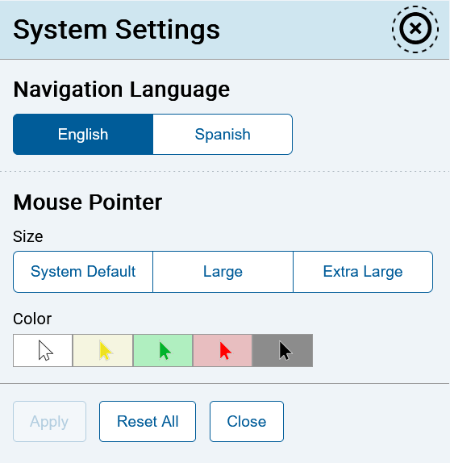

Systems Settings (All Tests)
Within System Settings, students can select their preference of several embedded accessibilty supports.
Notes:
New in 2025-26, students will access System Settings through a dedicated button on the interface rather than through the context menu. System settings include options for embedded accessibility supports such as text-to-speech, navigation language, and mouse pointer. Navigation language controls the language used for the icons and menus of the testing interface regardless of the presentation language used for test items.

Slide 11
OSAS Math Accessibility Updates
Beginning in 2025-26, the 100s Number Table and Multiplication Table are re-classified as non-embedded designated supports. These are available under OSAS Resources in the OSAS Portal.
The definition of abacus has been clarified to include resources typically referred to as counting frames, number racks, and Rekenreks. These are all allowable non-embedded designated supports.
  Refer to the Oregon Accessibility Manual for additional details and recommendations for use.
Notes:
Beginning in 2025-26, the 100s Number Table and Multiplication Table are re-classified from being accommodations to being designated supports. This means they are available for use by any student for whom the need has been indicated by an educator, or a team of educators with parent/guardian and student. These non-embedded supports are available under OSAS Resources in the OSAS Portal.
The definition of abacus has been clarified to include resources typically referred to as counting frames, number racks, and Rekenreks. These are all allowable non-embedded designated supports.
Refer to the Oregon Accessibility Manual for additional details and recommendations for use.

Slide 12



OSAS ELA Test Reminder: Pausing PTs
Because the ELA PT often spans multiple testing sessions, students should know the difference between pausing the session and submitting their test. TAs should review the testing interface with students before testing.
Figure 1. Pausing a Test
Figure 2. Submitting a Test
Notes:
In recent years, ODE has received numerous requests to reopen student tests that were accidentally submitted rather than paused. This interrupts and prolongs students’ testing experiences, and often requires additional test sessions to be planned for students to complete their test once reopened.
To support a more efficient testing experience, ODE has updated the student test directions to include a caution when students pause the ELA PT before completing their full write portion.
Test Administrators can use the Sample and Training Tests in the OSAS Portal to help students become familiar with the testing interface prior to testing.

Slide 13
Test Scheduling
Notes:
TOPIC 3: Scheduling
By the end of this section, Test Coordinators and Test Administrators should understand the information that will help them ensure that all students have sufficient time to complete the OSAS ELA and Math tests.

Slide 14
Statewide Test Windows
  Statewide test windows have been developed to provide districts with the flexibility to manage available resources.
  Federal and state laws require that at least 95% of students in grades 3-8 and 11 take the OSAS ELA and Math tests each year.
  Districts are responsible for testing all students enrolled on the first school day in May.
  Statewide Testing Windows for In-Person
  and Remote Administration
  Grades 3 – 8: March 31 – June 12, 2026
  Grade 11: February 3 – June 12, 2026
Notes:
ODE has developed test windows to provide districts with flexibility in scheduling and managing the logistics of test administration. Within these statewide dates, schools may set shorter school-level test windows.
Federal and state laws require that at least 95% of all students in grades 3-8 and 11 participate in state testing in ELA and Math each school year.
The statewide test windows for the current school year are shown here.
Please note that schools are responsible for testing all students enrolled on the first school day in May. Students who enroll after the first school day in May will NOT be included in the school’s accountability calculations; however, they may still be tested.
The complete list of OSAS test windows can be found in Appendix A of the TAM. More information about school-level test windows can be found in Training Module 1 and Section 5.2 of the TAM.

Slide 15
General Considerations
The OSAS ELA and Math Tests should be given on separate days; finish one before starting the other.
Neither the OSAS ELA nor Math Tests are timed; students should be allowed to continue working as long as they are making progress.
Oregon’s Statewide Summative Assessment Placement Policy allows students in grade 12 to retest in ELA and Math in order to demonstrate their readiness to enter credit-bearing, college level course work.
Notes:
Some guidelines and recommended practices for scheduling the OSAS ELA and Math Tests include giving them on separate days and ensuring students finish one before starting the other.
Neither of the tests are timed, meaning students should be allowed to continue working as long as they are making progress. However, schools should use the average testing times in Section 5.1 of the TAM to guide local planning and maximize instructional time.
Oregon’s Statewide Summative Assessment Placement Policy allows students in grade 12 to retest in ELA and Math in order to demonstrate their readiness to enter credit-bearing, college level course work. Under this policy, students achieving a specific performance level will be eligible to enroll directly in credit-bearing courses in English and/or Math rather than be required to take developmental courses that do not fulfill college course requirements. While grade 12 participation is optional, students should be made aware of the placement policy agreed to by all seven of Oregon’s public universities.

Slide 16
Estimated Testing Times (in hr:min)
Test and Grade Band | Computer Adaptive Test | Performance Task | Total Time
ELA: Grades 3 – 5 | 1:10 | 2:30 | 3:40
ELA: Grades 6 – 8 | 1:05 | 1:55 | 3:00
ELA: Grade 11 | 0:50 | 1:15 | 2:05
Math: Grades 3 – 5 | 0:55 | 0:50 | 1:45
Math: Grade 6 – 8 | 0:50 | 0:40 | 1:30
Math: Grade 11 | 0:40 | 0:25 | 1:05
Notes:
Estimated testing times can help plan the length of test sessions. This table reflects the approximate time it will take most students to complete the specified test at each grade level based on the previous year’s statewide administration. Note that these times are estimates to be used for planning purposes only. Actual student testing times may vary.

Slide 17
Grade 10 Assessment Opportunities
ODE provides the “challenge up” option for grade 10 students who have completed advanced coursework in ELA and/or math to participate in the respective grade 11 test.
  Contact your DTC if you have eligible students who wish to “challenge up”
  Eligible grade 10 students are not required to “challenge up”
  If a grade 10 student successfully meets the high school achievement standard, the score will be banked and reported in the student’s Grade 11 year
  If the student does not meet the high school achievement standard, the student must retest in their Grade 11 year, or they will be counted as a non-participant
Notes:
ODE will also provide a Grade 10 challenge up option. The option to take the Grade 11 assessment is only available to grade 10 students who have completed advanced coursework in the respective ELA and/or math content area.
The decision to challenge up should be made with the student and their family. Participation during a student’s Grade 10 year is not required, even if the student has successfully completed advanced coursework.
If a Grade 10 student successfully meets the high school achievement standard, the score will be banked and reported in the student’s Grade 11 year.
If the student does not meet the high school achievement standard, the student must retest in their Grade 11 year or they will be counted as a non-participant.
For more information, see Appendix B of the TAM.

Slide 18
Test Administration
Notes:
TOPIC 4: Administration
By the end of this section, Test Administrators should understand the basic guidelines for test administration, which ensure equitable access for all students.

Slide 19
Administering the OSAS ELA and Math Tests
  Ensure students are taking the correct content area assessment.
  Verify instructional resources (posters, visuals, etc.) have been covered up or removed from the testing environment.
  Read the required directions for the specific content area assessment being administered.
  Ensure that all accessibility supports are available for students who need them.
    Embedded supports include Spanish presentation (designated support), text-to-speech on ELA CAT (accommodation)
    Non-embedded supports include scratch paper (universal tool), math manipulatives (designated support), scribe (accommodation)
Notes:
A few guidelines will ensure tests are administered fairly in ways that lead to valid and reliable results.
First, ensure that the test administrator has activated the assessment for the correct content area.
Second, all instructional visuals, stimuli, and posters must be removed from the physical testing environment; and
Third, test administrators should have read the approved directions from the Test Administration Manual before beginning the assessment.
Finally, district and school personnel should ensure that all embedded designated supports and accommodations are set in TIDE for students who should have access. An embedded feature is one that is delivered in the secure browser as part of the test interface. An example of an embedded designated support is Spanish presentation for a student’s math assessment. An example of an embedded accommodation is text-to-speech for the ELA CAT. As a reminder, accommodations require documentation in a student’s IEP or Section 504 plan. Decisions around both designated supports and accommodations are to be made with the student’s school support team, the student themself, and the student’s family.
Similarly, Test Administrators should make available any non-embedded universal tools and/or designated supports for students who need them. A non-embedded feature is one that exists outside of the testing interface. An example of a non-embedded universal tool is scratch paper. An example of a non-embedded designated support is the use of math manipulatives. An example of a non-embedded accommodation is the use of a scribe.
On the topic of accessibility supports, ensuring that all test administrators in your school and district are consistent in these administration practices will greatly reduce the risk of test improprieties and, at worst, invalidated student assessments.

Slide 20
Scratch Paper
  Is a non-embedded universal tool available to all students
  Must be collected and securely shredded at the end of each test session
  May not be retained between test sessions for CAT items
  May be retained and securely stored between test sessions for PTs
Notes:
Scratch paper is one example of a non-embedded universal tool available to all students. Scratch paper may be securely retained between testing sessions for the performance task, but it may not be retained for the CAT.
If retained between test sessions, Test Administrators must direct students to write their names (or some appropriate identifying information) on their scratch paper, and then collect and inventory the scratch paper at the end of the test session.
Retained scratch paper must be kept in a securely locked room or cabinet that can only be opened by authorized staff. When students have completed and submitted their test, all retained scratch paper should be securely shredded.

Slide 21
Pause Rules and Test Expiration
  Tests can be paused at any time – students get a warning message to verify they want to pause.
  Students should be sure to pause a PT and not submit if they intend to resume the PT in a future session.
  If the ELA or Math CAT is paused for less than 20 minutes, students may review questions already answered.
  If the ELA or Math CAT is paused for 20 minutes or more, students may not review or change questions already answered.
Notes:
One embedded universal tool available to all students is the ability for tests to be paused at any time.
When a student selects the Pause button on the screen, that student will get a warning message to verify they want to pause their test. Students should take care to not accidentally submit their test when they intend to pause.
If an ELA or Math CAT is paused for fewer than 20 minutes, a student may review questions already answered.
If an ELA or Math CAT is paused for 20 minutes or more, a student may not review or change questions already answered.

Slide 22
Pause Rules and Test Expiration, cont.
  When resuming after a pause, the student sees the first page that has unanswered questions.
  If a test is idle for over 20 minutes, the system will automatically pause the test and log the student out.
  There are no pause limits for the PT portion of the OSAS ELA and Math tests.
  Both the CAT and PT in both the OSAS ELA and Math tests have a 20-day expiration period from the time a student begins each respective component.
Notes:
If a test is active but idle for over 20 minutes, the system will automatically pause the test and log the student out.
There are no pause restrictions for either the ELA or Math Performance Tasks. If a PT is paused for 20 minutes or more, the student can return to the section they were in and continue entering their response. Please note, however, that students may not navigate between segment 1 and segment 2 on the ELA PT.
Finally, tests can only be active for 20 days after they have been started. After this, they expire, and their contents are scored as they appear.

Slide 23
Resources
Notes:
TOPIC 5: Resources
In this final topic, we share additional resources that can help prepare test administrators and students for statewide testing.

Slide 24
OSAS Training and Sample Tests
Training Test
    ELA is organized by grade band 3-5, 6-8, and HS
    Math is organized by grade band 3-5, 6, 7-8, and HS
    6-9 questions, which include all item types
Sample Test
    Organized by specific grade level
    Approximately 30 items of varying difficulty
  Both Training and Sample Tests include all embedded universal tools, designated supports, accommodations, and language supports.
Notes:
There are two different practice tests available through the OSAS Portal.
First is the training test, which is aligned to grade bands. Training tests include 6-9 questions and are designed to allow students to try out embedded tools and supports, as well as to interact with each of the different item types.
In ELA, training tests are available for grades 3-5, grades 6-8, and high school. For Math training tests, available grade bands are grades 3-5, grade 6, grades 7-8, and high school.
The second is the sample test, which is aligned to specific grades. Sample tests provide students and educators with a look at the grade-specific operational assessment.
Sample tests include approximately 30 items that vary in difficulty. Scoring guides for the sample tests are available on the OSAS Portal under the Resources tab.
Both training and sample tests include all embedded universal tools, designated supports, accommodations, and language supports.
To most effectively use training and sample tests, it is helpful to consider their purpose.
Use the training test if you want to familiarize students with how to navigate the test, including universal tools and embedded supports. Also, use the training test to help students learn how to interact with each of the different item types.
Use the sample test if you want students to interact with specific grade-level items or you want students to experience items across all claims.

Slide 25
OSAS ELA and Math Test Documents
Test Blueprints | Content Specifications | Item Specifications
Number of items Score points (weighting) Depth of Knowledge (DOK) | List of all assessment targets Identify which standard each target assesses | Broken out by grade level, claim, and target Contain Task Models and stems for items
ELA Test Specifications and Blueprints
Mathematics Test Specifications and Blueprints
Notes:
Several documents outline the structure of the OSAS ELA and Math tests. Links to access these resources are provided at the end of this slide show. Educators should spend time looking at these materials to help inform how they prepare students to be successful on the tests.
Test blueprints indicate the number of items included on each test, how each test is scored, and the depth of knowledge intended to be used by students when answering items.
Content specifications list all assessment targets within each claim, as well as the ELA or Math standards aligned to those targets.
Item specifications provide task models and appropriate stems for each item type, and are broken out by grade level, claim, and target.

Slide 26
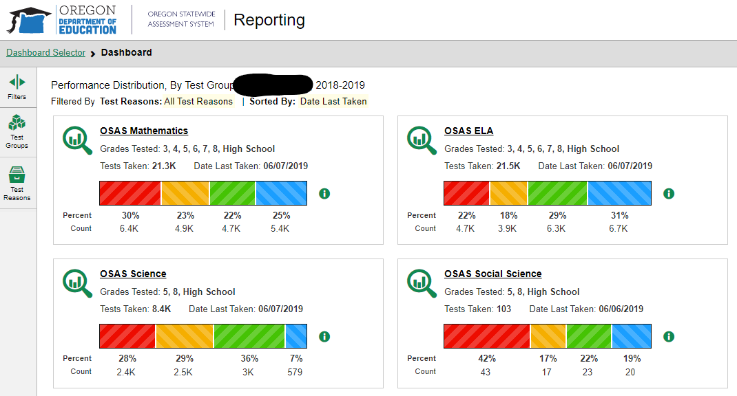
Accessing OSAS Results
  Available within the OSAS Portal, the Reporting System contains all summative and interim assessment results.
  Cross-Sectional Reports allow
  districts and schools to monitor
  system-wide student
  performance on assessment
  targets over time.
Notes:
One final key resource within Oregon’s statewide assessment system is data access. As a Test Administrator, you have access to summative and interim assessment data through the Centralized Reporting System (CRS) in the OSAS Portal.
CRS provides educators access to individual student-level results as well as to aggregated system-level data for each assessment target. Cross-sectional reports show the performance of schools and districts on specific assessment targets over time, allowing educators to determine targets that are strengths and targets that are opportunities for growth. The ISRs in the OSAS Portal reporting system are unofficial; the Oregon Department of Education will release official ISRs to districts and schools. Please contact your DTC for additional questions.
District Test Coordinators, School Test Coordinators, and Test Administrators have access to these reports and can use them in their collaboration and professional learning. District Test Coordinators may also create accounts for non-Test Administrators to access district or school-level data.

Slide 27
Q&A Discussion
What are the local considerations and challenges around scheduling the OSAS ELA and Math Tests within your school or district?
What resources or strategies do you plan to use to prepare for administering OSAS ELA and Math Tests?
How can you minimize the number of test improprieties during testing, specifically those occurring because students do not have accessibility supports in place?
What is our local process to handle opt-out forms?
Notes:
This is an optional point in the required training to pause and discuss the questions provided or a locally developed set of relevant questions. If you would like to pause, please pause now.
Suggested activities:
Small groups: use post-its to capture local considerations and challenges, one per sheet. Mount post-its.
Large group: facilitate review/summary of considerations/challenges from across the large group
Small groups: share effective approaches, look at artifacts
Large group: facilitate sharing out, writing down approaches via a chart pack
Small group or individual: use note organizer to capture take-homes, next steps

Slide 28
Online Resources
  OSAS Portal (Training & Sample Tests, Reporting System)
  ELA Test Specifications and Blueprints
  Mathematics Test Specifications and Blueprints
  Test Administration Manual
  Oregon Accessibility Manual
Notes:
This slide contains a list of linked resources that have been referenced throughout this training.
First, the OSAS Portal links to all components of the assessment system, including training and sample tests and the Reporting System.
Second, you can get more information on Test Blueprints, test design, assessment targets, and the number of items from each claim by visiting the ELA and Math Assessment websites.
Finally, the Test Administration Manual and Oregon Accessibility Manual provide technical support for districts, schools, and educators.
This concludes the required OSAS ELA and Math Test training module. Thank you for your time and attention!

