Slide 1
Accessibility Supports Training
Module 3
Oregon Statewide Assessment System
Required for DTCs, STCs, & TAs
Notes:
This is the accessibility supports training module for Oregon’s statewide assessment system, required for all district and school test coordinators, as well as test administrators.

Slide 2
Topics
  Overview of Accessibility Supports
  Resources that support appropriate:
    Selection of Accessibility Supports
    Administration of Accessibility Supports
    Evaluation of Accessibility Supports
Notes:
This training provides an overview of Oregon’s statewide assessment system accessibility supports, and reviews resources that support the appropriate selection, administration, and evaluation of these supports.

Slide 3
Resources
The Oregon Accessibility Manual (OAM), found in the Manuals accordion on the Assessment Administration page, contains all final accessibility policies and supports for the Oregon Statewide Assessment System.
Notes:
The Oregon Accessibility Manual (OAM) covers the selection and administration of universal tools, designated supports, and accommodations for the following components of the statewide summative assessment system: Mathematics, English Language Arts, Science, English Language Proficiency, the Oregon Extended Assessments, and the SEED Survey.
Only those supports included in the OAM may be provided to students during the administration of Oregon’s statewide assessments.

Slide 4
Provision of supports
All accessibility supports a student receives on Oregon statewide assessments should mirror the supports currently being provided to that student in their learning environment.
Notes:
Accessibility supports for testing should mirror the supports currently being provided to that student in their classroom instruction and assessments. It is never appropriate to introduce a support to a student for the first time during statewide testing.

Slide 5
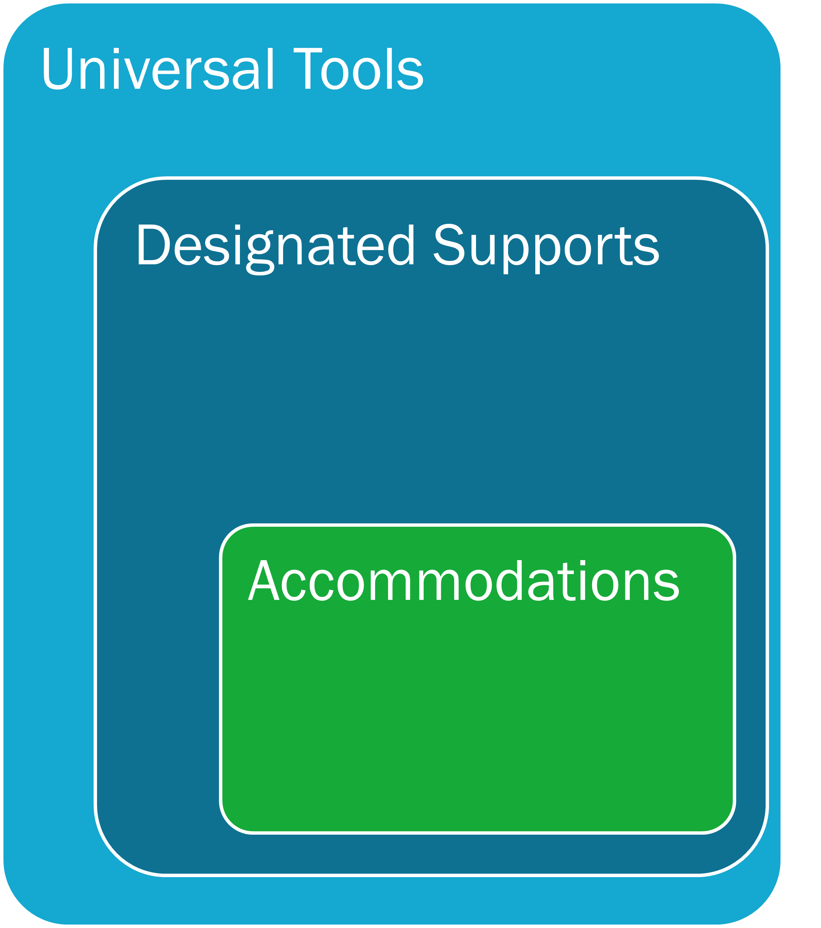
Accessibility Options
Oregon’s Statewide Assessment System provides three tiers of accessibility supports:
  Universal Tools
  Designated Supports
  Accommodations
Notes:
There are three tiers of accessibility supports: Universal Tools, Designated Supports, and Accommodations.
Universal tools are automatically available to all students and can be student-selected.
Designated supports are set in TIDE by test administrators, or provided outside of the testing platform, and are available to any student based on identified need.
Accommodations are also set in TIDE by TAs, or provided outside of the testing platform. Accommodations must be documented in the student’s IEP or 504 plan.
Supports may be embedded, meaning they are incorporated in the testing interface (such as text-to-speech), or they may be non-embedded, meaning they are implemented outside of the testing interface (such as the use of scratch paper).
For more details consult Table 1.1 in the Oregon Accessibility Manual.

Slide 6
Modification
  Any practice or procedure that changes the construct being measured and is not listed in the Oregon Accessibility Manual (OAM) is considered a modification.
  Students taking assessments with any modified conditions are counted as non-participants in all federal and state accountability measures.
Notes:
A modification is any practice or procedure that changes the construct being measured on an assessment. This includes changes to the content, the level of cognitive demand, or the expected performance or outcome. Any support not listed in the OAM is considered a modification. Students taking assessments under any modified condition are counted as non-participants in all federal and state accountability measures and reports.

Slide 7
Accessibility Guidance
Guidance related to the identification, administration, and evaluation of the use of accessibility supports for instruction and assessment of all students is found in the Council of Chief State School Officers’ (CCSSO) Accessibility Manual.
The process described in this manual is designed for use by general education teachers, teachers of students who are English Learners, special education teachers, test administrators, district level assessment staff, Individualized Education Program (IEP) teams, Section 504 Plan committees, or any other school team as they work with students to select and use appropriate supports during participation in Oregon’s Statewide Assessments.
Notes:
For guidance related to the identification, administration, and evaluation of accessibility supports, we recommend teams consult the Council of Chief State School Officers’ Accessibility Manual—specifically, Section III – The Five-step Decision-making Process and the Tools section.

Slide 8
Identification of Accessibility Supports
Increase equitable access to grade-level content assessments and supporting students in demonstrating what they know and can do.
Notes:
The identification of whether a particular support is offered as a universal tool, designated support, or accommodation is determined independently for each assessment based on the construct that assessment is designed to measure.

Slide 9
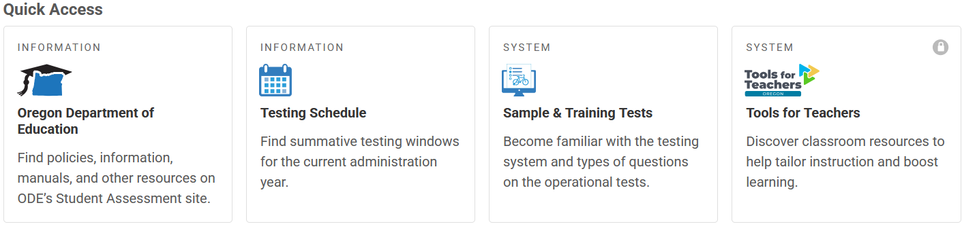
Sample Tests
  The Sample Tests on the OSAS portal can assist IEP/504 teams to determine which universal tools, designated supports, and accommodations are needed for each individual student to be able to demonstrate what they know and can do.
Test Administrator User Guide
Notes:
As part of the identification of accessibility supports process, ODE highly recommends using the sample tests to familiarize TAs and students to the tests and accessibility supports.
A proctored test session using the Sample and Training Tests site will be needed to enable any available embedded support in a sample test. The Online Test Administrator User Guide contains directions on how to set up a proctored sample test. It is never appropriate to initiate an operational assessment for this purpose.

Slide 10
Decision-Making Process
  The decision-making process for providing accessibility supports should consider at least three factors:
    Student characteristics
    Classroom instruction and assessment tasks
    Accessibility policy
  If multiple accessibility supports are employed for a student, educators should also be cognizant of the possible interactions of these accessibility supports.
Notes:
CCSSO’s Accessibility Manual contains assistance in identifying or selecting various types of accessibility supports for students, including consideration of at least three factors:
1. Student characteristics such as disabilities, language proficiency, and accessibility supports used in classroom instruction and on assessments.
2. Student needs, including tasks that will be required of the student and ways to remove physical and other barriers inhibiting a student’s ability to perform those tasks.
3. Accessibility policy for an assessment or for part of an assessment and consequences of those decisions.

Slide 11
Documenting Accessibility Supports
  Cumulative File
  Individualized Education Program (Statewide Assessments page)
  Section 504 Plan
  Local Documentation Processes
Notes:
Having identified the accessibility supports that each student needs, the next step is to ensure that these supports are documented according to federal and state requirements. For example, in the documenting accessibility supports section of a student’s IEP, there are potentially three areas in which accessibility supports can be addressed:
First, “Consideration of Special Factors” [Sec. 614(d)(3)(B)]. This is where communication and assistive technology supports are considered.
Second, “Supplementary Aids and Services” [Sec. 602(33) and Sec. 614(d)(1)(A)(i)]. This area of the IEP includes “aids, services, and other supports that are provided in regular education classes or other education-related settings to enable children with disabilities to be educated with nondisabled children to the maximum extent appropriate.”
Finally, and most relevant for assessment, the “Participation in Assessments” [Sec. 612(a)(16)]. This section of the IEP documents the accommodations needed to facilitate the participation of students with disabilities in general state and district-wide assessments.
[TCs may insert local policies/protocols for documentation at this point in the training.]

Slide 12
Administration of Accessibility Supports
Ensure reliable and valid administration of the assessment.
Notes:
The following slides discuss administration of accessibility supports.

Slide 13
Requirements
  Accessibility supports to be used during administration of an Oregon Statewide Assessment must be:
previously approved by the Oregon Accessibility Panel
listed in the appropriate OAM accessibility supports tables
implemented during instruction, and
familiar to the student prior to use during assessment.
Notes:
Accessibility supports to be used during administration of an Oregon statewide assessment must be: previously approved by the Oregon Accessibility Panel; listed in the appropriate accessibility supports table in the OAM; implemented during instruction; and familiar to the student prior to testing.

Slide 14
Administration Logistics
Identify accessibility supports and develop a plan for implementation and evaluation.
Become familiar with the online accessibility support options.
Test administrators must verify that the correct accessibility supports have been selected in TIDE and know how to enter and validate this information.
Administration guidelines ensure that test results reflect actual student knowledge and skills.
Test security expectations remain intact.
Notes:
After deciding about accessibility support provision, develop a plan for implementation and evaluation. Students must have opportunities to become familiar with the online assessment platform and process. Test administrators should know what accessibility supports each student will be using, and how to administer them properly, prior to the day of the test. TAs must appropriately administer accessibility supports to ensure test results reflect actual student knowledge. Test security must also be maintained.

Slide 15
Evaluation of Accessibility Supports
Ensure the meaningful participation of all students who use supports during statewide assessments.
Notes:
The following slides cover evaluation of accessibility supports.

Slide 16
Reasons to Evaluate
Ensure meaningful participation of students with IEPs and Section 504 Plans
Data may reveal patterns of use that can be evaluated
Data may indicate the need for additional training and support
Districts may supplement implementation data
Observations and interviews during assessment may yield data that supports improvement of practice
Notes:
Collecting and analyzing data on the use and effectiveness of supports ensures the meaningful participation of students with disabilities in statewide assessments. Data on the use and impact of supports during assessments may reveal patterns of use that can inform future decision-making. An evaluation may also indicate areas in which the IEP team, Section 504 plan committee, or TAs need additional training and support.
To identify systemic patterns, districts may decide to gather information on the implementation of supports during assessment from all schools. Observations conducted during test administration, such as interviews with TAs or students after testing sessions, may also yield information that can be used to guide future evaluation processes.

Slide 17
Q & A Discussion
What are the local considerations and challenges around the identification, administration, and/or evaluation of accessibility supports within your school or district?
What are some effective approaches you could use to support effective identification, administration, and/or evaluation of accessibility supports use in your school or district?
What resources do you plan to use to assist you in developing and/or implementing effective approaches to the identification, administration, and/or evaluation of accessibility supports?
Notes:
This is an optional point in the required training to pause and discuss the questions provided or a locally developed set of relevant questions. If you would like to pause, please pause now.
Suggested activities:
-Small groups: use post-its to capture local considerations and challenges, one per sheet. Mount post-its.
-Large group: facilitate review/summary of considerations/challenges from across the large group
-Small groups: share effective approaches, look at artifacts
-Large group: facilitate share out, writing down approaches via chart pack
-Small group or individual: use note organizer to capture take-homes, next steps

Slide 18
Online Resources
Assessment Administration webpage
Assessment Administration Resources webpage
Sample Tests
TA User Guide
Notes:
Finally, the links to the resources listed on previous slides are provided here. This concludes the Accessibility Support training module.

