Slide 1
DTC Learning Session
ODE Assessment Applications
June 12, 2025

Slide 2
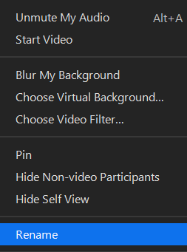
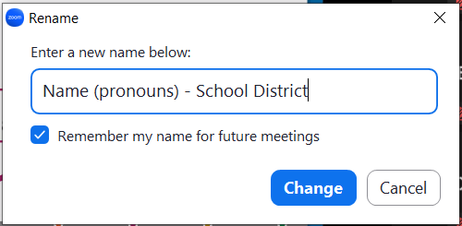
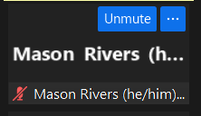
Please rename yourself…
Step 2
Step 3
Step 1

Slide 3
Regional ESD Partners are your best contact for Assessment and Accountability support
Assessment
Amy Rockwell
503-540-4444
Amy.Rockwell@wesd.org
Data Collections & Accountability Support
Karen Brown Smith
1-800-706-4447 ext. 3124
Karen.Brown@imesd.k12.or.us
Peter Campbell
1-800-706-4447 ext. 3203
Peter.Campbell@imesd.k12.or.us
Joe Doherty (ADM, SSID, 9OT)
1-800-706-4447 ext. 3140
Joe.Doherty@imesd.k12.or.us

Slide 4
Assessment Team Contacts
Andrea Lockard, Director of Assessment
Tony Bertrand, English Language Arts and Social Sciences
Andy Byerley, Math
Sody Fearn, K-2 Balanced Assessment
Audrey Lingley, Survey Specialist
Carla Martinez, Administrative Support
Crys Plattner, Administrative Support
Mason Rivers, Special Education
Mariela Salas Bao, Science
Ben Wolcott, English Language Proficiency

Slide 5
ODE Assessment Applications
The DTC Learning Session on June 4, 2025, focused on managing summative test records in the Assessment Record Updating Application (ARUA) located in ODE’s Central Login.
Today’s session will focus on the remaining ODE assessment applications, the only source for official statewide summative assessment results.
  Accountability Warehouse Extract (AWE)
  Secure Assessment Reports (SAR)
  Achievement Data Insight (ADI)
Notes:
The information in this webinar is designed to complement the training the data owners present and the guidance found in the user guides. Our hope is that the information presented today will assist you with a starting point and next steps in accessing official assessment data.
See the resources slide near the end of this presentation for links to additional trainings and resources.

Slide 6
What data is available in ODE Applications?
    Accountability Warehouse Extract (AWE)
    Download “Official” complete assessment records (with all fields) in a spreadsheet/table format, by resident and attending district/school
    156 columns wide, Assessment Reporting file format
    Preferred when looking for banked tests, importing in local systems, data analysis, etc.
    Secure Assessment Reports (SAR)
    “Official” PDF formatted reports: Individual Student Reports (ISR), Combined ISR, Class Roster, Class Summary, by resident and attending district/school
    Achievement Data Insight (ADI)
    Assessment summary validations by resident district/school
        Student Performance: English Language Arts, Mathematics, Science Next Gen (participation and performance summary and details)
        On-Track to English Language Proficiency, SEED Survey, ELP Standards

Slide 7
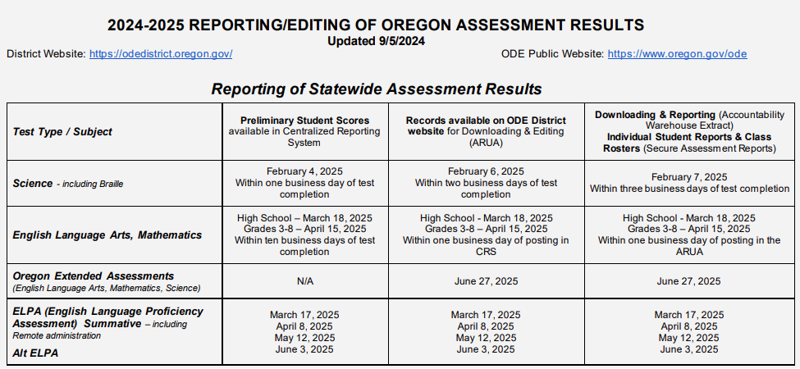
When is data available in ODE Applications?
Test records load on the schedule found in the AA Checklist page 51
  Example: Preliminary ELA and math records generally load in the Centralized Reporting System within ten business days of completing the CAT and PT.
  An additional business day is required to load in ODE’s Assessment Record Updating Application (ARUA)- 11 business days.
  And an additional business
  day (after loading in ARUA)
  to load in AWE and SAR-
  12 business days.

Slide 8
Test Record Load Dates
  Completed tests load based on the schedule in the AA Checklist (see previous slide)
  June 3 - ELPA summative batch 4 (including Alt ELPA)
  June 3 - Non-participation/virtual test records first created*
  June 27 - Partial test records for science
  June 27 - Extended assessments
  July 11 - Partial test records for ELA and math
Temporary Closures for ARUA, AWE and SAR:
  2024-25 tests not available 5/30 @5:00 pm- 6/2 @9:00 am; and 6/6 @5:00 pm- 6/9 @9:00 am
* Federal ESEA requires that tests be “administered to all public elementary school and secondary school students in the State” in required grades. (Title I Part A, sec. 1111(b)(2)(B)(II)). When processing begins in June, if a test record does not exist for a student who should have one, a virtual record will be created (if Third pd ADM is correct).
  Note: If a student has (or will have) a virtual and valid test record (i.e. extended or partial test), the virtual record should disappear after the following weekend’s processing of records.

Slide 9
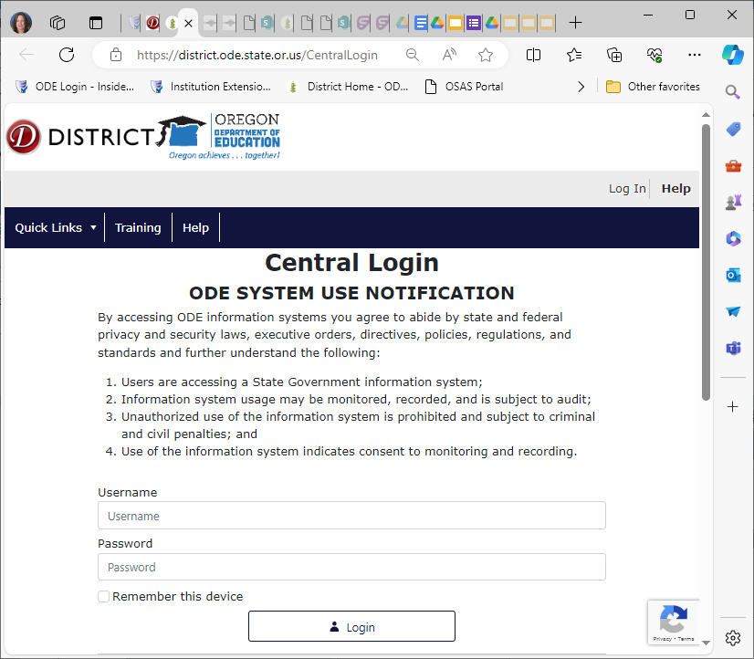
  ODE Central Login
ODE assessment applications are located in the ODE Central login application.

Slide 10
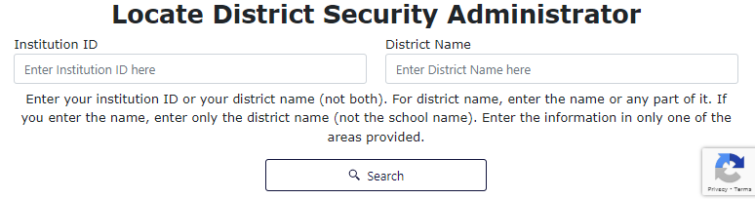
District Security Administrator (DSA) Lookup
  If you don’t have access to the ODE Central Login or don’t see the ODE application in your list, or forgot your Username, contact your District Security Administrator (DSA).
    Look up who your DSA is here: https://district.ode.state.or.us/apps/login/searchSA.aspx

Slide 11
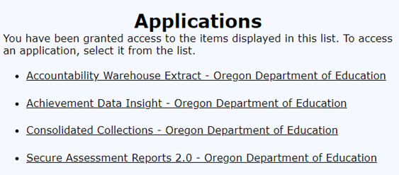
  ODE Central Login → Applications
Login the ODE Central Login Application: https://district.ode.state.or.us/apps/login/
Select the application from the Applications list. We will begin with the Accountability Warehouse Extract application

Slide 12
  Accountability Warehouse Extract (1/6)
The Accountability Warehouse Extract allows schools/districts to download Oregon historical test data for students they have claimed, regardless of where the test was taken. It includes summative test results (general and alternate/extended) for the following subjects:
English language arts
Mathematics
Science
English language proficiency assessment

Slide 13
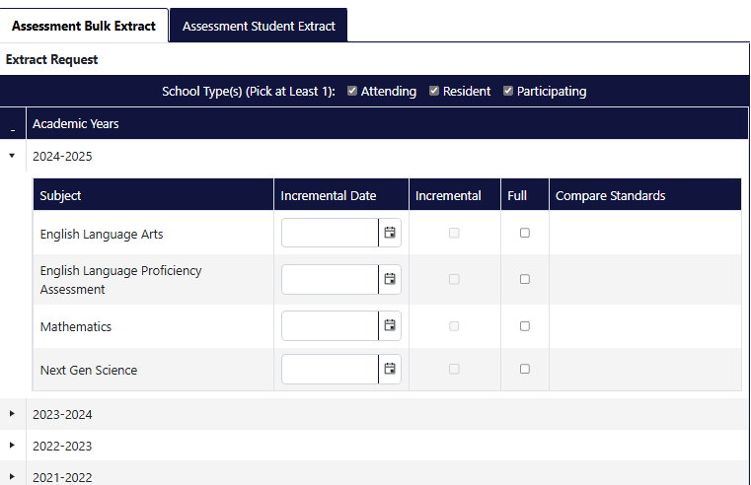
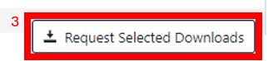
  Accountability Warehouse Extract (2/6)
For most districts and schools there are
two tabs in the AWE application:
Assessment Bulk Extract (default tab)
  One file for each subject/school year
  Full extract- includes all records
  Incremental- includes records updated
  since incremental date listed
  To order files:
  Expand a school year (click on black arrow)
  Click on the checkbox for each subject/
  year combination you want to order
  Click Request Selected Downloads
  A Secure file transfer will be sent via email
  for each subject /school year ordered
  (SFT expires in 7 calendar days)
  (Regional Warehouse Extract tab is available only if the district is part of a Regional warehouse)
1
2

Slide 14
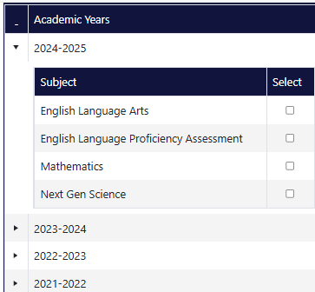
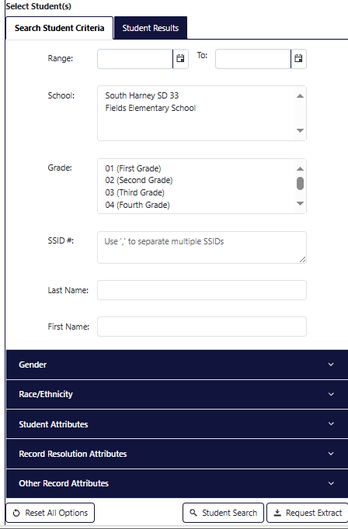
  Accountability Warehouse Extract (3/6)
Assessment Student Extract tab
  One file includes all subjects/school year
  (Unless the file size limit is exceeded, then by subject)
  To order files:
  Expand a school year (click on black arrow)
  Click on the checkbox for each subject/
  year combination you want to order
  Select Student search criteria (i.e. name, SSID, other attributes)
  or skip this step to request all students
  Click Student Search to preview subject/year results based
  on your selections, and edit criteria if necessary
  Click Request Extract to order the file
  A Secure file transfer will be sent for each academic year ordered

Slide 15
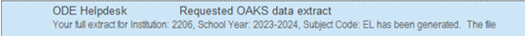
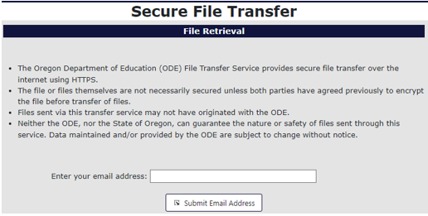
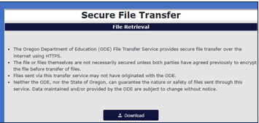
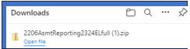
  Accountability Warehouse Extract (4/6)
Retrieving your Extract
You will receive an email when your extract is ready for download.
Click the link provided in the email. This will take you to a secure download page.
Enter your email address and click
  on the Submit Email Address
  button.
Then click on the “Download” icon.
A zipped CSV file will download to your computer, open file.

Slide 16
  Accountability Warehouse Extract (5/6)
Whose records can I see?
Test scores for resident or attending students the school/district is associated with as reported on the current record in the SSID System, or Cumulative ADM.
ODE uses a Formal and Inferred Registration System (FIRS) to determine which results will be included- including where the test was taken. Hard to find tests might include:
  Banked scores for students who challenged up in a prior year and scored proficient, and in 2024-25 are reported as enrolled in grade 11
    Filter on Test Year in column AC, and/or Test Date in column AD
    If banked scores are missing, let your Assessment RESD Partner know right away
  ELPA summative honoring high school proficiency
    Filter on Rescore flag (=Y) in column AQ

Slide 17
  Accountability Warehouse Extract (6/6)
What fields are included?
See the Assessment Reporting file format document for list of 156 columns
  Student and institution information
  Test identification specifics (subject, PADM ID, Test Type)
  Administration and accommodation codes
  All scores and performance levels related to the test including overall and score reporting category (SRC)/claim scores
  Reporting flags
  Details related to accountability reporting (participation and performance inclusion)
June 10 by 9:00 am files will include student group flags from Third pd ADM and other student collections (English Learner, Oregon Migrant Student Information System)

Slide 18
  Accountability Warehouse Extract
  Questions?

Slide 19
  Secure Assessment Reports (1/7)
OAR 581-022-2270 Individual Student Assessment, Recordkeeping, and Reporting requires school districts to report student scores on all state and local assessments at least annually to parents or guardians for all students.
Only source for official and final assessment reports in PDF format
  Individual Student Report (ISR) or Combined ISR
    ISR includes overall and claim scores with one subject per page
    Combined ISRs contain multiple subjects & overall score only for each subject per page
    NEW- Download files will be zipped with one separate PDF per student or all PDFs in one file
    NEW- Download ISR in English and Spanish enables ability to print front and back
    Asserted Name on ISR and Combined ISR- See Using a Student’s Asserted Name on Assessment Score Reports guidance document for instructions; or use Hide student name
  Class Roster
    Generate a report with multiple students per page
    Option to hide SSID numbers and/or student names on Class Rosters before printing them
    Rosters from TIDE are not copied to the ODE System
  Class Summary
    Generate a report with aggregated student data- school, grade, count, percent proficient, average scores, etc.
    May include more students than are accountable

Slide 20
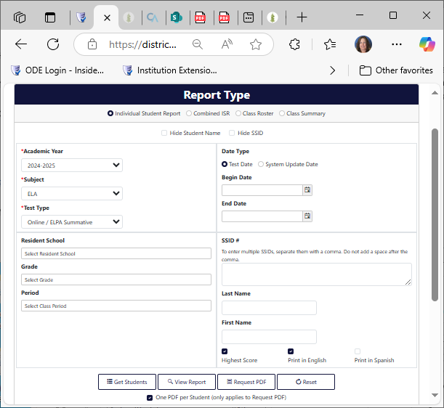
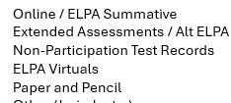
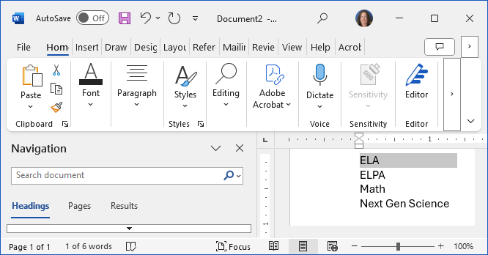
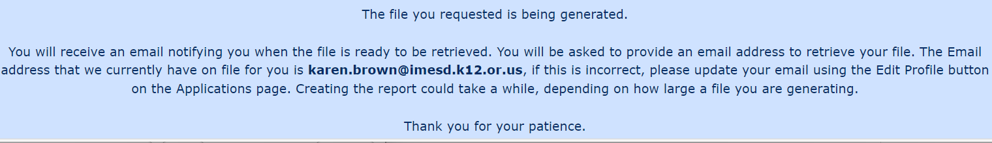
  Secure Assessment Reports (2/7)
1
3
Select one Report Type radio button- Individual Student Report (ISR), Combined ISR, Class Roster, or Class Summary
Select one of each for ISR & Summary; combined ISR- Academic year only
  Academic Year
  Subject
  Test Type
Select additional parameters if desired (e.g. Print in Spanish, Hide SSID)
Click
  Get students or View Report to see sample of records (20)
  Request PDF File to order file
2
3
4

Slide 21
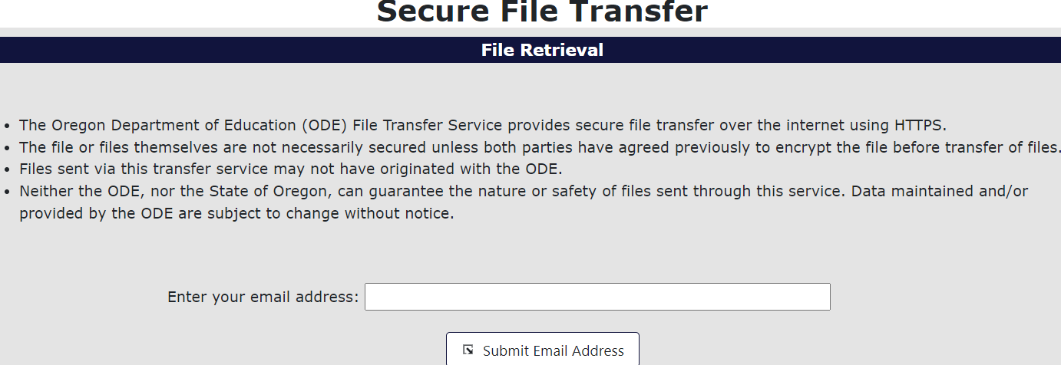
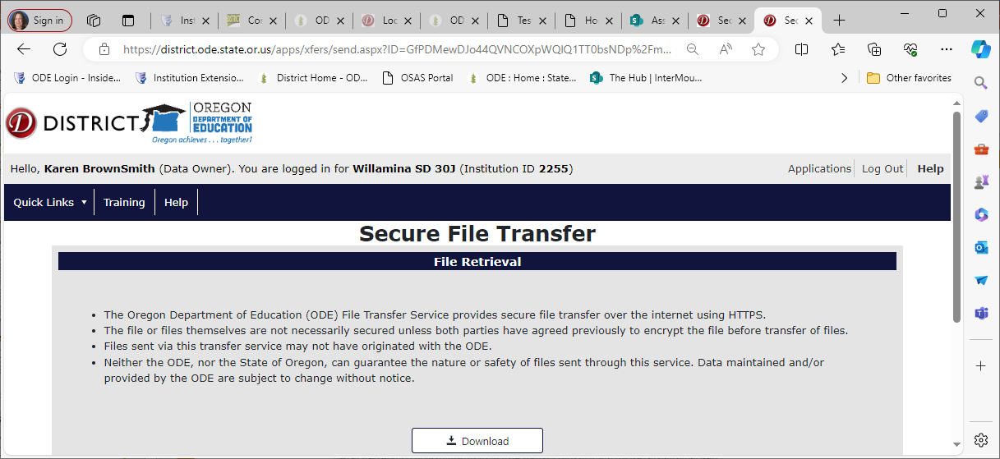
  Secure Assessment Reports (3/7)
You will receive an email from the ODE helpdesk (for each order placed), sent via secure file transfer to your email inbox
Open the email and click on the hyperlink, enter your email address when prompted, click Submit Email Address
Then click Download. Open and save the file in a safe location. Remember, the pdfs contain confidential student test scores and personally identifiable information.

Slide 22
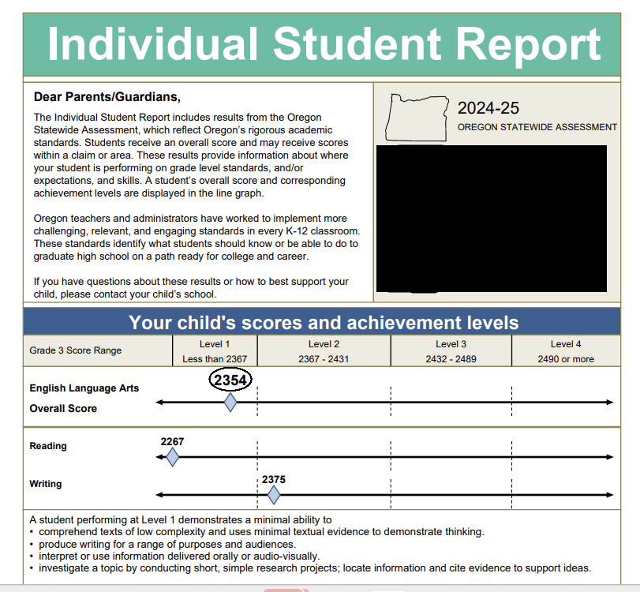
  Individual Student Report
  ELA Example

Slide 23
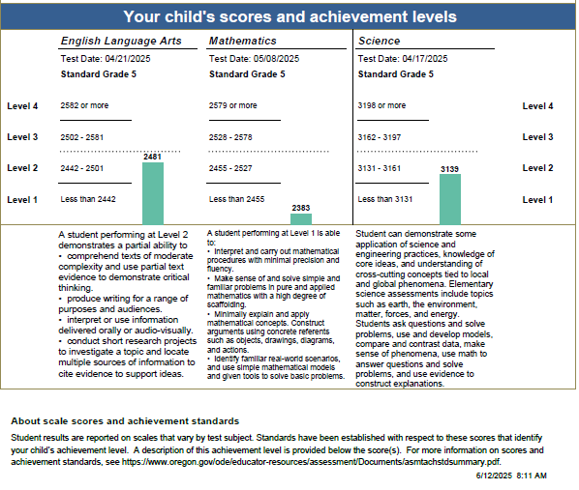
  Individual Student Report
  Combined

Slide 24
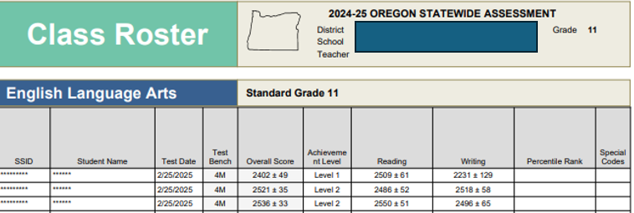
  Secure Assessment Reports (6/7)
Class Roster (sample report: English language arts)

Slide 25
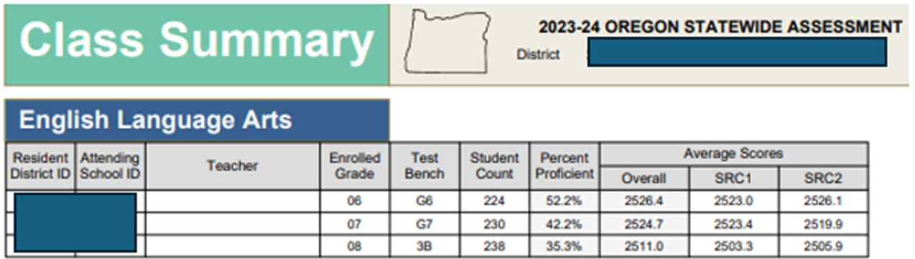
  Secure Assessment Reports (7/7)
Class Summary
After ODE applies the Third pd Cumulative ADM enrollment to the student records, users will be able to view a Class Summary report for the current school year. (May include more students than are accountable)
Class Summary (2023-24 sample report)

Slide 26
  Secure Assessment Reports
  Questions?

Slide 27
  Achievement Data Insight (1/12)
Achievement Data Insight is the application ODE uses to present a secure preview of unsuppressed validation summaries to districts and schools. There are 24 validations and two collections in ADI. Validation data in ADI cannot be edited directly in the application, changes are made to the source.
ODE summarizes the data and institutions can preview it prior to the public release date. Some data are used for federal, state and ed facts reporting, and are shared as public record requests.
Reminders:
The preview allows staff an opportunity to make necessary edits to the data source prior to the validation close date.
Review the data and submit necessary changes to the source data prior to the validation closing.
Do not share Preliminary or Embargoed data publicly or with unauthorized staff until the public release date (including no presentations at school board meetings).
When sharing information, use suppressed data and share on or after the public release date, to ensure confidentiality is maintained.

Slide 28
  Achievement Data Insight (2/12)
Reminders continued:
District Security Administrators assign rights to the Achievement Data Insight (ADI) application and must also assign rights to each individual validation or collection.
Be sure that Charter schools sponsored by your district have access to their data.
There is no accept or appeal button in the validations. Instead, when a user opens a validation, a log is created.
ODE assumes your data are correct as entered. Corrections must be made in source data or if the source data cannot be edited, reported to ODE via the “Ask a Question” feature.
For a complete list of Validations and open and close dates for each see the ODE Validations home page https://odedistrict.oregon.gov/CollectionsValidations/Validations/Pages/default.aspx.
If you have never used the ADI application or would like a refresher, we encourage you to watch the standalone 2024 ADI Training and review the PowerPoint located on the ADI page https://odedistrict.oregon.gov/Applications/Pages/adi.aspx.

Slide 29
  Achievement Data Insight (3/12)
Assessment related validations in ADI include:
English Language Arts Student Performance............... open 6/12/25 - 8/22/25
Mathematics Student Performance............................. open 6/12/25 - 8/22/25
Science Next Gen Student Performance...................... open 6/12/25 - 8/22/25
On-Track to English language proficiency (OTELP)....... open 7/24/25 - 8/22/25
SEED Survey.................................................................. open 8/07/25 - 9/26/25
ELP Standards Validation.............................................. open 8/07/25-8/21/25

Slide 30
  Achievement Data Insight (4/12)
ELA, Math and Science Student performance validations include summaries of Oregon’s participation and performance rates.
Validation data are generally updated/refreshed in ADI on Thursday by 1:00 pm PT
Test records are refreshed weekly through August, except the week after July 4
The Public assessment group reports (AGR Summary) tab opens August 14-22
Last day for changes to test records and Third pd ADM is August 22
Final AGR test results post in September, date TBA
Note: we will not review the business rules for the validations in detail today. See resource slides for additional training and user guides, and contact your Regional ESD partner for accountability support with questions about validations.

Slide 31
  Achievement Data Insight (5/12)
Login the ODE Central Login Application: https://district.ode.state.or.us/apps/login/
Select the application from the Applications list, in this case, the Achievement Data Insight application

Slide 32
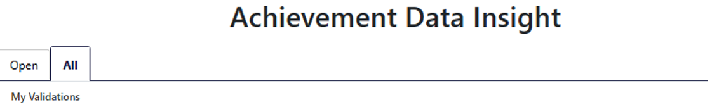
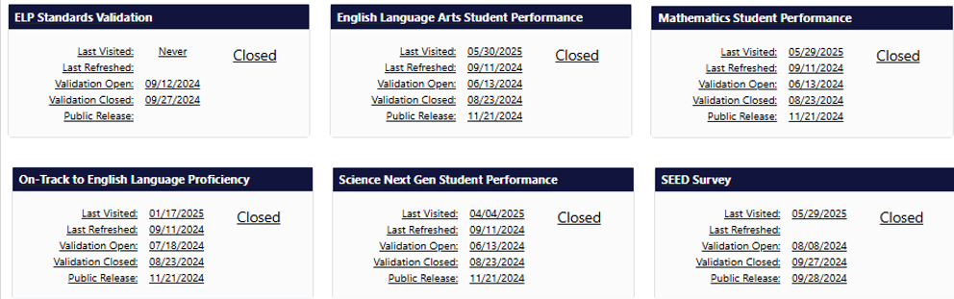
  Achievement Data Insight (6/12)
If the validation is open and under the My Validations section, click on the tile to open it.
  If the validation is closed, click on the All tab, then click on a tile to open it.
  Or click on the Closed Validations menu to select and open a validation.

Slide 33
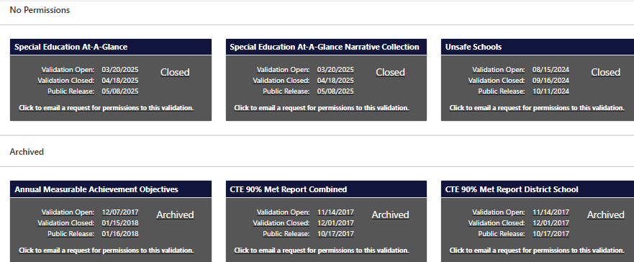
  Achievement Data Insight (7/12)
If the validation tile is under the No Permissions section, click on the tile to request permission, or contact your District Security Administrator.
There is also an Archived section for old validations that ODE no longer produces.

Slide 34
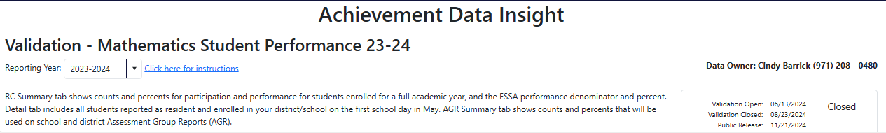
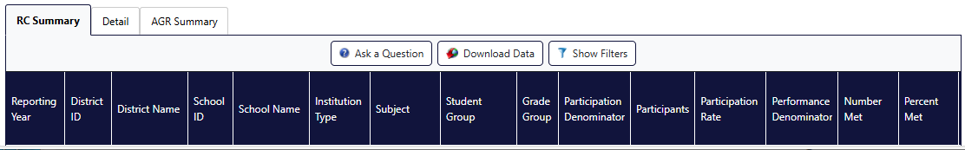
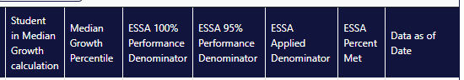
  Achievement Data Insight (8/12)
Below is a screenshot of the 2023-24 Mathematics Student Performance validation Report Card (RC) Summary tab- 22 columns wide

Slide 35
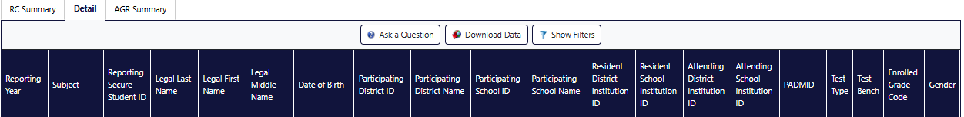
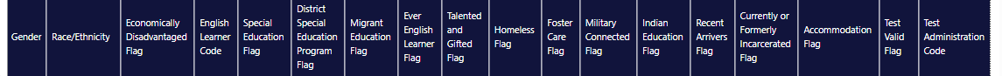
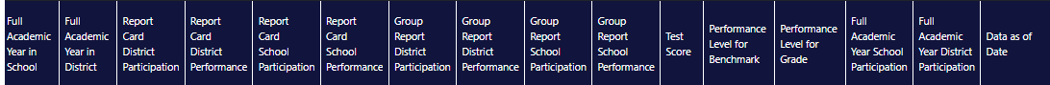
  Achievement Data Insight (9/12)
Here is a screenshot of the 2023-24 Mathematics Student Performance validation Detail tab (student level data- 53 columns wide)

Slide 36
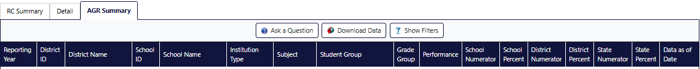
  Achievement Data Insight (10/12)
Here is a screenshot of the 2023-24 Mathematics Student Performance validation AGR Summary tab (Assessment Group Report- 17 columns wide)

Slide 37
  Achievement Data Insight (11/12)
RC Summary tab- shows counts and percents of participation and performance for students enrolled for a full academic year, and the ESSA performance denominator and percent.
Participation counts and rates include students reported as resident at the school/district on the first school day in May.
Performance counts and rates are based on those students who are included in the participation rate and enrolled a full academic year (total estimated ADM >.5 ADM) in the school or district, except first-year English Learner students.
Detail tab- includes all students reported as resident and enrolled in your district/school on the first school day in May.
AGR Summary tab- performance counts and percents are based on all students included in participation regardless of full academic year status, except first-year English Learner students. Will be used on school and district assessment group reports.

Slide 38
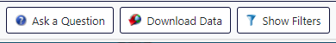
  Achievement Data Insight (12/12)
Features
Ask a Question- sends an email to the data owner inbox. Do not include student names, only include the SSID number when asking a question about a student.
Download Data- in CSV or Excel format. Be sure to save data in a secure location.
  If you need to share information, send it via secure file transfer.
Show/Hide Filters- allows filtering of the data you are viewing on your monitor.
Data as of date- cutoff for inclusion in the most recent refresh.
Click on a column heading to sort the data based on the column you click on.

Slide 39
  Achievement Data Insight
  Questions?

Slide 40
  Quality Checking (1/2)
Did all grade 3 – 8 and 11 students enrolled on May 1, 2025 participate in the required assessments?
Did all the Oregon Extended Assessments get entered? Deadline is June 13, 2025
Are these my students? (Does Resident School = May 1 School?)
Am I missing students?
  Review AWE records for accountability reporting flags
  Are the banked test records (from 2023-24) included in 2024-25 extract?
Are my Non-Participants accurate?
  Remember, extended & partial science load June 27, and ELA/math partials load July 11.
  Log into AWE, select Assessment Student Extract tab
  Choose the year and subject (i.e., 2024-2025 English Language Arts)
  Choose “Non-Participation” under Test Type
  Open Record Resolution Attributes section, set desired Record Resolution Attribute to ‘Y’
    (e.g. RC Participation District = ‘Y’ and/or RC Participation School = ‘Y’)
  Refer to Correcting Participation Results document (on Assessment Transactional page)
Source: ARUA- Spring 2425 PPT

Slide 41
  Quality Checking (2/2)
6. Are demographic and Program fields accurate?
  Most data comes from Third Period Cumulative ADM. If the data is wrong, update it in Third pd ADM by Friday, weekend accountability report processing will populate ARUA and be available on Tuesday.
  Migrant Ed Flag is filled from 23-24 OMSIS federal reporting table (not editable after May 30).
  Homeless Flag is filled from the 24-25 Summer Homeless Collection.
  Foster Care Flag is filled based on data from the Oregon DHS Office of Child Welfare Programs.
  How to Edit Demographic and Program Fields document
7. Is the Full Academic Year correct in AWE?
NOTE: Student demographics no longer validated against current SSID record after July 1. Districts can edit enrolled grade and race/ethnicity on test record (via file upload) after July 1.
Source: ARUA- Spring 2425 PPT

Slide 42
  Errors and Administration Codes
Resolve all district and vendor errors in the ARUA application*
Enter all applicable administration codes in the ARUA application*
  Home schooled, foreign exchange, or students resident or attending out of state (code = 6)
    Home schooled- must be registered with an ESD and do not receive core content instruction from the school.
    Do not use this code to exclude regular students who did not take a class in the subject assessed.
  Students with a medical emergency unable to test during the entire testing window (code = 9)
  Students opted out of ELA or Math (code = X)
    Partial/completed test records will be invalidated and count as non-participants.
    Virtual records count as non-participants.
  Parent requested exemption for religious or disability reasons on science and ELPA (code = 7)
  Students taking ELPA Summative but have an IEP to exclude specific domains
    ELPA Summative tests are scored using responses to appropriate domains (see codes on next slide)
* Must login at the school district level, and the student must be reported as a resident of your school district.
Source: ARUA- Spring 2425 PPT

Slide 43
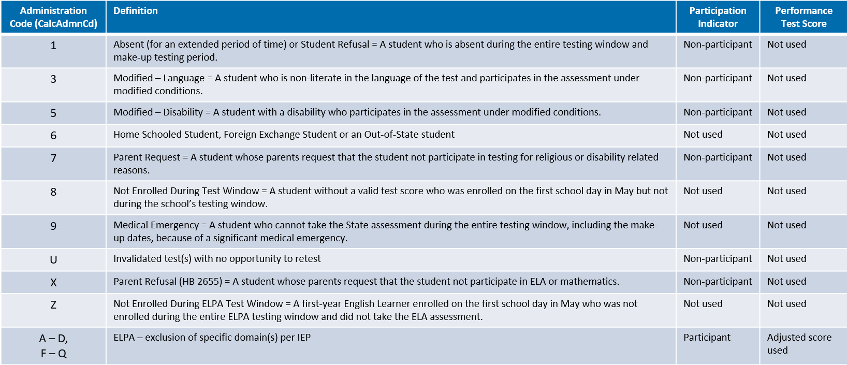
  TAM Administration Codes
TAM (pg 88-89)
Source: ARUA- Spring 2425 PPT

Slide 44
  Quality Checking - Final Edits
Last date for edits to enrollment or assessment records: August 22, 2025
  2024-25 Subjects in the ARUA close August 22 at 5 PM
  Third period Cumulative ADM final edits August 22 @ 11:59 PM
Not sure what to check?
See: May 15, 2025 Assessment Reporting (Editing and Checking Assessment Data, Third Period Cumulative ADM, and English Learners)
  PPT slides 49-58 https://odedistrict.oregon.gov/Training/Documents/arua_spring_2425.pptx
  Training Video https://youtu.be/i2R5ImcQy80

Slide 45
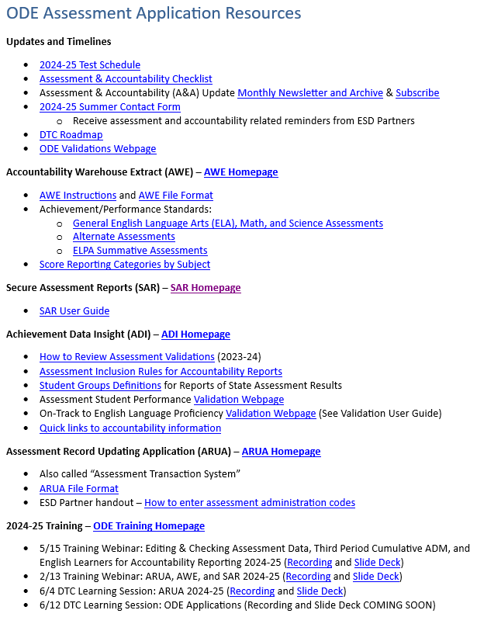
ODE Application Resources
http://bit.ly/4kKXlHS
Notes:
http://bit.ly/4kKXlHS

Slide 46
Thank You!

