Slide 1

Module 2 Presentation
Margaret Heritage
Notes:
Welcome to Module 2’s presentation. In this presentation we are going to focus on an important first step in how teachers implement formative assessment in their classrooms.

Slide 2
Section 1
LEARNING GOALS AND SUCCESS CRITERIA
Notes:
The presentation is in two parts and the first section will focus on learning goals and success criteria.

Slide 3
Guiding Questions
Where am I going?
Where am I now?
Where to next?
Notes:
Formative assessment is framed by three guiding questions that both teachers and students need to address in the lesson.
Where am I going?
Where am I now?
Where to next?
In this presentation we are going to think about the first two questions from the teacher’s perspective and in modules 3 and 4, we’ll focus on these questions as they apply to students. In the next module we’ll focus on the third question, where to next?
So let’s start with the first question: where am I going?

Slide 4
Where am I Going? Learning Goals
Make clear to students what they will learn (not what they will do) during a lesson – one or more periods of learning
Developed by teacher or co-constructed with students
Introduced at some point in the lesson
Notes:
Where am I going? Teachers answer this question by being clear about what the learning in the lesson will be. They create learning goals that help the students understand what it is that they are going to be learning in the lesson. Learning goals are sometimes referred to as learning targets or learning intentions. It really doesn’t matter what you call them as long as they refer to the learning focus of the lesson – and by a lesson, I mean 1 to 3 class periods.
Standards are the ultimate end of year learning goal and as such, they are too big for lesson-sized goals. However, lesson goals come from standards. You will need to analyze standards to decide what are the appropriate chunks of learning for a unit (which will combine several standards) and from the unit, appropriate size chunks for a lesson. Remember that lesson goals must be connected together to provide the coherence necessary for deeper learning.
It’s important to get the lesson goal right because it not only will guide your instructional plan, but will also guide formative assessment.
Learning goals are either developed by teachers or when students get really used to working from goals, teachers often co-construct them with their students. Learning goals need to be communicated to students in language they understand and introduced at some point in the lesson – it doesn’t always have to be at the beginning. The point is that students should know what they are learning and why they are learning it.

Slide 5
Where am I Going? Success Criteria
Performances of learning
Aligned to learning goal(s)
What students will say, do, make or write
Clearly understood by students
Used as a reference point during the lesson
Notes:
There is another part to the learning goal – success criteria. These are performances of learning, indicators that students are meeting the learning goal. Together with the learning goal, they answer the question, where am I going? Success criteria are not simply restatements of the learning goal in student-friendly language. Instead, they should help students understand what it means to achieve the goal. Importantly there should be clear alignment between the goal and criteria - we’ll see some examples of this alignment later.
Teachers need to be clear what meeting the learning entails – in other words, what will students say, do, make or write that will indicate they have met the goal?
And students really need to understand what meeting the goal and criteria involves. Helping students understand what learning goals and success criteria involve requires explanations and examples of successful performance. For example, teachers might use an essay from a prior year’s cohort and help students analyze the work in relation to the specified criteria, or provide examples of math problem solving strategies to discuss successful strategies and approaches to problem solving.

Slide 6

Learning Goals & Success Criteria
Learning Goals
Success Criteria
Understand the structure of a coordinate grid
Relate the procedure of plotting points in quadrants to the structure of a coordinate grid
I can talk & write about plotting points on a coordinate grid using correct vocabulary
I can plot and label points in each quadrant on a coordinate grid
I can create a rule about coordinates for each quadrant
Notes:
This example is from a 6th grade math lesson that the teacher taught over 2 class periods and there are two learning goals.
The first is: Understand the structure of a coordinate grid and the second is :Relate the procedure of plotting points in quadrants to the structure of a coordinate grid.
Notice how the teacher has aligned the first criterion to the first goal. She has determined that if the students can talk & write about plotting points on a coordinate grid using correct vocabulary that will be an indication to her that they understand the structure of a coordinate grid.
Notice how there are two success criteria for the second goal. To show that students have met the goal the teacher wants to see them plotting and labeling points in each quadrant on a coordinate grid, and then she wants them to be able to create a rule about coordinates for each quadrant.
Before the students began their learning activities, the teacher spent time discussing these with the students and made sure that they understood what they were learning and how they would know if they were learning it.
The teacher also used the criteria as a reference point several times throughout the class periods for students to think about where they were in relation to the goal.

Slide 7
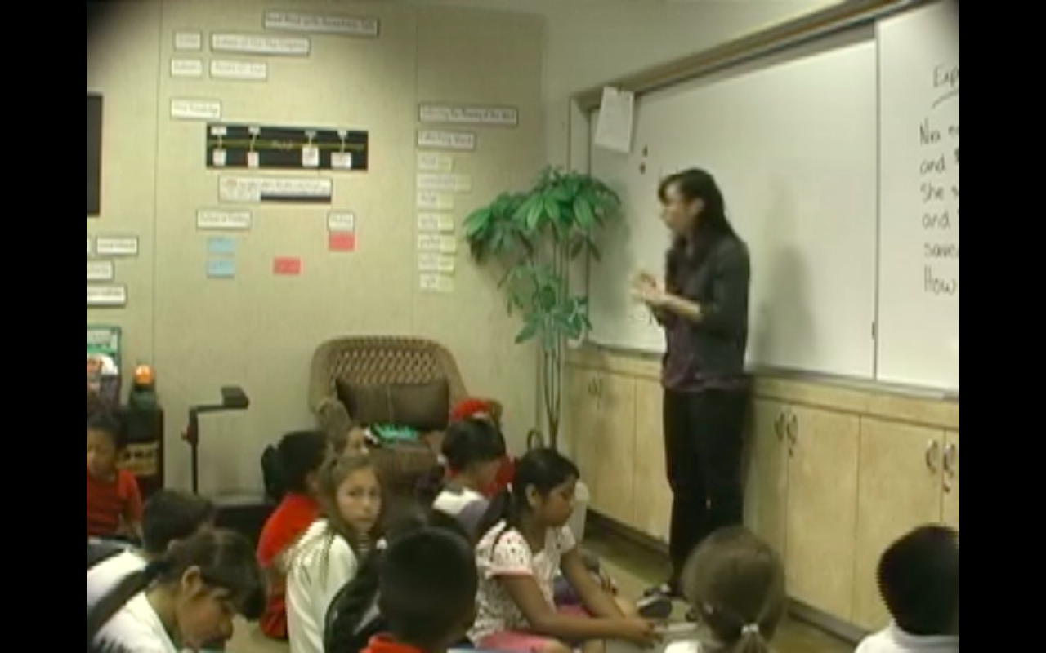
Learning Goal
Goal: Use multiplication and division to solve problems
Problem: Ricardo has 1,135 US stamps. He has 3 times as many foreign stamps as US stamps. How many stamps does he have altogether?
Notes:
In this 3rd grade math class, the focus of the lesson is using multiplication and division to solve problems. You can see the problem that the students are to solve in the lesson on the slide.

Slide 8
Success Criteria
I can determine when and how to break a problem into simpler parts
I can explain what the problem is asking me to do
I can explain the relationship between multiplication and division
Notes:
For the learning goal, the teacher has established three criteria:
I can determine when and how to break a problem into simpler parts
I can explain what the problem is asking me to do
I can explain the relationship between multiplication and division
Before the students begin solving the problem, the teacher spends time going over the success criteria, asking the students what the criteria mean. They have an extended discussion about the third criterion, in particular - explaining the relationship between multiplication and division

Slide 9
Co-Constructing Criteria
Notes:
In this middle school writing class, the teacher has provided feedback to the students about their persuasive writing drafts and has told the students that they are now in a position to develop their writing to make it even more persuasive – she tells them “they have the foundations down and now it’s time to build the building.”
Using an exemplar text, the teacher guides a discussion on how the author made his writing stronger and more persuasive. After the discussion, the teacher and the students co-construct the criteria for making their writing stronger. They now fully understand the criteria and are ready to use them in their second drafts.

Slide 10
What Makes a Good
Learning Goal?
Clear and linked to the big picture of learning;
Focused on the learning;
Written/communicated from the students’ perspective (i.e., not in teacher- or standards-speak);
Realistic and time-limited (i.e. span one lesson);
Lead to rich, productive learning experiences.
Notes:
Let’s summarize now what makes a good learning goal.
First learning goals need to be clear and linked to the big picture of learning. End of the year standards are too big for lesson goals, as our unit goals, but importantly the learning goal needs to be connected to the unit, which in turn needs to be connected to the standards. Students need to understand where they are ultimately headed.
Learning goals need to be focused on the learning – in other words, they should specify what students are going to learn as a result of the lesson activities.
Because students need to fully understand what the learning goal entails, they need to be communicated in language the students can understand. Obviously, this will vary according to the students’ grade level – how a kindergarten learning goal will sound will be very different from a 9th grade learning goal.
Learning goals also need to be lesson-sized. They need to be realistic and manageable with a lesson.
And learning goals should be substantive so that they lead to rich learning experiences that help students learn content deeply.

Slide 11
What Make Good Success Criteria?
Clear and closely linked to the learning goal;
Continue to focus on the learning;
Illustrate the expected learning;
Written/communicated from the students’ perspective (i.e., not in teacher- or standards-speak);
Support rich, productive learning experiences.
Notes:
Good success criteria also have particular characteristics. They need to be clear and closely linked to the learning goal so that when teachers are thinking about obtaining evidence in relation to success criteria, they will actually be getting the evidence they need.
Success criteria should focus on the learning – in other words, what it means to learn what teachers have planned for students to learn. As with learning goals, they need to be communicated in language the students can understand, and they and the learning goal should lead to rich, productive learning experiences.

Slide 12
Section 2
INTENTIONALLY GATHERING EVIDENCE OF LEARNING
Notes:
Gathering evidence answers the second key question in formative assessment: where am I now?
When teachers have clear learning goals and success criteria, they know what they need to obtain evidence of. In this next section, we’ll focus on gathering evidence of learning during the lesson.
Notice the word “intentionally” on the slide – this is key to evidence gathering. A constant stream of information is produced as students are engaged in learning. Identifying methods you will use to elicit evidence of students’ learning is critical to the process of formative assessment.
As you discussed in the last PLC, there is no single most effective method to elicit evidence of student thinking. To get quality evidence, the method must be aligned with learning goals and success criteria. If not, the information generated may be of little use in making decisions about what students need next to keep learning moving forward.
Another consideration when you are thinking about how to obtain evidence is the quality of the evidence that you will get. For example, if your question generates one-word answers from students, there is little for you to go in planning instructional next steps. Questions that reveal students’ thinking will provide richer information for you to act on.

Slide 13
Where am I now?
Notes:
Returning to the 3rd grade math lesson, after the students had discussed the learning goal and success criteria, they worked in groups to solve the problem. Here we can see the teacher joining one group (eventually she goes to each group in the class where there are 32 students). Here she is finding out if they can provide explanations about the problem and explain the relationship between multiplication and division. She is using dialogue to obtain evidence of the students’ thinking.
This is not the only opportunity she uses for obtaining evidence – she will ultimately have the students’ written explanations as well as their strategies for solving the problem.

Slide 14
Where am I now?
Second writing drafts using criteria
Notes:
In the middle school writing class, the teacher uses the second drafts of students’ writing to obtain evidence of how well they have strengthened their essays, using the criteria they co-constructed.

Slide 15
Recap
Clear learning goals and success criteria
Intentional planning for evidence gathering
Alignment among goals, criteria and evidence gathering method
Notes:
Now to conclude with a brief recap of key points from this presentation:
Formative assessment begins with clear goals and success criteria that answer the question:
Where am I going?
Evidence, aligned to the learning goals and success criteria is intentionally collected during the lesson to answer the question: Where am I now?

Slide 16
ODE Resources
Five Evidence Gathering Routines
Learning Goals and Success Criteria
Writing Tips for Learning Goals and Success Criteria

