Slide 1

Module 1 Presentation
Margaret Heritage
This content is offered by the Oregon Department of Education under a Creative Commons Attribution Non-Commercial Share Alike 4.0 license
Notes:
Welcome to Module 1’s presentation.

Slide 2

Section 1
FORMATIVE ASSESSMENT WITHIN A COMPREHENSIVE SYSTEM OF ASSESSMENT
Notes:
In the first section of this presentation, we are going to focus on what formative assessment is and how it operates within a comprehensive system of assessment.

Slide 3
Formative Assessment
Formative assessment is the term used to describe a type of assessment where the focus is on informing learning, rather than measuring it or summing it up.
Assessment that focuses on the learning as it is taking place
Purpose is to move learning forward from its current status
Notes:
Formative assessment is the term used to describe a type of assessment where the focus is on informing learning, rather than measuring it or summing it up. It is assessment that focuses on the learning as it is taking place. In other words, it occurs during daily lessons, sometimes once, sometimes more, to gauge where students are while they are learning so that teachers can take action to help students make progress. Formative assessment is completely within the purview of individual teachers in their classroom, unlike other types of assessment that are external to the classroom. External assessment that are required by the school, district or state are used for different purposes other than informing teaching and learning minute-by-minute, day-by-day.

Slide 4

One Size Does Not Fit All
Notes:
In the realm of educational assessment on size does not fit all. In other words, assessments are designed for different purposes. An annual assessment designed to assess how well students have met a specific standard, such as, the ELA standard explain how an author uses reasons and evidence to support particular points in a text cannot serve the purpose of diagnosing a particular reading difficulty the student is experiencing related to that standard, nor can it provide substantive insights into how a student is beginning to understand what constitutes evidence in a specific text. A central question then, in the use of any assessment is: “Am I using this assessment for the purpose for which it is intended?”

Slide 5
Comprehensive System of Assessments
student
standards
minute
by minute
daily
weekly
(Adapted from Herman & Heritage, 2007)
unit
quarterly
annually
Notes:
Ideally, different assessments for different purposes operate together in a coherent system of assessment that serves different decision-making purposes to support student achievement of standards – the ultimate learning goals.

Slide 6
Comprehensive System of Assessments
student
standards
minute
by minute
daily
weekly
(Adapted from Herman & Heritage, 2007)
unit
quarterly
annually
Notes:
Formative assessment operates at the level of the system that is closest to students’ immediate learning – that is, minute-by-minute, day by day – so that teachers and students can keep learning on track to meeting lesson goals. This type of assessment is the most fine-grained because it covers small chunks of learning. Annual assessments are at a much larger grain size because they sample a whole year’s worth of learning. All assessments, no matter the grain size, should support students along the pathway to meeting the ultimate goal which are the standards.

Slide 7
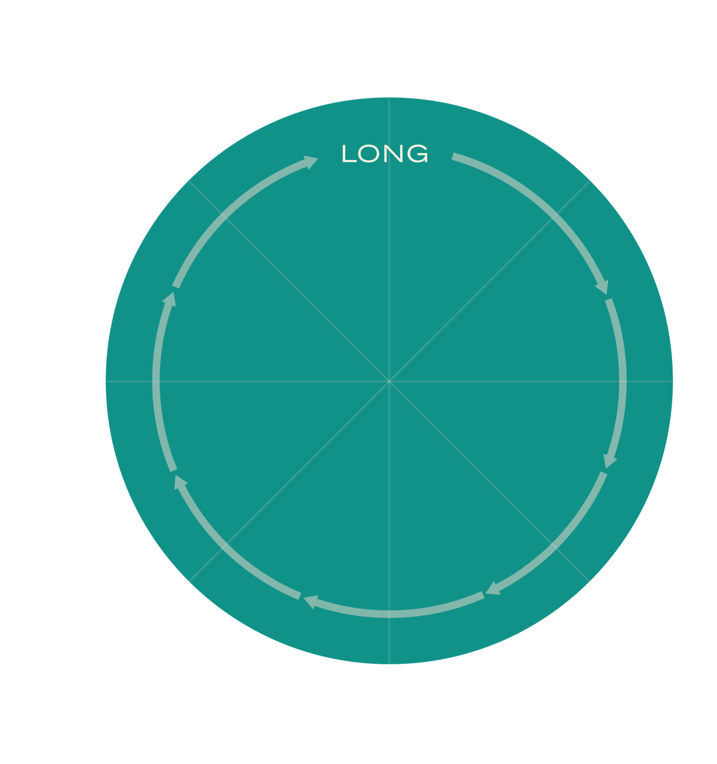
Assessment Cycles (Wiliam, 2006)
Extended periods of instruction
Long-term goals
What have my students learned in relation to the standards? Have they met the standard?
What are the overall strengths and needs in my class’s learning?
What are the strengths and needs in individual’s and groups’ learning?
What might I need to do differently next year?
Notes:
Another way to think about assessment for different purposes is to consider Dylan Wiliam’s idea of assessment operating in different cycles: long, medium and short. Each cycle provides information at varying levels of detail and inferences drawn from the assessment results are used to address specific questions about student learning and inform a range of decisions and actions.
Annual assessments are long-cycle assessments because they asses students’ achievement of long-term goals – the standards.
Some of the questions that results from these assessments can help teachers answer are:
What have my students learned in relation to standards? Have they met the standard?
What are the overall strengths and needs in my class’s learning?
What are the strengths and needs in individual’s and groups’ learning?
What might I need to do differently next year?
The information from the assessment will not be able to tell teachers and others why students performed the way they did. However, coming to an understanding the possible causes of student performance is important. Summative data can prompt further inquiry into other sources of data to uncover reasons for poor performance, for example, attendance data, trend patterns from interim data, opportunity to learn data and student perception data.

Slide 8
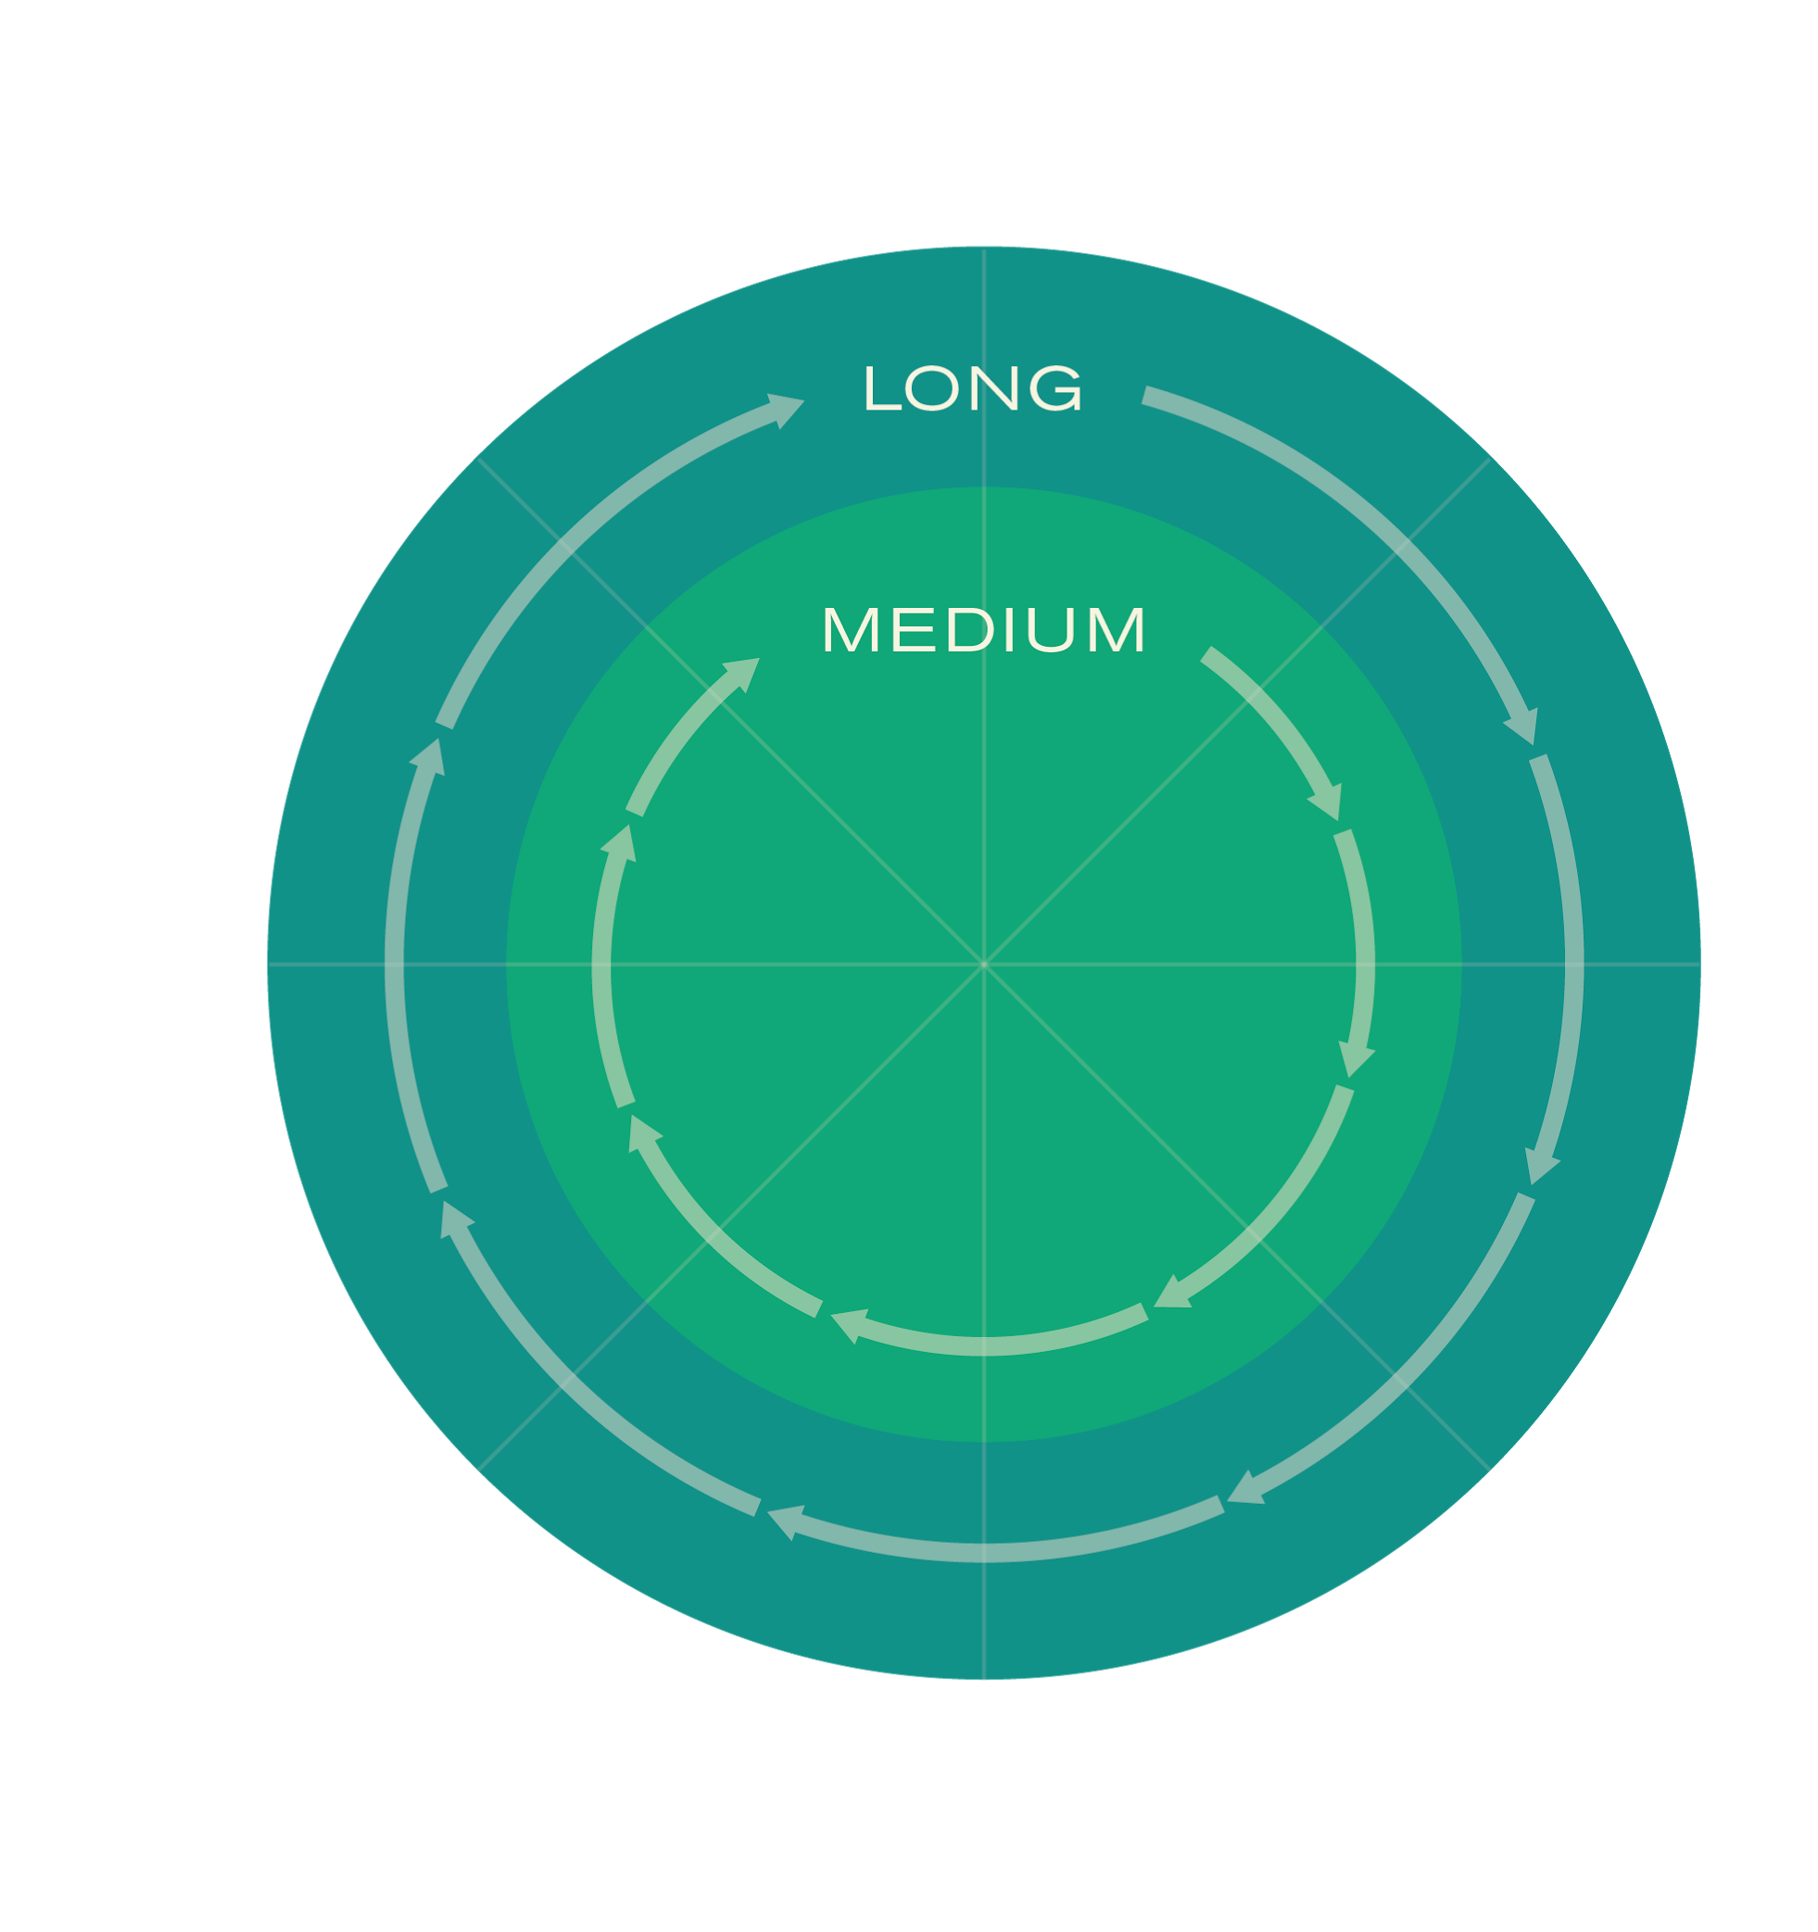
Assessment Cycles (Wiliam, 2006)
Interim goals
Monitoring progress
What has been learned
What have my students learned so far?
-Who has and who hasn’t met intermediate goals?
- Who is and who isn’t on track to meet the standards?
Notes:
Interim/benchmark assessments are medium-cycle and address intermediate goals on the way to meeting. Often administered quarterly or every six weeks, they cover a shorter period of instruction than long-cycle assessments and consequently provide more detail about student learning. Results from interim assessments provide periodic snap shots of student learning throughout the year. These snapshots assist teachers to monitor how student learning is progressing and to determine who is on track to meet the standards and who is not, so they can take any necessary action before the end of the year.
Results from these assessments can help teachers answer the questions:
What have my students learned so far?
Who has and who hasn’t met intermediate goals?
Who is and who isn’t on track to meet the standards?
Again, these data cannot provide the reasons for student performance and as with end of the year data further inquiry will be needed to reveal possible causes.

Slide 9
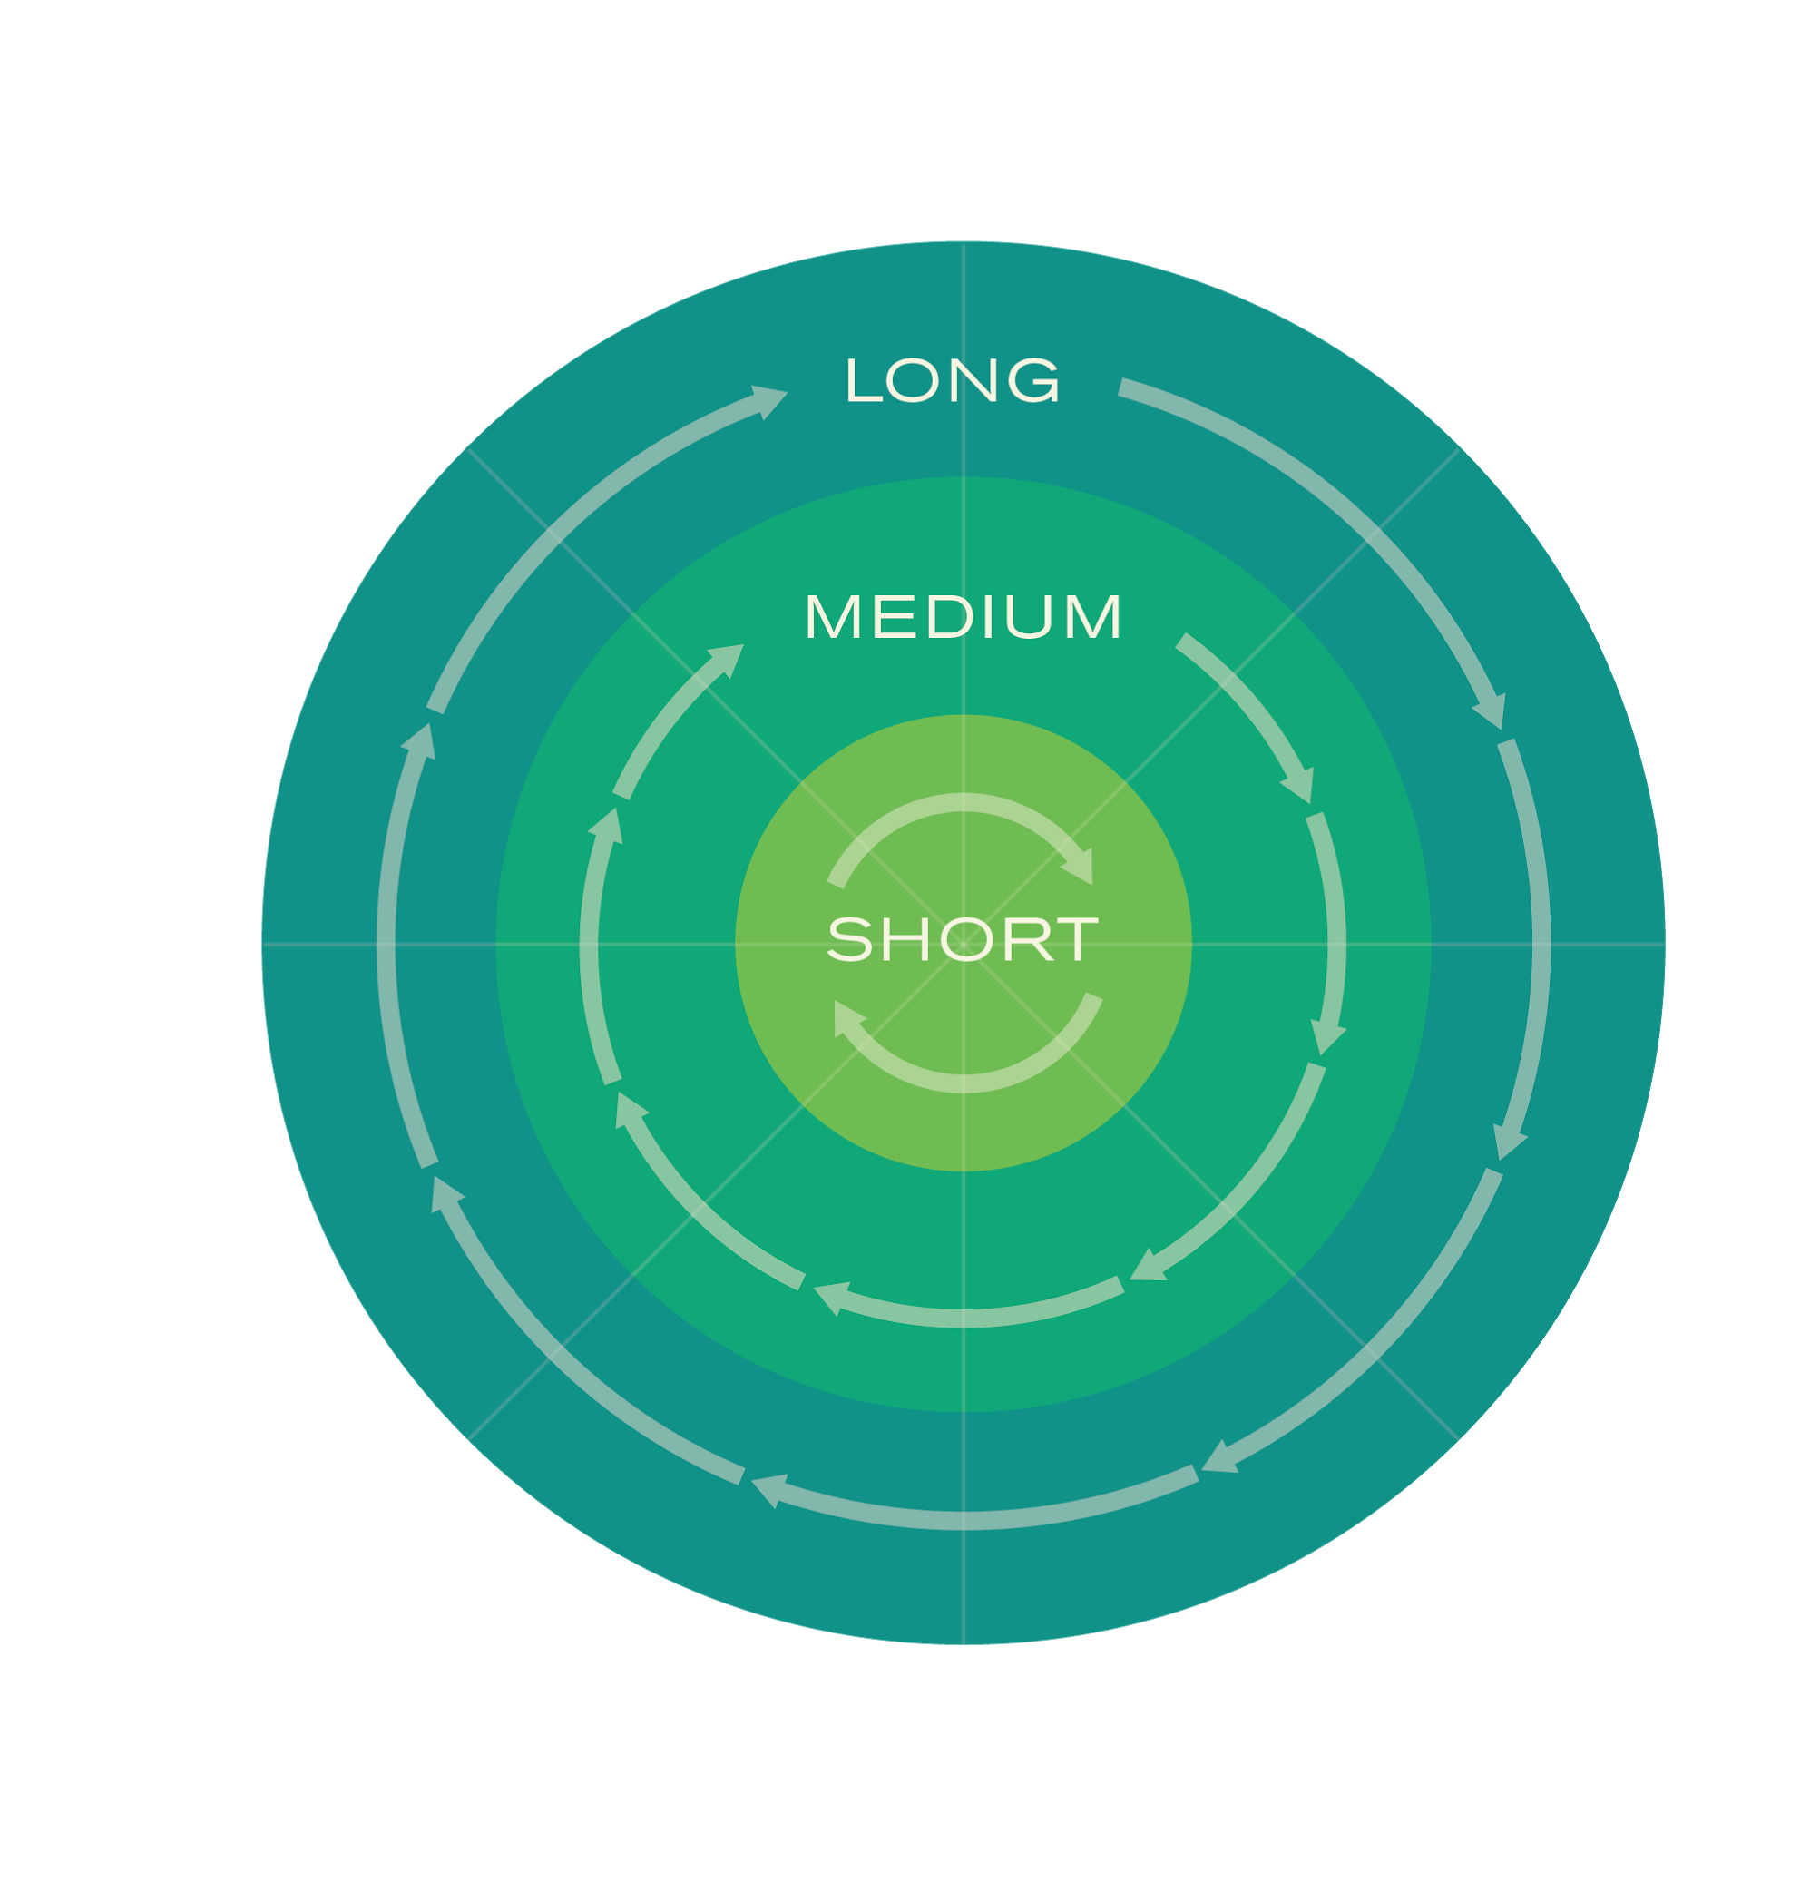
Assessment Cycles (Wiliam, 2006)
Short-term goals
Informing immediate teaching and learning
Where are my students in relation to learning goals for this lesson?
-What is the gap between students’ current learning and the intended lesson goal?
-What individual difficulties are my students having?
-Are any misconceptions apparent?
Notes:
Short-cycle formative assessment occurs when evidence of learning is gathered day-by-day from a variety of sources during ongoing instruction for the purpose of moving learning forward to meet short-term goals, that is lesson goals.
This type of assessment provides the most detailed information for teachers and their students. The idea of short-cycle formative assessment, or formative assessment does not apply to a specific tool or assessment. This is not to say that an assessment cannot be used for formative assessment purposes – it can – but only if it provides information about students’ learning status relative to the desired lesson goal that teachers can use immediately to adjust their instruction in the lesson or make plans for subsequent lessons.
The sources of evidence available to teachers in short-cycle formative assessment are what students say, do, make or write. For example, sources of evidence can be teacher-interactions fueled by well-designed questions, structured peer-to-peer discussions where the teacher listens in, dialogues that embed assessment into an activity already occurring in the classroom and student work from well-designed tasks.
Questions that short-cycle formative assessment can answer include:
Where are my students in relation to learning goals for this lesson?
What is the gap between students’ current learning and the intended lesson goal?
What individual difficulties are my students having?
Are there any misconceptions apparent?

Slide 10
Methods for Obtaining Evidence
Frequency | Method | Information | Uses/Actions
Minute-by-minute | Observation Questions (teachers and students) Dialogue Instructional tasks Student discussions Written work/ representations | Students’ current learning status Relative difficulties and misunderstandings Misconceptions Emerging or partially formed ideas Full understanding | Keep going Stop and find out more, Provide oral feedback to individuals, Adjust instructional moves in relation to student learning status (e.g., act on “teachable moments”)
Daily | Observation Questions (teachers and students) Dialogue Instructional tasks Student discussions Written work/ representations | Students’ current learning status Relative difficulties and misunderstandings Misconceptions Emerging or partially formed ideas Full understanding | Continue with planned instruction Instructional adjustments in this or the next lesson Find out more Feedback to class or groups or individual students (oral or written)
Notes:
In this slide, which you also have as a handout - Activity Sheet 2- shows the range of methods for obtaining evidence of learning. As you can see there is no one way. Evidence sources range from observation, to dialogue, to student work products. Teachers need to carefully select the method that is most appropriate for the evidence they are seeking. You’ll notice that instructional tasks can be a source of evidence. If instructional tasks are good learning tasks – that is they build students thinking - then they can often serve the assessment purpose as well. Importantly, formative assessment should not be left to chance and needs to be intentionally planned as part of the lesson. The whole point of gathering evidence is to obtain information about learning as it is developing so that action can be taken to maintain progress. We are going to return to this slide after the next section.

Slide 11
Section 2
FORMATIVE ASSESSMENT IN THE CONTEXT OF A MULTI-TIERED SYSTEM OF SUPPORT
Notes:
Now that we have considered formative assessment as part of a comprehensive system of assessment that operates within a short-cycle, we’re now going to think about formative assessment in the context of a multi-tiered system of support.

Slide 12
Supports
Tier 1:
Standards-based core
Learning for all students
Tier 3: Intensive
Tier 2: Targeted
intervention
Tier 3:
Individual instruction (IEP)
Special education
Additional assessment
Tier 2:
Targeted students & instruction
Needs-based learning
Frequent, predictive, reliable and skill-specific progress monitoring to ensure that intervention is impacting catch-up growth
In-process formative assessment at
all levels
Notes:
Within Oregon’s multi-tiered system of support, the goal of tier 1, or “core” content is that the classroom teacher should be able to meet the needs of the majority of students through high-quality, differentiated instruction. Ideally, 80% of students needs are met here, through quality teaching and learning with appropriate core materials
There is ample research evidence, that when well implemented, formative assessment can result in improved student achievement and for this reason, it must be an integral part of tier 1 instruction so that the goals of tier 1 can be achieved. Student learning is monitored minute-by-minute, day-by-day to ensure that teachers are making the necessary plans to keep individual student’s learning on track. In tier 1 instruction, all students receive support based on evidence from formative assessment.
Some students will need to receive specific interventions to ensure progress. However, these interventions can only be deemed necessary for students when they are not making the required progress even when teachers are being responsive to their learning needs as part of tier one instruction. An even smaller number of students will at some point require intensive intervention.

Slide 13
Supports
Progress Monitoring
Progress Monitoring
In Process Formative Assessment (occurs in all three tiers)
Universal Support/ Core Instruction
Targeted Support
Intensive Support
Notes:
However, even in the case of specific interventions for particular subject areas such as math or reading, teachers will still continue with tier 1 standards aligned instruction using formative assessment to guide their day-to-day decisions about meeting students’ ongoing learning needs for that content area and at that grade level “In process” formative assessment, that is formative assessment that takes place daily during lessons, will help teachers know where students are in their learning to secure progress. Progress monitoring assessments are used frequently during targeted intervention and intensive intervention to obtain information about students’ progress and to decide if the intervention is working, if it needs to be changed, or if it can be discontinued.

Slide 14
ODE Resources
Overview of the Fundamentals of Learning

