Slide 1

Module 4 Presentation
Margaret Heritage
Notes:
In part 1 of this presentation we are going to focus on the student role in formative assessment; and in part 2, we’ll consider the kind of classroom culture that is conducive to that student role.

Slide 2
Section 1
STUDENT ROLE IN FORMATIVE ASSESSMENT
Notes:
Before we get into the details of the student role, we begin with the question “why do students need to have a role in formative assessment?

Slide 3



Students actually DO the learning
Notes:
The answer is quite simple – because students actually do the learning. Teachers can help students learn but they can’t actually do the learning for them. Increasingly, there is recognition that students must participate in learning and take a measure of responsibility for their own learning, not just to be successful in school but also in college and the work place.

Slide 4
Student Role
Using feedback
Giving and receiving feedback
Self-assessment
Notes:
There are three primary ways that students take a role in formative assessment and each one is dependent on students being clear about learning goals and success criteria. The three main ways are: Using feedback to advance their own learning, giving feedback to peers and receiving peer feedback, and engaging in self-assessment. Let’s consider each one of these.

Slide 5

Feedback Should…
Be related to goals and criteria
Provide the learner with suggestions, hints or cues for how to improve rather than correct answers
Focus on the learning and not on the individual
Engage students’ thinking
Notes:
In formative assessment teachers provide descriptive feedback to the students about the status of their learning in relation to the success criteria, and give cues to the students about what they can do to progress and close the gap between where they are and the intended lesson goals. Remember from module 3 that teacher feedback should be related to goals and criteria, provide the learner with suggestions, hints or cues for how to improve rather than correct answer, focus on the learning and not on the individual – it should not be ego involving and it most definitely should engage students’ thinking.

Slide 6
Feedback
Feedback is only formative if it is USED by students
Teachers must allow TIME for students to use feedback
Using feedback helps students develop knowledge of LEARNING STRATEGIES
Notes:
6
If teachers are going to provide feedback, then students must be given opportunities to use it – otherwise teachers are wasting their time. Once students have feedback they must be given time in the lesson or time for homework to use it.
Effective feedback can help students develop learning strategy knowledge, the learning strategies that are most effective in particular subject areas. For example, drawing a diagram to solve a mathematical problem, or doing more research to analyze historical events, or re-reading a text to make the meaning clearer. Developing strategy knowledge is a critical element in students being able to take responsibility for their own learning and is a college and career ready skill.

Slide 7
Peer Feedback
“Research shows that the people providing the feedback benefit just as much as the recipient, because they are forced to internalize the learning intentions and success criteria in the context of someone else’s work, which is less emotionally charged than one’s own work”
(Wiliam, 2006:6).
Notes:
Teachers are not the only people in the classroom who can give feedback – peers are also sources of feedback for learning. Peer feedback has a number of advantages both for those students providing the feedback as well as those receiving it. It involves thinking about learning and can deepen students’ understanding of their own learning. As Dylan Wiliam states "research shows that the people providing the feedback benefit just as much as the recipient, because they are forced to internalize the learning intentions and success criteria in the context of someone else’s work, which is less emotionally charged than one’s own” (Wiliam, 2006, p. 6).
Feedback that students provide to each other can also be a formative assessment for teachers. What students say or write about each other’s work can show how well they understand the learning goals and success criteria, and the depth of their thinking about the task at hand.
Peer feedback can support self-assessment and can also foster collaboration among students – which is both a means to learning and a goal of learning.

Slide 8
Needs to Be Taught
Provide ground rules
Introduce in stages:
  Teacher modeling
  Whole class feedback on student work
  Model and discuss effective and ineffective feedback
  Templates for scaffolding peer feedback
  Practice and monitoring
Notes:
Peer feedback does not just occur naturally – it is a skill that needs to be taught and consistently addressed. Students don’t just learn how to give feedback and then they are all set. It is process of increasing sophistication over time. How students give feedback in the primary grades should differ substantially from how high-school students provide peer feedback.
Teacher modeling is one of the most important factors in peers learning to give feedback – students will model the feedback they give peers on the feedback they receive from their teachers.
Other strategies include working as a class to provide feedback on examples of student work – preferably from students not in the class; discussing when feedback is effective and ineffective, providing students with templates that help them go through the process of peer feedback and of course lots of practice in peer feedback and reflection about how effective the peer feedback provided was.

Slide 9
Self-Assessment
Involves metacognition: process of reflecting upon one’s own learning
  Adapt learning strategies
Notes:
Self-assessment involves students in metacognition – that is, thinking about their own thinking and reflecting on their own learning. Taking control over one’s learning is dependent on metacognition. When students are metacognitive they think about where they are in relation to learning goals and success criteria and then adapt their learning strategies based on the discrepancy they perceive between their current learning and desired goals. In this way, they are taking responsibility for their own learning.

Slide 10
Needs to Be Taught
Modeling
Asking questions that encourage reflection
Templates for scaffolding self-assessment
Notes:
Just as peer feedback skills need to be taught, so too does self-assessment. Teaching self-assessment is not just a one-shot deal – it is a continuous process for students of refining skills and becoming more sophisticated in understanding where they are in their learning, and deciding on the most effective learning strategy to move forward. Teacher modeling of self-assessment through think-alouds is one way to teach self-assessment; students can gain insights into the internal voice that is used to self-assess and begin to develop their own.
When teachers ask questions that encourage reflection, students are prompted to think about their learning and any discrepancies between where they are and the intended lesson goal. Eventually, they will become more independent and recognize when they do not understand, when they need to do something about it, and what they can do to improve. Teachers often use templates to scaffold self-assessment. You’ll see an example of a template one teacher used on the next slide.

Slide 11
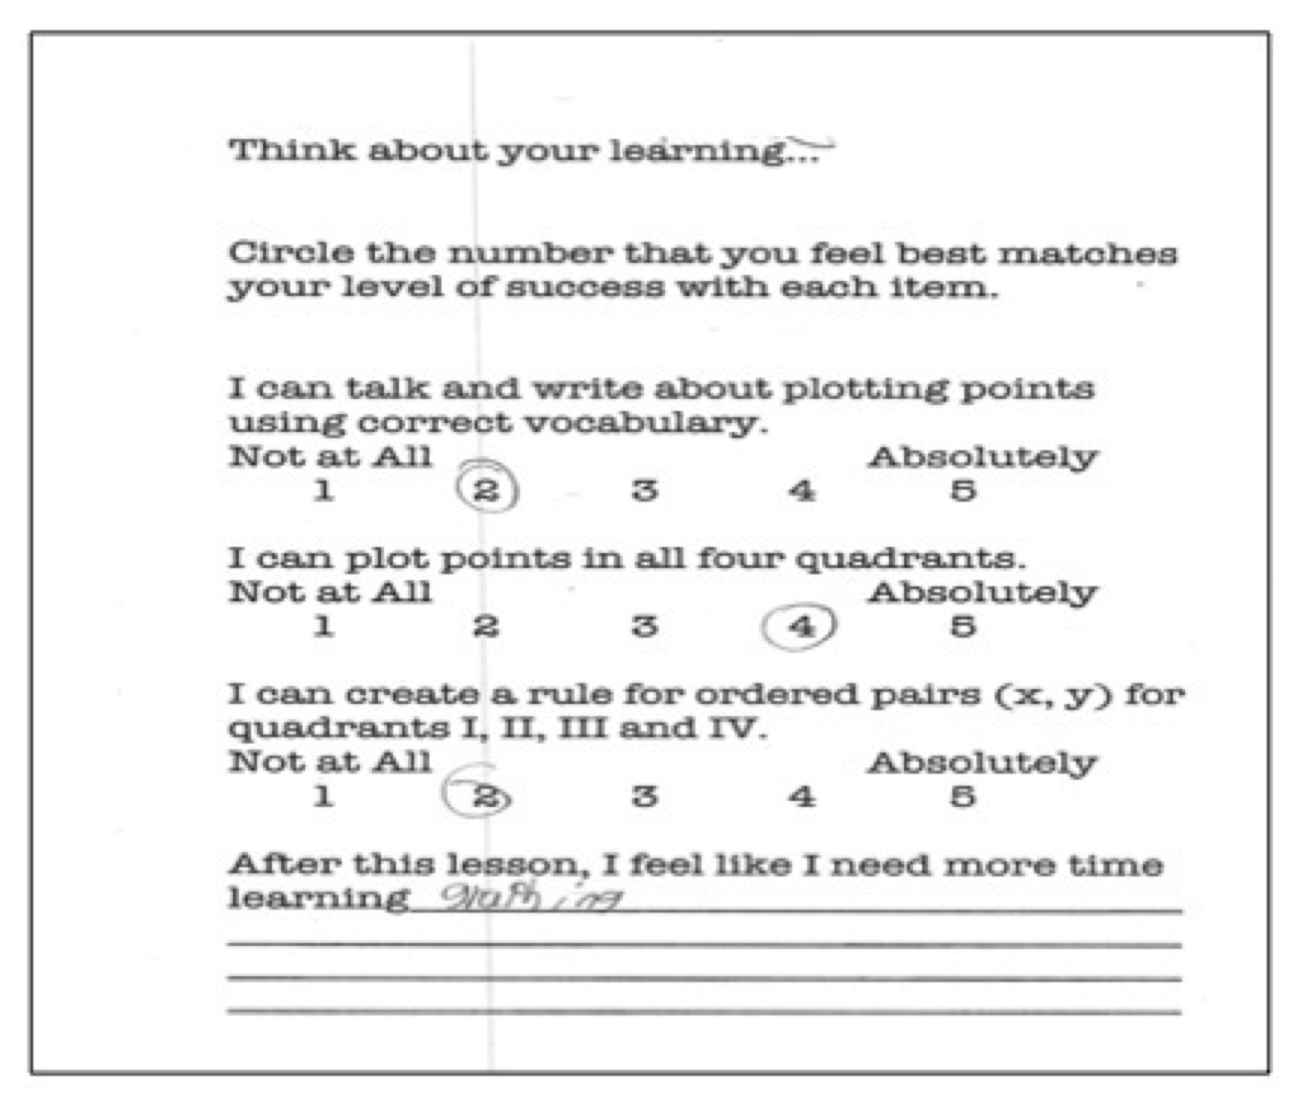
Self-Assessment Strategy: End of Lesson Reflection Against Success Criteria
Notes:
This sixth-grade teacher routinely asks students at the end of the lesson to consider where they are in relation to the success criteria. She uses the information from students’ self-assessment as a complement to her own evidence to decide on plans for the next lesson.

Slide 12
Section 2
CLASSROOM CULTURE CONDUCIVE TO FORMATIVE ASSESSMENT
Notes:
The whole process of formative assessment depends on a classroom culture where students feel safe to say they do not understand something, and to give and receive constructive feedback from peers. Teachers must establish a classroom culture characterized by a recognition and appreciation of individual differences. In a classroom where students listen respectfully to each other, respond positively and constructively, and appreciate the different skill levels among peers, all students will feel safe in the learning environment to learn with and from each other.
.

Slide 13
Classroom Culture Characteristics
Shared responsibility for learning
Expectation that
ALL STUDENTS CAN LEARN
Positive interactions modeled
Positive Classroom Culture
Intellectual Rigor
Supportive, collaborative relationships
Mutual Trust
Notes:
This slide shows 6 characteristics of a classroom culture that is conducive to students taking a role in formative assessment.
In formative assessment, teachers share responsibility for learning and assessment with their students. Since no one else can learn for them, students must take some responsibility for their own learning. When students understand learning goals and success criteria, and when they are involved in self-assessment and provide feedback to each other, they are better able to make judgments about their own learning and decide on their own, or in collaboration with the teacher and peers, the action they need to take to move learning forward.
Gaining insights into student thinking through formative assessment strategies means that students must be willing to share their thinking with the teacher and with each other. This requires a classroom culture where students feel safe to express where they are in their learning without fear of ridicule or sanctions. The models teachers provide to their students through their interactions with them will be a significant factor in how the norms of respect and supportive interactions and behavior among the students is established.
If students are going to learn with and from each other, and be willing to give and receive constructive feedback about their learning, then the classroom culture needs to be characterized by supportive, collaborative relationships. Once again, teacher modeling will play an important role as will the structures, opportunities and expectations for collaboration that the teacher provides.
The interactional models and the supportive, collaborative relationships lead to feelings of mutual trust between teacher and students and among students. Students know that their teacher respects them and wants the best for them and they, in turn, develop a feeling of trust within their community of peers.
Related to how teachers convey respect and regard for their students, is the level of challenge they provide for the students in their learning. Students need to feel that their teacher believes they can learn and in classrooms where this is case intellectual rigor, constructive criticism and challenging of ideas exists for all students. Of course, formative assessment is the means teachers will use to know what level of challenge individual students are ready for so that can consistently move forward from where they are currently to a more advanced state of learning.
6. The intellectual rigor of the classroom, in addition to the verbal and non-verbal interactions between the teacher and students, will convey a message to the students that their teacher believes ALL of them can learn.

Slide 14

Sharon
“Formative assessment has not only changed me as a teacher but I believe it has changed the students as learners.”
Heritage, 2010, p. 5
Notes:
We end this presentation with a reflection from a sixth-grade math teacher about formative assessment and the student role. After focusing on implementing formative assessment for a period of two years, she reflected that formative assessment had not only changed her as a teacher but had also changed students as learners – learners who were able to take much more responsibility for their own learning.

Slide 15
Recap
Students are involved in formative assessment through peer and self-assessment and using feedback
Creating a classroom culture that is conducive to formative assessment is a critical component for students taking a role in formative assessment
Notes:
Now to conclude with a brief recap of key points from this presentation:
Students are involved in formative assessment through peer and self-assessment and using feedback; these skills need to be taught and time needs to be provided for students to use feedback and to adapt their own learning strategies.
Creating a classroom culture that is conducive to formative assessment is a critical component of effective formative assessment implementation. Classroom cultures characterized by trust, respect, and appreciation of differences provide the context for formative assessment.

Slide 16
ODE Resources
Peer Assessment
Insights About Self-Assessment
Teaching Students Self-Assessment
Self-Assessment Protocol
Classroom Culture Inventory
3 student surveys: The Way I See School
(K-2, 3-6, 7-12)

