Slide 1


Module 6 Presentation
Margaret Heritage
This content is offered by the Oregon Department of Education under a Creative Commons Attribution Non-Commercial Share Alike 4.0 license
Notes:
Welcome to Module 6’s presentation.

Slide 2
Section 1
Assessing Language in Content Lessons
This content is offered by the Oregon Department of Education under a Creative Commons Attribution Non-Commercial Share Alike 4.0 license
Notes:
This Module continues the focus we began in Module 5: Using the DLLP to assess language in the content areas. In addition to thinking about oral language, we will also introduce how the DLLP can be used with students’ written language.

Slide 3
Formative Assessment
Formative Assessment
This content is offered by the Oregon Department of Education under a Creative Commons Attribution Non-Commercial Share Alike 4.0 license
Notes:
Recall from Module 5 that the teacher outcomes in our DLLP Theory of Action are that by using the DLLP teachers will be better able to obtain evidence of students’ language learning and engage in adaptive instruction, including feedback, to progress students’ language development. This outcome is achieved because the DLLP helps teachers know what language features to target, supports them in deciding the status of students’ language with respect to the features – not evident, emerging, developing, or controlled – then assists them to make decisions about what to do next instructionally to secure progress for each student.

Slide 4
Social Studies Lesson: Use evidence to answer an historical question: What kind of leader was Augustus? https://sheg.stanford.edu/history-lessons/augustus
This content is offered by the Oregon Department of Education under a Creative Commons Attribution Non-Commercial Share Alike 4.0 license
Notes:
Now we are going to look at an excerpt from a middle school social studies lesson to show the connections between content and language. The link to the complete lesson is provided on Module 6, Handout 1.
This lesson focused on using evidence to answer the question “What kind of leader was Augustus?” After a brief introduction about the purpose of the lesson and the inquiry, in small groups, students examined evidence from two artefacts, a map of the Roman Empire at the time of Augustus, and facsimiles of silver coins used in the Roman Empire. In their groups, they engaged in discourse to reason from the evidence and to develop a preliminary answer to the question about Augustus’ leadership.

Slide 5
DLLP Connections
Sophistication of Sentence Structures
Contrastive forms: X is bigger/smaller than y; additionally two clauses conjoined using disjunctive forms such as however, but, on the one hand/on the other hand
Contrastive & superlative adjectives: bigger, more land, strongest, largest
Adverbial forms: In contrast with…
“That” clauses: I argue/think/believe that…, I am persuaded/convinced that….
Descriptive noun phrases: require use of adjectives (noun modifiers) to provide pertinent, vivid details such as the writing on the left side of the front of the coin or the bared teeth of the aggressive-looking crocodile…
Sophistication of Topic Vocabulary
Possible Core Vocabulary: size, growth, comparison, before/beginning/start, after/end/conclusion, rule, ruler, emperor, reign, invade, conquer, countries, dark/light shaded area, celebrate, commemorate, traits, characteristics, leadership, successful, argue, support (an argument), convinced [core because they are predictable and likely used by many students in the class]
[NOTE: Topic words used in the prompts are not given credit on the DLLP: documents (map and coins), leader, Augustus, sources, reliable.]
Possible Related Vocabulary: notice, powerful, land, armies, strong, money, glory, victorious, believe, think, persuaded…
This content is offered by the Oregon Department of Education under a Creative Commons Attribution Non-Commercial Share Alike 4.0 license
Notes:
On this slide, you can see the anticipated connections between the DLLP high-leverage features, Sophistication of Topic Vocabulary and Sophistication of Sentence Structures and the content learning in the lesson.
On Module 6, Handout 1, you can see the anticipated connections between the content and discourse features. I will pause to give you a moment to read them.
When the teacher anticipates these DLLP connections, she is able to focus her attention on listening for them during her discussions with the students.
The teacher might notice, for example, that some students have limited core vocabulary and are not using words such as comparison, traits, leadership and argue. Additionally, some students might not be using contrastive sentence forms and contrastive and superlative adjectives in their graphic organizers comparing the documents.
Noting that one of her students was at the Emerging phase in both Topic Vocabulary and Sentence Structures on the DLLP, the teacher might decide to pair her with another student at a more sophisticated level on the DLLP as a model for both the types of vocabulary she might develop next, as well as the kinds of written sentence structures necessary for completing the graphic organizer.
We should mention here that vocabulary used in the source documents may be included or excluded for consideration of placement on the DLLP depending on instructional focus. If the source document vocabulary is a target of instruction and learning, it can be added to the core vocabulary, list in order to assess its acquisition. If teachers wish to focus on students’ generation of their own vocabulary on a topic, it can be omitted.

Slide 6
Section 2
Using the DLLP with Student Writing
This content is offered by the Oregon Department of Education under a Creative Commons Attribution Non-Commercial Share Alike 4.0 license
Notes:
In the next section, we are going to consider how teachers can use the DLLP with student writing to assess language features.

Slide 7
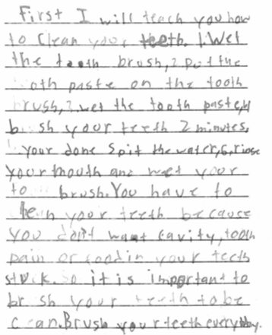
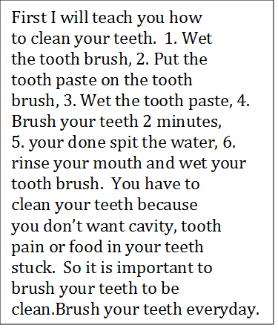
Prompt: Pretend you’re writing a letter to a friend who doesn’t know how to clean his/her teeth. When you’re ready, explain to him/her how to do it and why he/she should do it.
5th grade, EL student (Intermediate), Spanish L1
This content is offered by the Oregon Department of Education under a Creative Commons Attribution Non-Commercial Share Alike 4.0 license
Notes:
Here is a sample of writing from a 5th grade English learner. You have this writing sample on Module 6, Activity Sheet 2.

Slide 8
Placement on the DLLP
First I will teach you how to clean your teeth. 1. Wet the tooth brush, 2. Put the tooth paste on the tooth brush, 3. Wet the tooth paste, 4. Brush your teeth 2 minutes, 5. [when] your [=you are] done spit the water, 6. rinse your mouth and wet your tooth brush. You have to clean your teeth because you don’t want cavity, tooth pain or food in your teeth stuck. So it is important to brush your teeth [in order for them] to be clean. Brush your teeth everyday.
Key:
Sophistication of Topic Vocabulary : Controlled
Sophistication of Sentence Structure:
Developing
Coherence/Cohesion:
Emerging
This content is offered by the Oregon Department of Education under a Creative Commons Attribution Non-Commercial Share Alike 4.0 license
Notes:
Here is the writing sample again with the Key:
In bold text is Sophistication of Vocabulary:
Underlined is Sophistication of Sentence Structure:
In Italics is Coherence/Cohesion:
For Sophistication of Topic Vocabulary, this explanation was placed at Controlled because the student used a variety of core or essential topic vocabulary as well as a wide range of related vocabulary, and although this is a personal routine, the student even used a more formal or technical term (“cavity”).
For Sophistication of Sentence Structure, this explanation was placed at Developing because while this student used 2-3 complex structures, there were still several grammatically incorrect or incomplete attempts such as “it is important to brush your teeth to be clean,” which is a run on sentence and missing “in order for them.”
For Coherence/Cohesion, this explanation was placed at Emerging becausewhile the coherence is maintained by the enumeration and logical order, the student used just one transition word at the very start and omits other useful transition words along the way, such as “Then wet the toothpaste” or “Finally, rise your mouth…” In addition, there is no evidence of cohesive devices such as pronouns replacing full nouns, for example, using “them” for “teeth” to effectively tie established referents to later referents of the same thing.

Slide 9
Section 3
Continuing the Work
This content is offered by the Oregon Department of Education under a Creative Commons Attribution Non-Commercial Share Alike 4.0 license
Notes:
As this is the last module in the series, Section 3 focuses on how you can continue the work and become increasingly skilled in using the DLLP for formative assessment of language in content learning.

Slide 10

Communities of Practice
A group of people who share information, insights, tools and experiences about a common interest or subject
Group members interact regularly to learn from one another
Focused on knowledge exchange and growth rather than the production of work products or tasks
This content is offered by the Oregon Department of Education under a Creative Commons Attribution Non-Commercial Share Alike 4.0 license
Notes:
We recommend that you continue engaging in this work through a community of practice. A community of practice is a group of people who share information, insights, tools, and experiences about a common interest or subject, just as you have done as you worked together during the Modules. Within a community of practice, group members interact regularly to learn from one another. A community of practice is focused on knowledge exchange and growth rather than on creating work products or tasks. We recommend that you plan to work with a group of colleagues for several months in a community of practice to continue to develop your knowledge and skills in using the DLLP for formative assessment purposes.

Slide 11
Three Agenda Types
Deepening learning about high-leverage language features
Focus on linking DLLP to content instruction
Refining and deepening practices
This content is offered by the Oregon Department of Education under a Creative Commons Attribution Non-Commercial Share Alike 4.0 license
Notes:
To support you in planning your communities of practice, on Module 6 Handout 2, we have provided three types of detailed agendas. You can select one of these agendas depending on where you feel you are with your knowledge and skills in implementing the DLLP, and stay with it for as long as you like. However, we suggest that you begin with Agenda 1, which is focused on deepening your learning about high-leverage language features. You can move to the next agenda as soon as you feel you are ready. We recommend that you meet in a community of practice for least 60 minutes once per month. We have found that when teachers allocate this time, the community of practice is of most value.
We recommend that you schedule an additional time to meet to review the agendas carefully, and decide how you are going to organize your ongoing work.

Slide 12

This content is offered by the Oregon Department of Education under a Creative Commons Attribution Non-Commercial Share Alike 4.0 license
Notes:
At this point, we have reached the end of the final presentation of the 6 Modules on the Dynamic Language Learning Progressions. We hope you have enjoyed listening, and we wish you luck with your continued journey as you deepen your knowledge of the DLLP, and your skills in formative assessment of students’ language learning.

