Slide 1


Module 5 Presentation
Margaret Heritage
This content is offered by the Oregon Department of Education under a Creative Commons Attribution Non-Commercial Share Alike 4.0 license
Notes:
Welcome to Module 5’s presentation.

Slide 2
Section 1
The Theory of Action for Dynamic Language Learning Progressions
This content is offered by the Oregon Department of Education under a Creative Commons Attribution Non-Commercial Share Alike 4.0 license
Notes:
In section 1, we are going to take another look at the theory of action for the Dynamic Language Learning Progression that we introduced in Module 1 .

Slide 3
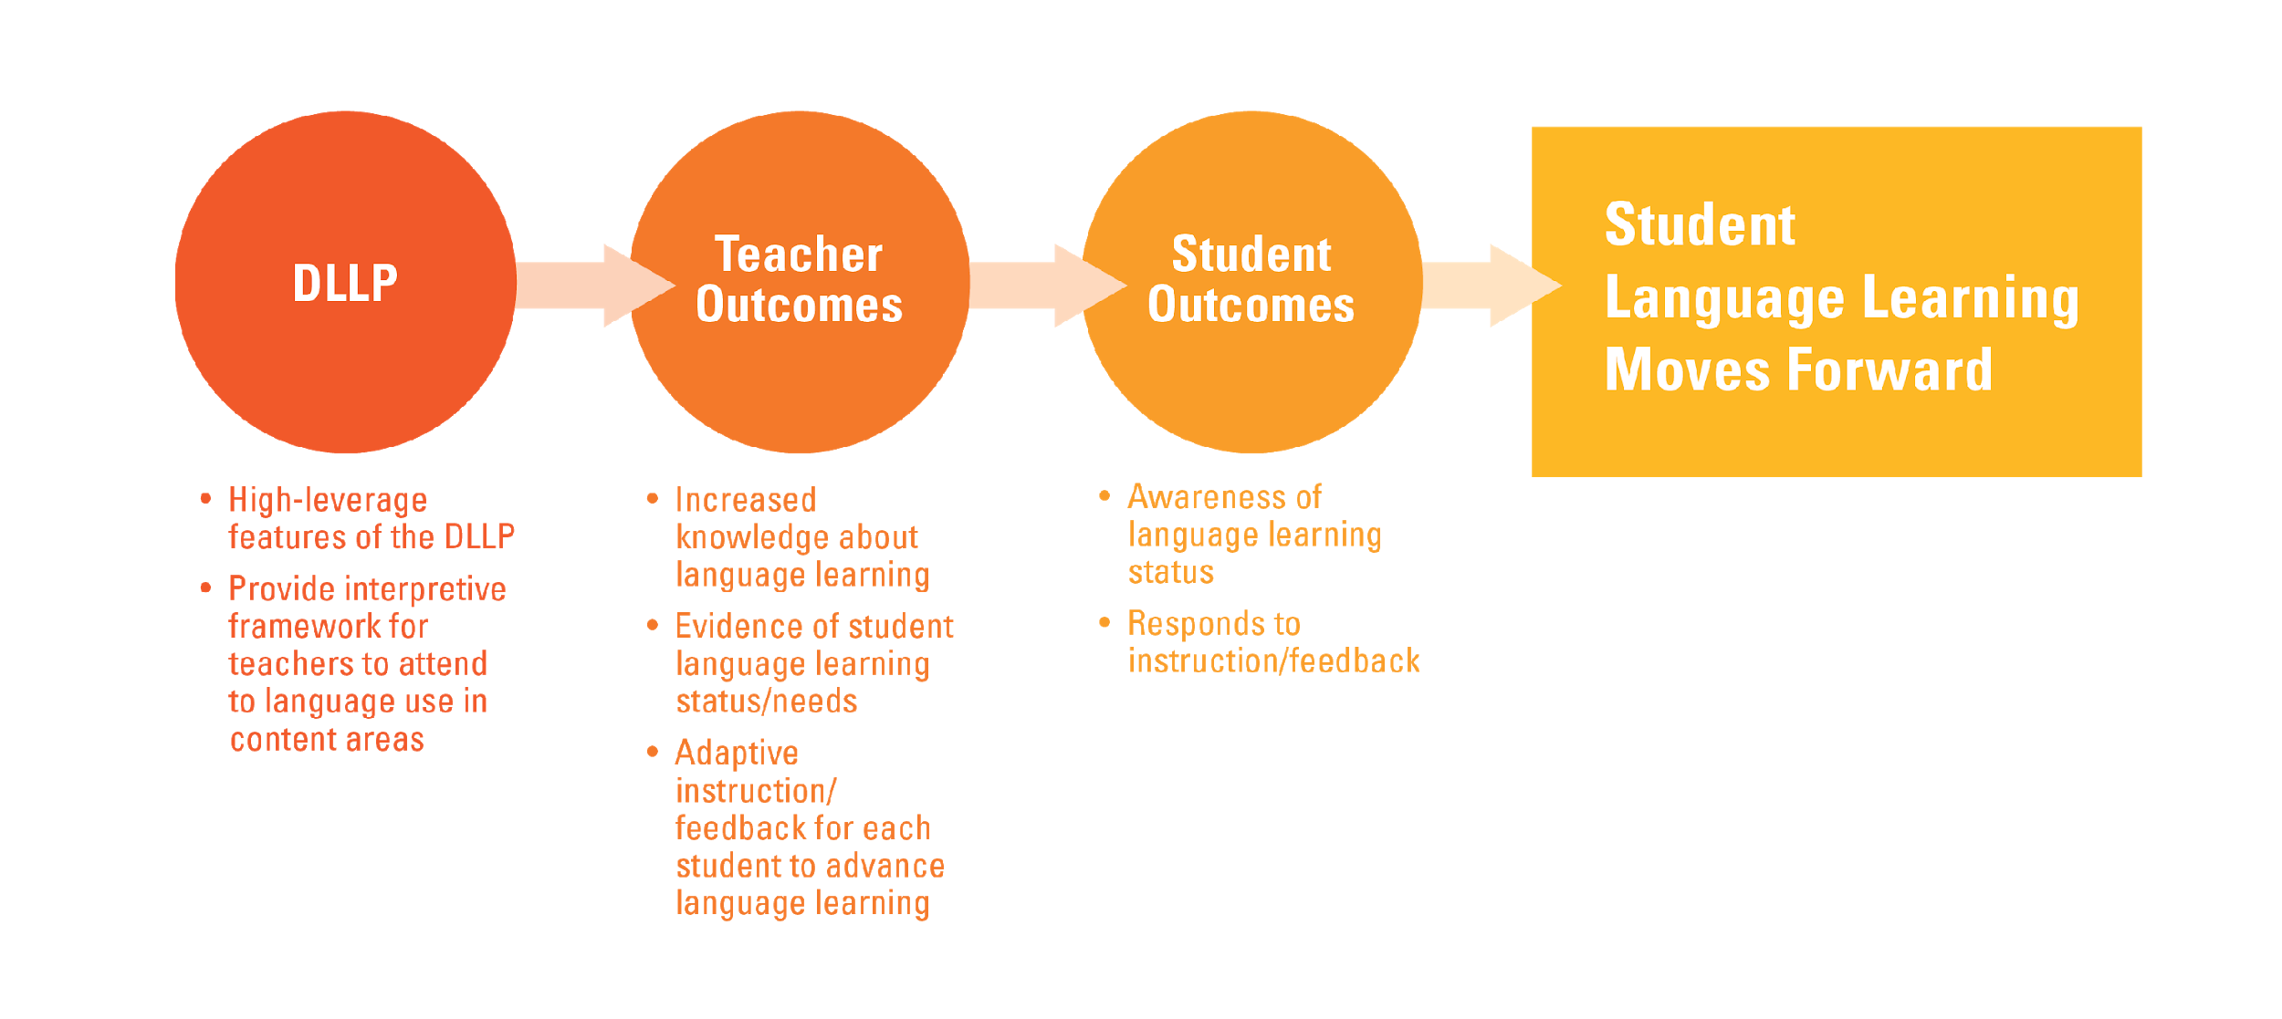
Dynamic Language Learning Progression Theory of Action
This content is offered by the Oregon Department of Education under a Creative Commons Attribution Non-Commercial Share Alike 4.0 license
Notes:
Recall that the DLLP provides the framework for teachers to identify language learning goals, collect evidence of learning, and interpret the evidence for the purpose of formative assessment.
We propose that by using the DLLP teachers will increase their knowledge of language learning. They will use this knowledge to obtain have evidence of students’ language use and make decisions about pedagogical next steps to advance each student’s language development. In other words, teachers will successfully engage in formative assessment to inform ongoing teaching and learning.
The use of the DLLP will also help students increase their awareness of their own language learning, and help them take their own next steps by responding to instruction and using feedback that their teachers provide, especially the feedback that assists them to understand where they are in their language learning.
For example, a teacher might say to a student, “I noticed that you are using some of the connector words we have been focusing on in your writing - that’s great. In this section you were comparing whales to fish. I wonder if you can think about what connector words we have talked about that you could use to show how the features of whales and fish contrast with each other?”
or “when you were describing the character in your book, I was beginning to get a picture from the words you were using. When you explain the character to your partner, think about adding more vivid words to really bring the character to life.”

Slide 4
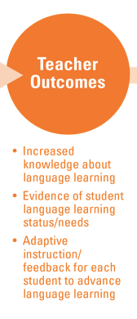
Formative Assessment
Formative Assessment
This content is offered by the Oregon Department of Education under a Creative Commons Attribution Non-Commercial Share Alike 4.0 license
Notes:
In this module, we are focusing specifically on the teacher outcomes in the Theory of Action: obtaining evidence of students’ language learning and engaging in adaptive instruction, including feedback, to progress students’ language development.
In previous modules, you have learned about the DLLP and practiced implementing the DLLP with respect to certain language features and finding the ‘best fit’ for specific students on phases of the DLLP. This is the first step in formative assessment, which, as we described in Module 1, is an assessment practice used by teachers and students to inform learning, not to measure it or sum it up.
Now we are going to focus on adapting instruction based on a student’s ‘best fit’ on the DLLP. In other words, deciding what next steps will help students move forward to a more advanced phase of the DLLP.

Slide 5
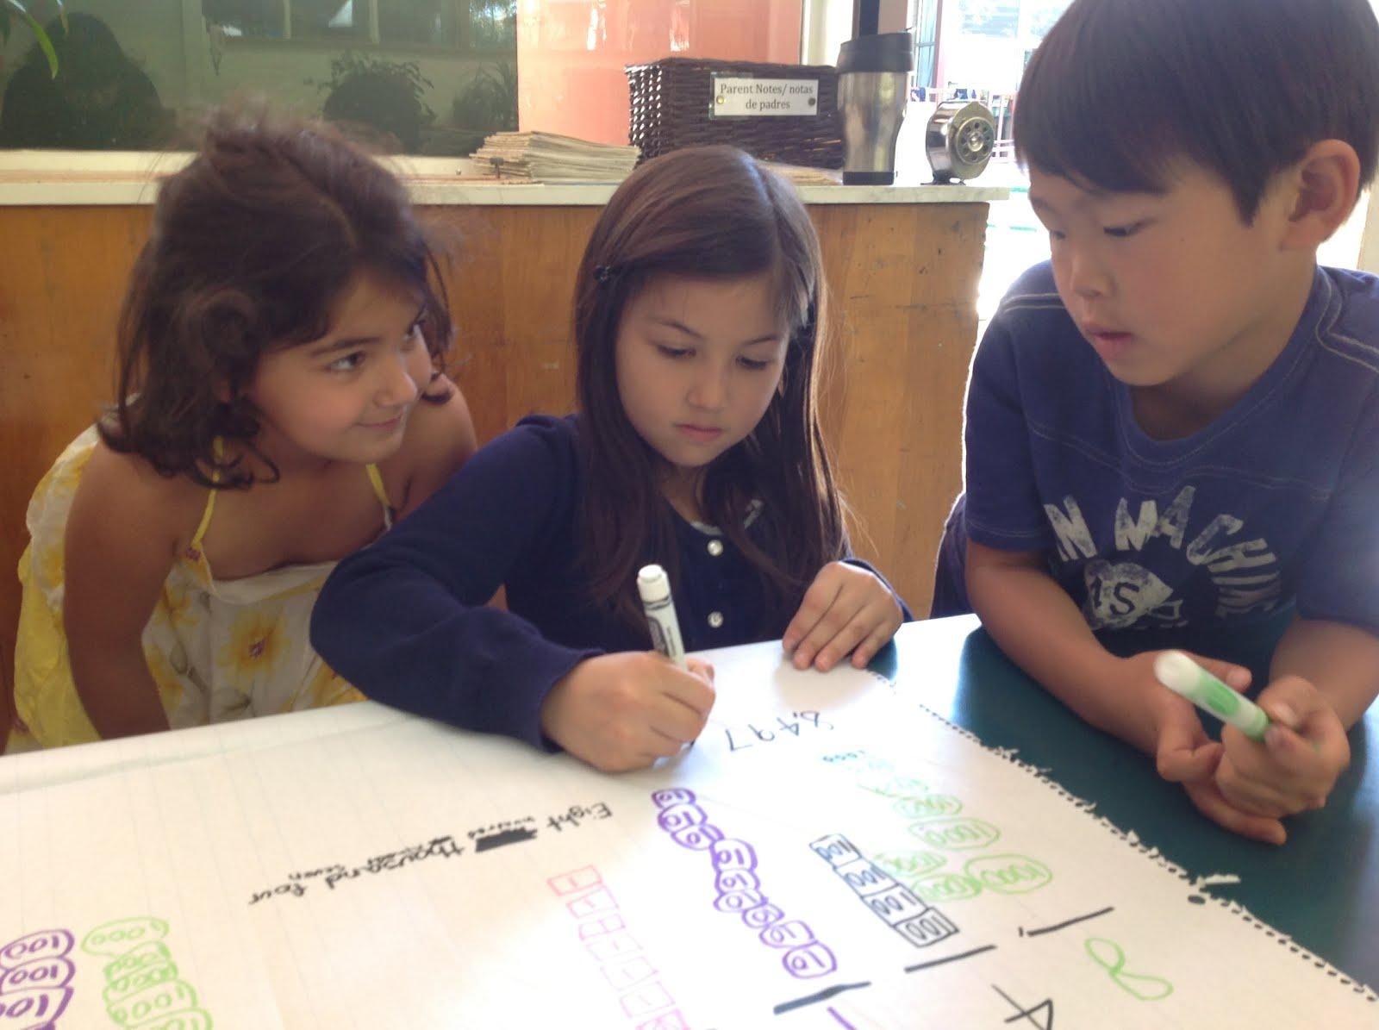
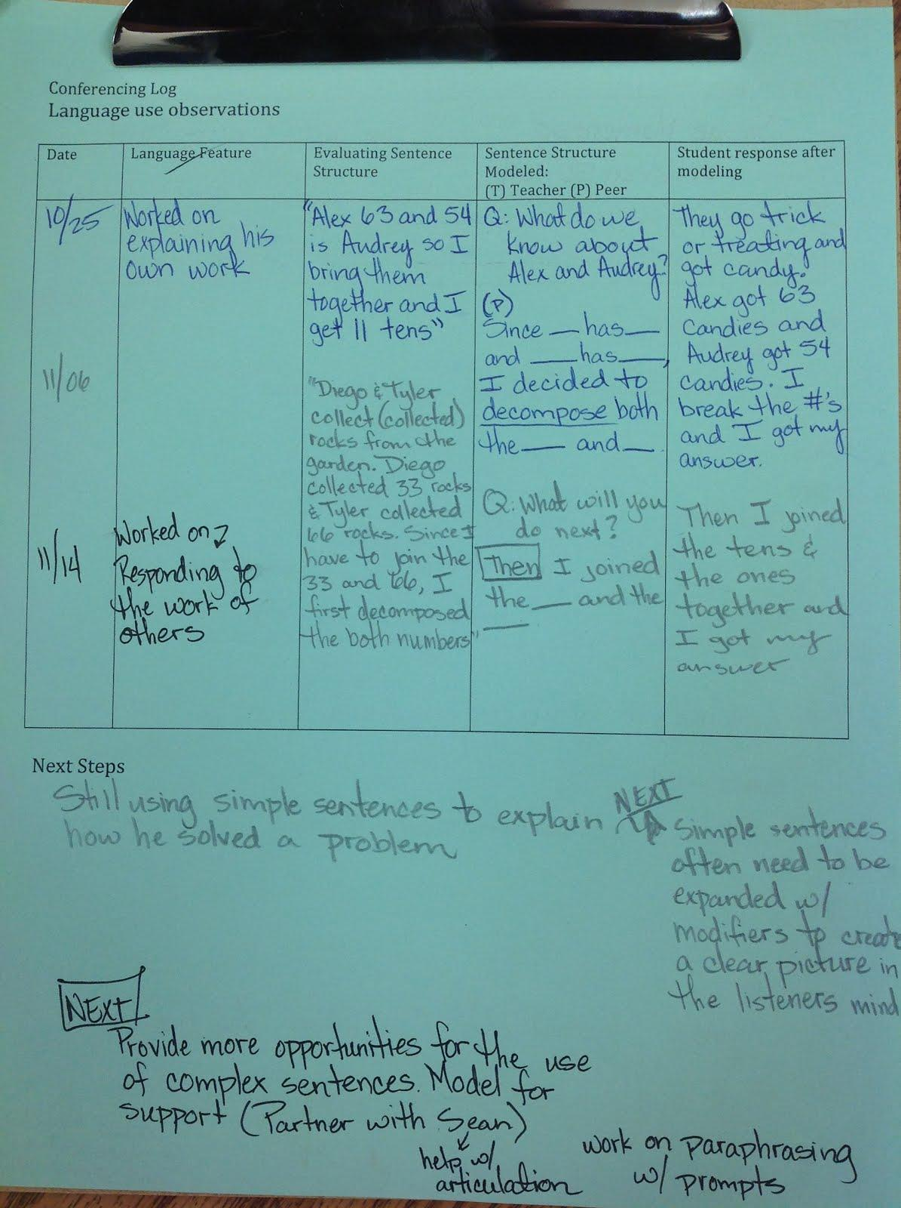
Formative Assessment
Still using simple sentence structures to explain how he solved a problem. Best fit-Emerging
Provide more opportunities for the use of complex sentences, model for support (partnering with Sean), work on paraphrasing with prompts.
This content is offered by the Oregon Department of Education under a Creative Commons Attribution Non-Commercial Share Alike 4.0 license
Notes:
Here is an example of how a primary teacher used the DLLP to obtain evidence of an EL student’s sophistication of sentence structure, and what she decided to do to advance the student’s development of this high-leverage language feature. She had created a note-taking template, which she placed on a clipboard and used for conferences with individuals and groups throughout math lessons. The template headings were: date, language feature, student language, language feature modeled, student response, next steps. During one lesson, in the context of math talk, using her knowledge of the sentence structure DLLP, she noted for one child that he is “still using simple sentence structures to explain how he solved a problem.” Still using the sophistication of sentence structure DLLP, she determined that the student’s ‘best fit’ was at the Emerging phase. To advance this student’s sentence structure use, in the next steps section she wrote “provide more opportunities for the use of complex sentences, model for support (partnering with Sean), work on paraphrasing with prompts.”
Notice that this teacher did not plan a separate language assessment. The formative assessment opportunities for language were already embedded in the students’ content area learning through their math talk.

Slide 6
Section 2
Planning for Formative Assessment of Language in the Content Areas
This content is offered by the Oregon Department of Education under a Creative Commons Attribution Non-Commercial Share Alike 4.0 license
Notes:
In this section, we are going to focus on how you can plan for formative assessment of language in your content lessons.

Slide 7
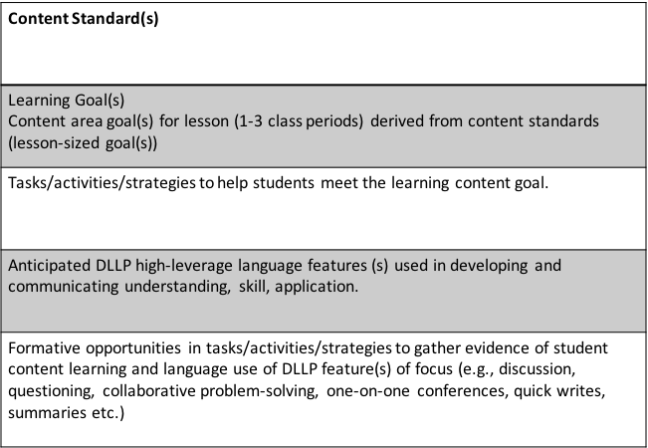
Lesson Planning with Formative Assessment
This content is offered by the Oregon Department of Education under a Creative Commons Attribution Non-Commercial Share Alike 4.0 license
Notes:
As we saw in the example from the primary classroom, the opportunities for obtaining evidence of language learning were already embedded in the lesson. The lesson planning template on this slide is one way to help you think about embedded opportunities in the lesson, (typically, one to four class periods) for obtaining evidence of language, as well as content learning.
The ultimate goal is for students to reach grade-level content standards, so lesson goals need to be derived from the standards. The content goal for the lesson should provide the answer to the question “what are my students going to learn in this lesson?” The next step in planning is to decide on the learning tasks and activities to help students meet the goal. Once these are determined, a teacher can then anticipate what language opportunities in the lesson are going to support the learning, and which specific DLLP high-leverage language features students will likely be using. These opportunities will be occasions for obtaining evidence of students’ language development, as well as for evidence of content learning.
We found in our pilot implementations that when teachers began using the DLLP for the purpose of formative assessment of language, they could only focus on one high-leverage feature at a time, and could not focus on both language and content learning simultaneously. We recommend that you adopt the same approach in the beginning - focus on either language or content learning. Eventually, our pilot teachers were able to address content and language simultaneously and, with practice, you will be able to do the same. However, in this Module and Module 6, we are going to focus on formative assessment of language only.

Slide 8
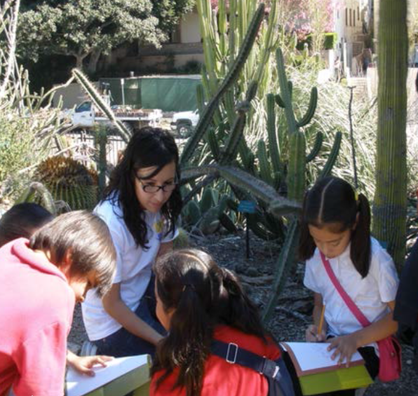
Science Unit
Lesson 1: Studying External Structures of Cacti
Content Goal: Understand the external structure of cacti and its functions.
Teacher input: guiding questions to deepen student thinking/observations
What do you notice?
What are some similarities and differences between the plants you see here and those we have at school?
Why do you think they have these particular features? What makes you say that?
This content is offered by the Oregon Department of Education under a Creative Commons Attribution Non-Commercial Share Alike 4.0 license
Notes:
For the next two slides, you will need to reference Module 5, Handout 1.
This third-grade teacher, whose students are mainly English learners, had developed a unit to address the science standards you can see on page 1 of the handout. As the kick-off to the unit, she took her students into the local neighborhood to make detailed observational drawings of cacti, and think about the particular external features of the cacti, and why they have these features.
On this slide you can see some of the questions that the teacher was planning to use during her discussions with the students about their observations and predictions.

Slide 9
DLLP Connections
Sophistication of Sentence Structures
Contrastive forms: X is bigger/smaller than y; additionally, two clauses conjoined using disjunctive forms such as however, but, on the one hand/on the other hand
Contrastive & superlative adjectives: bigger, more prickly, roughest, smoothest
Adverbial forms: In contrast with…
Descriptive noun phrases: require use of adjectives (noun modifiers) to provide pertinent, vivid details such as the tiny spikes of the cactus…, the teddy bear-shaped purple cactus…
Sophistication of Topic Vocabulary
Possible Core Vocabulary: prickly, sharp, spines or spikes, leaves, shape, smooth, desert, heat, shade, water, dry, protect, animals, eaten, etc. [core because they are predictable and likely used by many students in the class]
[NOTE: Topic words used in the prompts are not given credit on the DLLP: notice, same, different, cacti, plant, features]
Possible Related Vocabulary: observe, structures, contrast, external (outside), texture, drought, hardy, drink, survival …
This content is offered by the Oregon Department of Education under a Creative Commons Attribution Non-Commercial Share Alike 4.0 license
Notes:
On this slide, you can see the anticipated connections between the DLLP high-leverage features, Sophistication of Topic Vocabulary and Sophistication of Sentence Structure and the content learning in the lesson.
On the Module 5, Handout 1, you can see the anticipated connections between the content and discourse features. [Pause the presentation to give participants time to read them].
When the teacher anticipates these DLLP connections, she is able to focus her attention on listening for them during her discussions with the students. She might notice, for example, that the students had limited core vocabulary and were not using words such as prickly, sharp, spines or spikes. Considering her students to be at the Emerging phase of the Sophistication of Topic Vocabulary DLLP, she might decide to model specific vocabulary use as she describes what she notices about the features students have captured in their observational drawings. After the observation, when students are back in the classroom, she might ask them to write about the similarities and differences they observed between the outdoor cacti and the ones they have in their classroom. This might lead to her to decide that, while the students were using some structures that included complex sentences, they were not using a variety of forms, and, noticeably, for this specific task, no contrastive forms, which would put the students at the Developing stage of the DLLP. As a result, she might provide a classroom chart for the students’ reference that lists contrastive forms, for example, the outside cacti are bigger than the ones in the classroom; the classroom cacti are smoother than the ones outside and so on, and discuss them with her students. Their use of these contrastive forms on the chart would be another focus for subsequent formative assessment.

Slide 10

This content is offered by the Oregon Department of Education under a Creative Commons Attribution Non-Commercial Share Alike 4.0 license
Notes:
This is the end of Module 5’s presentation. Module 6 will continue to focus on DLLP connections with content lessons and also on using the DLLP with students’ writing.

