Slide 1


Module 4 Presentation
Alison Bailey
This content is offered by the Oregon Department of Education under a Creative Commons Attribution Non-Commercial Share Alike 4.0 license
Notes:
Welcome to Module 4’s presentation.

Slide 2
Section 1
High-leverage Feature: Sophistication of Sentence Structure the DLLP
This content is offered by the Oregon Department of Education under a Creative Commons Attribution Non-Commercial Share Alike 4.0 license
Notes:
The focus of this module is on the high-leverage language feature – sophistication of sentence structure.

Slide 3
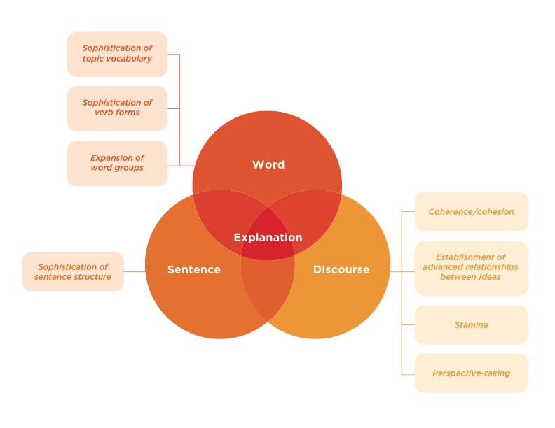
This content is offered by the Oregon Department of Education under a Creative Commons Attribution Non-Commercial Share Alike 4.0 license
Notes:
In module 2 you learned that the DLLP is organized around three key language dimensions – word, sentence and discourse and eight high-leverage features. In this module we are going to address the dimension, sentence- and the high-leverage feature: sophistication of sentence structures. Before we go into detail about this feature, we are going to review what makes a sentence.

Slide 4
What Makes a Sentence?
Words are combined to form sentences by a prescribed word order and according to grammatical rules (e.g., noun-verb agreement for number of people or things).
According to the Oxford English Dictionary (2018), a sentence is “A set of words that is complete in itself, typically containing a subject and predicate, conveying a statement, question, exclamation, or command, and consisting of a main clause and sometimes one or more subordinate clauses.”
Short as one word: Smile! Add!
Longer and complicated: And then when you're done putting them in groups, you can add up the cubes in each group because this will be easier for you.
This content is offered by the Oregon Department of Education under a Creative Commons Attribution Non-Commercial Share Alike 4.0 license
Notes:
Sentences are made up of words that are combined by a prescribed word order and according to grammatical rules such as agreement between a noun and a verb for the number of people or things involved.
According to the Oxford English Dictionary (2018), a sentence is “A set of words that is complete in itself, typically containing a subject and predicate, conveying a statement, question, exclamation, or command, and consisting of a main clause and sometimes one or more subordinate clauses.”
Sentences can be as short at one word—Smile! Add!—or they can be longer and complicated as in the sentence - And then when you're done putting them in groups, you can add up the cubes in each group because this will be easier for you.

Slide 5
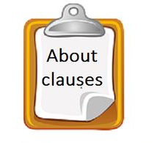
What makes a sentence?
Sentences comprise one or more clauses
A clause contains a subject—a noun or pronoun and a predicate–a tensed (finite) or conjugated verb: He adds, we add
An independent clause conveys a complete thought: I add 2 plus 2
A dependent, or subordinate clause does not convey a complete thought: Because I added 2 plus 2…
This content is offered by the Oregon Department of Education under a Creative Commons Attribution Non-Commercial Share Alike 4.0 license
Notes:
Sentences comprise one or more clauses; a clause contains a subject—that is a noun or pronoun and a predicate—that is a tensed (finite) verb (e.g., the verb must convey past, present or future action or state, etc.). An independent clause conveys a complete thought and can stand alone as a complete sentence (e.g., I add). A dependent, or subordinate, clause does not convey a complete thought and is not considered a complete sentence (e.g., Because I added).

Slide 6
Dependent Clause
Dependent clause usually functions within the sentence as a noun or as an adjective or adverb to modify the main noun or verb
Often signaled by a word that indicates its dependent status, e.g., when, that, because, though, if
Example:
“You can put the cubes into groups when you have sorted them by color.”
  Everything underlined is a dependent clause and is used to give more details about the timing of the main verb “put”
This content is offered by the Oregon Department of Education under a Creative Commons Attribution Non-Commercial Share Alike 4.0 license
Notes:
A dependent clause usually functions within the sentence as a noun or adjective or adverb, and it is often signaled by a word that indicates its dependent status (e.g., when, that, because, though, if, etc.).
For example:
“You can put the cubes into groups when you have sorted them by color.”
Everything underlined is a dependent clause and is used to give more details about the timing of the main verb “put”

Slide 7
Combined Clauses
Arrangement and relationship of the combined clauses create different types of sentences:
Simple
Compound
Complex
Compound-complex sentences
This content is offered by the Oregon Department of Education under a Creative Commons Attribution Non-Commercial Share Alike 4.0 license
Notes:
The arrangement and relationship of the combined clauses create different types of sentences: Simple, compound, complex, and compound-complex sentences. Handout 1 for this module explains what each of these sentence types are.

Slide 8
Section 2
The Phases of the Dynamic Language Learning Progression
This content is offered by the Oregon Department of Education under a Creative Commons Attribution Non-Commercial Share Alike 4.0 license
Notes:
In this section we are going to look in more detail at the dynamic language learning progression phases of sophistication of sentence structure.

Slide 9
Finding the Best Fit on the DLLP
Emerging Best fit?
Developing Best fit?
Controlled Best fit?
Not (Yet)
Evident
This content is offered by the Oregon Department of Education under a Creative Commons Attribution Non-Commercial Share Alike 4.0 license
Notes:
Recall from previous modules that the DLLP helps you identify students on pathways of the different language features.
This involves finding the ‘best fit’ on the progression for a student’s explanation. Determining the ‘best fit’ does not mean that students get a score or a grade.
The best fit is a low or no-stakes judgment of where the student’s language feature of interest, in this case, sophistication of sentence structure, should be placed on the progression so that a you can effectively target instruction to those identified elements of a feature that still need support for getting a student’s language to the next phase of the DLLP. Remember, you are listening for specific features, in this case sentence structures and not characterizing a student’s language holistically.

Slide 10
Phases of Sophistication of Sentence Structure
DLLP
Not Evident
One word responses
DLLP
Emerging
DLLP
Developing
Must attempt sentences with complex clause structures (i.e., an independent clause and at least one dependent clause)
DLLP
Controlled
Use of a variety of complex clause structures, including relative, adverbial, or noun clauses
2 or more word phrases not in English word order
Response in a language other than English
Sentence fragments placed in English word order
May have repetitive use of one dependent structure, such as relative, adverbial, or noun clauses
May or may not be accurate
Simple and compound sentences are mostly accurate/ grammatically correct
Simple and compound sentences are accurate and grammatically correct
Complex clause structures are mostly accurate/grammatically correct
Simple sentences
Compound sentences
May or may not be accurate
No use of embedding (dependent clauses)
Decide on the student’s ’best fit’ then ask: In what ways does this student need to grow in this
sentence structure to show a more sophisticated performance?
This content is offered by the Oregon Department of Education under a Creative Commons Attribution Non-Commercial Share Alike 4.0 license
Notes:
As you focus on sophistication of sentence structure, you will be listening to students’ oral explanations or reading their written explanations to make a determination of about the level of sentence structure sophistication related to one of these phases. You have these phases from Module 2, Handout 1.
The “best fit” for an explanation is considered
Not Evident – if…. [read text in slide].
Emerging - if…. [read text in slide].
Developing – if…. [read text in slide].
Controlled – if…. [read text in slide].
We call this determining the ‘best fit’ – which does not mean that students get a score or a grade. The ‘best fit’ is your judgment about where the student’s sentence structure sophistication lies on this progression.
Once you have determined a student’s ‘best fit,’ you then need to consider the question with reference to the DLLP: In what ways does this student need to grow in the sentence structure language feature to show a more sophisticated performance? When you have answered this question, you will know what to plan next for the student’s language learning.

Slide 11
Section 3
Determining the ‘best fit’ for sophistication of sentence structure
This content is offered by the Oregon Department of Education under a Creative Commons Attribution Non-Commercial Share Alike 4.0 license
Notes:
In the next section, you will see several examples of sentence structure and where we placed them on the DLLP. These are all oral language samples that were transcribed.

Slide 12
Why he should brush his teeth? So he doesn't get cavities neither, and he doesn't get sick, or he doesn't get cancer in his teeth.
[Okay. Can you explain to him how to do it?]
You brush your teeth back and forth like that. You do it from the back to everywhere, even your teeth in the back. And you do it on your teeth then from the back and from the top. Then you're done. You get water. You put it in your mouth to spit it out and you're done.
This content is offered by the Oregon Department of Education under a Creative Commons Attribution Non-Commercial Share Alike 4.0 license
Notes:
[Read example on slide]. Think about where you might place this sample on the DLLP. [ Pause to give them time to think]. The best fit for this sample is at the Emerging phase of the Sophistication of Sentence Structure progression.
We selected this phase because of the use of Simple Sentences
And Compound Sentences with coordinating conjunctions (e.g., You put it in your mouth to spit it out and you're done).

Slide 13
By counting them like I did or just by estimating. Or counting by twos or fives or tens.
[And why does using the cubes that way help him?]
Counting more faster and easier.
This content is offered by the Oregon Department of Education under a Creative Commons Attribution Non-Commercial Share Alike 4.0 license
Notes:
Read example. Think about where you might place this sample on the DLLP. [Pause to give them time to think]. The best fit for this sample is on the Sophistication of Sentence Structure Progression is Not Evident because the student uses Sentence Fragments not complete sentences.

Slide 14
You need to get your toothbrush, put some paste and put a little bit of water. And you go up and down with your toothbrush in the teeth. Then right to left. And then you clean your toothbrush and you take your tongue out and brush your tongue. Then you clean your toothbrush and put it where you put it. Then you wash your mouth three times and that's how you clean it. Then you need to clean it because there's some germs after you eat. And those germs make your teeth ugly and when you talk to someone, you smell bad. Then you need to brush your teeth three times a day: in the morning, and after you eat, and at night. That's why you need to brush your teeth.
This content is offered by the Oregon Department of Education under a Creative Commons Attribution Non-Commercial Share Alike 4.0 license
Notes:
[Read example on slide]. Think about where you might place this sample on the DLLP. [ Pause to give them time to think]. The best fit for this sample is Controlled Sentence Sophistication because the student uses a variety of complex clause structures – various adverbial clause (e.g., ) …that's how you clean it; …because there's some germs after you eat; …when you talk to someone; That's why you need to brush your teeth), relative clause (e.g., ...put it where you put it).

Slide 15
He should put it by putting together and then counting because it'll take a long time for you just to go like to put it, to take it off. Then put it like that.
This content is offered by the Oregon Department of Education under a Creative Commons Attribution Non-Commercial Share Alike 4.0 license
Notes:
Read example. Think about where you might place this sample on the DLLP [ Pause to give them time to think]. The best fit for this sample is Developing Sentence Sophistication – There is a long Compound-Complex sentence with an adverbial phrase (…because it'll take a long time for you just to go like to put it)

Slide 16

This content is offered by the Oregon Department of Education under a Creative Commons Attribution Non-Commercial Share Alike 4.0 license
Notes:
This is the end of Module 4’s presentation. In Module 5, we will talk about adapting instruction based on a student’s best fit on the DLLP to elp students move forward in their language learning.

Slide 17
Student Audio Files for Activity Sheet 1
OR Mod 4 Example A - https://youtu.be/iSVms-msLdg
OR Mod 4 Example B - https://youtu.be/LD6WLX0SMHI
OR Mod 4 Example C - https://youtu.be/3btCu1kVpuE
OR Mod 4 Example D - https://youtu.be/6x-tDpPezvU
This content is offered by the Oregon Department of Education under a Creative Commons Attribution Non-Commercial Share Alike 4.0 license
Notes:
This is the end of Module 4’s presentation. In Module 5, we will talk about adapting instruction based on a student’s best fit on the DLLP to elp students move forward in their language learning.

