Slide 1


Module 2 Presentation
Alison Bailey
This content is offered by the Oregon Department of Education under a Creative Commons Attribution Non-Commercial Share Alike 4.0 license
Notes:
Welcome to Module 2’s presentation.

Slide 2
Section 1
What are Dynamic Language Learning Progressions?
This content is offered by the Oregon Department of Education under a Creative Commons Attribution Non-Commercial Share Alike 4.0 license
Notes:
In Module 1 you learned about learning progressions. In this Module you will hear how progressions can be applied to language learning. There are three sections in this presentation. In the first section, we are going to focus on what Dynamic Language Learning Progressions are and how they are organized.

Slide 3
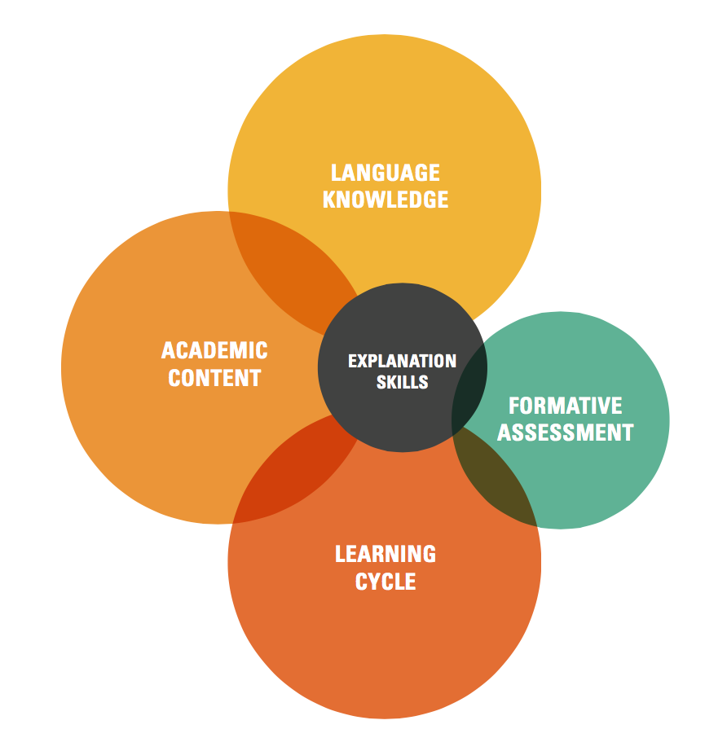
The DLLP Approach
Bailey & Heritage (2018)
This content is offered by the Oregon Department of Education under a Creative Commons Attribution Non-Commercial Share Alike 4.0 license
Notes:
Students must learn to use language for a purpose in the classroom: The DLLP focuses on a high utility language use across the curriculum – explanation.
Students use explanations skills to convey how things work or to justify their reasoning, for example.
Explanation skills are at the intersection of Language Knowledge (which we will expand on in a moment), the Academic Content that is the target of the explanation (so mathematics, science, ELA, or social studies content), and the Learning Cycle that comprises the interaction among experience, instruction and practice. Explanation skills are the result of developing new language and content knowledge from experience, instruction and practice in the Learning Cycle. Therefore, explanations can give teachers the evidence they need for formative assessment of students’ progress in both language and the content learning.

Slide 4
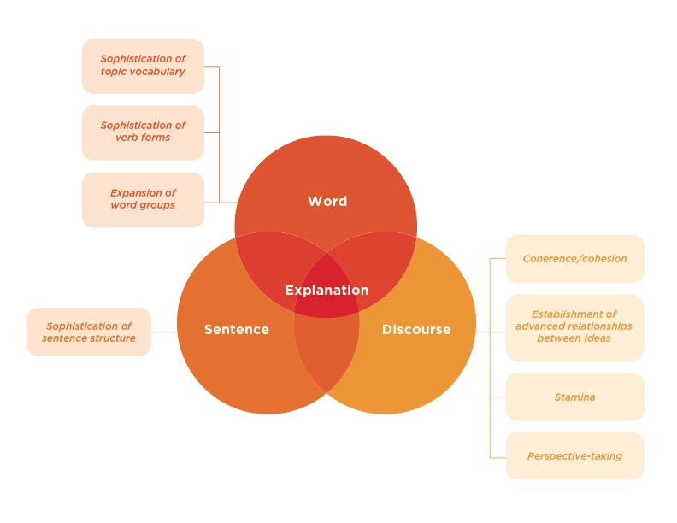
This content is offered by the Oregon Department of Education under a Creative Commons Attribution Non-Commercial Share Alike 4.0 license
Notes:
In module 1, you learned that learning progressions are empirically validated. For this purpose we developed the DLLP from students’ language data. We collected and examined several hundred oral and written explanations from students in kindergarten through sixth grade and were able to characterize them for 8 features or clusters of features at the Word, Sentence, and Discourse levels of language.
The DLLP is built on the premise that students learn word, sentence, and discourse dimensions of language combining them in their use of explanations (in this instance) to become progressively more skilled users of academic language, both oral and written.
A word is a singular unit of language that carries meaning and can be uttered or written alone or grouped with others words to make a phrase.
Under a Word level view of how students develop language, there is:
Sophistication of topic vocabulary:
Sophistication of verb forms:
Expansion of word groups:
Moving to Sentence:
Words are combined into sentences that are formulated by a prescribed word order and according to grammatical rules such as agreement in number between nouns and verbs.
Under a sentence level view of how students develop language, there is:
Sophistication of sentence structures:
Finally moving to Discourse.
Discourse pertains to extended talk or text, specifically the structure of multiple utterances or written sentences, for example a conversation or printed dialogue, or a monologue such as a speech or a narrative text.
Under a discourse level view of how students develop language, there is:
Coherence/cohesion:
Establishment of advanced relationships between ideas:
Stamina:
Perspective-taking:
We will give definitions of these different features in a moment.

Slide 5
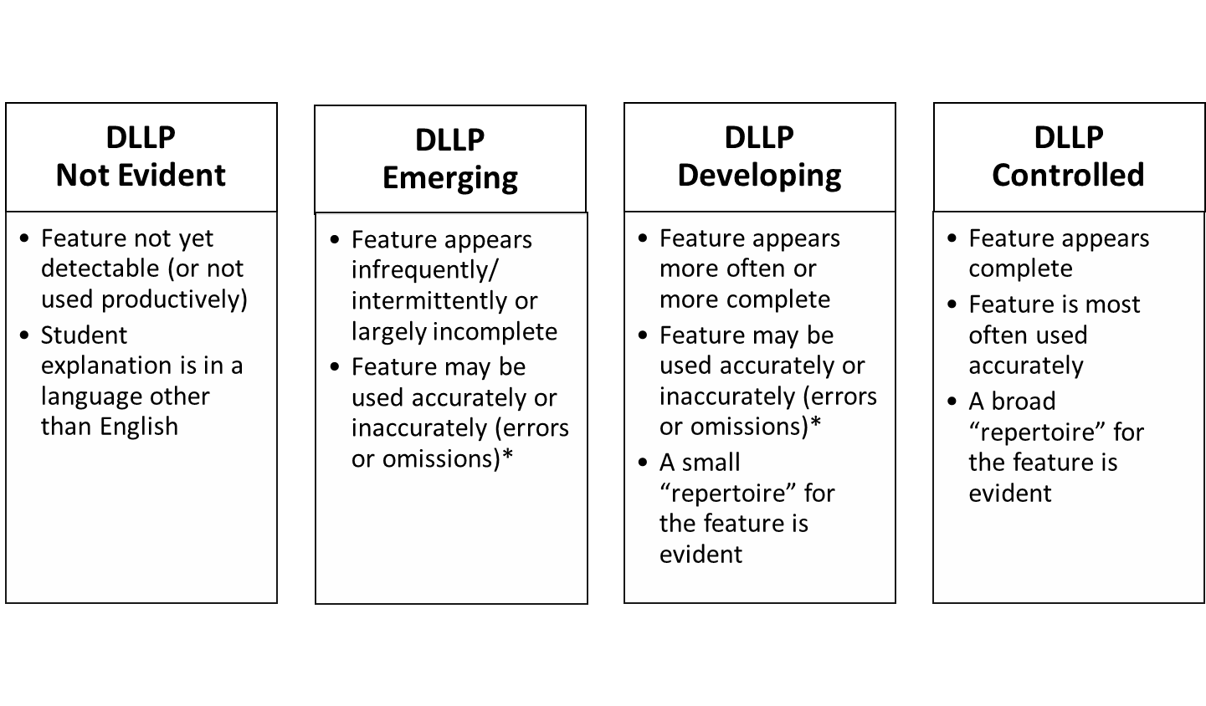
Phases of the DLLP
This content is offered by the Oregon Department of Education under a Creative Commons Attribution Non-Commercial Share Alike 4.0 license
Notes:
Language doesn't just develop by growing in amount but also by growing in its complexity or sophistication.
Each of these features could be placed on a progression in sophistication from Not Evident to Controlled.
The “best” fit for an explanation was considered
Not Evident – if…. [read text in slide].
Emerging - if…. [read text in slide].
Developing – if…. [read text in slide].
Controlled – if…. [read text in slide].

Slide 6
Use of DLLPs
DLLPs provide the specificity of what language needs to be acquired to support the general underlying language proficiency necessary for preparing students to meet the standards
Frequently overlooked and untaught foundational language skills
DLLPs can be used in conjunction with state and consortia English language development or proficiency standards
DLLPs can also be used in relation to the language demands inherent in the academic content areas of the college-and-career-ready standards
This content is offered by the Oregon Department of Education under a Creative Commons Attribution Non-Commercial Share Alike 4.0 license
Notes:
DLLPs provide the specificity of what needs to be acquired to support the general underlying language proficiency that is necessary for preparing students to meet the standards (both the language and the content standards).
These are foundational language skills that often go overlooked and untaught.
This includes using the DLLPs in conjunction with state and consortia English language development or proficiency standards.
DLLPs can also be used in relation to the language demands inherent in the academic content areas of the college and career ready standards.
We will show how the DLLP integrates with the content standards concretely in Modules 5 & 6.

Slide 7
Section 2
Overview of the high-leverage language features in the DLLP
This content is offered by the Oregon Department of Education under a Creative Commons Attribution Non-Commercial Share Alike 4.0 license
Notes:
In the next section, we describe the high-leverage language features that can each be placed on the four-phase progression.

Slide 8
DLLP Features
Sophistication of topic vocabulary
Sophistication of verb forms
Expansion of word groups
Sophistication of sentence structure
Coherence/cohesion
Establishment of advanced relationships between ideas
Stamina
Perspective-taking (K-3)
This content is offered by the Oregon Department of Education under a Creative Commons Attribution Non-Commercial Share Alike 4.0 license
Notes:
Please refer to the accompanying Module 2, handout 1 for the 8 features that each have their own language learning progression.
Before we review these language features, we want to emphasize that you are not expected to “master” all of them by the end of the six modules. Eventually, after practicing implementation, you will become familiar with all the features.
At the Word level, features include:
Sophistication of topic vocabulary: a small core topic vocabulary progressing to a more extensive topic vocabulary and use of precise/low frequency
Sophistication of verb forms: simple tensed verbs progressing to more sophisticated verb forms such as gerunds, participles, and modal auxiliary verbs, for example, could, should, might that convey notions of probability and obligation.
Expansion of word groups: a limited repertoire of word groups progressing to an expanded array including derived words, nominalizations (nouns formed from verbs or adjectives, such as multiplication, precipitation, wellness), adverbs, adjectives, relative clauses, prepositional phrases, and general academic vocabulary (words cutting across content areas with the same meaning such as report, analyze, observe).
At the Sentence level,
Sophistication of sentence structures: involves sentence fragments and simple sentences progressing to complex sentences that combine independent clauses and dependent clauses also known as subordinate or embedded clauses such as relative clauses.
At the Discourse level, features include
Coherence/cohesion: shifts from limited attempts at coherence and cohesion progressing to the use of temporal connectors (first, next, finally) and different cohesive devices such as referring back to nouns with unambiguous pronouns
Establishment of advanced relationships between ideas: limited repertoire progressing to a expanded array, for example through the use of causal discourse connectors (because, consequently), and contrastive discourse connectors (however, while) discourse connectors.
Stamina: no elaboration or lacks meaning progressing to a clear mental model with use of sufficient detail and elaboration for the listener to readily make meaning.
Perspective-taking: no linguistic reflection of perspective-taking abilities progressing through the maintenance of appropriate personal pronouns (“he” referring to one student, “they” referring to several students used unambiguously). (appropriate for K-3 – older students were predominantly at Controlled phase)

Slide 9
Section 3
Understanding how the DLLP can be used to identify students’ language learning status relative to the high-leverage features
This content is offered by the Oregon Department of Education under a Creative Commons Attribution Non-Commercial Share Alike 4.0 license
Notes:
In the next section, we present how the DLLP can be used to identify students’ language learning status relative to the high-leverage features

Slide 10
Example Progression in use of Verb Forms
No Evidence of Sophistication of Verb Forms:
“Six.” (English learner)
  No use of verb forms
Emerging Sophistication of Verb Forms:
“Maestro…. my teacher told me that I just have to help you do these things. Not that help you. You have to…. I'mma break them apart and you have to count them by colors, by colors and match them together. So if, if you, you have to use this, you have to connect them together because it's easier how to do it. And my teacher told me to tell you that.” (English learner).
  Use of simple verbs and infinitives
  Repetitive use of “have to” before a range of infinitive verbs (help, count, match, use, connect)
  Notice use of “I’mma” as a contraction of “I am going to” – possibly an unanalyzed whole or chunk.
This content is offered by the Oregon Department of Education under a Creative Commons Attribution Non-Commercial Share Alike 4.0 license
Notes:
Now refer to the DLLP for Sophistication of Verb Forms in the handout.
Remember this DLLP involves simple tensed verbs progressing to more sophisticated verb forms such as complex tense formations and use of auxiliary and modal verbs..
In the next few slides we will look across the four phases of the progression and notice why the four example explanations were placed at their respective phases.
The explanations in these examples are of students’ telling a hypothetical classmate the mathematical procedures they followed to find out the number of cubes in a pile of cubes they had previously been presented with. Students were also asked to give a justification for their chosen procedure (counting, repeated addition or multiplication).
We had just a few students who despite prompting did not produce any verbs, as in the first example here. This means a teacher needs to look for additional evidence of language knowledge – Perhaps a different task or sampled when interacting with peers – The onus is on the teacher to generate evidence.
At the Emerging phase, the verbs are all highlighted in red font. This student explained told us [read from text]

Slide 11
Example Progression in use of Verb Forms
Developing Sophistication of Verb Forms:
“Um so you like put, put the cubes in, in a group of by their color. And then when they're all in the groups, you can count how many they're in, in all. Like, for example, they're all ten or just count them all up together.”
Researcher: “Can you tell her why this way helps?”
“It helps this way because it's more organized or so you can, you can concentrate this way better. And like you would know what group this thing goes in if you lose one and then you put it back in its place.” (English-only/proficient student)
  Use of simple verbs
  Use of different modal verbs (can, would)
This content is offered by the Oregon Department of Education under a Creative Commons Attribution Non-Commercial Share Alike 4.0 license
Notes:
At the Developing phase, a student told us [read from text]

Slide 12
Example Progression in use of Verb Forms
Controlled Sophistication of Verb Forms:
“Count it like you can count it by tens because then you could um make it like way easier. And if um you get stuck, you can retry it again by another, by another number. First of all, I tried it by ones. But it didn't work. So I was just slow. Then I counted it by threes. Then I wanted a little easier. But then I um, then I went by tens and then it was way easier. And now um I know that.”
Researcher: “Can you tell him why this way helps?”
“Why? Um it helps because if you have in, in, if in your life you have to count how much marbles or like stuff you need, you could count it by other numbers. So it, it would be faster.”
Researcher: “Anything else?”
“Um you could make it, make it into…. Let's say you could have put it in estimates. So then like when you estimate something, then you could find if, if you could see if, if your answer's right. If it's not, you could try again.” (Former English learner)
  Use of range of modal verbs (can, could, would) with a range of verbs (count, make, retry, try)
  Use of present perfect (have put)
Notes:
At the Controlled phase, a student produced the following extensive explanation [read from text]

Slide 13
Finding the Best Fit on the DLLP
Listen/read
Choose a DLLP feature
Review the 4 phases
Emerging Best fit?
Developing Best fit?
Controlled Best fit?
Not (Yet)
Evident
Decide on the “best fit”
Ask: In what ways does this student need to grow on this language feature to show a more sophisticated performance?
This content is offered by the Oregon Department of Education under a Creative Commons Attribution Non-Commercial Share Alike 4.0 license
Notes:
The DLLP helps you identify students on pathways of the different language features; standards cannot do this.
This involves finding the ‘best fit’ on the progression for a student’s explanation.
Best fit is a low or no stakes judgment of where an explanation should be placed on the progression so that a teacher can effectively target instruction to those identified elements of a feature that still need support for getting a student’s language to the next phase of the DLLP.
Finding the best fit involves the following steps:
First, listen to a recorded or read a transcribed explanation if placing oral explanations or read a written explanation.
Next choose which of the DLLP features to focus on and review the characterization of the four phases for this features’ DLLP found in the previous handout.
Remember the four phases are: Not Evident (i.e., not yet detectable, may only use language from any prompt supplied, or is a non-English response), Emerging (i.e., occurs infrequently/intermittently; incomplete; no repertoire of types), Developing (i.e., occurs more frequently; more complete; a small repertoire of types), and Controlled (i.e., occurs where expected or in obligatory contexts; complete; broad repertoire of types; most frequently accurate).
Find the best fit for the explanation on the feature’s progression.
Finally, based on the best fit:, ask…
In what ways does this student need to grow on this language feature to show a more sophisticated performance?

Slide 14
Example Placement on the DLLP: Coherence/Cohesion
“Um by putting it on a row and the same colors that they are. When you use green and you find more greens, you put them together. And when there's no more green, you find another color. And then you put them together. And then the two colors, you stick them together in a row. That will be easy for her because if she splits it a lot around, she'll be counting them and then she's not gonna know. She's gonna count the same one.”
[Can you tell her why using the cubes this way helps her?]
“Because this is on a row and you could be counting them. And you know that and when you're done with this row, you're gonna know that this row you're not gonna count it anymore and count this row now. That's all.”
Full audio: https://youtu.be/VOZDIDrULm0
This content is offered by the Oregon Department of Education under a Creative Commons Attribution Non-Commercial Share Alike 4.0 license
Notes:
You have a handout and available audio file of this final more extensive example.
This explanation was placed at Developing as the best fit on the Coherence/Cohesion DLLP feature:
There is evidence of logical sequencing of statements; a small but expanding repertoire of coordinating conjunctions and transition words (“and” “and when”, “and then”)
Uses 2 different cohesive devices (reference with attempted pronominal ties and substitution [e.g., “the same one” for “same cube or same row”); BUT several ambiguous references that imply inaccurate control of pronoun referents “it” and “them” (e.g., could be referring to “cube(s)” or “row(s)”)

Slide 15

This content is offered by the Oregon Department of Education under a Creative Commons Attribution Non-Commercial Share Alike 4.0 license
Notes:
This is the end of Module 2’s presentation. In Module 3, we will go into detail about the progression of the high—leverage language feature, sophistication of topic vocabulary.

