Slide 1


Module 1 Presentation
Margaret Heritage
This content is offered by the Oregon Department of Education under a Creative Commons Attribution Non-Commercial Share Alike 4.0 license
Notes:
Welcome to Module 1’s presentation.

Slide 2
What I enjoyed most about this process [implementing the dynamic language learning progression]is really bringing to light the importance of oral language. We talk about it all the time, but it’s looking at these progressions in the different areas. It really makes it evident and obvious, at least to me, what are the things I can be working on in the classroom and what I should be listening in on. So that way I can incorporate it into the content that we’re currently working on.
Elementary Teacher
This content is offered by the Oregon Department of Education under a Creative Commons Attribution Non-Commercial Share Alike 4.0 license
Notes:
This quote from an elementary teacher sums up the value of the dynamic language learning progression: I will pause for a moment so you care read what the teacher said. Working from the progression she is clear about what language she wants to focus on so she can incorporate that specific language into her content lessons. She can also listen for this language as her students discuss what they are learning about. Listening to what students say is a formative assessment opportunity; the teacher can assess how students are using the target language and make instructional responses that support language development. This is the benefit of implementing the dynamic language learning progression. In these six modules, you are going to learn about how to implement the dynamic language learning progression to benefit your students’ language learning during content lessons.

Slide 3
Section 1
What are Learning Progressions?
This content is offered by the Oregon Department of Education under a Creative Commons Attribution Non-Commercial Share Alike 4.0 license
Notes:
There are three sections in this presentation. In the first section, we are going to focus on what learning progressions are and how they are different from standards.

Slide 4
“Kids learn. They start out by knowing and being able to do little, and over time they know and can do more, lots more. Their thinking becomes more and more sophisticated."
This content is offered by the Oregon Department of Education under a Creative Commons Attribution Non-Commercial Share Alike 4.0 license
Notes:
The basic idea of learning progressions is well captured by Fritz Mosher in a 2011 paper when he states, “Kids learn. They start out by knowing and being able to do little, and over time they know and can do more, lots more. Their thinking becomes more and more sophisticated” (p. 2).

Slide 5
Descriptions of how student learning develops
Lay out significant steps students are likely to follow
Not developmentally inevitable
Progressions are based on research
The Dynamic Language Learning Progression (DLLP) describes how language learning develops
This content is offered by the Oregon Department of Education under a Creative Commons Attribution Non-Commercial Share Alike 4.0 license
Notes:
Learning progressions (or trajectories as they are referred to in mathematics) are descriptions of how student learning in a domain develops from its most rudimentary forms through increasingly sophisticated states as students move through school (Corcoran, Mosher, & Rogat, 2009; Sztjan, Confrey, Holt, Wilson, & Edgington, 2012; Heritage, 2008; NRC, 2007; Smith, Wiser, Anderson, & Krajcik, 2006). These are not recorded– just here for reference if needed.
Progressions lay out the significant steps that students tend to, or are likely to follow, as they develop knowledge and skills associated with particular domains throughout their schooling.
Progressions describe development over an extended period of time. While they represent development in learning, progressions are not developmentally inevitable. Students’ movement along the progression depends on quality teaching and learning opportunities.
Progressions are based on research about how learning actually progresses and are empirically validated. A key question to be answered in the development of progressions is: “Does the progression describe how most students’ learning develops in a domain?”
Just as progressions lay out what it means to “develop” in an area of learning, the Dynamic Language Learning Progressions describe how students’ explanations become more sophisticated between kindergarten and grade 6. Its purpose is to provide a framework for teachers to use in support of students’ language learning and formative assessment in the content areas.
As an approach this can also be applied to higher grades. We encourage you to build this out at grades 7 and beyond by collecting language samples and seeing whether they too fit on the existing progressions and adding to the characteristics of the language features if necessary for this older age range.

Slide 6
Standards
End-of-grade level expectations
End-of-grade level expectations
End-of-grade level expectations
This content is offered by the Oregon Department of Education under a Creative Commons Attribution Non-Commercial Share Alike 4.0 license
Notes:
Standards are a prescription of outcome goals. They specify what students will know and be able to do at particular points in their schooling, for example, at the end of a particular grade level, or grade bands, on the way to graduation at grade 12

Slide 7

Intermediate Steps
This content is offered by the Oregon Department of Education under a Creative Commons Attribution Non-Commercial Share Alike 4.0 license
Notes:
Standards do not characterize in detail how students move from one standard to the next or describe how students might do that. By contrast, progressions identify many more significant steps along a pathway of development toward an ultimate goal.
Standards do not represent the level of detail needed for formative assessment to inform learning day by day. The information yielded from standards’ assessment is of a large grain size and does not provide sufficiently detailed information for teachers to know what the next instructional steps should be to progress learning

Slide 8
Section 2
How Learning Progressions Support Formative Assessment
This content is offered by the Oregon Department of Education under a Creative Commons Attribution Non-Commercial Share Alike 4.0 license
Notes:
In the next section, we describe how learning progressions can support formative assessment and instruction.

Slide 9
Formative assessment is the term used to describe a type of assessment where the focus is on informing learning, rather than measuring it or summing it up.
Assessment that focuses on the learning as it is taking place
Purpose is to move learning forward from its current status toward intended learning goals
This content is offered by the Oregon Department of Education under a Creative Commons Attribution Non-Commercial Share Alike 4.0 license
Notes:
Formative assessment is the term used to describe a type of assessment where the focus is on informing learning, rather than measuring it or summing it up as do interim/benchmark or end-of-year-assessments. Formative assessment focuses on the learning as it is taking place. In other words, it occurs during daily lessons, sometimes once, sometimes more, to gauge where students are while they are learning so that teachers can take action to help students make progress. Formative assessment is completely within the purview of individual teachers in their classroom, unlike other types of assessment that are external to the classroom. External assessments that are required by the school, district or state are used for different purposes other than informing teaching and learning minute-by-minute, day-by-day.

Slide 10
Formative Assessment
Learning goal
Learning goal
Learning goal
Learning goal
Learning Progression
This content is offered by the Oregon Department of Education under a Creative Commons Attribution Non-Commercial Share Alike 4.0 license
Notes:
For effective formative assessment, teachers need to be clear about what students are learning – their goal – and what learning performances – also called success criteria- will show that students have met the goal. With learning progressions, teachers have sufficient detail to identify important learning goals and recognize them as part of a bigger story in the development of expertise.
The intended learning goal will ideally, and as often as possible, represent a step on the path toward expertise. Learning progressions, including the DLLP, help teachers identify specific learning goals and performances of learning. When teachers have obtained evidence they can interpret it with reference to the progression and decide what the next steps for students need to be to advance their learning.
Student learning does not occur in lockstep – in other words, students do not learn at the same pace - so an advantage to using progressions is that student learning can be located on a continuum of developing expertise, helping teachers make decisions about what each student needs to help learning progress.

Slide 11
Section 3
The Theory of Action for Dynamic Language Learning Progressions
This content is offered by the Oregon Department of Education under a Creative Commons Attribution Non-Commercial Share Alike 4.0 license
Notes:
In the next section, we present the theory of action for the dynamic language learning progressions. A theory of action is description of an intervention in terms of the relationships between inputs, outputs and outcomes

Slide 12
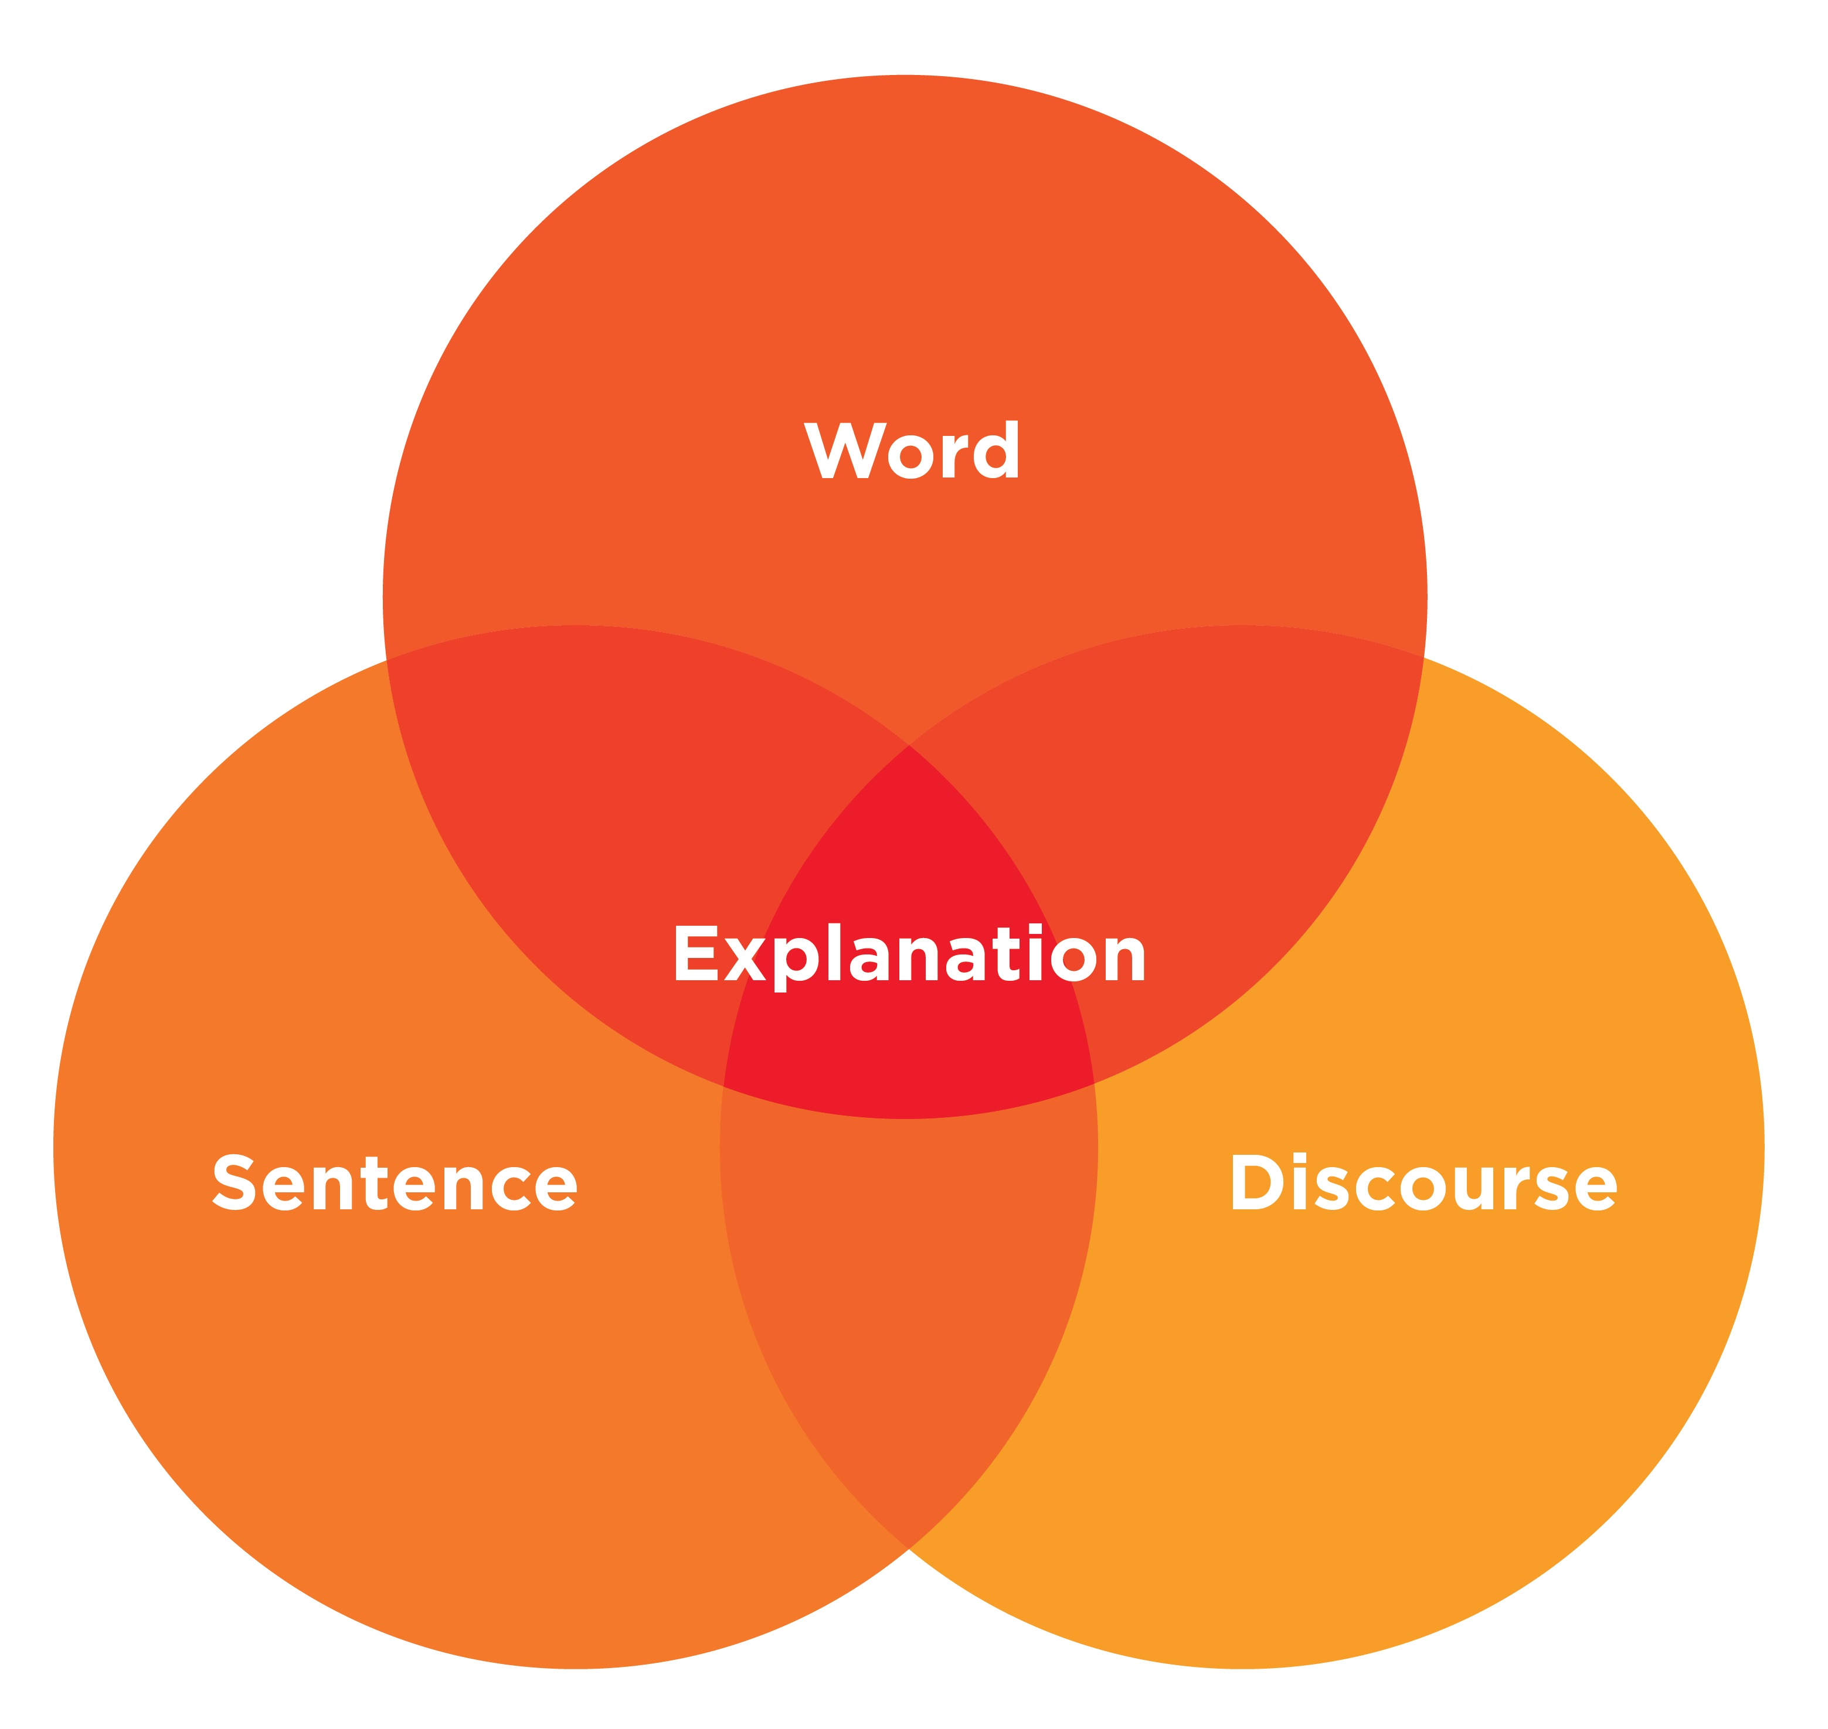
DLLP Overview
This content is offered by the Oregon Department of Education under a Creative Commons Attribution Non-Commercial Share Alike 4.0 license
Notes:
The Dynamic Language Learning Progression is structured around the features of three key language dimensions. A foundational premise of the dynamic language learning progression is that students progressively learn word, sentence, and discourse dimensions of oral language to become skilled users of academic language, both oral and written, in explanations. In reality, these three dimensions of language (i.e., word, sentence, discourse) do not operate as independent entities but rather as a mutually dependent and integral aspects of language. The DLLP treats them separately only to assist teachers in focusing on them for the purposes of instruction and formative assessment. There is no distinction between the three dimensions when learning and using language. Although split into three dimensions, the progression does not mean that teachers help students learn words, then sentences, then engage in discourse. Instead, the dynamic language learning progression helps teachers pay attention to these dimensions during classroom talk. The ability to acquire and coordinate the dimensions of word, sentence, and discourse features of English in sophisticated ways enables a speaker to effectively learn new content in school.
While this may be true for the academic language development of all students, it may be especially the case for English learners who are receiving most of their opportunities to learn English in the school context.

Slide 13
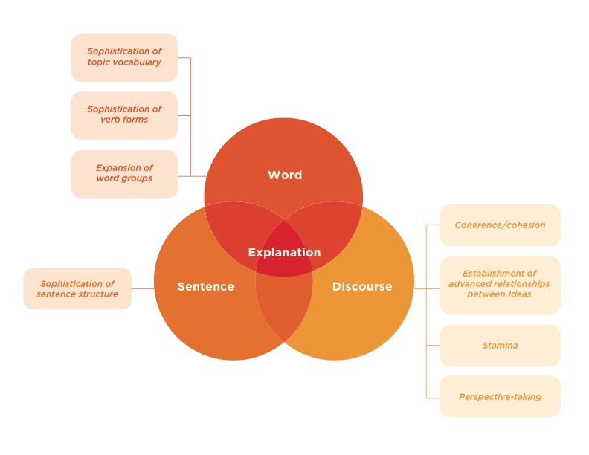
DLLP overview (cont.)
This content is offered by the Oregon Department of Education under a Creative Commons Attribution Non-Commercial Share Alike 4.0 license
Notes:
At a more detailed level of the progression are eight high-leverage language features related to the dimensions word, sentence and discourse. These features are referred to as “high-leverage” because they are important language competencies that students need to acquire in order to access the academic content of the college- and career-ready standards. The high-leverage features are listed on activity sheet 2. You will learn about these high-leverage features in detail in module 2.

Slide 14
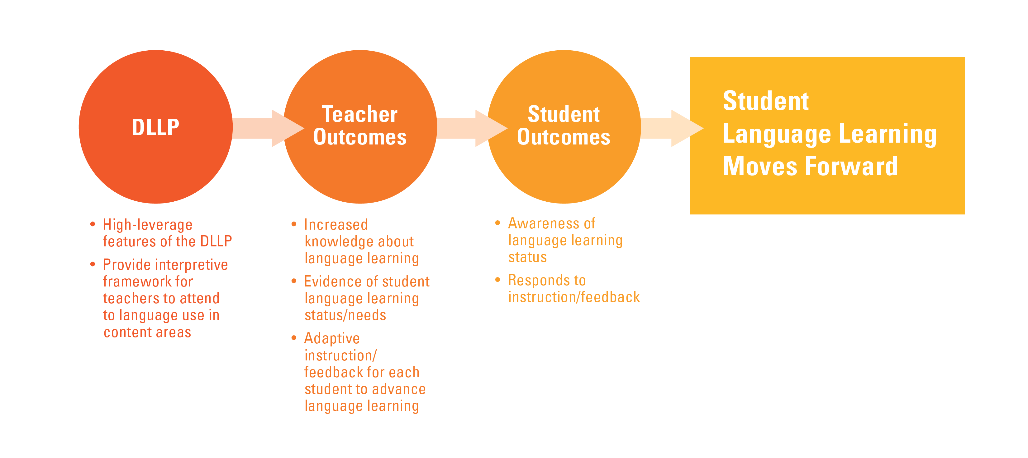
Dynamic Language Learning Progression Theory of Action
This content is offered by the Oregon Department of Education under a Creative Commons Attribution Non-Commercial Share Alike 4.0 license
Notes:
In broad terms the Dynamic language learning progression theory of action for teacher and students outcomes hypothesizes that the “input,” the familiarization of the DLLP by teachers, will result in an increase in their knowledge of how language learning develops (output), which in turn will assist them to attend productively to student language (output) so that instruction is informed by evidence obtained during formative assessment resulting in improved language learning by students (outcome).
More specifically, the DLLP provides the framework for teachers to identify language learning goals, collect evidence of learning and interpret the evidence.
By using the DLLP teachers will increase their knowledge of language learning – this is something we have found in our pilot studies of DLLP implementation – teachers have evidence of students’ language learning and they can make decisions about what is needed to advance each student’s language learning.
The use of the DLLP will help students increase their awareness of their own language learning and help them take their own next steps by responding to instruction and using feedback that their teachers provide. We also found this happened in our pilot implementation classrooms.

Slide 15

This content is offered by the Oregon Department of Education under a Creative Commons Attribution Non-Commercial Share Alike 4.0 license
Notes:
This is the end of Module 1’s presentation. Module 2 will focus on the DLLP and provide detail about its content, organization, and use.

